Slide 1
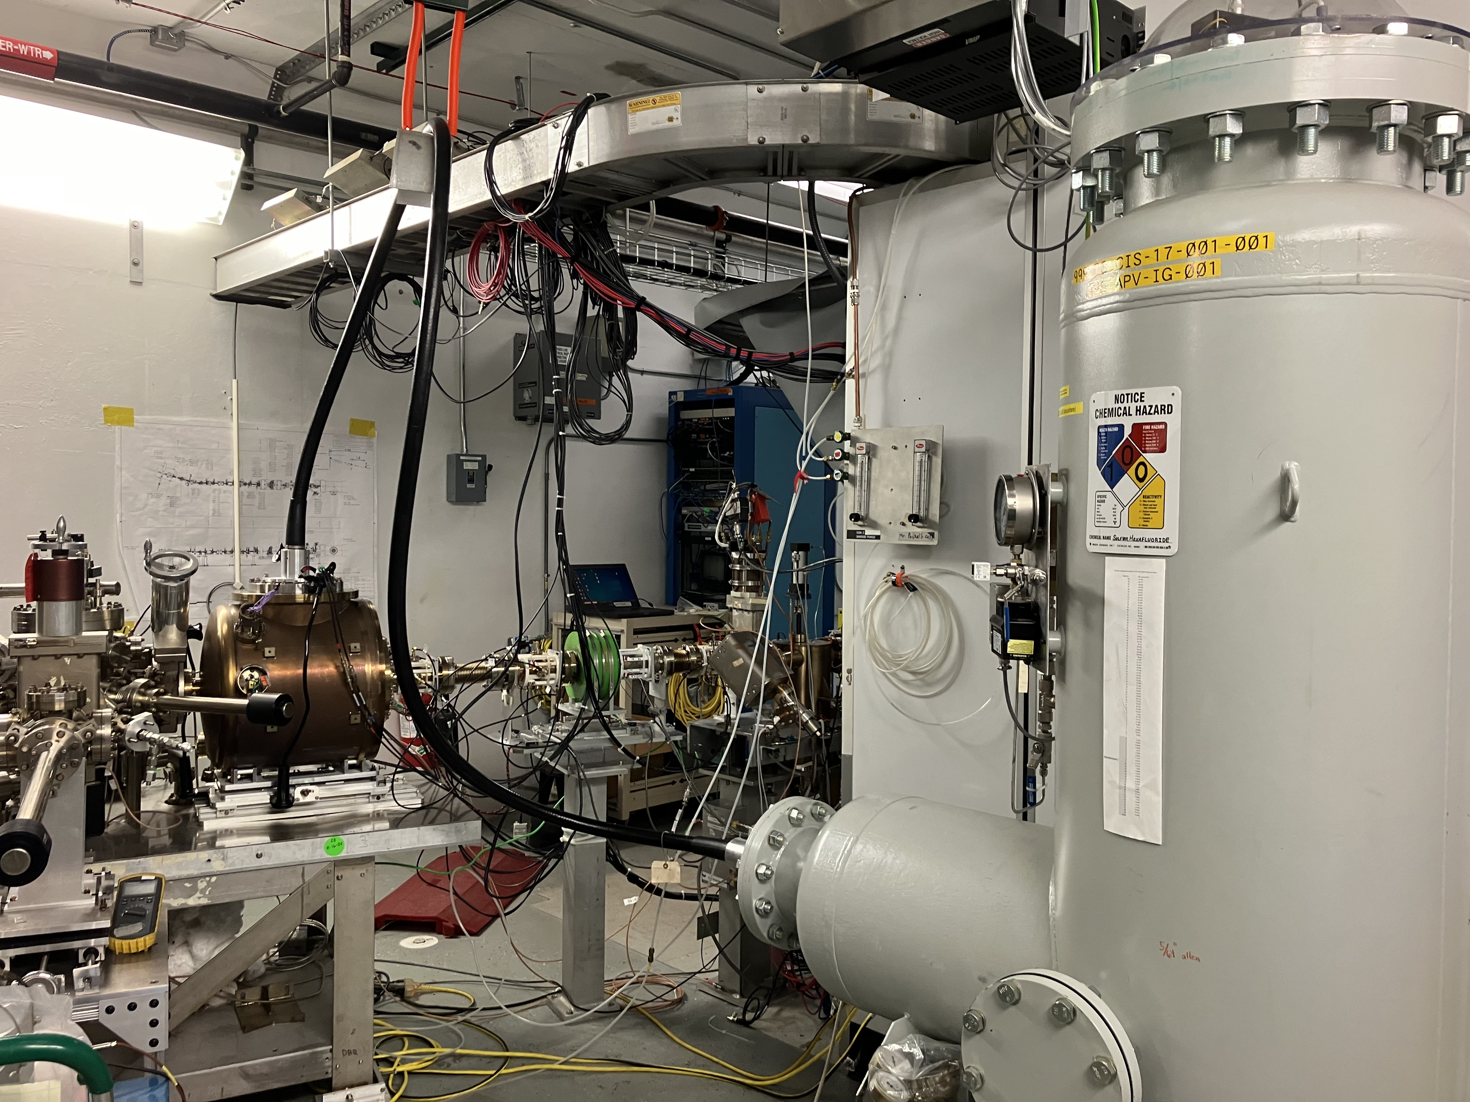
The 200 keV CEBAF polarized source electrode design and implementation process
Outline:
The 130 keV photogun era (2010-2024)
Why a higher voltage photogun?
The 200 keV photogun
Beam optics/electrostatic design
Fabrication, installation, HV conditioning
Functionality commissioning: 200 keV beam
Carlos Hernandez-Garcia for the source/injector team
PSTP , JLab, Newport News, VA, September 22-27, 2024

Slide 2
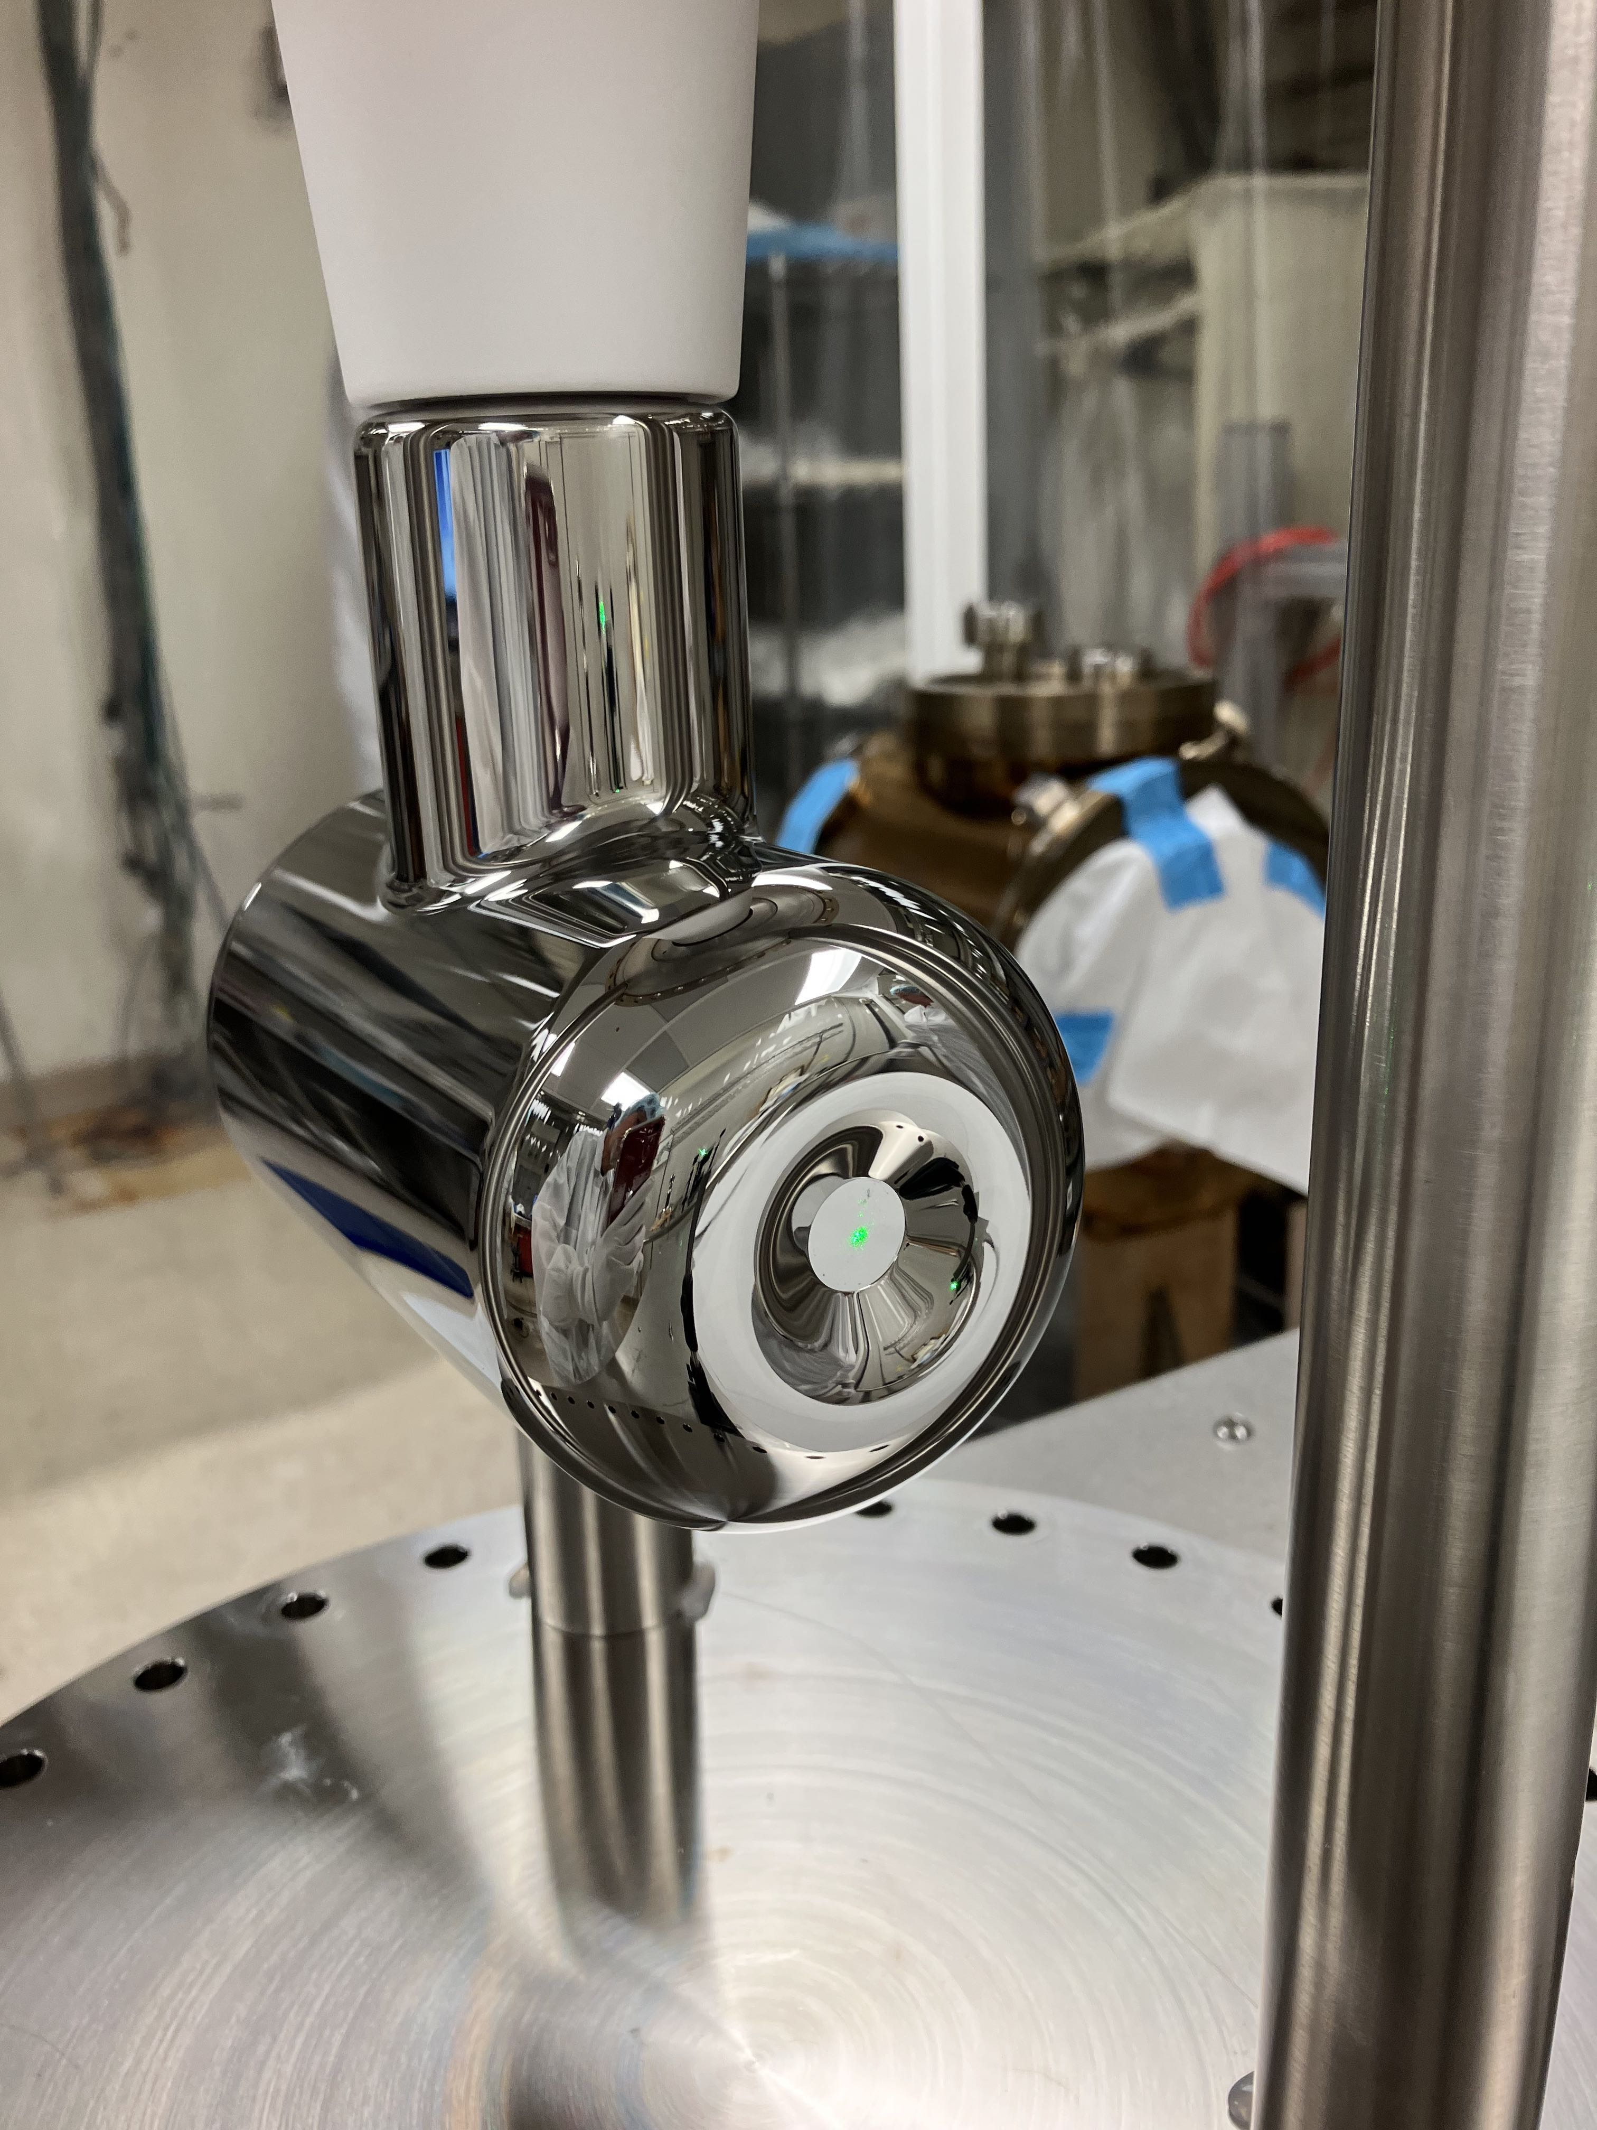
The CEBAF 130 keV polarized beam photogun era (2010-2024)
Installed and commissioned in 2010
Produced 130 keV beam with > 86% polarization for three experimental halls in the 6 GeV era and to four halls in the 12 GeV era
Maximum combined (four hall) beam current ~ 250 𝜇 A CW
Total extracted charge: 4.5 kC
Provided beam for PQB experiments
130 kV electrode (R28) ready for installation into the HV photogun vacuum chamber
5 in

Slide 3
Parity-Violating Experiments at CEBAF
PV Experiment | Energy (GeV) | Pol (%) | I (µA) | Target | A_{pv} (ppb) | Charge Asym (ppb) | Position Diff (nm) | Angle Diff (nrad) | Size Asym(δσ/σ)
HAPPEx-I 1998 – 1999 | 3.3 | 38.8 68.8 | 100 40 | ¹H (15 cm) | 15,050 | 200 | 12 | 3 | <10⁻³
G0-Forward 2003 – 2004 | 3.0 | 73.7 | 40 | ¹H (20 cm) | 3,000-40,000 | 300±300 | 7±4 | 3±1 | <10⁻³
HAPPEx-II 2004 – 2005 | 3.03 | 87.1 | 55 | ¹H, ⁴He (20 cm) | 1,580 | 400 | 2 | 0.25 | <10⁻³
G0-Backward 2006 – 2007 | 0.359, 0.688 | 85.8 | 60 | ¹H, ²H (20 cm) | 9,700-37,400 | -30±300 | 47±9 | 1.2±0.5 | <10⁻³
HAPPEx-III 2009 | 3.484 | 89.4 | 100 | ¹H (25 cm) | 23,800 | 200±10 | 3 | 0.5±0.1 | <10⁻³
PVDIS 2009 | 6.067 | 89.0 | 105 | ²H (20 cm) | 60,000-160,000 | 100 | 100 | 40 | <10⁻³
PREx-I 2010 | 1.056 | 89.2 | 70 | ²⁰⁸Pb (0.5 mm) | 657±60 | 85±1 | 4 | 1 | <10⁻⁴
QWeak 2010 – 2012 | 1.162 | 88.7 | 180 | ¹H (34 cm) | 226.5±9.3 | 20.5±1.7 | -4.6±0.2 | -0.07±0.01 | <10⁻⁴
PREx-II 2019 | 0.953 | 89.7 | 70 | ²⁰⁸Pb (0.5 mm) | 550±18 | 20.7±0.2 | 2.2±4 | 0.3±0.3 | <6x10⁻⁵
CREx 2019-2020 | 2.18 | 87.1 | 150 | ⁴⁸Ca (5 mm) | 2668±113 | -88±26 | -5.2±3.6 | -0.13±0.08 | <6x10⁻⁵
MOLLER 2026-2028 | 10.8 | 90 | 65 | ¹H (125 cm) | 35.6±0.74 | <10 | <0.6 | <0.12 | <10⁻⁵
An overview of how parity-violating electron scattering experiments are performed at CEBAF,
P.A. Adderley et al., Nuclear Inst. and Methods in Physics Research, A 1046 (2023) 167710 https://doi.org/10.1016/j.nima.2022.167710
Slide by R. Suleiman

Slide 4
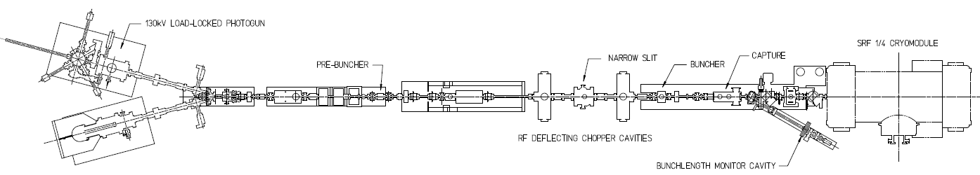
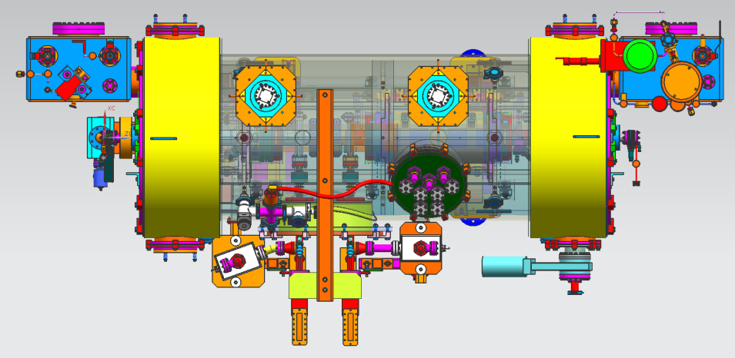
CEBAF Injector Upgrade
Increase gun voltage to 200 kV to suppress space-charge effects and improve parity quality beam, and to be compatible with booster design (Modify Wien filters for 200 keV beam)
Locate Wien filters (spin rotators) upstream of pre-buncher cavity and install quadrupoles to better compensate astigmatism
Increase aperture of chopper and beam line solenoids to suppress existing astigmatism and improve parity quality beam
Install new SRF booster that eliminates warm-RF capture cavity, RF deflection and x/y coupling
The new CEBAF booster
2 cell capture section + 7 cell cavity
Provides up to 10 MeV beam
Helps achieving Moller (parity violation experiment) beam requirements
Slide by M. Poelker

Slide 5
Why a higher voltage photogun?
The higher beam voltage of the R30 gun does two things for Moller
  Reduces beam intensity losses at apertures toward ~zero for required higher bunch charge
  Helps facilitate an injector with a SRF booster with design to decrease x/y coupling of position differences
Measurements by M. Poelker

Slide 6
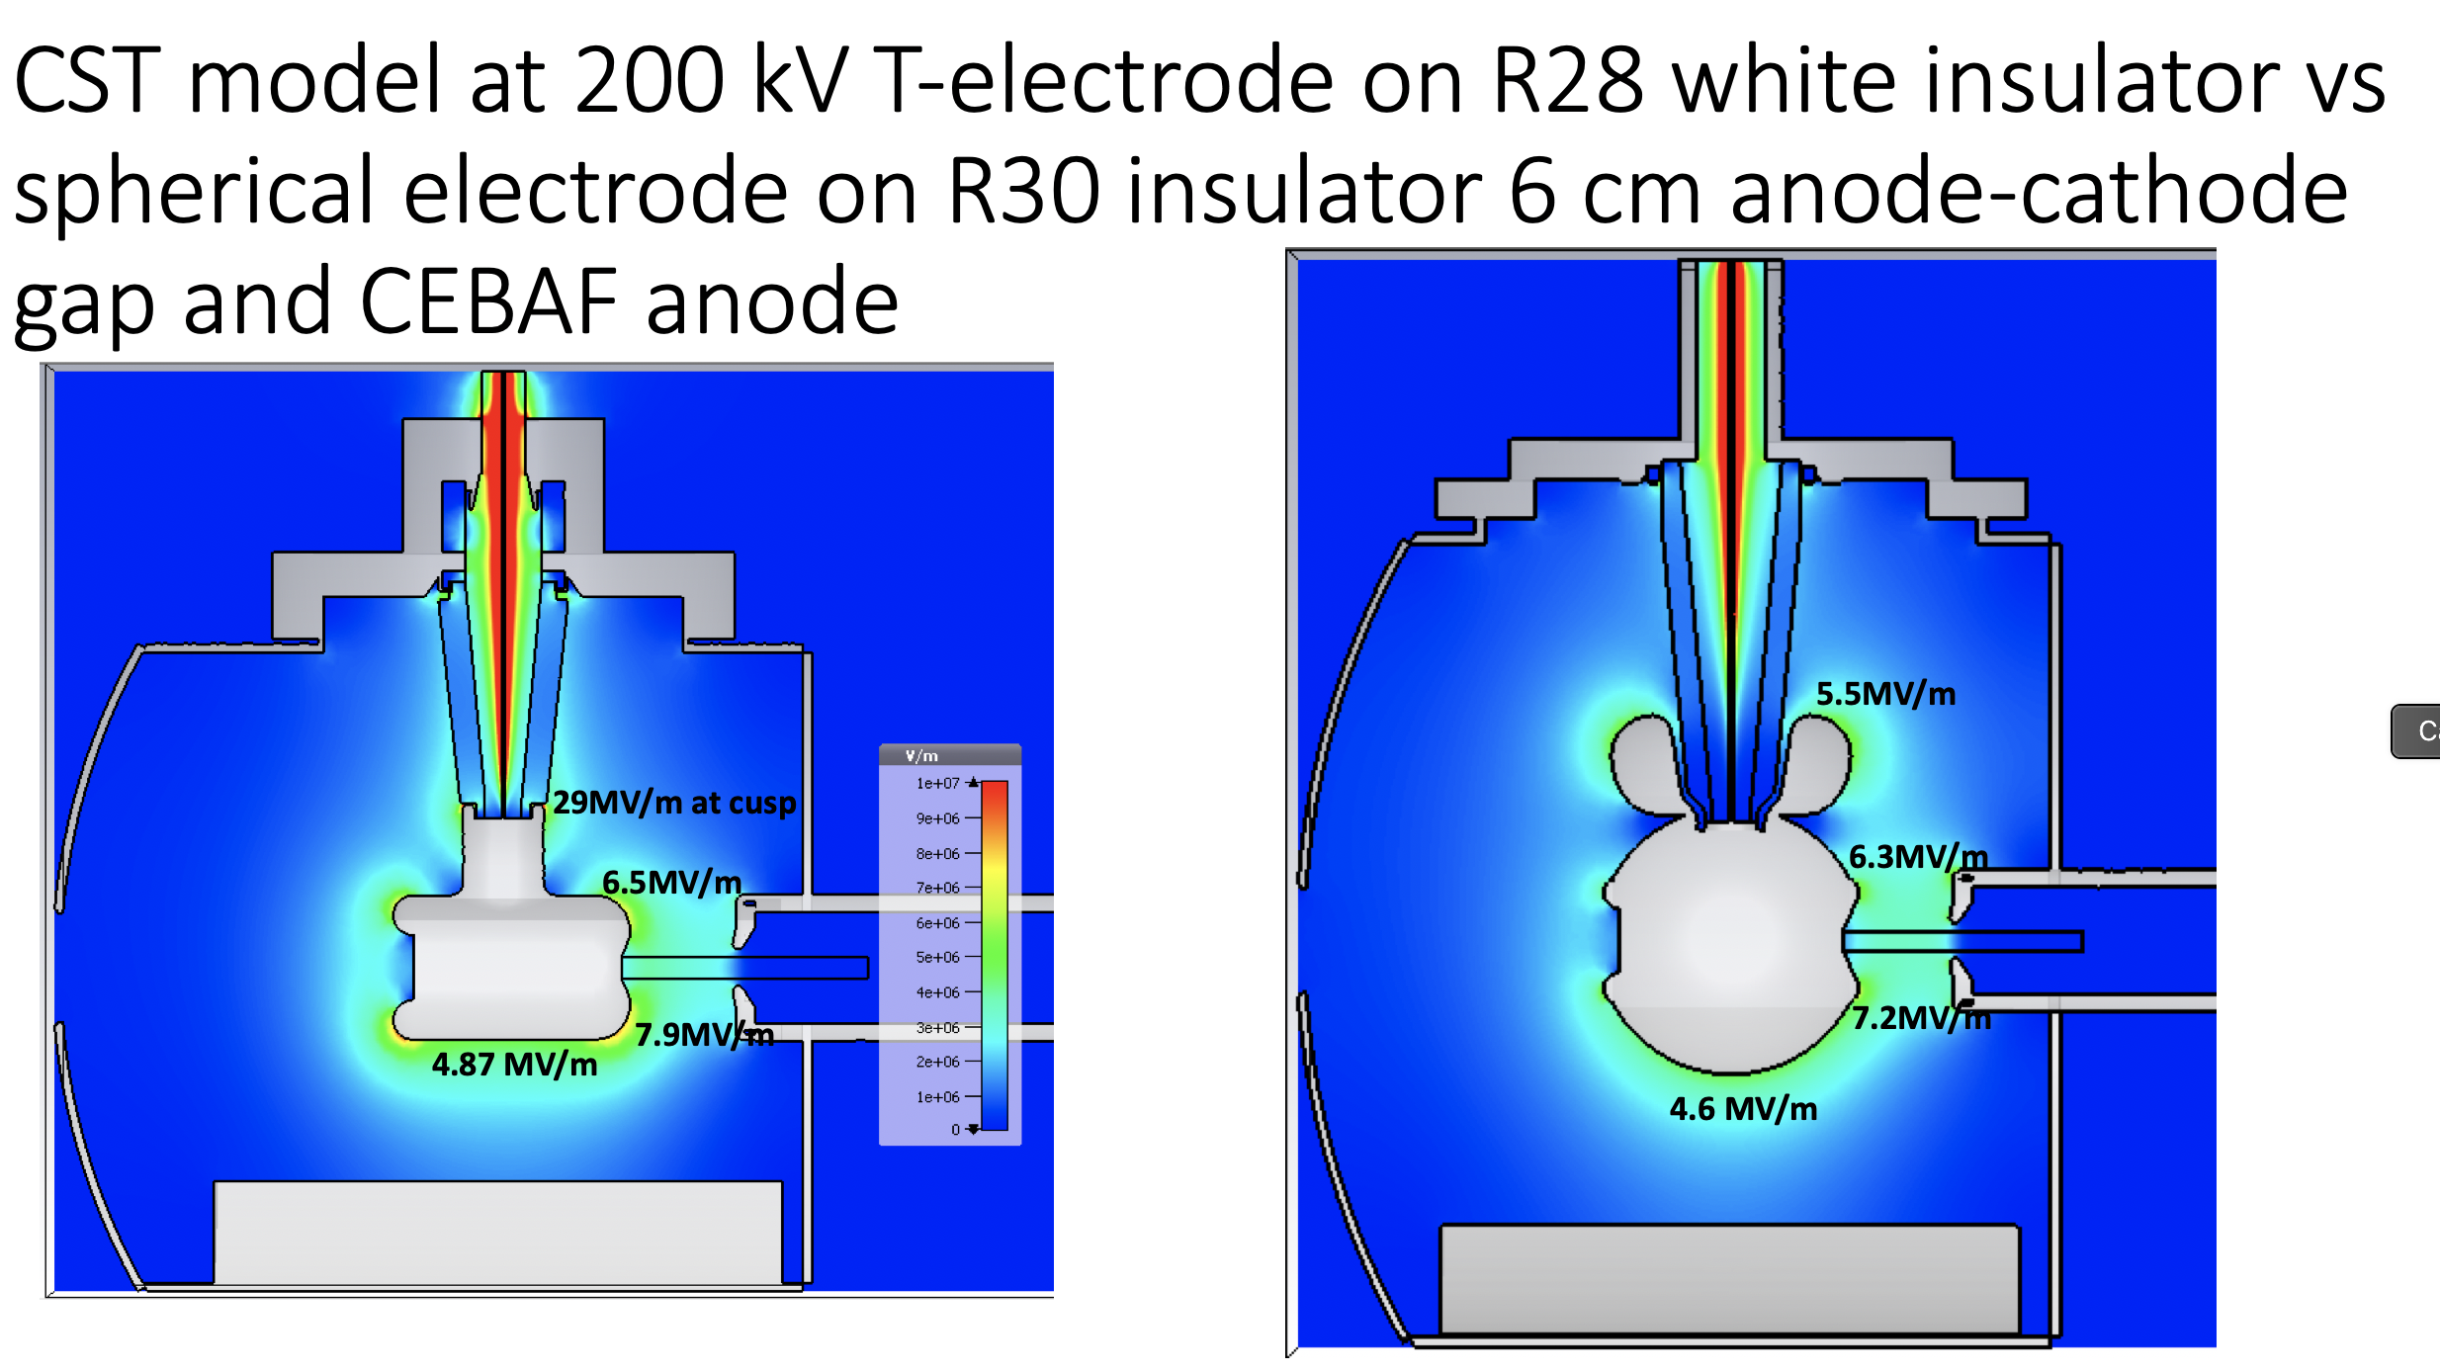
Higher photogun operating voltage requires larger electrodes for robust operation without field emission
CST models: G. Palacios-Serrano

Slide 7
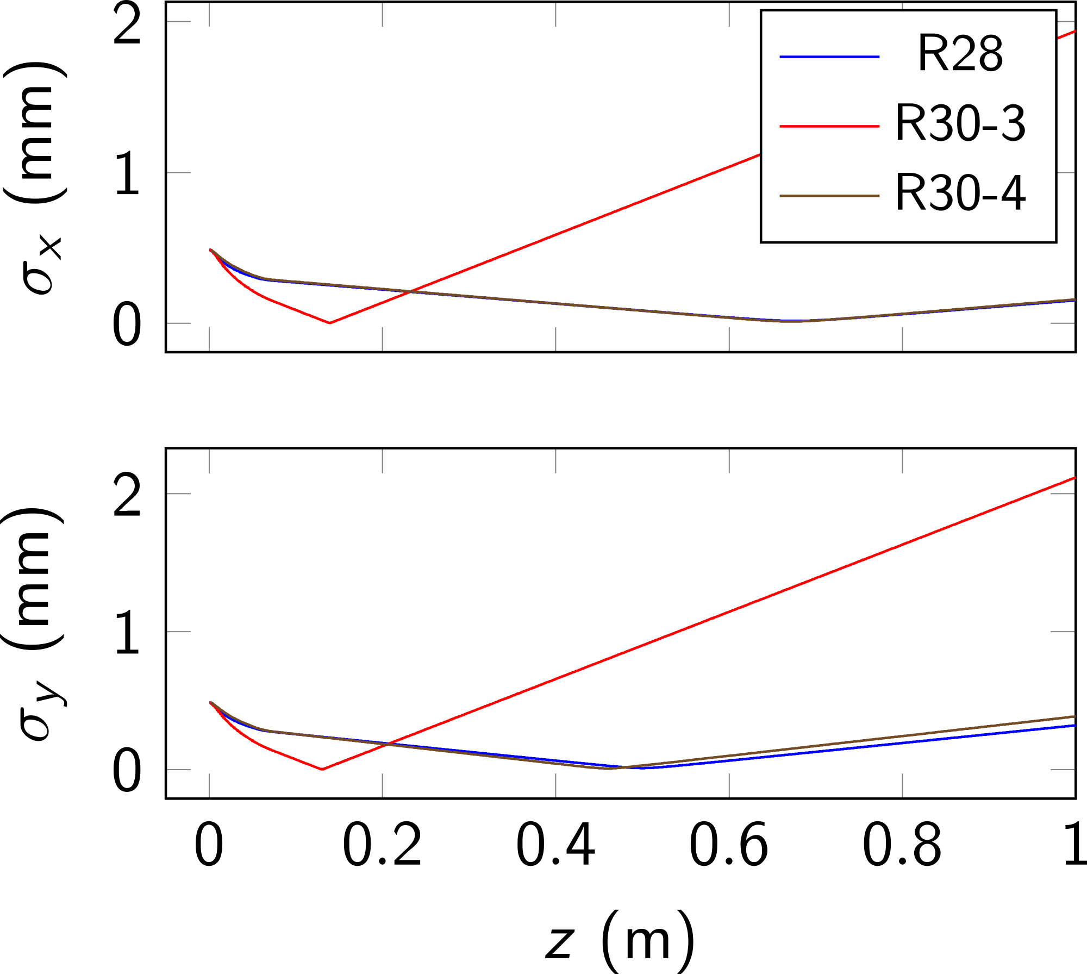
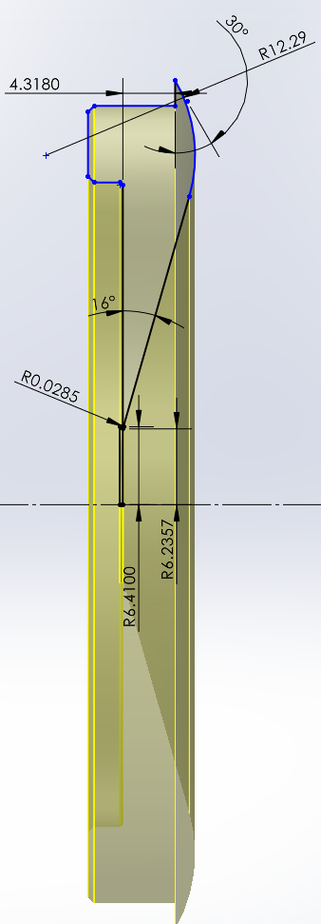
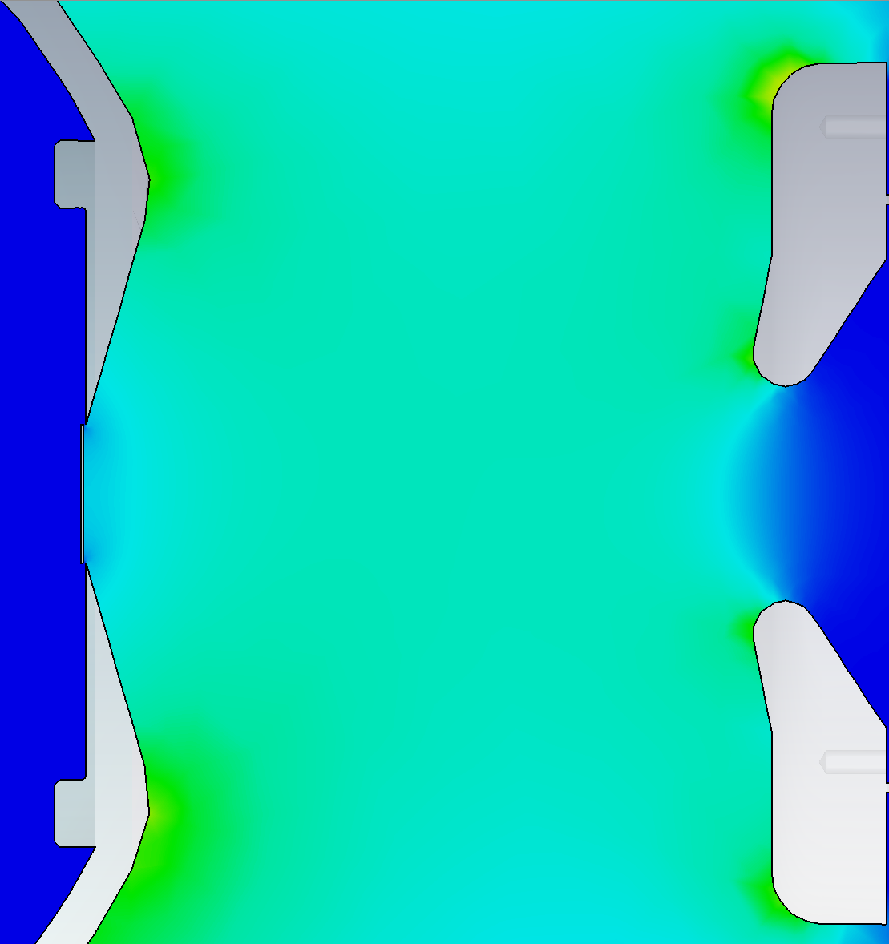
200 kV photogun (R30) design principles
Reliable operation at 200 kV, no field emission
Beam envelope similar to the 130 kV (R28) photogun
This required iterations between electrostatic models in CST to generate field maps at various Pierce electrode focusing angles, and GPT to model beam envelopes for each chosen angle
3 in
GPT simulations: M. Bruker
STEP
CST
Models: G. Palacios-Serrano

Slide 8
Focal length (pencil beam) measurements
Electrode optics design guided by pencil beam measurements
Measure gun optics with difference orbit method at two locations using BPMs: scan laser position on photocathode
Trajectories inside gun are not straight, but interpolation/extrapolation of BPM data outside gun is still valid
Method largely insensitive to beam parameters
Photocathode
BPM
BPM
Measurements & analysis: M. Bruker

Slide 9
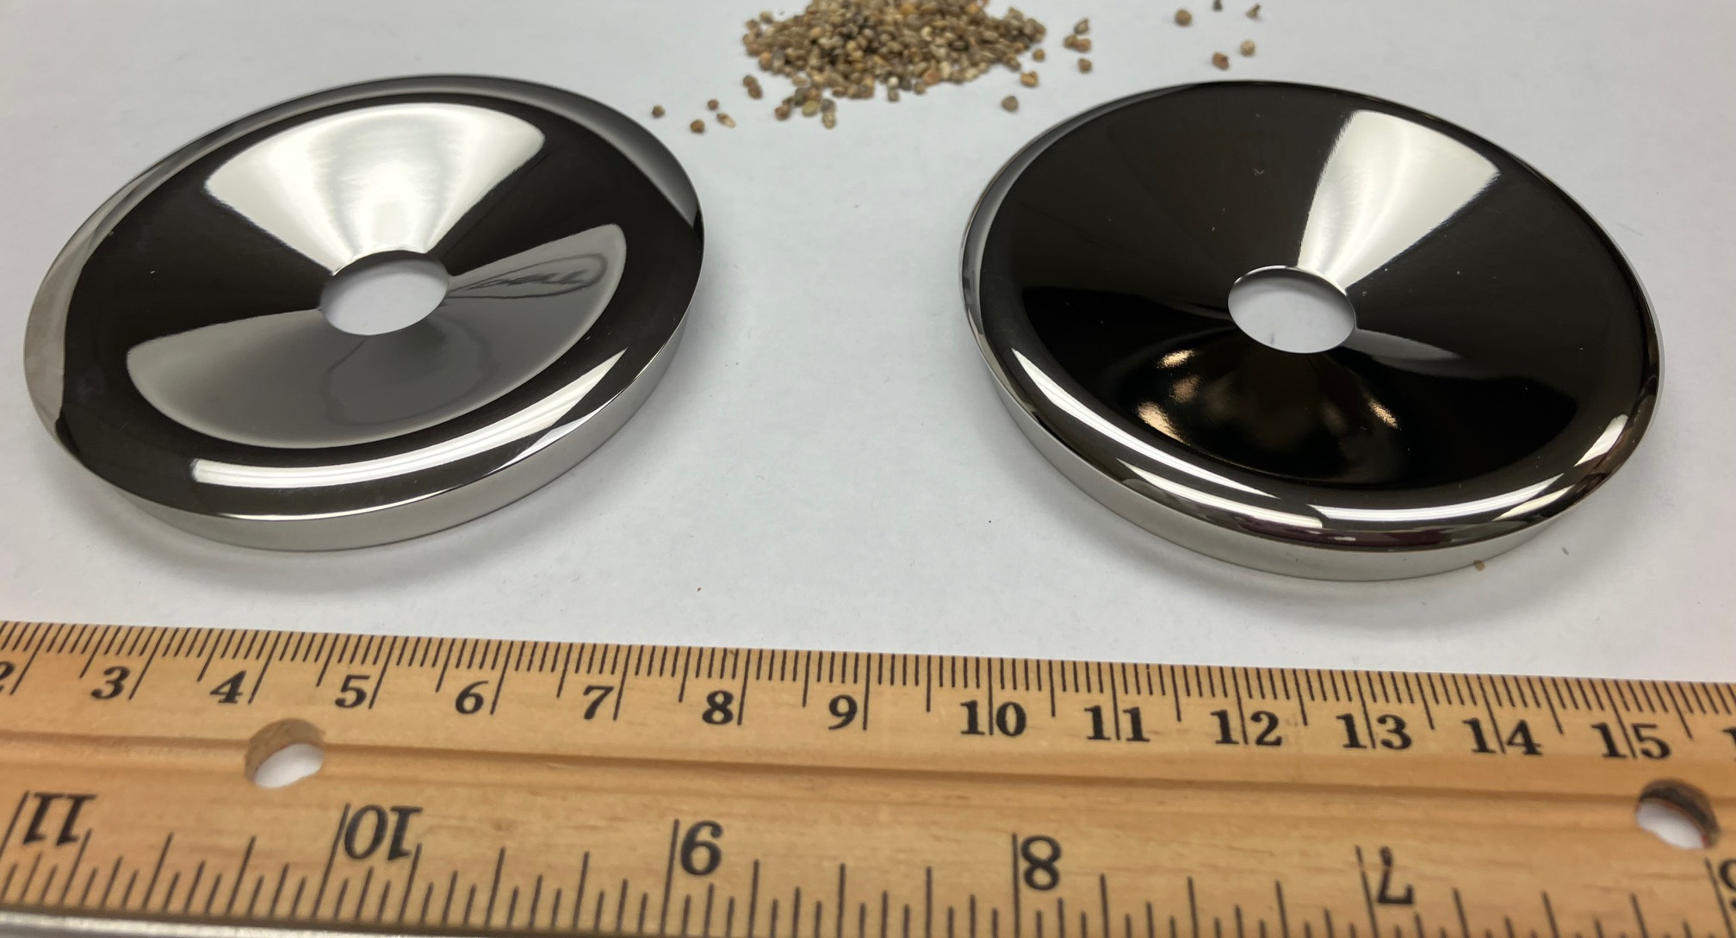
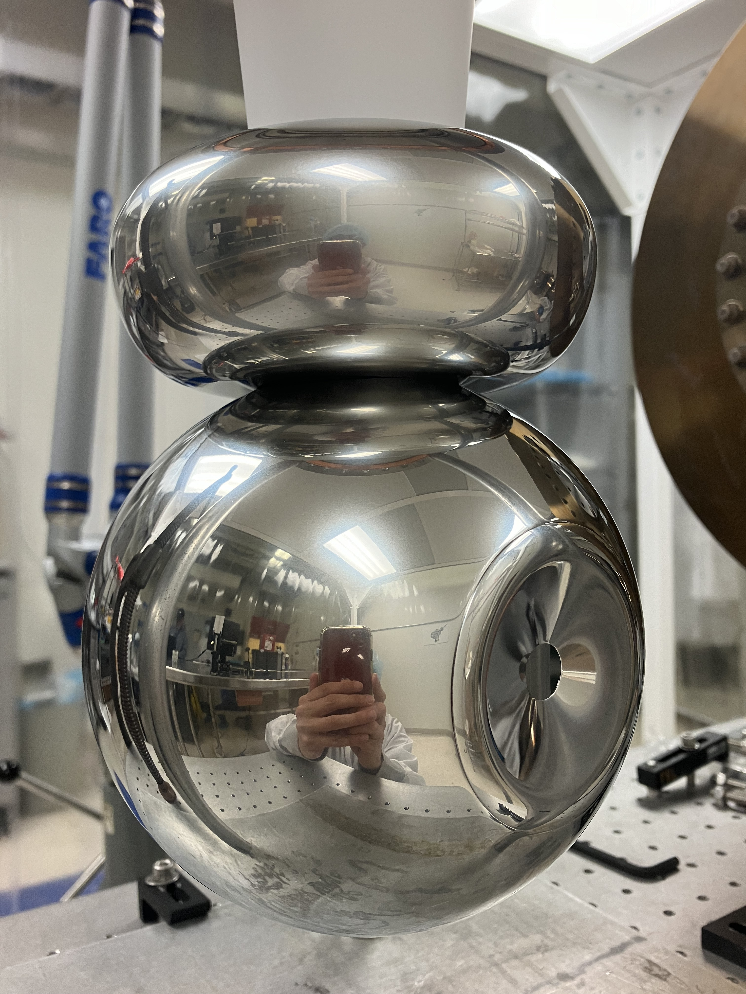
A new Pierce focusing electrode was manufactured, polished and installed
A pair of new Pierce focusing electrode after being polished with corncob
200 kV electrode assembled with new Pierce focusing electrode

Slide 10
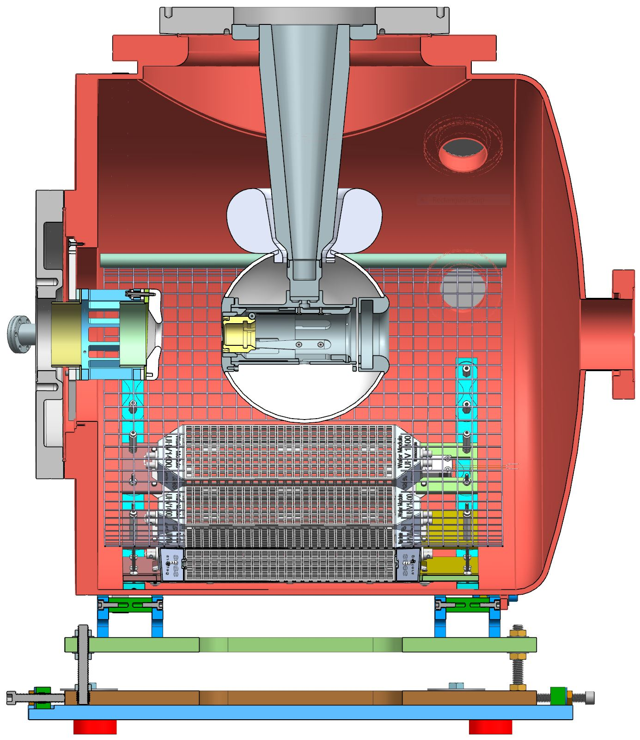
The 200 kV gun assembled and installed in CEBAF
10 in
CEBAF inverted insulator photogun

Slide 11
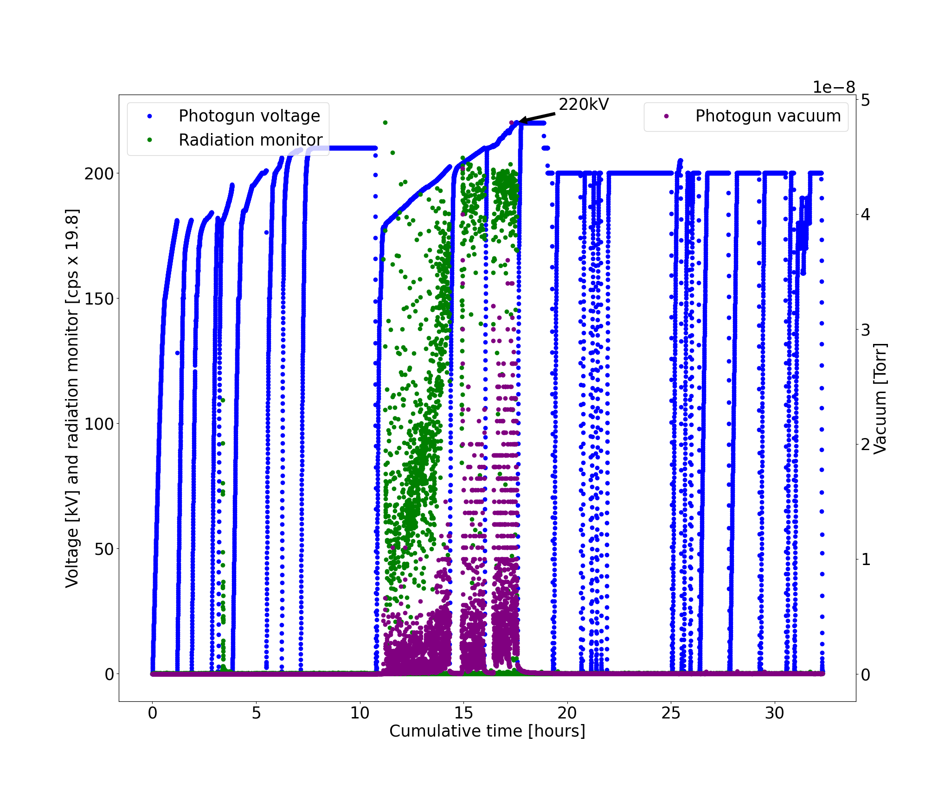
The R30 photogun was high voltage conditioned to 220 kV
Voltage induced gas desorption
HV soaking
Kr gas field emission processing
Data analysis by G. Palacios-Serrano

Slide 12
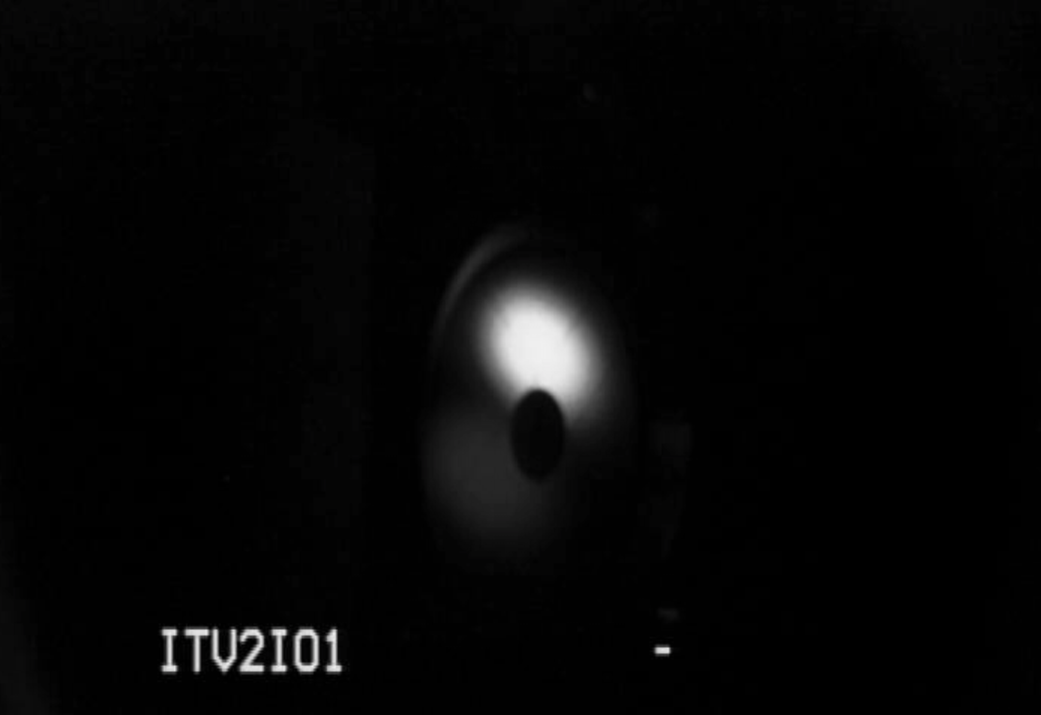
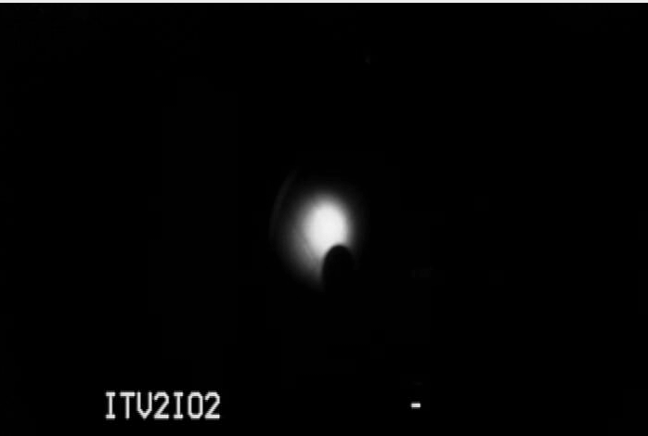
First beam! 200 kV photogun optics looks good comparable to 130 kV photogun
MFX2I01 turned off
16˚ focusing
electrode
  200 keV beam Aug-30-2024
MFX2I01 turned off
  R28 photogun
  130 keV beam May-26-2021
25˚ focusing
electrode

Slide 13
Comparison of focal lengths for the 130 kV (R28) and the 200 kV (R30) photoguns
Simulated
Measured
Measurements & analysis: M. Bruker
Simulation assumes 0.18 mm photocathode recess
Focusing consistently stronger than predicted by simulations. We need to further investigate why the focal length of the photoguns is shorter than simulated.

Slide 14
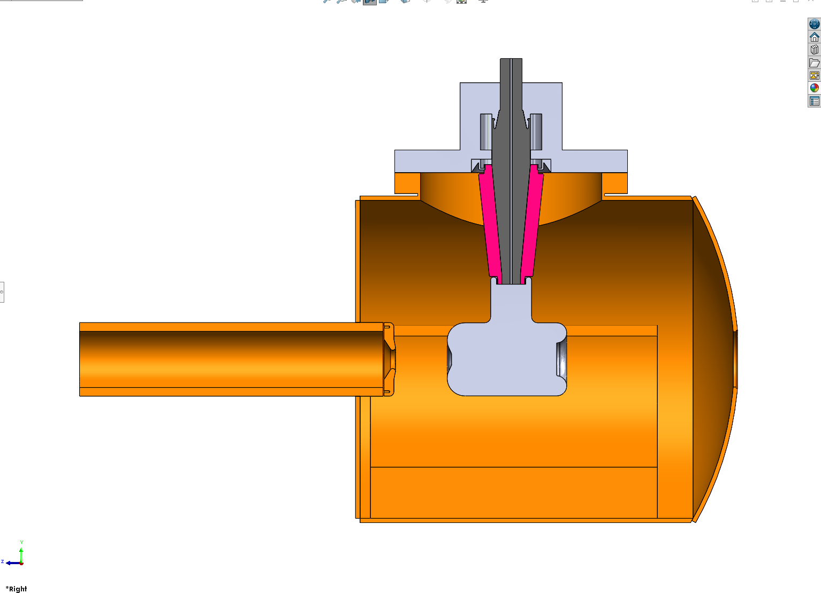
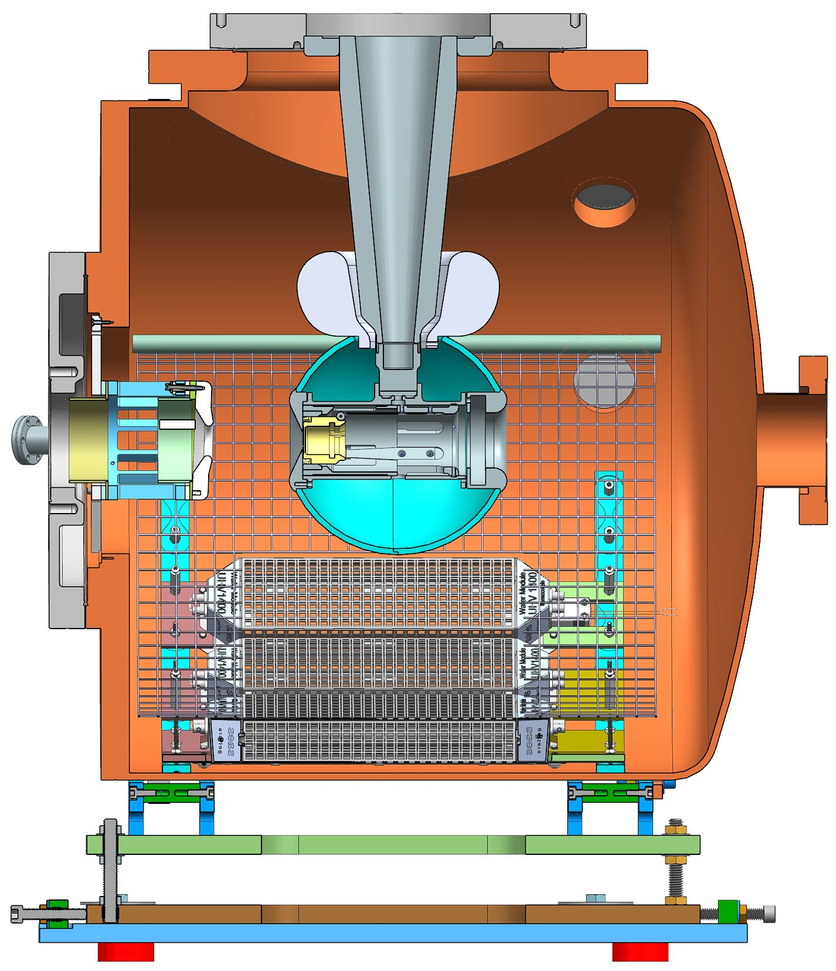
Summary
The 130 keV CEBAF polarized electron source:
  Based on an inverted insulator geometry
  Commissioned in 2010
  Provided 130 keV, > 85% spin polarized beam up to 250 𝜇A CW beam for PQB experiments
  Replaced in 2024 with a larger, 200 kV inverted insulator photogun
The 200 keV CEBAF polarized electron source
  Electrode geometry designed to reproduce 130 keV photogun beam envelope at 200 keV
  Functionality commissioning completed in August 2024
    Conditioned to 220 kV field emission free
    Produced 200 keV beam with beam envelope similar to that of the 130 keV photogun
    Tested up to 100 𝜇 A CW beam with no detectable beam loss on apertures (encouraging!)
    PQB evaluation scheduled for November 2024
10 in

Slide 15
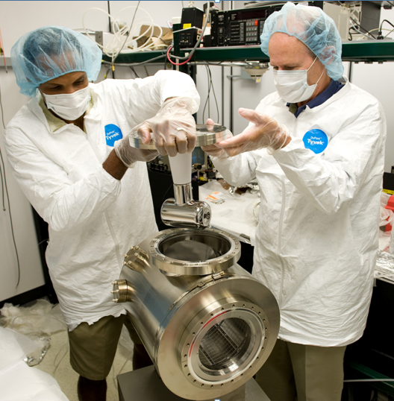
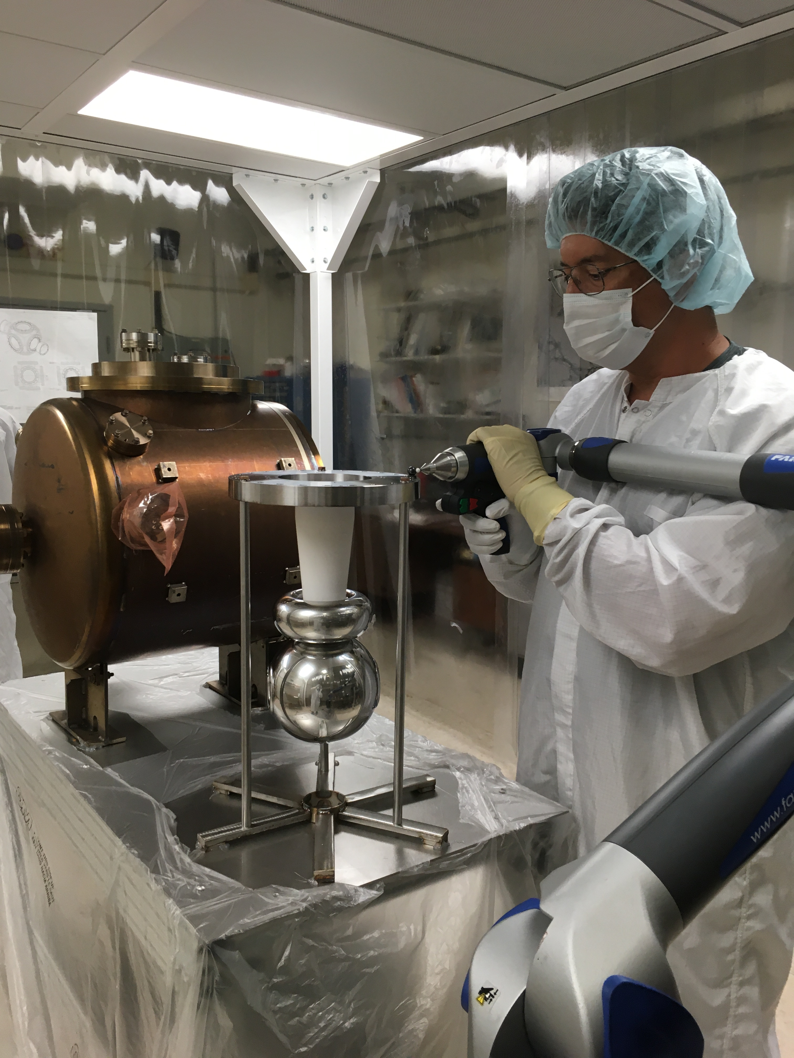
THANK YOU!!!
The JLab Source/Injector Team
CEBAF 130 kV photogun
CEBAF 200 kV photogun

Slide 16
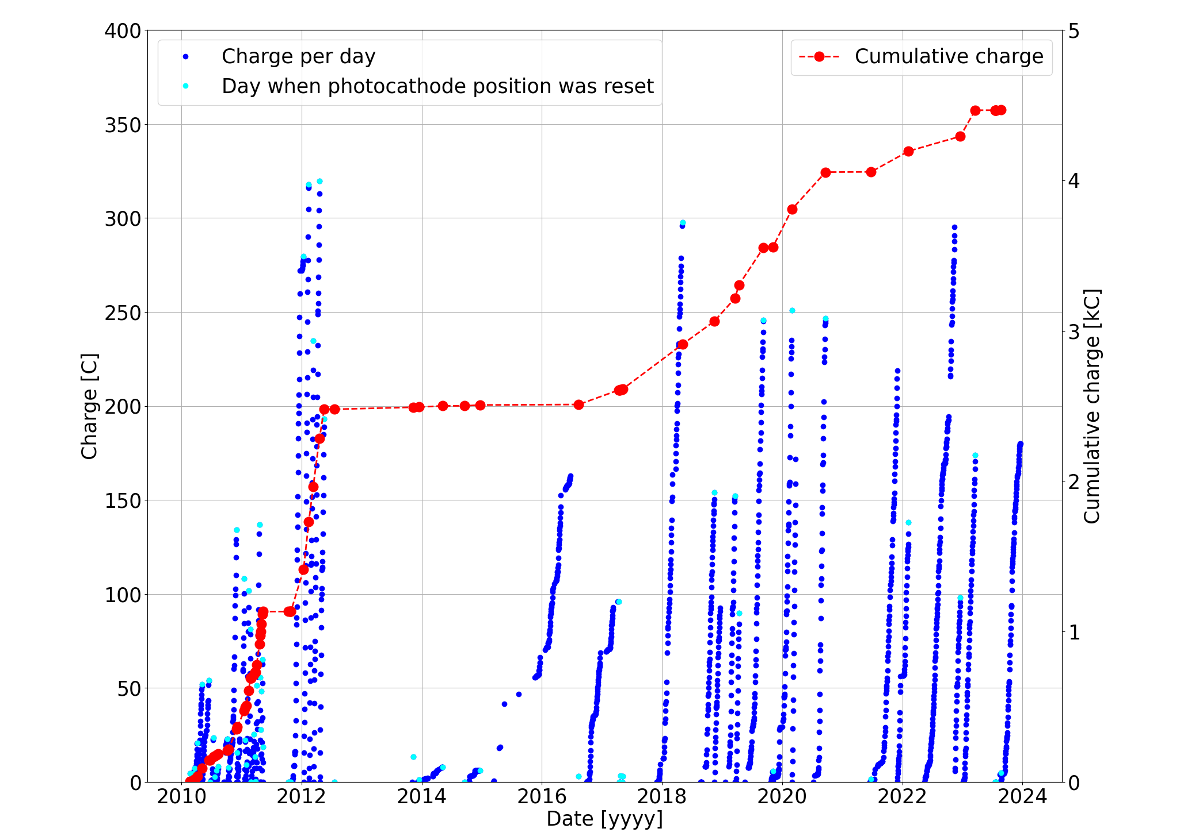
Extracted charge from R28 style CEBAF photogun 2010-2024
Data analysis by G. Palacios-Serrano

