Slide 1

Development of GaN as a Robust Spin-Polarized Photocathode at Cornell University
Samuel J. Levenson
2024 Workshop on Polarized Sources, Targets, and Polarimetry
Newport News, VA, USA
September 26, 2024

Slide 2
Acknowledgements
M.B. Andorf
I.V. Bazarov
J.M. Maxson
B.D. Dickensheets
H.G. Xing
A. Galdi
J. Encomendero
V. V. Protasenko
D. Jena
Special thanks to J.K. Bae, B.A. Carmona, L. Cultrera, N. Otto, and M. A. Reamon

Slide 3
Spin-Polarized Electron Sources

Slide 4
Spin-Polarized Electron Sources
Goals for Sources
>90% spin polarization
Spin orientation reversibility
mA-scale current delivery
Low emittance and energy spread
Long operational lifetime

Slide 5



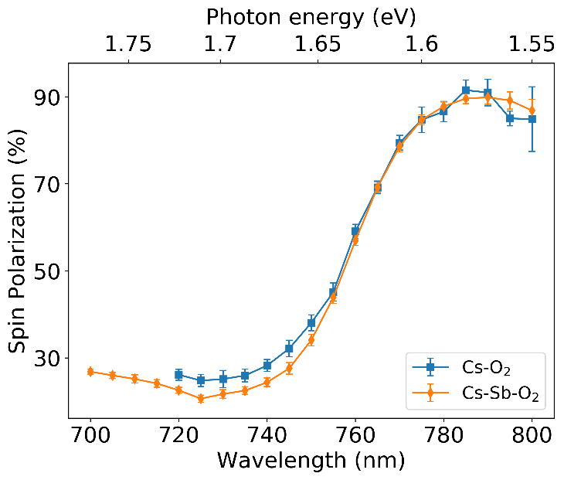
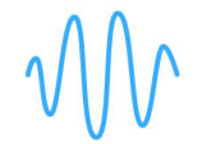
GaAs Photocathodes
>90% polarizations achievable with strained GaAs
52 mA record current (un-polarized)
<150 meV energy spread
High quantum efficiencies (QE)
Commercially available
Goals for Sources
>90% spin polarization
Spin orientation reversibility
mA-scale current delivery
Low emittance and energy spread
Long operational lifetime
Photocathode
Strained GaAs: >90% spin polarizations
Cs
Cs
Cs
Cs
Cs
Cs
GaAs Cathode
Cs:GaAs photocathode excited with circularly polarized light
Journal of Applied Physics. 127, 124901 (2020)

Slide 6
GaAs Photocathodes
>90% polarizations achievable with strained GaAs
52 mA record current (un-polarized)
<150 meV energy spread
High quantum efficiencies (QE)
Commercially available
Needs Cs layer, making the cathode unstable, sensitive and short-lived
Goals for Sources
>90% spin polarization
Spin orientation reversibility
mA-scale current delivery
Low emittance and energy spread
Long operational lifetime
Photocathode
Strained GaAs: >90% spin polarizations
Cs
Cs
Cs
Cs
Cs
Cs
GaAs Cathode
Cs:GaAs photocathode excited with circularly polarized light
Journal of Applied Physics. 127, 124901 (2020)

Slide 7
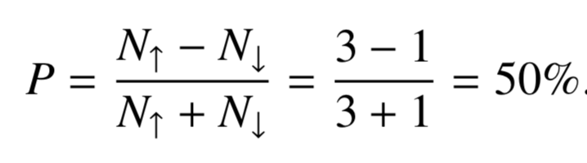
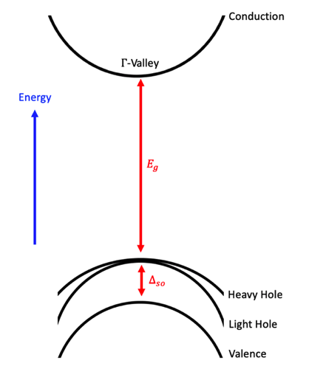




Spin Polarized Photoemission
m = -1/2
m = +1/2
$±ℏ$ Spin Angular Momentum
3
3
Opposite-handed circularly polarized light
1
1
2
2
$±ℏ$ Spin Angular Momentum
m = -3/2
m = -1/2
m = +1/2
m = +3/2
P_{3/2}
Split-off
P_{1/2}
$±ℏ$ Spin Angular Momentum
m = -1/2
m = +1/2
+1 in orange
D. T. Pierce & F. Meier. Phys. Rev. B 13, 5484.1976.
-1 in green

Slide 8
Gallium Nitride (GaN)

Slide 9
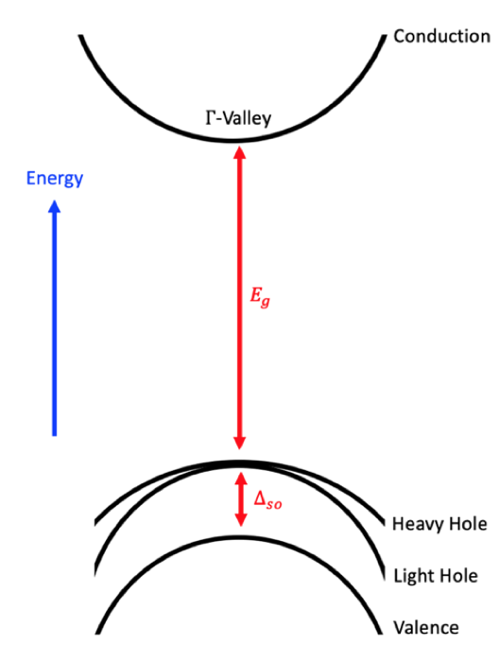
Gallium Nitride (GaN)
Can be grown in hexagonal Wurtzite or cubic zinc-blende orientations
Zinc-Blende GaN
Just like GaAs!

Slide 10
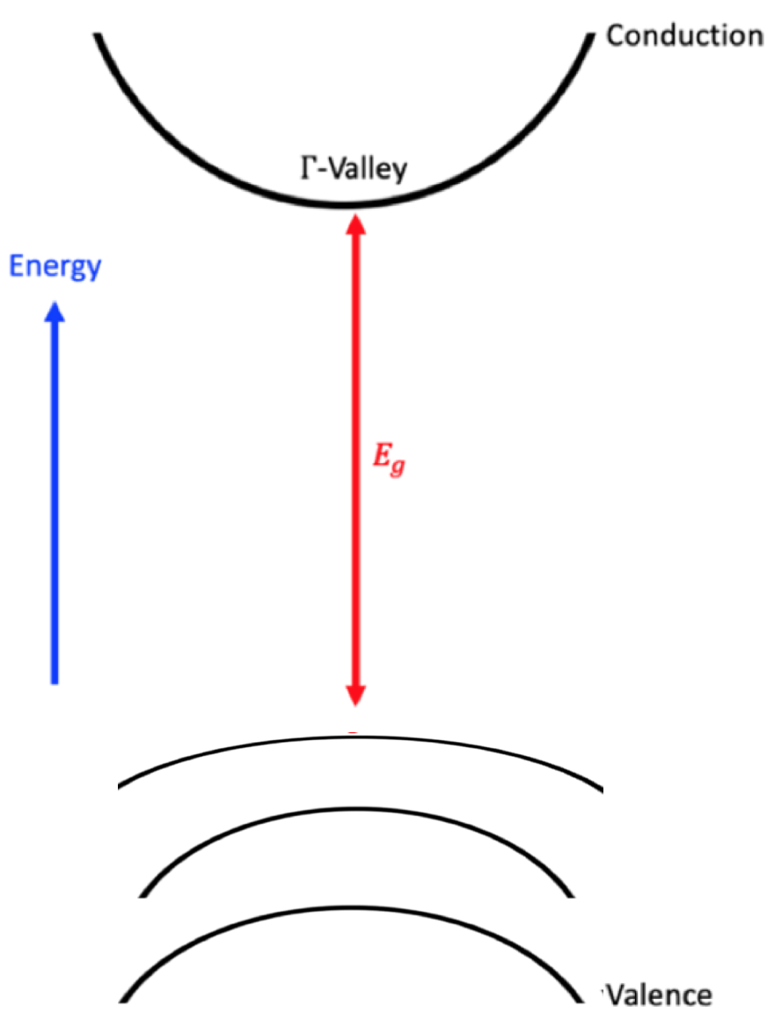
Gallium Nitride (GaN)
Can be grown in hexagonal Wurtzite or cubic zinc-blende orientations
Zinc-Blende GaN
Wurtzite GaN
E₁
E₂
E₃
Just like GaAs!
Non-Degenerate Valence Band!

Slide 11
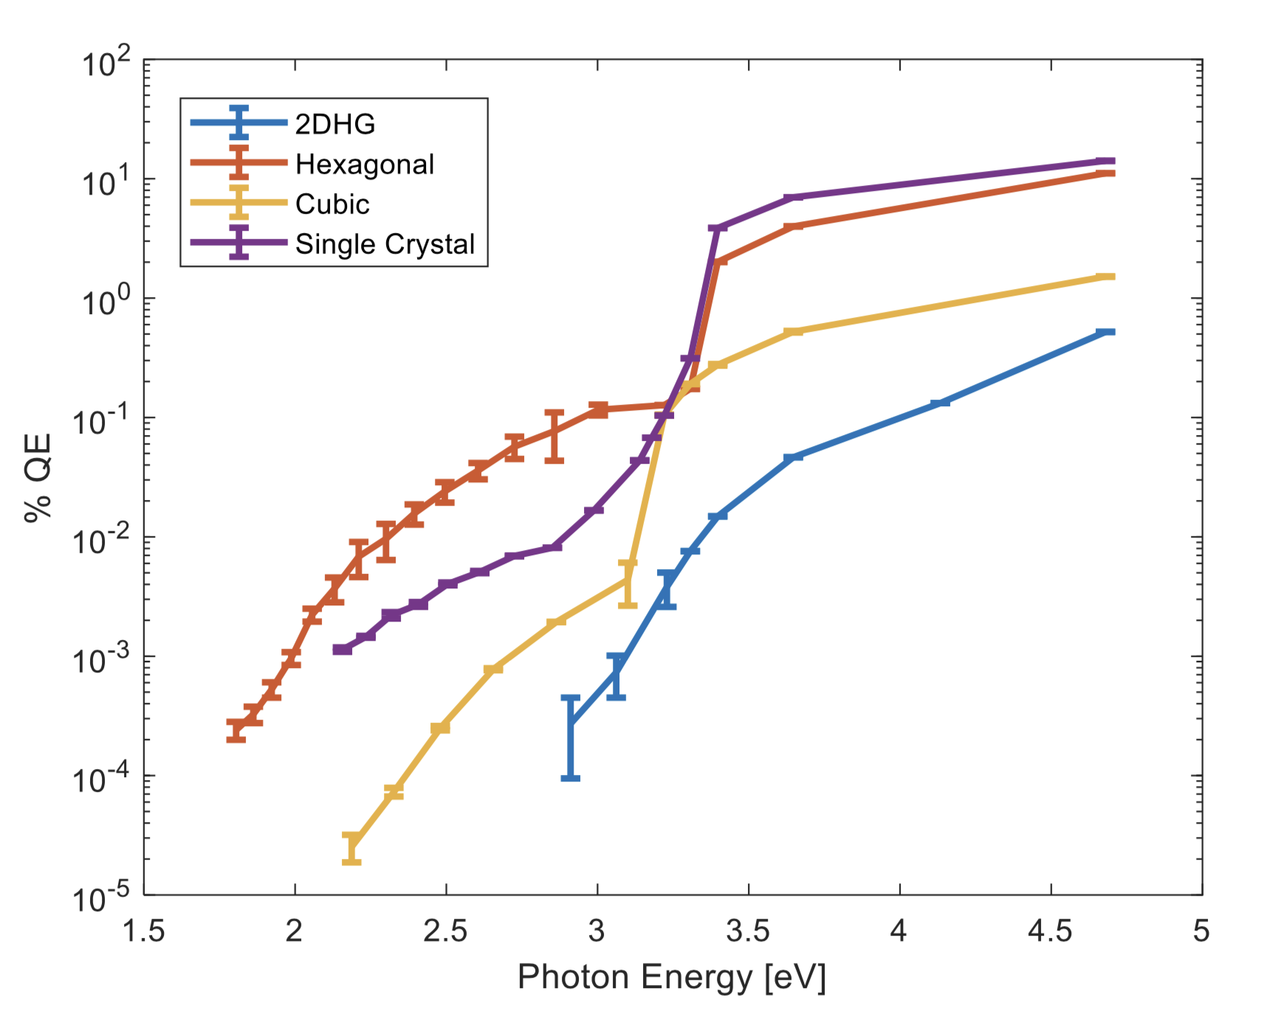
GaN as a Spin-Polarized Source
  Wurtzite or Zinc-Blende orientation
  >50% QE achievable with W-pGaN
  Comparable spin relaxation time to GaAs (~5 ns)
  Could be strained for high polarization
  3.2 eV band gap is conveniently at the second harmonic of Ti:Sapphire
  Less Cs to get to NEA→ stronger bond to Cs?
  NEA with Cs only
GaAs for comparison: ${E_{g}=1.42 eV, Δ}_{so}$ = 0.34 eV

Slide 12
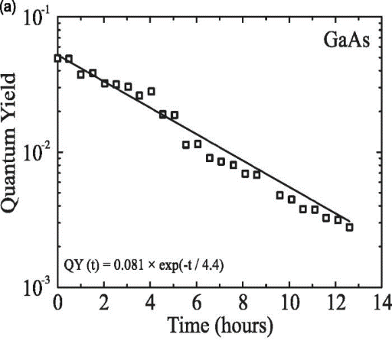
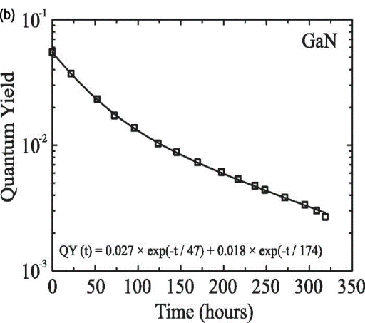
GaN as a Spin-Polarized Source
  Wurtzite or Zinc-Blende orientation
  >50% QE achievable with W-pGaN
  Comparable spin relaxation time to GaAs (~5 ns)
  Could be strained for high polarization
  3.2 eV band gap is conveniently at the second harmonic of Ti:Sapphire
  Less Cs to get to NEA→ stronger bond to Cs?
  NEA with Cs only
J. Vac. Sci. & Technol. B 32, 06F901 (2014)
GaAs for comparison: ${E_{g}=1.42 eV, Δ}_{so}$ = 0.34 eV

Slide 13
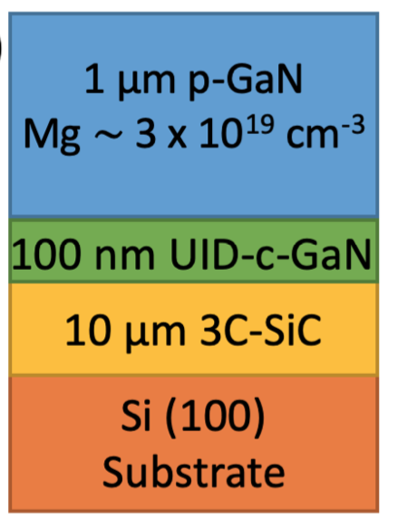
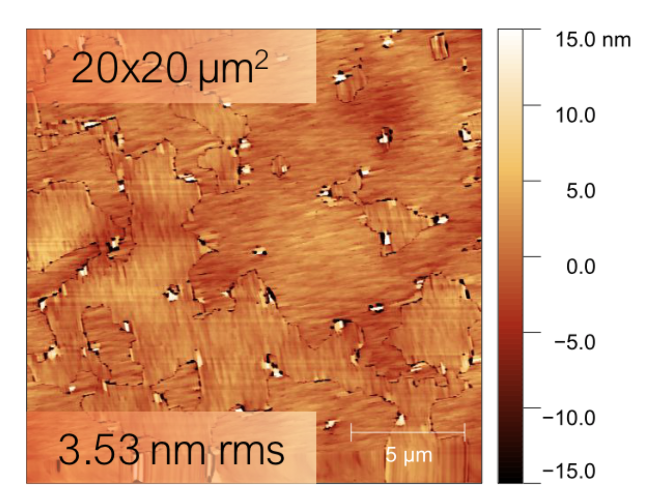
Our Cubic GaN Photocathode
Sample grown in molecular beam epitaxy growth chamber
AFM Images

Slide 14
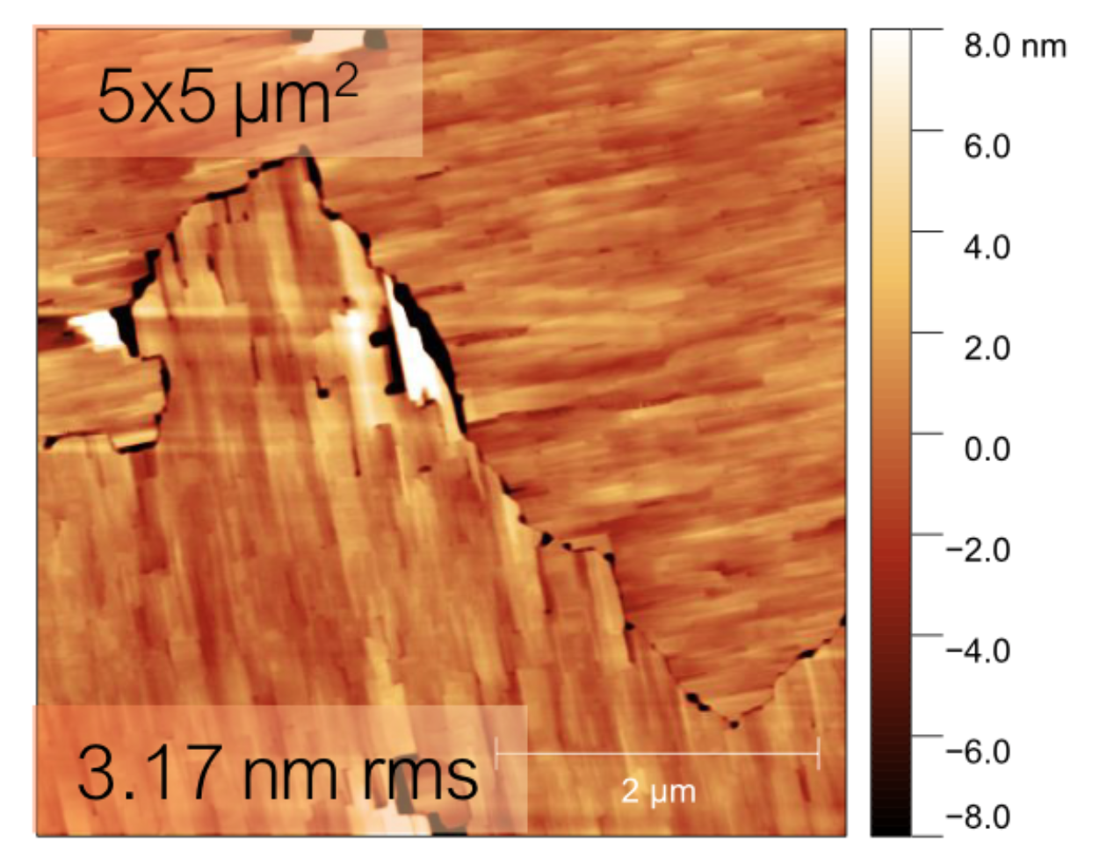
Our Cubic GaN Photocathode
Sample grown in molecular beam epitaxy growth chamber
AFM Images
Anti-phase boundary (APB) defects, characteristic of growths on 3C-SiC

Slide 15
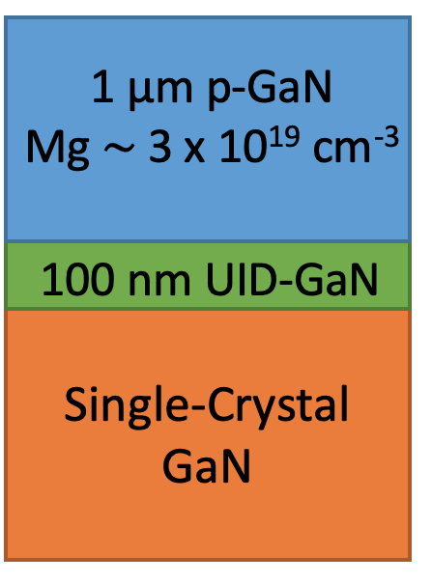
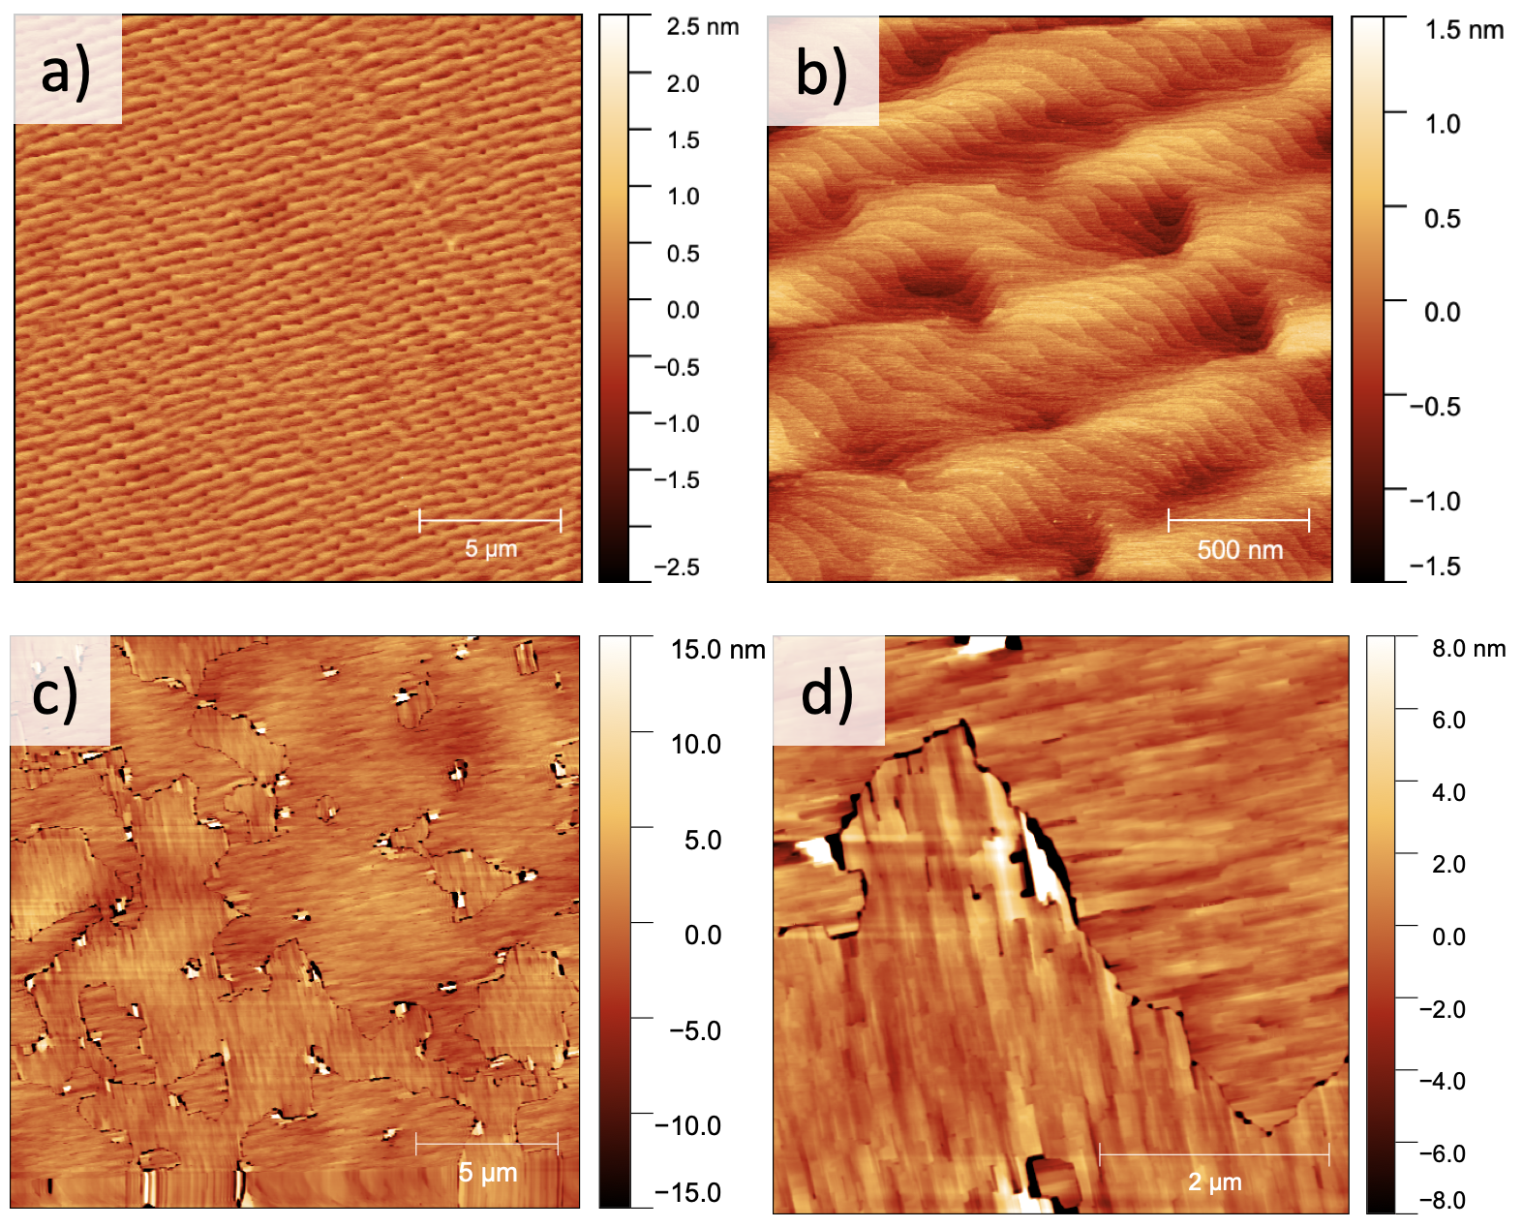
Our Hexagonal GaN Photocathode
Sample grown in molecular beam epitaxy growth chamber
AFM Images

Slide 16
Our Hexagonal GaN Photocathode
Sample grown in molecular beam epitaxy growth chamber
AFM Images
Much better-quality surface than the cubic sample!

Slide 17
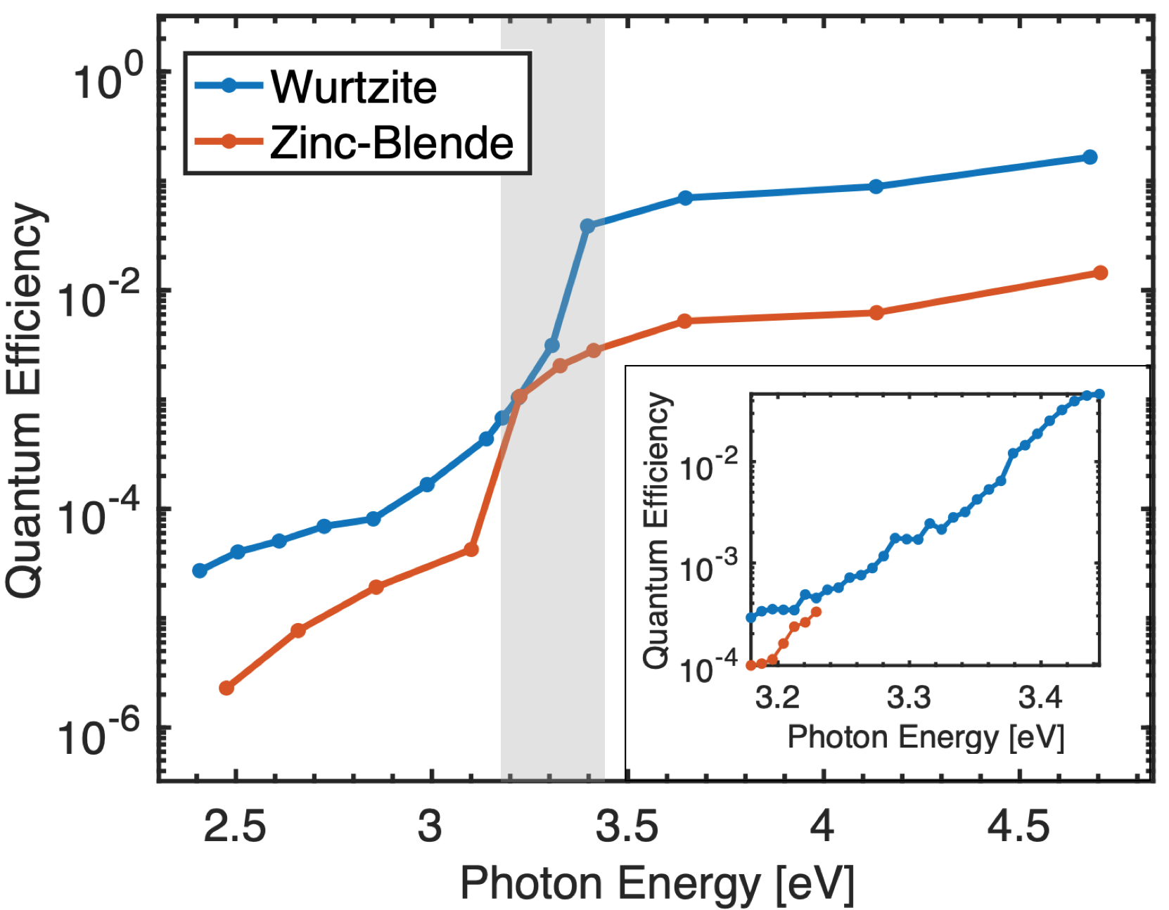

Activation to NEA

Slide 18
Activation to NEA
3.2 eV and 3.4 eV band gaps

Slide 19
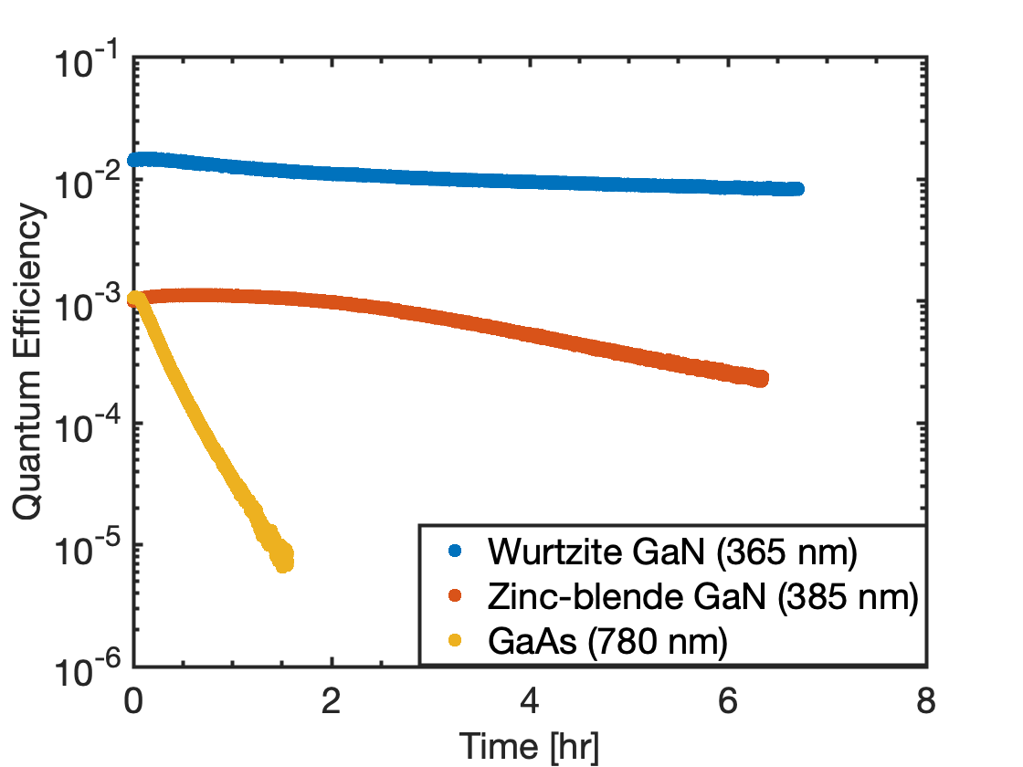
Activation to NEA
Lifetime monitored at respective threshold photon energies
Higher QE/Lifetime in W-GaN likely due to better crystal quality
GaAs activated in same chamber, monitored at 780 nm for reference (factors of 20 & 12 lifetime difference)

Slide 20
Time to measure the spin polarization!

Slide 21
Time to measure the spin polarization!
But first….

Slide 22
Theoretical Excitations
Recall the band structure and excitation of GaAs
1.43 eV
340 meV

Slide 23
Theoretical Excitations
ZB GaN
3.2 eV

Slide 24

Theoretical Excitations
ZB GaN
15 meV
3.2 eV

Slide 25
Theoretical Excitations
ZB GaN
15 meV
3.2 eV

Slide 26
Theoretical Excitations
ZB GaN
W GaN
15 meV
3.4 eV
3.2 eV

Slide 27
Theoretical Excitations
ZB GaN
W GaN
15 meV
5 meV
17 meV
3.4 eV
3.2 eV

Slide 28
Theoretical Excitations
ZB GaN
W GaN
15 meV
5 meV
17 meV
3.4 eV
3.2 eV

Slide 29
Theoretical Excitations
~1 nm wavelength window!
ZB GaN
W GaN
15 meV
5 meV
17 meV
3.4 eV
3.2 eV

Slide 30
- Design requirements:
  - Tunable from 360 nm – 390 nm
  - 1 nm bandwidth
  - 1-2 µW power at sample
  - Circularly polarized
We therefore have very stringent light source requirements

Slide 31
- Design requirements:
  - Tunable from 360 nm – 390 nm
  - 1 nm bandwidth
  - 1-2 µW power at sample
  - Circularly polarized
We therefore have very stringent light source requirements
1032 nm pulsed femtosecond laser
20 W
Optical Parametric Amplifier
Tunable 600-800 nm
2% efficiency
Diffraction grating
Frequency-doubling
BiBO crystal
Linear polarizer and quarter-wave plate
Single-mode optical fiber

Slide 32
- Design requirements:
  - Tunable from 360 nm – 390 nm
  - 1 nm bandwidth
  - 1-2 µW power at sample
  - Circularly polarized
We therefore have very stringent light source requirements
1032 nm pulsed femtosecond laser
20 W
Optical Parametric Amplifier
Tunable 600-800 nm
2% efficiency
Diffraction grating
Frequency-doubling
BiBO crystal
Linear polarizer and quarter-wave plate
Frequency-doubling
BiBO crystal
Single-mode optical fiber
Femtosecond pulsed laser + optical parametric amplifier + frequency doubling
  20-40 mW of UV light
  1.5 nm linewidth
  Widely tunable

Slide 33
- Design requirements:
  - Tunable from 360 nm – 390 nm
  - 1 nm bandwidth
  - 1-2 µW power at sample
  - Circularly polarized
We therefore have very stringent light source requirements
1032 nm pulsed femtosecond laser
20 W
Optical Parametric Amplifier
Tunable 600-800 nm
2% efficiency
Diffraction grating
Frequency-doubling
BiBO crystal
Linear polarizer and quarter-wave plate
Single-mode optical fiber
Final result: 1.4 nm bandwidth at Mott Polarimeter

Slide 34
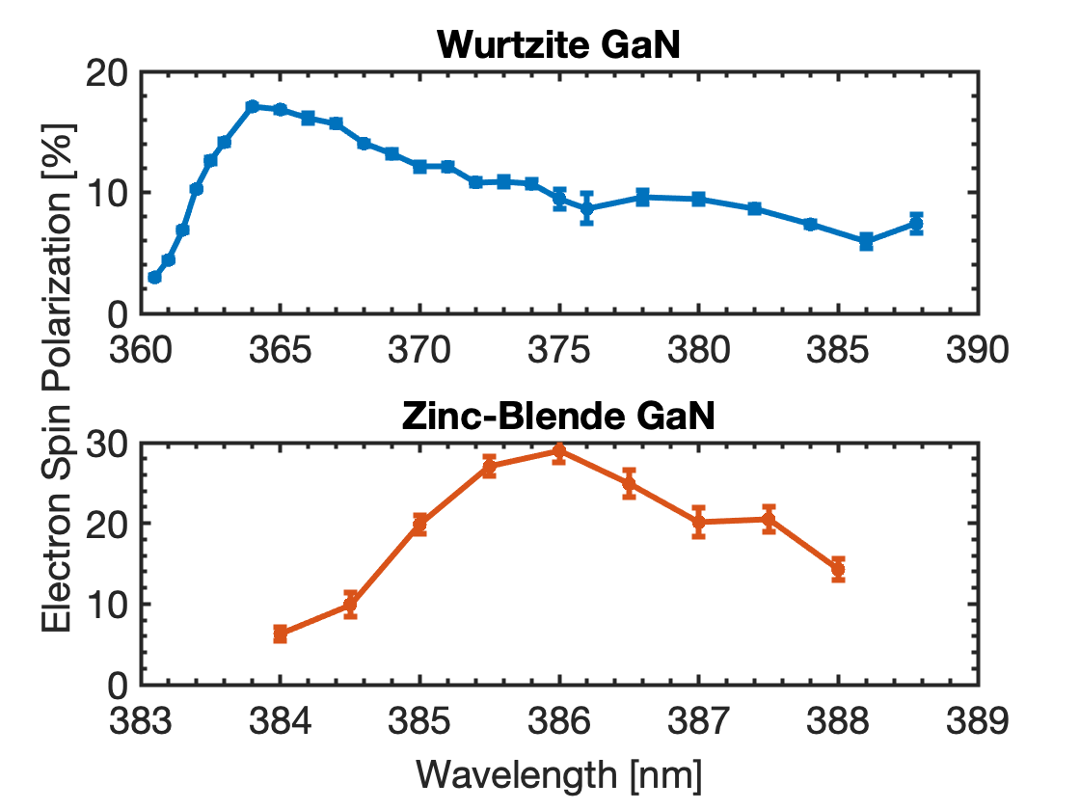
Results
Peaks: W: 17%, ZB: 29%
Do these measurements make sense?

Slide 35
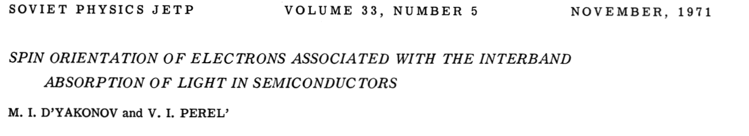

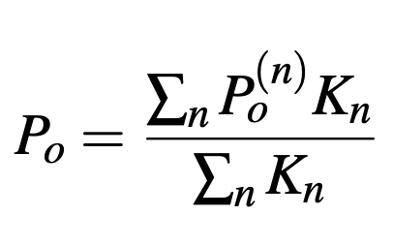
Modeling the Cubic Sample
Initial excited spin polarization approximated with model for ZB structures by D’yakonov and Perel
Excited distribution peaks at 50% maximum, as expected
Mixing of split-off band with light and heavy hold bands

Slide 36
Model
Scale model to approximate de-polarization effects
Peak (measurement maximum) at 33%, on par with that of GaAs
Note that the peak was scaled according to a fit with our data!

Slide 37
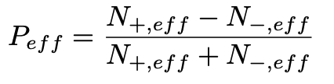
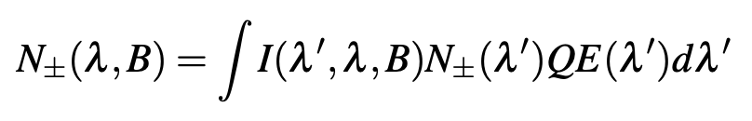
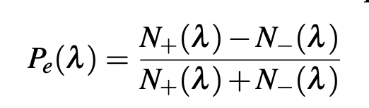

Model
Since the spin-orbit splitting is so small, need to consider measuring spectrum with incident light spectra
Calculate effective polarization based on the light bandwidth
Gaussian light spectrum with variable bandwidth (B) and center at lambda

Slide 38
Model
Measurements confirm bandwidth limit
We get good agreement with the convolved DP Model
Spin depolarization mechanisms may be similar to those in GaAs
Our 1.4 nm bandwidth measurements may be close to the theoretical maximum.

Slide 39
Hexagonal Sample
The W-GaN ESP spectrum extends far into the bandgap
  Why?

Slide 40
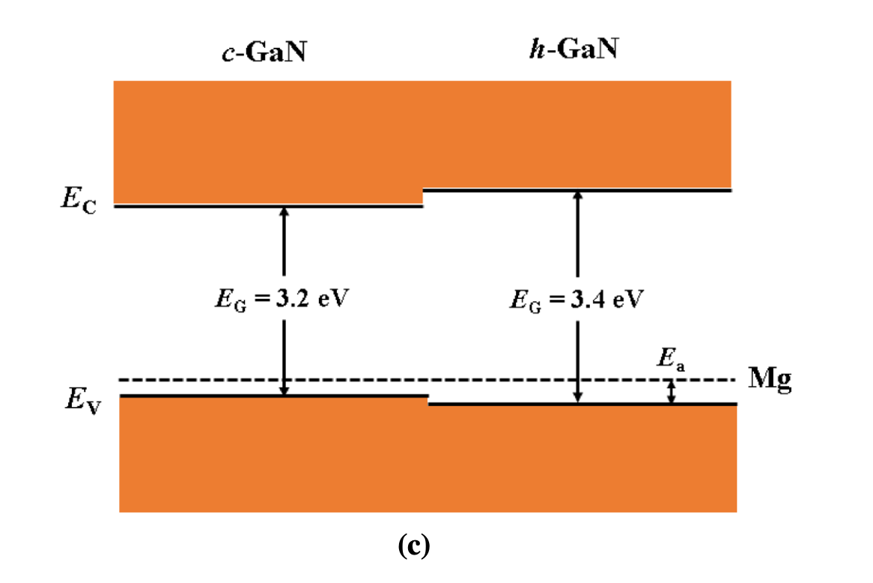
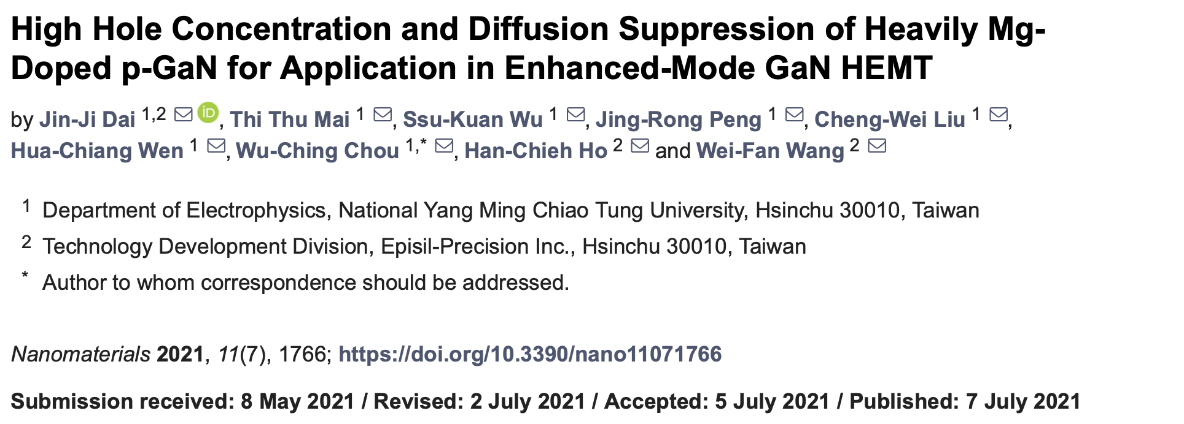
Hexagonal Sample
The W-GaN ESP spectrum extends far into the bandgap
  Why?
Mg-acceptor ~200 meV into bandgap

Slide 41
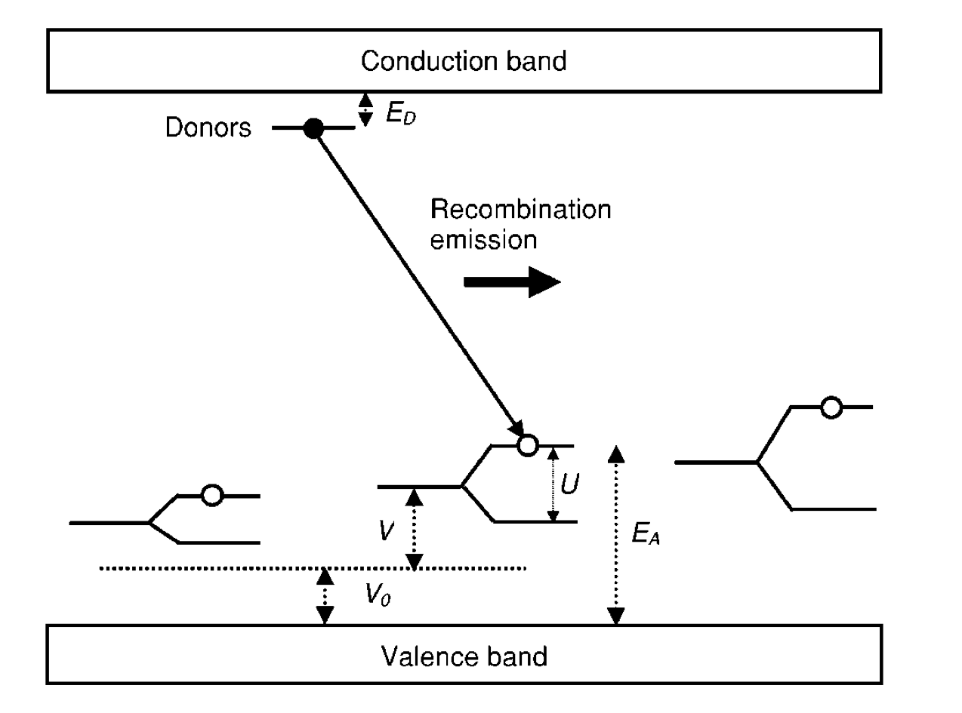
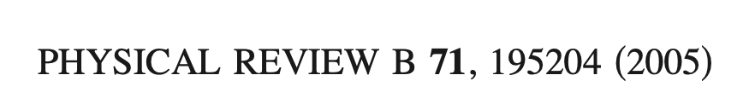
Hexagonal Sample
The W-GaN ESP spectrum extends far into the bandgap
  Why?
3/2 character seen in Mg-acceptor level in single-crystal sample
Mg-acceptor ~200 meV into bandgap

Slide 42
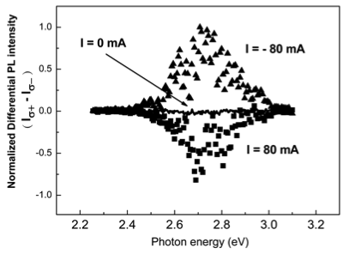
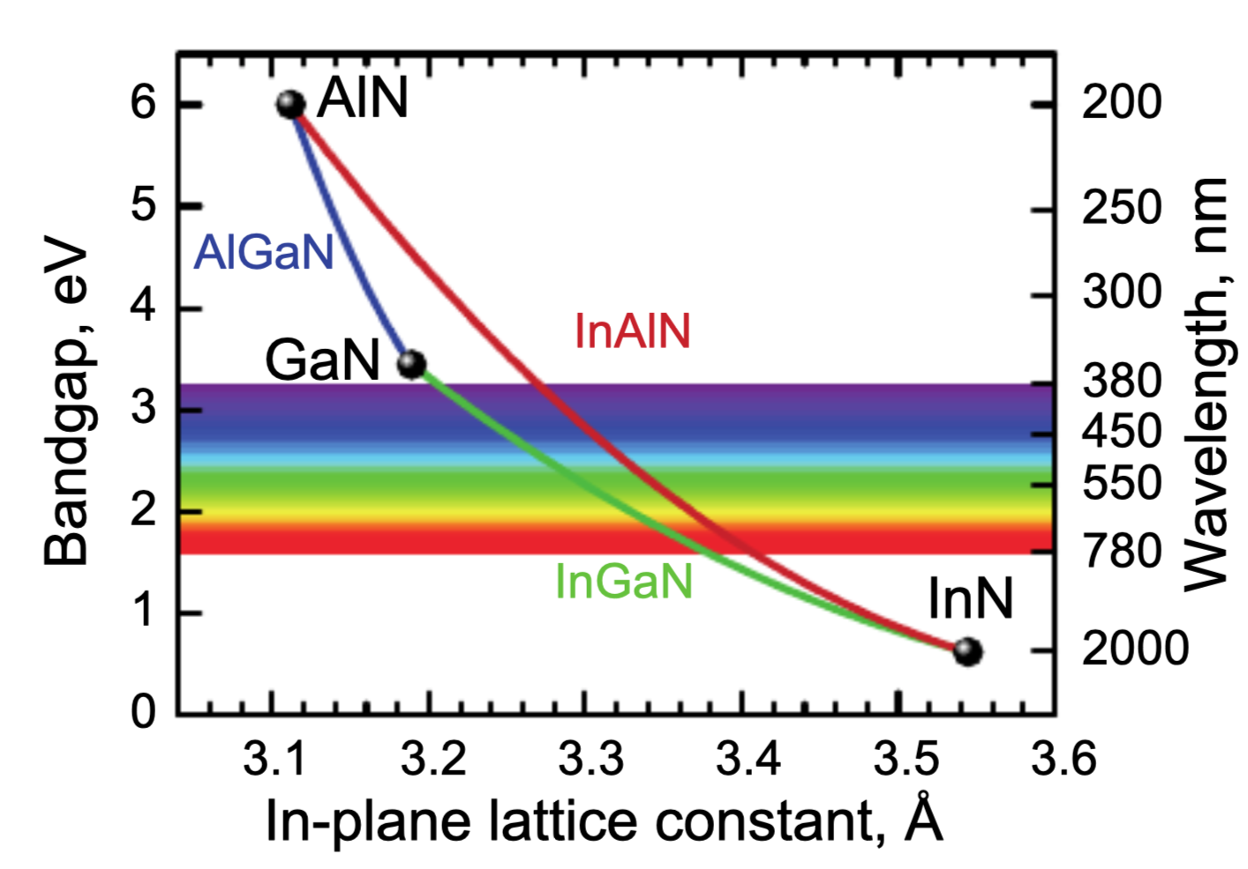
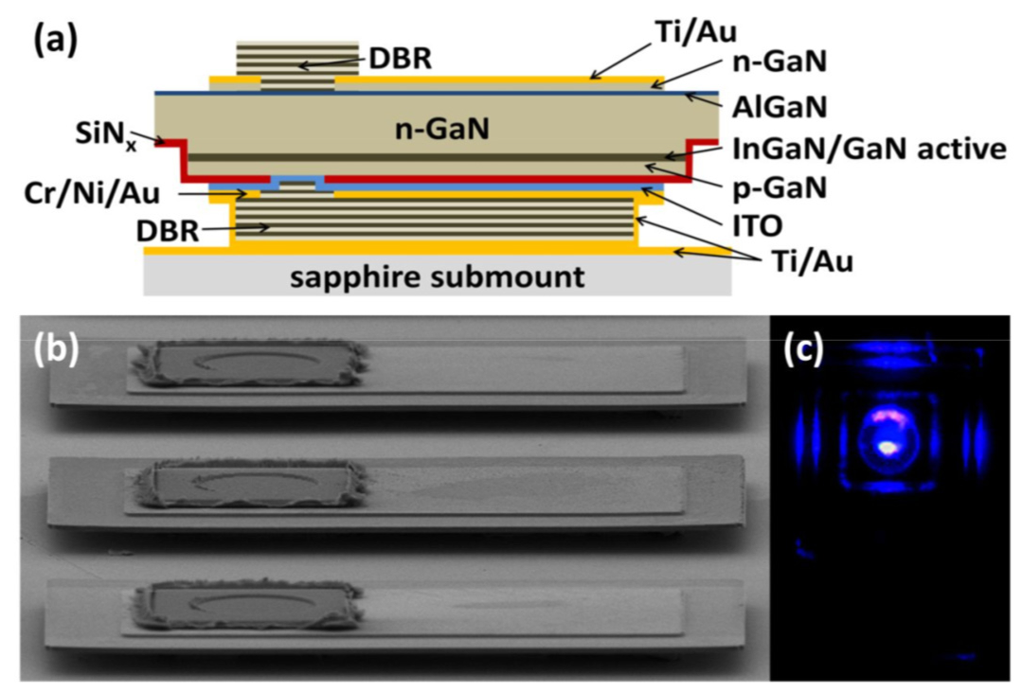
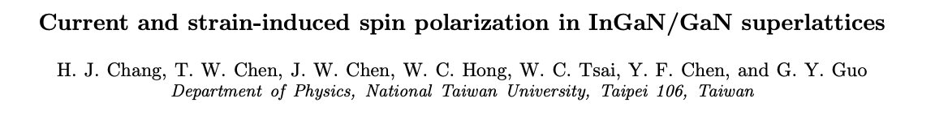
GaN Spin Polarization Outlook
While an interesting result, further work is needed for GaN to be used practically
Things already done with GaN can be applied to photocathodes! Like…
Strained GaN
InGaN
Distributed Bragg Reflector
D S Arteev et al 2018 J. Phys.: Conf. Ser. 1135 012050
C. Zhang et al. Appl. Sci. 2019, 9, 1593

Slide 43
Conclusion
GaN may be a more robust option than GaAs for spin-polarized electron beam production
Spin-polarization measured from ZB and W GaN photocathodes, small SO splitting/bandwidth limited measurements
Advances already made with GaN may provide the next industry standard spin polarized photocathode
Thank you so much for your attention!!

Slide 44

Mott
Polarization Measurement
Set light wavelength (λ)
Linear Polarizer
¼-Waveplate
Fiber Head
Unpolarized Light
Cathode
Circular Polarized Light
Circularly polarize light:
Linearly polarizer
λ/4 Waveplate
Scattering Detector
Scattering Detector
Bend electron trajectory for transverse spin orientation
θ
θ
Count scattered electrons on each detector (N_{L} & N_{R})
Tungsten Target

