Slide 1
GaAs-based Spin-polarized photocathode research at Cornell
Matthew Andorf

Slide 2
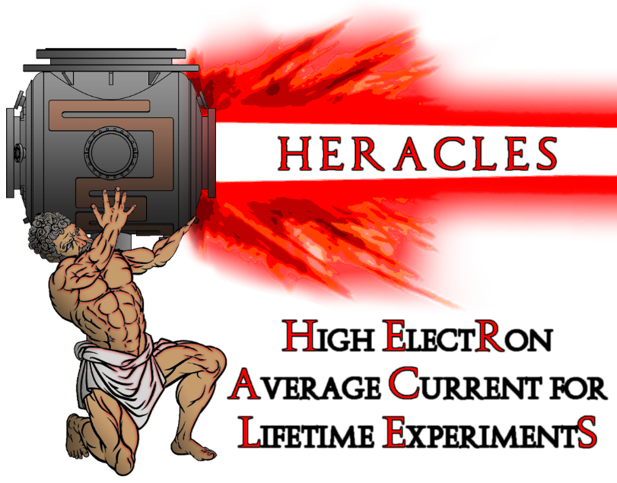
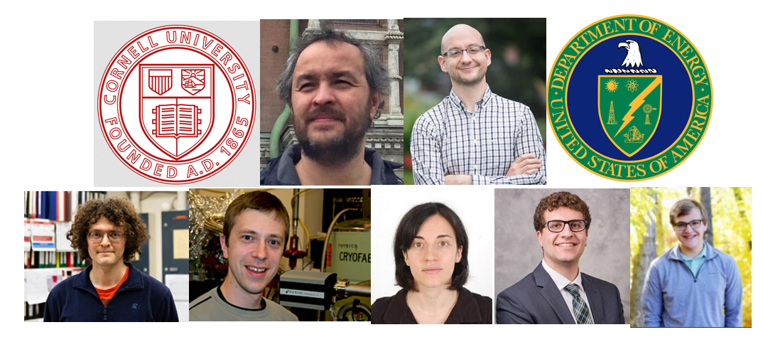
The Bright Beams Lab
Acknowledgements to:
NP-DOE DE-SC0023517
HEP-DOE DE-SC0021002
NFS PHY-1549132 CBB
Ivan Bazarov
Jared Maxson
Adam Bartnik
Alice Galdi (now @U. of Salerno)
Sam Levenson (graduate student)
Mark Reamon (undergrad)

Slide 3
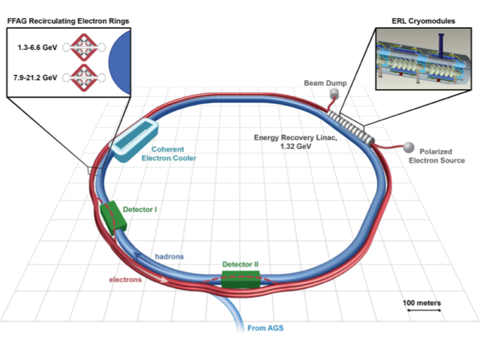
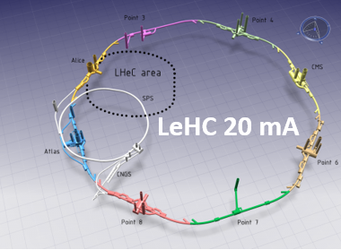
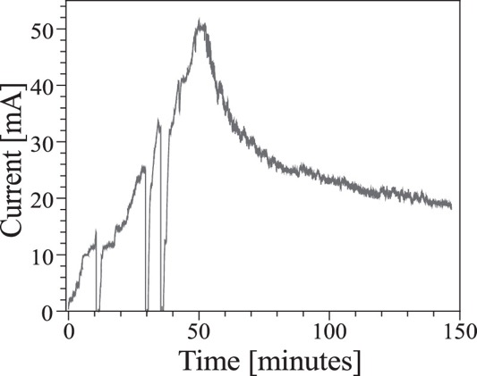
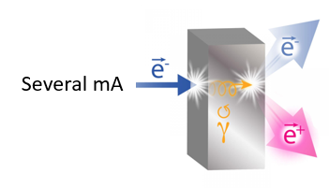
High current and spin polarization
One of the remaining challenges for photocathodes is a robust, spin-polarized electron source
GaAs is by far the most studied spin-polarized electron source
Charge lifetime: The amount of current extracted before the QE degrades by 1/e
1000 C is state of the art→6 hours at 50 ma!
Cornell ERL gun
PEPPo

Slide 4
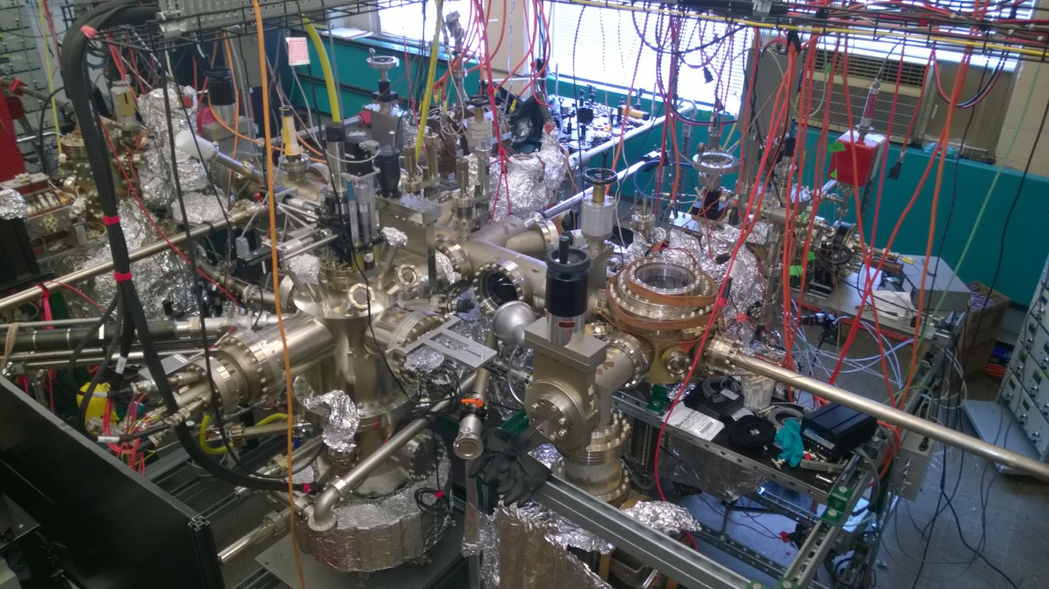
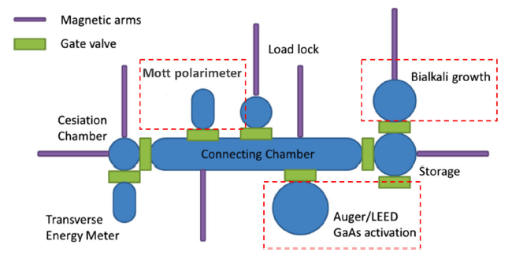
Cornell Photocathode Lab
Vacuum level is below 10⁻¹⁰ Torr

Slide 5
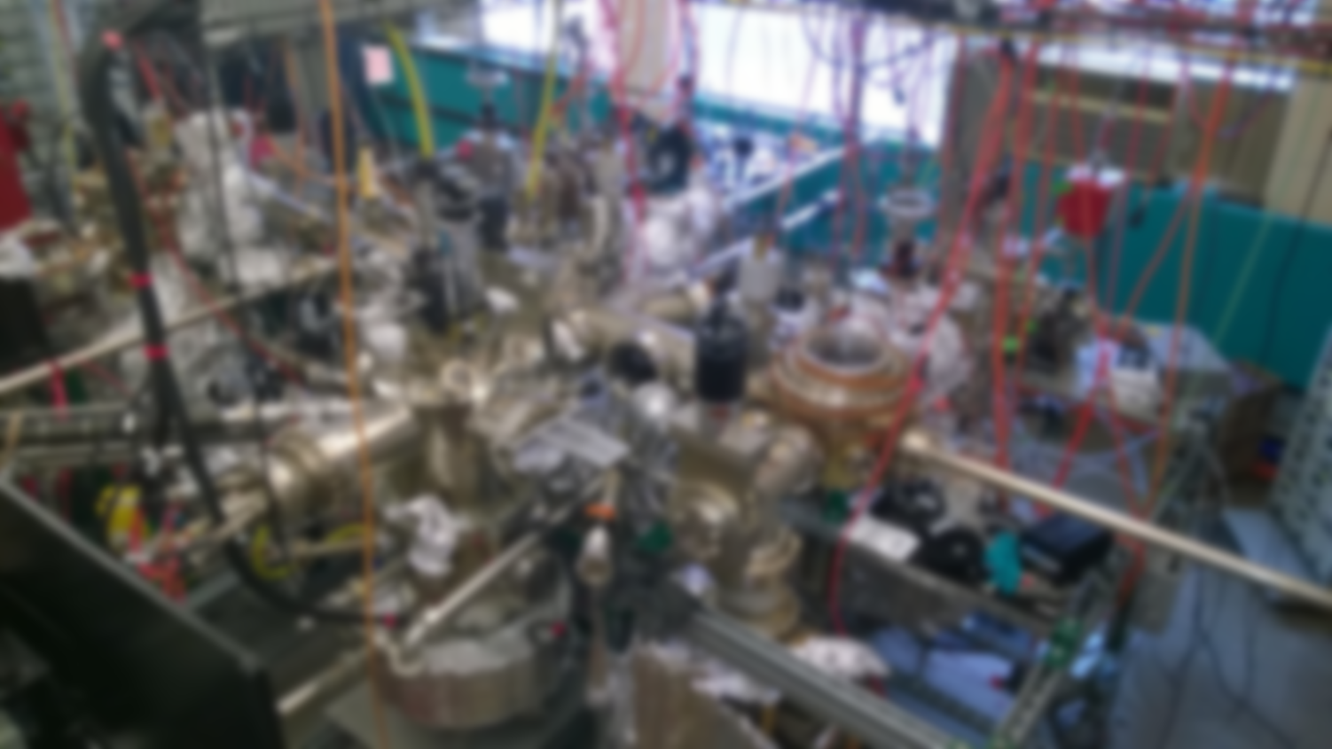
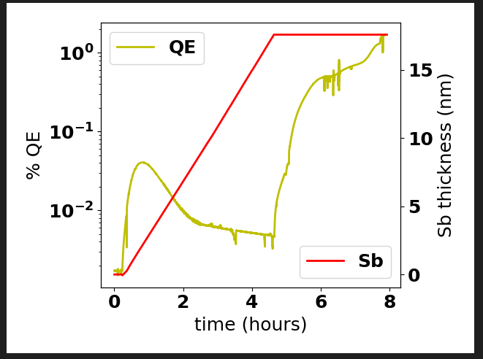
Cornell Photocathode Lab
Bialkali growth chamber
Cs,Sb,Te sources+O₂ leak valve, thermally regulated with pneumatic valve control
Quartz microbalance (QMB) for deposition monitoring
Substrate heater

Slide 6
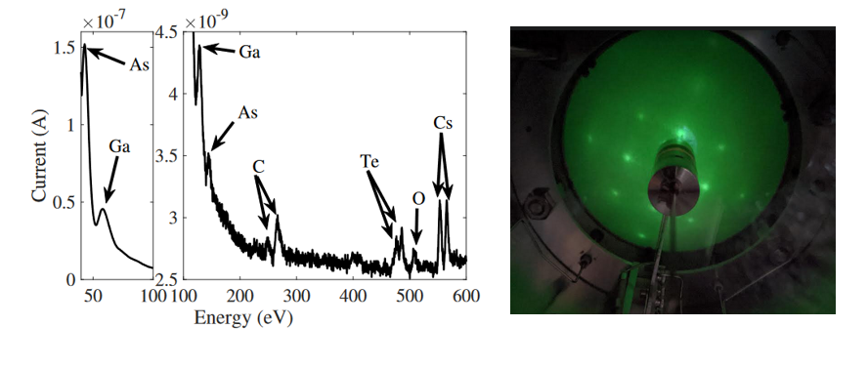
Cornell Photocathode Lab
AUGER Chamber
Auger Electron Spectroscopy-To characterize surface chemistry
Low Energy Electron Diffraction-Chararacterize surface crystallinity
Cs, O₂ leak valve.
Insulated, bias-able cathode holder

Slide 7
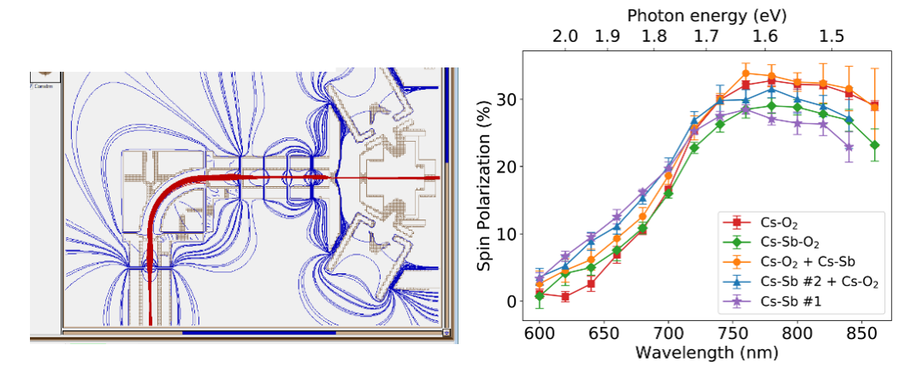
Cornell Photocathode Lab
Mott polarimeter
20 keV target bias + Einzel lens beamline
Tungsten scattering target
Measure spin-polarization

Slide 8
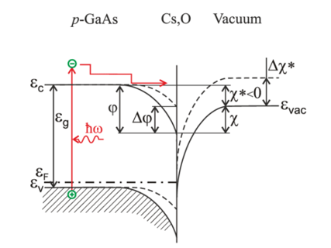
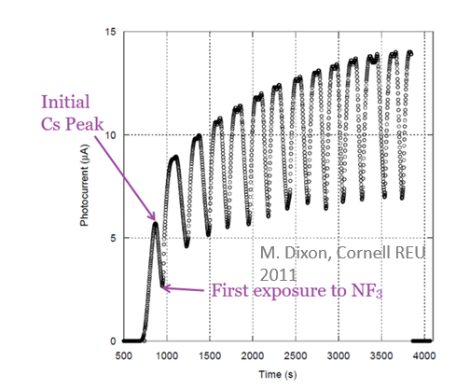
Negative Electron Affinity activation of GaAs
V. Khoroshilov at al. (2020). Journal of Physics: Conference Series. 1482. 012013 DOI: 10.1088/1742-6596/1482/1/012013.
For high QE, GaAs is “activated” to Negative Electron Affinity (NEA)
NEA means the bulk conduction band minimum is larger than the vacuum level
NEA is typically achieved by depositing a monolayer of Cs-Oxidant onto the GaAs surface can be done by:
Co-deposition: Cs is deposited until QE peaks, at which point an oxidant is leaked while Cs source remains on
Yo-yo method: the cathode is over cesiated at which point the cesium source turns off. It is then exposed to an oxidant until the QE peaks, the oxidant is then turned off and cesium source back on. The cycle is repeated numerous times.
Either O₂ and NF₃ can be used for an oxidant
Problem: A monolayer is a fragile thing!
Chemical poisoning: Interaction with residual gas
Ion back bombardment: residual gas is ionized and accelerated towards the cathode

Slide 9
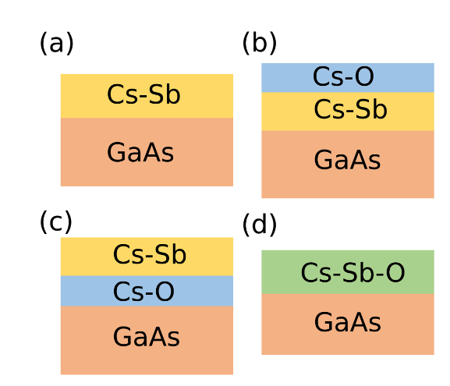
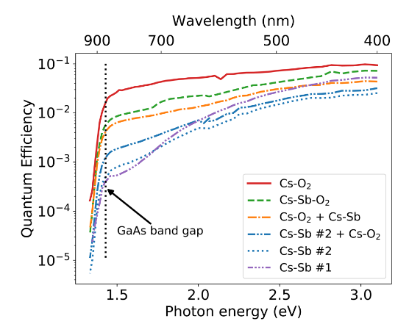
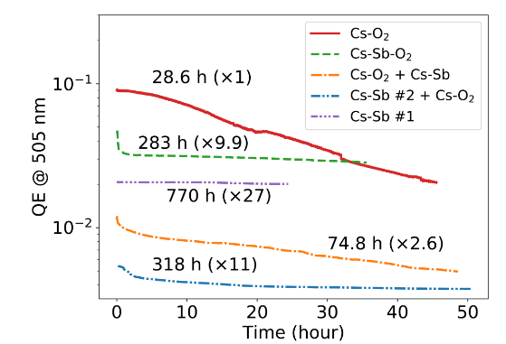
Sb-based recipes
Various activation recipes were compared to Cs-O₂
Overall, Cs-O₂ produced the highest QE while Cs-Sb had the worse
Including O₂ in the activation improved QE of Sb containing recipes
The QE was monitored over time to determine robustness
All Sb activations outperformed pure Cs-O₂ and pure Cs-Sb had the longest lifetime.
Co-deposition of Cs-Sb-O finds a happy middle ground
10x Improved lifetime over Cs-O activation.
10x improved QE over Cs-Sb activation at bandgap

Slide 10
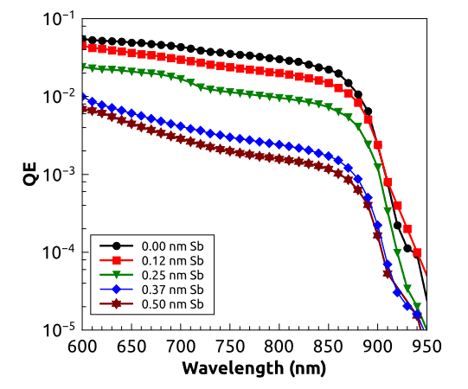
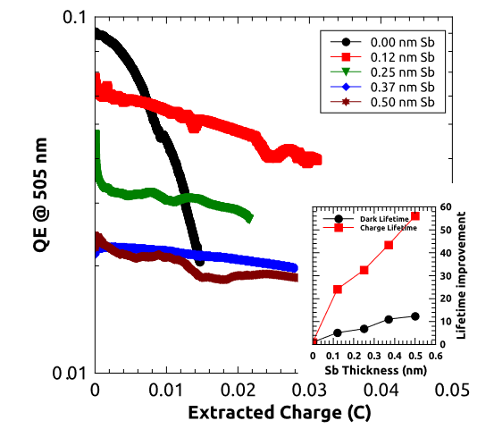
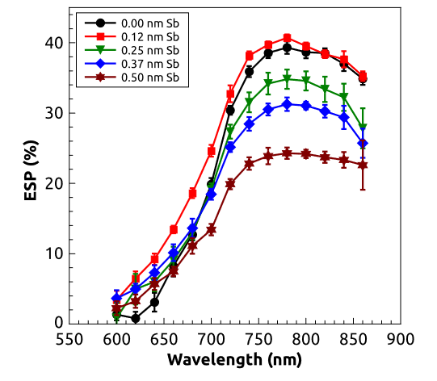
Sb-based activations-trade offs
Cs-O-Sb co-deposition recipe was further refined through scanning the Sb layer thickness:
QE and electron spin-polarization decrease with Sb layer thickness
0.12 nm layer results in only a small QE decrease while preserving max spin-polarization!
Cultrera et al, “Long lifetime polarized electron beam production from negative electron affinity GaAs activated with Sb-Cs-O: Trade-offs between efficiency, spin polarization, and lifetime (2020)”

Slide 11
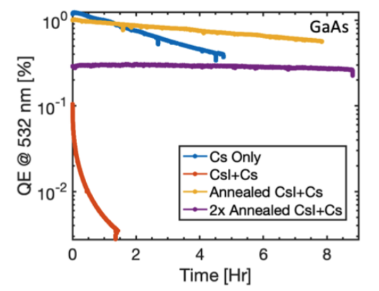
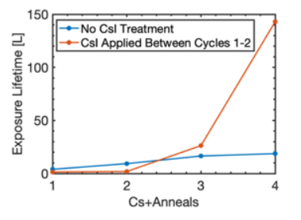
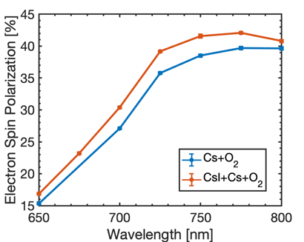
CsI surface treatment of GaAs
Use of CsI increases dark lifetime of GaAs!
30 second 1% HCl chemical etch+6 hour anneal at 600 C
~1 nm of CsI deposited on GaAs surface. Activated with Cs. Poor lifetime and QE.
Sample annealed and re-cesiated. Lifetime improvement with comparable QE Cs only GaAs activation
Additional anneal further improves lifetime at expense of QE
Lifetime improvement not simply the result of additional annealing cycles
S.J. Levenson et al. IPAC’24. MOPR82

Slide 12
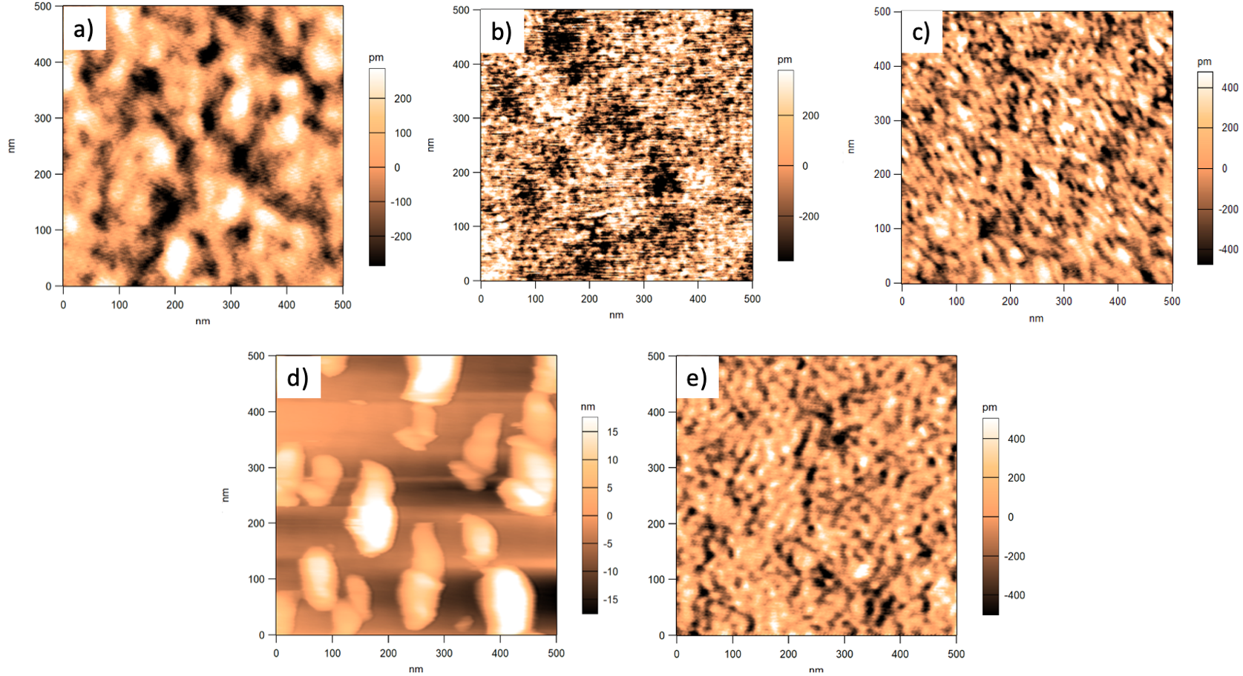
CsI surface treatment of GaAs
AFM performed at each step of surface treatment process
As received
After HCl etching
600 C anneal 6 hours
After CsI deposition
After 2nd 600 C, 6 hour anneal

Slide 13
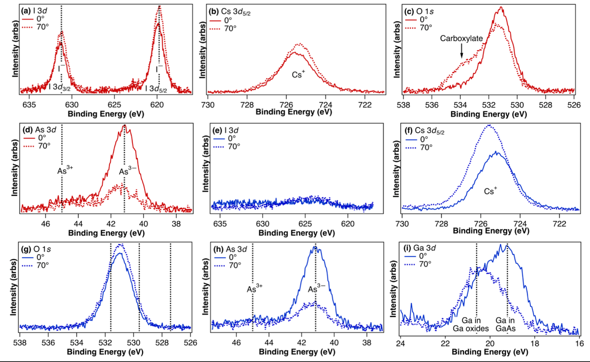
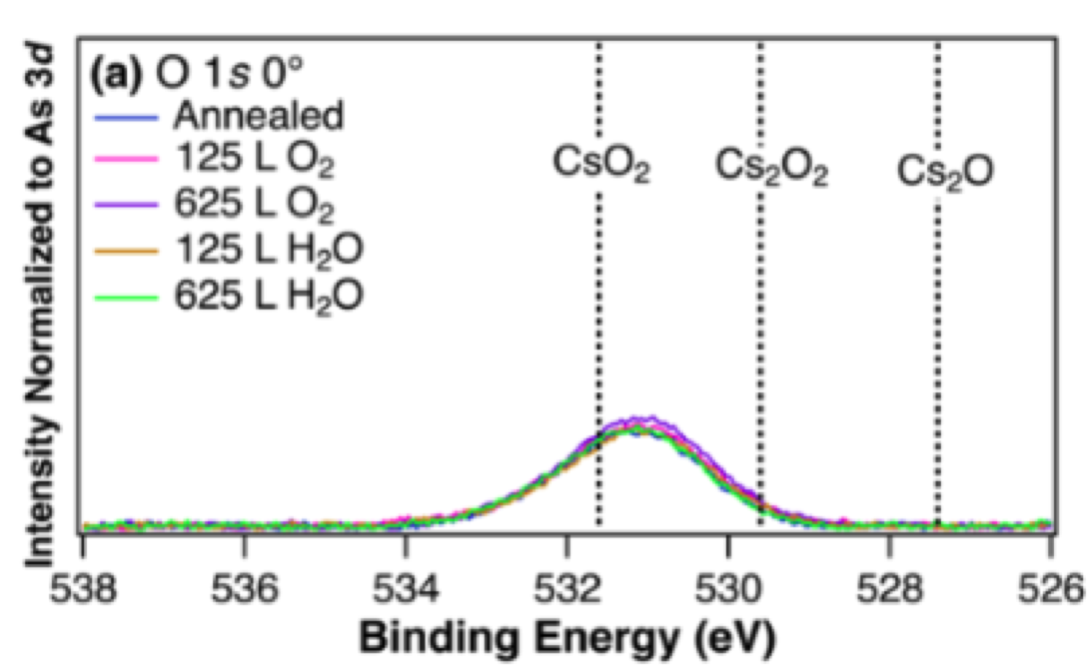
CsI surface treatment of GaAs
XPS analysis in collaboration with Q. Zhu and M. Hines, Cornell Chemistry Department
XPS analysis performed on pre- and post-annealed GaAs samples
Pre-annealed sample confirms presence of CsI
No Iodine detected on post-annealed sample!
Strong suppression Cs₂0

Slide 14
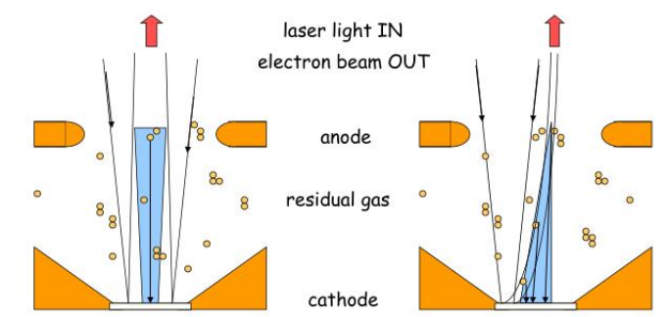
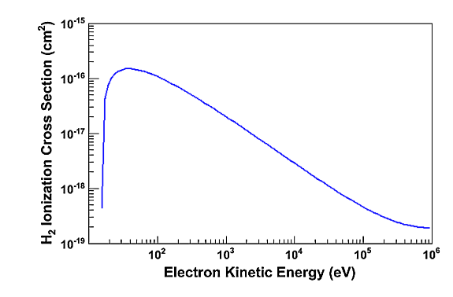
Ion back bombardment
An electron beam can ionize residual gas which will be positively charged
Ions will be accelerated towards the cathode and cause damage
So far, results have been in growth chamber
Low current (1-100 nA)
Low voltage (-18 V)
Main source of degradation comes from vacuum poisoning
In a high voltage DC gun, induced damage from ion back bombardment is more severe
Lower energy ions can sputter off activation layer
High energy ions damage GaAs crystal structure
Operation at high voltage and current is critical to testing efficacy of alternative activation layers!
Image courtesy J. Grames
J. Grames et al. PRAB 14, 043501 (2011) doi: http://dx.doi.org/10.1103/PhysRevSTAB.14.043501

Slide 15
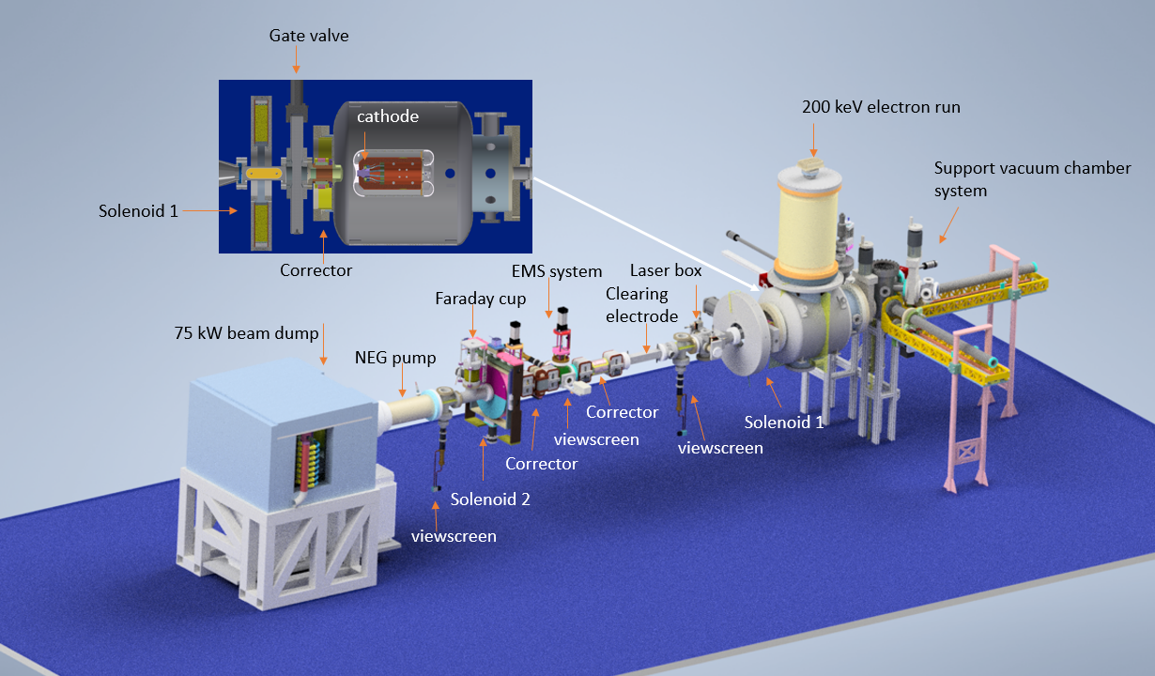
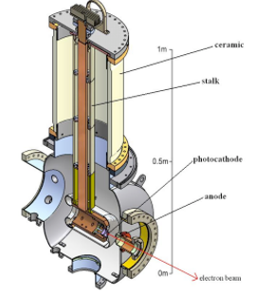
The HERACLES Beamline
A beamline dedicated to the study of high current beam running:
Former CU-ERL gun 200kV @ 10 mA
Ion clearing electrodes
75 kW beam dump
EPICS based control system

Slide 16
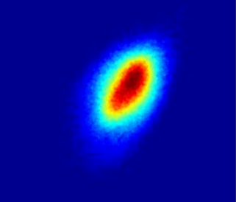
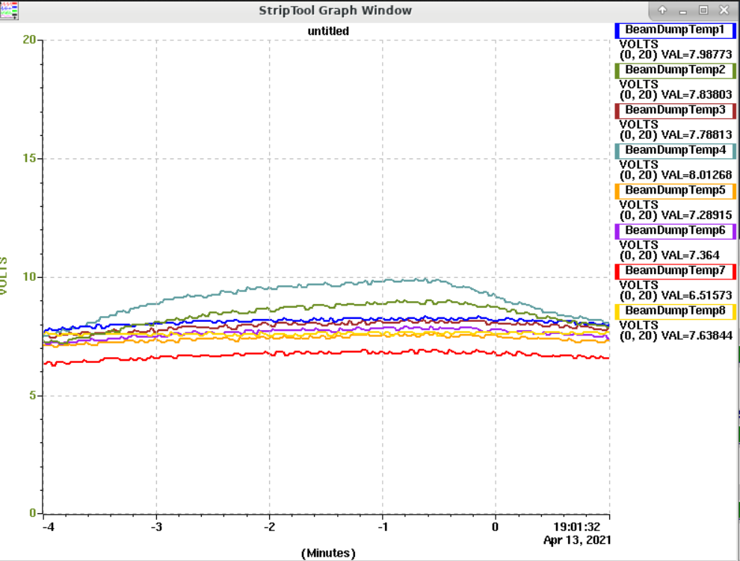
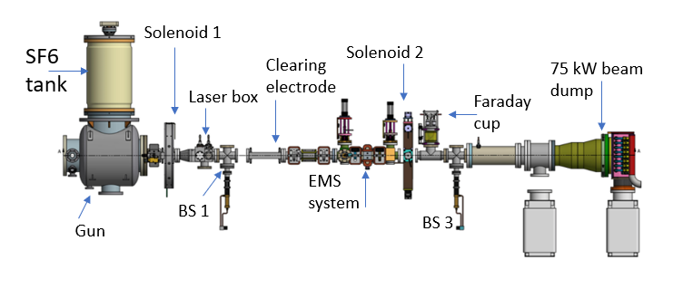
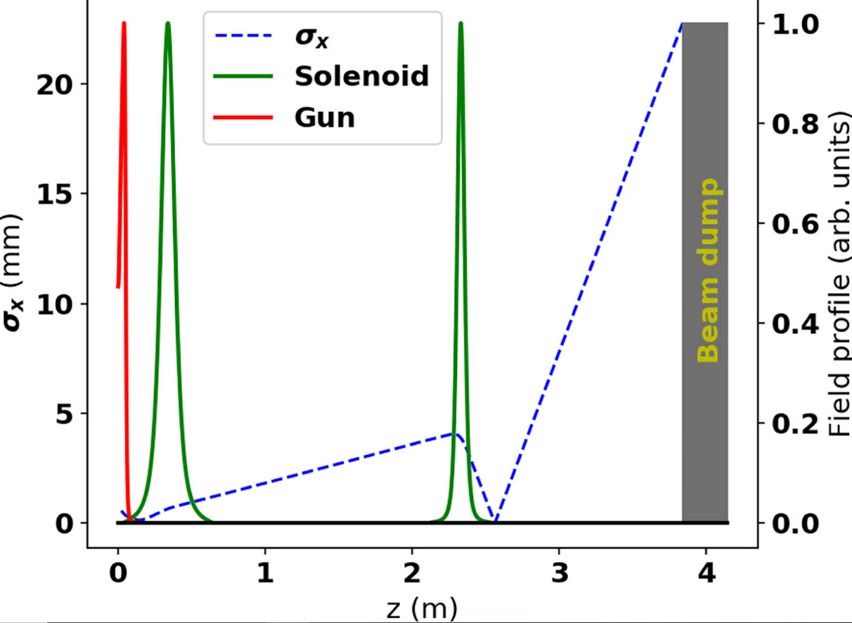
Beamline and Diagnostics
Solenoid scan characterizes cathode MTE
Thermal couples register beam induced temperature rise at the dump
Beamline
2 Solenoids, 3 corrector pairs (hor/vert)
2 clearing electrodes
3 screens, 1 quad detector
1 Faraday cup
EMS system (not implemented)
GPT simulation of fields/beam envelope

Slide 17
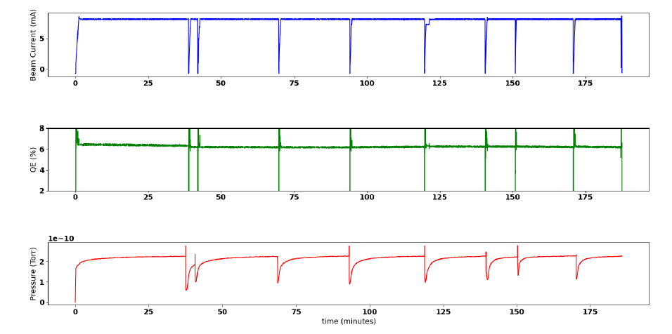
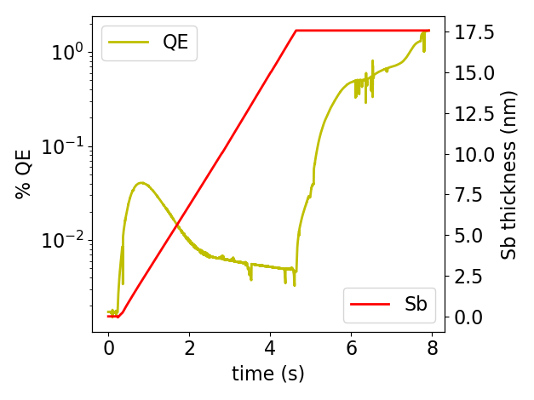
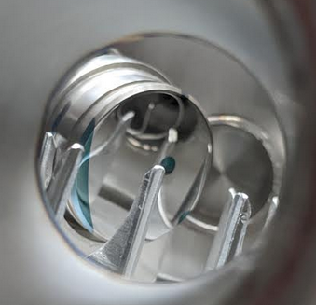
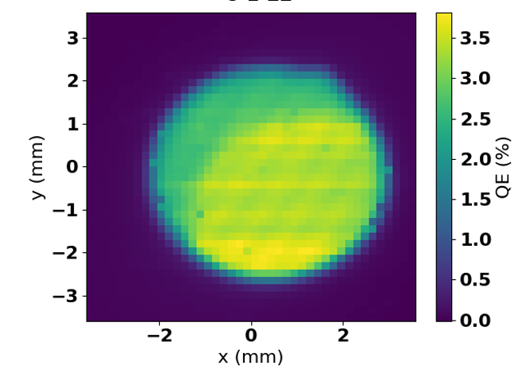
HERACLES high current performance
Cs₃Sb cathode on stainless steel puck
10 mA max current, limited by radiation trips
8 mA constant current for 3 + hours with no significant change in cathode QE
M. Andorf et al. NIMA: 1052 168240 (2023) https://doi.org/10.1016/j.nima.2023.168240

Slide 18
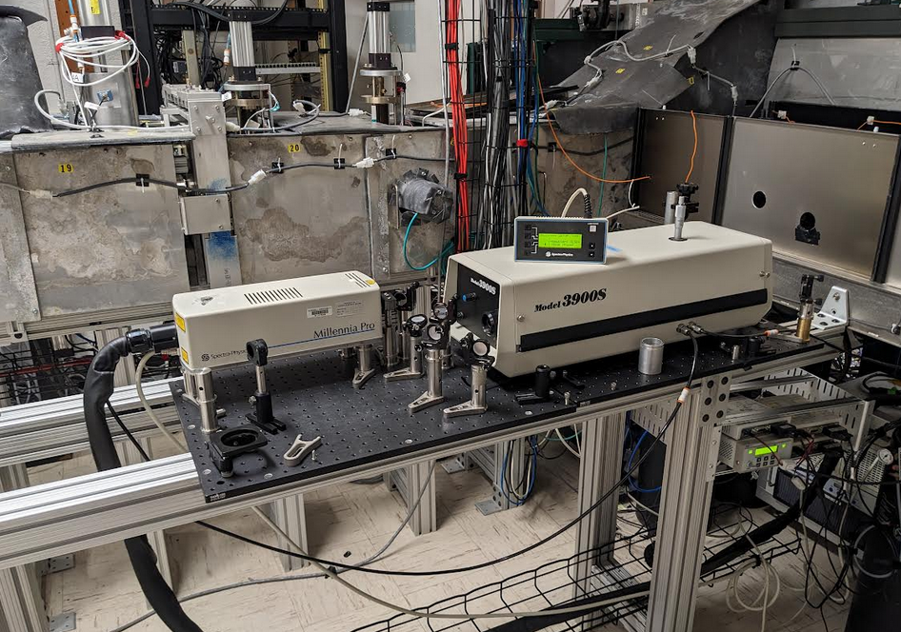
HERACLES DRIVE LASER
Drive Laser for high current GaAs operation
Ti:Sapphire oscillator: lasing at GaAs bandgap energy
Ti:Sapphire excited with external 532 nm diode laser
Easily switch between IR and green operation

Slide 19
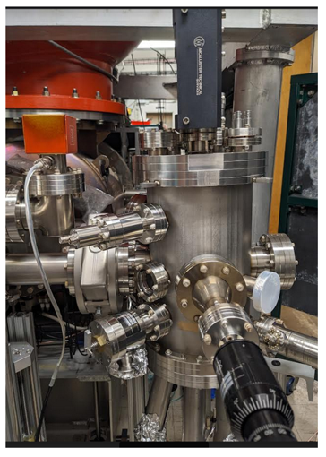
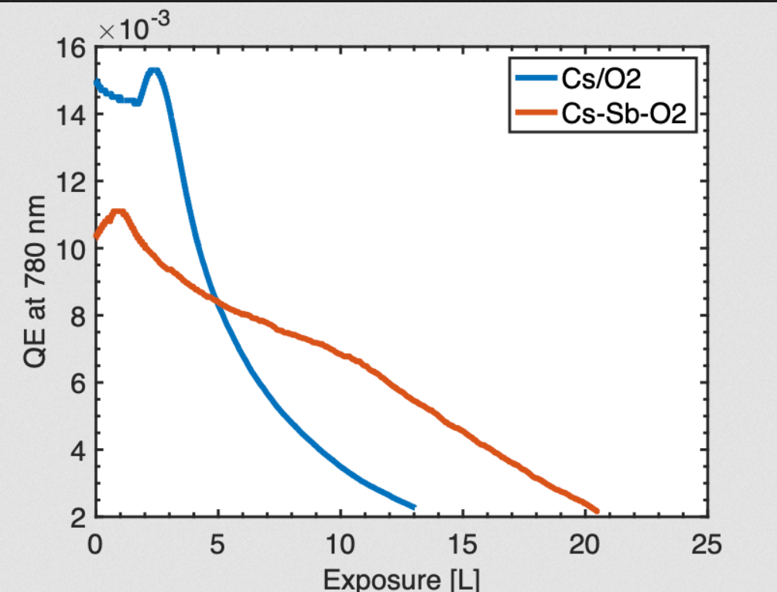
HERACLES growth chamber
Upgraded HERACLES to have an MBE growth chamber
3 Effusion cells (Cs, Sb, Te)+oxygen leak valve
Reproduced Sb-based activation lifetime improvements in growth chamber
Ready for high current runs!

Slide 20
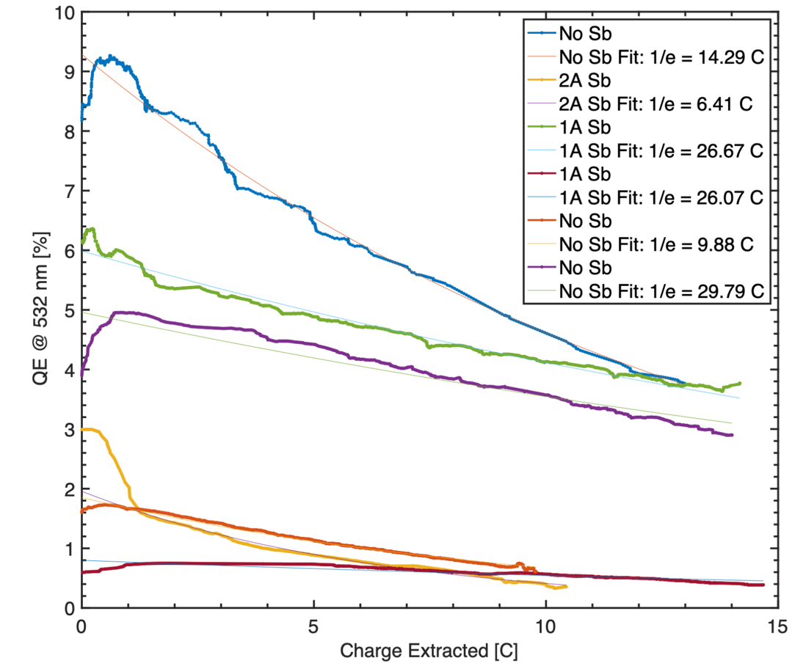
Initial high current runs
On going campaign to determine optimal Sb thickness for operational lifetime improvement
Average beam current of 1 mA operated at 532 nm
10-15 C of charge extracted per run
More runs to come!
Sb Thickness (Angstrom) | 0 | 0 | 0 | 1 | 1 | 2
Lifetime (C) | 14.3 | 9.88 | 29.7 | 26.7 | 26.1 | 6.4

Slide 21
Thank you for your attention!

Slide 22
BACK UP SLIDES

Slide 23
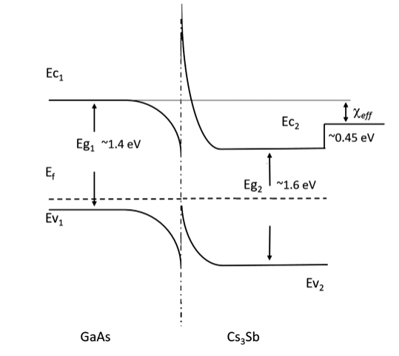
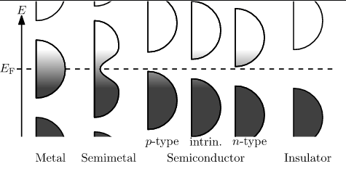
GaAs with alternative activation layers
NEA GaAs can be generated by forming a heterojunction at the surface with another semiconductor (activation layer) subject to two criteria:
In the activation layer, the gap from the fermi level to vacuum should be smaller than GaAs’s bandgap (~1.4 eV).
So that photoemission does not occur from activation layer, its bandgap should be larger than GaAs’s.
This criteria can be violated if the activation layer is sufficiently thin
The above suggest using p-doped GaAs with an intrinsic semiconductor with a small electron affinity for the activation layer
Cs₃Sb and Cs₂Te can form the NEA heterojunction
Known to be less sensitive to chemical poisoning
As a photoemitters they are robust at high currents
This indicates Cs-Sb Cs-Te may be a very robust activation layers!
p-type
intrinsic

