Slide 1
The effect of superlattice pairs on MOCVD-grown strained GaAs/GaAsP polarized electron sources
PSTP Conference September 2024
Adam Masters

Slide 2
Overview
MOCVD Photocathode Growth Process
Additional Considerations for MOCVD Cathodes
Experimental Parameters
Superlattice Characteristics
Device Results
Conclusion

Slide 3
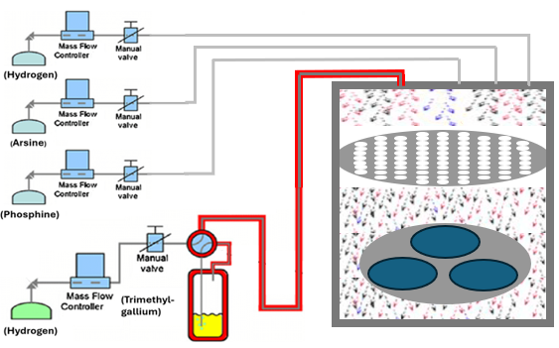
1. MOCVD Photocathode Growth Process
Process Step | Process Schematic | Photocathode
Purge Reactor Chamber
Flow H₂
Heat Clean Wafer
Set wafer surface temperature to 720ºC
Flow AsH₃
Growth Gallium Arsenide
Flow TMGa
Begin Metamorphic Growth
Slowly introduce PH₃
Grow Superlattice
Alternate PH₃ on and off
GaAs
5nm
H₂ Flow
Repeat 13x
GaAs_{0.65}P_{0.35} 2.8nm
AsH₃ Flow
GaAs
3.8nm
Showerhead
GaAs_{0.65}P_{0.35} 2000nm
PH₃ Flow
GaAs_{0.625}P_{0.375} 500nm
GaAs_{0.65}P_{0.35} 500nm
11 steps omitted
+2.5% P, 500nm
per step
TMGa Flow
GaAs_{0.975}P_{0.025} 500nm
Heating Element
GaAs
p-type GaAs Wafer

Slide 4
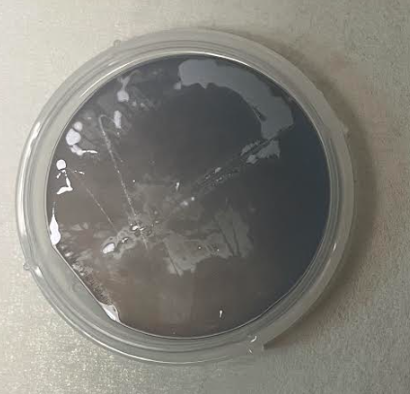
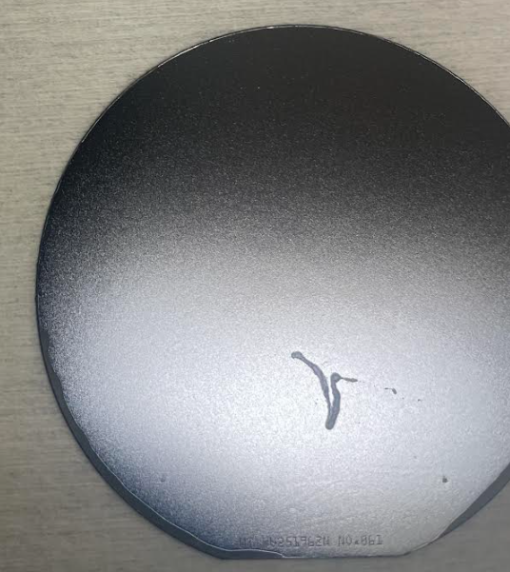
2. Additional Considerations for MOCVD Cathodes
Parasitic backside growth
Excess reactants can find their way to the underside of the wafer and form a parasitic growth.
Diminished electrical contact between cathode and stalk.
Must be removed with appropriate backside etch process.
No capping layer
MBE cathodes are capped with amorphous arsenic to protect cathode surface.
Formation of gallium oxide can occur along with atmospheric hydrocarbon contamination.
Must be removed with HCl etching and additional heating prior to activation
As grown (no chemical treatment)
After backside etching

Slide 5
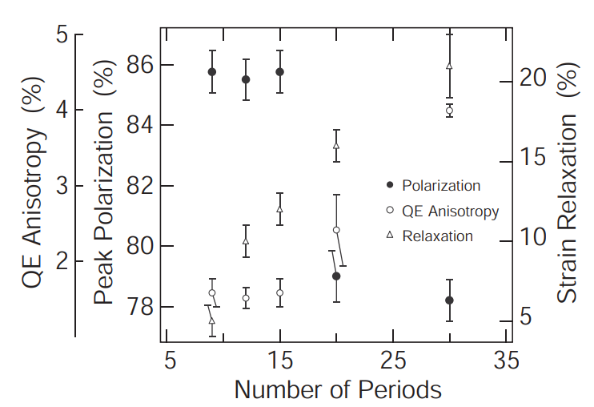
3. Experimental Parameters
Maruyama et. experimented with varying numbers of superlattice pairs in 2004 using MBE-grown samples (results shown on right)
Found that polarization drops rapidly past 15 periods while QE increases, due to relaxation
Superlattices were 4nm well, 4nm barrier thickness
We sought to test this using MOCVD-grown samples
Remove DBR to focus only on superlattice
Keep our 3nm well and 4nm barrier superlattice parameters

Slide 6
4. Superlattice Characteristics
Transmission Electron Microscopy (TEM) Images
Adjusted growth parameters to improve quality of bottom layers
All 30 pairs show uniform growth thickness

Slide 7
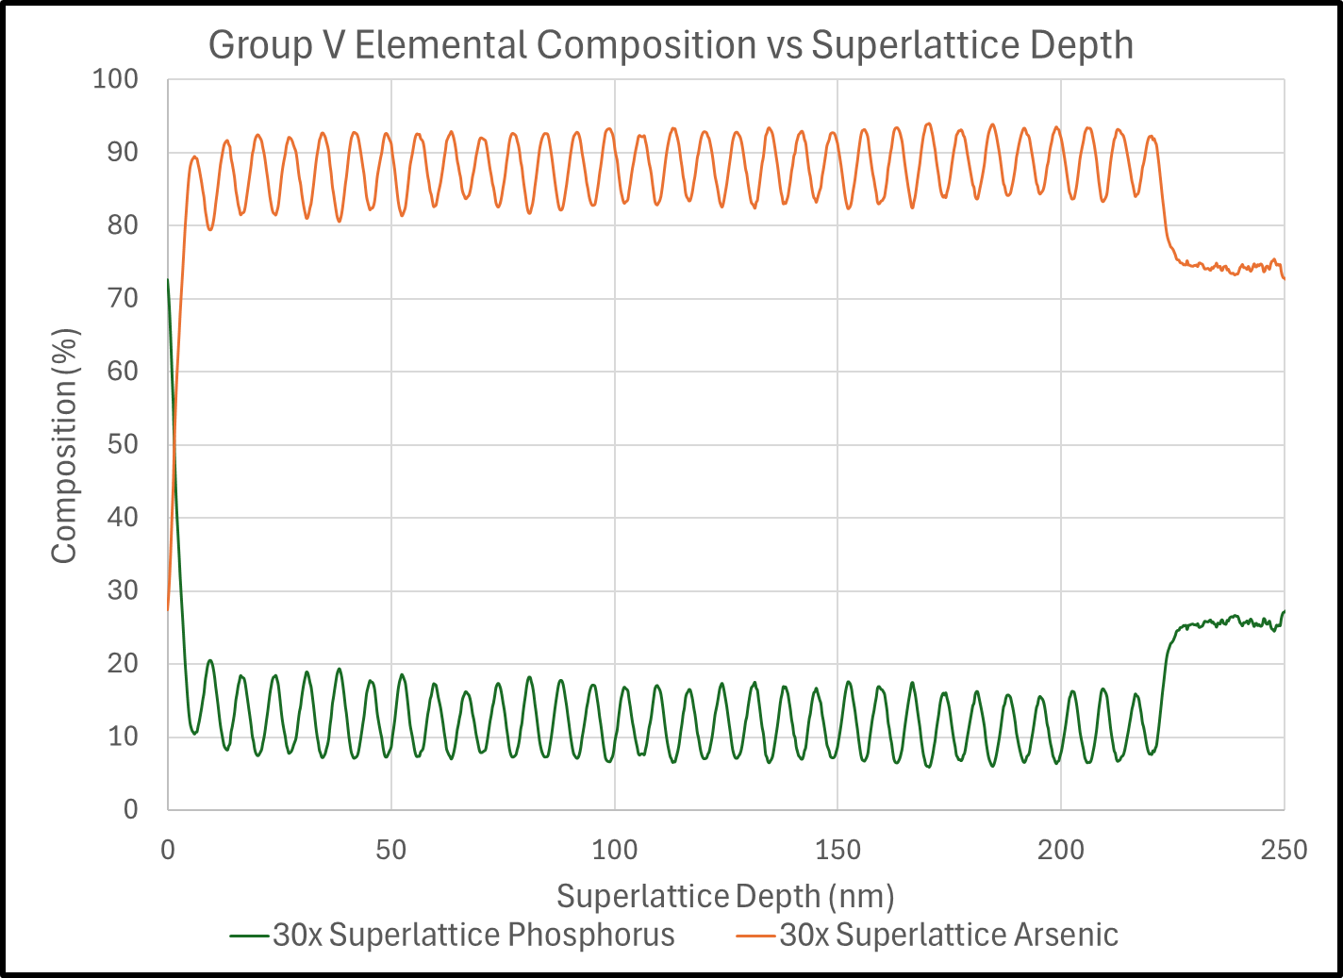
4. Superlattice Characteristics
Compositional Analysis
Energy Dispersive Spectroscopy (EDS) measurements were taken on the TEM samples
Phosphorus composition changes less than 5% through superlattice layers
Approximate Excitation Area

Slide 8
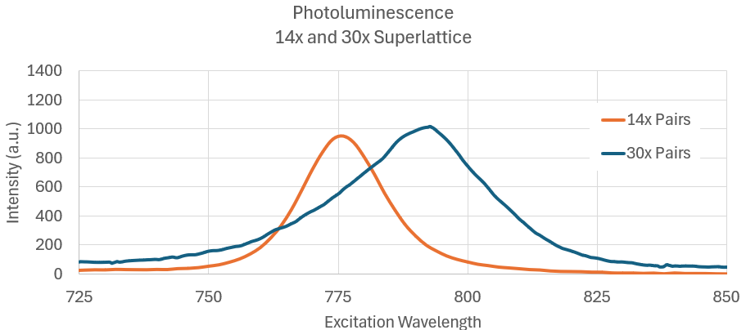
4. Superlattice Characteristics
Photoluminescence
Single-point photoluminescence shows peak shift from 776 to 792nm
Surface maps show a trend toward higher excitation wavelengths with increasing superlattice pairs

Slide 9
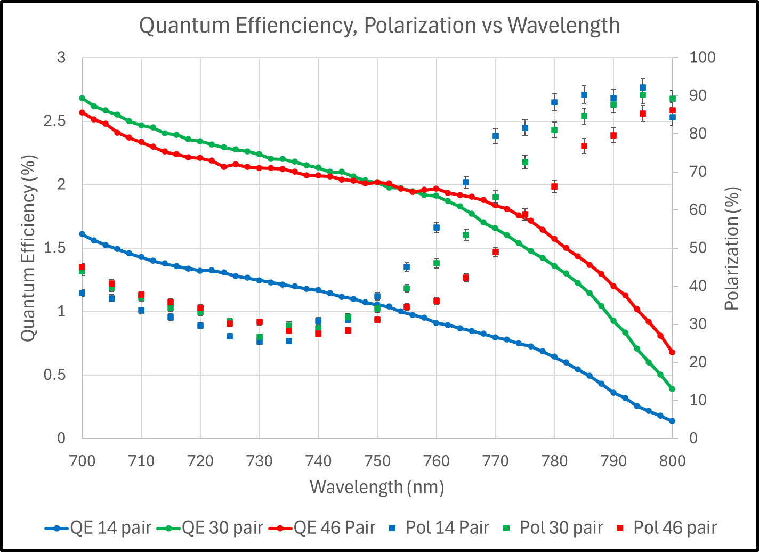
4. Superlattice Characteristics
Polarimetry Results
Measured at Jefferson Labs using the microMott polarimeter
Compared to the 14 pair sample, QE increased 211% in the 30 pair sample and 244% in the 46 pair sample at 780nm.
Maximum polarization stayed constant between the 14 and 30 pair samples with a slight shift toward higher wavelengths
Polarization dropped from 90% to 85% when compared to the 14 and 30 pair samples.

Slide 10
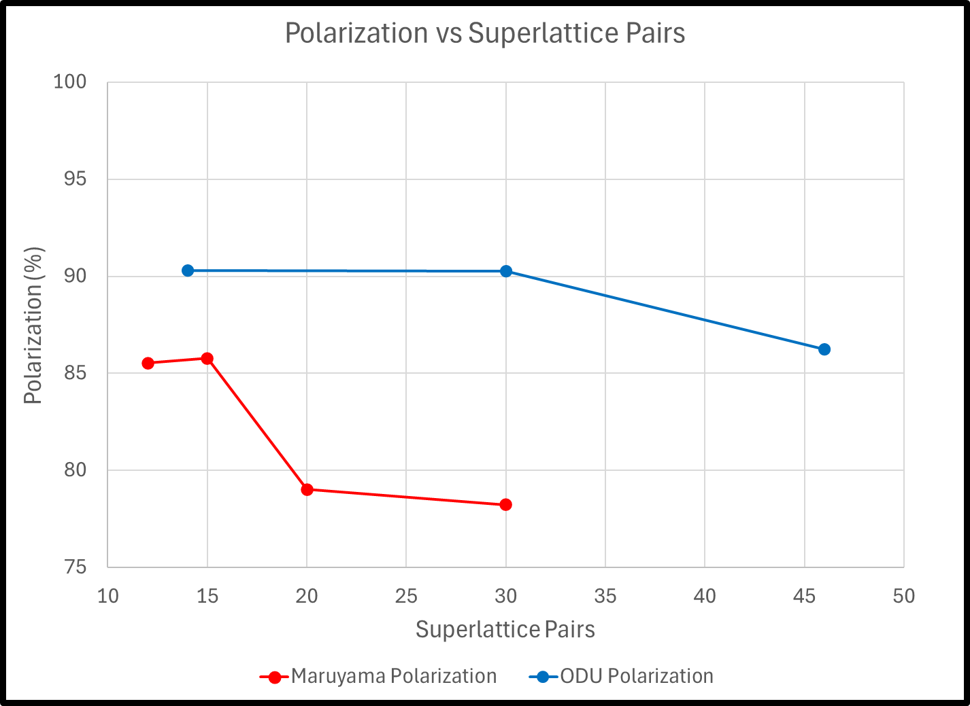
5. Conclusion
Our Findings
Maintains 90%+ polarization up to 30 pairs and over 85% up to 46 pairs
Upcoming Work
Currently testing 22 and 38 pair devices
Add DBR to optimize QE at 780nm
Further refinement of superlattice parameters to increase QE and polarization at 780nm

Slide 11
Additional Information

Slide 12
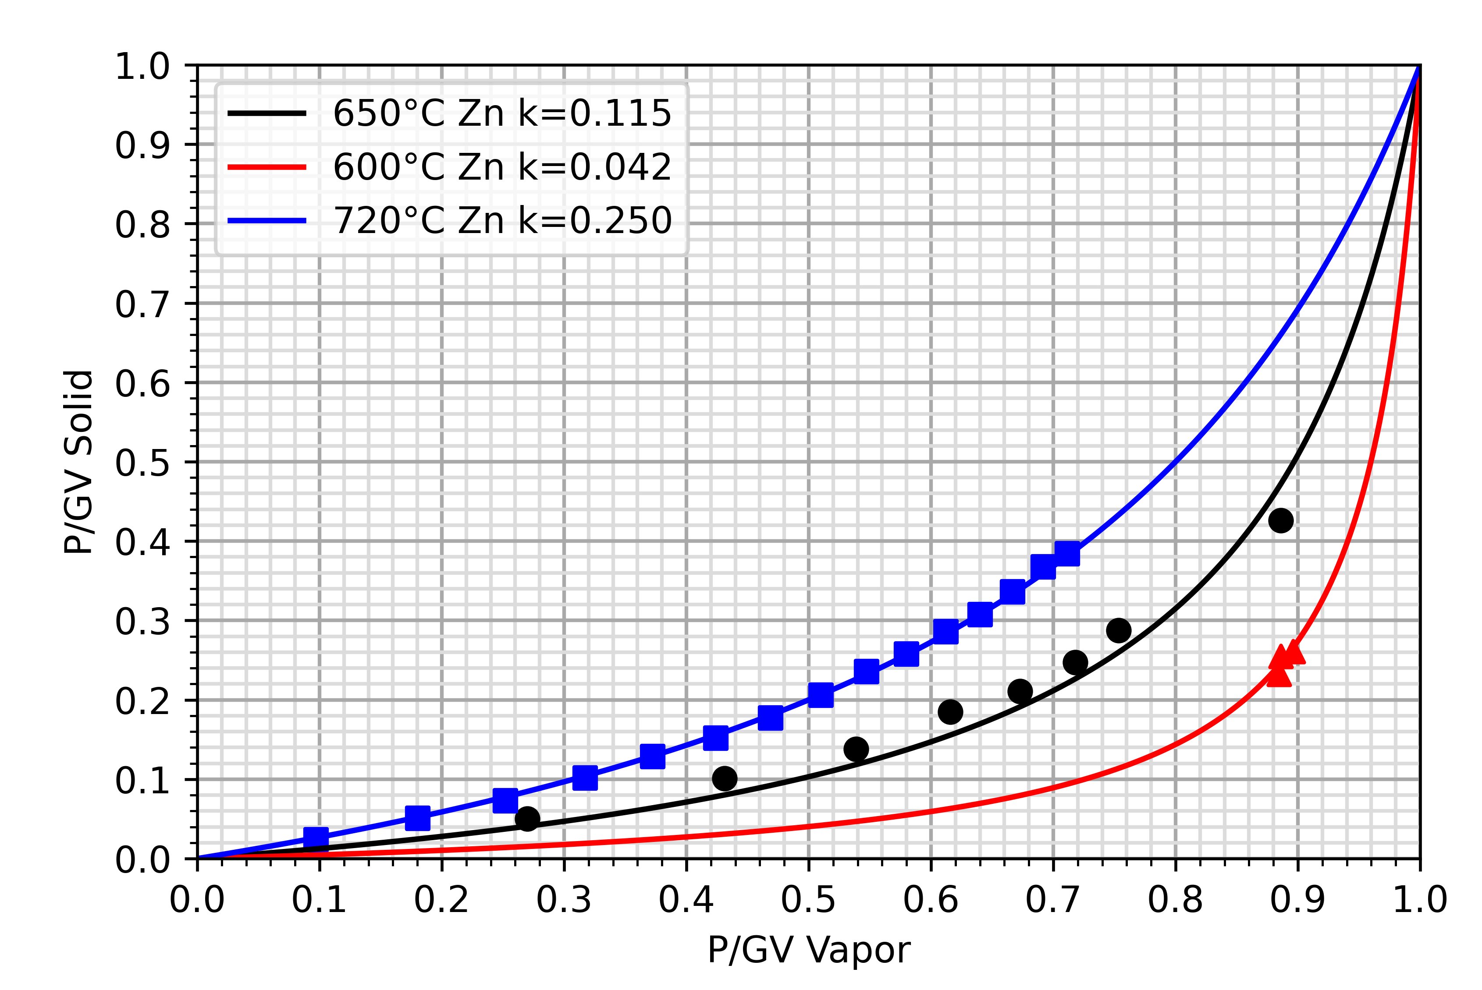
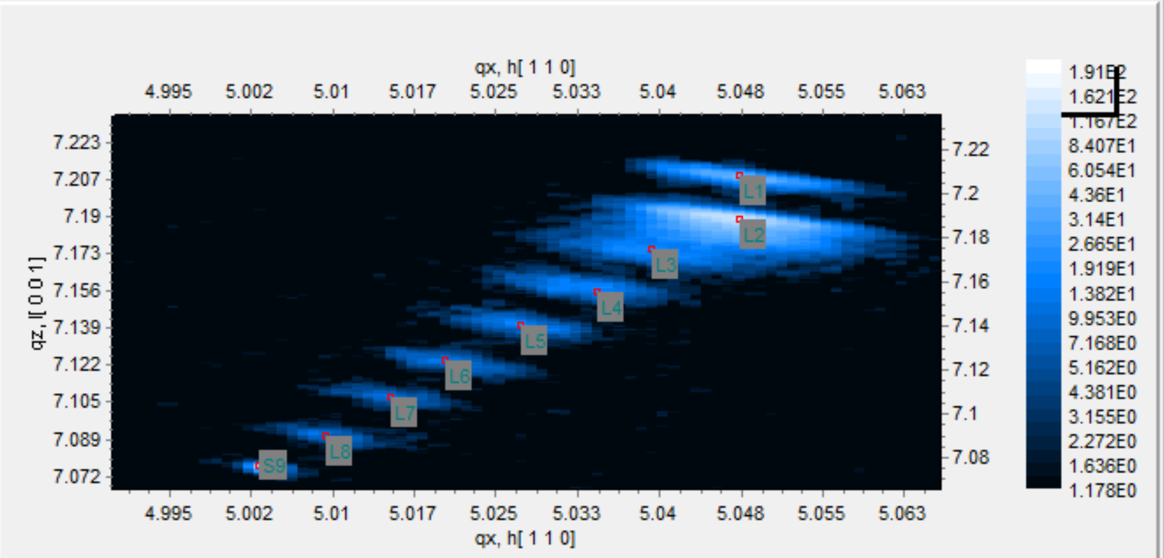
4. Establishing Gas Flow Ratios
Langmuir Curve
For a given growth temperature, the parital pressures of the phosphine and arsine are varied during growth.
After the growth is complete, the composition of the layers can be analyzed using x-ray diffraction
P/As Composition 3
P/As Gas Flow Ratio 3
P/As Gas Flow Ratio 2
P/As Composition 2
This gas flow partial pressure corresponds to this composition

Slide 13
4. Key Factors in the Growth Process
Cracking of Reactants Above Substrate Surface
As reactants move into the reactor chamber, they are exposed to high heat within the thermal boundary layer
Reactants inside the chamber can crack and form III-V compounds that precipitate on the surface, forming a film with high defect density
G. Stringfellow, "A critical appraisal of growth mechanisms in MOVPE," Journal of Crystal Growth, vol. 68, pp. 111-122, 1984.

Slide 14
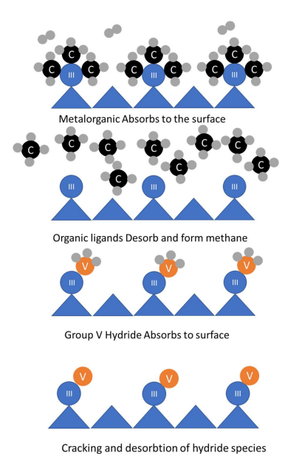
4. Key Factors in the Growth Process
Cracking of Reactants on Substrate Surface
Reactants enter the chamber and pass through the thermal boundary layer.
Upon contact with the substrate surface, the reactants crack and the group V and III elements bond to the surface, forming an epitaxial layer.
B. Belfore, "Development of High Quantum Efficiency Strained Superlattice Spin Polarized Photocathodes via Metal Organic Chemical Vapor Deposition," ODU Digital Commons, Norfolk, VA, 2022.

Slide 15
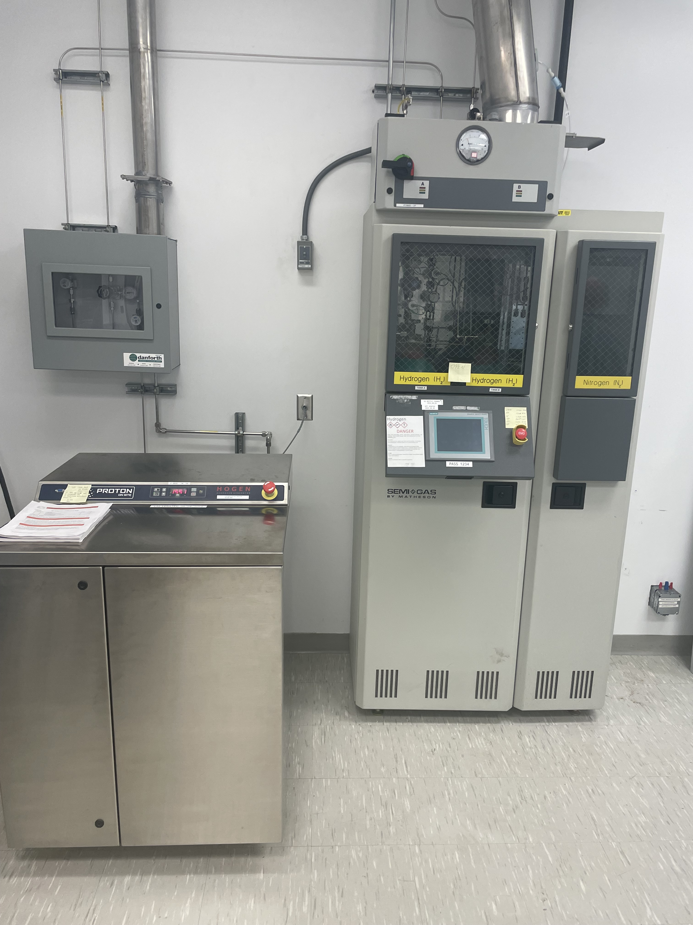
2. MOCVD System Components
Reaction and Carrier Gases
Hydrogen carrier gas can come from hydrogen generator or bottled UHP hydrogen
Reaction gases such as Arsine and Phosphine are bottled UHP gases
Mass flow controllers
Allow precise control of the input gases
G. Stringfellow, Organometallic Vapor-Phase Epitaxy, London, UK: Elsevier, 1999.

Slide 16
2. MOCVD System Components
Precursor Bubblers
Some reactants such as trimethyl-gallium are in liquid form and use bubblers to flow the gas into the reaction chamber
These precursors must be at a controlled temperature, usually in a bath
Veeco, "Piezocon Gas Concentration Sensor," 2023. [Online]. Available: https://www.veeco.com/products/piezocon-gas-concentration-sensor/. [Accessed 08 02 2024].

Slide 17
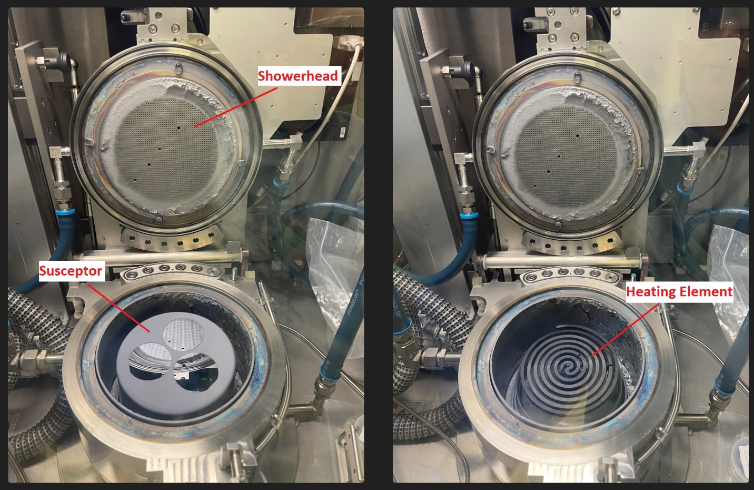
2. MOCVD System Components
Reactor Chamber
A showerhead allows uniform reactant flow over the reaction surface
The graphite susceptor allows the wafers to rotate during the growth process
The heating element provides uniform heating of the substrate
G. Stringfellow, Organometallic Vapor-Phase Epitaxy, London, UK: Elsevier, 1999.

