Slide 1
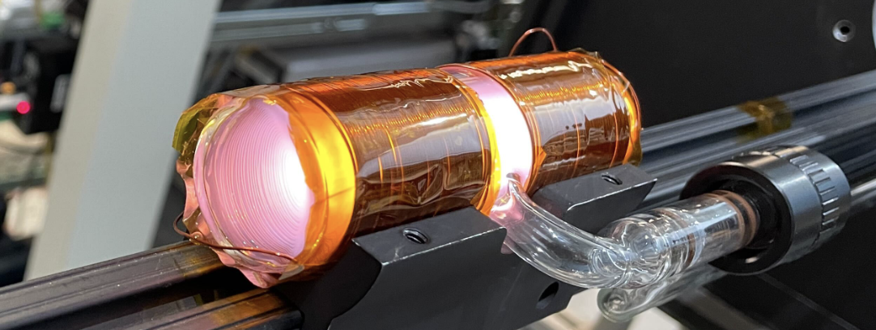




Polarized ³He Double-Cell Target Utilizing Metastability Exchange Optical Pumping at High Pressure and Magnetic Fields
Hao Lu
University of Tennessee Knoxville
for CLAS12 Polarized ³He Collaboration
PSTP 2024

Slide 2
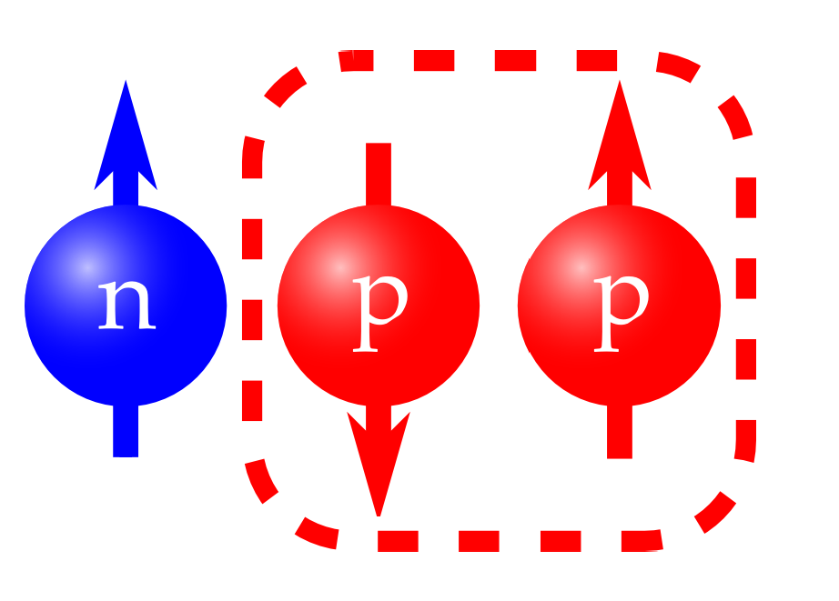
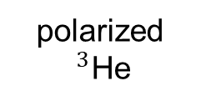
Polarized ³He
polarized
$^{3}$He
Neutron Scattering Experiments:
  Polarized neutron spin filter
  Target for probing nuclear few body system (Sepehr Samiei, Friday)
  Large spin-dependent neutron cross-section
Polarized free neutrons target:
  ³He’s proton spins are anti-aligned most of the time (~90%)
  ³He nuclear spin is primarily from neutron spin
  Polarized ³He is a good substitution for polarized free neutron target
unpolarized
neutrons
polarized
neutrons

Slide 3
Spin Exchange Optical Pumping
Optically pump Rb vapor in low field (~10-30G) using 795 nm laser: 5S_{1/2} to 5P_{1/2}
Circularly polarized light transfer spin angular momentum to alkali metal electrons; Spin exchange between polarized electrons and ³He
Polarize in oven: ~470 K
Large polarization-number density product
13 experiments in Hall A @ 6 GeV, 7 approved @ 12 GeV

Slide 4
Metastability Exchange Optical Pumping
Plasma discharge excites ground state to 2³S₁ states
1083 nm circular polarized laser drives polarization of electrons
Metastability exchange spins to ground state nuclei
ME requires low pressure
Much faster than SEOP

Slide 5
SEOP vs. MEOP
Property | SEOP | MEOP
Pump | Alkali metal mixture | Metastable ³He
Transfer | Spin exchange | Metastability exchange
Pumping rate | Slow | Fast
Laser power | ~ 100 W | < 10 W
Pumping temperature | > 400 K | > 100 K
Pressure range | 0.5 to 13 Bar | 1 to 200 torr

Slide 6
Polarized ³He Target for CLAS12
CEBAF Large Acceptance Spectrometer for Jefferson Lab’s 12 GeV upgrade
  High luminosity electron scattering
  Multi-particle final state response
  5 T solenoid in interaction region
Proposal to PAC48: A program of spin-dependent electron scattering using a polarized 3He target in CLAS12
  P_{T} -dependence of n longitudinal spin structure
  Nuclear corrections to SIDIS
Novel target needed for standard configuration

Slide 7
High Magnetic Field MEOP
Historically, both MEOP and SEOP were performed at low field
  High field increases wall relaxation for SEOP and weaken hyperfine coupling for MEOP
Kastler-Brossel Lab results show that high pressure MEOP is effective at high magnetic fields (Nikiel-Osuchowska et al, Eur. Phys. J.D., 2013.)

Slide 8
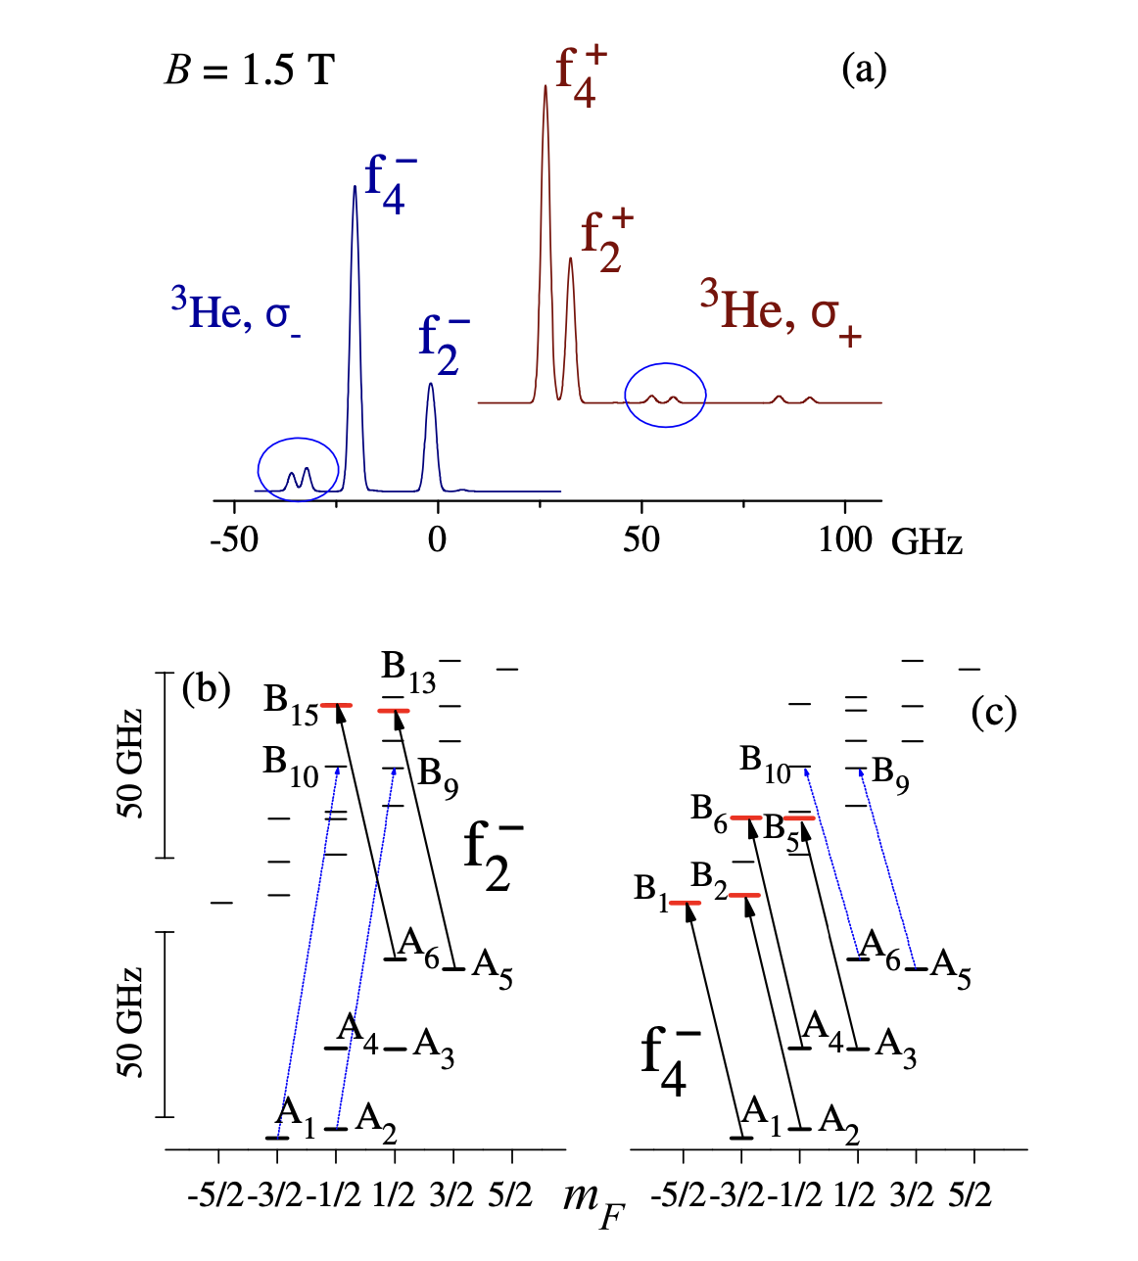
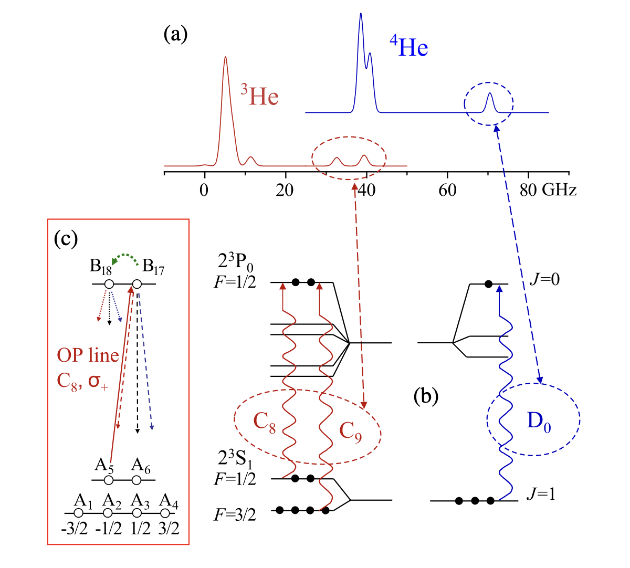
Low Field vs. High Field MEOP
High field polarimetry:
light absorption @ unused pumping lines
Low field polarimetry:
fluorescence light polarimetry @ 668 nm
Figures: T. R. Gentile et al.: Optically polarized He

Slide 9
High Field MEOP for EIC
High field MEOP already being applied for nuclear physics
BNL’s Electron Beam Ion Source operates at 5 T
MEOP tests between 2 to 4 T gave nearly 90% at 1.3 mbar (Maxwell et al., NIM A 959, 2020)

Slide 10
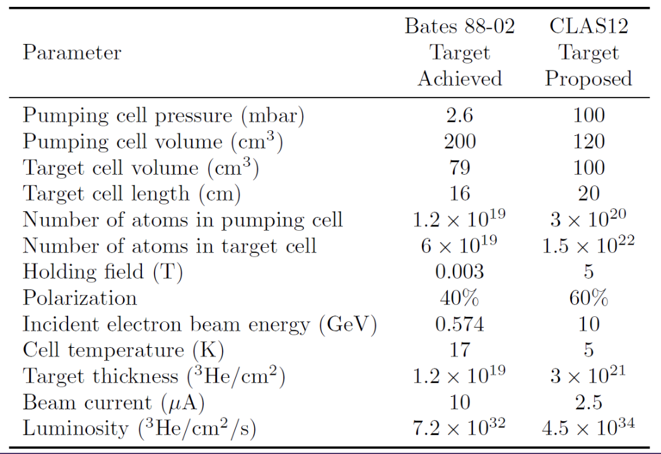
Double-cell Cryo Target Bates 88-02

Slide 11
New Target for CLAS12
Combining two technologies: double-cell polarized ³He target (Maxwell, Milner, NIM A, 2021.)
CLAS12’s 5 T solenoid standard configuration
5.4 amg, comparable to SEOP
High Field MEOP
High magnetic field (5 T)
Polarization ~ 60%
Higher pressure (100 times) compared to typical low field MEOP (100 mbar vs 1 mbar)
Double-Cell Cryo Target
Polarize ³He using MEOP at room temp (300 K)
Diffuse transfer to 5 K target cell
Density increase by 60 times

Slide 12
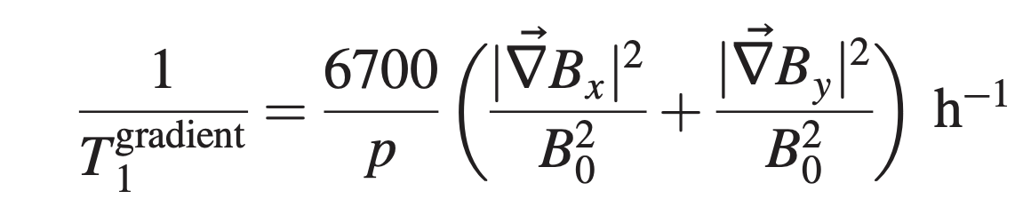
Depolarization Mechanisms
Transverse Field Gradient
In-beam Depolarization
Electron beam produces ³He₂⁺ ions, mitigated by high field
Wall Relaxation on aluminum cell
H₂ coatings will provide very > 1000 minutes relaxation at > 4 K (Lefevre-Seguin, Low Temp. P. 1988.)

Slide 13
Double-cell Target Design
Pumping Cell
  200 cm³ borosilicate glass
  Annular cylindrical volume
Target Cell
  100 cm³, 20 cm long aluminum cell
  Cooled by LHe heat exchanger

Slide 14
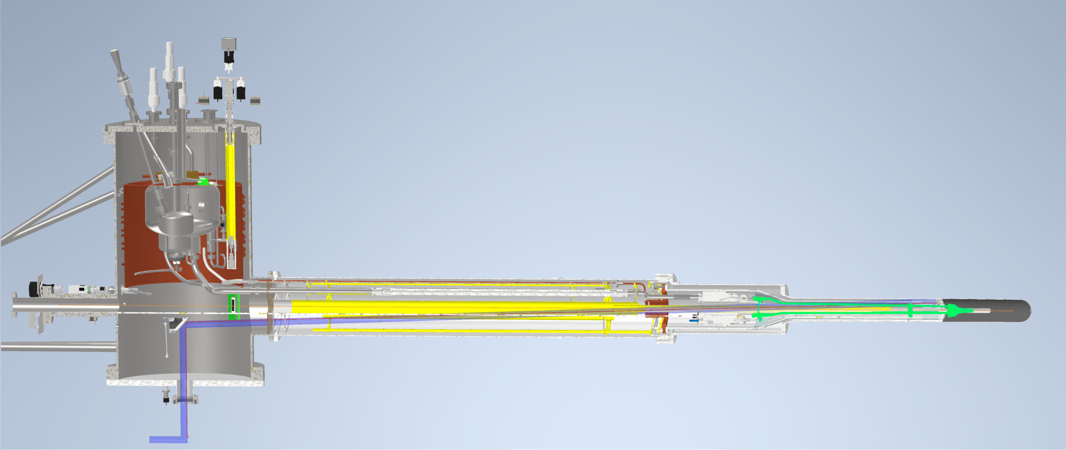
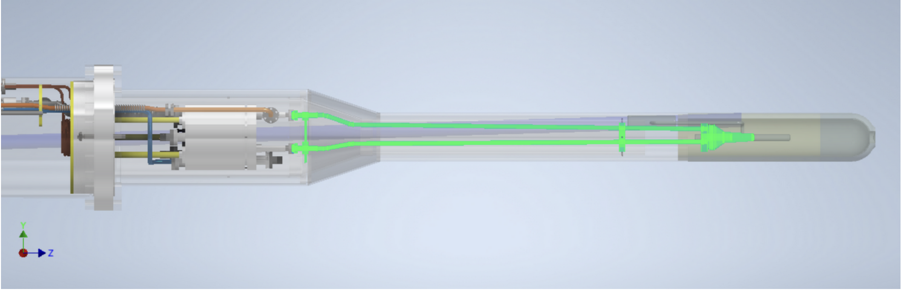
Double-cell Target Design
Modular design
Fit into the Hall B cryo-target standard config
Maximum available cooling power

Slide 15
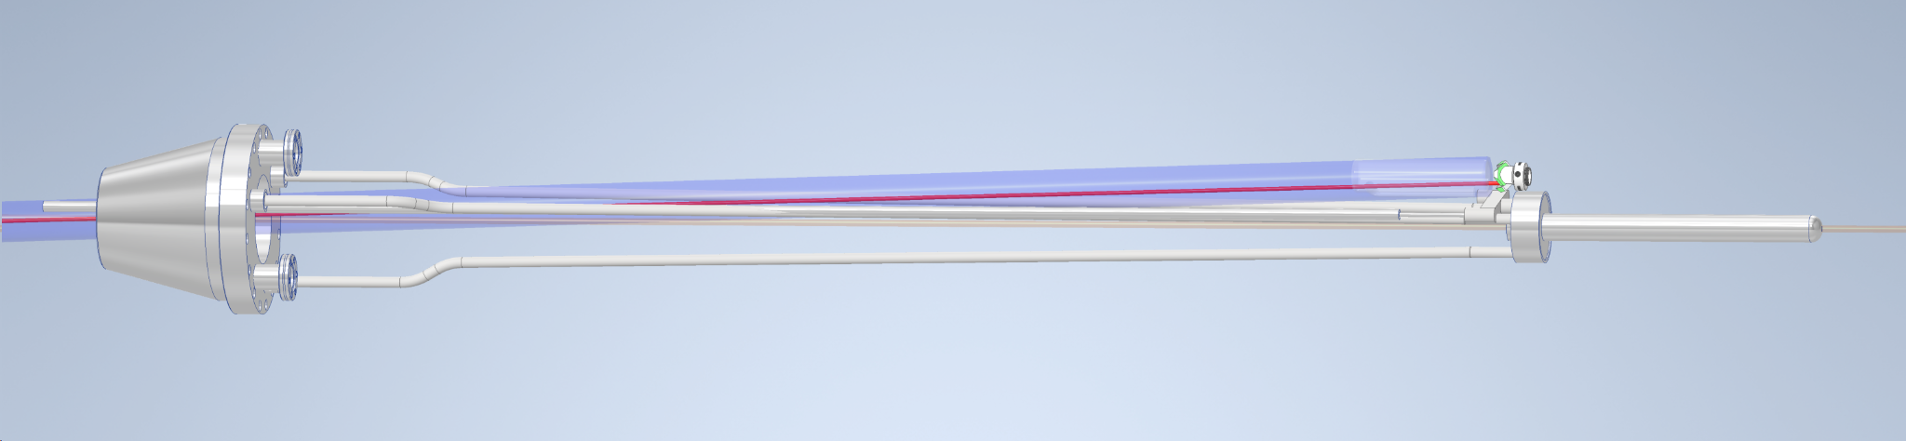

Slide 16
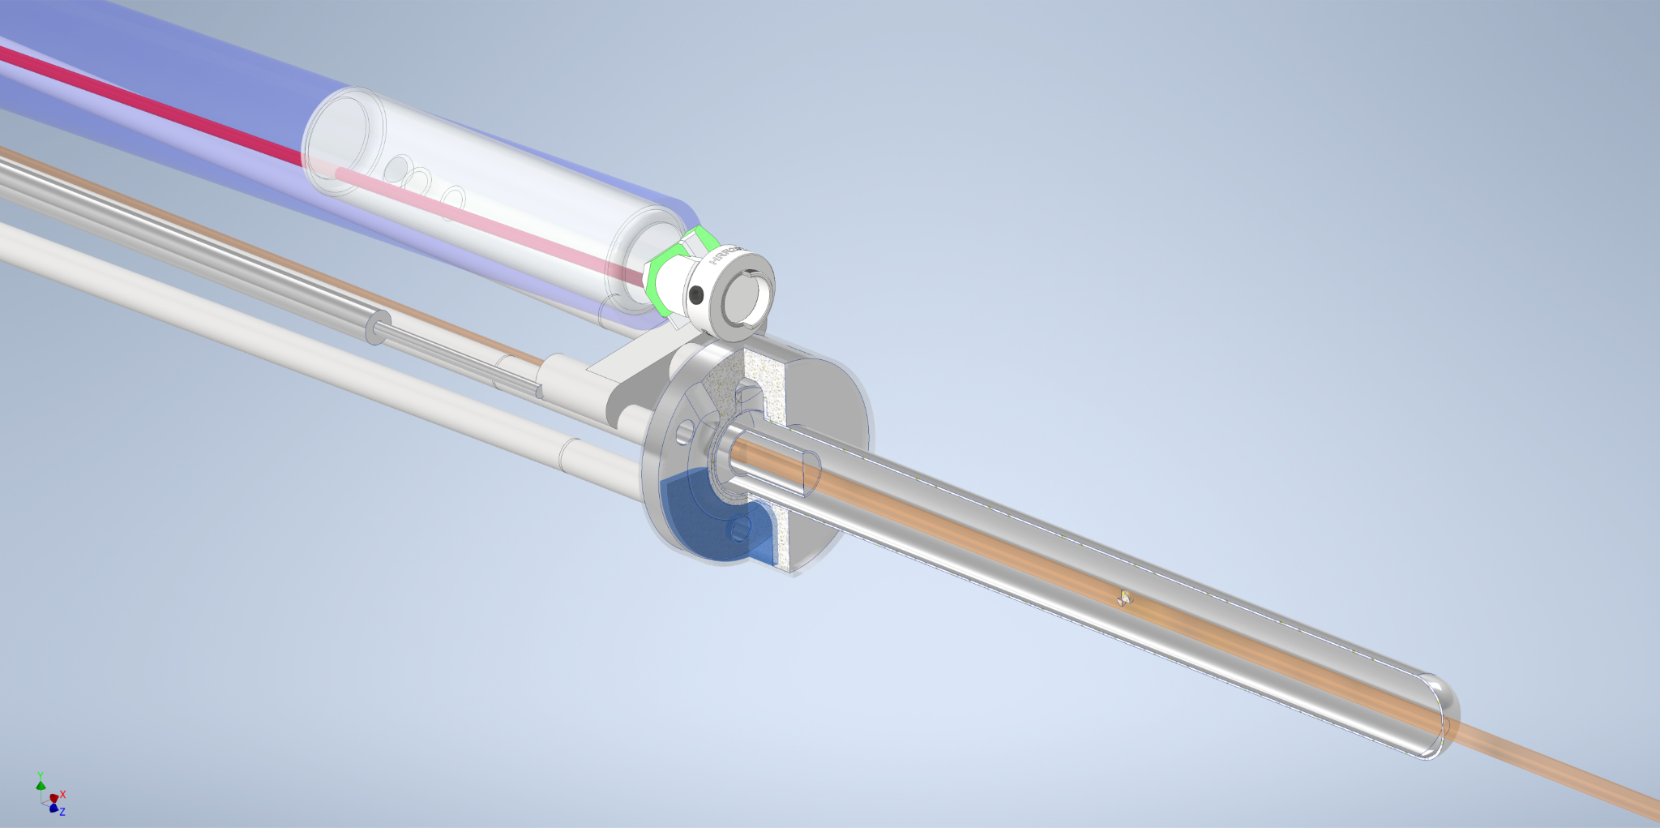
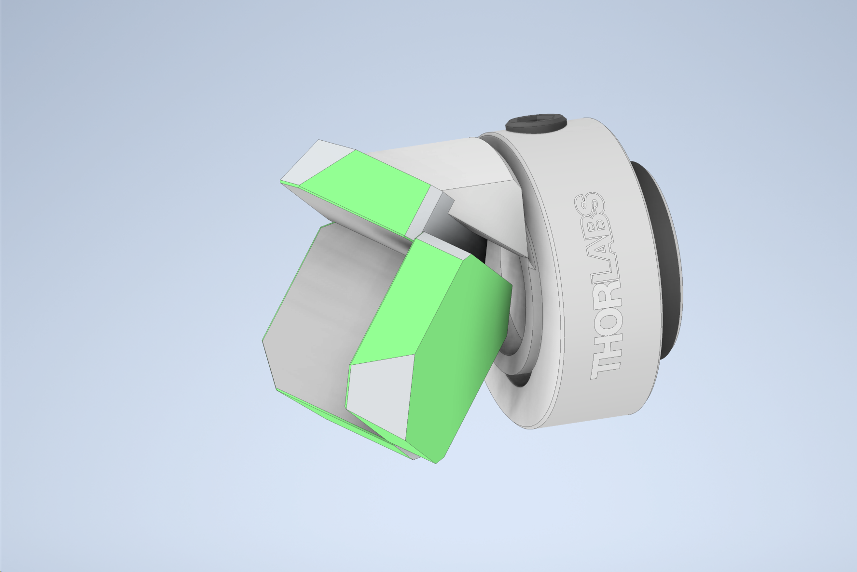
Double-cell Target Design
Images Credit: James Brock, JLab target group

Slide 17
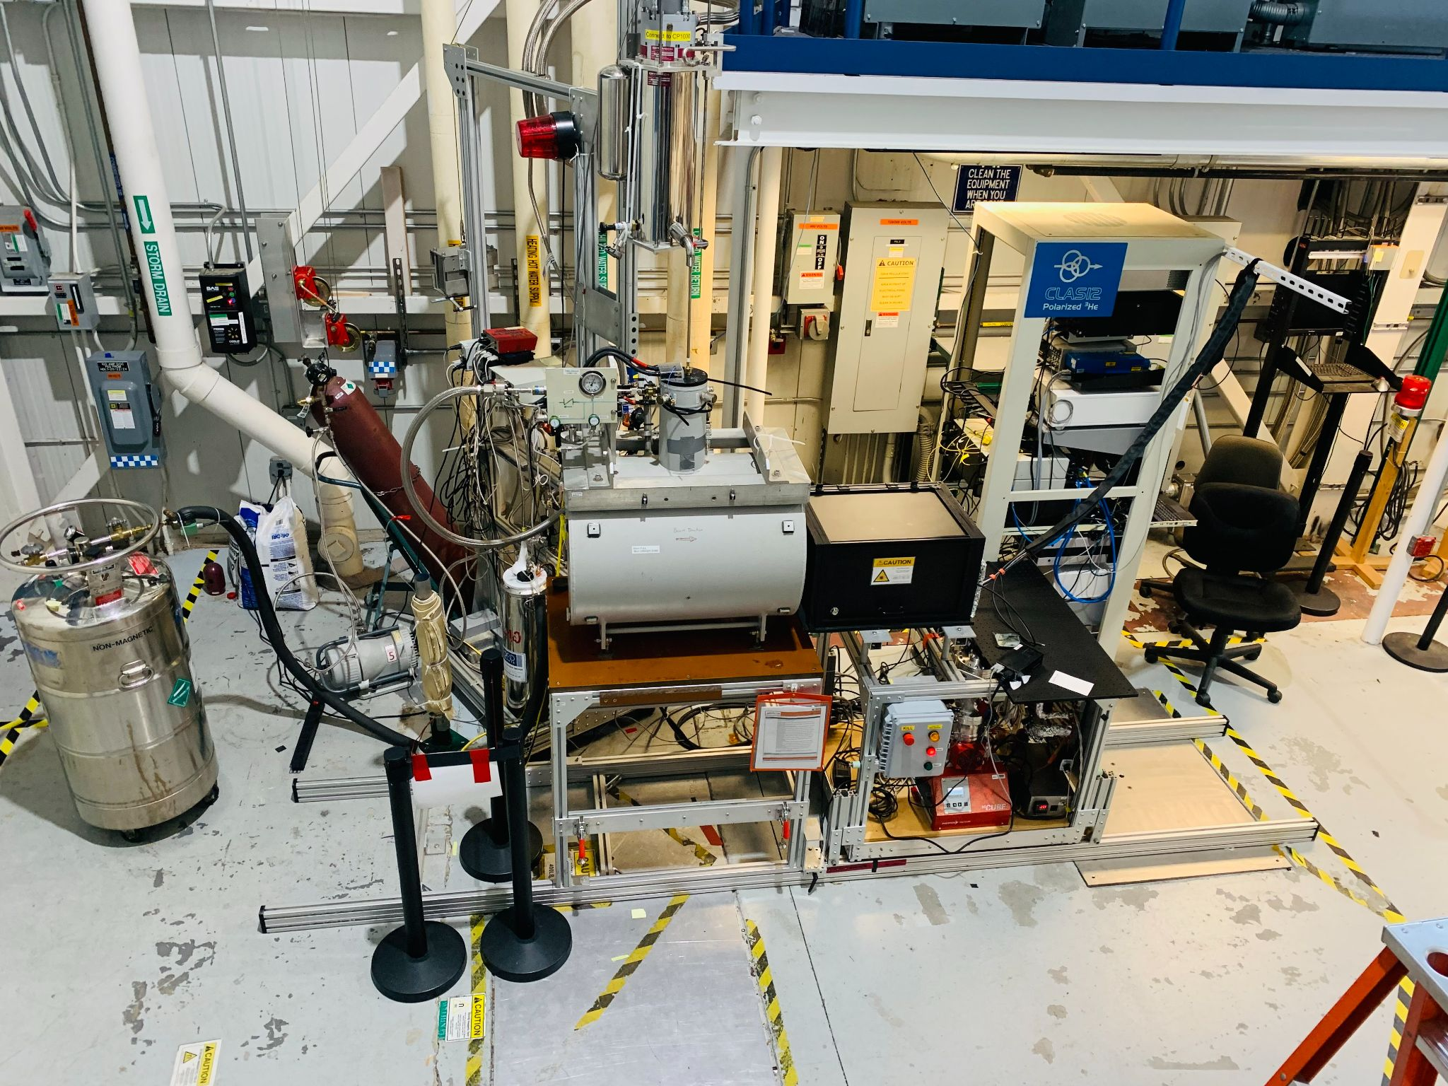
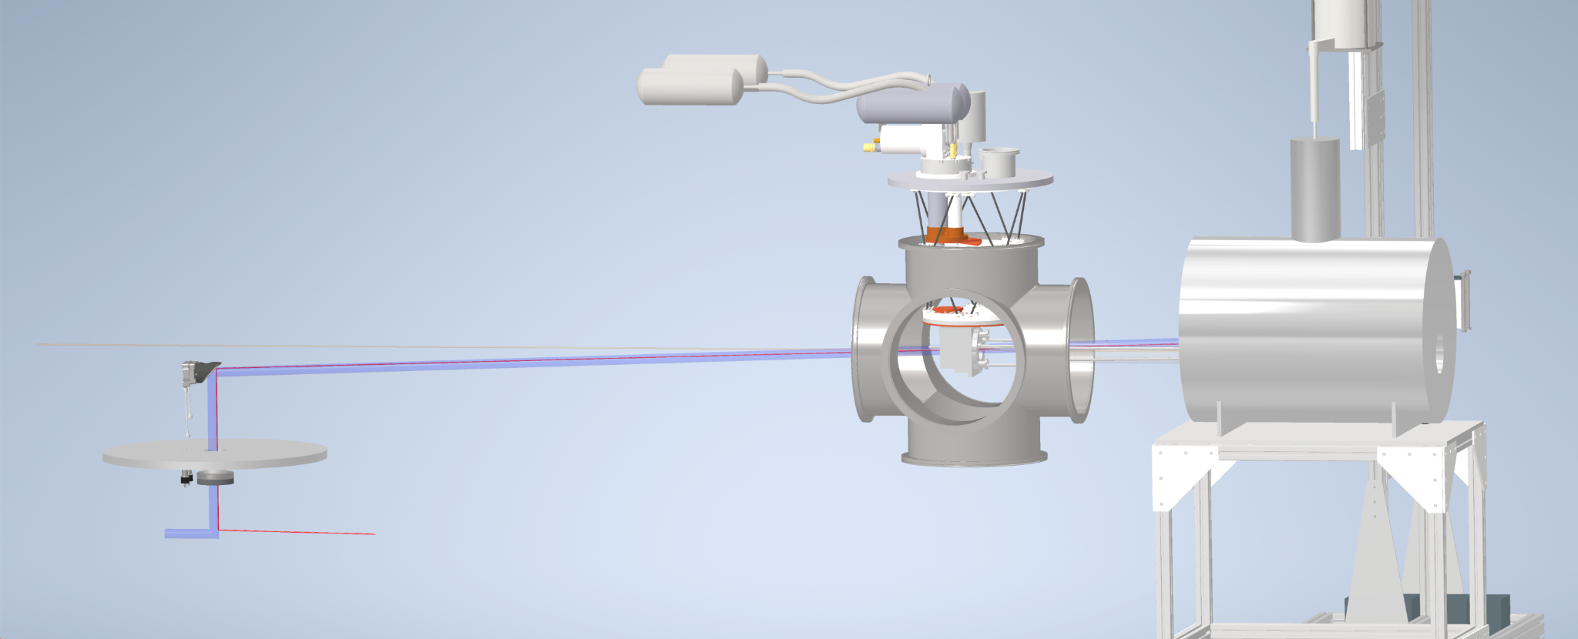
Steps Leading to Double-cell Target
High Field / High Pressure MEOP Testing; Explore polarization under various pressure and field
Flow Test between room-temp and cryo-cooled cell using Target Group’s 4 K test stand
Full Double-Cell Prototype and in-beam testing

Slide 18
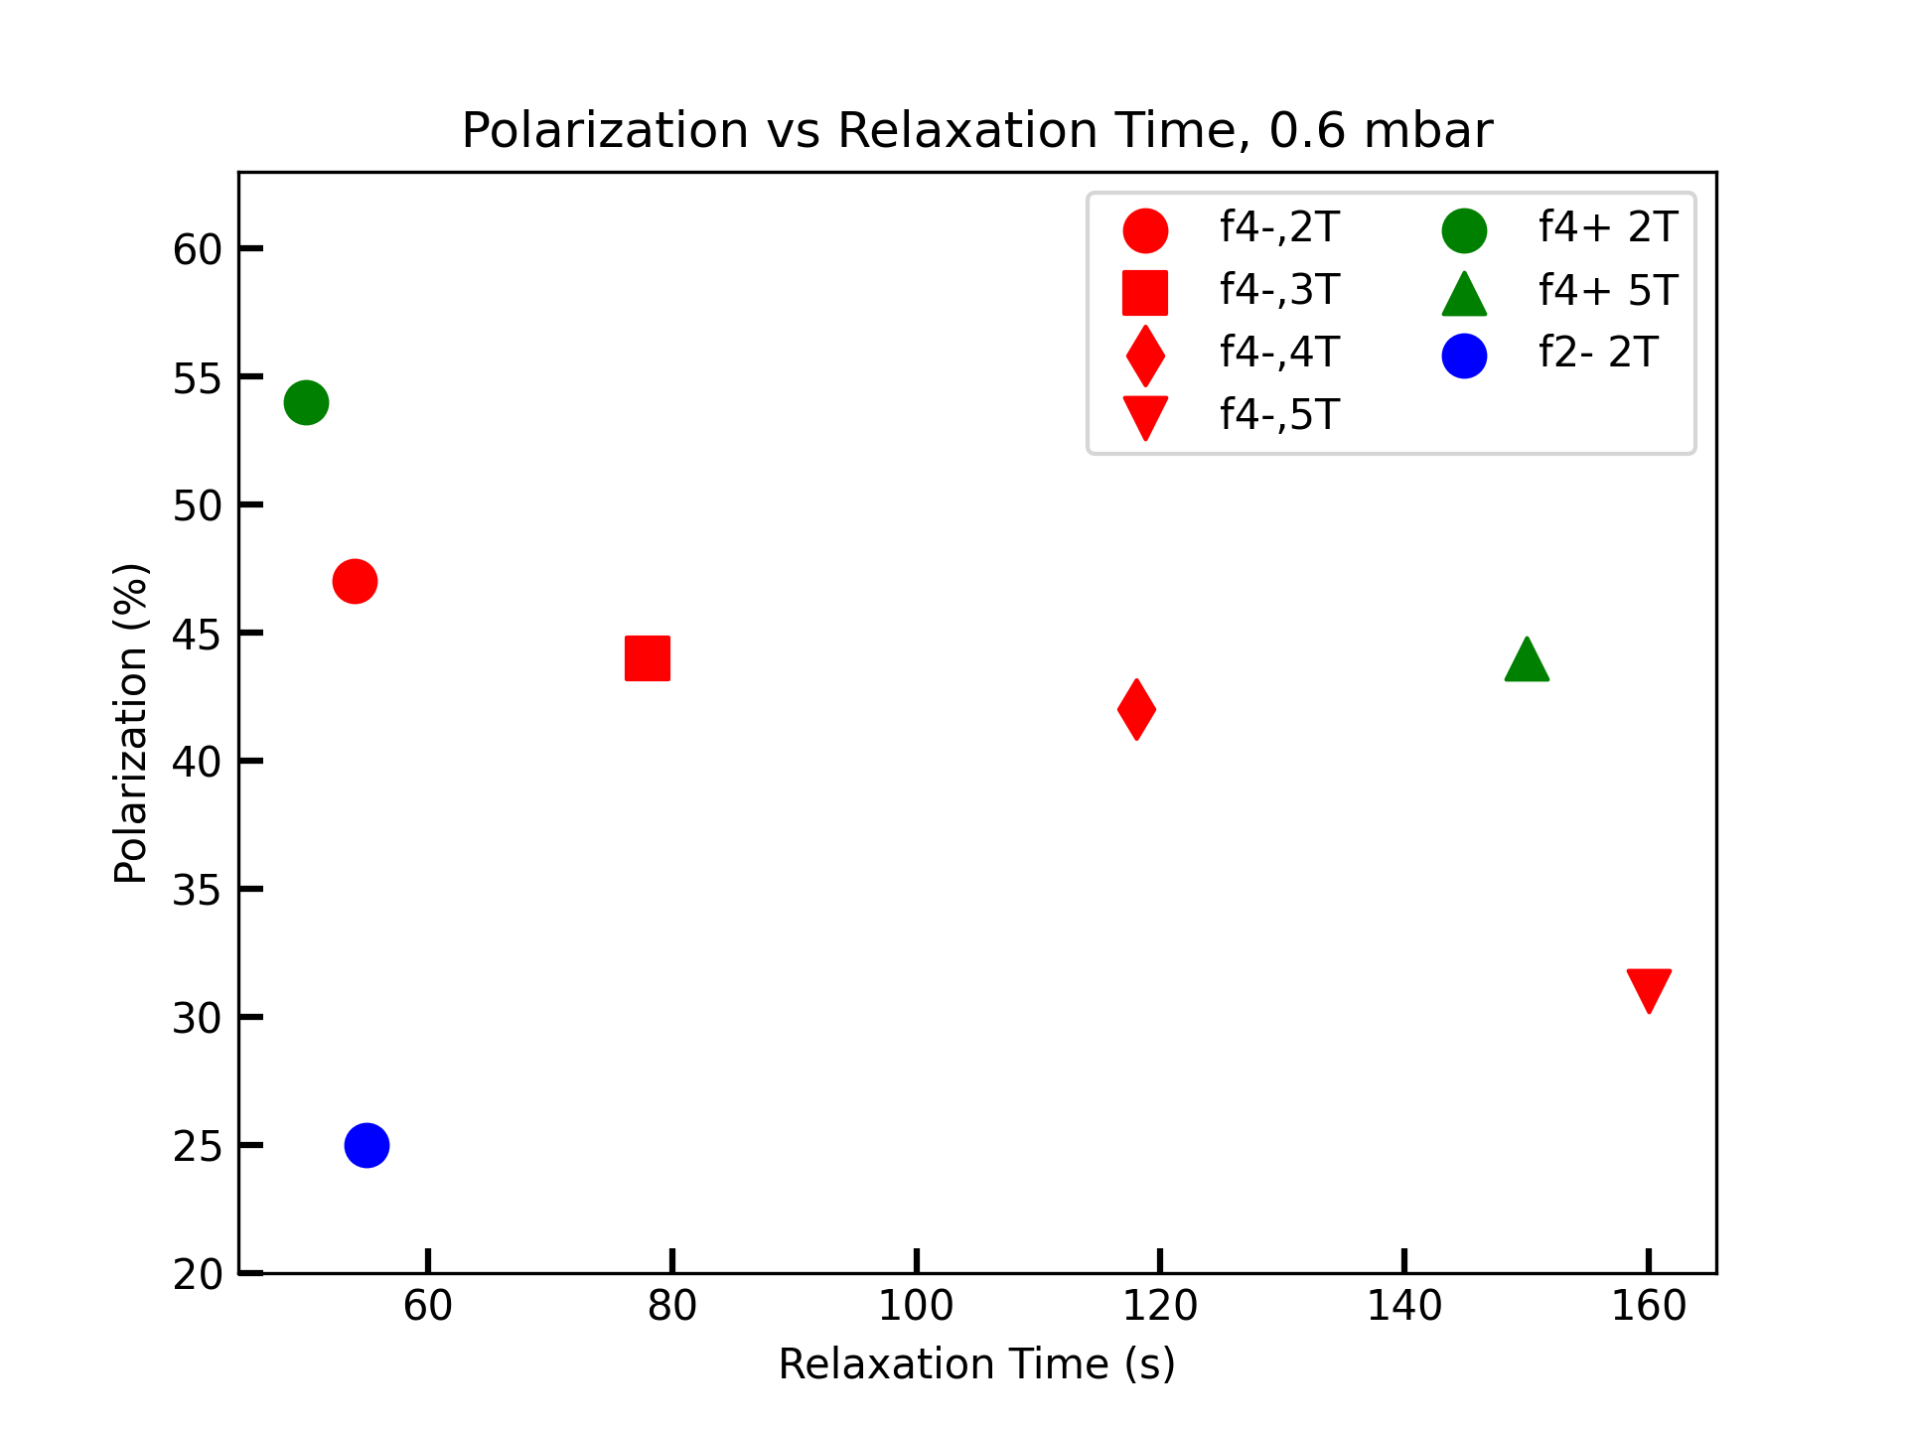
Current Status on High Field & Pressure MEOP
Initial high field test done on 1.3 mbar sealed cell (X. Li, NIM A, 1057, 168792 (2023))
Preliminary low pressure polarization test done with fillable cell

Slide 19
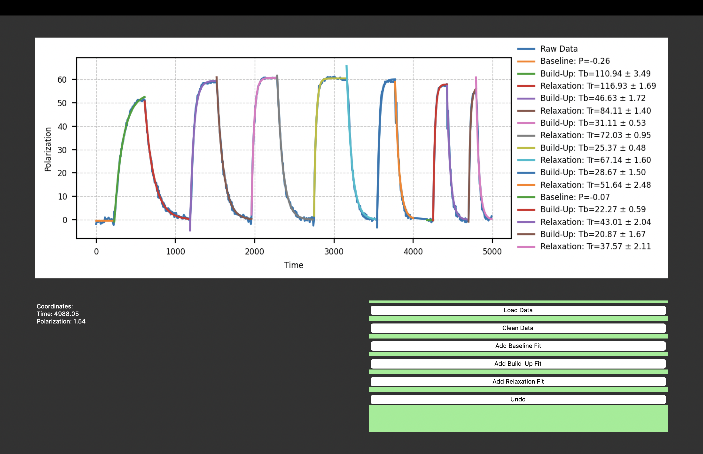
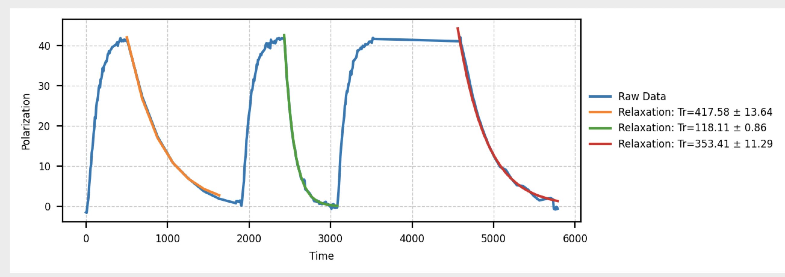
Plans for Near Future: Relaxation Optimization
Relaxation’s discharge dependency at 1.2 mbar, 2T
Preliminary measurement of Discharge off T₁
Unidentified source of relaxation:
³He gas impurities
Transverse field gradient
Magnetization of cell

Slide 20
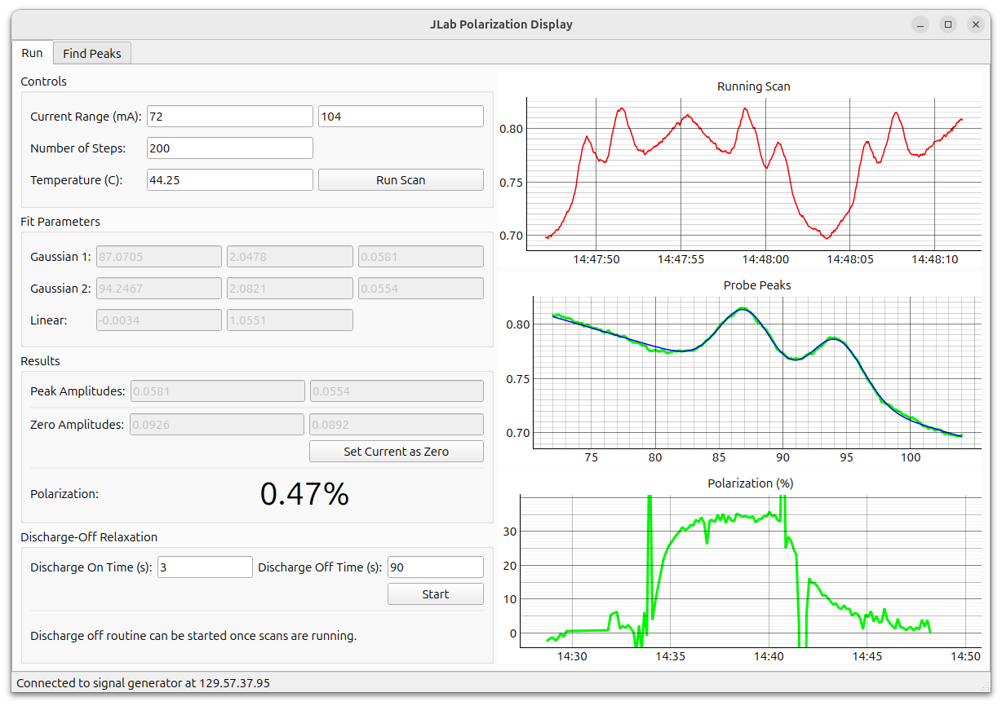
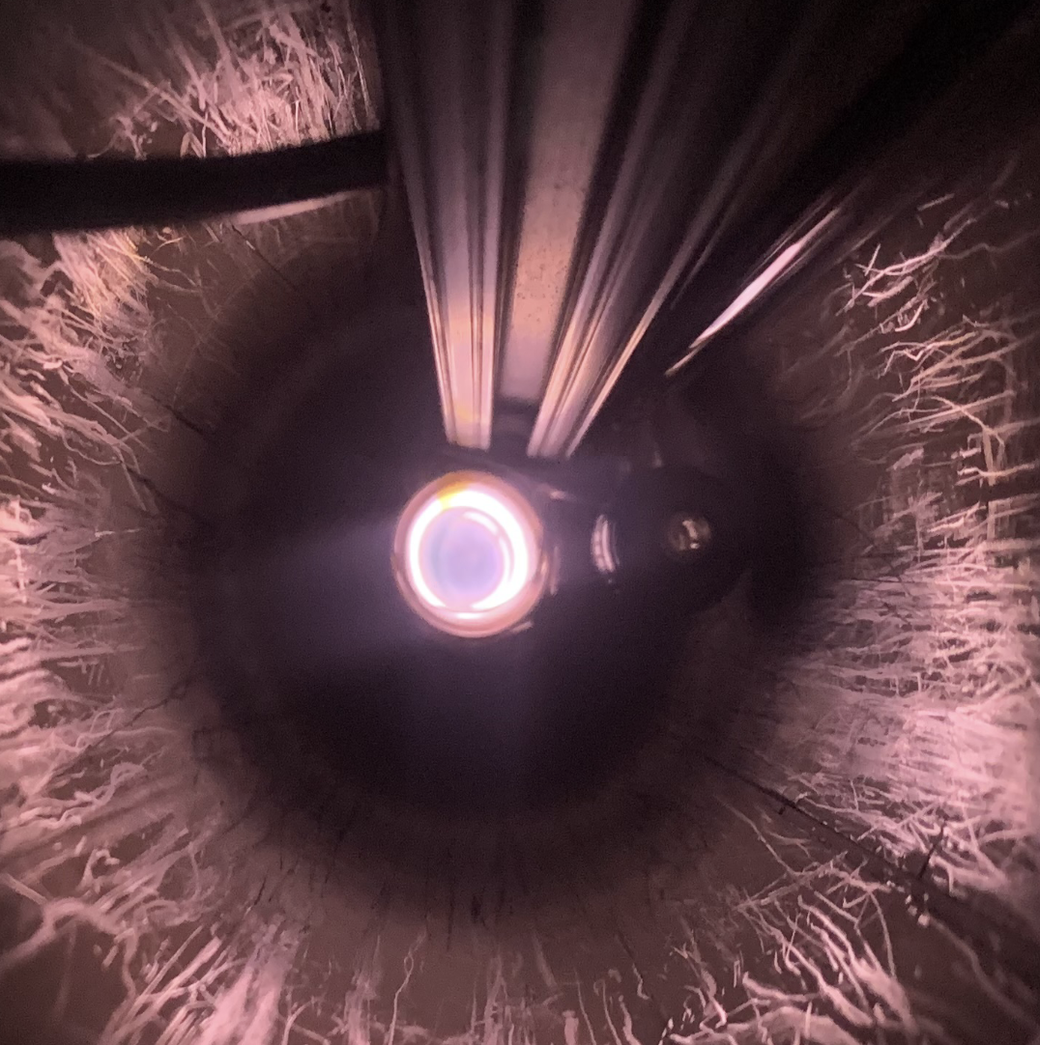
Optimization for High Pressure
Extremely poor SNR of probing absorption peaks
Due to discharge localization
Pressure broadening of absorption spectrum

Slide 21
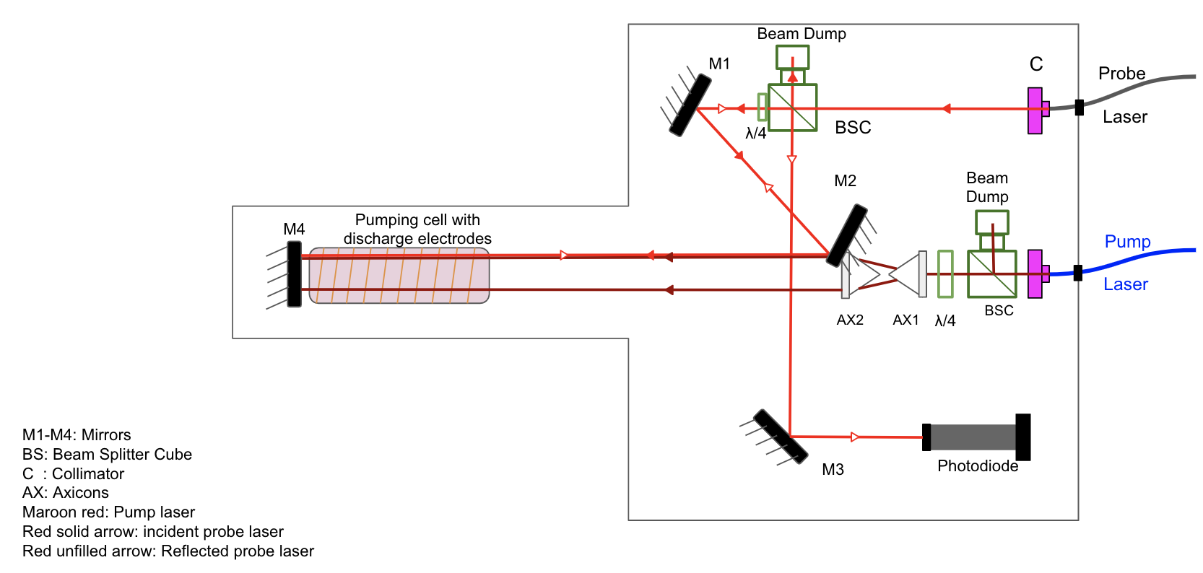
Optical Upgrade
Multipath probing optics
Axicon pumping optics
Matching discharge localization at high pressure / high field

Slide 22
Challenges moving forward
Optimize high field high pressure MEOP:
  Reproduce and improve polarization achieved by KBL group
Flow Test using Cryostand:
  Testing of relaxation induced during diffuse transfer of polarized ³He gas between 300 K pumping cell and 5 K target cell
In-beam Test:
  Understand relaxation at 5 T field, 100 mbar aluminum cell at 5 K in a 0.5 μA beam

Slide 23
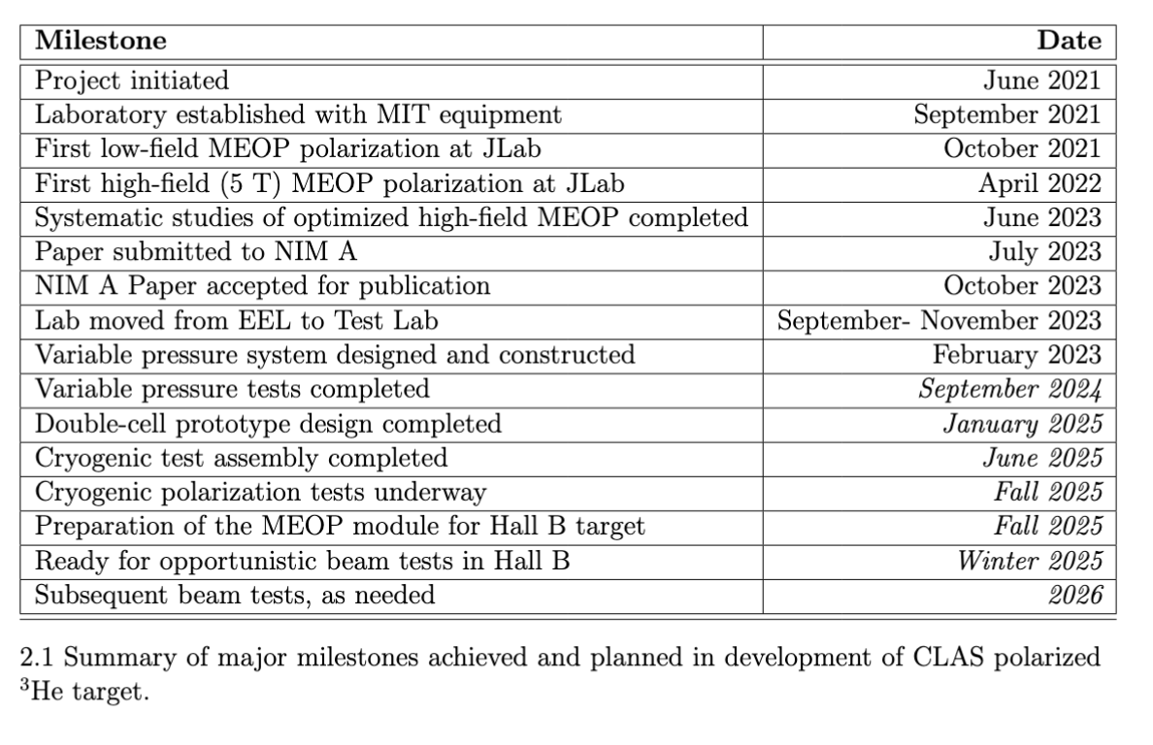
Project Schedule

Slide 24
Summary
Polarized ³He at high magnetic field and high pressure provides a crucial asset for CLAS12 collaboration to probe the spin structure of free neutrons
A double-cell design that connects a 300 K room temperature MEOP pumping cell and a 5 K cryo-cooled target cell is under development for use at 5 T CLAS12 solenoid
Initial tests on MEOP performance under various magnetic fields and pressure has been progressing swiftly and steadily

Slide 25
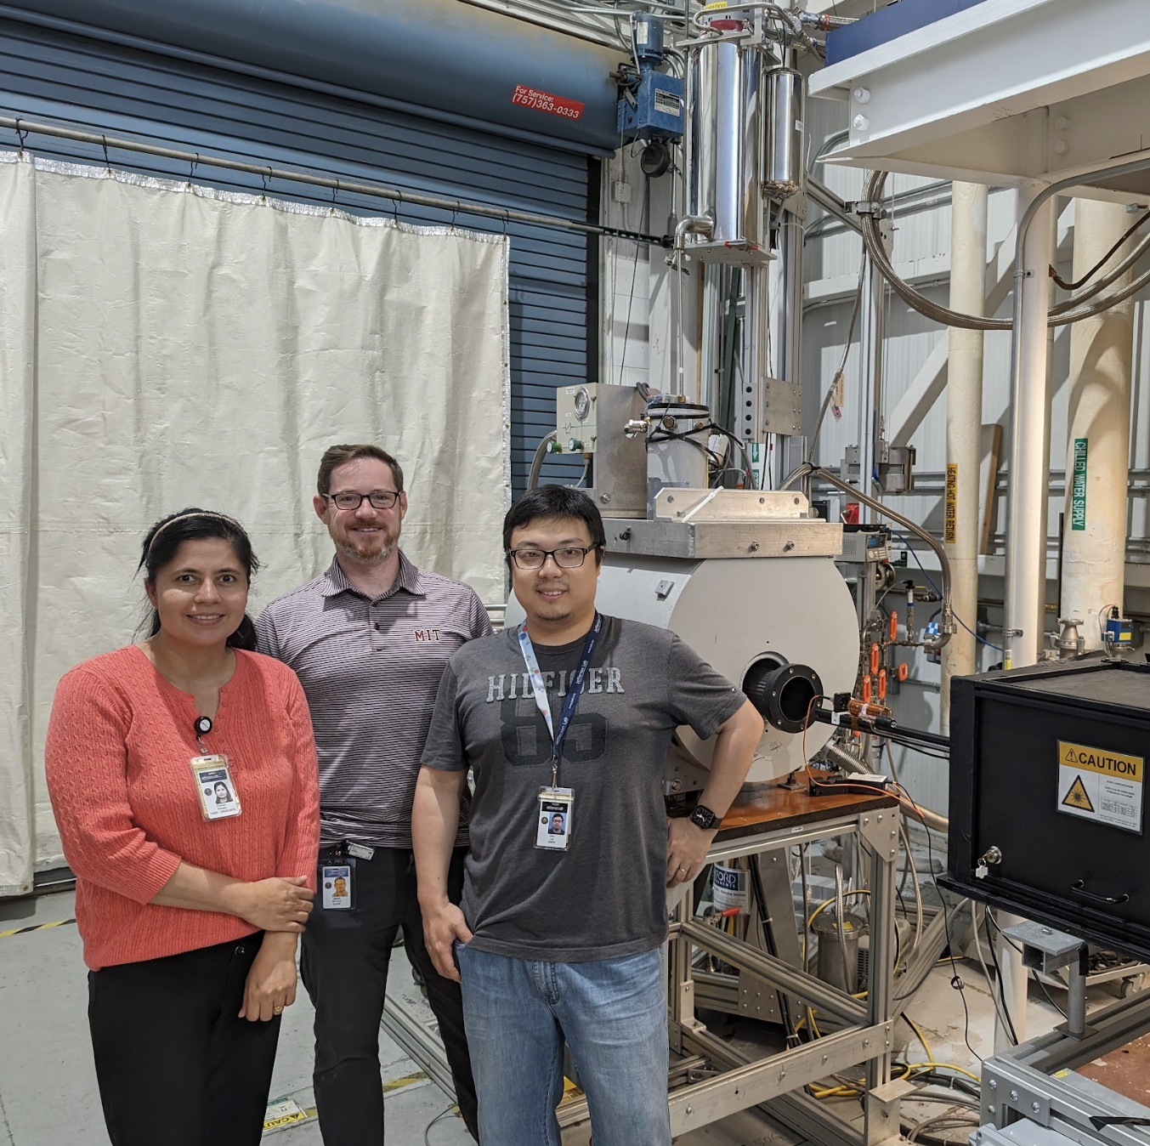
Acknowledgment
CLAS12 Polarized ³He collaboration:
  MIT : R. Milner, P. Pandey
  JLab: H. Avakian, C. Keith, J. Maxwell, J. Brock
  UTK: D. Nguyen, H. Lu
  Shandong U.: X. Li
This material is based upon work supported by the U.S. Department of Energy, Office of Science, Office of Nuclear Physics under contract DEAC05-06OR23177.

Slide 26
Backup Slides (and Pushpa’s Talk)

Slide 27
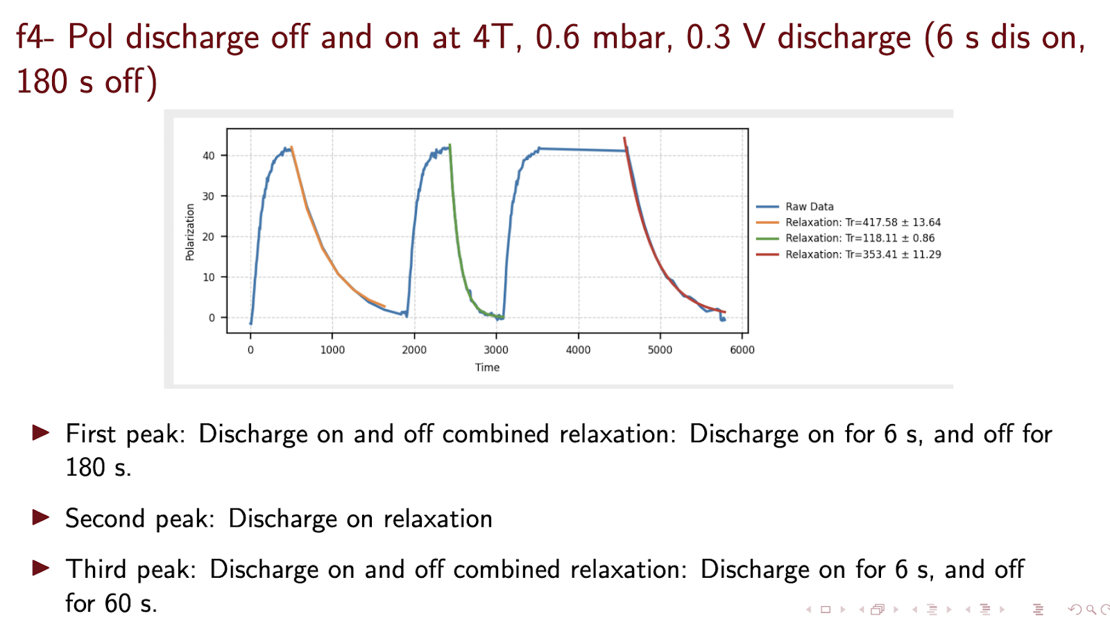
Discharge On / Off relaxation measurement

Slide 28
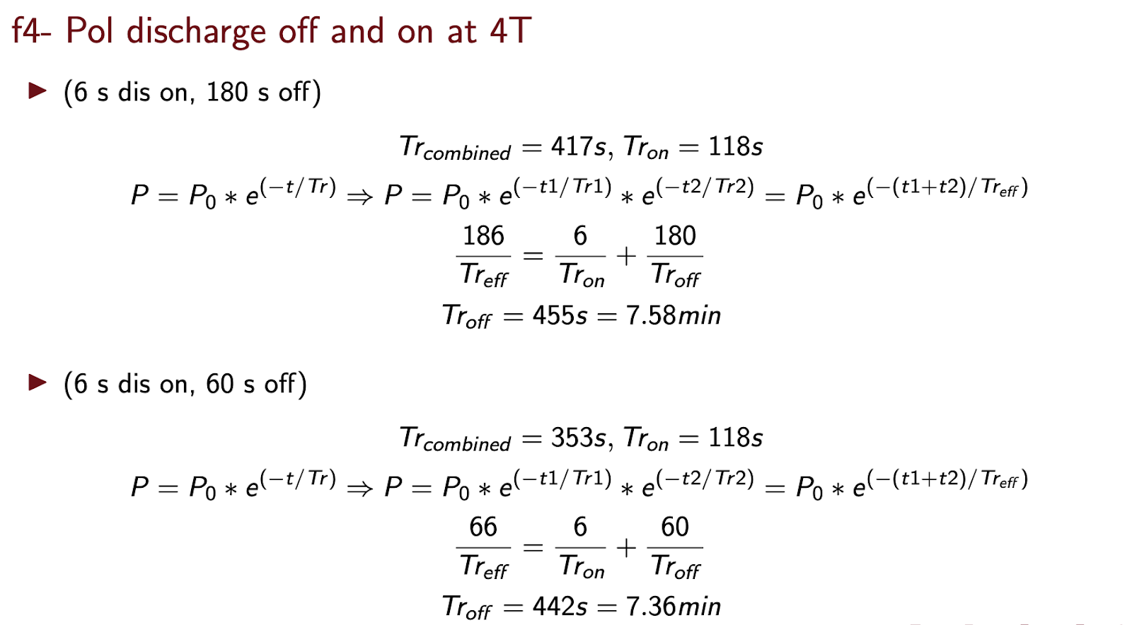
Discharge On / Off relaxation measurement

