Slide 1
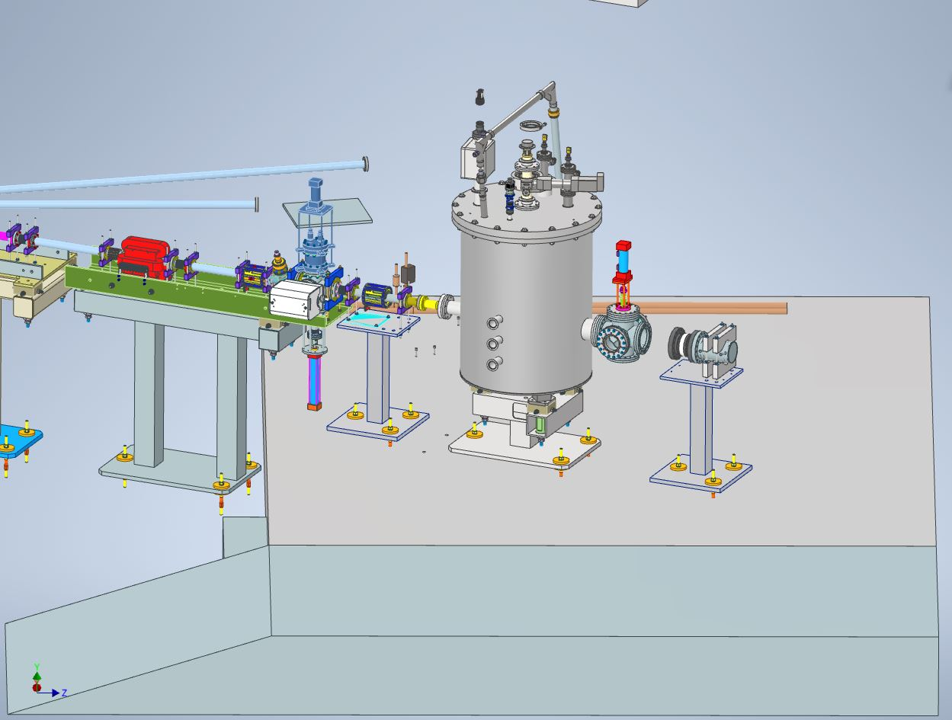
Developments of polarized ⁷LiD target system for spin-dependent EMC effect experiments at CLAS12
Tsuneo Kageya
Thomas Jefferson National Accelerator Facility (JLab)
D. Akers, J. Brock, C. Carlin, G. Dezern,
C. Flanagan, D. Griffith, M. Hoegerl,
P. Hood, C. Keith, J. Maxwell, S. Madlock,
D. Meekins (JLab Target Group)
P. Dobrenz, X. Wei (Jlab Hall B)
J. Creel, B. Mastracci (JLab Engineering
Division)
P. Dobrenz, M. Poelker, E. Pozdeyev
(JLab Accelerator Division)
Related talks: J. Brock, “A Solid Polarized Target Development Facility at Jefferson Lab.” (Tue.)
X. Wei, “Preparation at Jefferson Lab. for Spin Polarized Fusion Program” (Thurs.)

Slide 2

EMC effects
(European Muon
Collaboration)
Quark’s momentum distributions accessed by DIS: different for light and heavy nuclei ➾ Not anticipated results
Compare for F₂(A) with F₂(D) ( A: Fe, Ca and Cu, D: deuteron )
F₂ (A)
F₂ (D)
If NO EMC effects
F₂: unpolarized
structure function
From
U. Landgraf (NMC Collaboration.),
Nucl. Phys. A527, 123C (1991)
X_{Bj}

Slide 3
EMC effects observed
for light nuclei
³He
D
⁷LI : between ³He and ⁹Be
⁹Be
D
(J. Arrington (Hall C),
Phys. Rev. C 104, 065203 (2021))

Slide 4
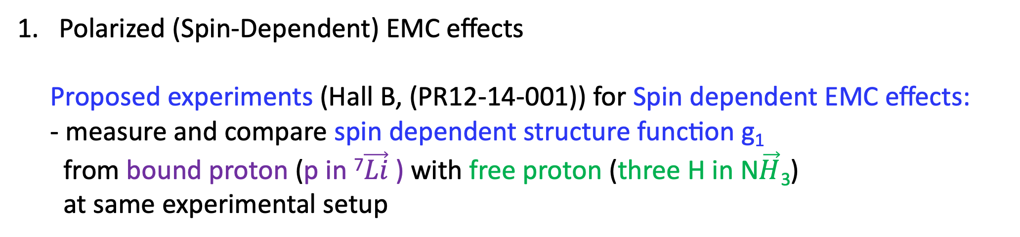
Polarized (Spin-Dependent) EMC effects
Proposed experiments (Hall B, (PR12-14-001)) for Spin dependent EMC effects:
- measure and compare spin dependent structure function g₁
from bound proton (p in ⁷$\vec{Li}$) with free proton (three H in N$\vec{H}$₃)
at same experimental setup
An example of theoretical prediction for polarized EMC for ⁷Li
Polarized EMC effect could be
more enhanced than
unpolarized Theoretical
predictions
x
(I. C. Clo ̈et etal. ADP-06-05/T636)

Slide 5
1. Longitudinally Polarized Solid Target for Spin dependent EMC effect at Hall B
Use the same setup of target system as Run Group C (Run in 2022-23).
DNP at 5 Tesla (Solenoid) and 1 K (⁴He evaporation cryostat)
Use Longitudinally polarized e⁻ beams (11 GeV)
(P. Pandey etal, Proc. of 25th Int.
Symposium of Spin Physics. 2023, 211)
Side view of the polarized target installed in Hall B. A few elements of the CLAS12
spectrometer are shown.

Slide 6
2. Advantages of using polarized solid ⁷LiD and NH₃ targets
for Spin dependent EMC effects
No so much data for ⁷LiD; use data from ⁷LiH, ⁶LiD and ⁶LiH
Solid ⁶LiD has been used as polarized targets in the past experiments:
its performances are rather well known, ⁷LiD is supposed to perform similarly.
a. Low mass nuclei like ⁷Li; detailed structure of nuclei is well known
b. ⁷LiD and NH₃ can be highly polarized with DNP
c. ⁷LiD and NH₃ are highly radiation resistant on electron beams
d. Reasonable Dilution Factor

Slide 7
a. Low mass nuclei like ⁷Li; detailed structure of nuclei is well known
Structure of ⁷Li in a simple shell model picture
⁷Li: p (∽ 87 % of Li spin)^{1,2} + n + n ($−$0.04 %)^{1,2} + ⁴He (zero pol.)
(From proposal
PR12-14-001)
Protons
Neutrons
( 1 : Shell model; S. Cohen, D. Kurath, Nucl. Phys. 73 (1965) 1.
2: Quantum Monte Carlo calculations; B.S. Pudliner etal., Phys. Rev. C 56 (1997) 1720)

Slide 8
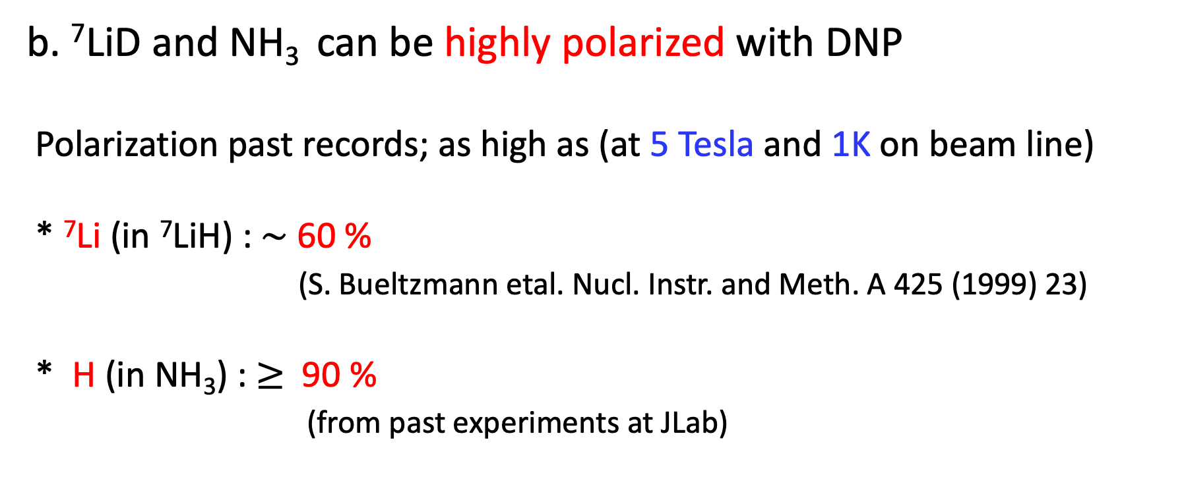
b. ⁷LiD and NH₃ can be highly polarized with DNP
Polarization past records; as high as (at 5 Tesla and 1K on beam line)
* ⁷Li (in ⁷LiH) : $\sim$60 %
(S. Bueltzmann etal. Nucl. Instr. and Meth. A 425 (1999) 23)
* H (in NH₃) : $≥$90 %
(from past experiments at JLab)

Slide 9
c. Radiation resistance for ⁶LiD (No data for ⁷LiD nor ⁷LiH)
Irradiation (180 K) dose of 2.0x10¹⁷ e⁻/cm²
During E155 experiments at SLAC, 50 GeV e beam
Max pol. at 5x10¹⁵ e⁻/cm^{2.} : about 5 times larger than ND³
Expect similar radiation resistance for ⁷LiD

Slide 10
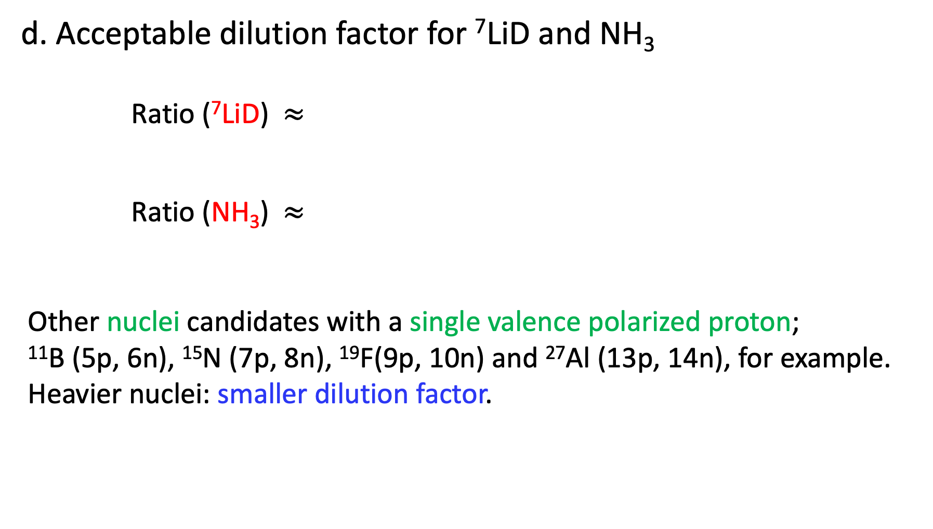
d. Acceptable dilution factor for ⁷LiD and NH₃
Ratio (⁷LiD) $≈$
Ratio (NH₃) $≈$
Other nuclei candidates with a single valence polarized proton;
¹¹B (5p, 6n), ¹⁵N (7p, 8n), ¹⁹F(9p, 10n) and ²⁷Al (13p, 14n), for example.
Heavier nuclei: smaller dilution factor.
Number of polarizable bound proton
1
=
= 0.11
Total number of nucleons
9
Number of polarizable free protons
3
=
= 0.18
Total number of nucleons
17

Slide 11
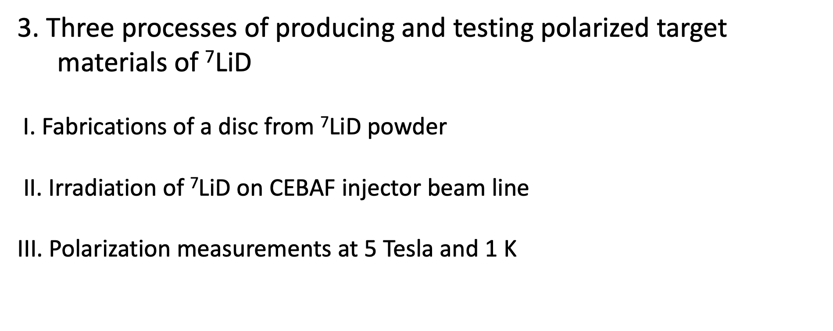
3. Three processes of producing and testing polarized target
materials of ⁷LiD
I. Fabrications of a disc from ⁷LiD powder
II. Irradiation of ⁷LiD on CEBAF injector beam line
III. Polarization measurements at 5 Tesla and 1 K

Slide 12
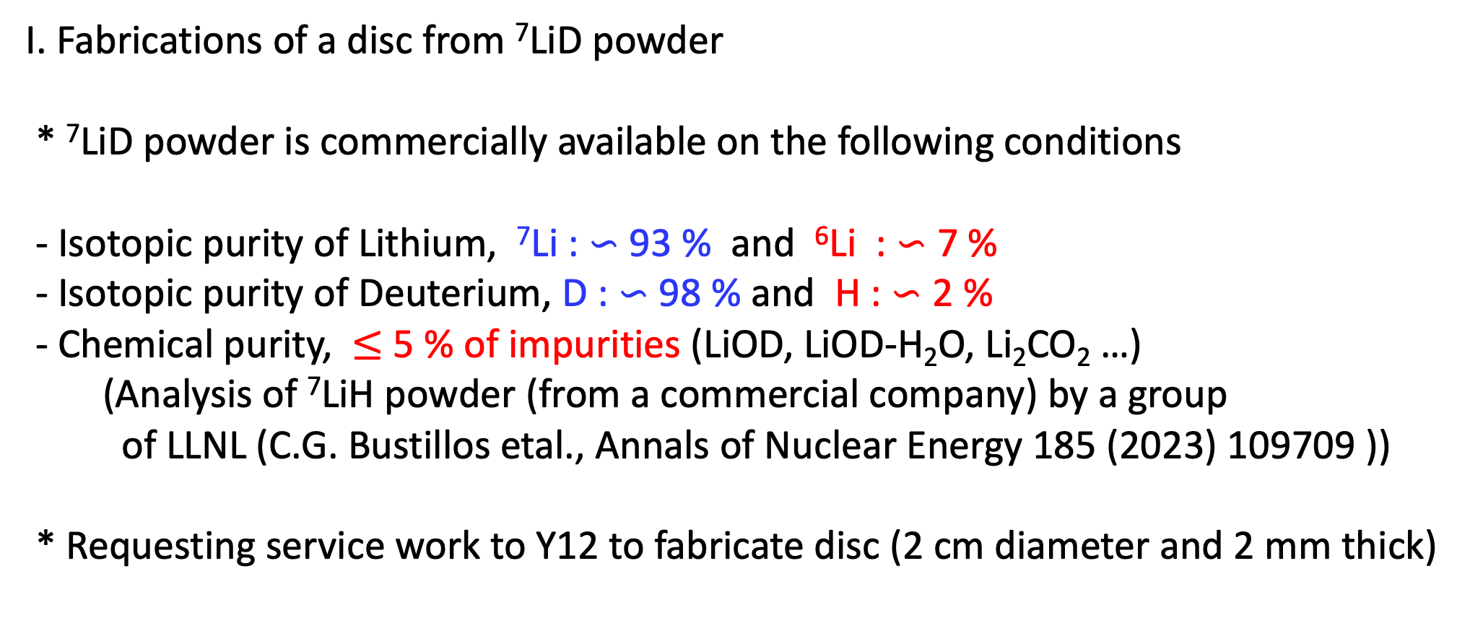
I. Fabrications of a disc from ⁷LiD powder
* ⁷LiD powder is commercially available on the following conditions
- Isotopic purity of Lithium, ⁷Li : ∽ 93 % and ⁶Li : ∽ 7 %
- Isotopic purity of Deuterium, D : ∽ 98 % and H : ∽ 2 %
- Chemical purity, $≤$ 5 % of impurities (LiOD, LiOD-H₂O, Li₂CO₂ …)
(Analysis of ⁷LiH powder (from a commercial company) by a group
of LLNL (C.G. Bustillos etal., Annals of Nuclear Energy 185 (2023) 109709 ))
* Requesting service work to Y12 to fabricate disc (2 cm diameter and 2 mm thick)

Slide 13
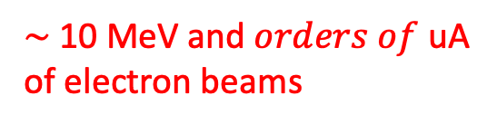
II. Irradiation of ⁷LiD on CEBAF injector beam line (JLab) : New
NH³ and ND³ had been irradiated at NIST with collaboration of UVA target group in the past
$\sim$10 MeV and $orders of$ uA
of electron beams
Irradiation
Cryostat
e⁻ beam
Raster Magnet
Beam dump
BPM
Faraday Cup
(Dose
measurements)

Slide 14
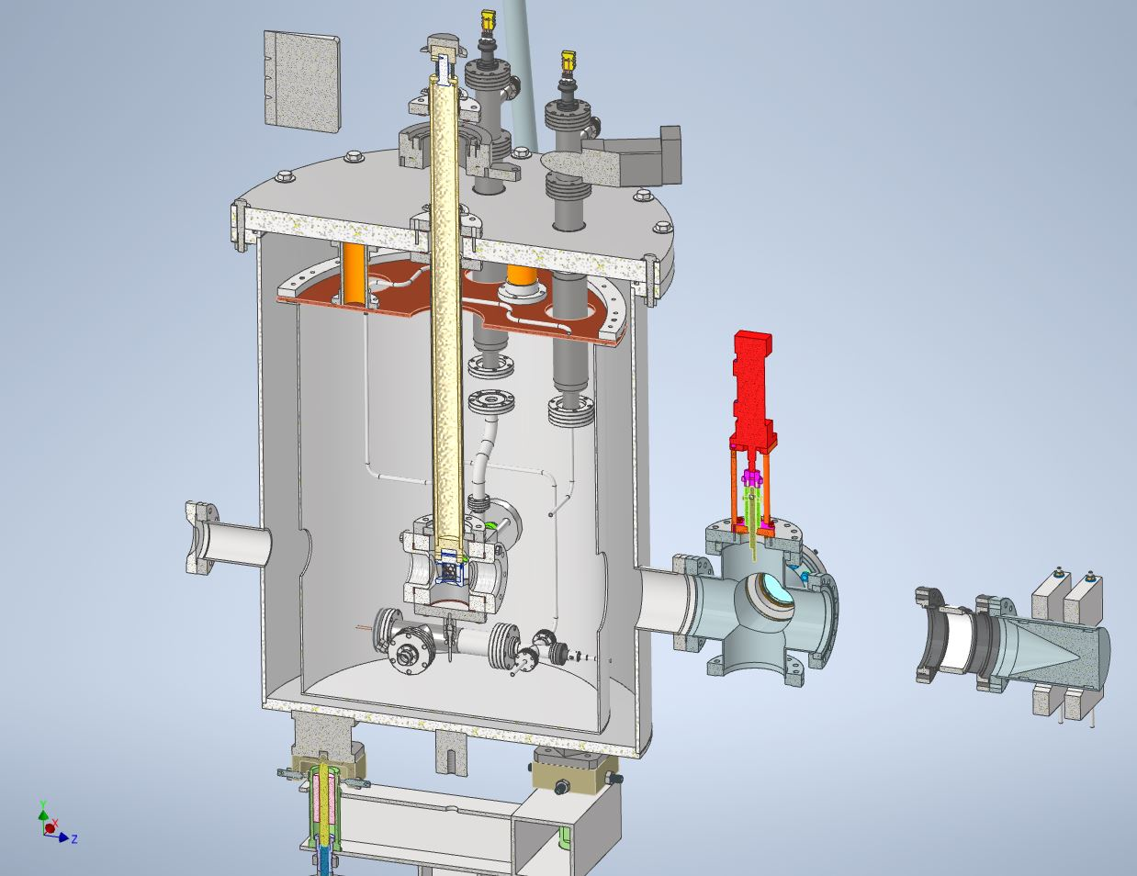
II. Irradiation Cryostat (detail)
Variable Temperature Irradiation cryostat (under design & construction)
3 K He coolant from Central He Liquefier
Temperature controlled by heater
Irradiate ⁷LiD and NH₃ at different
temperatures
Target materials
inserted and uninserted vertically
Veritically
Rastered e⁻ beam
Solid ⁷LiD/NH₃
_{Rotating 1 turn/min}

Slide 15
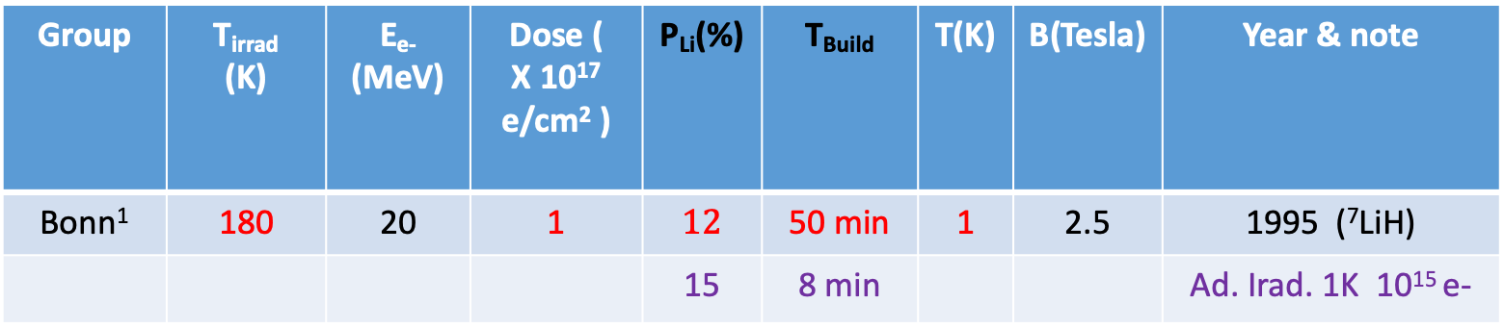
II. Irradiation conditions for ⁷LiD (higher polarization and shorter polarization building Time)
Some noteworthy past records for ⁷LiH & ⁶LiD (different irradiation temperatures and option)
Group | T_{irrad} (K) | E_{e-} (MeV) | Dose ( X 10¹⁷ e/cm² ) | P_{Li}(%) | T_{Build} | T(K) | B(Tesla) | Year & note
Bonn¹ | 180 | 20 | 1 | $12$ | 50 min | 1 | 2.5 | 1995 (⁷LiH)
 |  |  |  | 15 | 8 min |  |  | Ad. Irad. 1K 10¹⁵ e-
(1)
Standard
Additional irradiations at Lower Temperature (3K): can increase P_{max} and shorten T_{build}
(2)
SLAC² | 183 $±3$ | 30 | 1.3 – 4.5 | $\sim$ 60 |  | 1 | 5 | 1999 (⁷LiH)
(2) ⁷Li in ⁷LiD is expected to polarize as high as 60 % at 5 Tesla (may optimize dose)
(3)
Bochum³ | 190 | 20 | 0.1 | -17.8 | 220 min | 1 | 2.5 | 2001 (⁶LiD)
 | 140 |  | 1 | -17.9 | 60 min | 1 | 2.5 | Warm RT
(3) ⁶LiD at room temperature for 10 min; as od as on standard and may shorten T_{build}
∗ Irradiate NH₃ at 80 K (standard irradiation temperature) and 3 K (low temperature as (1)) in prior to 11 GeV beam.
NH₃ materials will be supplied by Univ. New Hampshire group.

Slide 16
1. S. Goertz etal., Nuclear Instruments and Methods in Physics Research A 356 (1995) 20
2. S. Bueltmann etal. Nuclear Instruments and Methods in Physics Research A 425 (1999) 23
3. A. Meier, 6LiD for the polarized target of the COMPASS experiment, PhD. Thesis, Ruhr-University Bochum 2001

Slide 17
III. DNP cryostat with 5 Tesla and 1 Kelvin (under design and construction)
Cryomagnetics Cryo-Free 5 T Warm Bore Magnet
Vertical 1 K cryostat
(Refer J. Brock’s presentation)

Slide 18
Summary
We are developing polarized ⁷LiD target system for Spin dependent EMC effect experiments at Hall B.
2. For this purpose, designing and constructing irradiation and polarizing
cryostats.
Plan to irradiate and polarize ⁷LiD target materials in the middle of 2025.
Test materials and optimize parameters to obtain higher polarization
and shorter building up time of polarization on the beamline.

Slide 19
Backup Slides

Slide 20
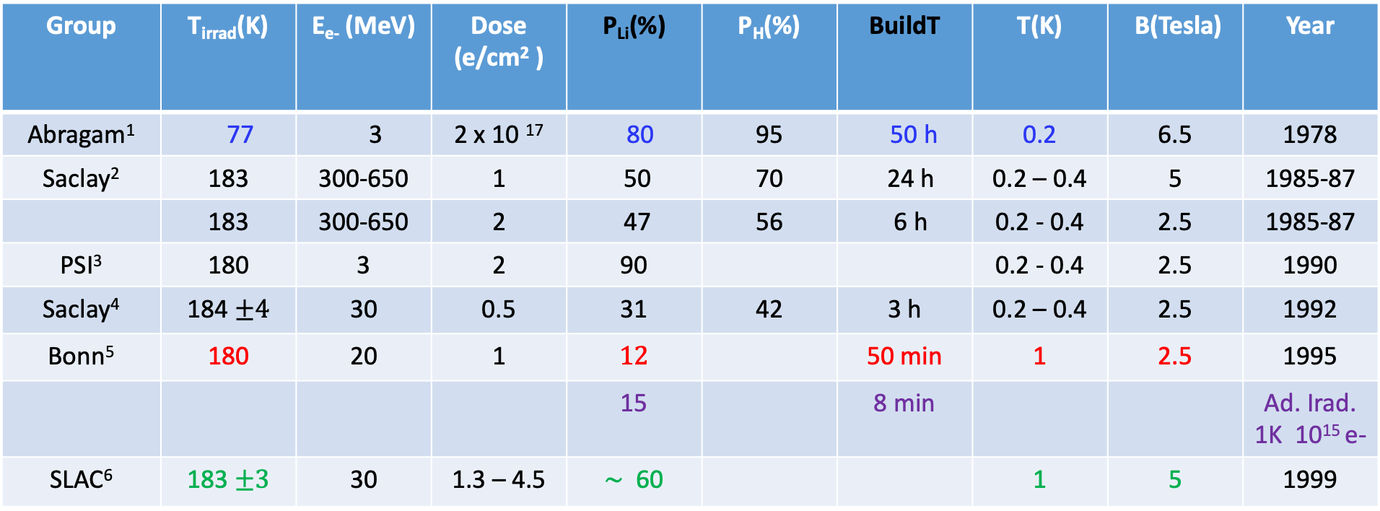
II. Irradiation of ⁷LiD (higher polarization and shorter polarization building Time)
Summary of some past records; T_{irrad}, Pol_{Max}, Time_{Build} and polarizing conditions for ⁷LiH
Group | T_{irrad}(K) | E_{e-} (MeV) | Dose (e/cm² ) | P_{Li}(%) | P_{H}(%) | BuildT | T(K) | B(Tesla) | Year
Abragam¹ | 77 | 3 | 2 x 10 ¹⁷ | 80 | 95 | 50 h | 0.2 | 6.5 | 1978
Saclay² | 183 | 300-650 | 1 | 50 | 70 | 24 h | 0.2 – 0.4 | 5 | 1985-87
 | 183 | 300-650 | 2 | 47 | 56 | 6 h | 0.2 - 0.4 | 2.5 | 1985-87
PSI³ | 180 | 3 | 2 | 90 |  |  | 0.2 - 0.4 | 2.5 | 1990
Saclay⁴ | 184 $±4$ | 30 | 0.5 | 31 | 42 | 3 h | 0.2 – 0.4 | 2.5 | 1992
Bonn⁵ | 180 | 20 | 1 | $12$ |  | 50 min | 1 | 2.5 | 1995
 |  |  |  | 15 |  | 8 min |  |  | Ad. Irad. 1K 10¹⁵ e-
SLAC⁶ | 183 $±3$ | 30 | 1.3 – 4.5 | $\sim$ 60 |  |  | 1 | 5 | 1999
Optional procedure: after irradiation keep ⁶LiD at room temperature for 10 min.
Bochum⁷ | 190 |  | 0.1 | -17.8 | -18.6 | 220 min | 1 | 2.5 | 2001
 | 140 |  | 1 | -17.9 | -18.7 | 60 min | 1 | 2.5 | Warm RT

Slide 21
1. A. Abragam etal., J. Physique Let. 41 (1980) L-309
2. P. Chaumette etal. Proc. of 8th Int. Symposium of High Energy Spin Physics. 1988, 1275
3. S. Mango etal. Proc. of 9th Int. Symposium of High Energy Spin Physics, 1990, 320
4. J.J. Jarmer etal., Proc. Of 10th International Symposium on High Energy Spin Physics, 1992, 363
5. S. Goertz etal., Nuclear Instruments and Methods in Physics Research A 356 (1995) 20
6. S. Bueltmann etal. Nuclear Instruments and Methods in Physics Research A 425 (1999) 23
7. A.Meier, 6LiD for the polarized target of the COMPASS experiment, PhD. Thesis, Ruhr-University Bochum 2001

