Slide 1
Polarized Photocathode R&D at BNL and spin consideration for the EIC
Jyoti Biswas
Electron Ion Collider, Brookhaven National Laboratory
On behalf of the collaborator
September 22-27, 2024
Newport News, VA

Slide 2
In collaboration with
BNL: Erdong Wang, John Skaritka, Luca Cultrera, Omer Rahman, Mengjia Gaowei, Kali Mondal, Wei Liu, Mike Blaskiewicz
JLAB: Joe Grames, Matthew Poelker, Carlos Hernandez-Garcia, Gabriel Palacios-Serrano
ODU: Sylvain Marsillac, Adam Masters
CUNY ASRC: Tai-De Li
Electron –Ion Collider
Jyoti Biswas

Slide 3
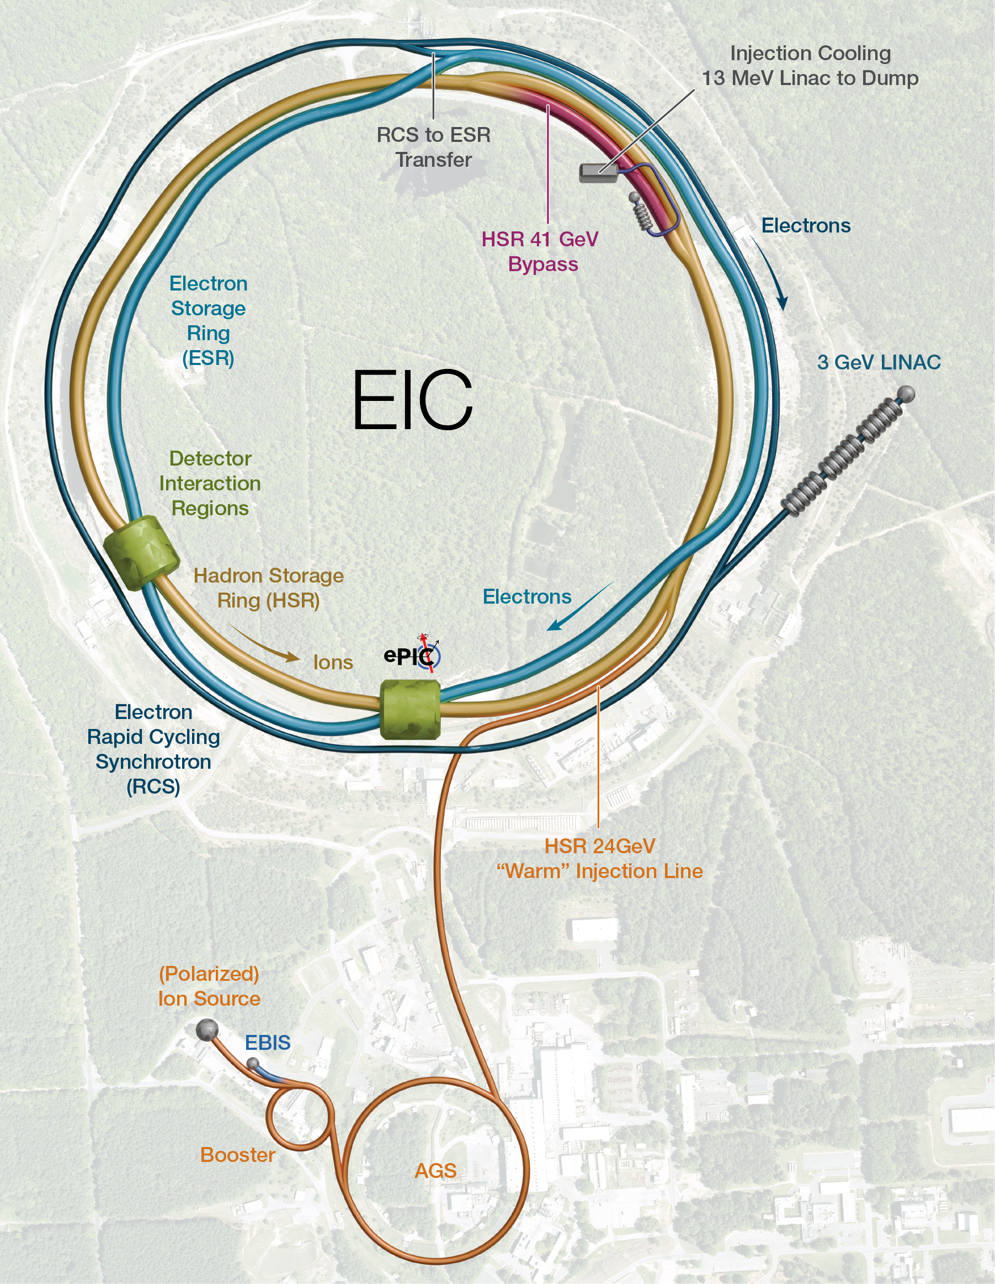
EIC - polarized electron requirements
Have existing hadron storage ring, electron storage ring and injector are new.
Phase I :7 nC / bunch; Phase II: 3 bunch train of 7 nC/bunch
At least 85% spin polarization from the source.
1.3 GHz linac with 7 nC bunch.
image courtesy: Vahid Ranjbar
Electron –Ion Collider
Jyoti Biswas

Slide 4
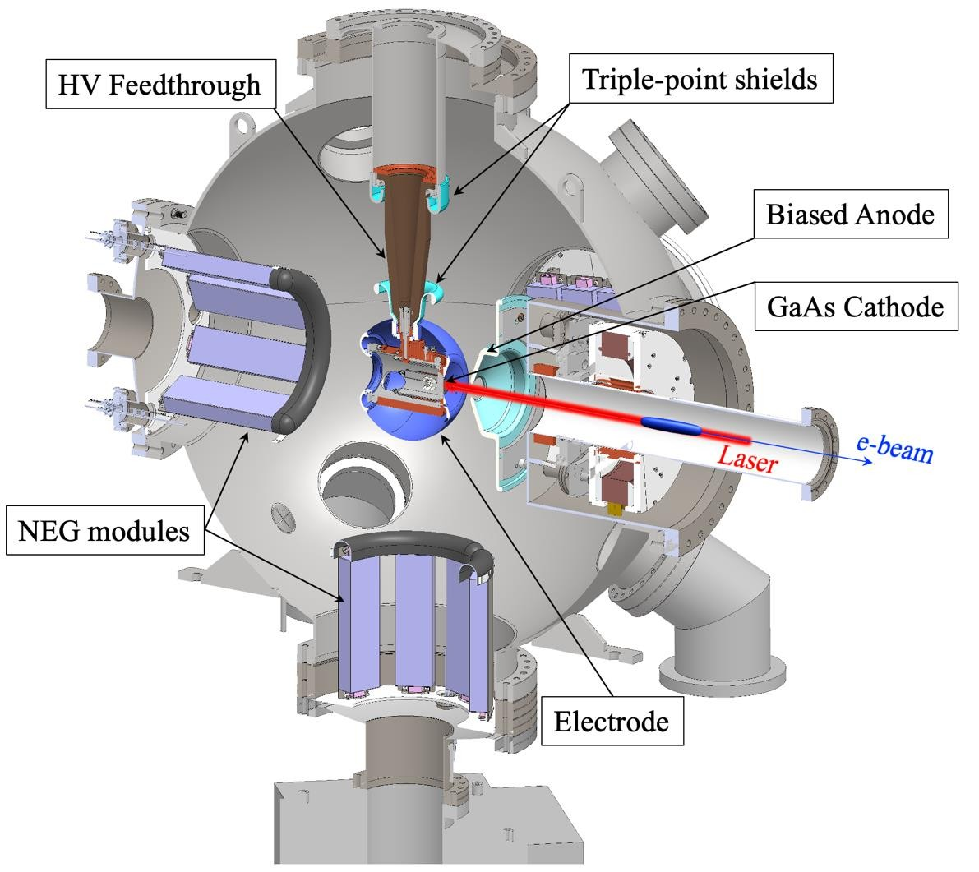
Polarized Electron Sources – HVDC gun
Layout of the beamline including the DC gun and prep chamber
Wang et al., Appl. Phys. Lett. 124, 254101 (2024), https://doi.org/10.1063/5.0216694
EIC 350 kV DC electron gun
3BG gauge | Gun Vacuum
Baseline | $7×{10}^{−12}$ torr
67.5 uA | $2×{10}^{−11}$ torr
EIC gun includes new features:
Large cathode area
Active cathode cooling
High gradient
Movable electrically insulated anode
This gun meet all EIC requirements
Electron –Ion Collider
Jyoti Biswas

Slide 5
GaAs photocathode
SL pairs
GaAsP
GaAsP
GaAs
GaAs
Superlattice GaAs
Superlattice DBR GaAs
DBR
ESP$\sim 92\% (@780nm)$
ESP$\sim 84\% (@780nm)$
Q$E\sim 0.6\% (@780nm)$
Q$E\sim 6\% (@780nm)$
TEM cross section image of SL-DBR
Biswas et el., NAPAC 24, 10.18429/JACoW-IPAC2024-MOPR77
Problems associated with GaAs photocathodes
Needs low ${10}^{−11} or{ 10}^{−12}$ Torr Vacuum.
Optimized surface doping needed
Laser induced heating could damage the QE
Transfer from facility to facility is challenging
Electron –Ion Collider
Jyoti Biswas

Slide 6
Chapter 1: GaAs photocathode R&D
“SPIN Crisis”
(lack of reliable SL-GaAs
R&D effort on
SL-GaAs (DBR)
Optimize pre-cleaning and heat treatment
Optimize surface doping and DBR pairs
GaAs with 2D protection layer
Electron –Ion Collider
Jyoti Biswas

Slide 7
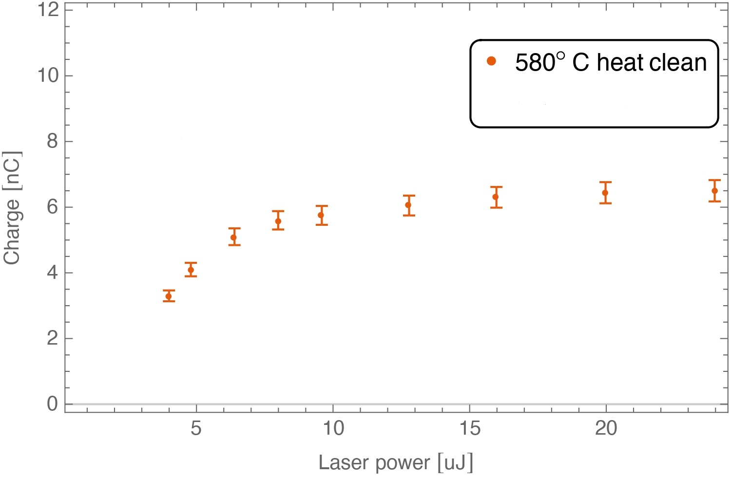
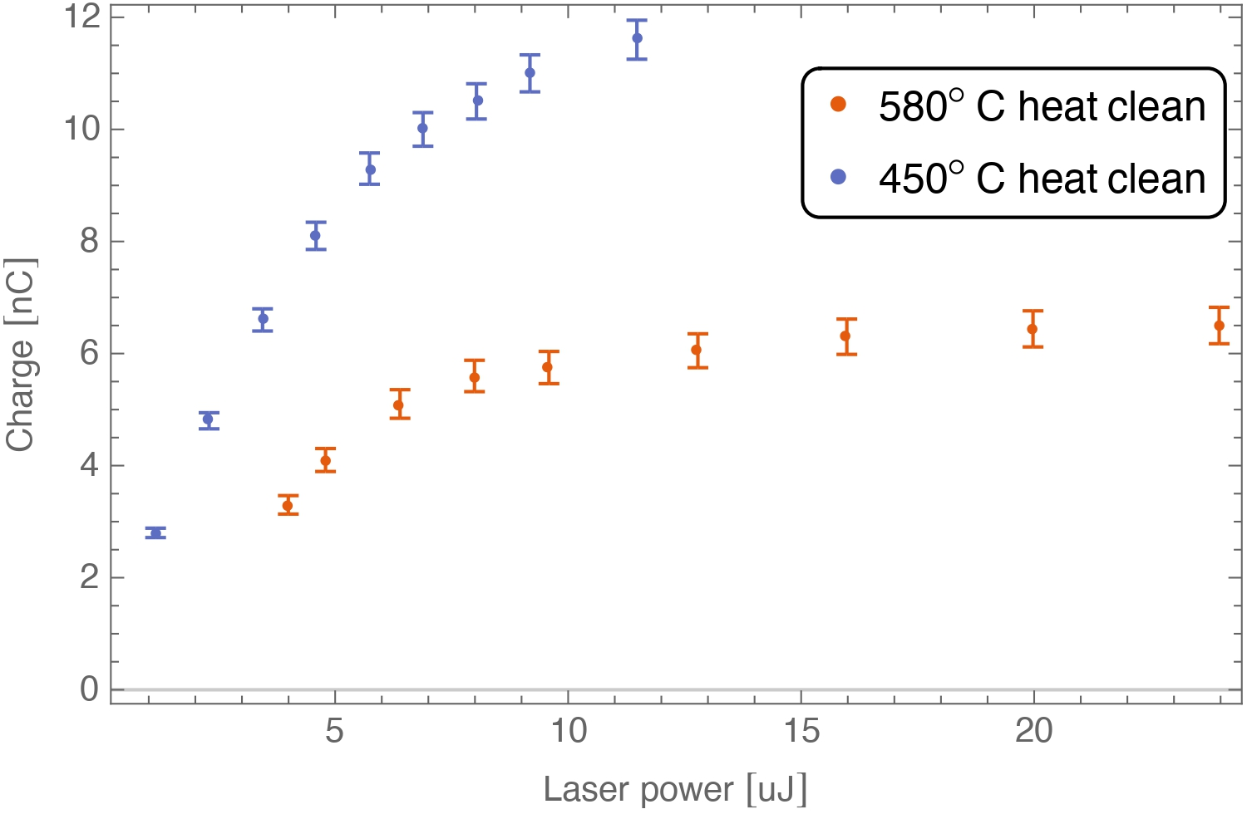
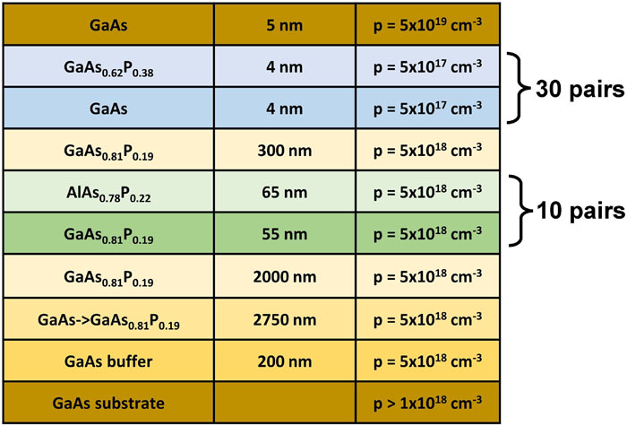
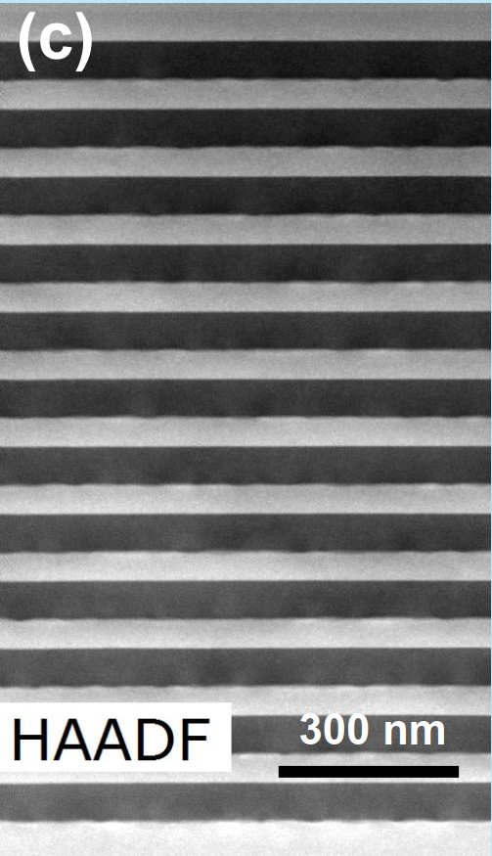
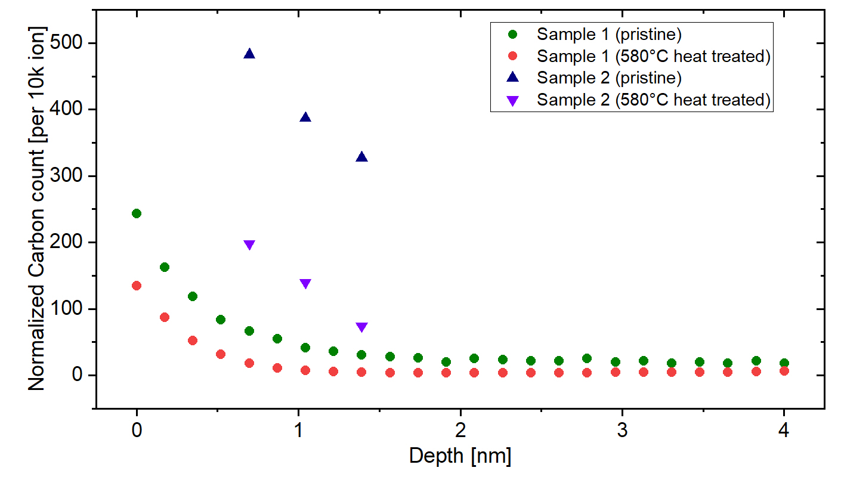
Optimizing pre-cleaning and heat treatment
HCL wet etch
A typical SL-DBR structure
TEM images
Extracted charge vs laser power
Incorporated HCL wet etch & reduced heat treatment temperature of 450°C for DBR cathode.
Test in HVDC gun shows, higher charge could be extracted from the cathode, limiting surface charge effect.
Secondary Ion Mass Spectroscopy (SIMS)
Electron –Ion Collider
Jyoti Biswas

Slide 8
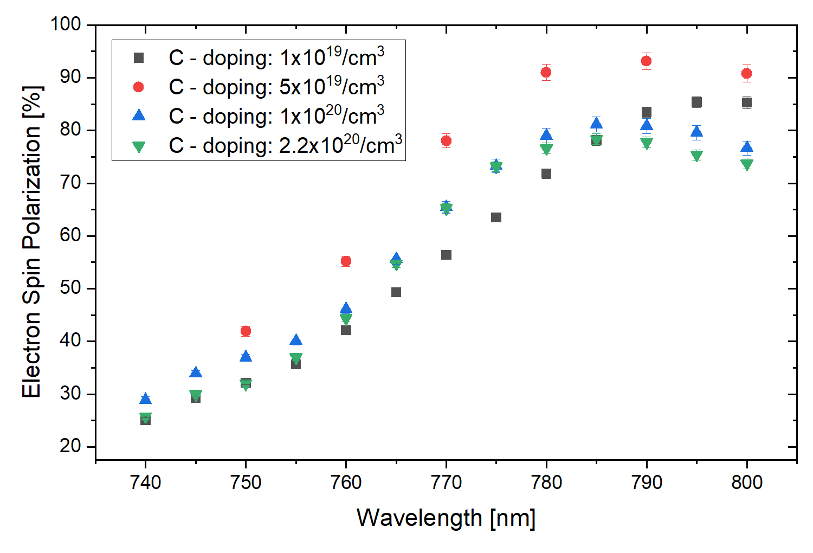
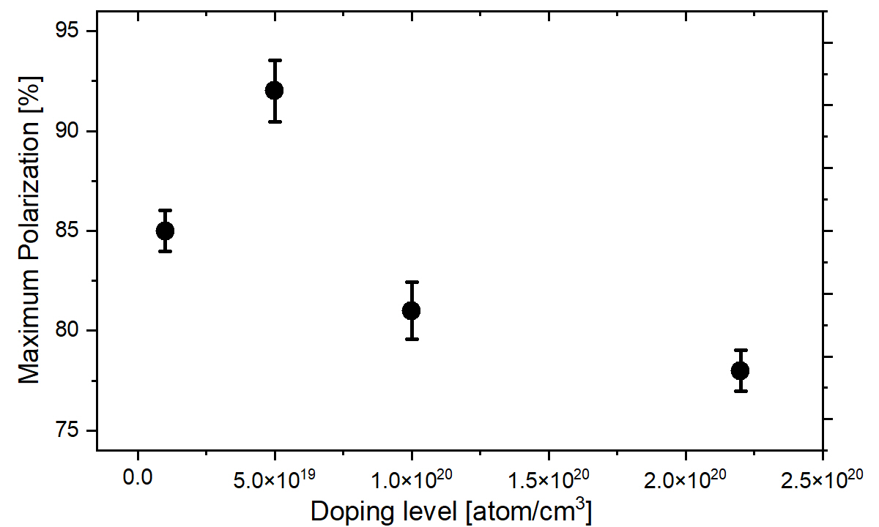
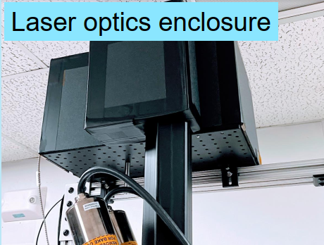
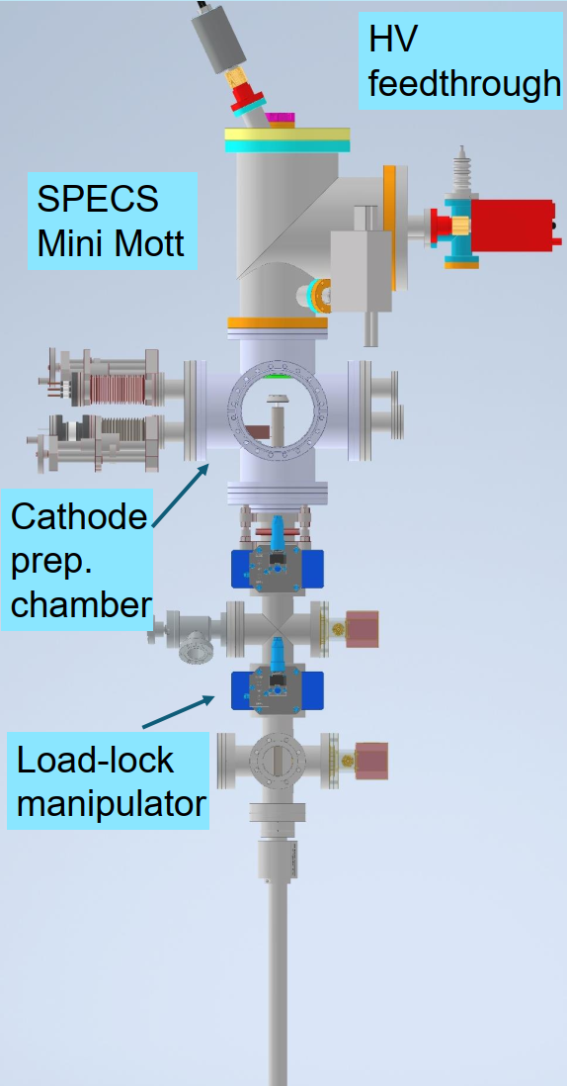
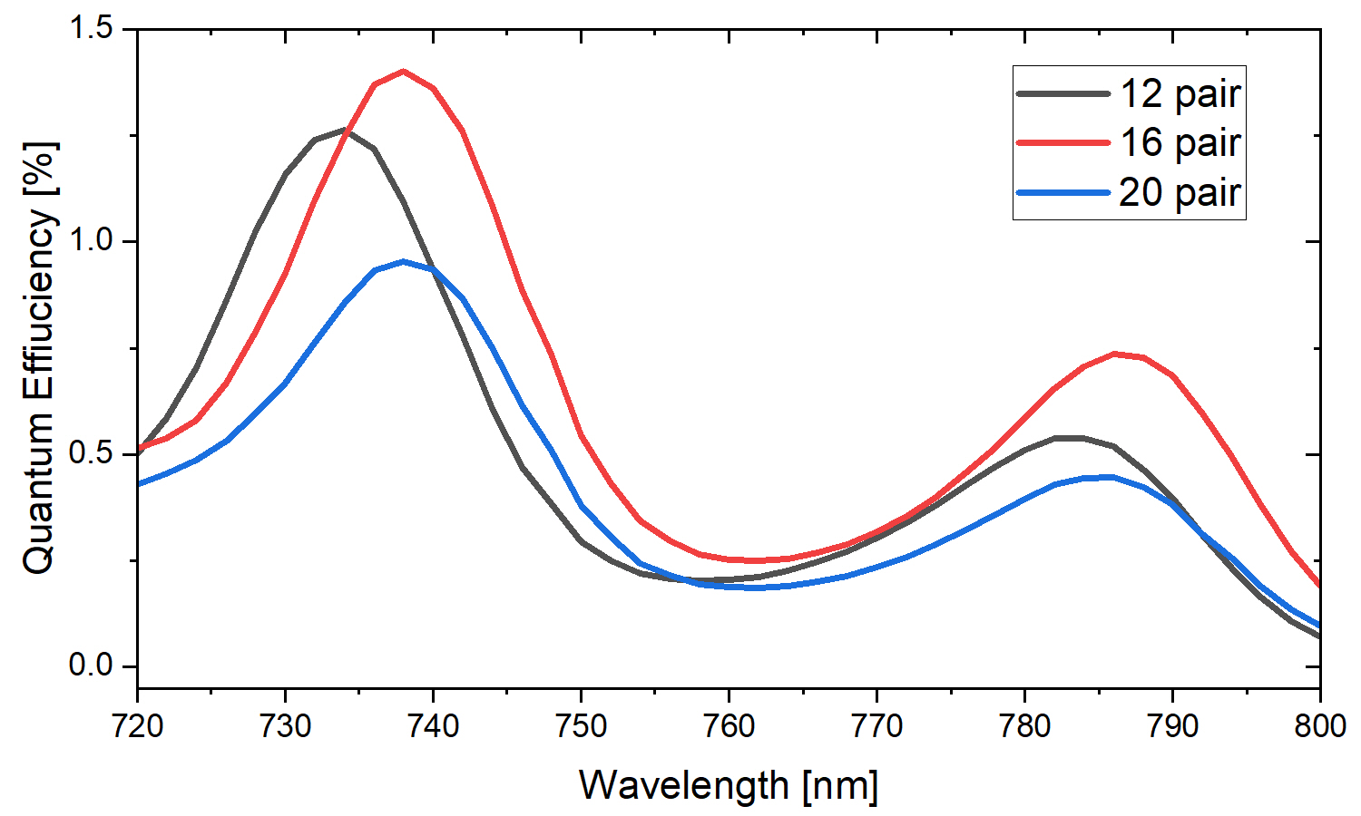
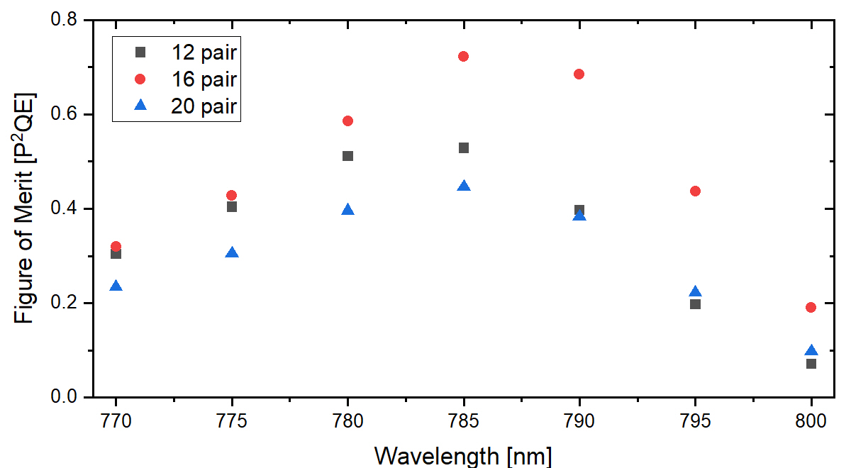
Optimizing doping and DBR pairs
Biswas et el., NAPAC 24, 10.18429/JACoW-IPAC2024-MOPR77
Surface doping of $5×{10}^{19} /{cm}^{3}$ shows higher polarization and 16 pairs of DBR shows higher figure of merit $P^{2}×QE$.
Mott Polarimeter located at EIC, BNL.
Electron –Ion Collider
Jyoti Biswas

Slide 9
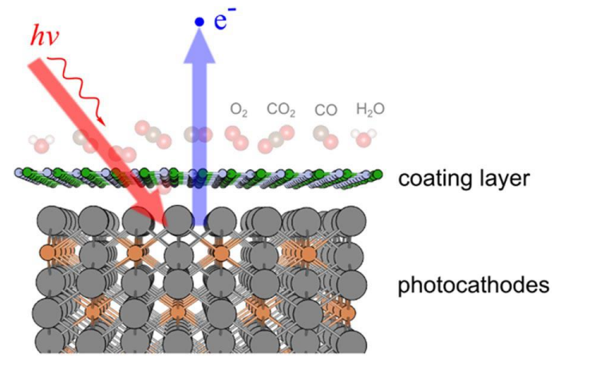
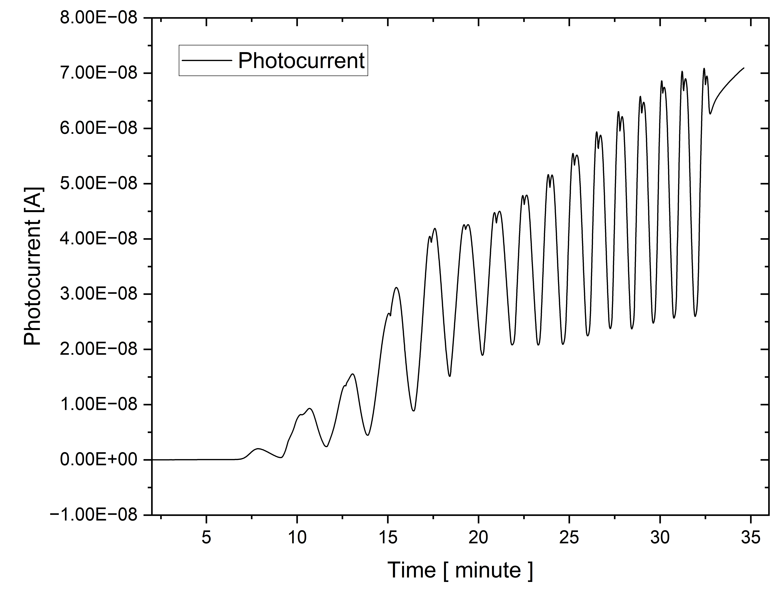
GaAs with 2D protection layer
G.Wang and N.Moody et al.
npj 2D Materials and Applications 17 (2018). doi:10.1038/s41699-018-0062-6
Successful growth of SL-GaAs with CsO activation layer underneath the graphene.
Similar activation of bulk GaAs was performed. We obtained better results on SL-GaAs with a cap layer.
Schematic of the graphene transfer on GaAs
Graphene protection layer makes the GaAs cathode less susceptible to heating.
Can sustain coarse vacuum environment with the protection layer. Meaning vacuum transfer of activated GaAs is a possibility.
Electron –Ion Collider
Jyoti Biswas

Slide 10
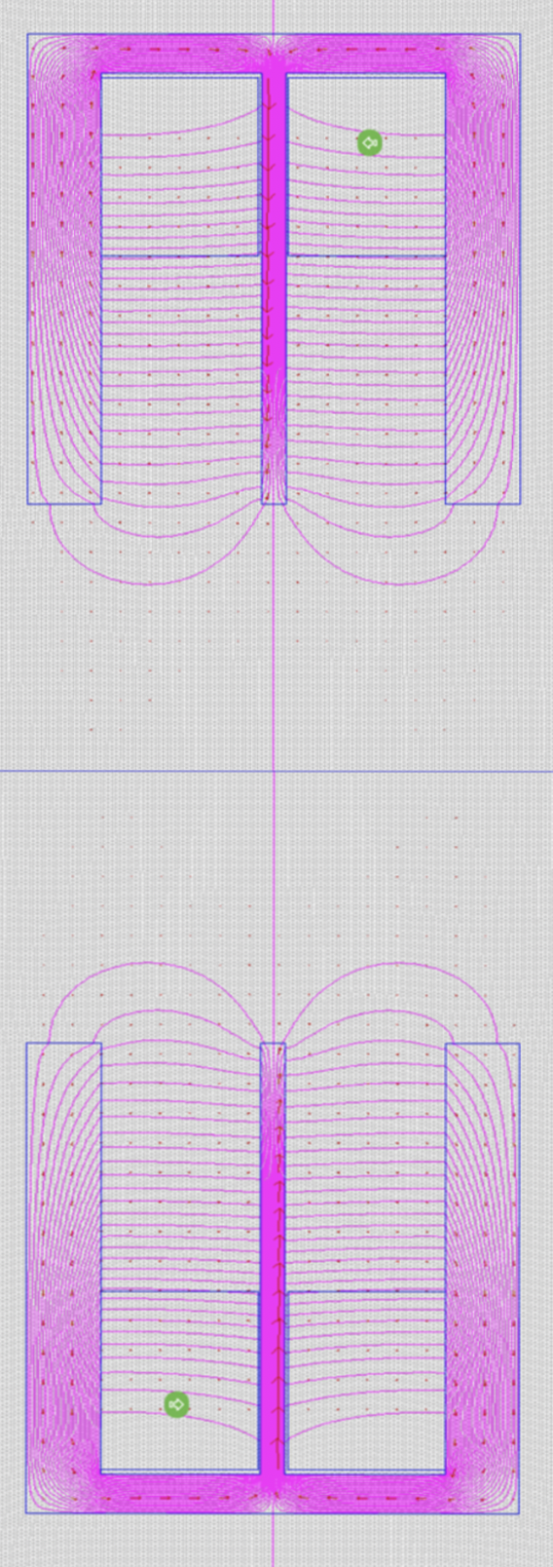
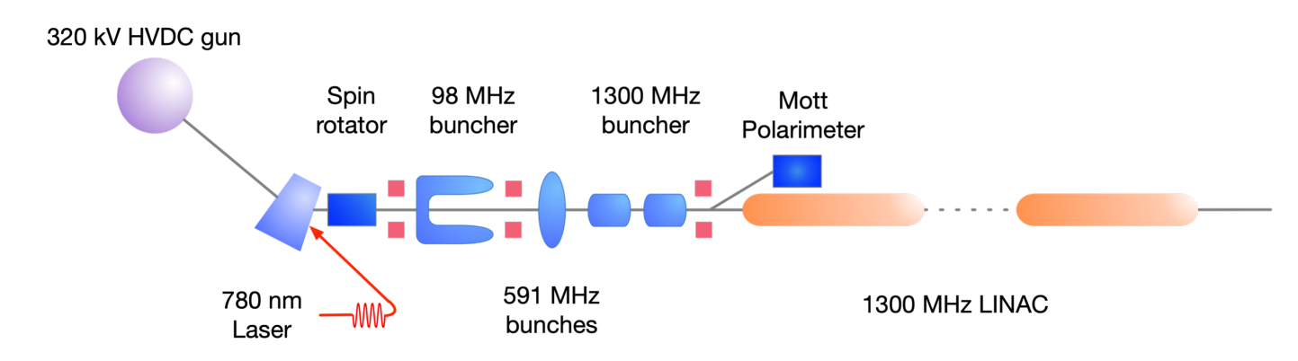
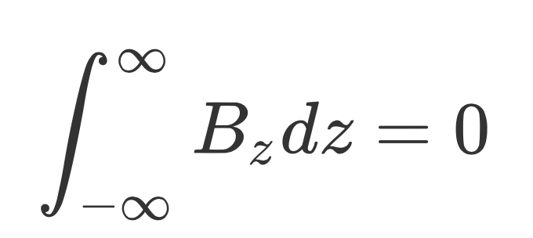
Chapter 2: Electron Spin consideration for EIC
z
solenoid:
EIC 1.3 GHz pre-injector layout including DC gun, spin rotator, and bunching section
Electron spin from the gun is longitudinal
Two spin rotator will be used to rotate the spin vertical
Electron –Ion Collider
Jyoti Biswas

Slide 11
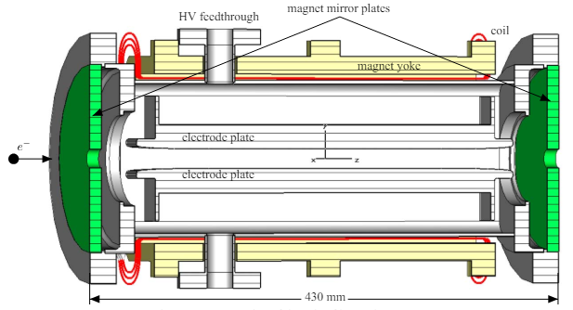
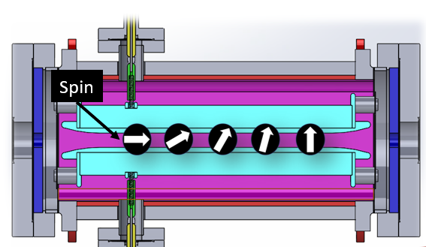
Spin rotator – Wien Filter
Schematic of the Wien filter for S-DALINAC and CEBAF
Name | Energy [keV] | Bunch charge | Plate length [cm] | Gap [cm] | Ey [MV/m] | Bx [mT] | Feedthrough (each) | Ref.
CEBAF | 130 | 2 pC | 32.28 | 1.5 | 1.6 | 9.1 | 12.4 kV | 1
CEBAF | 200 | 2.7 pC | 32.28 | 1.3 | 2.7 | 13 | 17.5 kV | 2
CEBAF | 300 |  | 32.28 | 1.3 | 4.3 | 18.8 | 28.5 kV | 2
S-DALINAC | 100 | 4 pC | 38.10 | 2.0 | 0.756 | 4.6 | 12 kV | 3
MAMI | 100 | 0.02pC | 32 | 2.0 | 1.07 | 6.56 | 12.5 kV | 4
EIC | 320 | 7 nC | 45.92 | 7.0 | 1.44 | 6.080 | 50.5 kV | 5
https://accelconf.web.cern.ch/ipac2021/papers/mopab324.pdf
https://inspirehep.net/files/a7bbe70b5f54adc3b7e7f320651d2dd7
https://accelconf.web.cern.ch/p07/PAPERS/MOPAN013.PDF
https://www.sciencedirect.com/science/article/pii/S0168900206014434
https://www.jacow.org/ipac2024/pdf/MOPC24.pdf
In EIC, its highly space charge dominated beam, prototyping is essential.
Electron –Ion Collider
Jyoti Biswas

Slide 12
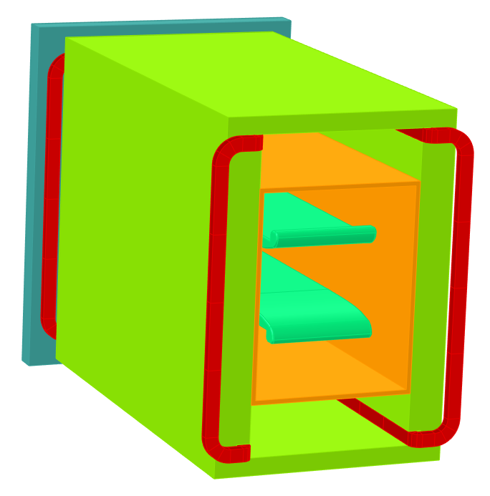
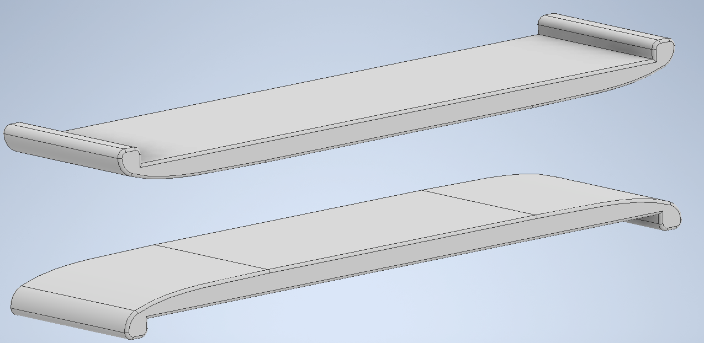
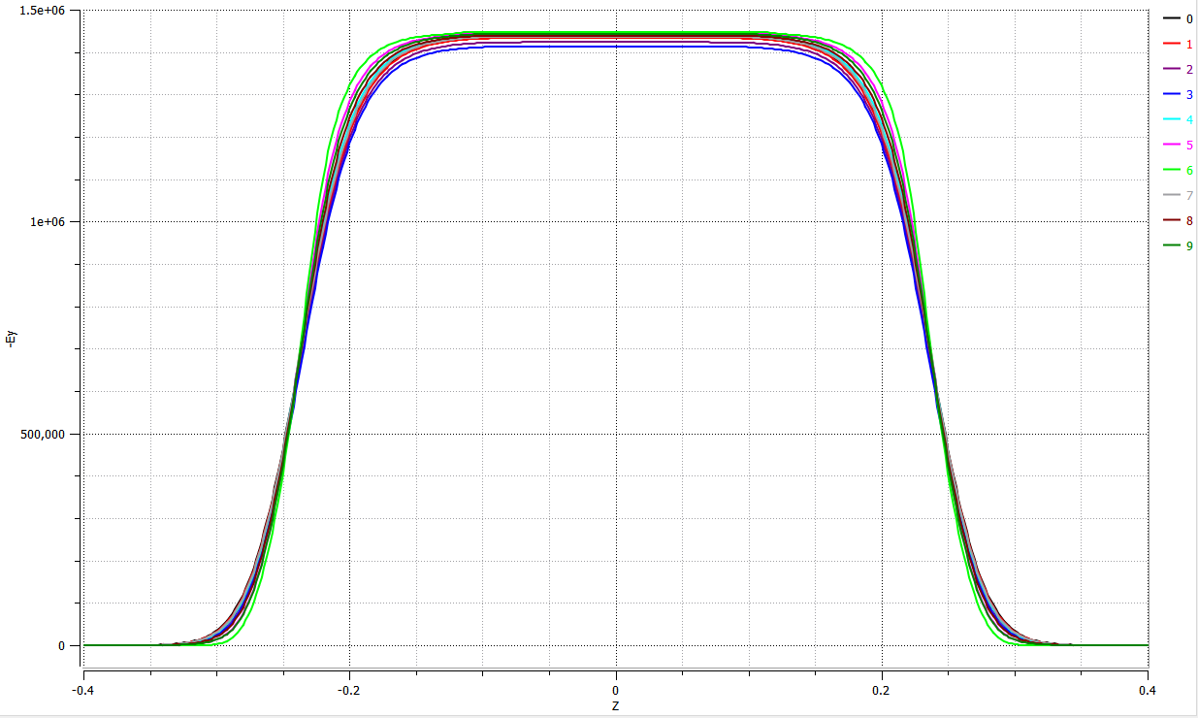
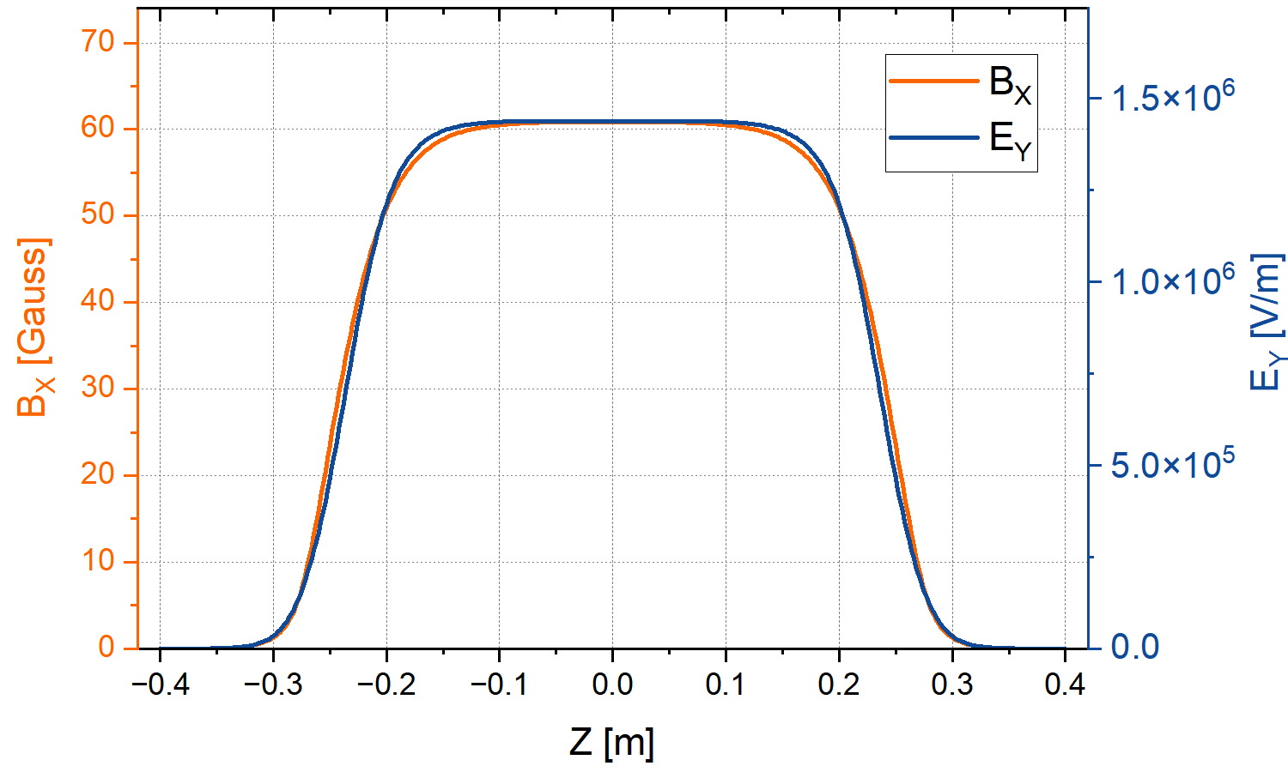
EIC Wien Filter Design
$$electrode$$
Parameter | Value
Bunch charge | 7 -14 nC
Energy | 320 keV
L | 45.92 cm
E_{Y} | 1.44 MV/m
B_{X} | 60.88 G
Electrode gap | 7 cm
Feedthrough | 50.5 kV each
$$iron core$$
14 cm
7 cm
Y
X
$$nickel$$
Z
At the centerline [X =0, Y=0]
Y
$$6$$
$$5$$
$$4$$
$$8$$
$$7$$
$$9$$
$$B=60.88 Gauss$$
X
$$E=1.44 MV/m$$
$$0$$
$$1$$
$$2$$
$$3$$
Z [m]
$E field variations at central location$ (< 1%)
Well matched E and B field achieved
Electron –Ion Collider
Jyoti Biswas

Slide 13
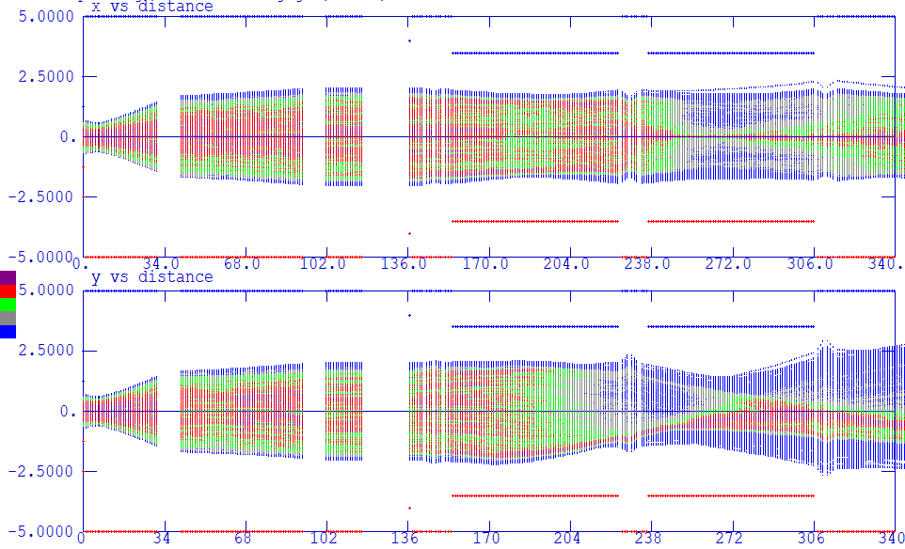
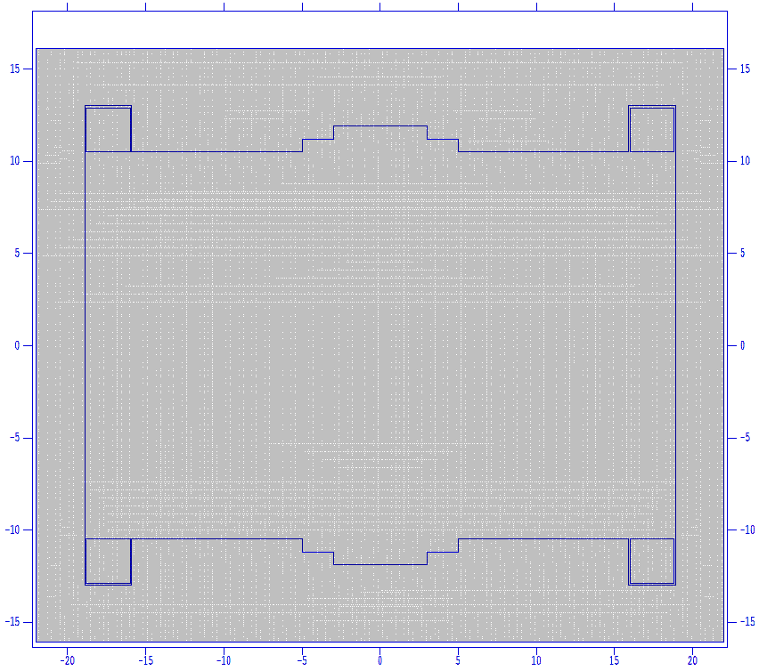
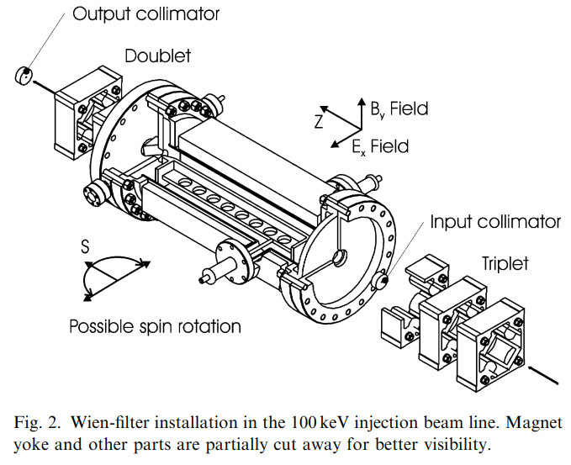
EIC Wien: Beam dynamics (with 7 nC)
X
Y
Cross-section of the magnet and yoke with 3D shaping
7 nC beam with space charge on, with triplet focusing
Transverse shaping is essential to better match both in longitudinal and transverse direction.
7 nC space charge dominated beam can go through both Wien Filter.
Thin quads in triplet configuration are used in beam dynamics. Quad optimization is in progress.
MAMI used triplet and doublet for focusing.
Electron –Ion Collider
Jyoti Biswas

Slide 14
Summary
Optimized pre-cleaning and heat treatment of MOCVD grown DBR GaAs/GaAsP photocathodes.
Wet etching with HCL and lower heat treatment temperature of 450°C shows lowering of surface charge effect in HVDC gun.
Rugged GaAs with 2D protection layer underway.
Initial design of the Wien Filter is showing promising results.
7 nC space charge dominated beam can go through both Wien.
Quadrupole lens in triplet configuration are used for beam focusing.
Quadrupole design optimization is ongoing.

Slide 15
Thanks for your attentions!
Questions
Suggestions
Electron –Ion Collider
Jyoti Biswas

Slide 16
Backup
Electron –Ion Collider
Jyoti Biswas

Slide 17
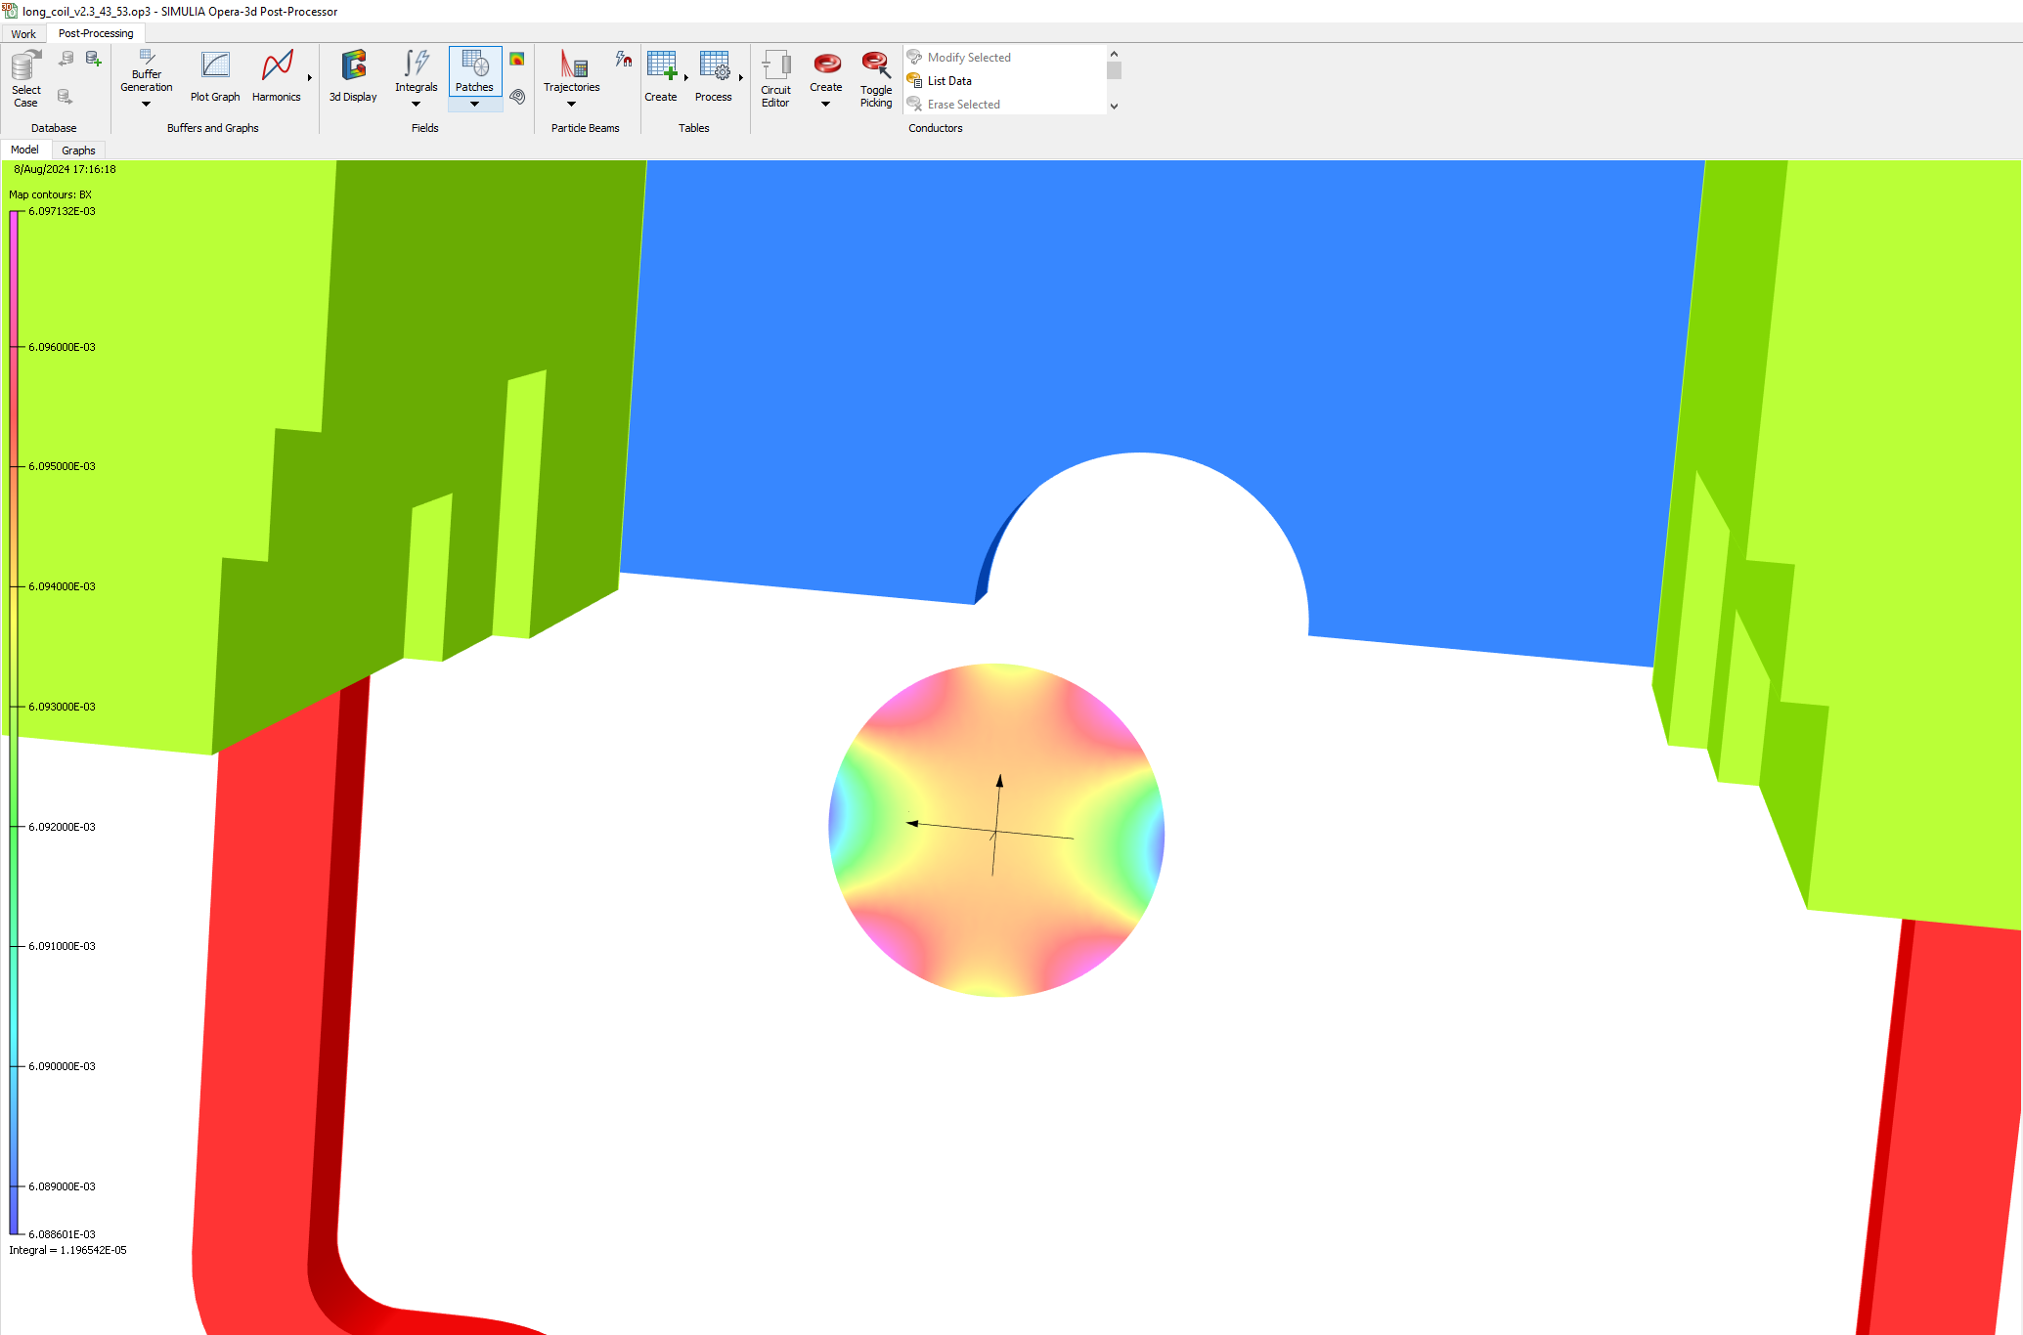
Magnet for the Wien
$$iron core$$
$$Nickel plate$$
Y
$$uniformity of$$
$$radius 2.5 cm$$
X
Z
$$\frac{60.971−60.886}{60.971}×100=0.14\%$$

Slide 18
Beam deflection Comparison: single particle in Parmela
Without 3d shaping
Wien -1
Y [cm]
Wien Version: v1.9
With 3d shaping
Wien -1
Y [cm]
Wien Version: v2.1

