Slide 1
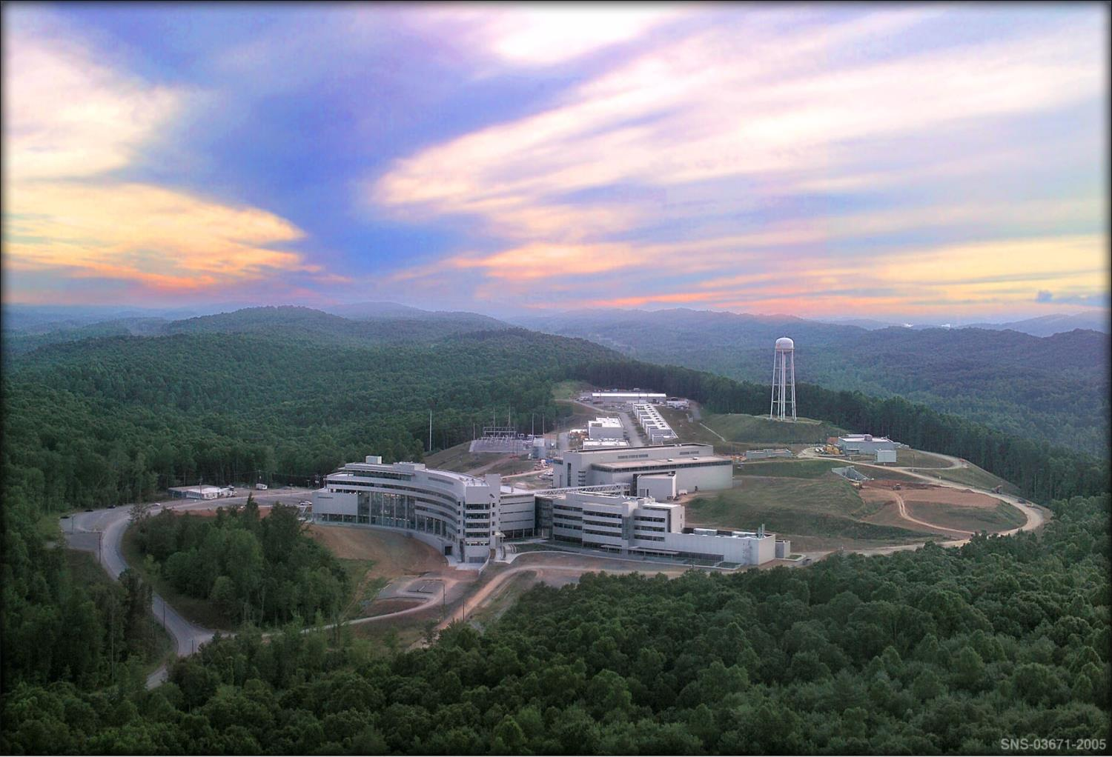


The pNab experiment and the quest for ever better neutron beam polarization
Stefan Baeβler
Inst. Nucl. Part. Phys.

Slide 2
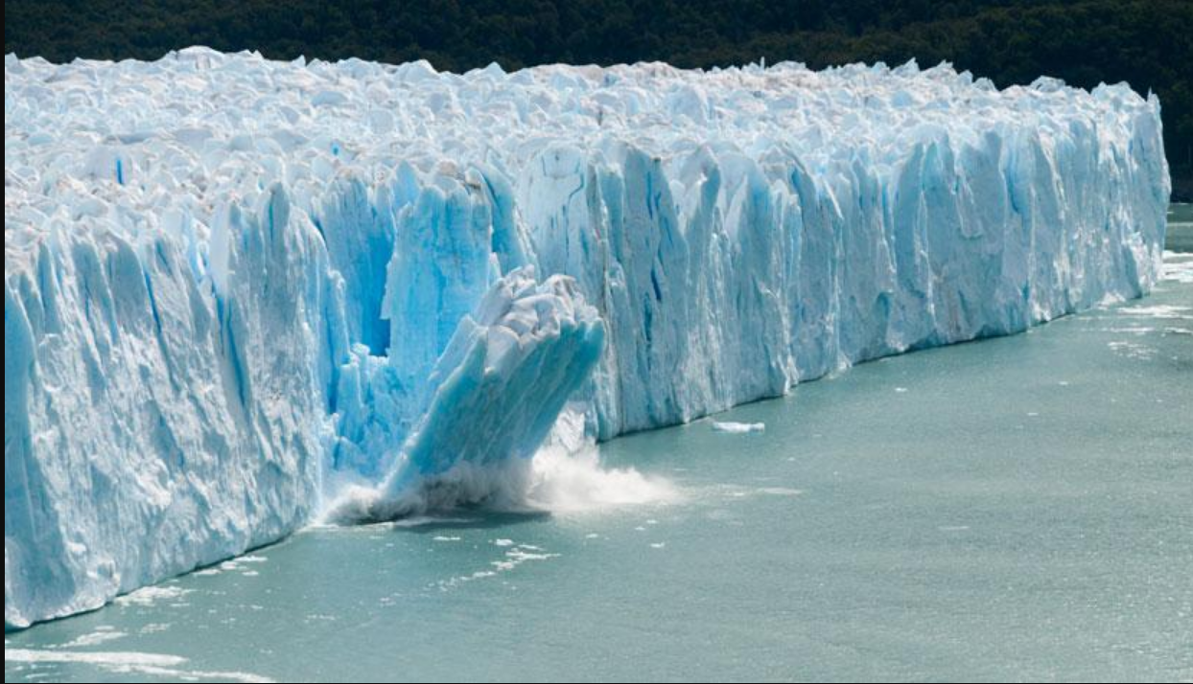
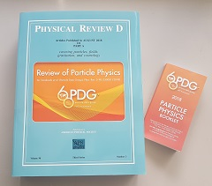
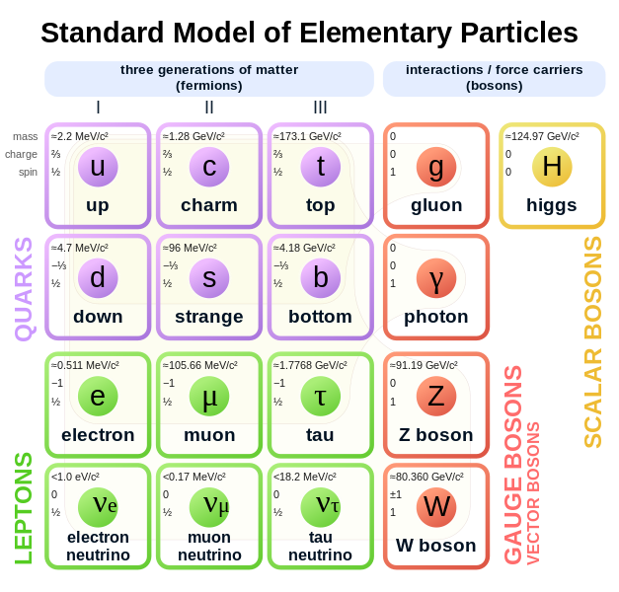

Standard Model of Elementary Particle Physics (SM)
Mountains of Knowledge in Particle Physics…
Example for SM successes: g-factor of electron:
Theory:
$g_{e}=2⋅\left[1+0.001 159 652 181 61 \left(23\right)\right]$
Experiment:
$$g_{e}=2⋅\left[1+\text{0}\text{.}\text{001 159 652 181 28 (18)}\right]$$
Challenge for theorists: How to not destroy the successes of the Standard Model with new Physics

Slide 3


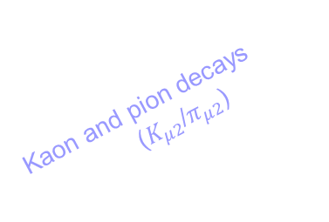


Is the Standard Model finally broken?
Neutron beta decay (selected)
0.226
Kaon decays ($K_{e3}$)
0.224
$$V_{us}$$
Kaon and pion decays
($K_{μ2}$/$π_{μ2}$)
0.222
Unitarity
Superallowed nuclear decays
0.220
0.960
0.965
0.970
0.975
$$V_{ud}$$

Slide 4

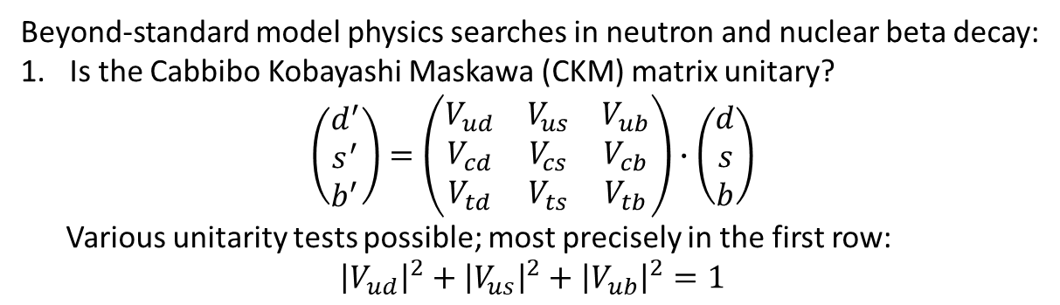




Motivation to study neutron beta decay
Beyond-standard model physics searches in neutron and nuclear beta decay:
Is the Cabbibo Kobayashi Maskawa (CKM) matrix unitary?
$$\left(\begin{matrix}d^{′} \\ s^{′} \\ b^{′}\end{matrix}\right)=\left(\begin{matrix}V_{ud} & V_{us} & V_{ub} \\ V_{cd} & V_{cs} & V_{cb} \\ V_{td} & V_{ts} & V_{tb}\end{matrix}\right)∙\left(\begin{matrix}d \\ s \\ b\end{matrix}\right)$$
Various unitarity tests possible; most precisely in the first row:
${\left|V_{ud}\right|}^{2}+{\left|V_{us}\right|}^{2}+{\left|V_{ub}\right|}^{2}=1$
d
u
s
c
b
t
CKM Unitarity:
$${\left|V_{ud}\right|}^{2}+{\left|V_{us}\right|}^{2}=1$$
Neutron beta decay (selected)
V_{us}
0.226
Kaon decays ($K_{e3}$)
$$K_{μ2}/π_{μ2}$$
0.224
$$K_{e3}$$
$$V_{us}$$
Kaon and pion decays
($K_{μ2}$/$π_{μ2}$)
V_{ud}
0.222
Unitarity
Superallowed nuclear decays
0.220
0.960
0.965
0.970
0.975
Beta decay
$$V_{ud}$$
From: 2023 Nuclear Physics Long Range Plan for Nuclear Science

Slide 5
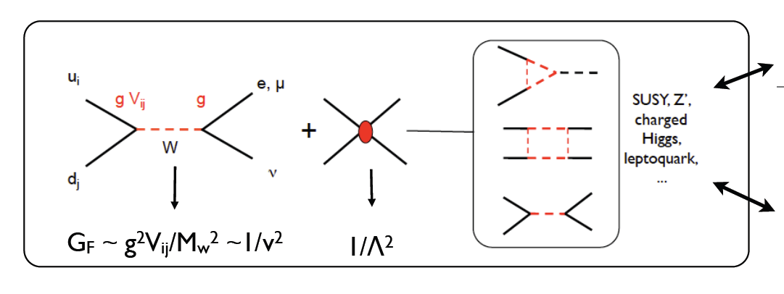
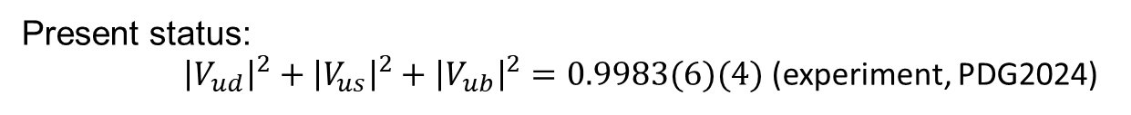
Motivation to study neutron beta decay, cont.
Present status:
${\left|V_{ud}\right|}^{2}+{\left|V_{us}\right|}^{2}+{\left|V_{ub}\right|}^{2}=0.9983(6)(4)$ (experiment, PDG2024)
Specific models: E.g.
W. Marciano, A. Sirlin, PRD 35, 1672 (1987).
R. Barbieri et al., PLB 156, 348 (1985)
K. Hagiwara et al., PRL 75, 3605 (1995)
A. Kurylov, M. Ramsey-Musolf, PRL 88, 071804 (2000)
Energy scale of new physics: $Λ≥11$ TeV V. Cirigliano et al., NPB 830, 95 (2010)

Slide 6





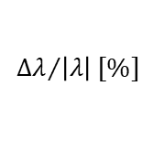





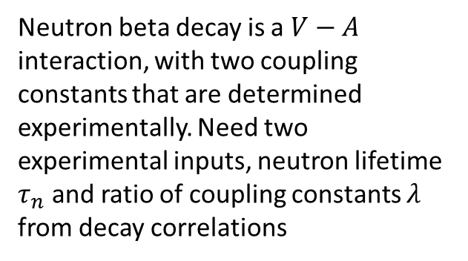
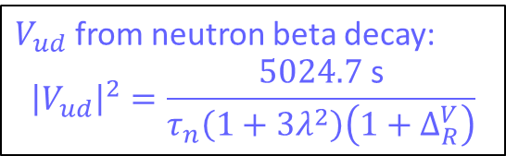




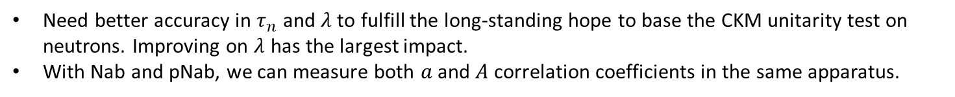



Primary motivation for Nab and pNab: $λ$ for CKM Unitarity test
Neutron beta decay is a $V−A$ interaction, with two coupling constants that are determined experimentally. Need two experimental inputs, neutron lifetime $τ_{n}$ and ratio of coupling constants $λ$ from decay correlations
$$0.6$$
${ΔV}_{ud}$ from SAF
$$2{ΔV}_{ud}$$
PDG2024
$$0.5$$
$$0.4$$
PDG2024
PERC (goal)
Nab (goal)
UCNTAU only
$$Δτ_{n} [s]$$
$$0.3$$
BL3 (goal)
pNab (goal)
UCNTAU, updated (Aug 24)
$V_{ud}$ from neutron beta decay:
$${\left|V_{ud}\right|}^{2}=\frac{5024.7 \text{s}}{τ_{n}\left(1+3λ^{2}\right)\left(1+Δ_{R}^{V}\right)}$$
$$0.2$$
UCNTAU+ (goal)
PERKEO III only
$$0.1$$
$${ΔV}_{ud}/2$$
$$0.0$$
$$0.00$$
$$0.02$$
$$0.04$$
$$0.06$$
$$0.08$$
$$0.10$$
$${Δλ}/{\left|λ\right|}[\%]$$
Need better accuracy in $τ_{n}$ and $λ$ to fulfill the long-standing hope to base the CKM unitarity test on neutrons. Improving on $λ$ has the largest impact.
With Nab and pNab, we can measure both $a$ and $A$ correlation coefficients in the same apparatus.

Slide 7
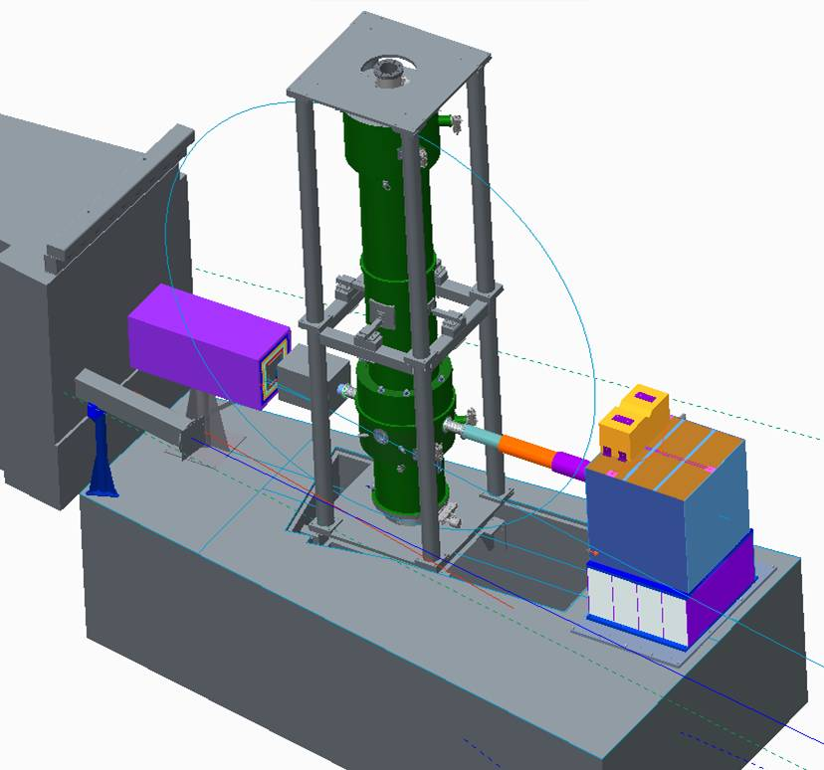
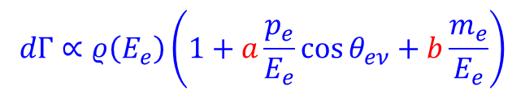

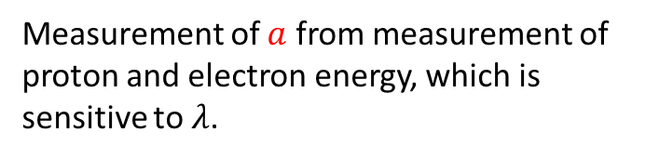

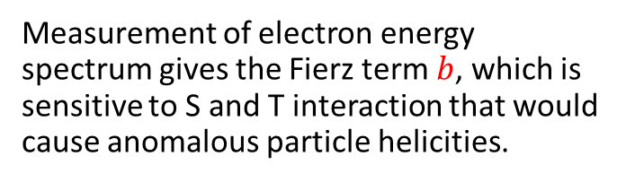
The Nab experiment
n
e⁻
Nab @ Fundamental Neutron Physics Beamline (FNPB) @ Spallation Neutron Source (SNS)
p
$$θ_{eν}$$
$$\overline{ν_{e}}$$
Multipixel Si detectors for decay electrons and protons
$$dΓ∝ρ\left(E_{e}\right)\left(1+a\frac{p_{e}}{E_{e}}\cos{θ_{eν}}+b\frac{m_{e}}{E_{e}}\right)$$
8 meters
Measurement of electron energy spectrum gives the Fierz term $b$, which is sensitive to S and T interaction that would cause anomalous particle helicities.
Measurement of $a$ from measurement of proton and electron energy, which is sensitive to $λ$.
Cold Neutron Beam from left
General Idea: J.D. Bowman, Journ. Res. NIST 110, 40 (2005)
Original configuration: D. Počanić et al., NIM A 611, 211 (2009)
Asymmetric configuration: S. Baeßler et al., J. Phys. G 41, 114003 (2014)
Simulated Performance: J. Fry et al., EPJ WOC 219, 04002 (2019)

Slide 8
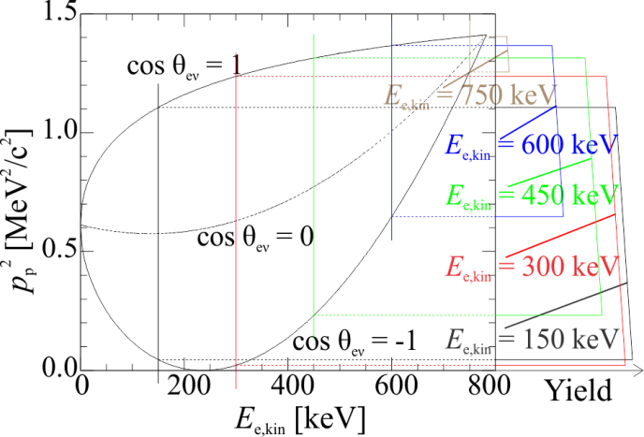



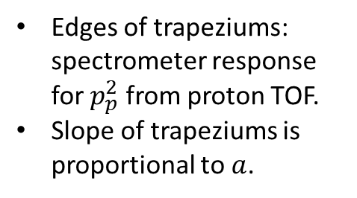


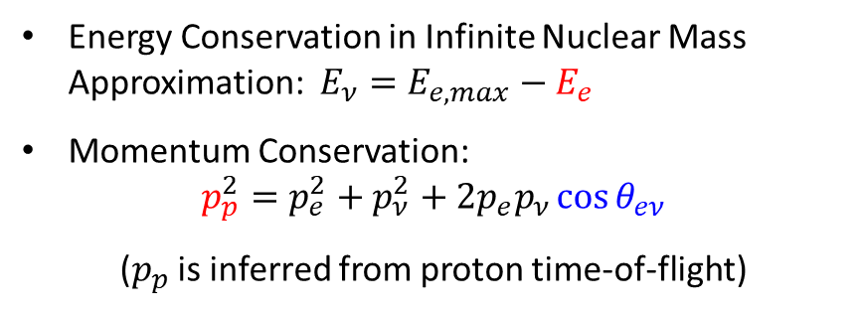

Idea of the cos θ_{eν} spectrometer Nab @ SNS
n
e⁻
Energy Conservation in Infinite Nuclear Mass Approximation: $E_{ν}=E_{e,max}−E_{e}$
Momentum Conservation:
$$p_{p}^{2}=p_{e}^{2}+p_{ν}^{2}+2p_{e}p_{ν}\cos{θ_{eν}}$$
($p_{p}$ is inferred from proton time-of-flight)
p
$$θ_{eν}$$
$$\overline{ν_{e}}$$
$$dΓ∝ρ\left(E_{e}\right)\left(1+a\frac{p_{e}}{E_{e}}\cos{θ_{eν}}+b\frac{m_{e}}{E_{e}}\right)$$
$${\vec{p}}_{e}$$
$$θ_{eν}$$
$${\vec{p}}_{ν}$$
$${\vec{p}}_{p}$$
Edges of trapeziums: spectrometer response for $p_{p}^{2}$ from proton TOF.
Slope of trapeziums is proportional to $a$.

Slide 9
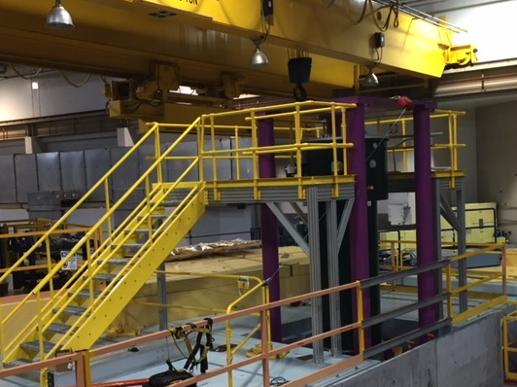
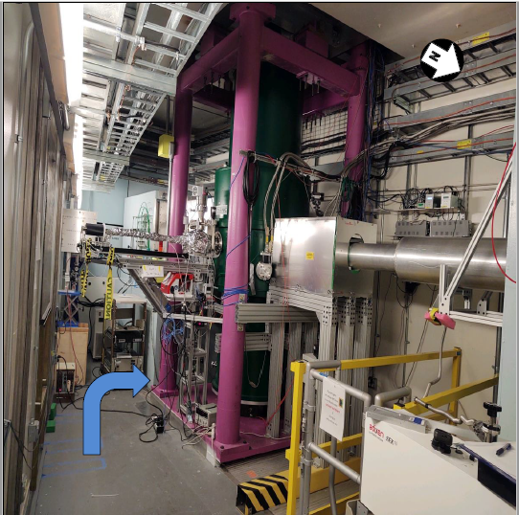
Nab setup at Spallation Neutron Source (SNS)
Si detectors
FNPB beamline @ SNS
8 m
Cold neutron beam
Spectrometer magnet

Slide 10
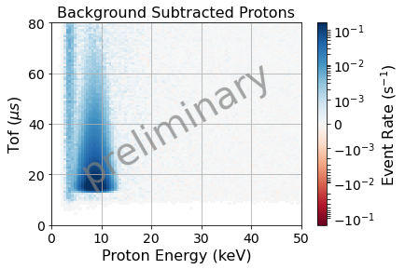
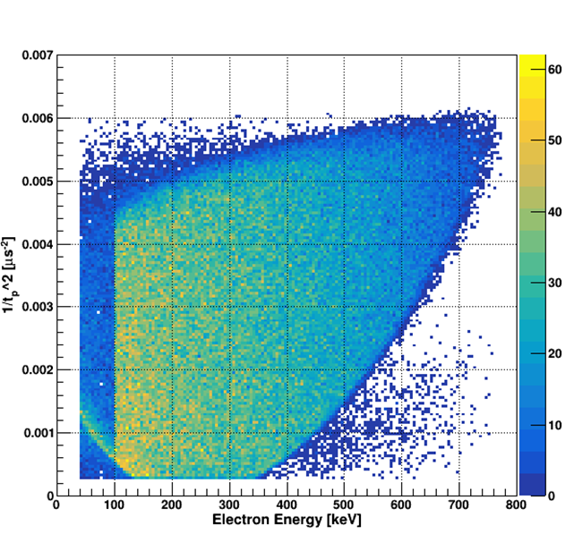
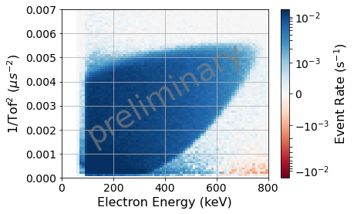
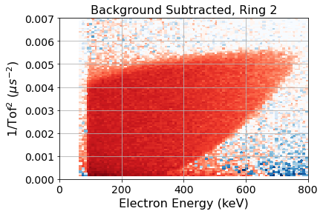




Nab Commissioning data from summer 2023
Commissioning data taken in July 2023, currently transitioning to physics data taking.
Proof-of-principle has been achieved:
  Right: Arrival time and energy for proton candidate signal after electron candidate signal.
Protons
  Bottom: Event topology from commissioning data
Simulation
$$60$$
$$40$$
preliminary
Events
$$20$$
$$0$$
Analysis: Frank Gonzales, ORNL

Slide 11
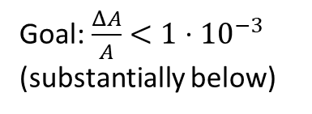




pNab: Measurement of correlation coefficients with polarized neutrons
$b$ or $b_{ν}$ may indicate S,T
$B_{0}≠B_{0}(λ)$ may indicate V+A
$$dΓ∝ρ\left(E_{e}\right)\left(1+a\frac{p_{e}}{E_{e}}\cos{({\vec{p}}_{ν},{\vec{p}}_{e})}+b\frac{m_{e}}{E_{e}}+A\frac{p_{e}}{E_{e}}\cos{({\vec{σ}}_{n},{\vec{p}}_{e})}+\left(B_{0}+b_{ν}\frac{m_{e}}{E_{e}}\right)\cos{({\vec{σ}}_{n},{\vec{p}}_{ν})}\right)$$
$$a=a\left(λ\right)$$
$$A=A\left(λ\right)$$
New addition:
Neutron beam polarizer
Goal: $\frac{ΔA}{A}<1⋅{10}^{−3}$ (substantially below)

Slide 12
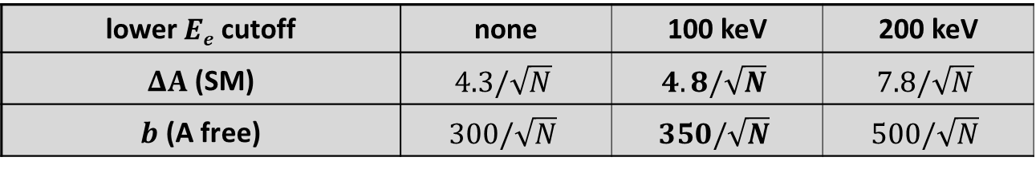
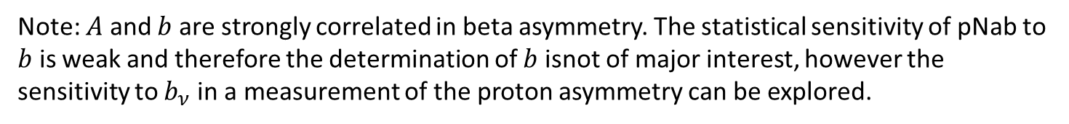
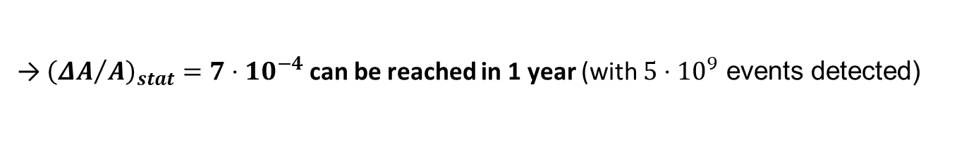


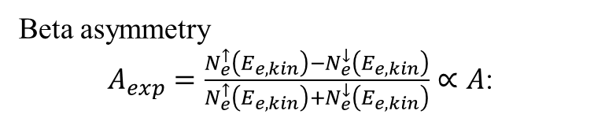
Statistical uncertainty for A and b from beta asymmetry
Beta asymmetry
$A_{exp}=\frac{N_{e}^{↑}\left(E_{e,kin}\right)−N_{e}^{↓}\left(E_{e,kin}\right)}{N_{e}^{↑}\left(E_{e,kin}\right)+N_{e}^{↓}\left(E_{e,kin}\right)}∝A$:
]
Beta asymmetry $A_{exp}$
$$b=−0.1$$
SM
0
2
0
0
4
0
0
6
0
0
8
0
0
E
(
k
e
V
e
)
,
k
i
Statistical uncertainty budget:
n
lower $Ee$ cutoff | none | 100 keV | 200 keV
$ΔA$ (SM) | $$4.3/\sqrt{N}$$ | $$4.8/\sqrt{N}$$ | $$7.8/\sqrt{N}$$
$b$ (A free) | $$300/\sqrt{N}$$ | $$350/\sqrt{N}$$ | $$500/\sqrt{N}$$
→ ${\left({ΔA}/A\right)}_{stat}=7⋅{10}^{−4}$ can be reached in 1 year (with $5⋅{10}^{9}$ events detected)
Note: $A$ and $b$ are strongly correlated in beta asymmetry. The statistical sensitivity of pNab to $b$ is weak and therefore the determination of $b$ isnot of major interest, however the sensitivity to $b_{ν}$ in a measurement of the proton asymmetry can be explored.

Slide 13
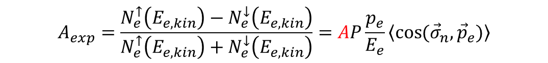
Systematic uncertainty for A from beta asymmetry
4
1
2
3
$$A_{exp}=\frac{N_{e}^{↑}\left(E_{e,kin}\right)−N_{e}^{↓}\left(E_{e,kin}\right)}{N_{e}^{↑}\left(E_{e,kin}\right)+N_{e}^{↓}\left(E_{e,kin}\right)}=AP\frac{p_{e}}{E_{e}}\left\langle \cos{({\vec{σ}}_{n},{\vec{p}}_{e})}\right\rangle$$
The main sources of systematic uncertainties of ours and other past experiments are:
Understanding of neutron beam polarization (see later slides)
Understanding of electron detector response (see next slide)
Understanding of solid angle coverage of each detector: Small uncertainty in magnetic spectrometer. S.B. et al, J. Phys. G 41, 114003 (2014)
Understanding of Backgrounds: Unlike competition, we have coincidence with protons. Assuming we detect all protons, this is expected to be negligible.

Slide 14
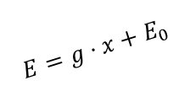
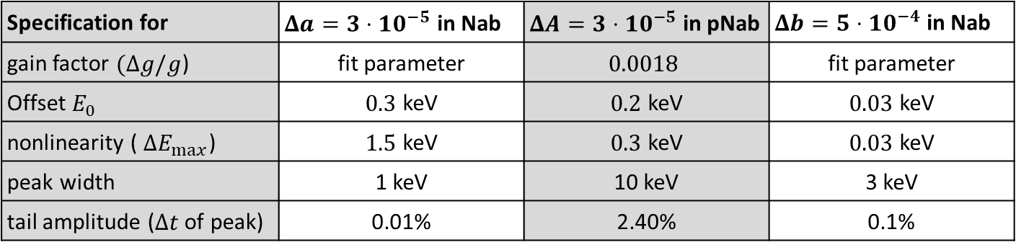






Detector systematics
Electron energy calibration
Detector response in Si detector for incoming electron with E_{e} = 300 keV
5
²⁰⁷Bi
10
detected E_{e} for e⁻ in lower detector
$$E=g⋅x+E_{0}$$
4
detected E_{e} with only lower detector
10
width
Reconstructed energy $E$
¹⁰⁹Cd
²⁰⁷Bi
3
¹¹³Sn
10
¹³⁹Ce
Yield
(mostly)backscattering
2
Pulse height $x$
10
1
Tail amplitude $t$
$$ΔE_{max}$$
10
$$0$$
Residual
(mostly) bremsstrahlung
$$ΔE_{max}$$
1
0
50
100
150
200
250
300
Pulse height
detected E_{e} [keV]
Specification for | $Δa=3⋅10^{−5}$ in Nab | $ΔA=3⋅10^{−5}$ in pNab | $Δb=5⋅10^{−4}$ in Nab
gain factor $(Δg/g$) | fit parameter | $$0.0018$$ | fit parameter
Offset $E_{0}$ | $0.3$ keV | $0.2$ keV | $0.03$ keV
nonlinearity ( $ΔE_{max}$) | $1.5$ keV | $0.3$ keV | $0.03$ keV
peak width | 1 keV | 10 keV | 3 keV
tail amplitude ($Δt$ of peak) | 0.01% | 2.40% | 0.1%
H.Li, Ph.D. thesis (2021)

Slide 15
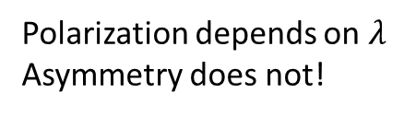
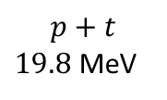







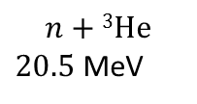
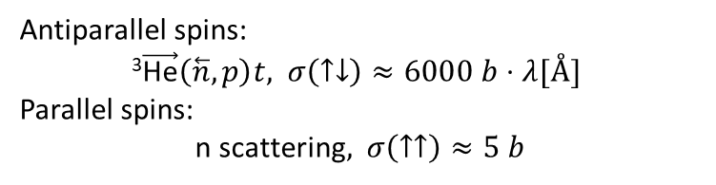
Neutron beam polarization, original idea
The original proposal for pNab was to use a He3 polarizer, due to the feature to obtain an in-situ measurement of the polarization. No correction for Stern-Gerlach effects, no depolarization error, no time dependence.
This is at the cost of some stat., and at the cost of having to nurture the polarized He cell continuously.
$$n+\text{3}\text{He}$$
$20.5$ MeV
$\text{4}\text{He}\text{∗}$ ($J=0$)
$20.1$ MeV
$Γ=270$ keV
$$p+t$$
$19.8$ MeV
Neutron TOF $∝λ$
$\text{4}\text{He}$ ($J=0$)
Antiparallel spins:
$\text{3}\vec{\text{H}\text{e}}\left(\overset{⃖}{n}, p\right)t,$ $σ\left(↑↓\right)≈6000 b⋅λ[Å]$
Parallel spins:
n scattering$,$ $σ\left(↑↑\right)≈5 b$
Polarization depends on $λ$
Asymmetry does not!
3He cell
Unpolarized neutron
beam
Polarized neutron
beam
$$⇑⇓$$
$$⇑$$
$$⇑$$
Neutron TOF $∝λ$
$$P_{n}=\tanh\left(0.0733⋅p\left[atm\right]⋅l\left[cm\right]⋅λ\left[Å\right]⋅P_{He}\right)$$
See S. Penttila, D. Bowman, J Res. NIST 110, 309 (2005)
But: Not favored currently, unproven and technologically difficult.

Slide 16
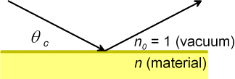
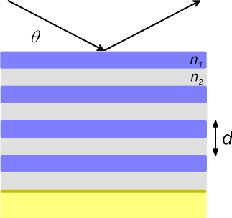
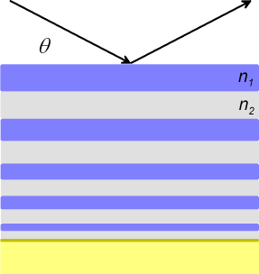
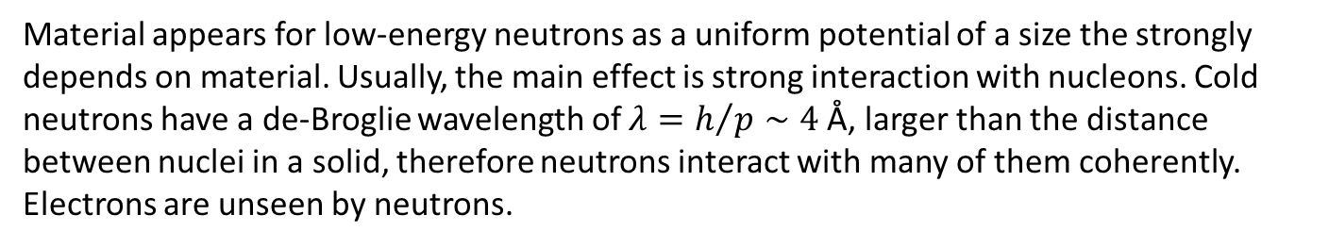
How to reflect a cold (low energy) neutron beam?
Material appears for low-energy neutrons as a uniform potential of a size the strongly depends on material. Usually, the main effect is strong interaction with nucleons. Cold neutrons have a de-Broglie wavelength of $λ=h/p∼4$ Å, larger than the distance between nuclei in a solid, therefore neutrons interact with many of them coherently. Electrons are unseen by neutrons.
@ smooth surfaces
@ multilayer
@ supermirror
refractive index n < 1 (for most materials)
total external reflection
e.g. Ni θ_{c} = 0.1°/Å

Slide 17
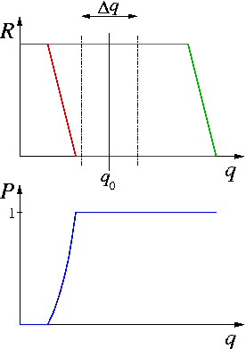

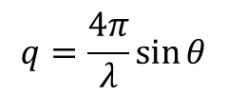


How to polarize a neutron beam?
Example: Fe/Si supermirror on silicon substrate, neutrons move in bulk Si
Idea: Coherent effect of magnetic interaction with electrons in a ferromagnet can be as large as strong interactions with nucleon. If so, refractive index is spin-dependent and cancellation of nuclear and magnetic scattering is possible.
$$1−n [A.U.]$$
Nb
N(+p)
$$1−n [A.U.]$$
Nb
$$1−n [A.U.]$$
N(-p)
Nb
$$q=\frac{4π}{λ}\sin{θ}$$
We can use reflected or transmitted beam. Both are polarized (in opposite directions).
Notes:
Another couple that works : Fe/Si (Fe magnetic)
same effect on contrast // - anti// but if it would be air : total R
assume subtsrate also Si :
not a dream to use Si : Absoption in Si : for 3A neutrons, absoption length is still 70cm

Slide 18
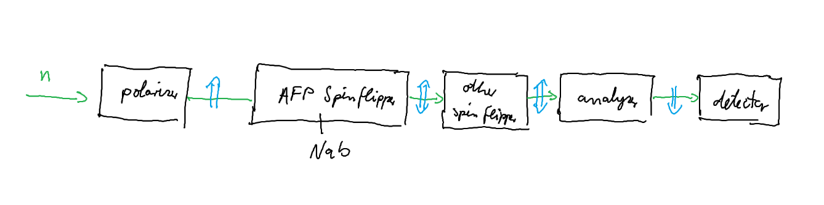
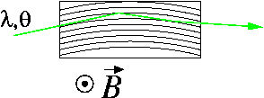
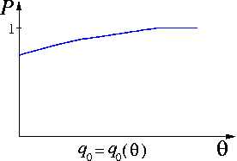

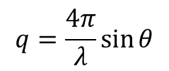
Issues for precision polarimetry
Spin flipper will be discussed by Rebecca Godri (UTK) in a following talk.
Supermirror angle to beam optimized
Few percent
5 percent
Product of polarizer and analyzer efficiency
→Angular
dependence
→Wavelength
dependence
$$q=\frac{4π}{λ}\sin{θ}$$
$λ$ [Å]
Problem: Want $ΔP_{n}=5⋅{10}^{−4}$, this is too hard if non-uniformities are at the percent level

Slide 19




Solution: Solid state polarizer, He3 analyzer
Idea: Very high polarization efficiency doesn’t allow for much non-uniformity
Magnet
Solid State Polarizer
Collimation system
FNPB guide
$$φ_{2}$$
neutron path
...
...
$$−φ_{1}$$
Decay volume
New solid state SM polarizer consist of two stacks of parallel sapphire plates (under a small angle, to avoid direct view).
Developed at Institute Laue-Langevin, Grenoble
A.K. Petoukhov et al., Rev. Sci. Instrum. 94, 023304 (2023)
Reoptimized for Fundamental Physics Beamline at Spallation Neutron Source (J. Pioquinto, UVa):
Transmission: 40% (of all neutrons) just behind polarizer, degrades to 20% (of all neutrons at this place) at the experiment, in straight line
Polarization: $P_{n}=99.5\%$
neutrons

Slide 20

Solution: Solid state polarizer, He3 analyzer
FNPB Beamline polarization setup at SNS:
Nab
Spectrometer magnet
Analyzingneutron monitor
Normalization neutron monitor
Neutrons
from FNPB guide
Spin flipper
Solid state SM polarizer
He3 cell
(analyzer)
Polarization is analyzed with He-3 spin filter. Transmission of neutrons through a cell with polarized gas is dependent on neutron wavelength, but for a cylindrical He-3 cell only weakly on position or angle.
We can determine beam polarization from three measurements (as a function of neutron wavelength $λ)$: He polarization up, He polarization down, He unpolarized:
$$T_{up/down}=\left(1±P_{n}\tanh\left(κP_{He}\right)\right)e^{−κ}\cosh\left(κP_{He}\right)$$
with κ = 0.0733∙p[Atm]∙λ[Å]∙l[cm]
$$T_{0}=e^{−κ}$$
Goal: $ΔP_{n}=5⋅{10}^{−4}$. The systematic uncertainty is smaller for $κP_{He}≫1$.

Slide 21

pNab proposal
The pNab proposal was submitted on July 1, 2024. Proposal Review and Advisory Committee will meet this year. Goal of pNab collaboration is to start after Nab has finished data taking.

Slide 22

Summary
Currently, unitarity of the CKM matrix is violated by about $2−3σ$. This test is based on $V_{ud}$ from superallowed nuclear decays and Kaon decays. Selected neutrons decay experiments contribute. All inputs are under scrutiny. $2−3σ$ is not usually considered a big deal, but should be understood.
Neutron beta decay could replace nuclear beta decay if experiments gain accuracy. There is steady, albeit slow progress. The experiments Nab and pNab at its goal uncertainty makes a substantial impact to the unitarity test (tackling the weakest neutron beta decay input).
Nab is transitioning to data taking
Proposal for pNab has been submitted. Most important systematic uncertainty is the measurement of the neutron beam polarization. The concept of neutron beam polarizer and analyzer is based on spin physics that is well-understood. However, the systematic uncertainties in the polarization measurement are complicated.

Slide 24





Neutron beta decay lifetime
Beam: Decay rate: $\frac{dN}{dt}=\frac{N}{τ_{n}}$
NIST-BL1/2
Bottle: Neutron counts : $N= N_{0}e^{−\frac{t}{τeff}}$
with $\frac{1}{τeff}=\frac{1}{τ_{n}}+\frac{1}{τ_{wall }}+\frac{1}{τ_{gas}}$
UCNTAU
Courtesy A. Young
Discrepancy between beam and bottle may be real (decay into dark particle, not otherwise detected, or an experiment error. Previous analysis uses only last data point. Many new experiments:
Magnetic bottles (UCNTAU+, LANL, τSPECT, TRIGA Mainz; PENELOPE, TU München)
Beam Lifetime BL2 and BL3, NIST
UCNProBe, LANL: UCN trap in which both decay rate and neutron count decay are observed.

Slide 25





Potential neutron decay sources stronger than in use in the past
Cold neutrons (PERC)
Magnetic Filter
Cryostat
Concept similar to PERKEO III, very high decay rate (up to MHz) in long neutron guide
Versatile source of decay products can be coupled with different proton or electron detectors
R×B spectrometer for $e^{−}$ or $p$ (NOMOS)
Electron or proton detector (Plastic scintillator, silicon)
(+ backscatter detector?)
MAC-E filter
(as in “aSPECT” – see later)
Transverse displacement of beam $∝p$
MLZ München, TU Vienna, U Heidelberg et al.

Slide 26


Potential neutron decay sources stronger than in use in the past
.
UCNA
Ultra cold neutrons
Recent upgrades of UCN source at LANL allow for count rates that allow for ${ΔA}/A<2⋅{10}^{−3}$ (UCNA+).
Also, improvements to detection system planned to reduce uncertainty associated with backscattering
UCN density (UCN/cm³)
200
180
160
140
120
100
80
60
40
20
0
T. Ito et al., PRC 97, 012501(R) (2018)
2004 2006 2008 2010 2012 2014 2016
Year

Slide 27





Status of Nab experiment: Characterization of Detector
127 pixel Si detector, 2 mm thick
Energy resolution a few keV
Lower (proton) detection threshold 10 keV
Detector transit time bias sub-ns
$e^{−}$, $p$
Detector Design: M. Makela et al., LANL, L. Broussard et al., ORNL
preliminary
Proton source:: N. Macsai, A. Mendelsohn, M. Gericke, (U. Mantiboa), R. Mammei (U. Winnipeg)
preliminary
Electron detection
Proton detection
Analysis:
Jin Ha Choi, Leendert Hayen

Slide 28

Supermirrors
Image from Swiss Neutronics web page
m-value: critical angle of supermirror in units of critical angle of natural Ni
Warning: Parametrization not standard, check definition of m and reflectivity
Larger m-value of a supermirror comes at a cost: One needs more and thinner layers, which increases internal stress, is more challenging to produce, and more expensive

