Slide 1
Amorphous Carbon-coated Storage Cell Tests for the Polarized Gas Target at LHCb
PSTP2024 / 26th September 2024 / for the SPIN@LHCb project
Ralf Engels (IKP-2@FZJ/GSI)
Notes:
25 minutes + 5 minutes discussion

Slide 2
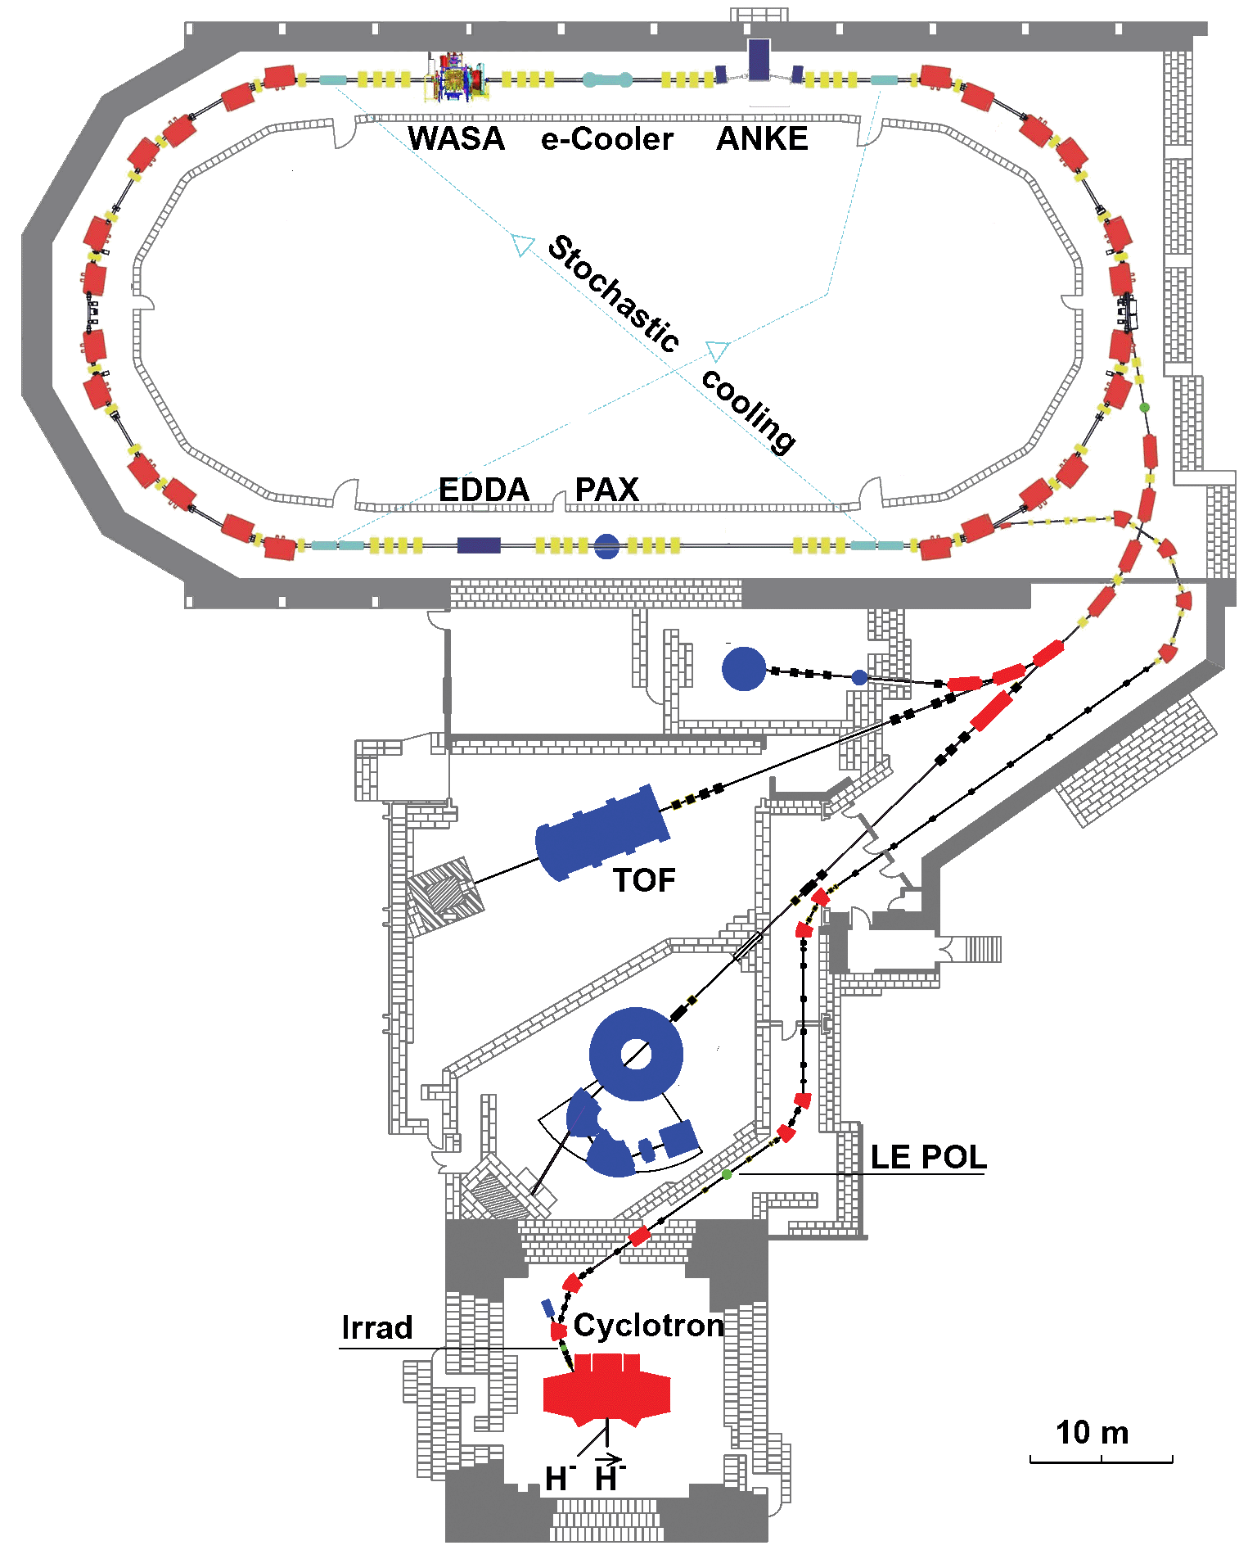
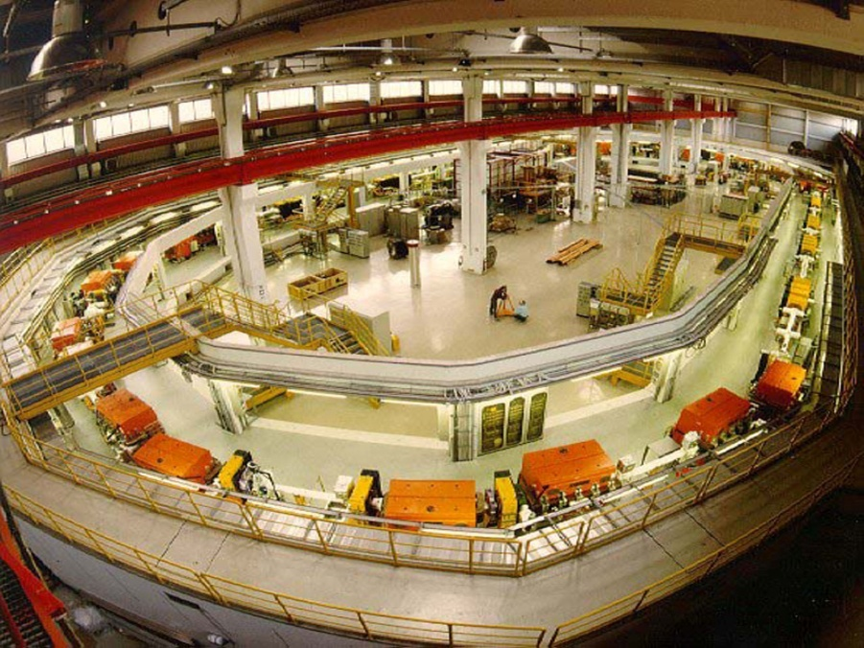
The Experimental Setup
p, p, d, d
with momenta up to 3.7 GeV/c
internal experiments –
with the circulating beam
external experiments –
with the extracted beam

Slide 3
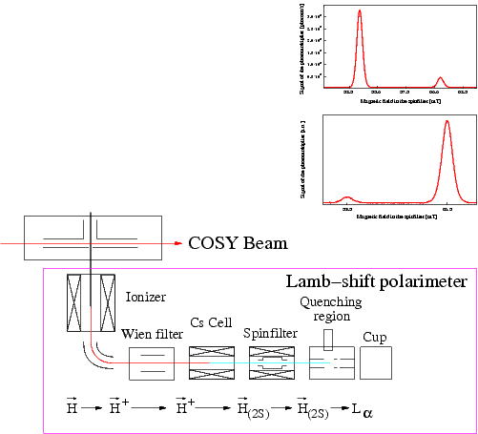
ABS and Lamb-shift polarimeter
6-pole
magnet
N₋
rf-transition
6-pole
magnet
N₊

Slide 4
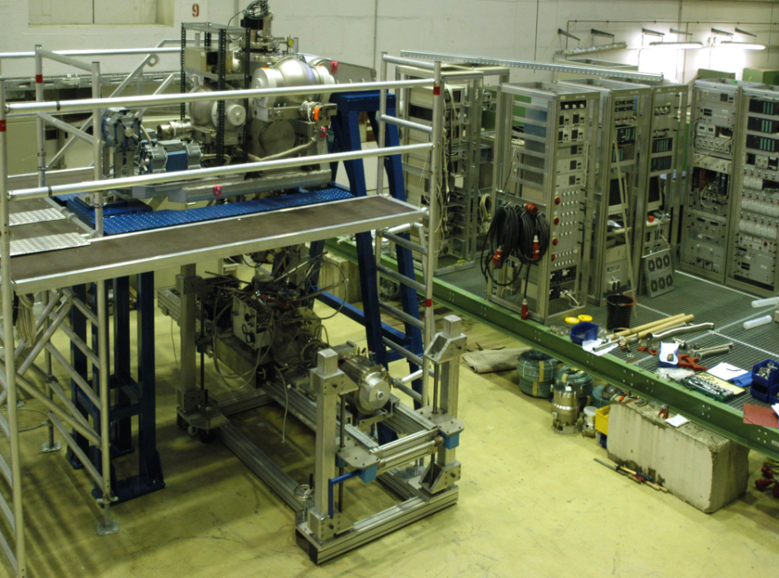
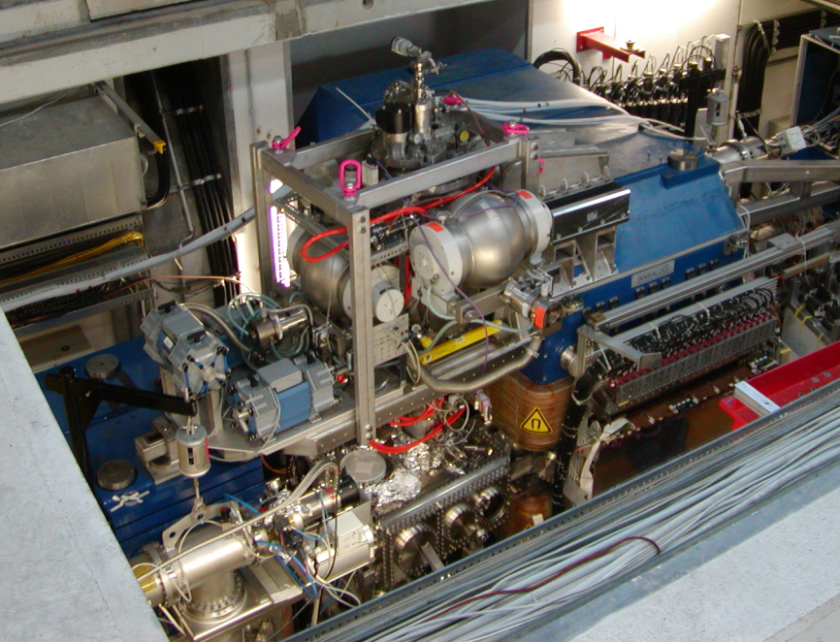
PIT at ANKE@COSY
Main parts of a PIT:
Atomic Beam Source
Target gas
hydrogen or deuterium
H beam intensity (2 hyperfine states)
8.2 . 10¹⁶ atoms / s
Beam size at the interaction point
σ = 2.85 ± 0.42 mm
Polarization for hydrogen atoms
P_{Z} = 0.89 ± 0.01 (HFS 1)
P_{Z} = -0.96 ± 0.01 (HFS 3)
Lamb-Shift Polarimeter
Storage Cell
M. Mikirtychyants et al.; NIM A 721 (0) 83 (2013)

Slide 5
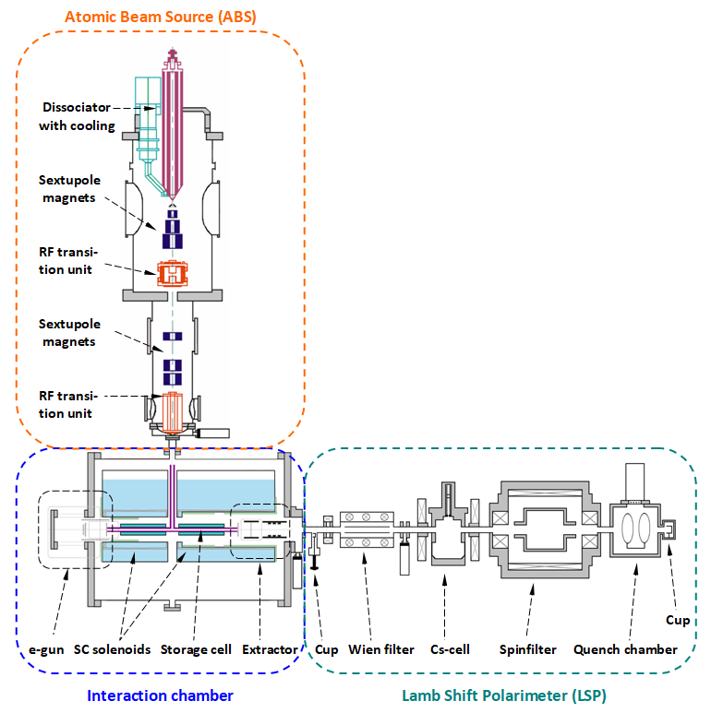
The Experimental Setup
2nd life of the ANKE ABS:
Measure the polarization of H/D atoms and H₂ / D ₂ / HD molecules after the recombination of polarized atoms from an ABS
PRL 124:113003 (2020)
PRL 115:113007 (2015)
Polarization must be preserved !!!
Problems:
Magnetic impurities must be avoided
Most chemical reactions, mostly recombination, destroy at least 50% of the polarization
Vaccum and Beam regulations do not allow all kinds of materials
Hydrogen Atoms are Radicals
Beam
Target Density: increased by a factor ~100 : 10¹⁴ atoms/cm²

Slide 6
The Experimental Setup
2nd / parallel life of the ANKE ABS:
Investigation of the nuclear polarization during:
Recombination processes
Wall interaction
---

Slide 7
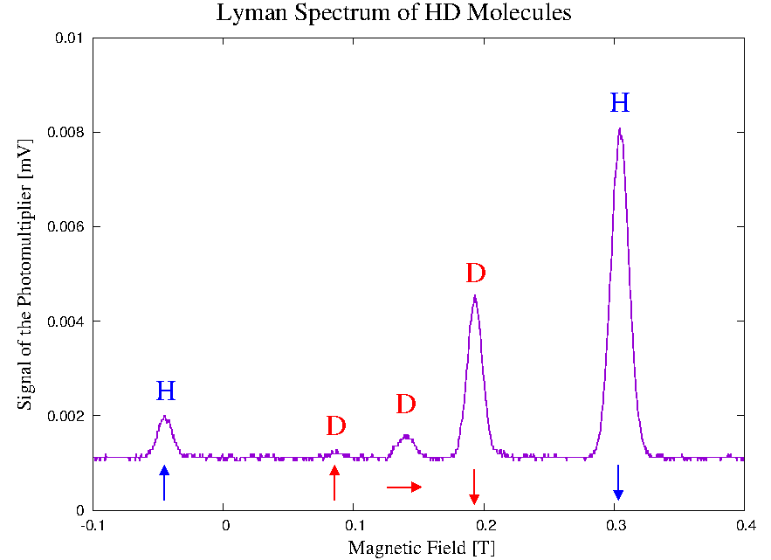
HD Molecules
Surface: Fomblin on Fused Quarz
T = 80 K / B = 0.528 T / E = 0.3 keV
P_{z} (H) = - 0.77
P_{z} (D) = - 0.79
P_{zz} (D) = + 0.69
Signal of the Photomultiplier [a.u.]
Magnetic Field [a.u.]
R. Engels et al., Phys. Rev. Lett. 124 113003 (2020)

Slide 8
Storage Cell Coating
Which surface coatings are working ?
1.) Aluminium cells -> Bad secondary-electron yield -> Beam disturbance
2.) Teflon cells -> Isolator -> Beam disturbance
3.) Water ice -> Vacuum problems !!!
4.) Fomblin oil -> Vaccum problems !!!
→ CERN: What about a carbon coating ???

Slide 9
Recombination on Carbon in the ISM
● Direct recombination is not probable due to energy and momentum conservation
● 3-particle interactions are very rare at these densities
● Recombination on a carbon surface as catalyser?

Slide 10
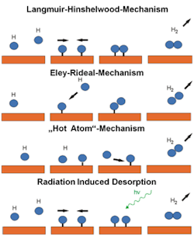
Recombination on Carbon in the ISM
Possible Recombination Mechanisms:
WWU Münster; Phys. Institute,
Prof. H. Zacharias
Strong C-H Bond (~ 4.3 eV) prevents recombination
Radiation induced Desorption

Slide 11
The Experimental Setup

Slide 12
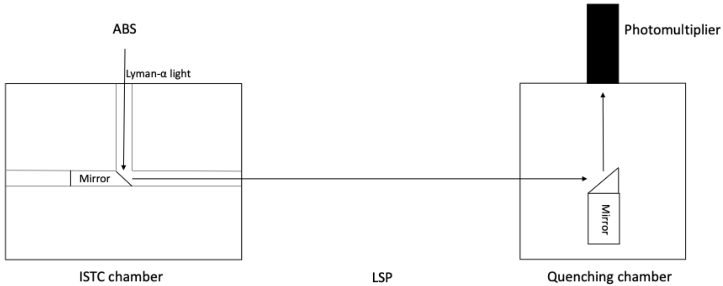
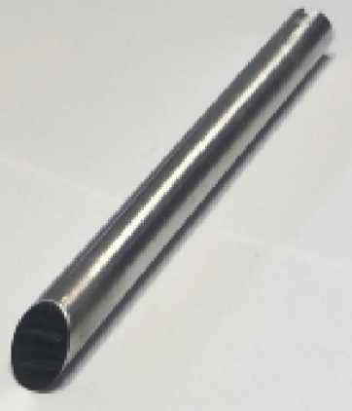
Radiation Test for Lyman-αlpha
Possible Light Source: Dissociator of the ABS
Bright Balmer light visible -> are there even Lyman photons ?
Reflections on aluminum surface for Lyman photons ~ 100%
Bachelor Thesis of Onur Bilen (HHU)

Slide 13
Storage Cell Coating
Which surface coatings are working ?
1.) Aluminium cells -> reflects Lyman-α photons
2.) Teflon cells -> transmission through the surface ?
3.) Water ice -> reflects Lyman-α photons / transmission through the surface ? (O-H: ~ 4.8 eV)
Expectation for Carbon: -> Large Recombination in Combination
with Lyman-α radiation !

Slide 14
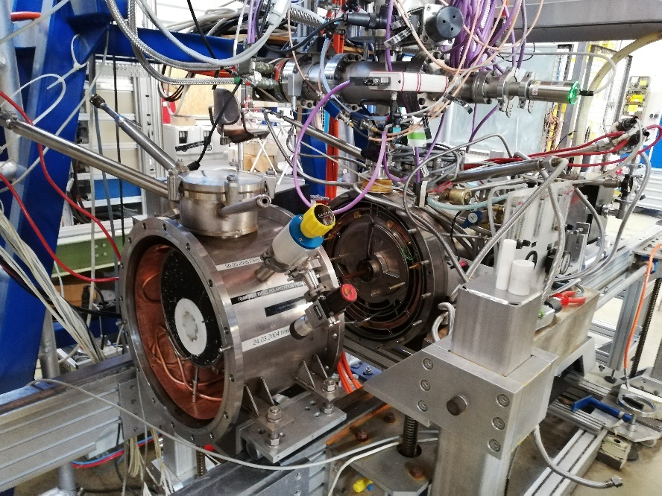
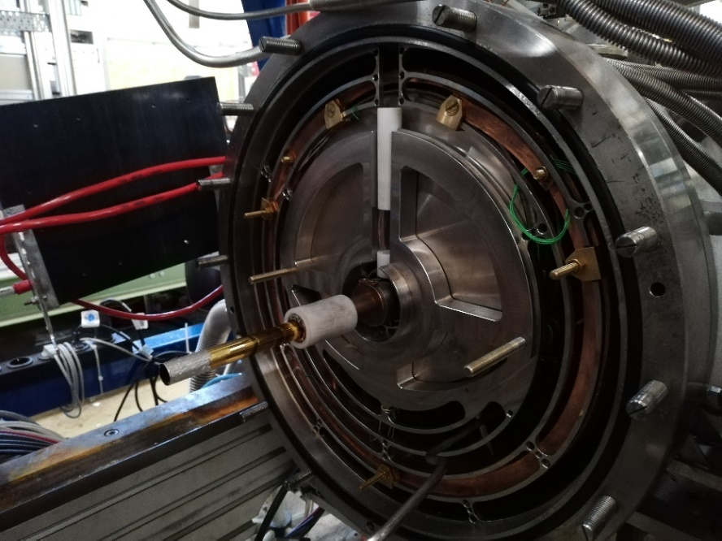
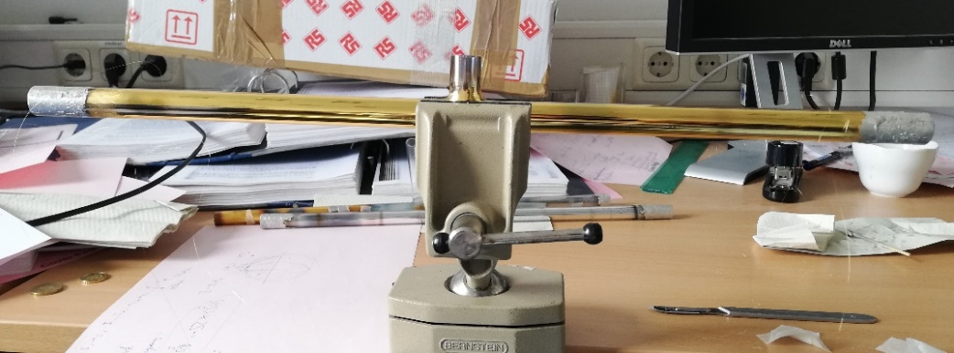
Preparation of new Storage Cell
●
●
●
●
A 200 nm amorphous carbon-coated storage cell was provided by Pedro Costa Pinto from CERN
Requirements:
- High polarization preservation
- No recombination
4 gold plated tungsten wires run along the inside of the storage cell
Installation into the interaction chamber

Slide 15
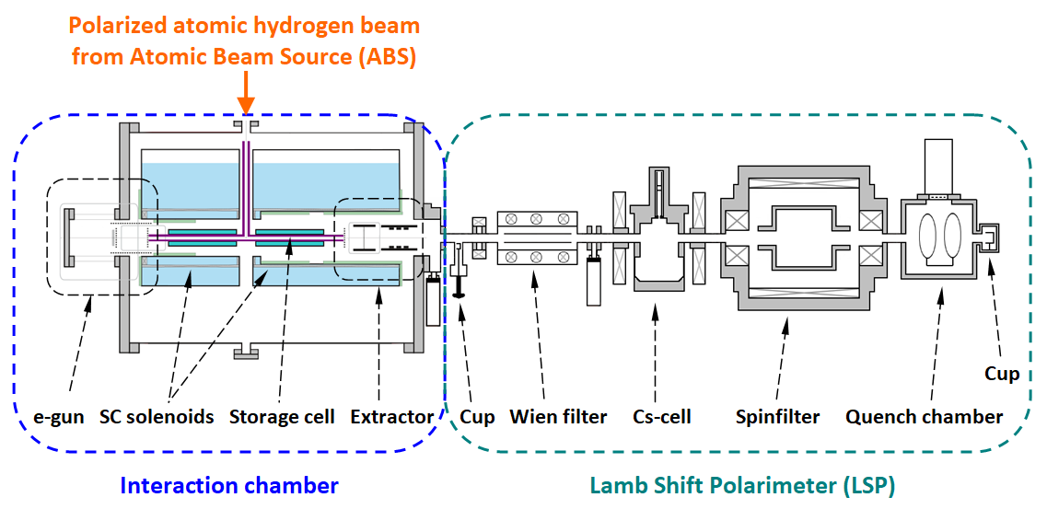
The Experimental Setup

Slide 16
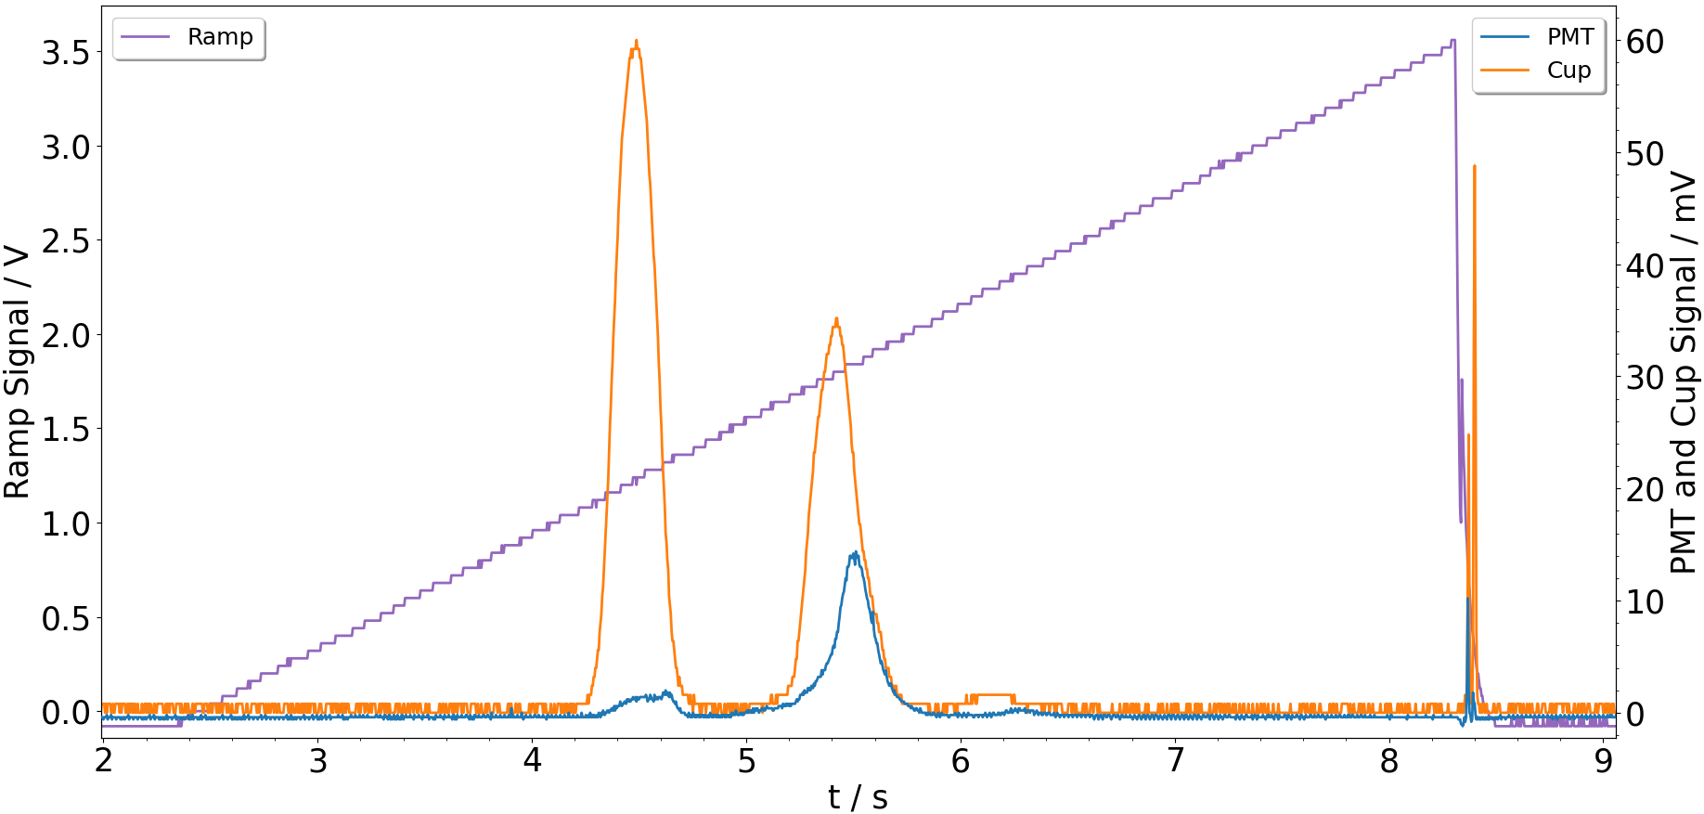
Mass spectroscopy
H⁺
H₂⁺
H₃⁺

Slide 17
The Experimental Setup

Slide 18
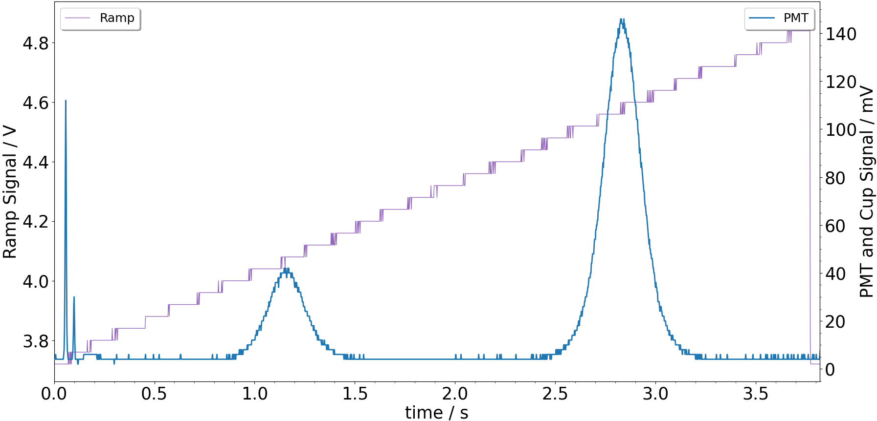
Lyman Spectra for H
Polarization spectrum of the Weak Field Transition Unit for H⁺ at B~0.5 T
$$p_{z}=−0.584±0.002$$

Slide 19
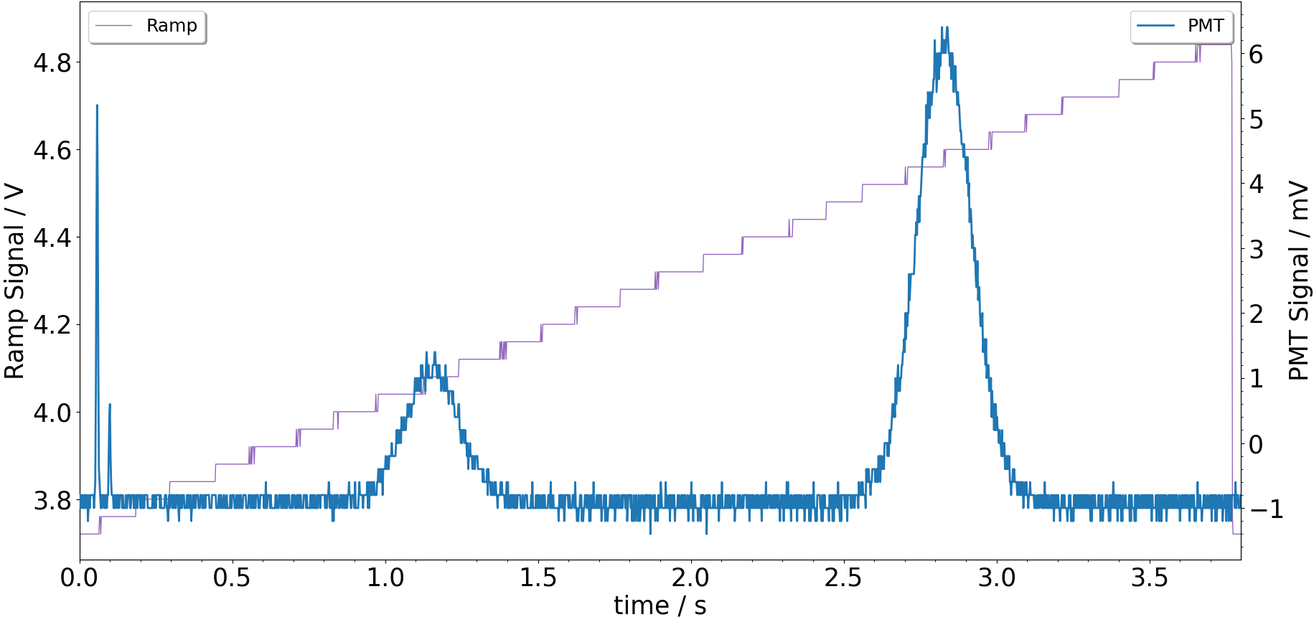
Lyman Spectra for H₂
Polarization spectrum of the Weak Field Transition Unit for H₂⁺ at B~0.5 T
$$p_{z}=−0.54±0.01$$

Slide 20
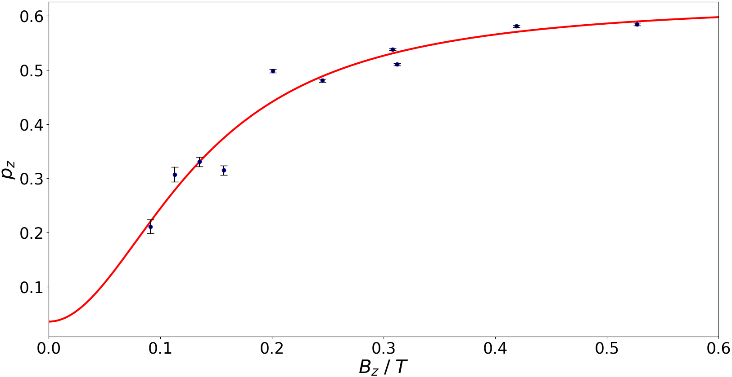
Polarization of the Protons
Proton fraction: a = 0.04 ± 0.15 95.5% < c < 100%
Wall collisions: n = 435 ± 236
Initial molecular pol.: P_{m} = 0.57 ± 0.03
Initial atomic pol.: P_{a} ≈ 0.8
Master Thesis of
Tarek El-Kordy
(FH Aachen)
B_{c} = 5.4 mT
$$P\left(B\right)=P_{a} a+P_{m} b e^{−n{\left(\frac{B_{c}}{B}\right)}^{2}}$$

Slide 21
Conclusion
● (Exceptionally) high recombination rate: 95.5% < c < 100%
driven by Lyman-α photons.
● No dominant water layer present; no buildup of water layer on
amorphous carbon.
● Initial molecular polarization (fit): P_{m} = 0.57 ± 0.03 (P_{a}= 0.78).
(Large B field is needed to decouple I and J)
T. El-Kordy et al.; „Amorphous carbon-coated storage cell tests for the polarized gas target at LHCb”, NIM A 1068, November (2024) 169707

