Slide 1
A facility for testing bulk superconducting MgB₂ cylinder for the production of holding magnetic fields for polarized targets and nuclear fusion fuels
Giuseppe Ciullo
INFN-Ferrara & University of Ferrara
Interest on Bulk Superconducting material :
in polarized nuclear targets a magnetic holding field is required,
nuclear targets might feel detector fields, influencing the polarization axis.
We are interested in fundamental studies on the orientation between projectiles and targets: indipendent fields and shielding of the surrounding fields are required.
We are around the interaction point, then we look for low thickness of material, low Z, reducing, or avoiding, material for powering, transportability from the preparation laboratory to the experimental site.

Slide 2
Outline of the idea for nuclear polarized target CLAS12-type
Choose a MgB₂ S.C. cylinder surrounding the target.
Set an outer transverse field.
Cool down the S.C. Cylinder in the IBC (In Beam Cryostat) at 4 K
Ramp down the outer magnetic field.
The perfect diamagnetism of the S.C. MgB₂ generates self supercurrents,
which mantain the seen field inside the cylinder.

Slide 3
Moving to experimental or test sites
IBC (In Beam Cryostat) can be moved and inserted in CLAS-12.
In case of increasing of CLAS-12 field: supplementary self supercurrents in the MgB₂ will mantain the transverse field.
Everything without any power supply and corrent leads, or coils, in the surrounding.

Slide 4
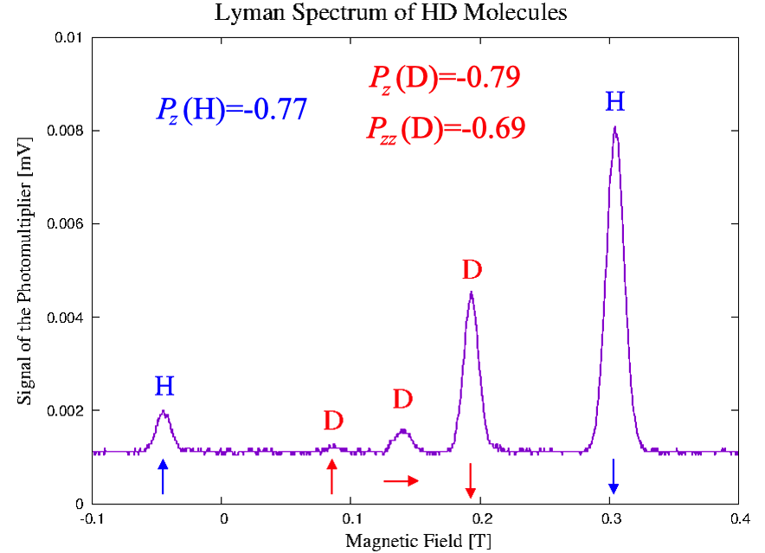
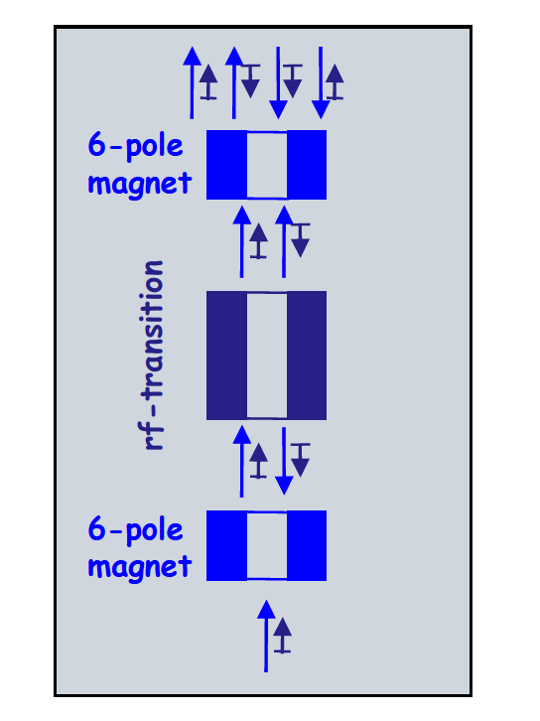
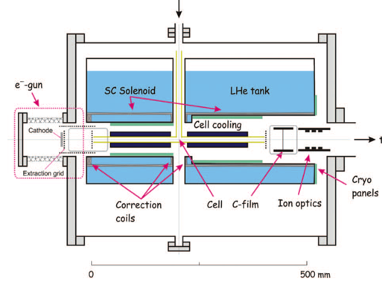
Outline of the Idea for Polarized Fuel for nuclear fusion tests
Polarized
Atomic
Beam
Cold Head with an MgB₂ cylinder
providing a holding field,
in this case it will parasitically
mantain the solenoidal field of the recombination chamber.
The cylinder hosts inside substrate for
condensation and it will be useful for
transportation for fusion studies and tests.
Cold
Head
T= 3-10K
Recombinig Polarized
Atoms in hyperpol. molecules
... our starting point for faisibility study is a magnetic field of 1 T.

Slide 5
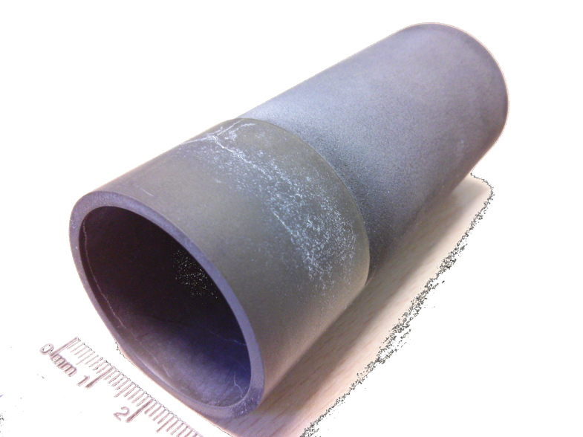
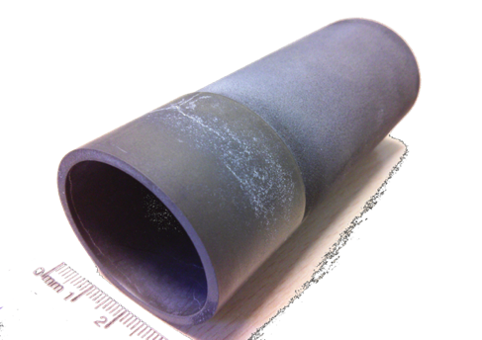
The compact «self» magnet
Cylinder
MgB₂
Shielding longitudinal fields
Mantaining transverse fields.
By
Bz
Advantages
No Power feeding
No Copper and Coils
Auto tuning
Semplicity
Low cost of production
few mm of thickness
External Magnet
90 mm
39
mm
M. Statera et al. (2015). IEEE Tr Appl. S:C., vol. 115(3): 1 - DOI: 10.1109/TASC.2015.2388855
Available Waste Material Machinable ( G. Giunchi)
diameter 39 mm - length 90 mm
thickness ~1 mm

Slide 6
Production of MgB₂
Discovered 2001 (J.Nagamatsu [1] Nature 410(2001) 63).
Different techinques of production:
Japanese scientists: high pressure sintering – HIP (Hot Isostatic Pressing)[1] or UHP (Uniaxial Hot Pressing).
American Scientists: Mg vapor sintering of B fibers [2]
Italian Scientists: Mg Reactive Liquid Infiltration [3]
(Italian Patent Edison Spa pat., G. Giunchi, S.Ceresara 2001)
[1] J.Nagamatsu et al. Nature 410 (2001) 63.
[2] P.C. Canfield et al. PRL 86 (2001) 2423].
[3] G. Giunchi et al. Int. J.Mod.Physics B 17 (2003) 453.
Available Waste Material Machinable
( G. Giunchi)
diameter 39 mm - length 90 mm
thickness ~1 mm

Slide 7
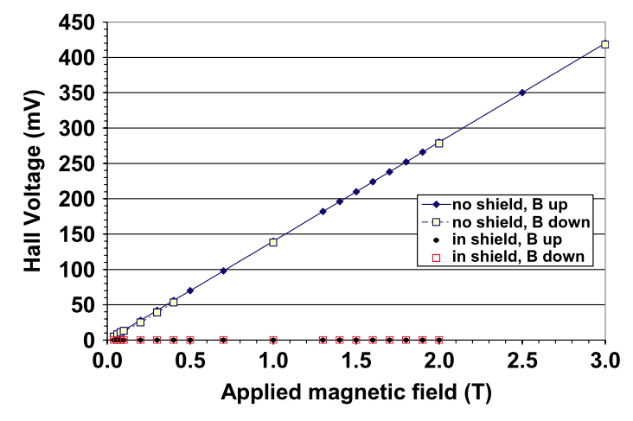
Field Cooling - Field Trapping
Field Cooling (FC), early cooling with applied field of 2 T, lowering down the applied field B_{appl} ,
B_{hall} measures the self field.
B_{Hall}
B_{appl}
P100 MgB₂ L = 70 mm
R_{ext}=17.75 mm, R_{int}=9 mm
J. J. Rabbers et al. “Magnetic shielding capability of MgB2 cylinders” Supercond. Sci. Technol. Vol. 23, 2010

Slide 8
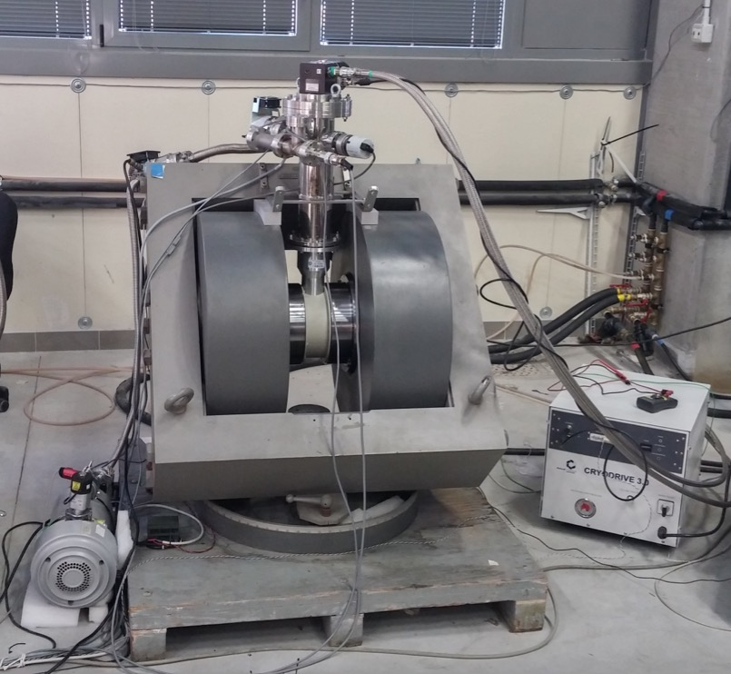
Field Trapping (Field Cooling)
cold head
7.5 hours to cool down from RT to 13 K
Field trapping after more than 12 h (thermal homogeneity?)
Low Temperature 13 K
Ramp down of the current feeding the magnet: : 0.25 A/4 s (0.06 A/s)
turbo pumps
316L chamber
Cu coil
Al chamber
nylon support
pole Fe ARMCO
A) temperature CLTS [K]
C) temperature RhFe [K]
B) current [A]
D) magnetic field @ center [mT]
yoke
942 mT
cylinder
Feasibility studies with oxford-Edwards
cold head 6/30

Slide 9
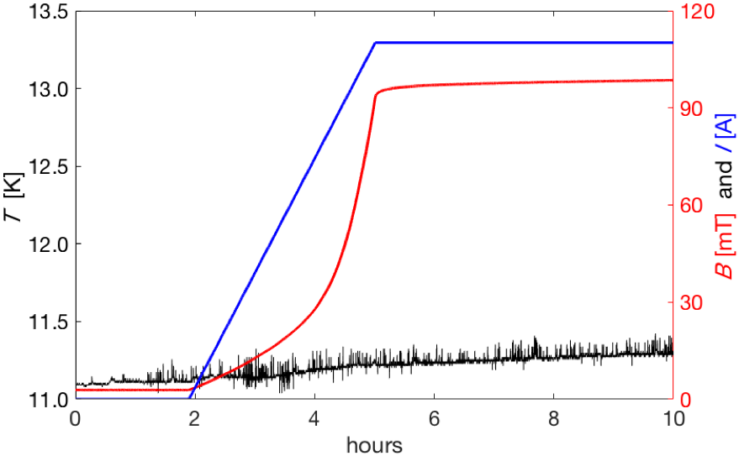
Zero Field Cooling or shielding
turbo pumps
cold head
316L chamber
Cu coil
Al chamber
nylon support
pole Fe ARMCO
yoke
B_{Hall}
B_{appl}
cylinder
Zero Field Cooling (ZFC)
early cooling without external field, increasing up the applied field, B_{appl}, B_{Hall} provides the penetrated fields.
J. J. Rabbers et al. Supercond. Sci. Technol. 23 (2010) 125003.

Slide 10
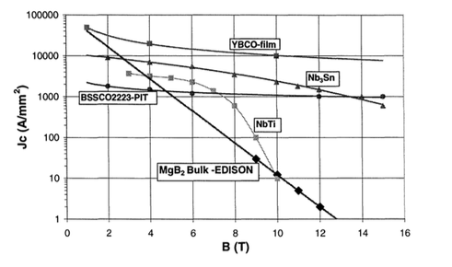
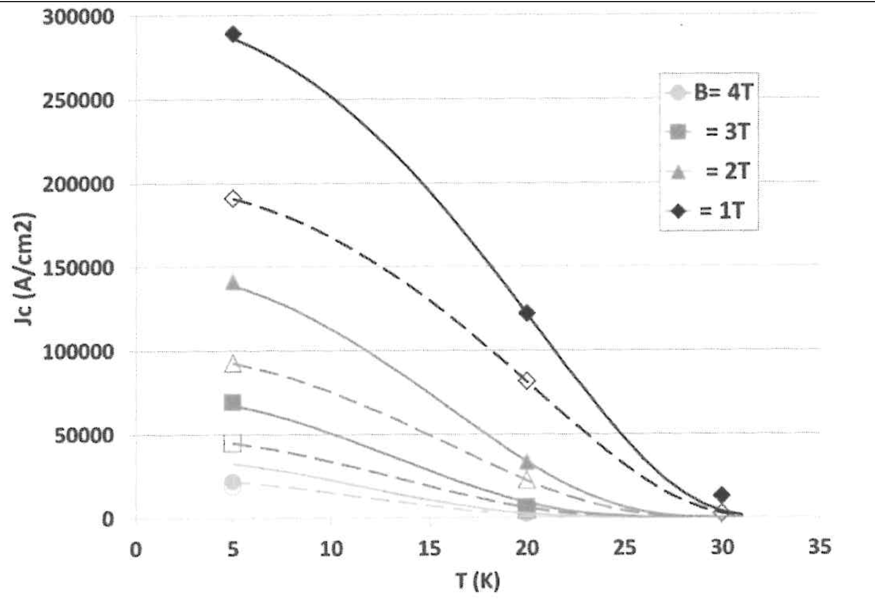
MgB₂
.
Low Z
Cheapper than LTS and HTS
Machinable: spark erosion and diamond tools
For the condition of
HD-ice at 4 K
Current density
J_{c} ≥ 10 000 A mm⁻²
(extrapolated)
G. Giunchi Internationl Journal of modern Physics B 17 (2003)
To be conservative we assumed
for our preliminary studies
J_{c} ≥ 1 000 A mm⁻²
J_{c} experimental data for
SG (Small Grain size) continuous
and LG (Large Grain size) dashed line

Slide 11
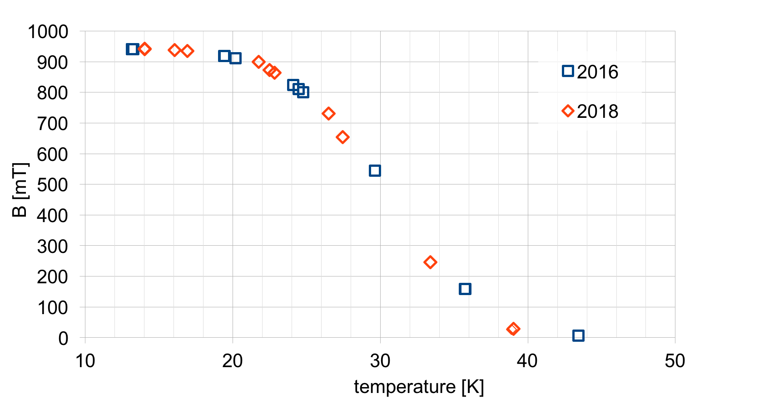
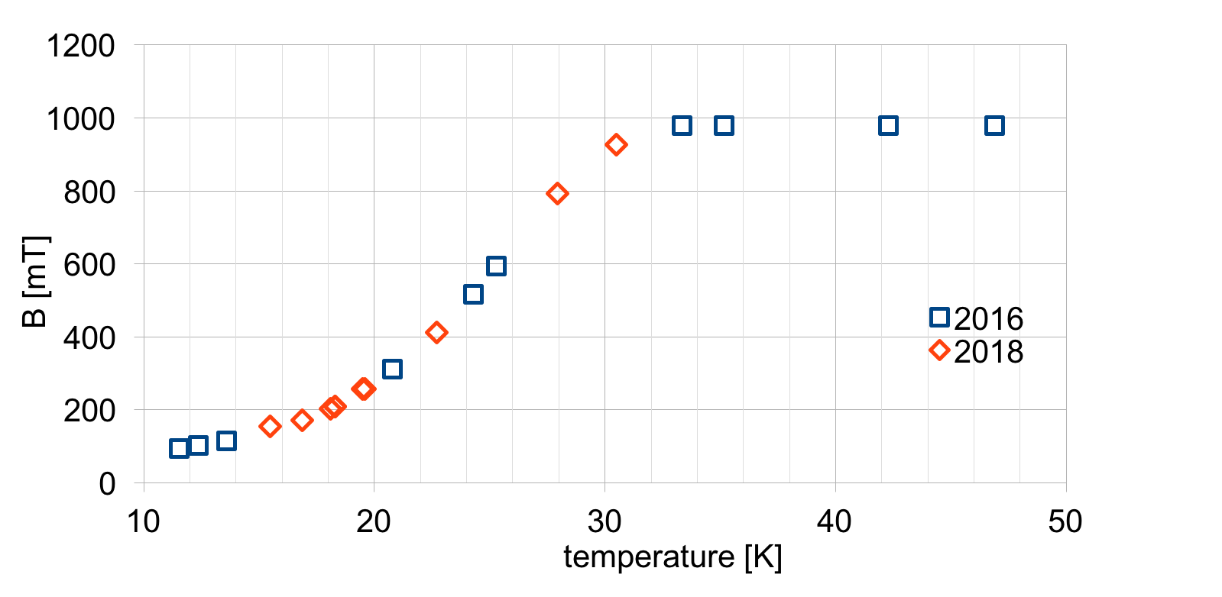
T Characterization in the feasibility study
Trapping Field
(Field Cooling)
Shielding
Zero Field Cooling
Evidence of T_{c} = 39.5 K
Good Performance @ T < 20 K
Good Reproducibility
More sensitive to T
Good performance at lower T
Reproducibility after many thermal cycles, quenches or flux jumps,
opening of system and change of thermal insulation materials
(2016 vs 2018)

Slide 12
New cold head (on loan from FZJ –R. Engels)
RDK-415D Sumitomo (SHI Cryogenics Group):
1st stage 35 W @ 50 K ,2nd stage 1.5 W @ 4.2 K
(previous: 30 W @ 77 K, 6 W @ 10 K) .
1st stage
2nd stage
Better thermal stability and lower themperature

Slide 13
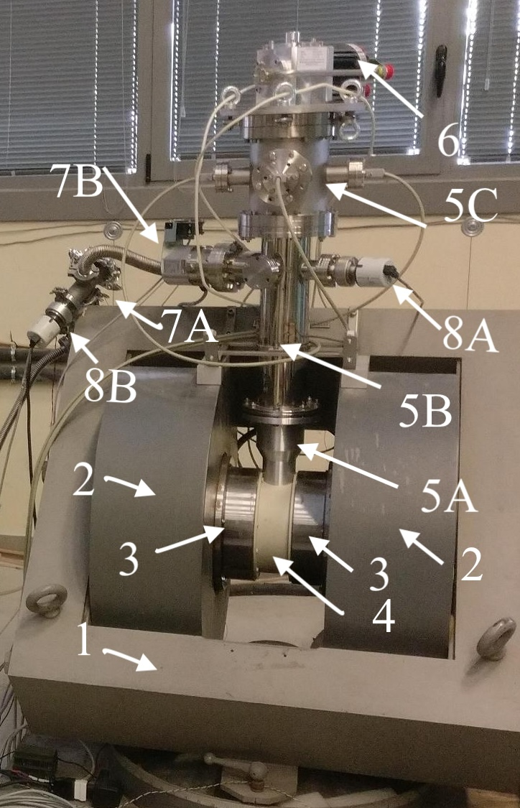
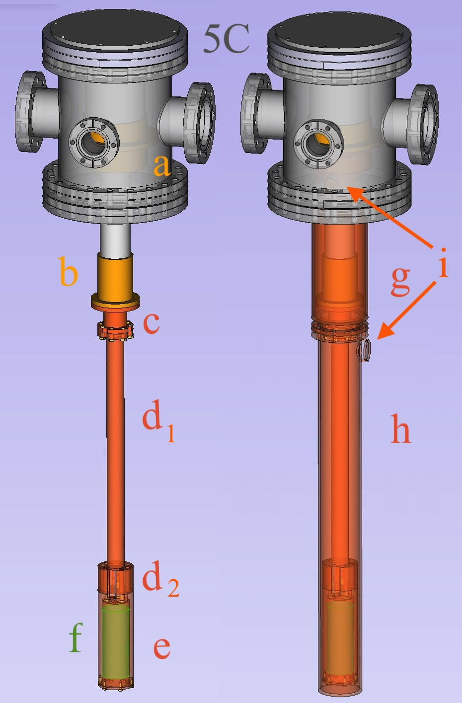
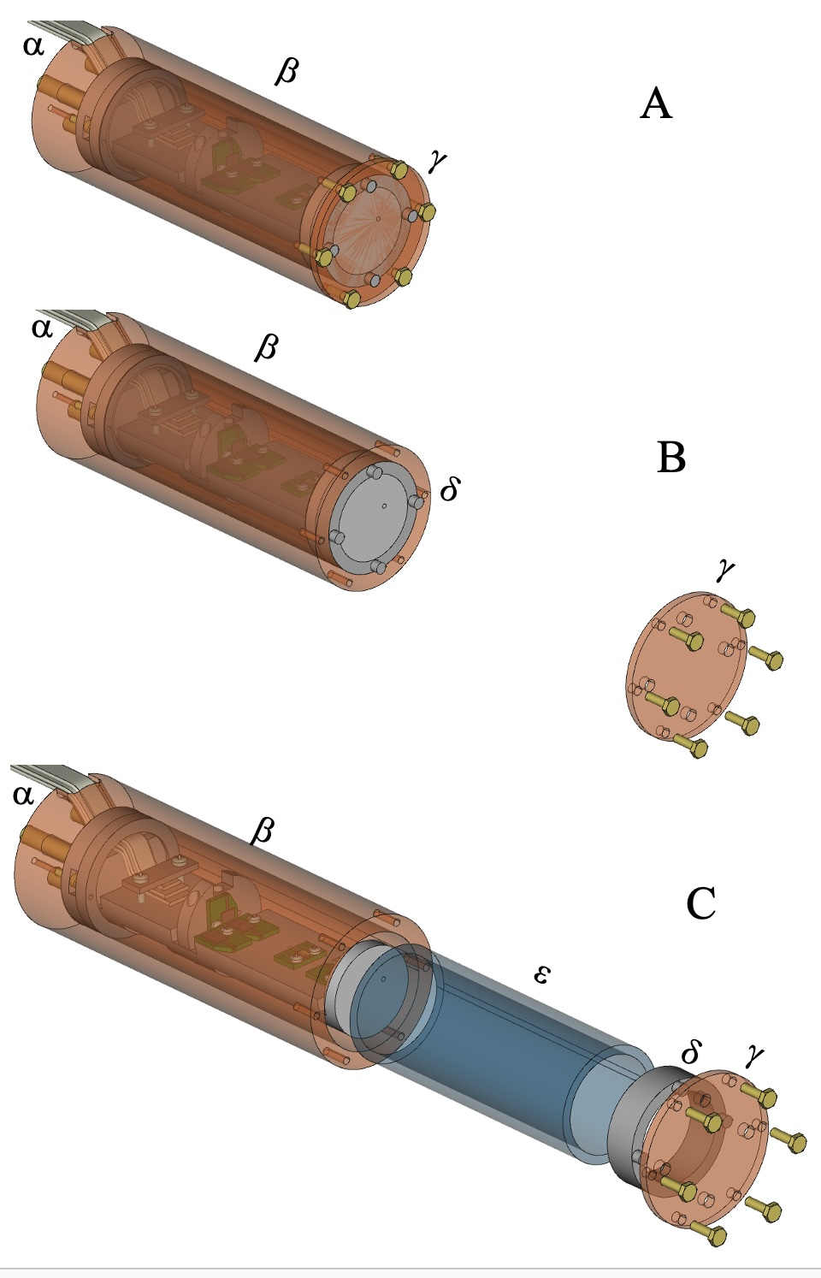
Upgraded system @ FE
Scroll pump
1- iron yoke, 2 –coils, 3-iron poles, 4- nylon support, 5A –Al Chamber, 5B-5C SS chambers, 6-cold-head, 7B -7A TM pumps, 8A-8B Penning gauges

Slide 14
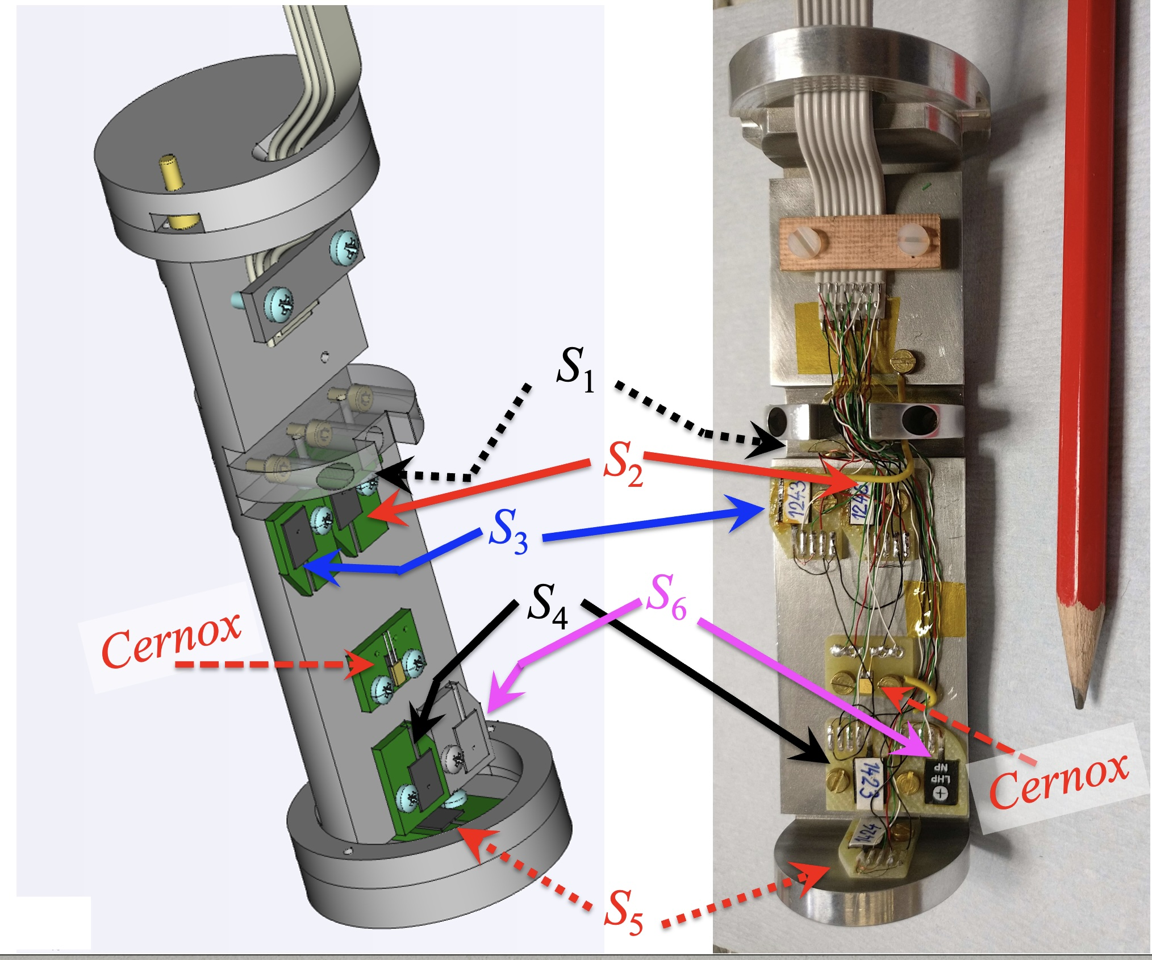
T_{RhFe}
under the copper can holding and shielding sensors and cylinder

Slide 15
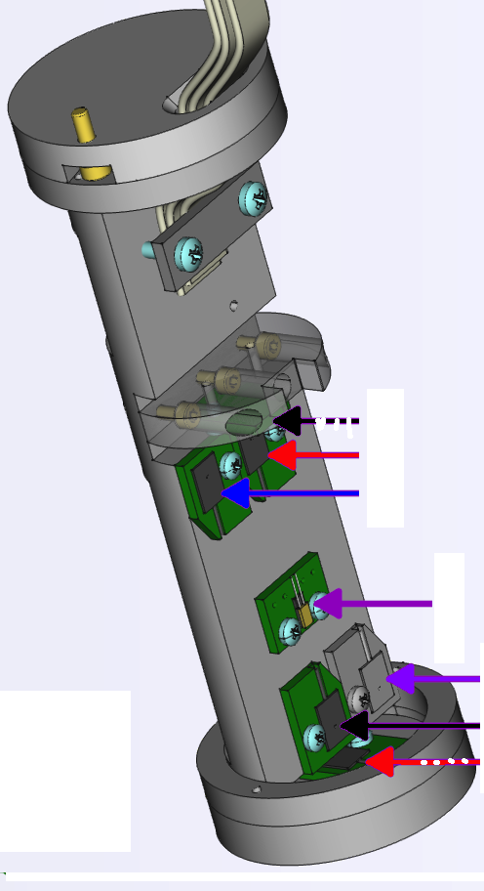
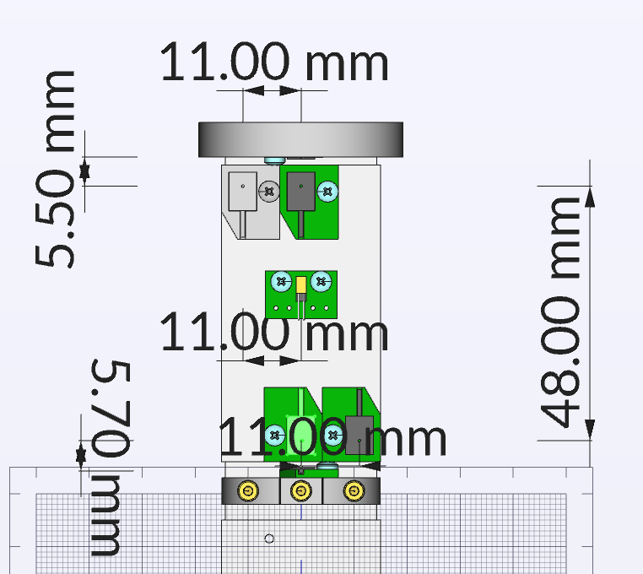
Locations of the transv. and long. Hall probes
S4= S4_{ect}(edge center transvere)
S6=S6_{ert}(edge radial transverse))
S1=S1_{mcl} (middle longitudinal)
S5=S5_{ecl}(edge center longitudinal)
T_{Cernox}
59.2 mm
S3=S3_{mrt}(middle radial transverse)
S2= S2_{mct}(middle center transverse)

Slide 16
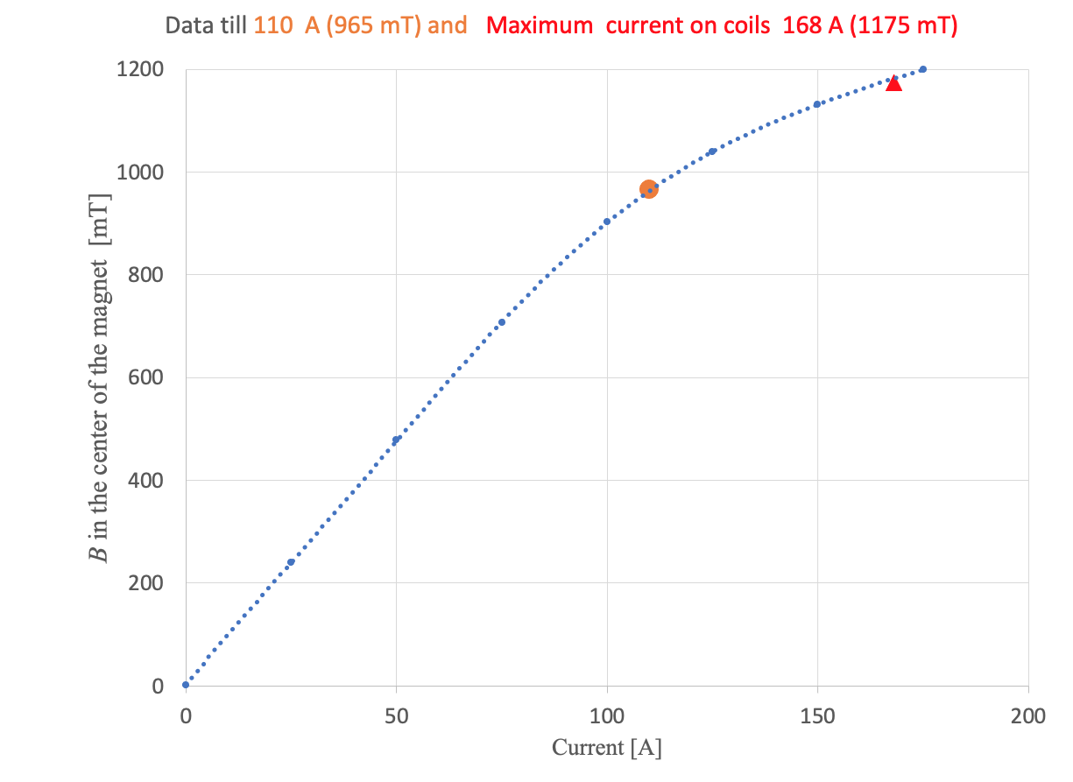
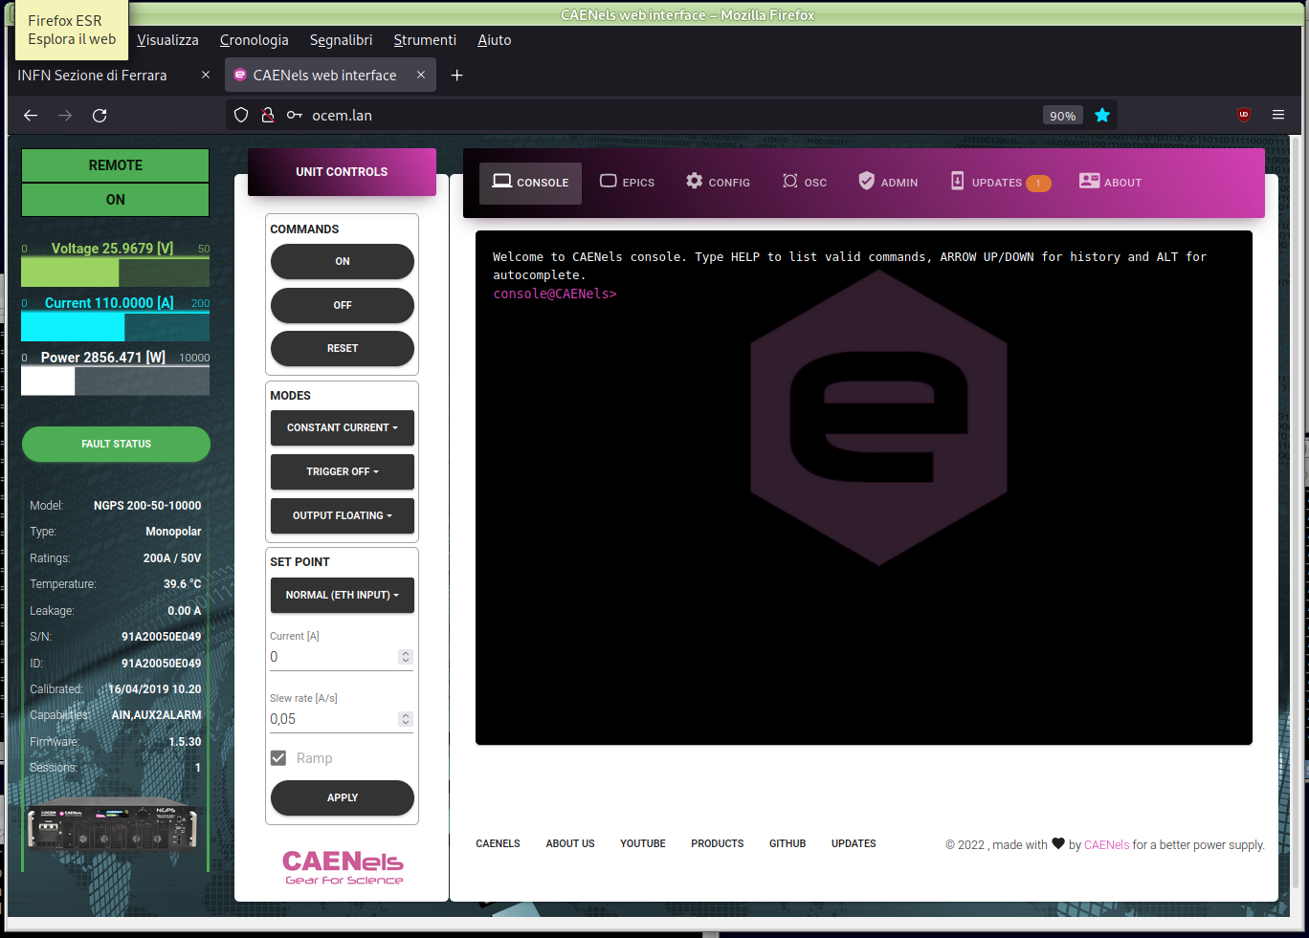
New power supply and transv. magnetic fiedl
Preliminary tests with 110 A (980 mT), now max current allowed on the coil 168 A (1 200 mT)..
OCEM-CAEN - NGPS 200 A- 50 V high stability power supply

Slide 17
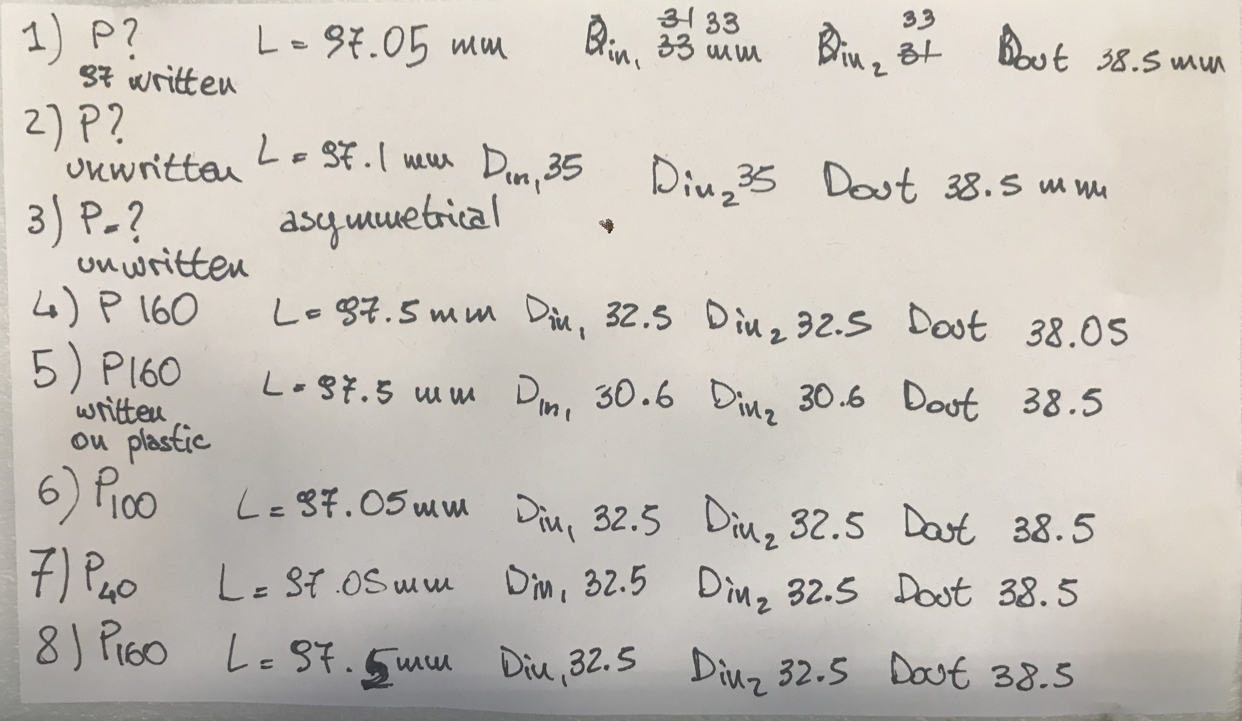
MgB₂ cylinders
Different
Boron (99.5 % pure) precursor
grain size (μm) from Boron chip (mm)
mechanically grounded
and sieved to less
than (P)nnn μm.
P100
P160
P40
2.75
3.0
2.75
3.0
P100
thickness in mm
P160
P160
2.75
Length 97.05 – 97.5 mm
4.0
3.0
Unknow
used
for prel.
studies
P100
3.0
Smaller the grain size higher transport characteristics,
but less thermal stability at lower T and lower B.
Connectivity P100 ~ 61 %, P40 ~89 %, PAM~73 %

Slide 18
Control, monitoring and DAQ
Temperature sensor monit. & Rec.
Cold head heater contr. Monit. & Rec.
Hall probe
Monit. & Rec.
Magnet power supply Monit. & Rec.
Room Temperature
and Humidity
Mon. & Rec.
Water circuit temperature 1) Water in,
2) Cryo Water out,
3) magnet body,
4) magnet water out.
Mon. & Rec.
Pressure Monitoring (Mon.) & Recording (Rec.)
(P_{pv} ~ 10⁻² mbar, P_{bp} ~ 10⁻⁶ mbar, P_{ch} ~ 10⁻⁸ mbar)

Slide 19
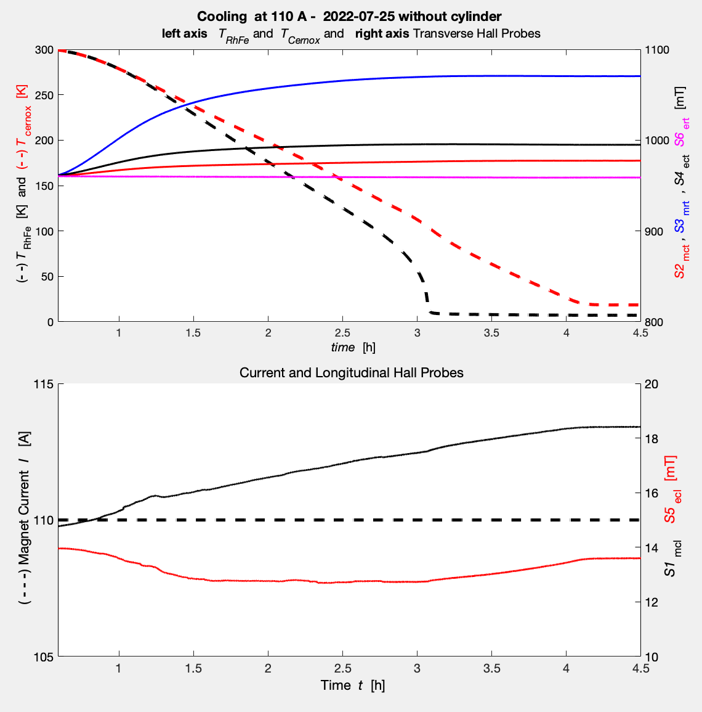
Cooling down W.O. cylinder less than 3.5 (4.5) h against > 7.5 h (blind)
T_{RhFe}
T_{Cernox}
T_{RhFe}
under the copper can holding and shielding sensors and cylinder

Slide 20
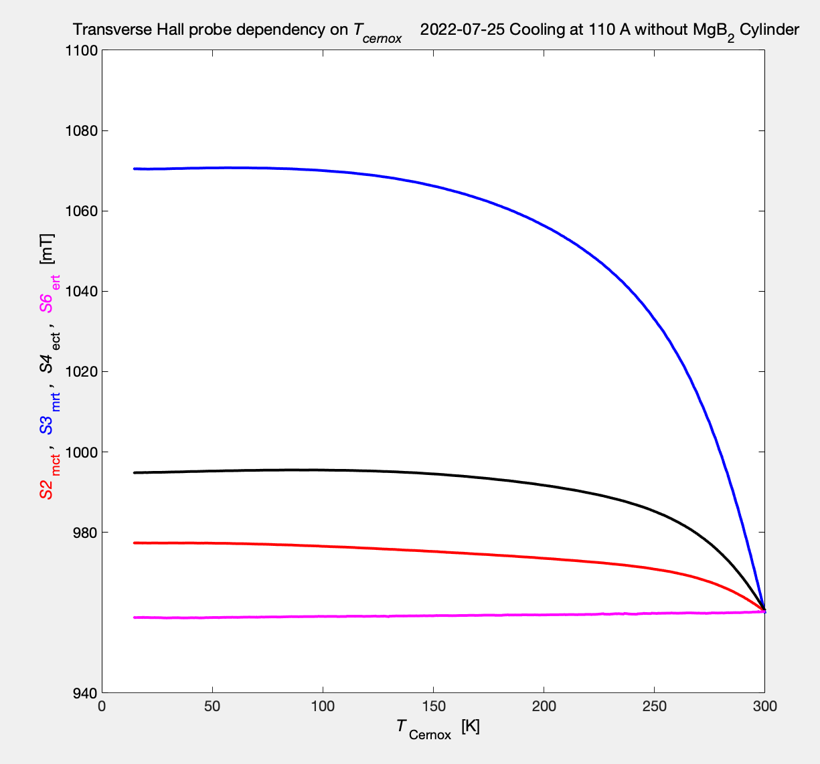
Temperature dependency of Hall probe
S3=S3_{mrt} (middle radial transverse)
S4= S4_{ect}(edge center transverse)
S2= S2_{mct}(middle center transverse)
S6=S6_{ert}(edge radial transverse)

Slide 21
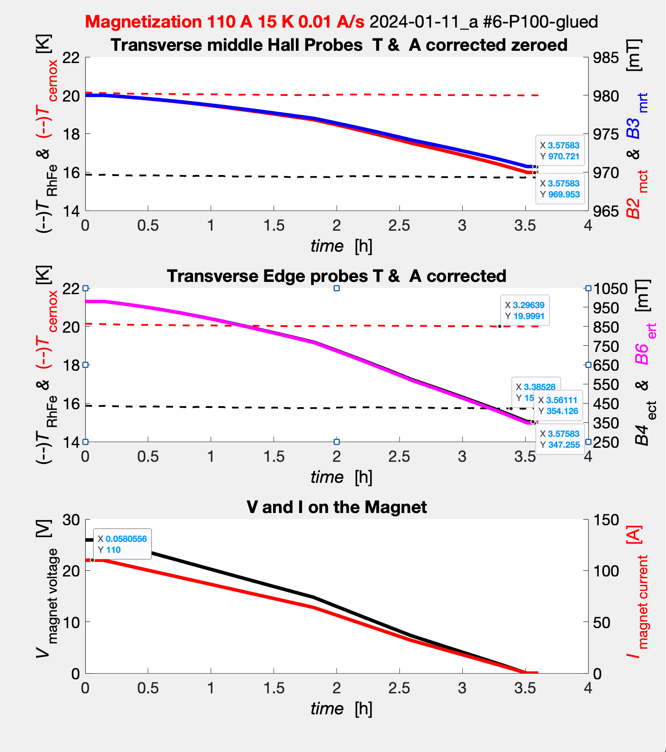
Field Cooling-Magnetization
B_{n} is the corresponding S_{n} corrected byT_{cernox}
T_{Cernox}
Ramping down from110 A:
from B_{appl} 980 mT
to zero
with
P100 #6
T_{RhFe}

Slide 22
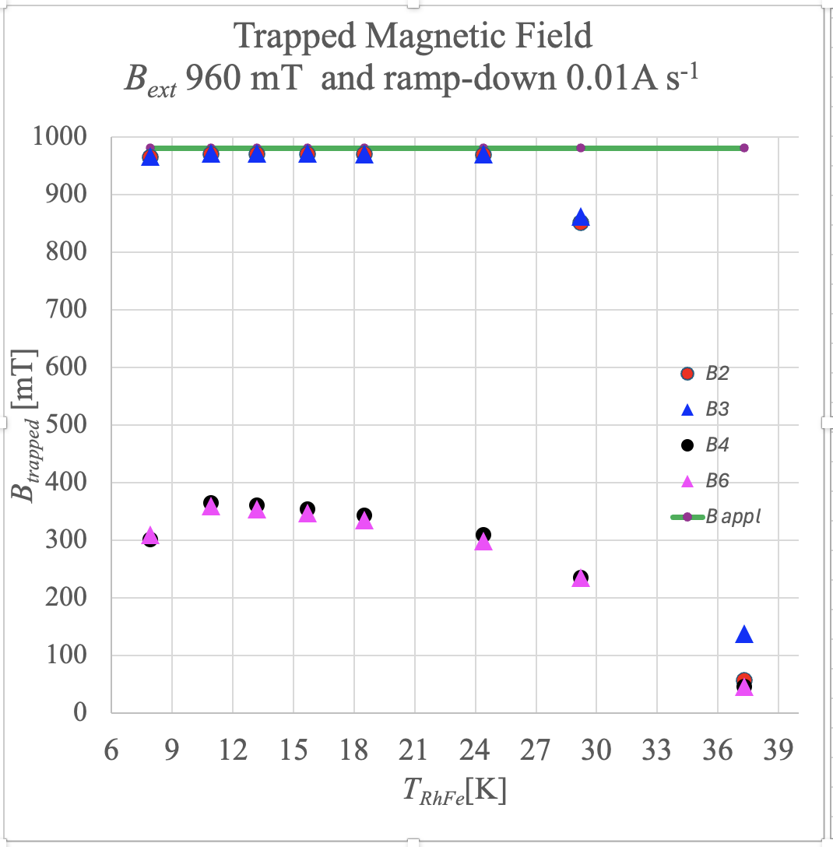
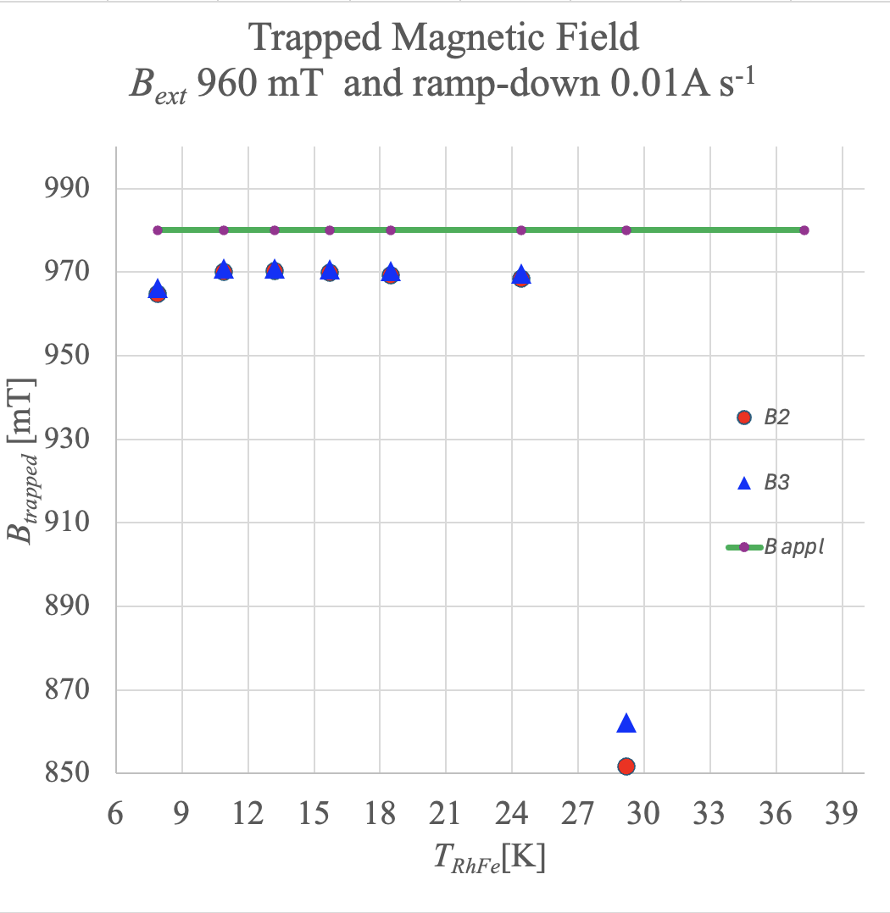
Trapped field vs Heating power (i.e. T)
48 mm
11
mm
B₂
B₃
T_{Cernox}
B₆
B₄
P100 #6
T_{RhFe}

Slide 23
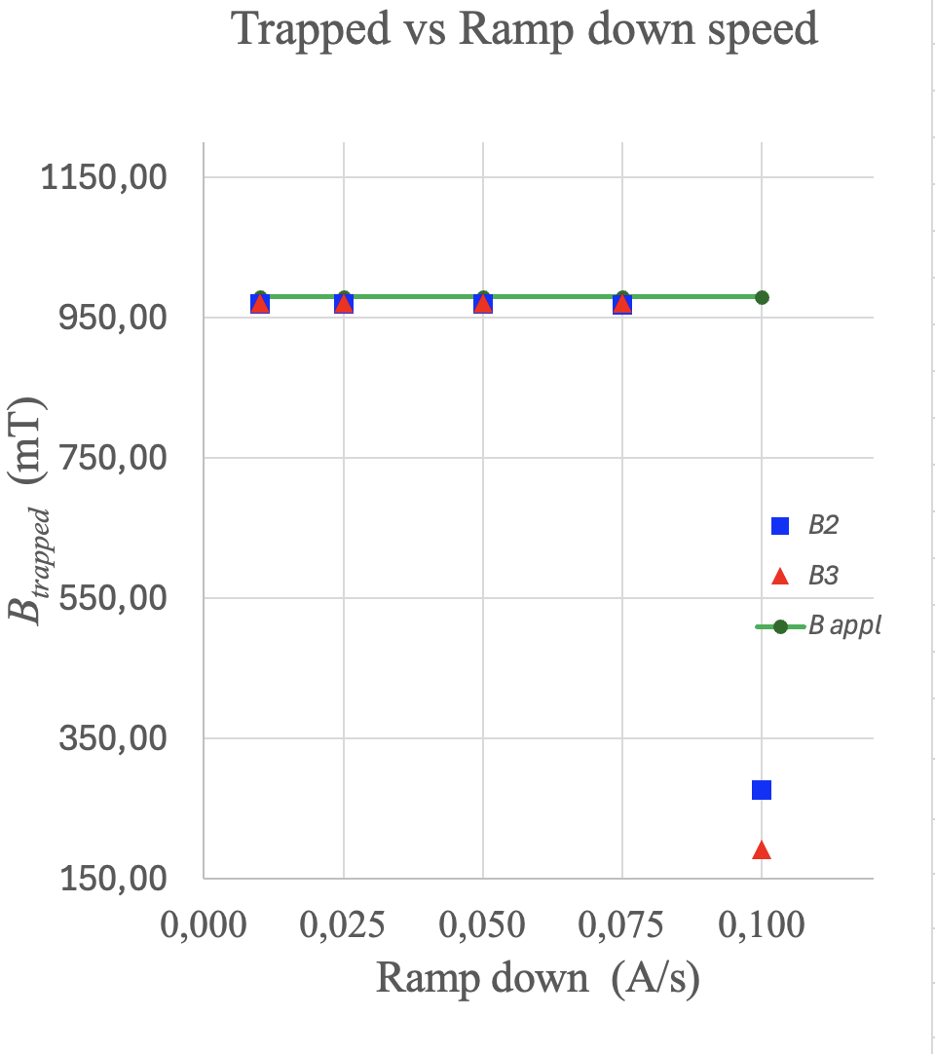
Trapped Field vs Ramp down speed
48 mm
11
mm
B₂
B₃
P100 #6

Slide 24
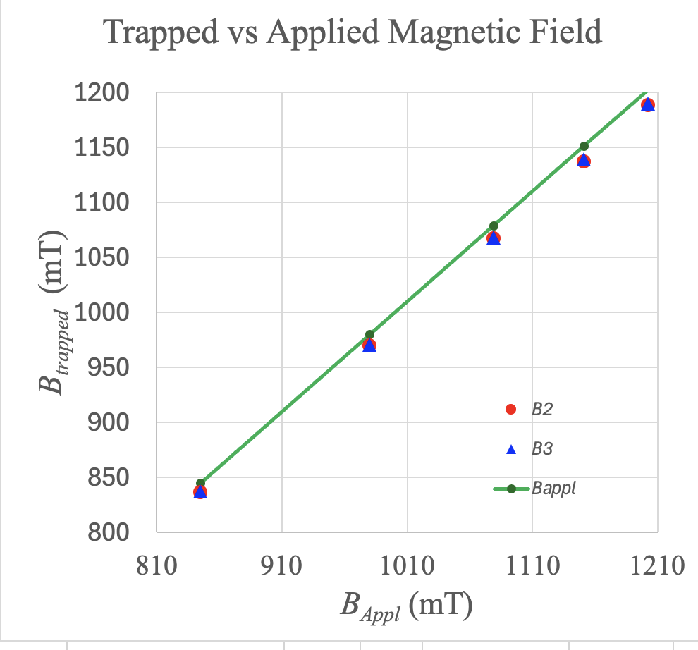
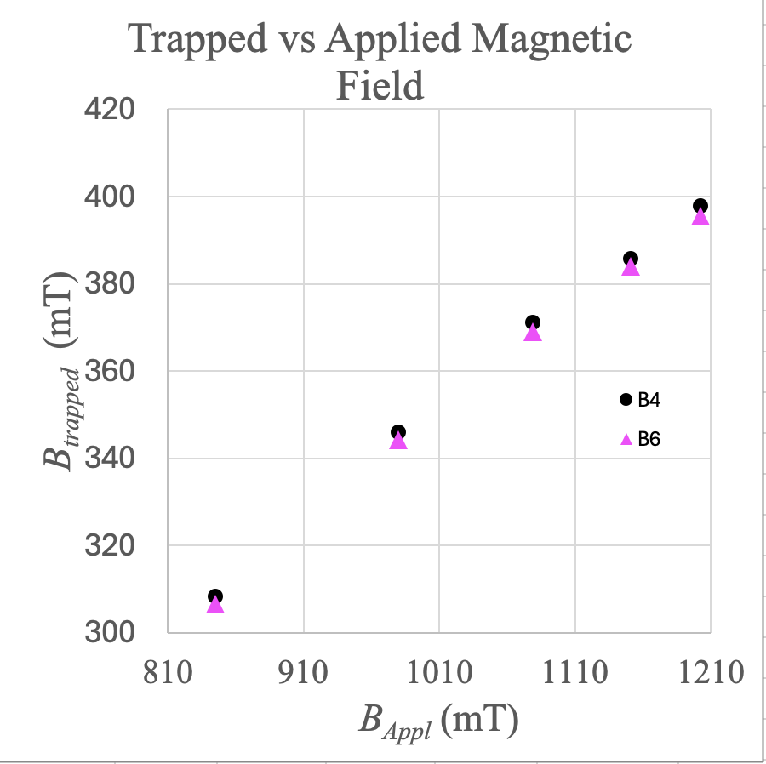
Trapped field vs B_{appl}
48 mm
11
mm
B₂
B₃
B₆
B₄
P100 #6

Slide 25
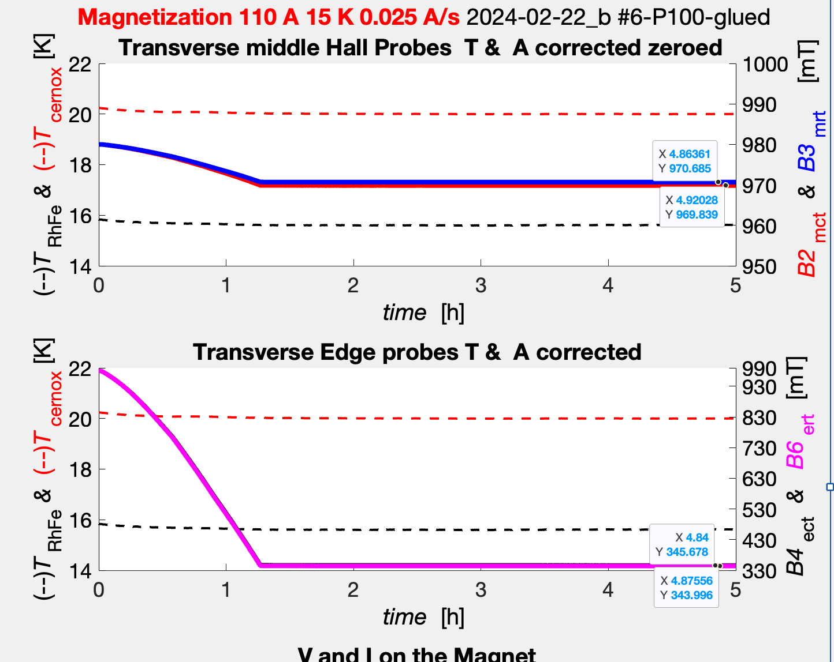
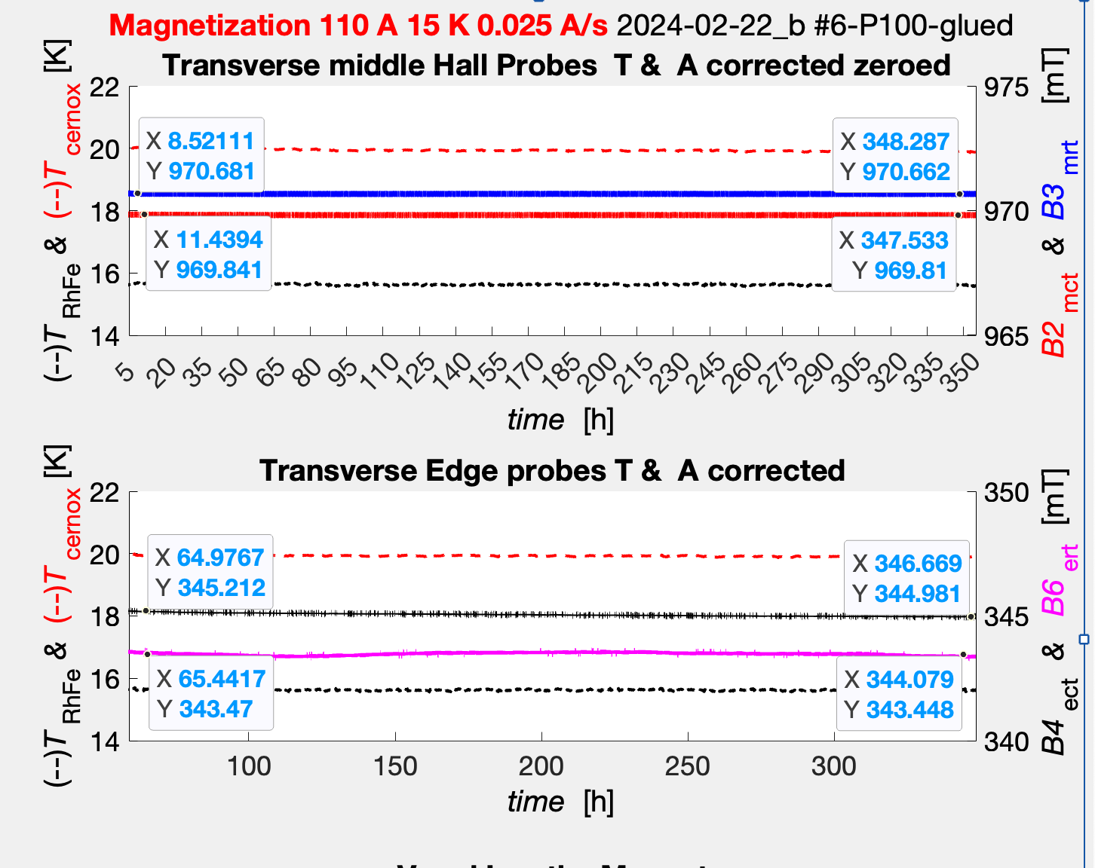
How long the fields can stay an how stable is?
ΔB ~ 0.02 mT in 15 days
P100 #6

Slide 26
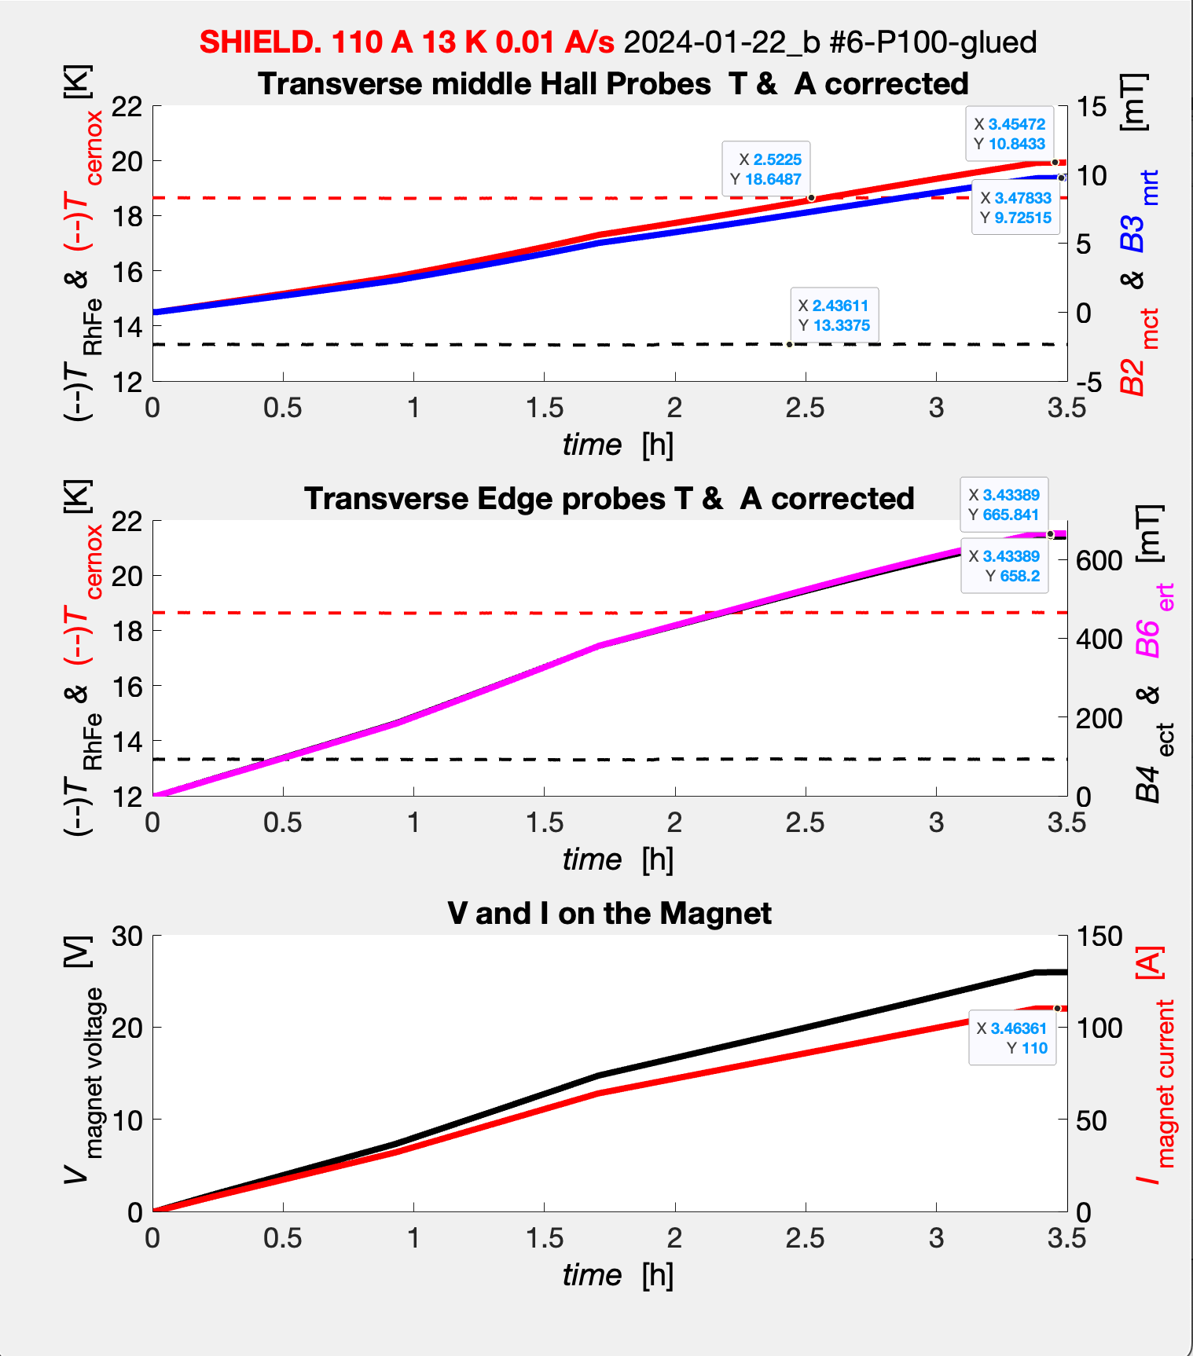
Zero Field Cooling (ZFC ) Shielding
Ramping up to 110 A:
to B_{appl} 980 mT.
P100 #6
T_{RhFe}

Slide 27
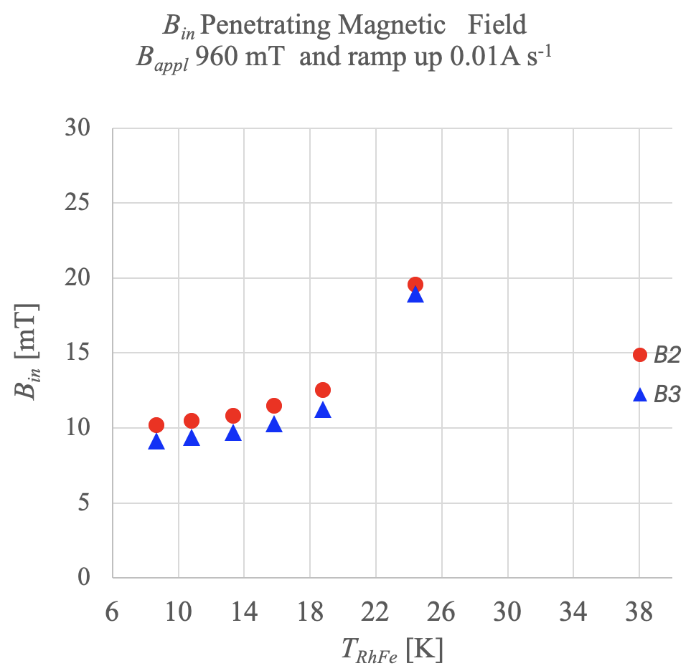
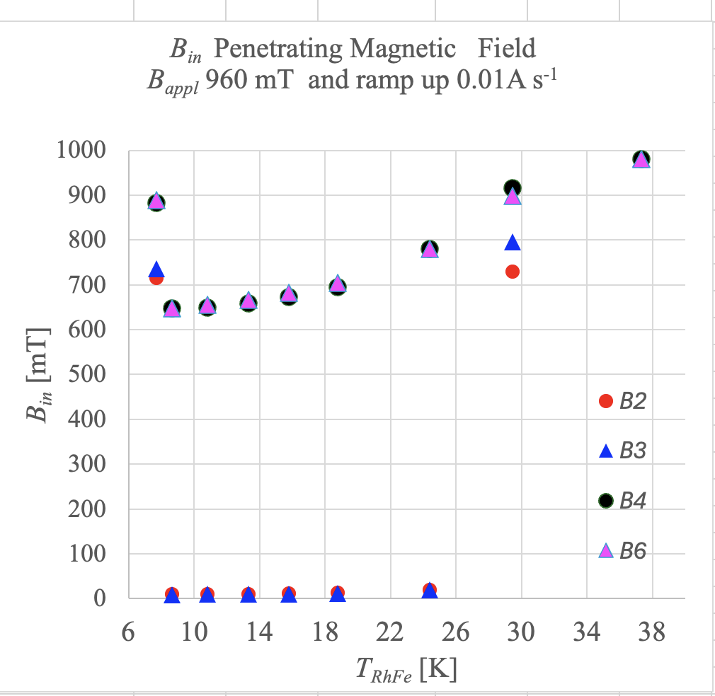
Shielding vs Heater power (Temperature)
B₂
B₃
B₆
B₄

Slide 28
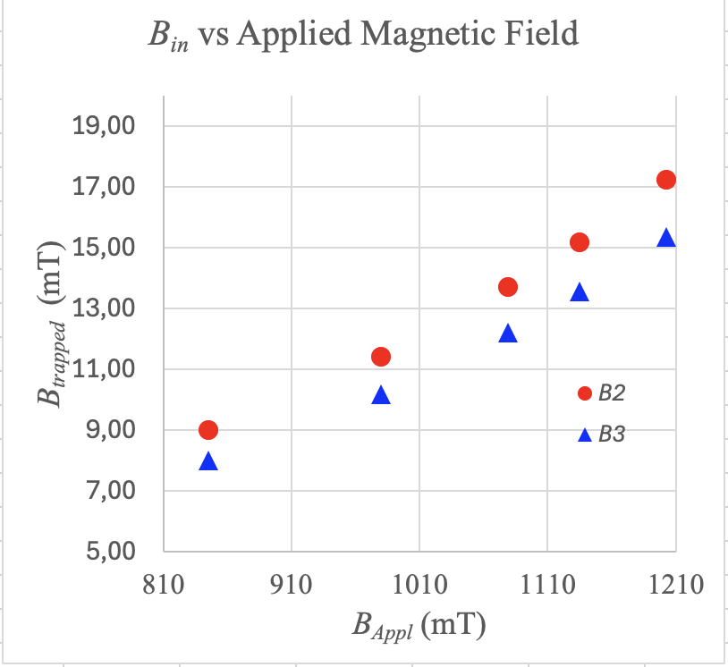
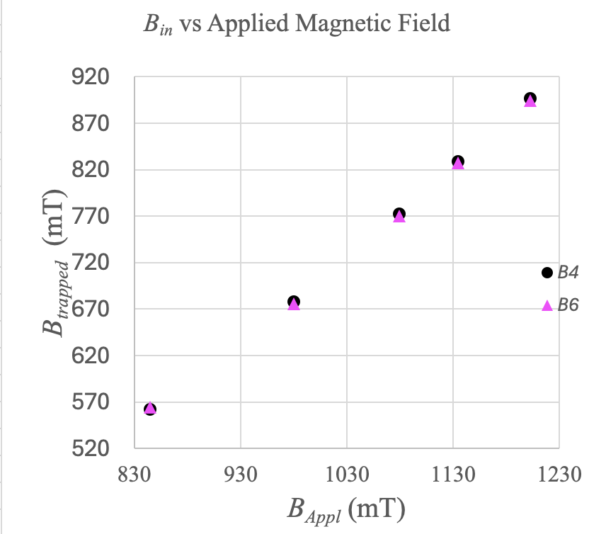
Shielding vs B_{appl}
B₂
B₃
B₆
B₄

Slide 29
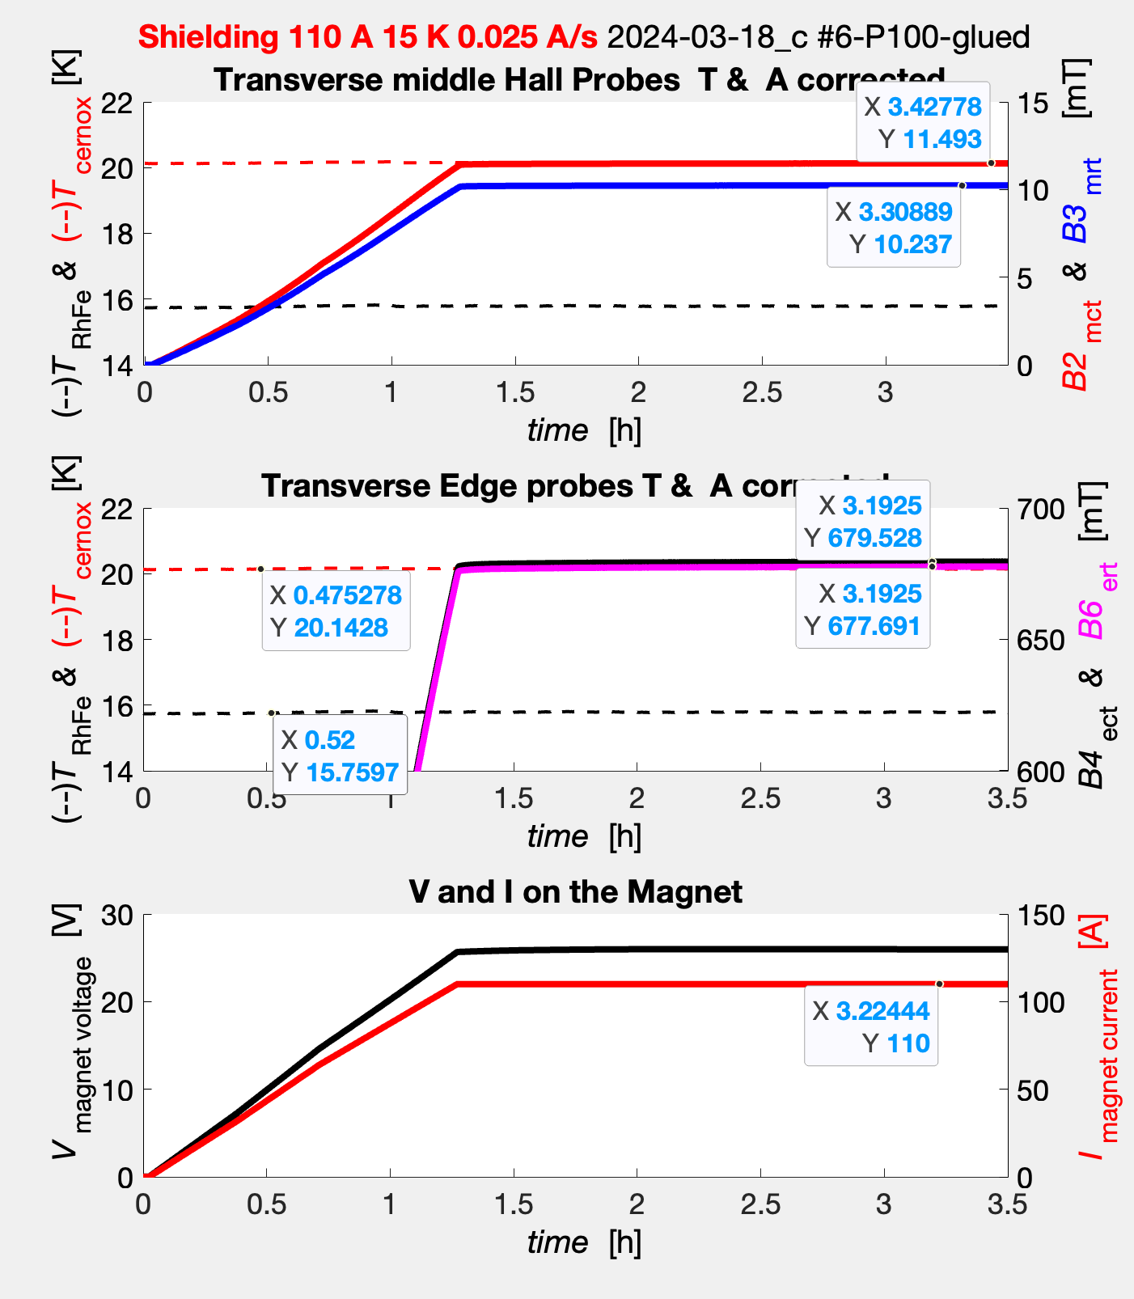
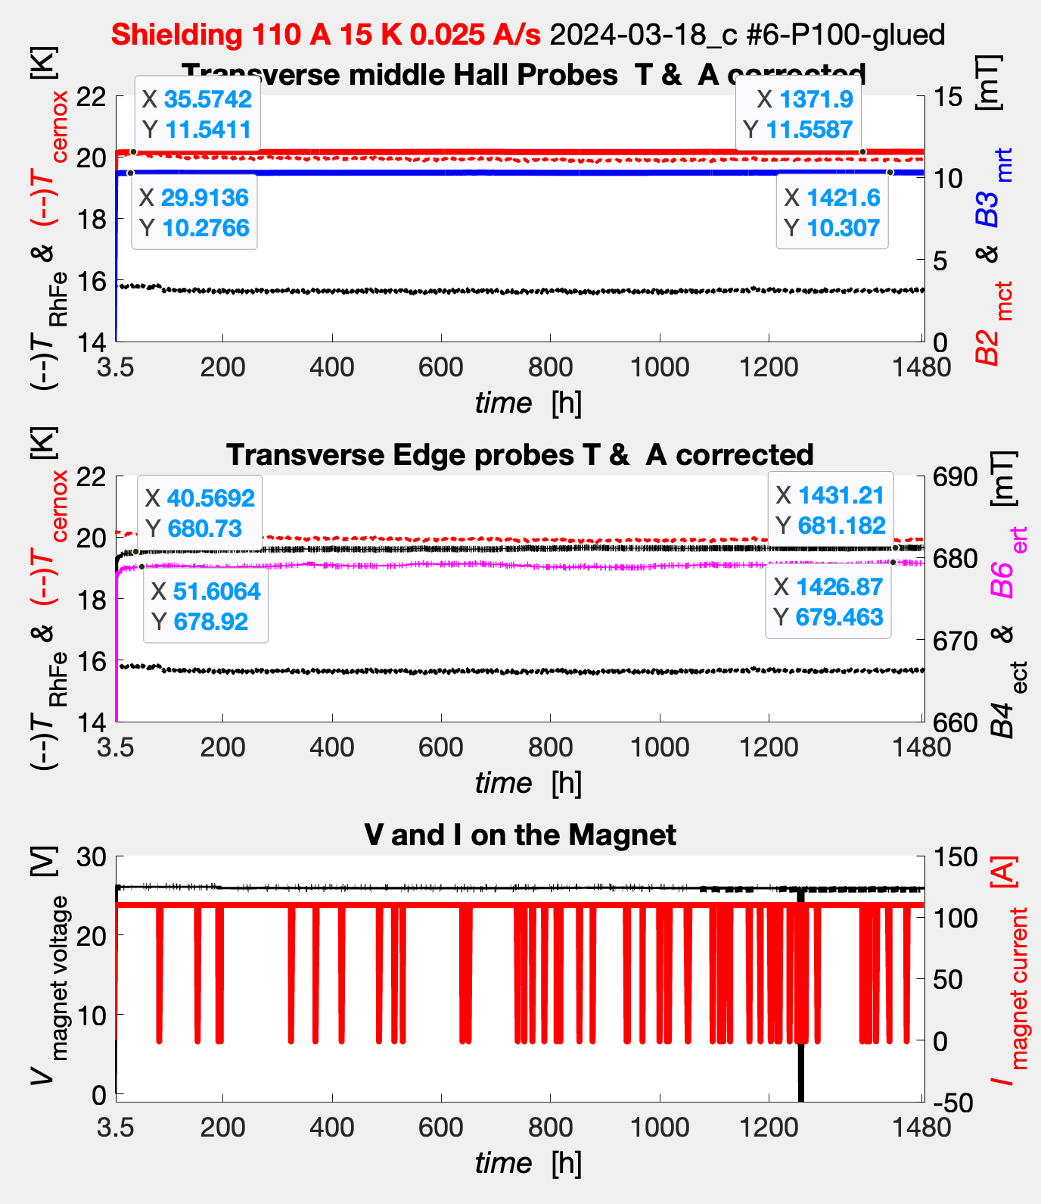
How long works the shield and how stable is it?
B₂
B₃
B₆
B₄

Slide 30
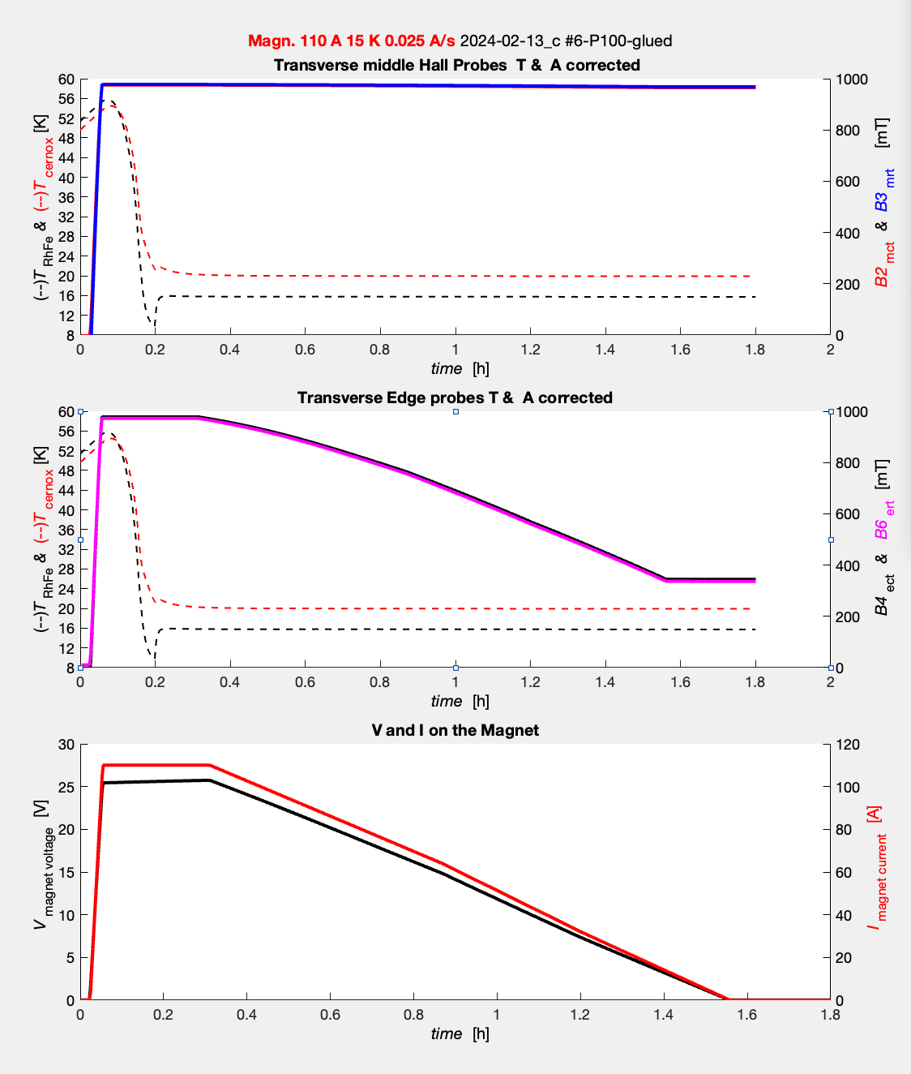
From SC to NC then Back in SC
in 1/2 hour,
we can go from superconducting state to the normal conducting one, and back at the set temperature.

Slide 31
And the other cylinders: P40 #7, P160 #8
P40 was the first one istalled after the upgrade, but ...
Smaller the grain size higher transport characteristics,
but less thermal stability at lower T and lower B.
Connectivity P100 ~ 61 %, P40 ~89 %, PAM~73 %
J_{c} experimental data for
SG (Small Grain size) continuous
and LG (Large Grain size) dashed line

Slide 32
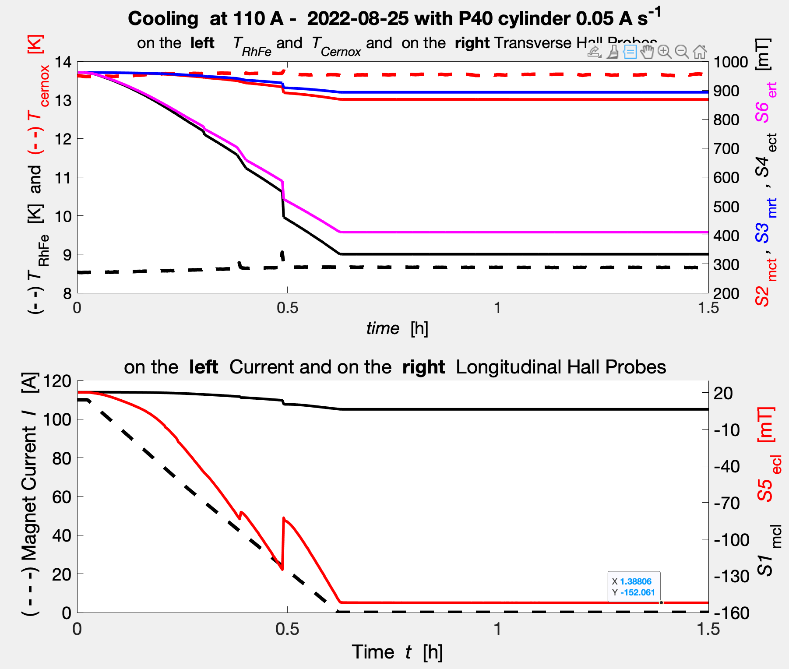
P40 #7 Sample Ramp down 0.05 A/s
11 mm }
B_{mrt} = 893 mT
B_{mct} = 868 mT
}
T_{cernox} = 13.6 K
{48 mm
B_{ert} = 410 mT
11 mm }
}
B_{ect} = 334 mT
T_{RhFe} = 8.6 K
B_{mcl} = 6.4 mT
59.2 mm }
B_{ecl} = -152 mT

Slide 33
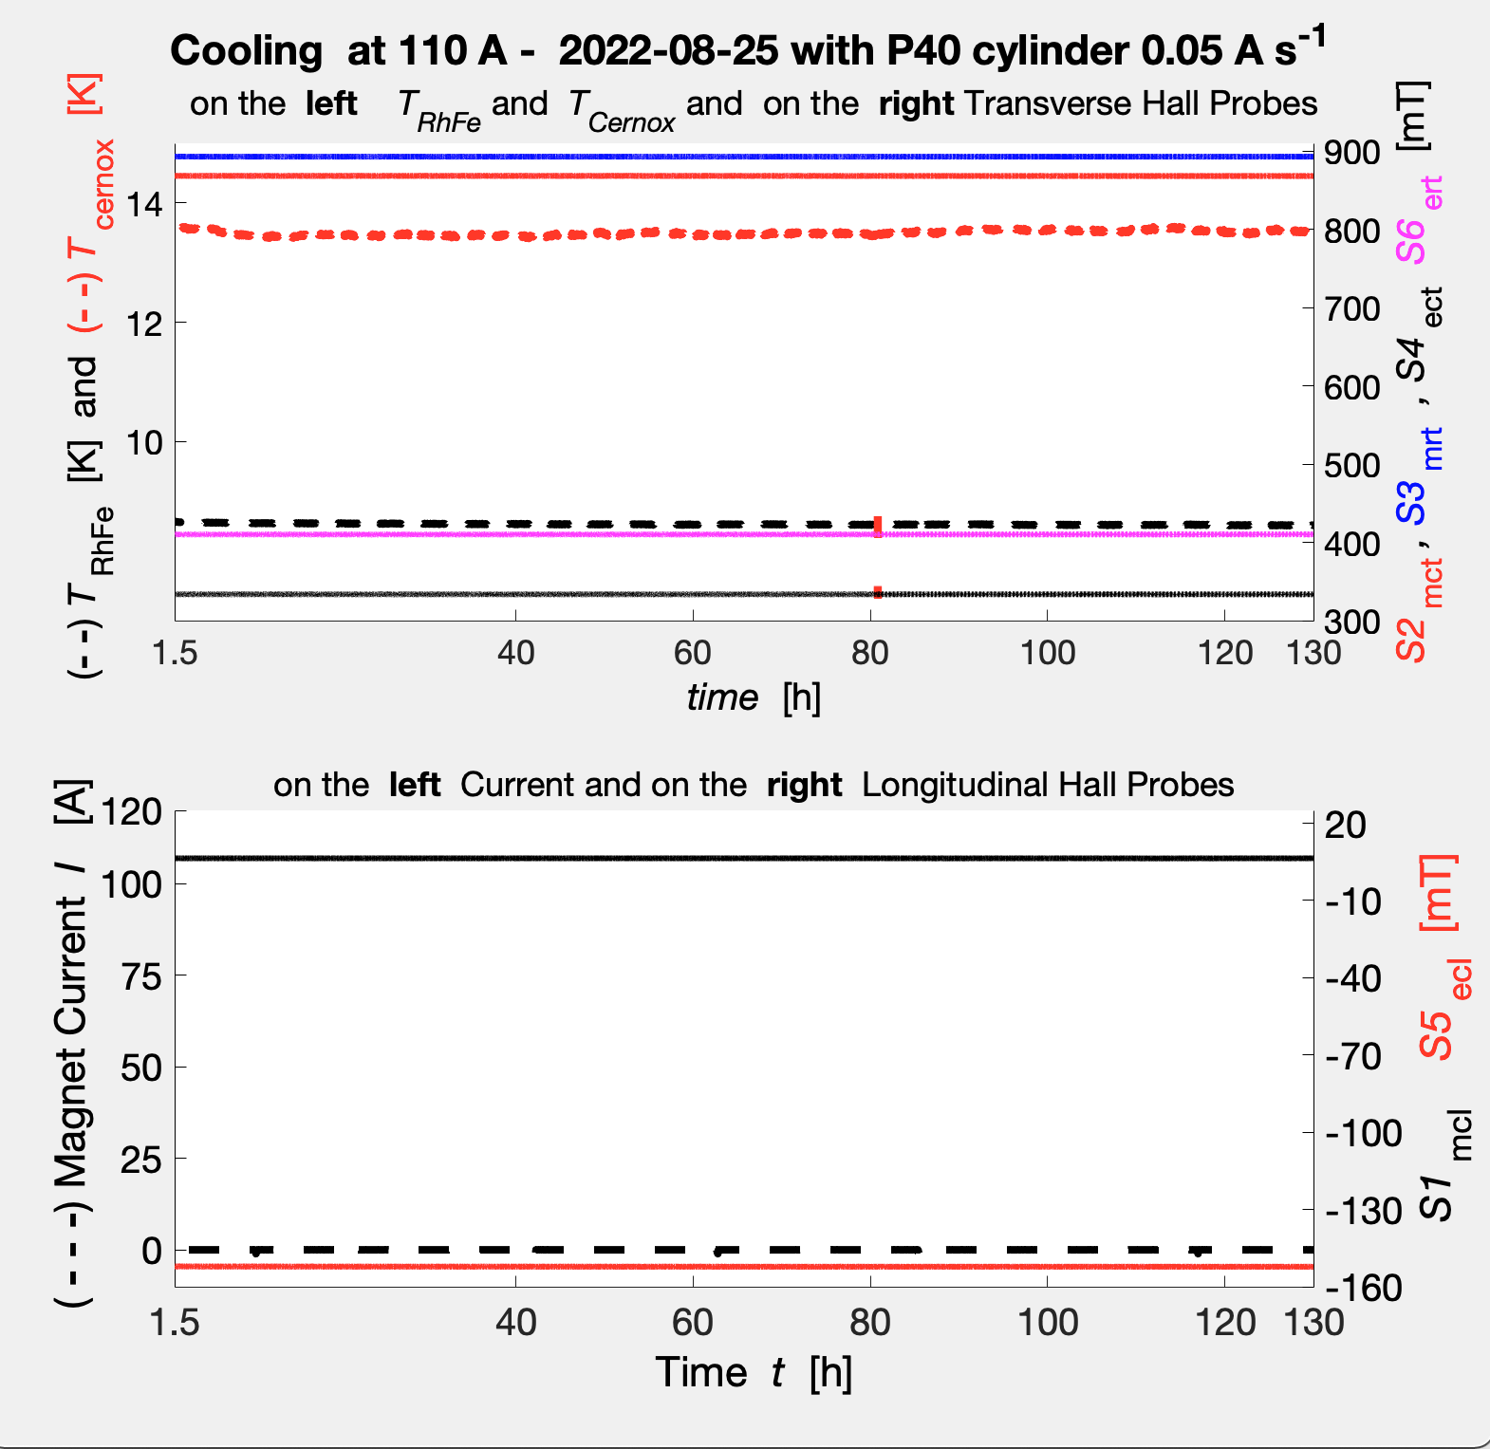
P40 #7 Sample Ramp down 0.05 A/s long
11 mm }
B_{mrt} = 893 mT
}
T_{cernox} = 13.6 K
B_{mct} = 868 mT
{48 mm
11 mm }
}
B_{ert} = 410 mT
B_{ect} = 333 mT
T_{RhFe} = 8.6 K
B_{mcl} = 6.4 mT
59.2 mm }
I_{magnet} = 0 A
B_{ecl} = -152 mT

Slide 34
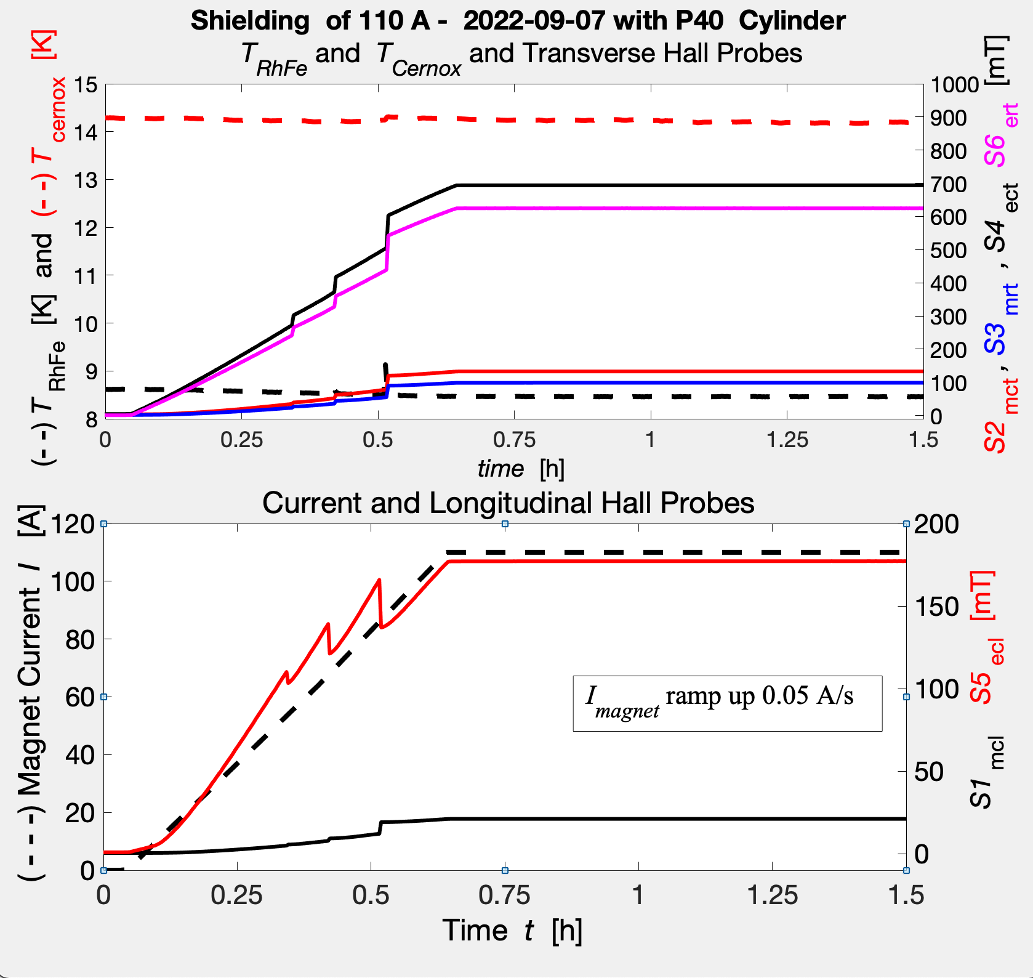
Shielding 110 A ramp up 0.05 A/s
P40 #7
Early
Zero Field Cooling
then after
reaching the lowest
temperature
Ramp up the
external field.

Slide 35
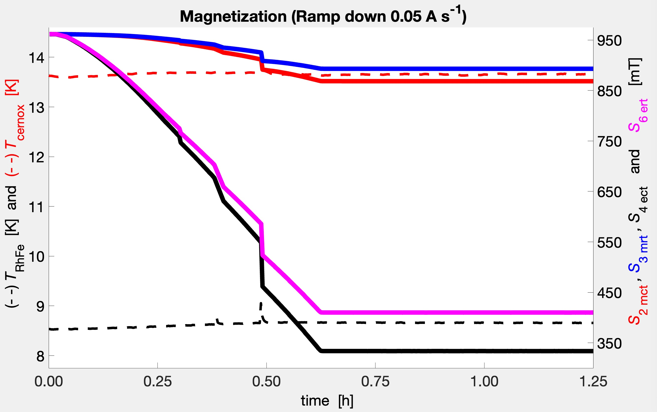
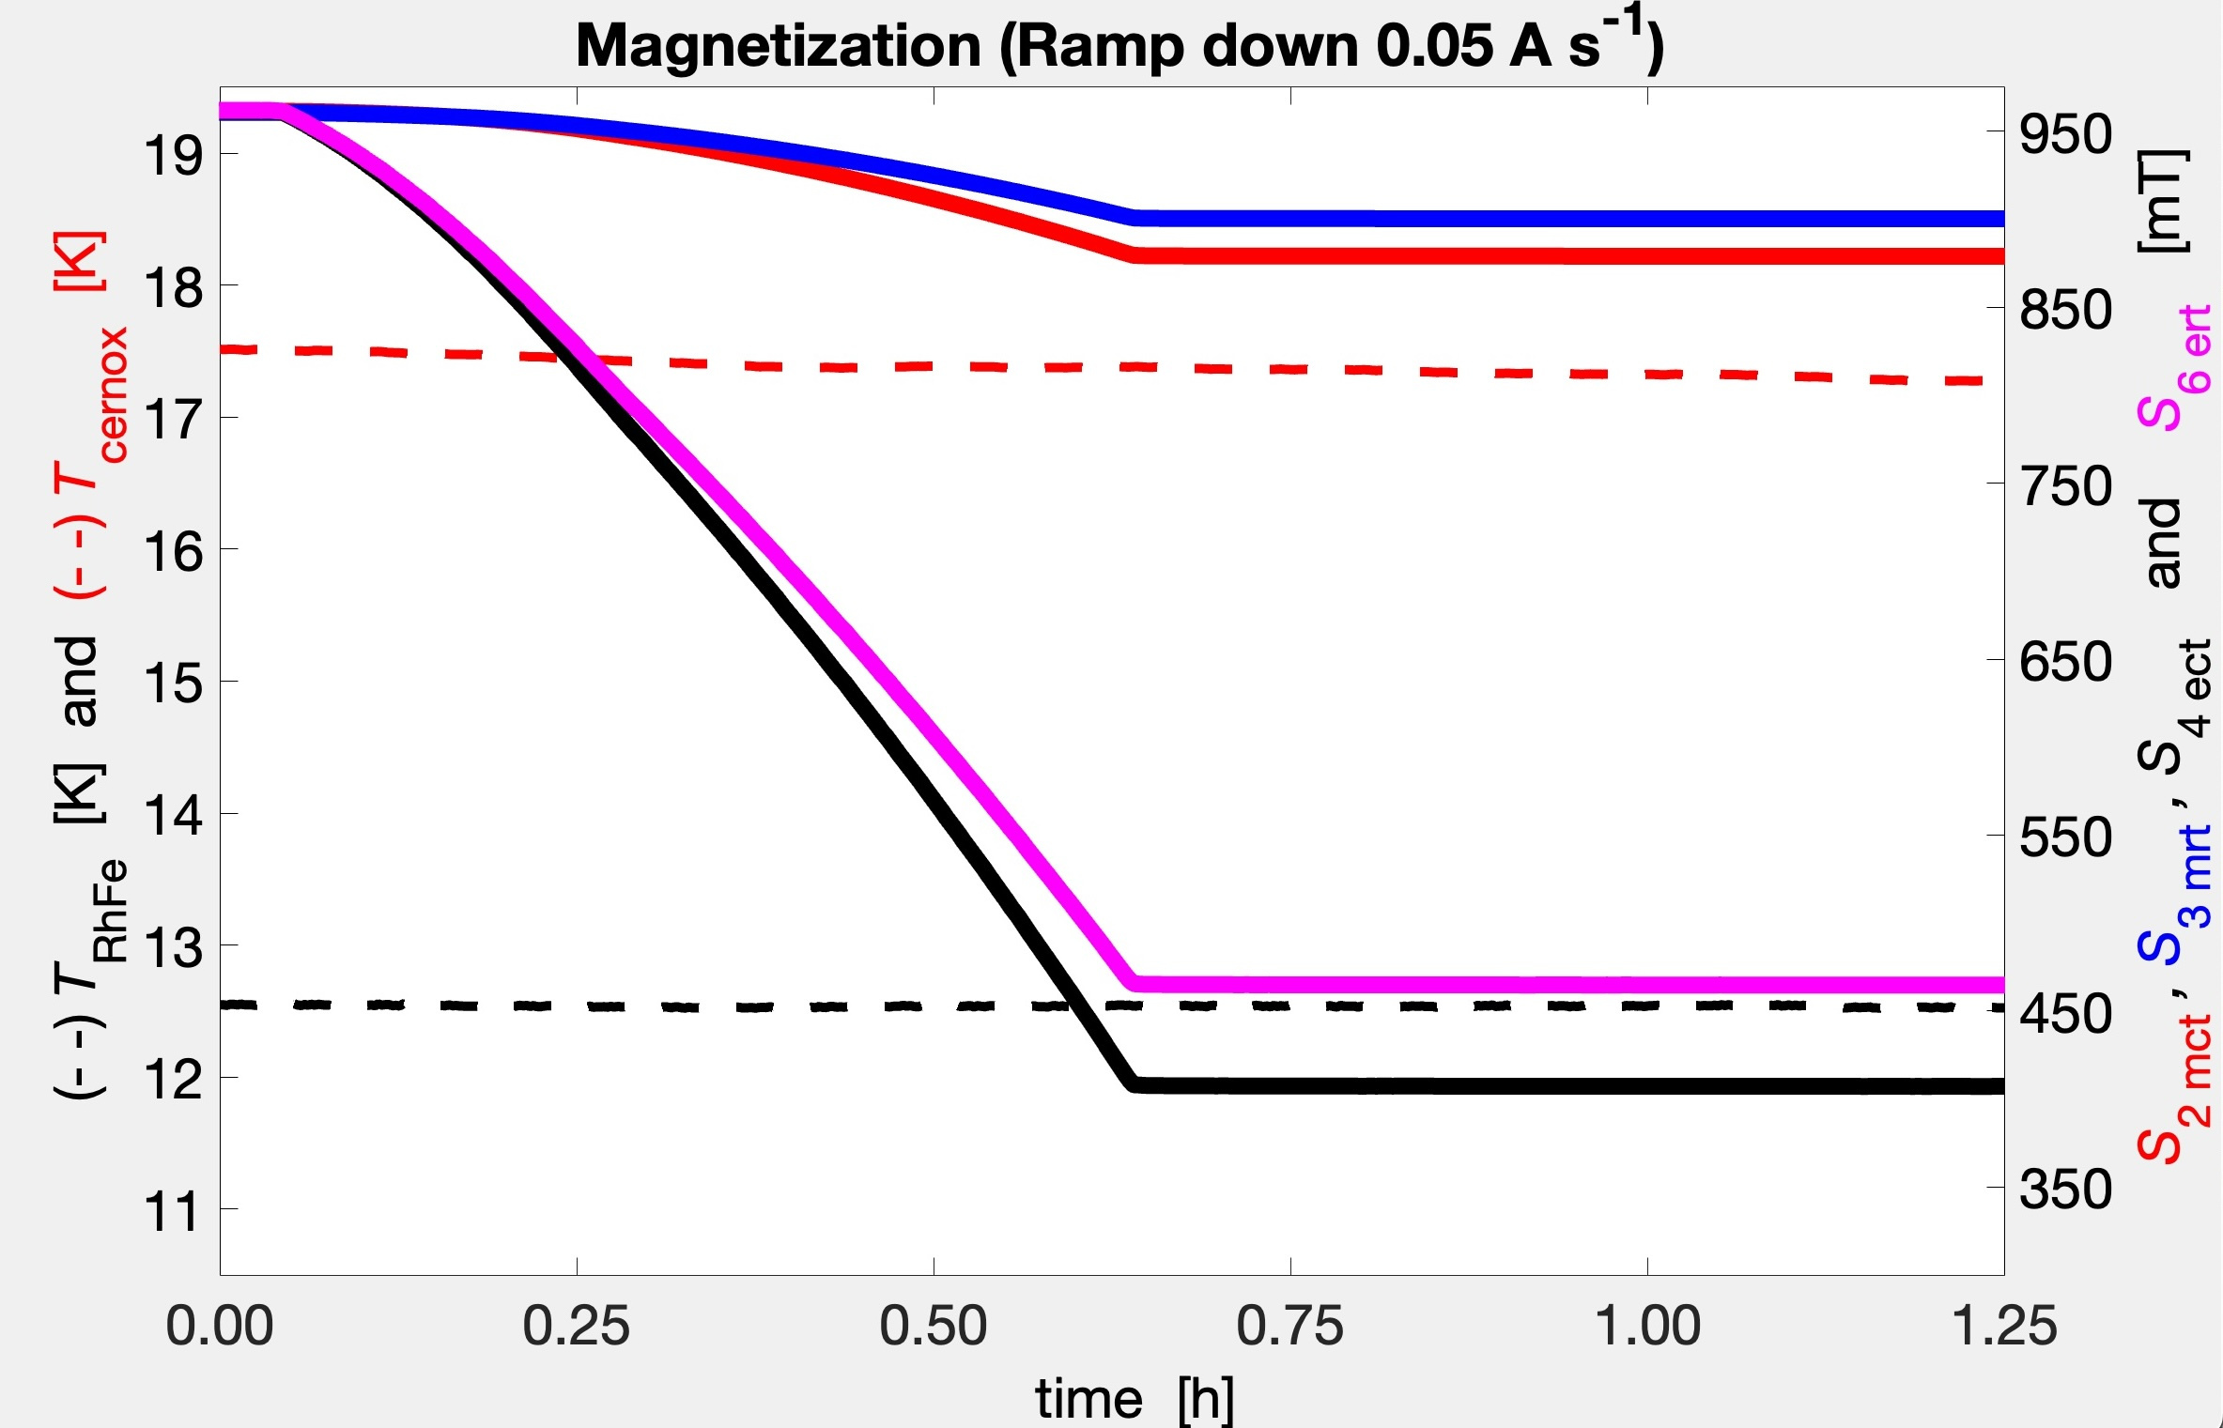
At higher temperature no flux jump
P40 #7
... but lower trapped field with respect to the P100 #6.

Slide 36
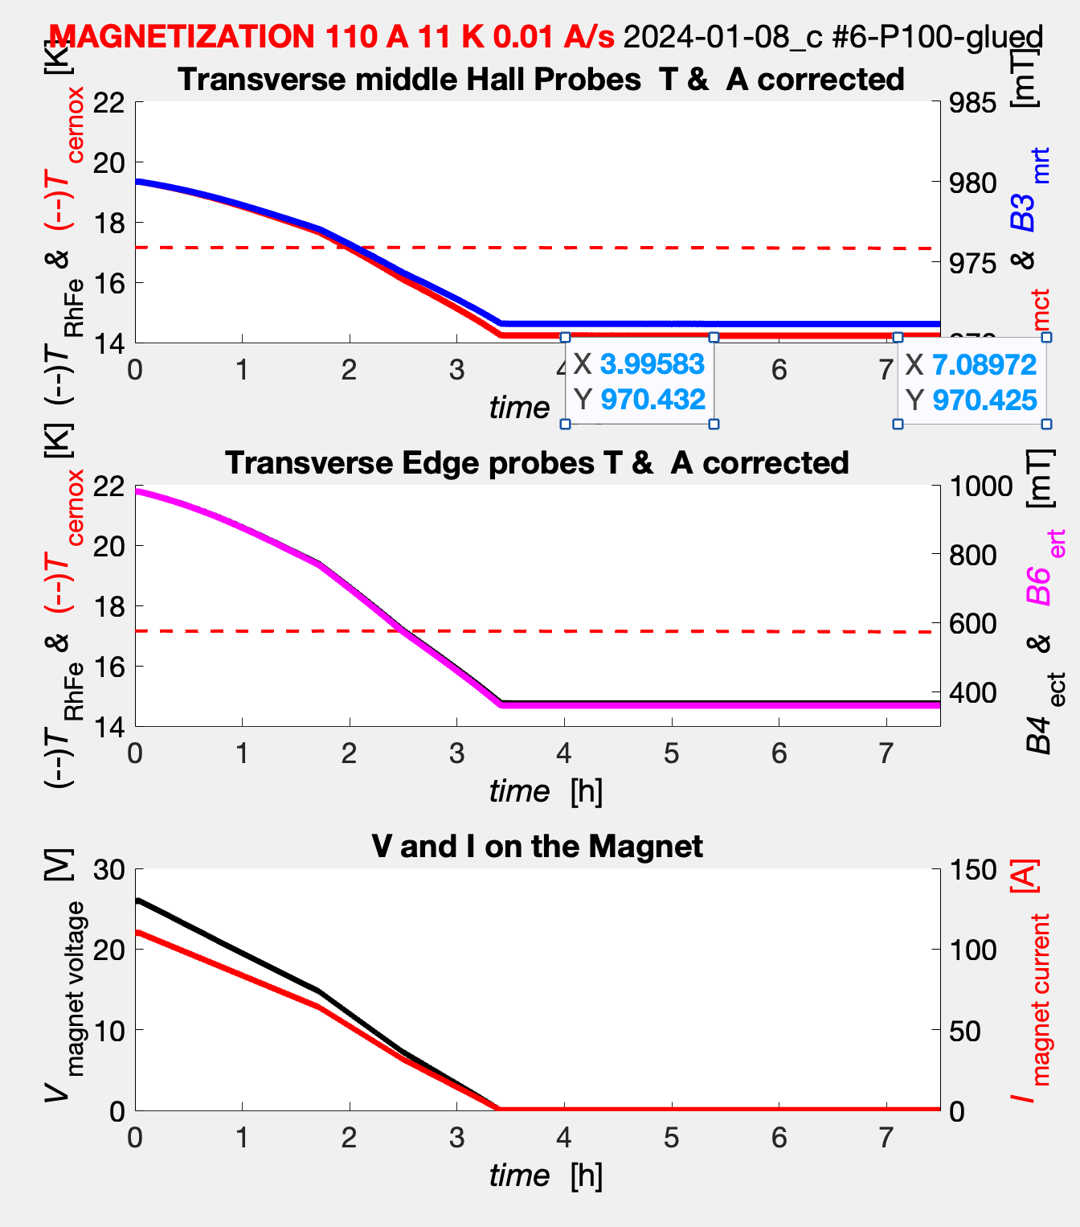
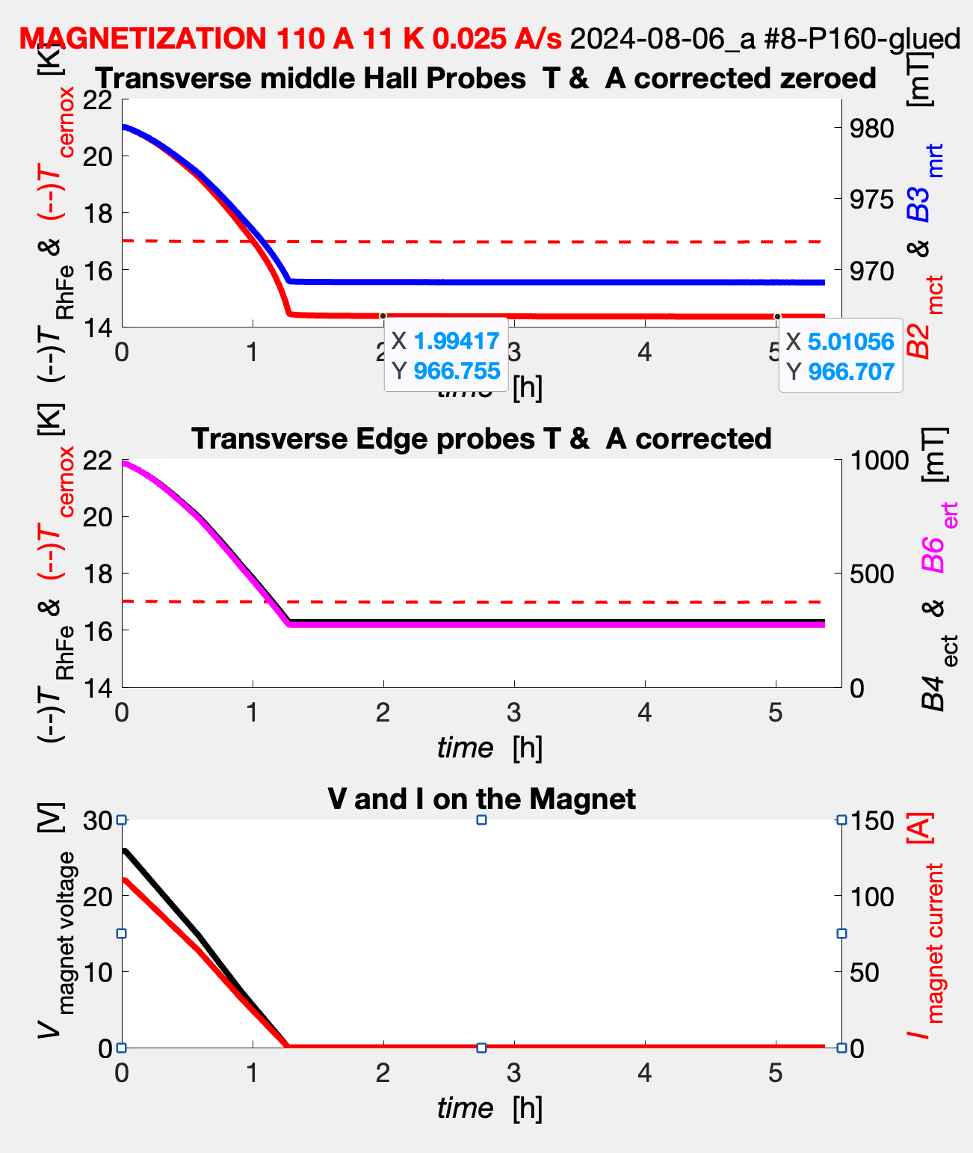
MAGNETIzzAZION: less Trapped field and decreasing speedly (10 times more)
P100 #6
P160 #8

Slide 37
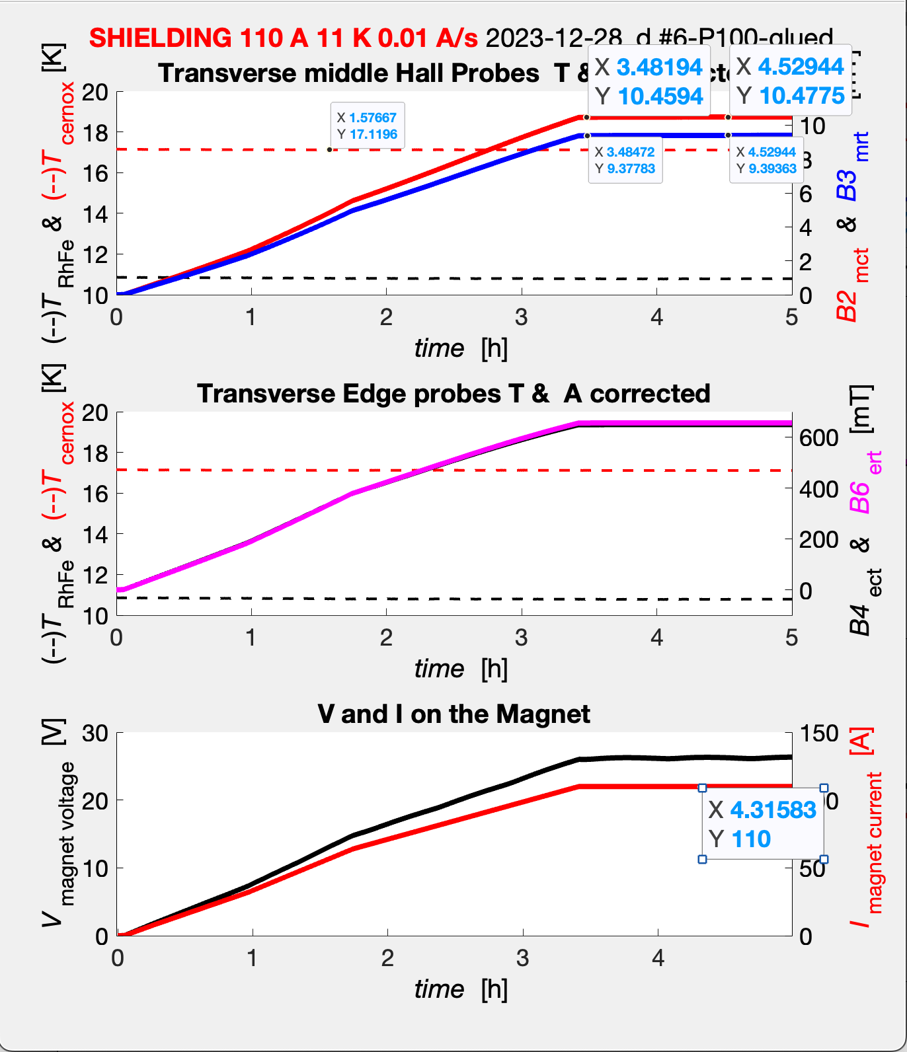
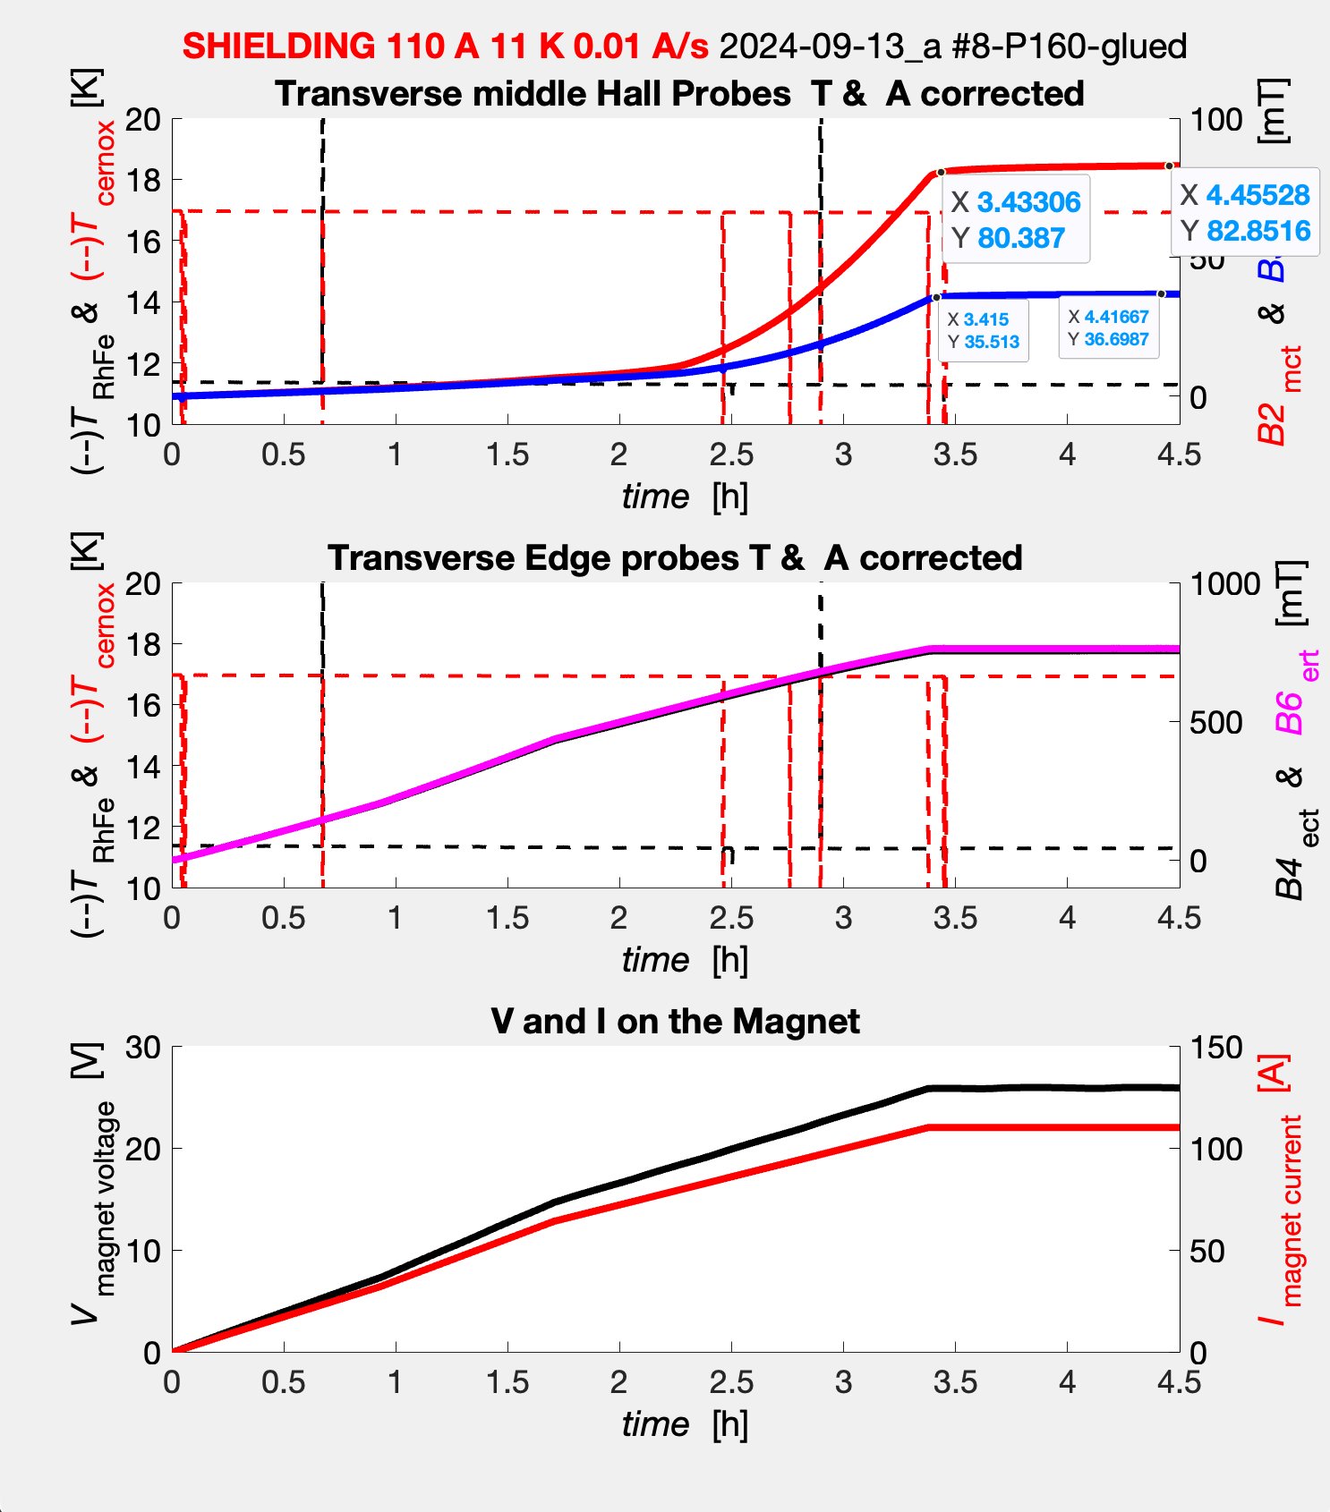
SHIELDING: higher B_{in}
and increasing speedly (100 times more)
P100 #6
P160 #8

Slide 38
Conclusions and Plans
We have in hands the system for testing «global» behavior of real bulk MgB₂ cylinders.
We can investigate the behavior of the cylinder with different preparation procedure also checking their reproducibility on the nominal label P160, P100, P40 and PAM cylinders.
We can test the superconducting behavior from the reached low temperature (T_{RhFe} 9 K - T_{cernox} 13 K) to the normal state transition.

Slide 39
FE apparatus at LASA-Milano (or...)
(Laboratorio di Acceleratori e Superconduttività Applicata)
At LASA is under plan to put in operation a 10 T superconducting solenoid.
Experimental tests on
Trapping of Tranverse field and shielding of longitudinal field (target).
Trapping of longitudinal field (fusion), but this is less critical than transverse field-
Mapping of field for tranverse self field and external longitudinal field, mapping of longitudinal field.
Checking theoretical model and tuning of them on data for field generation and shielding.
Long time stability test for crossed beam in time interval for JLab targets and fusion test.
Stability under movement in working conditions

Slide 40
Thanks to the organizers for accepting the contribution and to the audience for the attention.
I’d like to mention people involved in this work
Ferrara: Barion Luca, Contalbrigo Marco, Lenisa Paolo
Ferrara: SQUID measurements on MgB₂ sample of the production
Spizzo Federico and Del Bianco Lucia
Bari: Tagliente Giuseppe – DAQ
JLab: Lowry Michael, Sandorfi Andrew – HD-Ice and simulations
Milano: Statera Marco

Slide 41
Spare Slides for details

Slide 42
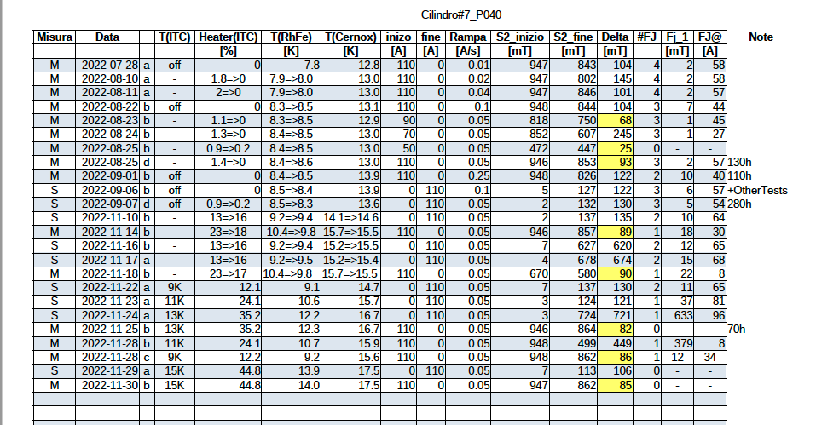
TEsts and measurements on P40 #7

Slide 43
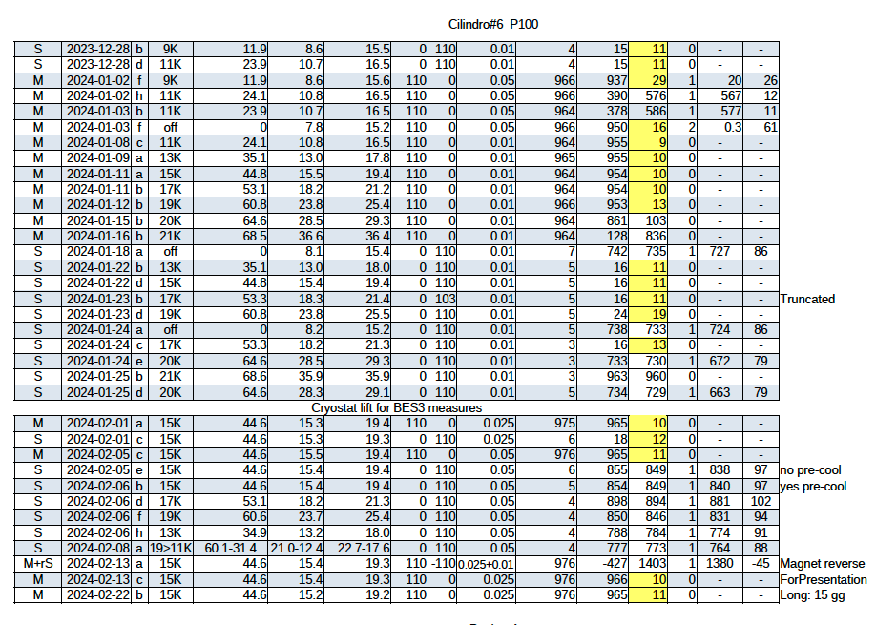
Tests and measurements on P100 #6

Slide 44
TEsts and measurements on P100 #6

Slide 45
TEsts and measurements on P160 #8

Slide 46
Shielding long term stability 1.5 -280 h.
B_{fed} = 962.5 mT
B_{ect} = 687 mT
11 mm }
T_{cernox} = 13.6 K
B_{ert} = 661 mT
{48 mm
11 mm }
B_{mct} = 147 mT
B_{mrt} = 118 mT
T_{RhFe} = 8.6 K
B_{ecl} = 177 mT
59.2 mm }
I_{magnet} = 110 A
B_{mcl} = 21mT
... ended on monday 19/9

Slide 47
CLAS12 INTEGRATION
courtesy of A. Sandorfi
In Beam Cryostat
entering CLAS12
SC magnet
4.5 T
persistent mode
LHe pumped (1.7 K)
shock absorbers
In Beam Cryostat
MgB₂ magnetization
HDice insertion
courtesy of X. Wei
47

Slide 48
Longitudinal polarized target

Slide 49
Our starting point for faisibility study

Slide 50
Lowry simulations

Slide 51
Lowry simulations

Slide 52
Production of MgB₂ by Mg-RLI (Mg Reactive Liquid Infiltration)
Fill a steel container by B Power and large chunks of MgB₂,
weld the container and perform thermal treatment at about 900-950 ºC in conventional oven for 12-24 h.
Critical temperature
(T_{C}) 39.5 K
High density 2.4 g/cm³
High connectivity
Very high superconducting characteristics
High value of critical currents

