Slide 1

The PREFER collaboration/projects
Giuseppe Ciullo & University of Ferrara
on behalf of the
COLLABORATION
Group (Responsible) | Institute
R. Engels et al. | IKP - FZJ @ Jülich
M. Büscher et al. | PGI - FZJ @ Jülich ILPP- HH University @ Düsseldorf
G. Ciullo et al. | INFN & University @ Ferrara
T.P. Rakitzis et al. | IESL-FORTH & University @ Crete

Slide 2
Fusion of Nuclear Polarized Fuel
From the point of view of the nuclear physics, the use of polarized fuel can help fusion reactions thanks to:
enhancement of cross sections,
control of angular distributions of the reaction products,
possible neutron lean reactors.
Its use is now under test in order to overcome open questions:
higher polarization and higher density (orders of magnitude more than available in nuclear polarized targets).
Preparation and Manipulation of fuel for fusion environments.
Survival of polarization in fusion environments.
It’s a challenging deal providing polarized fuel for the purposes of testing it in FUSION environments : by product we’ll gain in “better and better” targets.

Slide 3

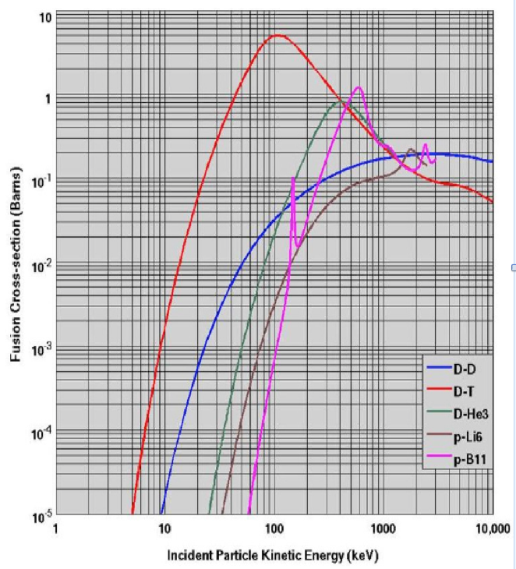
Nuclear Fusion with Polarized Fuel
Reaction generations sorted vs the relative energy (temperature) of reactants.
Generation: D + T → ⁴He + n
1.a) Increase of total cross section!!
1.b) differential cross section: control on angular distribution!!
2. Generation: D + D → T + p or ³He + n
Fuel available (30 g m⁻³ in ocean water) !!
2.a) Increase of total cross section ?
2.b) differential cross-section and angular distrib. control?
Still missing data for a complete description.
2.c) Possibility to suppress the reaction ³He + n
(QSF Quintet Suppression Factor)?
3. Generation: ³He + D → ⁴He + p
3.a) and 3.b) expected like 1.a) and 1.b)!!
3.c) Possibility of Neutron lean reactor if
D+D → ⁴He* → ³He + n suppressed (QSF)?
Missing data on D-D
spin-dependent cross-sections.
Challenge objectives
for PREFER
Missing polarized fuel
for fusion tests.

Slide 4
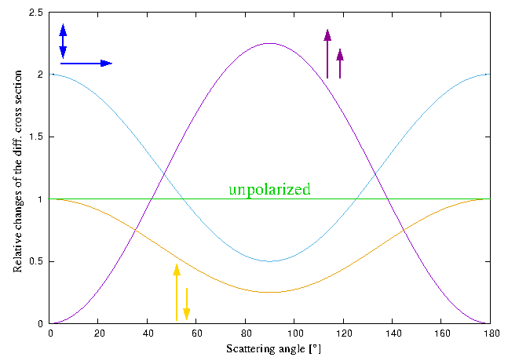
Polarized Fusion Spin ½ and 1
1.) Can the differential cross section of the fusion reactions be controlled by polarized particles ?
dσ/dΩ (ϑ) = σ₀/4π (1 – (½ P_{D}^{V} P_{T}) + (3/2 P_{D}^{V} P_{T} sin² ϑ) + ¼ P_{D}^{T} (1 – 3 cos² ϑ)
Total cross section
³He(d, p)⁴He Reaction
Leeman et al.
ANN. PHYS. 66 (1971) 810.
Factor 0.5
.
.
.
.
.
.
.
.
Factor 1.5
Factor 1
R.Engels et al. Advantages of Nuclear Fusion with Polarized Fuel in PoS 423 (SPIN2018) 176.
G. Hupin «Ab initio prediction for polarized deuterium-tritium fusion reaction»
Nat. Comm. 10 (2019) 351.

Slide 5


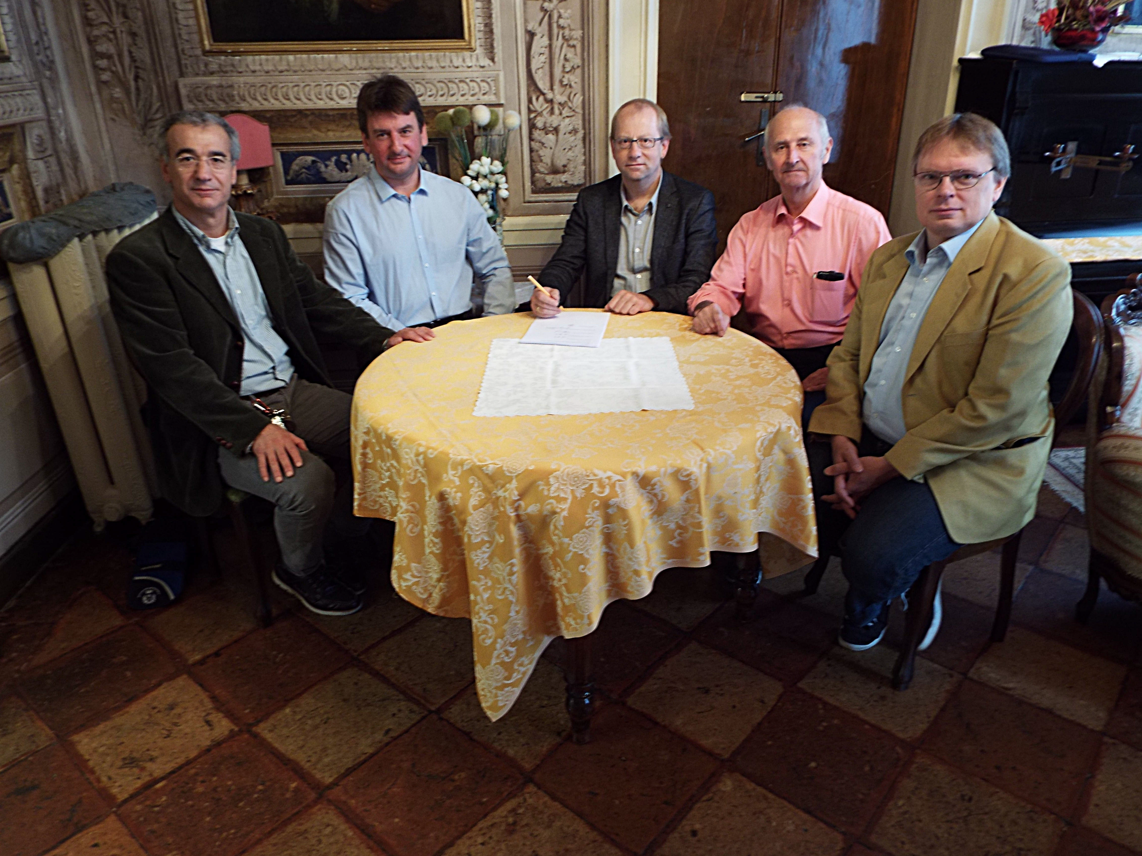
PSTP people try to involve fusion community
Contributions of the Workshops 2013 (Trento) 2015 (Ferrara)
collected in “Nuclear Fusion with Polarized Fuel”
(ed.s G. Ciullo, R. Engels, M. Büscher and A. Vasyliev)
Springer Proceedings in Physics 187
(Springer Verlag 2016 Switzerland)
The PREFER collaboration was signed in 2017 in Ferrara during a
Workshop on Polarized Fuel for Nuclear Fusion
COVID ended our meetings.
Russia-Ucraina conflict interrupted official collaboration and connection with the russian colleagues.

Slide 6
Challenge objectives of PREFER now
& before 02/2022
  @PNPI – D-D spin dependent cross-section measurements! Not anymore in the collaboration from 02/2022: just literature rumors.
  @IKP-FZJ - Production of polarized fuel: from pABS, and new proposals (Sona transitions).
  @BINP - Production of polarized fuel: from MBS Not anymore in the collaboration from 02/2022: just literature rumors.
  @ IESL-FORTH – Production polarized fuel by Laser IR-Quantum Beat (QB) excitation and Ultra Violet (UV) dissociation.
  @PGI-FZJ/HHDU - Laser Induced Plasma LIP: production, acceleration and reaction studies.
  @FE Magnets for holding, manipulating and transporting polarized fuel .

Slide 7

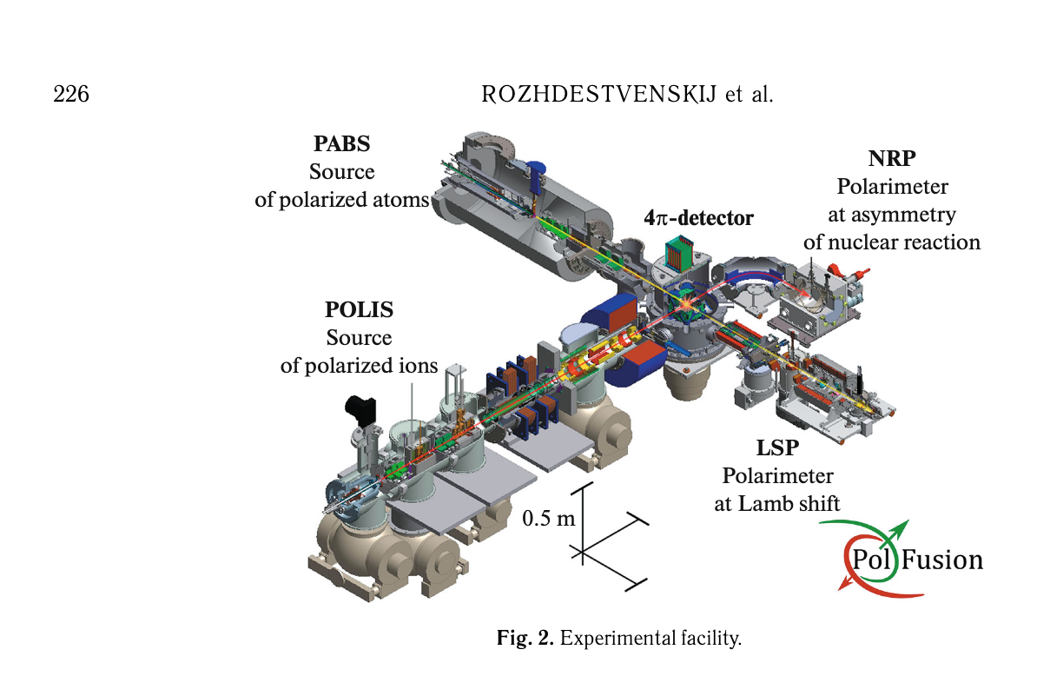


  @PNPI – D-D spin dependent cross-section measurements! Not anymore in the collaboration from 02/2022: just licterature rumors.
B. P. Ad'yasevich Czech. J. Phys. B 32 (1982) 1349.
P. Kozma et al. Czech. J. Phys. B 35 (1985) 1118.
Unpolarized with solid target
Unpolarized with gas target
Polarized beam with unpolarized solid target
Polarized beam with unpolarized gas target
A. Yu. Rozhdestvenskij et. al Phys. Atom. Nucl. 87 (2024) 224.
$$\vec{d} \left(0.1 keV\right)$$
4 10¹⁶ atom/s
Theoretical model and experiment settings: H. Paez gen Schieck
«Spin Physics and Polarized Fusion: where we stand» in Nuclear Fusion with Polarized fuel Ed.s. G. Ciullo et al. Spr. Proc. Phys. 187 (2016).
$${\vec{d}}^{+} \left(30 −100 keV\right)$$
15 μA

Slide 8
D+D → T + p / ³He + n
2° Generation
Fusing D + D, then D + T can fuses (n)
³He does not contribute at the ignition energy of D-D
The total cross section D + D in respect to the incoming polarization of the fusing particles:
Higher energy for fusion involves also P-, D-wave, togheter with S-wave and their interferences
D ↑ + D ↑ spin dependent cross section (data set very poor), and stilll worse at lower energy (electron screening ?)

Slide 9


Neutron lean fusion: QSF (Quintet Suppression Factor)
Spin alignements allows to enhance or suppress reaction channels?
Ad’yasevich 2.5 -3 (? Cited by Russian)
D↑ (d ↑ p) T and D↑ (d ↑ n) ³He suppressed
by choosing deuteron spin parallel each others
S 1 1 = 0 ⁵S₂ Quintet State Suppressed
D↑
D↑
⁴He*
S 1 -1 0 ¹S₀ Singlet state allowed

Slide 10
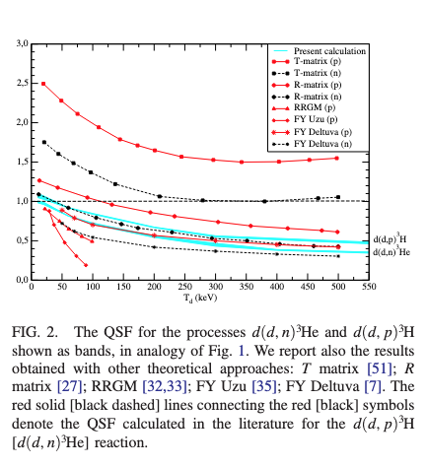
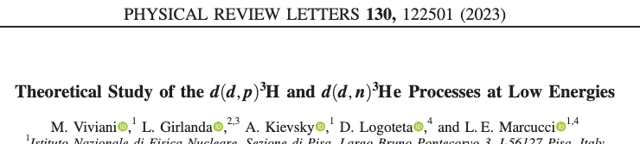
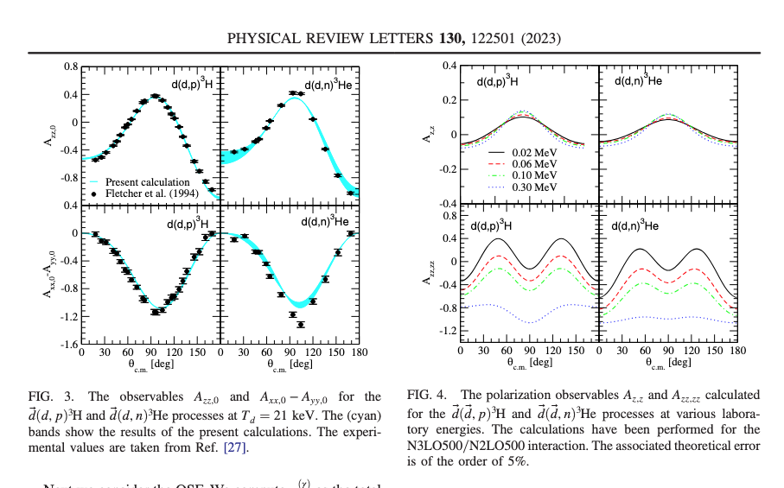

A. Yu. Rozhdestvenskij et. al Phys. Atom. Nucl. 87 (2024) 224.
$$\vec{d} \left(0.1 keV\right)$$
4 10¹⁶ atom/s
$${\vec{d}}^{+} \left(30 −100 keV\right)$$
15 μA
[9] A. Solovev et al., J. Instrum. 15, C08003 (2020)

Slide 11
Challenge objectives of PREFER now
& before 02/2022
  @PNPI – D-D spin dependent cross-section measurements! Not anymore in the collaboration from 02/2022: just literature rumors.
  @IKP-FZJ - Production of polarized fuel: from pABS, and new proposals (Sona transitions).
  @BINP - Production of polarized fuel: from MBS Not anymore the collaboration from 02/2022: just literature rumors.
  @ IESL-FORTH – Production polarized fuel by Laser IR-Quantum Beat (QB) excitation and Ultra Violet (UV) dissociation.
  @PGI-FZJ/HHDU - Laser Induced Plasma LIP: production, acceleration and reaction studies.
  @FE Magnets for holding, manipulating and transporting polarized fuel .

Slide 12
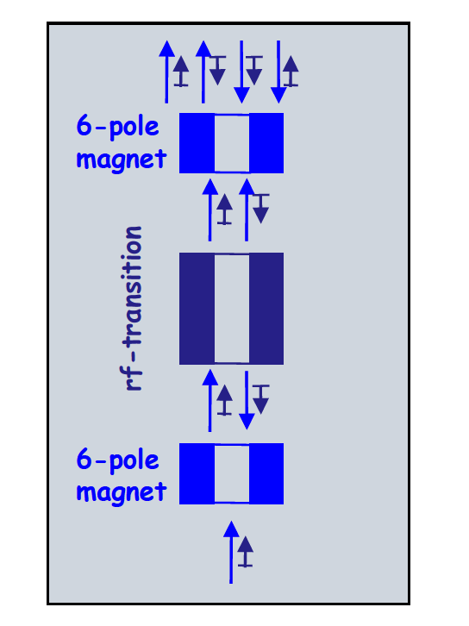
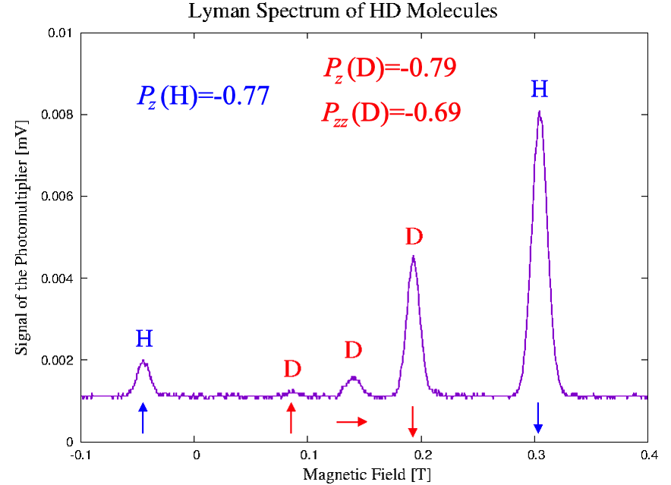
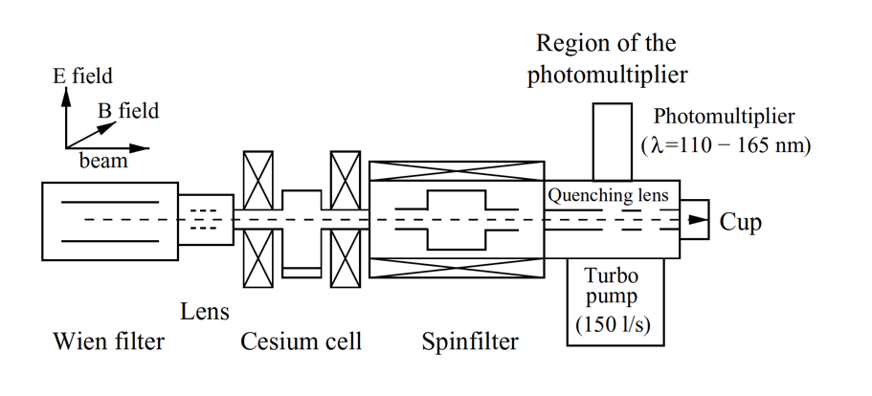
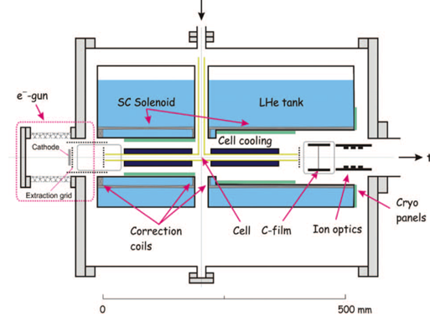

@IKP-FZJ - Production of polarized fuel: from pABS
Production
and new proposals.
See
R. Engels et al.
N. Faatz et al.
presentations in this workshop!
Polarimetry
recombination
R. Engels et al. «Production of HD molecules in definite hyperfine substates» Phys. Rev. Lett. 124 (2020) 113003

Slide 13
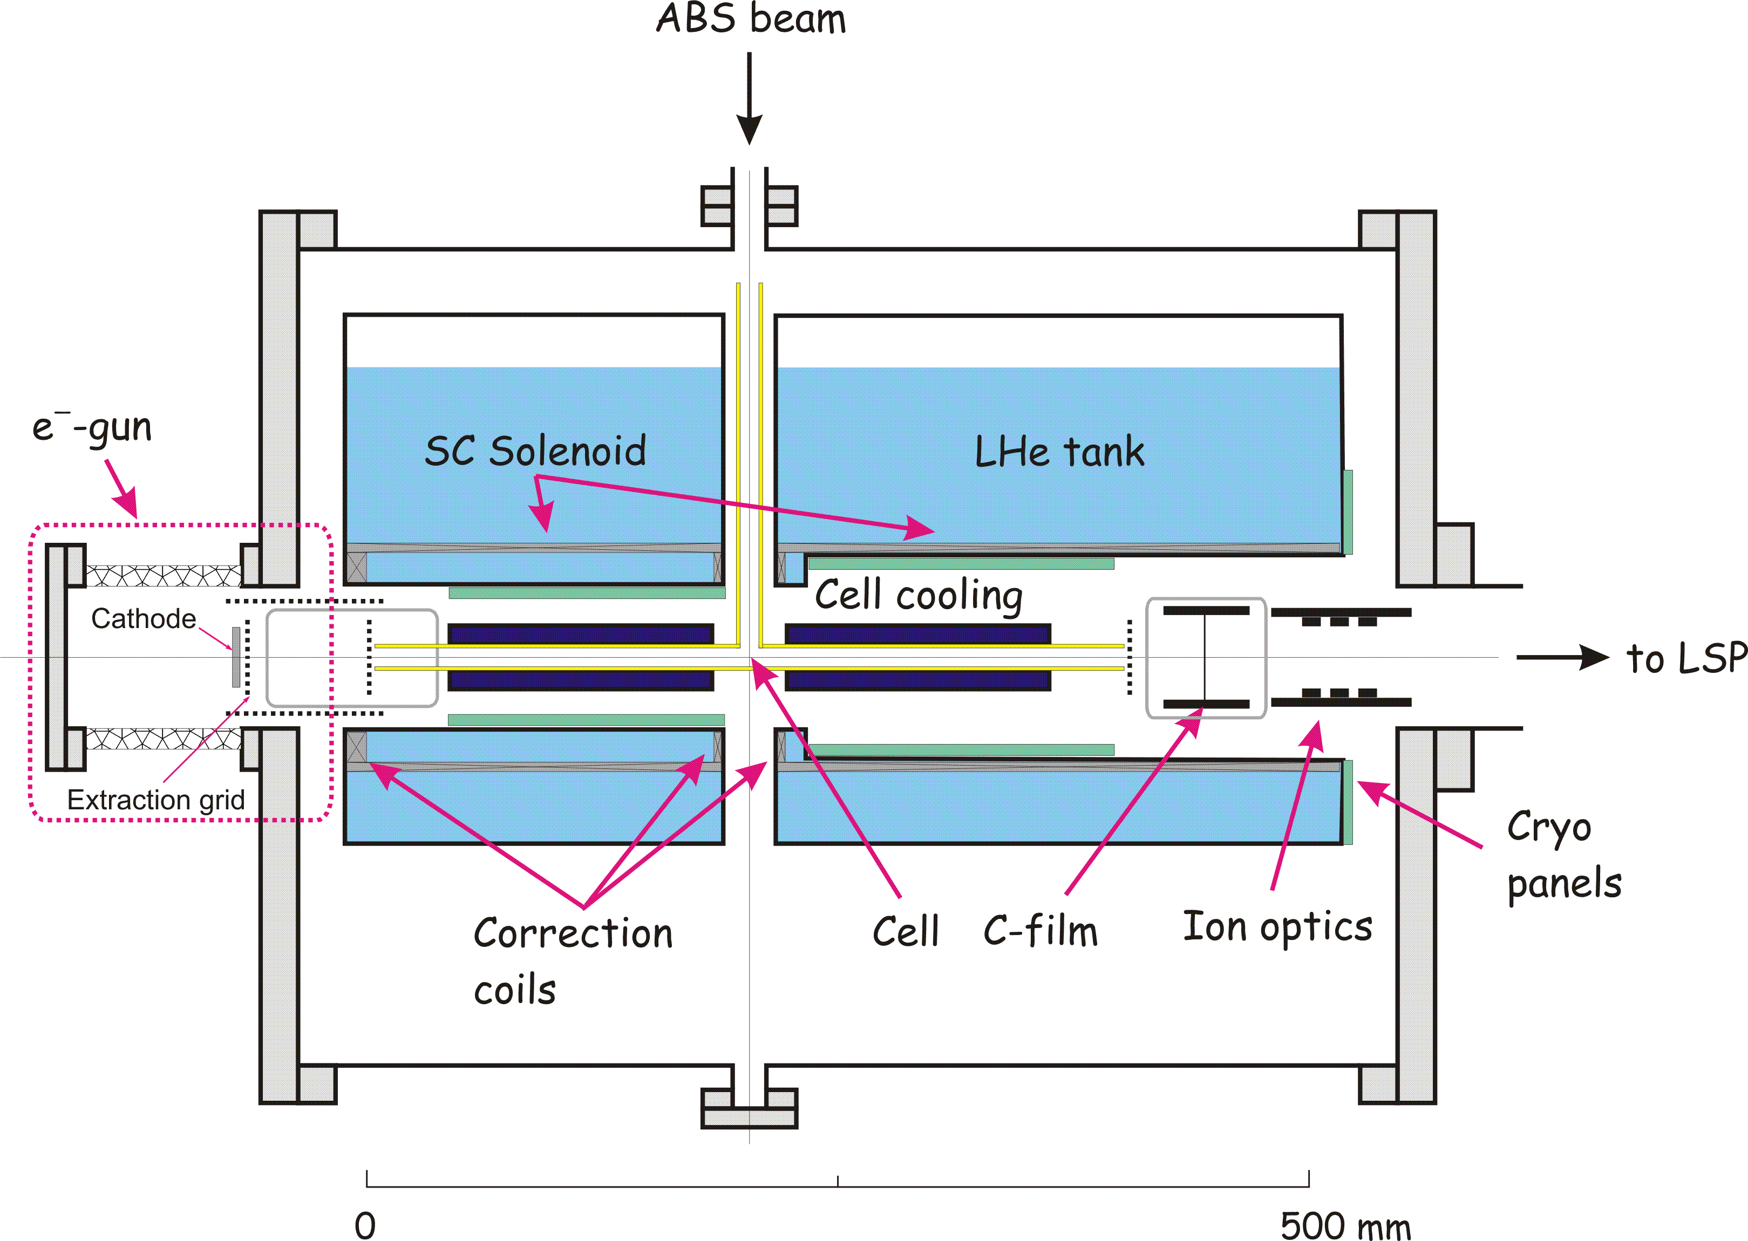
Condensation & transp. of pol. fuel
A holding magnetic field is required, for its transportation MgB₂ S.C. Bulk material @ FE
Production of 1 day
(>10²¹ molecules) is enough to feed a Tokamak for seconds,
in pellets or test in ICF !!
Cold
Head
T= 3-10K
The Target can be used for LIP fusion test and esperiments @PGI-FZJ/HHDU
D₂ ice
H₂, D₂, and HD hyperpolarized molecules can be produced with polarization of P ~ 0.8 ! For HD any spin combination is possible !
HD is a perfect training ground for the handling of TD !
The condenser is surrounded by a S.C. MgB₂ cylinder,
which provides the holding field also for transportation.
13

Slide 14
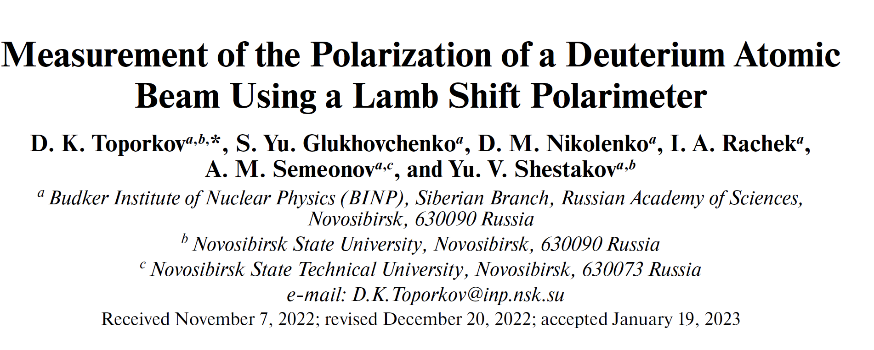
Challenge objectives of PREFER
before 02/2022
  @PNPI – D-D spin dependent cross-section measurements! Not anymore in the collaboration from 02/2022: just literature rumors.
  @IKP-FZJ - Production of polarized fuel: from pABS, and new proposals (Sona transitions).
  @BINP - Production of polarized fuel: from MBS Not anymore in the collaboration from 02/2022: just literature rumors: recent publication on LSP operation.
  @ IESL-FORTH – Production polarized fuel by Laser IR-Quantum Beat (QB) excitation and Ultra Violet (UV) dissociation.
  @PGI-FZJ/HHDU - Laser Induced Plasma LIP: production, acceleration and reaction studies.
  @FE Magnets for holding, manipulating and transporting polarized fuel .

Slide 15
Challenge objectives of PREFER now
  @PNPI – D-D spin dependent cross-section measurements! Not anymore in the collaboration from 02/2022: just literature rumors.
  @IKP-FZJ - Production of polarized fuel: from pABS, and new proposals (Sona transitions).
  @BINP - Production of polarized fuel: from MBS Not anymore the collaboration from 02/2022: just literature rumors.
  @ IESL-FORTH – Production polarized fuel by Laser IR-Quantum Beat (QB) excitation and Ultra Violet (UV) dissociation.
  @PGI-FZJ/HHDU - Laser Induced Plasma LIP: production, acceleration and reaction studies.
  @FE Magnets for holding, manipulating and transporting polarized fuel .

Slide 16
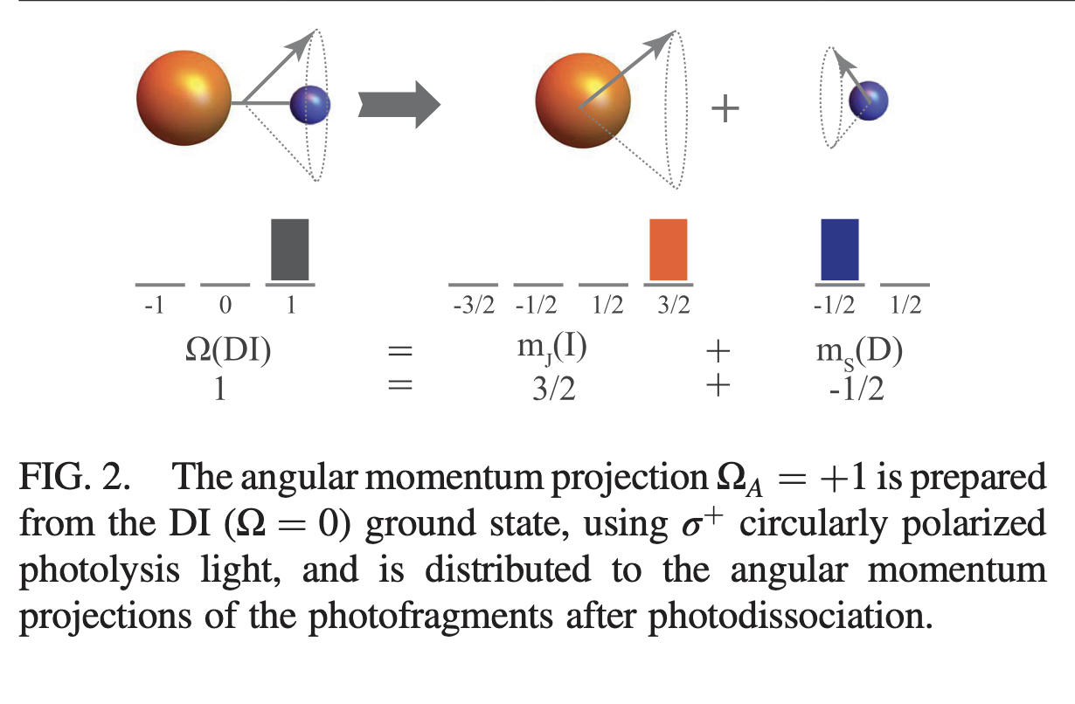
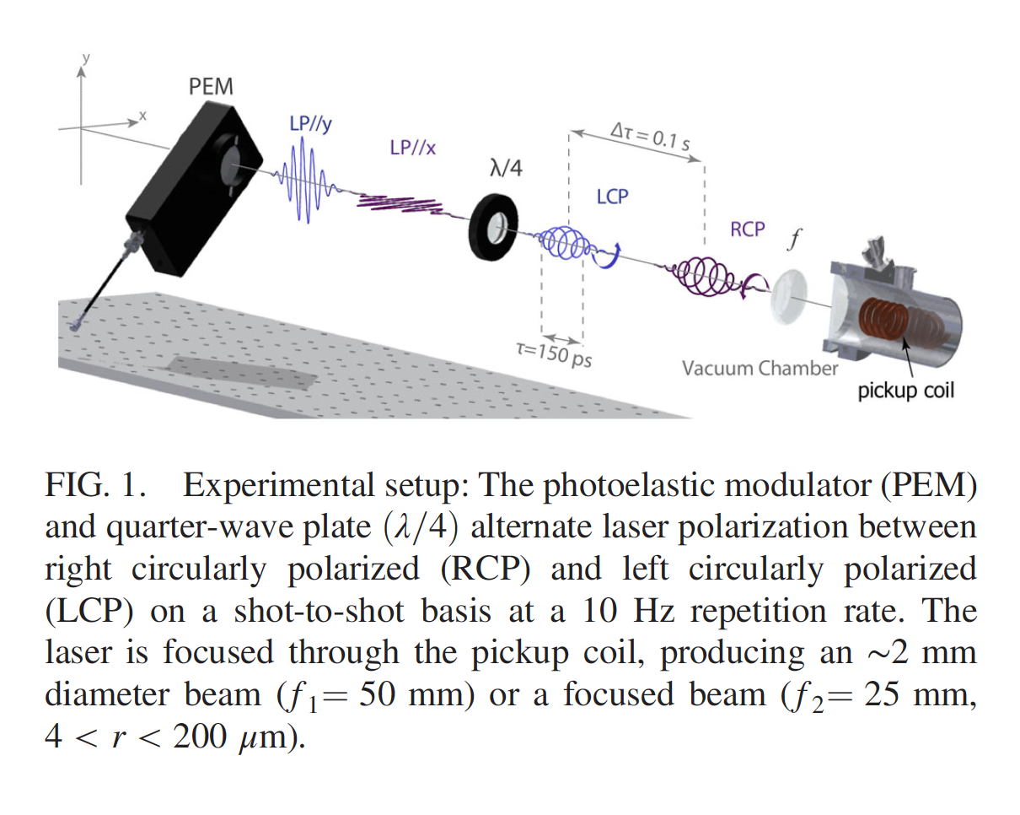
@ IESL-FORTH QB excitation and UV dissociation
The idea: ‘‘Highly nuclear-spin polarized deuterium atoms
from the UV dissociation of Deuterium Iodide”
10¹⁸ cm⁻³ SPD from DI
Pulsed Nozzle
DI
D atoms
LSP of Jülich Type
Sofikitis et a.; PRL. 118 (2017) 233401.
Laser
Excitation
> 10¹⁹ cm⁻³ SPH & SPD
Laser
Dissociation
Electron-Polarization = 1
Deuteron-Polarization ~ 2/3
HI
(Proton-Polarization = 1)
Proof-of-principle
(Univ. of Crete/FORTH, IKP/PGI in FZJ/HHUD).
Sofikitis et a.; Phys. Rev. Lett. 121 (2018) 083001.
16

Slide 17
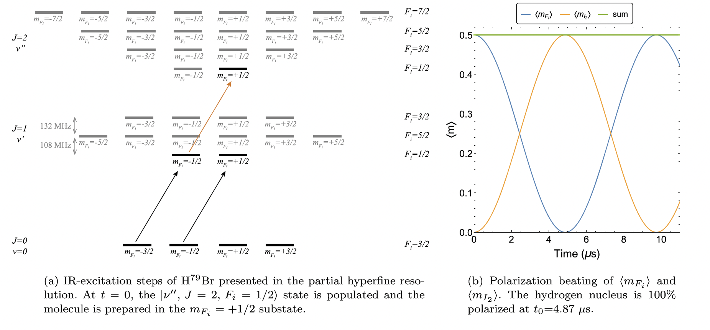
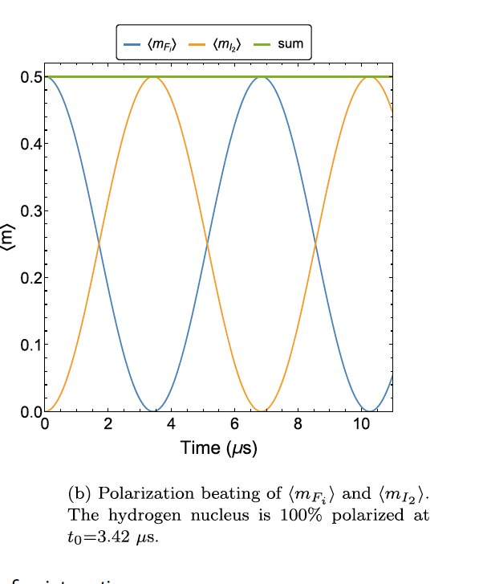
Accurate rotational state preparation and timing of shooting
HBr
I₂ proton spin and F_{i}=J+I₁
I₂ proton spin and F_{i}=J+I₁
HI
HBr excited with σ+ IR.
HBr excited with σ+ IR.
17
H isotope -Y diatomic molecules
SPH and SPD
> 10¹⁹ /cm³
vs
SEOP and S-G
~10¹³ /cm³
Notation: I₁ (Y nuclear spin) I₂ (H isotope nuclear spin) J (rotational angular momentum,
F_{i}=J + I₁ and F=F_{i}+I_{2.}
C. S. Kannis et al. Chem. Phys. Lett. 784, 139092 (2021)
After the IR excitation the UV shooting after the trasfer of polarization to p,
which can be «frozen» by a magnetic field.
C. S. Kannis et al. Mol. Phys. 120 (2022) e1975053.

Slide 18
Challenge objectives of PREFER now
& before 02/2022
  @PNPI – D-D spin dependent cross-section measurements! Not anymore in the collaboration from 02/2022: just literature rumors.
  @IKP-FZJ - Production of polarized fuel: from pABS, and new proposals (Sona transitions).
  @BINP - Production of polarized fuel: from MBS Not anymore the collaboration from 02/2022: just literature rumors.
  @ IESL-FORTH – Production polarized fuel by Laser IR-Quantum Beat (QB) excitation and Ultra Violet (UV) dissociation.
  @PGI-FZJ/HHDU - Laser Induced Plasma LIP: production, acceleration and reaction studies.
  @FE Magnets for holding, manipulating and transporting polarized fuel .

Slide 19
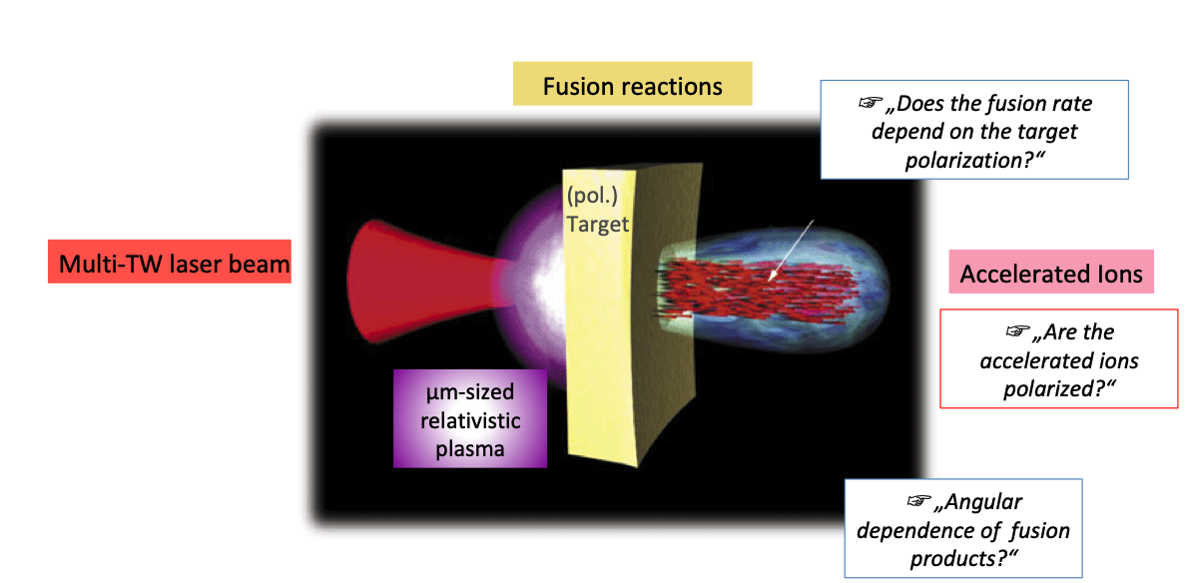
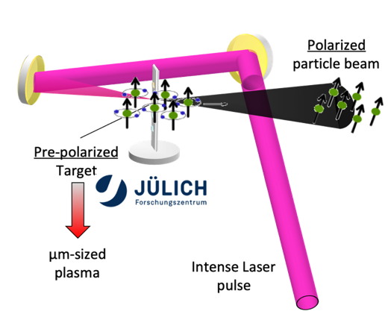
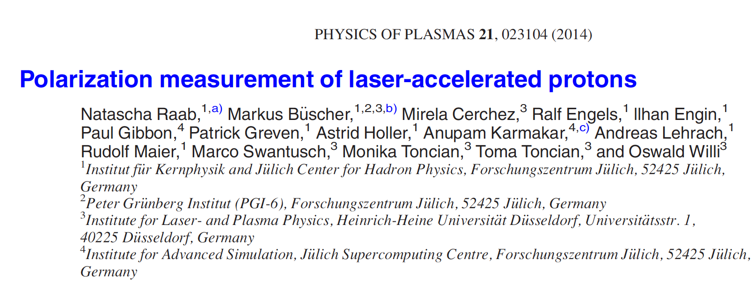
  @PGI-FZJ/HHDU - Laser Induced Plasma LIP: production, acceleration and reaction studies.
There are various proposal to produce high intense
and pure polarized fuel for fusion, but ...
... still an question is pending:
... the polarization survives in fusion environments?

Slide 20
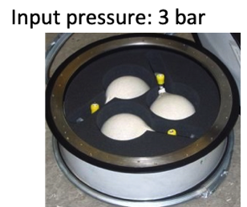
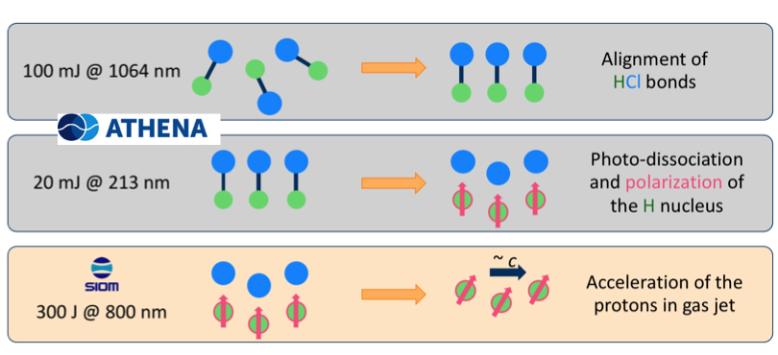
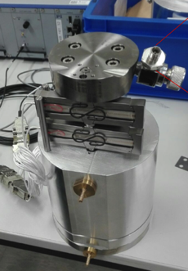
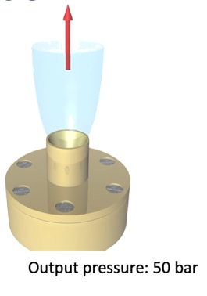
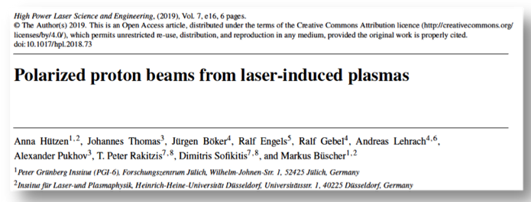
@ PGI-FZJ Polarized beams from LIP
It will be easier to start from a prepolarized beam
Polarized proton beams on IR-polarization
and post UV dissociation
compressor
Polarized He beams
From compressed polarized ³He
A. Hützen et al. High Power Las. Sci. Eng. 7 (2019) E16.
coming back to our dilemma: polarization will survive?

Slide 21
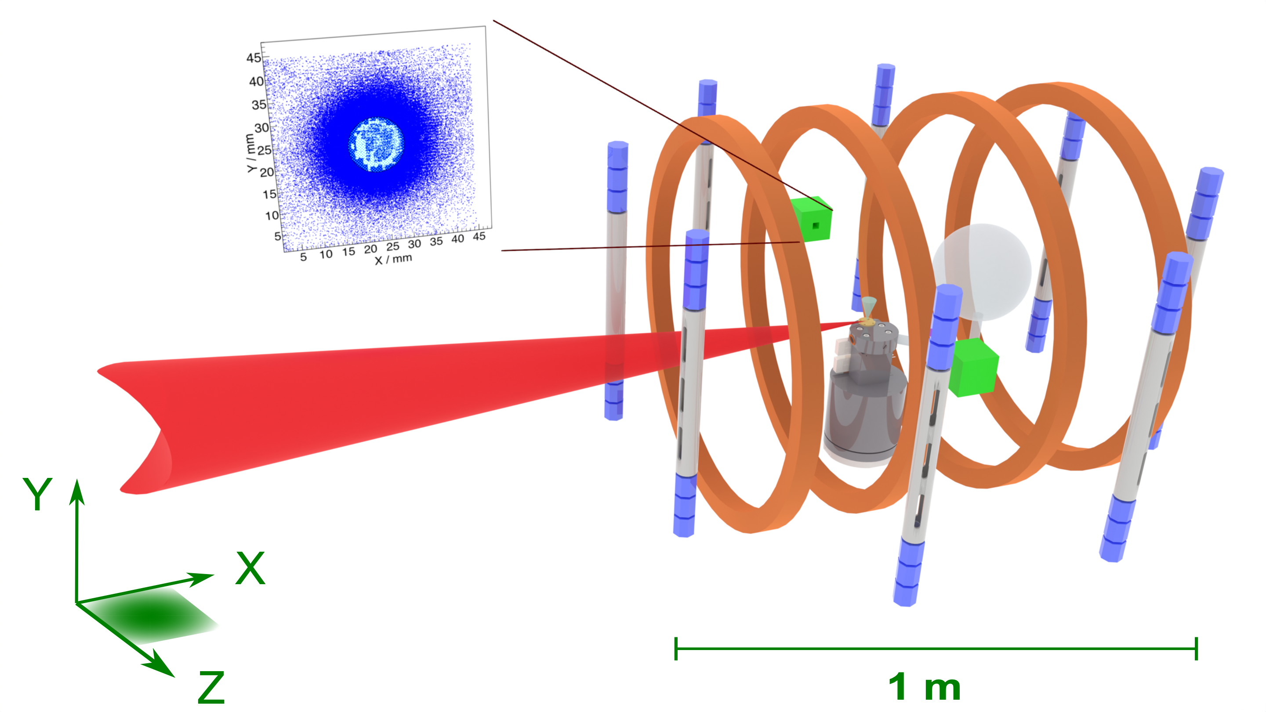
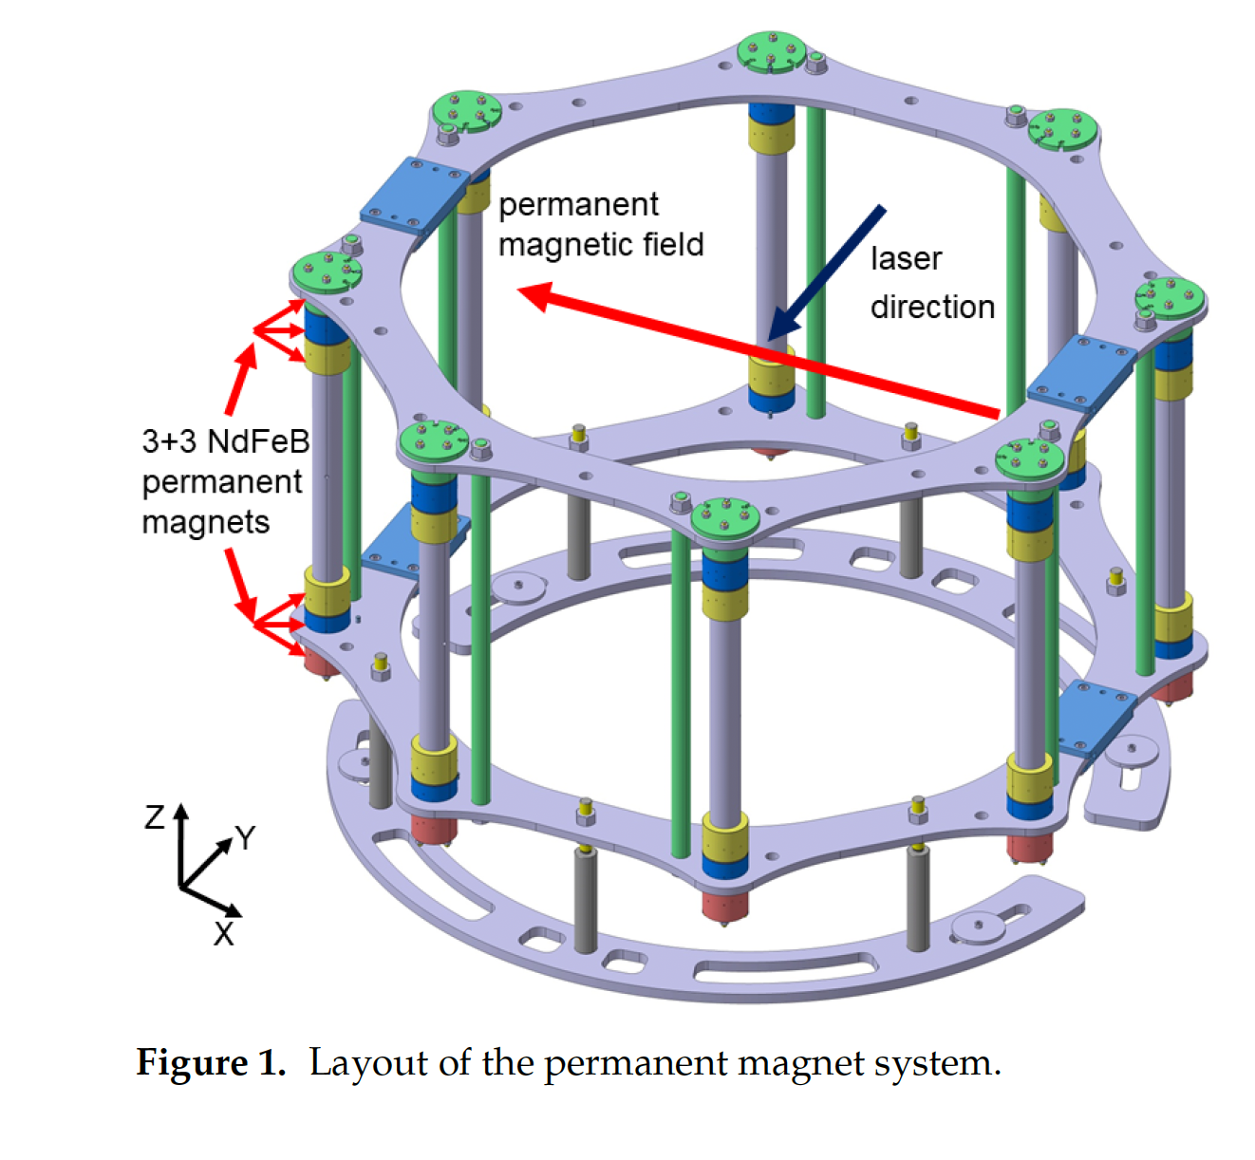
Experimental setup scheme @Phelix
Polarimeter
Polarized ³He gas glass ball.
Phelix laser beam
³He jet
Pressure booster

Slide 22
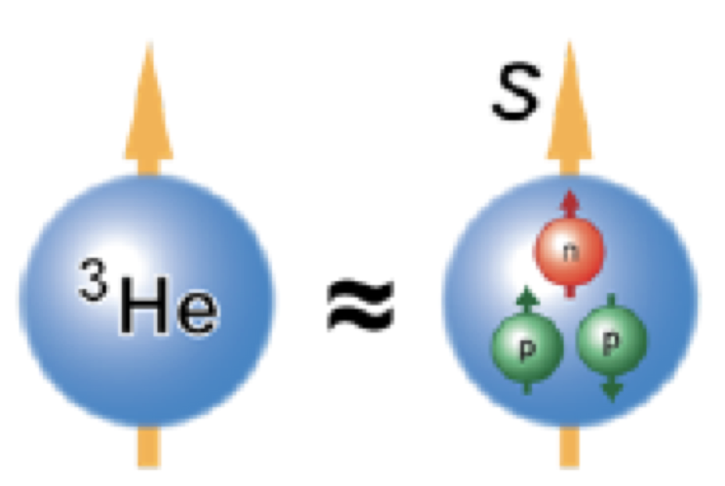
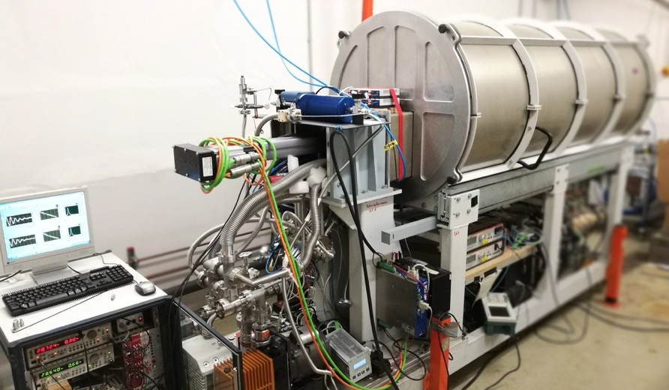
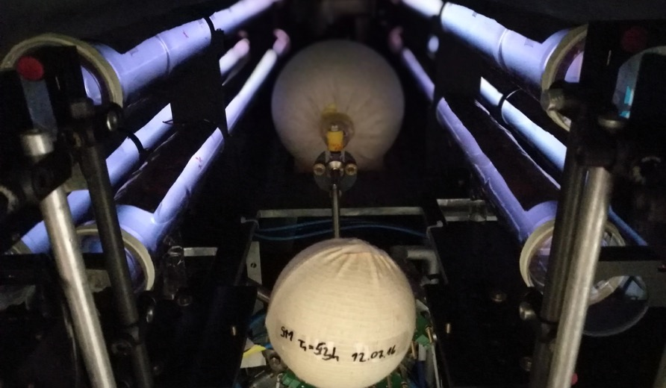
³He polarizer with recovering
Metastability-Exchange Optical Pumping
(polarizer borrowed from Univ. Mainz)
Max. ³He polarization: ~75%
Relaxation times: hundreds of hours (up to 3 bar in transport vessels)
C. Mrozik et al., Construction of a compact ³He polarizing facility, J. Phys. Conf. Ser. 2011, 294, 012007

Slide 23

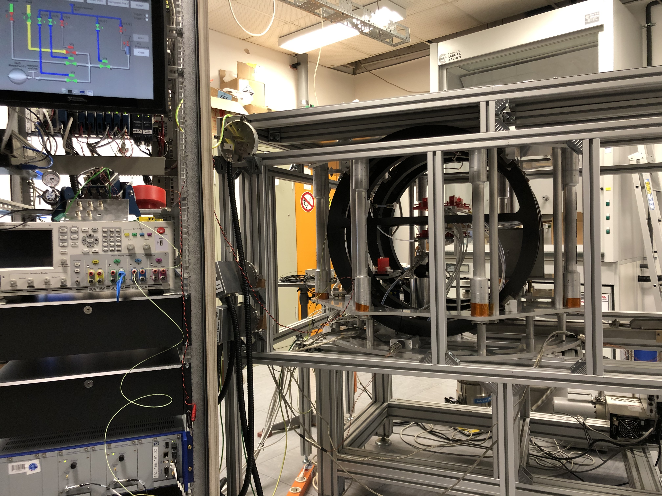
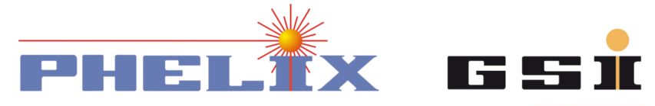
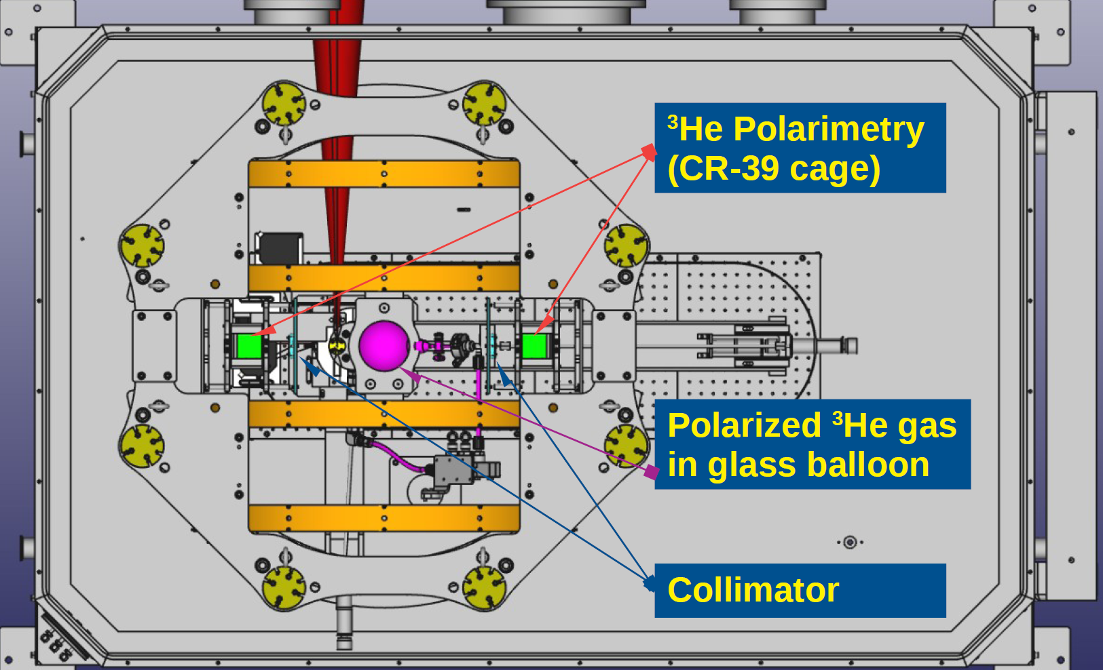
Polarized ³He gas-jet
Up to 80% nuclear polarization
magnetic holding field
for storing pre-polarized
³He gas @3 bar
compressor increases pressure of
³He gas to ~30 bar
non-magnetic nozzle provides the desired gas-jet target
Target @
Feasibility studies of laser induced acceleration on ⁴He
Best Working points:
+ 90° Laser dir.
⁴He⁺⁺ 4.65 MeV
⁴He⁺ 3.27 MeV.
Gas Backing p= 30 bar
40-60 J & 1.6-3.2 ps
jet of 4 10 ¹⁹ cm⁻³
I. Engin et al.,
Plasma Physics and Controlled Fusion 61 (2019) 115012
High density polarized ³He Gas-Jet Target 3/4 10¹⁹ cm⁻³
P. Fedorets et al.
Instruments 6 (2022) art.n. 18

Slide 24
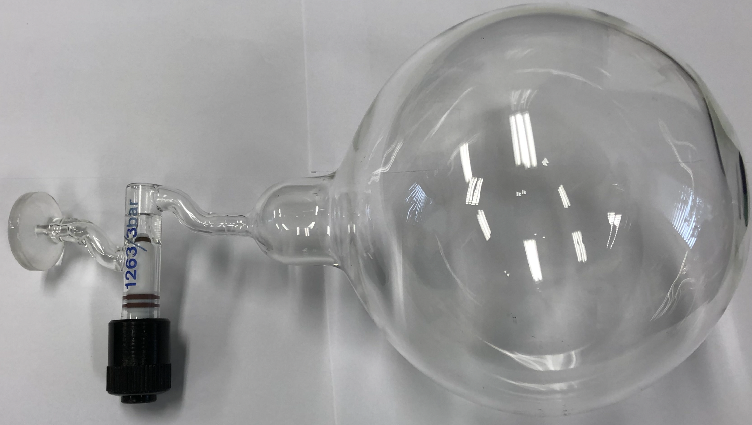

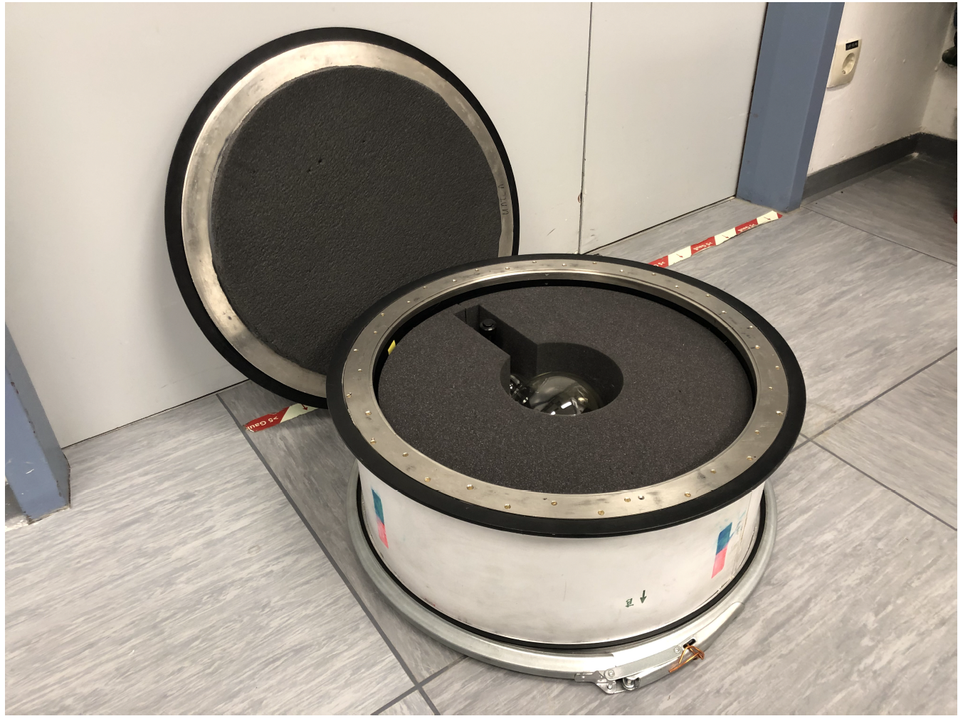

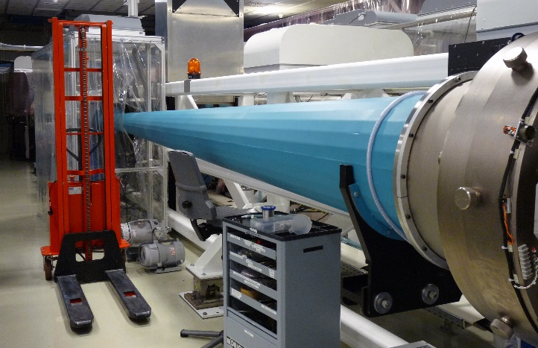

Transport of Polarized ³He gas
Every morning: Transfer of 3 bar-liter ³He from FZJ to GSI (250 km)

Slide 25
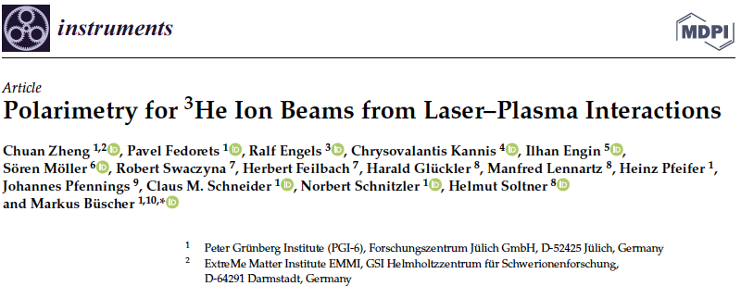
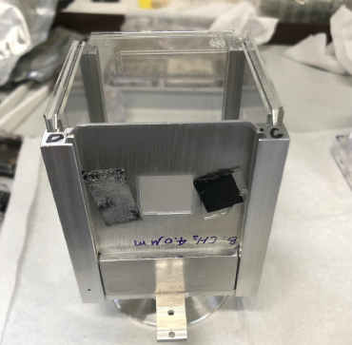
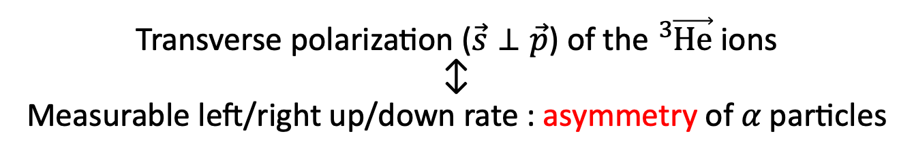
Polarimetry for ³He ions
Employing analyzing power of the $D\left({}_{ }^{3}{\vec{He}},α\right)p$ reaction
Polarimeter
Polarimeter
on
CD₂ foil
Helmholtz coils
off
Polarimeter
x
− on
z
³He polarization along z mantained with (1.3 mT), Helmoltz coils (10 A and 5 mT max) hallow to rotate the polarization along the x axis (+ 75.5°) relative to the ³He ion momenta.
Transverse polarization ($\vec{s}⊥\vec{p}$) of the ${}_{ }^{3}{\vec{He}}$ ions
↕︎
Measurable left/right up/down rate : asymmetry of 𝛼 particles
Contains CD₂/CH₂ foil and 5 CR-39,
front, left, right, bottom and top.
PSTP 24 Newport News

Slide 26
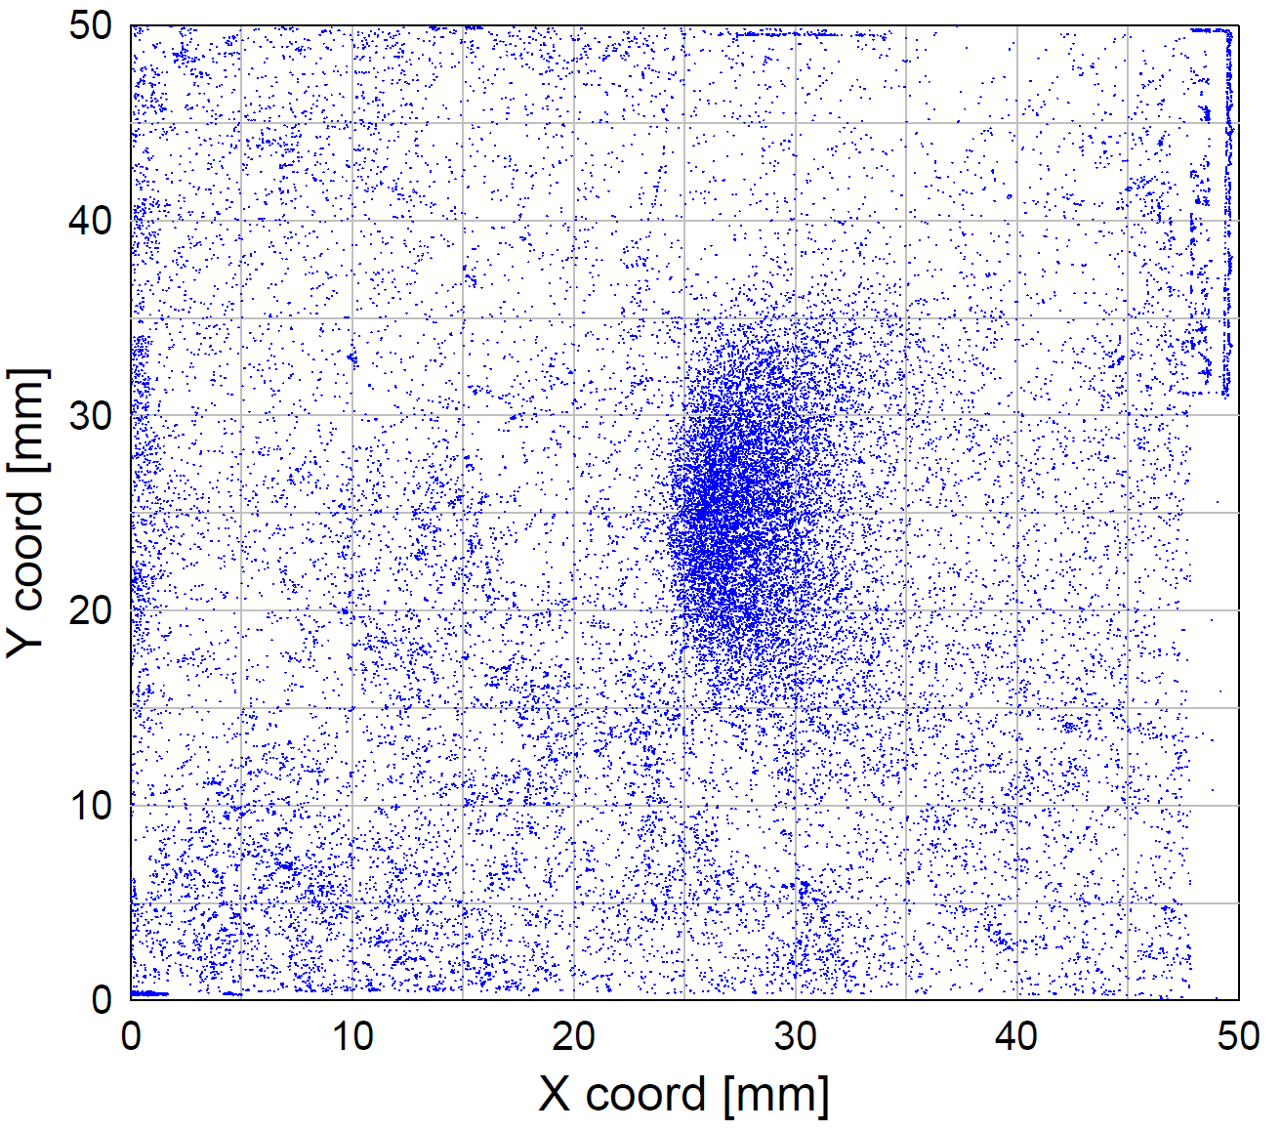
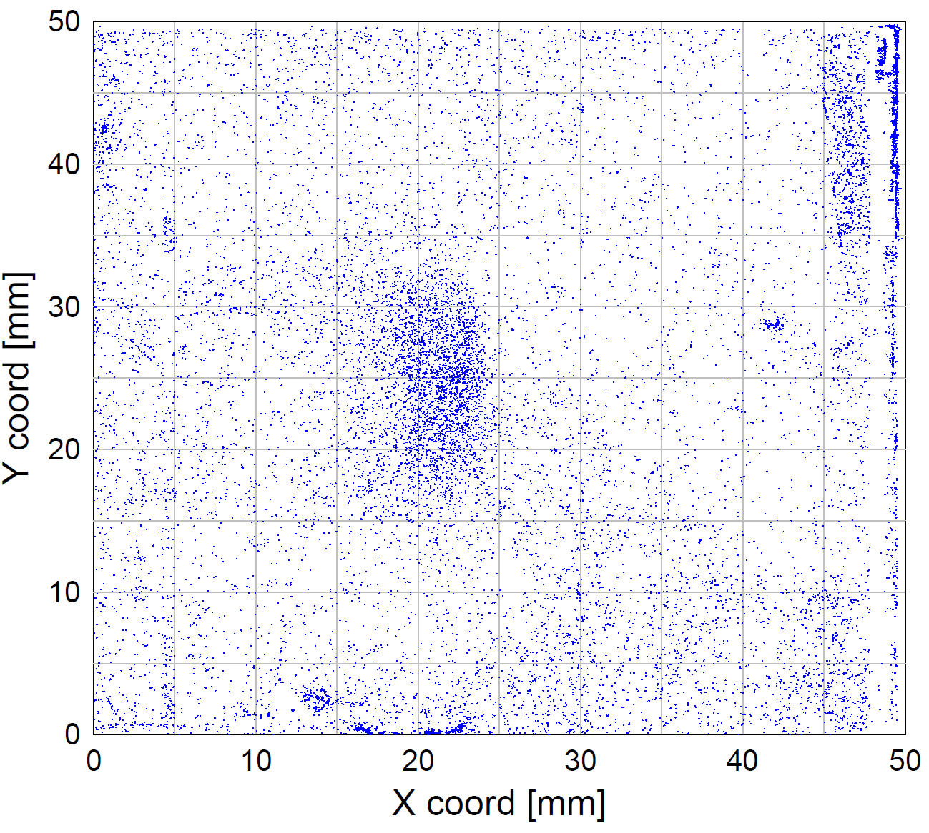

Polarimetry for ³He ions
Test beam time at Jülich Tandetron
with unpolarized ³He beam
CR-39 stack
³He beam
CD₂ foil:
$$D\left({}_{ }^{3}{He},p\right){}_{ }^{4}{He}$$
Analysis by: C. Zheng et al. Instruments 6 (2022) 61
26
Notes:
Fusionsreaktion mit Deuterium with unpolarized 3He
We employ this fusion reation with transplates the degree of polarization into a measuble angluar asymmetry
The degree of polariztion is tranferred into a spatical asymmetry, the so-called analysing power
Ersatz für pol. Neutronenstrahlen, da hier die Polarisation sitzt
Of course 3He is a bit special, in generall proton acceleration would be adventageous

Slide 27
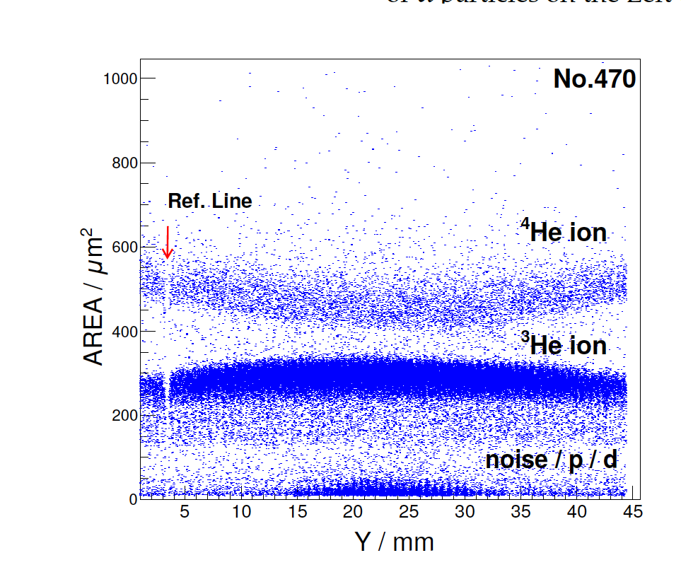
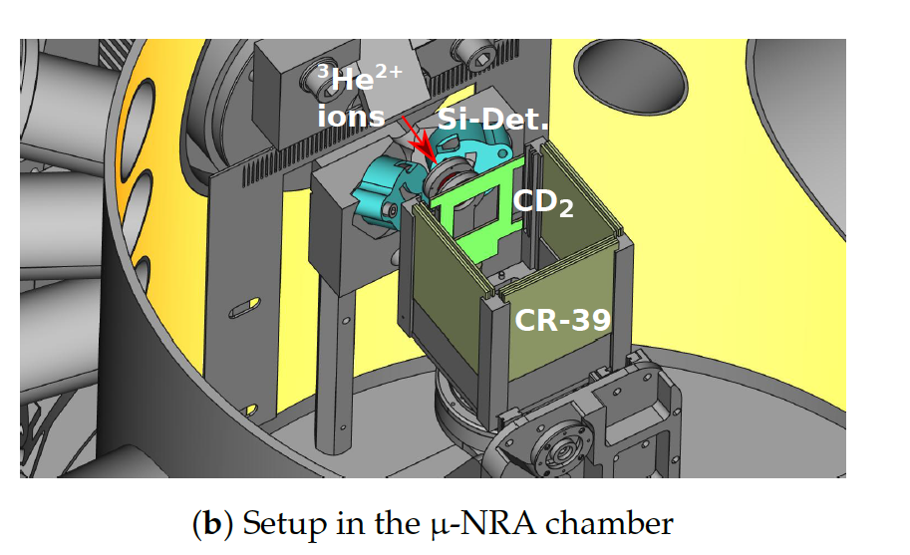
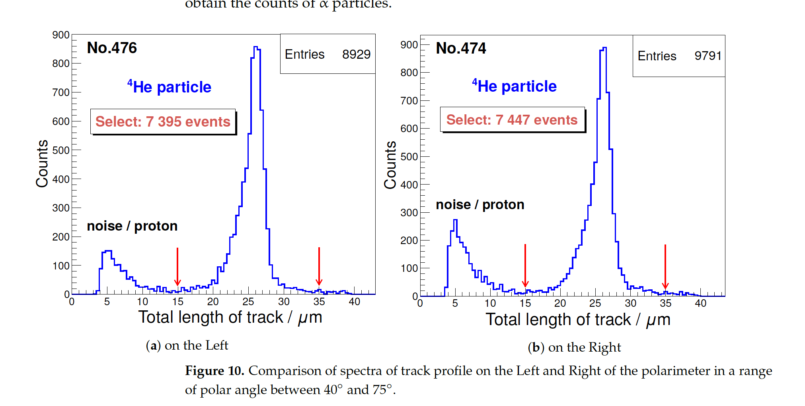
Polarimetry for ³He from LIP
Identification of the products of reaction of ³He⁺⁺ beam on CD₂, at lower energy till 0.64 MeV (fusion reaction resonance) on left, right CR-39 (SSNTD detectors) and forward (beam detection).
Minimal detectable polarization 21 % at 10⁹ ³He ions
entering the polarimeter.
forward
left
left
right
right
Forward

Slide 28
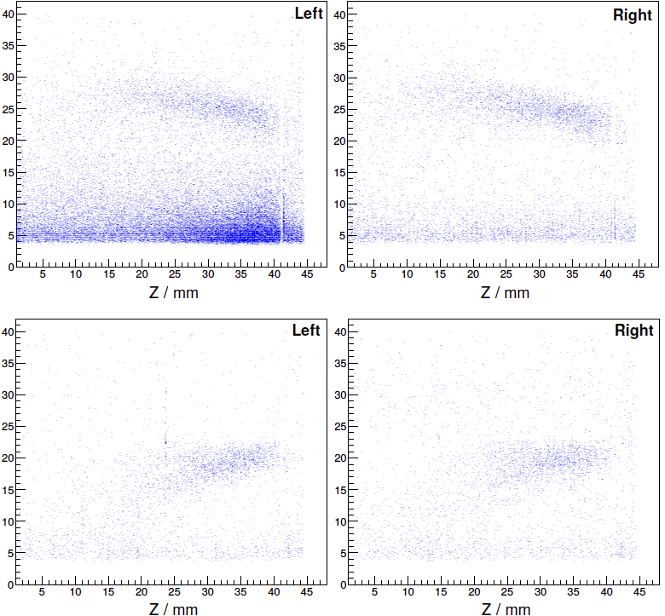

Measured (a-)symmetry
Unpolarized gas vs
polarized / Helmholtz coils off
Unpolarized ³He gas
Spot size
$D\left({}_{ }^{3}{\vec{He}},α\right)p$
x
Long. polarized ³He gas
z
😮
Change of 𝛼-distribution: modified kinematics for polarized ³He gas
In both cases no left/right (up/down) asymmetry ➔ polarimeter works as expected
Higher sensitivity on α particle.
😀
28

Slide 29

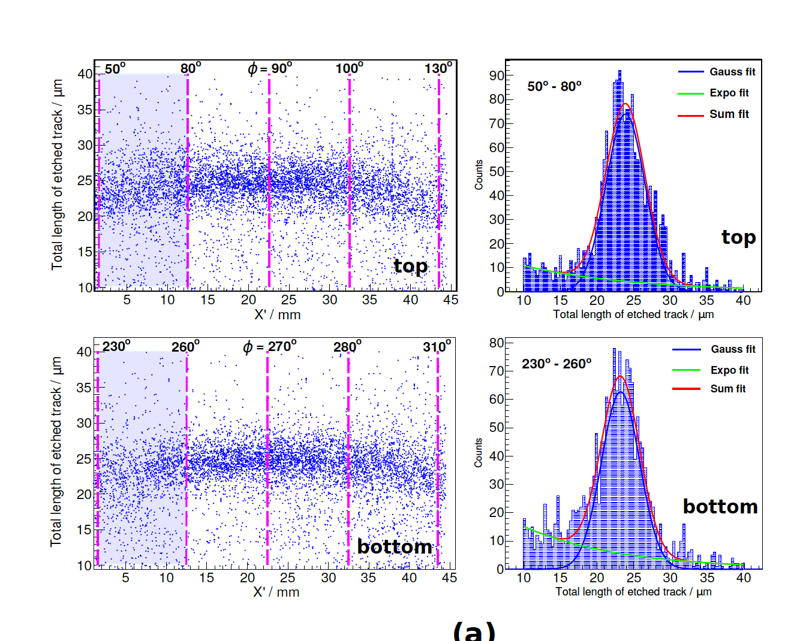
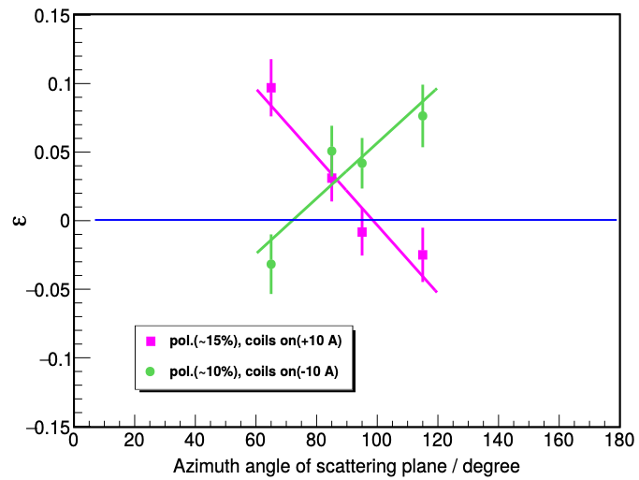

After 2 years of data analysis …
fusion events estraction
for the bin 50°-80° of the 4 bins
Hit pattern of α
ε=$\frac{(N_{t}−N_{b})}{(N_{t}++Nb)}$
Asymmetry ε
signal for unpolarized or longitudinally pol. ions
³He-ion polarization conserved after acceleration
2x increased ³He-ion flux from pol. plasma
Our concept (polarized target @ PW laser) works
Plasma acceleration of polarized beams (e–, p, ions) feasible
Models/simulation codes seem incomplete (spin-dependent ionization?)
C. Zheng et al. “First evidence of nuclear polarization effects in a laser-induced ³He fusion plasma” doi: 10.48550/arXiv.2310.04184
PSTP 24 Newport News

Slide 30
Challenge objectives of PREFER now
  @PNPI – D-D spin dependent cross-section measurements! Not anymore in the collaboration from 02/2022: just literature rumors.
  @IKP-FZJ - Production of polarized fuel: from pABS, and new proposals (Sona transitions).
  @BINP - Production of polarized fuel: from MBS Not anymore the collaboration from 02/2022: just literature rumors.
  @ IESL-FORTH – Production polarized fuel by Laser IR-Quantum Beat (QB) excitation and Ultra Violet (UV) dissociation.
  @PGI-FZJ/HHDU - Laser Induced Plasma LIP: production, acceleration and reaction studies.
  @FE Magnets for holding, manipulating and transporting polarized fuel : Next talk.

Slide 31
Conclusions of PREFER activities
We are still enjoy playing with spin for nuclear fusion, and we are coming closer and closer,
and friends and colleagues got the chance to test it soon, see Next talk By Xiandgong Wei
Still a missing information:
Sebastiano Filippi (named Bastianino) “The spin game”
A fresco on the cieling of the Games’s Hall – Este Castle – Ferrara
dated after earthquake of 1570.

