Slide 1
RUHR UNIVERSITY BOCHUM
EP1 AG Polarized Target
PSTP24, J-LAB, September 22 to September 27, 2024 G. Reicherz: Polarization behavior of fluorine-labeled glucose-water solution

Slide 2
Content
Motivation
Apparatus / Material
Measurement
Results
Conclusion

Slide 3
Motivation
PET with FDG in combination MRI
PET by MRI: Glucose Imaging by 13C-MRS without Dynamic Nuclear Polarization by Noise Suppression through Tensor Decomposition Rank Reduction
FDG‑PET/MRI in the presurgical evaluation of pediatric epilepsy, Pediatric Radiology (2024) 54:1589–1602, Springer
…
Goal: early identification cancer (e.g. Lymphoma) for intensification therapy by using the ¹⁸F-FDG-PET + hyperpolarized MR is a very promising imaging
Question: What are the dynamic polarization properties of FDG water solutions
Notes:
Hyperpolarized ¹³C-glucose magnetic resonance highlights reduced aerobic glycolysis in vivo in infiltrative glioblastoma, Sci Rep. 2021; 11: 5771.
FDG: ¹⁸F-Fluordesoxyglucose, Tracer in der Positronen-Emissions-Tomographie

Slide 4
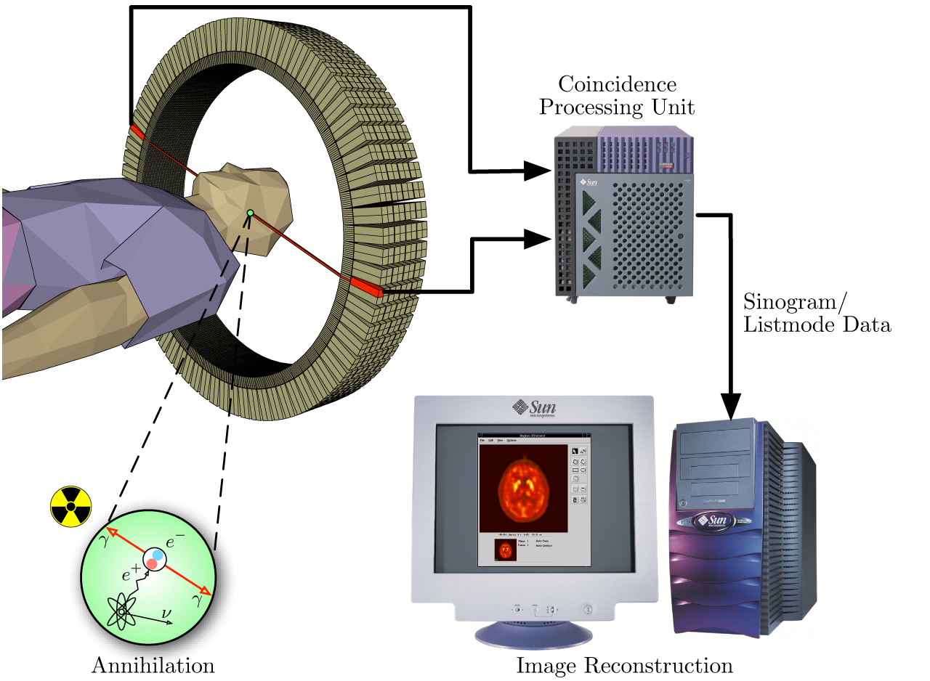
Motivation
Positron emission tomography
FDG, which is now the standard radiotracer used for PET neuroimaging and cancer patient management
Wikipedia.org, Positron emission tomography Sep 19 2024
Notes:
PET is a common imaging technique, a medical scintillography technique used in nuclear medicine. A radiopharmaceutical – a radioisotope attached to a drug – is injected into the body as a tracer. When the radiopharmaceutical undergoes beta plus decay, a positron is emitted, and when the positron interacts with an ordinary electron, the two particles annihilate and two gamma rays are emitted in opposite directions.^{[2]} These gamma rays are detected by two gamma cameras to form a three-dimensional image.

Slide 5
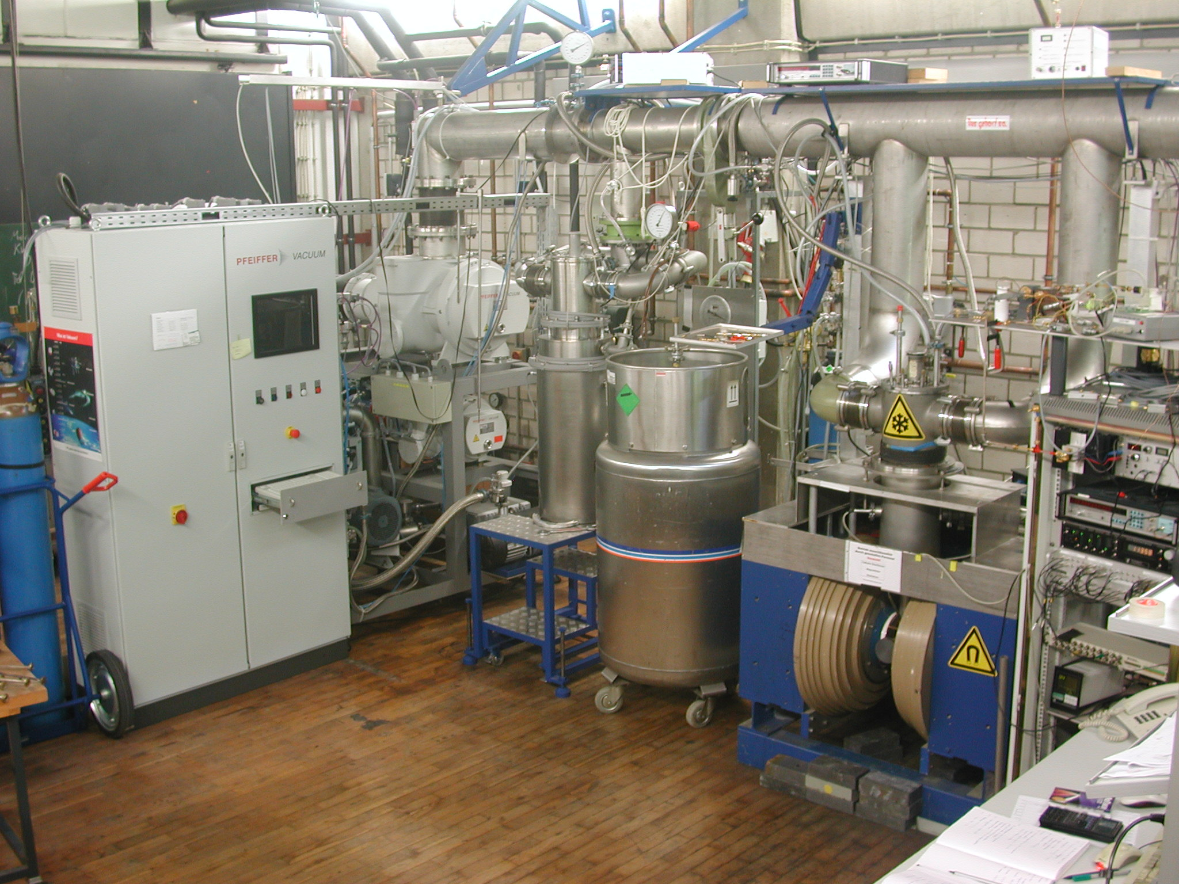
Polarized Target Facility Bochum
⁴He Evaporator
1k lowest temperature
2.5 T C-magnet
Different DNP systems with frequency modulation and u-wave power
NMR-systems 10 MHz up to 250 MHz
X-band EPR spectrometer
Very sensitive cw x-band spectrometer room temperature and 77 K
Bochum cw-NMR module
In-house developed sensitive cw-NMR system for polarization measurement

Slide 6
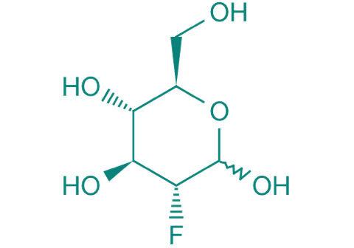
Preparation
FDG 2-Desoxy-2-fluor-D-glucose. 95 %
Mixture FDG Water TEMPO 0.5 % TEMPO 66.3 % D₂O 33.2 % FDG FDA: 0.1 g H₂O: 0.2 g TEMPO: 0.0015 g mixture heated for a few minutes to 70 °C results into a homogeneous liquid
Dropped in liquid nitrogen white colored beads

Slide 7
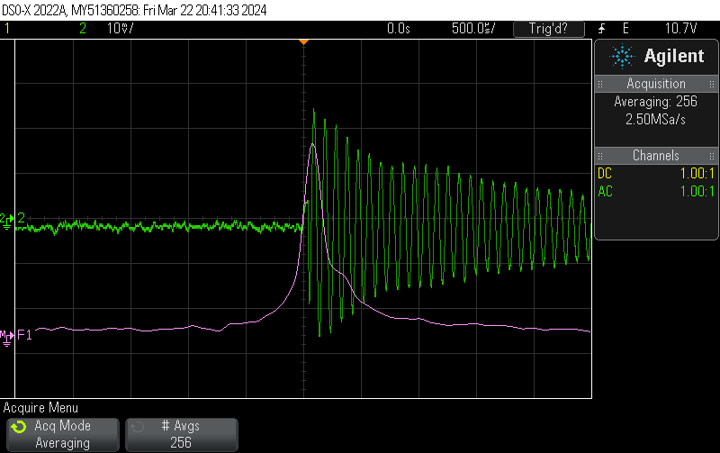
FDG D2O TEMPO in pNMR @ RT
nmr tube 70mg FDG + 140mg D2O pi_len = 6.84us
T1 proton ≈ 0,75s
FDG was stored at RT (maybe bad) Flourine FID good to see, but T1 couldn't measured.
< shows Florine FID and FFT

Slide 8
X-band EPR measurement
X-band EPR measurement at RT and 77 K EPR 77K: comparable to Butanol with TEMPO dilute liquid without spin exchange

Slide 9
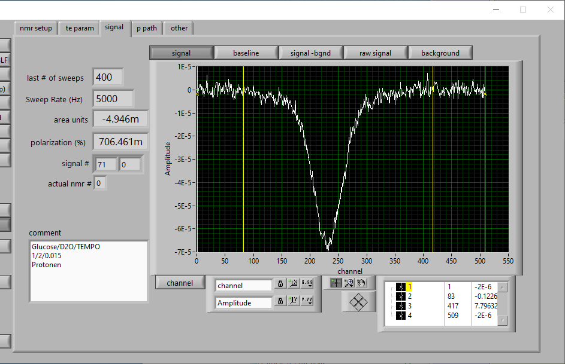
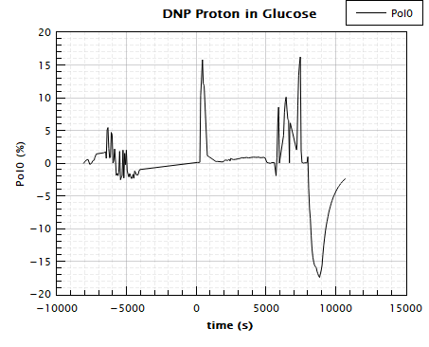
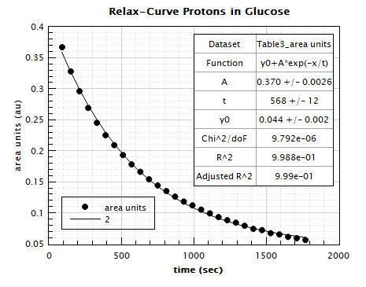
1 K , 2.5 T Glucose D₂O DNP measurement
First DNP tests with Glucose-D2O-TEMPO mixture to separate protons from Glucose and Water DNP MW+ ~ 69.9 GHz DNP MW- ~ 70.15GHz $→$ |P| > 15 % T1 ~ 10 min (@ 2.5 T, 1.1 K)

Slide 10
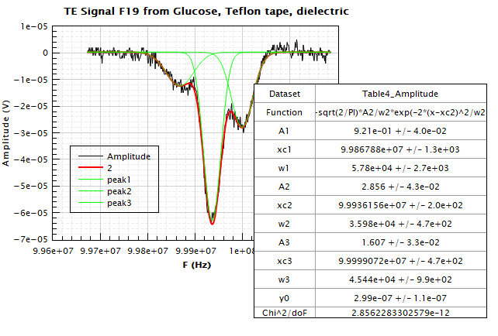
Florine 1 K , 2.5 T DNP measurement
Sample preparation for DNP: 0.095g FDG 0.2g D2O 0.0015(1) g TEMPO 5min at 60°C shaked
left signal F19 from FDG, middle Peak F19 from Teflon tape, right peak F19 from coax cable dielectric.

Slide 11
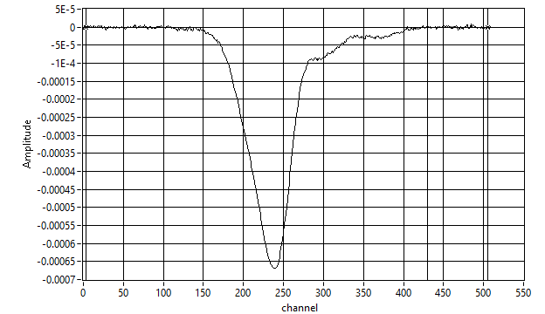
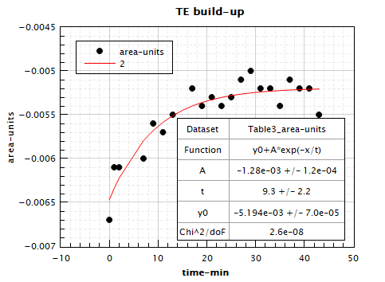
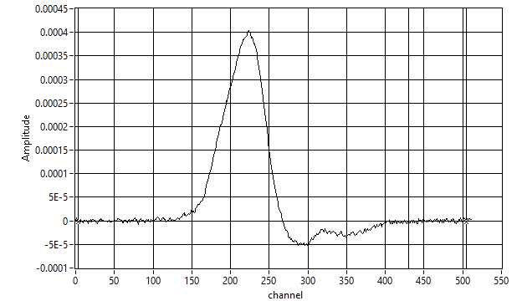
Florine TE at 1 K , 2.5 T
T1 = 8min (TE build-up time)

Slide 12
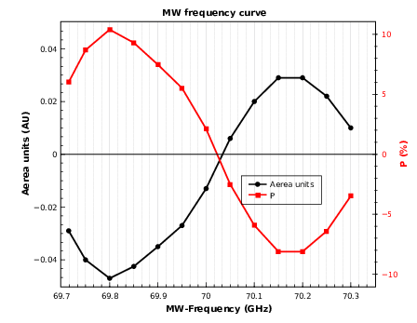
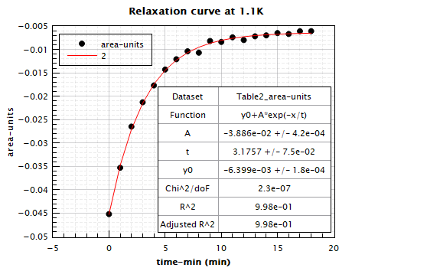
Florine DNP Frequency curve at 1 K , 2.5 T
Pmax = +10.6% and -8.3% (+-1.0%)
T1 = 3min (Polarization decay)

Slide 13
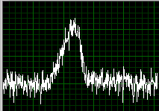
Relaxation T1 measurement with pure glucose D₂O mixture (1/2 at about 50°C mixed; no radical)
Container Ø = 10mm length = 20mm, 8 windings
Measurement of T1 at
1. Temperature = 1.1 K ⇒ T1 ≈ 140 min
2. Temperature = 1.8 K ⇒ T1 ≈ 31 min

Slide 14
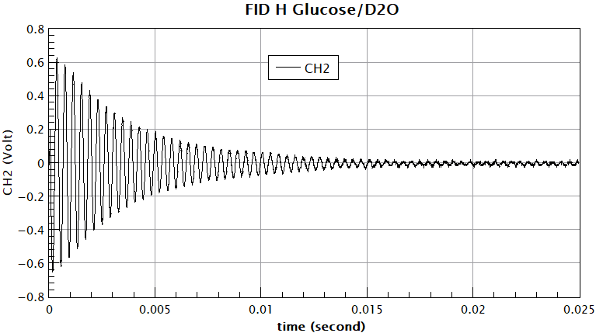
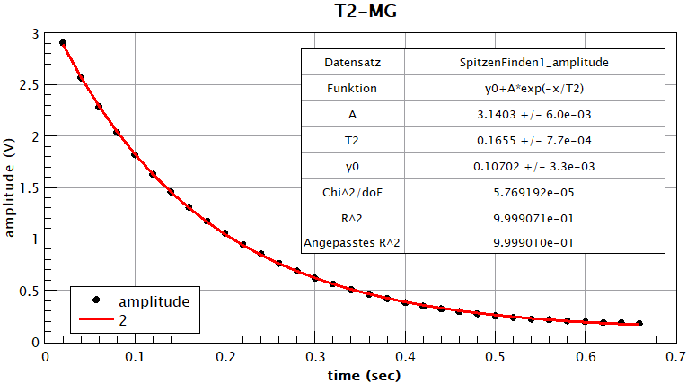
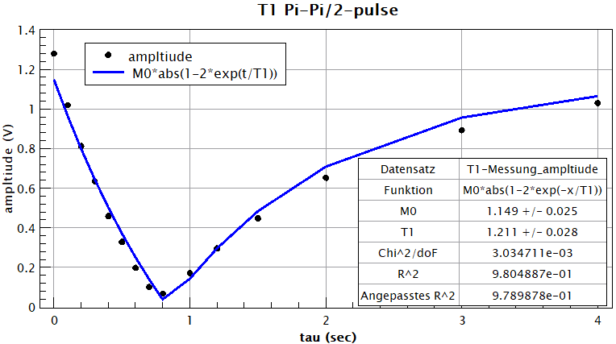
pNMR , B=0.5T at RM
Glucose - D2O mixture (ratio = 1/2)
F = 21.5523 MHz
A_len = 8.04 us
B_len = 4.02 us
P = 20 s
tau_0 = 900 ms - > 1.3s
T1 = 1.211 (28) s
T2 = 0.16550 (77) s

Slide 15
Conclusion
Goal: early identification cancer (e.g. Lymphoma) for intensification therapy by using the ¹⁸F-FDG-PET + hyperpolarized MR is a very promising imaging
DNP investigation of ¹⁹F-FDG mixed with heavy water and doped with TEMPO shows a high polarizability
For all nuclei, such as deuteron, proton and 19 fluorine, polarization of 10% was achieved at 2.5 T and 1.1 K.
The next steps could be to polarize ¹⁸F-FDG (determine Larmor frequency and degree of polarization) and to test another radical, such as the trityl radical which dissolves in water, for DNP.

