Slide 1
Correction of partial snake resonances with betatron coupling at the Brookhaven AGS
Vincent Schoefer
Chirag Birla, Eiad Hamwi, George Mahler, Haixin Huang, Ioannis Marneris, Keith Zeno, Levente Hajdu, Nicholaos Tsoupas, Richard Lynch, Sorin Badea, Timothy Lehn
9/23/24
Polarized Sources, Targets and Polarimetry (PSTP ’24), Newport News, VA, USA

Slide 2
RHIC Polarized Beam Complex
 | Max Energy [GeV] | Pol. At Max Energy [%]
Source+Linac | 1.1 | 82-84
Booster | 2.5 | ~80-84
AGS | 23.8 | 67-70 | p-Carbon
RHIC | 255 | 55-60 | Jet, full store avg*
2 Siberian Snakes/ring
Spin flipper
Absolute Polarimeter (H jet)
RHIC pC Polarimeters
PHENIX
For intensity ~2.2x10¹¹ at AGS extraction
* Includes both ramp loss and store decay
STAR
Spin Rotators
(longitudinal polarization)
Spin Rotators
(longitudinal polarization)
LINAC
BOOSTER
Pol. H⁻ Source
Helical Partial
Siberian Snake
 | Relative Ramp Polarization Loss (Run 17, full run avg)
AGS | 17 %
RHIC | 8 %
AGS
200 MeV Polarimeter
AGS Polarimeter
Strong AGS Snake

Slide 3
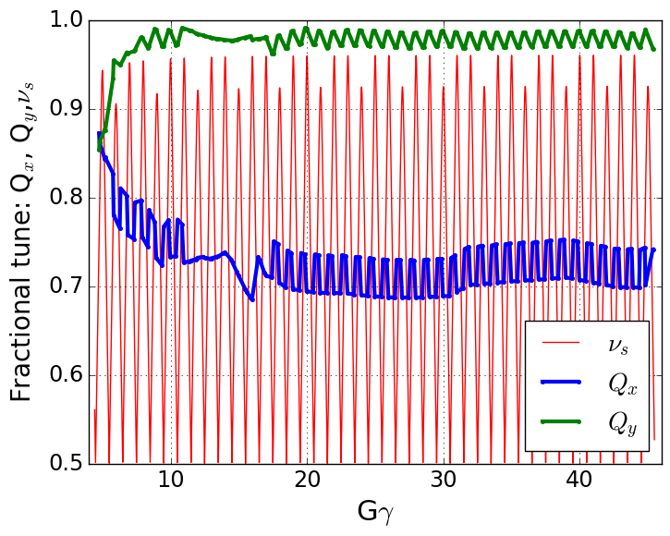
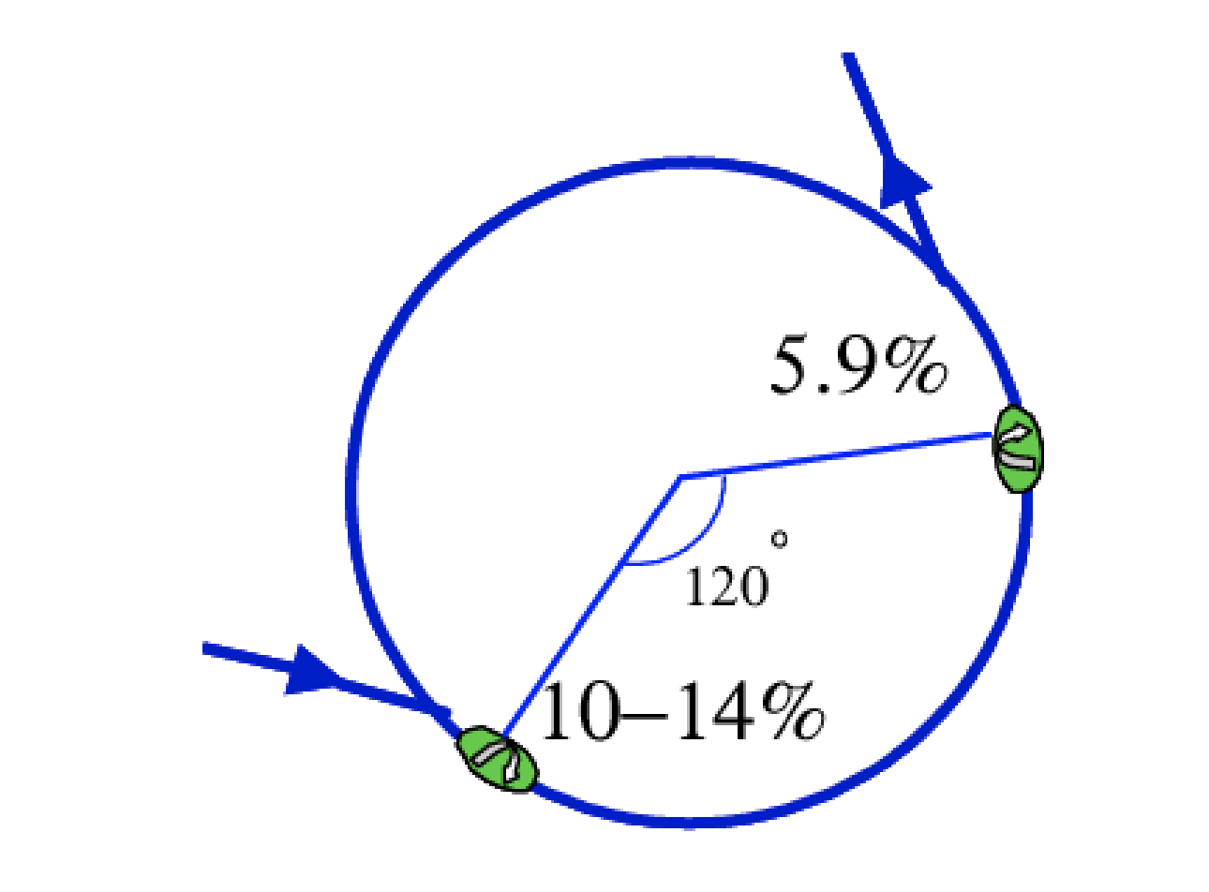
Polarized Protons in AGS
Polarization is preserved in the AGS with two partial helical dipole snakes (10% and 6% rotation)
Provides spin tune ‘gap’ where imperfection and vertical intrinsic resonance condition are never met
ν_{s} ≠ N (full spin flips)
ν_{s} ≠ N +/- Q_{y}
Horizontal resonance condition still met
ν_{s} = N +/- Q_{x}
Horizontal resonance are weak, but many (82 crossings)
Currently handled with fast tune jump
ΔQ_{x} = 0.04, 100 μs
Spin tune gap
Hor resonance crossings
Tune
jump
(pause tune jump near transition)
Extraction
Injection

Slide 4
Partial snakes drive horizontal resonances Simple case (one partial snake)
“Toy AGS ring”
Spin motion consists of
Spin rotation about longitudinal by angle $χs$
Design particle spin precesses about vertical by $2πGγ$ from main bend
From horizontal betatron motion, extra precession angle $\left(1+Gγ\right)∆x^{′}$
The horizontal betatron motion modulates the spin precession phase at every snake transit at Q_{x} producing sideband resonances at
$$e^{−\frac{i}{2}χsσ_{2}}$$
Partial snake
$$e^{−\frac{i}{2}\left(2πGγ−\left(1+Gγ\right)∆x^{′}\right)σ_{3}}$$
$\text{ν}\text{s}$ ≅ Gɣ = N +/- Q_{x}
$∆x^{′}$ = the one-turn change in betatron angle

Slide 5
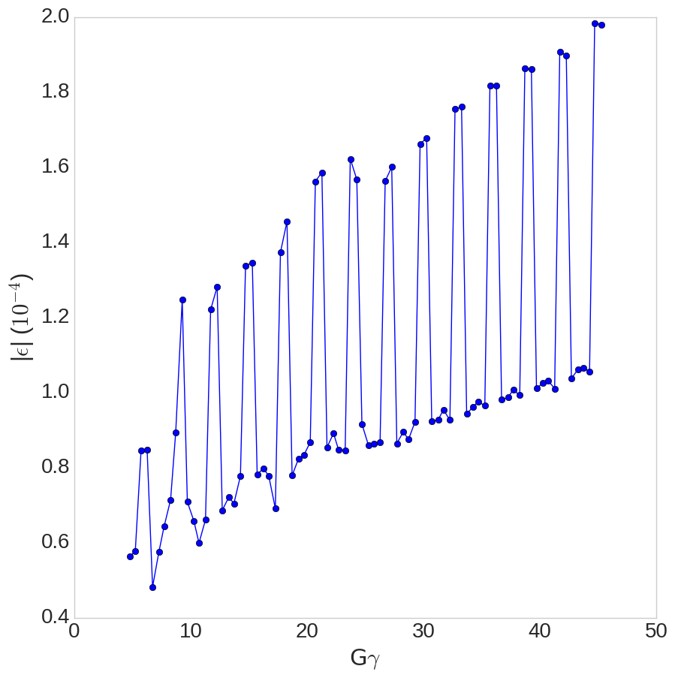
Horizontal resonances in the AGS
Horizontal Resonance Amplitudes in AGS
Two snakes, separated by 1/3 circumference
Modulated resonance amplitude highest near Gɣ = 3N (when snakes add constructively)
Horizontal resonances occur every 4-5 ms at the standard AGS acceleration rate
$$ε_{x,rms,norm}=1.67 μm$$

Slide 6
Polarization loss from horizontal resonances
With no mitigation: ~15-20% relative polarization loss
Horizontal tune jump (used since 2011): Avoids half the loss, ~10% relative polarization loss remains
Remaining polarization loss from residual crossing rate, spin tune spread comparable to tune jump size
Zgoubi simulation of polarization loss with and without tune jump, agrees well with measured tune jump performance
Goal of resonance compensation is to reduce the polarization loss from horizontal snake resonances to 0%
With jump
NO dp/p spread
With tune jump
+ dp/p spread
No mitigation
Plot courtesy of Y. Dutheil

Slide 7
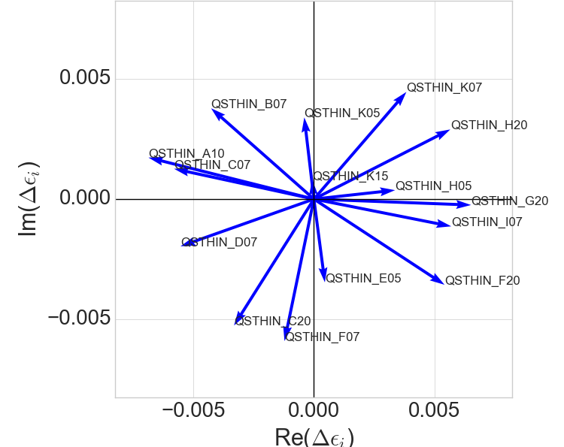
Resonance compensation via coupling
Depolarizing resonances from partial snakes and betatron coupling have the same frequencies
Spin resonance terms from skew quads in AGS
Gɣ = 43.72
$\text{ν}\text{s}$ ≅ Gɣ = N +/- Q_{x}
Every skew quadrupole represents a complex resonance driving term (calculated using SPRINT algorithm)
Place a collection of skew quadrupoles in the ring to cancel the partial snake driving term.
“Just” linear algebra

Slide 8
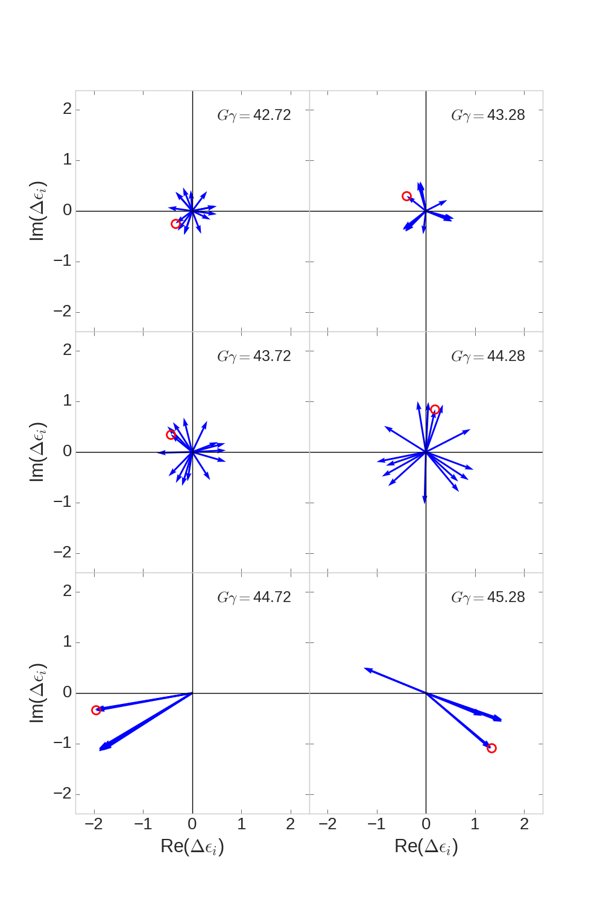
Partial snake resonance suppression with betatron coupling
Skew quad correction vectors (last six hor resonances)
In principle minimizing resonance strength (calculated with SPRINT) and coupling (two complex numbers) takes 4 skew quads
BUT:
There are 82 such linear algebra problems to solve
AND:
Phasing between skew quadrupole terms and snake terms varies wildly resonance to resonance
AND:
Correction vectors are frequently parallel, especially near strong vertical intrinsic resonances
Solution strategy: search for a solution with a distributed number of weaker, fast ramping skew quadrupoles
Phase offset chosen so that snake drive term is purely real
Red circle marks the same skew quad in each frame, phase changes rapidly from resonance to resonance

Slide 9
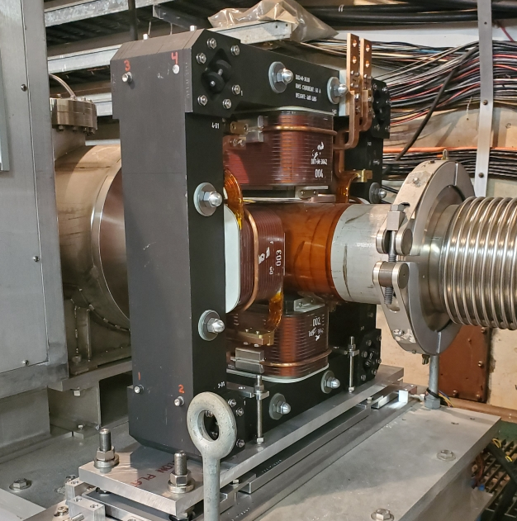
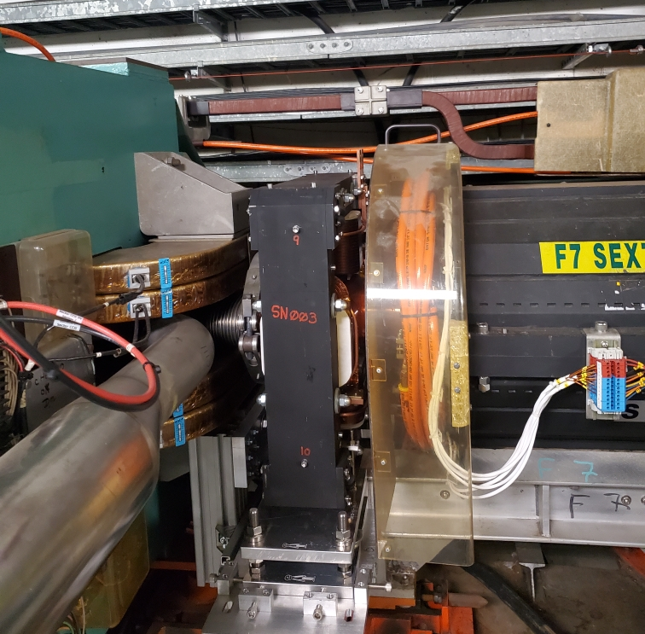
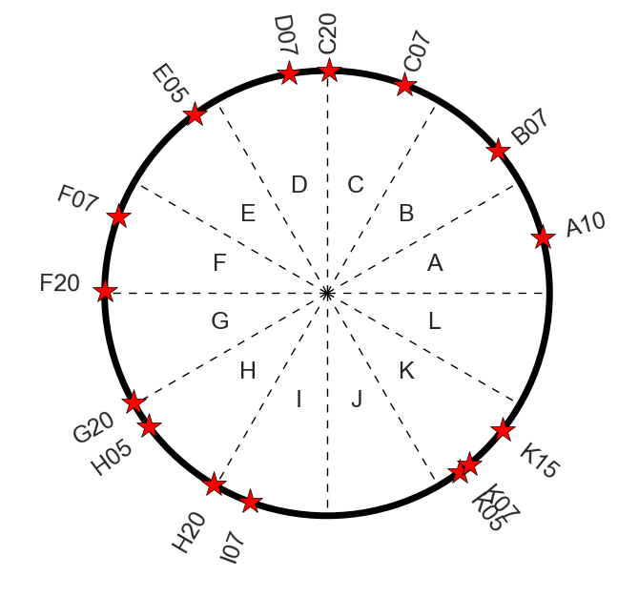
Magnets and locations
A set of 15 skew quadrupoles with integrated skew quadrupole gradient at least 0.2 T meets the physics requirements
9 placed at narrow locations in the AGS adjacent to sextupoles
6 locations in longer (mostly empty) straight sections
Locations determined largely by brute force optimization from the available ~30 locations
Note: At top energy one AGS main magnet causes ~70° of spin precession
Geographically close != close in phase
A10
F07
Tune kicker
Main magnet
Chrom sext
Magnet Param |  | unit
Length (mech.) | 0.17 | m
Bore diameter | 0.16 | m
Pole tip field (max) | 0.15 | T
Int grad (max) | 0.32 | T
Current (max) | 275 | A
Current (rms,max) | 60 | A
Lamination thick. | 0.635 | mm
AGS ring
4-Stranded coils
17 turns
Skew quad locations

Slide 10
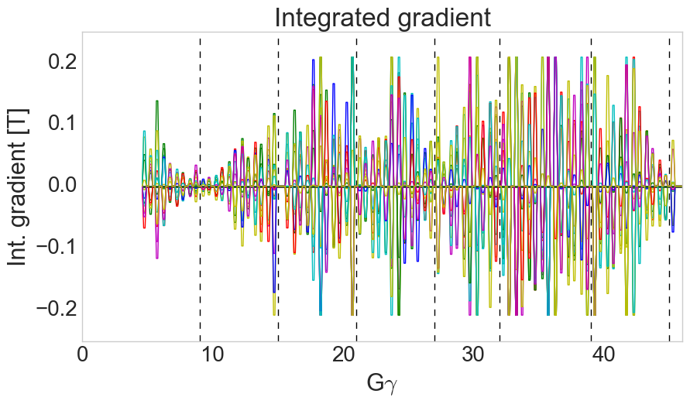
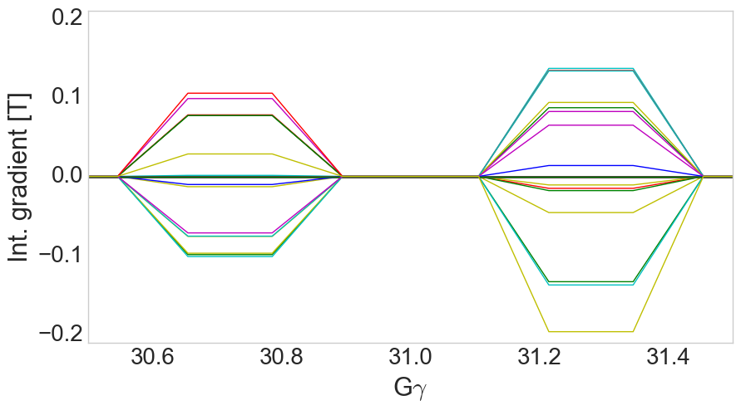
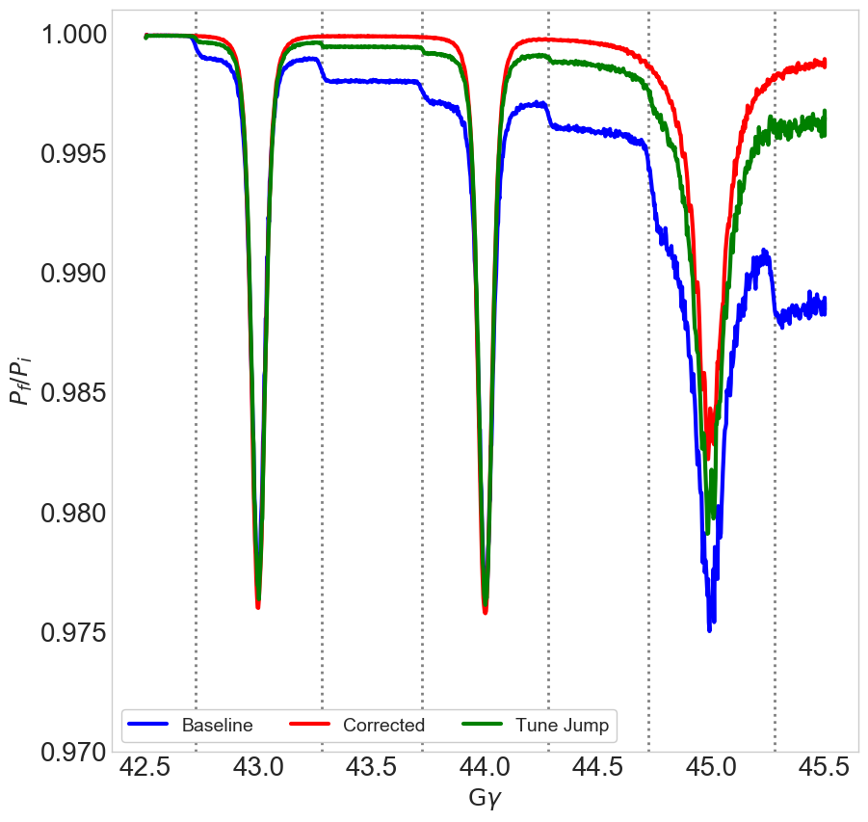
Calculated correction waveforms
Pulsing the skew quads with 1 ms rise, 1.3 ms flattop and 1 ms fall allows changing currents quickly to accommodate new correction vectors every resonance
Also avoids having skew fields during strong vertical intrinsics (tracking showed small polarization losses at these with skew quads powered)
Calculated resonance strength reducible to zero at almost every resonance
Resonance strength, |ε| = 0
Tune shift from coupling, ΔQ_{y}< 0.005
Correction active 10x longer than tune jump
Covers whole spin tune spread
Less sensitive to ‘drift’ in beam energy timing
No residual ‘crossing rate’: full compensation
Each trace= 1 skew quad
Zgoubi Spin tracking
1.0 ms
1.3 ms
1.0 ms
$$\left\langle P_{n}\right\rangle$$
ε_{x}= ε_{y} =2 μm (rms norm)
ε_{long} = 0.8 eV-s
10

Slide 11
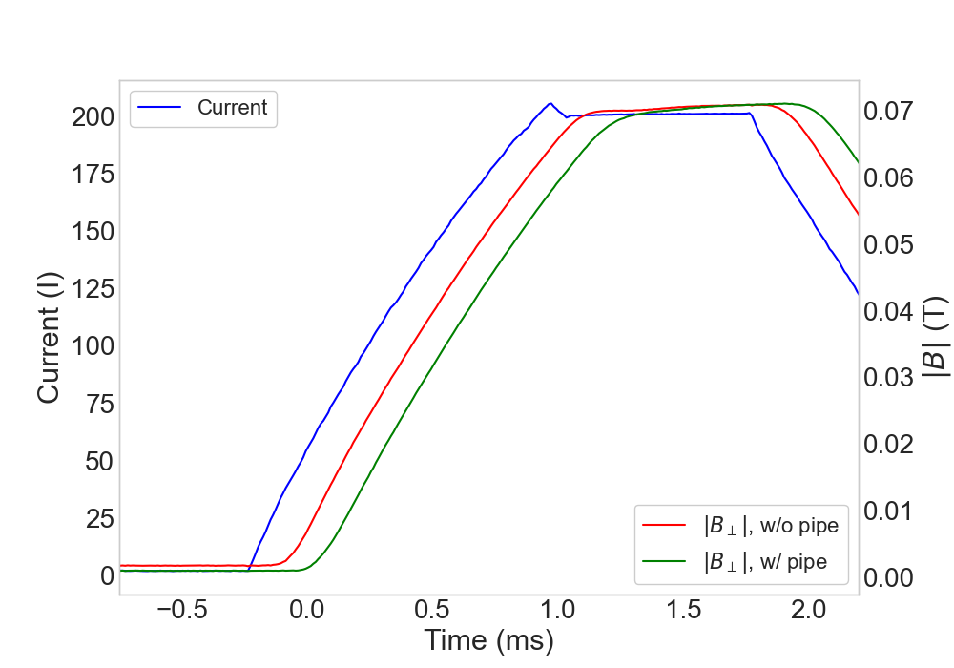
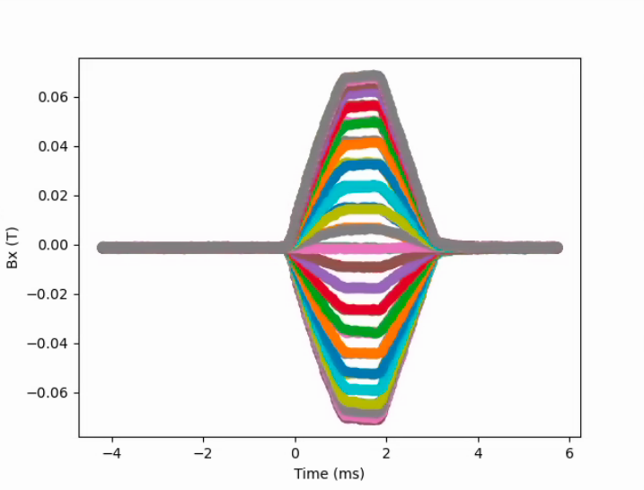
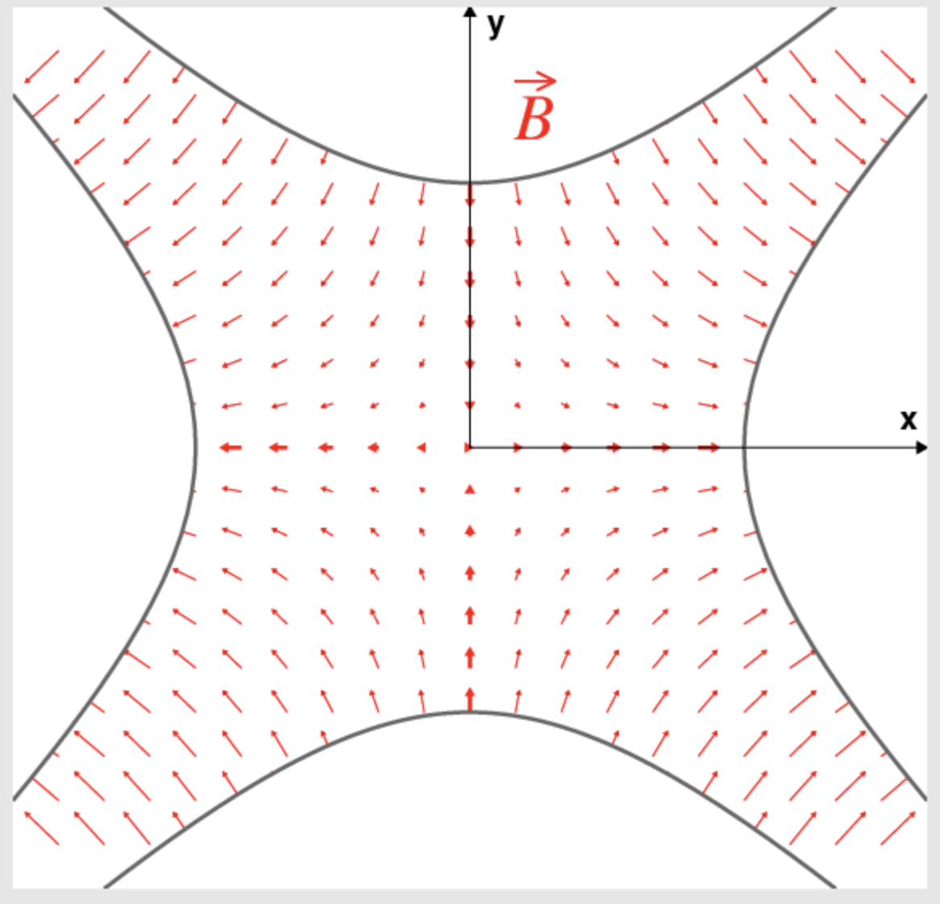
Magnetic measurements, field delay
Pulsed Hall probe measurements (200 A, 1.2 ms rise time)
Hall probe measurement during pulse(bandwidth 0-2.5 kHz)
49 points around a 50 mm reference circle, longitudinally centered in magnet
Measured with and without AGS straight section beam pipe
1.5 mm thick stainless steel, round cross section
Field delay (relative to applied current) is ~200 us, accounted for in pulse timing request
Hall probe field delay measurement
Hor Field Measurement
50 mm
One trace per angular position

Slide 12
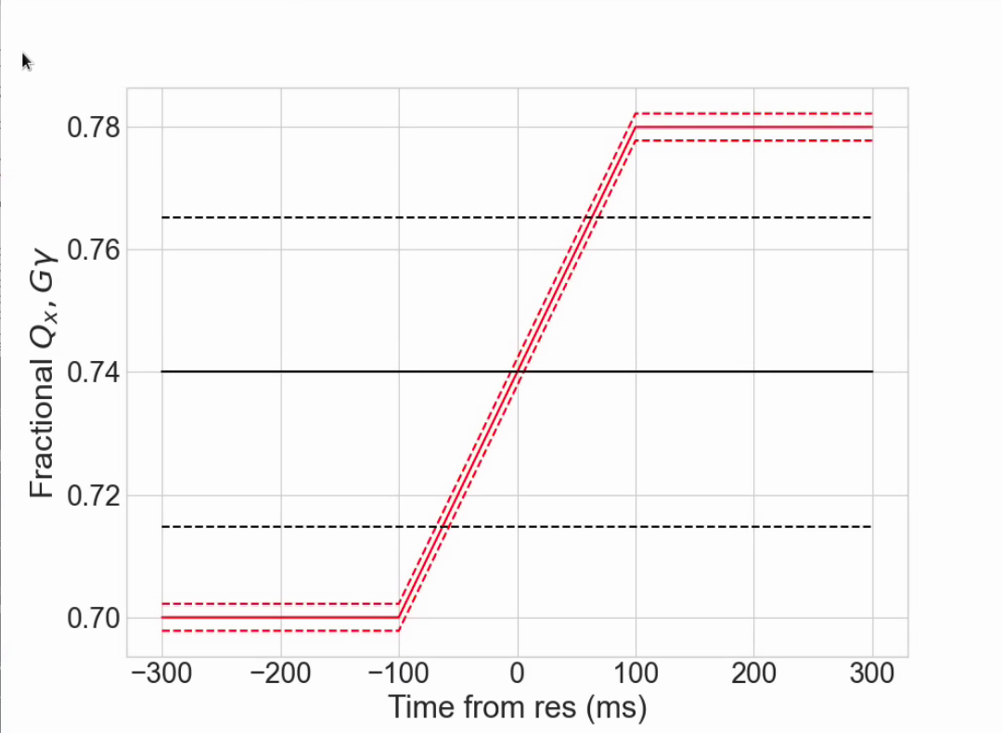
Commissioning: Proof of principle single resonance crossing
At nominal acceleration rate (dGɣ/dθ =4.7 x 10⁻⁵), max polarization loss from a single resonance is 0.1-0.5%
too small to to measure individually
Configure a crossing at fixed energy: just above nominal extraction, with ramped horizontal tune and very slow ramp rate (>100x longer)
Resonance crossing
Parameter | Value
Gɣ | 45.74
dp/p (full base) | 1x10⁻³
Chrom ξ_{x} | 4
ΔQx | 0.08
Tune ramp length [ms] | 200
Crossing rate (⍺) | 1.7 x 10⁻⁷
Slow crossing gives measurable 20-25% relative polarization loss
12

Slide 13
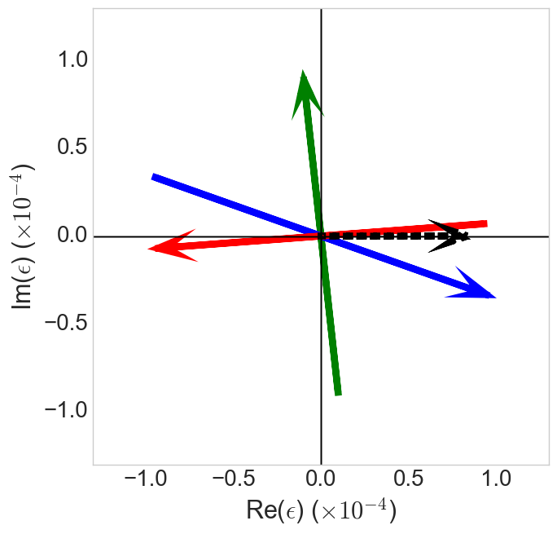
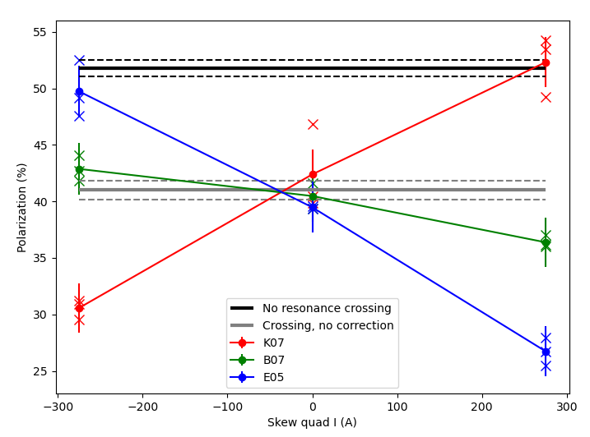
Commissioning: Proof of principle single resonance crossing
Resonance ‘portrait’ at Gɣ = 45.74
Polarization response to skew strength
B07
Snake drive
K07
E05
Select three skew quads with good relative phasing
K07 in phase with snakes
E05 180º from K07
B07 orthogonal to snake drives
Skew quad arrow length is full current range of supply (arrow head is positive)
Phasing of skew quads is as expected
Demonstration of total correction
In anti-correcting phase, expect more loss from simple Froissart-Stora estimate
May be multiple crossings from synchtron motion during long crossing
To be investigated in simulation

Slide 14
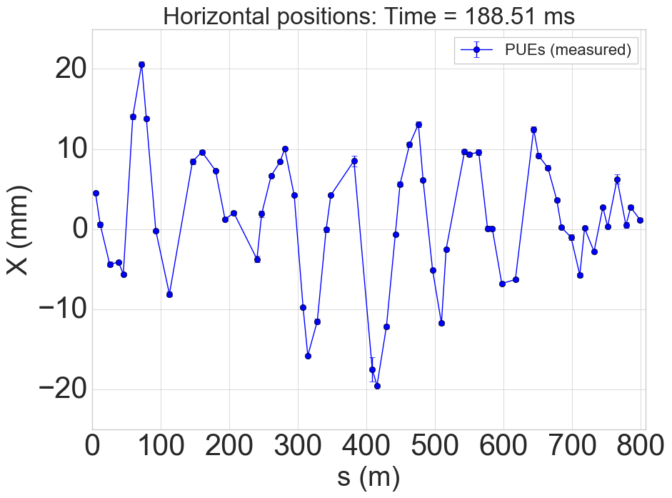
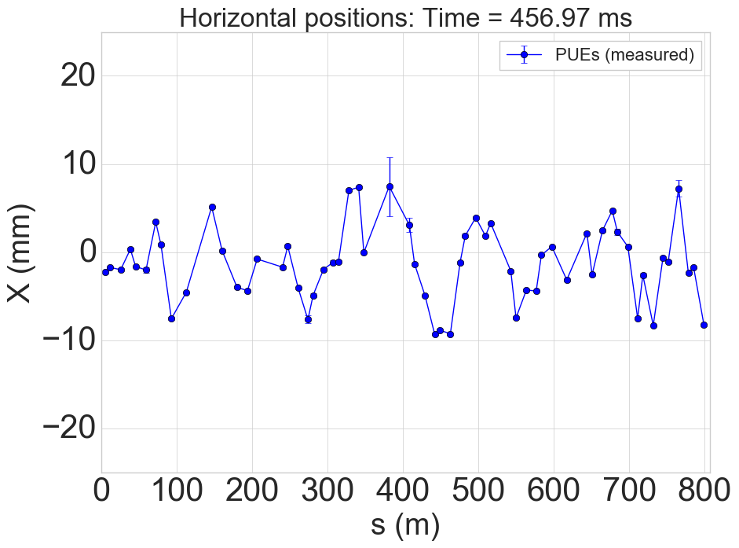
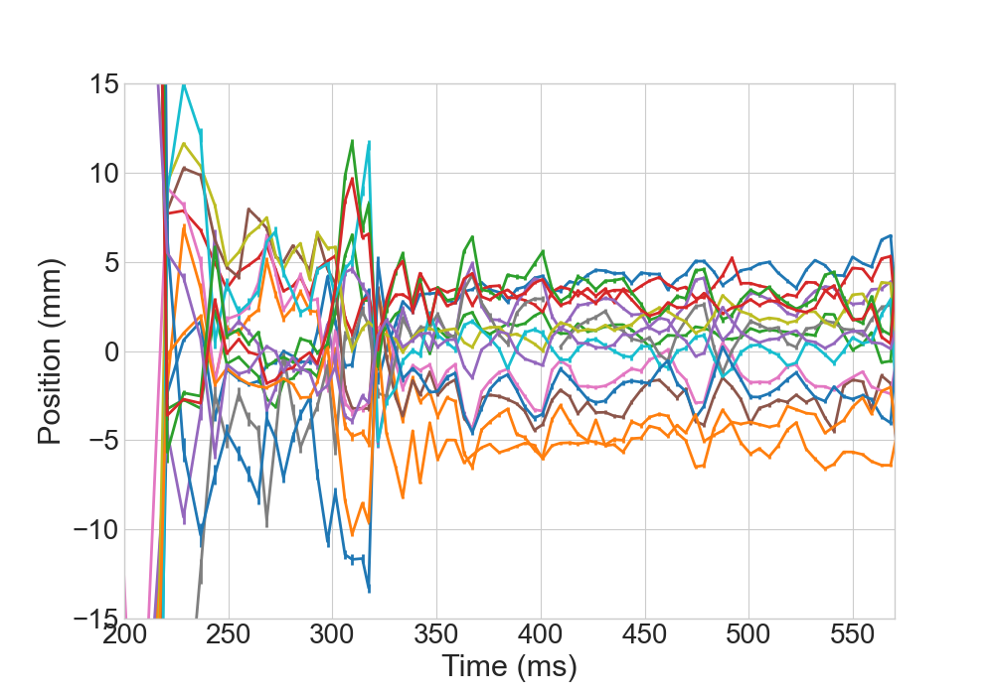
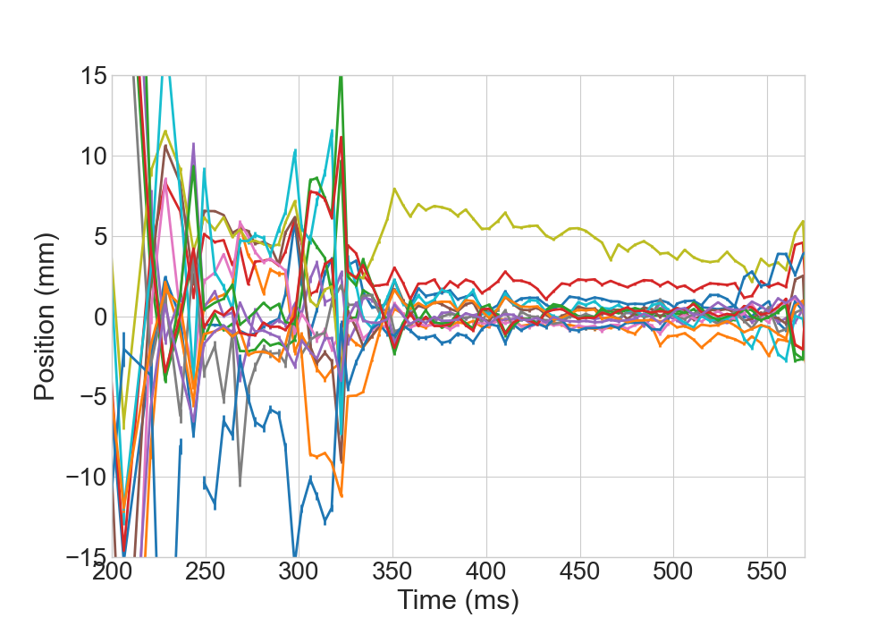
Commissioning: Orbit effects
Sample horizontal orbits (at BPMs)
Large horizontal orbit excursions in AGS
High vertical tune (8.985 – 8.991)
Horizontal off-centering in skew quads leads to large vertical orbit changes and beam loss.
Beam-based orbit offsets measured and corrected
Skew quads pulsed, infer offset from vertical orbit change + model
Correction limited by weak steering dipoles
Horizontal position at skew quads, inferred from orbit differences
Before correction
After correction
14

Slide 15
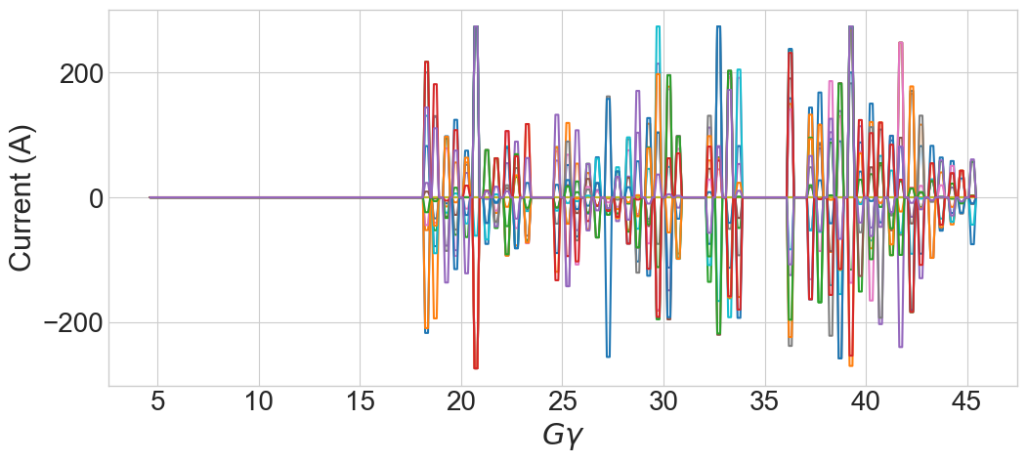
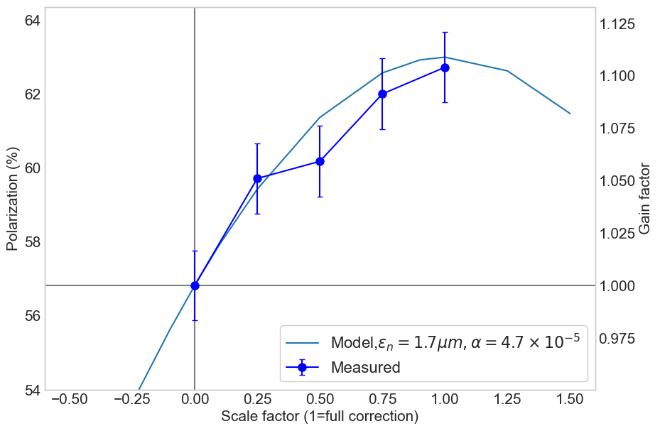
Polarization increase from skew quad resonance correction
Omitted for large orbit excursions
Initially, only about 2/3 of the pulses active
Omitting
Pulses for resonances where orbit excursions still caused beam loss
Early resonances where optics distorted by snakes (requires special care)
Leaving out two skew quads (C20, G20) which have difficult to correct for horizontal orbit mis-centering
Omitted for optical difficulties
Skew quad
A gain of 10% relative polarization is equivalent to gain from tune jump scheme
Good agreement with model expectation
Implies that for resonances that we can pulse the quads for, we get what we expect
Polarization (%)
Correction amplitude (1 = full correction,0 = no correction)

Slide 16
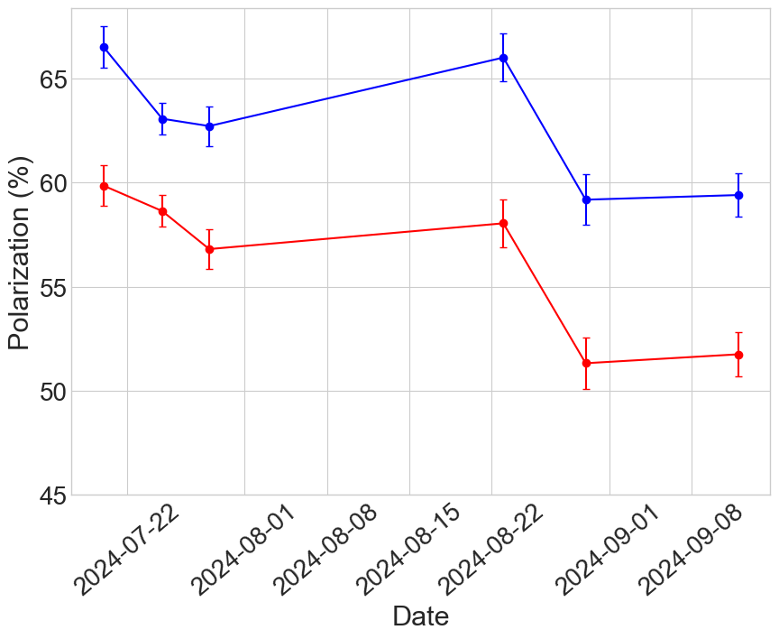
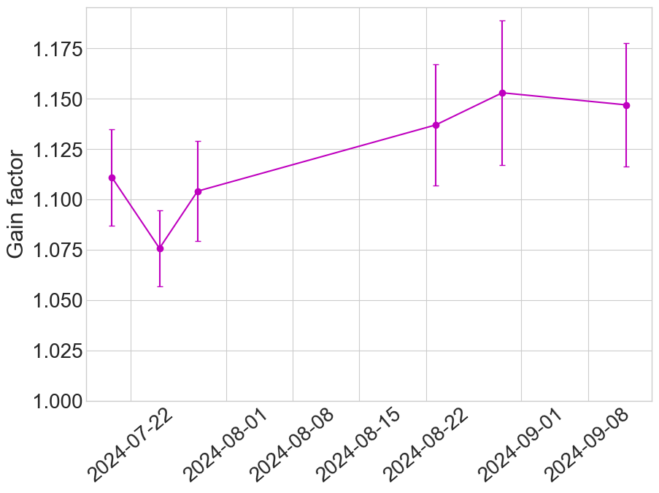
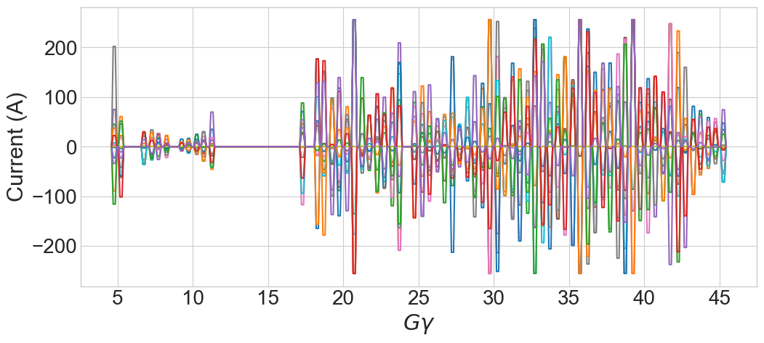
Polarization increase from skew quad resonance correction
Number of enabled pulses limited mostly by orbit effects
Included model-predicted orbit response of the skew quads in the optimization to minimize resulting vertical rms
Resonance strength, |ε| = 0
Tune shift from coupling, ΔQ_{y}< 0.005
Vertical |M_{orm}*(k_{skew}*x_{skew})|_{max} < 1 mm
Permits enabling more pulses
Up to 15% relative gain from skew quads (compared with 8-10% from tune jump)
Polarization comparison
Mysterious decline in base polarization
(our personal ‘spin crisis)
Skew quads ON
Skew quads OFF
Skew quad currents
Polarization ratio
Skew Quads ON/OFF

Slide 17
State of the project
15% relative gain factor improves over the 10% gain factor of the tune jump
Skew quad resonance correction configuration began commissioning in March 2024, mostly behind RHIC operations
March: polarity, orbit effect checks with unpolarized beam
Apr: polarized beam checks, single resonance tests
May-June: RHIC startup and development (limited AGS time)
July-Aug: Ramp tests and commissioning, orbit correction and compensation
Sep 6th to present: RHIC fills with AGS in skew quad resonance

Slide 18
State of the project: looking forward
Relative loss from horizontal resonances might be as high as 20% (only 15% accounted for)
Only one week left in Run 24 polarized proton operation in the RHIC (and injectors).
Might be last week of RHIC polarized proton operation ever
No more currently scheduled before RHIC shutdown after Run 25
Development runs planned in the AGS behind gold operation in 2025 and ~1 month/year during the “Middle Ages” between RHIC and EIC.
What can we do?
Heavily accelerator model-driven effort
Individual resonances too weak to tune individually empirically
Low energy corrections might be incomplete due to optical errors from
Large effects of complicated helical dipole field
Feed-down from orbit offsets/misalignments
Potentially ~2% from resonances near transition
Not currently corrected. Needs particular attention

Slide 19
Thanks for your attention!

Slide 20
Partial snake resonances are ‘hybrid’ resonances
M.Bai showed horizontal closed orbit motion can interact with a vertical intrinsic to produce a set of sideband resonances*.
Similar procedure shows horizontal betatron motion can interact with the snake spin kick in the same way
$\frac{dΨ}{dθ}=−\frac{i}{2}\left(\begin{matrix}F & −ξ \\ −ξ^{∗} & −F\end{matrix}\right)$ $Ψ$
$$Ψ=\exp{[\frac{i}{2}σ3(Gγθ−(1+Gγ\text{)}\text{x}\text{’(}θ)ρ\text{ ]}\tilde{Ψ}}$$
$\frac{d\tilde{Ψ}}{dθ}=−\frac{i}{2}\left(\begin{matrix}0 & −\tilde{ξ} \\ −{\tilde{ξ}}^{∗} & −0\end{matrix}\right)$ $\tilde{Ψ}$
$$ξ=i Xs δ\left(θ−θs\right)$$
$$spin precessing frame$$
$\tilde{ξ}=i Xs δ\left(θ−θs\right)$ $e^{−i(Gγθ−\left(1+Gγ\right)x^{′}\left(θ\right))}$
$$F=Gγ−\left(1+Gγ\right)x′′(θ)ρ$$
$\tilde{ξ}=i Xs δ\left(θ−θs\right)$ $e^{−i(Gγθ−\left(1+Gγ\right)x^{′}\left(θ\right))}$
$$x^{′}(θ)=\tilde{x^{′}}sin⁡(νxθ)$$
Expansion to get trig out of the exponent. Keep linear terms and Fourier transform:
$$εK=\frac{iXs}{2π}\int{δ(θ−θs)}e^{−iGγθ+iKθ}\left[1−\tilde{x^{′}}\frac{1+Gγ}{2} e^{±νxφ(θ)}\right]dθ$$
*Phys Rev Lett, Vol 84, 6, 2000

Slide 21
Partial snake resonances are ‘hybrid’ resonances
$$εK=\frac{iXs}{2π}\int{δ(θ−θs)}e^{−iGγθ+iKθ}\left[1−\tilde{x^{′}}\frac{1+Gγ}{2} e^{±νxφ(θ)}\right]dθ$$
Term 1: Amplitude X_{s}/2π, non-zero when $Gγ=K$ , snake imperfections
Term 2: Amplitude ~ $\tilde{x^{′}}$, non-zero when$Gγ±νx=K$ , intrinsic resonance driven by the phase modulation of the snake imperfections
What if another intrinsic resonance is present at frequency ν_{x}:
$ξ=i Xs δ\left(θ−θs\right)$+ ${εxe}^{±νxφ(θ)}$
$$εK=\frac{iXs}{2π}\int{δ(θ−θs)}e^{−iGγθ+iKθ}\left[1−\left(\tilde{x^{′}}\frac{1+Gγ}{2}+εx\right) e^{±νxφ(θ)}\right]dθ$$
A second intrinsic resonance at the horizontal betatron tune can be used to cancel the partial snake resonance term.
Easiest way to make one is with betatron coupling

Slide 22
Error tolerance
What if the calculated correction has the wrong phase or amplitude? Difficult to tune individual resonances, signal very small.
Froissart-Stora polarization loss for small residual resonance $∆ε$
$$\frac{P_{f}}{P_{i}}= \frac{1−\frac{{π\left|∆ε\right|}^{2}}{α}}{1+\frac{{π\left|∆ε\right|}^{2}}{α}}≈1−\frac{{2π\left|∆ε\right|}^{2}}{α}$$
$$∆ε \text{=} ε_{snk}−ε_{correction}$$
$${ ε}_{snk,max} =2×{10}^{−4}$$
$α$ = 4.7 $×{10}^{−5}$
1-(P_{f}/P_{i})_{max} = 0.5% (single uncorrected res)
Phase error
Worst case is global phase error
Dominated by determination of Gɣ
Error on Gɣ bounded by observation that tune jump is effective:
$∆$Gɣ <= 0.02 (~8° phase error)
$\frac{|∆ε|}{{|ε}_{snk,max}|}≈$ |$\sin\left(2π∆\text{G}\text{ɣ}\right)|$ = 0.14 → 1-(P_{f}/P_{i})_{residual} = 0.02%
Amplitude error
Dominated by optical error: coupling spin resonance ~ $\sqrt{β_{x}β_{y}}$
Vertical beta beat ~25% (measured) >> horizontal
Even if there was a total resonance amplitude error of 25%
$\frac{|∆ε|}{{|ε}_{snk},max|}=$ $0.25$ → 1-(P_{f}/P_{i})_{residual} = 0.04%
Resonance compensation is robust with respect to likely errors. Even worst case over 90% of the correction effect persists.

