Slide 1
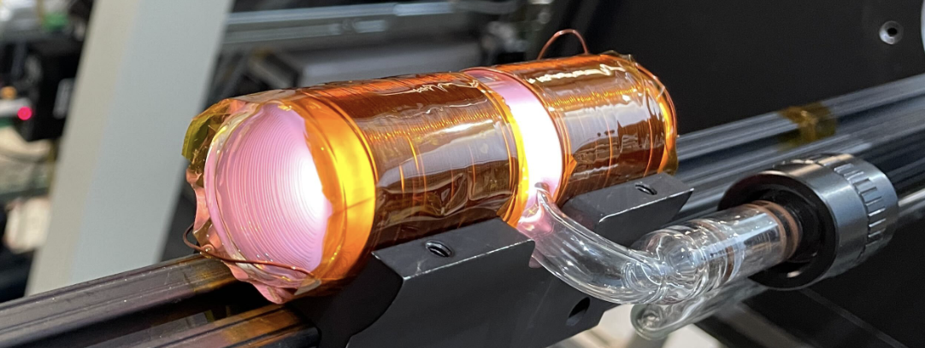
Metastability Exchange Optical Pumping to Polarize ³He at High Magnetic Fields
Pushpa Pandey
Massachusetts Institute of Technology
On behalf of CLAS12 Polarized ³He Collaboration
PSTP Conference
September 26, 2024

Slide 2
Outline
Polarized ³He for Nuclear Physics
Current Set Up:
Outlook
Metastable Exchange Optical Pumping
Design
Current Status

Slide 3
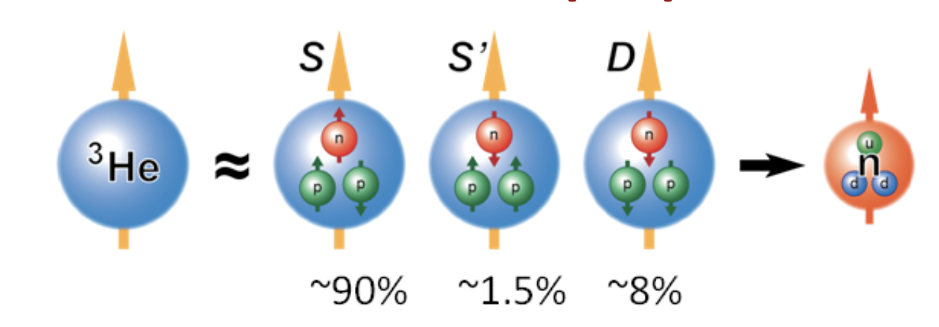
Polarized ³He
Why Polarized ³He ?
Neutron spin structure study
Polarized spin asymmetries: ³He is a good surrogate for a neutron.
Facilities involved for successful polarized ³He targets in
lepton scattering experiments: SLAC, HERMES, MIT-Bates, JLab 6 and 12 GeV (Hall A & C)
Emerging possibilities for polarized ³He at CLAS12:
Recent advancements in high-field metastability exchange optical pumping (MEOP) techniques
Collaborative efforts by MIT and BNL to develop a polarized ³He ion source for the Electron-Ion Collider (EIC)

Slide 4
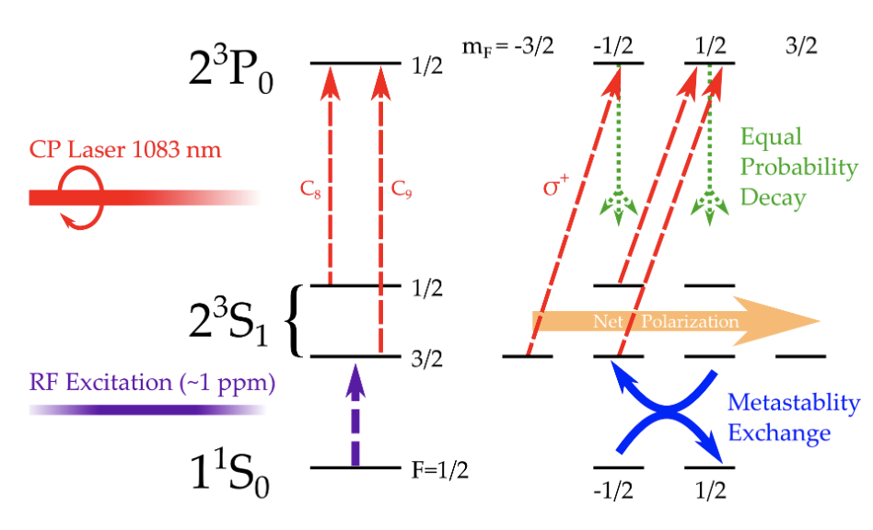
Metastability Exchange Optical Pumping
Discharge excites atoms to the 2³S1 state
Optically pump Metastable State ³He
Laser drives transition and induces polarization on metastables.
Collisions between 2³S1 state and ground state atoms polarize the nuclei
High field MEOP is attractive since it doesn’t require exchange of gases

Slide 5
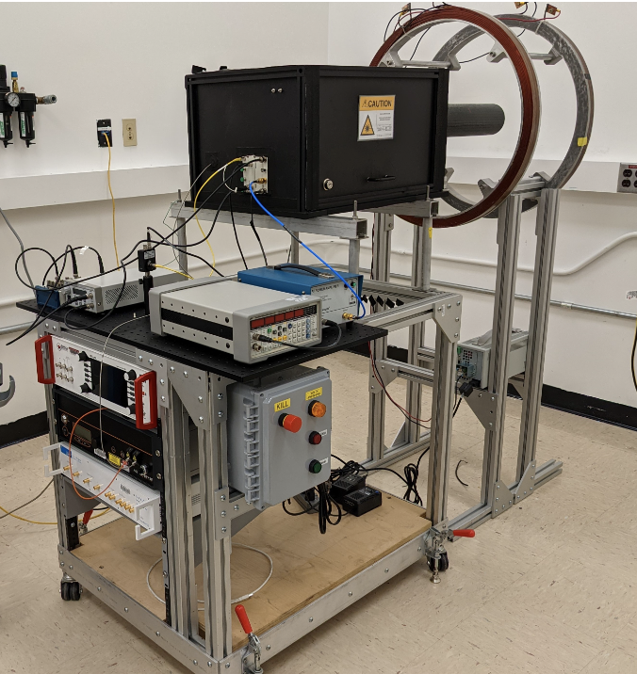
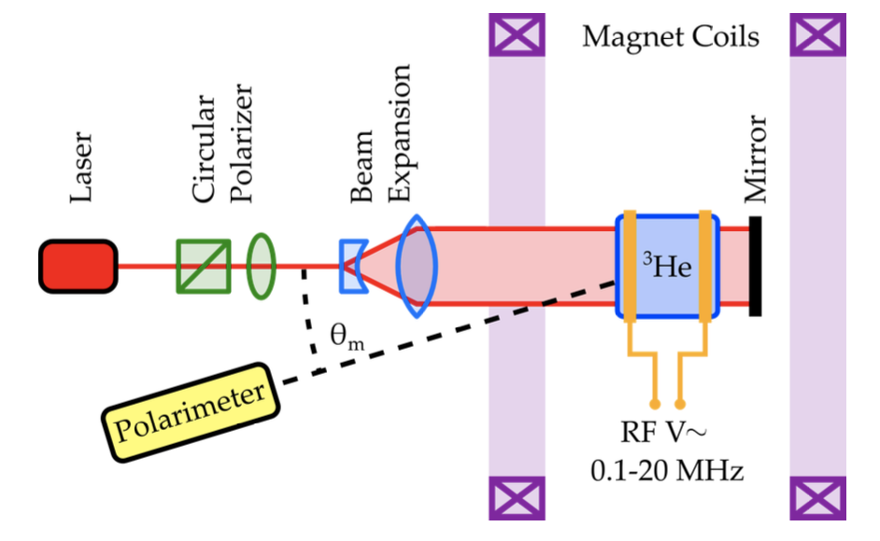
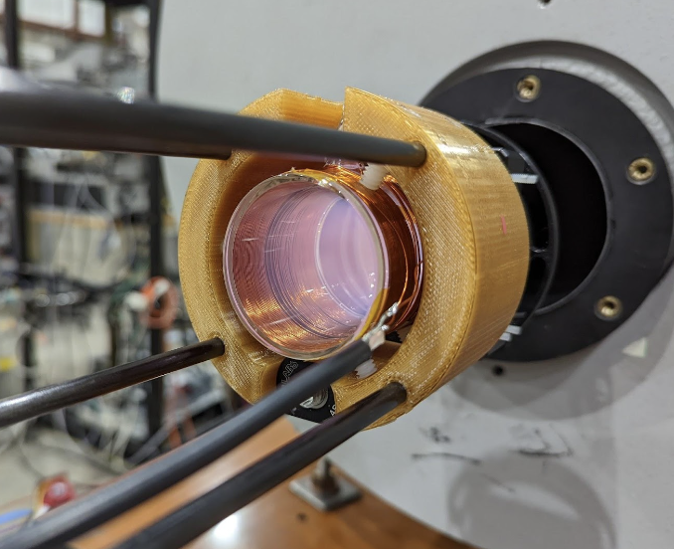
CLAS12 Polarized ³He Gas Target First Development (Low-B)
Sealed ³He cell at ~1 Torr
Helmholtz pair provides ~30 Gauss magnetic field
D. Nguyen, X. Li, J. Maxwell

Slide 6
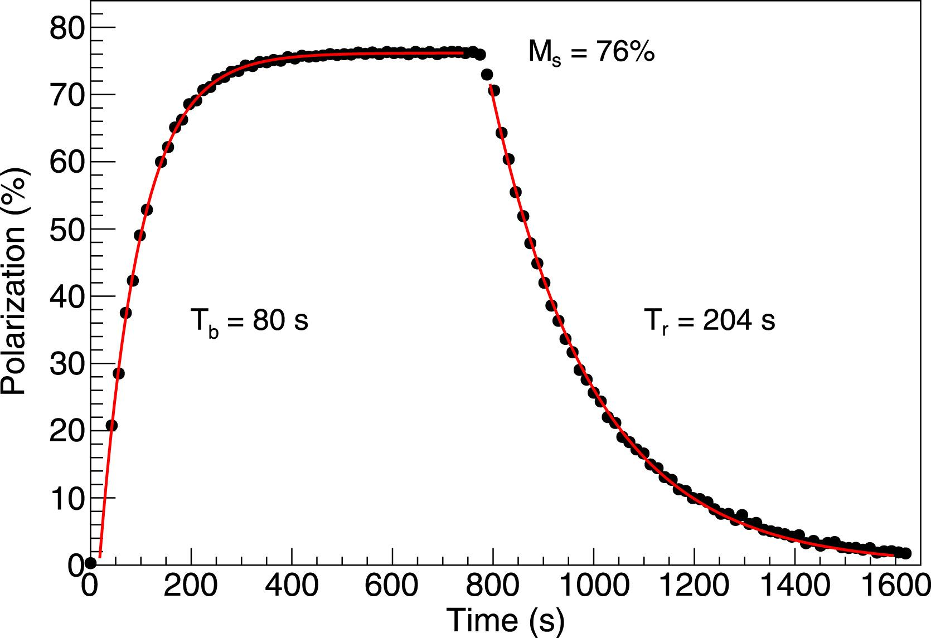
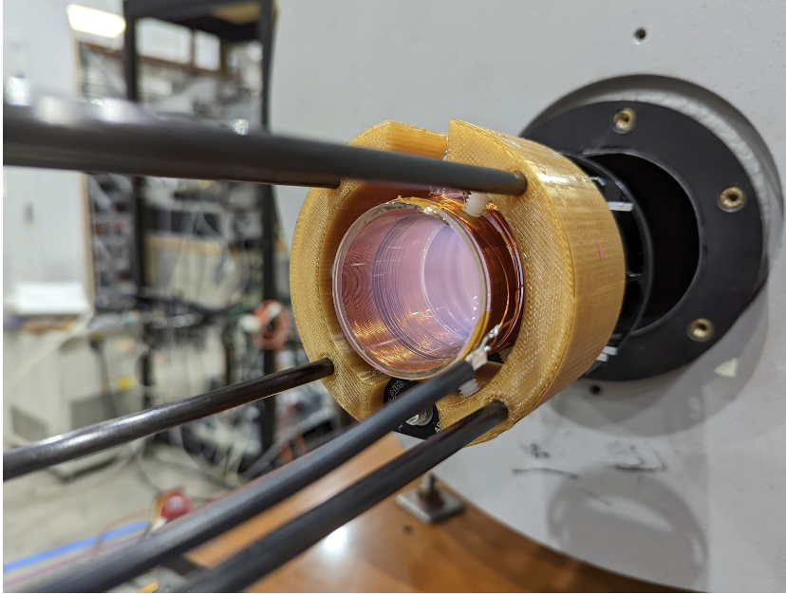
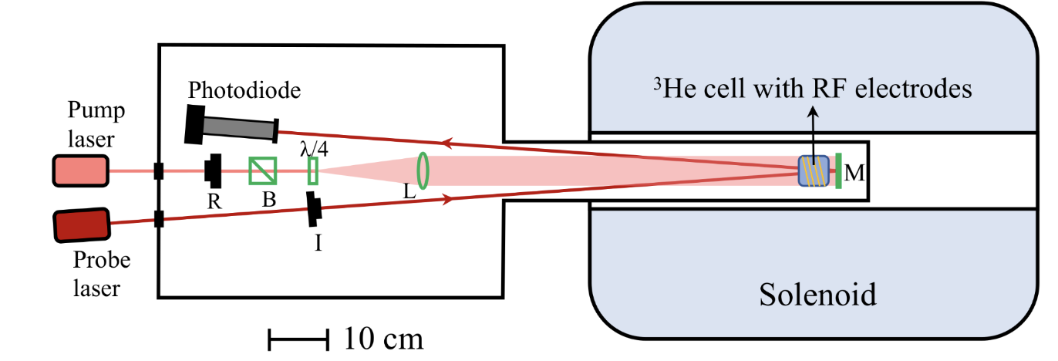
First Development (High Field)
High-field tests
Sealed ³He cell
5T warm-bore solenoid
1083 nm probe laser
70% nuclear polarization with 1400 seconds relaxation time
D. Nguyen, X. Li, J. Maxwell
X. Li, NIM A, 1057, 168792 (2023)

Slide 7
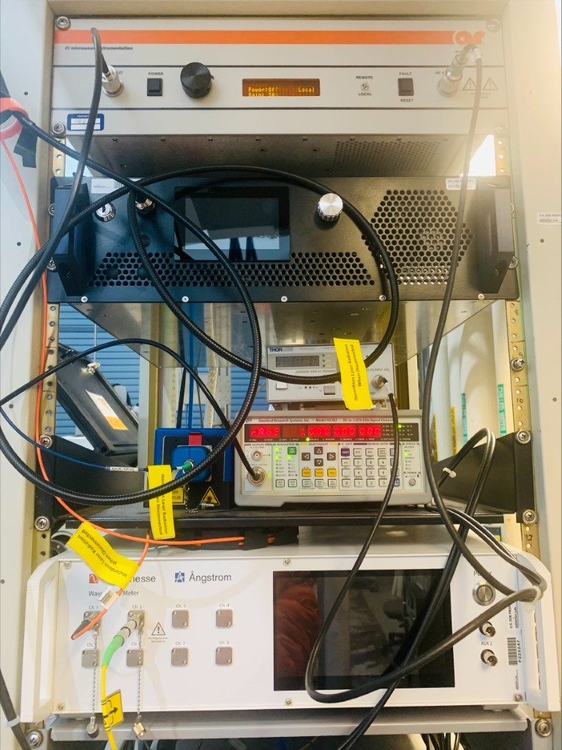
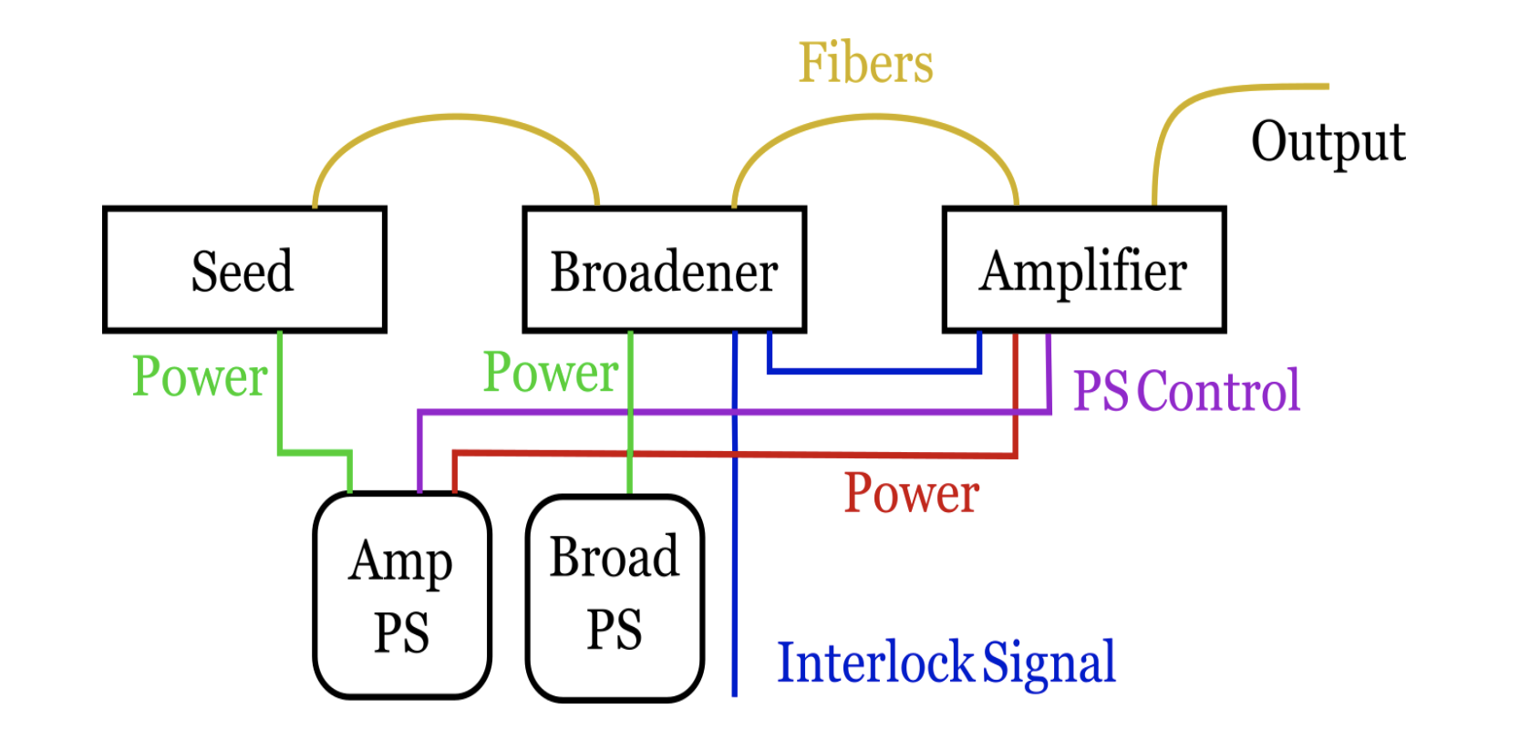
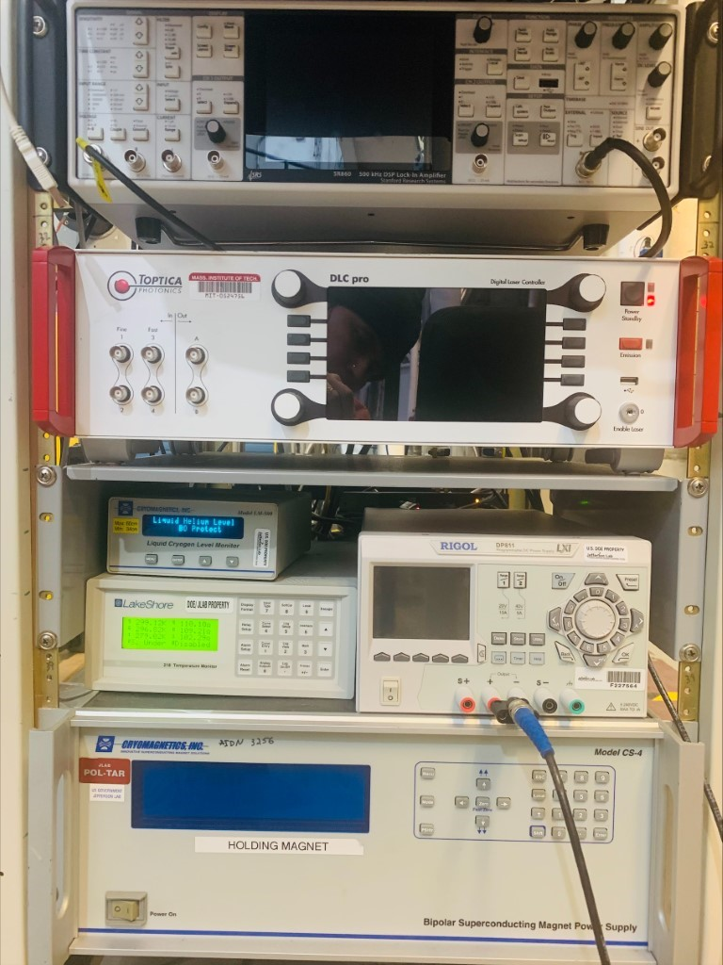
MEOP Apparatus (Electronics)
Rf (25 W)
Pump Laser(0.1 -10)W
Photodiode Amplifier
Signal Generator
Wavelength Meter
Lock-In Amp
Probe Laser (70 mW)
There are three modules in the pumping laser system: a low-power seed laser, a broadener to expand the laser line wavelength to cover our pumping lines, and an amplifier to increase the power of the broadened
laser light to anywhere from 0.1 to 10 W.

Slide 8
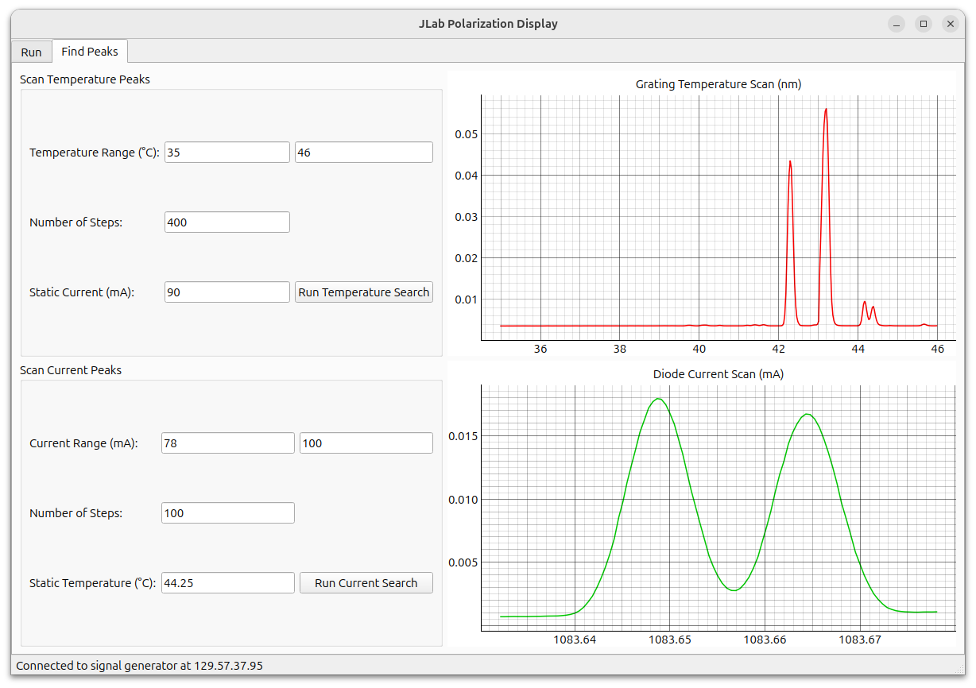
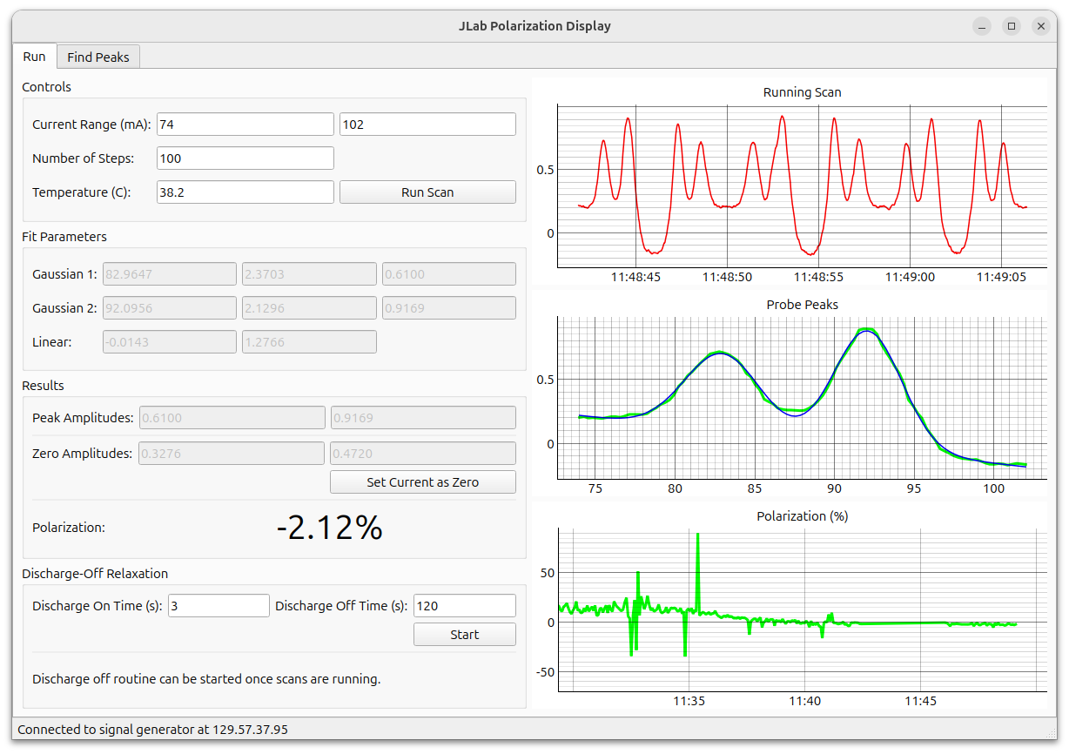
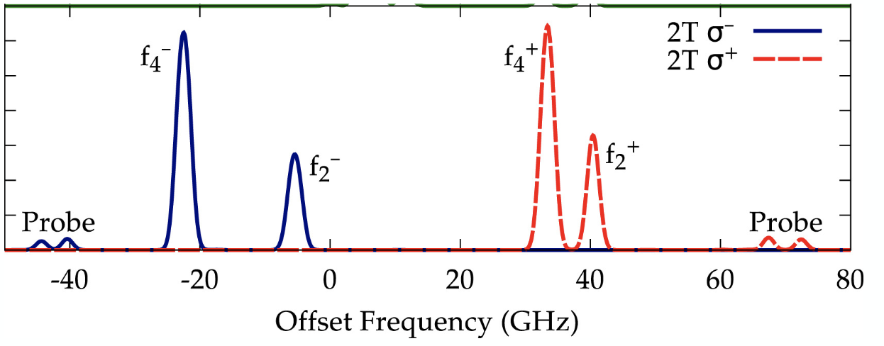
MEOP Software
J. Maxwell
Peak Type | Probe QWP | PumpQWP
f2- | 𝞂ᐩ | 𝛔−
f4- | 𝛔− | 𝛔−
f2+ | 𝛔− | 𝞂ᐩ
f4+ | 𝞂ᐩ | 𝞂ᐩ

Slide 9
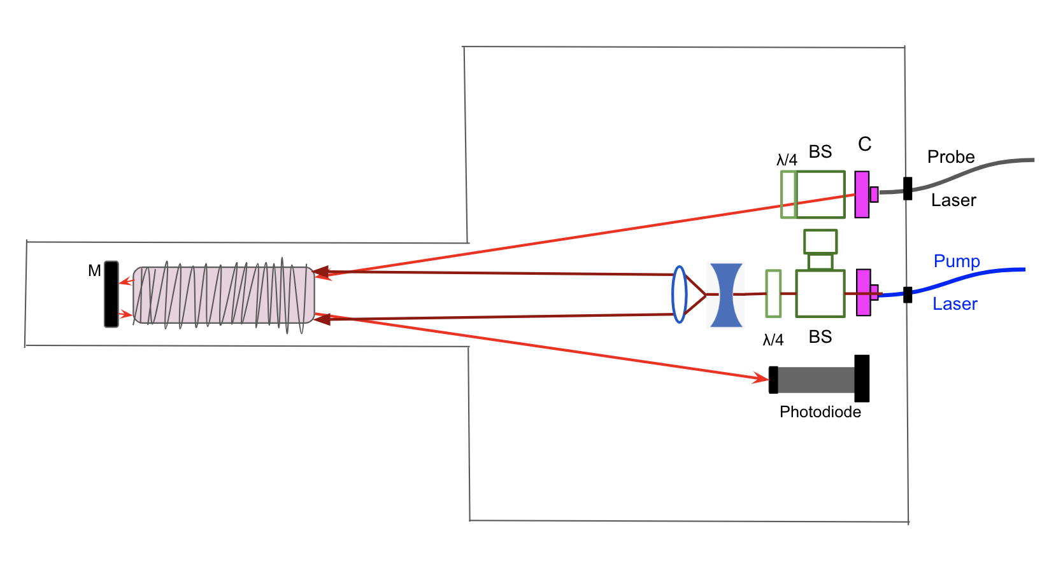
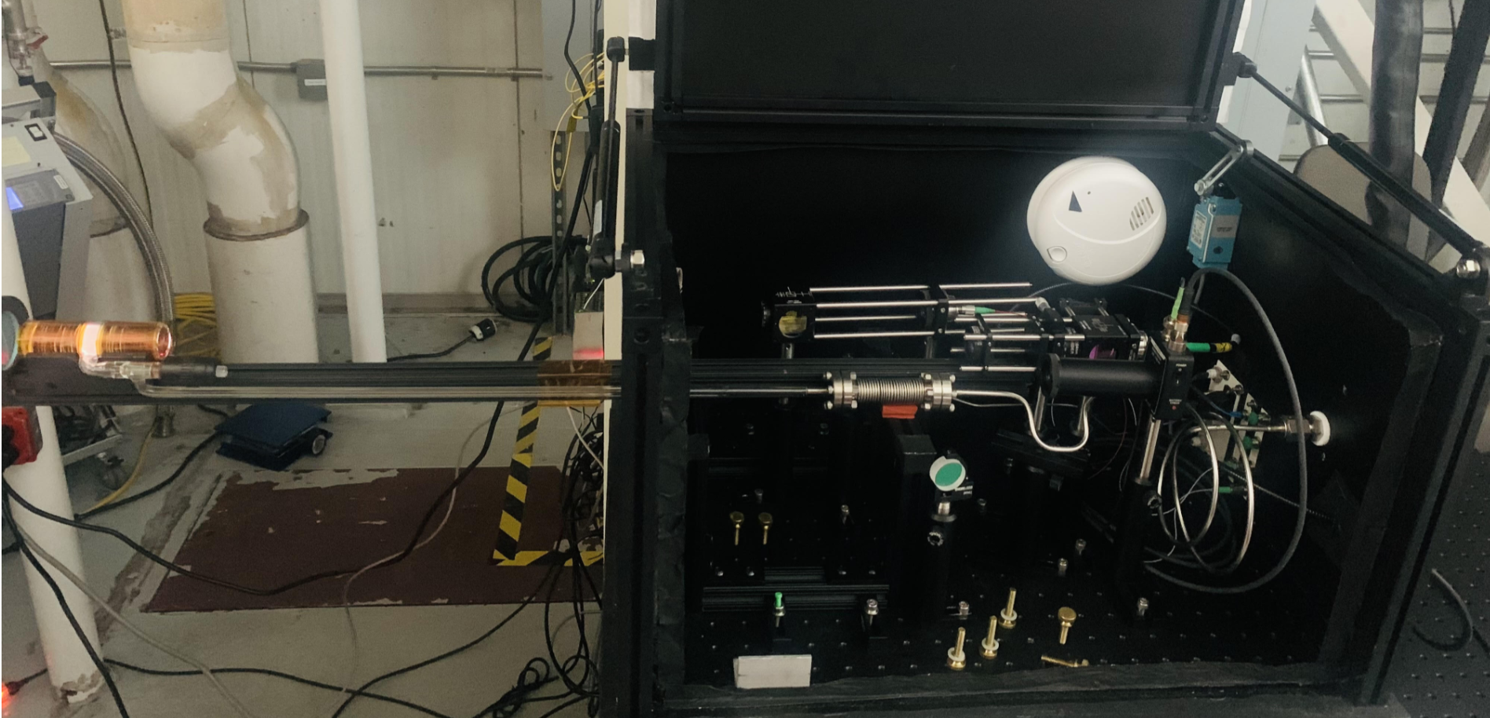
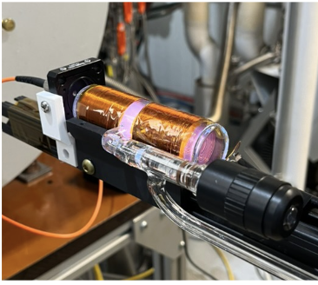
MEOP Apparatus (Optics)

Slide 10
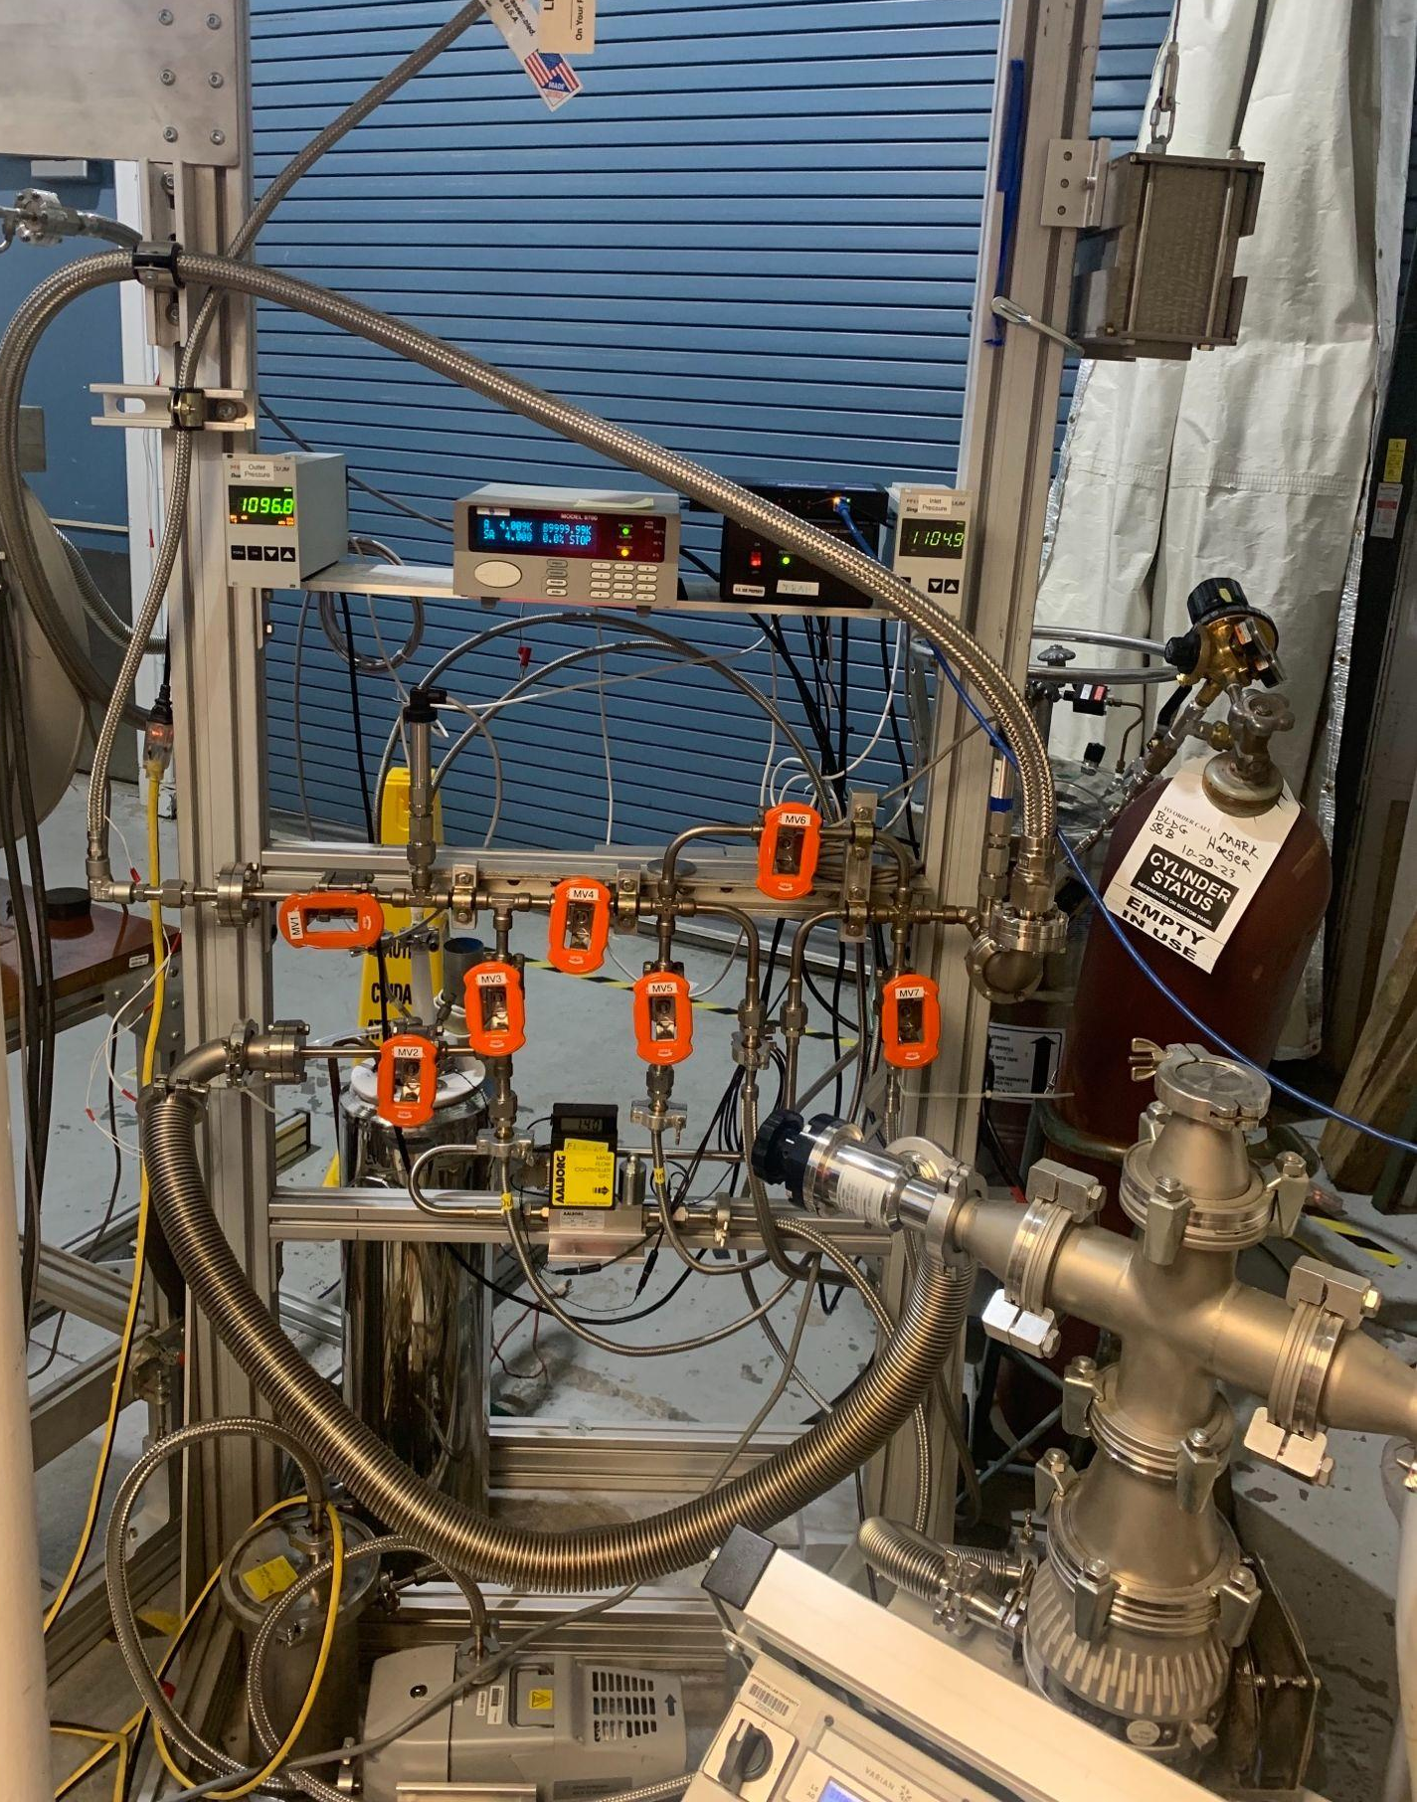
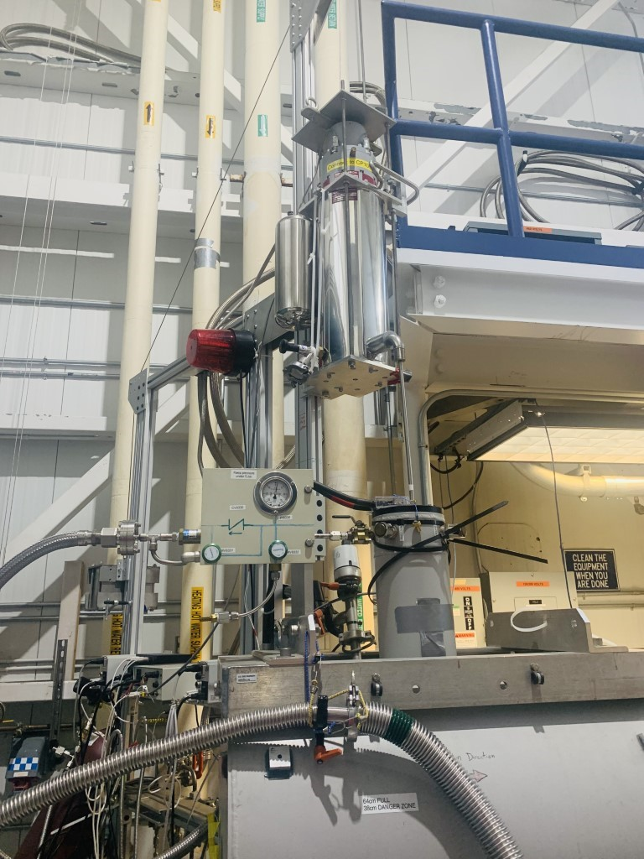
Magnet Re-liquefier
Back to the reliquifier
Reliquifier
⁴He gas
back from the magnet
⁴He gas into the reliquifier
Liquified ⁴He
Into the magnet
ByPasses
Warm gas out from the magnet back to the inlet for recirculation (reliquifying)
⁴He gas inlet
LN2 trap
To produce the field, warm bore magnet has to be cooled by liquefier
To the pumps

Slide 11
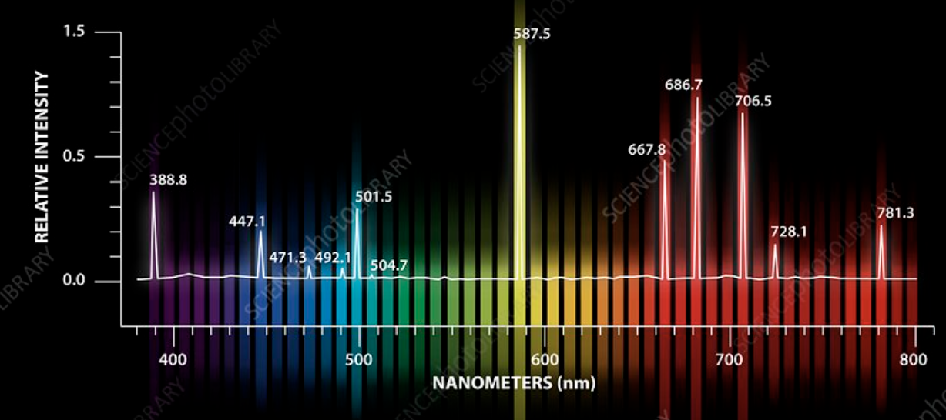
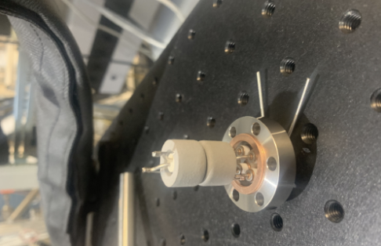
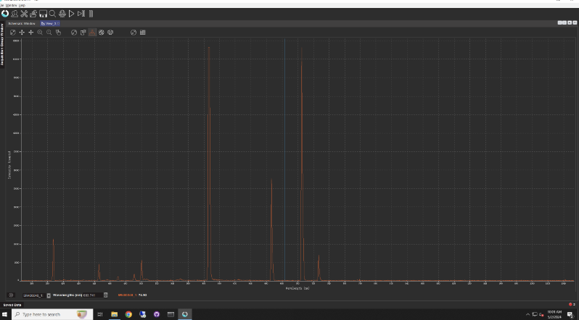
Gas Purity
Baked the cell, and the helium path to cell for about 2 weeks before the use.
Getter takes care of gas purity, but needs re-activation when purity gets worse

Slide 12
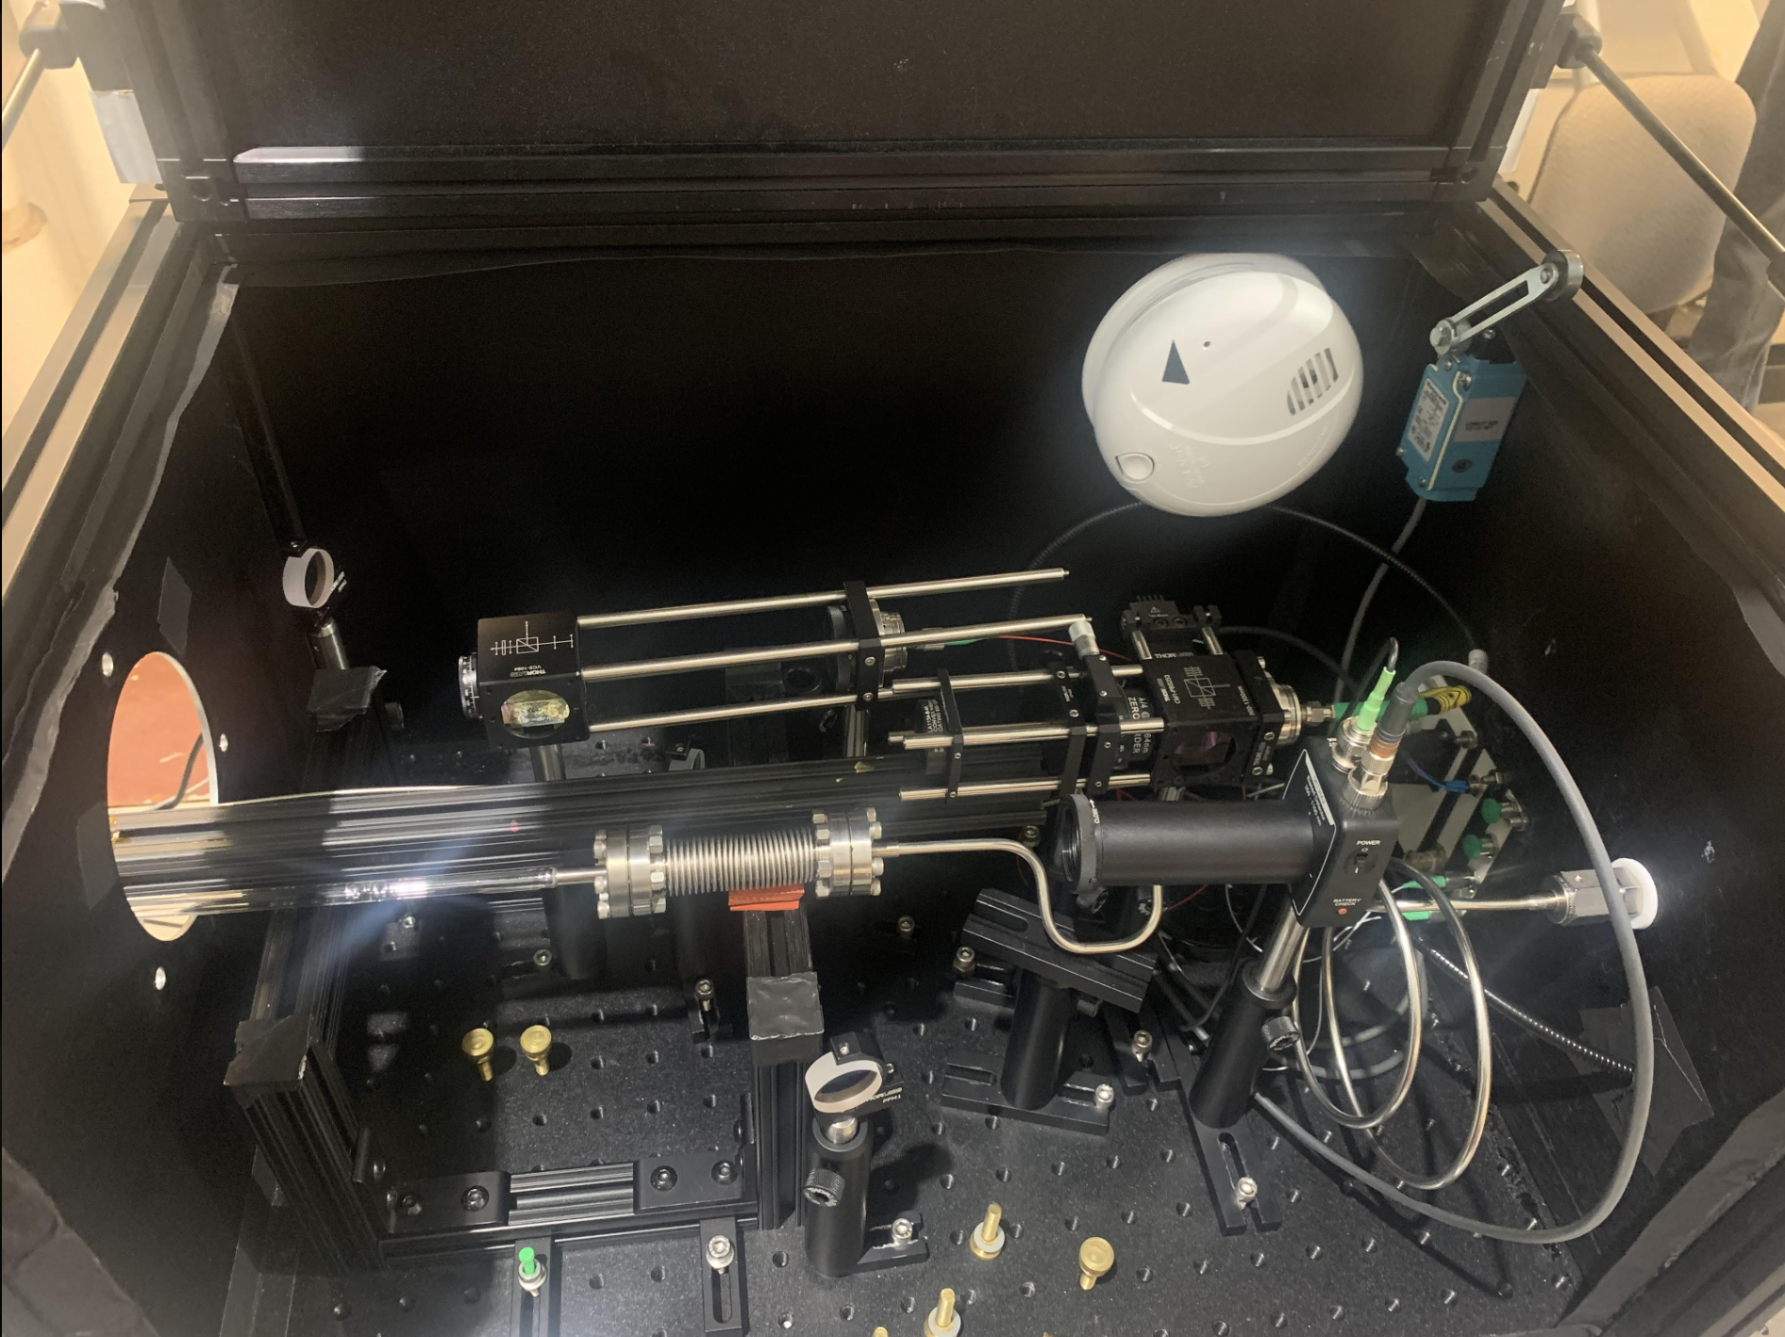
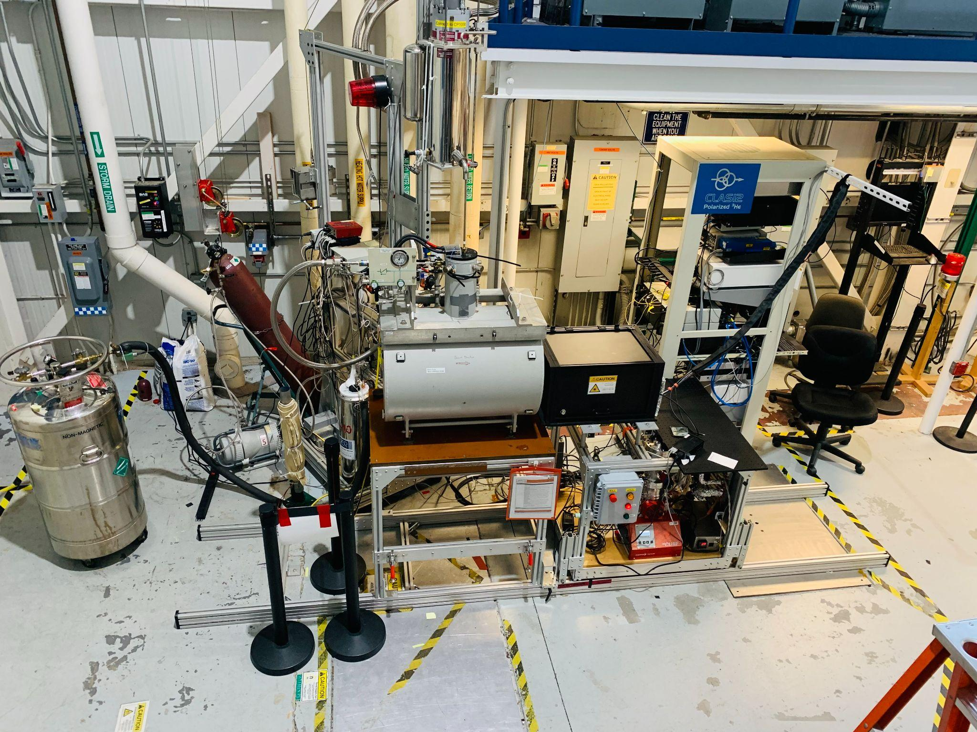
Target Development Lab (MEOP’s home)
Fillable ³He cell at various mbars
FROST Magnet provides 1-5T magnetic field
Tested with various magnetic field and the cell pressure

Slide 13
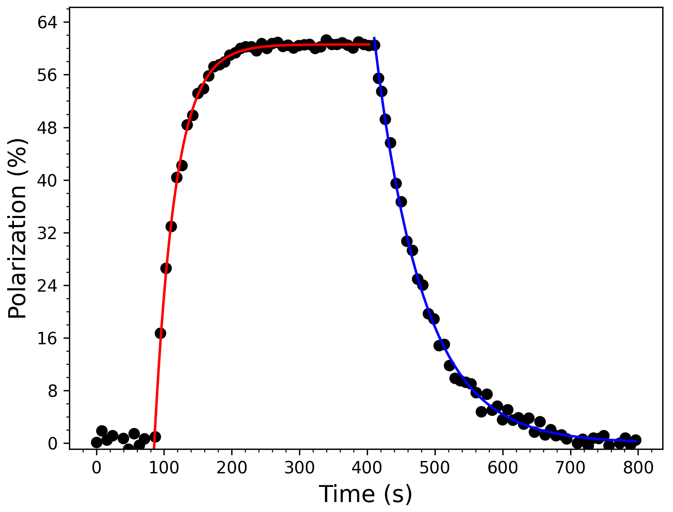
Polarization Tests (Sealed Cell Vs Fillable Cell)
Preliminary
Mₛ = 60 %
Tᵣ = 75 s
Tb = 31 s
1 torr, 2T, f4-
This talk: 1 mbar, 2T, f4+
X. Li, NIM A, 1057, 168792 (2023)

Slide 14
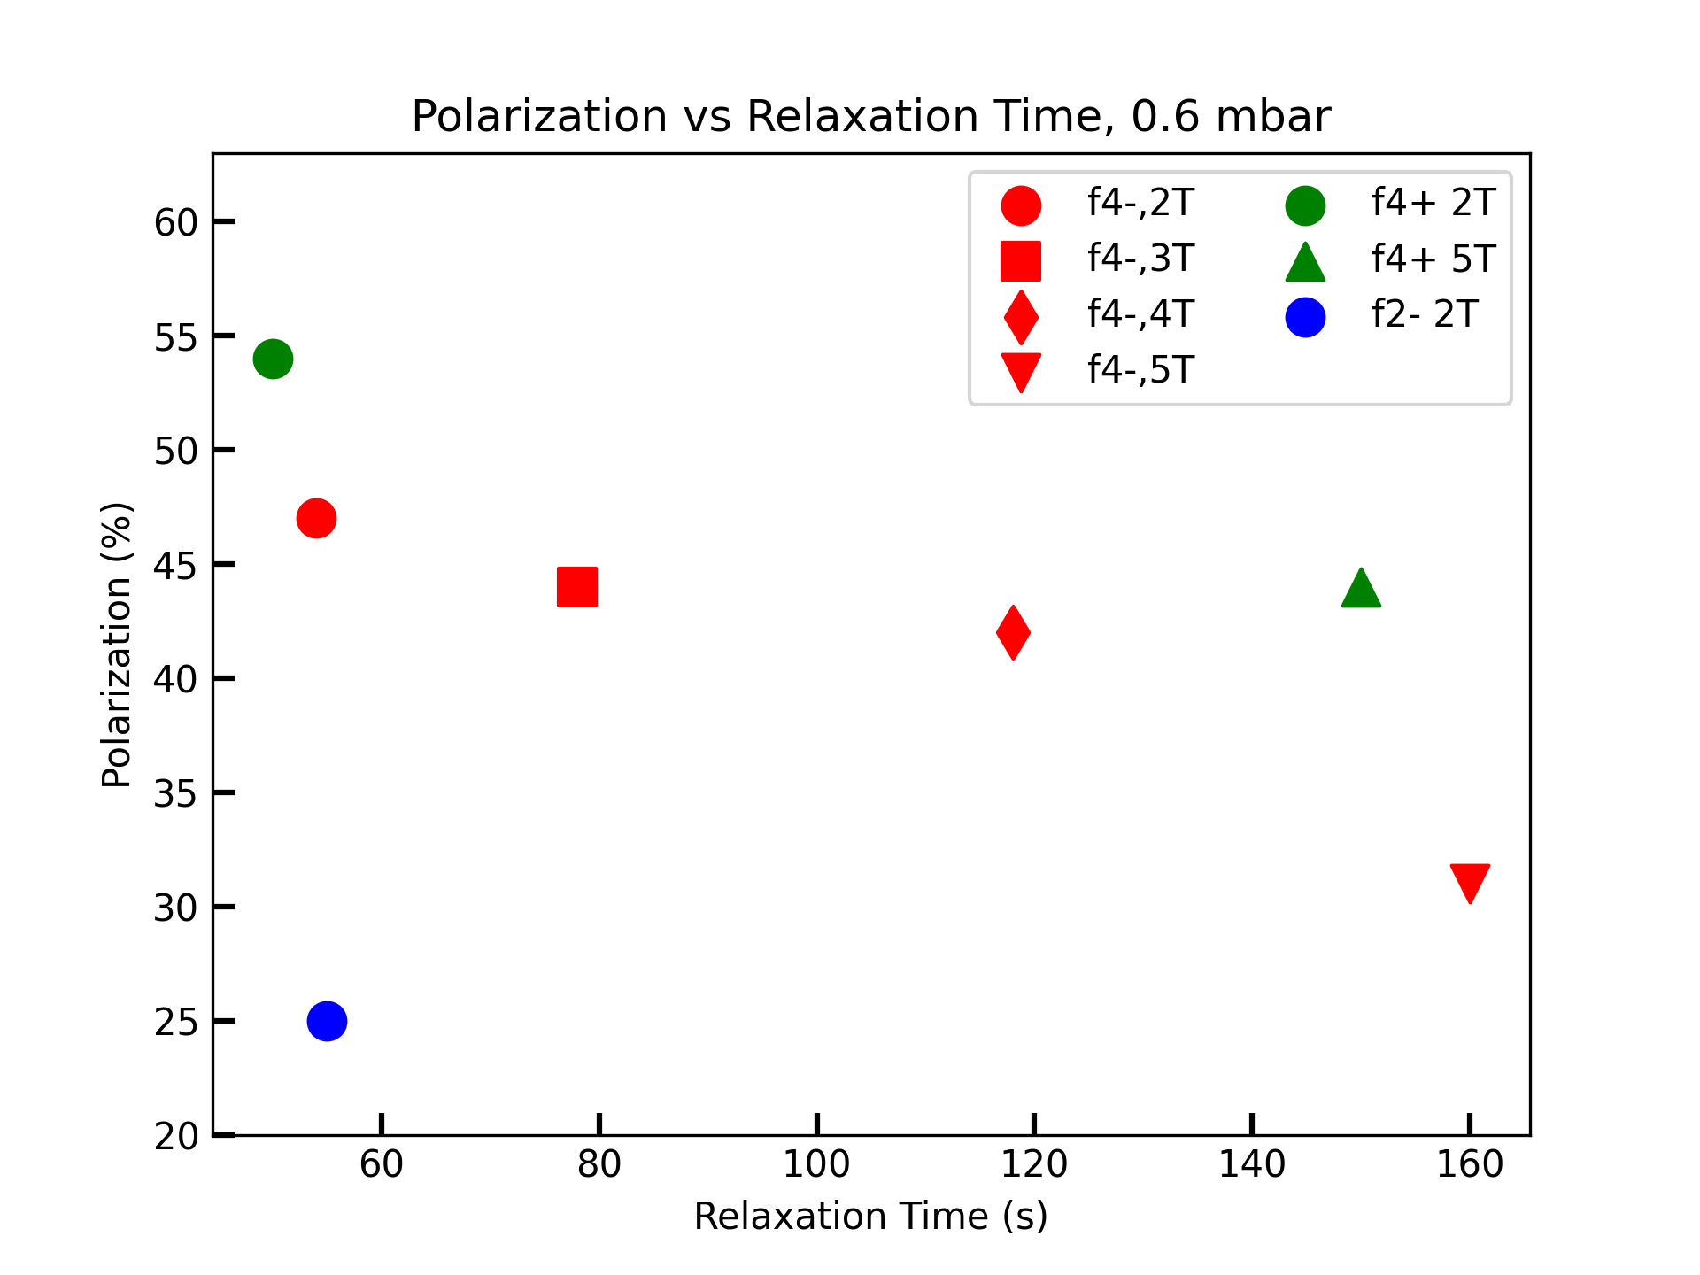
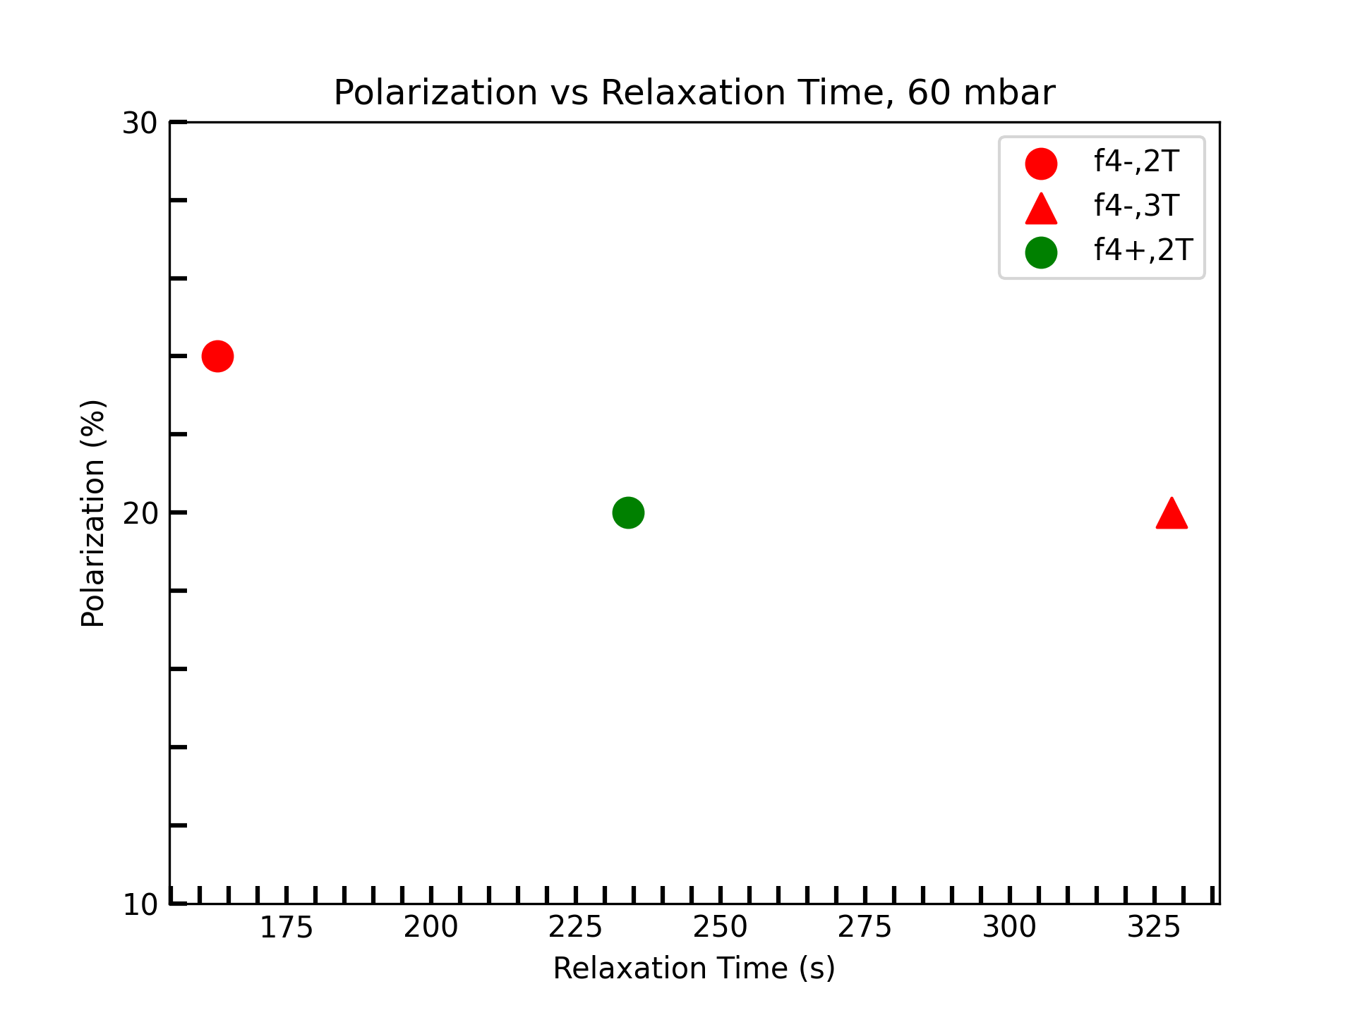
Polarization Tests (Field Variance)
Preliminary Results

Slide 15
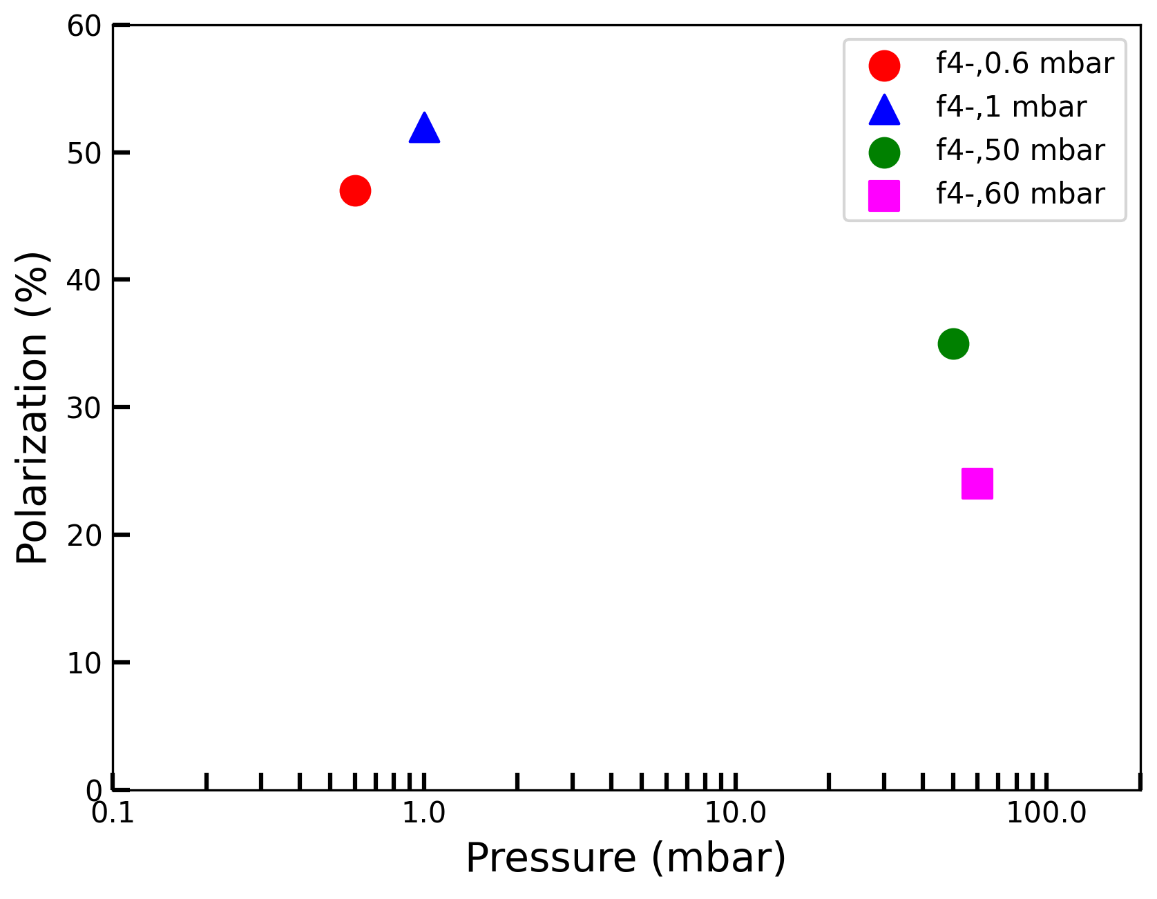
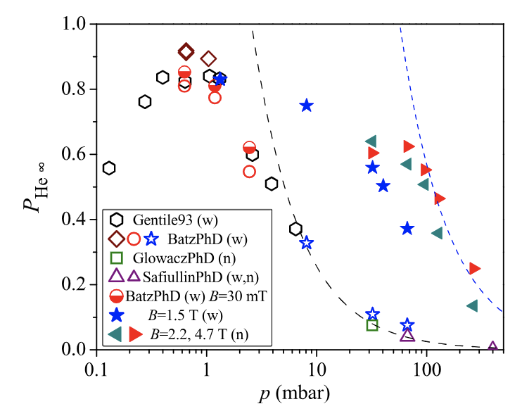
Polarization Tests (Pressure Dependancy)
2T
Preliminary
T. R. Gentile et. al., Rev. Mod. Phys. 89, 045004 (2017)
High pressure tests need high enough RF power, high discharge amplitude

Slide 16
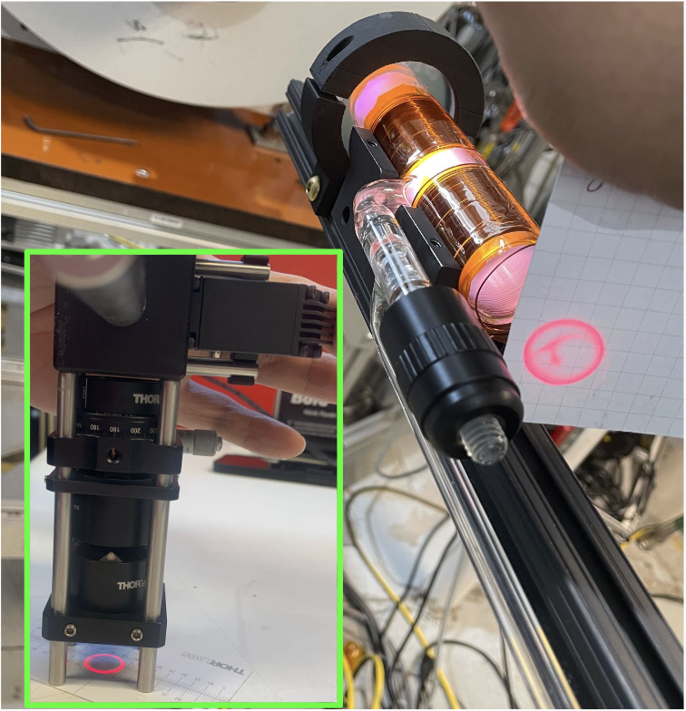
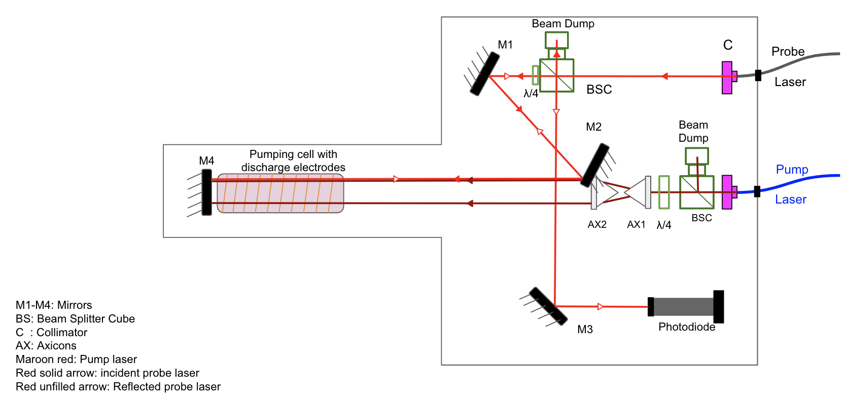
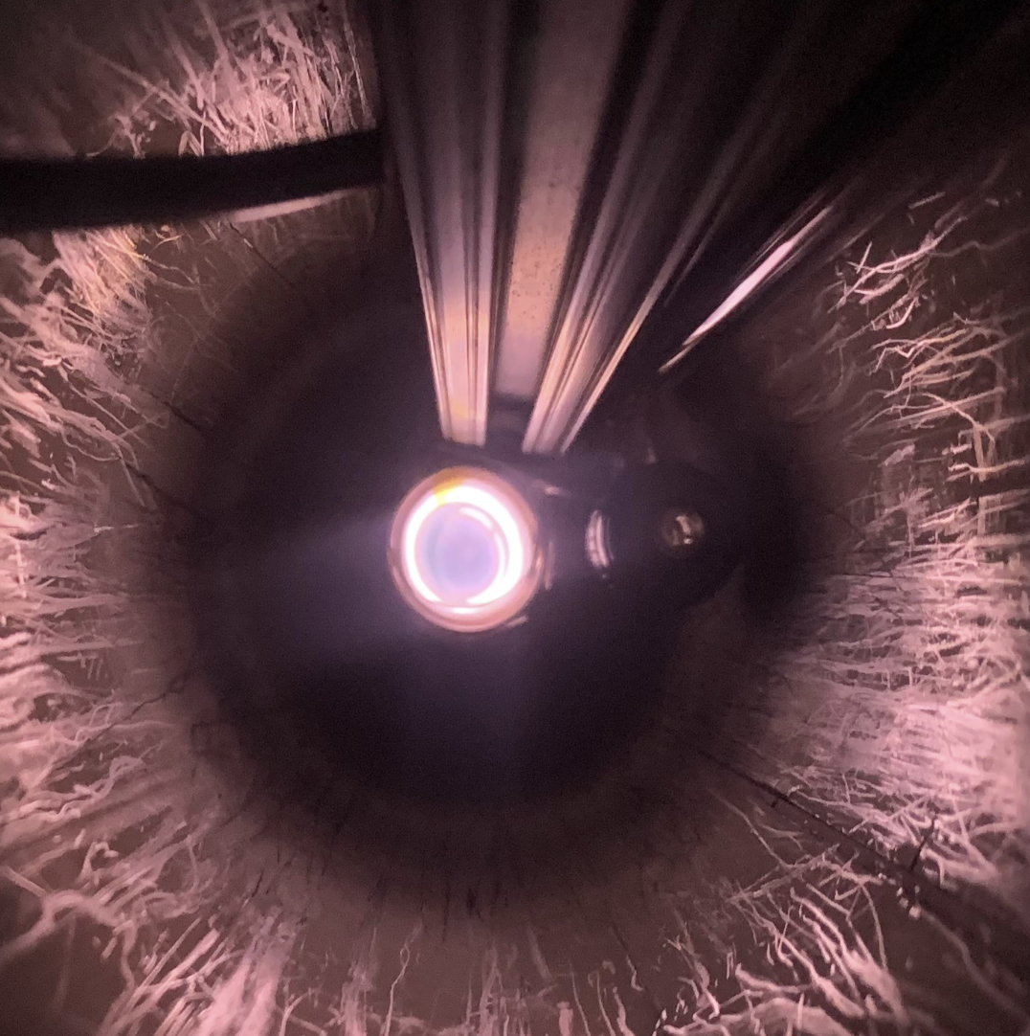
High Pressure Optics Set Up

Slide 17
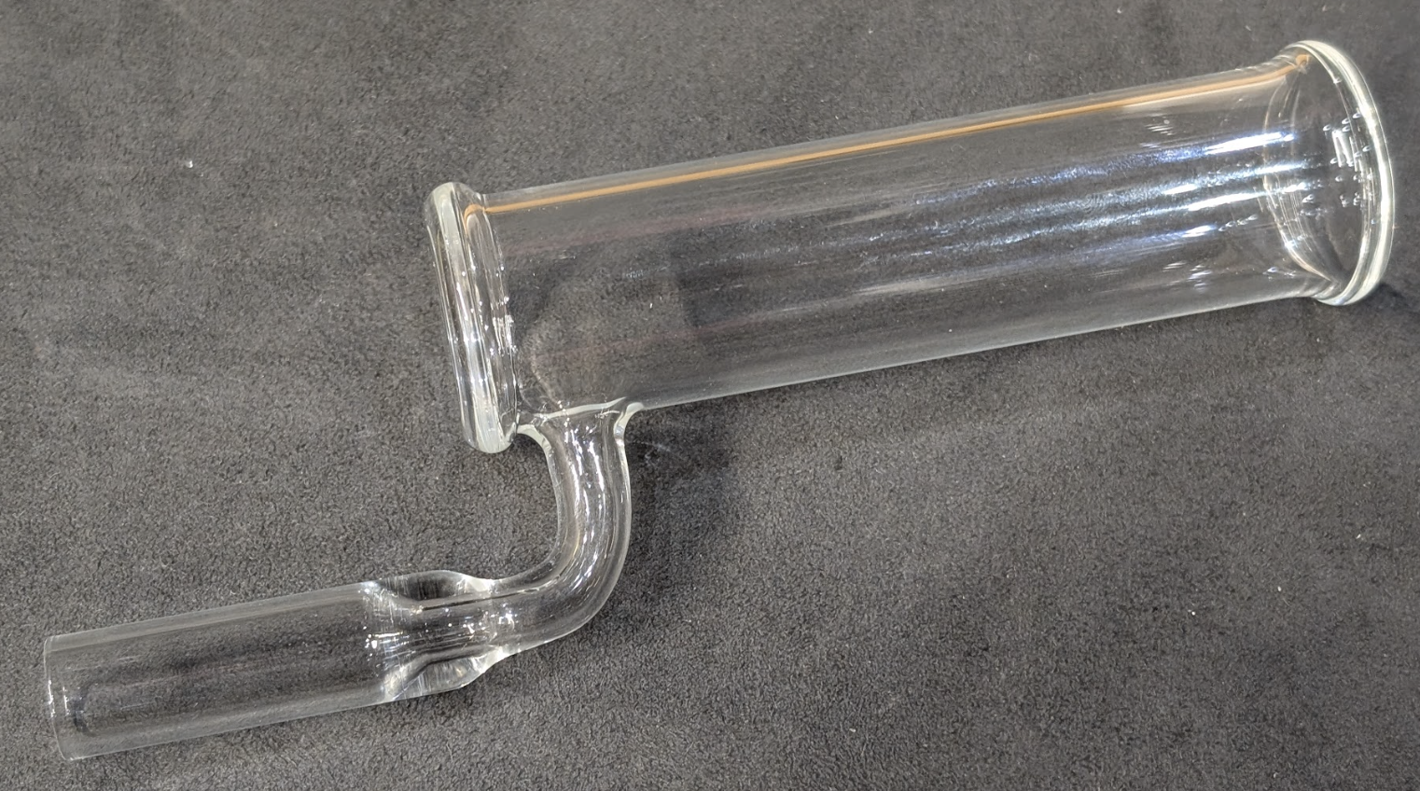
Near Next
Metastability Exchange Optical Pumping (MEOP) of ³He in situ, Guilhem Collier’s Thesis
Continue high pressure tests with a new smaller radius cell that fits with axicons
Axicon enables beam profile matching
discharge distribution
Install coated mirrors
Future design in H. Lu’s talk (next)

Slide 18
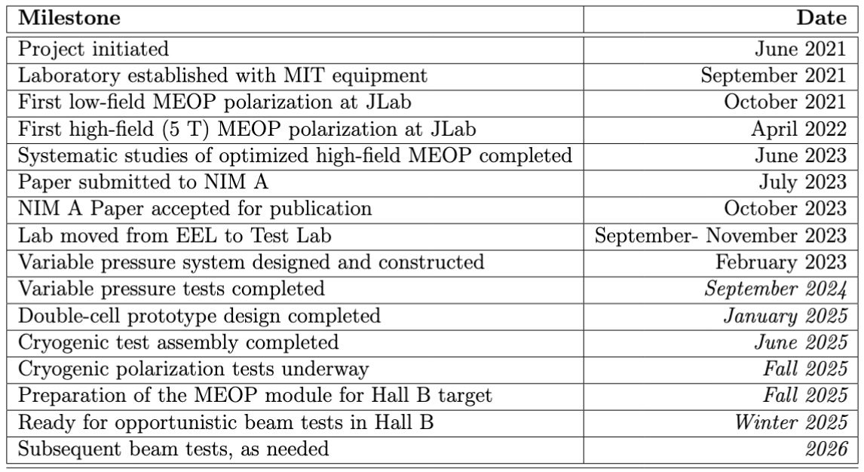
Tentative Schedule

Slide 19
Summary
A polarized ³He target in CLAS12 would provide a valuable new set of observables related to the quark and gluon structure within the neutron.
76 % Polarization with sealed cell at 1 Torr achieved.
Polarization tests done at various fields and pressure, using smaller and longer fillable cell. Achieved maximum of ~60 % polarization.
Test at high pressure with a new cell, and optimize it.

Slide 20
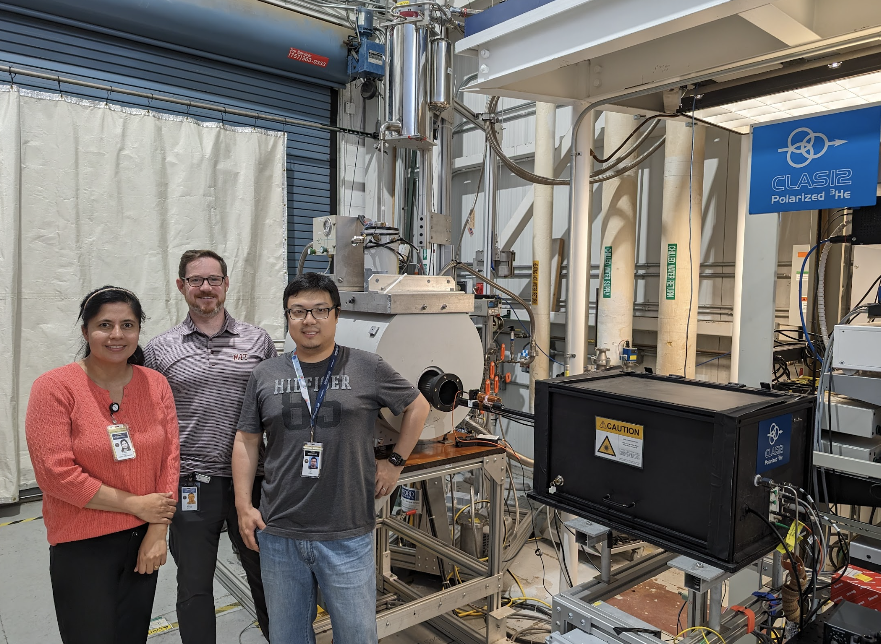
Acknowledgments
CLAS12 Polarized ³He collaboration:
MIT : R. Milner, P. Pandey
JLab: H. Avakian, C. Keith, J. Maxwell, J. Brock
UTK: D. Nguyen, H. Lu
Shandong U.: X. Li
Supported by:
This material is based upon work supported by the U.S. Department of Energy, Office of Science, Office of Nuclear Physics under contract DEAC05-06OR23177.
Thank you for your attention !

Slide 21
Back Up

Slide 22
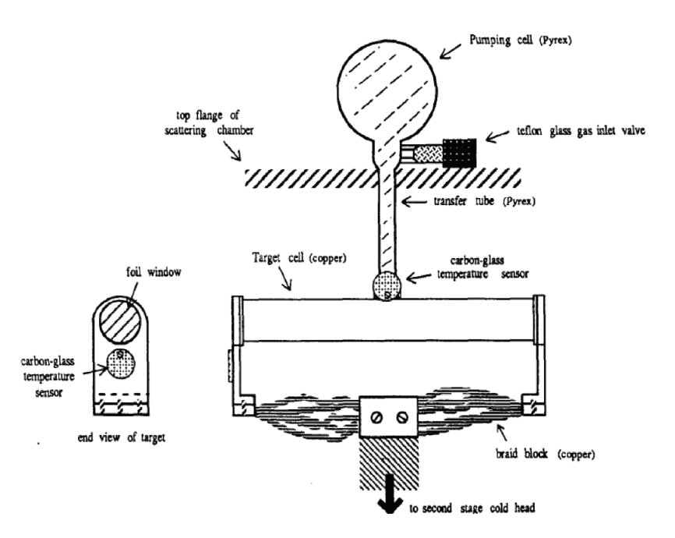
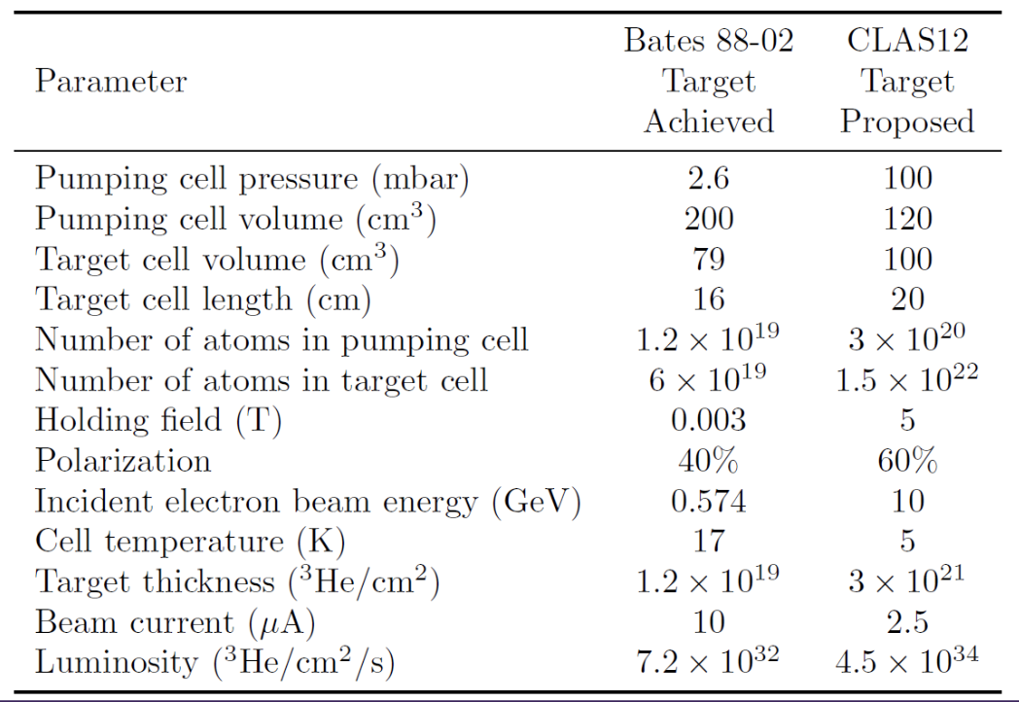
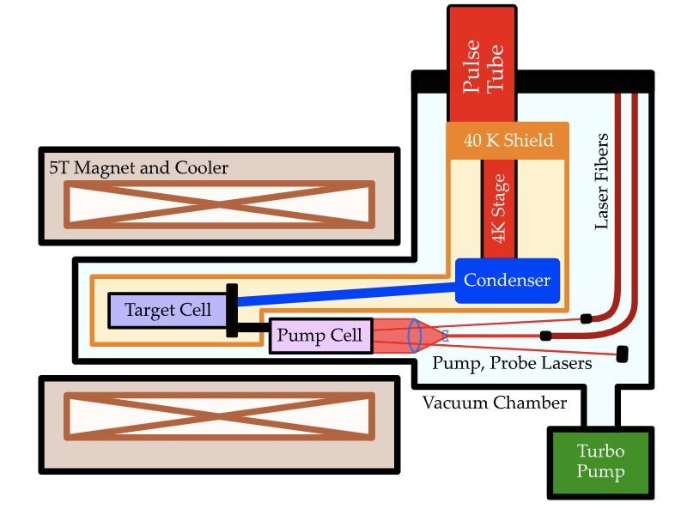
Planned double cell for CLAS12
Polarized ³He target double-cell system developed at Caltech for Bates experiment 88-02

Slide 23
Target Conceptual Design
293 K Pumping Cell:
Volume: 200 cm³ borosilicate glass
MEOP achieving 60% polarization
Annular cylindrical shape
5 K Target Cell:
Volume: 100 cm³, 20 cm long aluminum cell
Cooled by LHe heat exchanger
Luminosity: 2.7×10³⁴ nuc/cm²/s at 0.5 μA

Slide 24
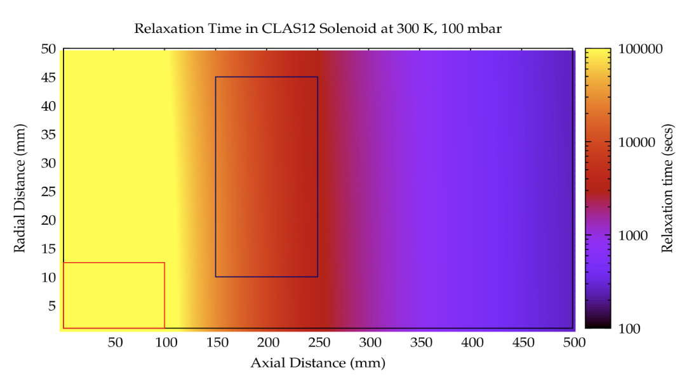
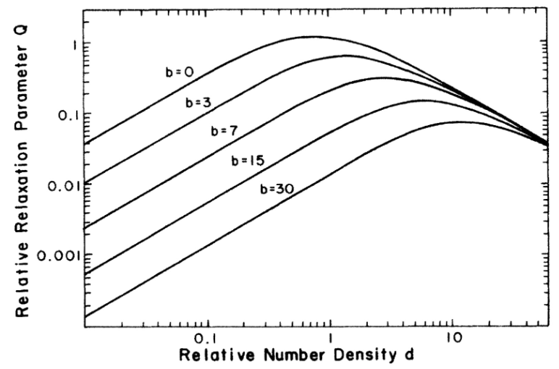
Planned double cell for CLAS12
Wall Relaxation:
Borosilicate glass
Aluminum with coating
Field Gradient:
Relaxation time around the pumping region: 10^4seconds
Ionizing Radiation:
Formation of 3He2+molecules
Suppressed with higher magnetic fields

Slide 25
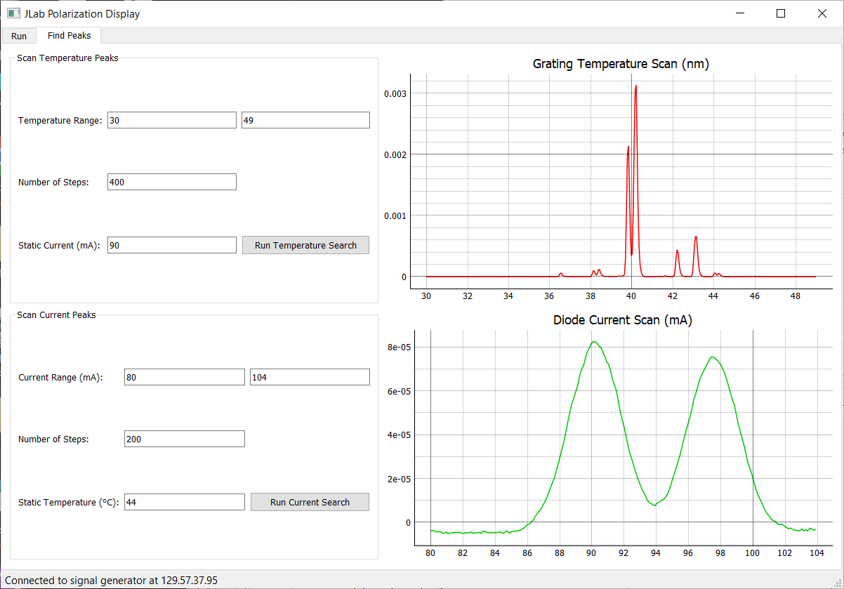
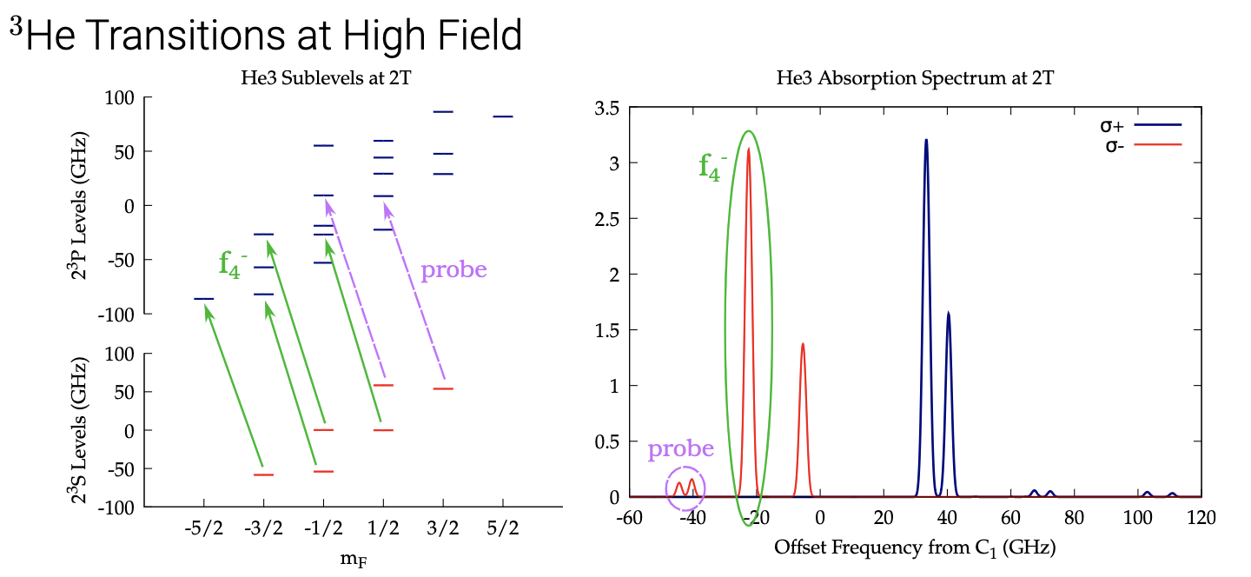

Slide 26
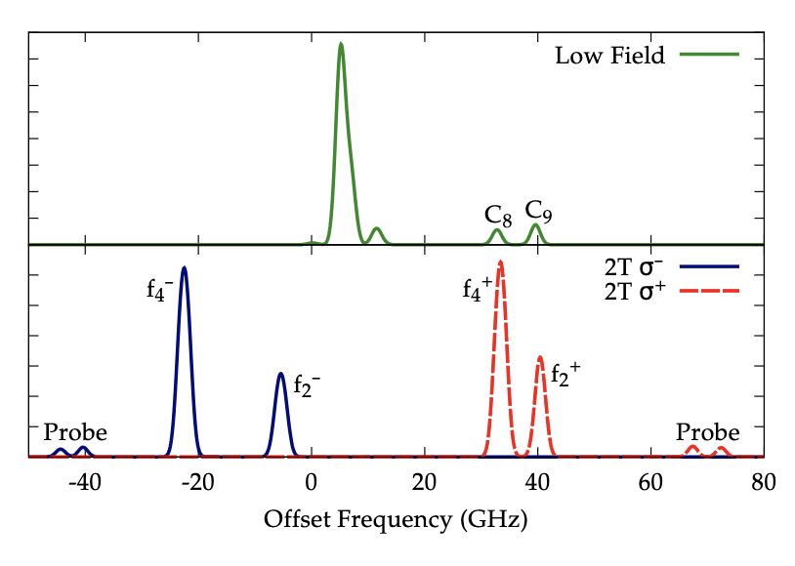
Absorption spectrum of
3He at low magnetic field and 2 T, showing the separation of degenerate Zeeman states with increasing field. Pumping
transitions are labeled by name, as are lines useful for probes.

