Slide 1
Small Polarized Electron Storage Ring for Fundamental Physics Experiments
R. Suleiman, Ya. S. Derbenev, V. S. Morozov

Slide 2
Outline
Spin transparency and figure-8 storage rings
Measurement of Electric Dipole Moment of free electron
Search for axions
Summary
Riad Suleiman, Vasiliy S. Morozov and Yaroslav S. Derbenev, "High precision fundamental physics experiments using compact spin-transparent storage rings of low energy polarized electron beams", Physics Letters B, Volume 843, 2023, 138058, ISSN 0370-2693, https://doi.org/10.1016/j.physletb.2023.138058

Slide 3
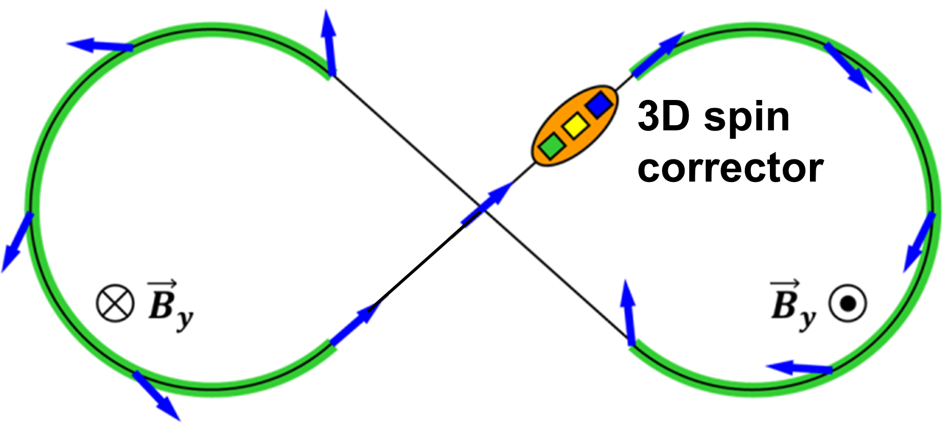
Spin-Transparent Ring Concept
Storage ring with degenerate spin motion:
Spin transformation in one turn around ring is a unit operator, i.e., no net spin rotation
Can be understood as spin-echo effect
Figure-8 topology is most natural example:
Straightforward concept: spin rotation in one arc is compensated by spin rotation in second arc
No first-order spin chromaticity, compensation is energy independent
Originally proposed for polarized storage rings at JLEIC
Well-understood theory for magnetic rings:
$${\vec{B}}_{z}$$
$${\vec{B}}_{z}$$
https://doi.org/10.1103/PhysRevLett.124.194801
https://doi.org/10.3390/sym13030398

Slide 4
Reaching Spin Transparency in Real Ring
Imperfections such as dipole roll and quad misalignment lead to closed orbit excursion and break spin degeneracy in a real-world ring
Error effect is rather weak, spin sensitivity to errors can be described through spin response function based on linear optics
Closed orbit excursion leads to coherent spin rotation, same for all particles
Effect of imperfections can be experimentally measured and compensated by a local 3D spin rotator consisting of weak magnets, e.g., a sequence of alternating dipoles and solenoids can provide a rotation about an arbitrary axis cancelling error effect
Higher-order incoherent spin rotations result from betatron and synchrotron motion and set a fundamental limit on Spin Coherence Time (SCT)

Slide 5
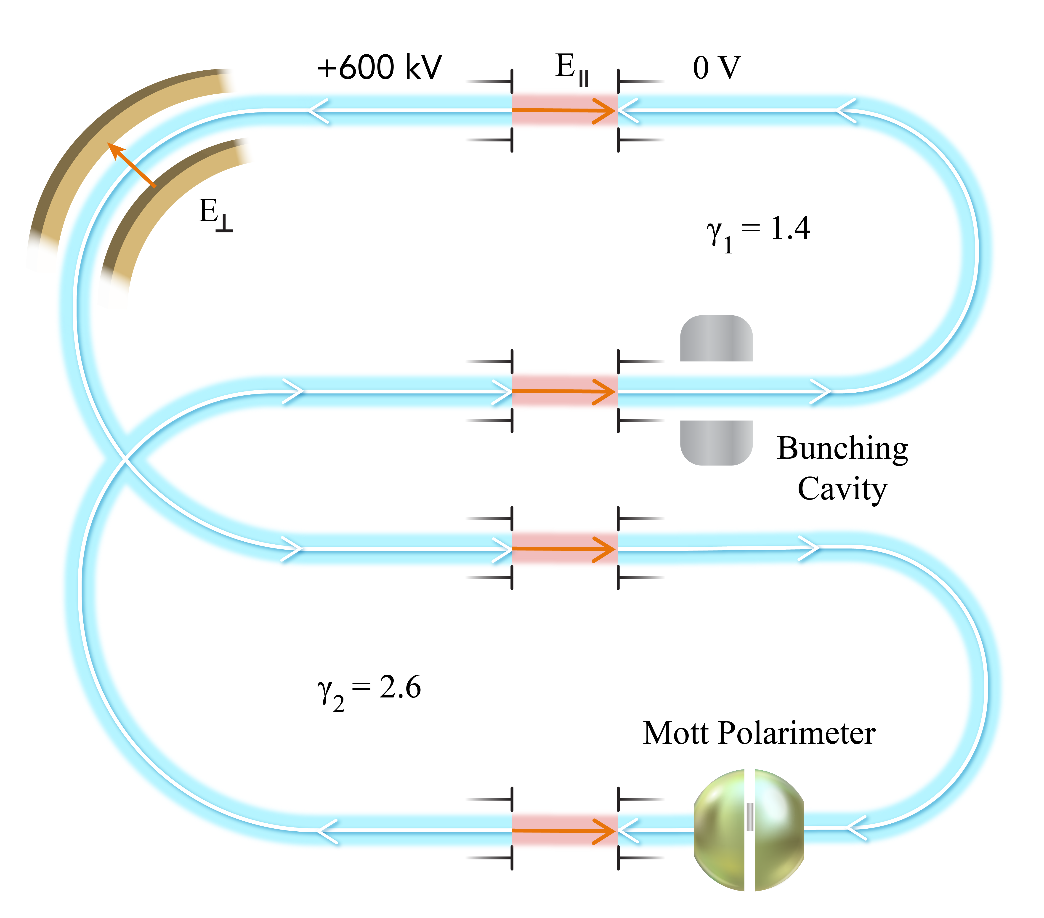
Measurement of Electric Dipole Moment (EDM) of Free Electron
EDM is very sensitive to physics beyond Standard Model and new sources of Charge-conjugation and Parity (CP) violation – such CP violation could signal presence of new physics and explain puzzle of matter-antimatter asymmetry in Universe
Current electron EDM upper limit ($d_{e}<4.1×{10}^{−30}$e $∙$ cm) has been extracted from measurement using HfF⁺ ions
Any measurement of EDM relies on measuring spin precession rate in an electric field of a particle’s rest frame, $\frac{d\vec{S}}{dt}=\vec{μ}×{\vec{B}}_{rest}+ \vec{d}×{\vec{E}}_{rest}$
Magnetic Dipole Moment (MDM) effect is naturally suppressed at any energy due to spin-transparent ring topology and symmetry
All-electric design with no magnetic fields to allow for two counter-rotating electron beams (CRA and CRB) to circulate concurrently – only one beam is shown in right figure
EDM ring consists of two low-energy and two high-energy arcs connected by longitudinal static electric field sections – they preserve suppression of MDM effect but remove degeneracy of EDM spin precession
Notes:
Hafnium Fluoride
/prəˈseSH(ə)n/

Slide 6
Mott Polarimeter
Ring is filled with four polarized electron bunches, each 2 nC, in one direction and another four bunches, each 2 nC, in opposite direction
Use half charge of each bunch to measure initial bunch polarization at t = 0 using a conventional Mott polarimeter
Measure final bunch polarization at end of store time, t = SCT
EDM results in a build-up of vertical component of beam polarization due to spin precession from longitudinal to vertical
Detector Coverage:
$φ:0 → 2π$
$θ:90° → 160°$

Slide 7
Projected Electron EDM Statistical Limit
Statistical uncertainty per fill:
After five years of data taking, projected statistical limit is:
with expectation that further optimization and improvements will lower this limit
$$σ_{EDM}=\sqrt{8}\frac{qsℏ}{2m_{e}c}\frac{1}{\sqrt{N_{e} ε} A_{y} P Ω_{EDM} SCT}$$
Electrons per Fill | $$N_{e}$$ | $$5.0∙{10}^{10}$$
Polarimeter Efficiency | $$ε$$ | $$0.0024$$
Analyzing Power | $$A_{y}$$ | $$0.45$$
Beam Polarization | $$P$$ | $$0.90$$
Spin rotation per $η$ per time ($η=6.0×{10}^{−19}$) | $$Ω_{EDM}$$ | $0.45×{10}^{9}$ rad/s
Spin Coherence Time | $$SCT$$ | 1 day ($86400$ s)
$2.5×{10}^{−28}$ e $∙$ cm
$5.8×{10}^{−30}$ e $∙$ cm

Slide 8
Sources of Systematic Uncertainties
Both proton EDM collaborations have done extensive studies:
Many sources have been identified: background magnetic fields, vertical velocity, errors in construction and alignment, vertical E-field, …
Counter-rotating beams (and with both helicities) will suppress some uncertainties
Elaborate state-of-art shielding of background magnetic fields is practical since ring is very small but electron lighter mass (relative to proton) increases sensitivity to these fields
Store all polarization states (longitudinal, vertical, and radial) and with both helicities (positive and negative) at same time to control systematic uncertainties
Mott Polarimetry related systematic uncertainties

Slide 9
Search for Axions
Axions:
Axion is a new particle beyond Standard Model that can explain strong CP problem of Quantum Chromodynamics (QCD), so called “QCD axion” – no CP-violation has ever been seen in any experiment involving only strong interaction in spite of fact that Standard Model as a whole violates this symmetry
Axions are also a viable candidate for dark matter which dominates mass of Universe
Search for axions:
Spin precession due to interaction of Milky Way’s dark matter axions with electrons: https://doi.org/10.1016/j.physletb.2023.138058
Spin precession due to axion-mediated nucleon-electron forces from Earth or test mass – next slide
Spin-transparent storage rings:
Same as electron EDM ring, or
All-electric and one-energy (300 keV) ring – both MDM and EDM are suppressed
$$\vec{e}$$
N
axion
$$g_{s}^{N}$$
$$g_{p}^{e}$$
$$\vec{e}$$
N

Slide 10
Experimental Bounds on Axion-mediated Forces
Spin-transparent ring can measure nHz (${10}^{−9}$ Rad/s) spin precession frequency
Axion sources:
Earth – produces vertical axion coherent field
Test Mass (e.g. lead bricks around ring) – produces radial axion coherent field
Spin-transparent ring would surpass any existing or near-future search by several orders of magnitude
Xing Fan and Mario Reig, https://doi.org/10.48550/arXiv.2310.18797
and private communication
Test Mass
Earth

Slide 11
Summary
Spin-transparent storage rings have many exciting applications: measurement of EDM of free electron and search for axions
Presented new method for a direct measurement of $d_{e}=5.8×{10}^{−30}$ $e∙cm$ and to search for axions using small rings in energy range below 1 MeV
New method has following advantages:
energy-independent spin tune, long SCT, any energy, minimum safety issues, straightforward polarimetry, counter-rotating beams, room-sized facility, manageable, low cost, and finally, such rings can serve as testbed for larger-scale experiments
Concept could potentially be extended to low-energy polarized positron, proton, deuteron, and muon beams
Thank you

Slide 12
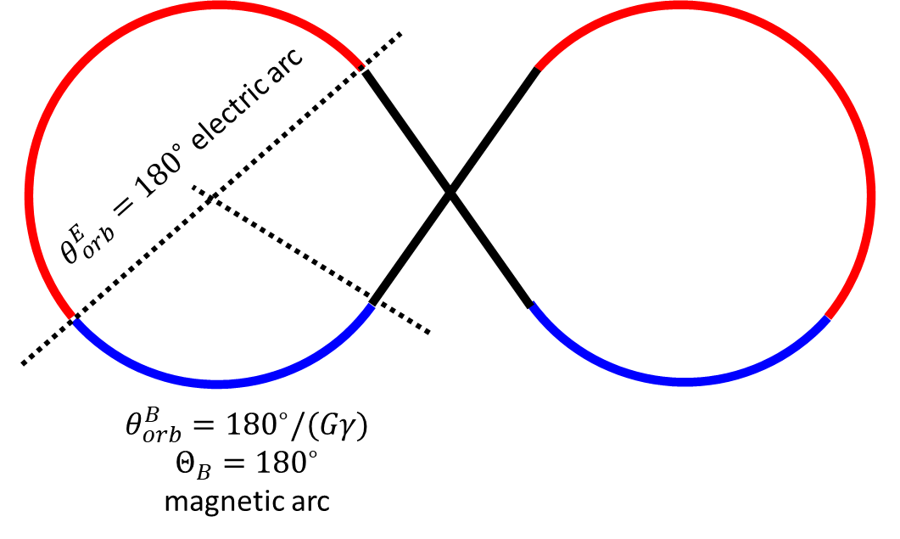
Measurement of EDM of Free Proton
In collaboration with Bogdan Wojtsekhowski
Fully electric or magnetic figure-8 ring ⇒ Both MDM and EDM rotations suppressed
Alternating electric and magnetic arcs in figure-8 ring ⇒ MDM suppressed, EDM rotation is not!
EDM rotation $\frac{∂\left|ψ\right|}{∂N}=4\left|\frac{ω_{EDM}^{E}}{ω_{MDM}^{E}}−\frac{ω_{EDM}^{B}}{ω_{MDM}^{B}}\right|\left|\sin{\frac{Θ_{B}}{2}}\sin{\frac{Θ_{E}}{2}}\right|$ $\frac{ω_{EDM}^{E}}{ω_{MDM}^{E}}=\frac{η}{2}\frac{γ^{2}β}{1−Gγ^{2}β^{2}}, \frac{ω_{EDM}^{B}}{ω_{MDM}^{B}}=−\frac{ηβ}{2G}$ $Θ_{E}=−\frac{1−Gγ^{2}β^{2}}{γ}θ_{orb}^{E}\text{,} Θ_{B}=Gγθ_{orb}^{B}$
$p=100$ MeV/$c$, $d_{p}=2×{10}^{−27}$ e $∙$cm ($η=3.8×{10}^{−13}$) ⇒ $ψ=0.337η=1.28×{10}^{−13}$ rad/turn
Extract signal through proton velocity dependence by measuring at several different $β$’s:
$\frac{∂P}{∂t}∝C_{1}Gβ+C_{2}ηβ^{2}+C_{3}β^{3}$
Proton EDM can also be measured at magic energy (232.8 MeV) [arXiv:1912.07881, PhysRevD.105.032001]
X (m)
Z (m)
Notes:
Using a dual-energy ring is not effective for protons because it is harder to produce an adequate energy difference. There are ideas about using a hybrid electric and magnetic ring that can keep the MDM signal suppressed but still have a net EDM signal at a fixed energy.

