Slide 1

New insights into Sona transitions
23th September 2024
Ralf Engels (IKP-2@FZJ/GSI)
Notes:
25 minutes + 5 minutes discussion

Slide 2
What is a Sona transition?
P. G. Sona: „A new method proposed to increase polarization in polarized ion sources of H⁻ and D⁻ “
(Energia Nucleare 14, 295 (1967))
→ efficient method to exchange the occupation numbers of the
‘pure‘ hyperfine substates |F=+1, m_{F}=+1> and |F=1, m_{F}=-1>
→ Electron polarization can be transferred into nuclear polarization
Idea: Rotate the quantization axis faster than the Larmor precession can influence the electron/nuclear spin.
Use: - polarized Lamb-shift sources (Uni. of Cologne)
- optically pumped source (RHIC)

Slide 3
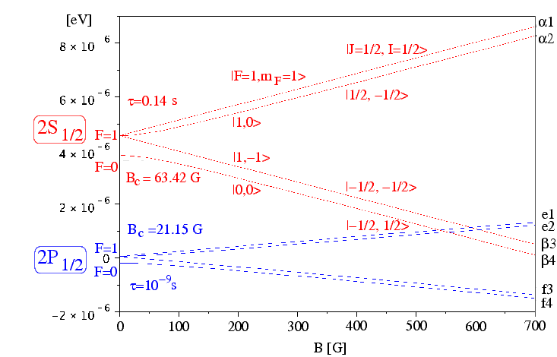
The Breit-Rabi Diagram of metastable Hydrogen
τ = 1/7 s
τ = 10⁻⁹ s
Notes:
In 1934, with James Chadwick from the Cavendish Laboratory at Cambridge, he was the first to measure accurately the mass of the neutron
“I don’t have time to age.”

Slide 4
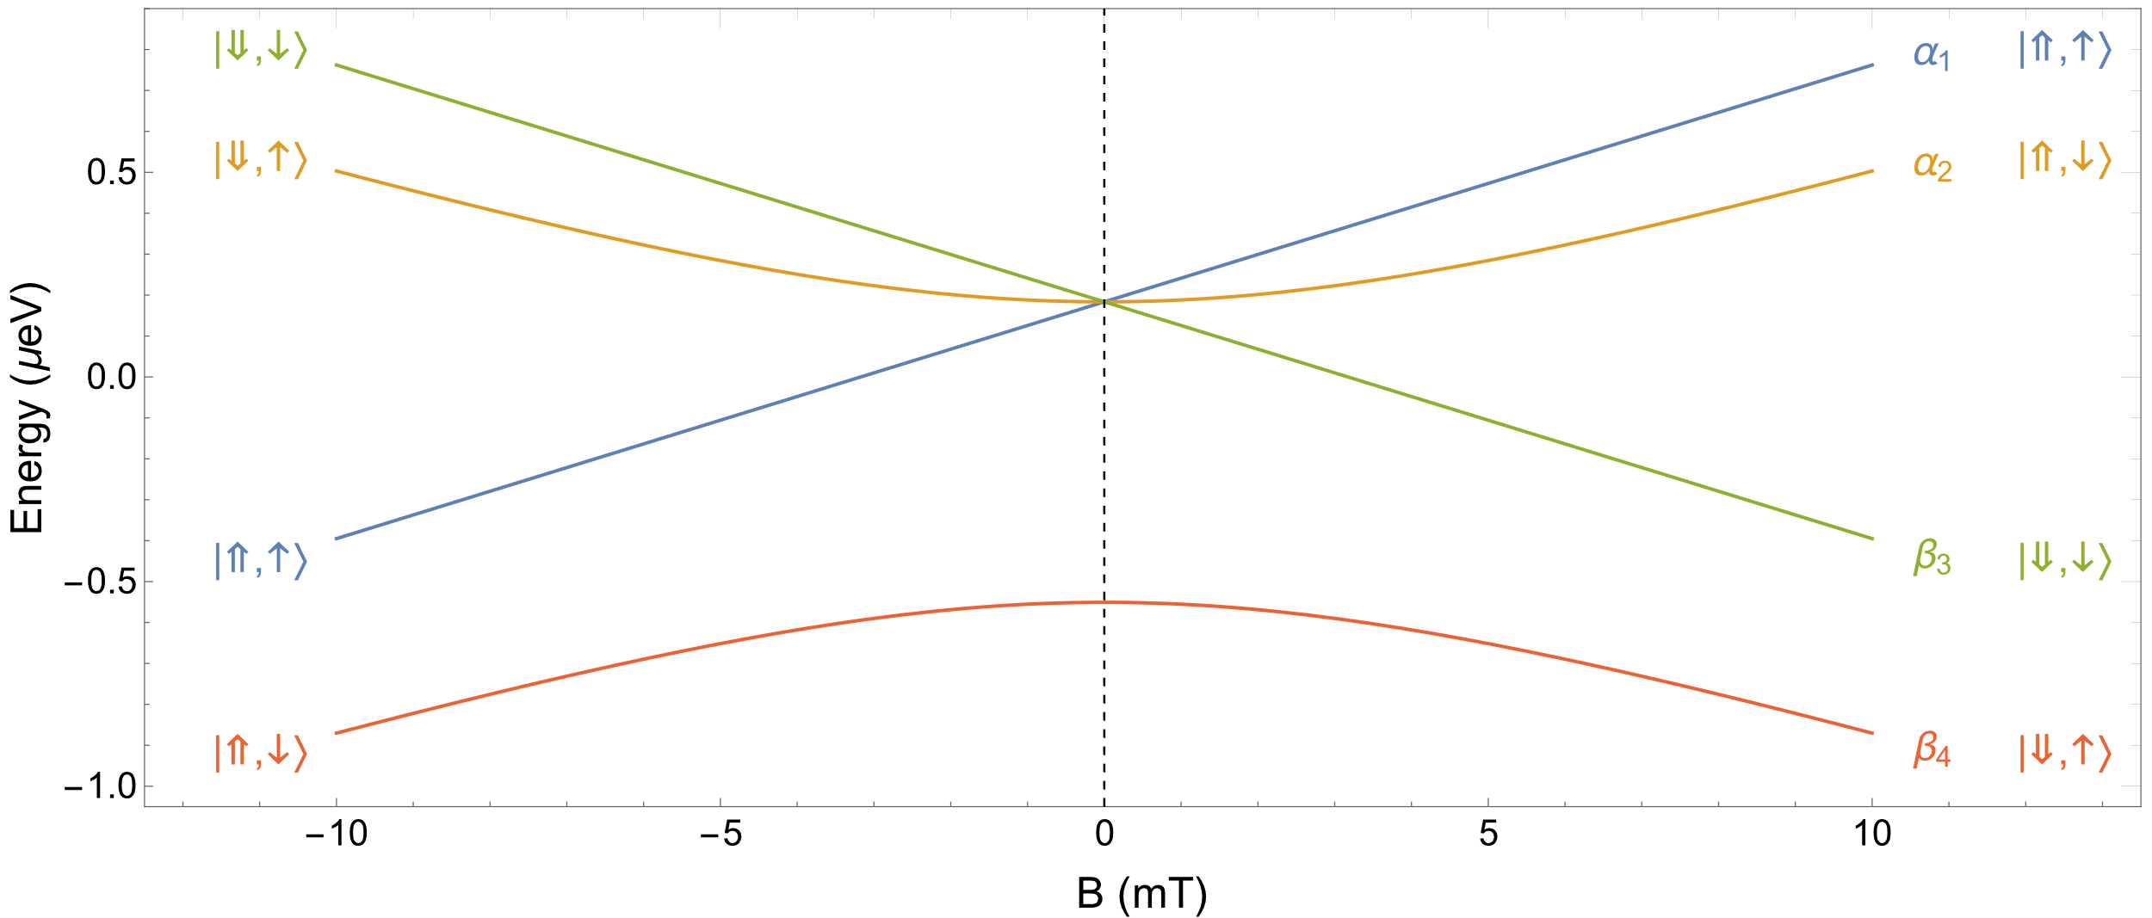
What is a Sona transition?
Theoretical framework
B_{z}
B_{z}

Slide 5
What is a Sona transition?
Theoretical framework
B_{z}
B_{z}

Slide 6
What is a Sona transition?
Theoretical framework
B_{z}
B_{z}

Slide 7
The classical Sona Transitions
ω_{B}
B
Start: α1
End: β3
ω_{Larmor}
Sona coil 1
Sona coil 2
μ
B
Zero-Crossing Point
B
μ
ω_{B} >> ω_{Larmor}: 2v/λ >> μ_{e} B_{rad.} = e/2m_{e} · dB_{long.}/dz · r/2
B_{z}´ << 8 v m_{e} / e r λ
Beam = 2 cm / λ=20 cm / E=1 keV B_{z}´ << 100 mT/cm

Slide 8
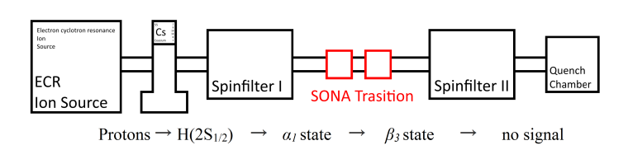
Experimental Setup
Sona Transition
Spinfilter:
See talk by N. Faatz

Slide 9
Experimental Results
Distance between the coils: 10 cm
P. Buske, Bachelor Thesis, RWTH Aachen
E_{beam} = 1 keV:
11 Oscillations up to 1 A

Slide 10
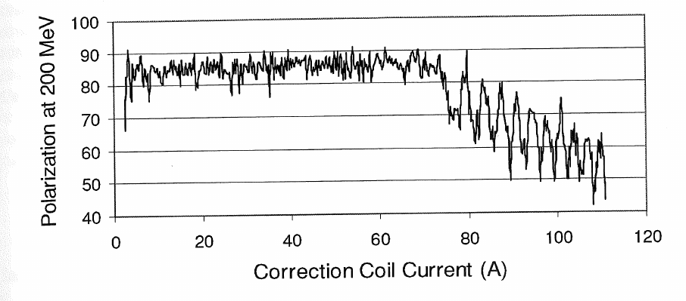
Experimental Results
Measurements at OPPIS@RHIC
R.D. Hight, R.T. Robiscoe,
Phys. Rev. A 17, 561 (1978)
F. Garisto, B.C. Sanctuary,
Phys. Rev. A 23, 1234 (1981)
Kponou et al.; Proc. of the 12th Int. Workshop on Pol. Ion Sources,
Targets and Polarimetry (PSTP2007), Brookhaven 2007, AIP Conf. Proc. 980
Zelenski et al.; …
E.P. Antishev and A. Belov; …
A. Zelenski, J.G. Alessi, A. Kponou, D. Raparia, in Proc. 11th European Particle Accelerator Conf. (EPAC’08), Genoa, Italy, Jun. 2008, paper TUOBM03, pp. 1010

Slide 11
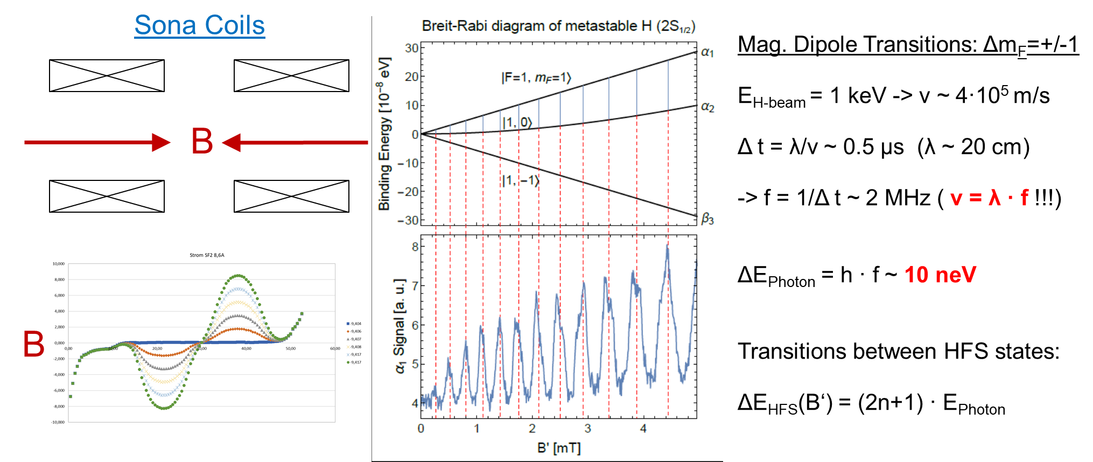
The Explanation: RF-induced Transitions

Slide 12
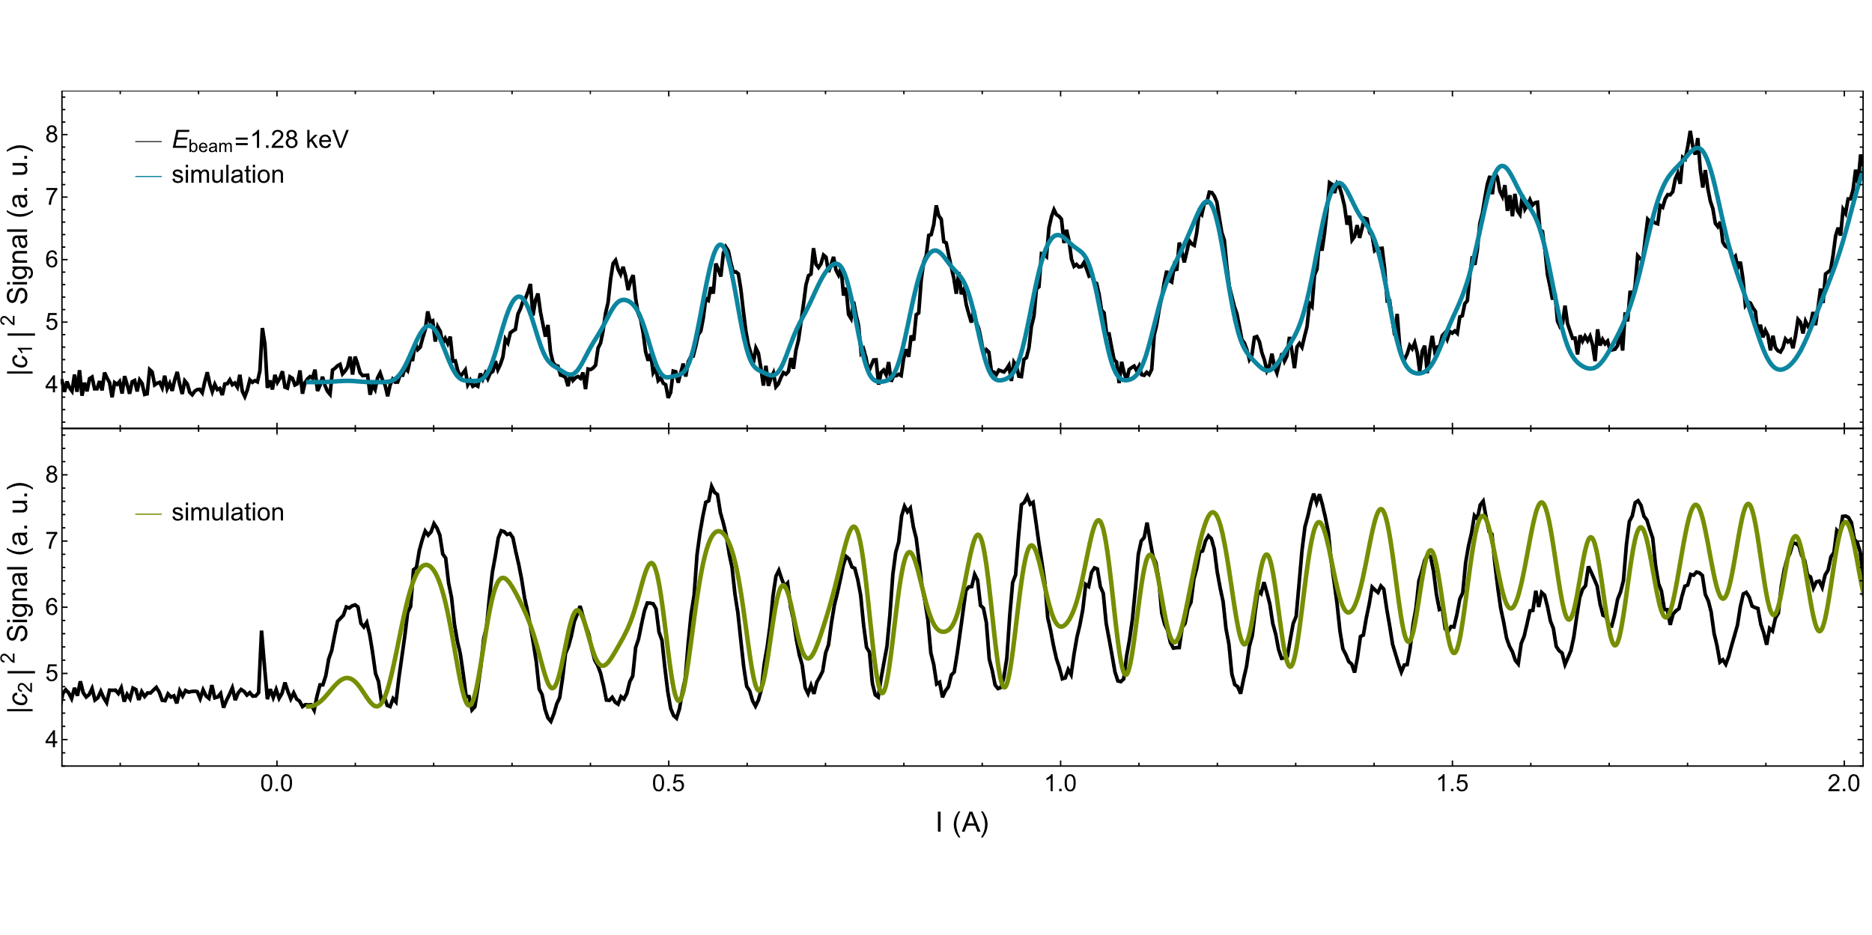

Theory
$$H\left(t\right)=A I⋅J−\left(g_{J}μ_{B}J+g_{I}μ_{N}I\right)⋅B\left(t\right)=H_{0}+V\left(t\right)$$
Time-dependend perturbation theory $iℏ\frac{∂\left|ψ\left(t\right)\right\rangle }{∂t}=H\left(t\right)\left|ψ\left(t\right)\right\rangle$
Works perfect for a single state
PhD of Chr. Kannis

Slide 13
Measured Spectra
Only α1:
Both α states:
Unpolarized Beam:

Slide 14
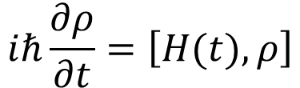
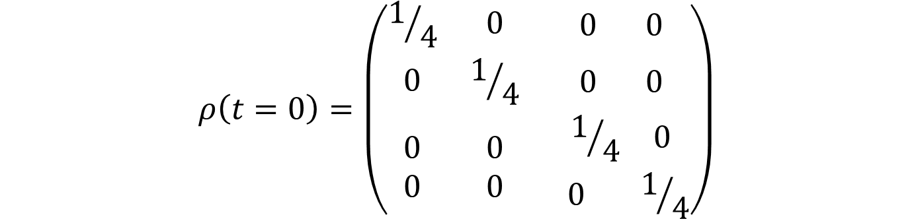

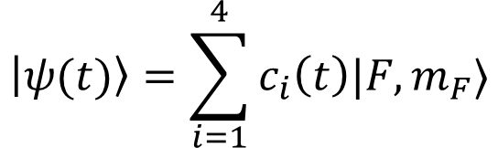

Theory
$$iℏ\frac{∂ρ}{∂t}=\left[H(t),ρ\right]$$
Unpolarized beam: von Neumann equation
and density operator
Starting condition:
                Incoherent
Coherent
$$\left|ψ(t)\right\rangle =\sum_{i=1}^{4}{c_{i}\left(t\right)|F,m_{F}⟩}$$
$$ρ=|ψ(t)⟩⟨ψ(t)|$$
$$ρ\left(t=0\right)=\left(\begin{matrix}1/4 & 0 & \begin{matrix}0 & 0\end{matrix} \\ 0 & 1/4 & \begin{matrix}0 & 0\end{matrix} \\ \begin{matrix}0 \\ 0\end{matrix} & \begin{matrix}0 \\ 0\end{matrix} & \begin{matrix}\begin{matrix}1/4 & 0\end{matrix} \\ \begin{matrix} 0 & { 1}/4\end{matrix}\end{matrix}\end{matrix}\right)$$
$$ρ\left(t=0\right)=\left(\begin{matrix}1/4 & ⋯ & 1/4 \\ ⋮ & ⋱ & ⋮ \\ 1/4 & ⋯ & 1/4\end{matrix}\right)$$

Slide 15
Theory
Incoherent Beam

Slide 16
Theory
$$iℏ\frac{∂ρ}{∂t}=\left[H(t),ρ\right]$$
Unpolarized beam: von Neumann equation
and density operator
Starting condition:
                Incoherent
Coherent
$$\left|ψ(t)\right\rangle =\sum_{i=1}^{4}{c_{i}\left(t\right)|F,m_{F}⟩}$$
$$ρ=|ψ(t)⟩⟨ψ(t)|$$
$$ρ\left(t=0\right)=\left(\begin{matrix}1/4 & 0 & \begin{matrix}0 & 0\end{matrix} \\ 0 & 1/4 & \begin{matrix}0 & 0\end{matrix} \\ \begin{matrix}0 \\ 0\end{matrix} & \begin{matrix}0 \\ 0\end{matrix} & \begin{matrix}\begin{matrix}1/4 & 0\end{matrix} \\ \begin{matrix} 0 & { 1}/4\end{matrix}\end{matrix}\end{matrix}\right)$$
$$ρ\left(t=0\right)=\left(\begin{matrix}1/4 & ⋯ & 1/4 \\ ⋮ & ⋱ & ⋮ \\ 1/4 & ⋯ & 1/4\end{matrix}\right)$$

Slide 17
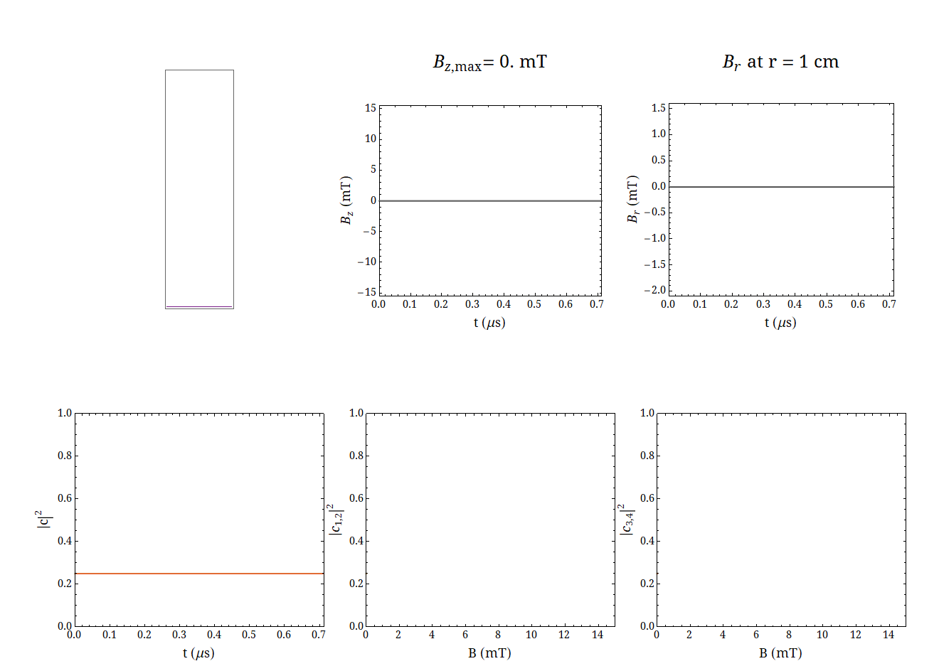
Theory
Coherent

Slide 18
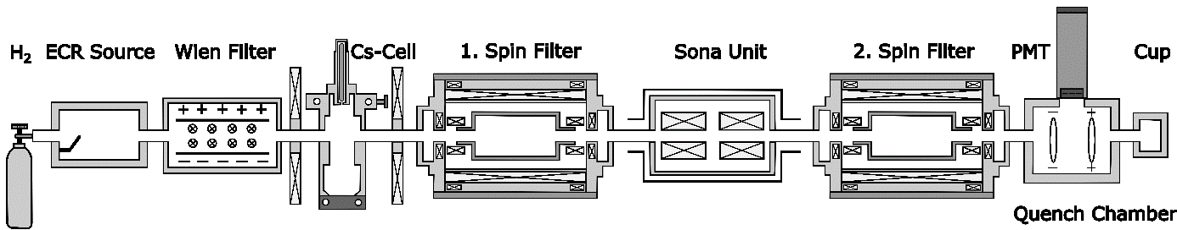
Experiment
Possible Explanation:
1.) Can Wien filter produce coherent states ….. ?
2.) Did we ever have had an unpolarized (metastable) beam ?
Combination of magnetic and electric fields can do „selective quenching“?

Slide 19

Unpolarized beam ?
$E=v ⊗B$_{r}
B-Field in the Spinfilter

Slide 20
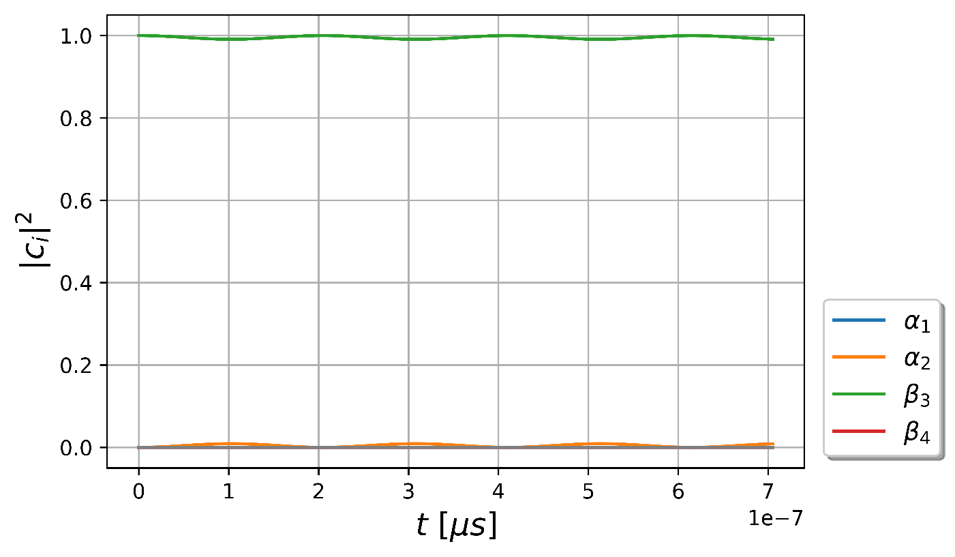
Unpolarized beam ?

Slide 21
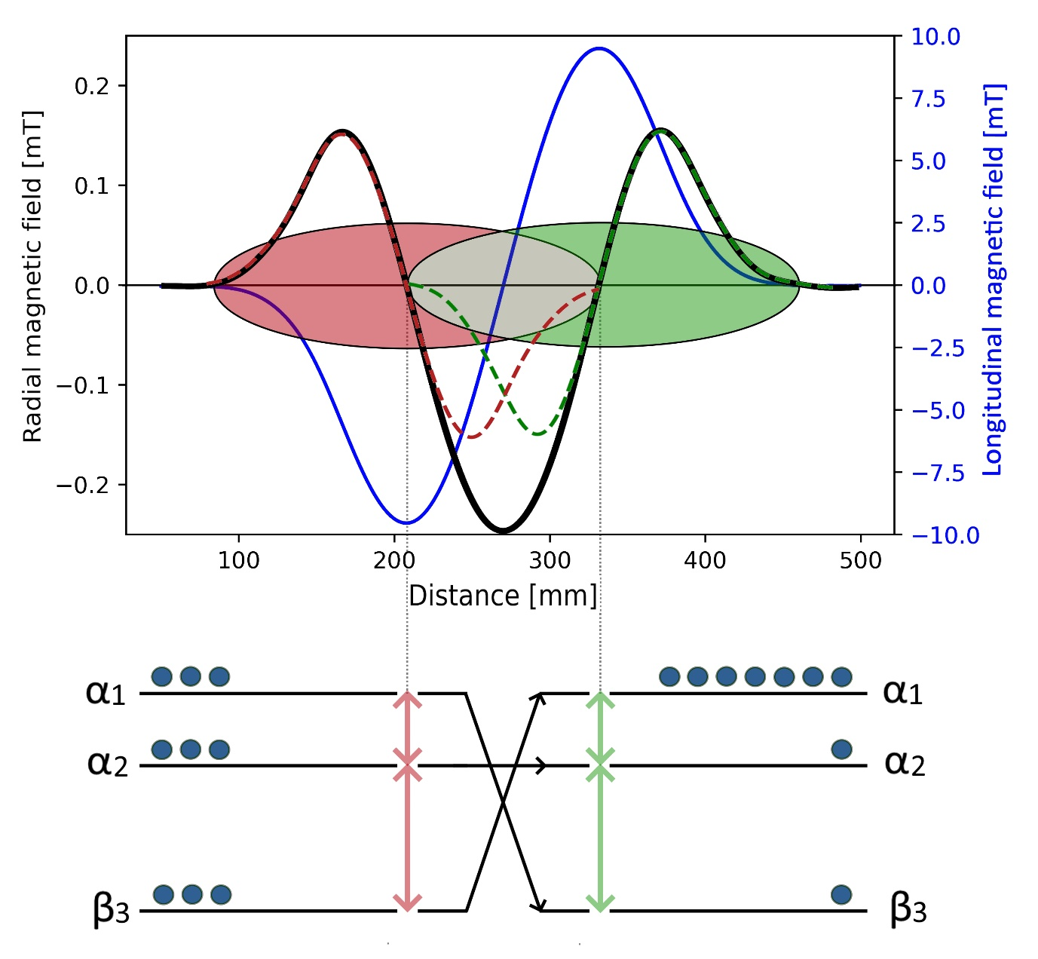
Photon Modell
m_{S}= +1
E_{Ph}= h ∙ f = h ∙ v/λ
v = λ · f
0.1 nm ≤ λ ≤ 1 m
10⁸ m/s ≥ v ≥ 10² m/s
→ 100 Hz ≤ f ≤ 1 PHz
→ 1 peV ≤ E_{Ph} ≤ 10 keV
m_{S}= -1
tuneable, (single-pulse) laser

Slide 22
Possible application: spectroscopy
LASER MASER / Cavity
v = c v = c
1 µm > λ > 100 nm 1 m > λ > 1 mm
100 THz < f < 1 PHz c = λ ∙ f 100 MHz < f < 100 GHz
1 eV < E_{Ph} < 10 eV E = h ∙ f 1 µeV < E_{Ph} < 1 meV
ΔE/E ~ 10^{-14/-15} ΔE/E ~ 10⁻⁸
(2-Photon Spectroscopy/ Frequency Combs) (Atomic Clock)

Slide 23
Possible Application: Spectroscopy
Resonant Coherent Excitation
Velocity v and wavelength λ can be tuned
Some Examples:
v ~ 10⁸ m/s / λ ~ 10⁻¹⁰ m → E_{Ph} ~ keV (E1) Y. Nakano et al.; PRA 87, 060501 (2013)
v ~ 10⁷ m/s / λ ~ 100 µm → E_{Ph} ~ meV (M1) Nagata et al.; PRL 124, 173202 (2020)
v ~ 10⁵ m/s / λ ~ 100 mm → E_{Ph} ~ neV (M1) Engels et al.; EPJ D 75, 257 (2021)
v ~ 10² m/s / λ ~ 100 mm → E_{Ph} ~ peV (M1) Chadwick et al.; Nat. Com. 13, 2287 (2022)

Slide 24

Other Options: Polarized Sources
We still can transform electron polarization into nuclear polarization !
1.) Optical pumping for deuterium
2.) Polarized Heavy Ions, e.g. ¹³⁷Ba⁺ (selective ionization with a laser at 5.4 eV /
optical pumping: ¹³⁷Ba²⁺ $+$ $\vec{Rb } →$ ¹³⁷Ba⁺
Rb-Cell
Ionizer
IR-
Laser
D₂ d ($d+$ $\vec{Rb }$→ $\vec{D}$ + ${Rb}^{+}$) $\vec{ D}$(electron) tensor-/vector polarized D

Slide 25
Other Options
3.) Polarize D₂ / H₂ molecules:
LSP
ΔE ~ 10⁻¹² eV
  Polarized Fuel for Fusion Reactors
  See talks: G. Ciullo, X. Wei on Thursday
Cold velocity IR- Sona experience at
nozzle filter laser coils Uni./FORTH Crete
The IR laser adjust the rotational magnetic moment m_{J} of the molecules → coherent state

