Slide 1
new developments for lamb-shift polarimeter
23rd september 2024 Nicolas faatz

Slide 2
Motivation
Lamb-shift polarimeters measure nuclear polarizations of molecules, atoms and ions made out of hydrogen and/or its isotopes $(H,H^{+},H^{−},H_{2},H_{2}^{+}, HD,etc…)$
Simple, cheap and fast method to verify the nuclear polarization of a source
Automatization measurement process makes “live analysis” possible

Slide 3
LSP used for different experiments
Los Alamos ➔ invented the first spin filter
Moscow State University ➔ pulsed polarized proton source
TUNL ➔ hydrogen and deuterium ion beams
University of Cologne ➔ polarized atomic and ion beams
RHIC ➔ optically pumped polarized $H^{−}$ source
FZ Jülich ➔ H and D atomic beam source for ANKE/$H^{−}$ source
PNPI ➔ investigations for double-polarized DD-fusion

Slide 4
Start In Jülich
Measuring the nuclear polarization created by the ABS
Simple and cheap detection method
Working for hydrogen atoms their isotopes molecules and ions

Slide 5
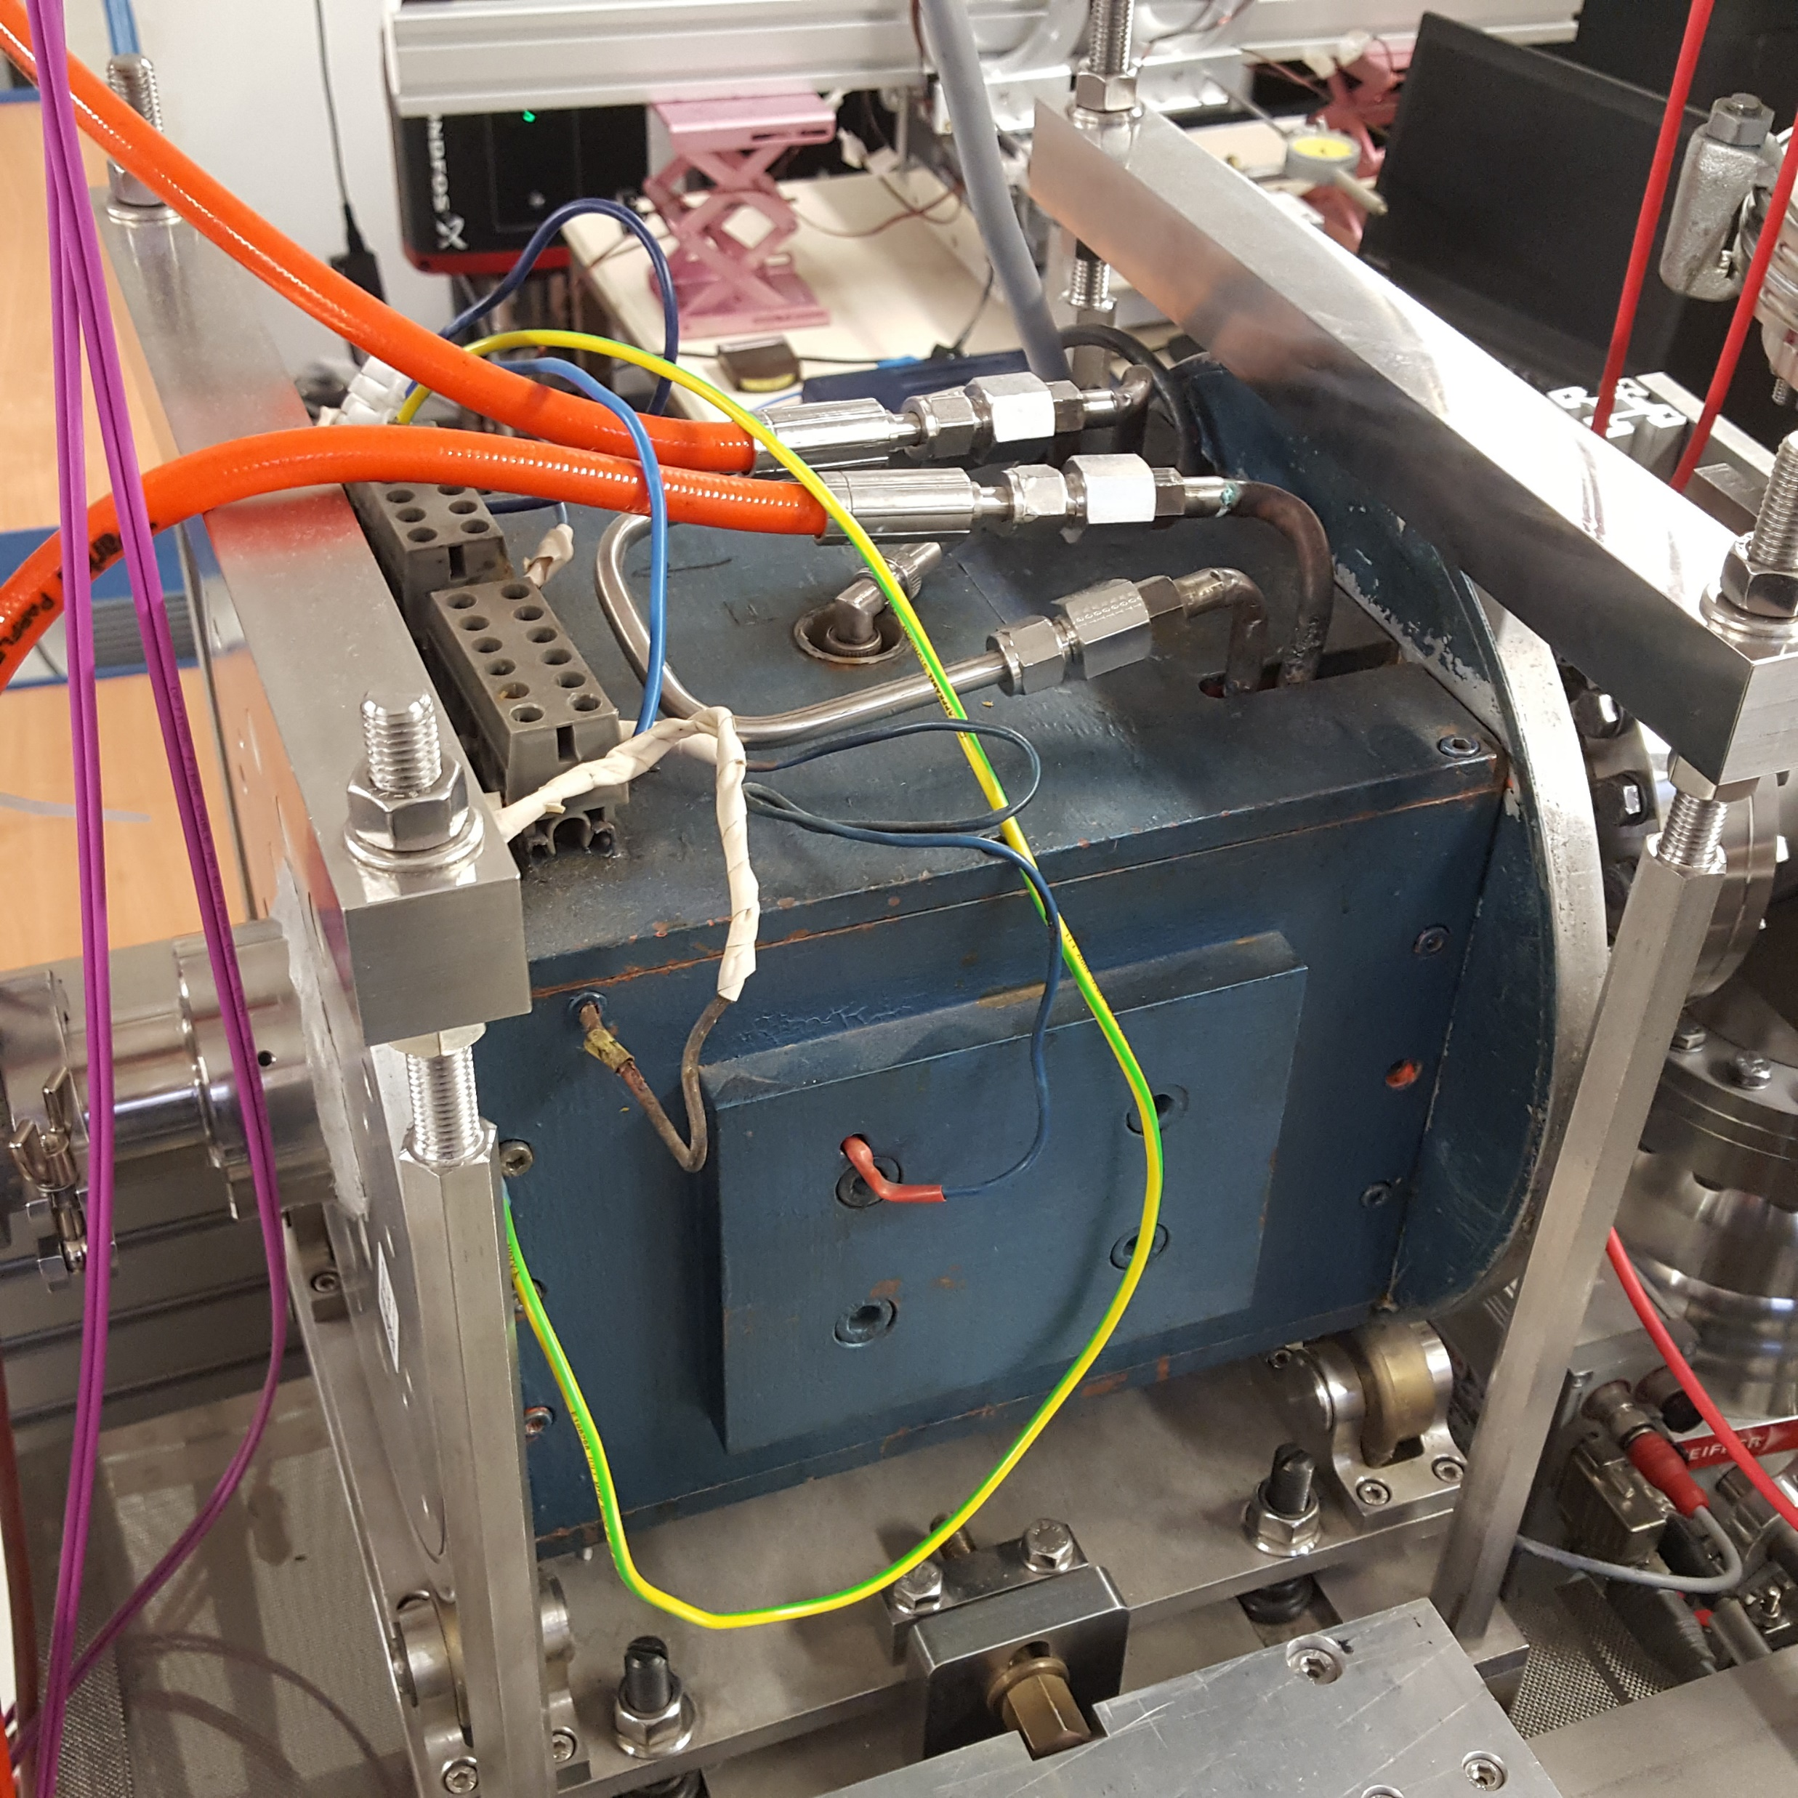
Wien-filter
Electric and magnetic field perpendicular to beam direction
$$\overset{⃑}{v}⊥\overset{⃑}{ε}⊥\overset{⃑}{B}$$

Slide 6
Wien-filter
Electric and magnetic field perpendicular to beam direction
$$\overset{⃑}{v}⊥\overset{⃑}{ε}⊥\overset{⃑}{B}$$
Defining the beam velocity
$$\left|v\right|=\frac{\left|ε\right|}{\left|B\right|}$$
$${\overset{⃑}{F}}_{el.}=q\overset{⃑}{ε}=q\left(\overset{⃑}{v}×\overset{⃑}{B}\right)={\overset{⃑}{F}}_{Lorentz}$$

Slide 7
Wien-filter
Electric and magnetic field perpendicular to beam direction
$$\overset{⃑}{v}⊥\overset{⃑}{ε}⊥\overset{⃑}{B}$$
Defining the beam velocity
$$\left|v\right|=\frac{\left|ε\right|}{\left|B\right|}$$
$${\overset{⃑}{F}}_{el.}=q\overset{⃑}{ε}=q\left(\overset{⃑}{v}×\overset{⃑}{B}\right)={\overset{⃑}{F}}_{Lorentz}$$
For a fixed beam energy then works as a mass filter
$$E_{kin}=\frac{1}{2}mv^{2}$$
$$m=\frac{2E_{kin}B^{2}}{ε^{2}}$$

Slide 8
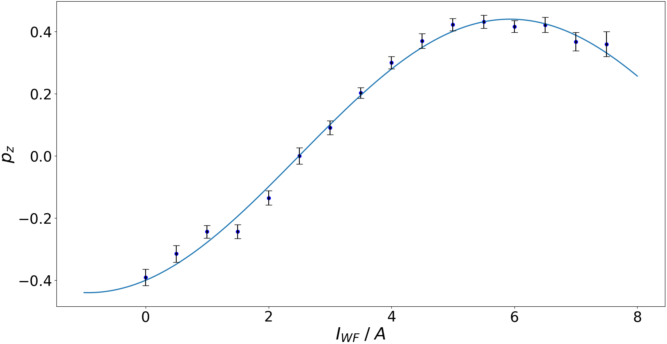
Wien-filter
Spins of the particles interact with the magnetic field
$$ω_{Larmor}=−\frac{gqB}{2m}$$

Slide 9
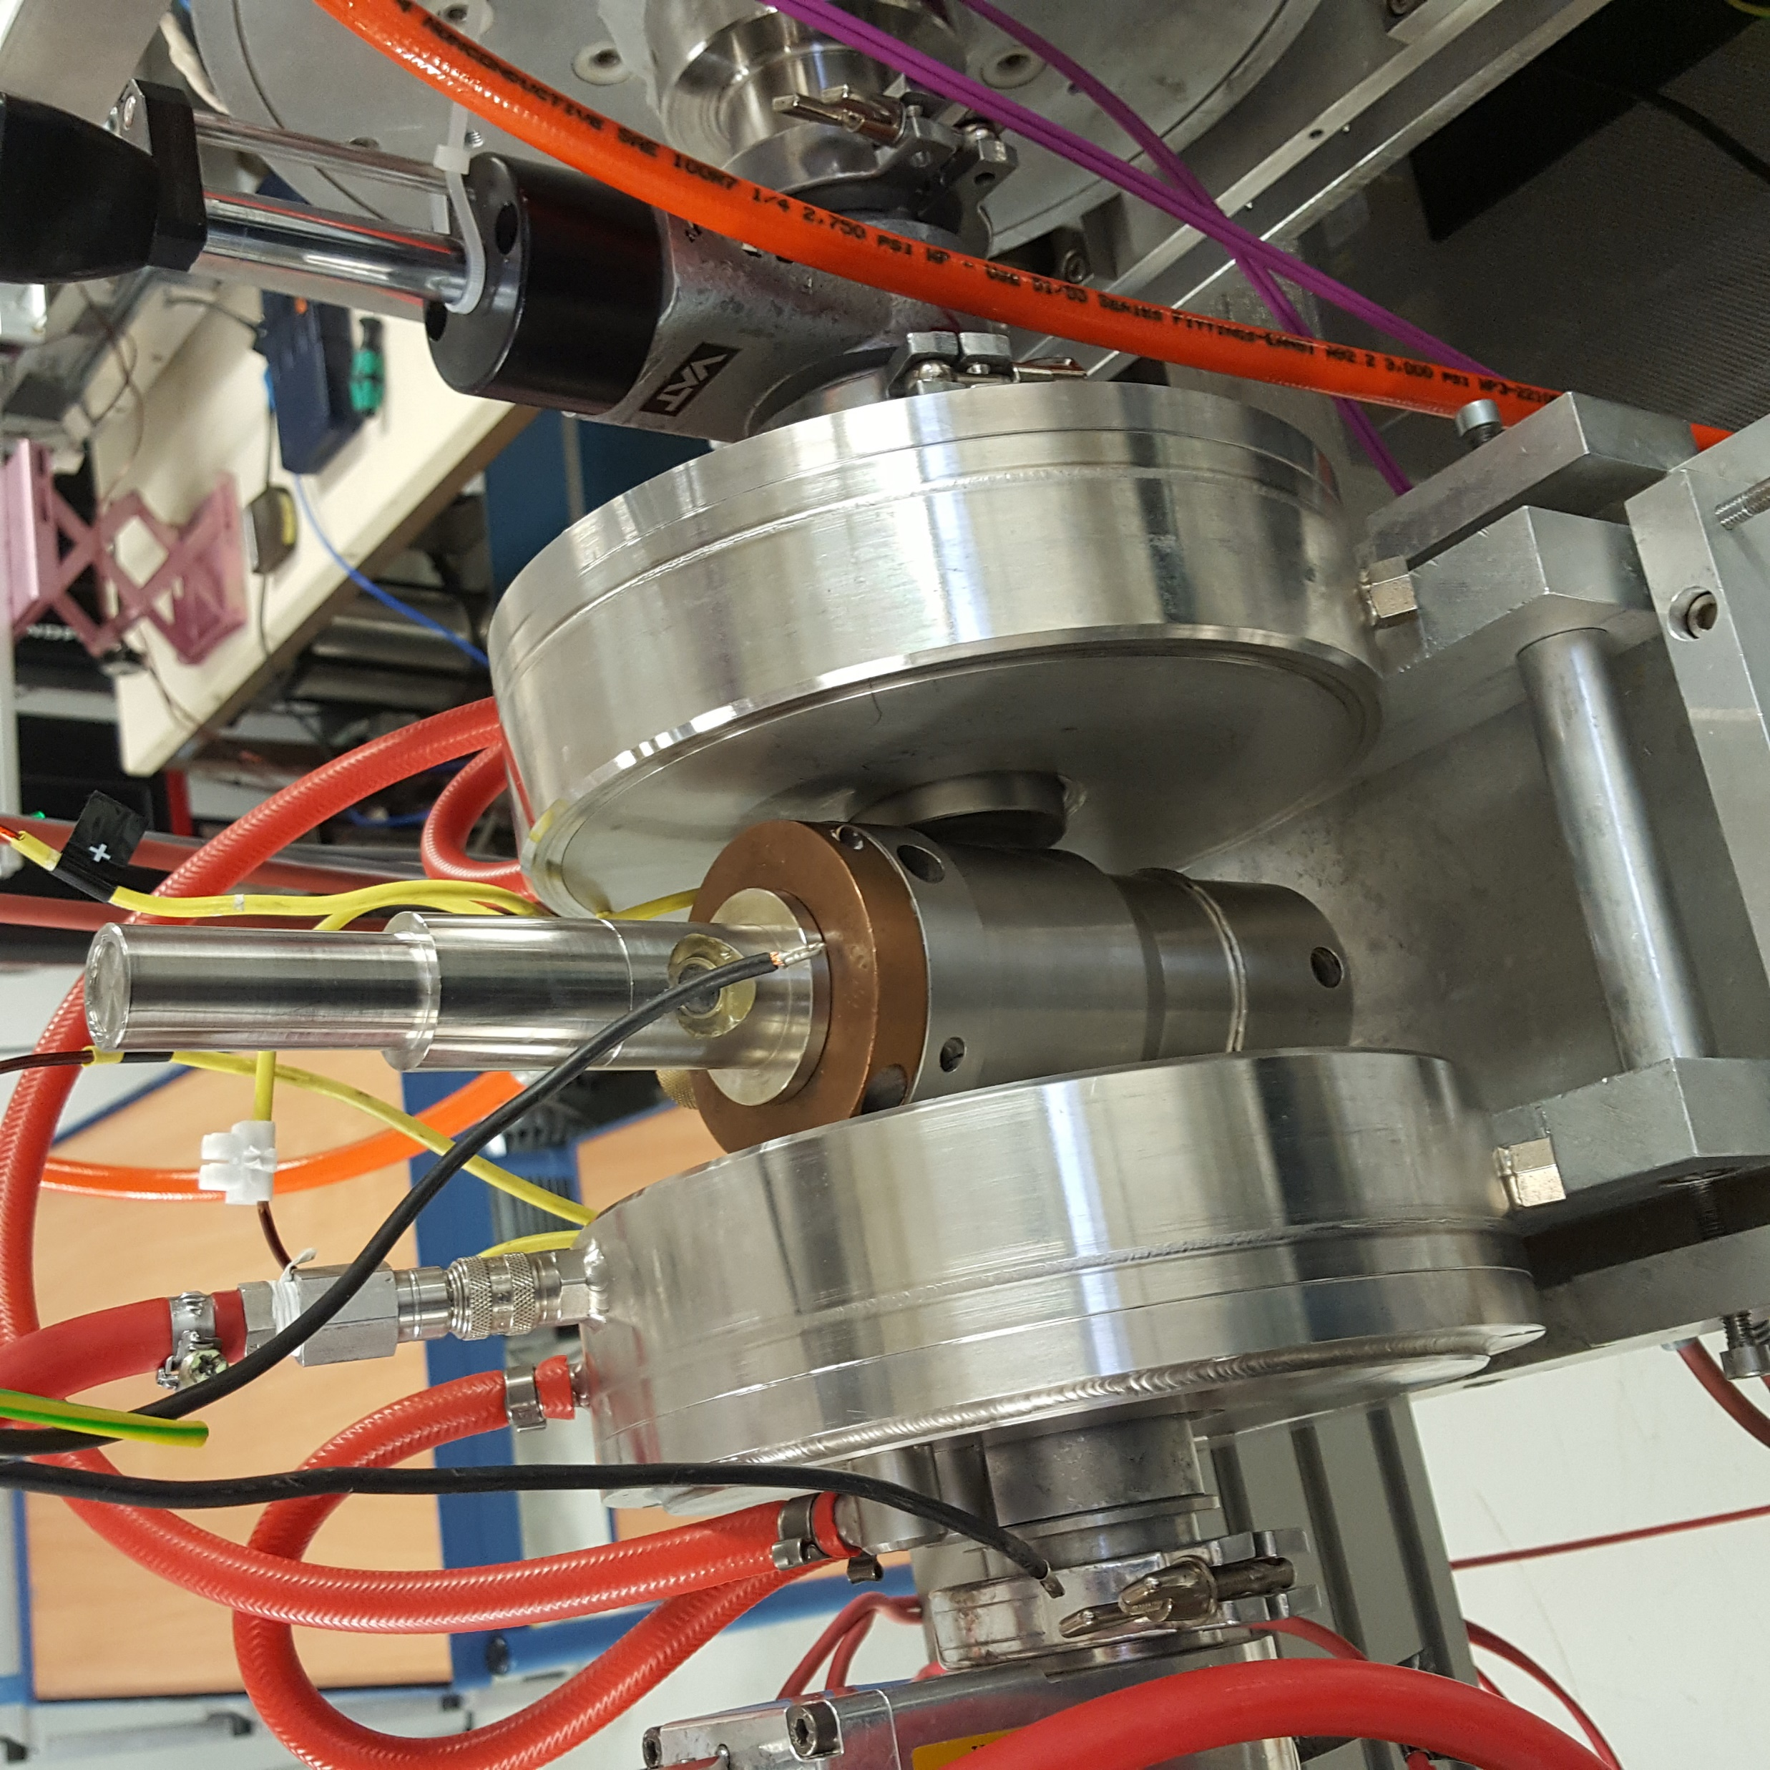
Caesium cell
Using elements with low electronegativity for charge exchange

Slide 10
Caesium cell
Using elements with low electronegativity for charge exchange
Creating metastable hydrogen
$$H^{+}+Cs→H_{2S}^{∗}+Cs^{+}$$

Slide 11
Caesium cell
Using elements with low electronegativity for charge exchange
Creating metastable hydrogen
$$H^{+}+Cs→H_{2S}^{∗}+Cs^{+}$$
Preserving nuclear polarization by applying external magnetic field

Slide 12
Caesium cell
Using elements with low electronegativity for charge exchange
Creating metastable hydrogen
$$H^{+}+Cs→H_{2S}^{∗}+Cs^{+}$$
Preserving nuclear polarization by applying external magnetic field
Lower temperature (Cs: 160 °C / Na: 350 °C)

Slide 13
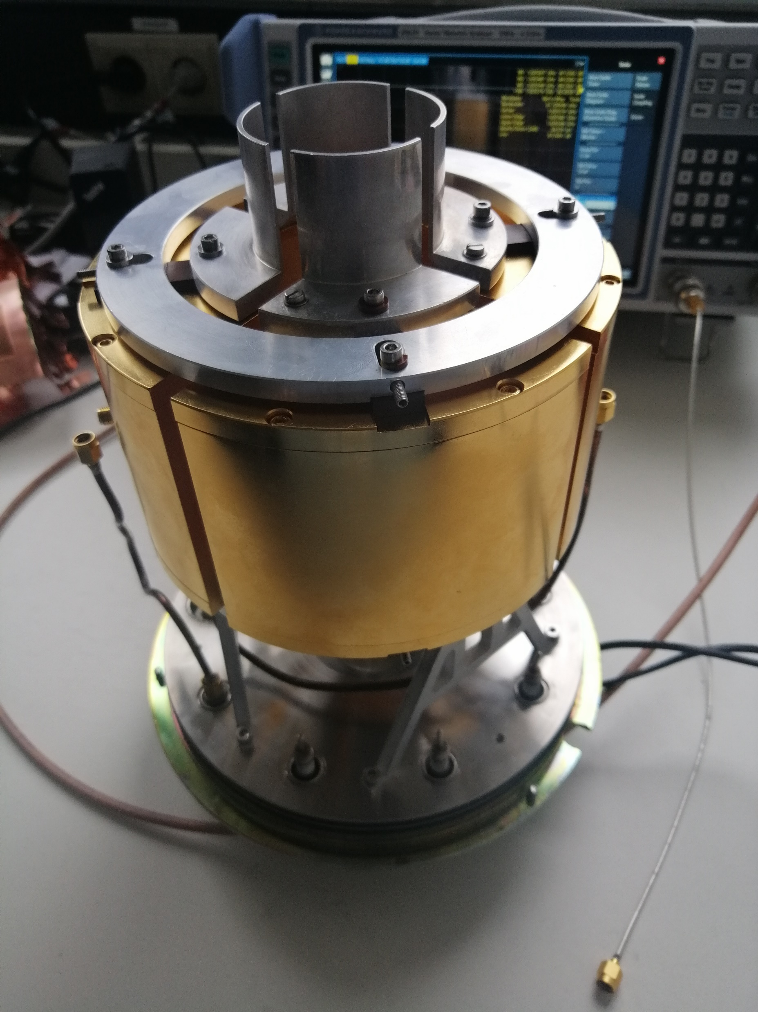
Spin filter
Separate the Breit-Rabi states
Coils produce a homogeneous static magnetic field in beam direction
In a cavity a radio frequency is induced
On the cavity a static electric field is applied

Slide 14
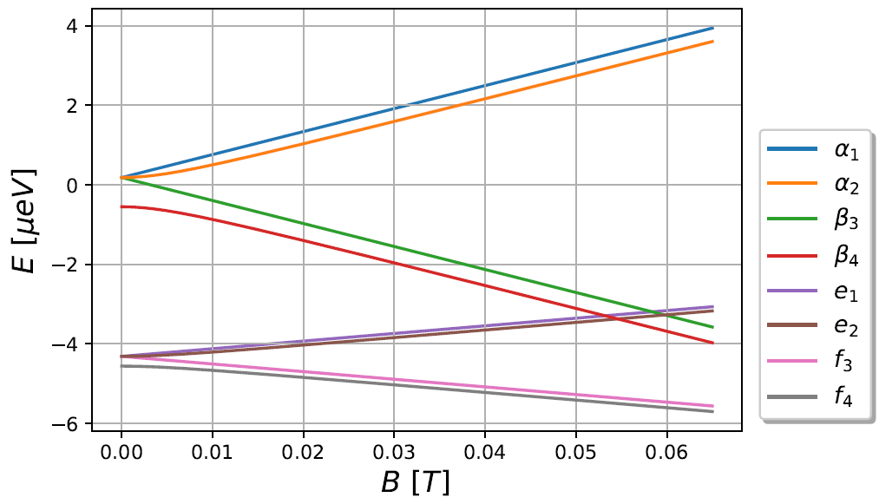
Breit-rabi diagram
At high magnetic fields
$$\left.|m_{J},m_{I}\right\rangle$$
$${2S}_{1/2}$$
$$\left.|↑,↑\right\rangle$$
$$\left.|↑,↓\right\rangle$$
$$\left.|↓,↓\right\rangle$$
$$\left.−|↓,↑\right\rangle$$
$$\left.|↑,↑\right\rangle$$
$$\left.|↑,↓\right\rangle$$
$$\left.|↓,↓\right\rangle$$
$${2P}_{1/2}$$
$$\left.−|↓,↑\right\rangle$$

Slide 15
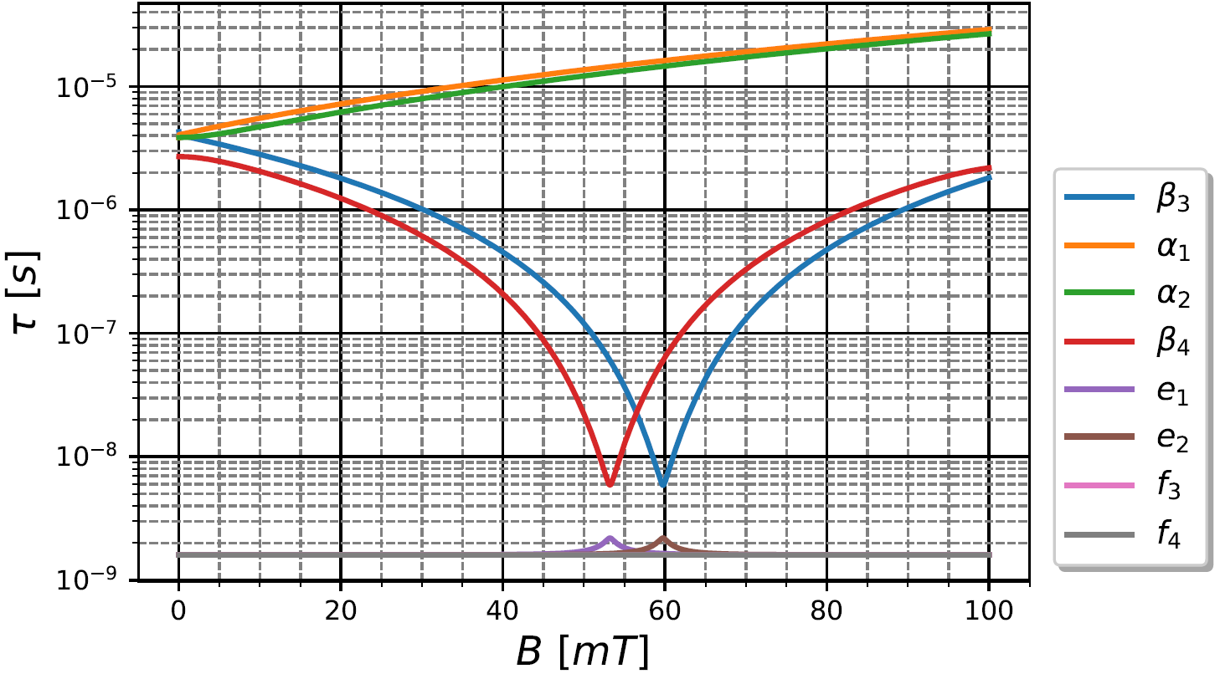
lifetime
$$E_{x}={10}^{3}\frac{V}{m}$$
$$\left.|↓,↓\right\rangle$$
$$\left.|↑,↑\right\rangle$$
$$\left.|↑,↓\right\rangle$$
$$\left.−|↓,↑\right\rangle$$
$$\left.|↑,↑\right\rangle$$
$$\left.|↑,↓\right\rangle$$
$$\left.|↓,↓\right\rangle$$
$$\left.−|↓,↑\right\rangle$$

Slide 16
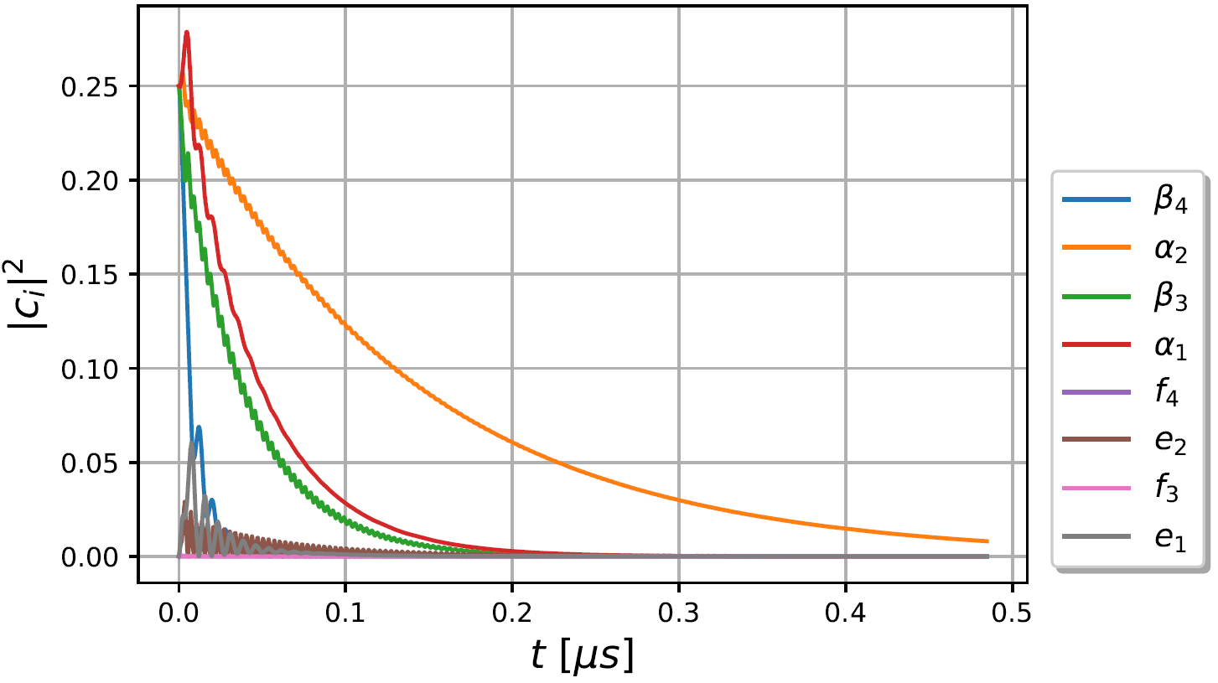
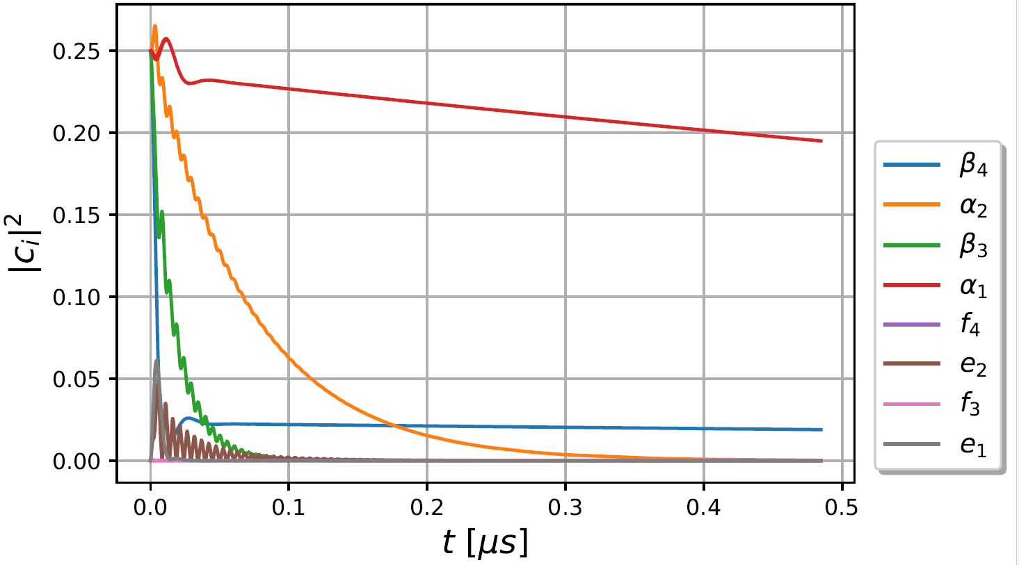
Evolution in time
$${\left|c_{{2S}_{1/2}}\right|}^{2}=0.25$$
$$B=54 mT$$
$$B=50 mT$$

Slide 17
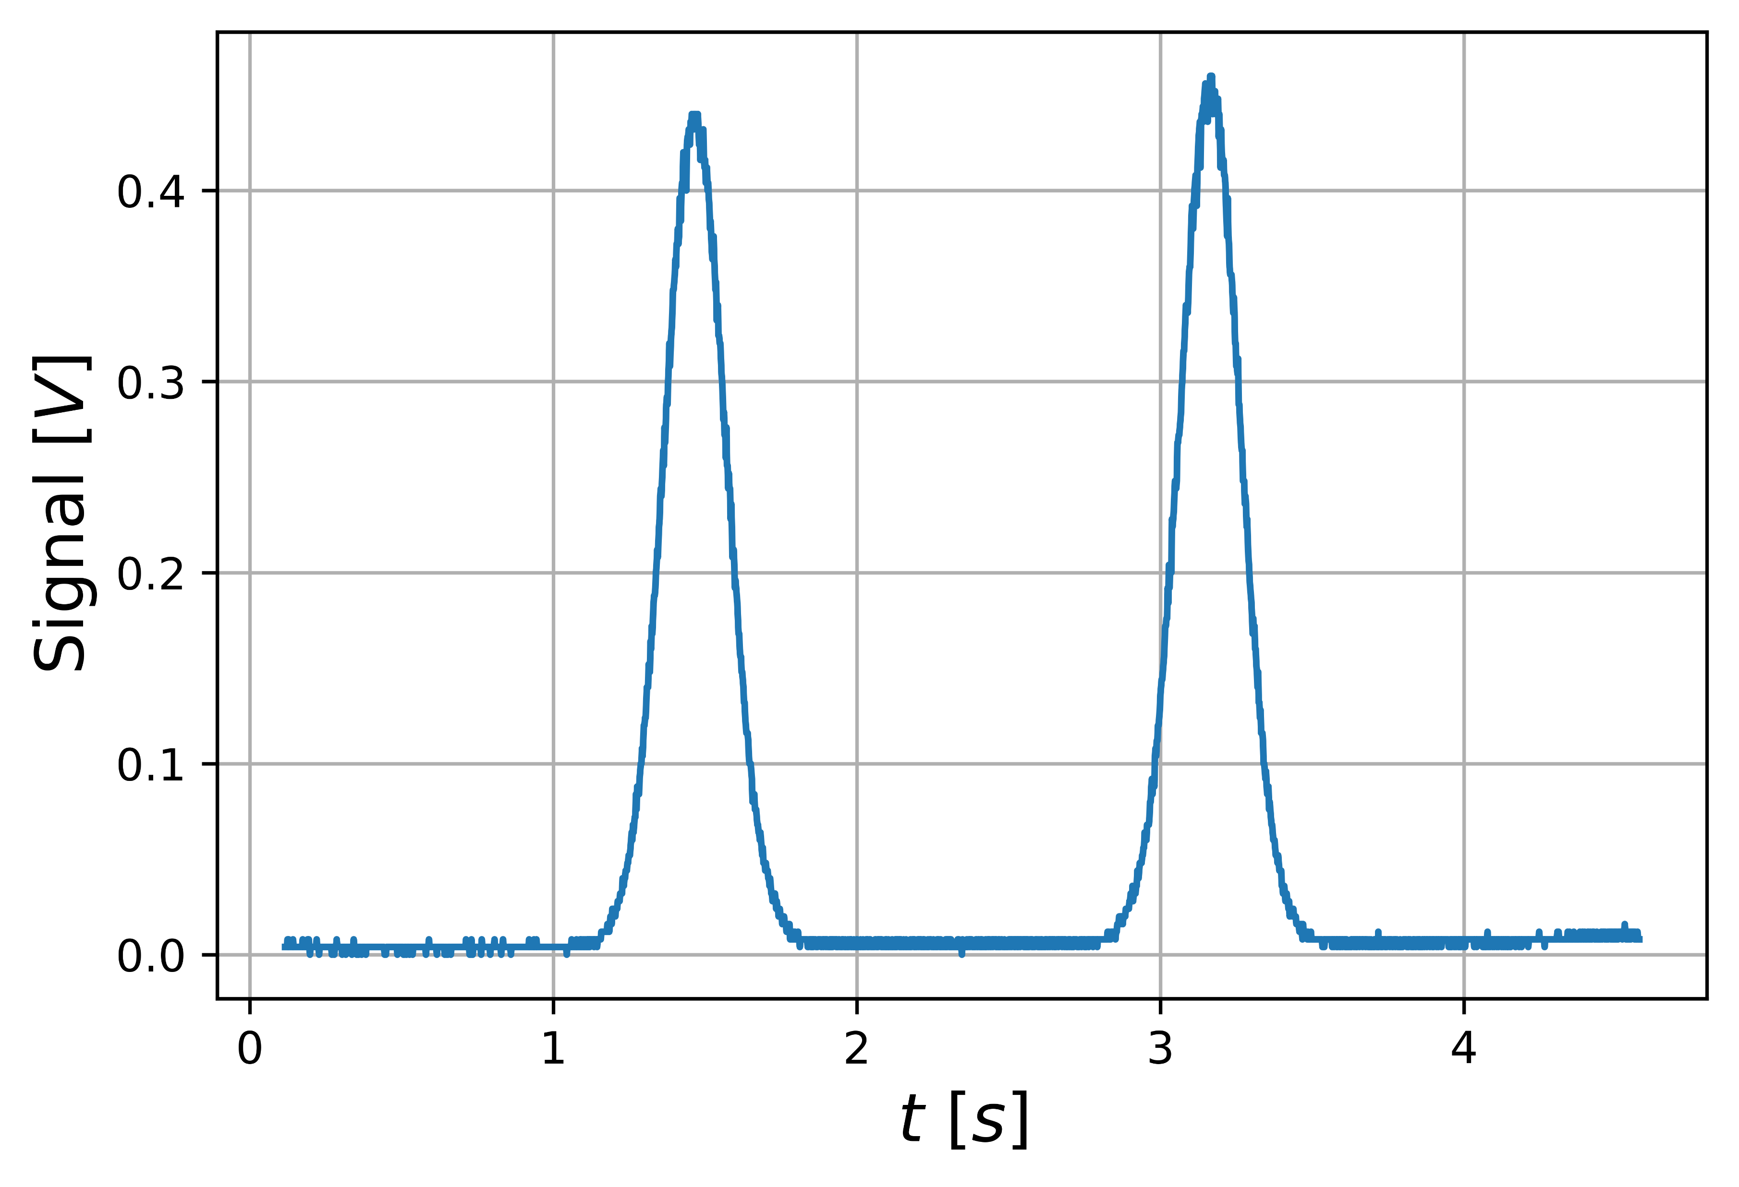
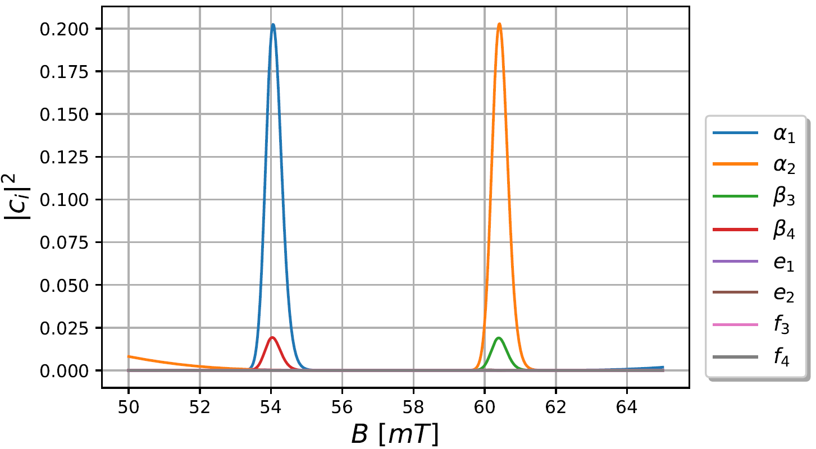
Ramped magnetic field
Measurement
Simulation
$$B\sim t$$

Slide 18
Motivation for further developments
Nuclear polarized sources
$$n$$
$$n→{H^{∗}}_{{2S}_{1/2}}+{\overline{ν}}_{e}$$
Bound beta decay (BoB)
$${2S}_{1/2}→{2P}_{1/2}$$
Parity violation
$$P={\left(−1\right)}^{l}: 0→1$$
Sona transition unit
$${\overline{ν}}_{e}$$
$$H$$
Axion research
➔ Necessity to detect $β$ states

Slide 19
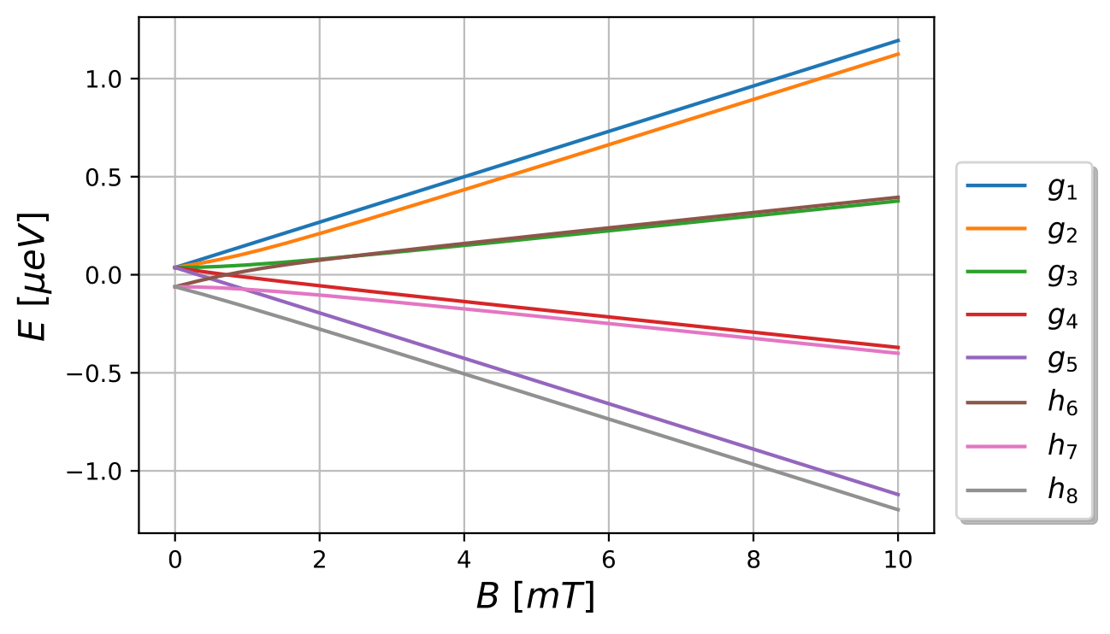
Second generation spin filter
Extend the spin filter such that also $β$ states can be selected
Use the interaction with the ${2P}_{3/2}$set
https://arxiv.org/abs/2409.07396

Slide 20
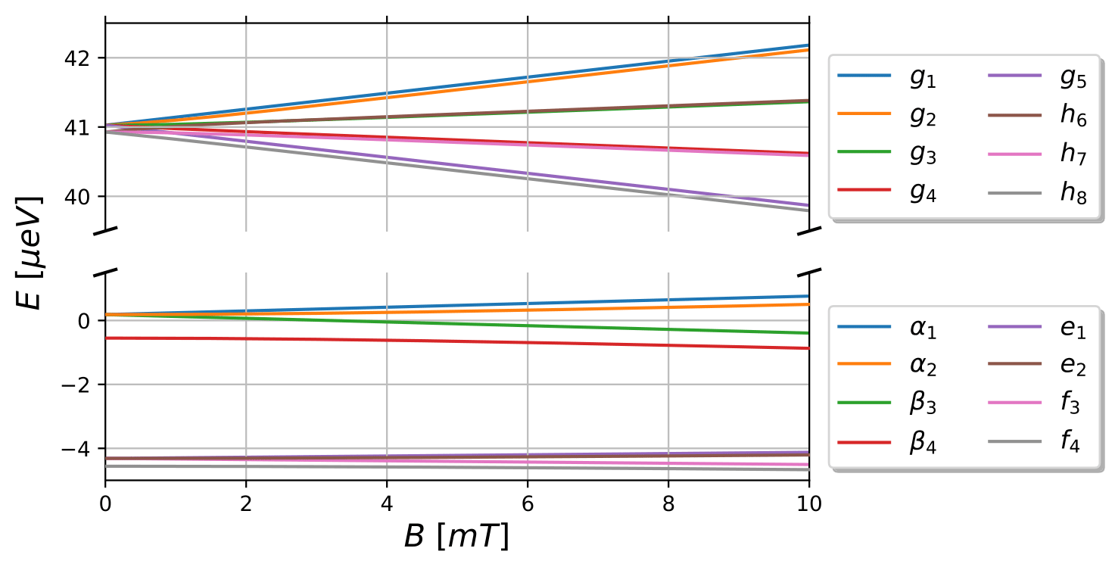
Second generation spin filter

Slide 21
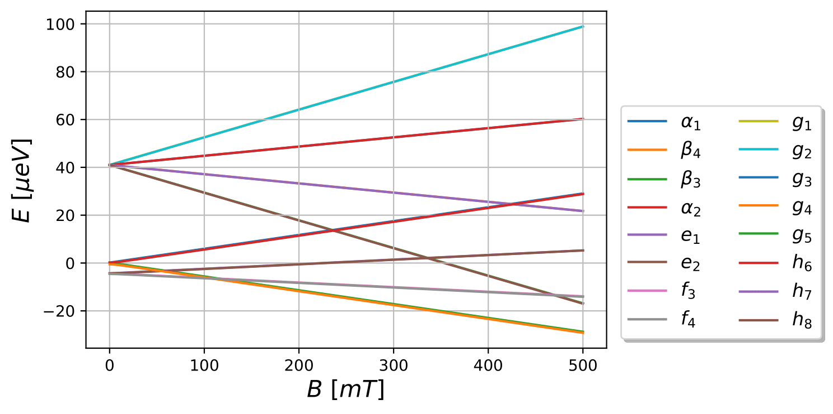
Second generation spin filter
$$11,94GHz$$

Slide 22
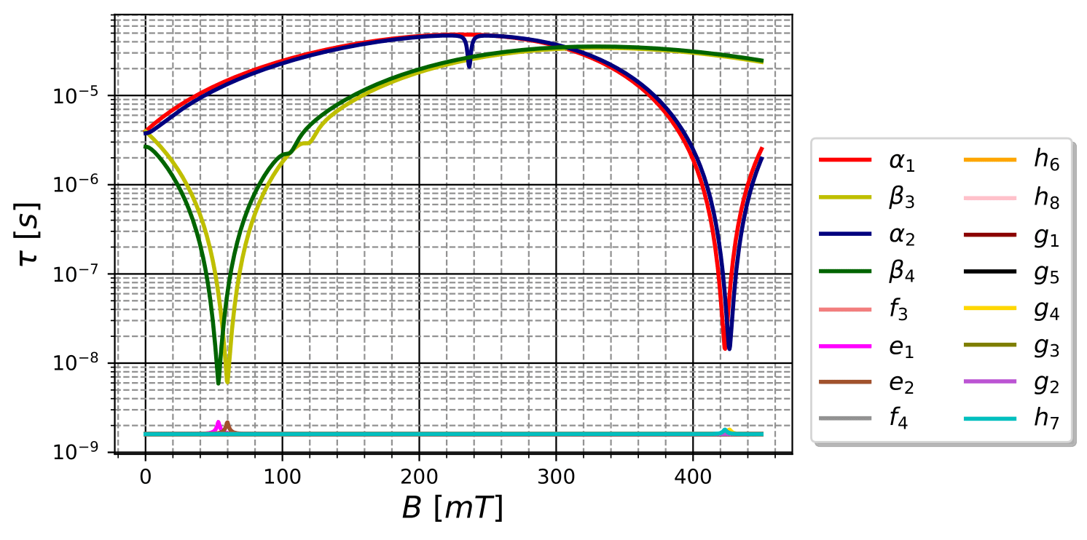
Lifetimes including ${2P}_{3/2}$
$$E_{x}={10}^{3}\frac{V}{m}$$

Slide 23
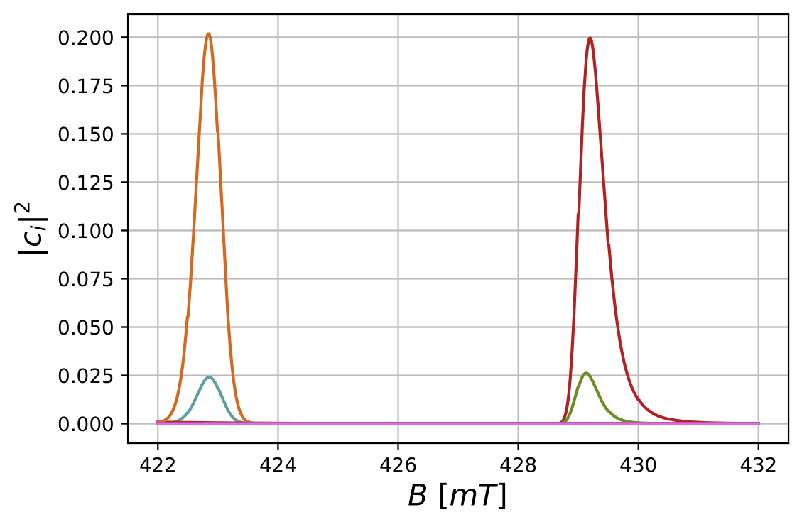
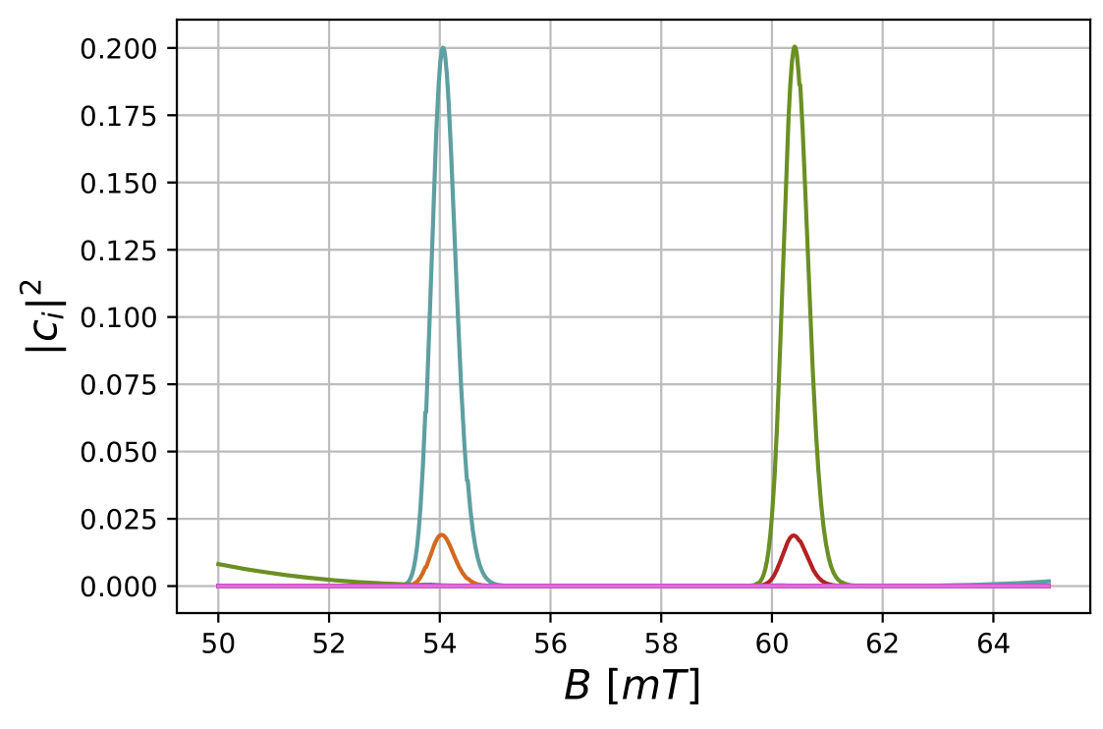
Ramped magnetic field
$$β_{4}$$
$$β_{3}$$
$$α_{1}$$
$$α_{2}$$

Slide 24
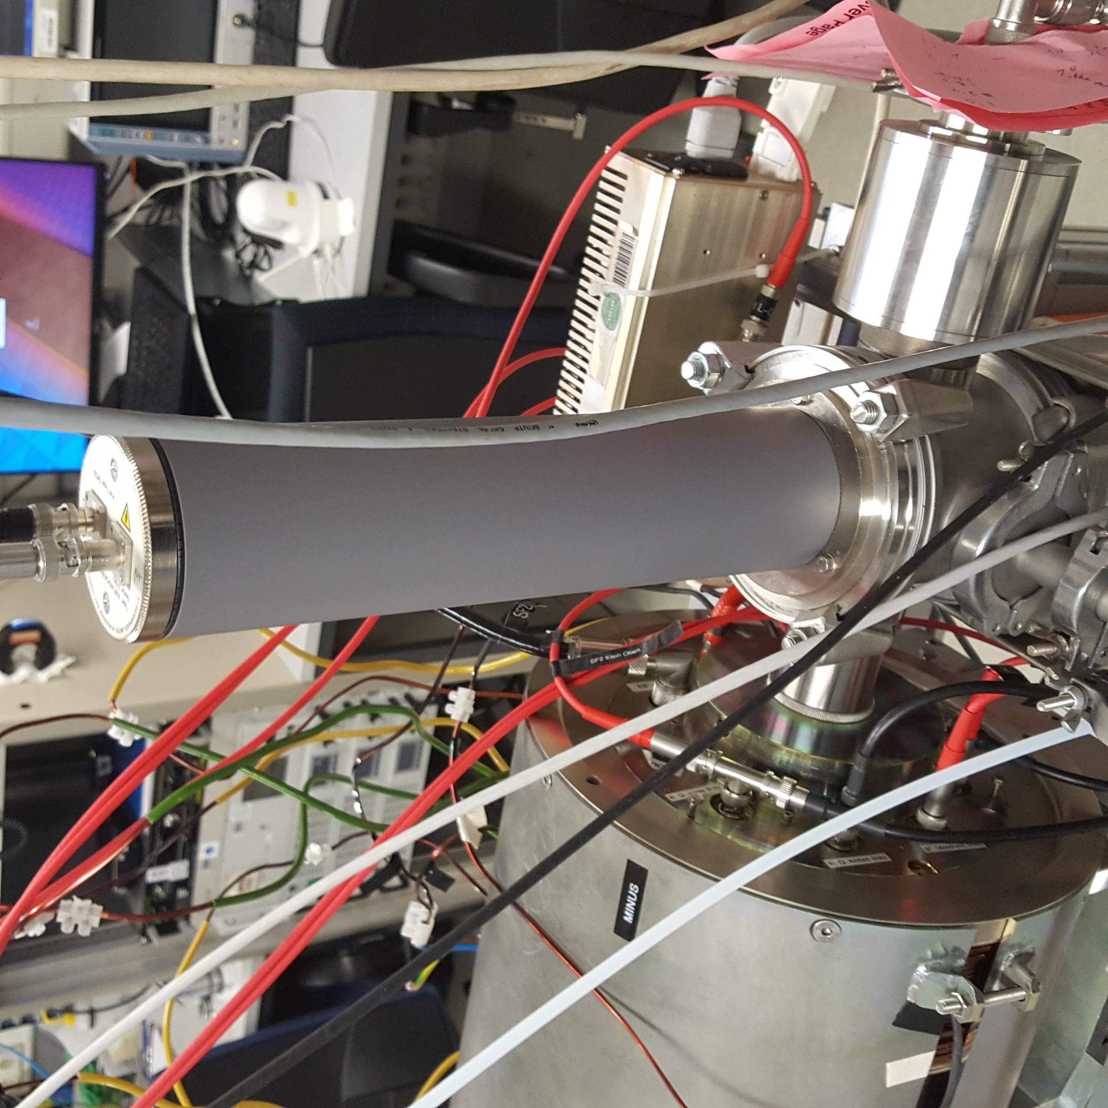
Quenching chamber
Using Stark effect to quench all metastable into the ground state
Created Ly-$α$ photons are detected by a photomultiplier
Observing the relative metastable occupation numbers

Slide 25
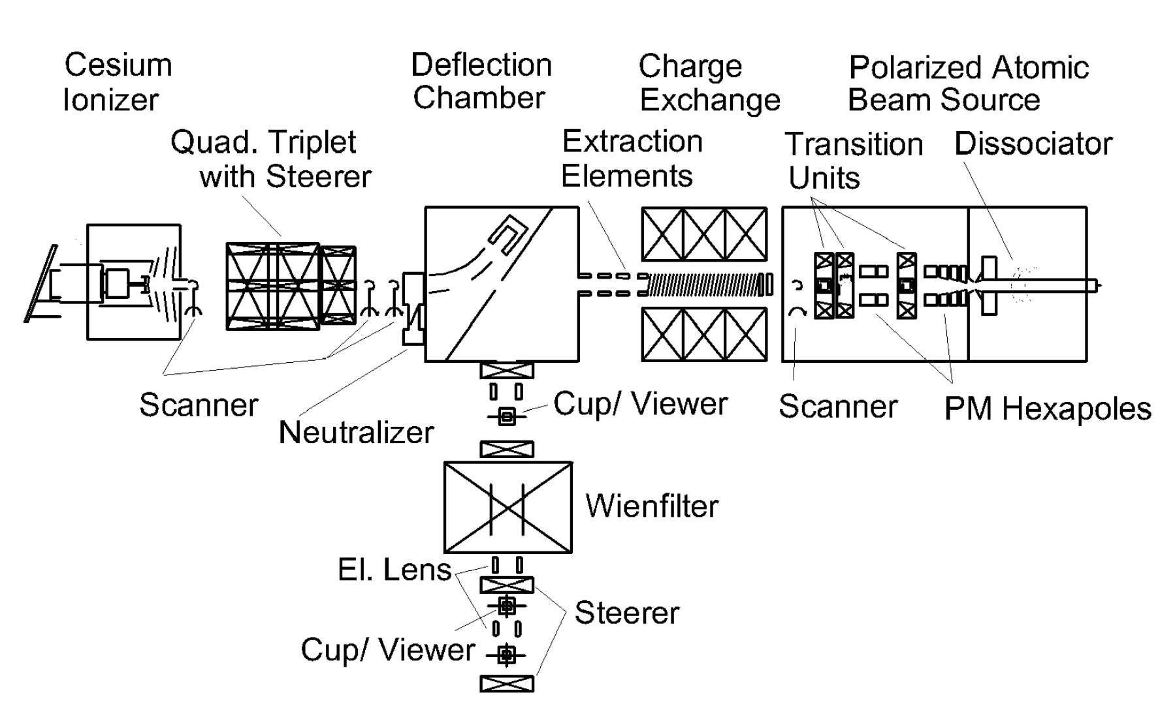
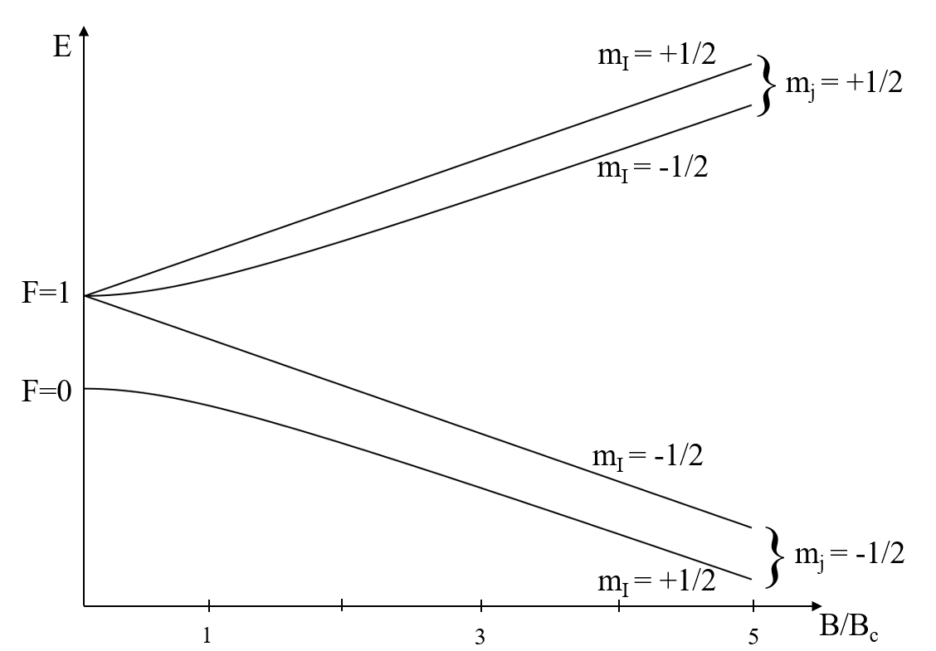
Pulsed $H^{−}$ source
Polarized ion source (Colliding beam source)
Pulsed ion beam:
$E=2$ keV
$f=0.5$ Hz
$Δt=20$ ms
Charge exchange reaction
$$Cs +\vec{H} −> {\vec{H} }^{−} + Cs^{+}$$
n=1

Slide 26
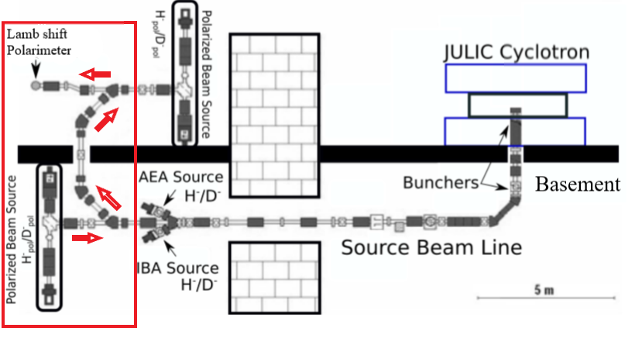
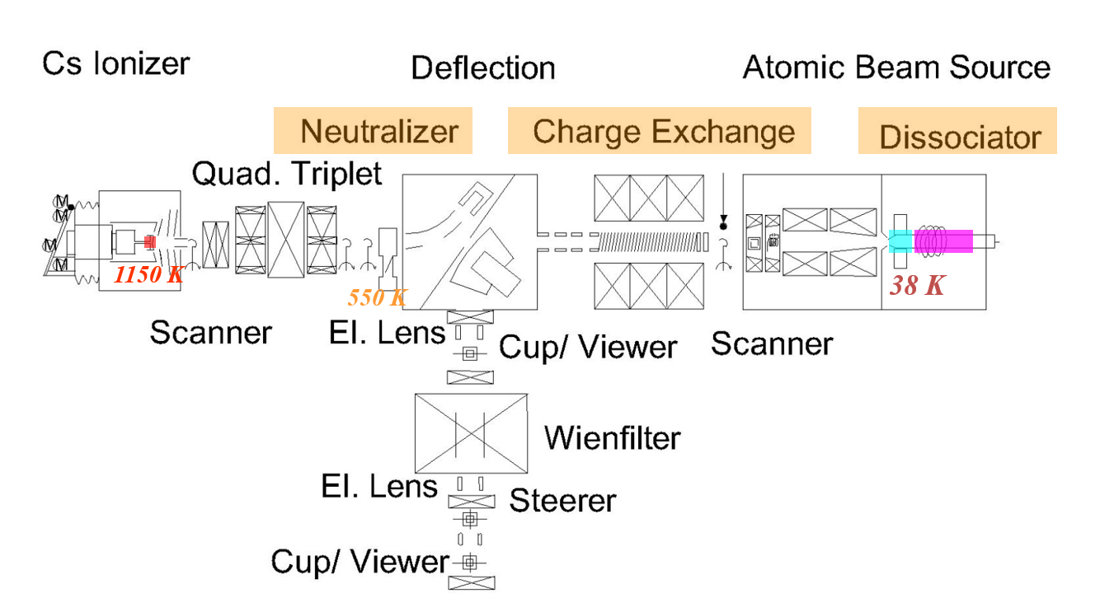
Beam line
Parallel operation of COSY
LEP
COSY
OTHER EXPERIMENTS
Better time efficiency

Slide 27
Lamb-shift polarimeter
$$H^{−}$$
Measuring the nuclear polarization of $H^{−}$ created by the polarized ion source
Automatization process for “live analysis”
Unknown reaction to create metastable hydrogen

Slide 28
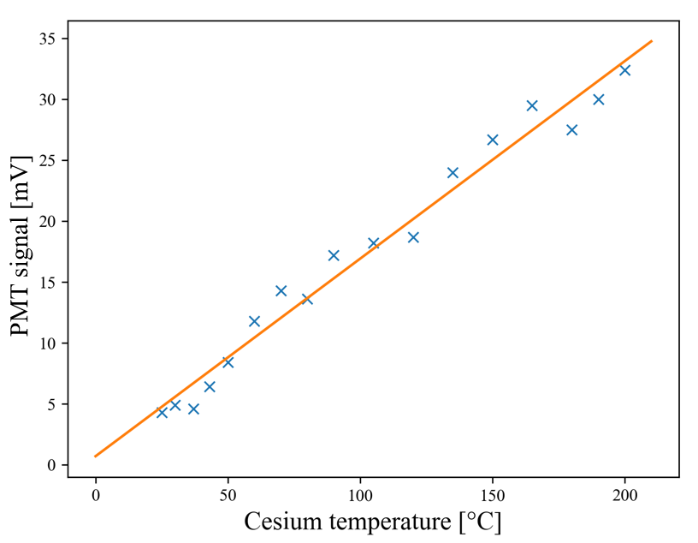
$Cs$ Temperature scan for $H^{−}$
Unknown reaction for $H^{−}$
$$Cs+H^{−}→ ??→Cs+H_{2S}^{∗}+e^{−}$$
Higher optimal temperature
Measurement limited due to vacuum sealing

Slide 29
Polarization measurements – sequence
SWEEP AFTER SWEEP

Slide 30
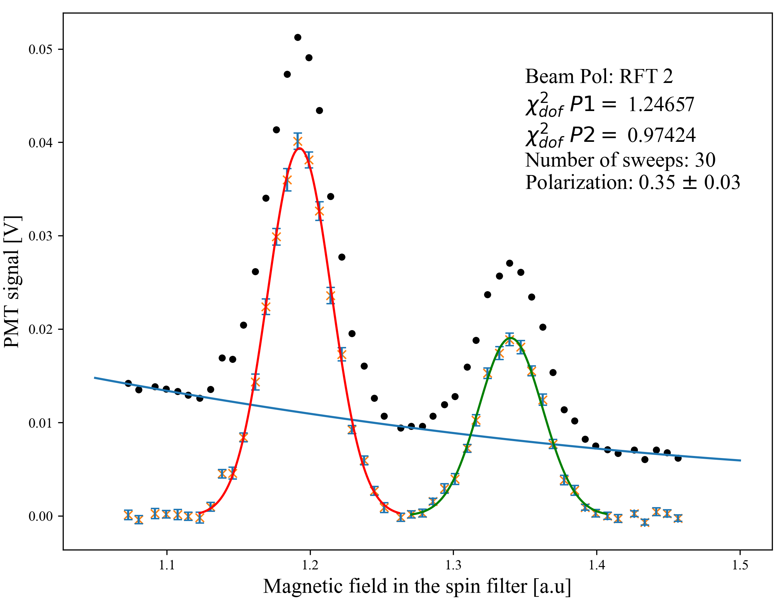
Polarization measurement
Problems at the source
Complicated beam line
Problems on the Lamb-shift polarimeter
➔ The automatization and detection process could be demonstrated

Slide 31
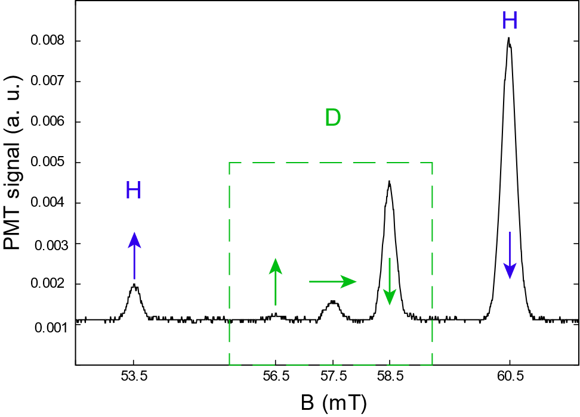
conclusion
Lamb-shift polarimeter is a simple and consistent tool to verify nuclear and electron polarization
Continuous and pulsed sources detectable
Usage for hydrogen and its isotopes in atomic, ionic and molecular form
New generation of spin filter developed to detect $β$ states

Slide 32
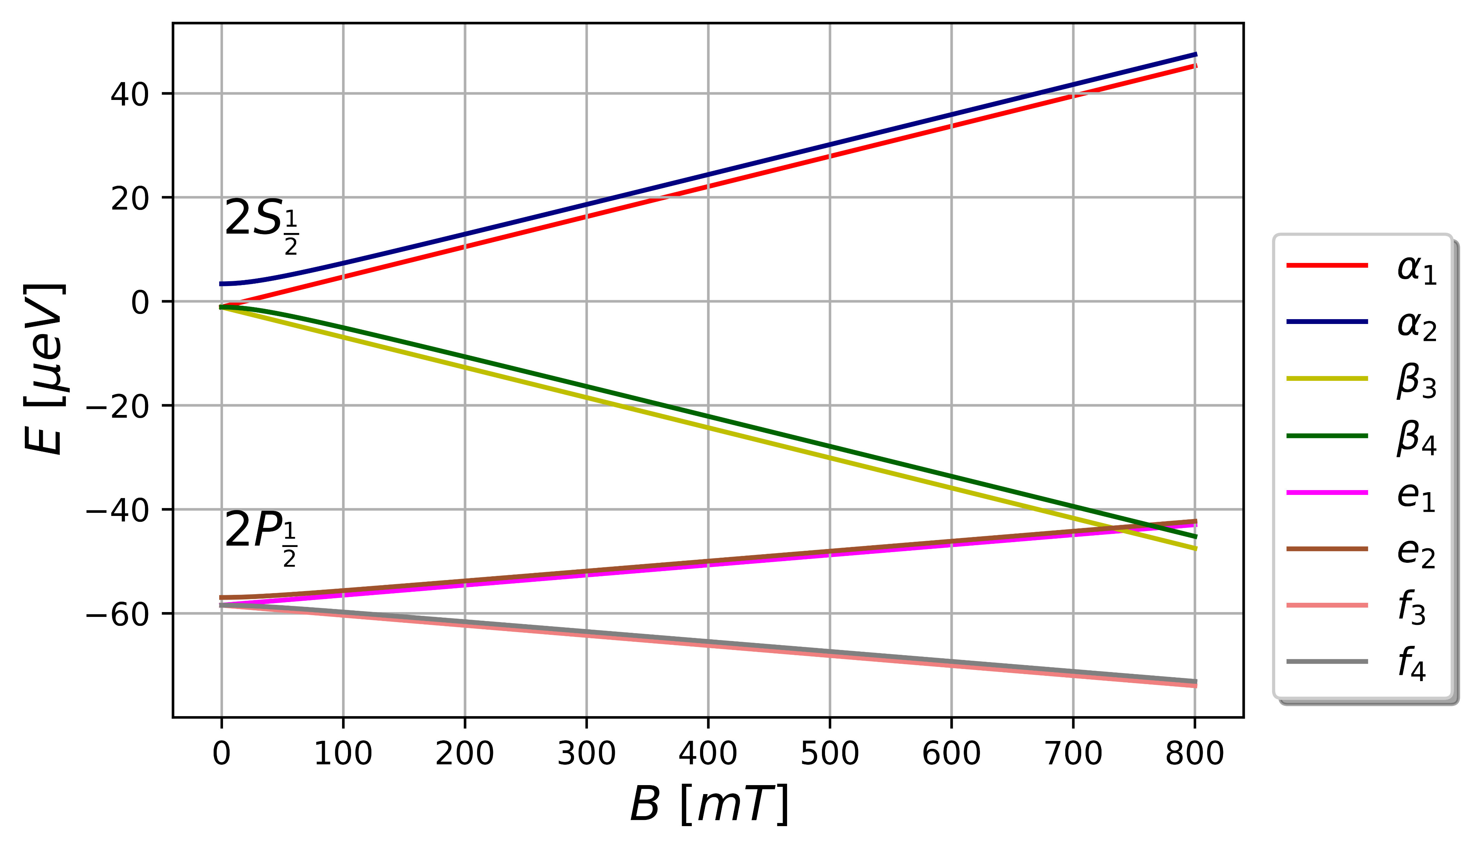
Outlook
Realization of a 2nd generation spin filter to verify experiments like BoB or parity violation
Replace the vacuum sealing to find the optimal Cs temperature for $H^{−}$
Ideas to work on a ${}_{ }^{3}{He^{+}}$ based Lamb-shift polarimeter

Slide 33
sources
G. Ohlsen and J. McKibben. Theory of a Radio-Frequency ”Spin Filter” for a Metastable Hydrogen, Deuterium, or Tritium Atomic Beam. Technical report, Los Alamos Scientific Laboratory of the University of California,1967
A.S. Belov and et. al. Pulsed high-intensity source of polarized protons, Nuclear Instruments and Methods in Physics Research Section A: Accelerators, Spectrometers, Detectors and Associated Equipment, Volume 255, Issue 3, 1987
S.K. Lemieux and et. al. A spin-filter polarimeter for low energy hydrogen and deuterium ion beams, Nuclear Instruments and Methods in Physics Research Section A: Accelerators, Spectrometers, Detectors and Associated Equipment, Volume 333, Issues 2–3, 1993,
R. Engels, R. Emmerich and et. al. Precision lamb-shift polarimeter for polarized atomic and ion beams. Rev. Sci. Instrum., 74(11):4607–4615, 10 2003
A. Zelenski, Polarimetry at RHIC: RHIC polarized beam in Run 2011

Slide 34
sources
M. Mikirtychyants, R. Engels and et. al., The polarized H and D atomic beam source for ANKE at COSY-Jülich, Nuclear Instruments and Methods in Physics Research Section A: Accelerators, Spectrometers, Detectors and Associated Equipment, Volume 721, 2013
A. Solovev and et. al. Optimization and first tests of the experimental setup to investigate the double-polarized DD-fusion reactions, Journal of Instrumentation, Volume 15, 2020
J. McAndrew and et. al. Neutron bound beta-decay: BOB. Hyperfine Interact., 210(1-3):13–17, 2012.
R. W. Dunford and R. J. Holt. Parity violation in hydrogen revisited. JPhysG: Nuclear and Particle Physics, 34(10):2099–2118, sep 2007
R. Engels and et. al. Direct observation of transitions between quantum states with energy differences below 10 neV employing a Sona unit. EPJ D, 75(9):257, 2021
Q. Yang and S. Dong. Probing dark matter axions using the hyperfine structure splitting of hydrogen atoms. Phys. Lett. B, 843:138004, 2023

