Slide 1
Polarized Positrons at Ce⁺BAF
Concept of Ce⁺BAF injector
Development of high-power targets
Design of CW NC capture cavity
Beam and spin tracking simulations
Andriy Ushakov (Jefferson Lab)
on behalf of the Ce⁺BAF Working Group
Work supported by the U.S. Department of Energy Office of Nuclear Physics under contract DE-AC05-06OR23177 and Office of High Energy Physics US-Japan Science & Technology Cooperative Program

Slide 2
Acknowledgments
We would like to acknowledge members of the Ce⁺BAF Working Group, the Jefferson Lab Positron Working Group, the DOE industry partner Xelera, members of the DOE US-Japan HEP Collaboration, and collaborators at Universities and National Labs which contribute to the positron R&D effort.
T. Abe, J. Benesch, A. Bogacz, L. Cardman, J. Conway, S. Covrig, P. Degtiarenko, Y. Enomoto, S. Gessner, P. Ghoshal, S. Gopinath, J. Grames, J. Gubeli, C. Gulliford, S. Habet, C. Hernandez-Garcia, D. Higinbotham,
A. Hofler, R. Kazimi, M. Kostin, F. Lin, V. Kostroun, V. Lizarraga-Rubio, K. Mahler, Y. Morikawa, S. Nagaitsev,
E. Nanni, S. Ogur, M. Poelker, N. Raut, B. Rimmer, Y. Roblin, A. Seryi, K. Smolenski, M. Spata, R. Suleiman,
A. Sy, N. Taylor, D. Turner, C. Valerio-Lizarraga, E. Voutier, M. Yamamoto, S. Zhang

Slide 3
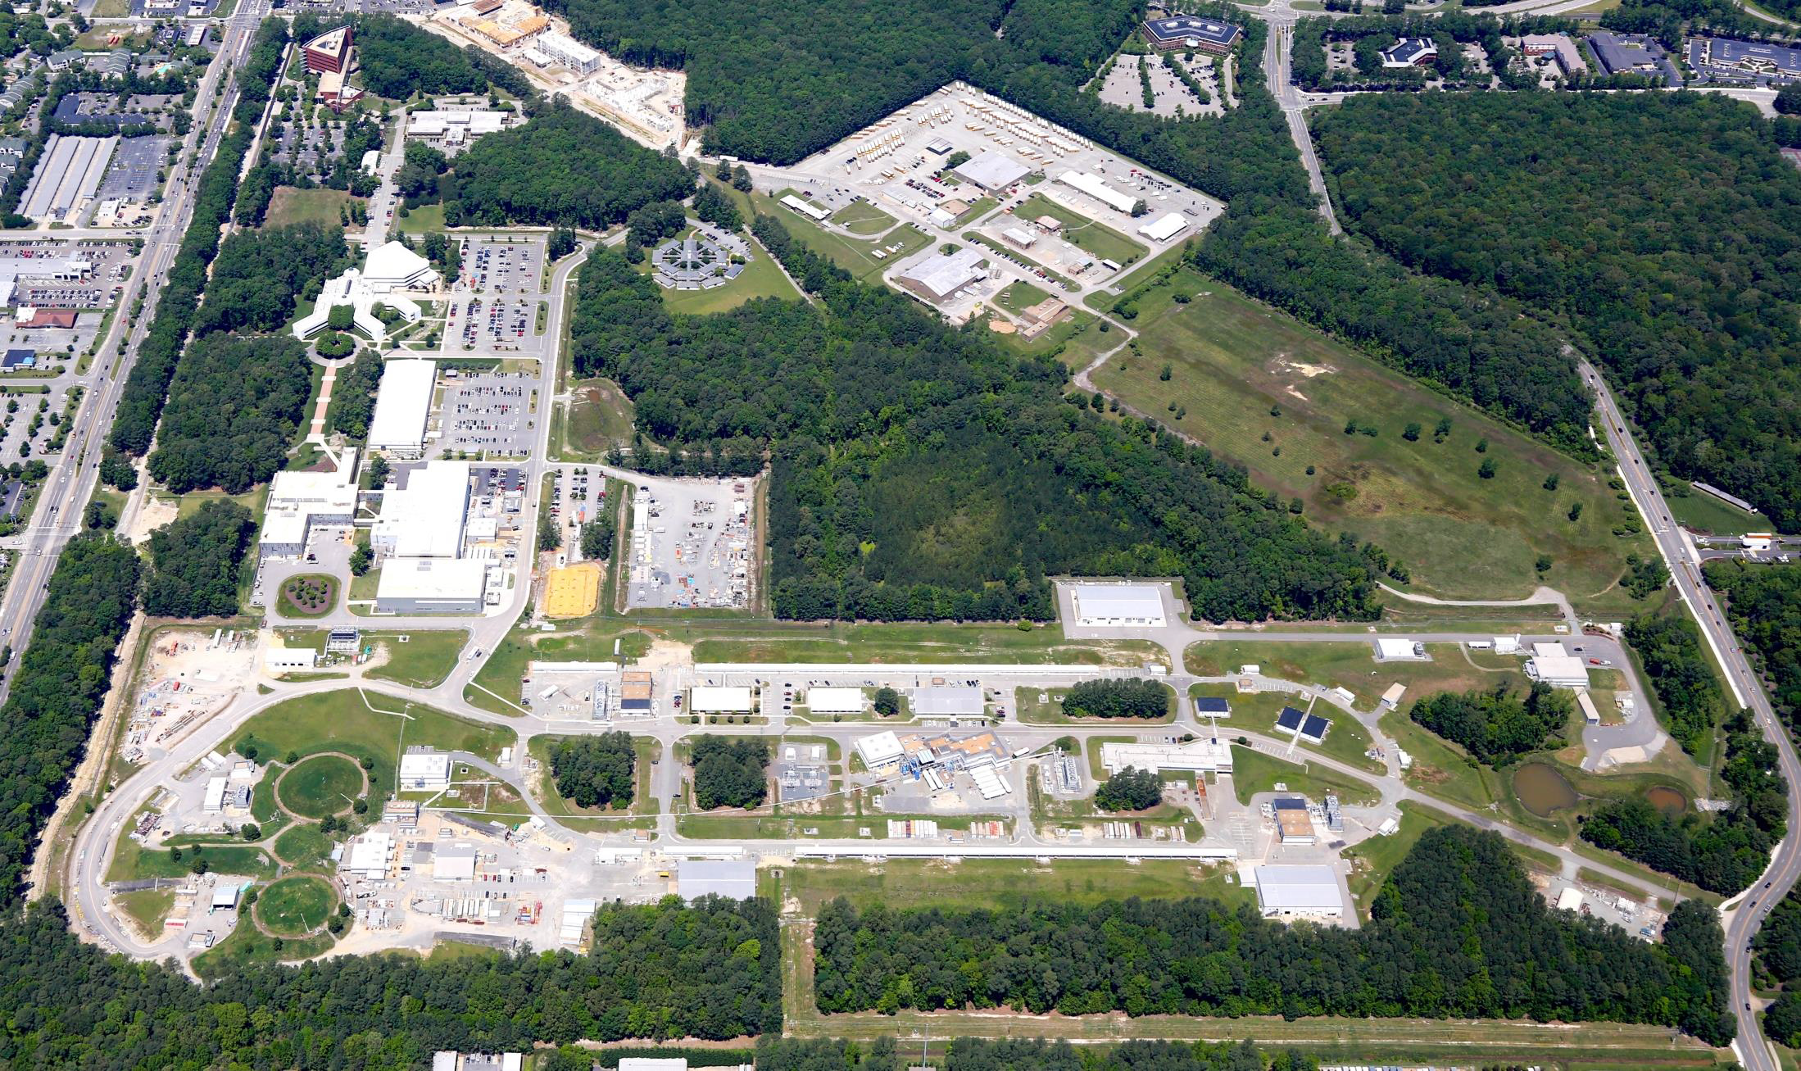
12 GeV Ce⁺BAF : Polarized Electron or Polarized Positron Beams
Machine Parameter | Electrons | Positrons
Hall Multiplicity | 4 | 1 or 2
Energy (ABC/D) | 11/12 GeV | 11/12 GeV
Beam Repetition | 249.5/499 MHz | 249.5/499 MHz
Duty Factor | 100% cw | 100% cw
Unpolarized Intensity | 170 µA | > 1 µA
Polarized Intensity | 170 µA | > 50 nA
Beam Polarization | > 85% | > 60%
Fast/Slow Helicity Reversal | 1920 Hz/Yes | 1920 Hz/Yes

Slide 4
Positron Experiments Approved by JLab Program Advisory Committee (PAC)
NUMBER | TITLE | CONTACT PERSON | HALL | DAYS REQUESTED | DAYS AWARDED | SCIENTIFIC RATING | PAC DECISION
PR12+23-002 | Beam charge asymmetries for deeply virtual Compton scattering on the proton at CLAS12 | Eric Voutier IJCLab, Orsay, France | B | 100 | 100 | A- | C1
PR12+23-003 | Measurement of deep inelastic scattering from nuclei with electron and positron beams to constrain the impact of Coulomb corrections in DIS | Dave Gaskell Jefferson Lab | C | 9.3 | 9.3 | A- | C1
PR12+24-005 | A dark photon search with a JLab positron beam | Bogdan Wojtsekhowski Jefferson Lab | B | 55 | 55 | A- | C1
PR12+23-006 | Deeply virtual Compton scattering using a positron beam in Hall C | Carlos Munoz Camacho IJCLab, Orsay, France | C | 137 | 137 | A- | C1
PR12+23-008 | A direct measurement of hard two-photon exchange with electrons and positrons at CLAS12 | Axel Schmidt George Washington University | B | 55 | 55 | A | C1
PR12+23-012 | A measurement of two-photon exchange in unpolarized elastic positron-proton and electron-proton scattering | Michael Nycz University of Virginia | C | 56 | 56 | A- | C1
C1 = Conditionally Approved with Technical Review by the Lab
Approved 210 days Hall B & 202 days in Hall C for 357 total PAC days
(PAC day = two calendar day)

Slide 5
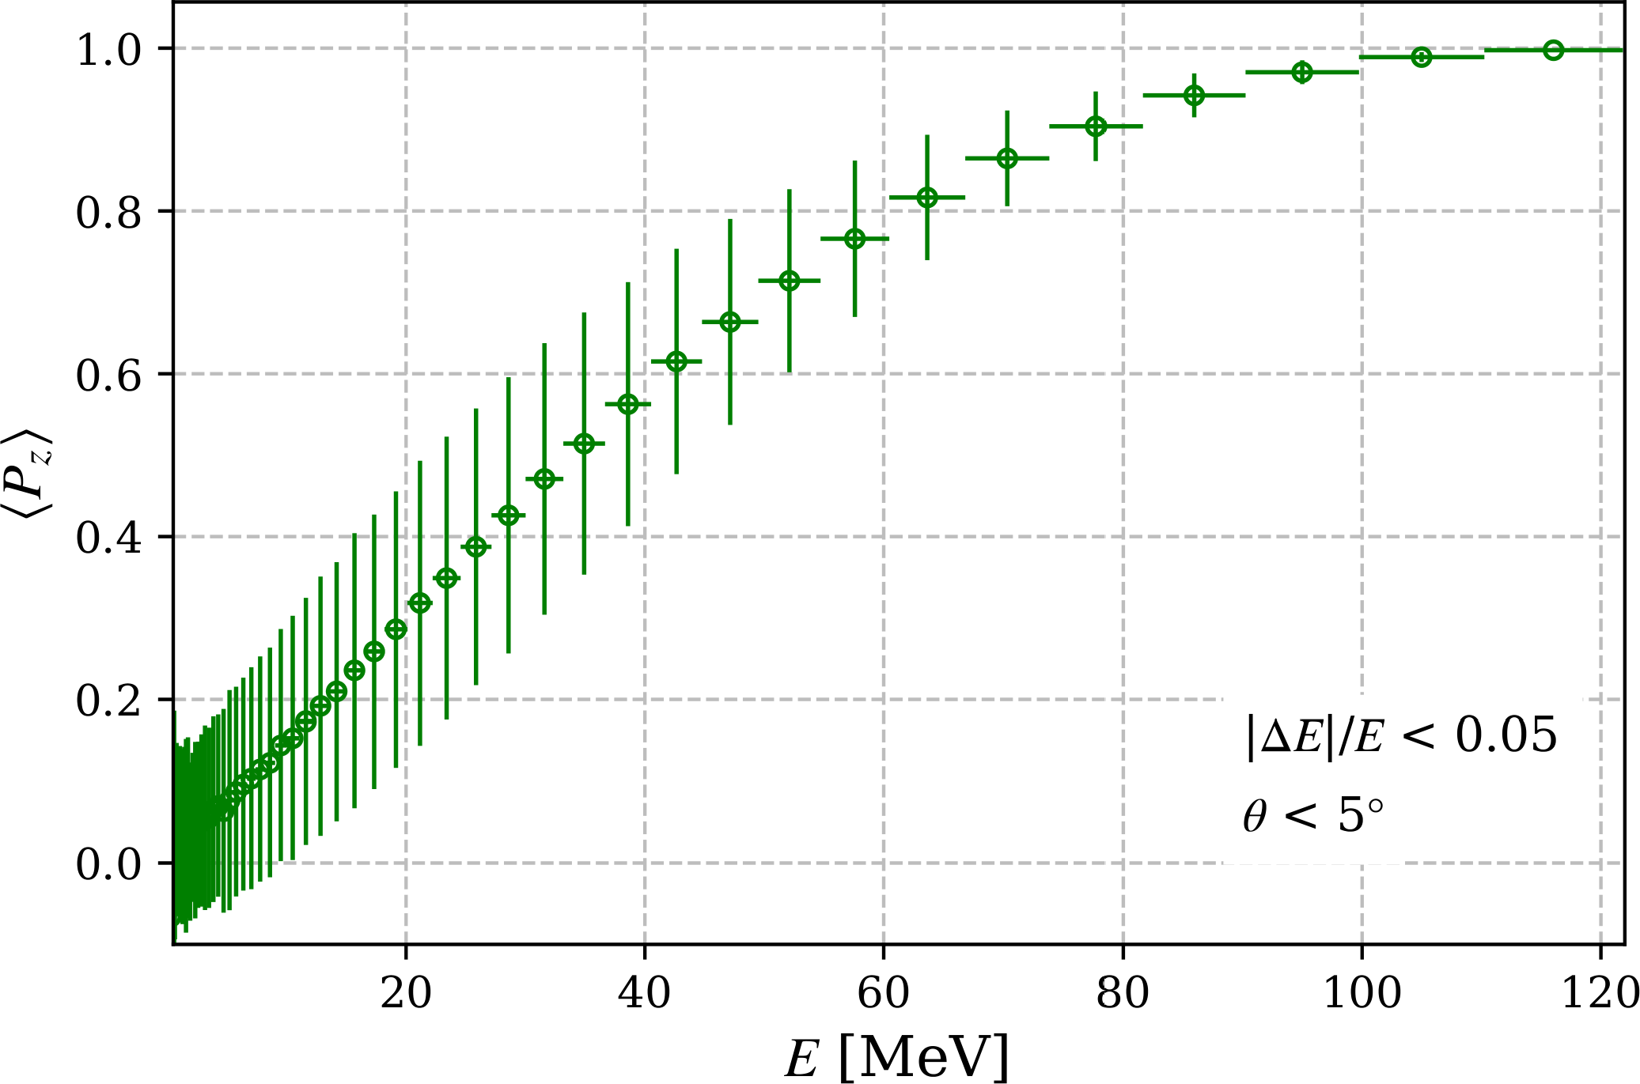
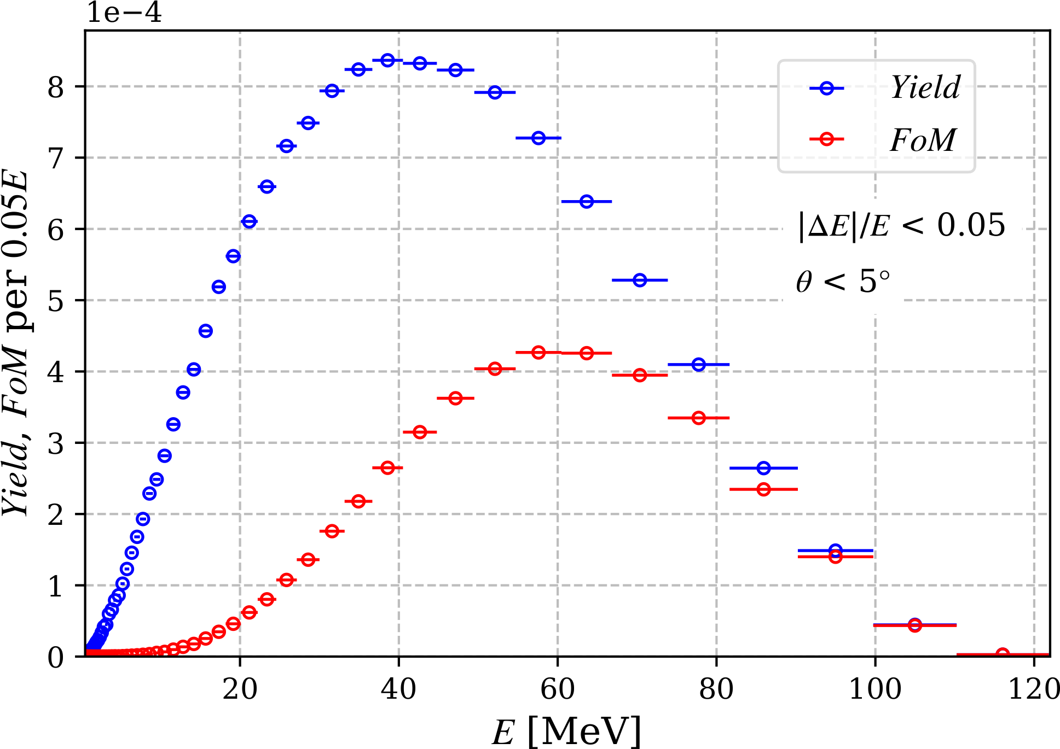
Selection of e⁺ Energy at Exit of 4 mm W Target for 120 MeV e‒ and P_{z} = 1
e⁺ Long. Polarization vs Energy at Target Exit
e⁺ Yield [e⁺/ e⁻] and Figure-of-Merit (FoM) vs Energy
$FoM=Y{P_{z}}^{2}$, where $Y$ is e⁺ yield and $P_{z}$ is e⁺ long. polarization
For 120 MeV drive e‒ beam, if e⁺ captured with energy spread $|∆E|/E$ < 0.05 and opening (divergence) angle $θ$ < 5°:
Max $FoM$is for $E_{e^{+}}≈$ $0.5 E_{e^{−}}$ and $P_{e^{+}}≈$ $0.78 P_{e^{−}}$
Captured e⁺ yield is relatively low (~5·10⁻⁵-10⁻³ e⁺/e‒) → high current polarized e‒ source is required ($≳$1 mA, up to 90% pol.)
Calculations results of e⁺ yield, polarization and FOM for different thicknesses of tungsten targets and liquid metal targets (GaInSn, PbBi) and at different energies of drive e ‒ beams:
V. Lizarraga-Rubio et al., PSTP24 presentation
Notes:
S. Habet et al., “Characterization and optimization of polarized and unpolarized positron production”, Tech. Rep. JLAB-ACC-23-3794, Feb. 2023. doi:10.48550/arXiv.2401.04484

Slide 6
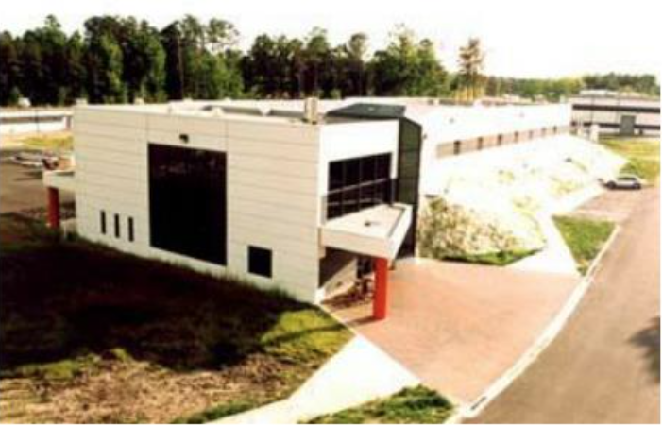
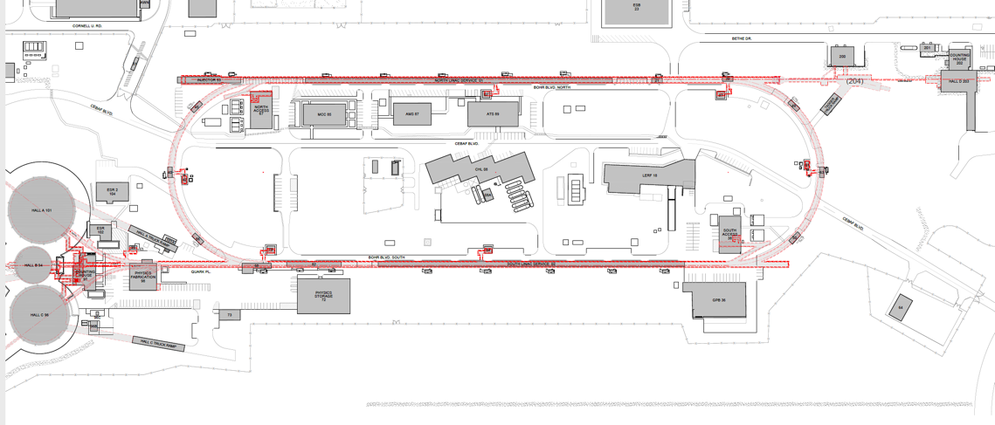
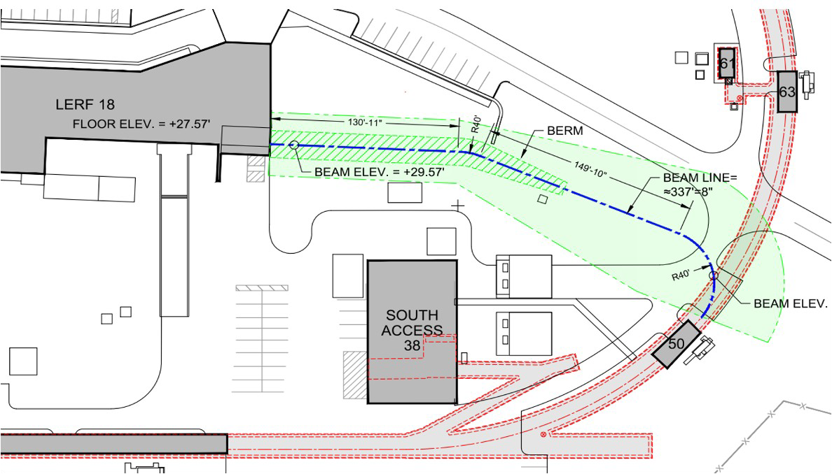
Positron Injector and Transport Line at CEBAF
LERF
CEBAF Polarized Electron Injector
123 MeV e⁺ Beam Injected to NL
North Linac
West Arc
New e⁺ Injector at LERF
East Arc
123 MeV e⁺
New Beamline to CEBAF Tunnel
South Linac
New Transport Line along SL and West Arc
LERF – Low Energy Recirculation Facility
J. Grames et al., IPAC’23, MOPL152

Slide 7
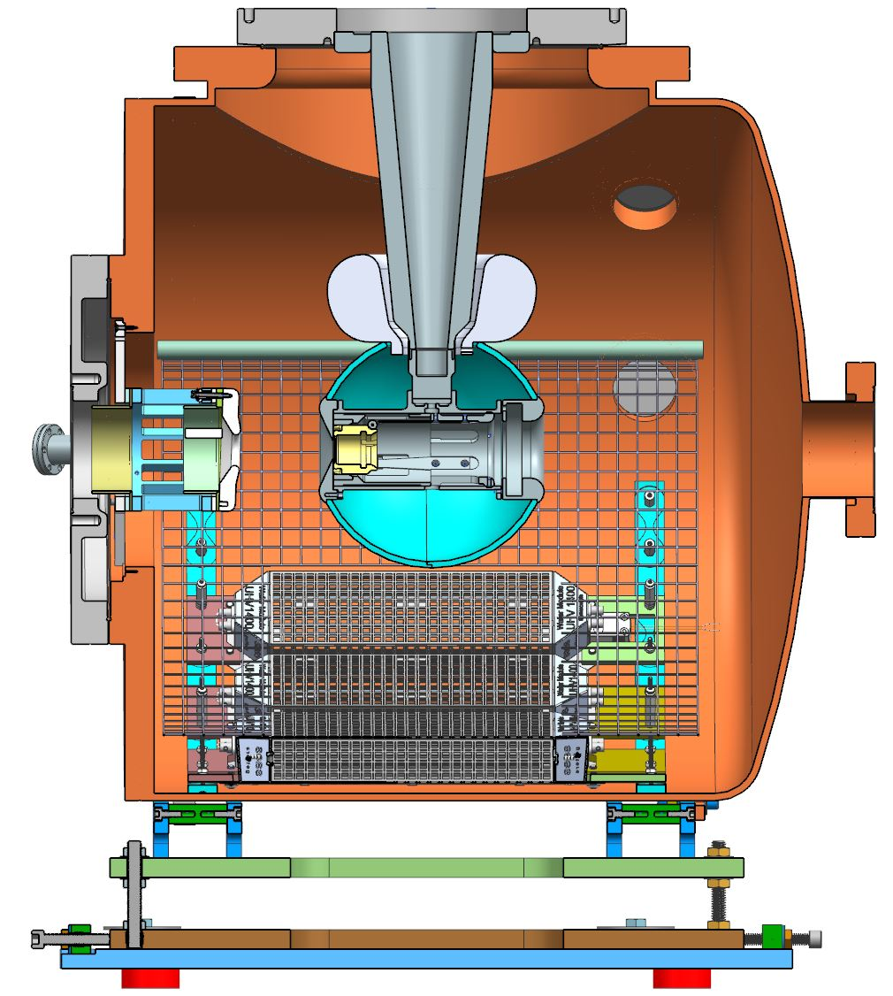
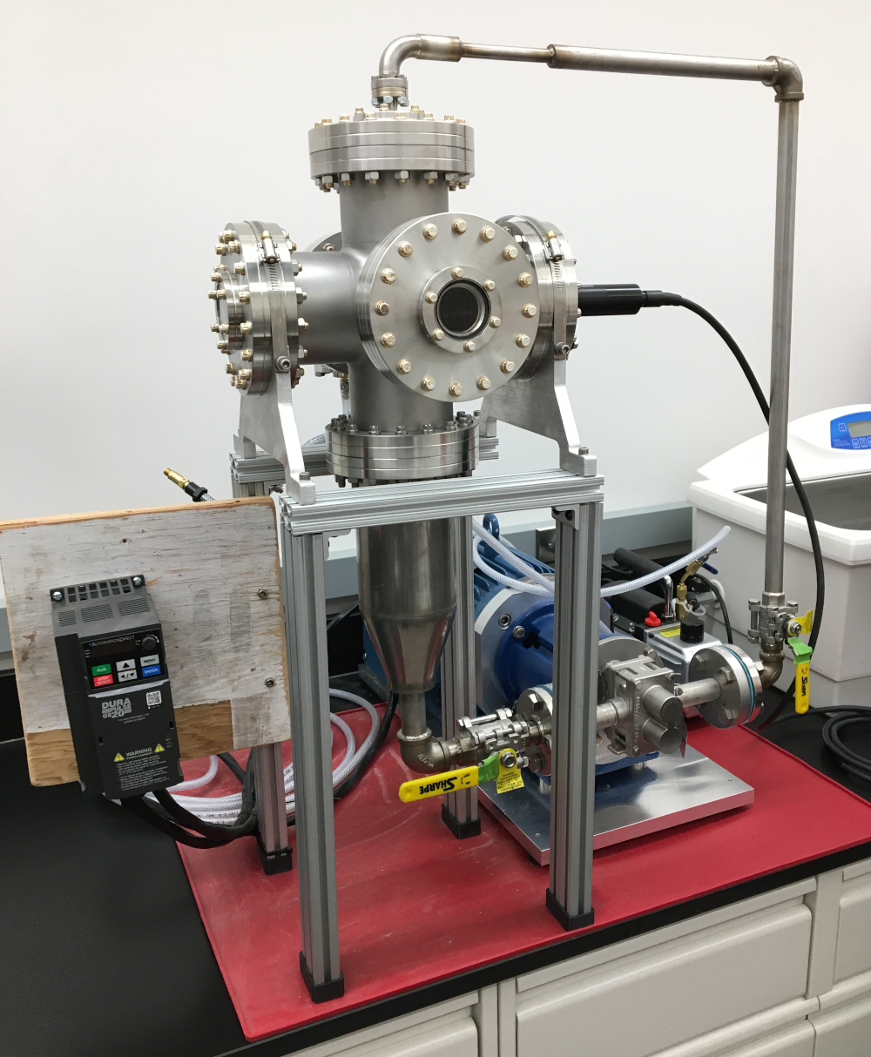
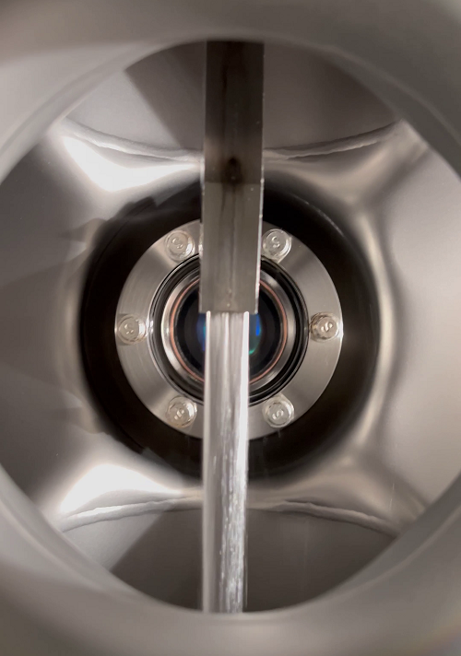
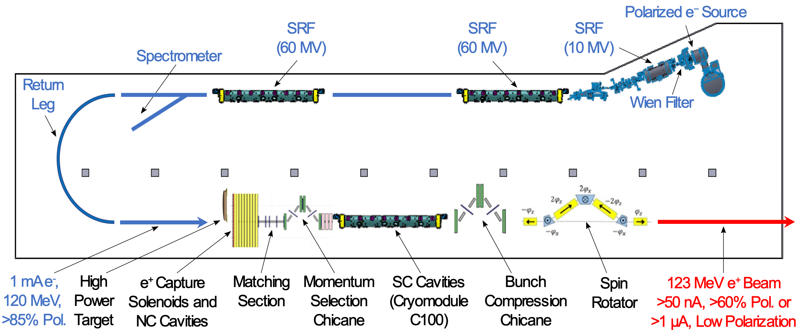
Pol. e⁺ Injector Critical Risk Areas mA e‒ Source, High Power Targets, Capture Cavity
Two target concepts are considered
1) Solid high-Z target (i.e. tungsten) ⇒ next slide 2) Liquid metal targets
Conceptual Development
Improve design of e⁺ injector
Develop pCDR
High current e‒ source (<10 mA @ 10 MeV)
Up to 90% polarization
Long life time
Liquid Metal Targets are developed by
Xelera Research LLC DOE SBIR Phase2, Oct 2024 – Sep 2026
GaInSn Jet
Liquid Metal Target Test Area
Prototype of GaInSn Test Stand
N. Taylor et al., IPAC’24, TUPC83
GaInSn target will be tested at JLab with up to 10 mA @ 10 MeV e‒ beam
Development of liquid PbBi target and test with 1mA @ 120 MeV e‒ is planned

Slide 8
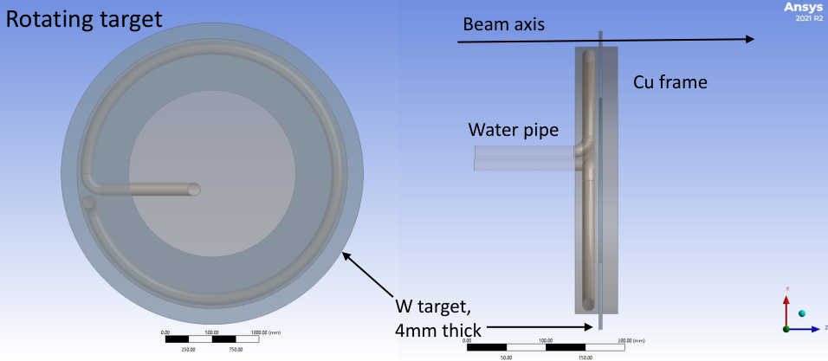
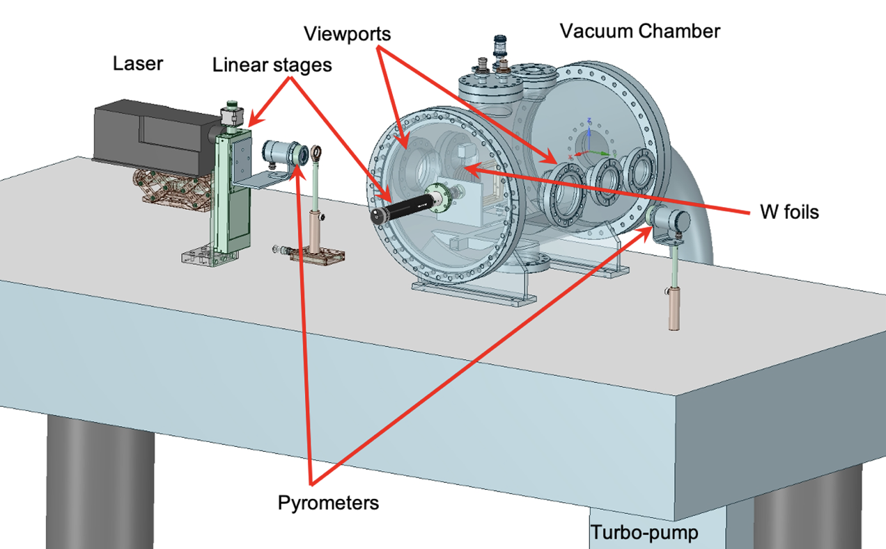
Concept of Tungsten Target, CFD Simulations, Prototype Testing (S. Covrig)
Focused on assessing with CFD solid high-Z targets, mostly W, for e⁺ production at CEBAF:
A rotating target (<10 Hz, >30 cm diameter) could take 20 kW beam power with T_{max} < 1000 K
e- beam has a Gaussian profile with σ ~ 1 ÷ 3 mm
The beam hits the W target on a circle with radius 18 cm
The W target rotates at 2 Hz and the water flow is 0.3 kg/s, water pressure loss is 1.5 psi
Full time-dependent CFD simulations implemented
No studies on target material lifetime
Started looking at the target engineering, radiological issues, shielding
Tungsten Target Test
DOE HEP Advanced Positron Concepts, U.S.-Japan Collaboration (SLAC/JLab/KEK)
DOE FY2024 R&D for Next Generation Nuclear Physics Accelerator Facilities
Max T of Tungsten vs Time
Max T of Cooling Water vs Time

Slide 9
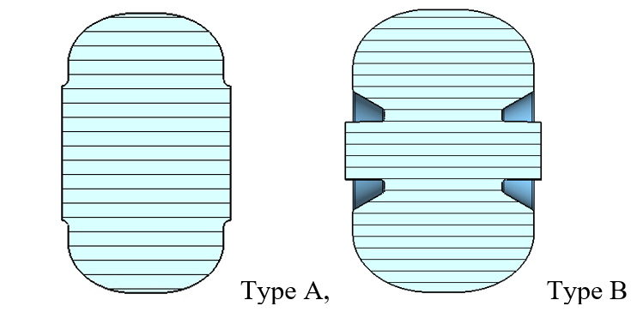
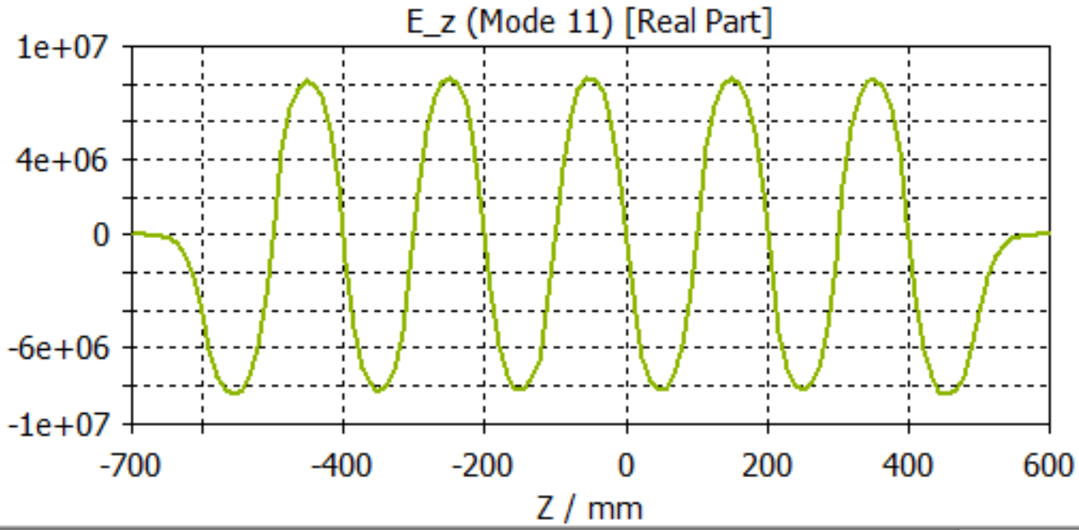
Conceptual Development and Design of CW NC Capture Cavity (S. Wang)
Capture Cavity Design Strategy
Working plan
Year 1:
Define solenoid and cavity specifications
Generate preliminary cavity fields
Integrate with target geometry
Perform radiation simulations
Thermal analysis
Preliminary e⁺ and e⁻ beam tracking
Year 2:
Iterate and optimize magnet and cavity design
Explore beam loading and magnetization effects
Find optimal parameters of capture system with an adjustable energy selection band
At the early design stage, the goal is not to produce a single design but to provide a range of options
Type A: simpler structure, larger cell-to-cell coupling
Type B: typically higher shunt impedance
Capture cavity set for CW Ce⁺BAF was obtained for further capture section design
Studied influence of solenoid magnetic field to the e⁺ transportation before entering cavity
Performed initial studies of the action of cavity field on 20, 60 MeV positrons
Balance and Tradeoff
Large cavity iris radius is expected, >15mm, to accommodate more e⁺ transversely → lowers the shunt impedance
As high as possible E field gradient is desired to manipulate the incoming e⁺ beam longitudinally → requires high shunt impedance
S. Wang et al., IPAC’24, MOPC51

Slide 10
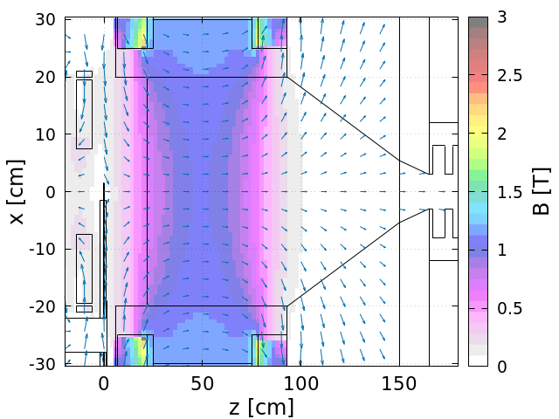
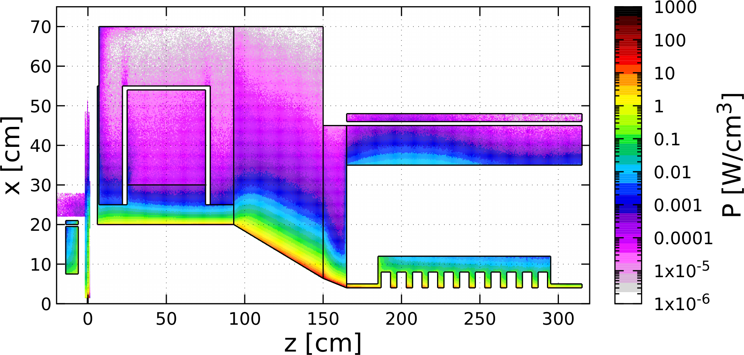
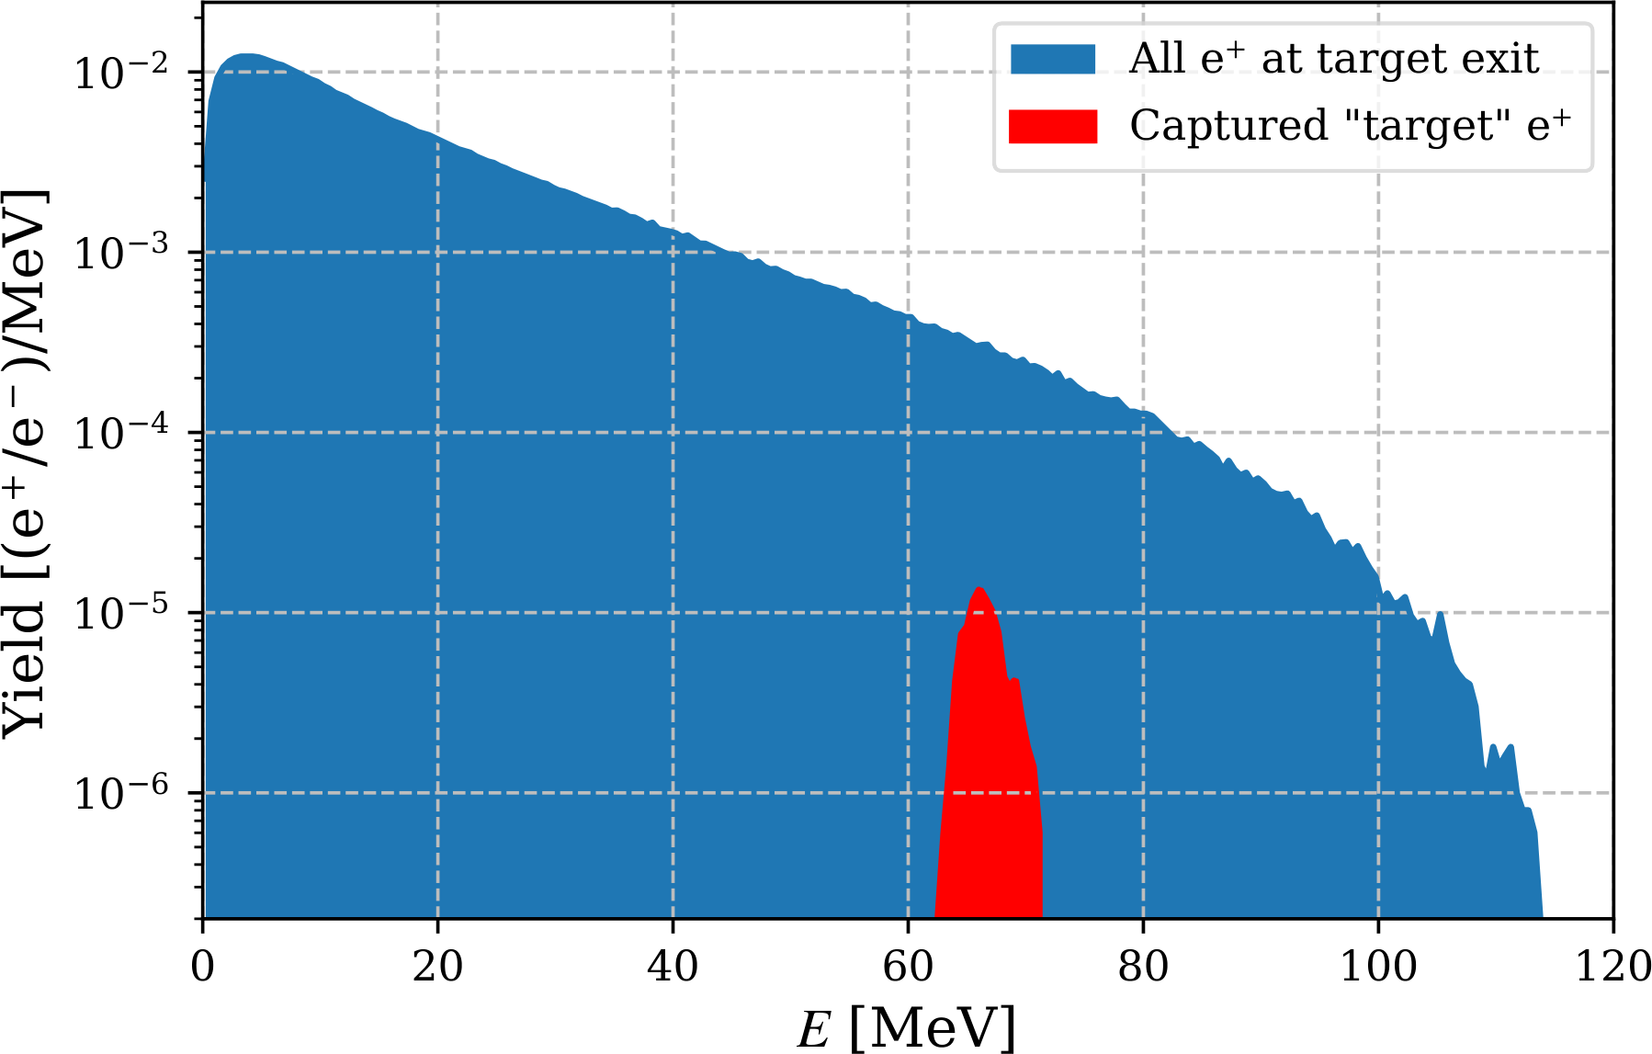
Ce⁺BAF: Simulations of CW Positron Beam Generation, Capture and Acceleration
Scheme of Positron Generation, Capture, Selection of e⁺ Energy Band and Acceleration to 123 MeV
1 mA 120 MeV
Target and Capture Magnets
Power Deposited by 1 mA e‒ Beam @ 120 MeV
e⁺ Energy Spectrum at Target Exit and Captured e⁺
Bucking Solenoid
Main Solenoid
Absorbers
Steel
Target
TZM
Cu Coil
Cu Coil
W10Cu
W10Cu
Cavity
Cu Cavity*
Compensation
Solenoid
Target
A. Ushakov et al., IPAC’24, MOPC54

Slide 11
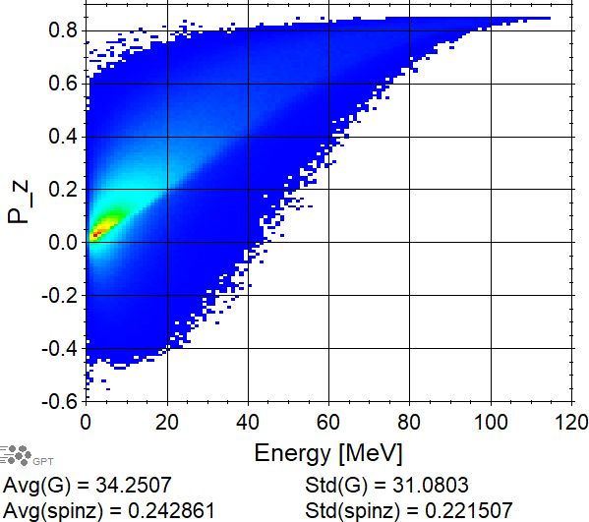
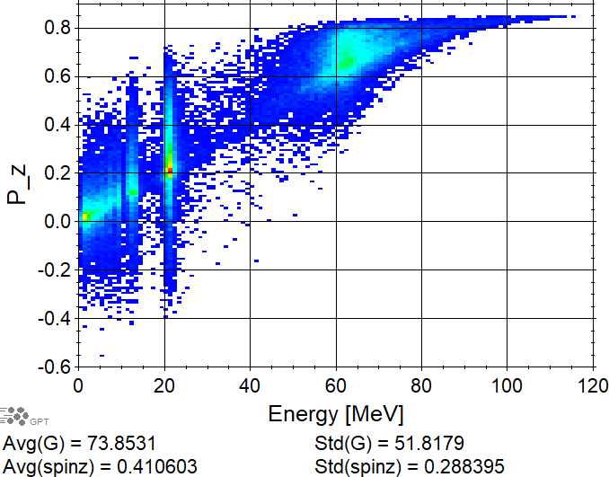
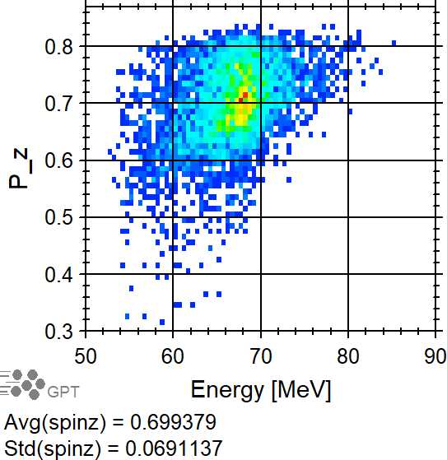
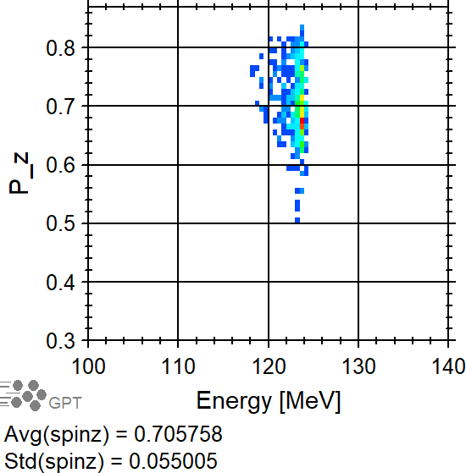
Spin Tracking in Geant4 and General Particle Tracer (GPT)
At Target Exit
At Exit of Capture Cavity
At Exit of Col. #1
At Exit of C100

Slide 12
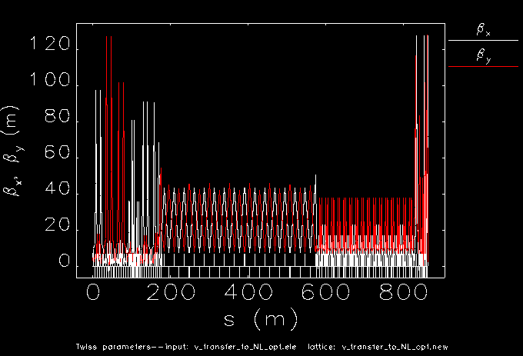
Design of Low-Dispersion e⁺ Transfer Line from LERF to North Linac
S. Ogur, J. Benesch, Y. Roblin, D. Turner
Needs fine-tuning according to the crossover
ARC to NL Transfer needs Twiss matching and Low D and Beta optics
LERF Transfer Line
(LTL)
South Transfer Line
(STL)
The Crossover
Polished DBA Arc low dispersion and low beta optics, fitting layout
West Transfer Line
(WTL)
X [m]
LERF
SL to ARC Twiss matchings
The new SL with the half # quads
LERF matched to the new SL
Tunnel Walls
Z [m]

Slide 13
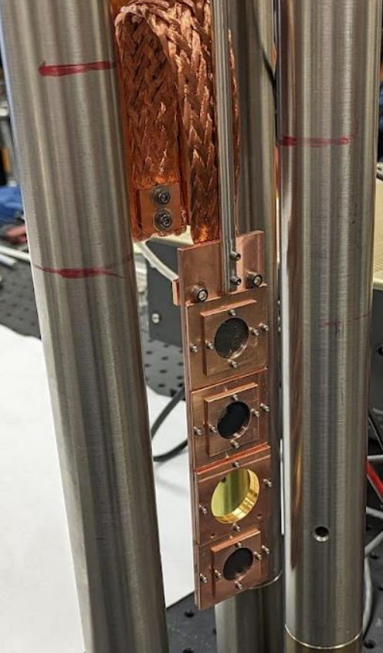
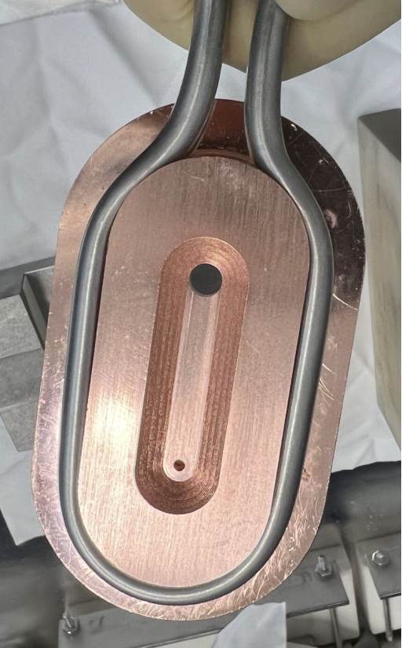
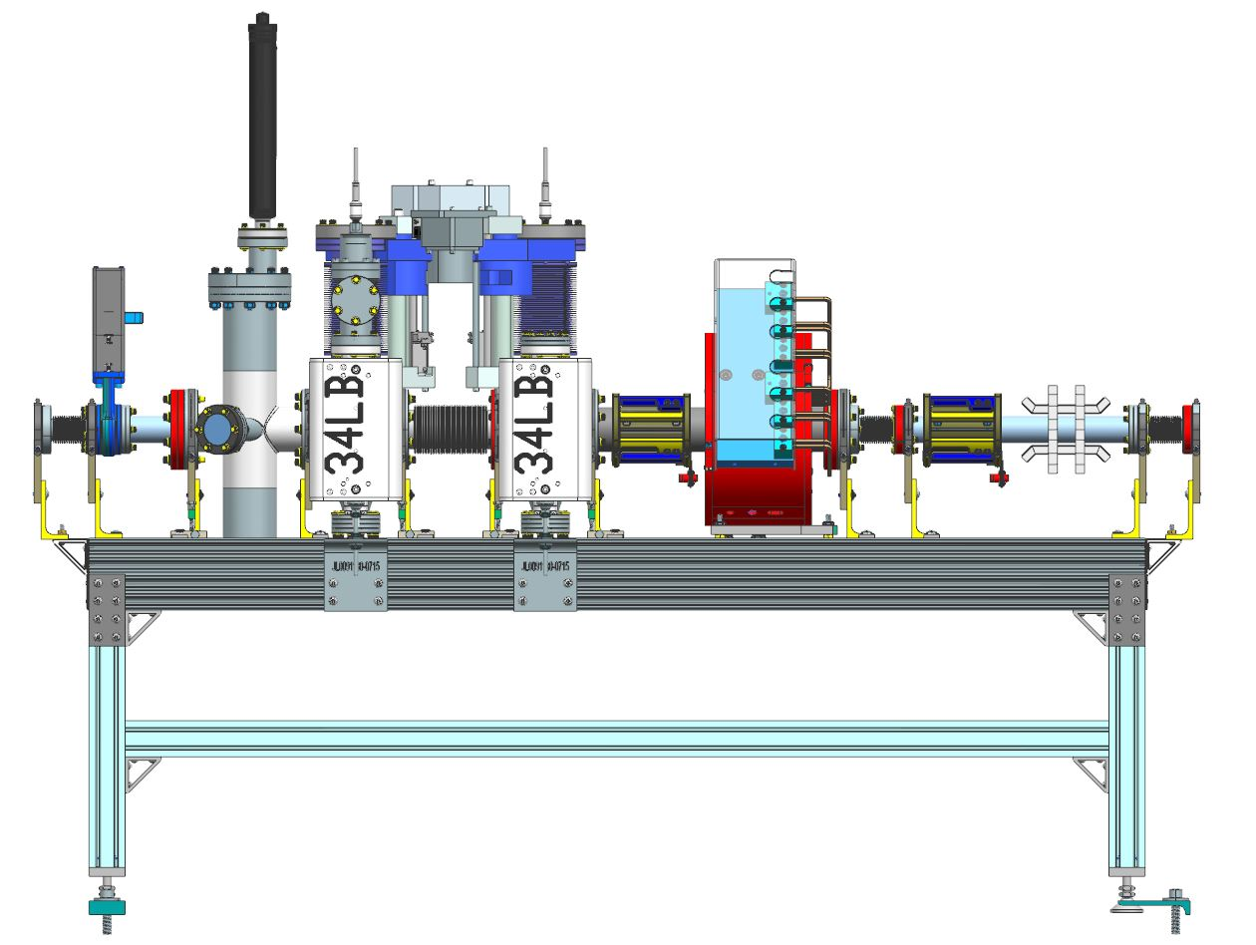
Measurement of CEBAF Acceptance with Degraded e‒ Beam (A. Sy)
Measurement of CEBAF Acceptance is a JLab Laboratory Directed Research & Development (LDRD) project
Goal: determine acceptance of CEBAF by increasing beam emittance and energy spread through multiple scattering in thin carbon foils and using two apertures to define the maximum transverse emittance. The energy spread can be additionally increased by adjusting field phase of accelerator cavities.
Degrader location: downstream injector booster, 6.24 MeV e‒
Targets: carbon foils with thicknesses of 1 µm, 5 µm and 10 µm
Degrader apertures:
1st aperture: 2 mm and 6 mm diameter
2nd aperture: 8 mm and 16 mm diameter
14.9 cm distance from target to 1st aperture and 27.3 cm between apertures
Degrader components have been built and installed in CEBAF injector
Experiments will be performed soon
Aperture 1
Aperture 1
Aperture 2
Target Ladder
Solenoid
Corrector
Corrector
Helicity Coil
A. Sy et al., IPAC’24, MOPC53

Slide 14
Summary
Continue working on design of Ce⁺BAF injector and critical risk areas:
Optimization of positron capture system
Beam/spin tracking simulations for Ce⁺BAF injector at LERF and beam tracking from LERF to North Linac (and later to the experimental halls)
mA polarized electron source
High power solid and liquid targets
CW capture cavities

