Slide 1



Compton polarimetry for SuperKEKB
D. Charlet¹, T. Ishibashi², H. Kaji², A. Martens¹, M. Masuzawa², F. Mawas^{1*}, Y. Peinaud¹, D. Zhou², F. Zomer¹
1: IJCLab; 2: KEK; *: PhD student

Slide 2
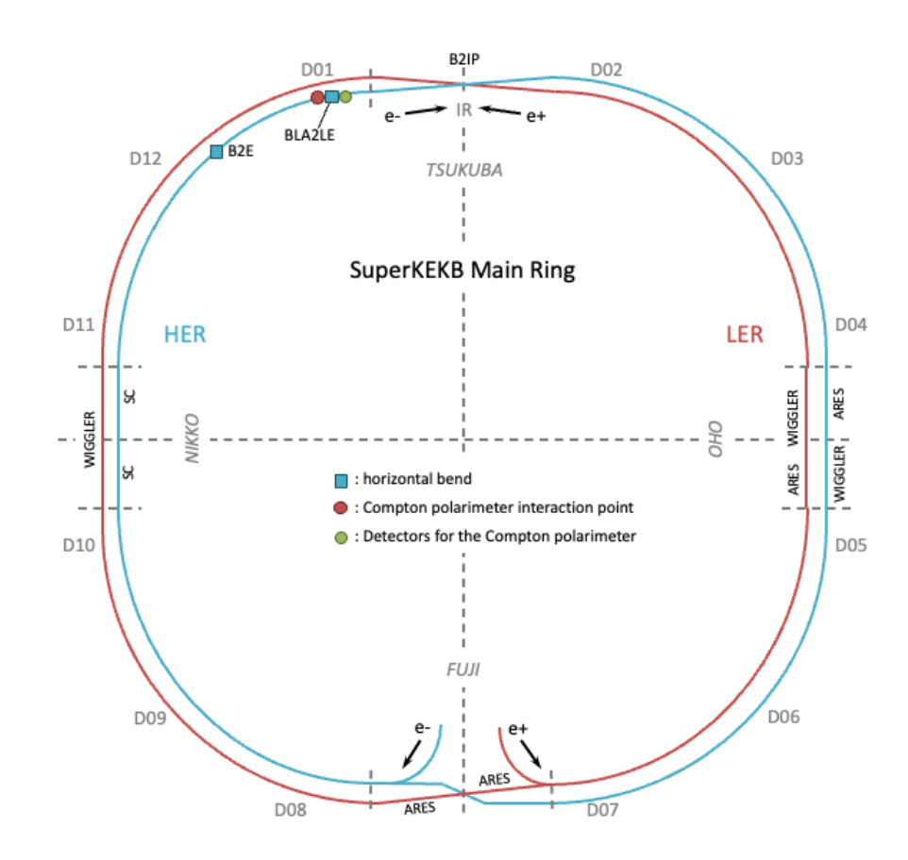
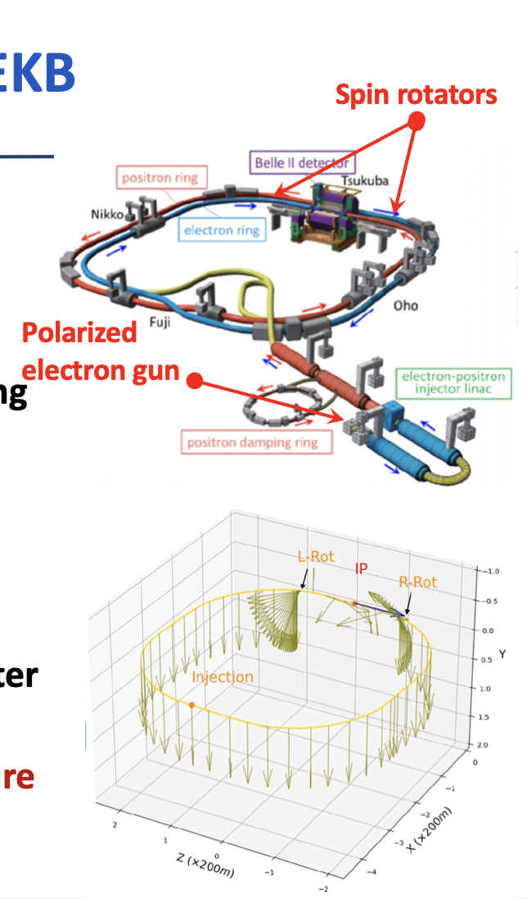
SuperKEKB polarization upgrade
Compton polarimeter
See Belle II upgrade framework CDR arXiv:2406.19421; M. Roney talk at ICJHEP 2024
Only for electrons
Beam transport of polarized beam
Top-up injection at nominal energy
Spin rotators (combined function magnets from BNL)
Preservation of polarization

Slide 3
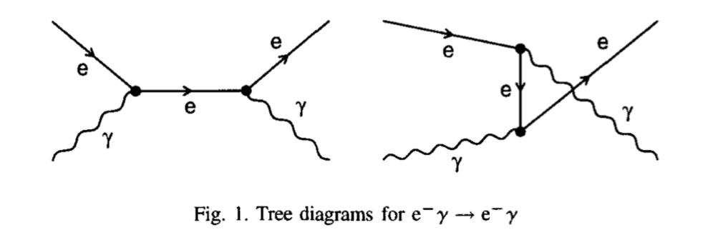
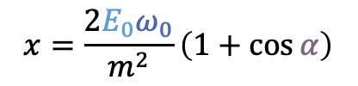
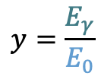

Compton scattering
$$x=\frac{2E_{0}ω_{0}}{m^{2}}\left(1+\cos{α}\right)$$
$$y=\frac{E_{γ}}{E_{0}}$$
The Compton cross-section averaged over scattered particles spins:
Differential cross-section
Linear laser polarisation: nuisance parameter to minimize and keep under control
Transverse electron beam polarisation: intervenes as an asymmetry in the transverse plane
Berestskii & Lfshitz QED textbook
$$\frac{dσ}{dydφ_{obs}}\left(x,y\right)=\frac{dσ_{0}}{dy}\left(x,y\right)+\frac{dσ_{L}}{dy}\left(x,y\right)\cos\left(2\left(φ_{obs}−φ_{las}\right)\right)𝒫_{L}^{las}+\frac{dσ_{∥}}{dy}\left(x,y\right)𝒫_{C}^{las}(P_{T}f_{T}\left(x,y\right)\cos\left(φ_{obs}−φ_{elec}\right)+P_{z}f_{z}(x,y))$$
Electron beam polarization independent
Electron beam polarization dependent
$$\frac{dσ}{dy}(x,y)≅\frac{dσ_{0}}{dy}\left(1+{𝒫_{z}𝒫_{C}^{las}A}_{LR}\right)$$
What we want to measure
Expected polarization orientation at Compton IP longitudinal and parallel to that of Belle II IP !
⚠️ But small opening angle of scattered particles:
  Transverse polarimetry is more difficult to implement wrt longitudinal polarimetry

Slide 4
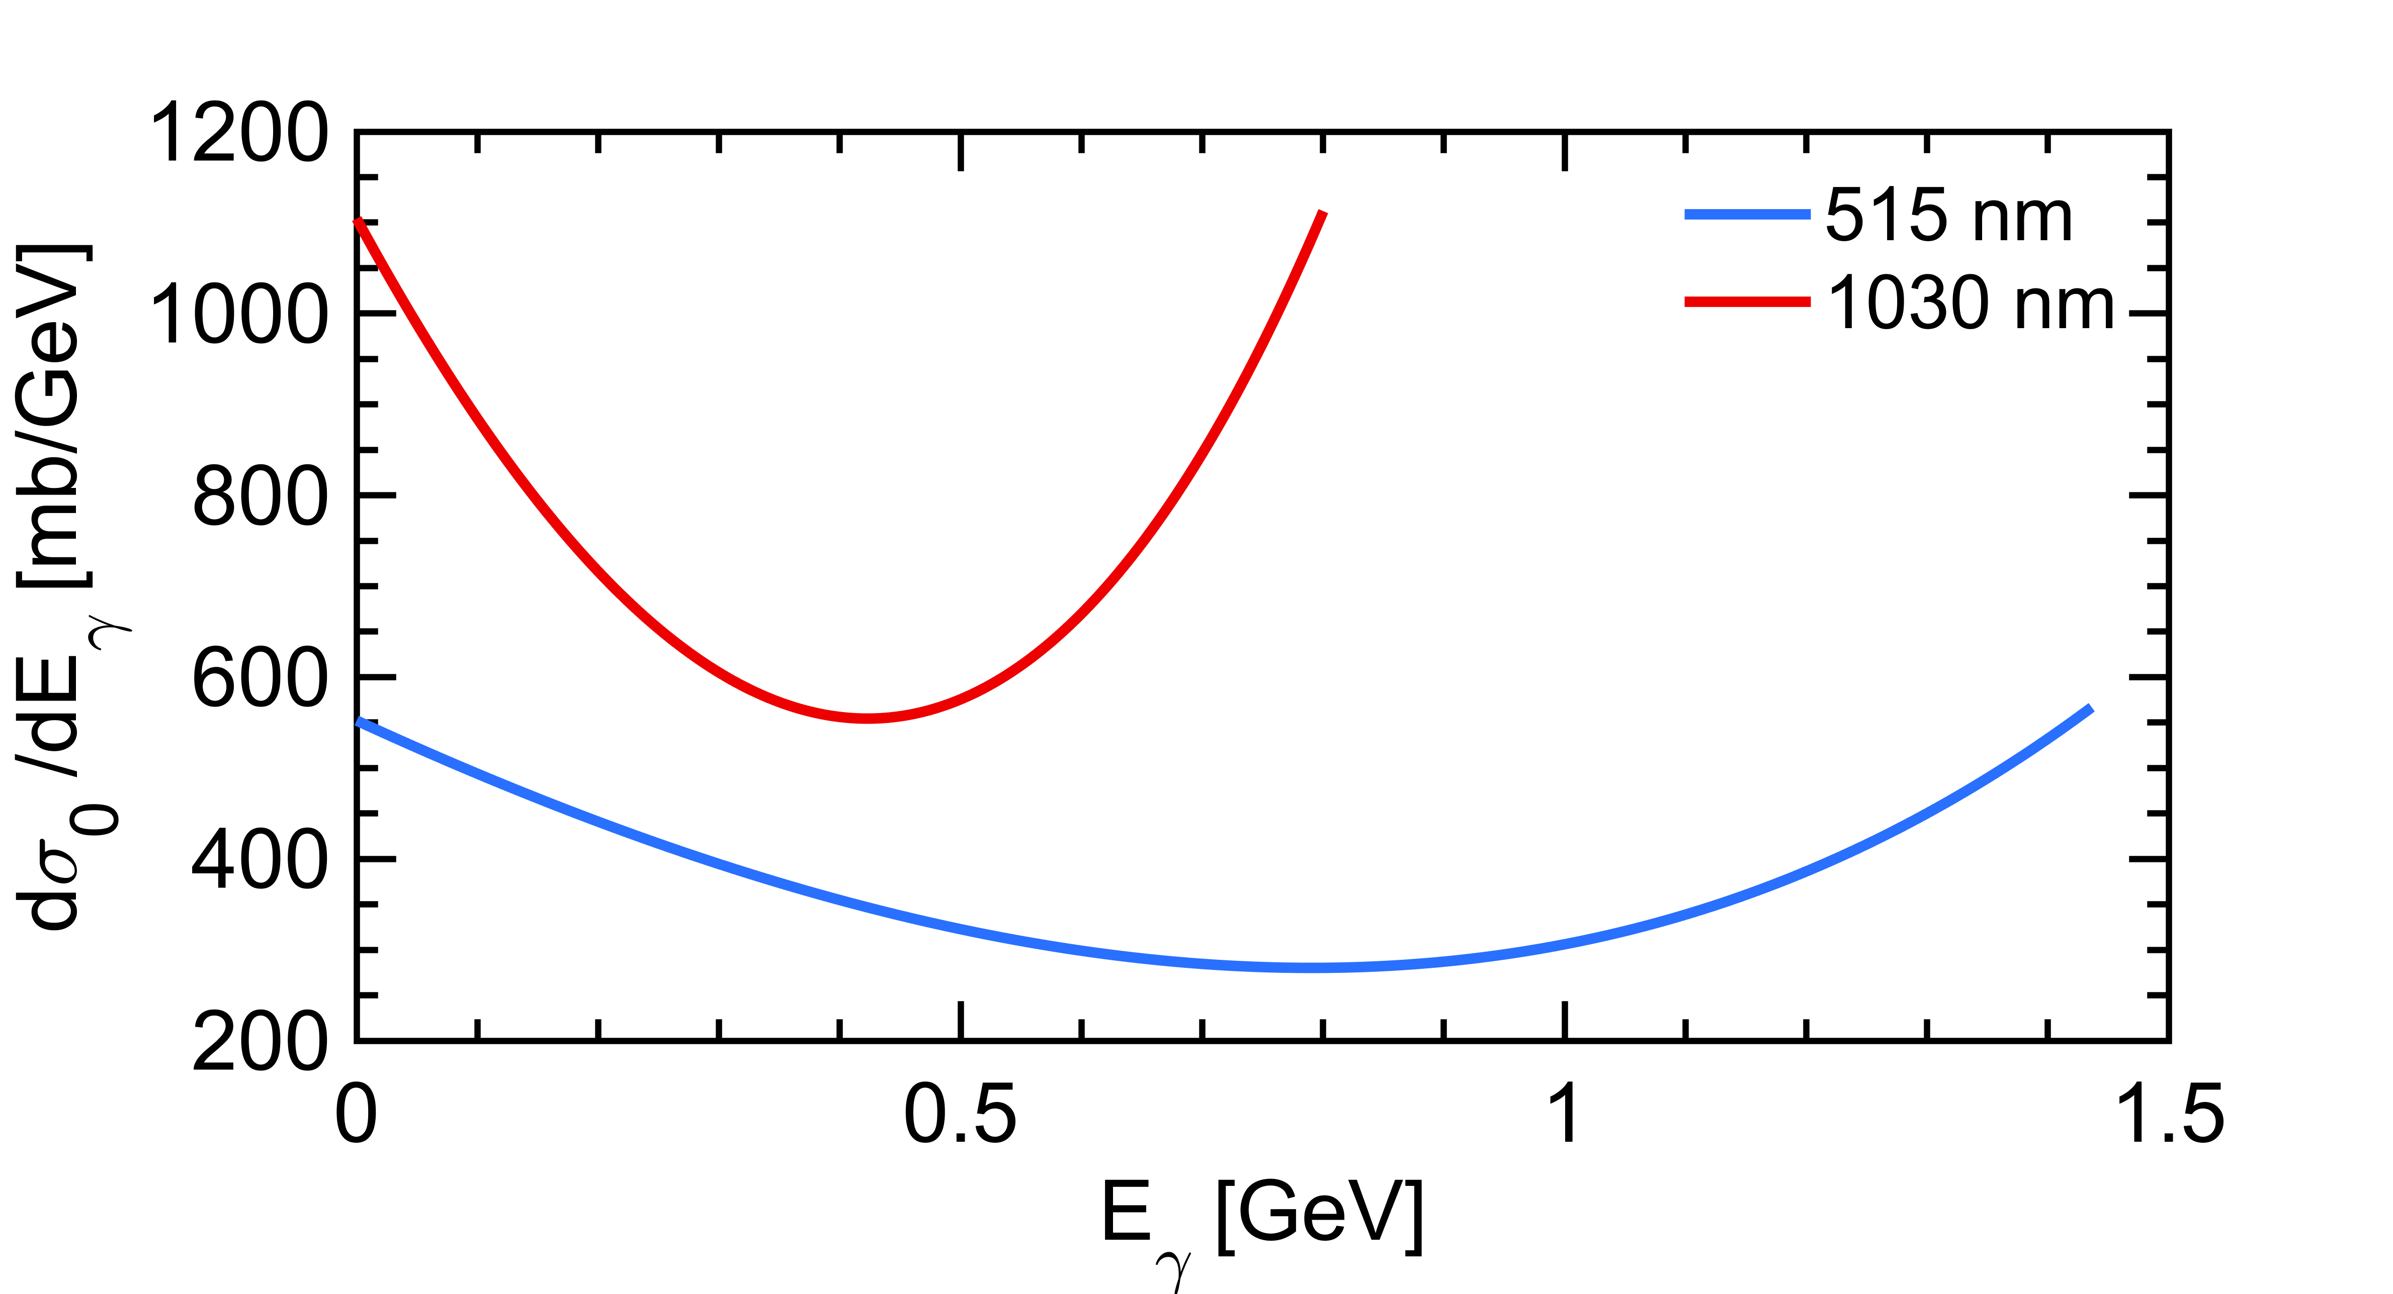
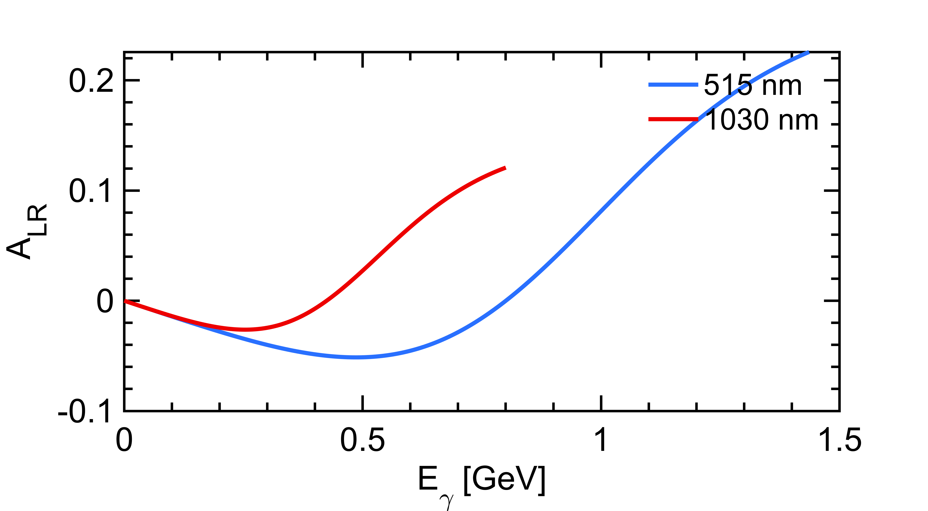
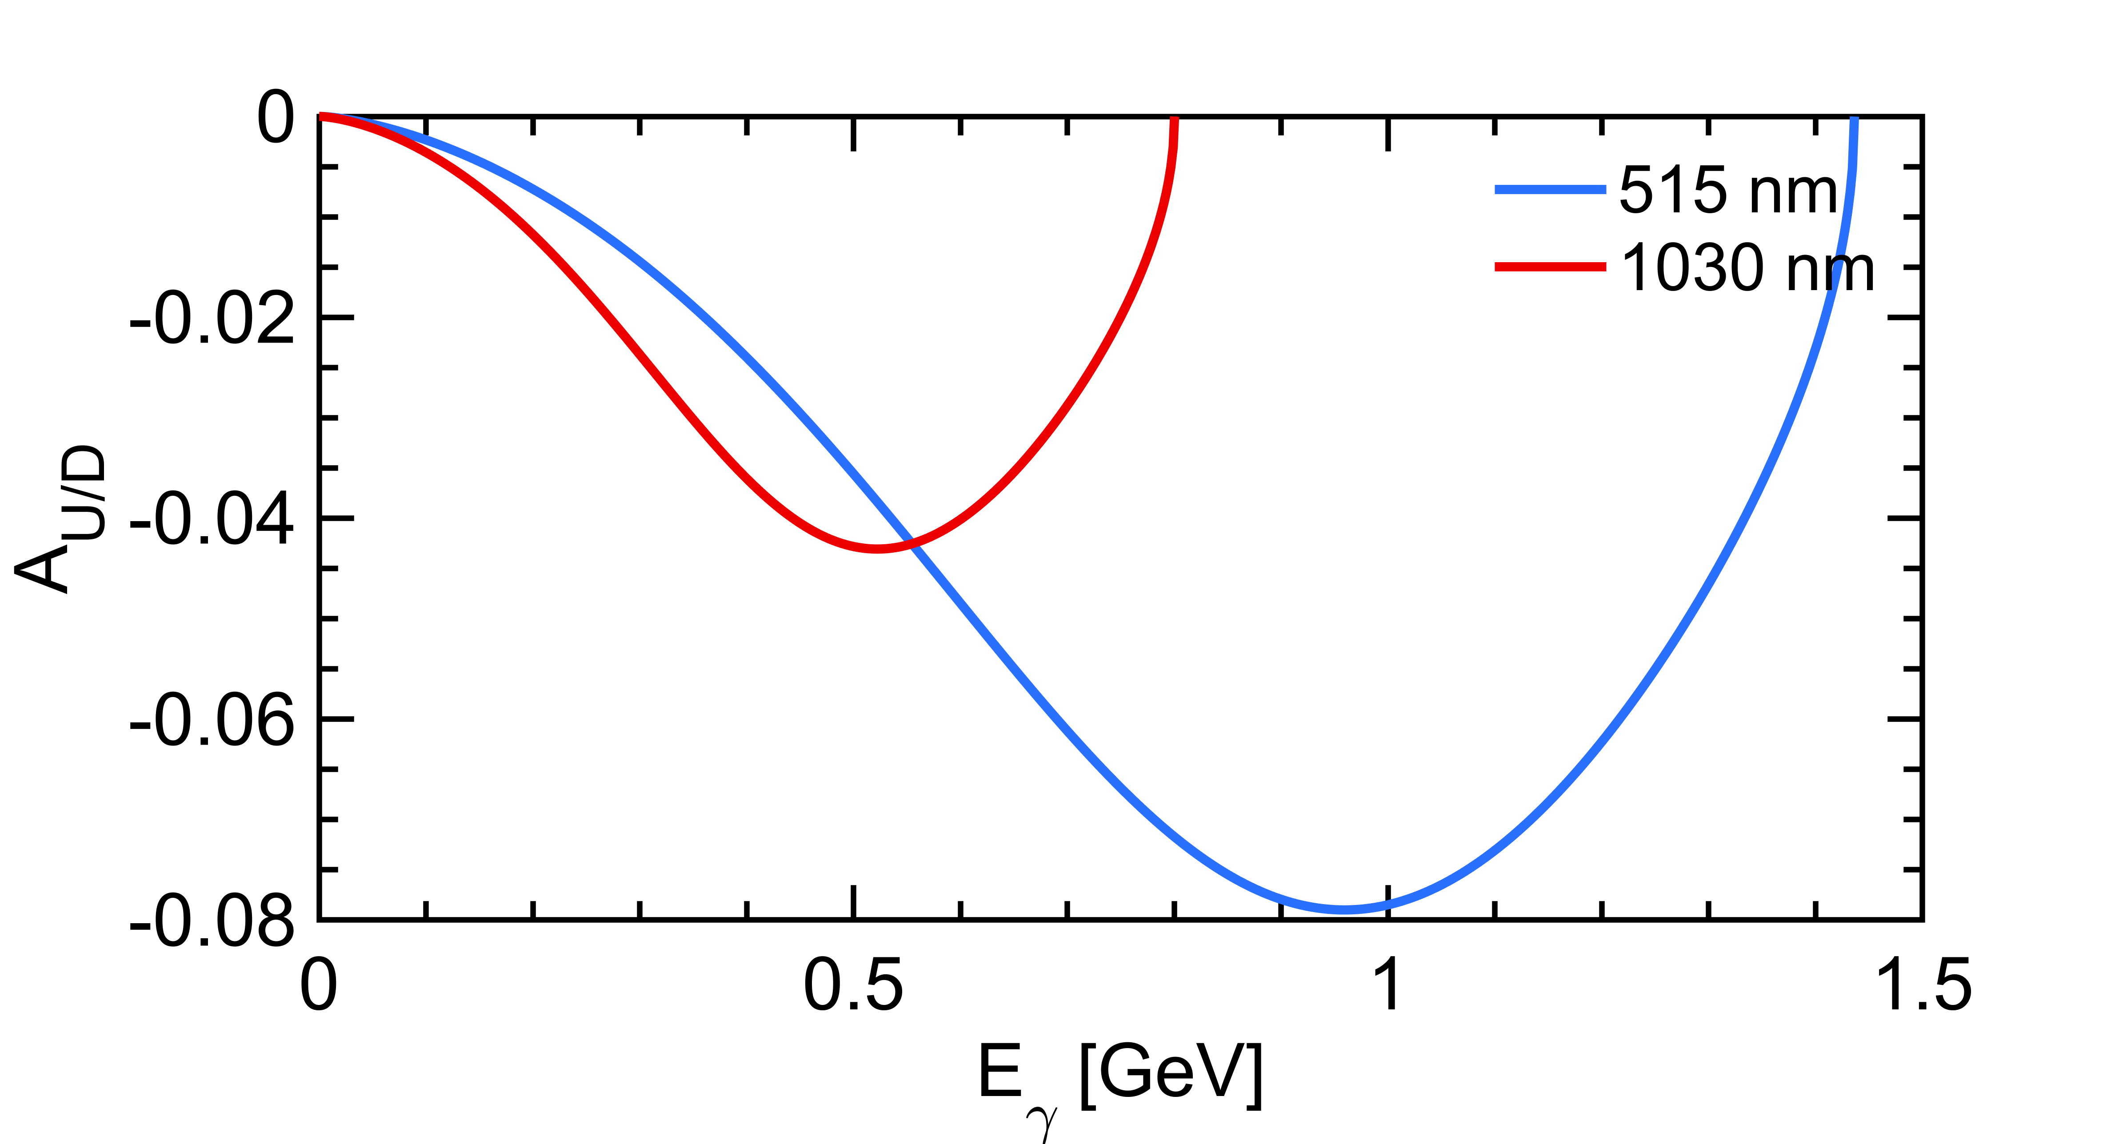


Compton polarimetry
$$\frac{dσ}{dy}(x,y)≅\frac{dσ_{0}}{dy}\left(1+{𝒫_{z}𝒫_{C}^{las}A}_{LR}\right)$$
$$\frac{dσ}{dy}(x,y)≅\frac{dσ_{0}}{dy}\left(1+{𝒫_{T}𝒫_{C}^{las}A}_{UD}\right)$$
Polarization dependent term generates a left-right asymmetry function of $E_{γ}$
Landau-Lifshitz QED book paragaphs 86 and 87
Use green (~515nm) laser
Concentrate on measurement of scattered photon
Electron measurement difficult (integration, quads in the beam line)

Slide 5
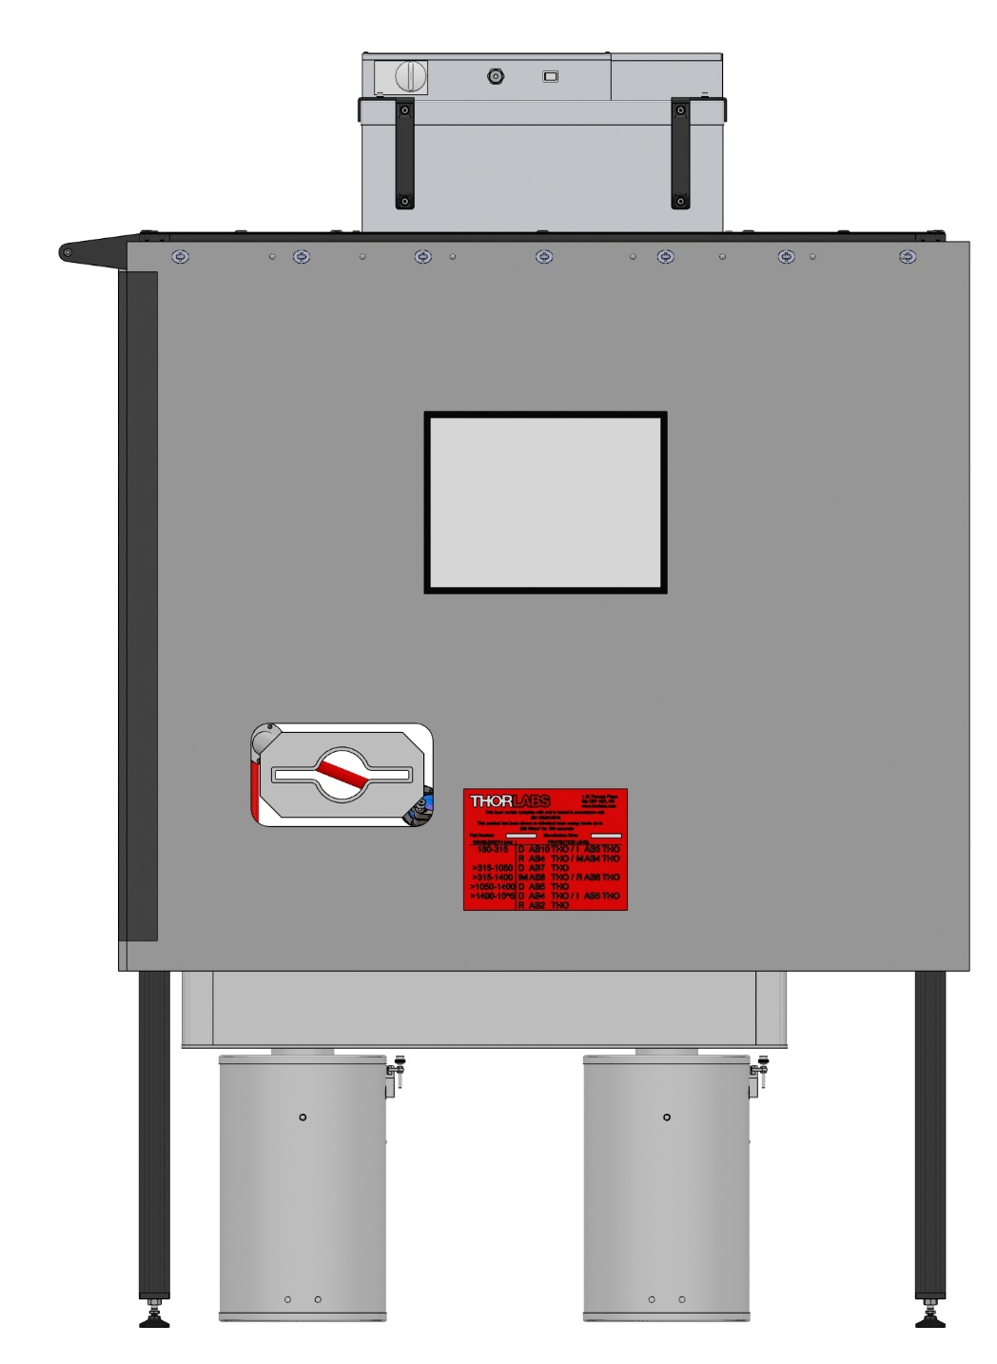
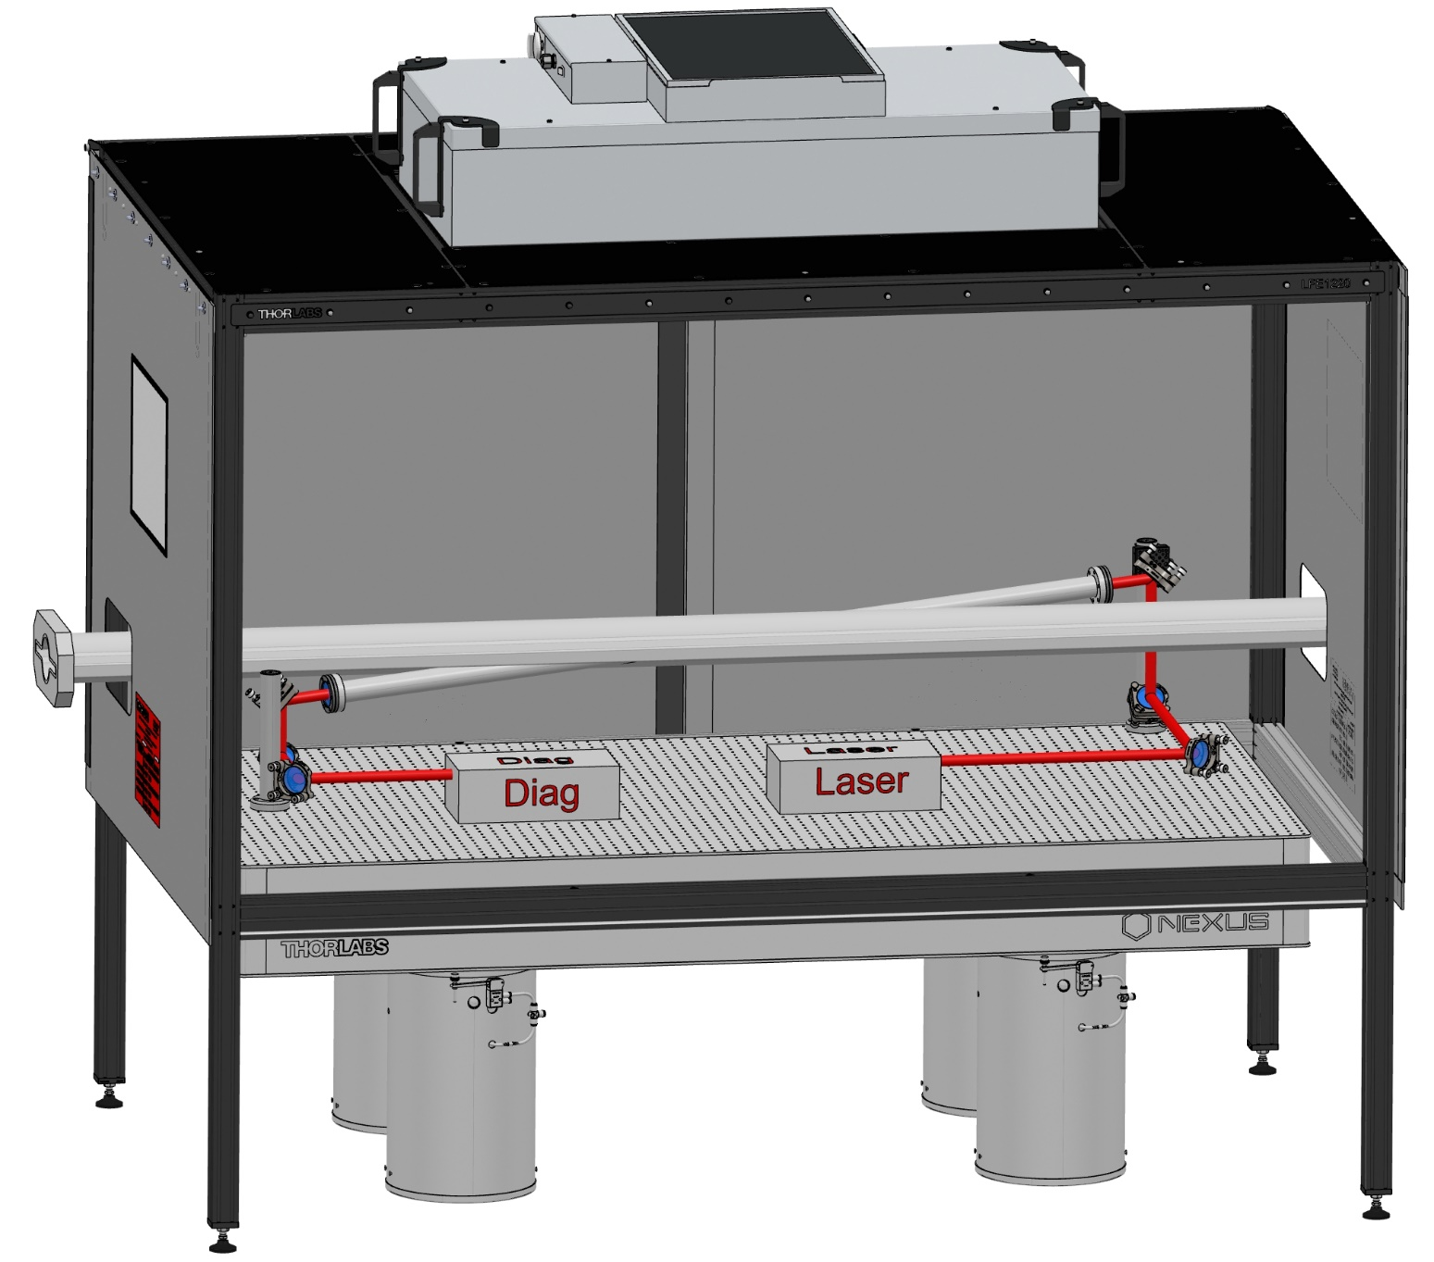
Mechanical system integration
D. Charlet et al., 2023 JINST 18 P10014
910 mm
450 mm
Crossing Angle Horizontal : 8 deg
Crossing Angle Vertical : 4 deg
+ some neutron + lead shielding around electronics to be located below the table
+ some lead shielding around the table to protect the laser

Slide 6
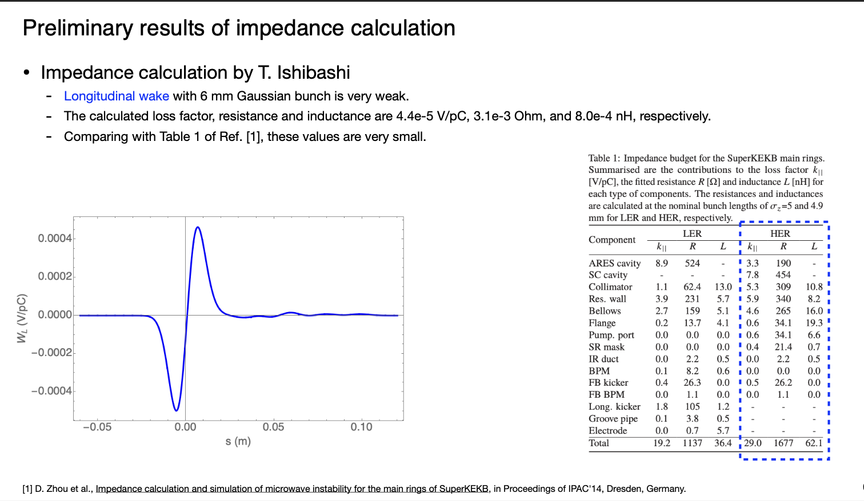
Beam impedance (longitudinal)
Zhou, Ishibashi

Slide 7
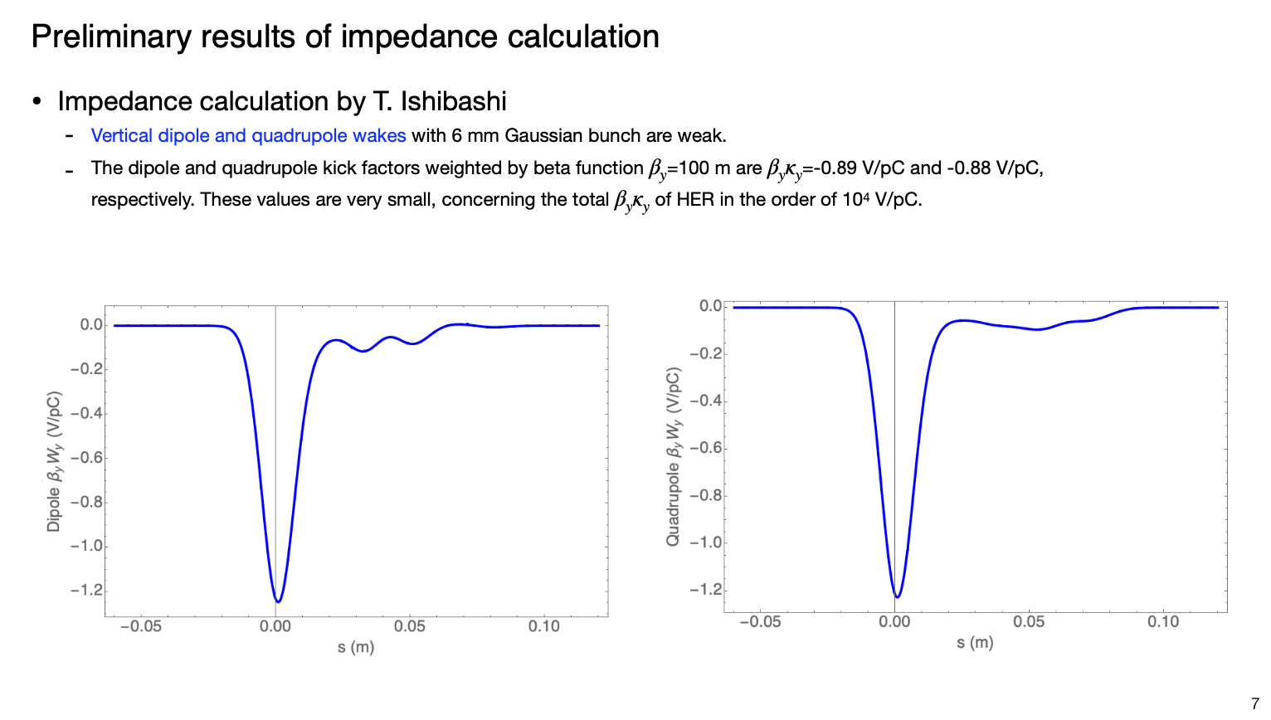
Beam impedance (vertical)
Zhou, Ishibashi

Slide 8
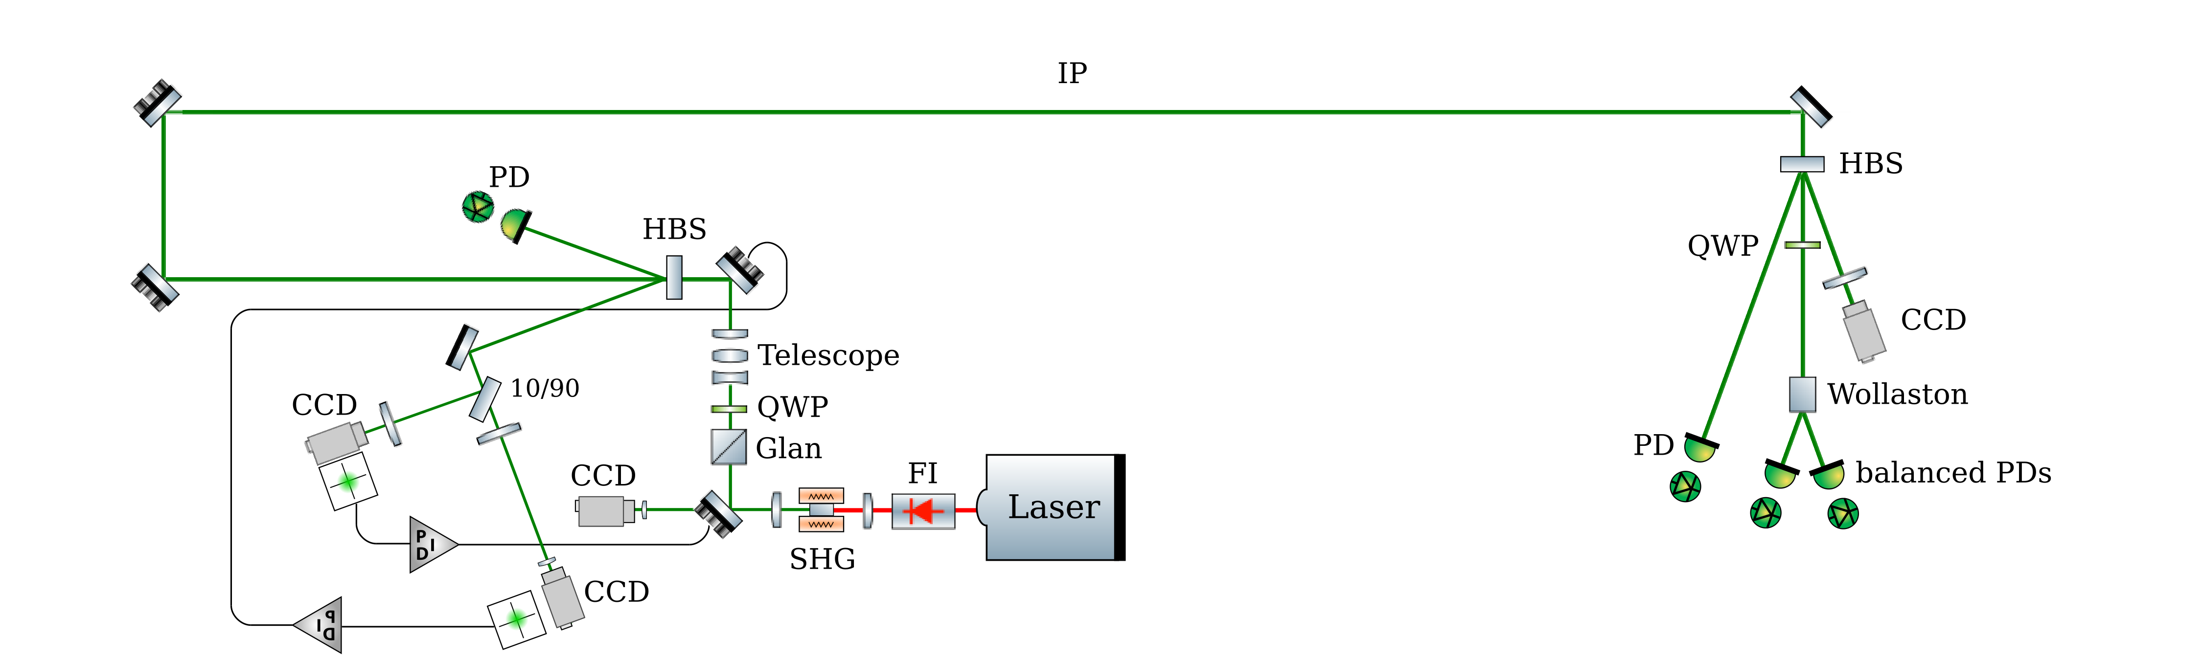
Laser system
Possibility to insert mirror for laser polarization calibration
250MHz
D. Charlet et al., 2023 JINST 18 P10014
Box with rough temperature control
Box with rough temperature control
design based on past experience
Elliptic beam can be delivered with cylindrical lenses/mirrors (not planned for a first step)
Key aspect: remote operation of the system that will be located in the tunnel
Possibility to synchronize the laser on the RF clock of the accelerator using the WhiteRabbit+IDROGEN technology under experimental investigation at IJCLab

Slide 9
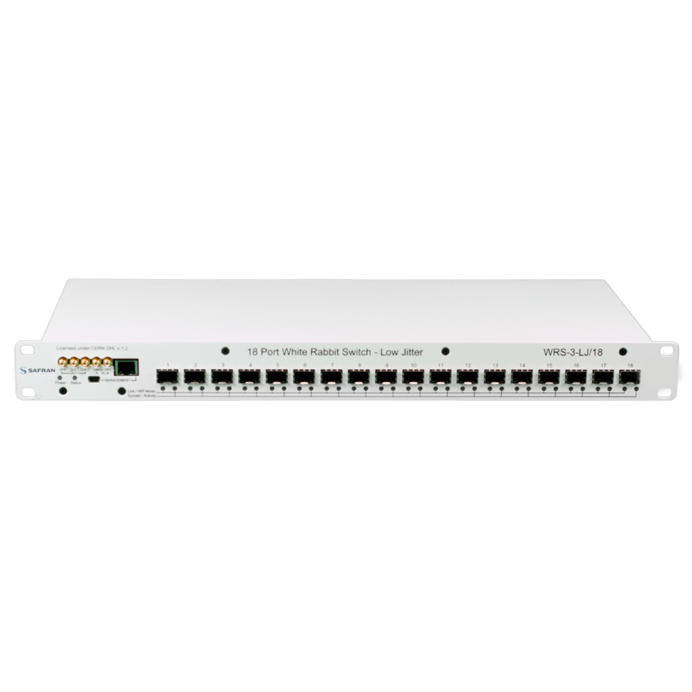
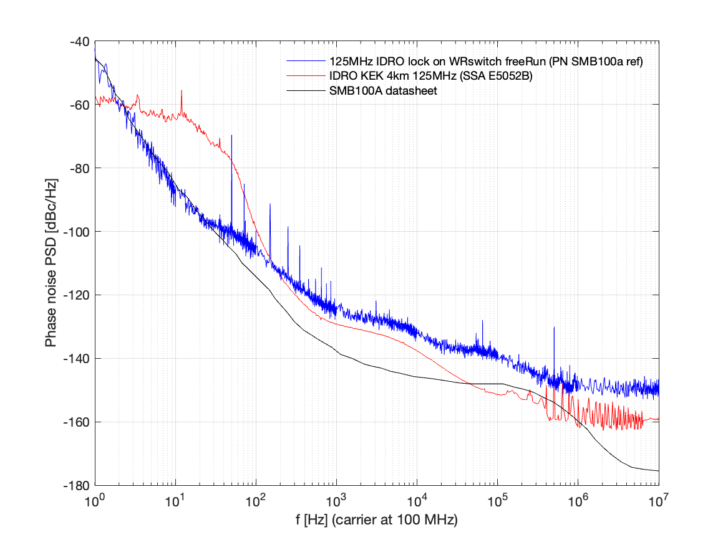
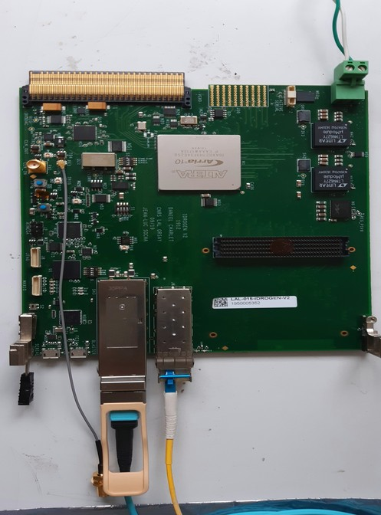
WhiteRabbit/IDROGEN synchronisation
H. Kaji, D. Charlet
Master Oscillator (510MHz/51)
WhiteRabbit
IDROGEN, high speed DAQ
Low noise WR node
June’24
D. Charlet et al., https://cds.cern.ch/record/2893372?ln=en
Sept’24
4km fibre link
4km optical link does not affect noise performance
→ Possible low impact/cost integration of laser frequency control
RMS time jitter <500fs above 30Hz
Demo with laser expected soon

Slide 10
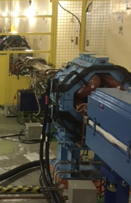
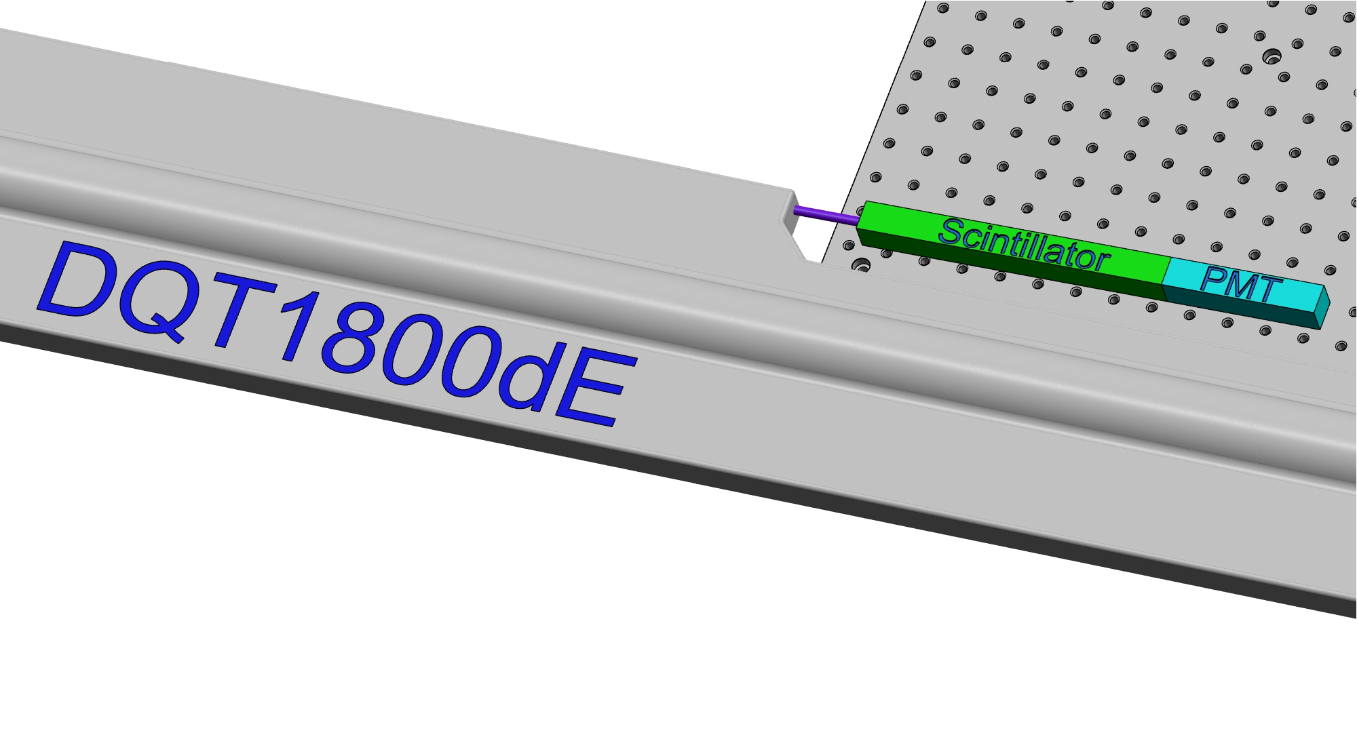
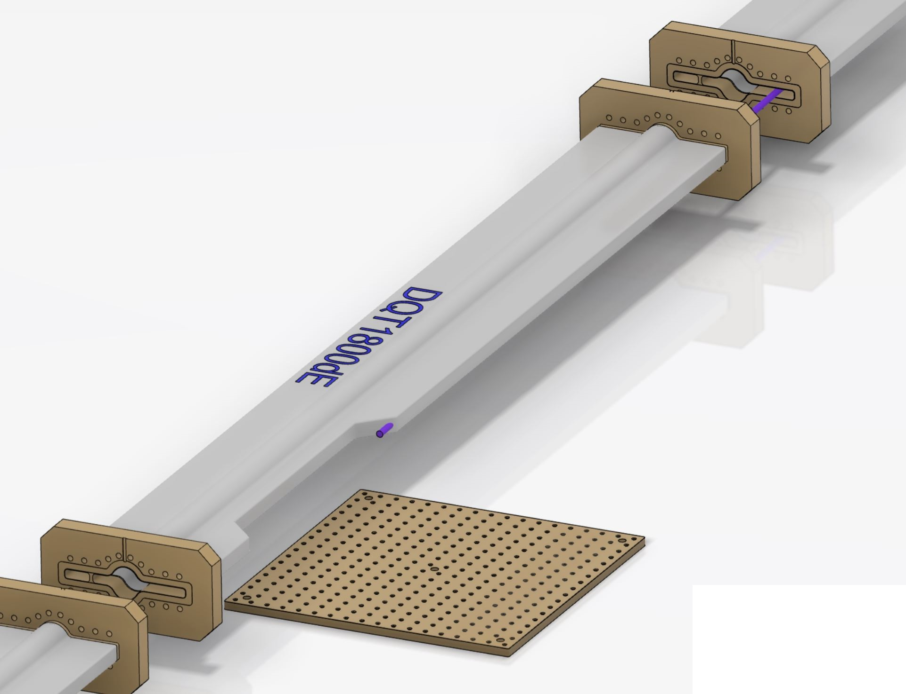
Photon detector integration
‘minor’ modifications of beam pipe modification (validated for impedance)
Beam pipe at ~1m from ground
Electronics can be located and shielded on ground below scintillator +PMT
Xray out : 210 µrad
≈ Ø6 mm at 14,5 meters
BreadBoard 450x450 mm²

Slide 11
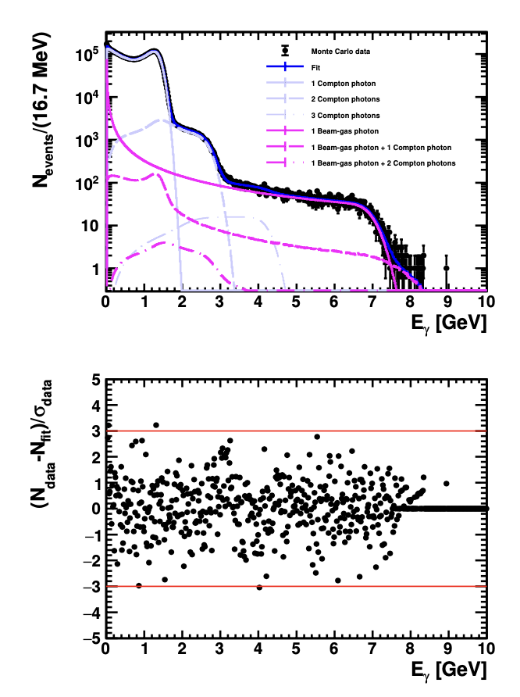
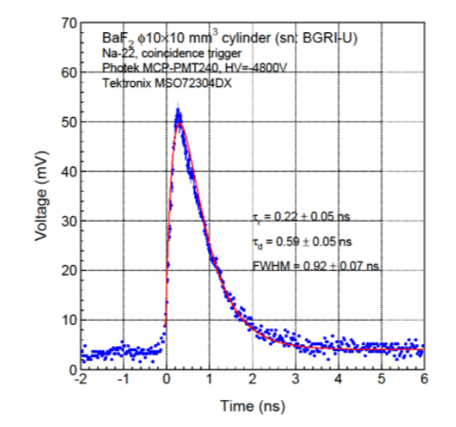
Single channel photon detector
Basic elements
  a VERY FAST radhard scintillating crystal → BaF2
    Need to filter out the slow component → UV optical filters
  a PMT with low transit time dispersion → commercially available (hamamatsu for instance)
  Bunch/bunch measurement
…
Energy measurement
2500 histograms
Currently ‘waiting’ for funding
External collaborators welcome

Slide 12
Conceptual acquisition chain
Optical filter
BaF2
PMT
2500 histograms
Fast treatment: fit
Every 4ns
FPGA
IDROGEN board
White Rabbit node
Reduced data
To online monitoring
Analog Front-end
+ ADC (>=10bits)
clock
To remote storage (10MB/min)
Update program, constants
1rst Bunch identifier
Accelerator RF

Slide 13
Expected performance
Fast simulation
D. Charlet et al., 2023 JINST 18 P10014
Statistical precision: 1%/bunch every 5min
NB: fit can be performed in 1min for the 2500 bunches assuming few nuisance parameters known and fixed (calibration can occur from time to time)

Slide 14
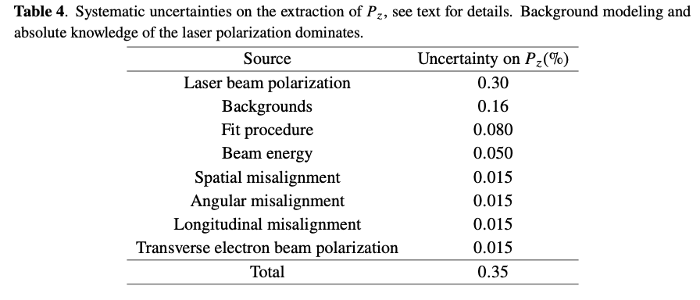
Expected performance
D. Charlet et al., 2023 JINST 18 P10014
Systematic uncertainty related to beam transport from Compton IP to Belle 2 IP need to be evaluated → misalignements in beam transport

Slide 15
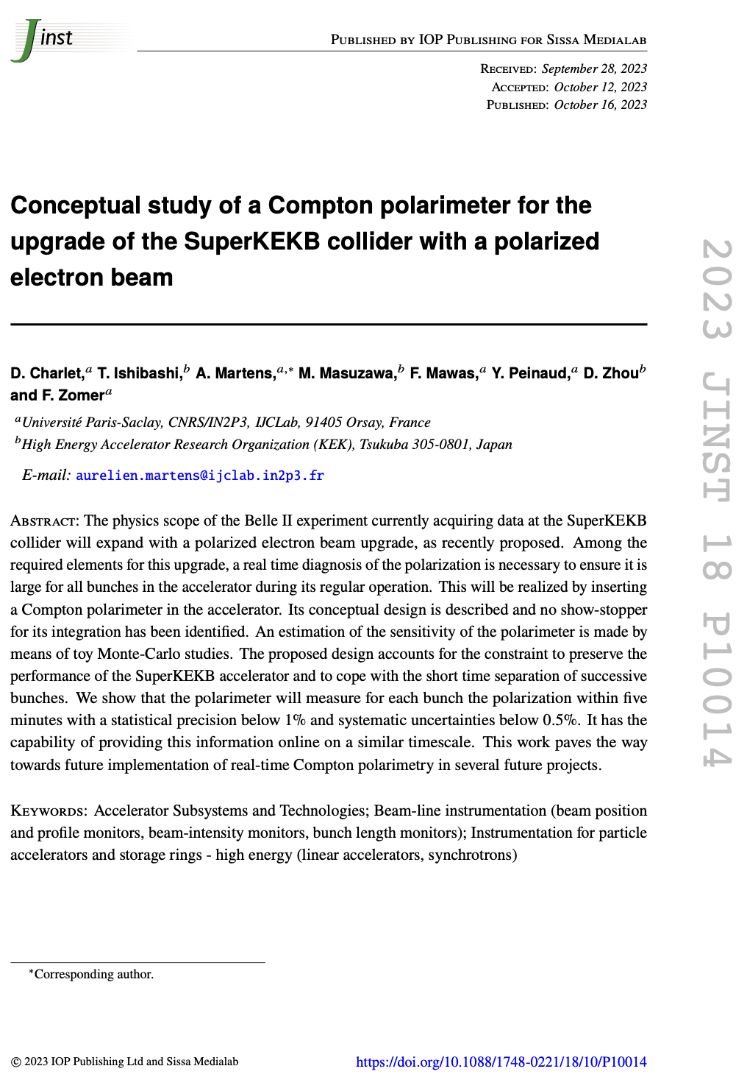
Conclusion & Prospects
SuperKEKB upgrade with electron beam polarization is a challenging project
  Existing machine → minimize modifications
  Goal for ‘transparency’ of upgrade
Longitudinal Compton polarimeter can be inserted in the existing lattice with no impact on impedance
  Bunch/bunch
  1% precision /bunch every 5min
Design of laser system, pipe modifications and detector concept available
Synchronization tests ongoing (use of WhiteRabbit technology)
Detector development will start as soon as funding is available
Open to new collaborators

Slide 16
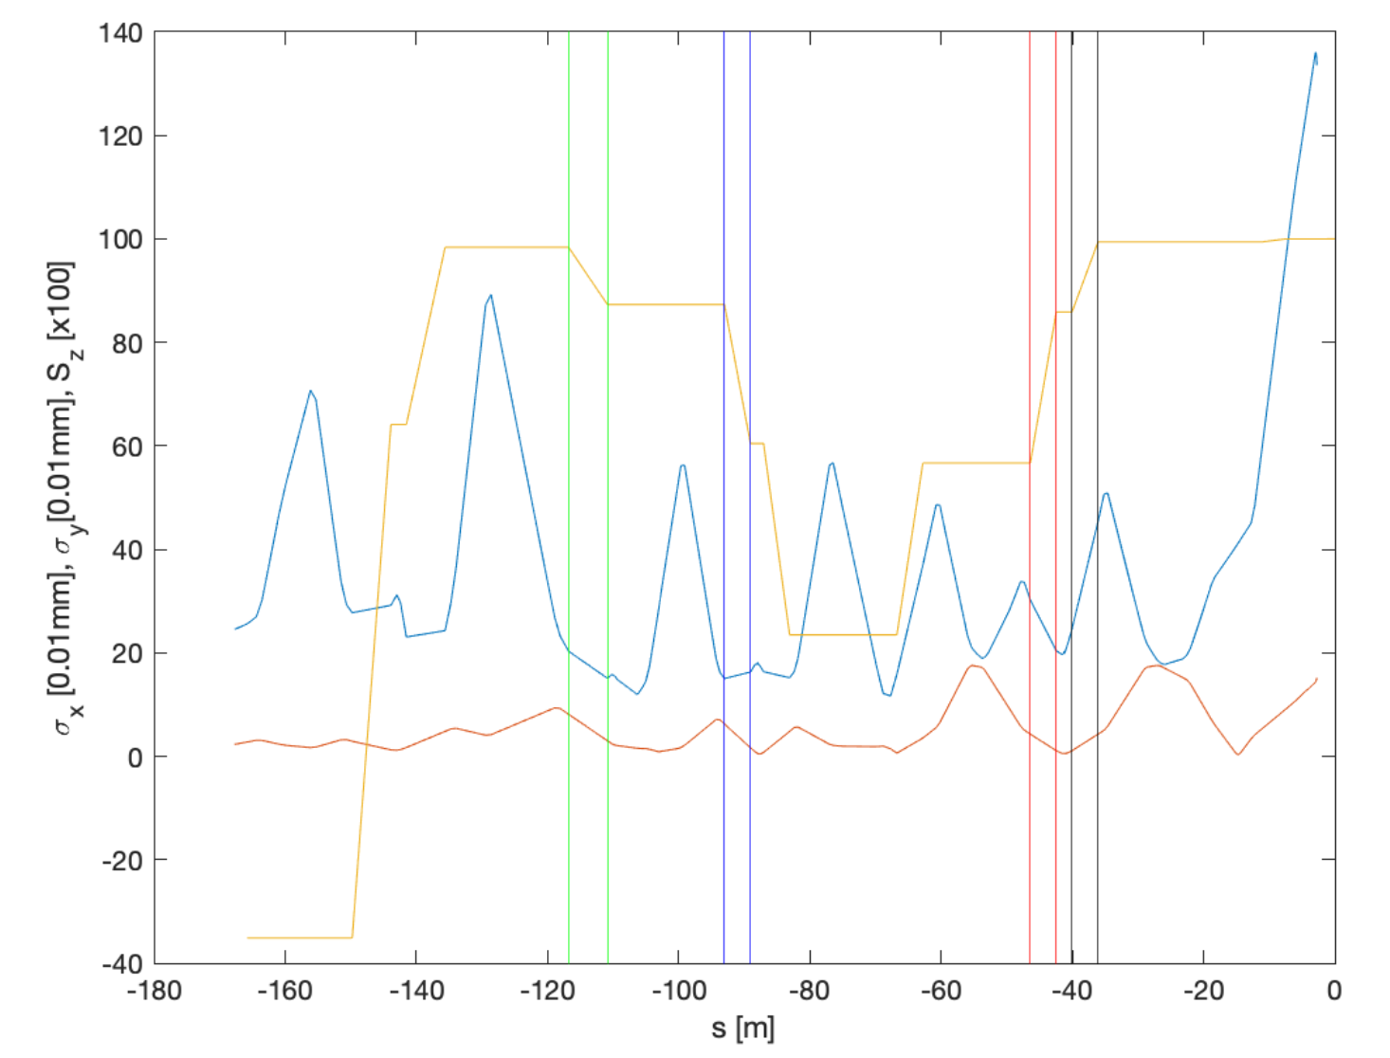
Expected beam polarization at Compton polarimeter
Location of Compton IP
Spin orientation longitudinal
And // to that of Belle II IP !
Snowmass document: arXiv:2205.12847
Elliptical beam size

Slide 17
Integration
Spin rotators planned to be installed far away from Belle II IP
→ a nice place before BLA2LE where polarization is longitudinal and enough free space
→ polarimeter data is representative of polarization at Belle II IP (up to magnet mislalignments)
Photon detection
Laser/e-beam interaction point
BLA2LE

Slide 18
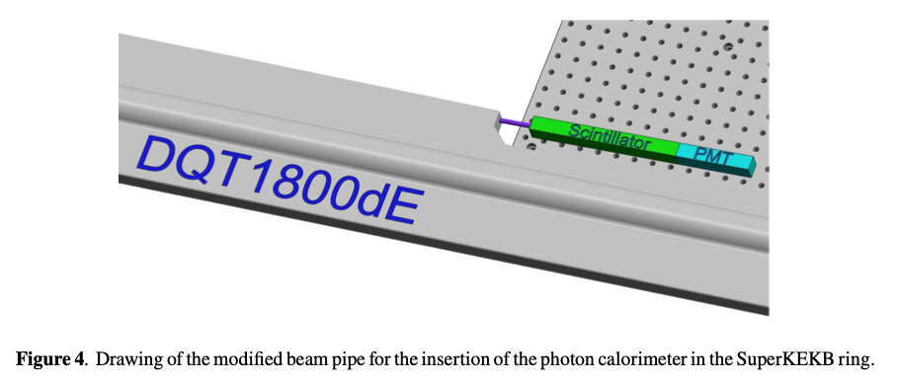
Conceptual design
A summary of the conceptual studies performed for the laser system and the scattered photon detector has been published recently
A summary of the results is inserted in the current CDR draft

Slide 19
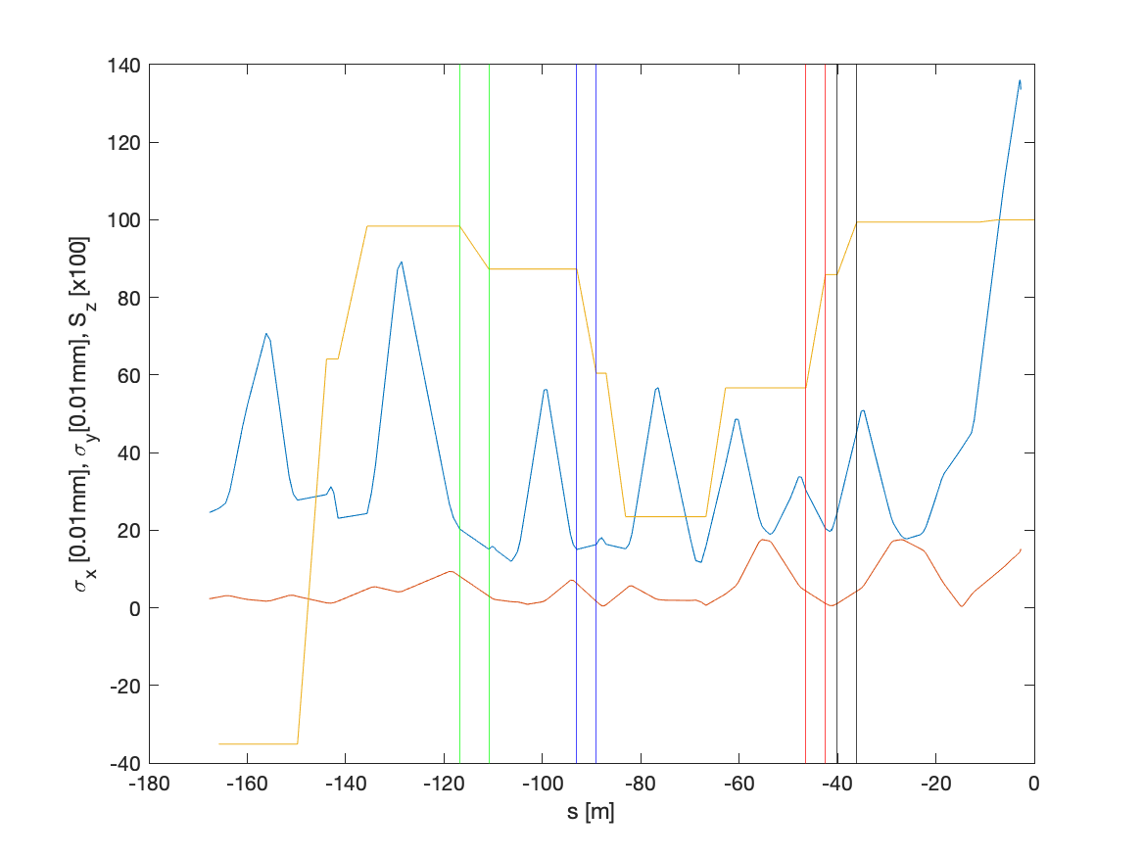
Beam sizes and spin projection in z
Using Y. Peng data, https://indico.belle2.org/event/5306/
BLA2LE
BLX2LE.2
BLY1LE.1/2
99% of the IP Sz
85% of the IP Sz
55% of the IP Sz

Slide 20
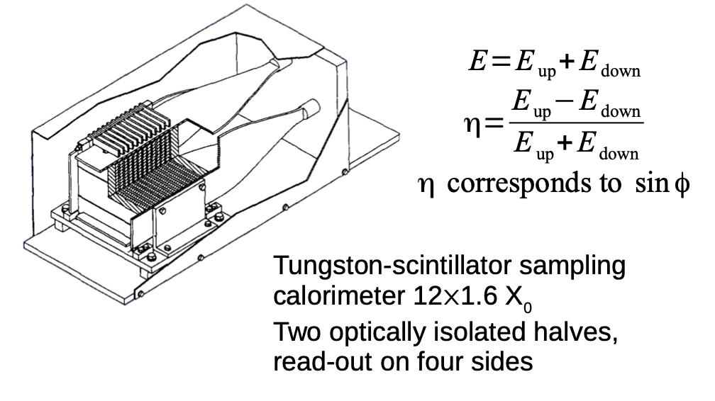
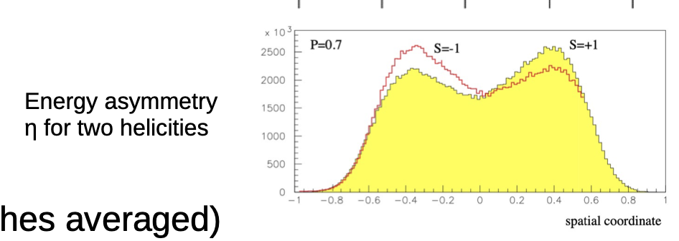
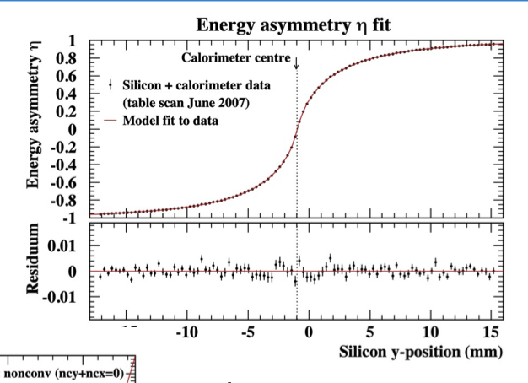
Transverse polarimetry at HERA
https://indico.cern.ch/event/1181966/contributions/5046178/attachments/2512013/4318517/220905_tpol.pdf
Exactly the operation that was done at HERA TPOL a long time ago.
Notoriously a difficult task but ‘do-able’
Requires detailed simulations
Requires some transverse sampling (not easy for photons)
Eased by implementing a nicely vertically segmented electron detector.

Slide 21
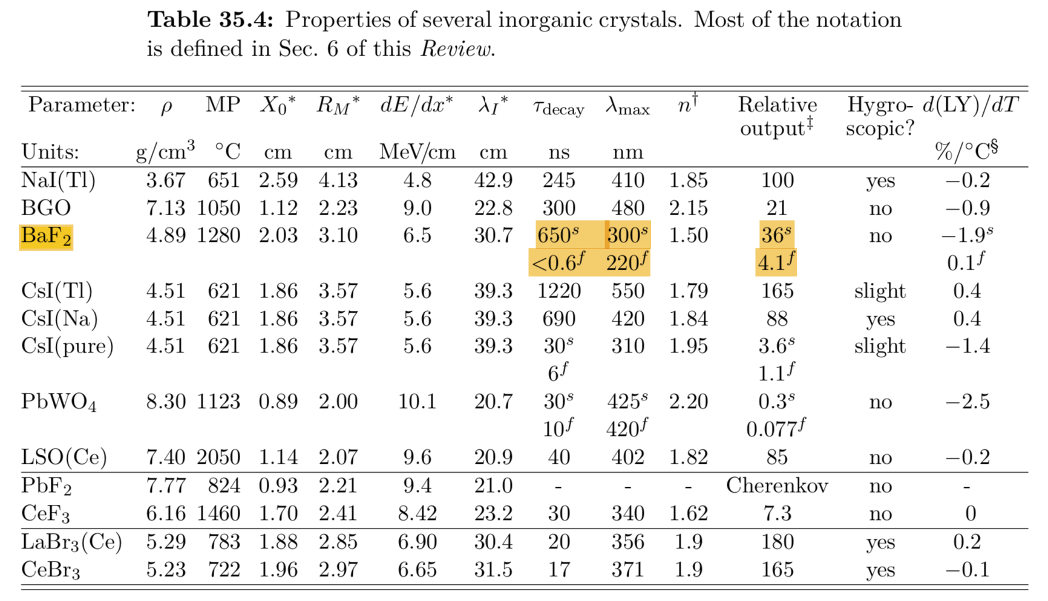
Choice of scintillating material
Basic elements
  a VERY FAST radhard scintillating crystal → BaF2, the only solution ?
  Filter for the slow component
  a PMT with low transit time dispersion (AND solar blind ?) → commercially available ?
  Associated electronics

Slide 22
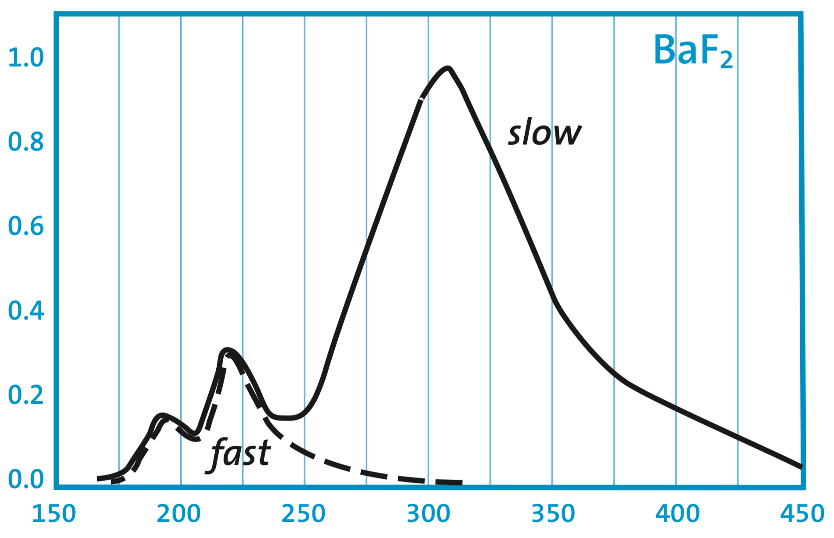
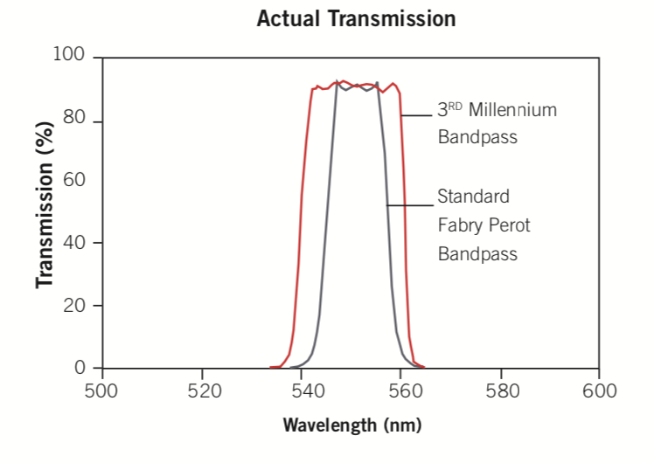
Slow component filtering
From Saint-Gobain datasheet.
Long tail → pile-up
Requires subtraction (in average), but fluctuations remain → spoil resolution
Solar blind photocathodes (CsTe) only reduce the. Slow component such that is amounts about 50% of the final light yield
Stefan Diehl et al 2015 J. Phys.: Conf. Ser. 587 012044
Use UV optical filters instead→commercial products exist for instace at 185nm +- 20nm (FWHM)
Y doped BaF2 being investigated

Slide 23
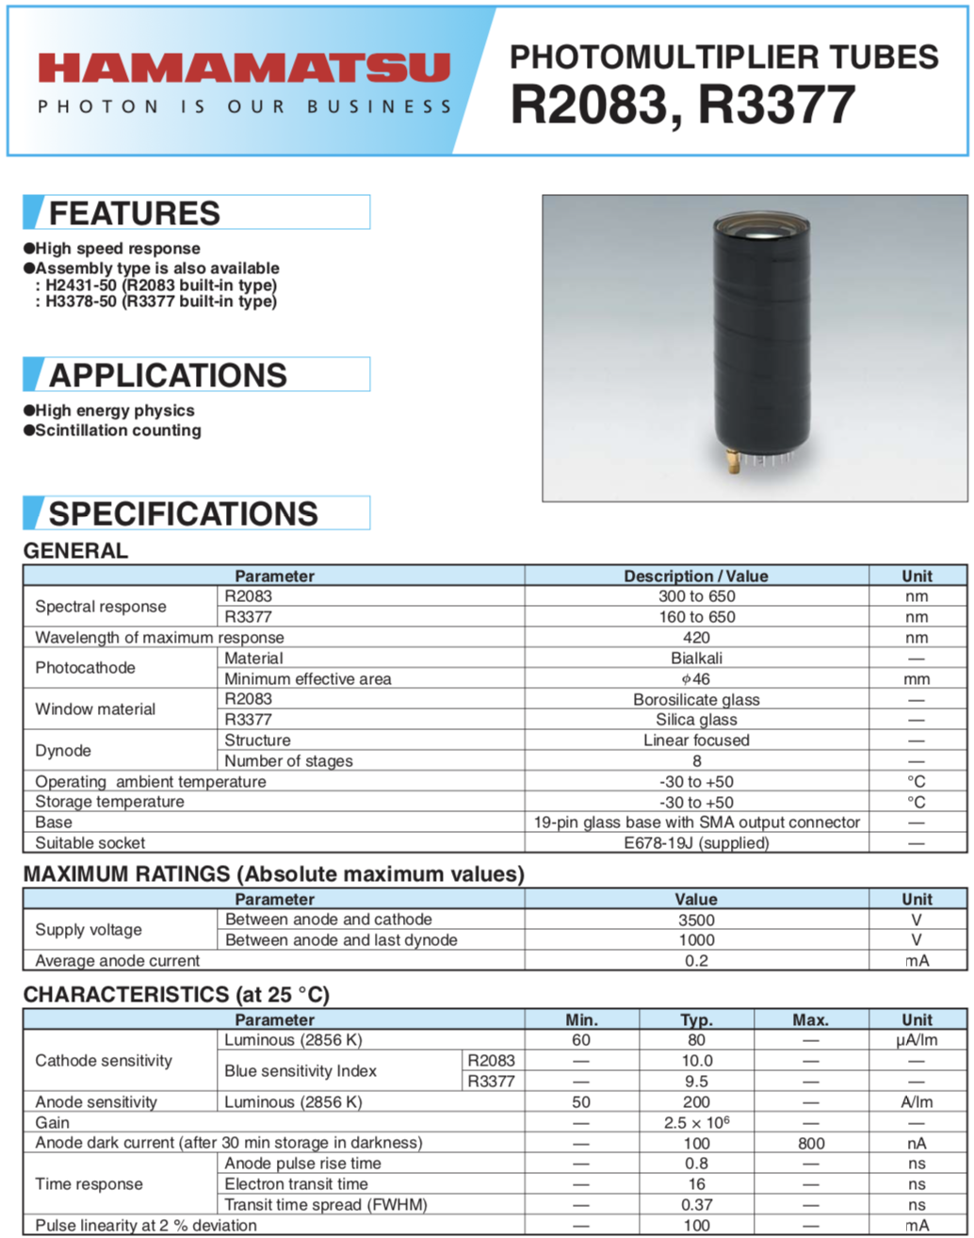
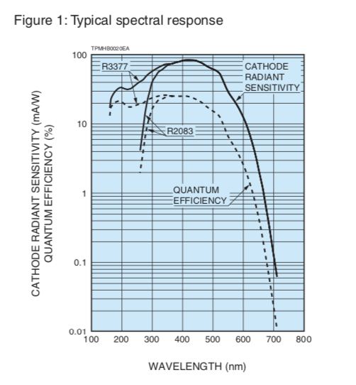
PMT
Main requirements: fast (low rise time, low transfer time spread) and not blind to UV.

