Slide 1
Precision Moller Polarimetry in Hall A at Jefferson Lab
Donald Jones
for the Hall A Moller polarimetry team
Sept. 2024
PSPT2024

Slide 2
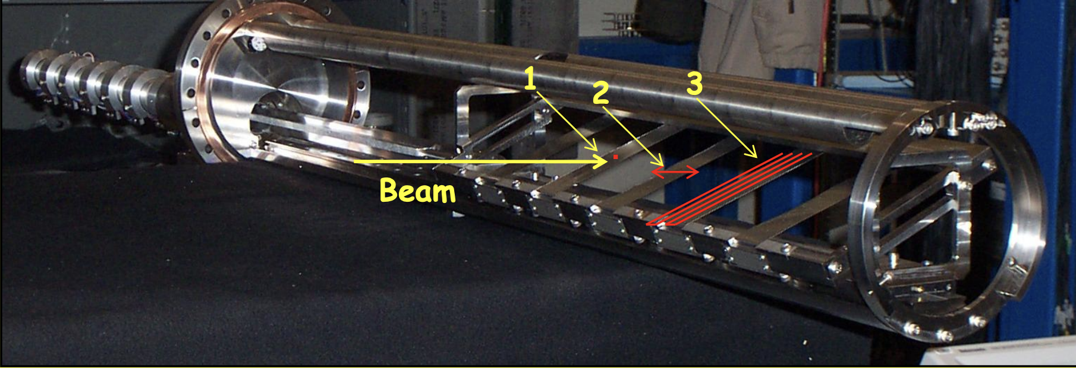
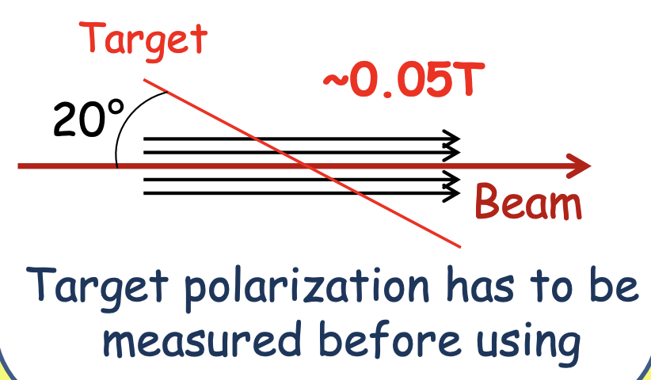
History of Moller polarimetry in Hall A
The Moller polarimeter in Hall A was installed in the late 1990s using polarized ferromagnetic foils (max polarization ~8%)
For the first decade tilted foil target was used
Polarization measured with pickup coils.
Early measurements having systematic errors >3% due to target polarization uncertainty
With lots of effort systematics reduced to 1.7% for HAPPEX-III but still dominated by target polarization
~0.024T

Slide 3
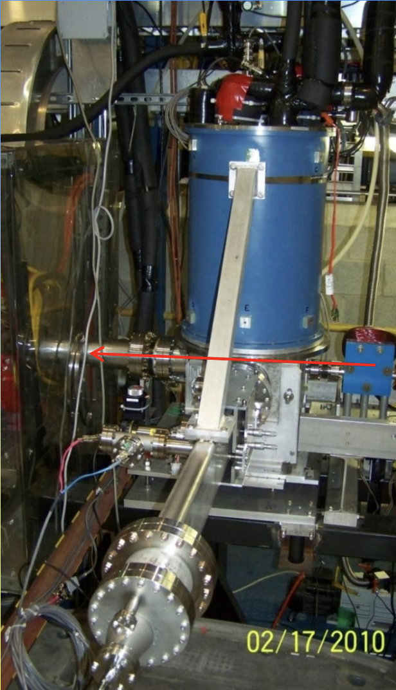
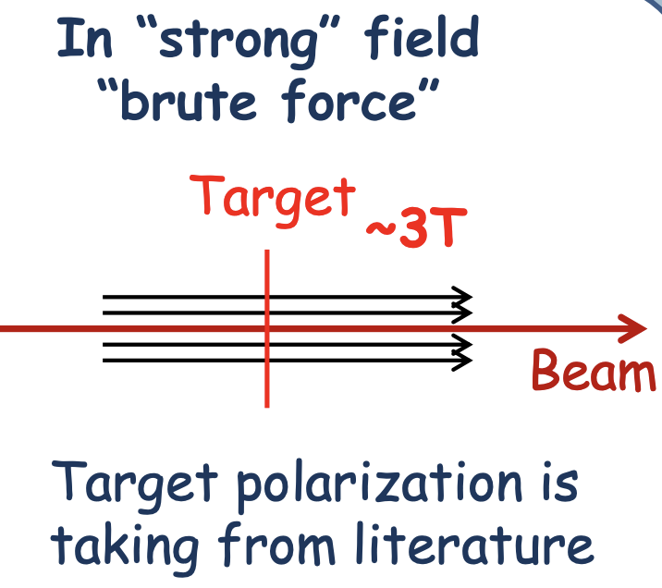
History of Moller polarimetry in Hall A
The Moller polarimeter in Hall A was installed in the late 1990s using polarized ferromagnetic foils (max polarization ~8%)
For the first decade tilted foil target was used
Polarization measured with pickup coils.
Early measurements having systematic errors >3% due to target polarization uncertainty
With lots of effort systematics reduced to 1.7% for HAPPEX-III but still dominated by target polarization
In 2009 new 4T magnet installed to polarize Fe foils out of plane along beam direction
Can achieve (in theory) full saturation
Polarization for pure Fe foils out of plane known to 0.24% at saturation magnetization
Reached 1.2% relative uncertainty during PREX-1
~0.24T

Slide 4
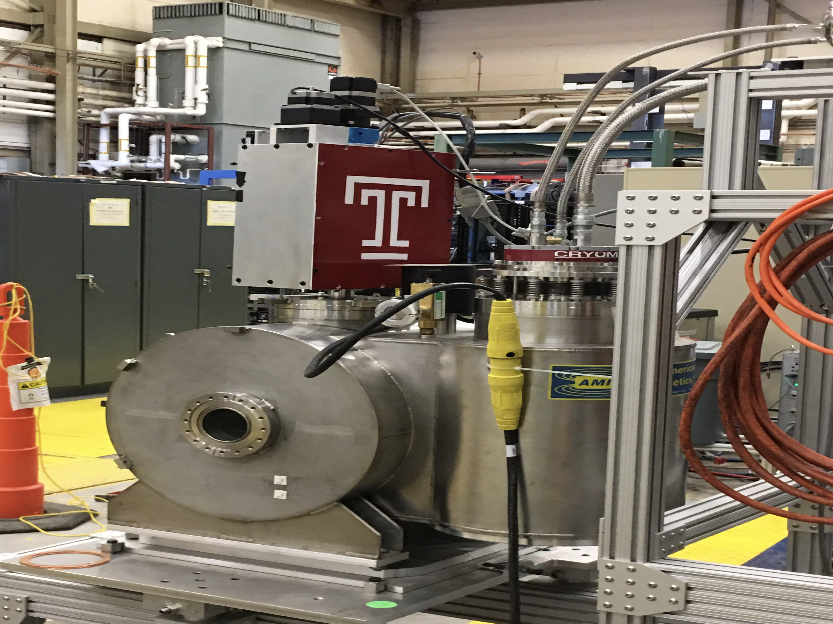
History of Moller polarimetry in Hall A
The Moller polarimeter in Hall A was installed in the late 1990s using polarized ferromagnetic foils (max polarization ~8%)
For the first decade tilted foil target was used
Polarization measured with pickup coils.
Early measurements having systematic errors >3% due to target polarization uncertainty
With lots of effort systematics reduced to 1.7% for HAPPEX-III but still dominated by target polarization
In 2009 new 4T magnet installed to polarize Fe foils out of plane along beam direction
Now can achieve (in theory) full saturation
Polarization for pure Fe foils out of plane known to 0.24% at saturation magnetization
Reached 1.2% relative uncertainty during PREX-1
In 2016 a new 5T self-contained superconducting Helmholtz coil magnet installed with a rotatable target ladder
Reached 0.85% systematic uncertainty for CREX

Slide 5
History of Moller polarimetry in Hall A
The Moller polarimeter in Hall A was installed in the late 1990s using polarized ferromagnetic foils (max polarization ~8%)
For the first decade tilted foil target was used
Polarization measured with pickup coils.
Early measurements having systematic errors >3% due to target polarization uncertainty
With lots of effort systematics reduced to 1.7% for HAPPEX-III but still dominated by target polarization
In 2009 new 4T magnet installed to polarize Fe foils out of plane along beam direction
Now can achieve (in theory) full saturation
Polarization for pure Fe foils out of plane known to 0.24% at saturation magnetization
Reached 1.2% relative uncertainty during PREX-1
In 2016 a new 5T self-contained superconducting Helmholtz coil magnet installed with a rotatable target ladder
Reached 0.85% systematic uncertainty for CREX
Continuing on this trajectory:
MOLLER experiment (2025) and the SoLID (future) both in Hall A experimental program require polarimetry at the $±$0.4% level of accuracy
I will focus on efforts in Hall A to reach this level of accuracy.

Slide 6
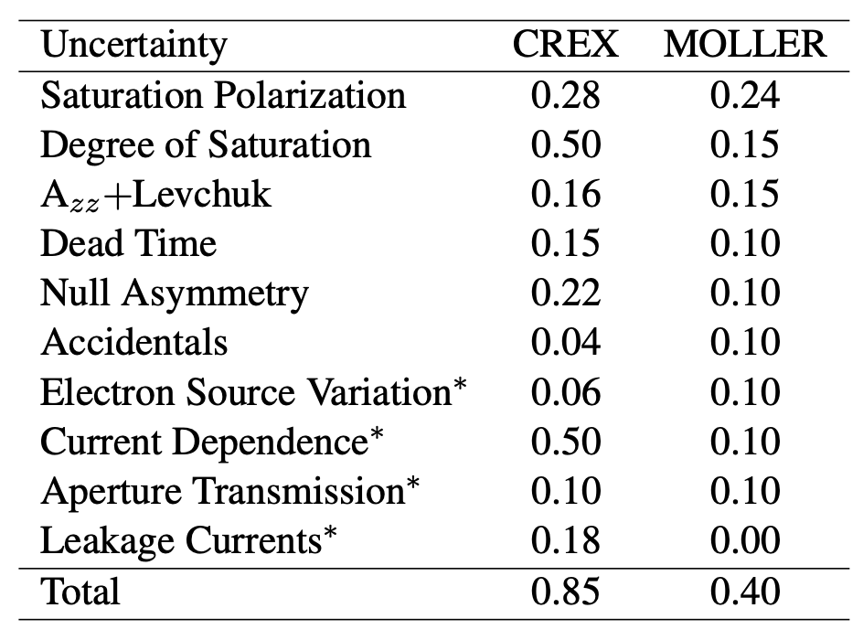
Moller polarimetry in Hall A
Learned a lot from PREX2/CREX (2019-2020) and GEn (2022-2023)
Elastic ee scattering from a Fe foil polarized || beam
Low current dedicated measurement (~1 μA) experiments run at tens of μA
Parity conserving Moller asymmetry
$$A=\frac{σ_{↑↑}−σ_{↓↑}}{σ_{↑↑}+σ_{↓↑}}$$
$$A_{meas}=\sum_{i,j=x,y,z}{P_{i}^{t}A_{ij}P_{j}^{b}}$$
Measured asymmetry
$$A_{long}=P_{z}^{t}A_{zz}P_{z}^{b}$$
(Foil)
(Foil)
Key
systematics
Beam time measurements needed to reduce/constrain these

Slide 7
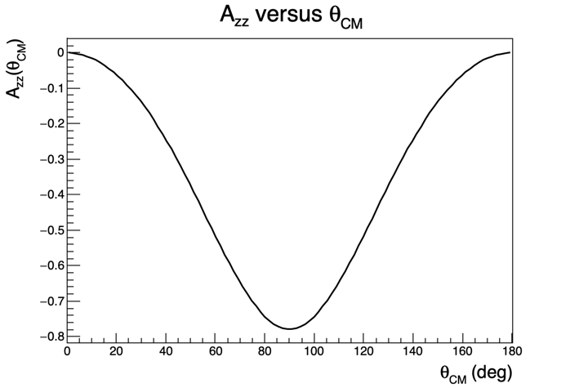
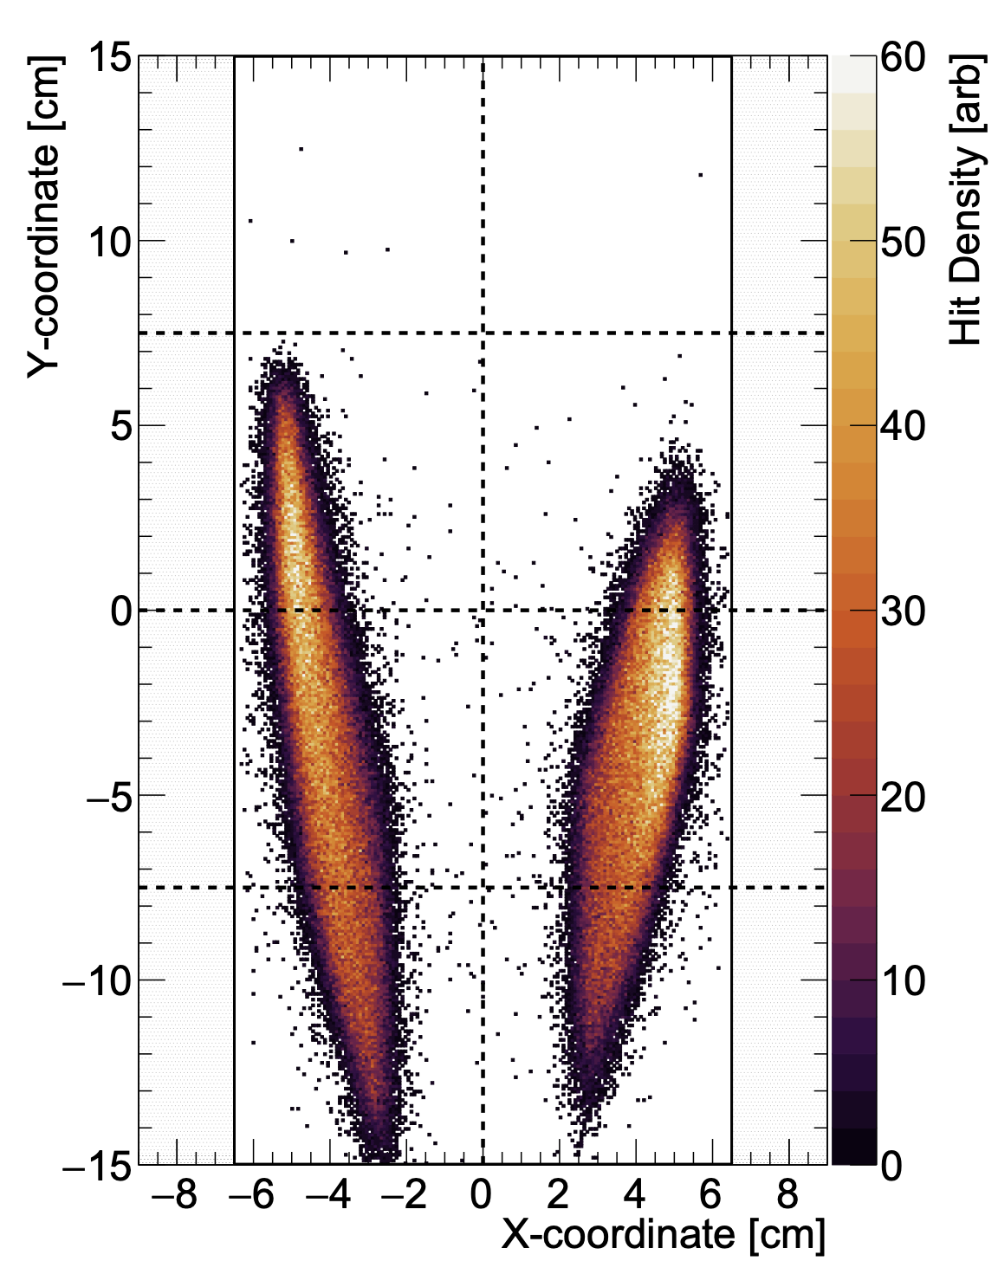
Moller Azz + Levchuk
Azz is a function of center of mass scattering angle
Must be averaged across the detector acceptance i.e. comes from simulation
Simulated event
distribution for
CREX experiment
arXiv 2207.02150
typical acceptance
Levchuk effect
Kinematic change to scattering angle (and thus Azz) from intrinsic motion of bound atomic target electrons
Inner unpolarized atomic electrons have higher intrinsic momenta → greater transverse momenta preferentially modify the trajectories of these unpolarized electrons modifying their acceptance probability

Slide 8
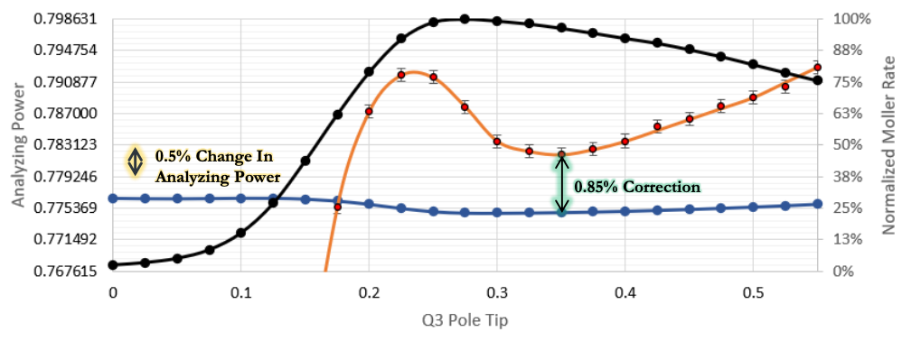
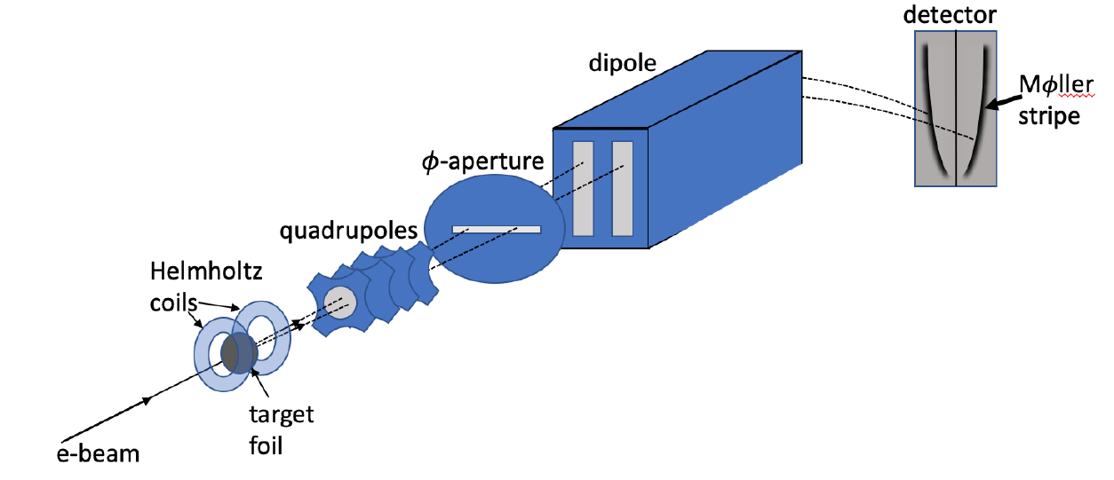
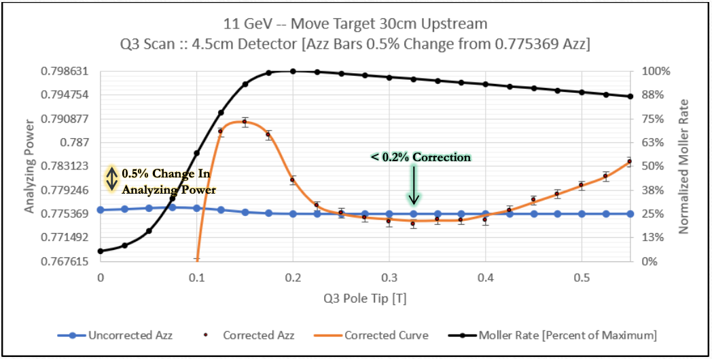
Moller Azz: two useful discoveries
Coincidence Rate
1. Our knowledge of spectrometer optics (field maps) is limited to several percent uncertainty, BUT simulation shows if we calibrate our settings relative to the rate maximum, we are highly insensitive to absolute knowledge of optics.
Levchuk Corr Azz
Simulated Azz
2. Limiting the vertical detector acceptance allows one to tune the Levchuk correction to nearly 0 AND create a large flat region of Azz.

Slide 9
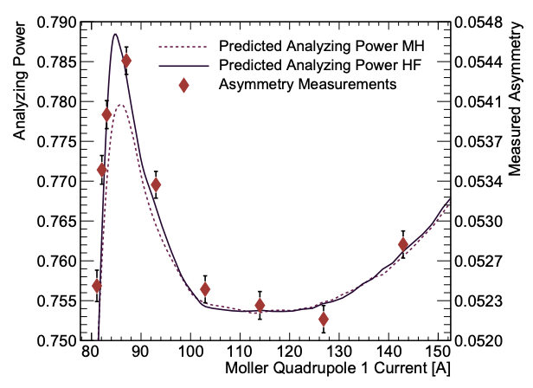
Levchuk correction improvement
Levchuk correction requires a model of the momentum distributions for polarized and unpolarized electrons in Fe
For past two decades this correction has been done using distributions from modified hydrogen wavefunctions (MH)
Data from CREX showed that this calculation predicted a 30% smaller “peak” than measured
Colleagues at Temple University suggested using a Hartree-Fock (HF) model (and provided the momentum distributions).
Exciting agreement!
arXiv 2207.02150

Slide 10
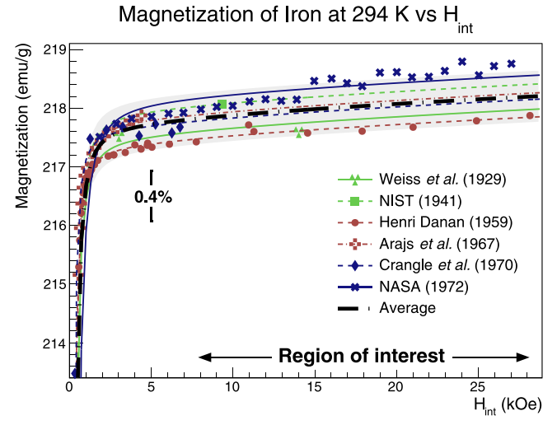
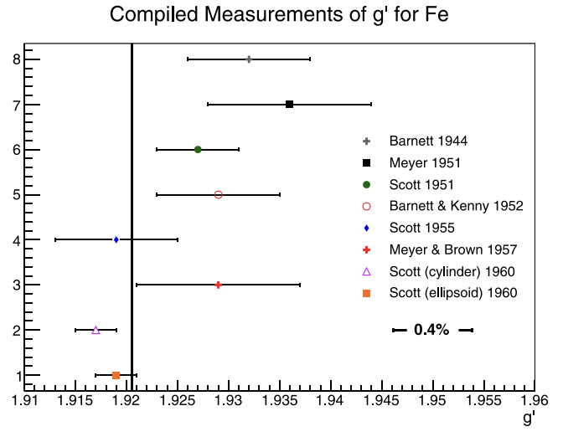
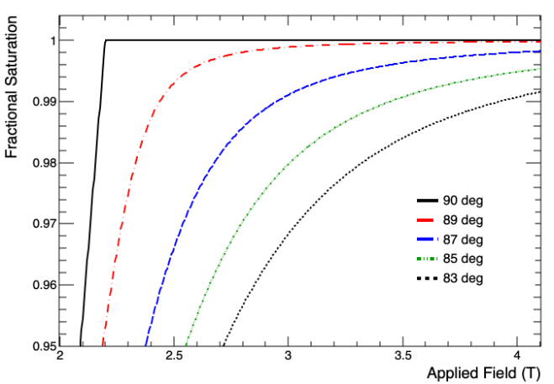
Fe foil target polarization
In a recent publication we demonstrate using world data on saturation magnetization and on the fraction of magnetization from spin that electron polarization in Fe foils is known to $±$0.24%.
Difficult to improve.
arXiv 2203.11238
arXiv 2203.11238
Stoner-Wohlfarth model of magnetization vs field
Degree of saturation: two key things prevent reaching full saturation magnetization
Magnetic field not strong enough
Difficult to magnetize out of plane
Crystal imperfections and stresses/strains create stubborn domain walls (ideal crystal fully saturated at 2.2T)
Imperfect alignment of foil (not taut, wrinkles, not precisely normal to magnetic field)

Slide 11
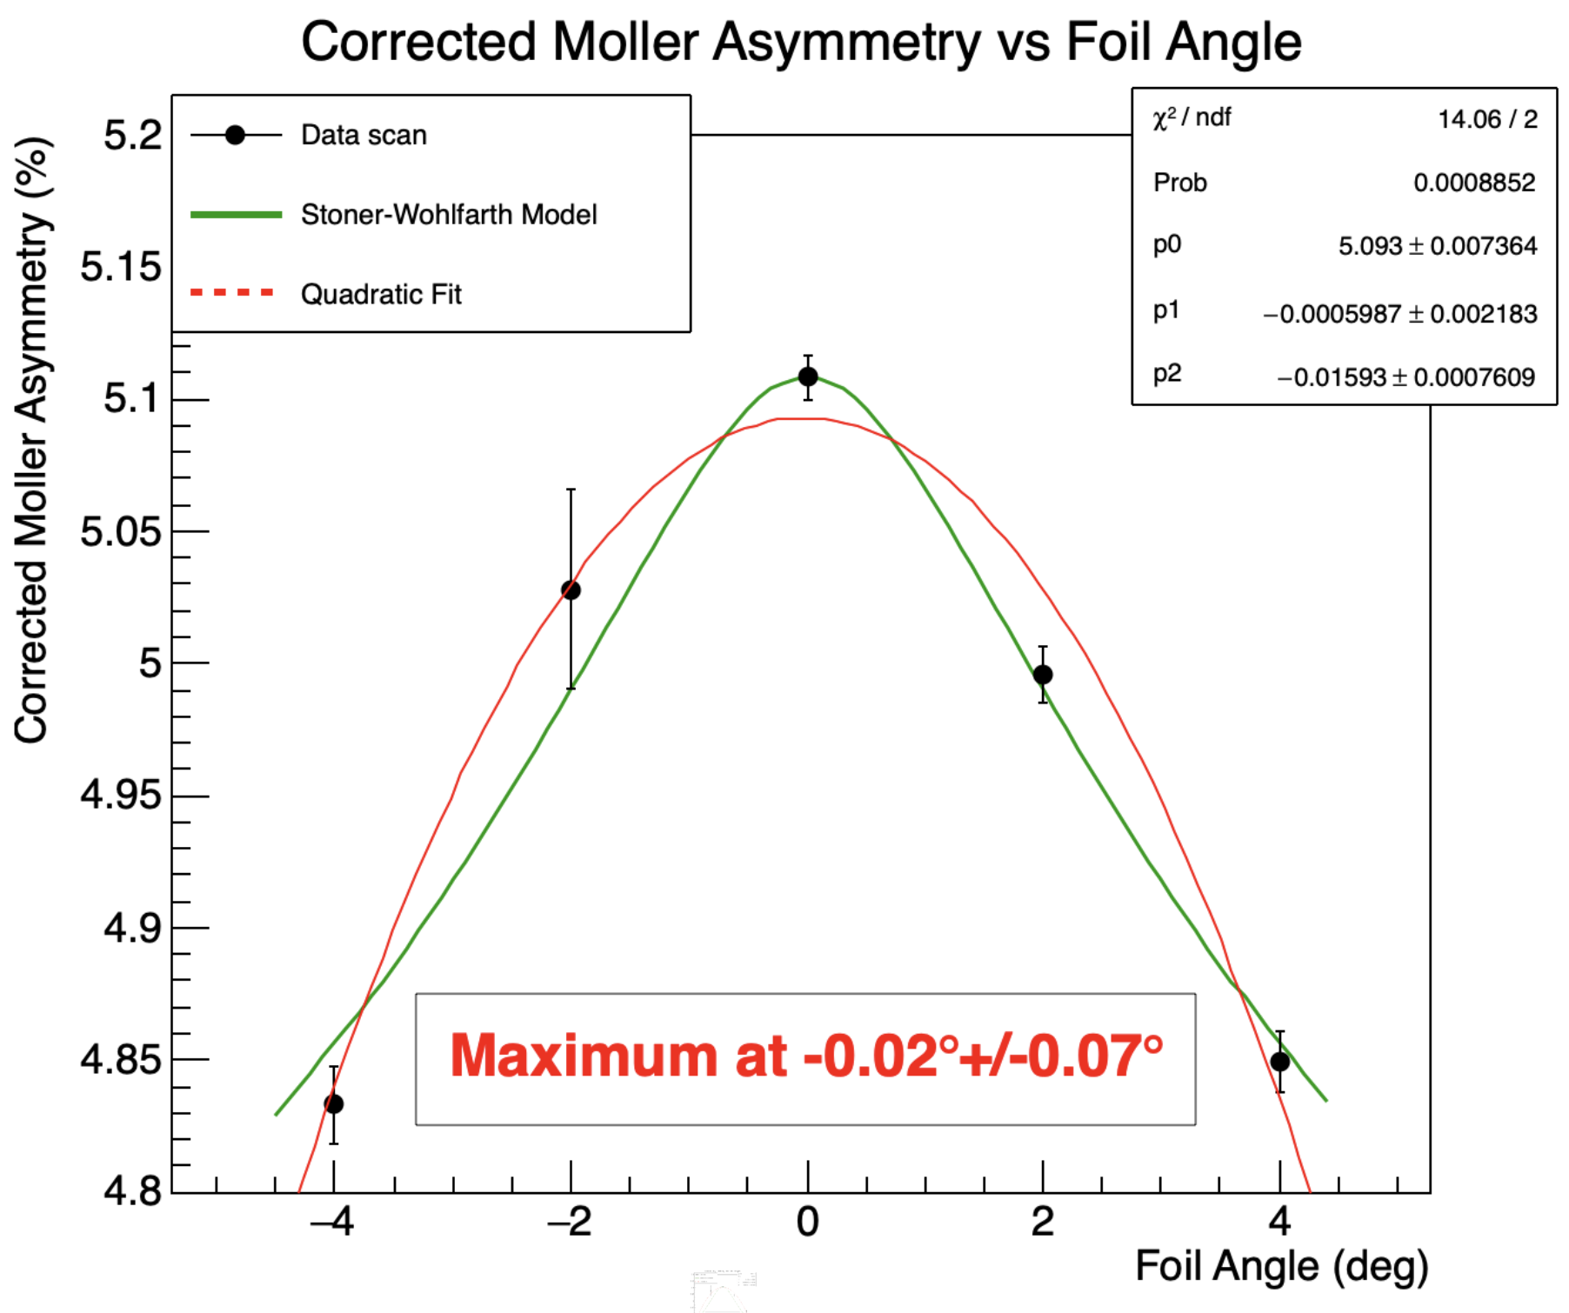
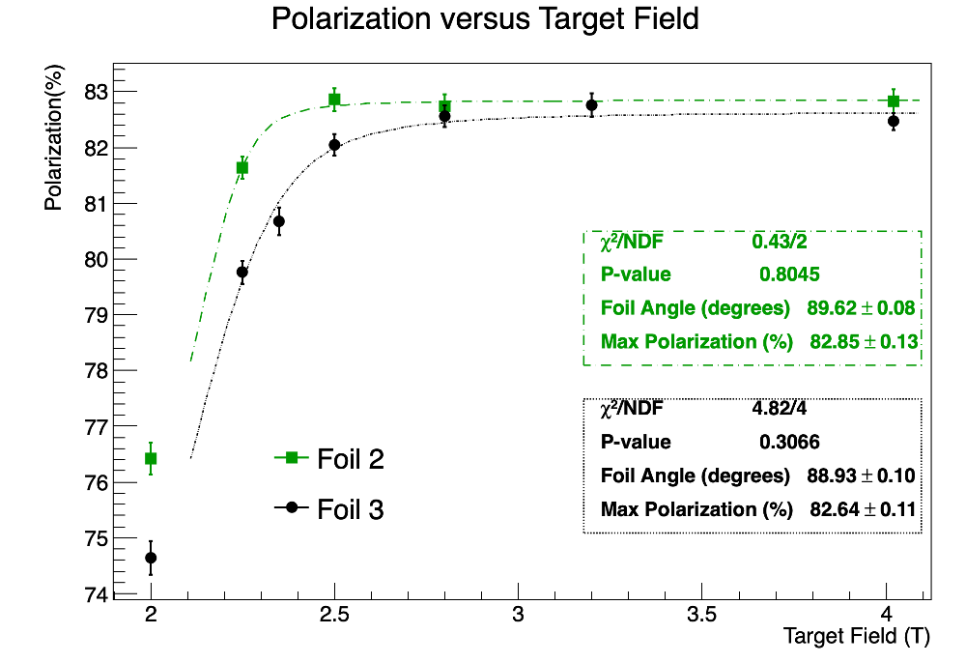
Fe foil target polarization
Ideal: demonstrate saturation precisely using an asymmetry vs. field scan
Previous scans/data have demonstrated
Apparent agreement with Stoner-Wohlfarth model and ability to align foils to within a fraction of a degree of normal using asymmetry vs foil angle scans
Results with two foils apparently aligned to within $±1°$ agree at 1.24σ on saturation polarization.
Wrinkle in foil during PREX2 showed 1% lower polarization
Also, loosely mounted foils may contribute to interpretation difficulties as the foil angle is not completely correlated with the ladder angle
Working on techniques to ensure foils mounted taut and flat and perpendicular to field

Slide 12
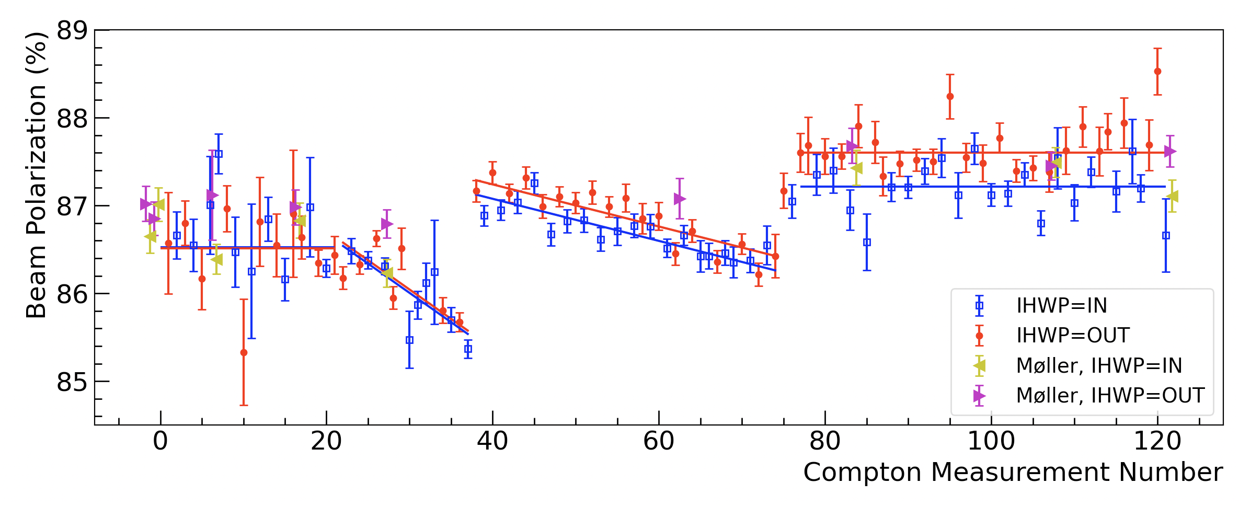
Compton/Moller comparison during CREX
Compton average: $86.90\%±0.31\%\left(\text{syst}\right)±0.02\%(\text{stat})$
Moller measurements on average $0.286±0.74\% ($percentage points) higher than Compton (0.85% relative error)
Polarization with Compton and Moller combined: $86.95\%±0.29\%$ (0.33% relative uncertainty!)

Slide 13
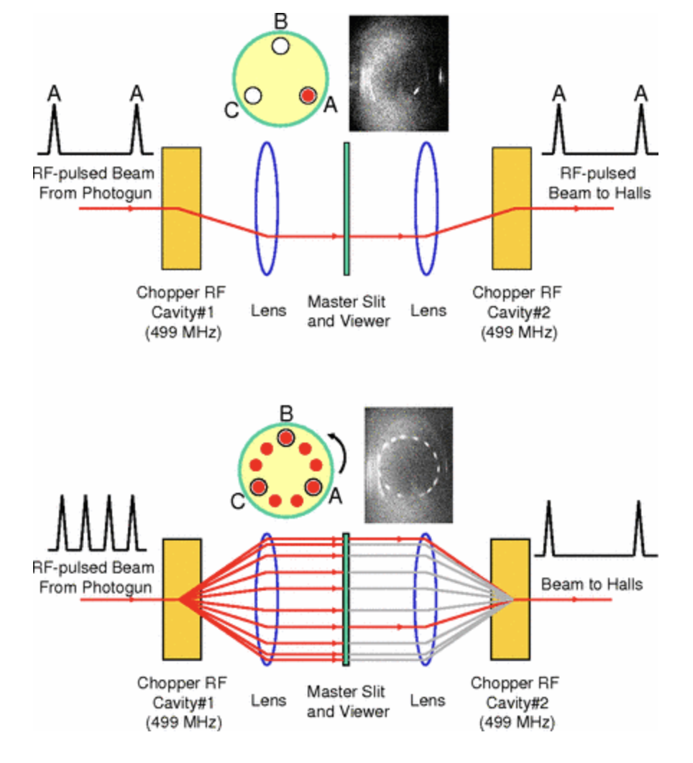
Current dependence
There is a class of uncertainties which I call “extrapolation uncertainties” which arise not from imprecision in the polarization measurements but instead from the fact that the Moller measurements are taken at different conditions (beam current, energy, source laser polarization and phase, photocathode QE etc.) and time from the main experiment.
The dominant extrapolation uncertainty is the current dependence: does the polarization measured at 1uA match that of the main experiment at 50uA or greater.
This was 0.42% during PREX-2 and 0.5% during CREX. Needs to be <0.1% during MOLLER.
Uncertainty bounded via studies using “beat frequency technique” from 2007 will likely be resurrected.
Laser frequency set just off the 499MHz of the accelerator cavities such that it beats on 499 MHz so only Nth bunch actually goes through
https://journals.aps.org/prab/pdf/10.1103/PhysRevSTAB.10.053502

Slide 14
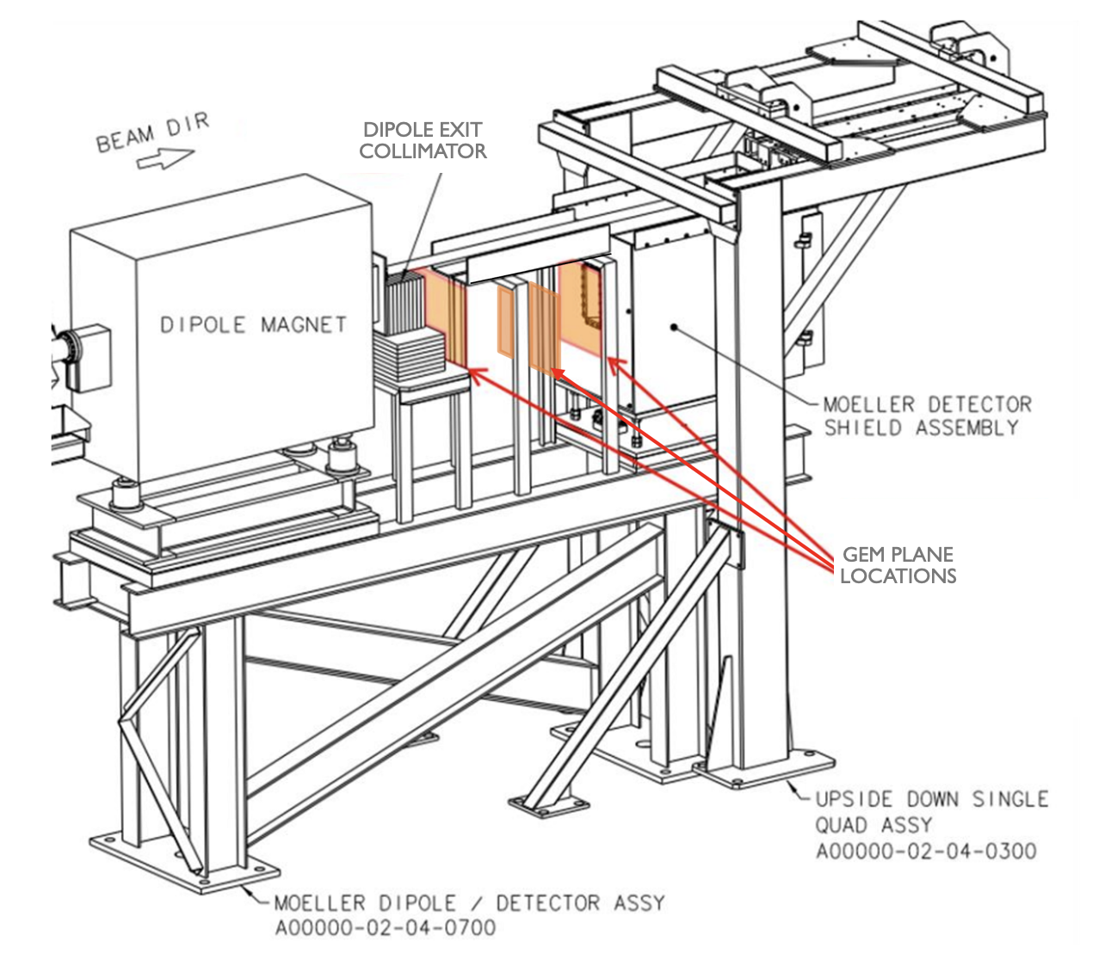
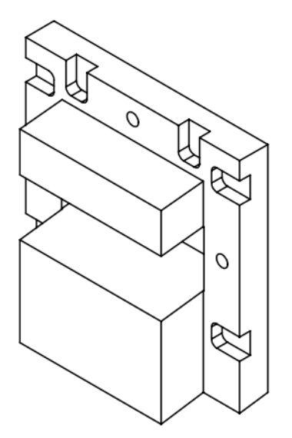
Improvements before MOLLER
Adding GEM tracking planes in drift region between dipole and detector to verify models for multiple scattering, radiative corrections and Levchuk effect
New FADC-based DAQ under development with ability to count events, integrate yields and produce energy spectra
New tungsten collimator in front of detector will limit acceptance and virtually eliminate sensitivity to the Levchuk correction
Utilizing a new CAEN detector emulator to directly measure dead time and understand accidentals in the DAQ
No showstoppers at this point keeping us from reaching proposed 0.4% uncertainty

Slide 15
Recent esoteric issues: accidentals (too many events)
Accidentals (keep at or below 1%)
Measure accidentals using a copy of the left detector signal delayed by 120 ns which we use to form a coincidence with the un-delayed right detector
Left events
coinc
left
single
Right events
Left delayed
accid
accid
Recently we have realized this is incorrect
Delayed line includes singles with no left/right correlated pair and true Moller coincident events
time
True accidentals happen when uncorrelated right and left detector events happen at nearly the same time such that they lie inside the coincidence time window. True accidentals add extraneous events.
Measured accidentals between a single uncorrelated right electron and a left coincidence electron (or vice versa) should not be counted unless this class could spuriously add coincidence events to the un-delayed signals. NOTE. This would mean that a right or left electron would have to be counted twice: once with an uncorrelated electron and once with its true coincidence electron.
Utilizing a detector emulator that can produce coincidence and singles events Poisson-distributed in time to help us understand. Ongoing studies to figure out correct way of doing this correction.
Because we keep accidental rates and corrections small, we expect our past quoted uncertainties to cover this: (Eg. Acc. correction CREX 0.21+/-0.04% PREX-2 0.12+/-0.02%)

Slide 16
Recent esoteric issues: dead time (too few events)
Dead time: coincidence events lost because they occur too close in time for the DAQ to measure them both as
discrete events
Cartoon of dead time with parameters of existing Moller DAQ in Hall A
We currently measure dead time using LEDs that flash simultaneously in right and left operating during beam on data taking. Measure fraction of LED flashes lost.
Dead time measurements with detector emulator show much higher dead time with LED measurements. Working to understand how to determine this correction accurately
Dead time corrections have typically been small with 100% uncertainty quoted on the corrections (Eg CREX 0.15+/-015%) so not expected to significantly affect past measurements.

Slide 17
Conclusions
Stringent requirements from future experiments MOLLER and SoLID in Hall A at Jefferson Lab are pushing us towards a new level of accuracy in electron beam polarimetry with both Compton and Moller polarimeters aiming to attain 0.4% uncertainty
Significant progress has been made in understanding the Moller polarimetry and while only 0.85% uncertainty has been reached thus far, that is in large part due to the fact greater precision wasn’t required. Significant reductions can be achieved with a measurement program with beam time allocation.
Each source of systematic error is being studied and minimized or eliminated.
Thank you

