Slide 1
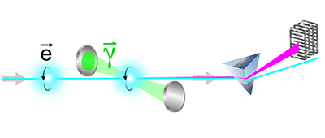
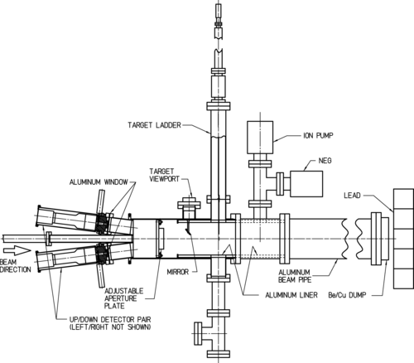
Electron Polarimetry
Dave Gaskell
Jefferson Lab
PSTP 2024
September 22, 2024

Slide 2
Outline
Introduction
Common Electron Polarimetry Techniques
  Mott Polarimetry
  Møller Polarimetry
  Compton Polarimetry
  Analyzing power, advantages/disadvantages, examples for all the above
Summary

Slide 3
Electron Beam Polarimetry
Beam polarization determined via measurement of scattering asymmetry with known analyzing power
A_{effective} incorporates theoretical analyzing power, convoluted over polarimeter acceptance
→ May include additional corrections (radiative effects, “Levchuk” effect, etc.)
Process may rely on a double-spin or single-spin asymmetry
Double-spin measurements rely on knowledge of the target polarization
Single-spin asymmetry → no target polarization, but only one useful process (Mott scattering), can only be used at low energy
Electron polarimetry → for all useful processes, analyzing power known with high precision (QED)

Slide 4
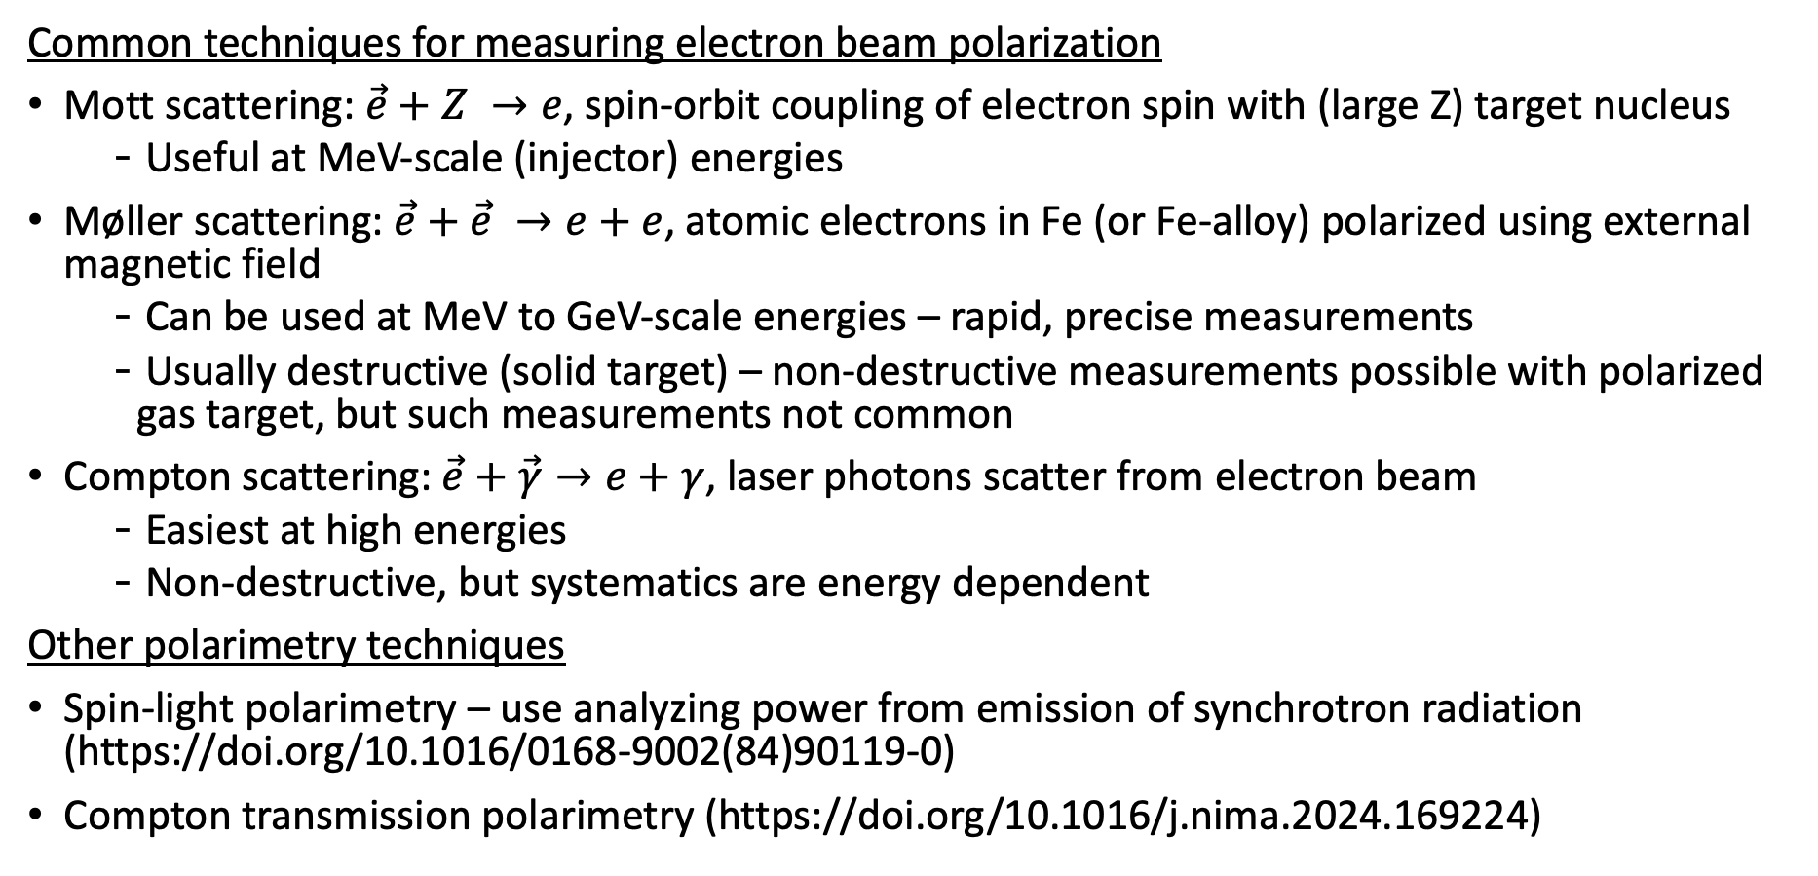
Electron Polarimetry Techniques
Common techniques for measuring electron beam polarization
Mott scattering: $\vec{e}+Z →e$, spin-orbit coupling of electron spin with (large Z) target nucleus
  Useful at MeV-scale (injector) energies
Møller scattering: $\vec{e}+\vec{e} →e+e$, atomic electrons in Fe (or Fe-alloy) polarized using external magnetic field
  Can be used at MeV to GeV-scale energies – rapid, precise measurements
  Usually destructive (solid target) – non-destructive measurements possible with polarized gas target, but such measurements not common
Compton scattering: $\vec{e}+\vec{γ}→e+γ$, laser photons scatter from electron beam
  Easiest at high energies
  Non-destructive, but systematics are energy dependent
Other polarimetry techniques
Spin-light polarimetry – use analyzing power from emission of synchrotron radiation (https://doi.org/10.1016/0168-9002(84)90119-0)
Compton transmission polarimetry (https://doi.org/10.1016/j.nima.2024.169224)

Slide 5
Introduction – Towards High Precision Electron Polarimetry
Experiments have become ever more demanding in terms of electron beam polarization and required precision on knowledge of degree of polarization
Hadronic physics experiments using polarized beams/targets dominated by knowledge of target polarization → usually on the order of 3-4%
  Requirements on electron beam polarimetry correspondingly modest
Precision in electron beam polarimetry has been driven by needs of parity violating electron scattering experiments
  Precision of 1% or better desired
Future PV experiments aim for precision better than 0.5%
Future EIC will make measurements with highly polarized hadron beams
  High precision polarimetry will become increasingly relevant for hadronic physics experiments
Experiment | Beam Energy | Polarization | Polarimetry Precision
JLab GEp/GMp (1999) | 1-4 GeV | 60% | 3%
SLAC E154 DIS g1n (1997) | 48 GeV | 82% | 2.4%
HERMES g1n DIS (2007) | 30 GeV | 55% | 2.9%
SLAC 122 PV-DIS (1978) | 16-22 GeV | 37% | 6%
Bates SAMPLE (2000) | 0.2 GeV | 39% | 4%
MAMI PV-A4 (2004) | 0.85 GeV | 80% | 2.1%
JLab Q-weak (2017) | 1.2 GeV | 88% | 0.62%
SLD A_{LR} (2000) | 46.5 GeV | 75% | 0.5%

Slide 6
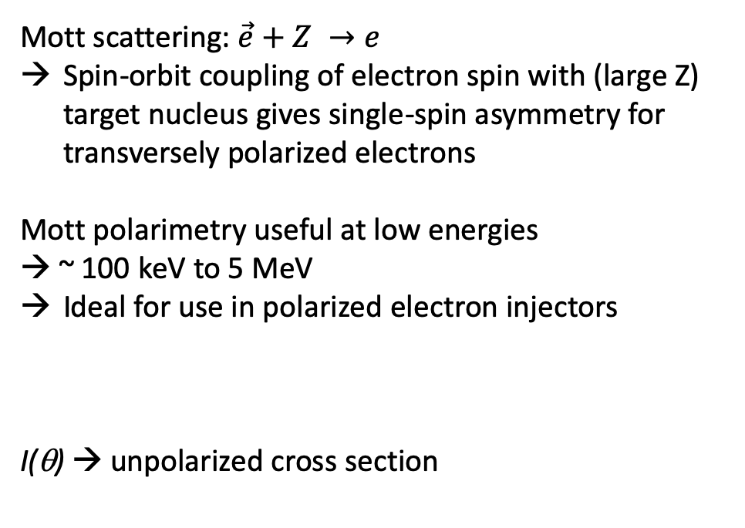
Mott Polarimetry
Mott scattering: $\vec{e}+Z →e$
Spin-orbit coupling of electron spin with (large Z) target nucleus gives single-spin asymmetry for transversely polarized electrons
Mott polarimetry useful at low energies
→ ~ 100 keV to 5 MeV
Ideal for use in polarized electron injectors
I(θ) → unpolarized cross section
S(θ) is the Sherman function
must be calculated from electron-nucleus cross section
Dominant systematic uncertainty but controlled to better than 1%

Slide 7
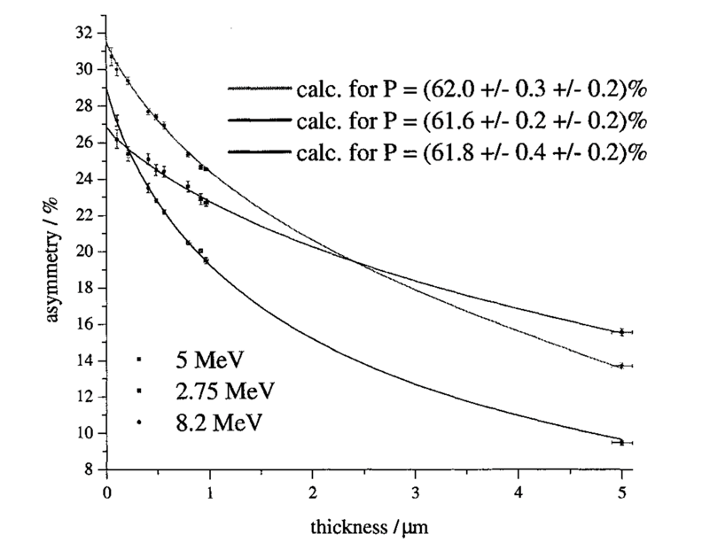
Sherman Function
Sherman function describes single-atom elastic scattering from atomic nucleus
Spin flip amplitude
Direct amplitude
f and g can be calculated exactly for spherically symmetric charge distribution
Finite thickness, electron may scatter more than once → Effective Sherman function
→ Measure at various foil thicknesses, extrapolate to zero
Knowledge of nuclear charge distribution and atomic electron distribution leads to systematic error
→ Controlled better than 0.5% for regime 2-10 MeV

Slide 8
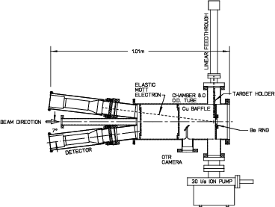
JLab 5 MeV Mott
Routinely used in CEBAF injector
Optimized for operation at 5 MeV
  Studied between 3-8 MeV
Detectors at 172.7 degrees
  Thin and thick scintillators
Typically uses thin gold target (1 mm or less)
Some backgrounds possible due to nearby beam dump
  Has been studied using lower duty cycle beam + time of flight
Recent extensive systematic studies yield overall systematic uncertainty < 1%
Jefferson Lab 5 MeV Mott Polarimeter
J.M. Grames et al, Phys.Rev.C 102 (2020) 1, 015501

Slide 9
Møller Scattering
Electron beam scatters from (polarized) atomic electrons in atom (typically iron or similar)
Longitudinally polarized electrons/target:
→ At θ*=90 deg. → -7/9
Transversely polarized electrons/target
→ At θ*=90 deg. → -1/9
Maximum asymmetry independent of beam energy

Slide 10
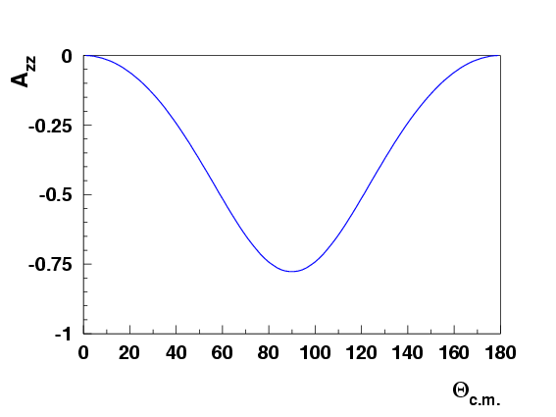
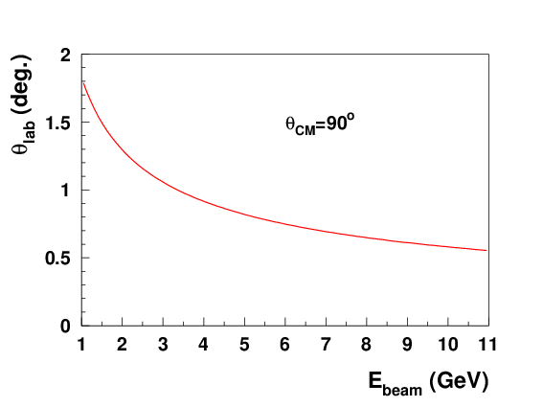
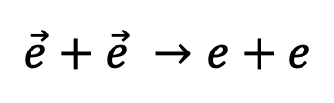
Møller Polarimetry
$$\vec{e}+\vec{e} →e+e$$
Møller polarimetry benefits from large longitudinal analyzing power → -7/9 (transverse → -1/9)
    Asymmetry independent of energy
    Relatively slowly varying near θ_{cm}=90º
    Large asymmetry diluted by need to use iron foils to create polarized electrons
Large boost results in Møller events near θ_{cm}=90º having small lab angle
  Magnets/spectrometer required so that detectors can be adequate distance from beam
  Dominant backgrounds from Mott scattering – totally suppressed via coincidence detection of scattered and recoiling electrons
  Rates are large, so rapid measurements are easy
  The need to use Fe or Fe-alloy foils means measurement must be destructive
  Foil depolarization at high currents
-7/9

Slide 11
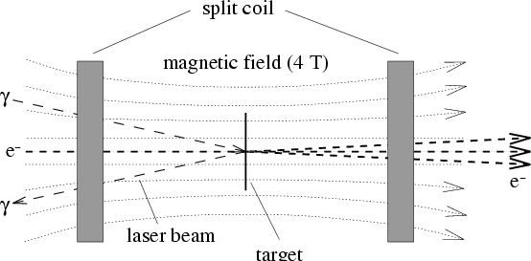
Polarized Target for Møller Polarimetry
Originally, Møller polarimeters used Fe-alloy targets, polarized in plane of the foil
  Used modest magnetic field
In-plane polarized targets typically result is systematic errors of 2-3%
  Require careful measurement magnetization of foil
Pure Fe saturated in 4 T field
  Spin polarization well known → 0.25%
  Temperature dependence well known
  No need to directly measure foil polarization
Effect | M_{s}[μ_{B}] | error
Saturation magnetization (T→0 K,B→0 T) | 2.2160 | ±0.0008
Saturation magnetization (T=294 K, B=1 T) | 2.177 | ±0.002
Corrections for B=1→4 T | 0.0059 | ±0.0002
Total magnetization | 2.183 | ±0.002
Magnetization from orbital motion | 0.0918 | ±0.0033
Magnetization from spin | 2.0911 | ±0.004
Target electron polarization (T=294 K, B= 4 T) | 0.08043 | ±0.00015

Slide 12
Levchuk Effect
On average, about 2 out of 26 atomic electrons in Fe atom are polarized
  Polarized electrons are in outer shells
  Inner shell, more tightly-bound electrons are unpolarized
Electrons scattering from inner-shell electrons result in a ”smearing” of the correlation between momentum and scattering angle
For finite acceptance detector, this can result in lower efficiency for detection of events scattering from more tightly bound (unpolarized) electrons
Ignoring this “Levchuk*” effect can result in incorrect polarization measurements
First observed experimentally at SLAC in 1995 – size of effect depends on detector acceptance
M. Swartz et al., Nucl. Instrum. Meth. A363 (1995) 526
*L. G. Levchuk, Nucl. Instrum. Meth. A345 (1994) 496

Slide 13
SLAC E154 Møller Polarimeter
Single-arm polarimeter used in End Station at SLAC in the 1990’s
Low field, in-plane polarized target
2-detectors, but did not detect scattered and recoil electrons in coincidence
Scattered electrons steered to detectors using dipole – no focusing quads
Electrons detected with silicon strip detectors
Overall systematic uncertainty 2.4%, dominated by target polarization (1.7%) and background subtraction (2%)

Slide 14
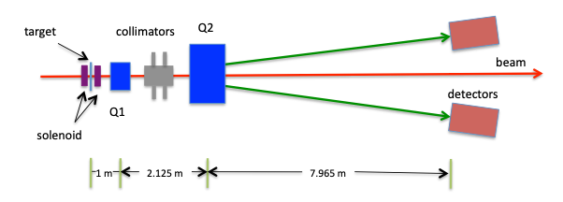
Hall C Møller Polarimeter at Jefferson Lab
First polarimeter to use high field, out-of-plane polarized target
Detects scattered and recoil electron in coincidence
2 quadrupole optics maintains constant tune at detector plane, independent of beam energy
“Moderate” acceptance mitigates Levchuk effect → still a non-trivial source of uncertainty
Target = pure Fe foil, brute-force polarized out of plane with 3-4 T superconducting magnet
Target polarization uncertainty = 0.25% [NIM A 462 (2001) 382]

Slide 15
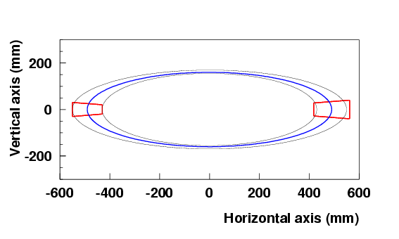
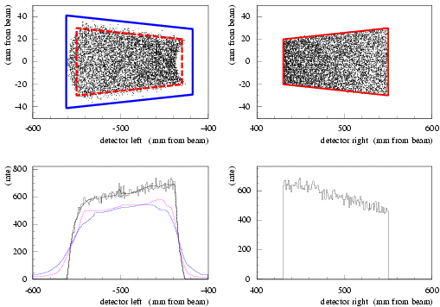
Hall C Møller Acceptance
Møller events
Optics designed to maintain similar acceptance at detectors independent of beam energy
Detectors
Collimators in front of Pb:Glass detectors define acceptance
One slightly larger to reduce sensitivity to Levchuk effect

Slide 16
Møller Systematic Uncertainties
Systematic error table from Q-Weak (2nd run) in Hall C (2012)
Some uncertainties larger than usual due to low beam energy (1 GeV)
Levchuk effect, target polarization same at all energies
Total uncertainty less than 1%

Slide 17
Hall A Møller Polarimeter at Jefferson Lab
Like Hall C, uses high field target polarized out-of-plane
Initially used low field target, but upgraded to achieve higher precision
Large detector acceptance to mitigate Levchuk effect
Optics uses combination of 3(4) quadrupoles + dipole
Same tune cannot be used for all energies – each energy requires new solution
Overall systematic uncertainties comparable to Hall C

Slide 18
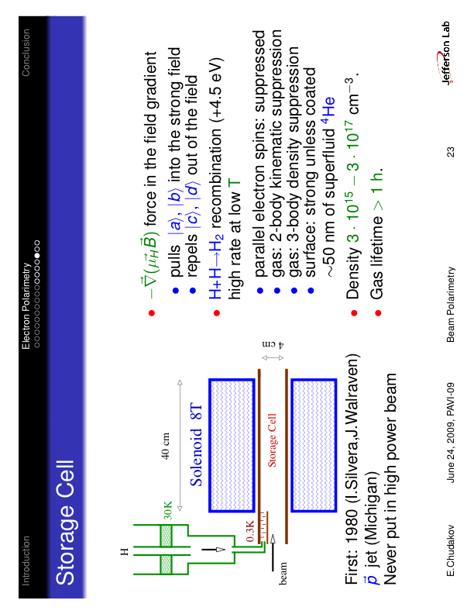
Møller Polarimetry with an Atomic Hydrogen Target
Proposal to use atomic hydrogen as target; operates at full beam current, non-destructive measurement
at 300 mK, 8 T, P_{e} ~ 100%
density ~ 3 10¹⁵ cm⁻³
lifetime >1 hour
Expected precision < 0.5%!
Contamination, depolarization expected to be small → < 10 ⁻⁴
Such a target allows measurements concurrent with running experiment, mitigates Levchuk effect
Application in storage rings?
→ Gas heating by radiation drops density
Beam creates fields that may trap positive ions
Maybe some kind of H jet target can be used instead?
System is under development for use at MAINZ for the P2 experiment → polarization measurements expected within the next couple years

Slide 19
Compton Polarimetry
Polarimeter | Energy | Sys. Uncertainty
CERN LEP* | 46 GeV | 5%
HERA LPOL | 27 GeV | 1.6%
HERA TPOL* | 27 GeV | 2.9%
SLD at SLAC | 45.6 GeV | 0.5%
JLab Hall A | 1-6 GeV | 1-3%
JLab Hall C | 1.1 GeV | 0.6%
JLab Hall A | 2 GeV | 0.36%
Compton polarimetry has been used extensively in both fixed-target and collider environments – standard technique in storage rings since it is non-destructive
Highest precision has been achieved using electron detection, for longitudinally polarized electrons

Slide 20
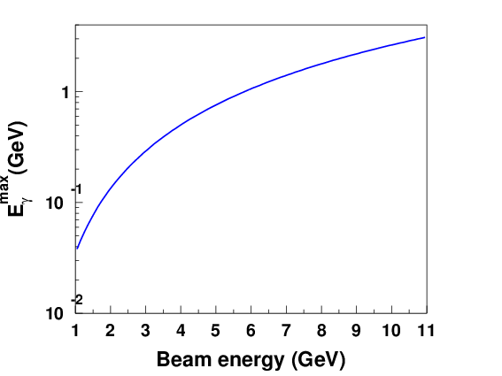
Compton Scattering - Kinematics
Laser beam colliding with electron beam nearly head-on
Backscattered photon
Energy proportional to γ²
Maximum backscattered photon energy at
θ=0 degrees (180-degree scattering)
For green laser (532 nm):
E_{γ}^{max} = 34.5 MeV at E_{beam}=1 GeV
E_{γ}^{max} = 3.1 GeV at E_{beam}=11 GeV

Slide 21
Polarization Measurement via Compton Polarimetry
Compton polarimetry can be used to measure both longitudinal and transverse electron beam polarization
φ=0

Slide 22
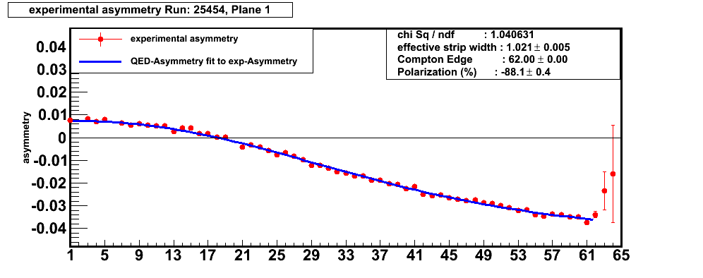
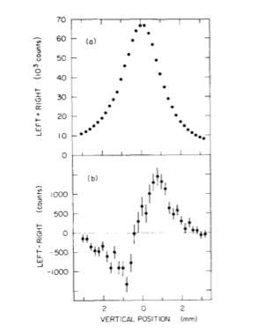
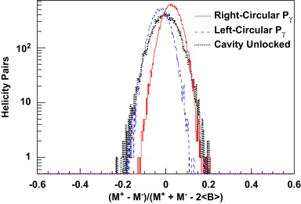
Polarization Measurement via Compton Polarimetry
Longitudinal polarization measured via counting asymmetry vs. energy, or energy-integrated asymmetry
Transverse polarization typically measured via spatial dependence (up-down) of asymmetry
JLab – Hall C
SPEAR @ SLAC
Detector strip # → Scattered electron energy
Photon-energy weighted asymmetry
JLab – Hall A

Slide 23

HERA Longitudinal Compton Polarimeter
HERA Longitudinal polarimeter installed in long straight section near HERMES experiments
Laser system: single pass, pulsed laser synced to beam frequency
Backscattered photons detected in sampling calorimeter
Operated in “multi-photon” mode – up to thousand photons produced per laser pulse
Polarization extracted using energy integrated asymmetry
Total systematic uncertainty = 1.6%, dominated by detector response
M. Beckmann et al, NIM A479 (2002) 334-348

Slide 24
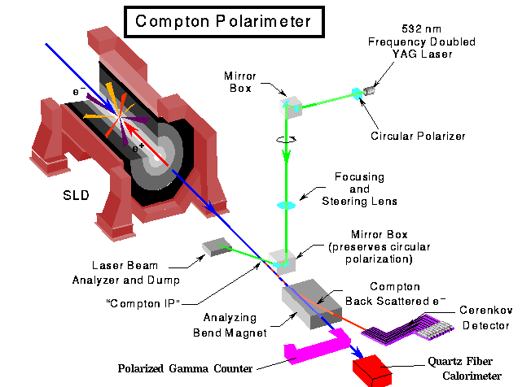
SLAC SLD Compton Polarimeter
Highest precision achieved with Compton polarimetry → dP/P = 0.5%
Operated at 45 GeV → endpoint analyzing power was very large: ~ 75%
Used single-pass, pulsed laser – excellent control of laser polarization at interaction point
Multichannel gas Cherenkov detector → electrons ~ 10 cm from nominal beam path
M. Woods - SLAC-PUB-7319

Slide 25
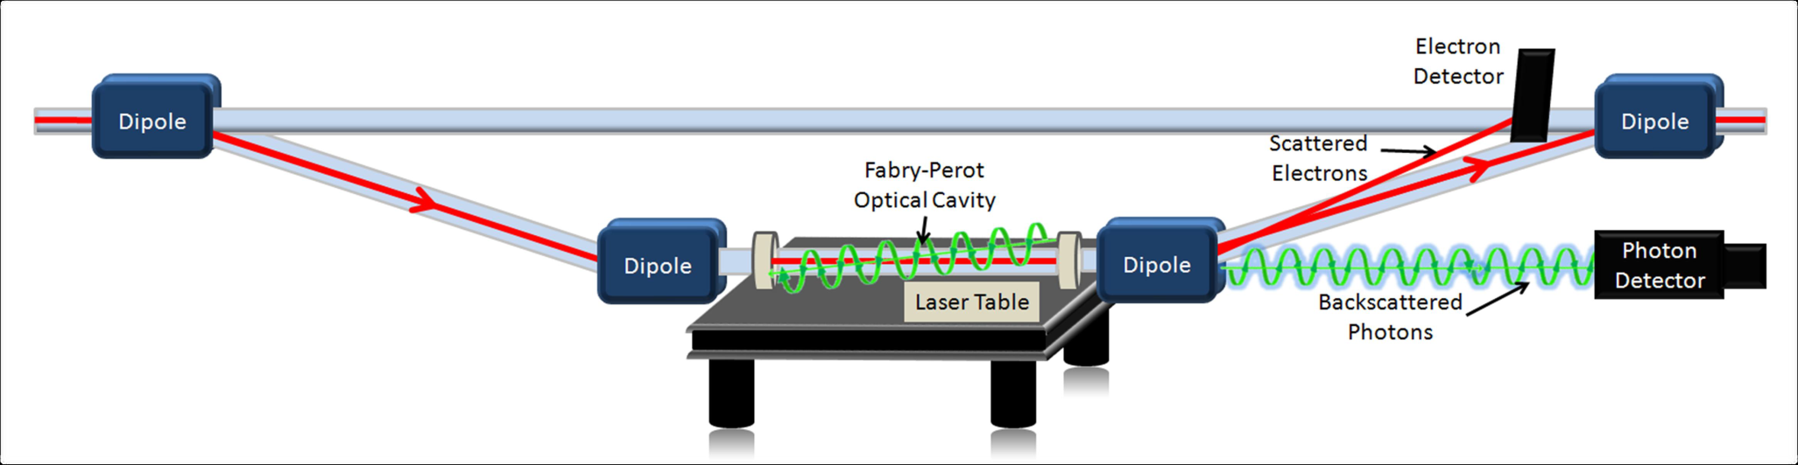
Compton Polarimeters in Halls A and C at Jefferson Lab
Compton polarimeters in Hall A and C:
4 dipole chicane to deflect beam to laser system
Fabry-Perot cavity to provide kW level CW laser power
Diamond/silicon strip detectors for scattered electrons
Photon detectors operated in integrating mode
Hall C has achieved dP/P=0.6% (electron detector)
Hall A has achieved dP/P=0.36% (photon detection)

Slide 26
Polarimeter Comparisons: Hall C Møller and Compton
Compton measurements at 180 μA concurrent with experiment
Møller measurements taken intermittently, at 1 μA
Dedicated test with both Møller and Compton at 4.5 μA

Slide 27
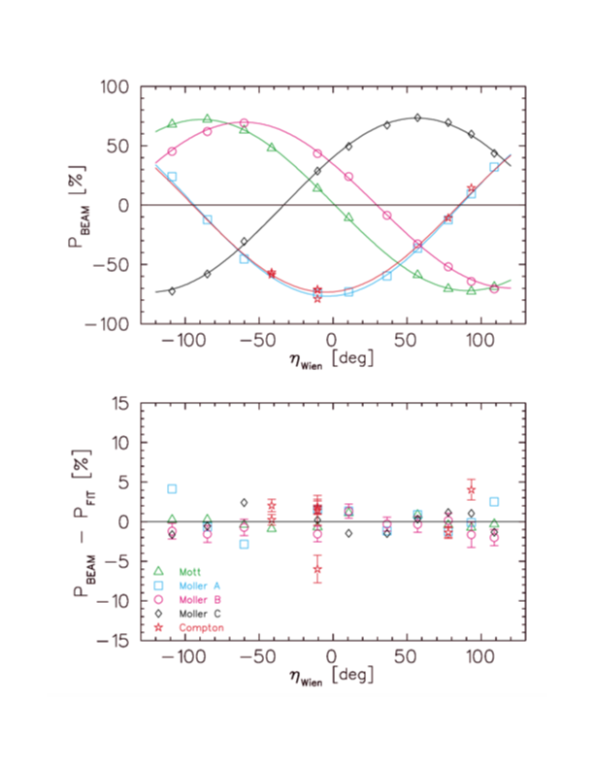
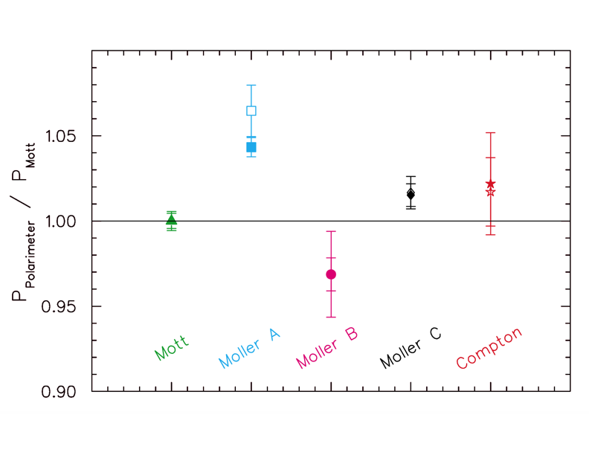
Jefferson Lab Polarimeter Comparisons: Spin Dance
Compared electron polarimeters in Halls A, B, C by taking measurements at several Wien angles – compare maximum polarization
Discovered unexpected systematic in Hall A Møller
Updated multi-hall Spin Dance would be beneficial since polarimeters have improved since original results from 2004

Slide 28
Development of a Compton Polarimeter for EIC
EIC Electron Beam Properties
Energy (GeV) | Current (A) | Polarization (%) | Frequency (MHz)
5 | 2.5 | 70 | 99
10 | 2.5 | 70 | 99
18 | 0.26 | 70 | 25
Electron-ion collider in U.S. → Highly polarized electron and proton/light ion beams and high luminosities
Physics measurements will have high statistical precision. Excellent control of systematic uncertainties needed to fully leverage potential of the EIC
Precise polarimetry (both electron and hadron) will be important
Primary electron polarimetry technique will be Compton → lessons learned from earlier polarimeters will shape design of EIC Compton

Slide 29
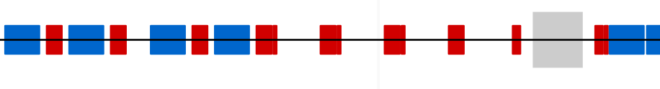
Compton Polarimetry at EIC
D6EF_6
θ_{B}=12 mr
D5EF_6
θ_{B}=1.5 mr
D4EF_6
θ_{B}=1.5 mr
D3EF_6
θ_{B}=13 mr
Crab cavity
D2EF_6
*
Q10EF_6
Q9EF_6
Q8EF_6
Q7EF_6
Q6EF_6
Q5EF_6
Q4EF_6
Q3EF_6
Laser IP
74 m upstream of IP-6
Photon Detector
(30 m from Laser IP)
Electron Detector
Polarization components at Laser IP
Polarimeter Components:
RF-pulsed laser system (under development)
Position sensitive detectors (diamond strips) for scattered electrons and backscattered photons
Calorimeter for backscattered photons
Will operate in single-photon mode
Beam energy | P_{L} | P_{T}
5 GeV | 99.1% | 13.2%
10 GeV | 96.5% | 26.2%
18 GeV | 89.0% | 45.6%
High precision measurement of P_{L} and P_{T} required!

Slide 30
Summary
Several useful techniques for absolute electron polarimetry
  Mott polarimetry used primarily at/near electron beam injector
  Møller polarimetry used in fixed-target facilities but could possibly be employed in colliders/rings – R&D would be required
  Compton polarimetry most commonly employed in colliders, but increasingly useful at relatively low intensity fixed target facilities
High precision has been achieved with all three techniques discussed here
  In general, highest precision has been achieved for measuring longitudinal polarization
Comparison between multiple devices with different systematic errors provides confidence in measurements and improved precision
EIC will require precise measurements of both electron and hadron polarization
  Compton polarimeter design for EIC draws on experience from earlier devices
  EIC Compton polarimeter will need to be able to measure longitudinal and transverse electron polarization simultaneously

Slide 31
Extra

Slide 32
MAINZ MeV Mott
Mott polarimeter in MAMI accelerator at Mainz installed after injector linac
Scattering angle = 164 degrees
Sherman function peaks at 2 MeV
Background from dump suppressed by using deflection magnets to steer scattered electrons to detectors – no direct line of site to beam dump
Dominant systematics from Sherman function, zero-thickness extrapolation, background
GEANT simulations suggest backgrounds ~ 1%
Systematic uncertainty better than 1% achievable with some additional effort

Slide 33
Møller Polarimetry with Jet Targets
Møller not typically used in storage rings since commonly used targets are destructive to the beam → iron and iron-alloy foils
Jet target would be non-destructive – some measurements with jet targets have been done at VEPP-3
What precision on target polarization can be achieved with jet targets?
RHIC H-JET target polarization known to better than 1%
Some R&D would be required, but precision Møller polarimetry in storage rings may be feasible
A. Grigoriev et al, Proceedings of EPAC 2004

Slide 34
Polarization Measurement Times
Luminosity for Compton scattering at non-zero crossing angle:
Beam size at interaction point with laser dictates luminosity (for given beam current and laser/electron beam crossing angle)
Time for measurement of precision ΔP/P:
Time required for measurement can vary significantly with beam energy due to changing asymmetry
Lower energies/beam currents can require novel laser solutions

Slide 35
Electron Detector Polarization Extraction
An “integrating” technique can be employed by fitting asymmetry zero-crossing
Worked well for earlier Hall A experiments yielding 1% level results
Drawback: extremely sensitive to strip/detector efficiency
Hall C Compton employed a 2-parameter fit (polarization and Compton edge) to the differential spectrum
This has yielded good results → strip width (resolution) is important
Zero-crossing must be in acceptance to constrain the fit well
Systematic uncertainty dP/P = 0.6%

Slide 36
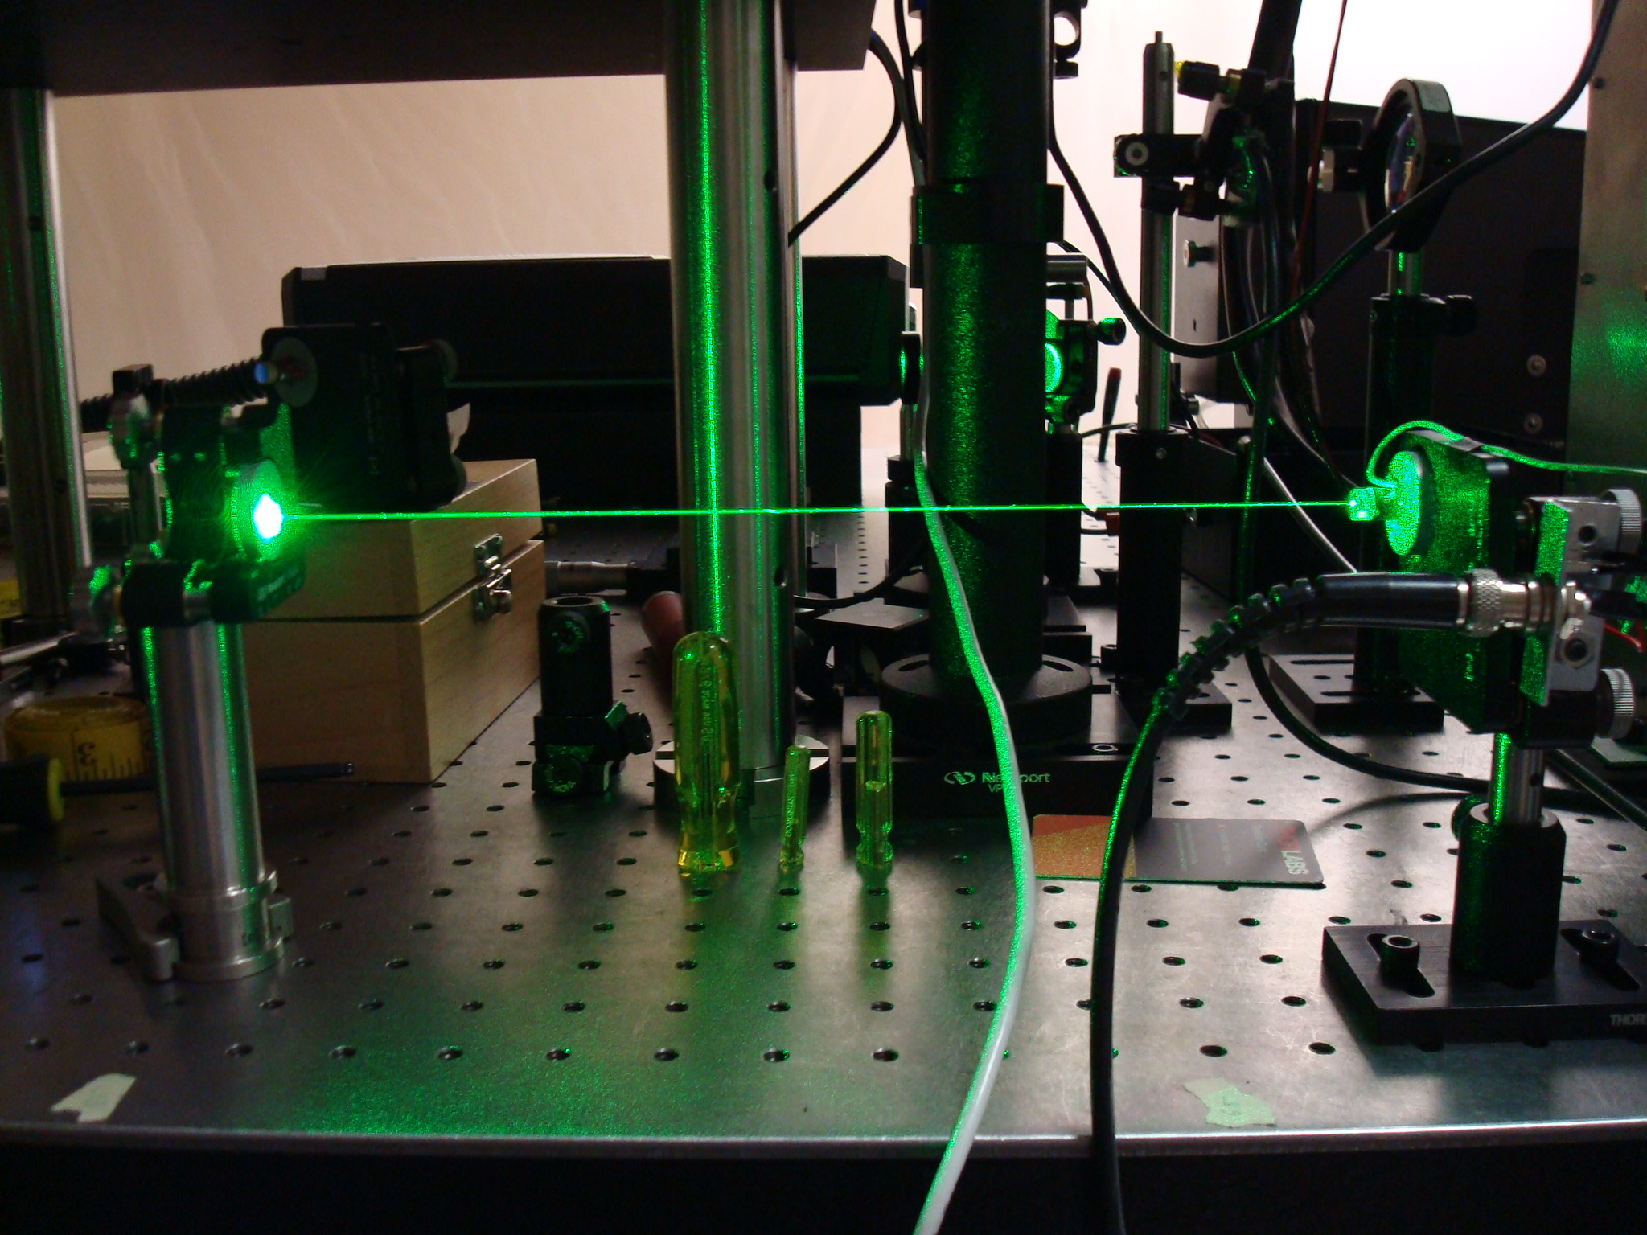
Laser Polarization
Propagation of light into the Fabry-Pérot cavity can be described by matrix, M_{E}
Light propagating in opposite direction described by transpose matrix, (M_{E})^{T}
If input polarization (ε₁) linear, polarization at cavity (ε₂) circular only if polarization of reflected light (ε₄) linear and orthogonal to input*
Steering mirrors, vacuum exit window
ε₁
ε₂
M_{E}
Laser
M_{T}
ε₃
(M_{E})^{T}
ε₄
Steering mirrors, vacuum entrance window, half and quarter wave plates
ε₂=M_{E}ε₁
ε₄=(M_{E})^{T}ε₃
ε₄=(M_{E})^{T}M_{E}ε₁
Exit-line polarization monitoring
JINST 5 (2010) P06006
*J. Opt. Soc. Am. A/Vol. 10, No. 10/October 1993

Slide 37
Laser Polarization
Propagation of light into the Fabry-Pérot cavity can be described by matrix, M_{E}
Light propagating in opposite direction described by transpose matrix, (M_{E})^{T}
If input polarization (ε₁) linear, polarization at cavity (ε₂) circular only if polarization of reflected light (ε₄) linear and orthogonal to input*
Steering mirrors, vacuum exit window
ε₁
ε₂
M_{E}
Laser
Warning! Birefringence of light in FP cavity also plays a role
M_{T}
ε₃
(M_{E})^{T}
ε₄
Steering mirrors, vacuum entrance window, half and quarter wave plates
ε₂=M_{E}ε₁
ε₄=(M_{E})^{T}ε₃
ε₄=(M_{E})^{T}M_{E}ε₁
Exit-line polarization monitoring
JINST 5 (2010) P06006
*J. Opt. Soc. Am. A/Vol. 10, No. 10/October 1993

Slide 38
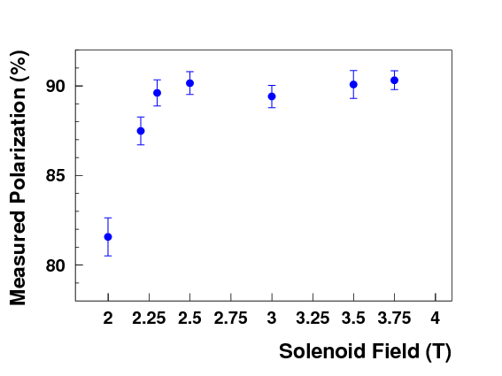
Saturated Iron Foil Target
Polarization of target not directly measured when using iron foil driven to magnetic saturation
Rely on knowledge of magnetic properties of iron
One can test that foil is in magnetic saturation using magneto-optical Kerr effect (polarization properties of light change in magnetic medium)
Example: Measure degree of saturation vs. applied magnetic field
→ This can also be tested with polarimeter directly
Can also test dependence on foil angle (misalignment) and heating
Kerr effect measurement of foil saturation
JLab measurements of asymmetry vs. applied field

Slide 39
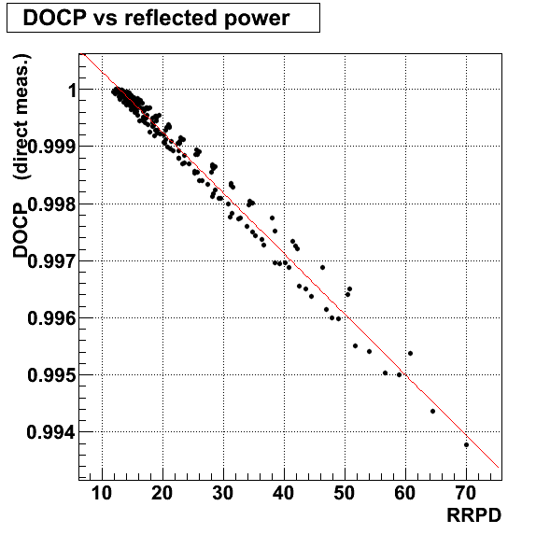
Polarization at Cavity Entrance via Reflected Power
“If input polarization (ε₁) linear, polarization at cavity (ε₂) circular only if polarization of reflected light (ε₄) linear and orthogonal to input”
→ In the context of the Hall A Compton, this means that the circular polarization at cavity is maximized when retro-reflected light is minimized
Optical reversibility allows configuring system to give 100% DOCP at cavity entrance, even when the system is under vacuum, just by minimizing signal in one detector
In addition, response of whole system can be modeled by sampling all possible initial state polarizations
Technique applicable to any Compton polarimeter → eliminates uncertainties due to birefringence in vacuum windows (very difficult to control)

Slide 40
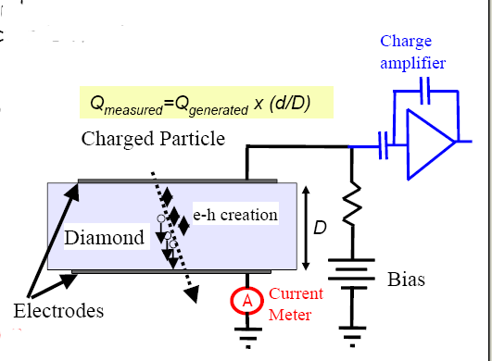
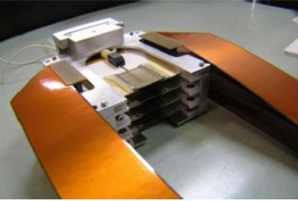
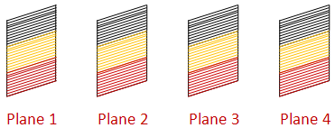
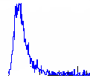
Hall C Compton Diamond Electron Detector
Diamond microstrips used to detect scattered electrons
→ Radiation hard: exposed to 10 MRad without significant signal degradation
Four 21mm x 21mm planes each with 96 horizontal 200 μm wide microstrips.
Rough-tracking based/coincidence trigger suppresses backgrounds
Radiation-hard diamond detector

Slide 41
Fabry-Perot Cavity Laser System
Optical
isolator
Cavity
Due to relatively low intensity of JLab electron beam, need higher laser power
Use external Fabry-Perot cavity to amplify 1-10 W laser to 1-5 kW of stored laser power
Laser
EOM
~
Photodiode
Oscillator
Servo
amp
Phase
shifter
Mixer
Low-pass filter
Key systematic: Laser polarization in Fabry-Perot cavity
→ Constrain by monitoring light reflected back from cavity and measurement of cavity birefringence

Slide 42
HERA Transverse Compton Polarimeter
Transverse Compton at HERA was used to provide absolute polarization measurements with 2-3% precision
→ Transverse Compton polarimeters have been relatively common, but not typically used as absolute devices
Key difference from longitudinal case is need to measure spatial dependence of asymmetry
Used a sampling calorimeter with top and bottom optically isolated: → Polarization measured via up-down energy asymmetry
Key systematic uncertainty is understanding the η(y) transformation function
Strip detectors provide can be used to help calibrate the detector response
B. Sobloher et al, DESY-11-259 , arXiv:1201.2894

