Slide 1
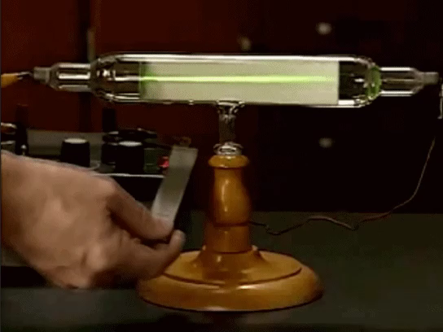
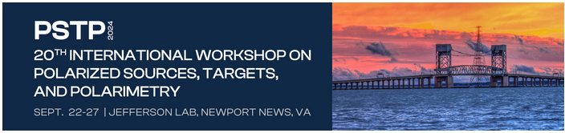
Polarized Electron Sources
Topics discussed:
GaAs – 50 years of experience
Today’s ‘spin crisis’
Vacuum
Matt Poelker
Video by Mateus Silva Rêgo

Slide 2
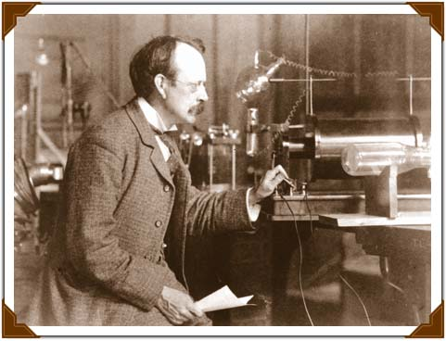
Electrons discovered!
J. J. Thomson credited with ‘discovery’ ~ 1897, awarded the Nobel Prize for physics in 1906 for this work. Estimated mass of electron compared to lightest known element, hydrogen
1869-1875 Crookes tube: ‘cathode rays’ = stream of free electrons created via ionization of residual gas by DC voltage
Video by Mateus Silva Rêgo
‘Vacuum tubes’ invented ~1904 superseded the Crookes tube, operating at lower pressure. Free electrons no longer generated via ionization, but via heated filament - electrons released by thermionic emission

Slide 3
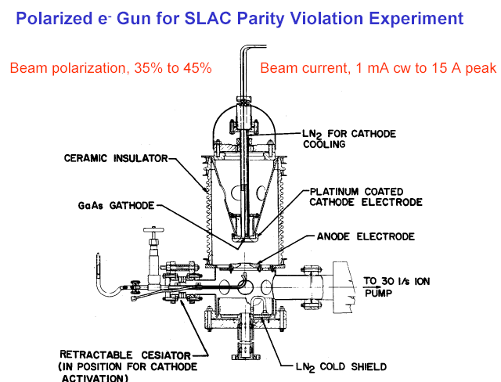
The First (DC High Voltage) Photogun
Gallium Arsenide was known to have polarized internal electrons when optically pumped by circularly polarized light
(Ekimov and Sakarov, JETP Letters 13, 495, 1971)
Bell and Spicer had shown that the conduction band electrons could be photoemitted by adding Cs-O monolayers to the surface
Gallium Arsenide as source of polarized electrons proposed by Garwin, Pierce and Siegmann in 1974
Started with a thermionic gun housing, circa 1976

Slide 4
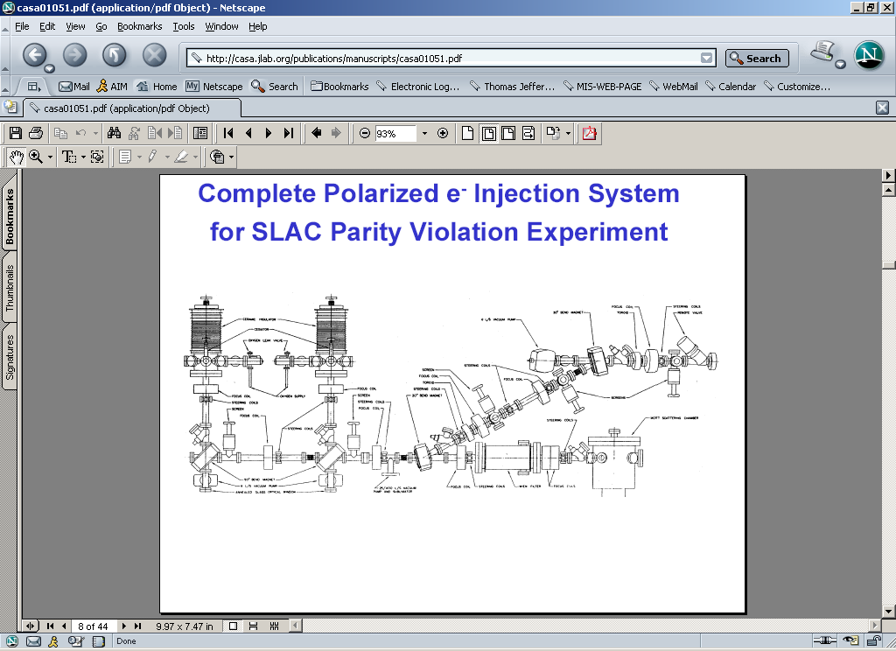
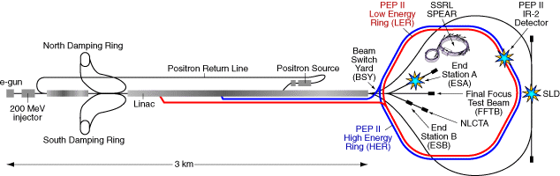
First Photoinjector
‘Photoemission of spin-polarized electrons from GaAs’, Daniel T. Pierce and Felix Meier, Phys. Rev. B 13, 5484 – June 1976
Polarized electrons accelerated at SLAC December 1977
E122 announces parity violation June 1978 - an important verification of the Standard Model

Slide 5
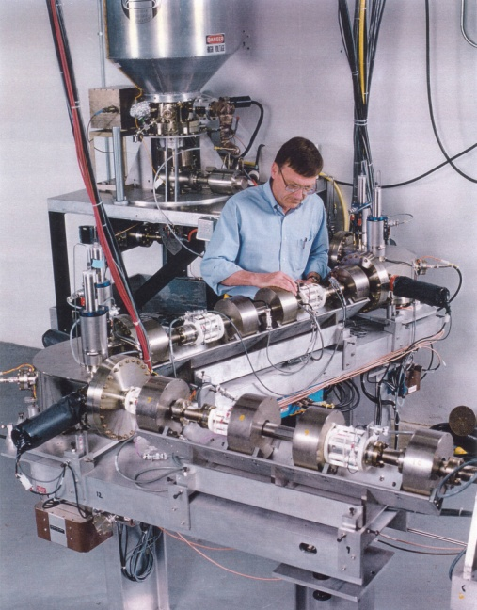
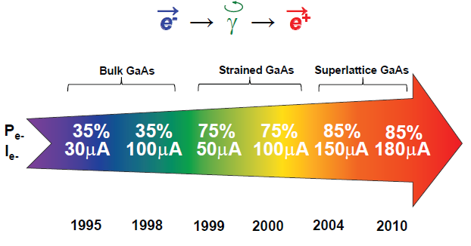
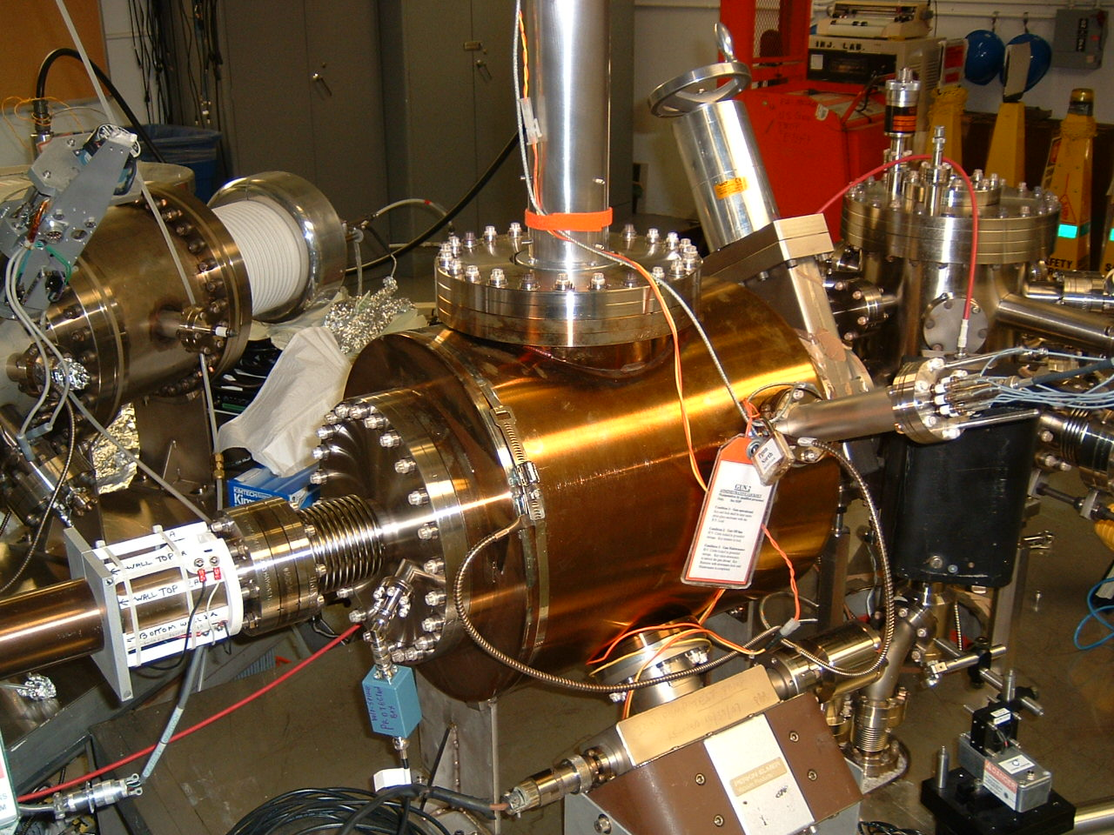
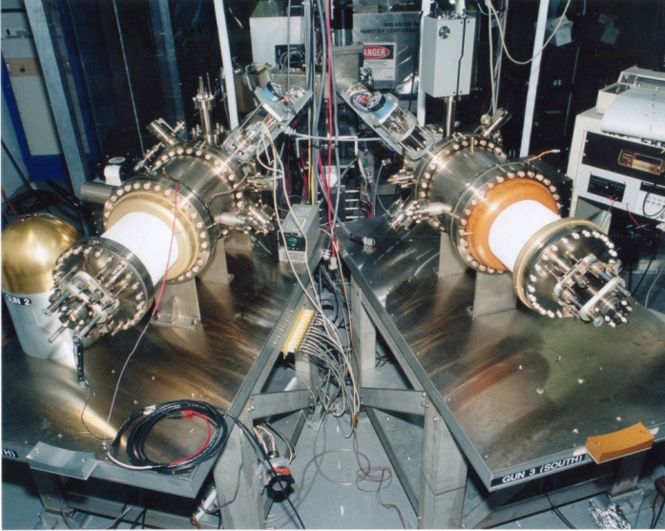
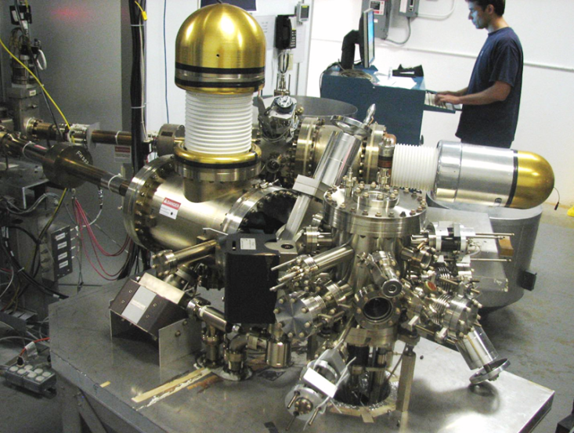
Always Tweaking the Design
1
4
Endless quest for perfection
2
3

Slide 6
Key Features of a Polarized Photogun
Photocathode
  High Polarization
  High QE (photoemission yield)
  Long Lifetime
Vacuum
  Static Vacuum
  Dynamic Vacuum
High Voltage
  Eliminating field emission
Drive Laser
  Reliable, phase locked to machine
  Adequate Power
  Wavelength Tunable

Slide 7
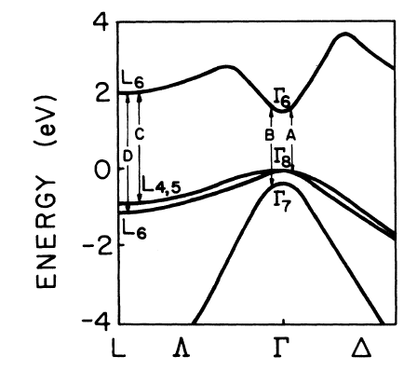
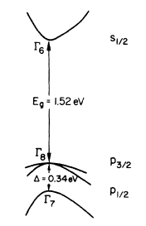
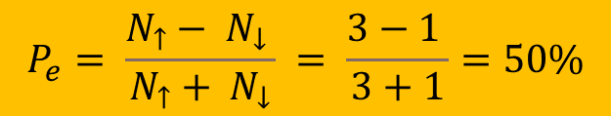
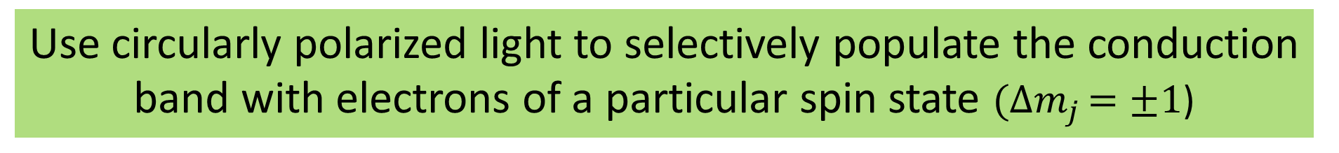
Making Polarized Electron Beams
GaAs energy levels
(spin down)
(spin up)
Conduction band
m_{j}: angular momentum quantum numbers
m _{j} = -1/2
+1/2
σ ⁻
σ ⁻
(left circ.)
Circled numbers represent transition probabilities
3
1
Valance band
m _{j} = -3/2
-1/2
+1/2
+3/2
m _{j} = -1/2
+1/2
$$P_{e}= \frac{N_{↑}− N_{↓} }{N_{↑}+ N_{↓}} = \frac{3−1 }{3+1}=50\%$$
Energy vs wave vector
Use circularly polarized light to selectively populate the conduction band with electrons of a particular spin state $({∆m}_{j }=±1$)

Slide 8
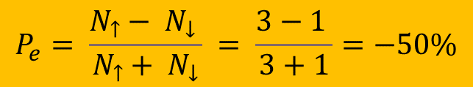
Making Polarized Electron Beams
GaAs energy levels
(spin down)
(spin up)
Conduction band
m_{j}: angular momentum quantum numbers
m _{j} = -1/2
+1/2
σ⁺
σ⁺
(right circ.)
Circled numbers represent transition probabilities
3
1
Valance band
m _{j} = -3/2
-1/2
+1/2
+3/2
m _{j} = -1/2
+1/2
Energy vs wave vector
$$P_{e}= \frac{N_{↑}− N_{↓} }{N_{↑}+ N_{↓}} = \frac{3−1 }{3+1}=−50\%$$
Use circularly polarized light to selectively populate the conduction band with electrons of a particular spin state $({∆m}_{j }=±1$)

Slide 9
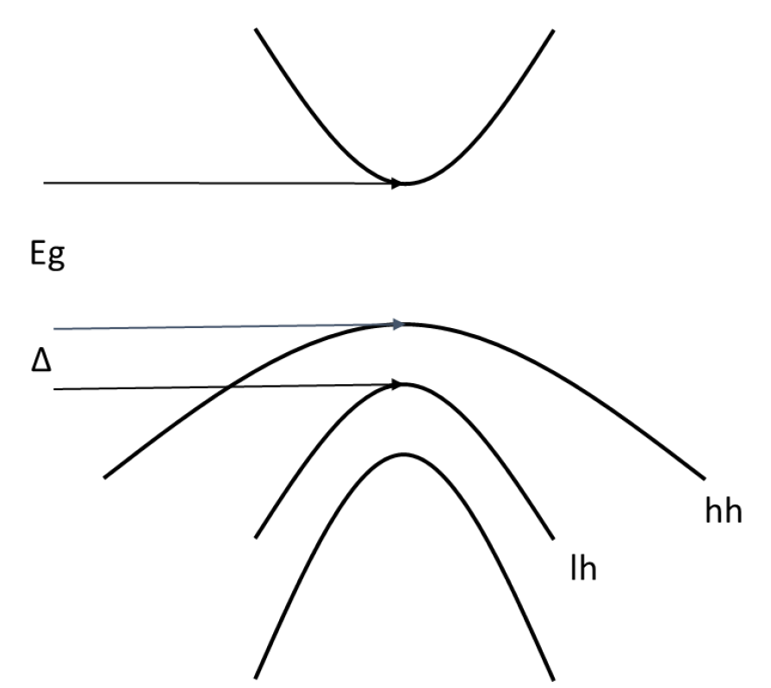
How to eliminate the valence band degeneracy?
This is what we want
m _{j} = -1/2
+1/2
σ⁺
σ ⁻
3
3
m _{j} = -3/2
+3/2
-1/2
+1/2
m _{j} = -1/2
+1/2
hh: heavy hole
lh: light hole
Maximum Polarization 100%

Slide 10
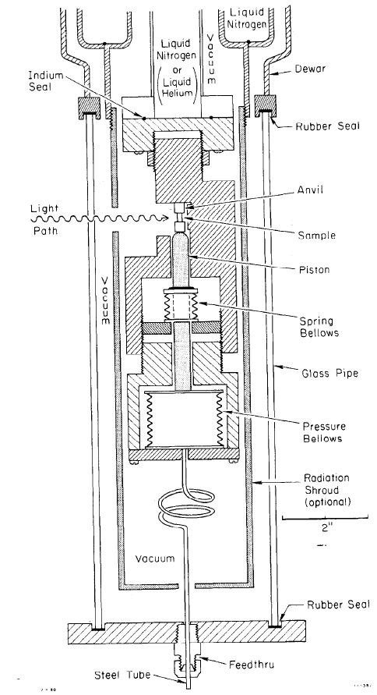
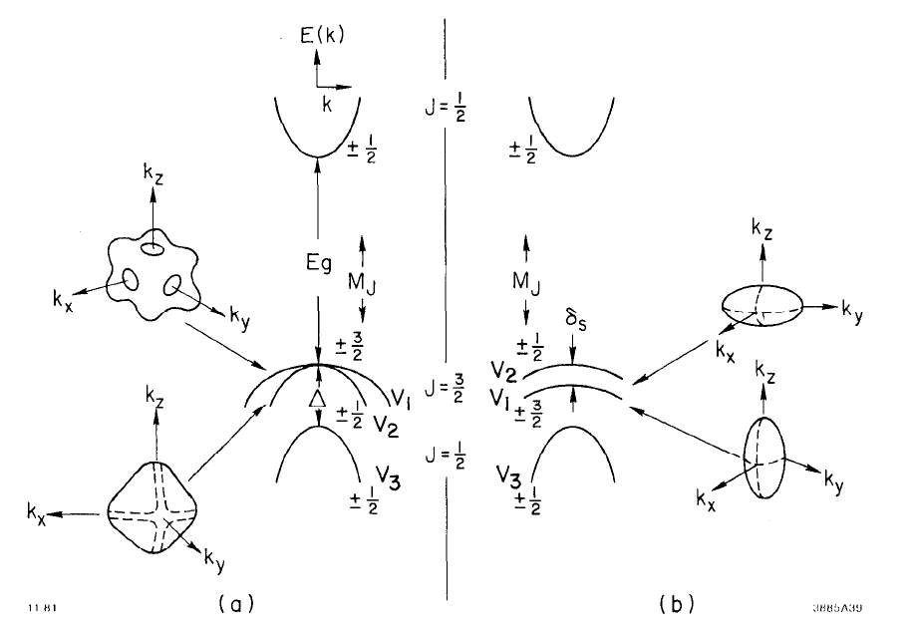
How to eliminate the valence band degeneracy?
PhD thesis, Paul Zorabedian, SLAC Report 248, 1982
Stress splits the degeneracy of valence band
Compress the GaAs crystal using a hydraulic press!
Hard to keep the sample from shattering

Slide 11
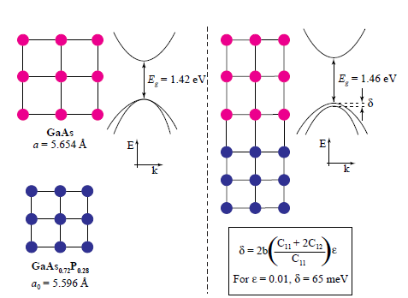
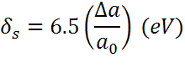
There’s a better way
Lattice mismatch provides stress
The band gap of the substrate layer must be larger than surface layer
Lattice constants must differ enough to introduce suitable strain
Adjust lattice constant of substrate by varying concentration of third element
Pablo Saez, PhD Thesis, SLAC Report 501, 1997
1% lattice mismatch provides equivalent force of hydraulic press!

Slide 12
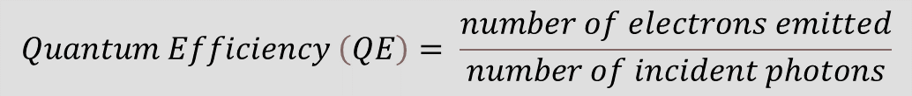
Strained-Layer GaAs – a game changer
Zn dopant
~5.10¹⁸
(cm⁻³)
MOCVD-grown
Polarization ~ 75% at ~ 850nm
QE ~ 0.1%
Strain relaxation – that’s the problem with this photocathode
Thickness beyond ~ 10 nm problematic
  Balancing QE vs Polarization
Required finicky modelocked Ti-sapphire lasers
No arsenic cap
GaAs
100 nm
GaAs_{0.71} P_{0.29}
2.5 μm
GaAs_{1-x} P_{x} (0<x<0.29)
2.5 μm
GaAs buffer
p-type GaAs
substrate
625 μm
$$Quantum Efficiency \left(QE\right)= \frac{number of electrons emitted}{number of incident photons}$$
Manufactured by Bandwidth Semiconductor

Slide 13

Quantum Engineering
Electrons tunnel through very thin buffer layers!!
Slide courtesy Toru Ujihara, PESP 2008
NEA surface
GaAs
Nanometer scale layers
GaAsP
GaAs
GaAsP
Conduction mini-band
GaAs
GaAsP
GaAs
GaAsP
GaAs
Strain-relaxed
GaAsP buffer layer
×
GaAs substrate
eg., GaAs/GaAsP
strained superlattice
Heavy hole mini-band
Light hole mini-band
D. Luh et al., SLAC, PESP2002
Only excite electrons from heavy-hole mini-band

Slide 14
Strained Superlattice GaAs/GaAsP – today’s benchmark
5.10¹⁹
MBE-grown epitaxial spin-polarizer wafer
Polarization ~ 85 to 90% at 780nm
QE ~ 1%
Thin layers eliminate strain relaxation – but complicate fabrication
Arsenic cap very beneficial
Highly doped surface layer to combat surface charge limit
Can use frequency doubled gain-switched diode laser/fiber amplifier to provide cheap RF-pulsed light at 780 nm
GaAs
5 nm
5.10¹⁷
14 pairs
GaAsP
3 nm
GaAs
4 nm
5.10¹⁸
GaAs_{0.64} P_{0.36}
2.5 μm
GaAs_{1-x} P_{x} (0<x<36)
2.5 μm
GaAs buffer
Be
(cm⁻³)
p-type GaAs
substrate
625 μm
Manufactured by SVT Associates

Slide 15
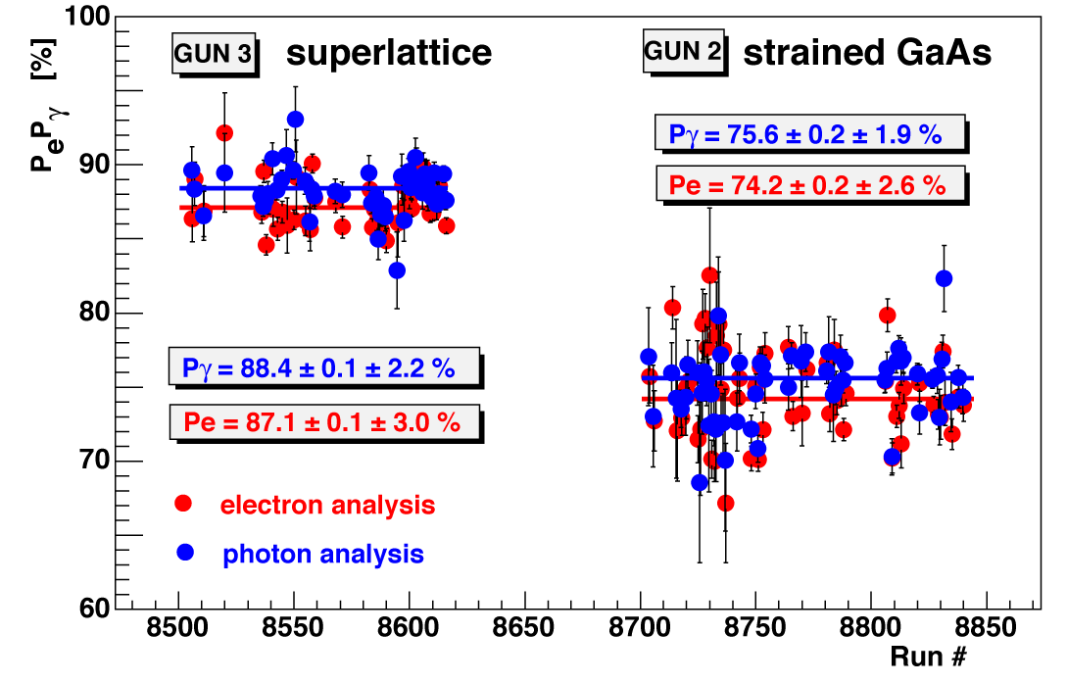
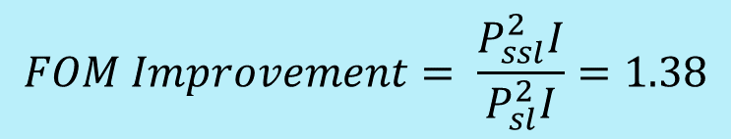
Experimenters appreciate higher polarization
Compton Polarimetry at Hall A
$$FOM Improvement= \frac{P_{ssl}^{2}I}{P_{sl}^{2}I}=1.38$$
This means it takes less time to do an experiment with same level of statistical accuracy

Slide 16
Today’s ‘spin crisis’
Today, there no longer exists a commercial supplier of strained superlattice GaAs/GaAsP photocathode. oh no! the physics community has come to expect 90% polarization – we can’t go back to bulk GaAs and 35% polarization
Historically, Labs worked with Universities to demonstrate high polarization photocathodes. Mostly this happened at SLAC, Nagoya University, and St. Petersburg Polytechnic University. T. Maruyama, Prof. Nakanishi, and Prof. Mamaev were central figures
DOE then assisted the commercialization of high polarization photocathodes via SBIR/STTR program: Bandwidth Semiconductor and SVT Associates in USA
DOE to the rescue….(let’s do what we did ‘last time’)
Ongoing programs:
  JLab and BNL partnered with Old Dominion University (Prof. Sylvain Marsillac)
  JLab and University of California Santa Barbara (M. Stutzman, C. Palmstrøm)
  BNL and Sandia National Lab (L. Cultrera and Center for Integrated Nanotechnology)
  BNL and Structured Materials Industries, Inc (L. Cultrera)
  Cornell University, and Center for Bright Beams

Slide 17
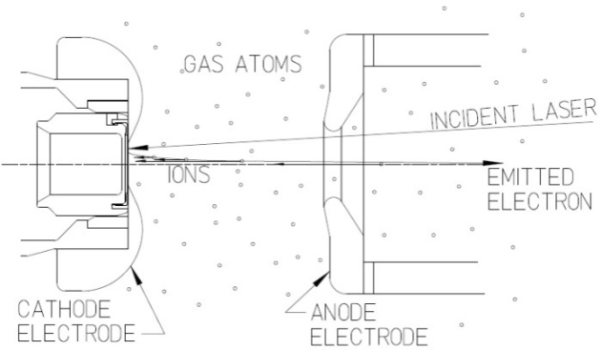
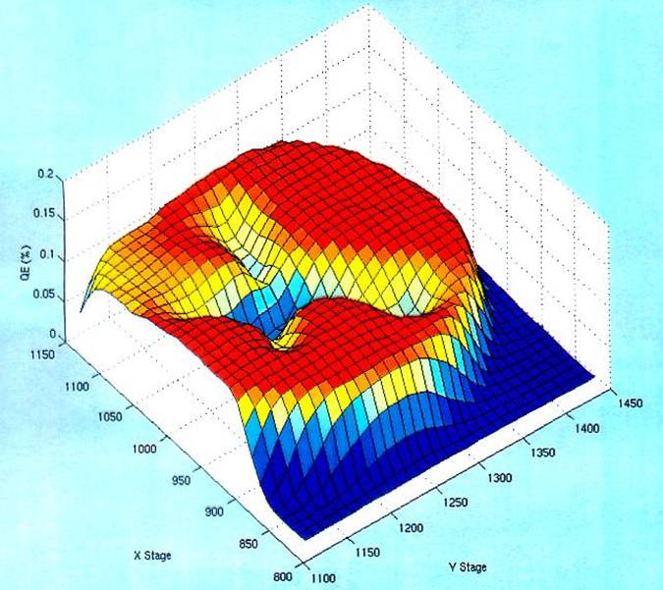
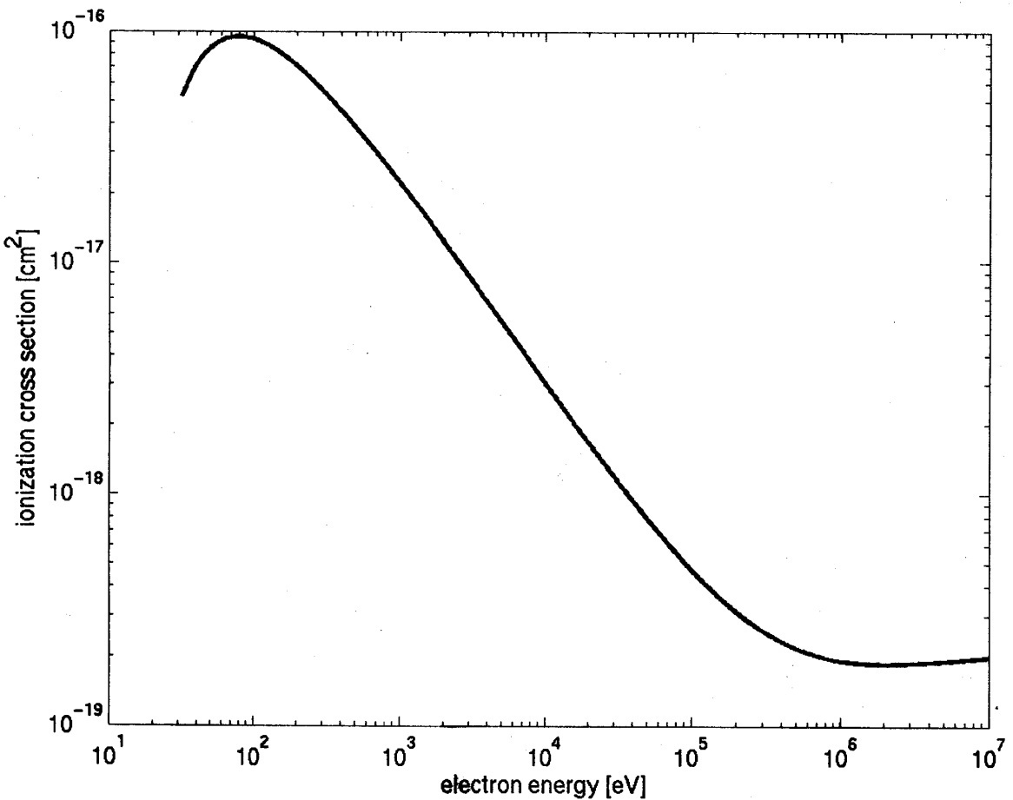
Imperfect Vacuum = Finite Lifetime
Ion bombardment - notice characteristic “trench” from laser spot to electrostatic center of photocathode
Ionization cross-section for H₂
Most ions created at low energy
200kV

Slide 18
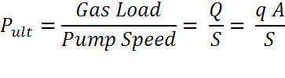
Improve Vacuum and Improve Lifetime
Q= gas load, q= outgassing rate, A = surface area, S = pump speed
Make Gas Load small and Pump Speed large
Gas Load inside a polarized photogun comes from:
leaks (real and virtual)
outgassing from the vacuum chamber walls and things you put inside the gun
from the accelerator beamline
Limited selection of pumps for UHV and XHV

Slide 19
Pumpdown: effect of outgassing on p(t)
In a “perfect” vacuum vessel of volume V, pumped with constant pumping speed S, if p(t) is the pressure at time t, without leaks, permeation or outgassing:
10⁻⁴
10⁻⁵
Pressure
Volume depletion
10⁻⁶
1
10
100
1000
time
with 0.5 < n < 1.2
ln(p) versus ln(t)
Slide from G.Vandoni, CERN

Slide 20
Phenomena behind outgassing
All relatively well understood and modeled:
It’s their combination which is not easy to understand!
Surface:
Adsorption
chemisorption/ physisorption
Desorption
Bulk:
(Dissociation and) Permeation
Diffusion
Outgassing:
Combination of all these!
Molecules deposited while exposed at atmospheric pressure desorb under vacuum
(Dissociation) and diffusion of atomic species in the near surface, through microcracks and the oxide layer
Diffusion from bulk of atomic H, trapped during manufacturing process, recombination at the surface and desorption as H₂
Permeation through thin walls and elastomeric seals
Slide from G.Vandoni, CERN

Slide 21
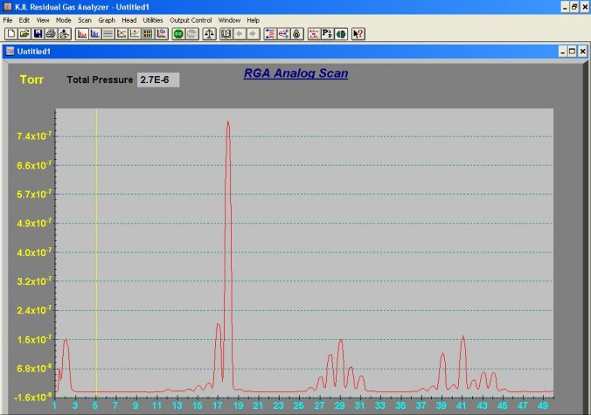
Get rid of the water…
What does “bake” mean? It means heat the vacuum chamber at 250ºC for 30 hours to rid the interior surface of the photogun of adsorbed water
“Residual Gas Analysis” of
un-baked vacuum chamber:
We need vacuum 10⁻¹¹Torr
H₂O
CO
H₂
CO₂

Slide 22
Post-Bakeout
These compounds are chemically inert
H₂
CH4
CO
CO₂

Slide 23
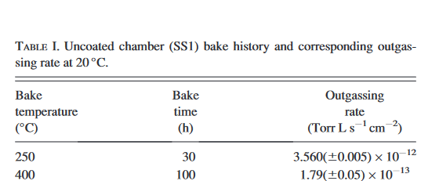
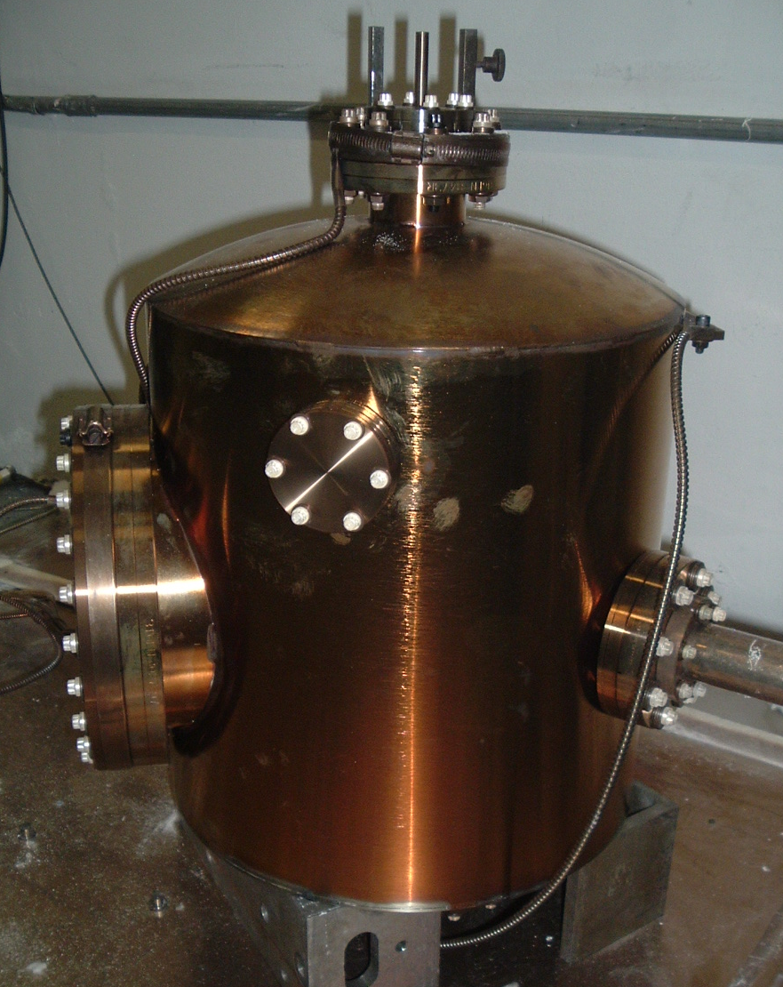
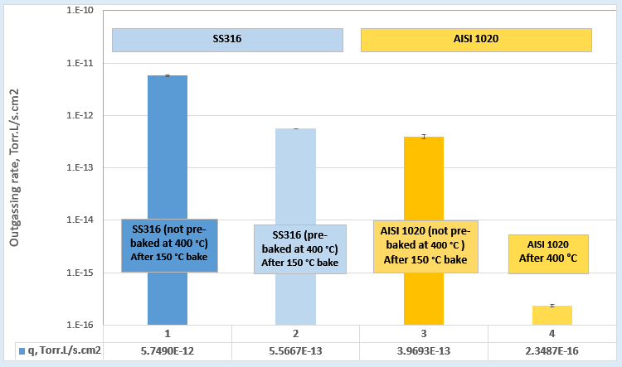

Get rid of the hydrogen…
‘VIRGO/LIGO” bake: 400ºC bakeout for 9 days, under vacuum
Our stainless-steel measurements
"Effect of heat treatments and coatings on the outgassing rate of stainless-steel chambers”, Journal of Vacuum Science & Technology A 32, 021604 (2014)
$P_{tomorrow}= \frac{P_{today}}{1000}$ ?
Low carbon steel

Slide 24

Get rid of the hydrogen…
‘VIRGO/LIGO” bake: 400ºC bakeout for 9 days, under vacuum
Our stainless-steel measurements
"Effect of heat treatments and coatings on the outgassing rate of stainless-steel chambers”, Journal of Vacuum Science & Technology A 32, 021604 (2014)
$P_{tomorrow}= \frac{P_{today}}{1000}$ ?
Low carbon steel

Slide 25
Back up slides

