Slide 1

Polarized Ion Sources
Deepak Raparia

Slide 2
Outlines
Introduction
Polarization techniques
Electron polarization
Nuclear polarization
Ionization
Polarized Sources H, D, ³He, ⁶Li
Conclusion

Slide 3
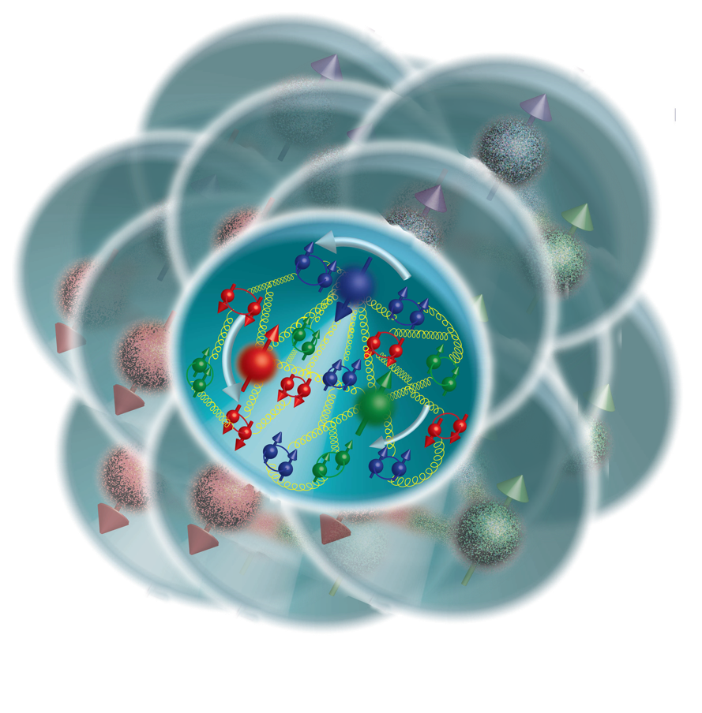
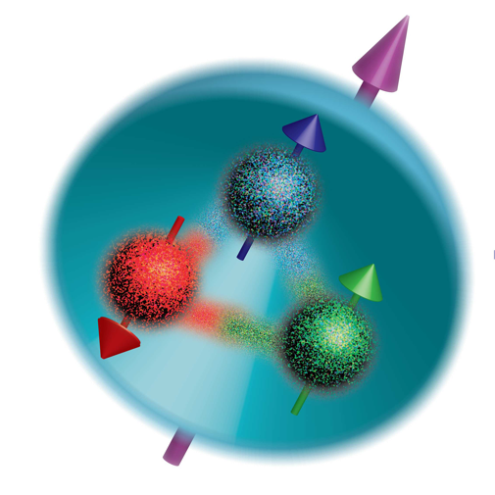
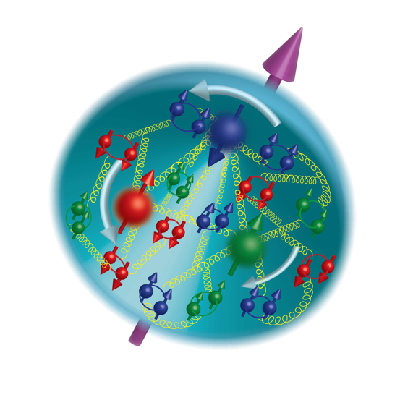
Some Fundamental Physics Questions
Proton in a nucleus
The Proton
in 1975
The Proton
in 2015
The Spin of the Proton
Proton is composed of three “valence quarks”
Each quark carries spin ½
Proton carries spin ½ - two quarks with spin “up” and one with spin “down” would yield a net “up” spin of ½
However, experiments in the 1980’s revealed that the three valence quarks only contribute a few percent of the proton spin!

Slide 4
Only Polarized Proton Collider
EBIS

Slide 5
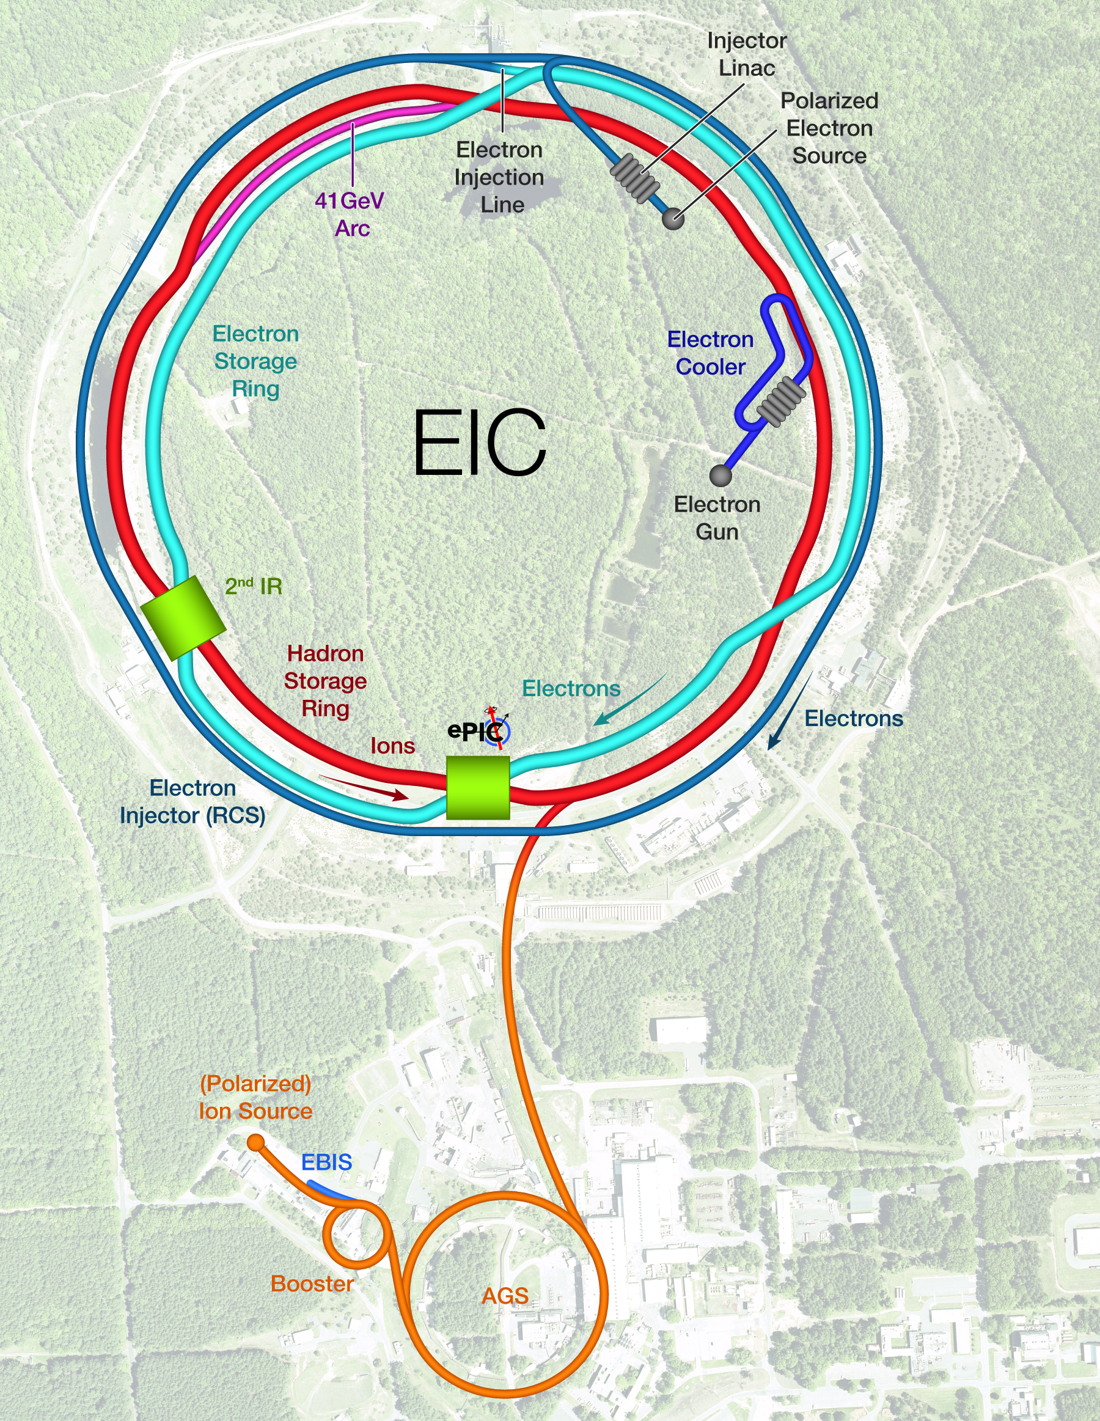
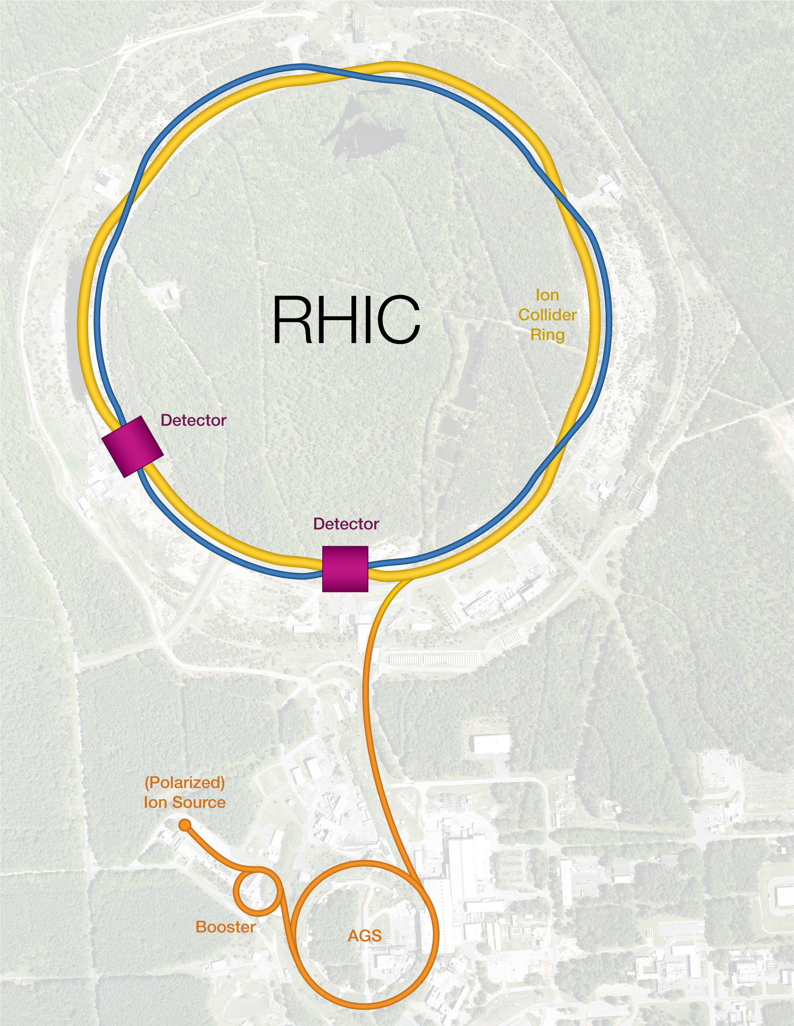
Electron Ion Collider

Slide 6
Ion Polarization Techniques
Three-step process
First electron spin polarization
-Spin filter
- Optically pumped cell
(2) Electron spin transfer to nucleus
-RF transition
-Sona Transition
(3) Ionization to positive ot negative ions
-Electron beam, ECR ionizer
-Cs cell, Cs Beam
-Plasma ionizer
-Alkali vapor
-He cell

Slide 7
Polarization: Nuclear Scattering
All the proton have spin with randomly distributed
To collect proton with same spin in a group > Polarized proton
E M. Hafner 1958
Unpolarized P 220 MeV, 0.3 𝝻A , scattered with Carbon 12
Highly polarized >90% 4 10⁶ P /s,
higher momentum spread
and angular spread
Ref: E. M. Hafner, Physical Review, 111(1) , 1958

Slide 8
Spin filter
Electron has much larger Magnetic moment than proton
In H atom proton feel very strong magnetic filed (~20T) due to electro
Thermal H-atom passed in an inhomogeneous magnetic field (4-pole or 6-pole)
atoms with spin up are driven towards the axis of magnet, atoms with spin down are defocused. The acceptance angle ⍺ only depends on atomic beam energy and pol-tip B-filed, and is independent of radius and length
Since the direction of the field pointing
in all direction , at the exit of magnet ,
average polarization od the beam is zero
Ifa homogeneous dipole filed
after the multipole magnet: adiabatic
change if the angular velocity of the
field seen by H-atom is low compered to
the Larmor Precession of the atom in
that filed
Homogeneous dipole
Guide filed
W. Haeberly . PSTP 2007, AIP Conf. Proc. 980,15, (2008)

Slide 9
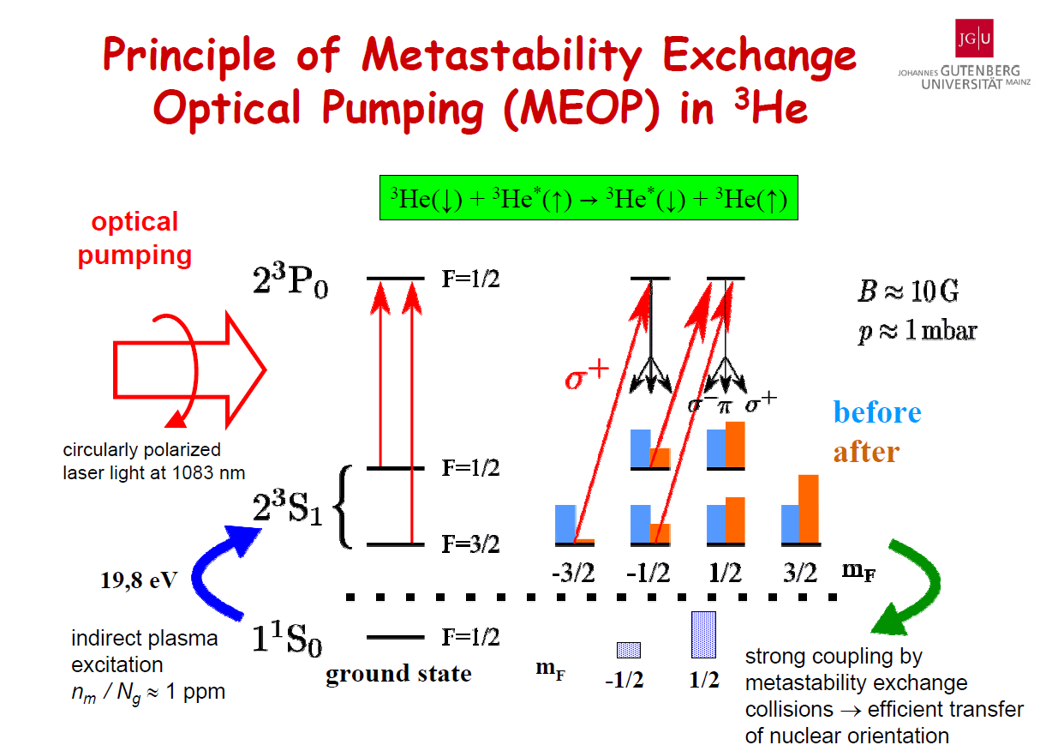
Optical Pumping
Absorption of polarized photon and subsequent spontaneous emission of unpolarized photon (optical pumping) Angular momentum of atom electron shell is changed during the process and atom takes on electron polarization
Direct optical pumping of H atom need 121.5 nm laser, unavailable
Polarized ³He atoms are obtained by exciting transitions 2³ S1 → 2³P0 by 1083 nm laser
Colegrove, Schearer
And Walters 1963

Slide 10
Optically pump polarized ion source (OPPIS)
For optical pumping of rubidium atoms laser radiation with wavelength of 795 nm is used to excite transitions: 5S1/2 → 5P1/2
spontaneous decay 5S_{1/2} 100% polarization Rb atom
Charge exchange collision Polarized electron transfer to H
Superconducting solenoid 2.5T
Laser-795 nm
Optical pumping
Rb: NL(Rb) ~10¹⁴ cm-2
Rb⁺
Rb
Proton
source
H⁺
H⁰
Charge-exchange collisions:σ ~10¹⁴ cm2
A. Zelenski, AIP Conf. Proc. 570, 179, (2000)

Slide 11
Nuclear polarization
Week guide field
Strong guide field with RF (BNL pulse source)
Sona transition (BNL OPPIS)
(1) Pure spin state (↑↑), maxed state (↑↓)
Use week guide filed ( weak compared to the hyperfine interaction filed B=50.7 mT)
pure state remain completely polarized P=1
Mix state atoms preces one about other (↑↓+↓↑) P=0
Net polarization p=0.5 ,

Slide 12
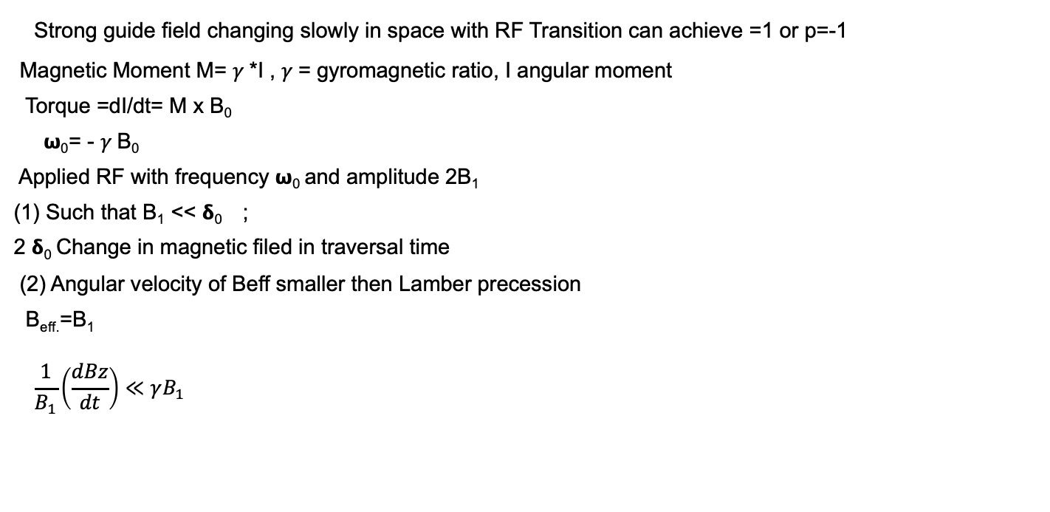
Nuclear Polarization: RF Transitions
Strong guide field changing slowly in space with RF Transition can achieve =1 or p=-1
Magnetic Moment M= $γ$*I , $γ$= gyromagnetic ratio, I angular moment
Torque =dI/dt= M x B₀
𝞈₀= - $γ$B₀
Applied RF with frequency 𝞈₀ and amplitude 2B₁
(1) Such that B₁ << 𝝳₀ ;
2 𝝳₀ Change in magnetic filed in traversal time
(2) Angular velocity of Beff smaller then Lamber precession
B_{eff.}=B₁
$$\frac{1}{B_{1}}\left(\frac{dBz}{dt}\right)≪γB_{1}$$
W. Haeberli, Ann. Rev. Nucl. Sci. 17, 1967

Slide 13
Nuclear polarization: Sona transition
Change the quantization axis of an external magnetic field faster than the electron spin could follow its redirection through Larmor precision. This would lead to an inversion of occupation numbers in the pure states of the hyperfine splitting in which both, proton and electron spin, are aligned in the same direction, Example H atom
B>dB/dz
Off axis filed rotation as seen by atoms
Larmor Precision
Sona condition:
Karl Engels
New Insights into Sona Transitions
Ref: A. Kponou, etal, AIP Vol. 980, 2008
W. Haeberli, Ann. Rev. Nucl. Sci. 17, 1967

Slide 14
Ionization
(1) By electron, Less efficient, ( 2e-4)
electron beam with solenoid filed improve ionization (1e-3)
Example : Preposed polarized H3-3 source at BNL
(2) Charge exchange ,
Example: BNL source 1982’s
(3) Resonant Charge Exchange
Example : INR Mosco ,D+ source
(4) Alkali Vapor
Example : OPPIS at BNL

Slide 15
BNL pulse polarized H⁻ source (1982)
Atomic Beam
Pulse Ground state atomic beam line with an RF Disassociator (pulse), Nozzle thermalized at 100 K
Sextupole for electron polarized beam
RF transition for polarization transfer to Nuclear Pulse to pulse basis
Density of H⁰ beam 2-3 10¹¹ atoms /cm³
Charge Exchange
Surface ionization of cesium on a hot porous
Tungsten button , 30KeV 15 mA Cs⁺
Neutralized by cesium vapor (pulse)
6-10 particle mA,30 cm long
Charge exchange ionization
H↑ +Cs⁰ -> H⁻ ↑+ Cs⁺
H⁻ ↑ , 25 uA, 75% polarization,
emittance 0.065 pi cm mrad
500 𝜇s
J. Alessi , etal, “ A 25 uA Pulsed Polarized H- ion source, 6th internation Symp. On high energy Spin Physics, France, 9/12-19, 1984

Slide 16
INR Polarized H/D Source
Resonant Plasma Ionizer
Atomic beam:
RF Dissociator , cooled 20-80 K
Electron polarization: Sextupole Spin filter
Nuclear polarization: RF Transition Unit
Plasma guided by axial (plasma coil) and transverse (electromagnet) toward to neutralizer surface Plasma interact with neutralizer surface and reflect as neutral hot atom towards molybdenum converter surface. At converter hot atoms are converted to partially negative ion and injected into ionization region
INR Moscow achieved 4 mA of polarized H⁻ with > 90% polarization and D⁻ current
up to 60 mA
Ref:A. Belov, AIP Conf. Proc. 980,209 (2008)

Slide 17
Polarized source for NICA ion collider (JINR)
Atomic beam,
RF dissociator pulse length 3 ms, 2 mm Pyrex channel , cool to 80K
For Hydrogen WFT and SET. +1 and -1
Deuterium MFT, WFT, and SET +1, _1, Tensor polarization +1, -2,
Charge exchange storage cell
Polarized D⁰ ↑ injected in storage cell and Hydrogen plasma Jet
generated by a plasma arc-discharge source
Charge exchange collision
D^{0↑} H⁺ -> D^{+ ↑} + D⁰
And proton
H^{0 ↑.} + D^{+.} -> H^{+ ↑} +D⁰
2016-2017: 6 mA D⁺ , 88% polarization

Slide 18
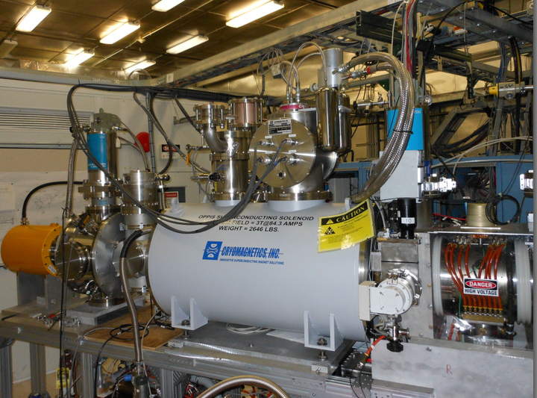
Optically pumped Polarized Ions Source (OPPIS)
OPPIS produces Polarized H⁻ ion pulse current. 0.6 mA
81-85% polarization @200 MeV
Electron polarization : optical pumping
Nuclear polarization: Sona transition
Ionization:: Na vapor
A. Zelenski, etal, AIP Conf. Proc. 980, 221 (2008)

Slide 19
OPPIS Layout
OPPIS: Six steps: (1) Atomic beam, FABS, (2) Ionization of atomic beam, He-Cell, (3) Rb-electron polarization, Rb-Cell, (4) Rb-electron transfer to H, Rb-cell (5) nuclear polarization, Sona Transition and (6) ionization, Na cell
95%
60%
70%
8%
D. Raparia, CAD Seminar 24/09/13

Slide 20
Optically –Pumped Rb- vapor Cell
Polarization Vs Rb-vapor thickness
Polarization vs. Magnetic field in Rb cell

Slide 21
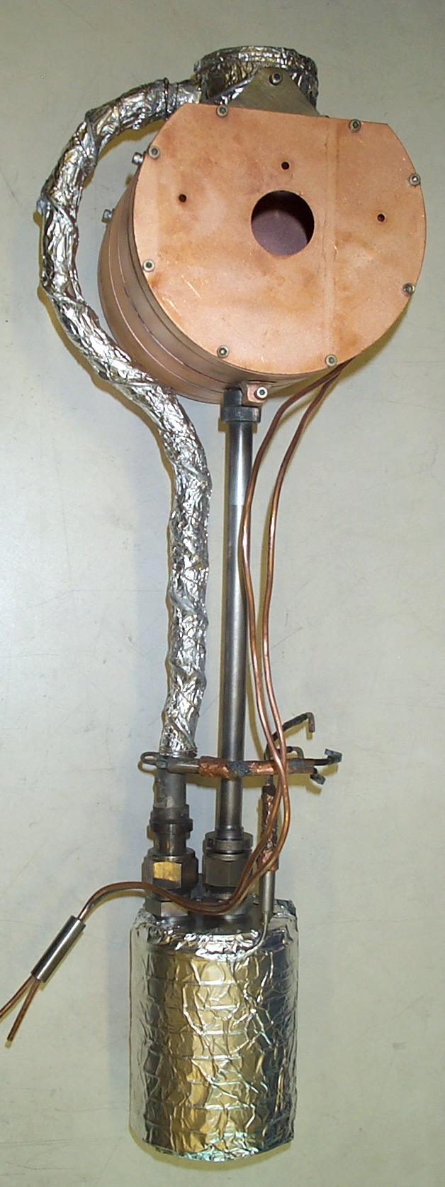
Sodium –Jet Ionizer Cell

Slide 22
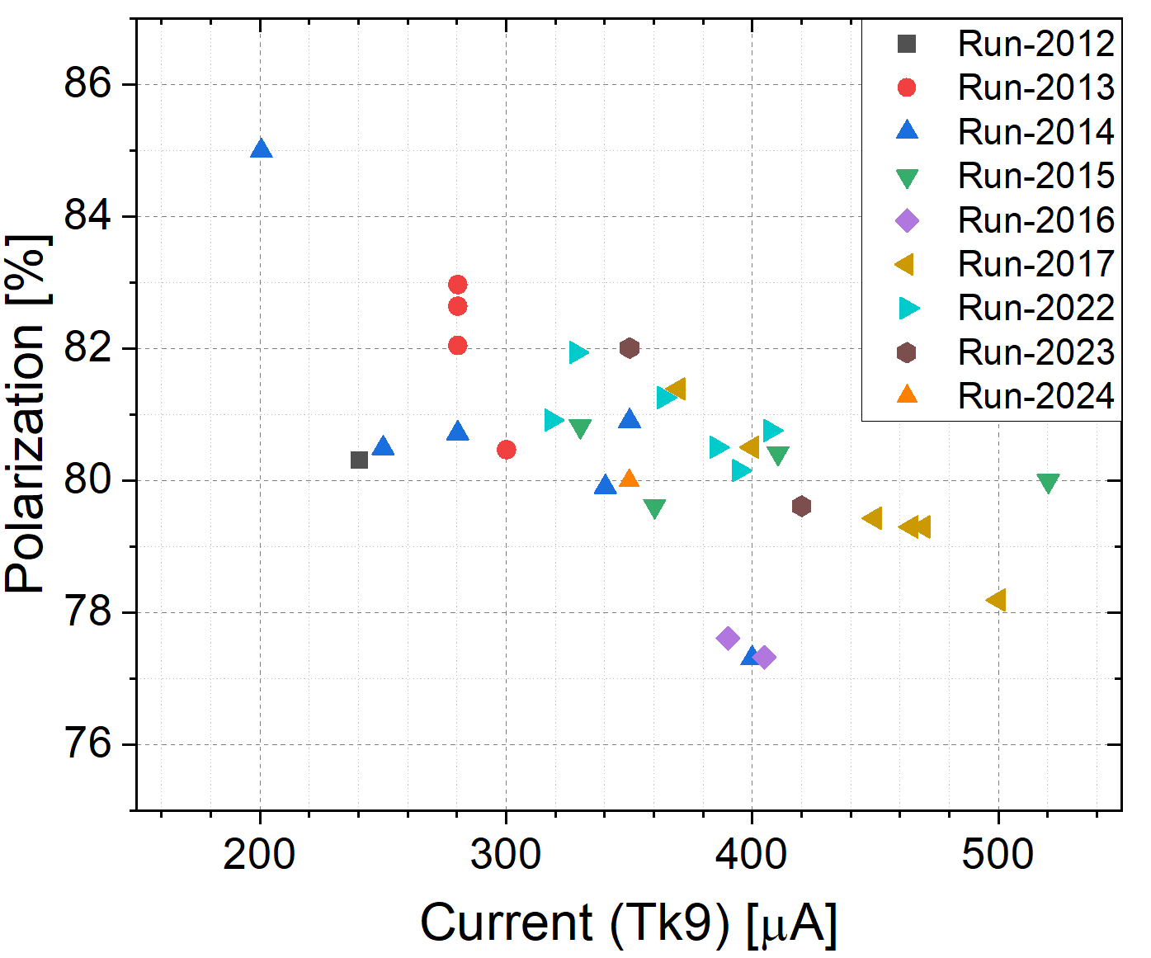
H- Current at 200 MeV
Operation of the OPPIS H- ion Source during the RHIC Run-2024
A. Cannovo

Slide 23
Requirements to the 3He⁺⁺ Source at BNL
J. Alessi, G. Atoian, E. Beebe, S. Ikeda, S. Kondrashev, J. Maxwell, M. Musgrave, R. Milner, M. Okamura, A. Poblaguev, D. Raparia, J. Ritter, A. Sukhanov, S. Trabocchi, N. B. Wuerfel, A. Zelenski,
Intensity ~ 2.5∙10¹¹ 3He⁺⁺ ions in 20 us pulse ~5.0 mA-peak current
Maximum polarization > 80%
Compatibility with the operational EBIS for heavy ion physics.
Spin flip for every source pulse in the beam transport line.
³He polarization by optical pumping and metastability-exchange technique inside the EBIS in high (5.0T) magnetic field. No polarization losses in ³He⁺ state.
EBIS is used for efficient ionization and accumulation of polarized ³He⁺⁺ ions to the full capacity of about (2.5-5.0)∙10¹¹ , ³He⁺⁺ ions.
Polarized ³He⁺⁺ source is a part of the EBIS. The development of the polarized ³He ion source is being done as a collaboration between BNL and Massachusetts Institute of Technology (MIT).

Slide 24
Principle of EBIS Operation
10A, 10-20 keV
Radial trapping of ions by the space charge of the electron beam.
Axial trapping by applied electrostatic potentials at ends of trap.
The total charge of ions extracted per pulse is ~ (0.5 – 0.8) x ( number electrons in the trap ~1.0∙10¹² )
Ion output per pulse is proportional to the trap length and electron current.
Ion charge state increases with increasing confinement time.
Output current pulse is independent of species or charge state!
Notes:
24

Slide 25
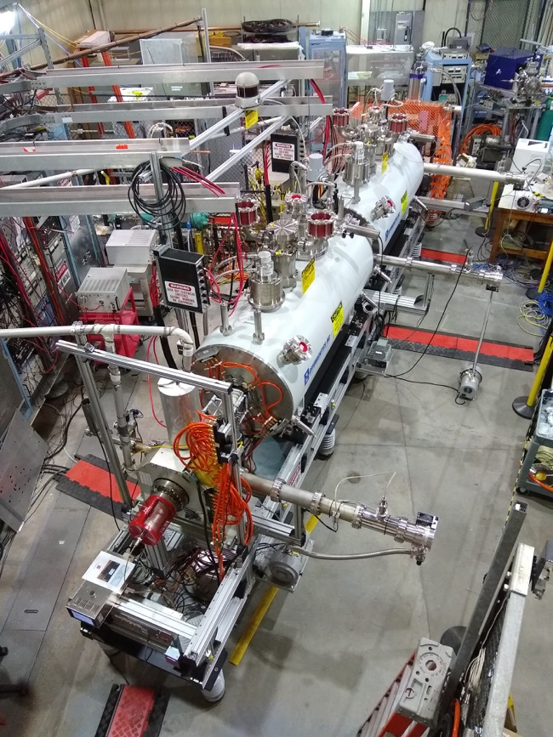
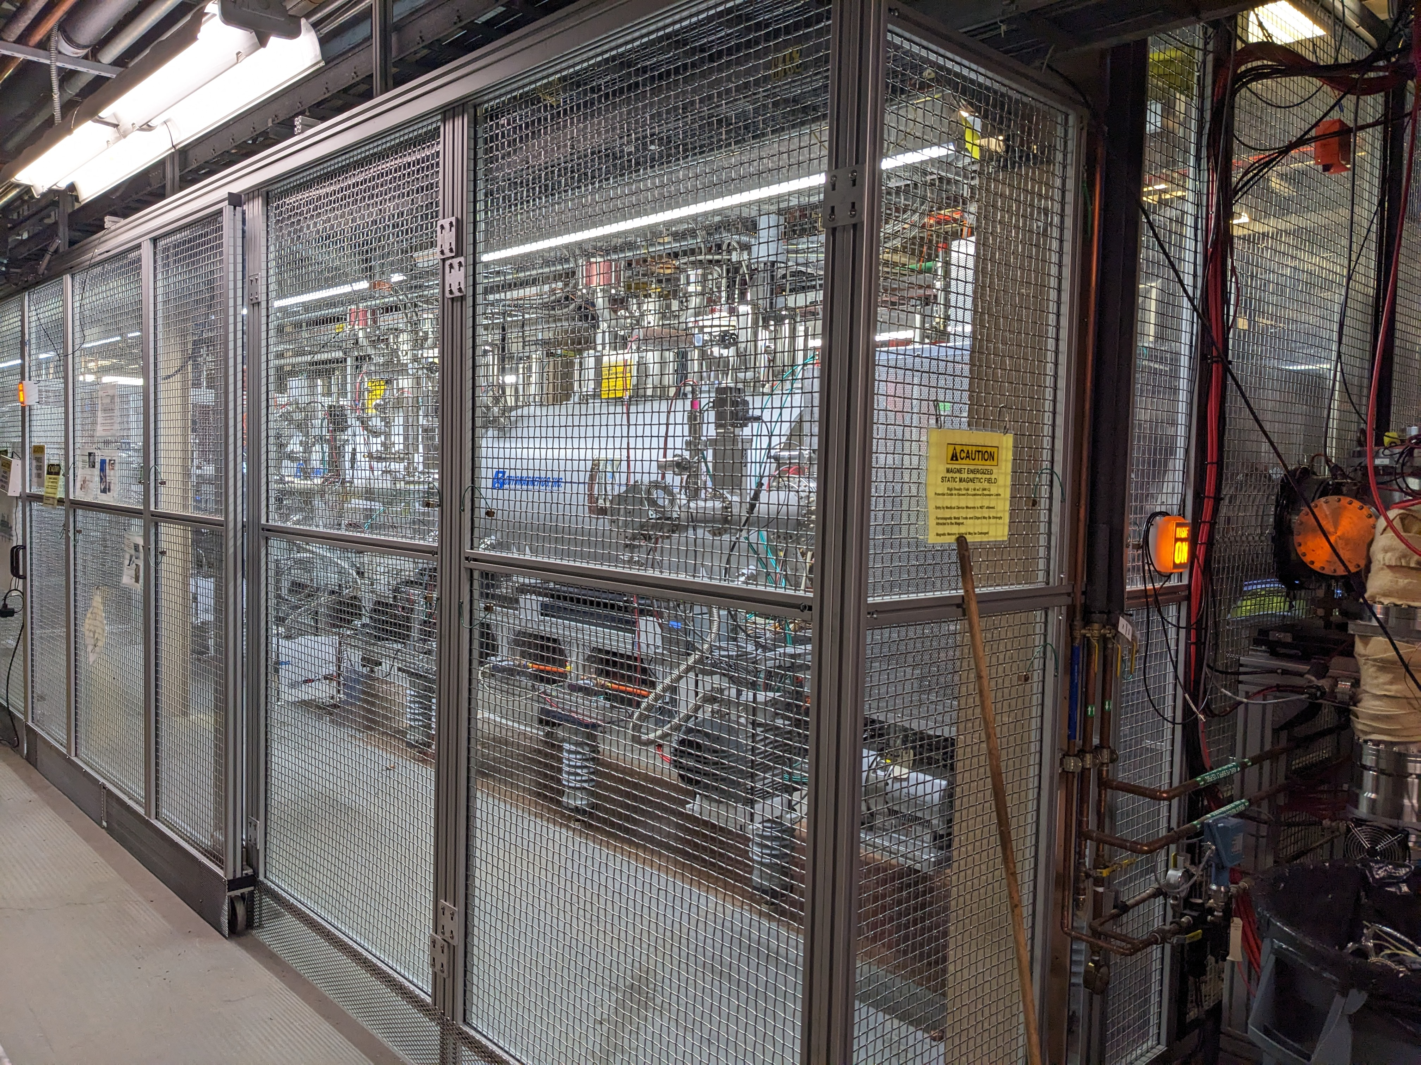
EEBIS
At the site
In the test Lab

Slide 26
Optical Pumping and Probe Lasers Layout
WS6-200
wavemeter
Pumping laser
Probe laser, Toptica, DL-100, diode laser
Detector
Pumping laser-Keopsys 10 W 1083 nm- fiber laser

Slide 27
Circular polarized
Laser light at 1083 nm

Slide 28
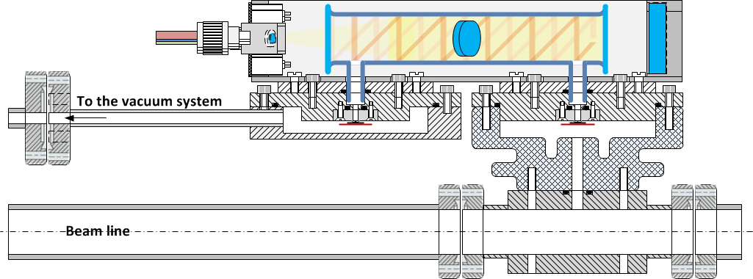
³He-cell with filling and injection valves inside the EBIS SC Solenoid-1
Prepare the ³He gas for polarization by the purification system; Valve1-open/ Valve2-close
Polarize the ³He gas inside the glass-cell by a MEOP technique; Valve1-close/ Valve2-close
Continually control the polarization of the injected ³He gas by using the Optical Probe polarimeter
Inject a polarized ³He portions into drift tube (beam line) through the pulsed valve ( ~2-3*10¹² atoms/pulse); Valve1-close/ Valve2-open
Ionize the polarized atoms of ³He by electron beam (~10 A).
³He-cell
Rf –discharge
To the purification system
³He Injection pulse Valve2
³He Filling Valve1
HV isolator
e-beam ~10A
Drift tube (20-40 kV)

Slide 29
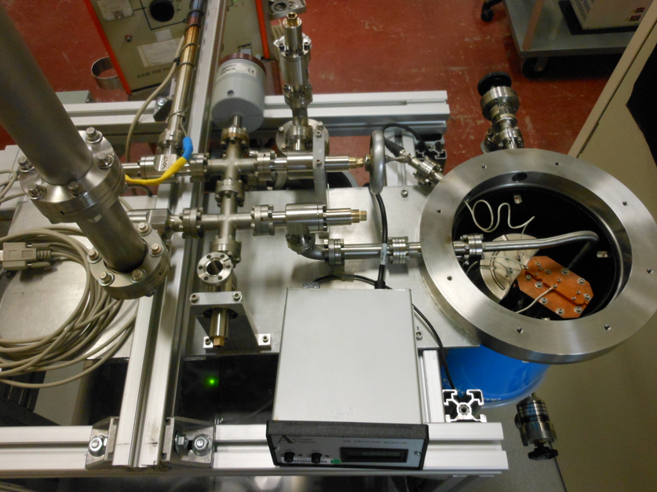
³He-gas purification and filling system
Modified Cryo-pump for 3He
purification and storage
Vessel filled with charcoal granules
The hydrogen Balmer-alpha line intesty at 656 nm is strongly reduced <0.4%. Relative to the 668 nm 3He line after 10 hours of RF discharge with the solation valve closed
The pump also absorbs quite a significant amount of ³He gas (of about 100 scc).
The absorbed gas is released by the pump vessel heating ~20K.
This provides gas storage and supply for ³He-cell operation at the optimal pressure value (3-5 Torr).

Slide 30
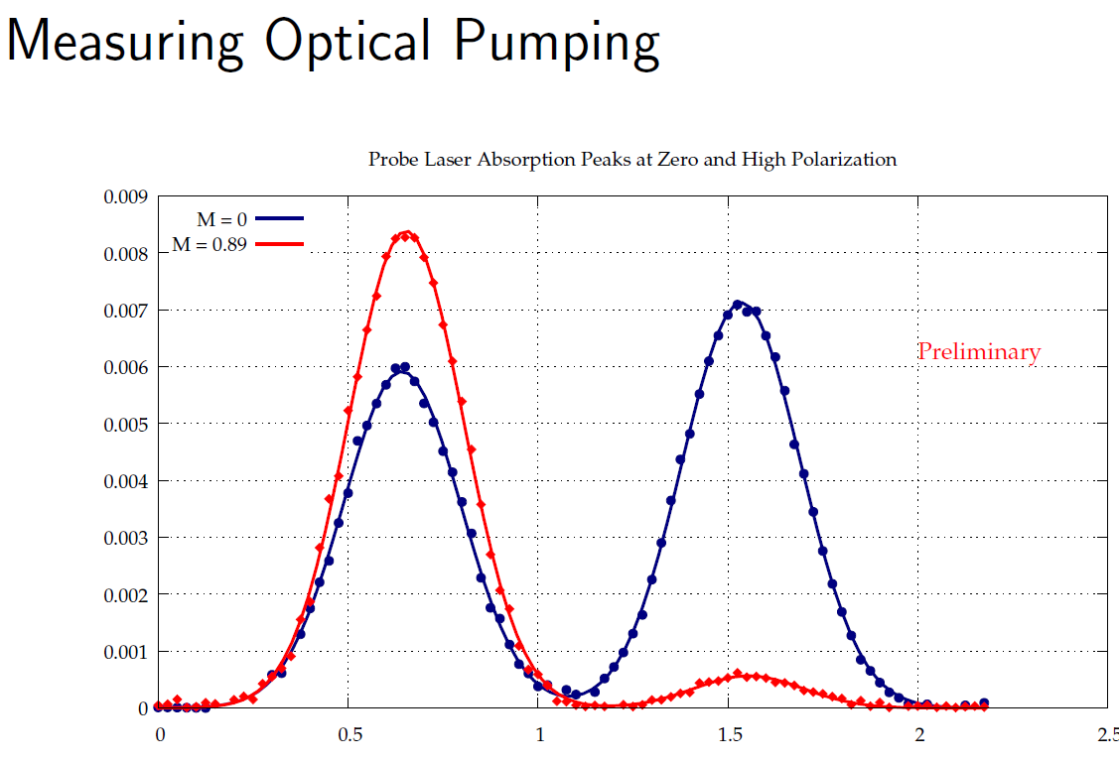
Polarization Measurements by the Probe Laser Absorption
Closed cell
Open cell
89% polarization in. sealed
³He cell at 3 Torr pressure
Polarization build-up time .
0-4 min: Valve open
5-27 min: valve closed
29 min: laser off and valve opened
(3 Torr valve closed)

Slide 31
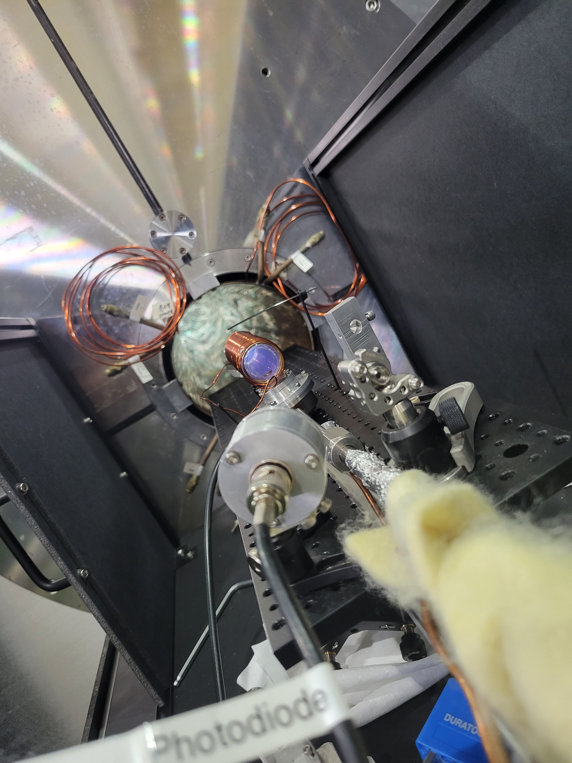
Gas Cell Testing at EBIS Test Lab
Progress On a Polarized 3He⁺⁺ ion source at BNL
Noah Wuerfel 09/23

Slide 32
Development of Polarized Lithium ion Source for EIC
This topic will be discussed on Monday 09/23 , 11:40 AM
By Chao Peng

Slide 33
Polarized Ion Source
09/23 10:40 – 11:00
Karl Engels
New Insights into Sona Transitions
11:00 - 11:20
Antonino Cannavo
Operation of the OPPIS H⁻ Ion Source during the RHIC Run-2024
11:20 - 11:40
Noah Wuerfel
Progress on a Polarized 3He++ Ion Source at BNL
11:40 - 12:00
Chao Peng
Development of Polarized Lithium Sources for EIC

Slide 34
Summary
Polarize ion source three steps
Electron polarization: Spin filtering, optical pumping
(2) Transfer to nucleus polarization : RF transition, Sona transition
(3) Ionization: electron collision , charge exchange, resonance plasma charge exchange, alkali vapor
BNL Polarized H- source(1982): 25 𝝻A, 75%
INR Polarized H⁻ source with Resonant Plasma Ionizer: 4mA, 90%
NICA Polarized H⁺/D⁺ Source: 6mA D⁺, 88 %
BNL OPPIS (Pol. H-): 1.6 mA, P=85 % Reliable. Run unattended
BNL Polarized ³He: High polarization of He was achieved in the "open" cell in the high magnetic field. Final test for Cell cell is underway.
Will be world highest intensity pol. ³He source

Slide 36
Relativistic Heavy Ion Collider (RHIC) world’s only polarized proton collider
Two superconducting storage rings
3.8km circumference
Energy up to 255GeV protons, or 100GeV/n gold
110 bunches/beam
Ion species from protons to uranium
60% proton polarization
Exceeded design luminosity by factor 44
6 interaction regions, 2 detectors
First high energy e-cooling
Very successful stochastic cooling for
In operation since 2001
EIC is based on existing RHIC facility

Slide 37
Fast Atomic Beam Source

Slide 38
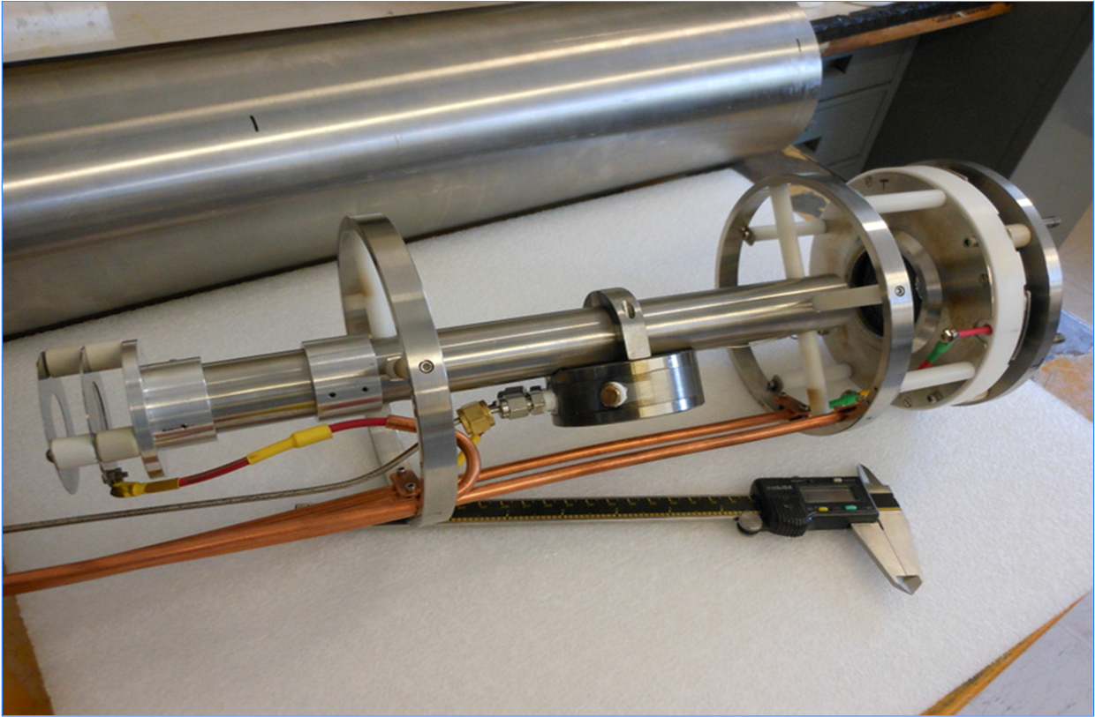
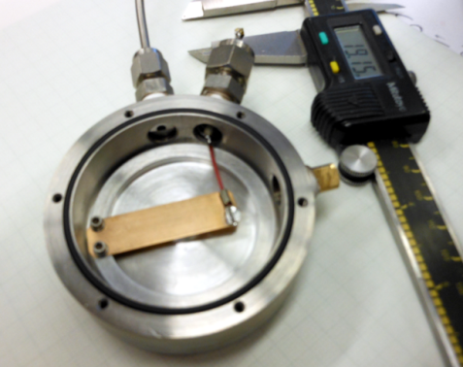
He-Ionizer Cell with 3-grid Energy Separation System
Two functions of the new He-cell with pulsed valve:
Ionization of the injected neutral beam
Deceleration of the ionized part of the beam to separate from the no-ionized part
He-valve
Operating in high magnetic field ~1-3T
He-cell
He-pulsed
valve
3-grid beam
Deceleration system

Slide 39
Extended EBIS for ³He⁺⁺
The polarized ³He ion source will be mounted on the Solenoid-1.
The atoms of the ³He gas will be polarized by Metastability Exchange Optical Pumping (MEOP) technique and
After injected through a fast pulse valve in the ion trap region of the EBIS.
There the ³He ions will be trapped and bred to the ³He⁺⁺ state.

Slide 40
P/D Polarization Techniques
A. Zelenski
Three step Process: (1) electron polarization, (2) polarization transfer E-P,
(3) ionization positive or negative

