Slide 1

PSTP
2024
Thomas Jefferson National Accelerator Facility
An Introduction to
Polarized Solid Targets
Chris Keith
Jefferson Lab Target Group

Slide 2

Outline
Target and Polarization Basics
Dynamic Nuclear Polarization
Polarized Target Equipment
  Target Materials
  Magnets
  Refrigerators
  Microwaves
  NMR
In-beam Behavior
Tensor Polarization & Deuteron NMR Signals
What to Expect this Week

Slide 3
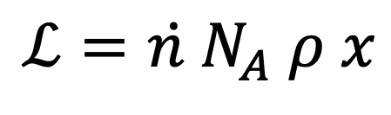
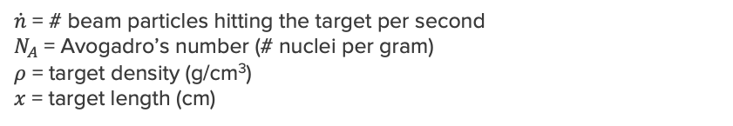
Luminosity
Luminosity is a measure of the intensity of the beam + target interaction
$$ℒ=\dot{n }N_{A} ρ x$$
$\dot{n}$ = # beam particles hitting the target per second
$N_{A}$ = Avogadro’s number (# nuclei per gram)
$ρ$ = target density (g/cm³)
$x$ = target length (cm)
Beam current
Target thickness
Experiment (location) | Beam s⁻¹ | Target material | Length cm | Luminosity 10³⁵ s⁻¹ cm⁻² | Limiting factor
MOLLER (Hall A c. 2026) | 4 x 10¹⁴ | Liq. Hydrogen | 125 | 20 000 | Beam power
Typical experiment (Hall A/C) | 2 x 10¹⁴ | Liq. Hydrogen | 10 | 1000 | Target boiling
Polarized gas target (Hall C) | 2 x 10¹⁴ | 3He | 60 | 20 | Radiation damage
Polarized solid target (Hall C) | 6 x 10¹¹ | NH3 | 3 | 10 | Radiation damage
Polarized solid target (B) | 6 x 10¹⁰ | NH3 | 5 | 1 | Detector rates
GlueX (D) (photon beam) | 10⁸ | Liq. Hydrogen | 30 | 0.001 | Tagger rates

Slide 4

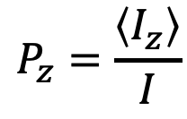



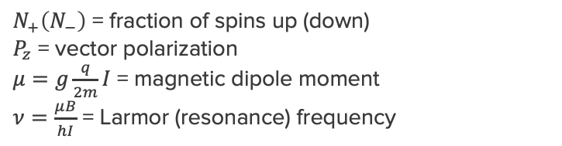
Polarization
Polarization is a measure how many target spins are pointing in a specified direction (usually a magnetic field)
$N_{+}\left(N_{−}\right)$ = fraction of spins up (down)
$P_{z}$ = vector polarization
$μ=g\frac{q}{2m}I$ = magnetic dipole moment
$ν=\frac{μB}{hI}$ = Larmor (resonance) frequency
Magnetic field, z
$$P_{z}=\frac{\left\langle I_{z}\right\rangle }{I}$$
ν
I
For spin-1/2 (protons, electrons, ³He, etc)
$P_{z}= N_{+}−N_{−}$
$1= N_{+}+N_{−}$
$$N_{+}=\frac{1}{2}\left[1+P_{z}\right]$$
$$N_{−}=\frac{1}{2}\left[1−P_{z}\right]$$
Deuterons (spin-1) also have a 2nd type of polarization (more on this later)

Slide 5
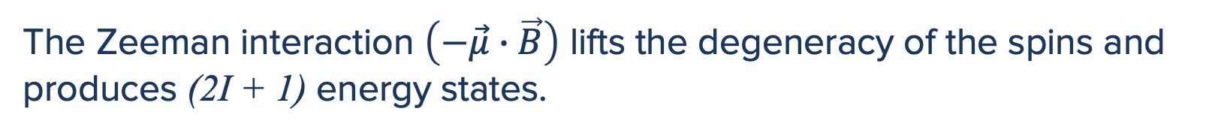
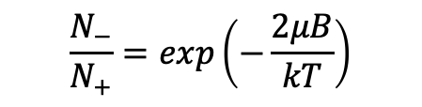

Thermal Equilibrium
The Zeeman interaction $\left(−\vec{μ}∙\vec{B}\right)$ lifts the degeneracy of the spins and produces (2I + 1) energy states.
Left undisturbed, an ensemble of spins will eventually come into thermal equilibrium with its environment and the levels will be populated according to the Boltzmann relation
Energy
An oscillating field at the resonance frequency will induce transitions between the states (spin flips)
-1/2
$$\frac{N_{−}}{N_{+}}=exp\left(−\frac{2μB}{kT}\right)$$
0
h$ν=\frac{μB}{I}$
N₋
+1/2
Magnetic field
N₊

Slide 6

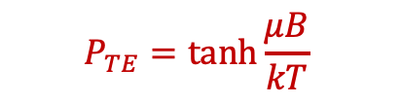

Thermal Equilibrium
The spins approach equilibrium in an exponential manner.
The 1/e constant is T₁, the spin-lattice relaxation time.
T₁ depends on the temperature, field, and sample purity.
P_{TE}
P_{TE}, the thermal equilibrium polarization, is given by the Brillouin function
Appreciable nuclear polarization requires ultra-low temperatures and high magnetic fields.
$$P_{TE}=\frac{2I+1}{2I}\coth\left(\frac{2I+1}{2I}x\right)−\frac{1}{2I}\coth\left(\frac{1}{2I}x\right)$$
Electrons are much more forgiving.
Electrons: short T₁
Nuclei: long T₁
$$x=\frac{μB}{kT}$$
for spin-1/2
$$P_{TE}=\tanh{\frac{μB}{kT}}$$

Slide 7
Dynamic Nuclear Polarization
Thermal equilibrium (aka “Brute-Force”) polarization of nuclear requires very high magnetic fields and ultra low temperatures.
Almost all polarized solid targets utilize a different polarization method:
Dynamic Nuclear Polarization (DNP)
  Select an appropriate dielectric solid with the nucleus you want to polarize (usually protons or deuterons)
  Implant it with a low concentration (10⁻⁴) of unpaired electron spins (paramagnetic impurities)
  Polarize the electrons at a moderate field and temperature (∼ 5 T/ 1 K)
  Transfer the electron polarization to the nuclei

Slide 8
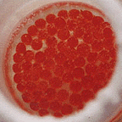
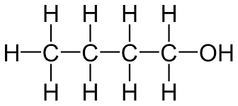
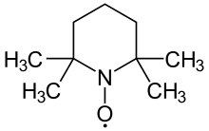
Dynamic Nuclear Polarization
Thermal equilibrium (aka “Brute-Force”) polarization of nuclear requires very high magnetic fields and ultra low temperatures.
Almost all polarized solid targets utilize a different method:
Dynamic Nuclear Polarization (DNP)
  Select an appropriate dielectric solid with the nucleus to polarize (eg protons or deuterons)
  Implant it with a low concentration (10⁻⁴) of unpaired electron spins (paramagnetic impurities)
  Polarize the electrons at a moderate field and temperature (∼ 5 T/ 1 K)
  Transfer the electron polarization to the nuclei
Butanol has 10 free protons
TEMPO has one unpaired electron
EXAMPLE
TEMPO-doped butanol

Slide 9

Dynamic Nuclear Polarization
Consider an electron – proton “pair” in a strong magnet field
$ℋ=−{\vec{μ}}_{e}∙\vec{B}−{\vec{μ}}_{p}∙\vec{B}$
The Zeeman interaction will produce four energy levels
Magnetic field, z
proton
electron
NMR
An oscillating field can produce
Electron spin flips at the ESR frequency ν_{e} = 28 GHz/ T
Proton spin flips at the NMR frequency ν_{p} = 42.6 MHz/ T
Double spin flips are “forbidden”
ESR

Slide 10

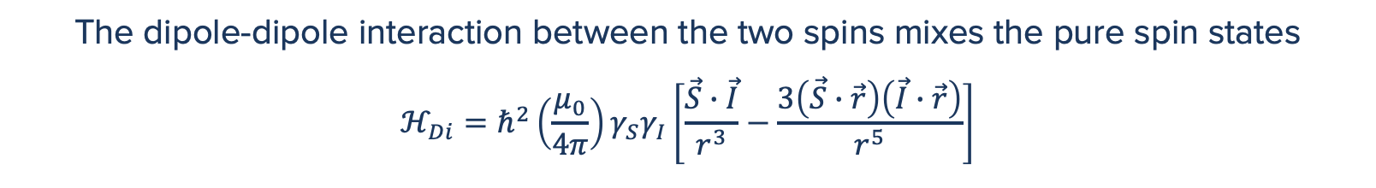






Dynamic Nuclear Polarization
The dipole-dipole interaction between the two spins mixes the pure spin states
$$ℋ_{Di}=ℏ^{2}\left(\frac{μ_{0}}{4π}\right)γ_{S}γ_{I}\left[\frac{\vec{S}∙\vec{I}}{r^{3}}−\frac{3\left(\vec{S}∙\vec{r}\right)\left(\vec{I}∙\vec{r}\right)}{r^{5}}\right]$$
000
Magnetic field, z
000
000
000
$$A=(1−3\cos^{2}{θ)S_{z}I_{Z}}$$
r
$$=ℏ^{2}\left(\frac{μ_{0}}{4π}\right)γ_{S}γ_{I}\frac{1}{r^{3}}\left(A+B+C+D+E+F\right)$$
$$B =−\frac{1}{4}(1−3\cos^{2}{θ)(S_{+}I_{−}+S_{−}I_{+})}$$
$$C =−\frac{3}{2}\sin{θ}\cos{θ}e^{−iφ}(S_{+}I_{z}+S_{z}I_{+})$$
$$D =−\frac{3}{2}sin{θ}\cos{θ}e^{iφ}(S_{−}I_{z}+S_{z}I_{−})$$
a
b
-
$$E =−\frac{3}{4}\sin^{2}{θ}e^{−2iφ}S_{+}I_{+}$$
$$F =−\frac{3}{4}\sin^{2}{θ}e^{2iφ}S_{−}I_{−}$$
a
b
+
An oscillating field can now produce the “forbidden” transitions where both spins flip
Flip-flips at ν_{e} - ν_{p}
Flip-flops at ν_{e} + ν_{p}
flip-flip
a
b
flip-flop
+
a
b
-

Slide 11
Dynamic Nuclear Polarization
Consider a single electron spin surrounded by several protons in a high field at low temperature. (Say, 5 T and 1 K)
The electron is polarized by the field and temperature, but the protons are not.
Microwaves at ν_{e} – ν_{p} induce flip-flip transitions between the electron an a nearby proton
The electron relaxes back to its ground state (T₁ ∼ 0.1 s)
The proton does not (T₁ > 100 s)

Slide 12
Dynamic Nuclear Polarization
Consider a single electron spin surrounded by several protons in a high field at low temperature. (Say, 5 T and 1 K)
The electron is polarized by the field and temperature, but the protons are not.
Microwaves at ν_{e} – ν_{p} induce flip-flip transitions between the electron an a nearby proton
Microwaves continue to drive these transitions until all the proton spins are opposite the electron (positive polarization)

Slide 13
Dynamic Nuclear Polarization
Consider a single electron spin surrounded by several protons in a high field at low temperature. (Say, 5 T and 1 K)
The electron is polarized by the field and temperature, but the protons are not.
Microwaves at ν_{e} + ν_{p} induce flip-flop transitions
and lead to negative polarization.
One unpaired electron can polarize about 10⁴ nuclear spins

Slide 14
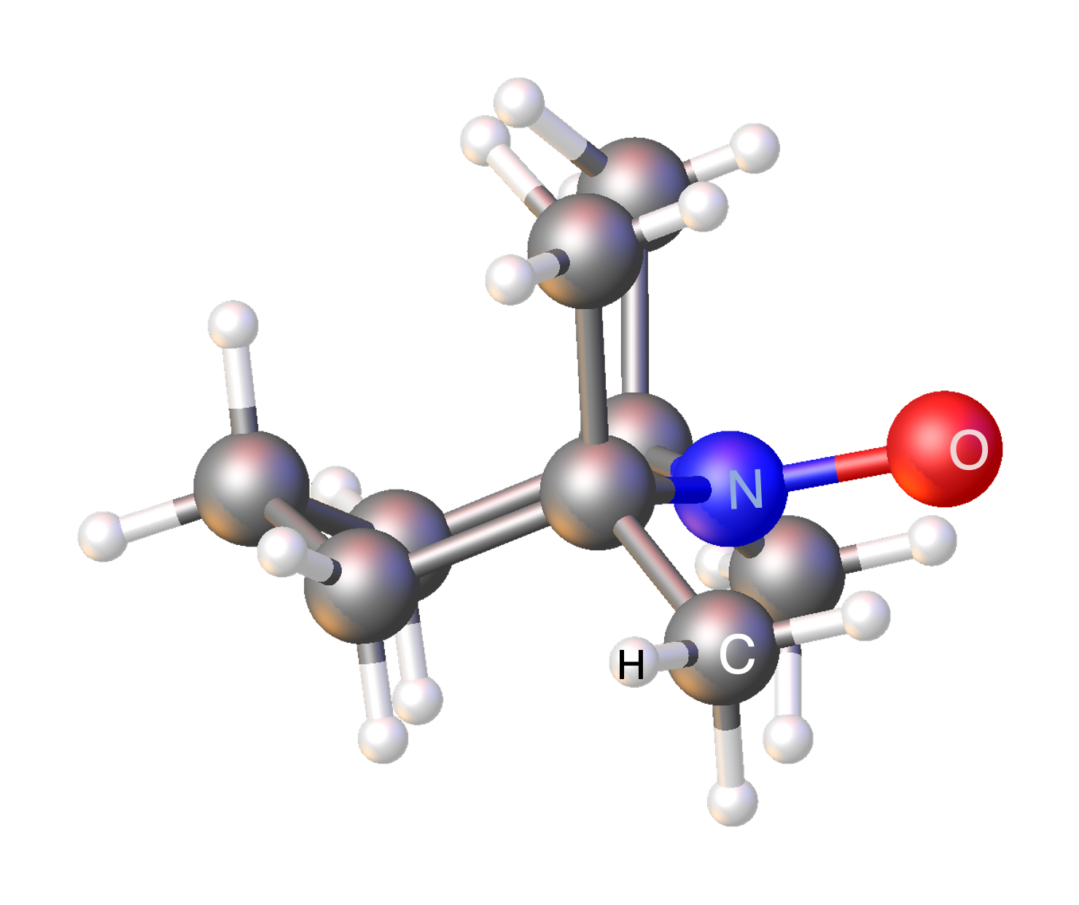
Dynamic Nuclear Polarization
Jeffries (1957)
Abragam and Proctor (1958)
This method of dynamic polarization is called the SOLID EFFECT.
“One electron polarizes one proton, one spin-flip at a time” -cdk
Microwave
absorption
The SE requires a very narrow ESR line and produces a polarization curve with well resolved + and – polarization peaks.
Polarization
0
Microwave
frequency
ν_{e} – ν_{p}
ν_{e}
ν_{e} + ν_{p}
Most modern-day target materials don’t display this behavior, so other “spin-transfer” mechanisms are needed to explain how DNP works.
Cross Effect: “Two electrons polarize one proton.”
Thermal Mixing: “A network of electrons polarizes a network of protons.”
TEMPO + BUTANOL
Microwave
absorption
TEMPO
Polarization
Microwave
frequency
ν_{e} – ν_{p}
ν_{e}
ν_{e} + ν_{p}

Slide 15
Polarized Target Equipment
There are five major components to a typical solid polarized target system
  Target sample
  Magnet
  Refrigerator
  Microwaves
  NMR
For optimum results, the field-to-temperature ratio should be at least 5:1
Historically this has meant
2.5T & 0.5 K
5T & 1K
Superconducting
Magnet
NMR
Refrigerator
Microwaves
Vacuum Pumps
Target Sample

Slide 16
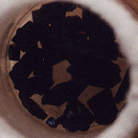
Target Material
DNP target material is characterized by three main quantities:
  Maximum polarization (“Can you make it higher?”)
  Radiation resistance (“Why is the polarization going down?”)
  Dilution Factor, the ratio of polarized to unpolarized nucleons (“What’s all this junk?”)
Chemically doped (eg TEMPO)
Radiolytically doped
Material
Dilution Factor (%)
Polarization (%)
Butanol, C₄H₉OH
13.5
> 90%
Ammonia, NH₃
17.7
> 90%
Lithium hydride, ⁷LiH
25.0
90%
Material
Dilution Factor (%)
Polarization (%)
d-Butanol, C₄D₉OD
23.8
> 80%
d-Ammonia, ND₃
30.0
50%
Lithium deuteride, ⁶LiD
50.0
55%
Radiation resistance
Comments
moderate
Easy to produce and handle
high
Works well at
5T and 1K
extremely high
Slow polarization,
long relaxation

Slide 17
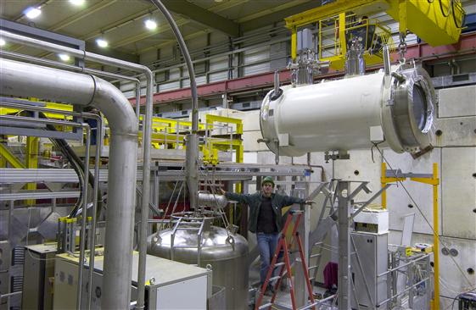
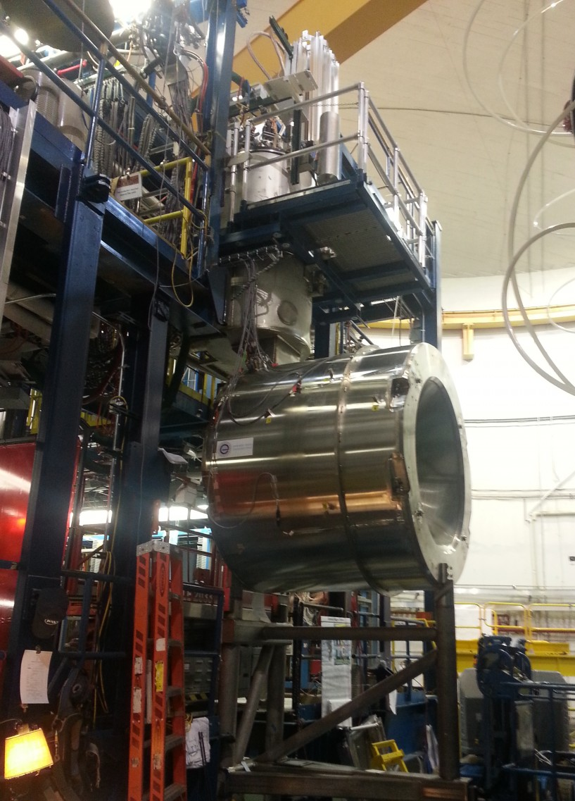
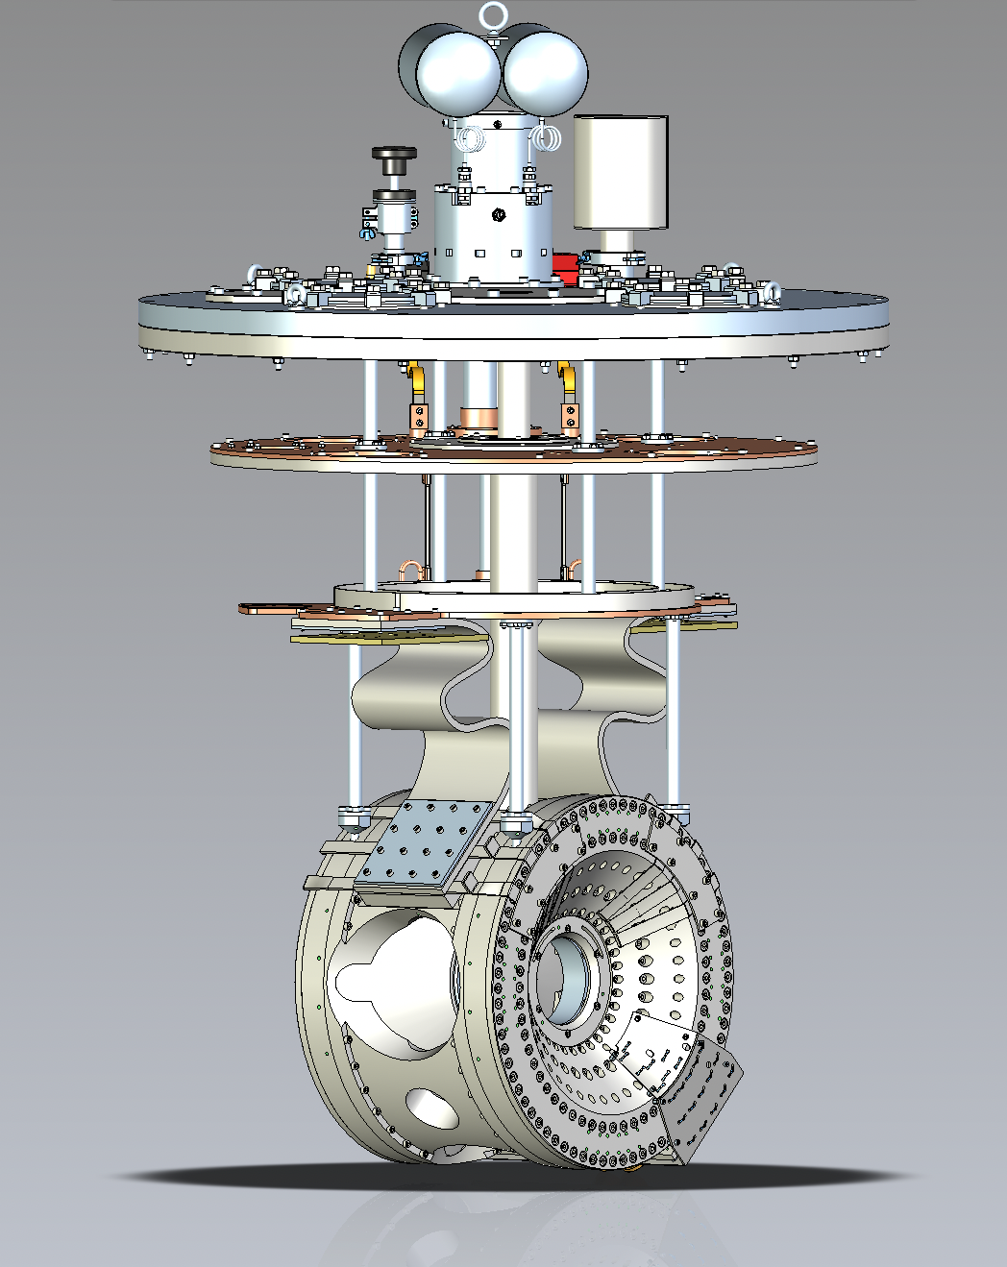
Magnets
Typical polarizing fields for DNP are 2.5 – 5 T, generated by superconducting magnets
We typically aim for a field uniformity of about 100 ppm over the sample volume
In many cases, the structure of the magnet dictates the range of available scattering angles → frozen spin target
COMPASS 2.5 T magnet
Solenoid + correction coils + saddle coils
CLAS12 5 T solenoid
Solenoid + counter windings
JLab 5 T split coil
Pseudo Helmholtz geometry
Rotate for longitudinal or transverse polarization

Slide 18
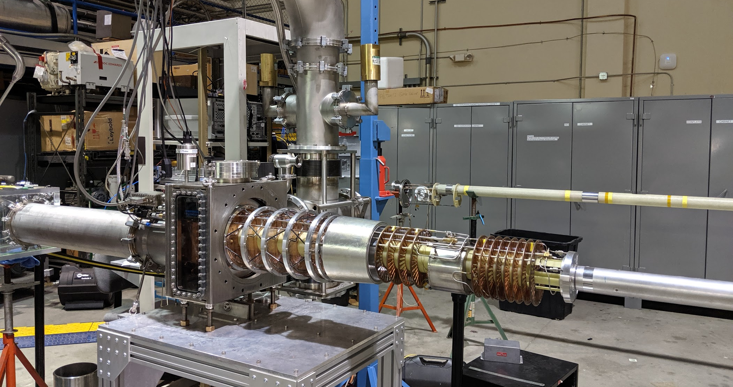
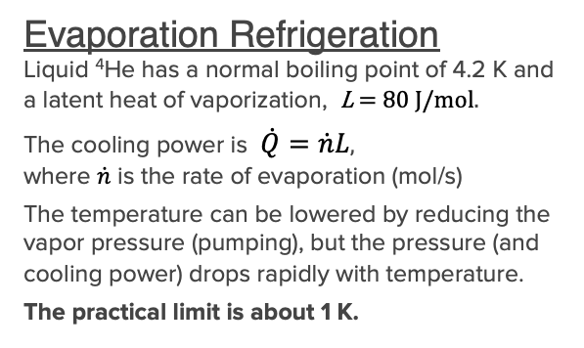
Refrigerators
Maximum polarization requires cooling the target sample ≾ 1 K
The only practical forms of refrigeration are the evaporation of ⁴He (or ³He) and ³He-⁴He dilution refrigeration
Evaporation Refrigeration
Liquid ⁴He has a normal boiling point of 4.2 K and a latent heat of vaporization, L = 80 J/mol.
The cooling power is $\dot{Q}=\dot{n}L$,
where $\dot{n}$ is the rate of evaporation (mol/s)
The temperature can be lowered by reducing the vapor pressure (pumping), but the pressure (and cooling power) drops rapidly with temperature.
The practical limit is about 1 K.
Superfluid
Below 2.2 K 4He is a superfluid with outstanding thermal conductivity and heat transport.
DNP targets operating at 5 T and 1 K have become the de facto standard for experiments with intense, ionizing beams.
Vacuum pump
Transfer line
Heat exchanger
Valve
Vapor
Liquid
4.2 K
Target sample
Horizontal 1 K refrigerator for CLAS12 polarized target
LHe dewar
Vacuum chamber

Slide 19
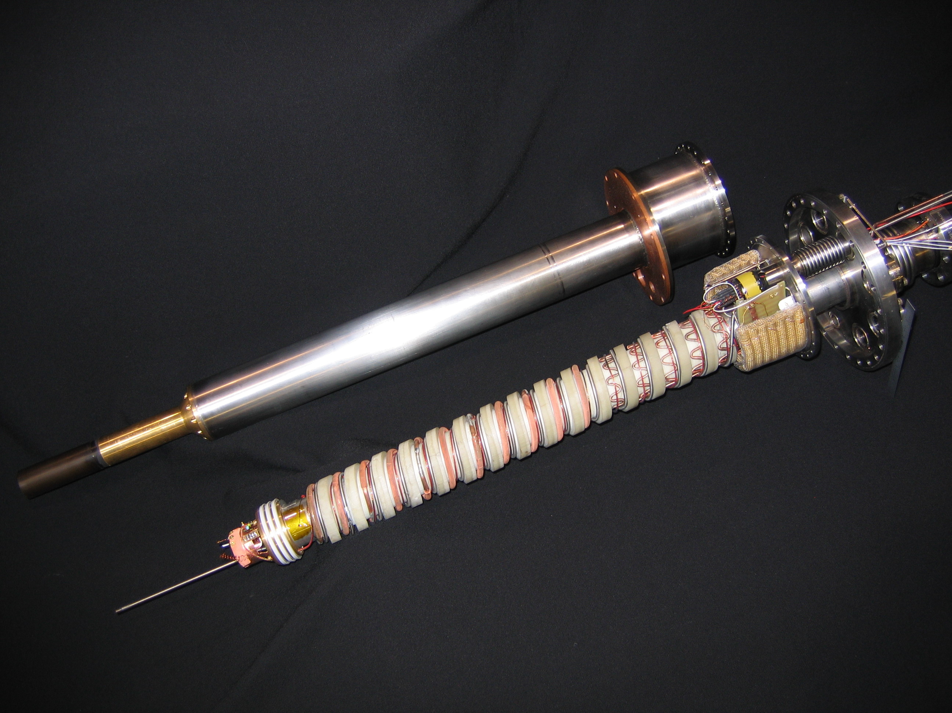


Refrigerators
Maximum polarization requires cooling the target sample ≾ 1 K
The only practical forms of refrigeration are the evaporation of ⁴He (or ³He) and ³He-⁴He dilution refrigeration
Dilution Refrigeration
Below 0.8 K a mixture of ³He and ⁴He will separate into two distinct phases.
The upper phase is mostly ³He (concentrated)
The lower phase is mostly ⁴He (dilute), but always contains ≥6.6% ³He.
Heat is removed when ³He from the conc. phase dissolves into the dilute phase.
The practical limit is less than 0.01 K.
Frozen Spin Targets
Compared to evaporation refrigerators, “DilFridges” are much more difficult to build and operate.
They are mostly used to cool frozen spin targets for lower-intensity beams and high-acceptance detectors.
³He pump
⁴He pump
$$\dot{Q}=\dot{n}\left(H_{d}−H_{c}\right)$$
Condenser
$$≈\dot{n}\left[95T_{m}^{2}−11T_{i}^{2}\right]$$
Vapor: <97% ³He
Heat exchanger
Liquid: >1% ³He
T²
Heater
The “still” ~ 0.7 K
Heat exchanger
Mixing chamber
Vacuum chamber
Horizontal dilution refrigerator for Hall B frozen spin target

Slide 20
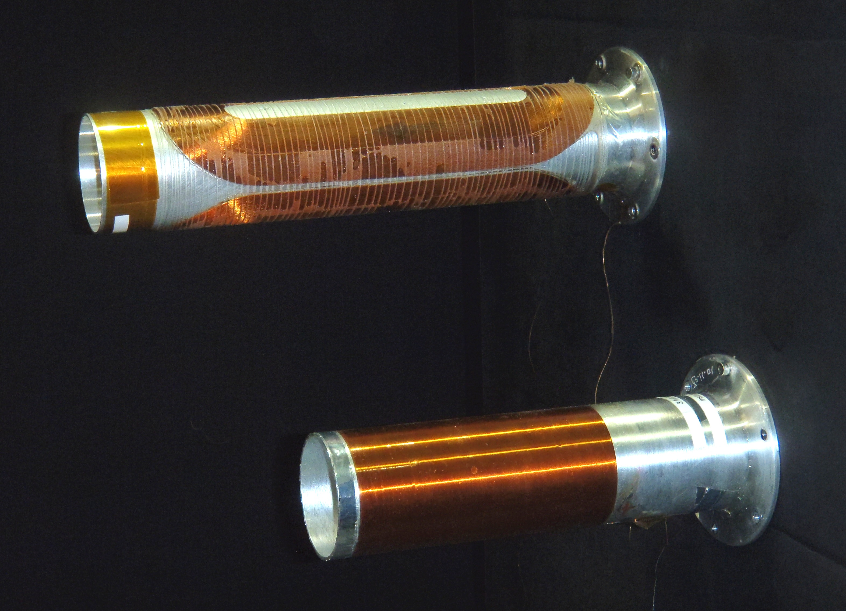
Frozen Spin Targets
Frozen Spin Targets are used to take advantage of high acceptance detectors (eg Crystal Ball)
Nuclear spin relaxation is strongly temperature dependent and reaches 1000s of hours at ultralow temperatures
Target sample is dynamically polarized in a massive, high-field polarizing magnet
Scattering data is acquired with the sample in a thin, low field holding magnet
Requires cooling sample to milliKelvin temperatures
Beam heating limits beam flux to ∼10⁸ s⁻¹
Polarize (+)
High Field
Take beam (+)
Low field
Polarization
Time
Mainz-Dubna Frozen Spin Target
Polarize (-)
High Field
Take beam (-)
Low field
Holding coils, JLab Frozen Spin Target

Slide 21
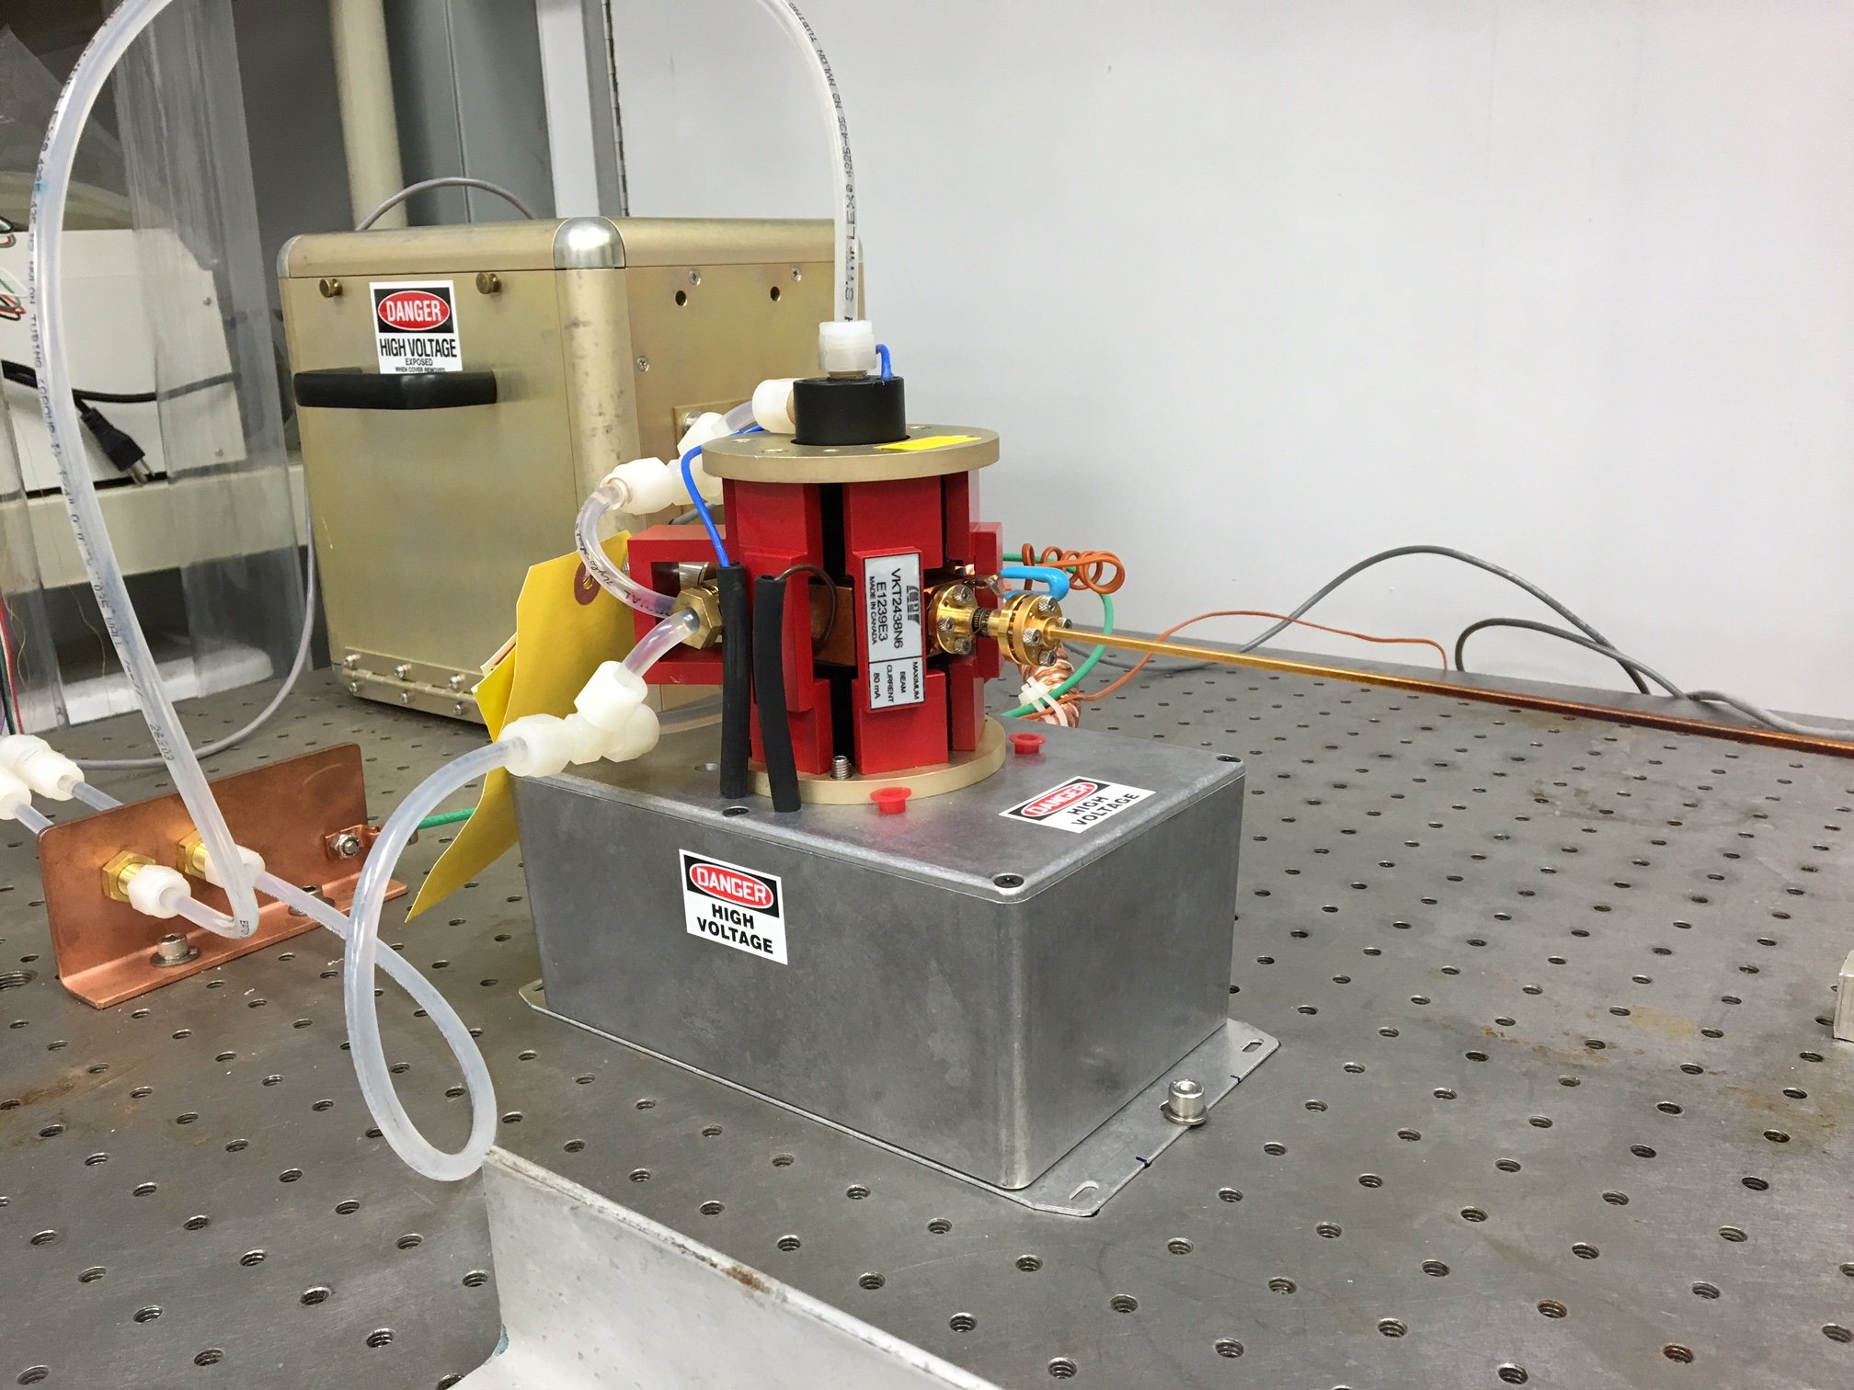
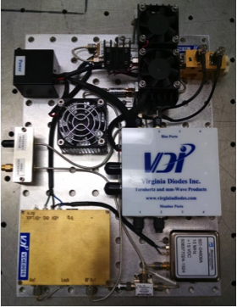
Microwaves
The microwave frequency for DNP is determined by the magnet: 28.02 GHz/T
The microwave power is determined by the field & temperature combination:
  2.5 T & 0.5 K: ∼4 mW/g
  5.0 T & 1 K: ∼100 mW/g
Microwaves are transmitted thru metal waveguide
Rectangular outside the cryostat
Oversized circular inside
Typical rectangular waveguide losses
70 GHz (WR-12): -2 dB/m
140 GHz (WR-6): -6 dB/m
Measure the microwave power at the target
At 1 K the 4He evaporation rate increases ∼16.8 slpm per watt of power
Extended Interaction Oscillator
100 W @ 70 GHz (2.5 T)
20 W @ 140 GHz (5.0 T)
CPI Canada
IMPATT Diode
1 W @ 70 GHz
0.3 W @ 140 GHz
VA Diode, Inc

Slide 22




NMR
CW-NMR is the standard method to measure the nuclear polarization
A weak RF field, polarized ⟂ to B_{o} will induce both upward and downward transitions with equal probability as it sweeps through the resonance frequency
The net emission (or absorption) of energy is proportional to (N₊ - N₋), the polarization
The constant of proportionality can be measured with the microwaves off and the sample at its thermal equilibrium (TE) polarization
Care must be given to not use too strong RF or dwell at the resonance frequency. This can drive the populations to equality (saturation).
Species | Spin | NMR Freq (MHz/T)
1H | ½ | 42.58
2H | 1 | 6.54
3H | ½ | 45.41
3He | ½ | -32.44
6Li | 1 | 6.27
7Li | 3/2 | 16.55
13C | ½ | 10.71
14N | 1 | 3.08
15N | ½ | -4.32
19F | ½ | 40.08
N₋
$$N_{↓}$$
$$N_{↓}=cN_{−}$$
(Emission)
$$N_{↑}$$
$$N_{↑}=cN_{+}$$
(Absorption)
N₊

Slide 23
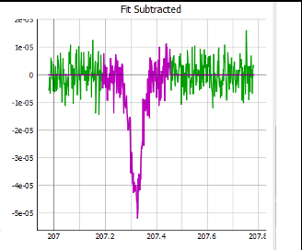
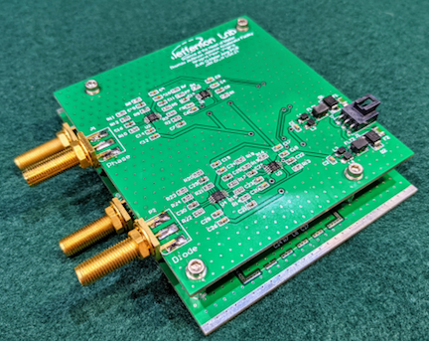
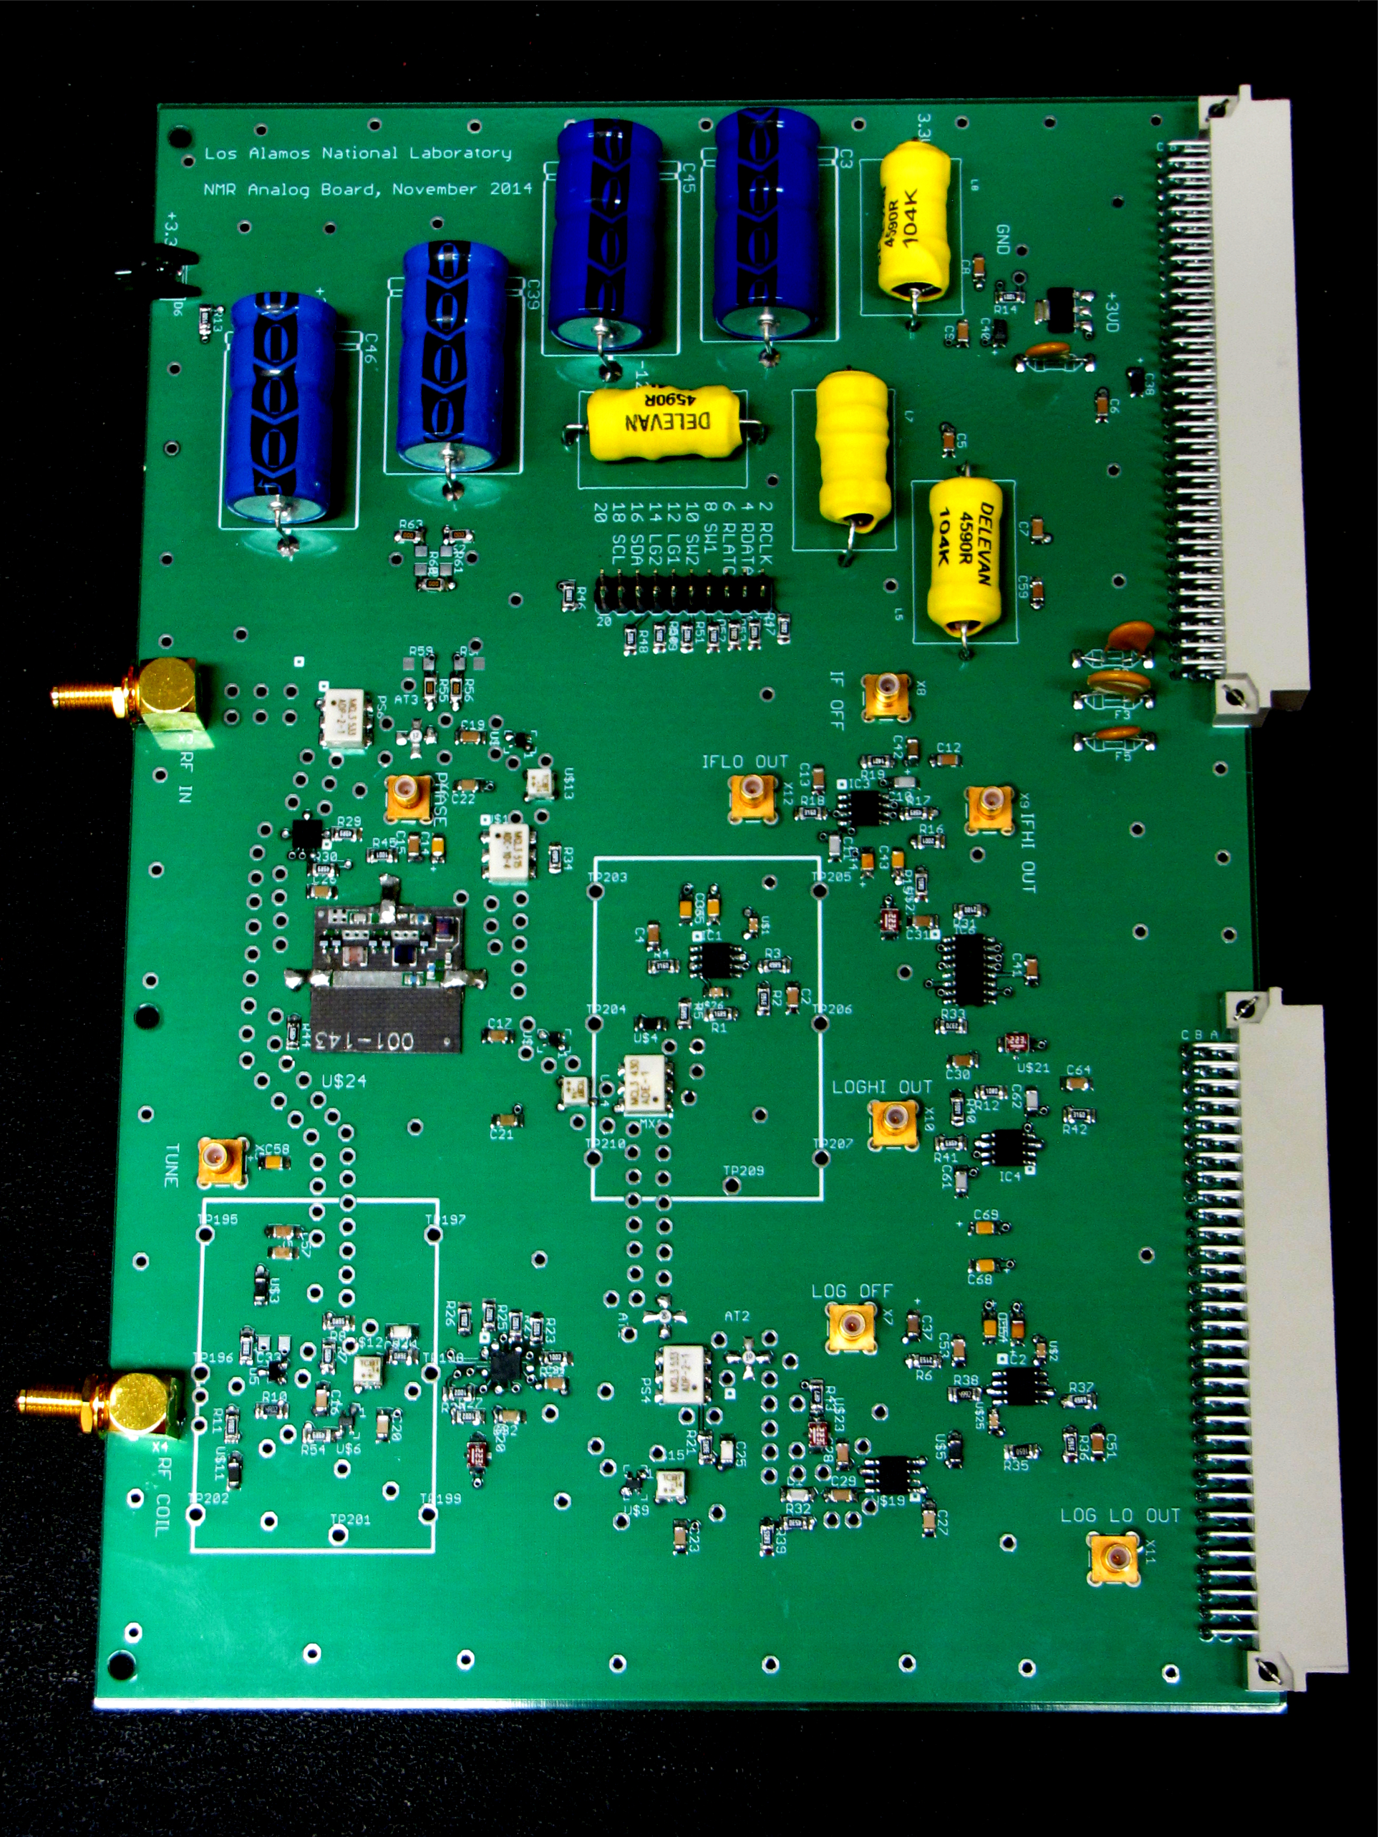
NMR
NH3 @ Thermal Equilibrium 0.3%
NH3 @ +85%
RF Signal
Generator
Phase-Sensitive Detector
Reference
Phase-adjust cable
Output
ADC
Signal
Cryostat
nλ/2 cable

Slide 24
In the Beam
Two observable effects of a high intensity beam
Beam Heating
Immediate polarization drop of a few percent
Proportional to volume-to-surface area of the sample
Use numerous mm-sized grains of material immersed in helium coolant
Increase the beam spot on the target sample (or raster the beam)
In a rastered beam, each bead can warm as much as 2-3 K, but cools back to 1 K in milliseconds
Liquid helium temperature, T_{L}
Surface
temperature, T_{S}
Interior
temperature, T(r)

Slide 25
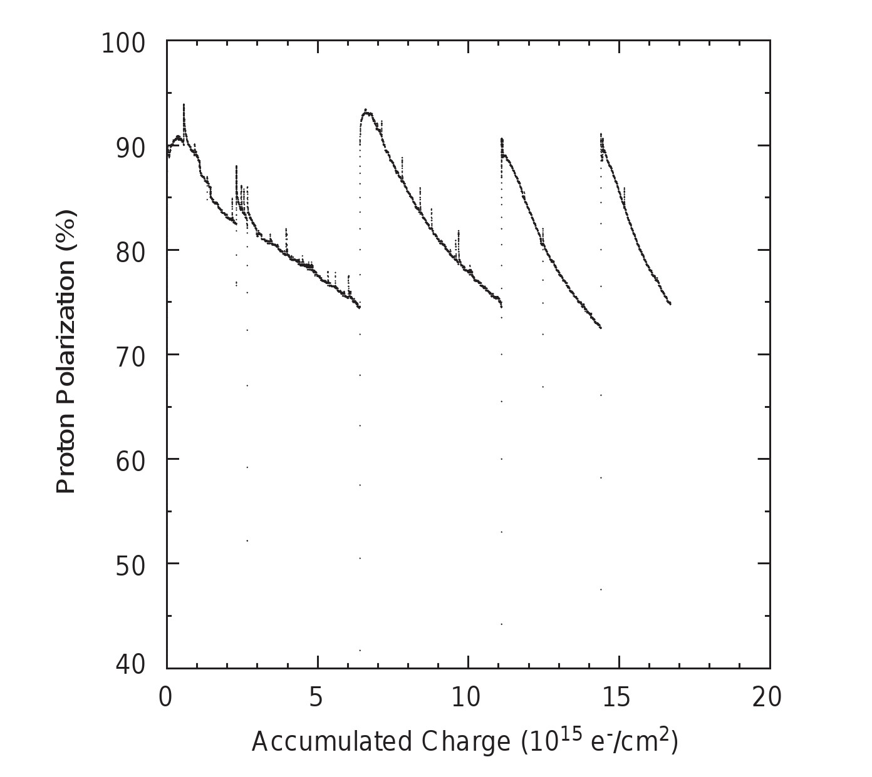
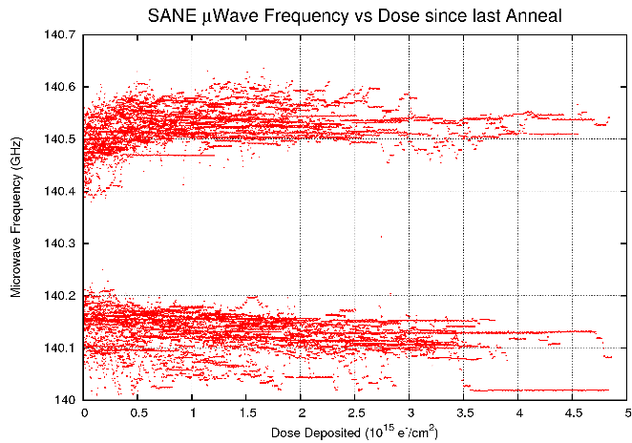
Radiation Damage
Radiation Damage
Slow loss of polarization
Production of radiolytic, paramagnetic impurities (e-, atomic H, etc) reduces T₁
Some materials (LiH, NH₃) are naturally more radiation resistant than others (butanol, propandiol)
  Increase the beam spot on the target (raster)
  Adjust microwave frequency as dose increases
  Warm (anneal) the sample to ∼100 K to remove unwanted impurities
  Replace the sample after 5-10 anneals
Fresh ⌀2cm target: anneal after 5 x 10¹⁵ e-/cm²
  700 hrs @ 1 nA
  70 hrs @ 10 nA
  7 hrs @ 100 nA

Slide 26
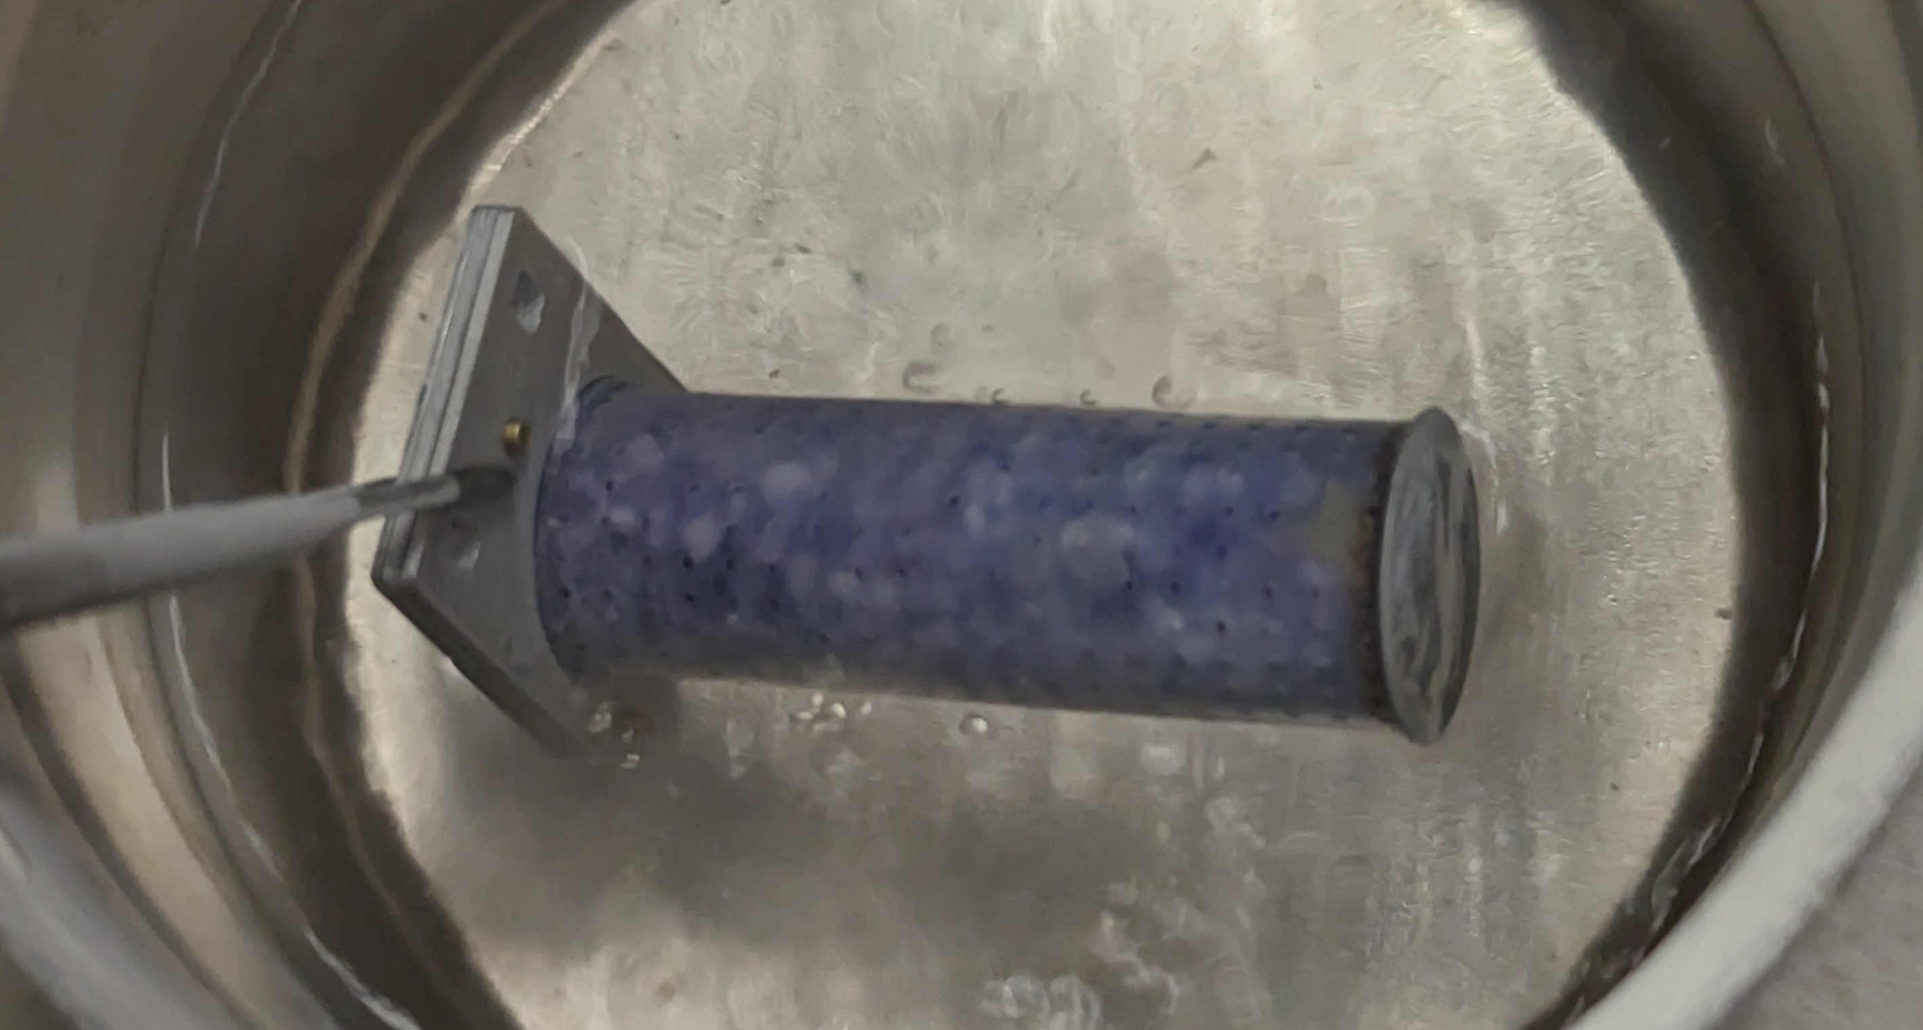
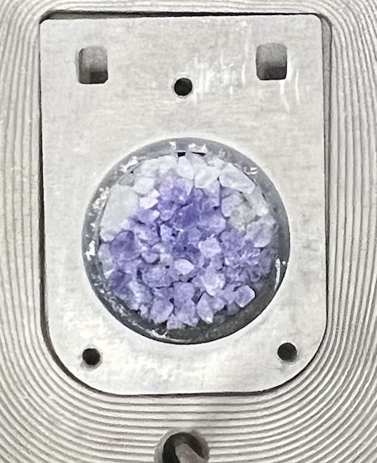
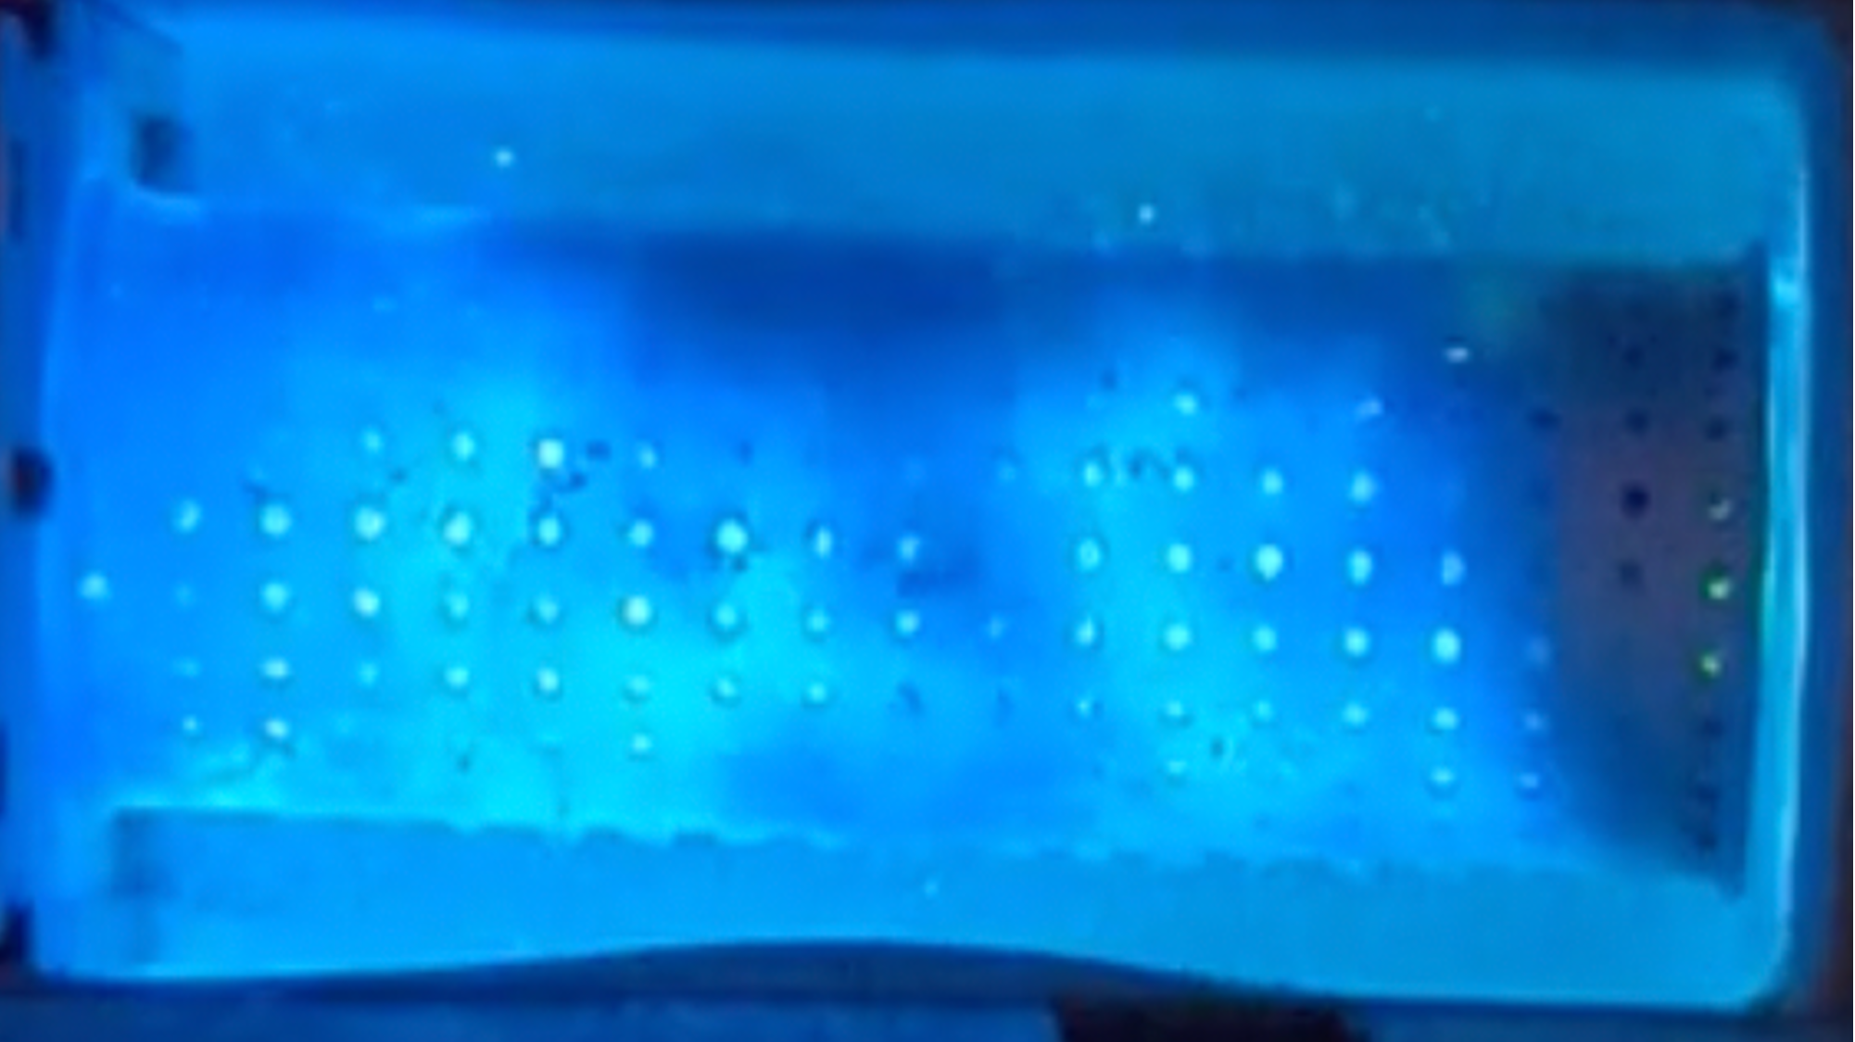
Radiation Damage
Images from the most recent JLab polarized target experiment:
Run Group C in Hall B
⌀1.5 x 5 cm³ sample container filled with ND₃
Beam spot on target
Thermoluminescence during anneal

Slide 27
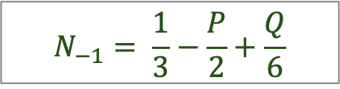

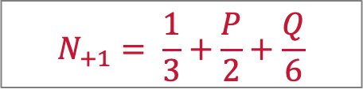



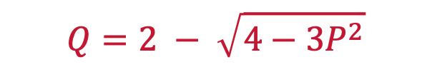
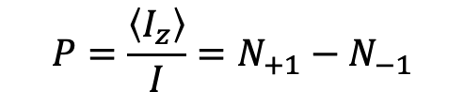
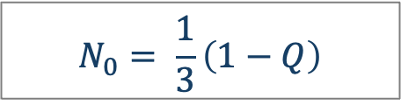
Tensor Polarization
We need (2I+1) = 3 numbers to describe the spin populations of the deuteron (spin-1)
Total number of spins
Vector polarization
Tensor polarization (alignment)
$$N_{+1}+ N_{0}+ N_{−1}=1$$
$$P=\frac{\left\langle I_{z}\right\rangle }{I}=N_{+1}−N_{−1}$$
$$Q=\frac{\left\langle 3I_{z}^{2}−I^{2}\right\rangle }{I^{2}}={(N}_{+1}−N_{0})−{(N}_{0}−N_{−1})$$
$$=1 −3N_{0}$$
$$N_{+1}= \frac{1}{3}+\frac{P}{2}+\frac{Q}{6}$$
$$N_{−1}= \frac{1}{3}−\frac{P}{2}+\frac{Q}{6}$$
If the three levels are populated according to a Maxwell-Boltzmann distribution
(aka ”Spin Temperature”)
$$Q=2 − \sqrt{4−3P^{2}}$$
$$+1 ≥ Q≥0$$
$$N_{0}= \frac{1}{3}\left(1−Q\right)$$
In a high-intensity experiment using ND3,
P_{max} ≈ 50%
Q_{max} ≈ 20%
Can we increase the tensor polarization?

Slide 28
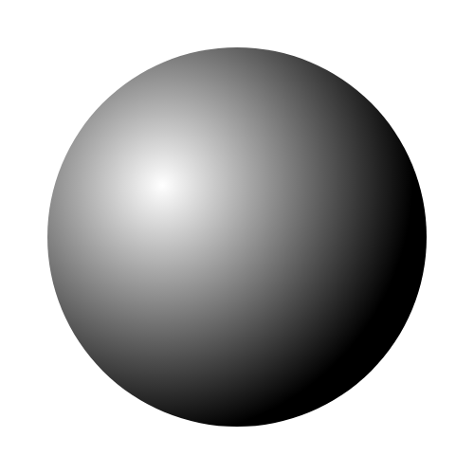
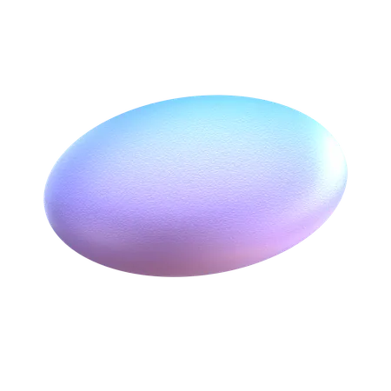


NMR Lineshape of Deuterons
Deuteron has a magnetic dipole moment, μ = 4.33 x 10⁻²⁷ J/T = 0.86 μ_{n}
Deuteron also has an electric quadrupole moment, eQ = 2.86 e.fm²
eQ interacts with electric field gradients within the lattice (or molecule) and shifts the energy levels by an amount hν_{Q}
ν_{D} = deut. Larmor freq. (6.54 MHz/Tesla)
ν_{Q} = quadrupole freq. (335.6 kHz for ND3)
= 1/8 (e²qQ/h)
eQ = deuteron quadrupole moment
eq =electric field gradient
θ = angle between eq. & B
Example:
the ND₃ molecule
$$\vec{B}$$
m = -1
θ
N
m = 0
$$\vec{E}$$
D
m = +1
θ = 0
cos² θ = 1/3
θ = π/2

Slide 29


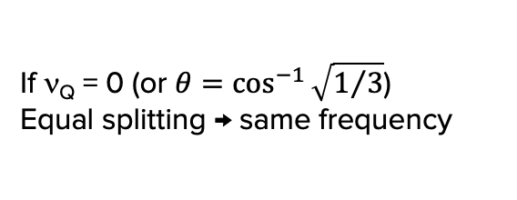
NMR Lineshape of Deuterons
$$\vec{B}$$
m = -1
θ
-1 ↔ 0
m = 0
If ν_{Q} = 0 (or $θ=\cos^{−1}{\sqrt{1/3}}$)
Equal splitting → same frequency
$$\vec{E}$$
+1 ↔ 0
m = +1
frequency

Slide 30



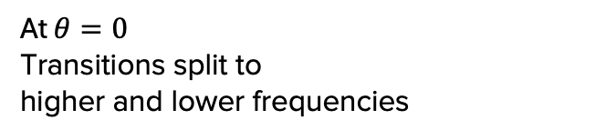

NMR Lineshape of Deuterons
$$\vec{B}$$
m = -1
-1 ↔ 0
$$\vec{E}$$
m = 0
At $θ=0$
Transitions split to
higher and lower frequencies
+1 ↔ 0
m = +1
frequency
$$θ=0$$
$$θ=0$$

Slide 31
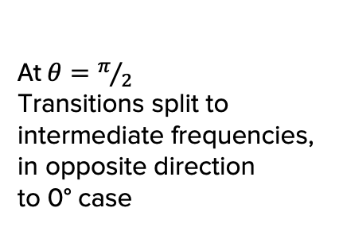



NMR Lineshape of Deuterons
$$\vec{B}$$
m = -1
π/2
-1 ↔ 0
m = 0
$$\vec{E}$$
At $θ=π/2$
Transitions split to intermediate frequencies, in opposite direction
to 0° case
+1 ↔ 0
m = +1
frequency
$$θ=\frac{π}{2}$$
$$θ=\frac{π}{2}$$

Slide 32


NMR Lineshape of Deuterons
$$\vec{B}$$
m = -1
π/2
-1 ↔ 0
m = 0
$$\vec{E}$$
At $θ=π/2$
Transitions split to intermediate frequencies, in opposite direction
to 0° case
+1 ↔ 0
m = +1
frequency
$$θ=\frac{π}{2}$$
$$θ=\frac{π}{2}$$

Slide 33





NMR Lineshape of Deuterons
In amorphous or polycrystalline samples, all values of θ are possible, although not with equal probability
$n\left(θ, θ+dθ\right)dθ∝ \frac{1}{\cos{θ}}$ $dθ$
-1 ↔ 0 transition
+1 ↔ 0 transition
$$θ=\frac{π}{2}$$
$$θ=0$$
$$θ=0$$
$$θ=\frac{π}{2}$$
The size of this transition is proportional to (N_{o} – N₋)
The size of this transition is proportional to (N₊ - N₀)
The size of the sum is proportional to (N₊ - N₋)
the vector polarization!

Slide 34
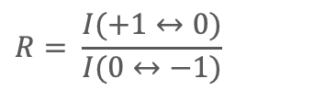
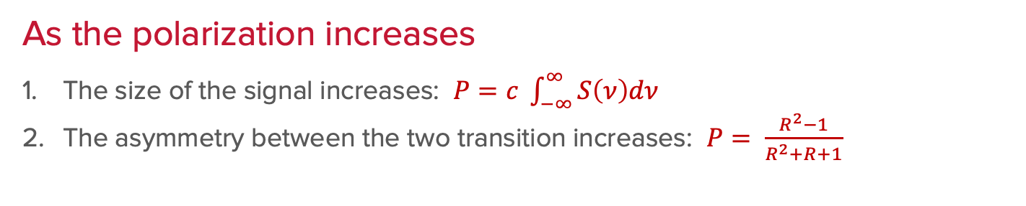
NMR Lineshape of Deuterons
N₋
T_{s} ≈ 2 mK
N₋
T_{s} ≈ 1 mK
N₋
T_{s} ≈ 0.5 mK
T_{s} = spin temperature
in a 2.5 T field
N₀
N₀
N₀
N₊
N₊
N₊
P = 0.25
Q = 0.05
P = 0.50
Q = 0.20
P = 0.75
Q = 0.48
As the polarization increases
The size of the signal increases: $P=c \int_{−∞}^{∞}{S\left(ν\right)dν}$
The asymmetry between the two transition increases: $P= \frac{R^{2}−1}{R^{2}+R+1}$
$$R= \frac{I(+1↔0)}{I(0↔−1)}$$

Slide 35
NMR Lineshape of Deuterons
N₋
N₋
N₋
T_{s} ≈ -0.5 mK
T_{s} = spin temperature
in a 2.5 T field
N₀
N₀
T_{s} ≈ -1 mK
N₀
N₊
T_{s} ≈ -2 mK
N₊
N₊
P = -0.25
Q = 0.05
P = -0.50
Q = 0.20
P = -0.75
Q = 0.48
As the polarization increases
The size of the signal increases: $P=c \int_{−∞}^{∞}{S\left(ν\right)dν}$
The asymmetry between the two transition increases: $P= \frac{R^{2}−1}{R^{2}+R+1}$
$$R= \frac{I(+1↔0)}{I(0↔−1)}$$

Slide 36
What to Expect this Week
Karl Slifer: Polarized target program at University of New Hampshire
Masataka Iinuma: Polarized target for tests of time-reversal invariance
Gerhard Reichertz: NMR of hyperpolarized fluorine-19
Victoria Lagerquist: Frozen spin targets and thin superconducting magnets
Allison Zec
Chhetra Lama
Nathaly Santiesteban
Elena Long
Michael McClellan
James Brock: Target development lab at Jefferson Lab
Mikhail Yurov: DNP program at Oak Ridge National Lab
Vibodha Bandara:
Kenichi Nakano:
Silviu Covrig-Dusa: Designing targets using computational fluid dynamics
Tsuneo Kageya: Lithium-deuteride target for JLab
Nadia Fomin: Polarized target development at University of Tennessee
Monday
Tuesday
The New Hampshire Block
Wednesday
Friday
(polarized gas targets II)

