Slide 1
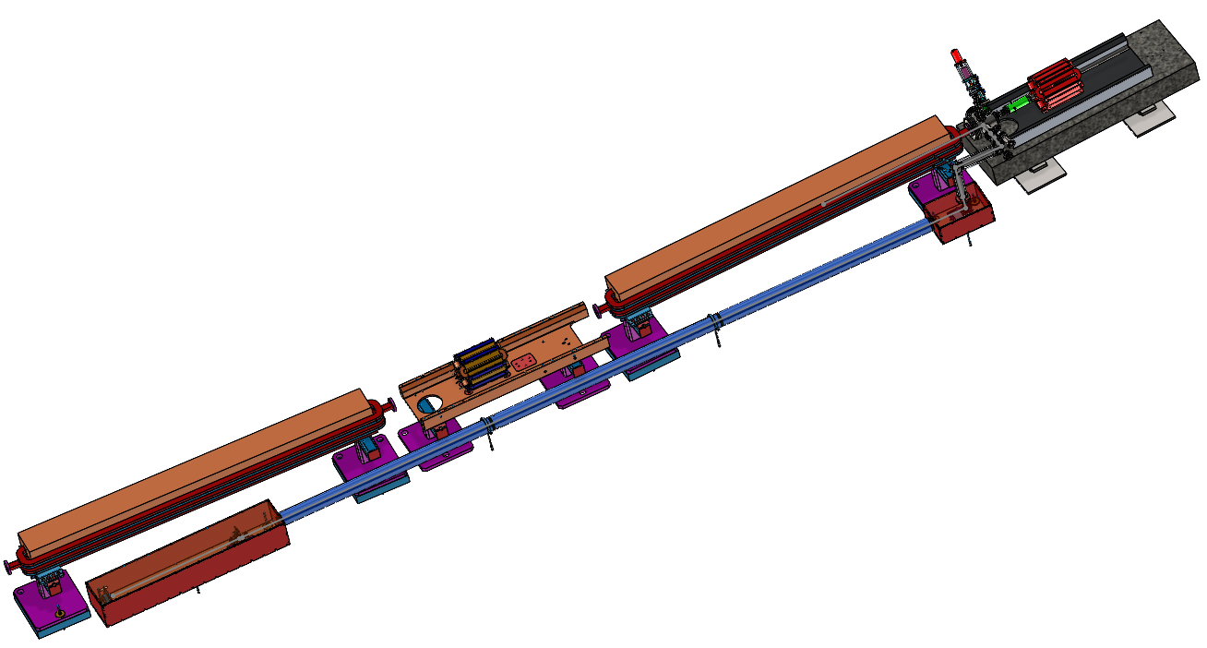
HYPERNUCLEAR ENERGY SPREAD MEASUREMENT
MEASURING THE ENERGY SPREAD OF DIPOLE 3C08 PRESENTATION FOR HYPERNUCLEAR MEETING 03/22/2024
JOE GUBELI

Slide 2



CALCULATE THE ENERGY SPREAD
CALCULATE THE ENERGY SPREAD BY MEASURING THE HORIZONTAL BEAM SIZE
  BEAM SIZE (σ) HAS TWO CONTRIBUTIONS
    SIZE DUE TO EMITTANCE – σ_{β}
      Emittance – MEASURED FROM TBD DIAGNOSTIC
      Beta - MEASURED FROM TBD DIAGNOSTIC
    SIZE DUE TO DISPERSION – σ_{D}
      Dispersion - MEASURED FROM TBD DIAGNOSTIC

Slide 3
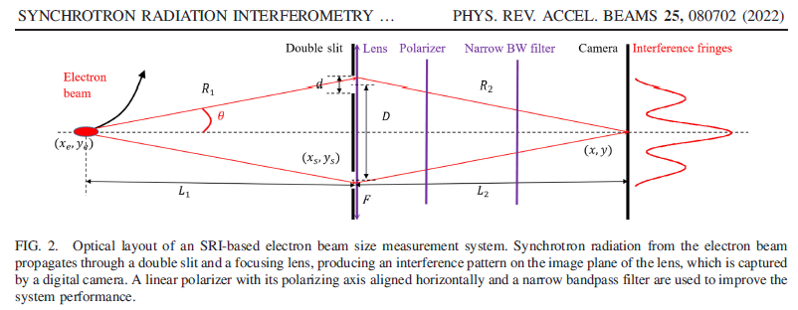
MEASURING THE BEAM SIZE [NON-INVASIVE]
SYNCHROTRON RADIATION INTERFEROMETER

Slide 4
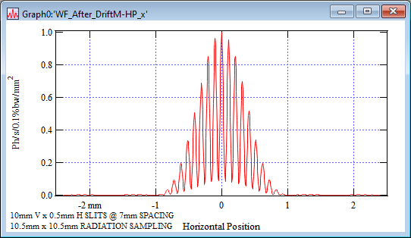
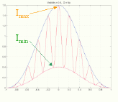
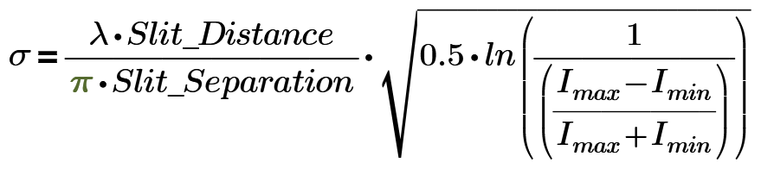
SYNCHROTRON RADIATION WORKSHOP (SRW) SIMULATIONS
TYPICAL FULL CAMERA FRAME
TYPICAL ZOOMED IN CAMERA IMAGE
HORIZONTAL SLICE THROUGH IMAGE CENTER

Slide 5
SRW RESULTS FOR VARIOUS BEAM ENERGY SPREADS
0.5E-5 ENERGY SPREAD
1.0E-5 ENERGY SPREAD
1.5E-5 ENERGY SPREAD
2.0E-5 ENERGY SPREAD
2.5E-5 ENERGY SPREAD
3.0E-5 ENERGY SPREAD

Slide 6
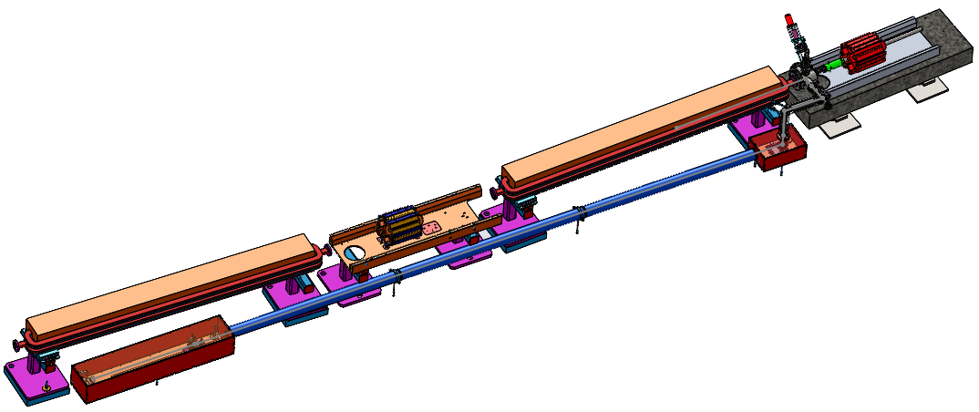
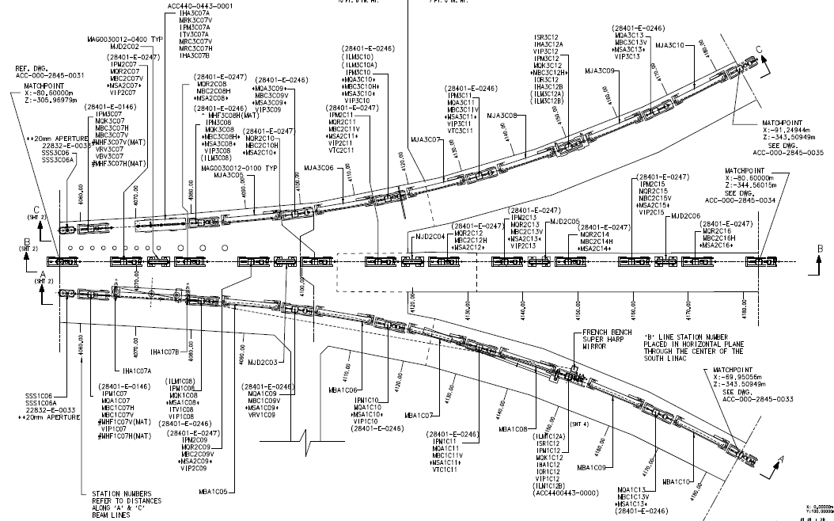
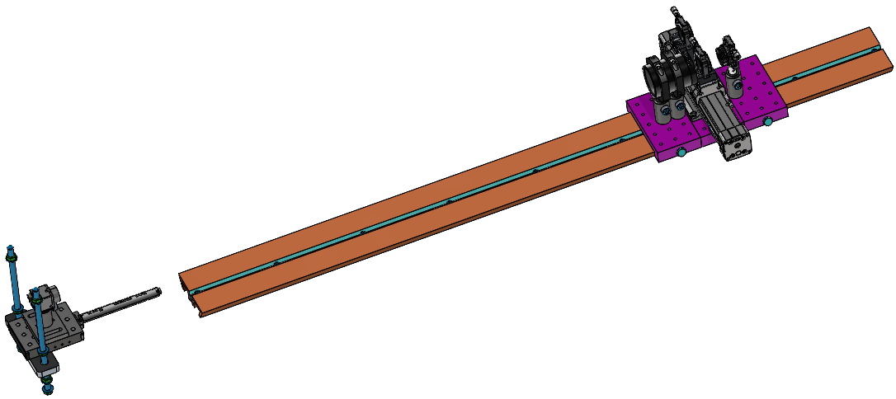
LAYOUT – SRI3C12
SYNCHROTRON RADIATION INTERFEROMETER (SRI)
INSERTABLE MIRROR
(AIR, SOLENOID & TWO LIMIT SWITCHES)
MJA3C08 DIPOLE
3C12 GIRDER
TURNING MIRROR
(TW0 AXIS SERVO)
SLIT STAGE
(AIR, SOLENOID & TWO LIMIT SWITCHES)
GigE CAMERA
(POE & ONE AXIS SERVO)

Slide 7
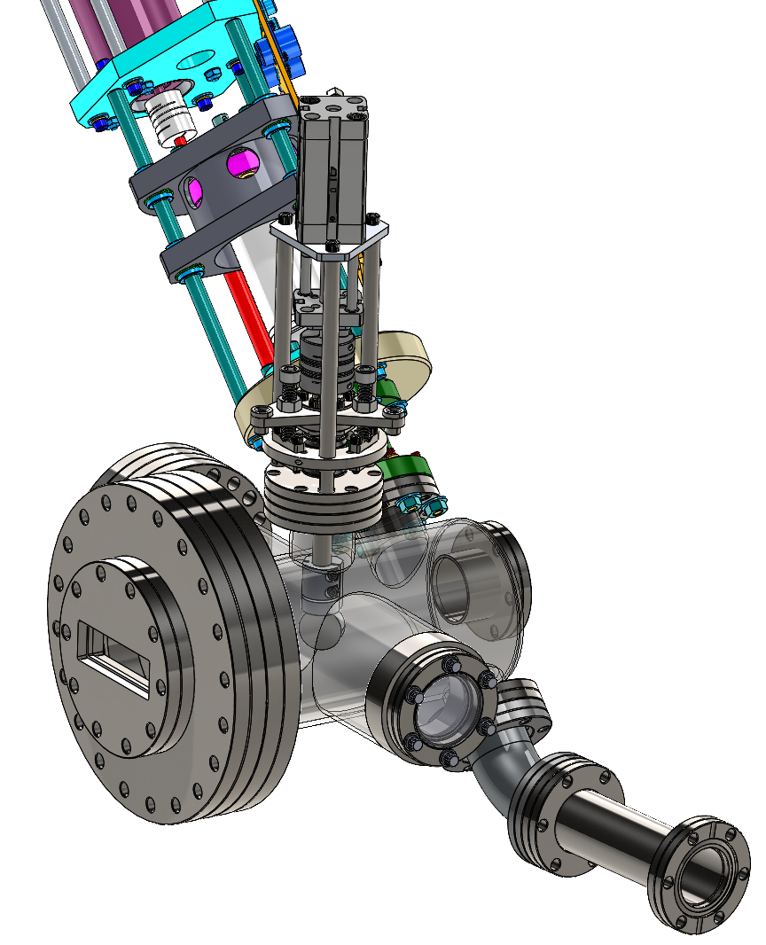
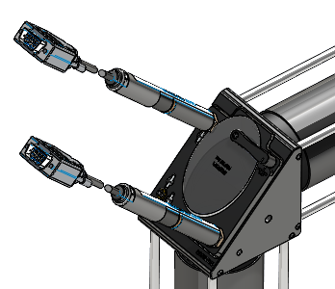
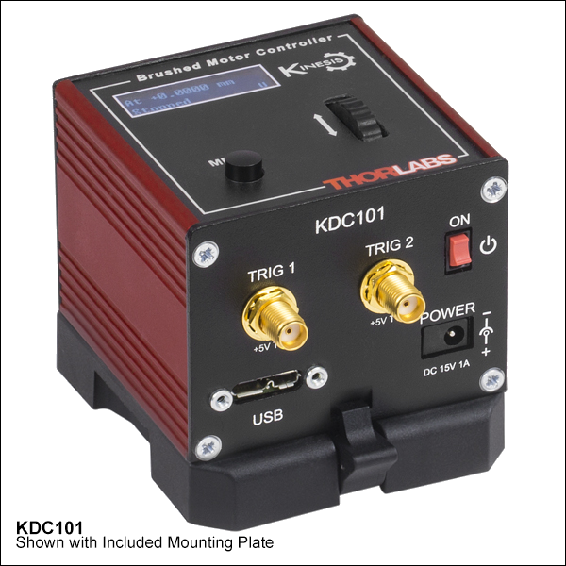
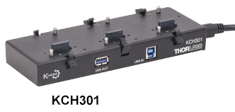
ELEMENTS
HARP
BEAM INTERCEPTING – CAN BE USED TO VERIFY SRI BEAM SIZE CALCULATIONS
INSERTABLE MIRROR
NON-BEAM INTERCEPTING – CAN BE INSERTED/RETRACTED IN ANY BEAM MODE
2x THORLABS KDC101 DC SERVO CONTROLLER MOUNTED ON A KCH301 USB CONTROLLER HUB
TURNING MIRROR
TYPICAL Z812 THORLABS DC SERVO MOTORS
Y-AXIS
X-AXIS

Slide 8
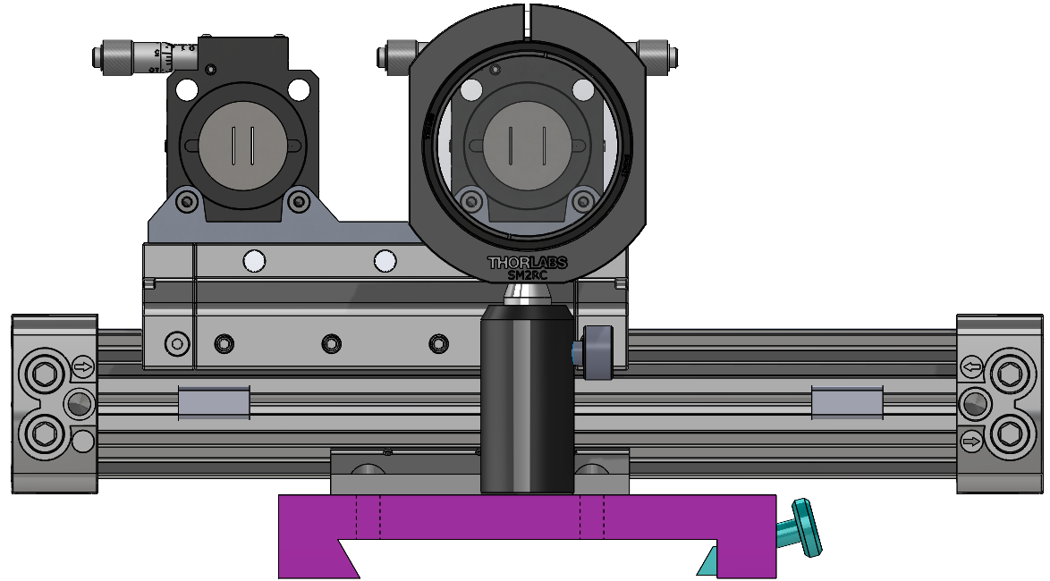
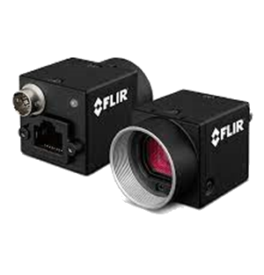
ELEMENTS CONT.
SLIT POSITION #1
SLIT POSITION #2
(FUTURE SL IMAGER POSITION
SLIT STAGE
GigE CAMERA
FLIR BFS-PGE-120S4M-C(S)
(75% QE @ FILTER BW)

Slide 9
PLANS
IDENTIFY DIAGNOSTICS TO OBTAIN THE EMITTANCE, BETA AND DISPERSION
INSTALL THE HARDWARE DURING THE 2024 SCHEDULED ACCELERATOR DOWN (SAD)
  HAVE ALL THE HARDWARE EXCEPT THE SLIT THAT ARE DUE NEXT MONTH
TEST OUT VARIOUS SLIT WIDTHS DURING THE 2024-2025 ACCELERATOR OPERATIONS
  HAVE FIVE SLIT APERTURES TO TEST
  WILL NEED TO SWAP OUT APERTURES DURING MAINTENANCE DAYS
  ~TWO HOUR TO SWAP APERTURES
OPTIMIZE THE SOFTWARE AND GUI
DETERMINE THE ENERGY SPREAD MEASUREMENT ERRORS
FINALIZE THE BEST SLIT WIDTH APERTURE
DURING THE 2025 SAD CONVERT THE SECONDARY SLIT POSITION TO A SYNCHROTRON RADIATION IMAGER
QUESTIONS?

Slide 10
POST PRESENTATION SLIDE

