Slide 1
Degraded electron beams for Ce⁺BAF
JLab LDRD project and beyond
A. Sy

Slide 2
What are degraded electron beams?
Degraded electron beams are electron beams with enlarged emittance due to multiple scattering in targets
Most accelerators try to improve the beam brightness by reducing emittance for same intensity
We are purposely trying to degrade the beam brightness to map out limits in 12 GeV CEBAF
w: target thickness
X₀: material radiation length

Slide 3
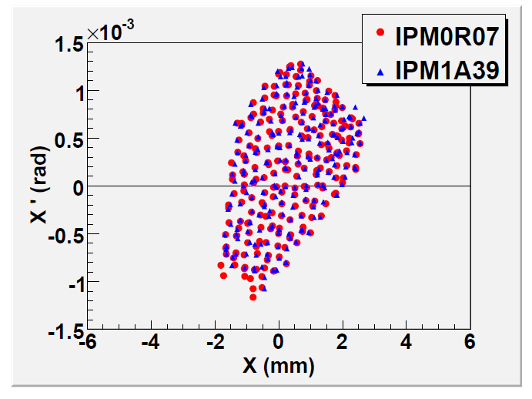
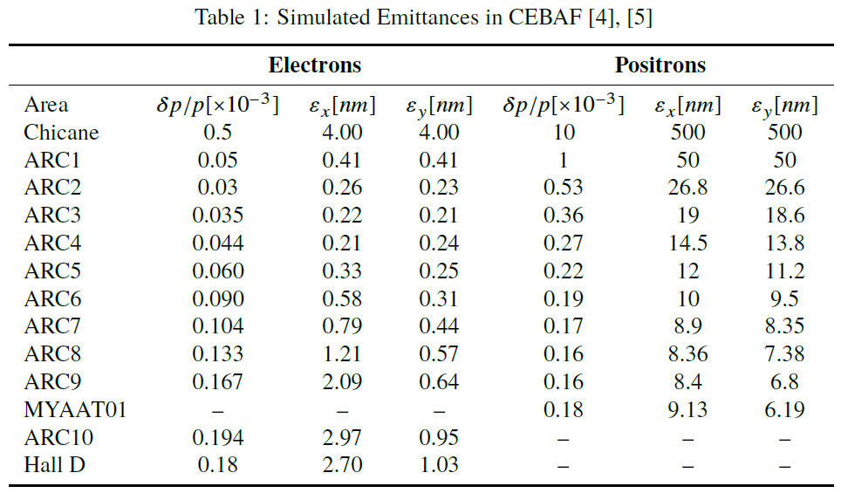
Degraded electron beams to approximate positron beams
Positron beams will be much larger in phase space than nominal electron beams at CEBAF
We want to understand the transport of larger phase space beams in 12 GeV CEBAF
Do these larger beams fit in the machine?
How does the emittance evolve for higher number of passes?
Limits on positron phase space?
Horizontal admittance data from two different IPMs in 6 GeV CEBAF
S. Golge Ph.D. thesis
Simulated emittance evolution in CEBAF for electron and positron beams
Y. Roblin JLAB-TN-21-043
Notes:
Measured admittance ~ 10 mm-mrad at injector chicane location

Slide 4
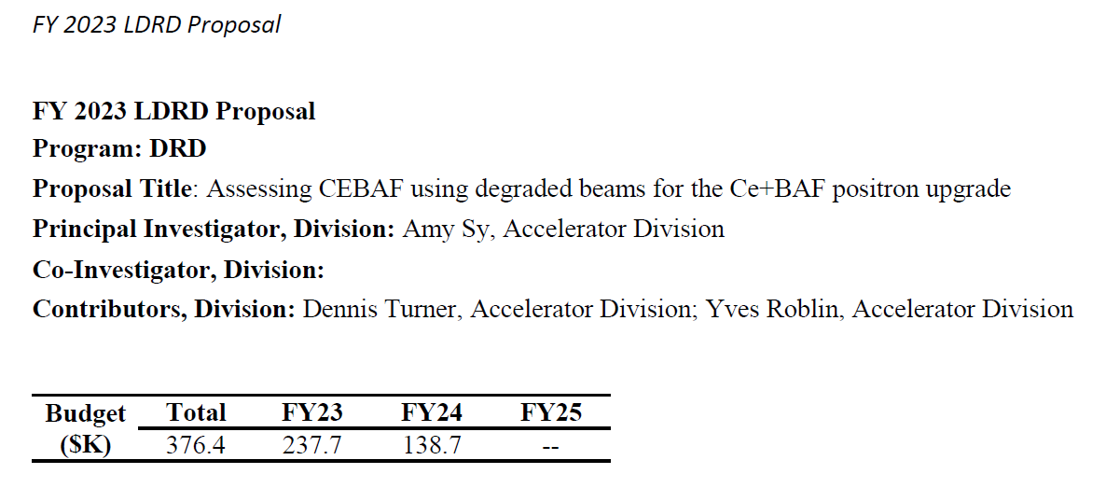
Approach: design, build, install a device to degrade beams
Funded 2 year JLab LDRD project with proposed objectives:
Design and build a beamline to make electron beams “look like” positron beams
Measure machine acceptance and emittance evolution in CEBAF
Victor Lizarraga-Rubio, Gary Hays, Shaun Gregory, Marcy Stutzman
Joe Grames, Carlos Hernandez-Garcia, Cristhian Valerio Lizarraga

Slide 5
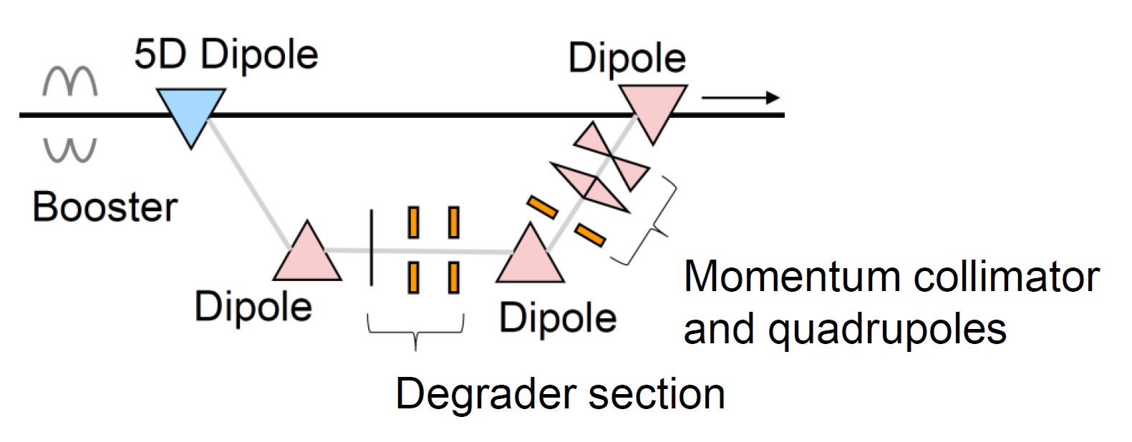
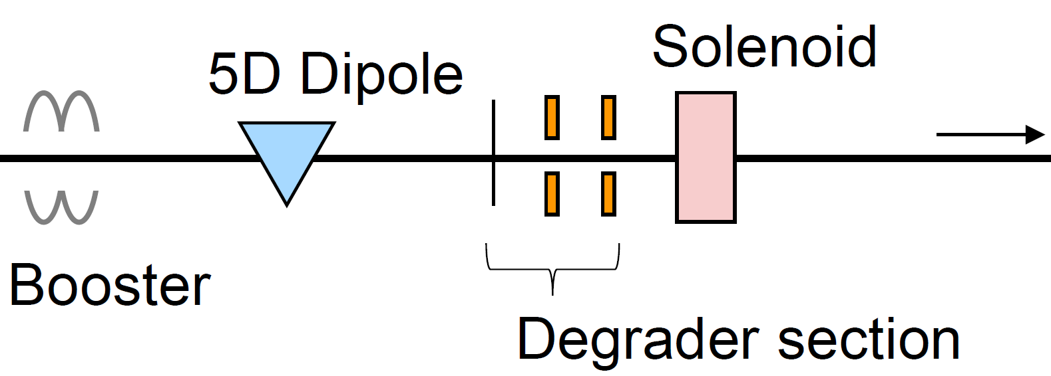
Early design decision for straight-ahead degrader
Major components include the degrader target and apertures to collimate very large angle particles
Many ways to implement
Original Design
More flexible
More complicated and expensive
Final Design
Compact
Easier to implement
Less flexible

Slide 6
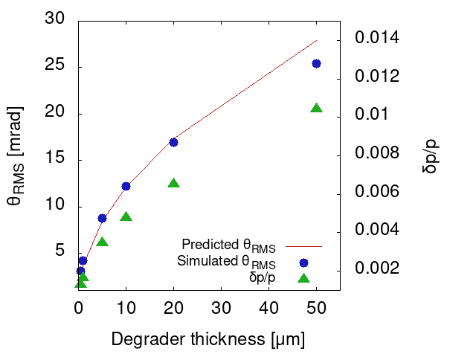
Target materials and thicknesses simulated
Started with high-Z materials, like W for PEPPo
Higher fraction of radiation length increases induced angular and energy spread
Balance with losses due to collimation
Choice of straight-ahead degrader implementation motivated shift to low-Z target material: Carbon, 1-10 μm thick
w: target thickness
X₀: material radiation length
RMS polar angle due to multiple scattering
RMS polar angle and energy spread in Carbon targets

Slide 7
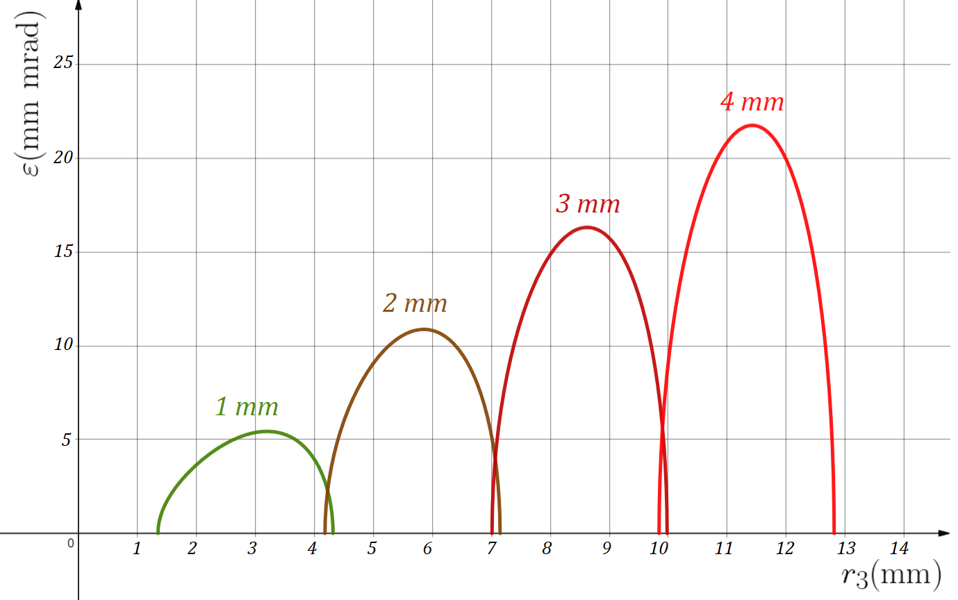
Two apertures to act as an emittance filter
Maximum transmitted emittance determined by aperture size and spacing to target location
$$ε^{2}=\frac{\left[\frac{r_{2}^{2}\left(r_{1}^{2}+r_{3}^{2}−2r_{2}^{2}\right)}{2}−\frac{{\left(r_{1}^{2}−r_{3}^{2}\right)}^{2}}{16}\right]}{L^{2}}$$
$r_{1},r_{2},r_{3}$are aperture radii, $L$ is distance between apertures
[JLAB-TN-89-191, JLAB-TN-90-261]
Generalized for arbitrary spacing
[V. Lizarraga]
$$ε^{2}=r_{2}^{2}\frac{L_{1}\left(r_{3}^{2}−r_{2}^{2}\right)+L_{2}\left(r_{1}^{2}−r_{2}^{2}\right)}{L_{1}L_{2}(L_{1}+L_{2})}−{\left(\frac{L_{2}^{2}\left(r_{1}^{2}−r_{2}^{2}\right)−L_{1}^{2}\left(r_{3}^{2}−r_{2}^{2}\right)}{2L_{1}L_{2}(L_{1}+L_{2})}\right)}^{2}$$
We will have two hole sizes per aperture assembly
Maximum transmitted emittance values are a few orders of magnitude larger than emittance near this location now

Slide 8
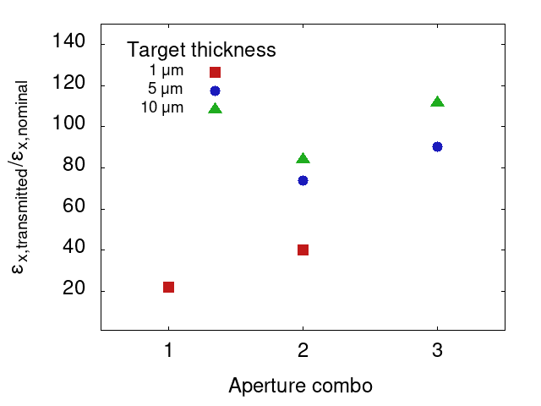
Expect transmitted emittances 20x-100x larger than nominal
Nominal emittance at the future degrader location ~ 0.05 mm-mrad
Simulated; agrees with measured emittance from beam study
https://logbooks.jlab.org/entry/4116344
Emittance transmitted through degrader varies based on target thickness and aperture hole selection

Slide 9
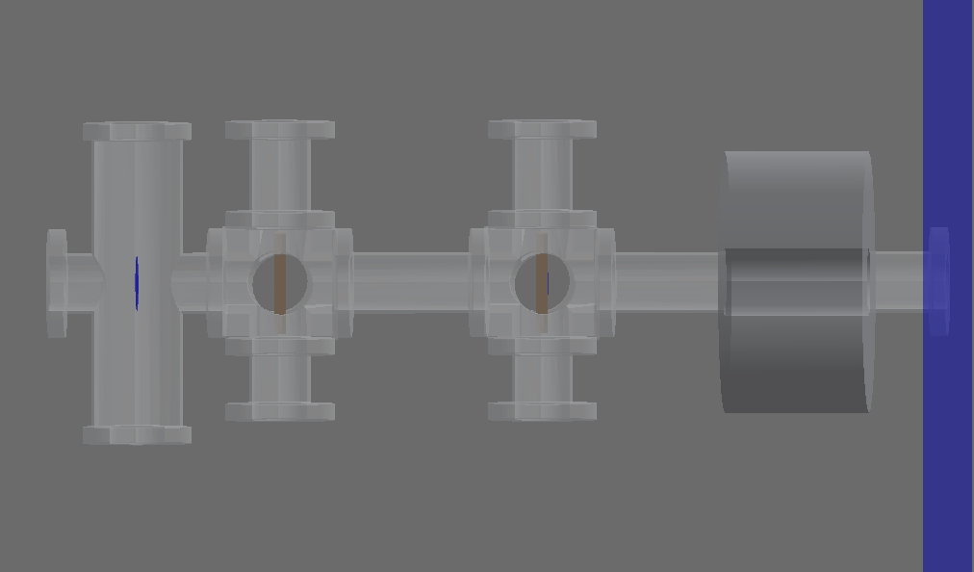
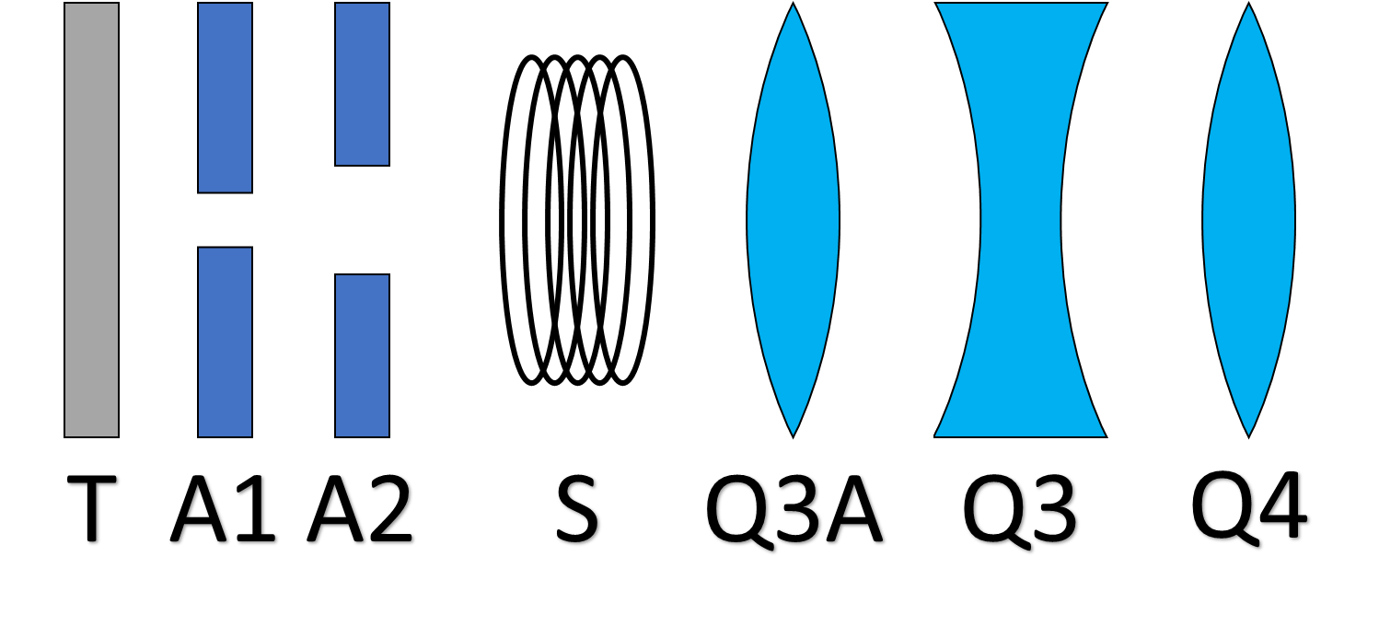
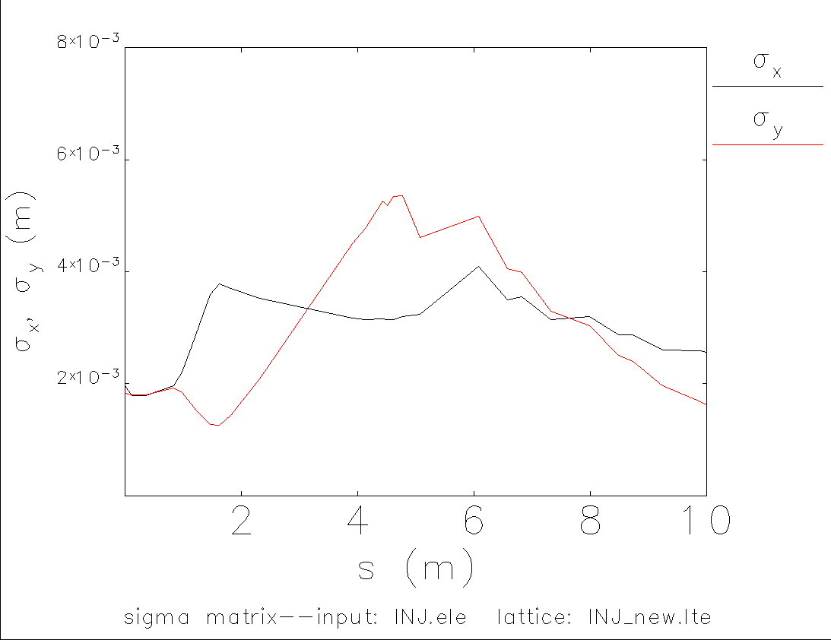
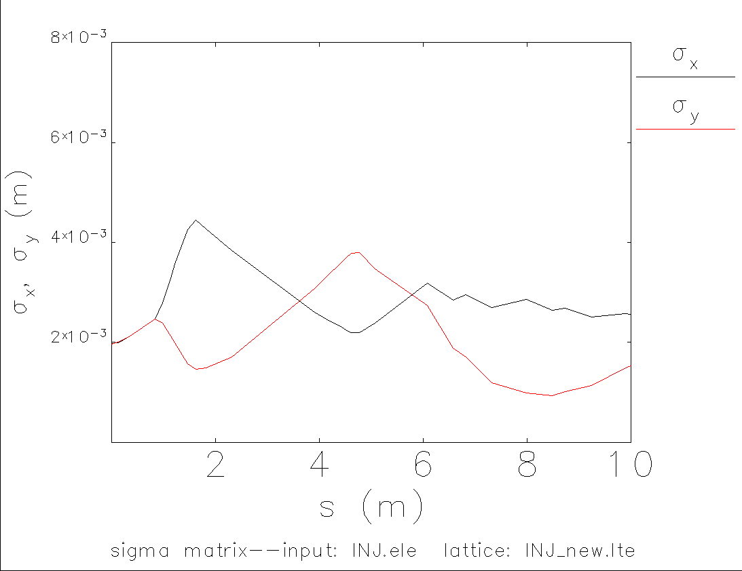
Optics optimization for maximizing transmission
From Elegant: p=6.74 MeV/c; σ_{x}=0.85 mm; dpp=1e-3
Degraded beam distribution from GEANT4
Back to Elegant for further beam transport
Distribution from here to Elegant
Degrader elements
Injector elements
Field map with
$B_{0}$ central field
Before optimization
After optimization
QS4
Q3
Q3
QS4
Q3A
Q3A
Estimated transmission for many target/aperture combinations > 50%
Q4
Q4

Slide 10
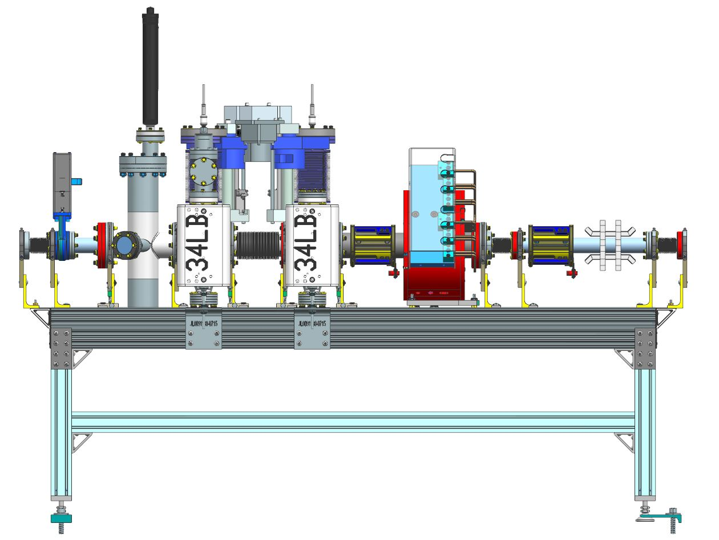
Moving towards reality: engineering design
Target ladder
[G. Hays, S. Gregory]
Aperture
Aperture
Solenoid
Corrector
Corrector
Helicity coil

Slide 11
Parts being fabricated and assembled now

Slide 12
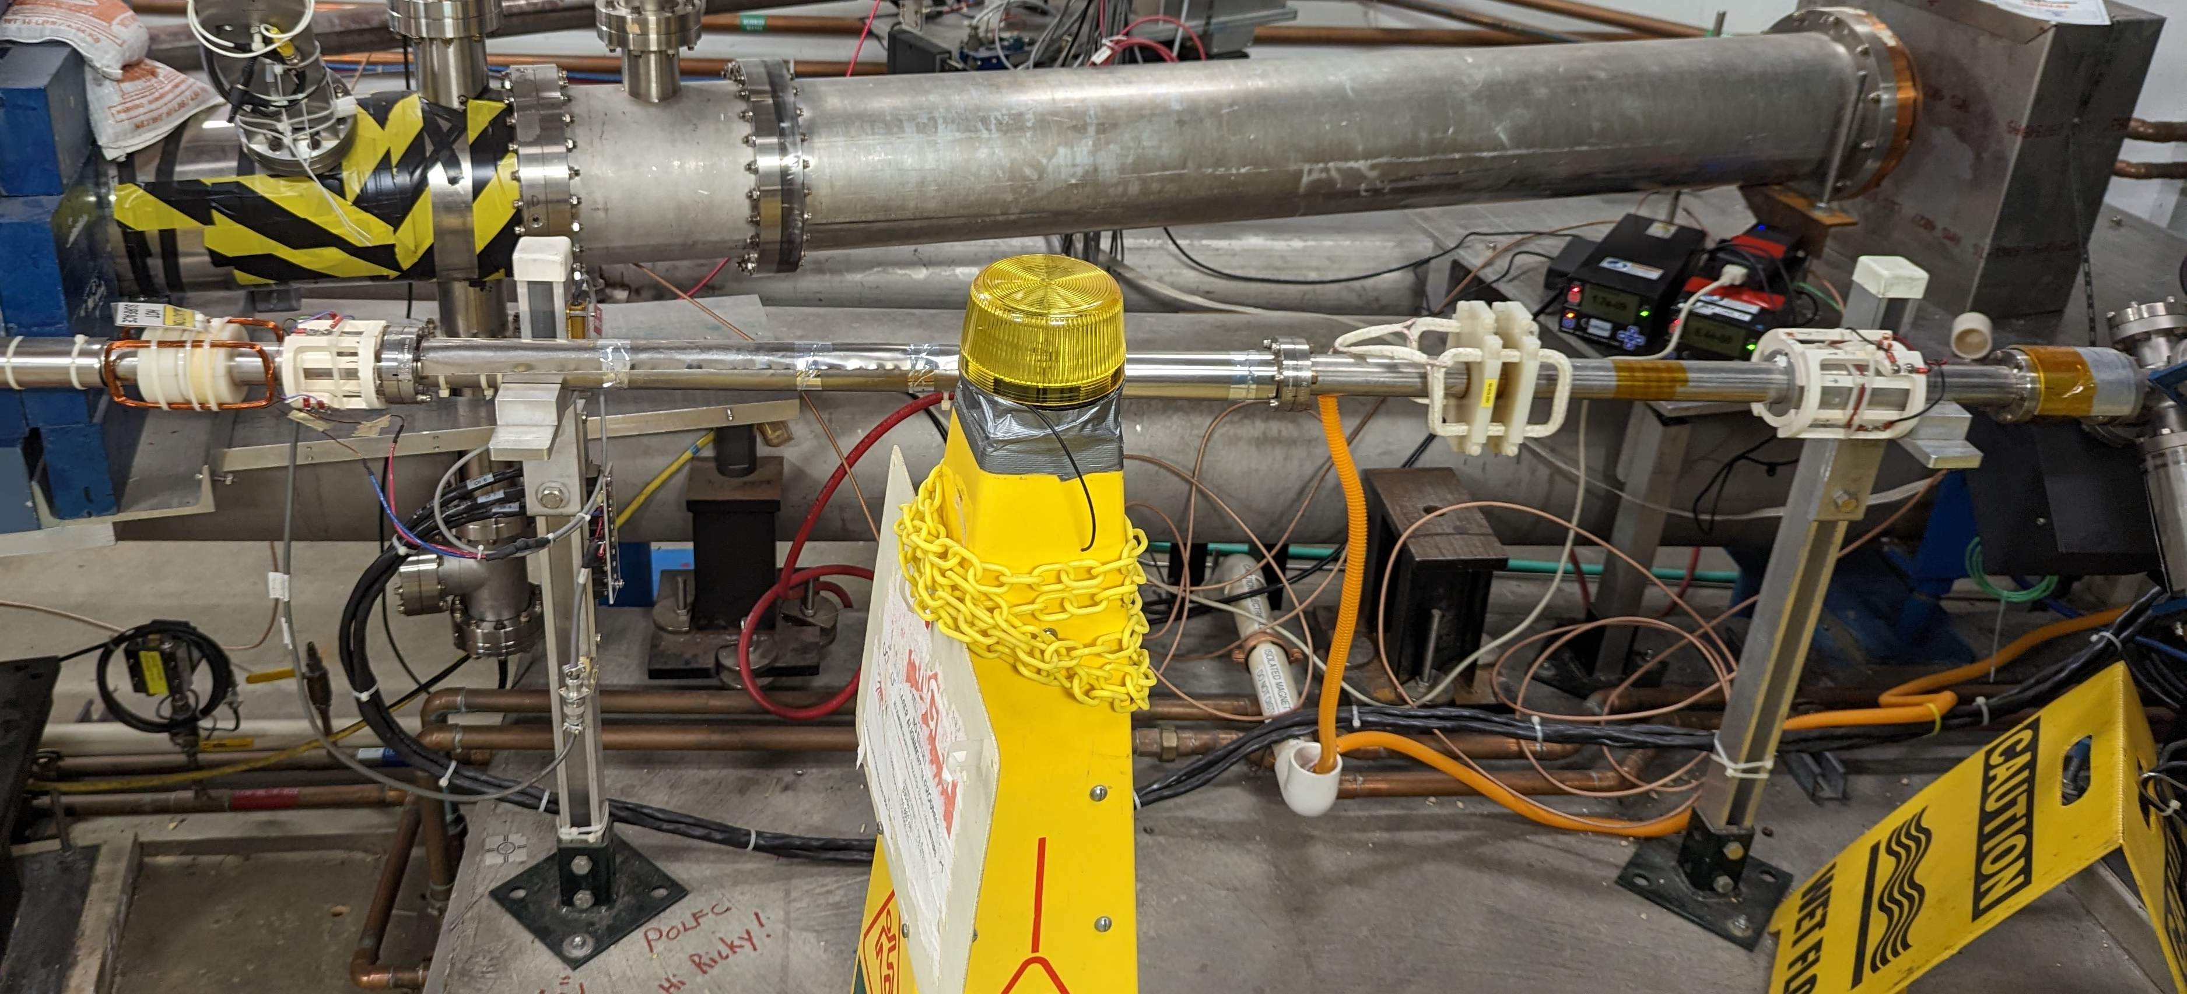
Degrader girder location in CEBAF
Mott
DP can
DP can
booster
First full CM
Beamline valves
Fast valves
MHB0L02BH
MHE0L03V
58 inch section
Break at yellow markers

Slide 13
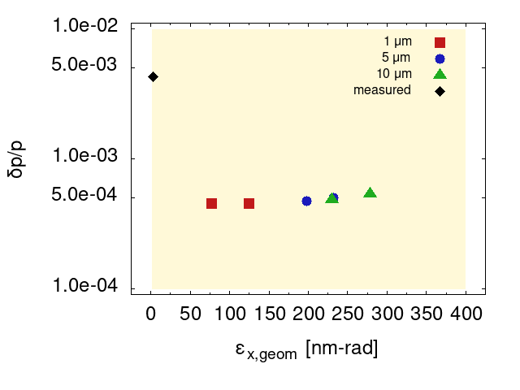
Degraded beam parameter space @ 123 MeV beam energy
Trying to span the range between nominal electron parameters and potential positron parameters
Maximum transverse geometric emittance injected at front of NL estimated to be 167-500 nm-rad [doi: 10.18429/JACoW-IPAC2023-MOPL152]
Current focus is on expanding the energy spread parameter space
Exploring variation of energy spread in beam before the degrader target and optics in the injector chicane

Slide 14
Degraded beam emittance evolution in CEBAF
We have started simulations of degraded beam distributions in CEBAF
Results show ~ 2x larger emittance with degraded beams
Not included: analysis of beam loss, information on physical beam pipe apertures
 | ε_{x} [nm] | ε_{y} [nm]
INJ | 197 | 155
ARC1 | 20.7 | 16.2
ARC2 | 11 | 8.55
ARC3 | 7.51 | 5.85
ARC4 | 5.75 | 4.46
ARC5 | 4.71 | 3.68
ARC6 | 4.19 | 3.11
ARC7 | 4.2 | 2.85
ARC8 | 4.19 | 2.57
ARC9 | 4.41 | 2.6
ARC10 | 5.45 | 2.49

Slide 15
Commissioning and measurement plans
During commissioning after installation, we plan to test each target and select aperture combinations → ensure we can transport degraded beams in the CEBAF injector
Emittance measurements after acceleration in injector → compare simulated and generated degraded beam distributions
Transverse acceptance measurements at entrance to Arc 1 → machine acceptance of 12 GeV CEBAF
Transport degraded beam distributions through rest of CEBAF → emittance evolution through 5 passes
Different settings in booster to generate distributions with larger momentum spread upstream of degrader target → transport of beams with larger transverse and momentum spread
Repeat measurements using polarized beam → effects of degrader on polarization, depolarization in larger beams?
Study beam loss with larger beams
…

Slide 16
Degraded electrons beams in Ce⁺BAF
Both e+/e- generated in the pair production process – most efforts naturally focus on positron collection (see A. Ushakov’s earlier talk)
Electrons with the same properties as collected positrons are needed for beam charge asymmetry measurements
Also for detector commissioning, early machine setup
Positron collection system is already complicated – bipolar collection system significantly increases complexity
What if we can mimic the collected positron distribution with degraded electron beams?
Provides the needed electron beam
Collection system for single charge easier to design and implement

Slide 17
Degraded electron beams in the LERF
[J. Grames concept]

Slide 18
Future study plans for degraded beams
With information from CEBAF degrader measurements, we can study the LERF degrader concept, including
Degrader placement and effects on generated distributions
Degrader apparatus design modifications for CW operation
Beam dynamics towards approximating positron distributions

Slide 19
Summary
Because positron beams will be much larger in phase space than nominal electron beams, we want to understand the transport of large phase space beams in CEBAF
We are building a device to generate large phase space beams through multiple scattering in thin carbon targets
The degraded beam parameter space available from this device has substantial overlap with the parameter range of interest
We are working towards installation during the upcoming 2024 SAD, and expect first measurements later this year
What we learn will help inform further measurements and future studies on degraded beams in Ce⁺BAF

