Slide 1
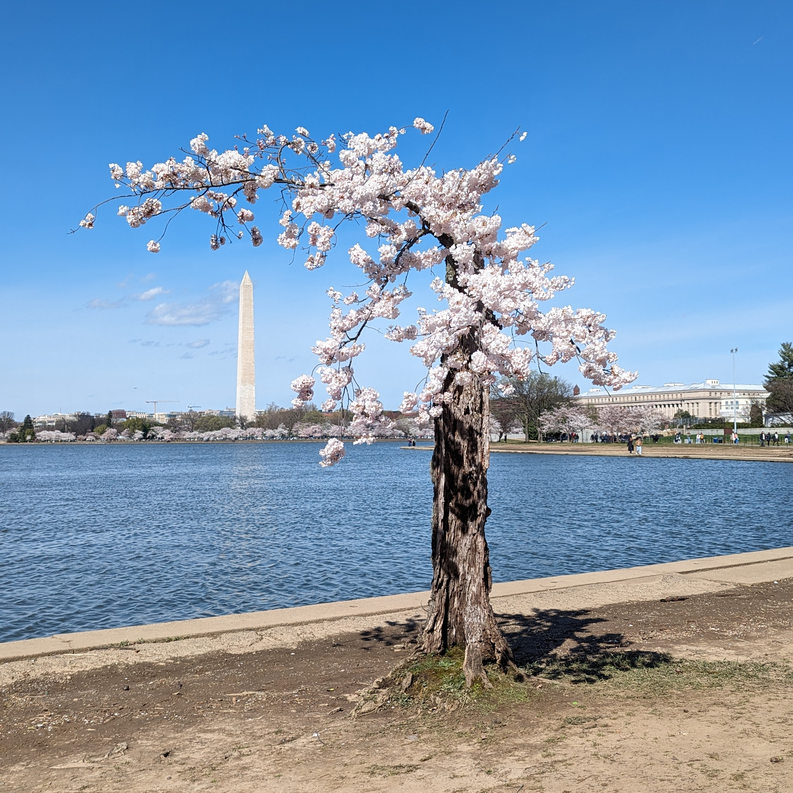
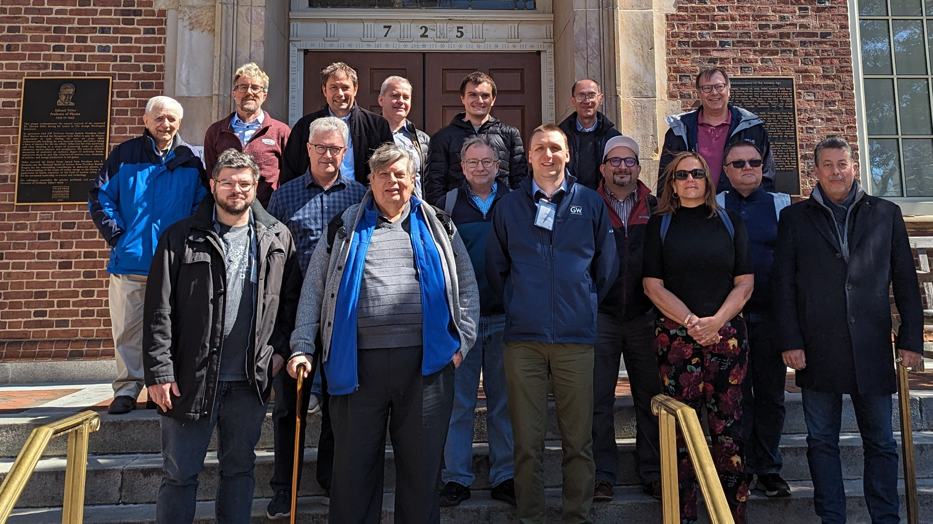
Positron pCDR Yellow Report
Update from Douglas Higinbotham

Slide 2
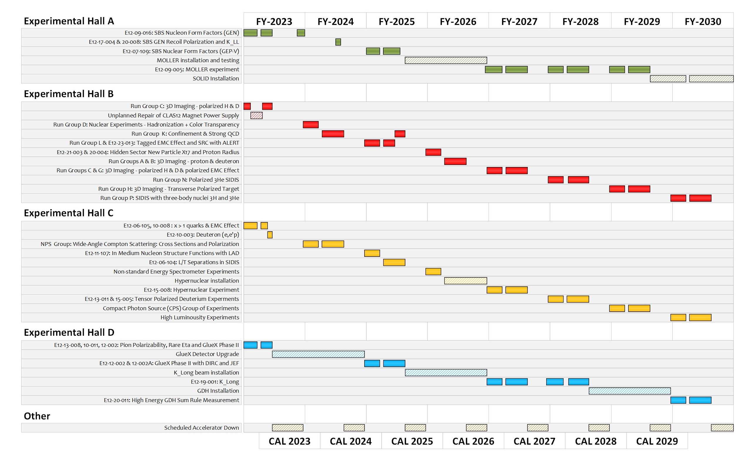
Extended Experimental Schedule

Slide 3
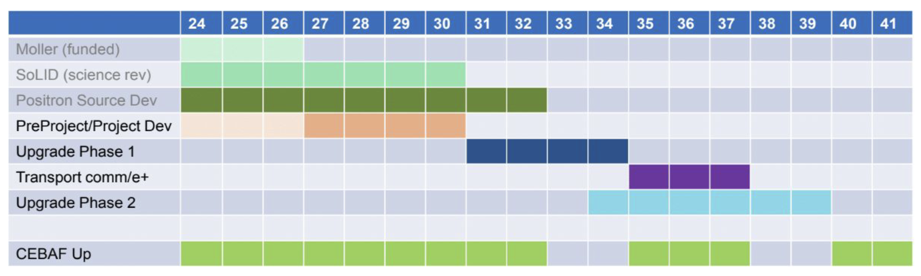
EXTREMELY ROUGH Timeline CEBAF’s Future
( though 2040 maybe seem very far away, this is actually a very aggressive schedule )
Phase 1 includes building a positron source and the tunnel & beamline connecting the source to main machine.
Phase 2 includes the new permanent magnets to allow 22 GeV within current CEBAF footprint.
NOTE: Plan was formulated by David Dean so that these projects are ramping up as the EIC project cost is ramping down.

Slide 4
Transition to Operations
This funding profile, V4 (Version 4), is based on actuals through FY23 and forecasts.
V5 will use FY24 actual and revised forecasts.
V6 will be the CD-2 Performance Baseline.
4

Slide 5
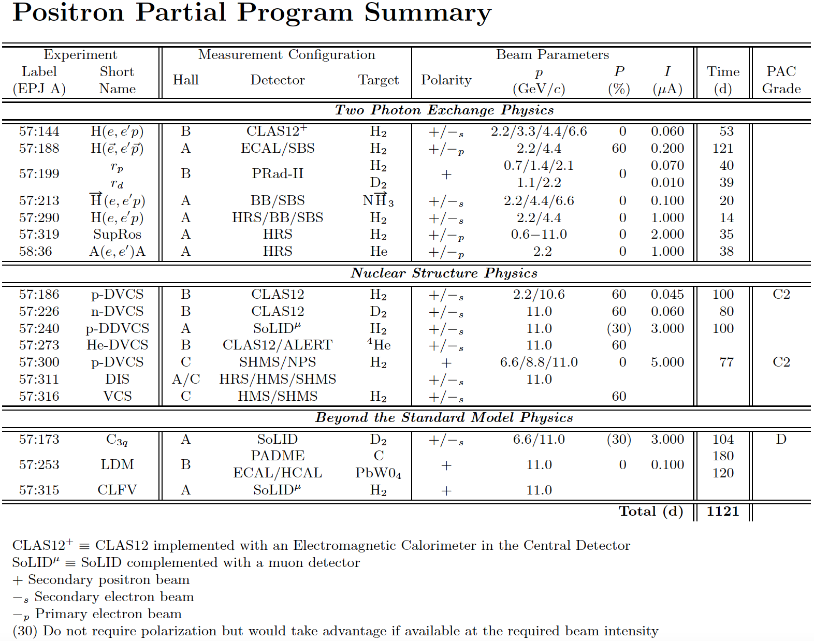
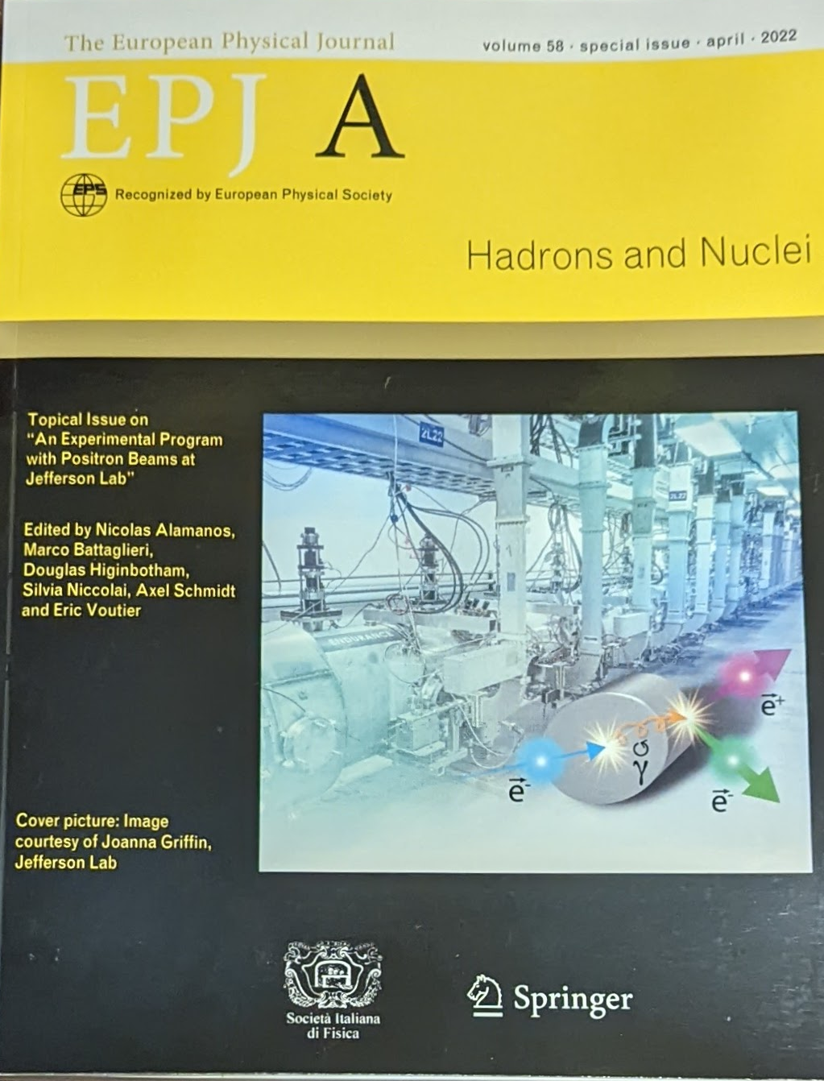
Positron Program White Paper Published 2022
https://doi.org/10.1140/epja/s10050-022-00699-6

Slide 6
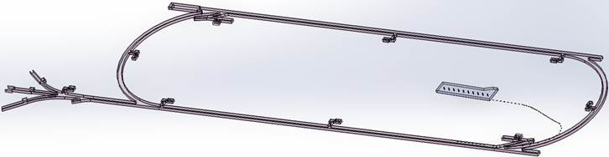

Low Energy Recirculator Facility (LEFRF) As The New Injector Facility for CEBAF
123 MeV e+
(650 MeV e-)
Inject e⁺ into North Linac to usual 12 GeV (w/ magnets reversed)
Build e⁺ injector at the LERF
Build new LERF to CEBAF tunnel
123 MeV e+
(650 MeV e-)
Build new transport line along South Linac and West Arc

Slide 7
12 GeV CEBAF vs. Ce⁺BAF
Machine Parameter | Electrons | Positrons
Hall Multiplicity | 4 | 1 or more
Max. Energy (ABC/D) | 11/12 GeV | 11/12 GeV
Beam Repetition | 249.5/499 MHz | 249.5/499/1497 MHz
Duty Factor | 100% cw | 100% cw
Unpolarized Intensity | 170 μA** | > 1 μA
Polarized Intensity | 170 μA** | > 50 nA
Beam Polarization | > 85% | > 60%
** Total beam power at Jefferson Lab is limited to 1.1 MW with a max. of 0.9 MW to individual high power dumps.

Slide 8
Program Advisory Committee Positron Results (July 2023)
NUMBER | TITLE | CONTACT PERSON | HALL | DAYS REQUESTED | DAYS AWARDED | SCIENTIFIC RATING | PAC DECISION
PR12+23-002 | Beam Charge Asymmetries for Deeply Virtual Compton Scattering on the Proton at CLAS12 | Eric Voutier | B | 100 | 100 | A- | C1
PR12+23-003 | Measurement of Deep Inelastic Scattering from Nuclei with Electron and Positron Beams to Constrain the Impact of Coulomb Corrections in DIS | Dave Gaskell | C | 9.3 | 9.3 | A- | C1
PR12+23-005 | A Dark Photon Search with a JLab positron beam | Bogdan Wojtsekhowski | B | 60 |  |  | Deferred
PR12+23-006 | Deeply Virtual Compton Scattering using a positron beam in Hall C | Carlos Munoz Camacho | C | 137 | 137 | A- | C1
PR12+23-008 | A Direct Measurement of Hard Two-Photon Exchange with Electrons and Positrons at CLAS12 | Axel Schmidt | B | 55 | 55 | A | C1
PR12+23-012 | A measurement of two-photon exchange in unpolarized elastic positron–proton and electron–proton scattering | Michael Nycz | C | 56 | 56 | A- | C1
C1 = Conditionally Approved w/Technical Review by the Lab
Approved 155 days Hall B & 202 days in Hall C for 357 total PAC days!
Three years of running at 34 weeks per year. ( PAC day = two calendar day)
8

Slide 9
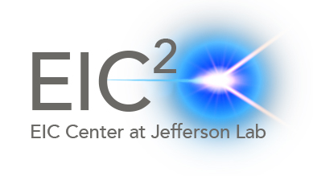
EIC Yellow Report
Posted to the arXiv on 8 March 2021:
https://arxiv.org/abs/2103.05419
902 pages, 415 authors, and 151 institutions
also published in a refereed journal:
Nucl.Phys.A 1026 (2022) 122447
As of 20 March 2024 has 776 citations.
The document is broken into three volumes:
Executive Summary
Physics
Detectors
ePIC collaboration is now getting ready to write the draft
Technical design document for the detector package.

Slide 10
Positron Yellow Report
( decided to Stumpy the cherry tree )
I spoke with David Dean (deputy director) just prior to coming to this meeting and he agreed it is a bit premature for a pCDR (~2 years from now is probably the right time); BUT he very much liked the idea we follow the EIC’s path and put together a Yellow Report.
Of order 100 pages seems appropriate.
We could likely write it in a way so that it could go directly to Nucl.Phys.A
( EIC did not do this and it was HUGE task to reformat )
The document could again be broken into three volumes:
Executive Summary (can be done last)
Physics
Positron Source
Note: ePIC collaboration is now getting ready to write the draft Technical design document for the detector package as they are now at the CD2/3A stage of their project.

Slide 11
Time for your thoughts and Discussion

