Slide 1
Status of Jefferson Lab Upgrade Initiatives
Thia Keppel
Positron Working Group Workshop
March 18-20, 2024
George Washington University

Slide 2

The community did a lot of work (science workshops, accelerator studies, cost estimating, profile development in EIC era,…) to quickly prepare for the Long Range Plan
- We did not seek to be a recommendation this time (too new, too uncertain).
- Critical just to be mentioned, and mentioned favorably!

Slide 3
Recommendation IV
How did we do? Where can I find the upgrades in the plan?
We recommend capitalizing on the unique ways in which nuclear physics can advance discovery science and applications for society by investing in additional projects and new strategic opportunities.
Today’s investments enable tomorrow’s discoveries, with corresponding benefits to society. We underscore the importance of innovative projects and emerging technologies to extend discovery science, which plays a unique role in supporting national needs.

Slide 4
Recommendation IV
How did we do? Where can I find the upgrades in the plan?
We recommend capitalizing on the unique ways in which nuclear physics can advance discovery science and applications for society by investing in additional projects and new strategic opportunities.
Today’s investments enable tomorrow’s discoveries, with corresponding benefits to society. We underscore the importance of innovative projects and emerging technologies to extend discovery science, which plays a unique role in supporting national needs.

Slide 5
Section 1.3: Strategic Opportunities
1.3.1 Opportunities to Advance Discovery
Strategic opportunities exist to realize a range of projects that lay the foundation for the discovery science of tomorrow. These projects include the 400 MeV/u energy upgrade to FRIB (FRIB400), the Solenoidal Large Intensity Device (SoLID) at Jefferson Lab, targeted upgrades for the LHC heavy ion program, emerging technologies for measurements of neutrino mass and electric dipole moments, and other initiatives that are presented in the body of this report.
Future advances in nuclear physics rely upon a vibrant program of detector and accelerator R&D, pushing for instance the current limits on detector sensitivity and on accelerator beam transport technology. R&D for novel nuclear physics detector and accelerator ideas influence fields such as medicine and national security. Such developments must continue.

Slide 6
JLab UPGRADE SCIENCE in the LRP – some direct excerpts
The possible addition of a polarized positron beam to CEBAF would enable precise separation of signal and background for one of the relevant processes to access GPDs.
To investigate the other XYZP states, higher beam energy is required; the tetraquark candidate Z_{c} states would Z_{c} be copiously produced at a high-luminosity, fixed-target electron machine operating above 20 GeV.
The staged upgrade plan for CEBAF foresees a first phase to establish intense polarized positron beam capability at 12 GeV, allowing for new measurements in nucleon tomography and providing precision extraction of contributions from higher order electromagnetic processes.The nontrivial operation with positron beams (polarized and unpolarized) will open a new area of study for CEBAF in the future. The subsequent phase is an energy upgrade of CEBAF to more than 20 GeV. Recently, the Cornell Brookhaven Electron Test Accelerator (CBETA) facility demonstrated eight-pass recirculation of an electron beam with energy recovery employing arcs of fixed-field alternating gradient magnets. This exciting new technology could enable a cost-effective method to double the energy of CEBAF, allowing wider kinematic reach for nucleon femtography studies in the existing tunnels and with no new cryomodules required.

Slide 7

LRP Excerpts Continued…
The role of two-photon exchange can be determined by measurements using a positron beam, which could be realized at Jefferson Lab with a modest accelerator upgrade.
A CEBAF upgrade plan, including positron beams and a novel energy upgrade, is being pursued.
A potential staged upgrade of the CEBAF accelerator has been under investigation for some time (Section 9.7) that would initially provide a 12 GeV polarized positron beam, and then a 22 GeV electron beam, while maintaining the world-leading luminosity. This capability would uniquely provide precise information on the role of two-photon exchange in lepton–hadron scattering, allow access to a new sector of hadron spectroscopy, and offer an unprecedented view of the complex nucleon structure in the valence region, one not accessible at other machines.
This may not be all, but I think it’s clear….

Slide 8

This is what we needed to really get started – grEat job, all!!
Now, where do we go? We need to:
Keep the science prominent in the community dialogue (talks at conferences and workshops, show plots with 12 GeV, positrons, and possible 22 GeV where possible, have dedicated workshops for the upgrade, keep your working group active, discuss often,…)
For positrons, keep good PAC proposals coming
Develop the science case, publish as possible
Hone the technical design, demonstrate feasibility
Develop and submit to DOE a pre-CDR well before the next LRP
  science, technical design, cost and timeline
e+
pre-CDR
2023 Long Range Plan

Slide 9
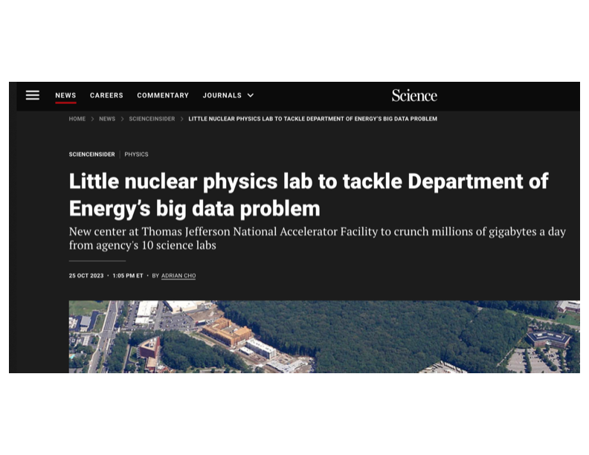
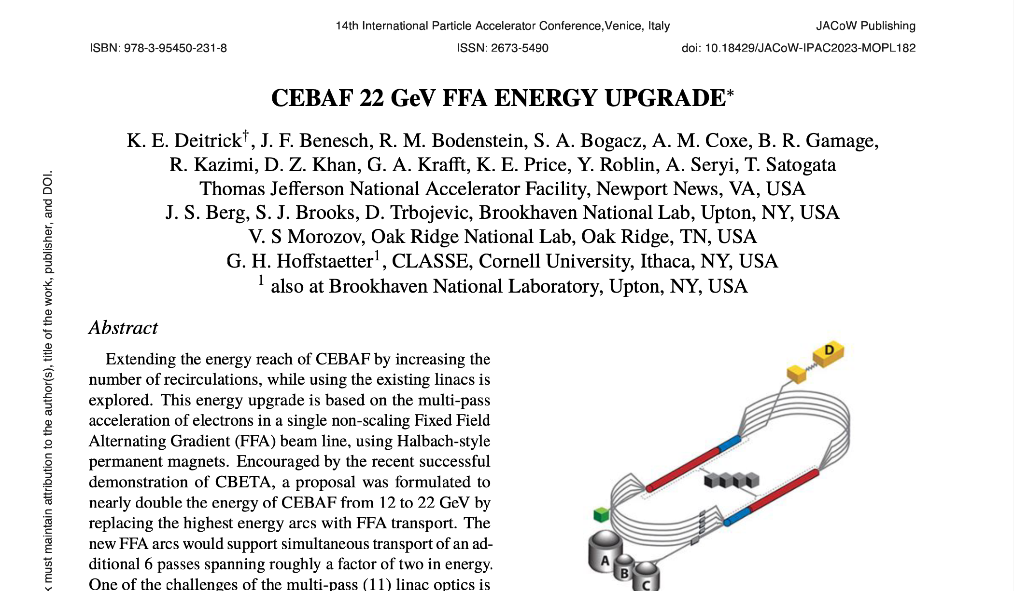
At JLab
Working group established, led by David Dean, to guide path towards preCDR
- users and staff, positrons and 22 GeV efforts represented
- expect to invite speakers, attendees, open up more once on track (a la EIC)
  - expected to eventually lead preCDR writing group(s)
Continue to develop a strong science case – discussions ongoing
Planning for 22 GeV workshop at Frascati December 9-13, 2024
Continue dialogue with DOE, secure funding for necessary technical development
  - high non-operations priority in Lab Management Budget Briefing 2/24
  Hone the technical design, demonstrate feasibility – defer to Joe’s talk for e+
Strong Interaction Physics at the Luminosity Frontier with 22 GeV Electrons at Jefferson Lab
Accepted to EPJ
~450 authors
141 pages
“CEBAF’s 1,800 scientific user community is proposing to push the high-luminosity frontier with a new capability: high-energy positron (anti-electron) beams on fixed targets. Furthermore, the Plan explores science that could be addressed by increasing CEBAF’s precision electron beams to 22 GeV…”

Slide 10
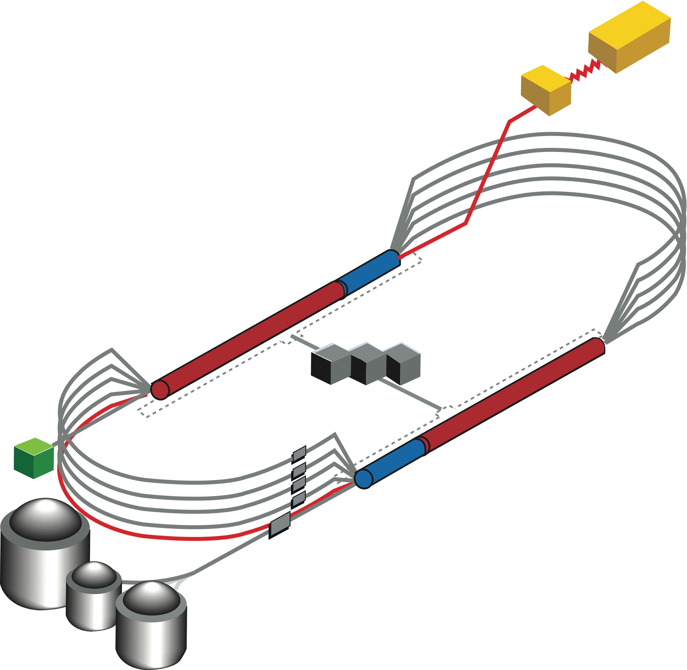

22 GeV CEBAF baseline: 650 MeV inj + 4-pass CEBAF + 6-pass FFA*
Developing a pre-conceptual design for additional FFA* racetrack in the existing CEBAF tunnel to reach the top energy of about 22 GeV
FFA Arc Architecture
  Non-scaling FFA based on high-gradient permanent magnets
  Compact merger to control orbits, beta functions and dispersion at arc ends
Multi-pass linac optics
  650 MeV injector upgrade
  Strongly focusing triplet lattice periodic optics for lower passes
Modified CEBAF ‘switchyard’, Arcs 1-8 and TOF correction ‘splitters’
*FFA (Fixed Field Alternating-Gradient)
Slides from Alex Bogacz – anything said wrong is on me!
TOF
650 MeV
TOF
Enabling Technology:
Novel permanent magnets, -style used for power and cost savings

Slide 11
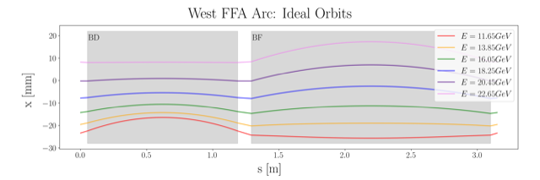
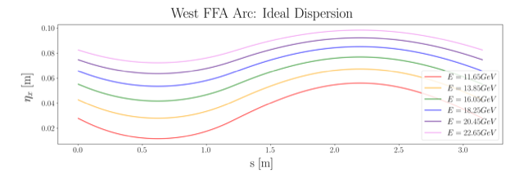
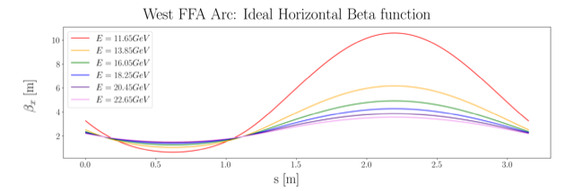
Non Scaling FFA Arc − Compact FODO Cell
orbits
Large momentum acceptance FFA cell, configured with combined function magnets capable of transporting six beams with energies spanning a factor of two
Arc composed of 75 cells, L_{cell} = 3.15 m
Closely spaced orbits for all six beams (~ 4 cm)
Low betas (~ a few m)
Extremally low dispersions (a few cm) - Virtue of combined function FFA magnets
dispersions
beta functions

Slide 12
Permanent Magnet Design
Very compact compared to conventional electro magnets
Allows for accommodating 6 additional passes in CEBAF tunnel
Provides power and cost savings
Concept successfully tested at
Open mid-plane geometry
Focusing Magnet BF
G_{F}= -41.13 T/m
L_{QF}= 1.67 m
B_{F}= -0.812 T
Defocusing Magnet BD
G_{D}= 43.44 T/m
L_{BD}= 1.24 m
B_{D}= -0.593 T
12 cm
12 cm
13 cm
13 cm

Slide 13
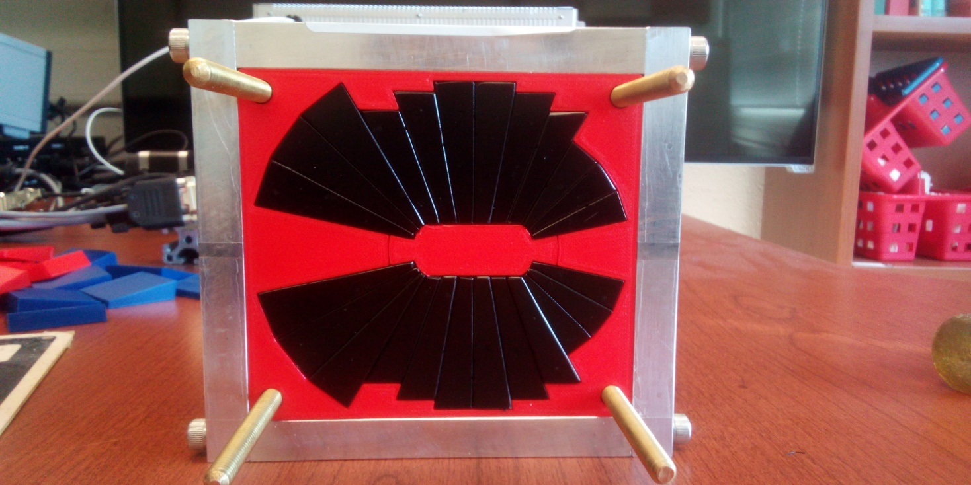
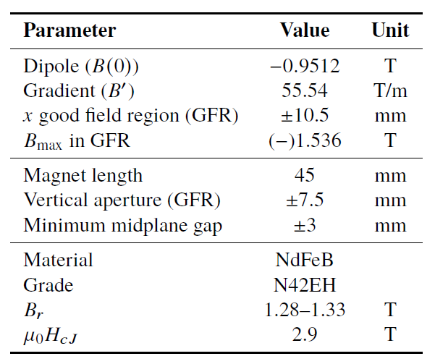

Prototype Magnet
Prototype open-midplane BF magnet successfully built and evaluated for mechanical integrity
>1.5 Tesla measured in good field region
Field accuracy of ${10}^{−3}$
Test of radiation resilience at CEBAF - LDRD project started Oct. 1, 2023

Slide 14
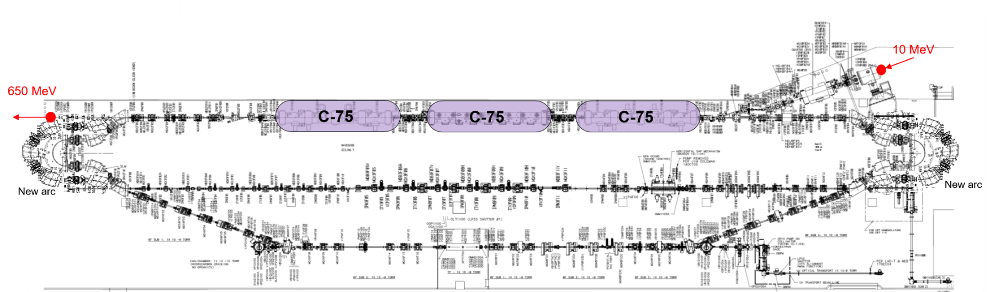
Injector Upgrade − 650 MeV Recirculating Injector based on LERF
With the present 123 MeV injector, the difference in the first and final pass energies in the North Linac is too large (1:175) to effectively control the beam.
650 MeV recirculating injector (3-pass) based on LERF will allow a manageable difference in energies (1:33)

Slide 15


Energy loss, Emittance dilution and Energy spread
  Doubling the energy, while staying within current CEBAF footprint, makes the synchrotron radiation effects of paramount importance.
  Quantum nature of a ‘recoil’ effect on electrons due to photon emission makes significant impact on both the transverse and longitudinal beam dynamics, leading to cumulative emittance growth (transverse and longitudinal).
Energy loss
Emittance dilution
Natural energy spread
Maximize $ρ$, minimize H
  Cumulative emittance dilution (transverse and longitudinal) at 22 GeV (4 CEBAF + 6 FFA passes)
Projected value from the Spr/Rec contribution

Slide 16


Summary
Present Baseline (1.1 GeV per linac):
  650 MeV Recirculating Injector (additional three C-75 cryomodules)
  Recirculate 4 passes with the current CEBAF
  Plus Additional 6 passes via a single FFA: 10 – 22 GeV
Non Scaling FFA Arc Architecture configured with compact FODO cells
  Beta and dispersion matching to the linacs through cell-by-cell variation (length, bend)
  Open mid-plane permanent magnet design: B-field ≤ 1 T, Gradient ≤ 50 T/m
Synchrotron Radiation impact on beam quality:
  Net transverse emittance (normalized):
  Net natural energy spread: 1.5×10⁻³
  Net synchrotron radiated energy: 1 GeV
$$σ=\sqrt{β\frac{ε_{N}}{γ}}$$
$$ε_{N}=\text{80 }\text{mm} \text{mrad}$$
at 22 GeV, β = 20 m → σ = 175 microns
at 22 GeV → ΔE = 33 MeV

Slide 17
Near Term Strategy (next 3 years)
Accelerator design focus for the next few years should be on:
  Developing a pre-conceptual design for additional FFA racetrack in the existing CEBAF tunnel to reach the top energy of about 22 GeV (current baseline), more specifically:
    Complete optics design for a pair of FFA arcs, including merger transitions to linacs
    TOF Splitters design for NE and SW arc ends, including momentum compaction compensation and beta matching
    Extraction system design capable of delivering all FFA passes (1-5) to A,B,C (same energy) and one pass above to D
    Finalize multi-pass linac optics based on strongly focusing triplets
    650 MeV recirculating injector design (in the LERF vault)
    Carry out S2E simulation including errors
    Implement a robust correction system
    Complete emittance dilution budget (longitudinal and transverse) via tracking studies

Slide 18
Near Term Strategy (next 3 years) – cont.
Technical design focus for the next few years should be on:
  Testing resilience of permanent magnets in CEBAF beam environment
  Developing a prototype FFA FODO cell and testing its performance with multi GeV beams at CEBAF, more specifically:
    Orbit mapping for different energies
    Beam based optics measurement and validation
    Validating effectiveness of orbit correction system
  Designing and prototyping special magnets, more specifically:
    Compact Splitter magnets
    Vertical septa for extraction system
    RF separator multi cell cavities

Slide 19
Fingers crossed….
Solicitation: DE-FOA-0003261, FY 2024 Research and Development for Next Generation Nuclear Physics Accelerator Facilities
Proposal entitled, "Novel Accelerator Design for 22 GeV CEBAF”… received by the DOE Office of Science 3/1/24
2 years, total funding 2M$

Slide 20
Summary
We’re doing well, on a good path – need to keep up the good work!
Continue to develop and advertise the science case – very important!
Demonstrate technical feasibility
Develop “final” technical design for costing
Work towards pCDR submission in ~6 years
Exciting times
Thank you!

