Slide 1
Challenges in the extraction of physics beyond SM from electron scatterings
Xuan-Gong Wang
CDMPP/CSSM, The University of Adelaide
In collaboration with Anthony Thomas
PWG Workshop, Mar 18-20, 2024

Slide 2
Outline
Asymmetry in electron/positron scattering off deuteron
Corrections to (leading) asymmetries
Numerical results
Summary

Slide 3
Electron/positron scattering off deuteron

Slide 5
DIS off deuteron target
PVDIS Electron charge asymmetry

Slide 6
X. Zheng, J. Erler, Q. Liu, H. Spiesberger, Eur. Phys. J. A 57 (2021) 173

Slide 7
Experiments

Slide 8
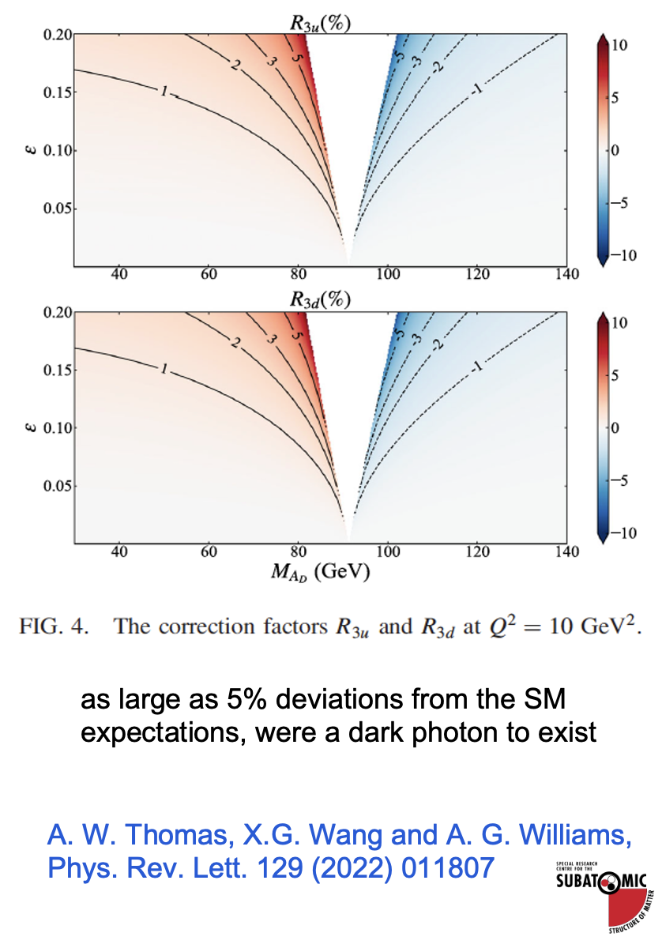

Slide 9
II. Corrections to (leading) asymmetries

Slide 10
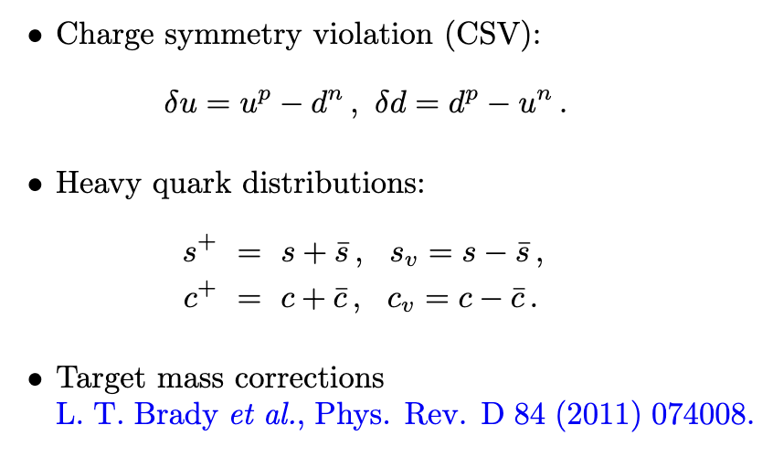
Possible sources

Slide 11
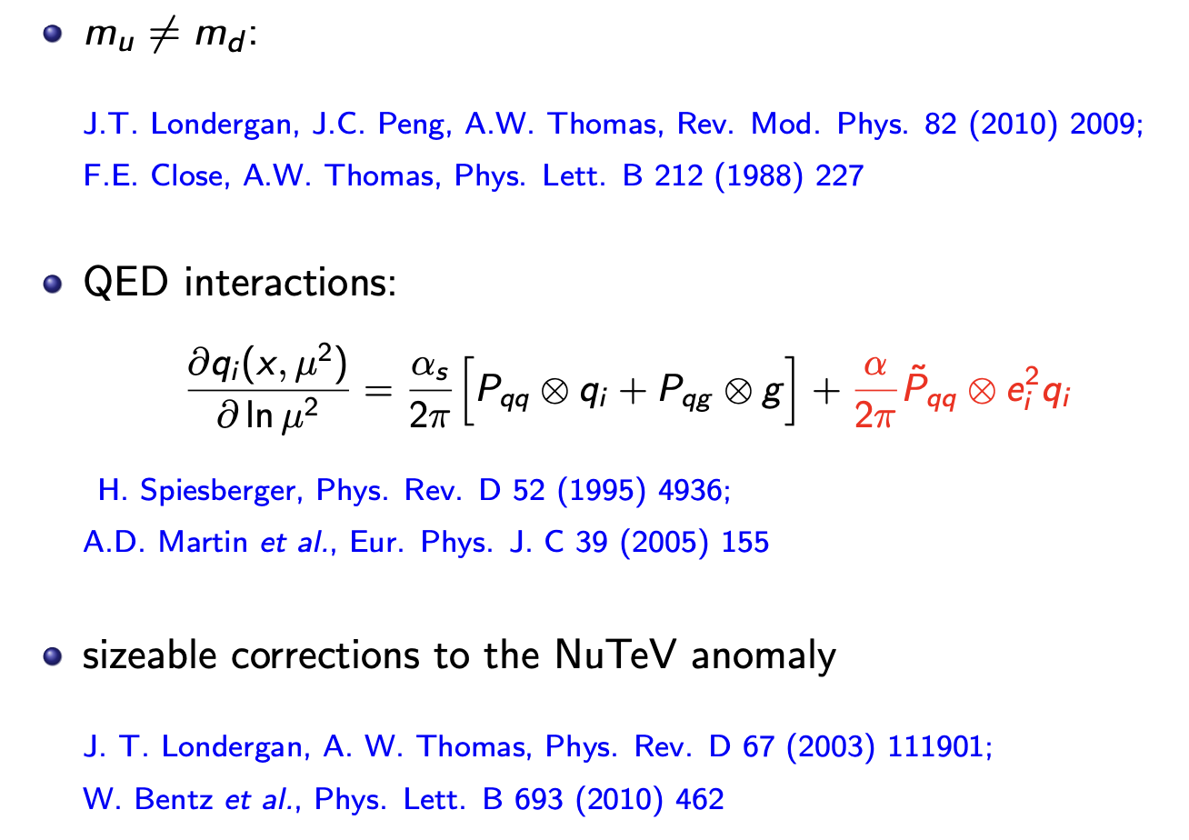
CSV

Slide 12
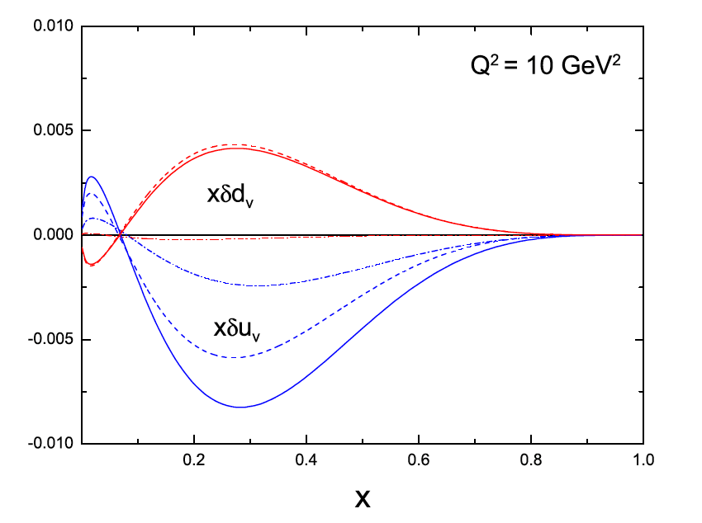
CSV
X.G. Wang, A.W. Thomas, R.D. Young, Phys. Lett. B 753 (2016) 595
QED (dash-dotted)
QCD (dashed)
Total (solid)

Slide 14
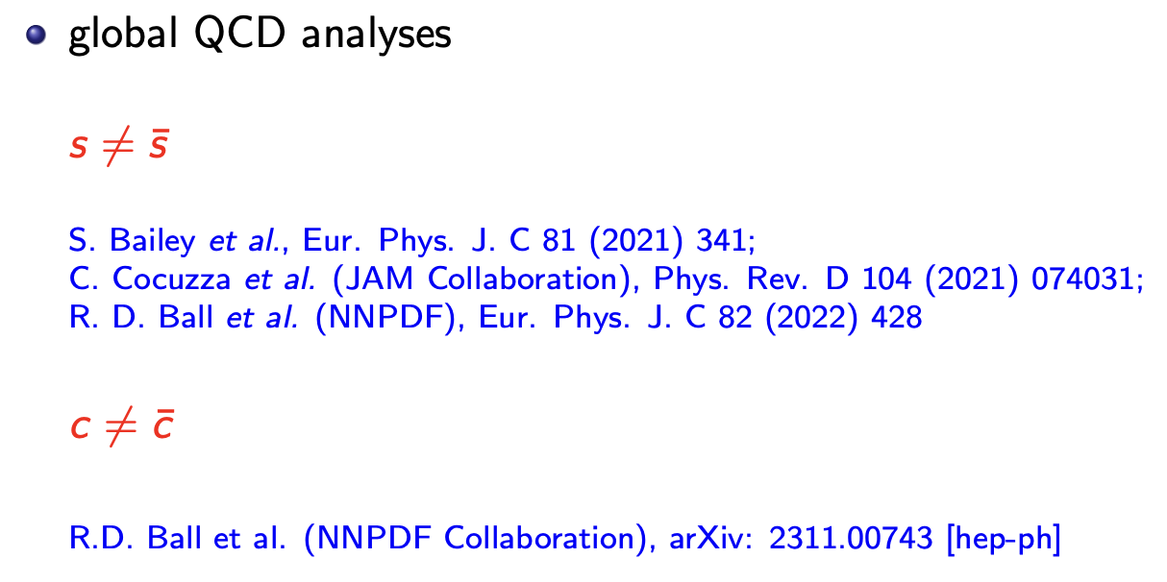

Slide 15
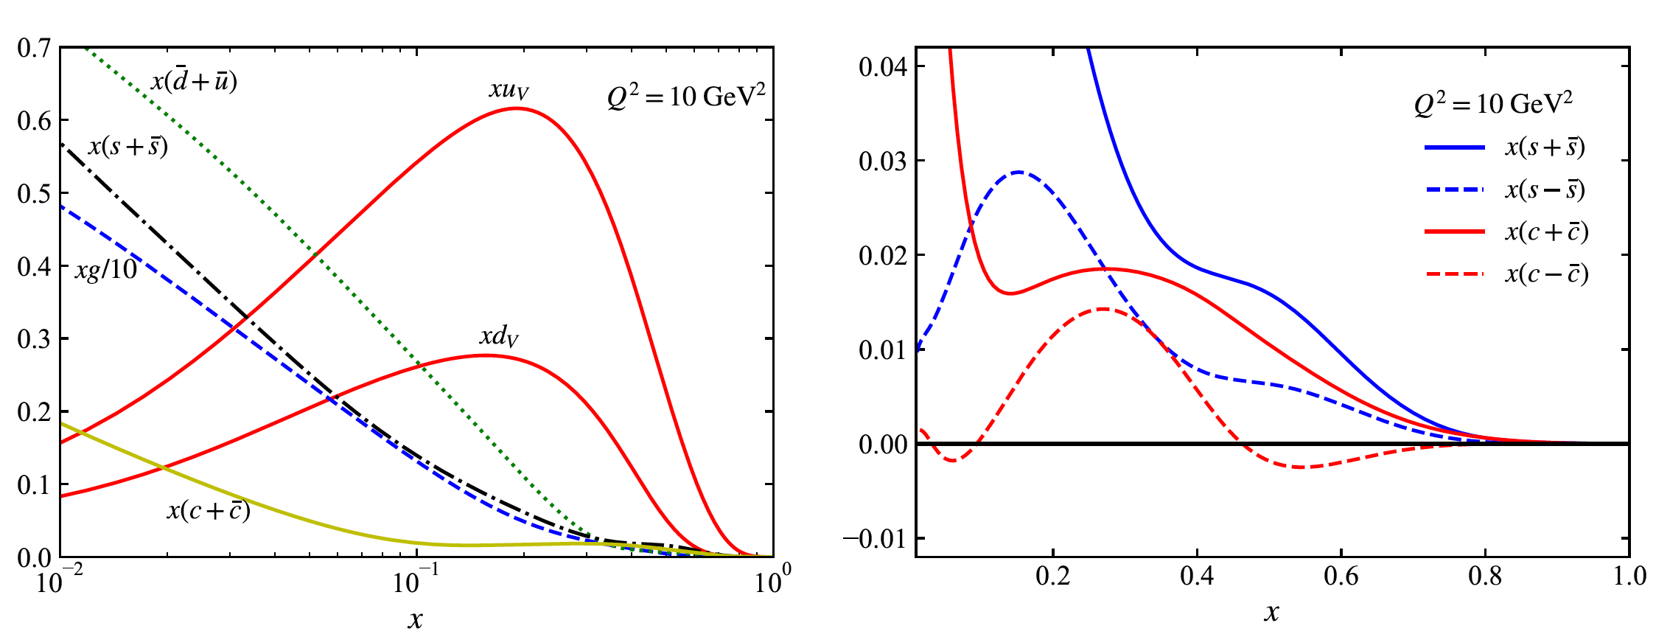
PDF set
R.D. Ball et al. (NNPDF Collaboration), arXiv: 2311.00743 [hep-ph]

Slide 16
III. Numerical results

Slide 17
X.G. Wang, A.W. Thomas, arXiv: 2403.07327 [hep-ph]

Slide 18
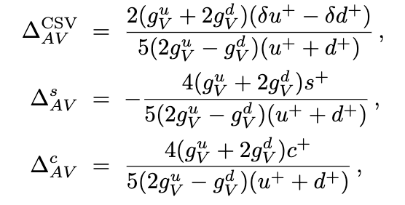
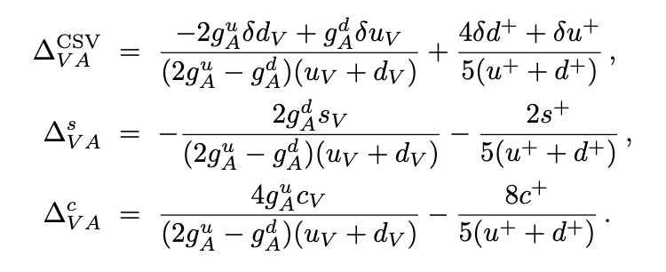

Slide 19
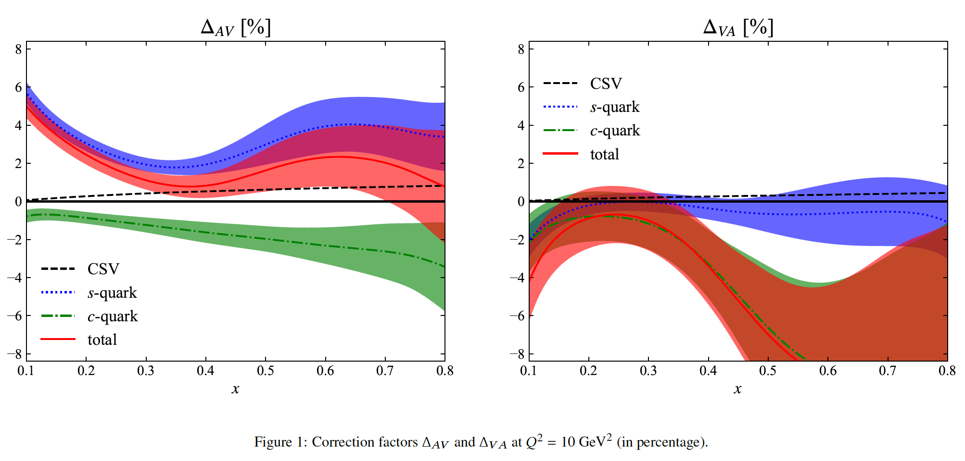

Slide 20
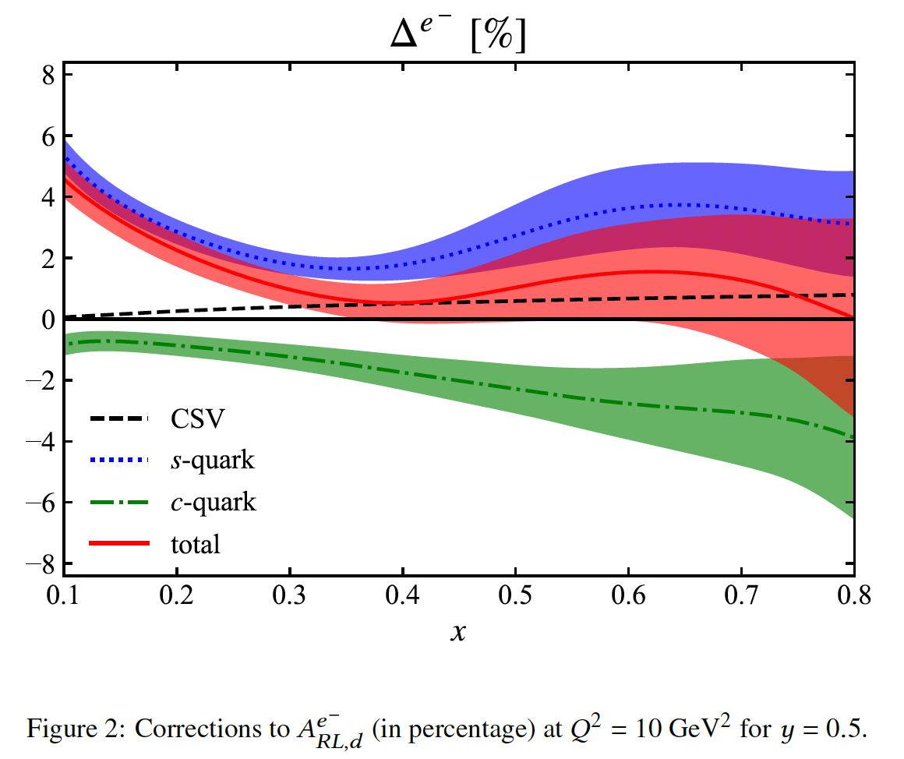
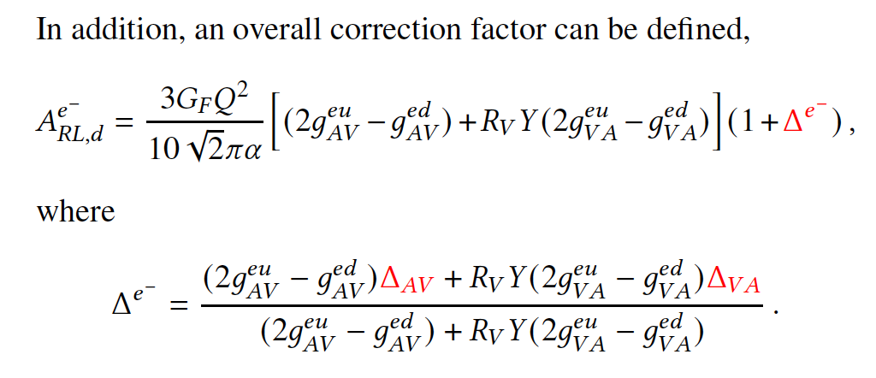

Slide 21
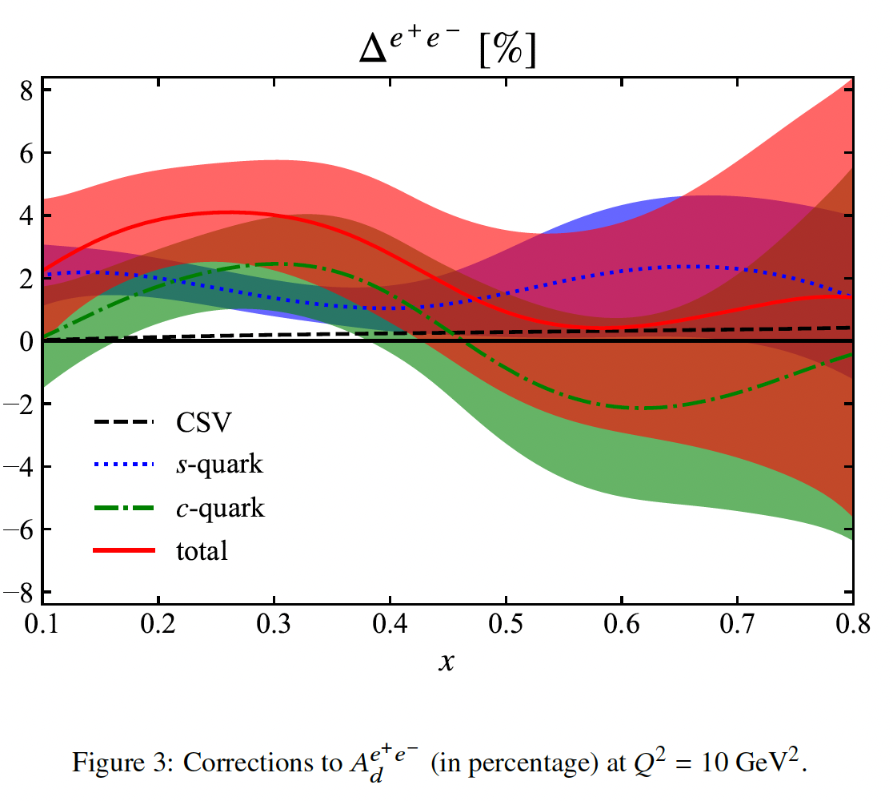

Slide 22
IV. Summary

Slide 24
Thanks!

