Slide 1
Positron beams at Ce⁺BAF
Status and a 3-Year R&D Plan
Joe Grames
Positron Working Group Workshop
George Washington University
https://indico.jlab.org/event/819/
March 18-20, 2024

Slide 2
Outline
Ce⁺BAF concept
3 Year R&D plan
Q&A

Slide 3

12 GeV Ce+BAF
Machine Parameter | Electrons | Positrons
Hall Multiplicity | 4 | 1 or 2
Energy (ABC/D) | 11/12 GeV | 11/12 GeV
Beam Repetition | 249.5/499 MHz | 249.5/499 MHz
Duty Factor | 100% cw | 100% cw
Unpolarized Intensity | 170 µA | > 1 µA
Polarized Intensity | 170 µA | > 50 nA
Beam Polarization | > 85% | > 60%
Fast/Slow Helicity Reversal | 1920 Hz/Yes | 1920 Hz/Yes

Slide 4

Upgrade framework
Assumptions
  Staged approach (e⁺ then 22 GeV)
  Utilize LERF infrastructure
Objectives
  Build two new injectors (e⁻ and e⁺)
  Provide e⁻ or e⁺ on-demand
  Use CEBAF for acceleration to 12 GeV

Slide 5
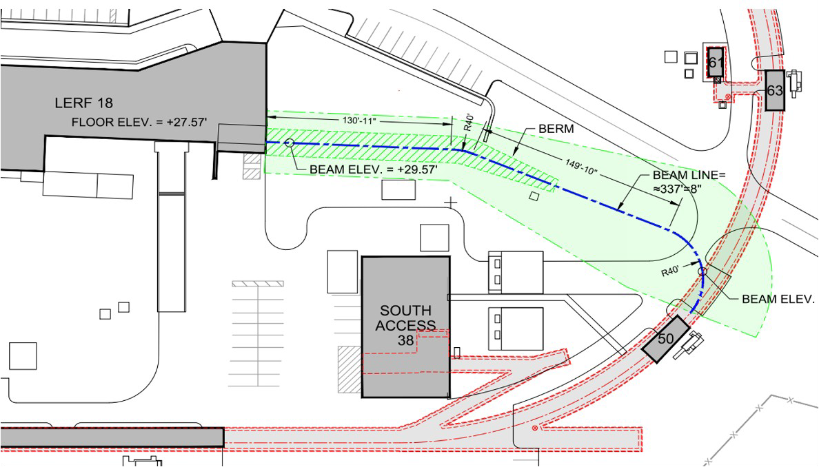
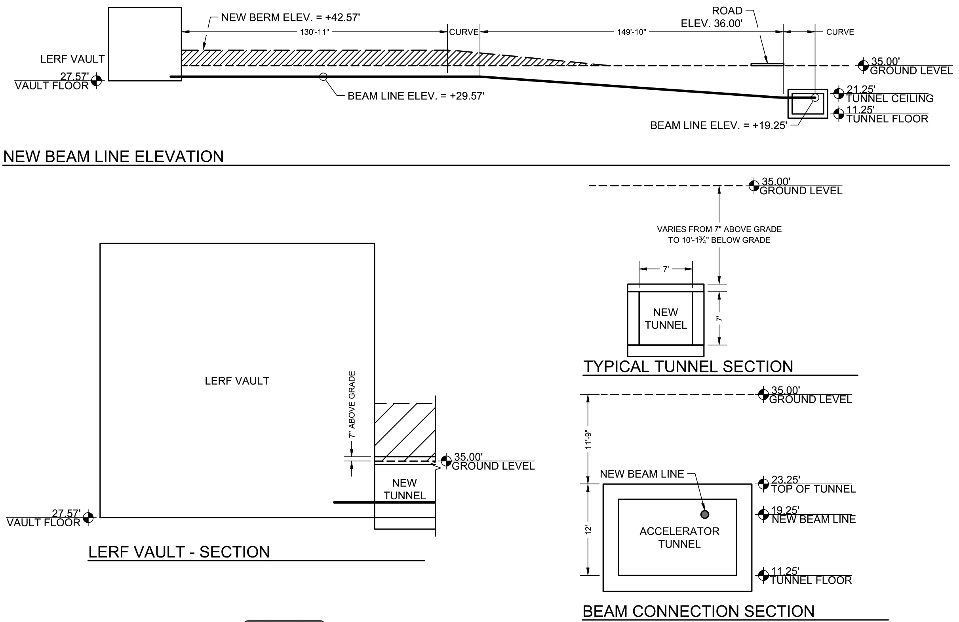
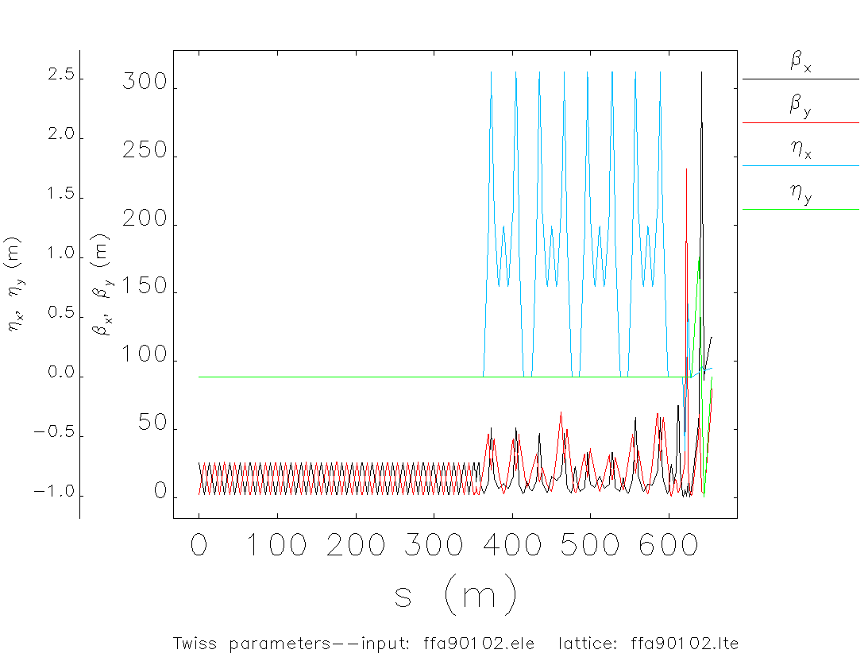
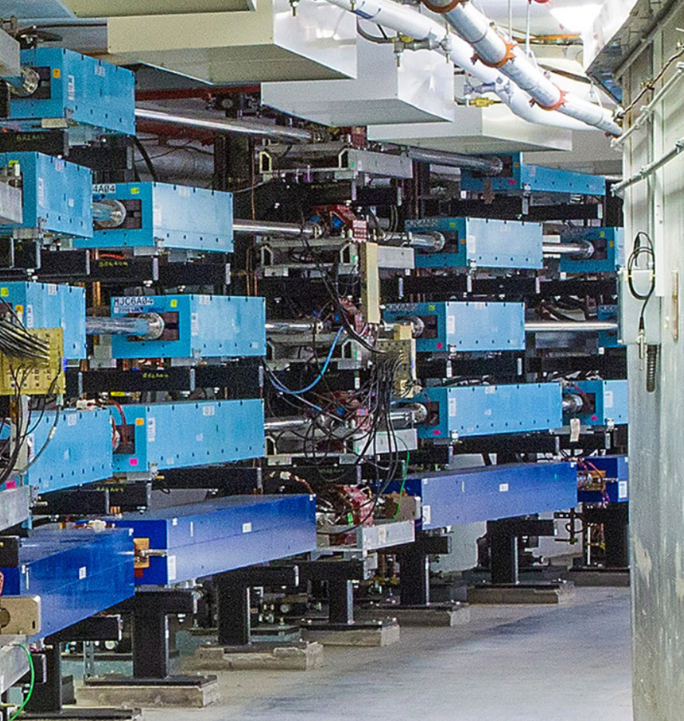
Injecting e⁺ to CEBAF 12 GeV
Once e⁺ source is ready, civil construction connects the LERF by a new tunnel to CEBAF. The transport line will maintain the e⁺ polarization in plane.
e⁺ transported in new beamline and injected to CEBAF for 12 GeV, with magnet polarities reversed
(an LDRD is exploring the transport of large emittance beams at CEBAF)

Slide 6
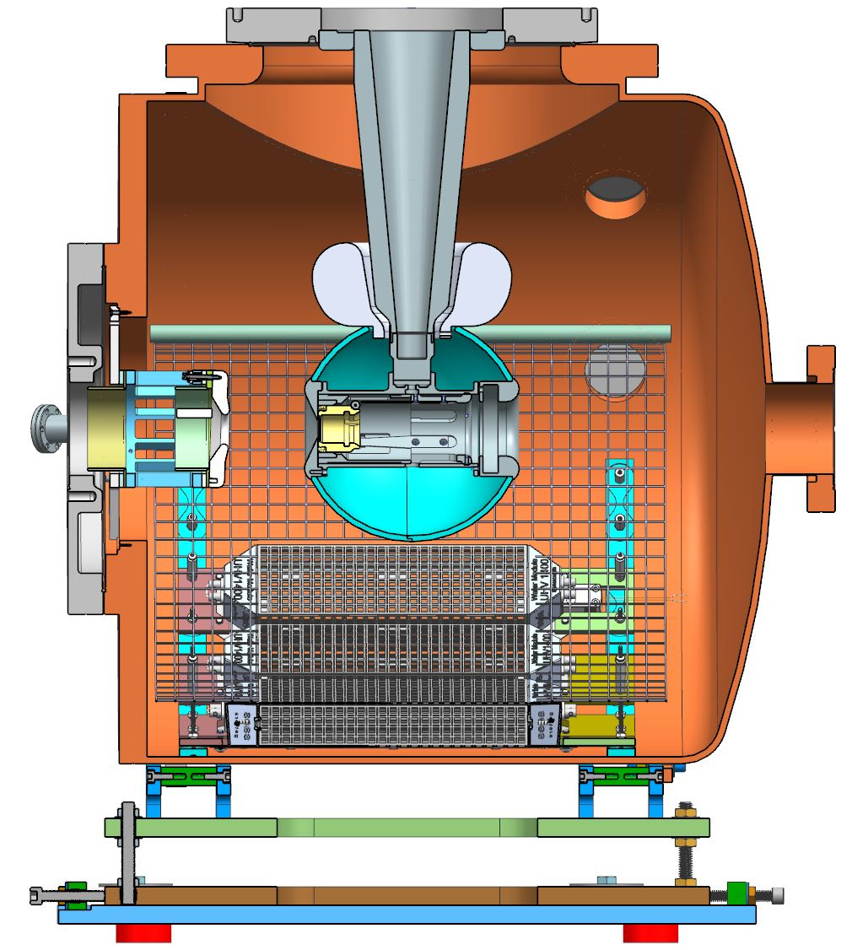
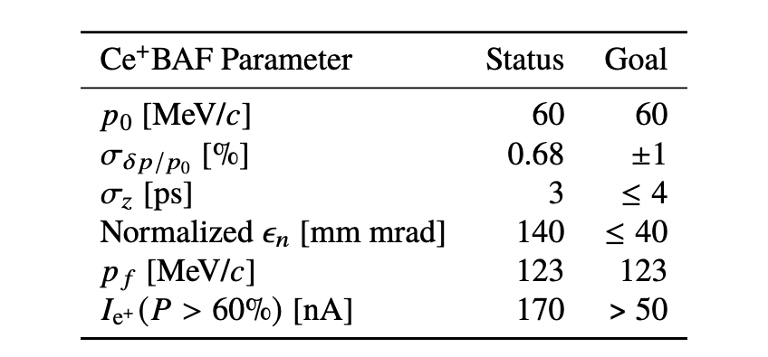
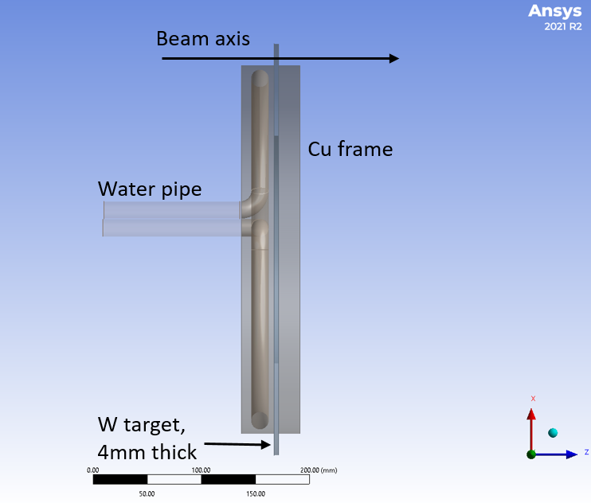
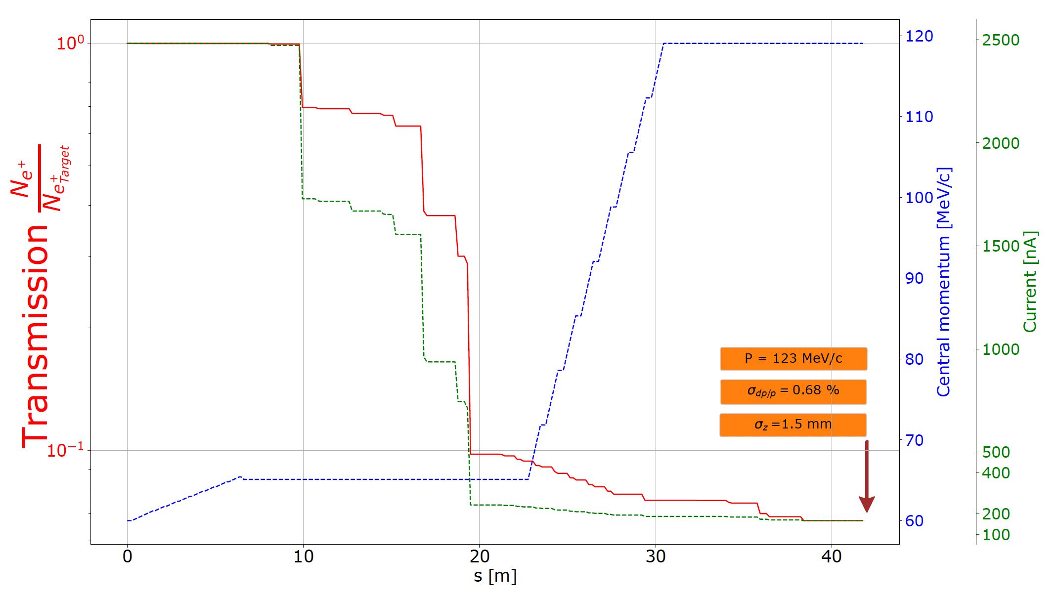
Design two new injectors (e⁻ and e⁺)
>300 kV dc-high voltage GaAs photogun generates milliAmp e⁻ beam with polarization ~90%
Two challenging injectors have to be built
  >1 mA polarized e- injector >150 MeV
  >100 kW target & cw-collection beam line
+ Solenoid
120 kW e⁻ beam irradiates water cooled spinning tungsten target,

Slide 7
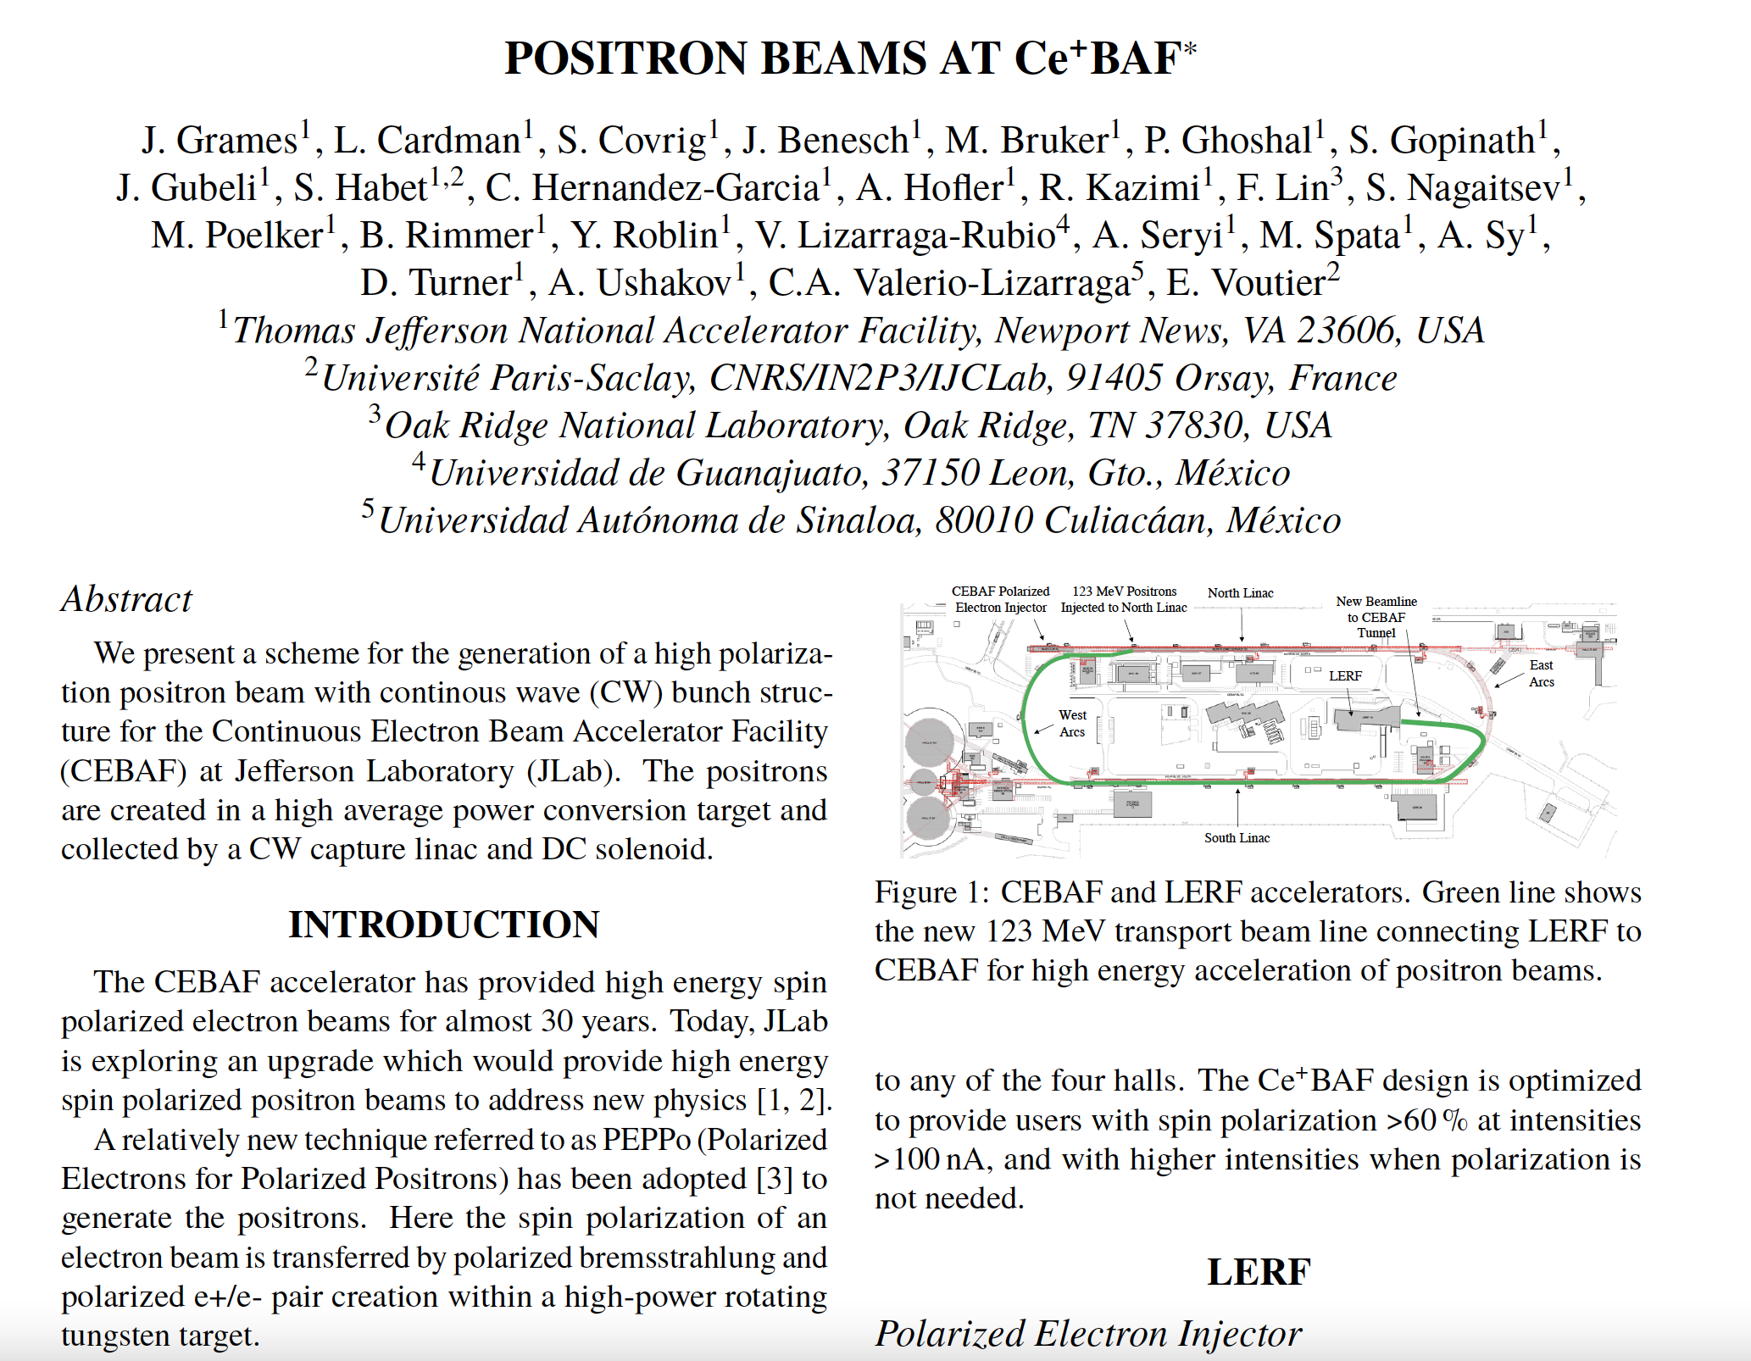
FY23 Goal : Start-to-End Ce⁺BAF Concept https://accelconf.web.cern.ch/ipac2023/doi/jacow-ipac2023-mopl152/

Slide 8
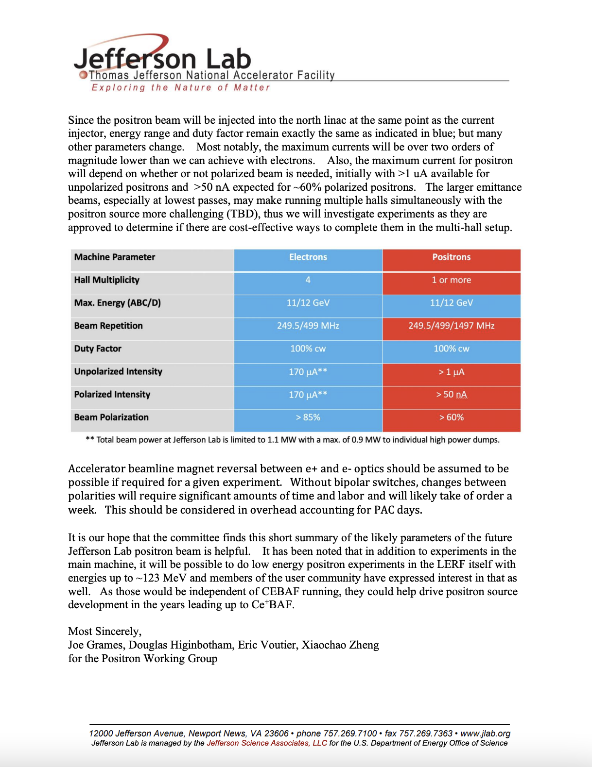
Guidance to PAC51 https://www.jlab.org/physics/PAC/PAC51
Letter to PAC51 on Positrons at 12 GeV Jefferson Lab

Slide 9
Outline
Ce⁺BAF concept
3 Year R&D plan
Q&A

Slide 10

3 Year e+ R&D Plan
Conceptual Development –
evolve design & develop new ideas to prepare the pCDR
Address Critical Risk Areas – starts an experimental program to address technical risk areas
Create e+ testbed –
Restore LERF 100 kW & 10 MeV injector area to test prototype e+ targets & mA e- photo-guns
King Neptune Statue Virginia Beach

Slide 11
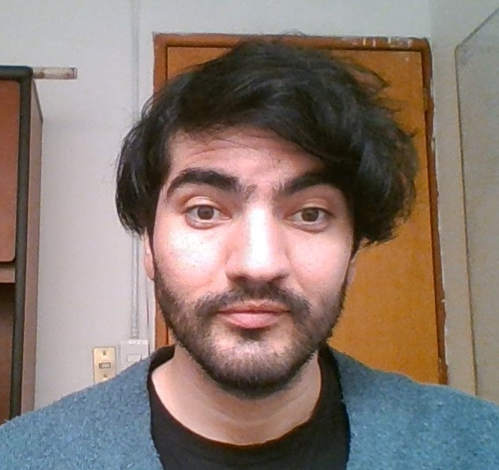

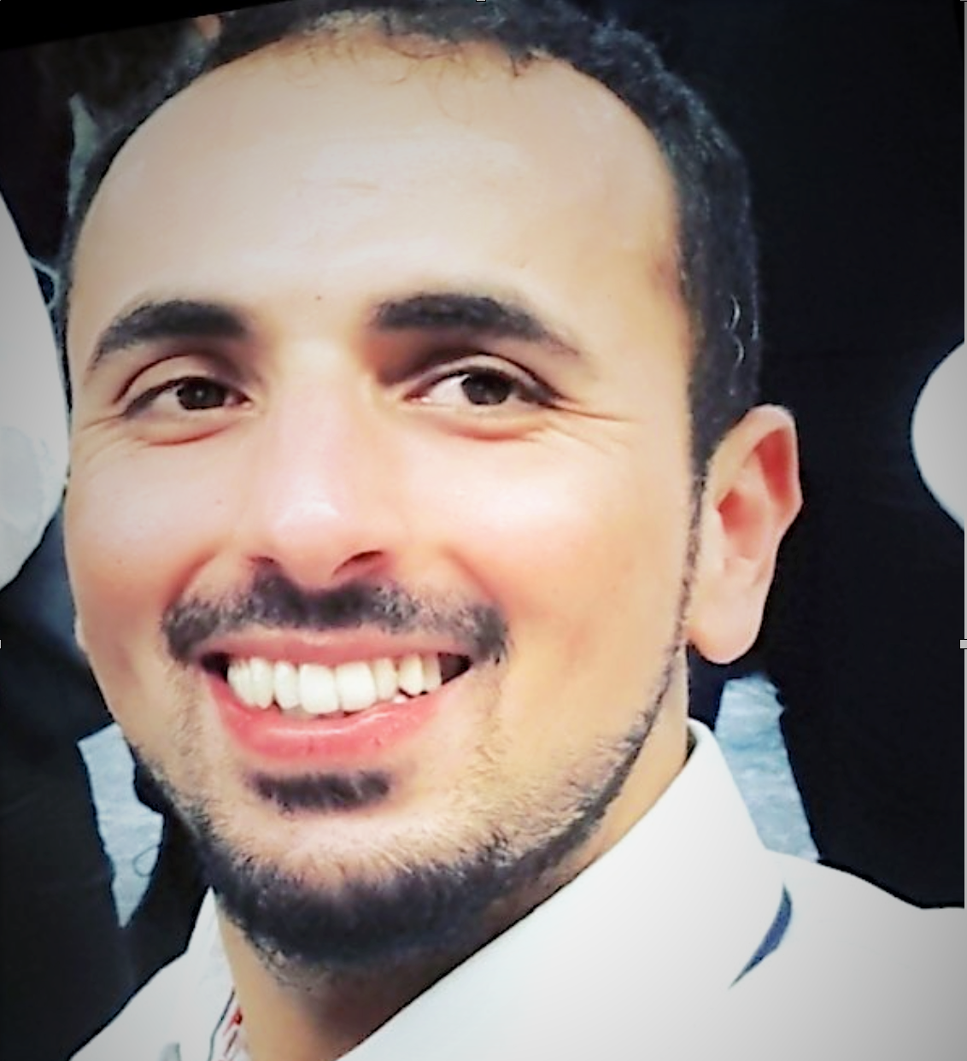
Conceptual development – people
Sami Habet, PhD from University of Paris-Saclay (December 2023)
  “Conceptual Design of a Tunable CW Polarized Positrons Source”
Expanded participation by Jefferson Lab staff
  Radiological Control Group (Mikhail Kostin & Pavel Degtiarenko)
  Superconducting Radiofrequency Department (Bob Rimmer, Shaoheng Wang, Nabin Raut)
Growing the working group
Victor Lizarraga Rubio, Universidad de Guanajuato Physics Ph.D. Graduate student supervised by Cristhian Valerio, Amy Sy and Carlos-Hernandez-Garcia
Kathleen Mahler, ODU Mechanical Aerospace Engineering Ph.D. Graduate Student supervised by Miltos Kotinis, Gene Hou, and Silviu Covrig (VITA scholar)
Salim Ogur, Herman Grunder Postdoctoral Fellow in Center for Advanced Studies of Accelerators, supervised by Alex Bogacz (starting April 1st, 2024)

Slide 12
Conceptual development – pCDR
Study group (meets monthly)
  Lead by lab and division leadership
  pCDR timeline about 2 years
pCDR draft outline
  physics motivation
  beam requirements
  CEBAF layout
  e⁺ beam
  e⁻ beam
  beam transport
  polarimetry
  alternative layouts
  staging strategies

Slide 13
Critical risk R&D – designing two new injectors for e+
>mA e- source & photocathodes
C. Hernandez-Garcia
Polarized e- injector
High power solid target
S. Covrig
e+ beam to CEBAF
High power liquid target
V. Kolstrum
Transport large emittance e+ beams
A. Sy
e+ collection system
A. Ushakov

Slide 14
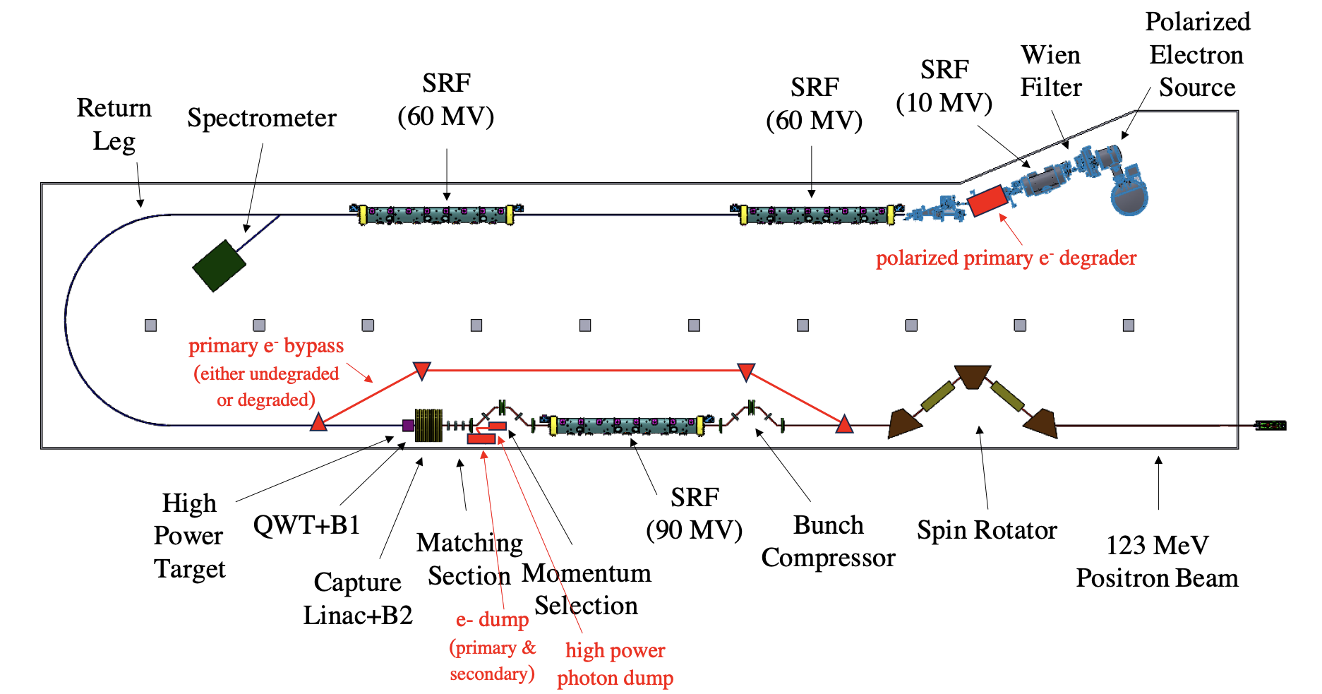
Critical risk R&D - flexibility to provide degraded e⁻ on-demand
  Polarized e- beam with Ce+BAF e+ properties
    Reduces radiological footprint
    Increases beam intensity
Create large emittance e- beams
A. Sy

Slide 15
Critical risk R&D – Machine parameters
Machine parameter table now more comprehensive
Machine Parameter | CEBAF e- | Ce+BAF
 |  | e+ | Degraded e- | e-
Multiplicity | 4 | 1 or 2
Max. Energy (ABC/D) | 11/12 GeV | 11/12 GeV
Beam Repetition | 250/499 MHz | 250/499 MHz
Duty Factor | 100% cw | 100% cw
Unpolarized Intensity | 170 μA** | > 1 μA | >> 1 uA | 170 μA**
Polarized Intensity | 170 μA** | > 50 nA | >> 1uA | 170 μA**
Beam Polarization | > 85% | > 60% | >85% ? | >85%
** Total beam power at Jefferson Lab is limited to 1.1 MW with a max. of 0.9 MW to individual high power dumps.

Slide 16
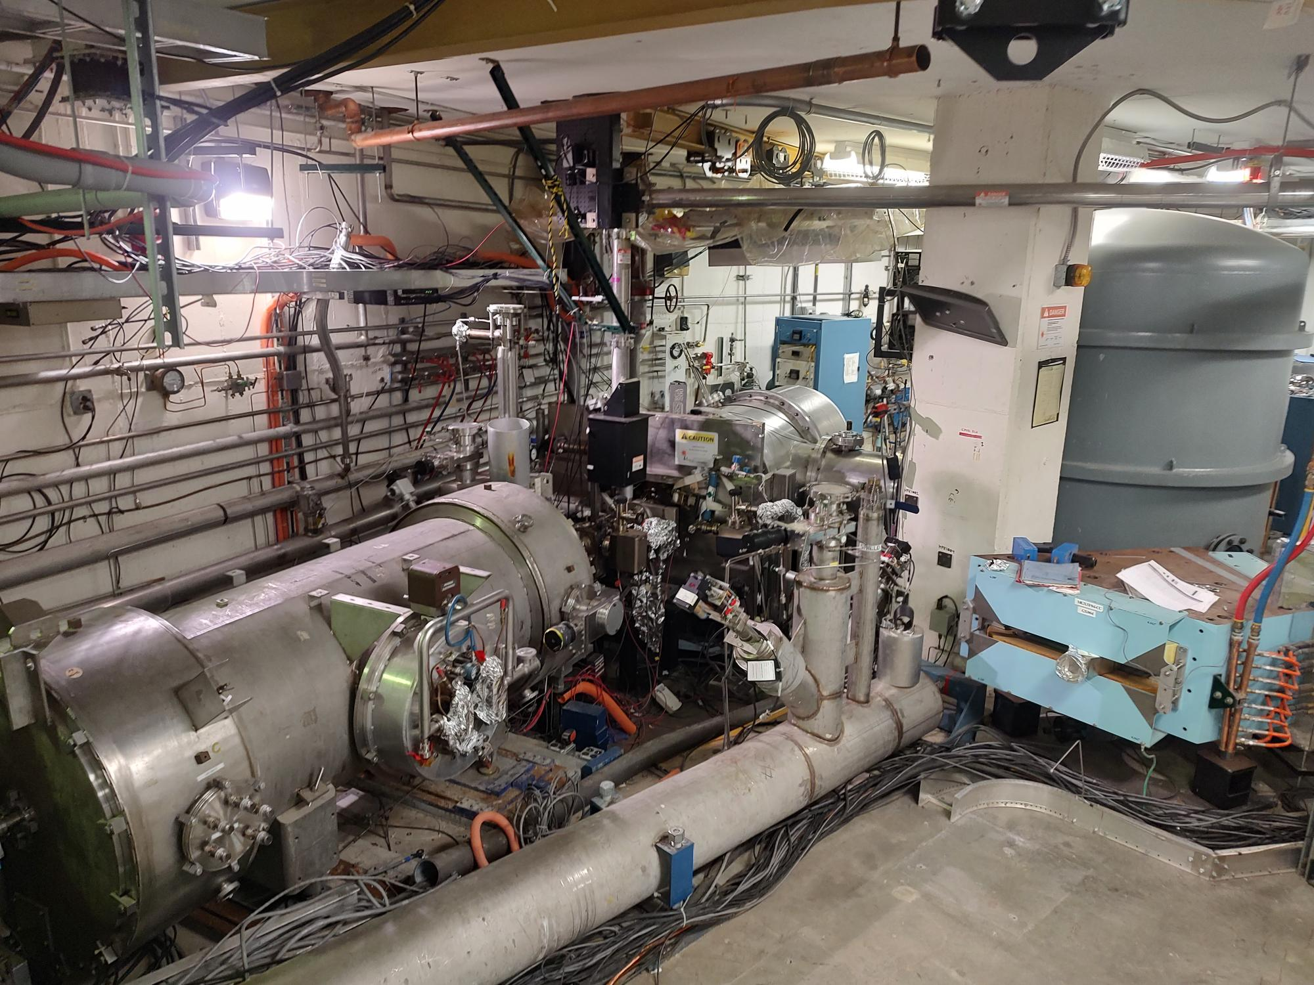
LERF – testbed for e⁻/e⁺ beam sources
FEL 100 kW e- injector
Year1 – Replace photogun
Year2 – Refurbish cryomodule
Year3 – Test e- sources & e+ targets

Slide 17
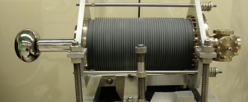
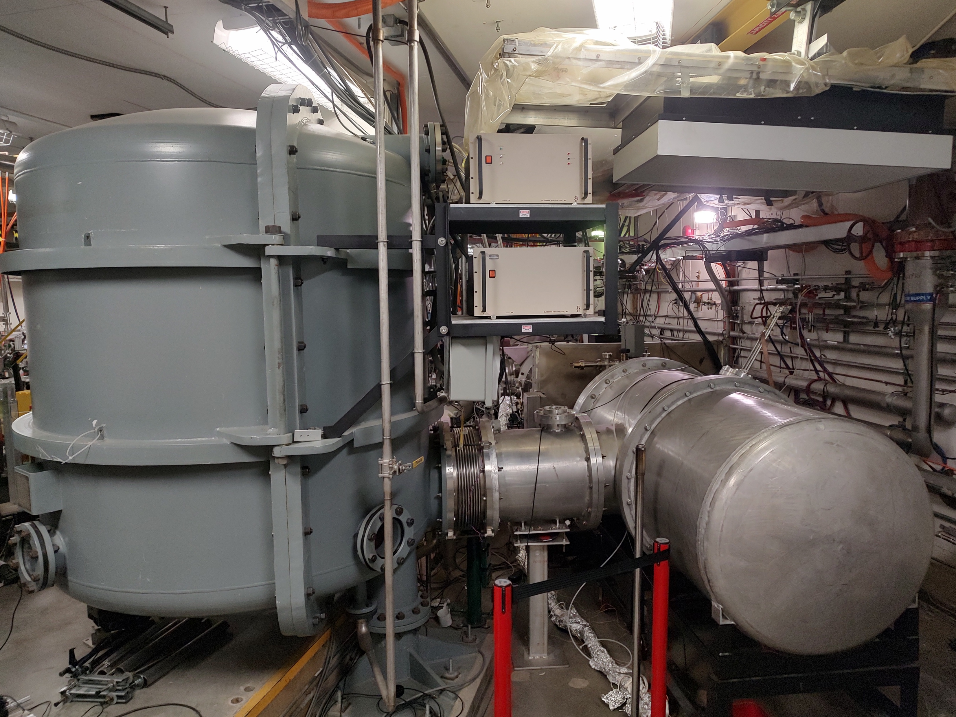
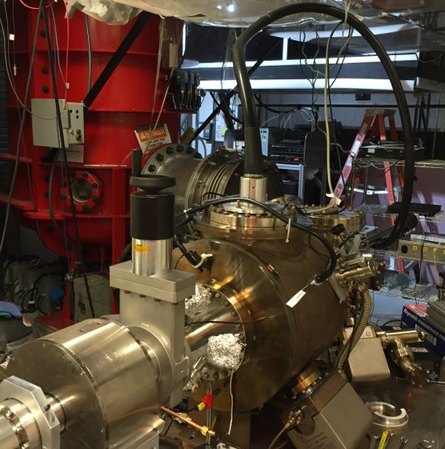
LERF – Year 1 : replace photo-gun
LERF vent-bake gun….out
GTS load-lock gun…in

Slide 18
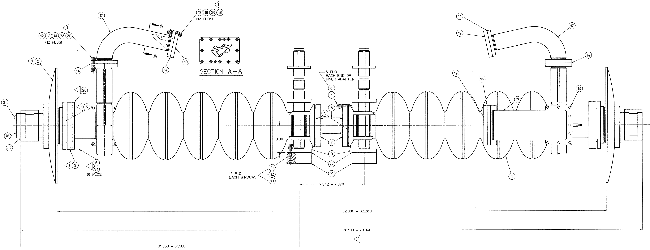
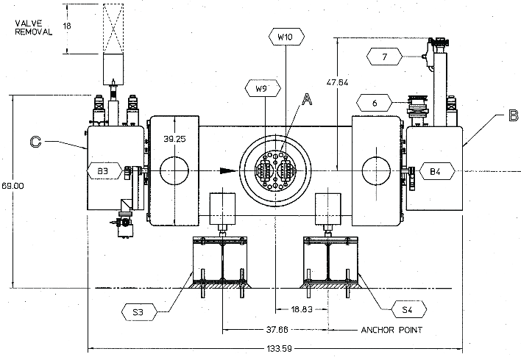
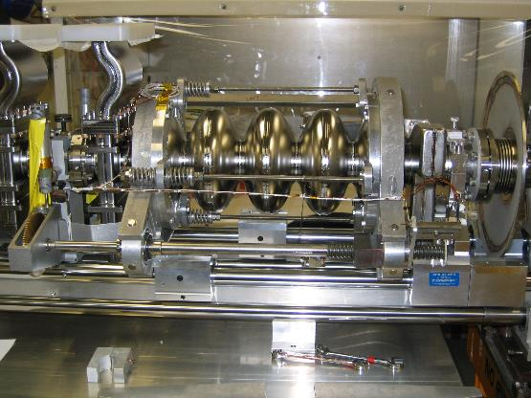
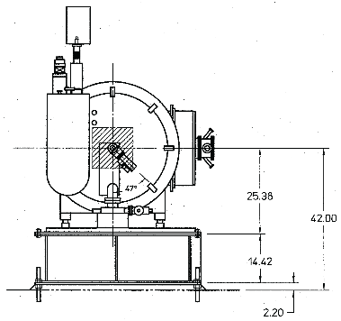
LERF – Year 2 : refurbish cryomodule
Courtesy Roger Ruber
Two (2) Cornell/CEBAF-style 5-cell superconducting cavities
  Indium vacuum seals, shared liquid helium vessel
Modifications for higher power operation at 10 mA, 10 MeV
  RF windows
  Thermal anchoring of the cold RF waveguide
  Thermal anchoring of the cavity higher order mode RF dampers
  to thermal shield instead of into 2K liquid helium bath
To be refurbished
  Repair helium-to-insulation vacuum leak
  Process cavities to ensure optimal performance
Beam Direction
Original CEBAF SRF cavity with tuner

Slide 19
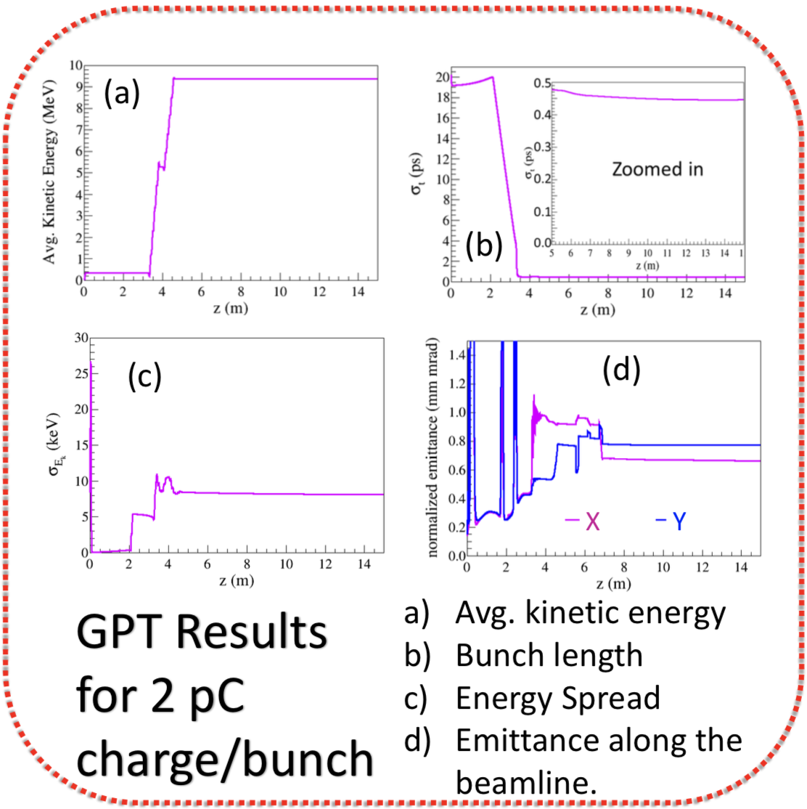
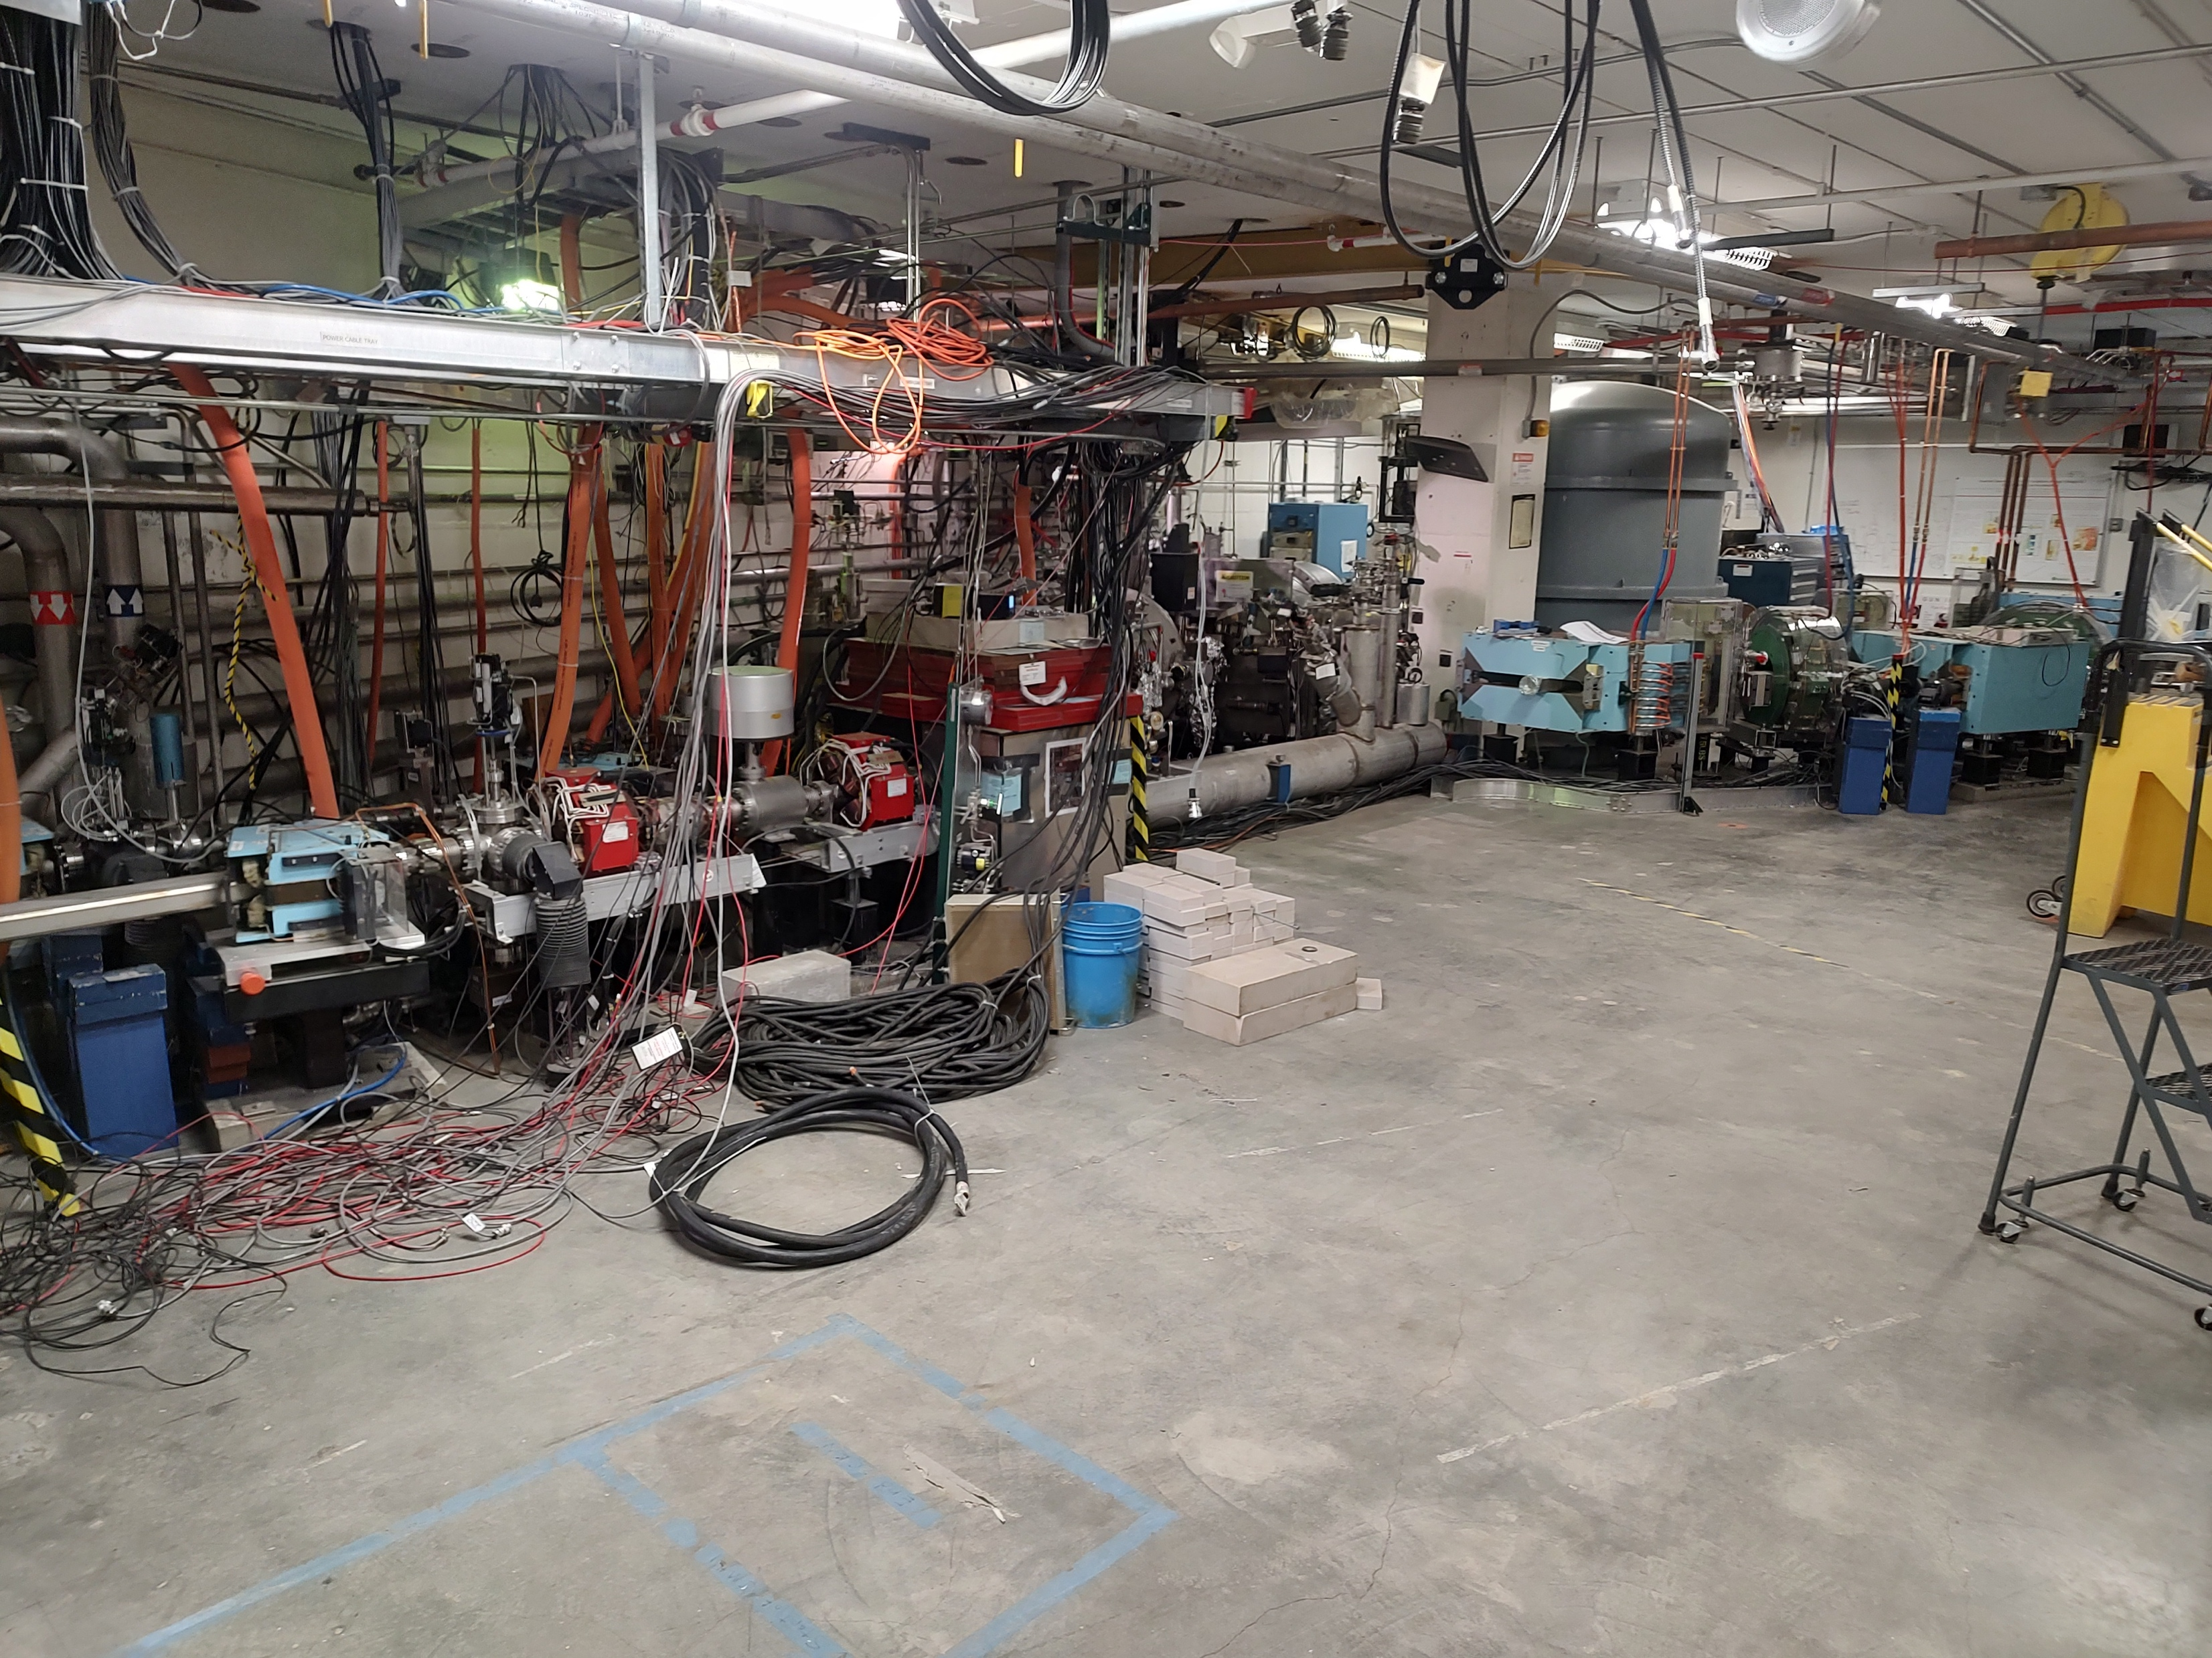
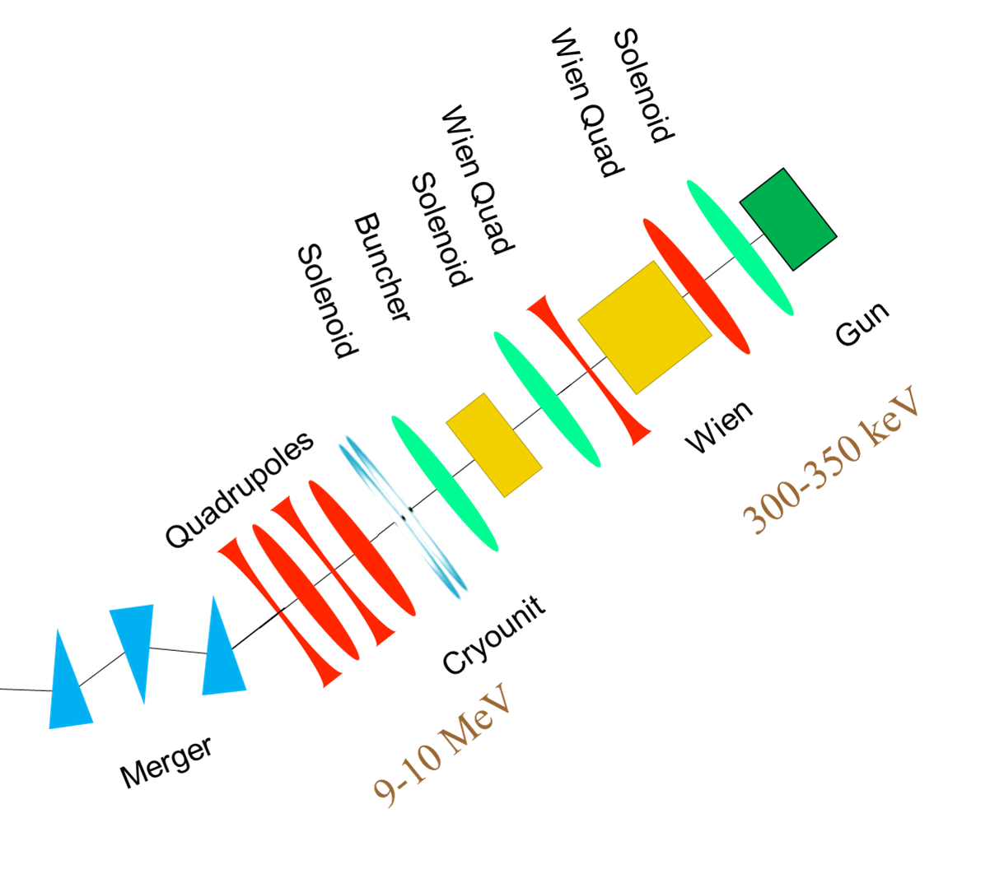
LERF – Year 3 : test e- sources & e+ targets
Injector simulations
A. Hofler, R. Kazimi

Slide 20
3-Year R&D overview – aggressively pursuing FOA’s

Slide 21
Conclusions
S2E concept for 12 GeV Ce+BAF developed
Study group integrates 22 GeV and e+ R&D with lab leadership
A comprehensive 3-year R&D plan was developed
Focus resources strategically (pCDR, critical risks, LERF)
We’ll learn a lot in next few months about the FOA’s
Maximize use of e- beams to define future e+ requirements

Slide 22







Acknowledgments
I would like to acknowledge the Ce⁺BAF Working Group, the Jefferson Lab Positron Working Group and all those who have been supportive to this progression of activity.
J. Benesch, A. Bogacz, L. Cardman, J. Conway, S. Covrig, P. Degtiarenko,
S. Ghoshal, S. Gopinath, J. Gubeli, S. Habet, C. Hernandez-Garcia, D. Higinbotham,
A. Hofler, R. Kazimi, M. Kostin, F. Lin, V. Kolstrum, V. Lizarraga-Rubio, S. Nagaitsev,
M. Poelker, N. Raut, B. Rimmer, Y. Roblin, A. Seryi, K. Smolenski, M. Spata, R. Suleiman,
A. Sy, D. Turner, A. Ushakov, C. Valerio-Lizaraga, E. Voutier, S. Zhang

Slide 23
Outline
Ce⁺BAF concept
3 Year R&D plan
Q&A

