Slide 1

Simulations of Positron Beam Generation and Capture at Ce+BAF
e⁺ LERF concept
Managing beam power budget (120 kW) and radiation levels in target and capture section
Development of capture cavity
Update on simulations of positron capture
A. Ushakov, J. Benesch, S. Covrig Dusa, J. Grames, R. Rimmer, S. Wang
Jefferson Lab

Slide 2
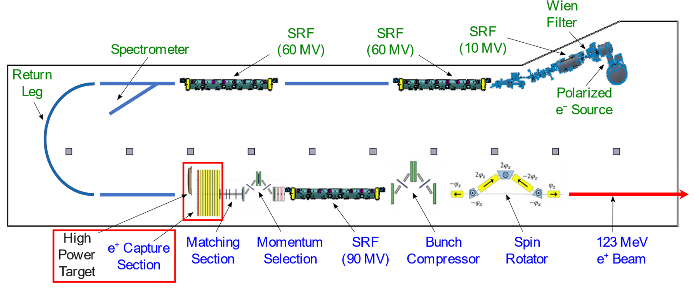
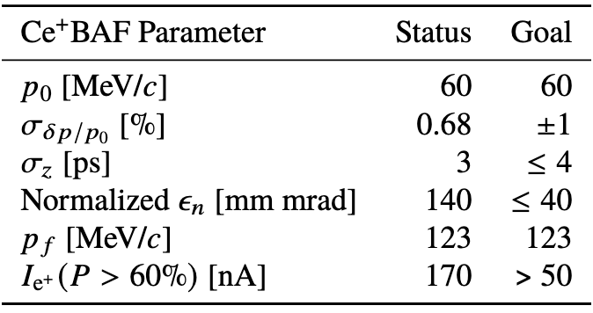
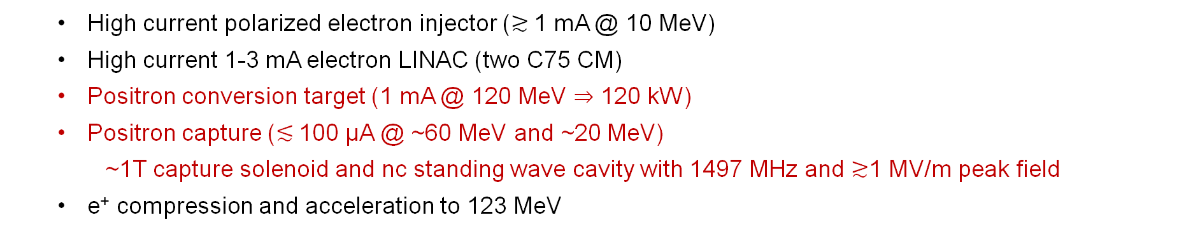
LERF Polarized Positron Injector Concept
  High current polarized electron injector ($≳$1 mA @ 10 MeV)
  High current 1-3 mA electron LINAC (two C75 CM)
  Positron conversion target (1 mA @ 120 MeV $⇒$ 120 kW)
  Positron capture ($≲$100 µA @ ~60 MeV and ~20 MeV)
    ~1T capture solenoid and nc standing wave cavity with 1497 MHz and $≳$1 MV/m peak field
  e⁺ compression and acceleration to 123 MeV
Simulations of Sami Habet, 2022

Slide 3
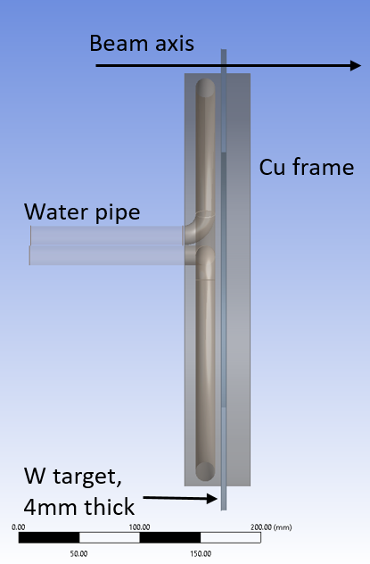
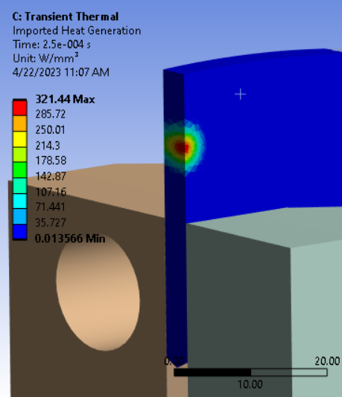
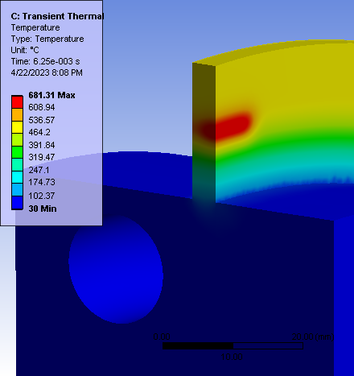
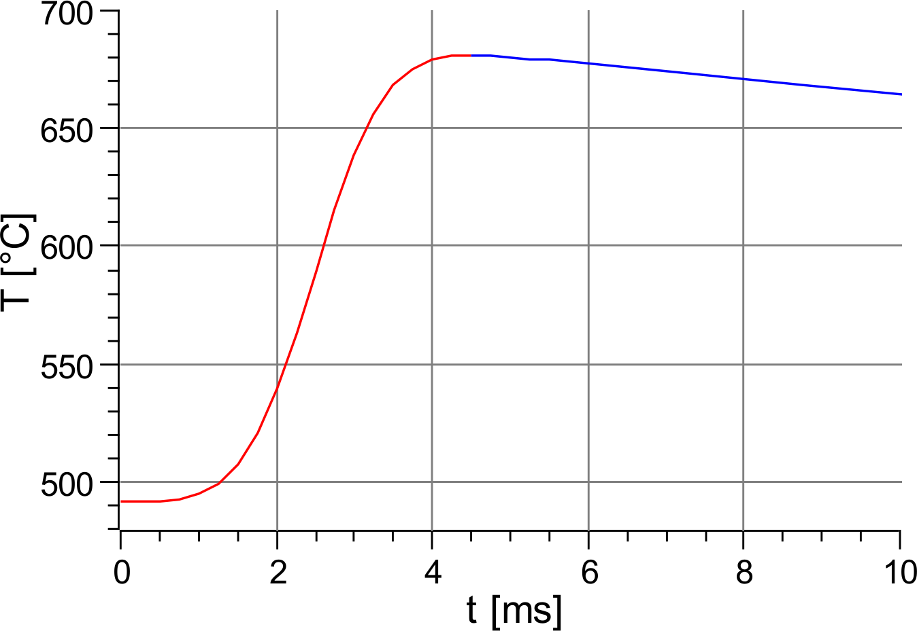
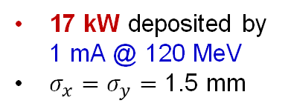
Concept and Challenges of High-Power Target
Target Concept (Side View)
Heat by Beam
Temperature in Rot. Target
A. Ushakov et al, IPAC’23
Cycling Temperature
Some parameters of currently considered high-power e⁺ target:
~40 cm target diameter
2 Hz rot. frequency
8 mm radius of water channel
0.3 kg/s water mass flow (1.5 m/s)
Target Challenges:
High power deposited by beam → cool and rotate
Radiation damage → rotate
Material fatigue cause by cycling temperature → study material properties under realistic conditions
17 kW deposited by 1 mA @ 120 MeV
$σ_{x}=σ_{y}=$ 1.5 mm

Slide 4
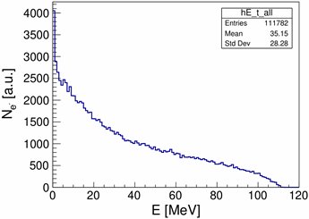
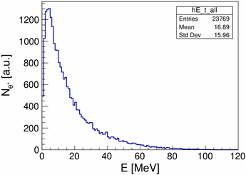
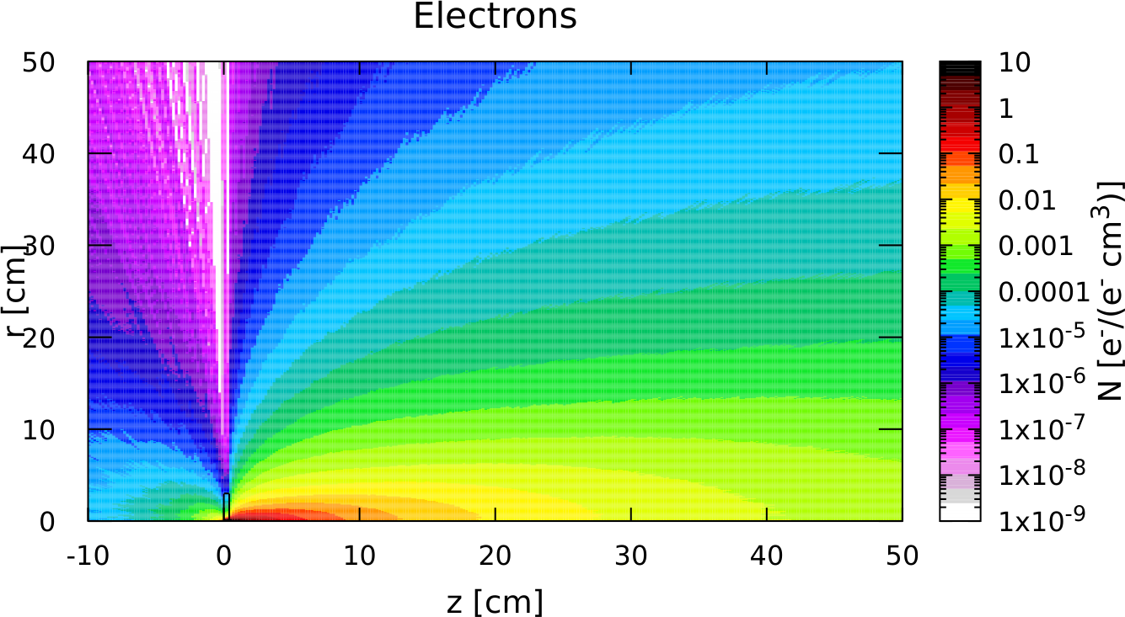
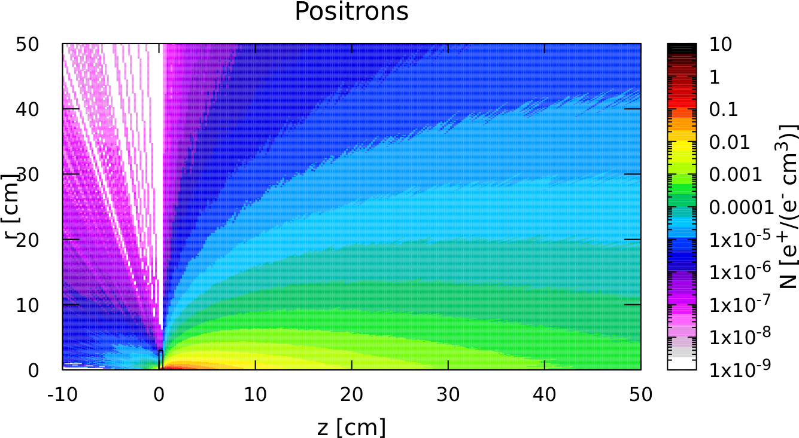
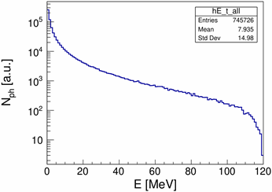
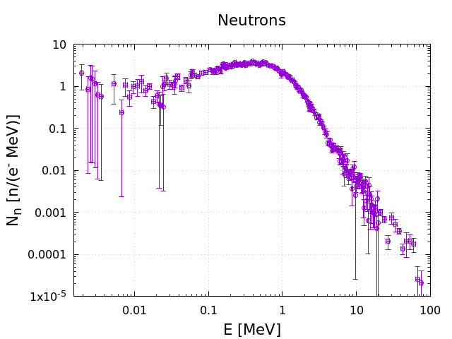
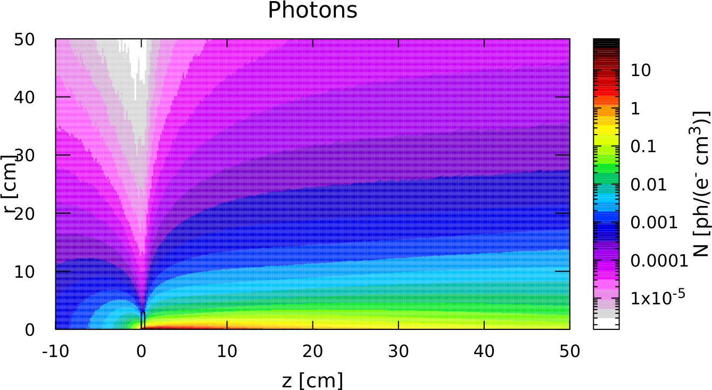
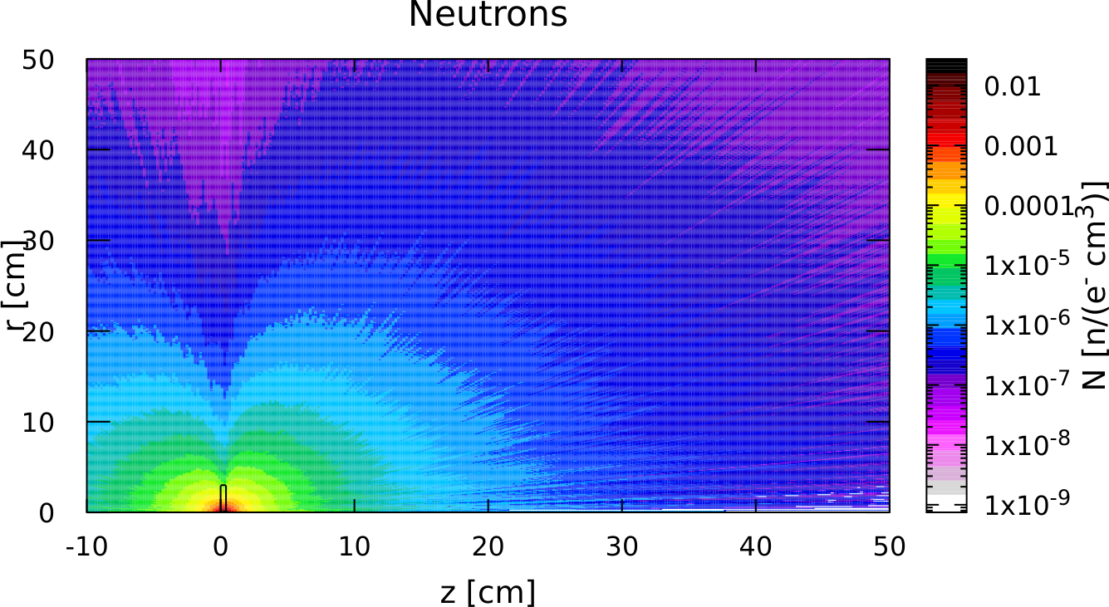
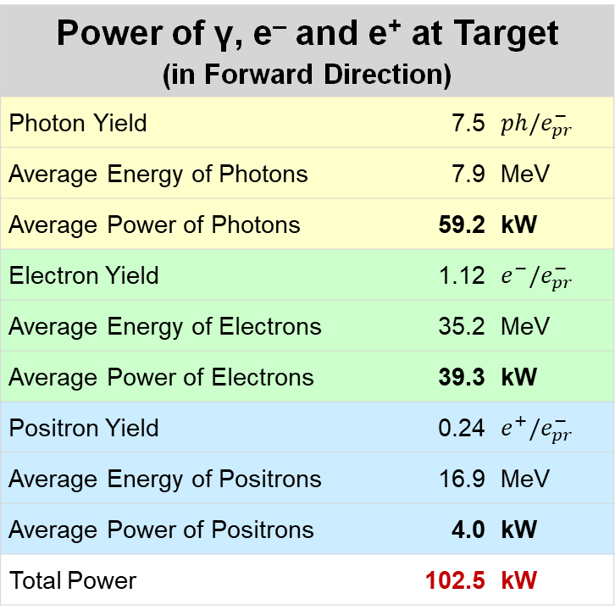
Managing Beam Power Budget (120 kW)
Thick target is needed to get enough positrons
Shielding beam power is needed to put focusing magnet with small field on target
We need some space for shielding in front of RF cavities
Our focus is to make design of first meters of e⁺ source realistic
Power of γ, e‒ and e⁺ at Target (in Forward Direction)
Photon Yield | 7.5 | $$ph/e_{pr}^{−}$$
Average Energy of Photons | 7.9 | MeV
Average Power of Photons | 59.2 | kW
Electron Yield | 1.12 | $$e^{−}/e_{pr}^{−}$$
Average Energy of Electrons | 35.2 | MeV
Average Power of Electrons | 39.3 | kW
Positron Yield | 0.24 | $$e^{+}/e_{pr}^{−}$$
Average Energy of Positrons | 16.9 | MeV
Average Power of Positrons | 4.0 | kW
Total Power | 102.5 | kW
Electrons
Positrons
Electrons
Positrons
Photons
Neutrons
Photons
Neutrons
Power Deposition in Target | 17 | kW
n Yield = 4.7·10⁻³ n/e⁻

Slide 5
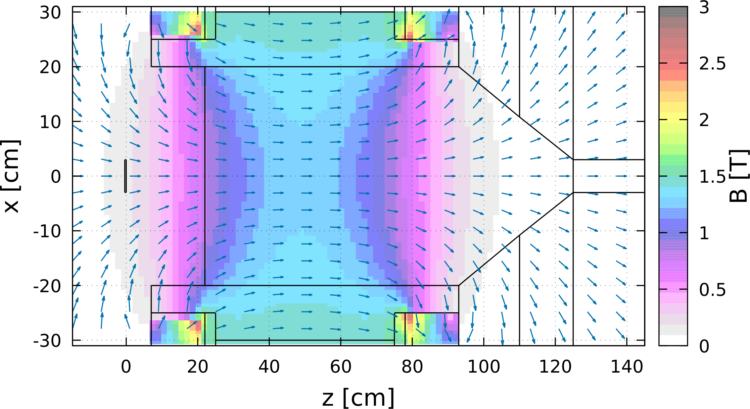
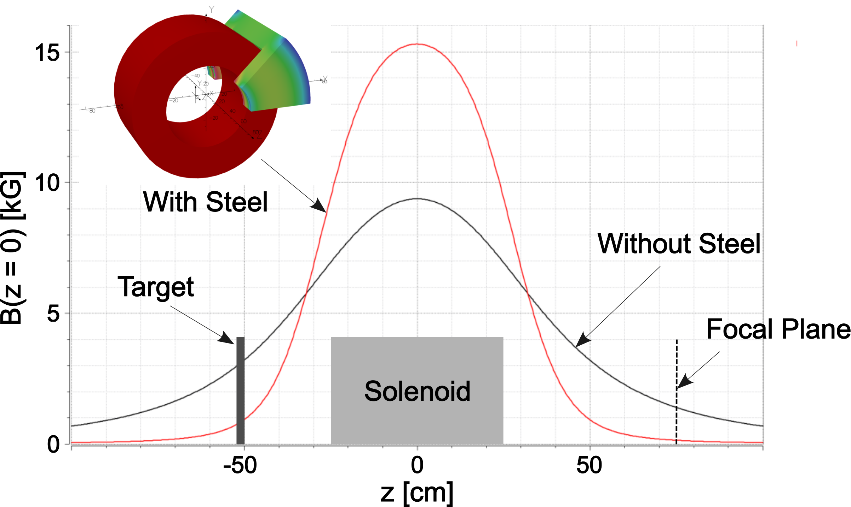
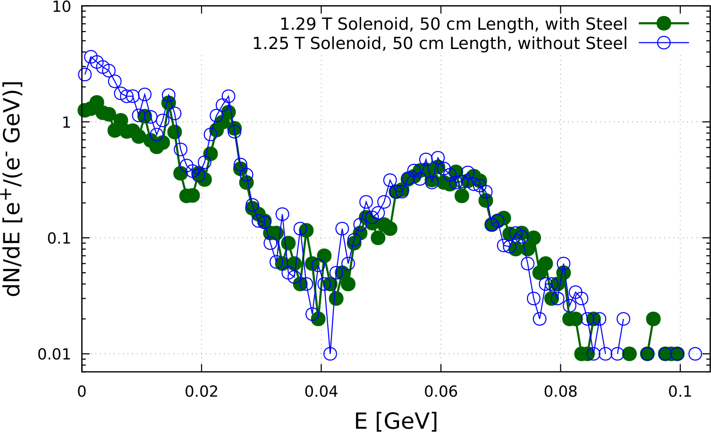
High Field Solenoid
Field Map (imported in FLUKA)
1.29 T Solenoid
Absorbers
Solenoids with and without Steel
(calculated by J. Benesch)
Target
e⁺
Highly
Polarized e⁺
15 cm thick good magnet steel with inner radius of 25 cm
allows significant reduction of current density and
reduces field in rotated target

Slide 6
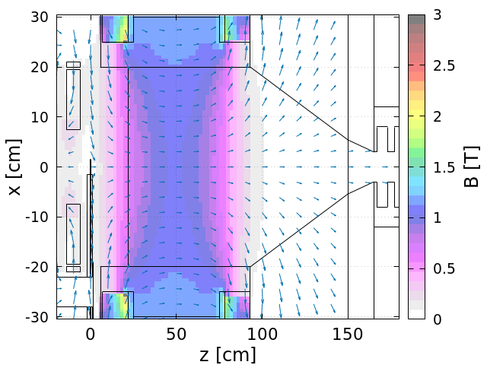
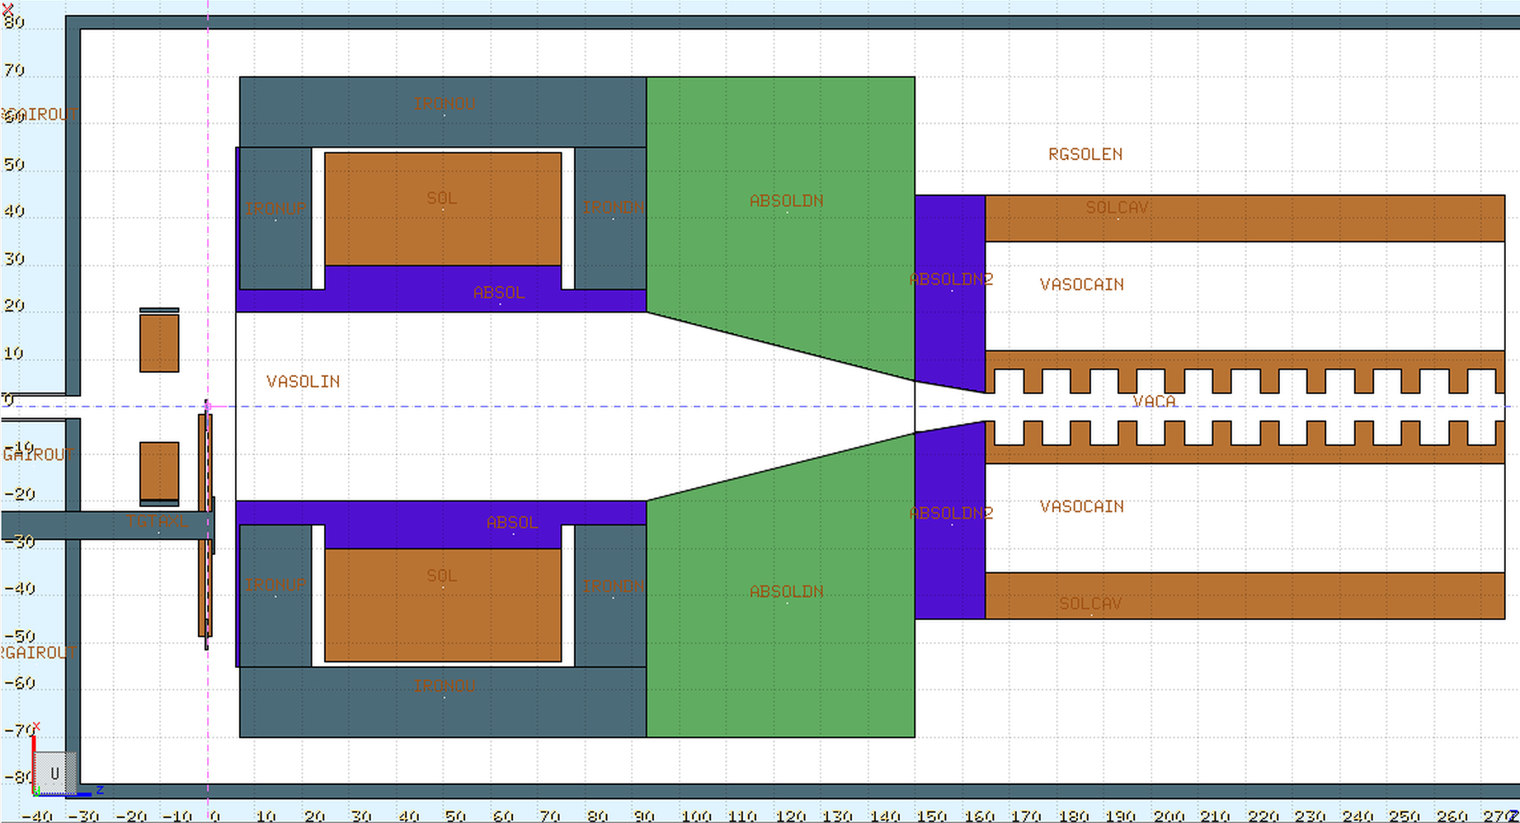
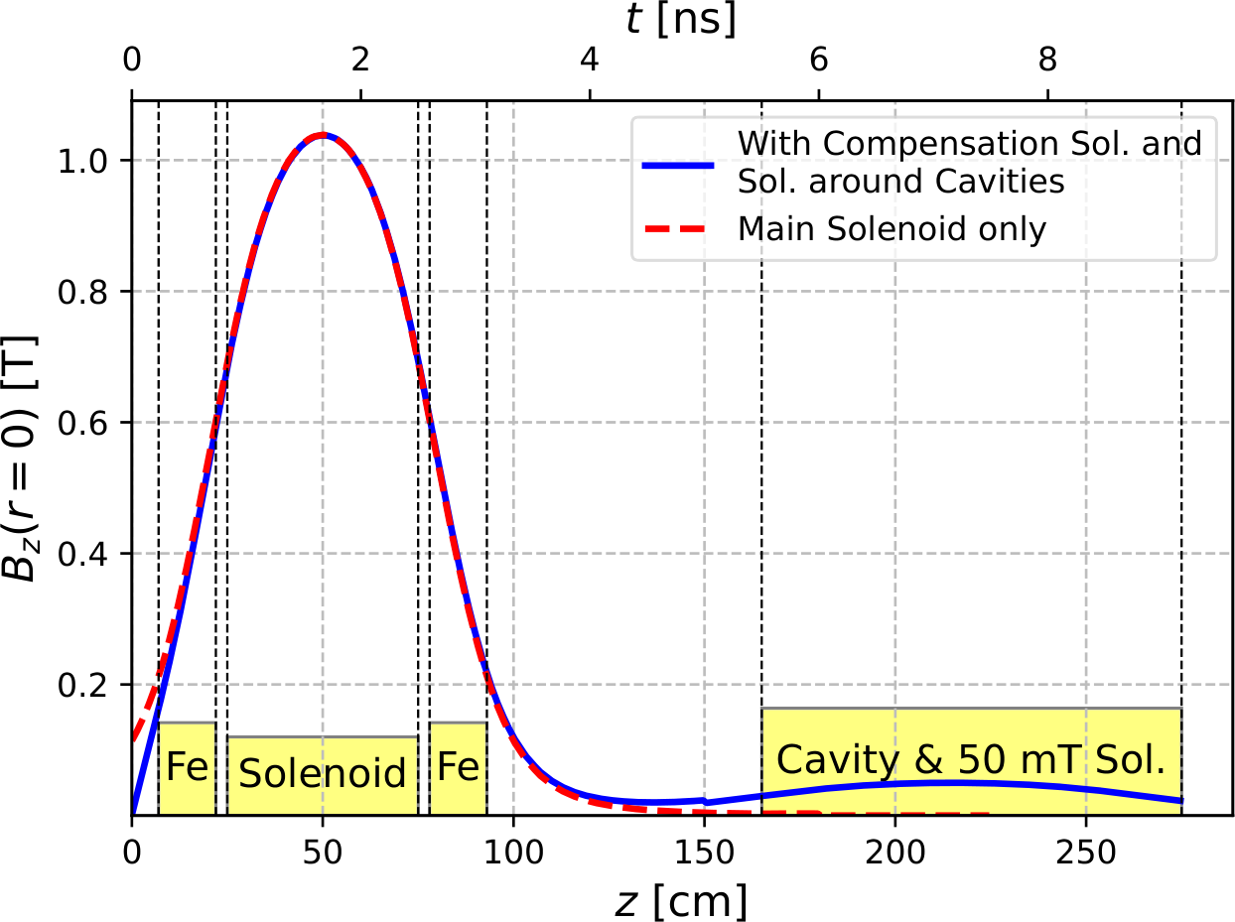
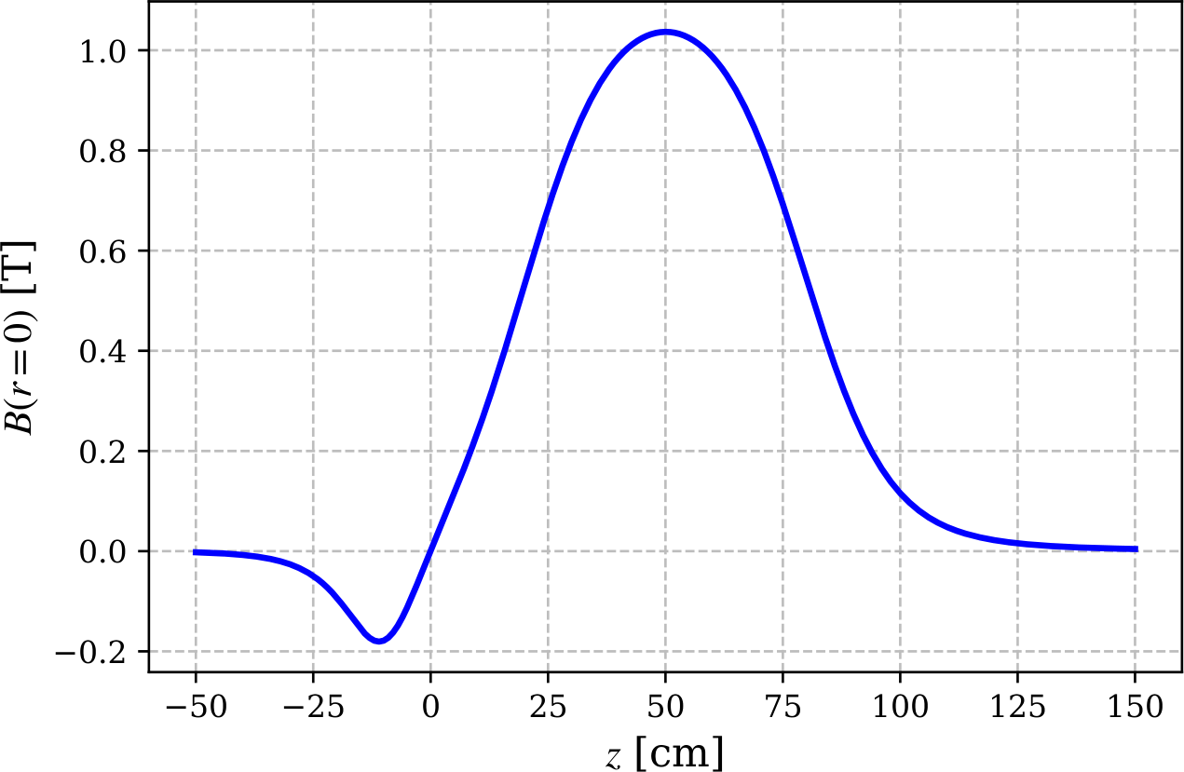
Model with Compensation Solenoid and Cavities
Geometry (FLUKA)
Compens.
Solenoid
Main Solenoid
Absorbers
Target
e⁺
Cavity
Conductor of comp. sol.:
L = 8 cm
R_{in} = 7.5 cm
R_{out} = 19.5 cm
Conductor of main sol.:
L = 50 cm
R_{in} = 30 cm
R_{out} = 54 cm
Solenoids modeled by J. Benesch
Same 15 mm square Cu conductor
with 11 mm hole
for both main and compensation
solenoids
j ≈ 446 A/cm²
B_{max}(r = 0) = 1.03 T
Water flow:
~500 cc/sec, 18 bar

Slide 7
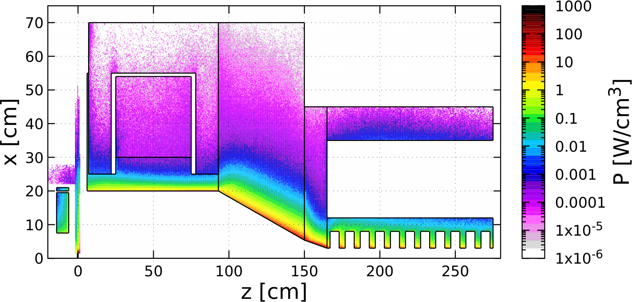
Distribution of Power Deposed by 1 mA @ 120 MeV e‒ Beam (FLUKA)
 | Power [kW]
Target | 18.11
Compensation Solenoid | 0.74
Coil of Main Solenoid | 0.02
Iron of Main Solenoid | 0.06
W10Cu Absorber inside Main Solenoid | 18.88
TZM Absorber (99.4% Mo, 0.5% Ti, 0.1% Zr) | 58.66
W10Cu Absorber upstream Cavities | 12.50
Solenoid around Cavity | 0.12
Cu Cavities | 6.50
Total Absorbed Power | 115.56 (96.3%)
Beam Power at z = 275 cm, r < 3cm | 3.20
Steel
TZM
Cu Coil
Cu Coil
W10Cu
W10Cu
Cu Cavity*
Compensation
Solenoid
Target
 | Photons | Electrons | Positrons
Yield per primary e⁻ | 0.123 | 0.029 | 0.005
Mean Energy [MeV] | 12.7 | 49.6 | 35.7
Power [kW] | 1.57 | 1.44 | 0.19
Fraction in Total Beam Power | 49.1 | 44.9 | 6.0
Mechanical design and simulations of temperature,
thermal stress, radiation damage and
optimization of whole e⁺ capture system
have to be done / will be continued
* FLUKA model does not have E-field in cavity

Slide 8
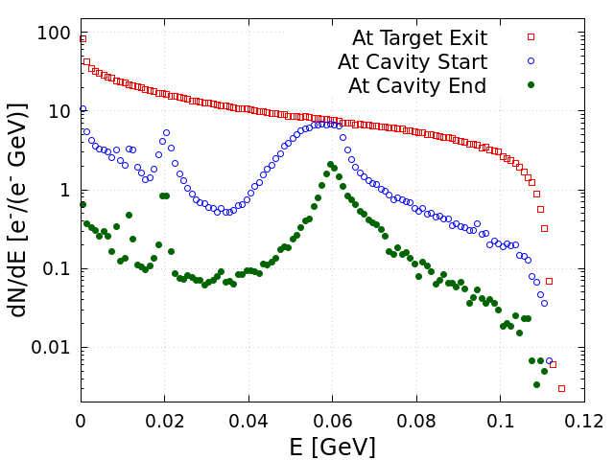
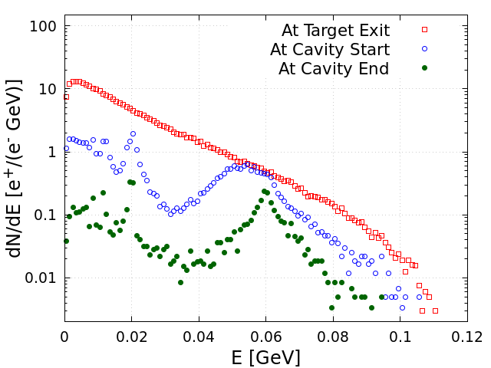
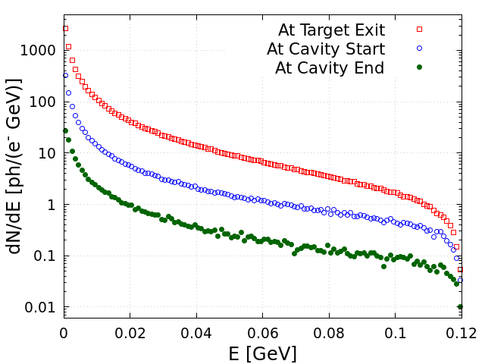
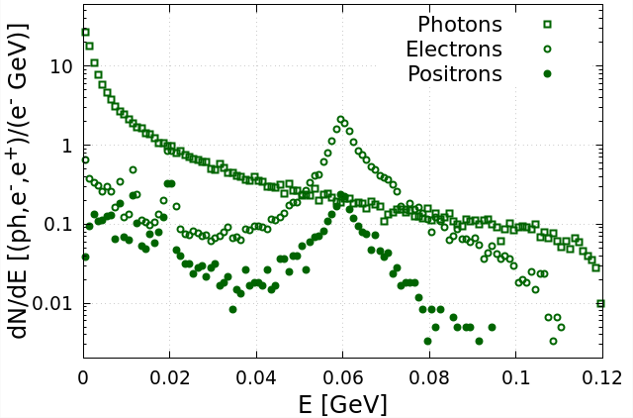
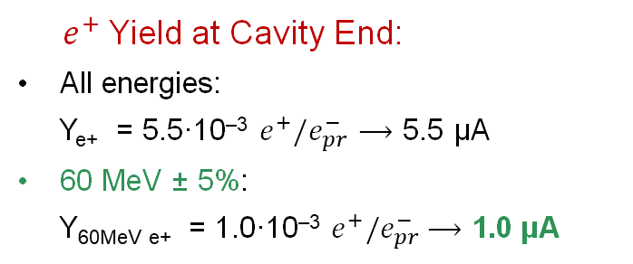
Energy Distributions of e‒, e⁺ and γ at Different Z-Positions (FLUKA)
Electrons
Positrons
Photons
At Cavity End
will be removed by forward dump
will be deflected by dipole
and dumped
${ e}^{+}$Yield at Cavity End:
All energies:
Y_{e+} = 5.5·10^{‒3} $e^{+}/e_{pr}^{−}⟶$ 5.5 µA
60 MeV ± 5%:
Y_{60MeV e+} = 1.0·10^{‒3} $e^{+}/e_{pr}^{−}$ $⟶$ 1.0 µA

Slide 9
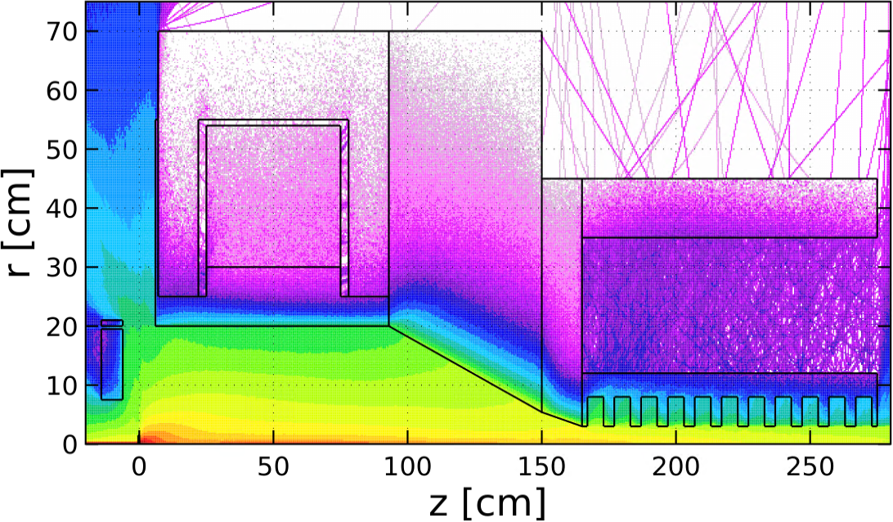
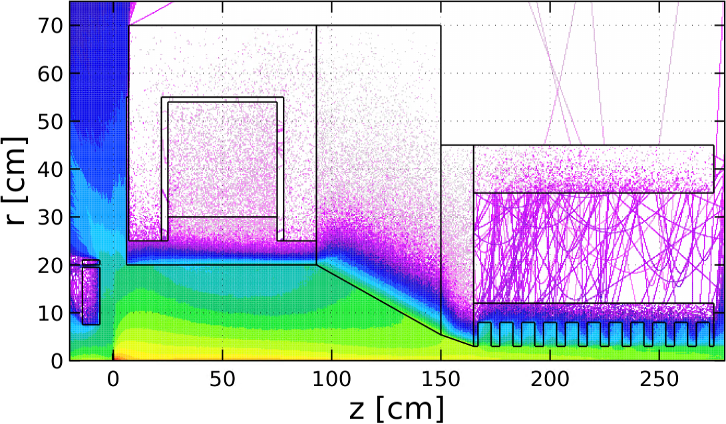
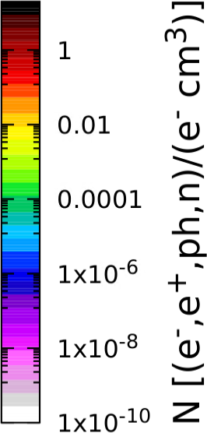
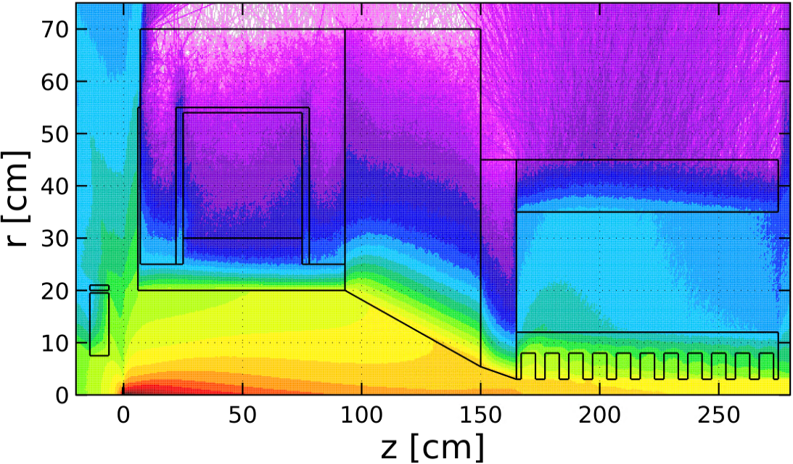
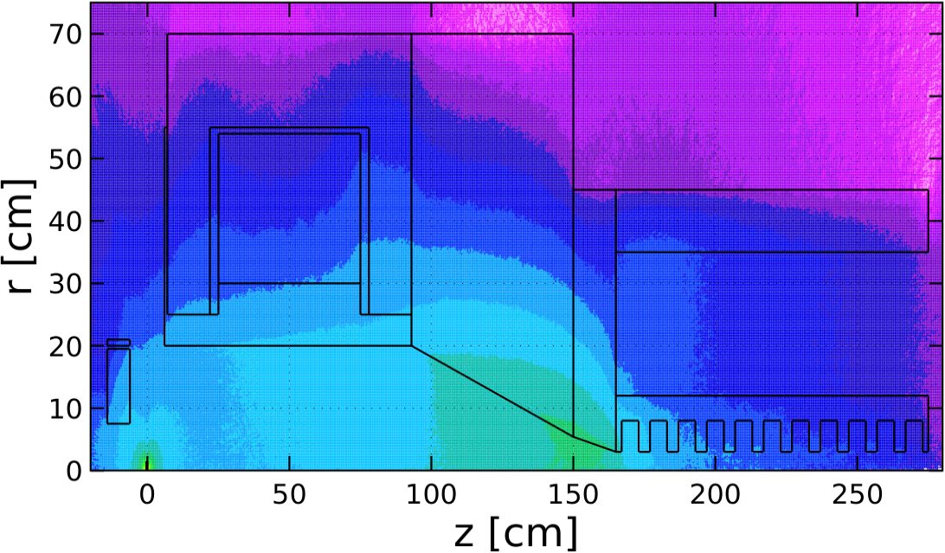
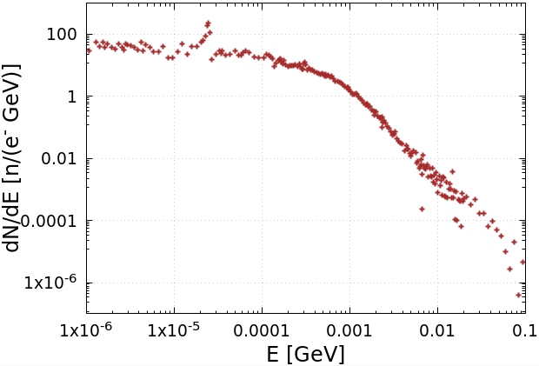


Spatial Distributions of e‒, e⁺, γ and n. Neutron Energy and Yield (FLUKA)
Electrons
Positrons
We have begun working with the Radiation Control Department on radiation shielding
Photons
Neutrons
Energy Spectrum of Neutrons
Neutron Yield:
$Y_{n}=9.2∙{10}^{−3}$ ${n/e}_{pr}^{−}$
$(5.7∙{10}^{13}$ $n/s)$

Slide 10
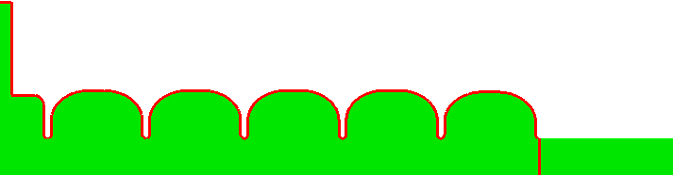
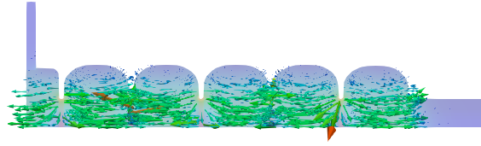
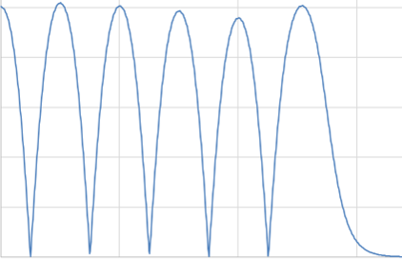
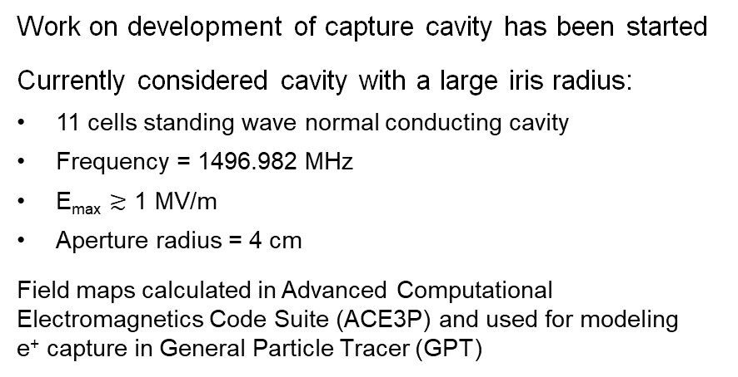
Standing Wave Capture Cavity (Shaoheng Wang)
11 Cells Cavity
1 MV/m
0
Cavity design is strongly coupled with
incoming e-, e+ beam status
solenoid design
beam dynamics in capture process
So, we won’t nail down the cell shape, cell number, cavity number at the early design stage.
Instead,
two extreme cavity models are produced for extreme large iris radius and high gradient cases
a parameterized cavity model is produced in between, it will evolve with whole capture design
Work on development of capture cavity has been started
Currently considered cavity with a large iris radius:
11 cells standing wave normal conducting cavity
Frequency = 1496.982 MHz
E_{max} $≳$ 1 MV/m
Aperture radius = 4 cm
Field maps calculated in Advanced Computational Electromagnetics Code Suite (ACE3P) and used for modeling
e⁺ capture in General Particle Tracer (GPT)

Slide 11
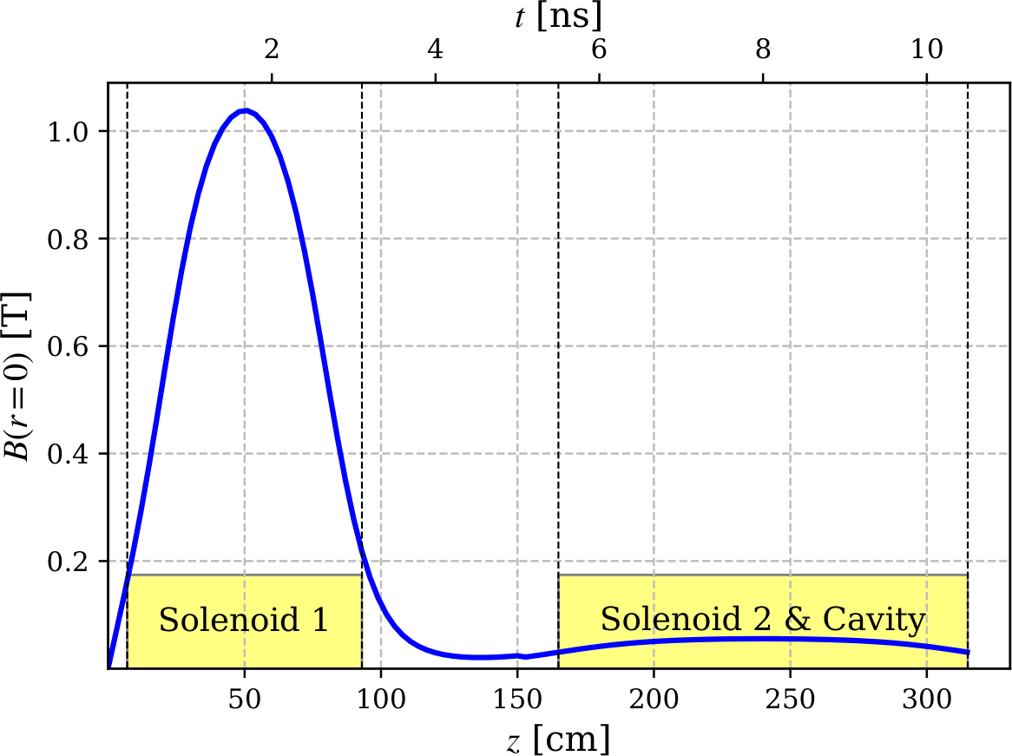
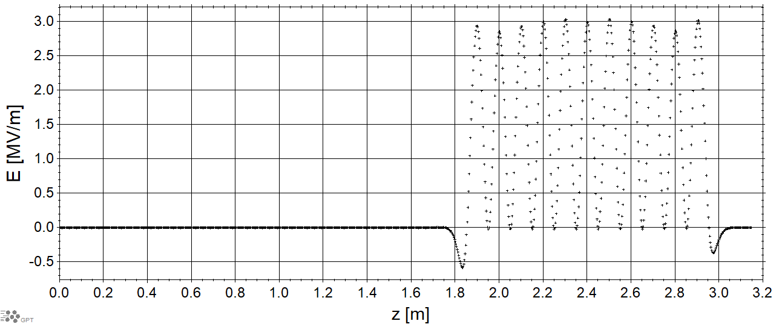
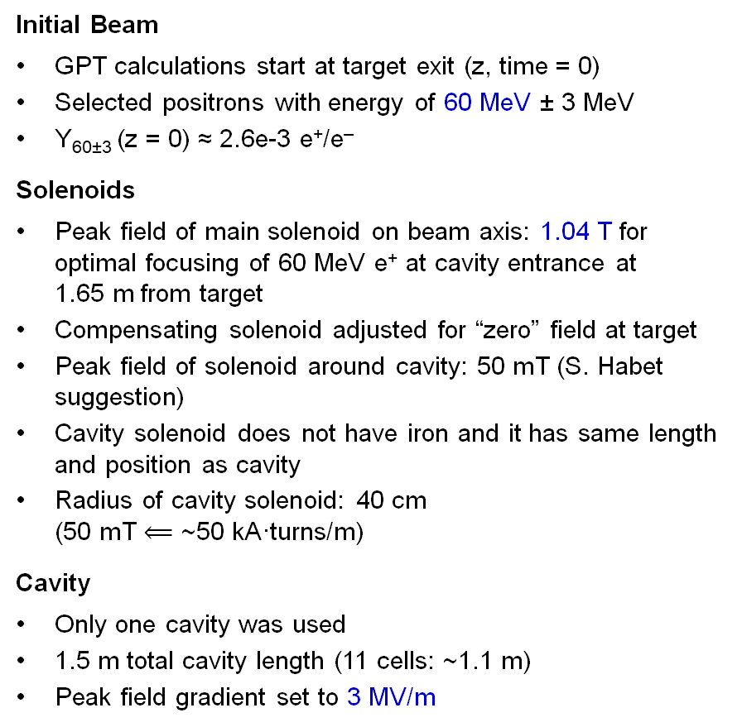
GPT: e⁺ Beam at Target Exit and Magnetic & Electric Fields
Initial Beam
GPT calculations start at target exit (z, time = 0)
Selected positrons with energy of 60 MeV ± 3 MeV
Y_{60±3} (z = 0) ≈ 2.6e-3 e⁺/e‒
Solenoids
Peak field of main solenoid on beam axis: 1.04 T for optimal focusing of 60 MeV e⁺ at cavity entrance at 1.65 m from target
Compensating solenoid adjusted for “zero” field at target
Peak field of solenoid around cavity: 50 mT (S. Habet suggestion)
Cavity solenoid does not have iron and it has same length and position as cavity
Radius of cavity solenoid: 40 cm
(50 mT $⟸$ ~50 kA·turns/m)
Cavity
Only one cavity was used
1.5 m total cavity length (11 cells: ~1.1 m)
Peak field gradient set to 3 MV/m
B-Field on Beam Axis
E-Field on Beam Axis

Slide 12
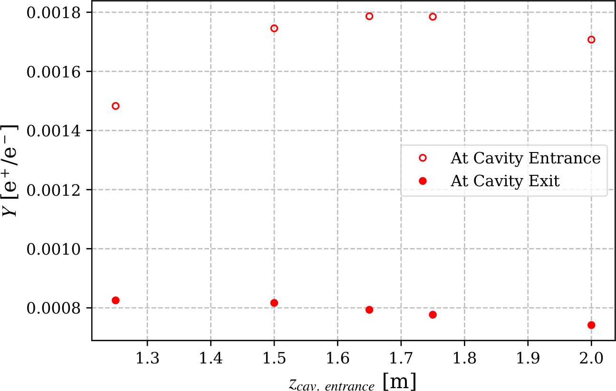
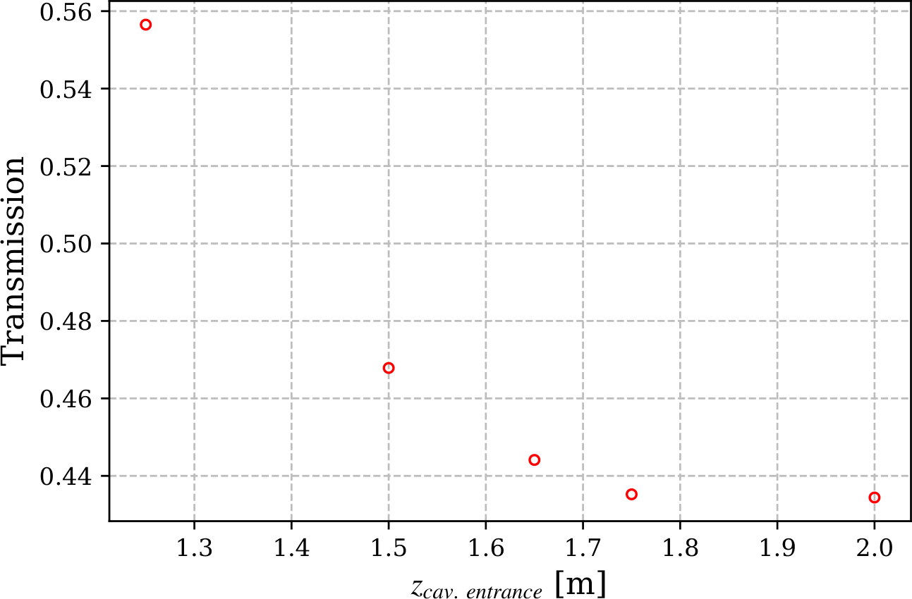
Is the Cavity Position Optimal for Capture 60 MeV e⁺?
Yield vs Cavity Distance to Target
Positron Losses in Cavity
Yield at cavity entrance is highest at 1.65 m
(in agreement with FLUKA)
Longer distance to target reduces e⁺ yield
at cavity end
Positron losses in cavity are significant

Slide 13
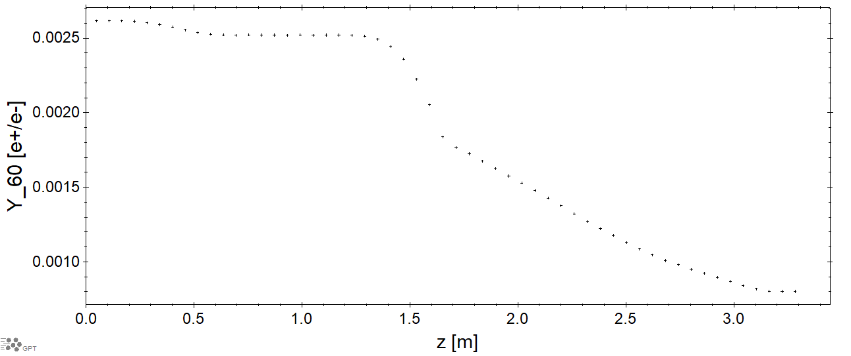
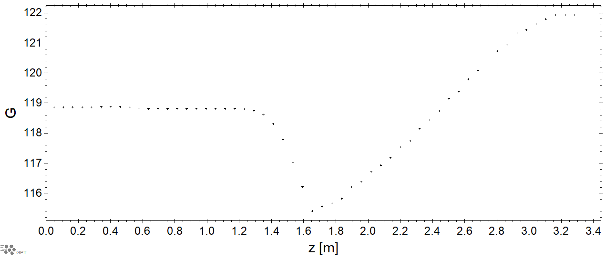
Yield of Positrons (60 MeV ± 3 MeV) and Energy (Gamma Factor) vs Z
Yield vs Z
Lorenz Gamma Factor vs Z

Slide 14
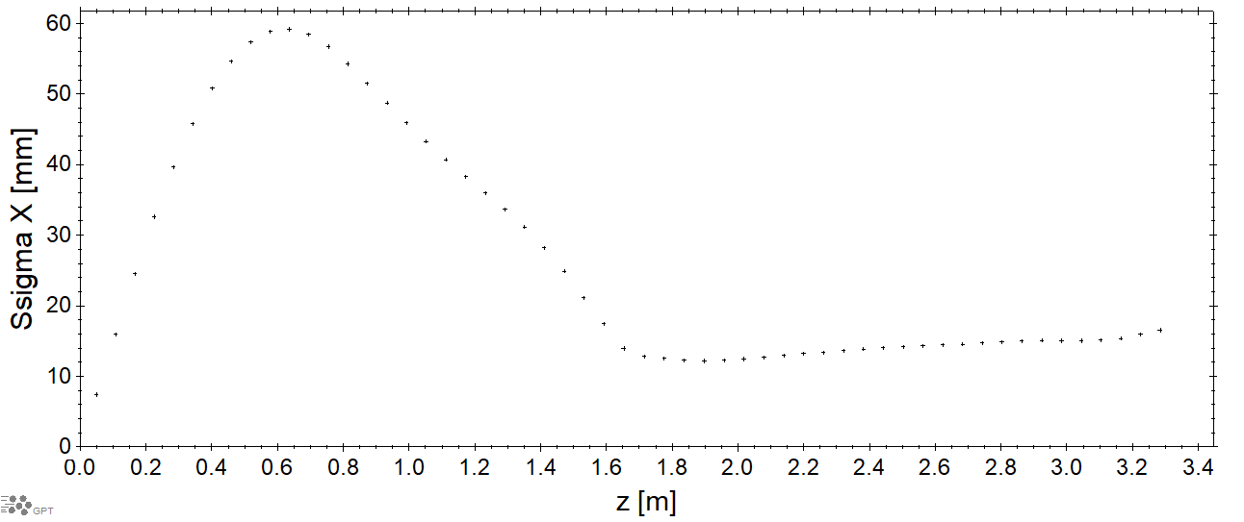
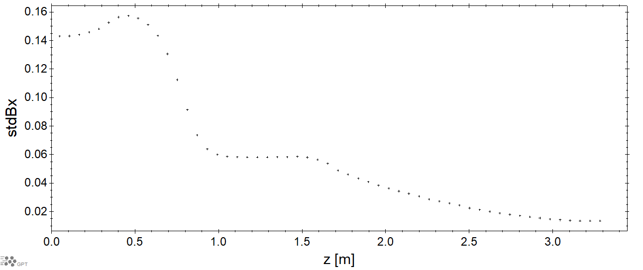
Transverse RMS Bunch Size and Angle vs Z
RMS Transverse Bunch Size X vs Z
STDEV Beta X vs Z
(Bx = v_{x}/v)

Slide 15
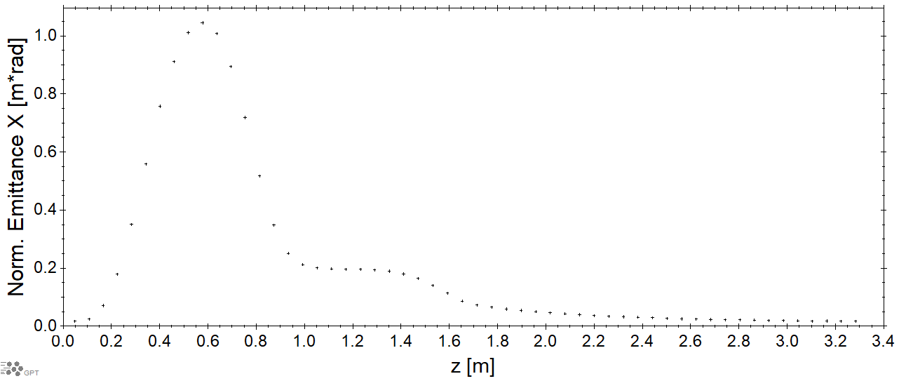



Positron Yield and Normalized Emittance vs Z
Normalized Emittance X vs Z
ε_{nx} @ Cav. End = 1.8e-02 m·rad
Long. Bunch Size vs Z

Slide 16


Impact of Solenoid around Cavity on e⁺ Yield
Yield vs Strength of Cavity Solenoid
Transmission vs Strength of Cavity Solenoid
Higher field of capture solenoid increases e⁺ yield

Slide 17



e⁺ Beam Current vs Z (e⁺ with All Energies)
e⁺ Current along whole Beam Line
(S. Habet, PhD Thesis, Dec. 2023)
e⁺ Current vs Z at Capture Solenoid
and 1st Cavity
Current at the End of Capture Cavity:
  Elegant (Sami): $I_{e^{+}}$= 3 µA
  GPT (Andriy): $I_{e^{+}}$= 7 µA

Slide 18
Summary
Created realistic model of capture system for 60 MeV e⁺ (>60 % polarization) with ~1 T main capture solenoid and low field in rotated water-cooled tungsten target
Calculated radiation levels in target and capture section areas where 96% of beam power is absorbed
Work together with RadCon Department on shielding of positron source has begun
Development of capture magnets and capture cavities with Magnet Group and SRF S&T Department have been started
First capture simulations of highly polarized (60 MeV) positrons have been performed
Capture and transport of beams with huge emittance is a challenge. Work on optimization of capture and acceleration of e⁺ beams is ongoing.

Slide 19
Backup Slides

Slide 20



Beam Dynamics of 60 MeV e⁺: Evolution of Bunch Parameters in Time
Transverse and Longitudinal
Bunch Size vs Time
X Phase Space vs Time
G-Z Phase Space vs Time
Cavity Phase = -150°
z = 0 – is position of average z
z = 0 – is position of average z

Slide 21


Energy Gain and Positron Yield vs E-Field Phase (3 MV/m, 1.1 m Length)
Average Energy vs Cavity Phase
e⁺ Yield vs Phase

