Slide 1
A high-power positron converter based on a recirculated liquid metal in-vacuum target
V.O. Kostroun, Karl Smolenski, Joe Conway, Nick Taylor
Xelera Research LLC
March 18, 2024
Positron Working Group Workshop at GWU

Slide 2
Liquid metal (LM) targets: introduction
The very large power in electron beams needed to generate positrons and the accompanying enormous power densities preclude solid targets unless some complicated means of heat removal is implemented (e.g., cooled high-speed target rotation).
Liquid metal targets are used in a number of high power applications. These include fully enclosed liquid metal targets for neutron generation, free liquid metal jets that allow extraction of pions and muons as well as other radioactive species generated in high energy particle reactions.
If one considers directly impinging electron beams on liquid metal targets for positron production, this has been proposed for some time and was actively developed at the Budker Institute.

Slide 3
Liquid metals: Advantages and disadvantages
Liquid metal targets are conceptually very simple. The main components of the target are the nozzle, solenoid for collecting positrons, heat exchanger, and pump.
Free surface liquid metal jet targets present a number of technical challenges but also possess some advantages. These include jet stability due to the thermal heat load and resulting mechanical pressures plus jet behavior in the magnetic field of a solenoid collecting the positrons. In addition, there may be the added complexity of the liquid metal being at an elevated temperature. On the other hand, such targets are conceptually simple compared to solid metal targets, can operate directly in an ultra high vacuum environment and can handle very high heat loads.

Slide 4
General Schematic of LM positron converter

Slide 5
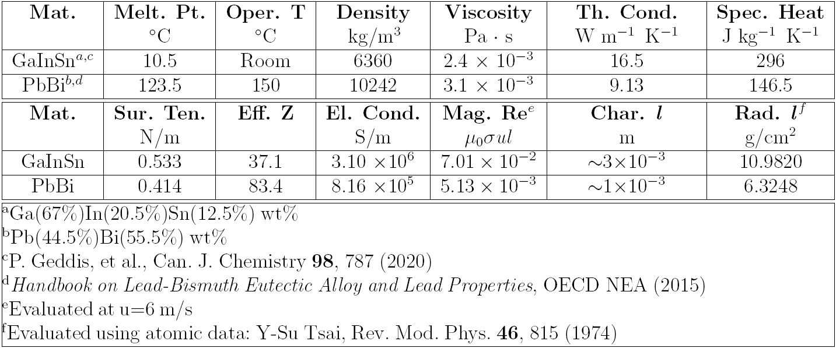
Two LMs of interest: GaInSn and PbBi eutectics

Slide 6
GaInSn prototype converter under investigation
A free surface, liquid metal jet positron converter is being investigated at Xelera Research LLC. The converter uses a free surface GaInSn jet as target for bremsstrahlung generated positrons. (GaInSn was selected because it is a liquid at room temperature.)
An MCNP6 calculation of positron production by a 10 MeV electron beam incident on a GaInSn target showed that a 3 mm thickness (Xo=1.727 cm) produced the largest number of positrons exiting the target.

Slide 7
Calculated positron energy distribution
(a) Positron energy distribution generated by 10 MeV electrons incident on a 3 mm thick GaInSn target, (b) angular distribution, (c) bremsstrahlung energy distribution.

Slide 8
LM jet nozzle design
Starting with a 3 mm × 10 mm output jet, the rest of the dimensions were scaled to obtain a nozzle contraction of 4. The nozzle input was set at 12 mm × 10 mm and the 15 mm length chosen arbitrarily. Using these values, a jet nozzle design was carried out using OpenFOAM with the standard solver simpleFoam, a steady-state solver for incompressible, turbulent flow, using the SIMPLE algorithm.
The nozzle uses a fifth-order polynomial contour function. It was constructed from two halves of stainless steel and welded together. It was tested with water, and the jet speed measured with a laser doppler velocimeter. The results agreed with the measured input flow rate and OpenFOAM calculations.

Slide 9
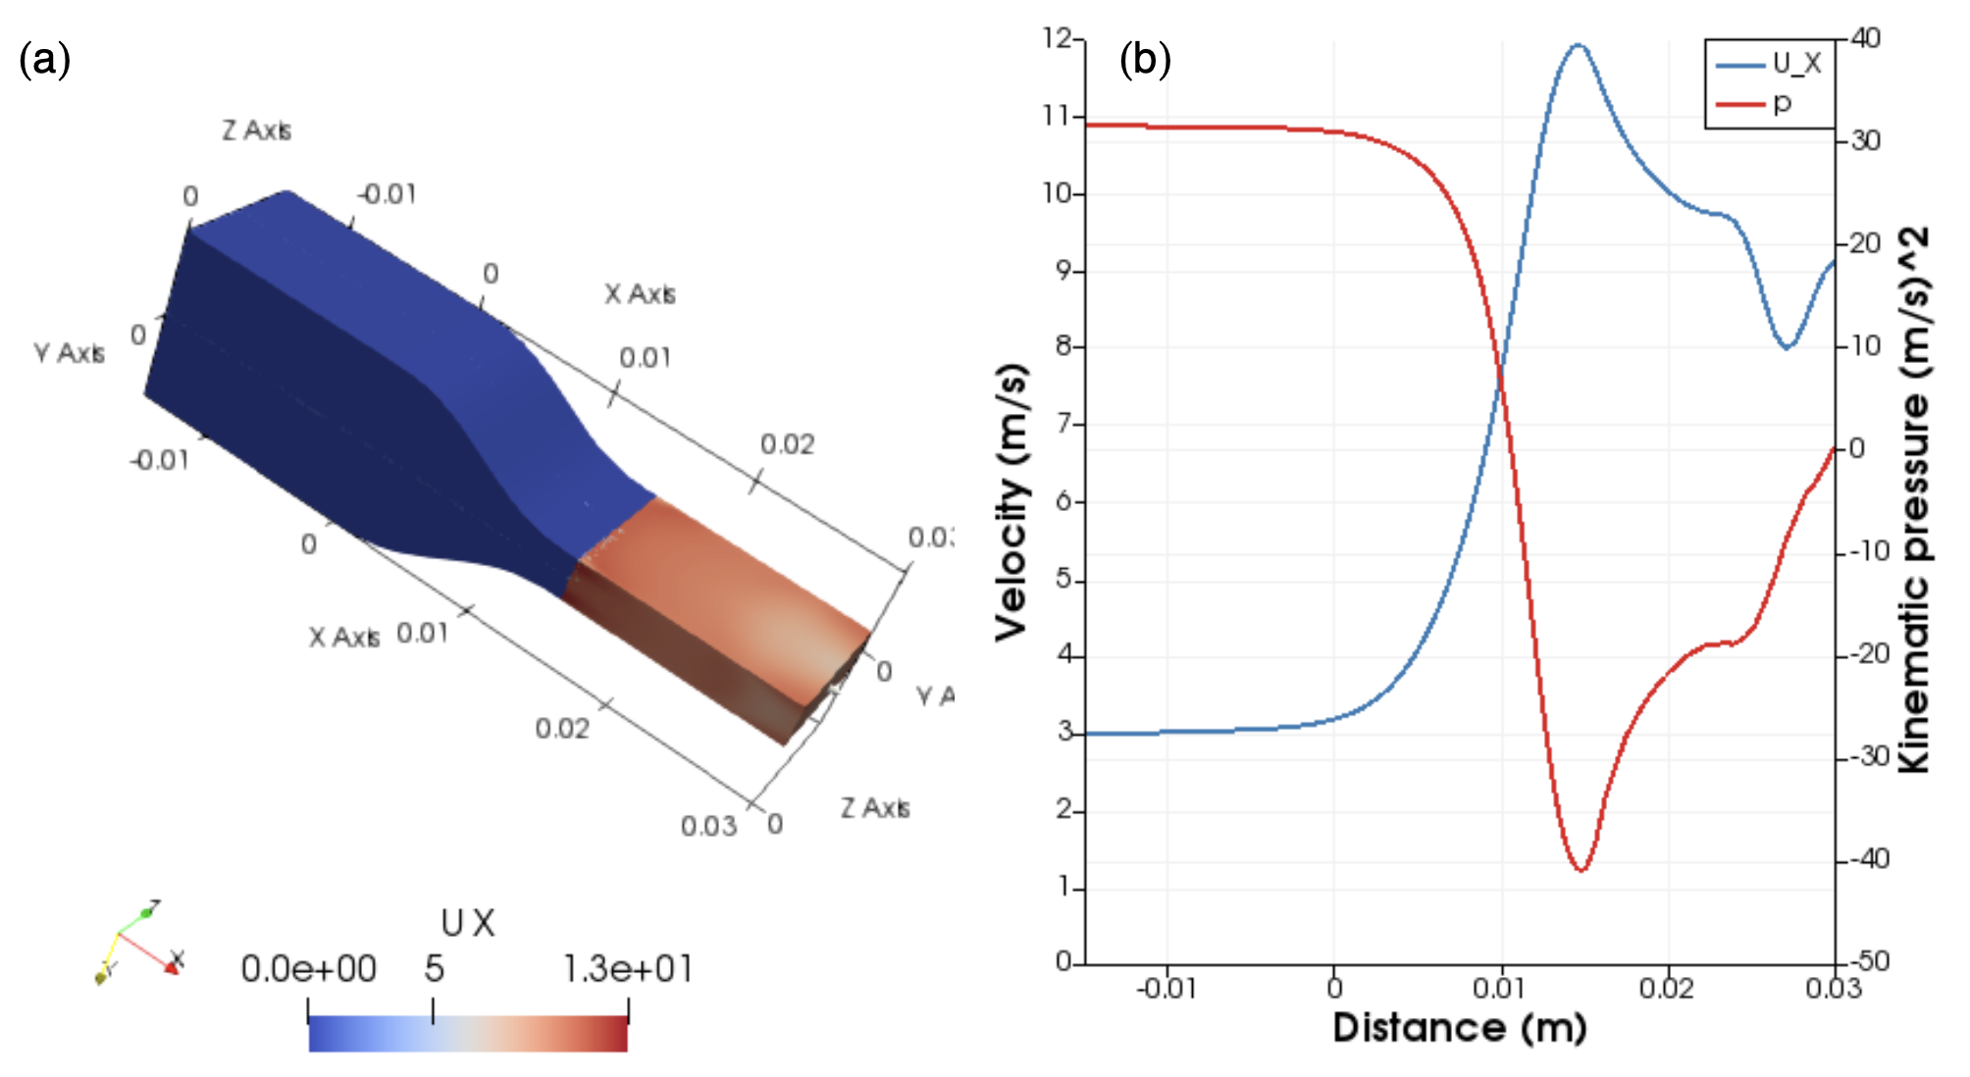
Nozzle for GaInSn target investigated using OpenFOAM.
The red part shows a 3 mm × 10 mm jet. The nozzle extends from 0 to 0.015 m.
Nozzle velocity (blue), for an input velocity of 3 m/s. The output velocity is ∼12 m/s. The red curve is the kinematic pressure p/ρ.

Slide 10
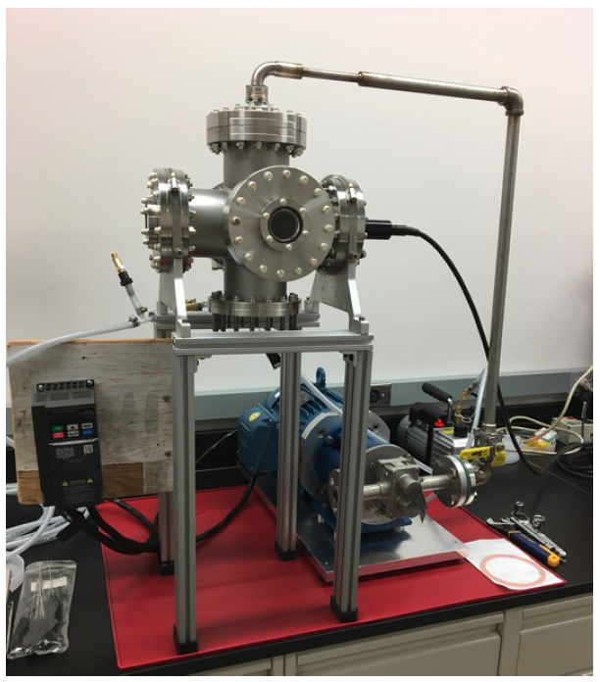
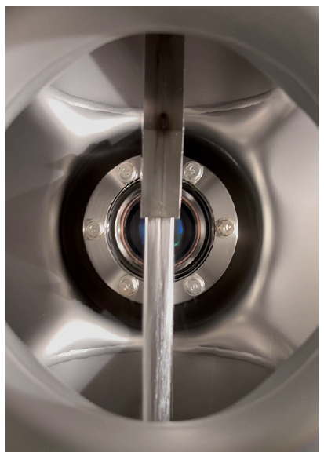
GaInSn prototype test stand
A free surface GaInSn liquid metal test stand was constructed from 304 SS.
The GaInSn is pumped by a Liquiflo Model H7F Mag-Drive gear pump with speed controlled by a constant-torque VFD.
Example GaInSn jet with speed ∼ 8 m/s.

Slide 11
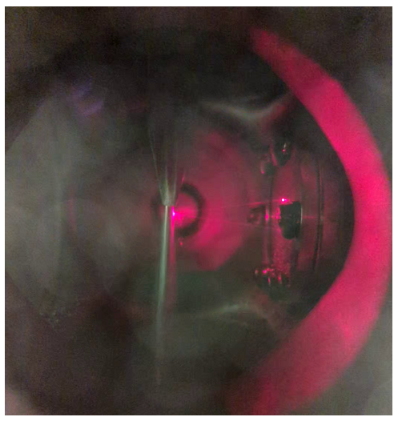
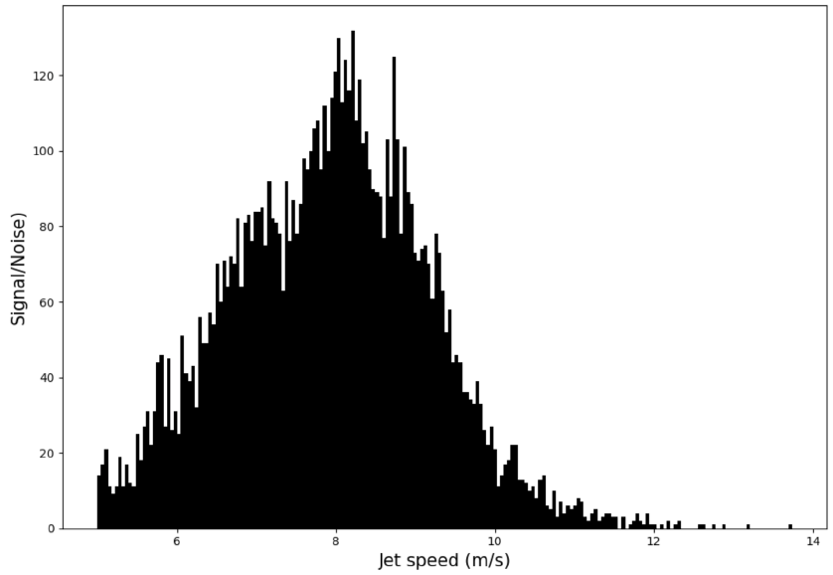
Jet velocity measurement
Laser doppler velocimeter measurement of the jet speed.
Jet velocity profile, with pump VFD at a frequency corresponding to a jet speed of 8.41 m/s.

Slide 12
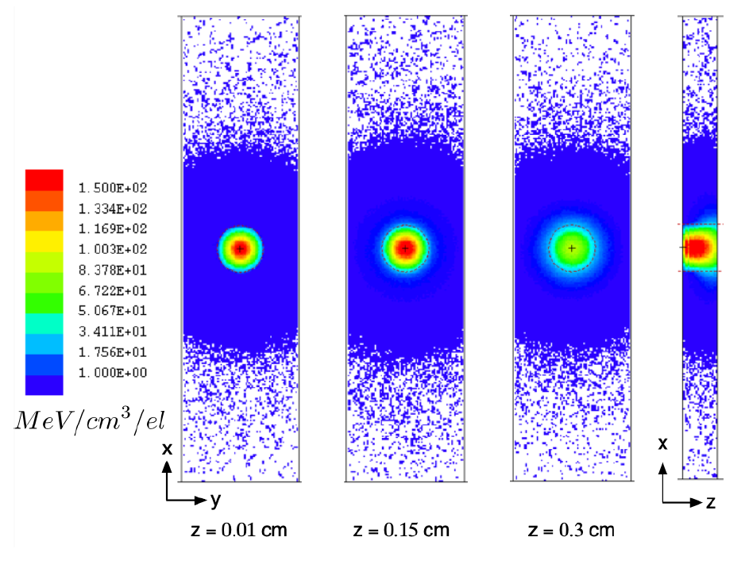
Energy generated in target
MCNP6 calculation of energy deposited (MeV/cm³/electron) in a x=4 cm × y=1 cm × z=0.3 cm target of GaInSn by a 10 MeV Gaussian electron beam with σ_{x} = σ_{y} = 1 mm at different depths in the target. The dashed circle is the outline of the 2σ “cookie cutter”.

Slide 13
Functional form of energy deposited
The energy deposited is on a 0.1 mm × 0.1 mm × 0.1 mm grid and recorded by an energy deposition mesh tally in MCNP6 that scores the deposited energy per unit volume from all particles, in this case electrons, positrons, and photons.
From the x and y data at various values of z and the total energy deposited in the target the following functional dependence was obtained:

Slide 14
Estimating thermal shock in the target
As an energetic electron beam enters a material, the energy deposited heats up the material on a short time scale. The resulting thermal stresses may be large enough to cause material failure. It is of interest to calculate the thermal shock pressure and stress pulses in the material.
The basic approach here is to use the Mie-Grüneisen equation,
$$p_{th}=γ\frac{Q_{th}}{V},$$
which relates the pressure p_{th} to the thermal energy Q_{th} deposited in volume V through the Grüneisen parameter γ.

Slide 15
Temperature increase
The Grüneisen parameter is a dimensionless quantity given by
$γ=\frac{αK_{T}}{ρC_{V}}$,
where α is the volume expansion coefficient, K_{T} the isothermal bulk modulus, ρ the density, and C_{V} the specific heat at constant volume.
A 1 mA electron beam in this case deposits ∼3.8 kJ each second in a target at rest in the volume bounded by |(x or y)| ≤ 1.25 mm and 0 ≤ z ≤ 0.3 cm, or in 0.014 cm³. However, for a jet moving at 10 m/s, the volume swept out in one second is 1000 cm × 0.25 cm × 0.3 cm = 75 cm³, so that the temperature rise ∆T for GaInSn is
$Δ$T = $\frac{Q}{ρVC_{V}}$ = $\frac{3800 J}{6360 kg/m^{3}}$ $×75×{10}^{−6}m^{3}×296\frac{J}{kgK}=26.9 K$

Slide 16
Pressure increase
K_{T} for GaInSn is ∼ 44 Gpa. The thermal expansion coefficient α is 1.26×10⁻⁴ /K and the Grüneisen parameter is 2.9. In this case the pressure due to this temperature rise is
$p_{th}= \frac{0.95 J}{4×{10}^{−8} m^{3}}=$ 197 MPa$≅$2.0 kbar
The heat deposited into the moving jet is governed by the equation
$∇$ $∙\left(k∇T\right)+\dot{Q}=vρc\frac{∂T}{∂x}$,
where k is the thermal conductivity, T the temperature, $\dot{Q}$is the heat per unit volume per N electrons deposited in the target, v is the speed of the medium, (in this case the x direction), ρ is the density and c is the heat capacity.

Slide 17
LM free-surface jet in magnetic field
One key question is how liquid-metal free-surface jets behave in the ∼ 1 T magnetic fields necessary for positron focusing/collection.
A preliminary study of this question was undertaken by investigating the behavior of a PbBi free-surface jet (6.32 mm × 10 mm) in a uniform 1.29 T magnetic field coaxial with the electron beam direction. (The 6.32 mm thickness corresponds to the radiation length Xo of GaInSn.)
A CFD study using the OpenFOAM solver simpleFoam was used to calculate the behavior of a PbBi jet in the absence of a magnetic field and the solver mhdFoam was used to calculate the effect of a 1.29 T magnetic field on the same jet. The calculation corresponds to Hartmann flow in that the surfaces perpendicular to the magnetic field are assumed to be a perfectly conducting and the side surfaces perfectly insulating.

Slide 18
PbBi jet without magnetic field
Velocity components of a PbBi free jet exiting a nozzle (1 cm × 0.632 cm) with a speed of 14 m/s along the x-direction in the absence of a magnetic field.

Slide 19
PbBi jet in 1.29 T magnetic field
Effect of a uniform 1.29 T magnetic field By on the velocity components of a PbBi free jet exiting a nozzle (1 cm × 0.632 cm) moving with a speed of 13 m/s along the x-direction.

Slide 20
Radioisotope production
High-energy electrons incident on materials can produce radioactivity by knocking out nuclear particles directly, or, much more likely, by converting some of their kinetic energy into gamma radiation which can induce photo-nuclear reactions. The gamma reactions that must be considered in the GaInSn case are (γ, n) and (γ, p) reactions.
However, the gamma ray flux above 6 MeV is smaller by two orders of magnitude or more compared to that at ∼1 MeV, and the neutron and proton binding energies in the GaInSn isotopes are 6 MeV or greater. Furthermore, the rate of radio-isotope production depends on the photo-nuclear cross section (typically of the order of mb), the half-life, and the irradiation time, all of which contribute to ensuring that the rate of radio-isotope production in GaInSn is very small.

Slide 21
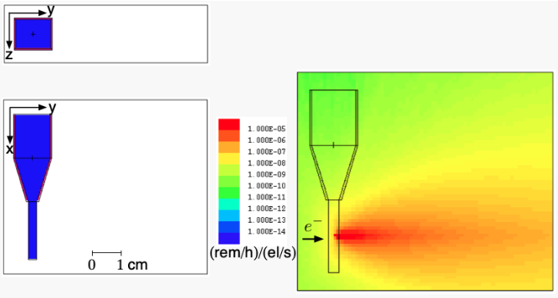
Gamma radiation
The gamma radiation field generated by the target is quite intense and must therefore be shielded against.

Slide 22
Planned upgrades and tests
The 6" cross in the prototype will be replaced by a smaller cylindrical structure and a heat exchanger added. The resulting converter will be tested at the Upgraded Injector Test Facility (UITF) at JLab at beam currents < 100 nA and 10 MeV.
A Compton transmission polarimeter will be used to measure the polarization of x-rays in the MeV energy range from the GaInSn liquid jet target. Measuring the x-ray spectrum dependence on jet target parameters (thickness, flow) demonstrates a critical target performance metric and will be used for benchmarking simulation codes.
In addition, an emittance filter will be used to characterize charged particle transmission through the liquid metal target and to benchmark the rate of positron production when correlated with simulation results. The apparatus is being built to generate large phase-space electron beams for machine acceptance measurements in CEBAF at JLab, with first measurements anticipated near the end of FY24, and will be available for measurements in the second year of this project.

