Slide 1
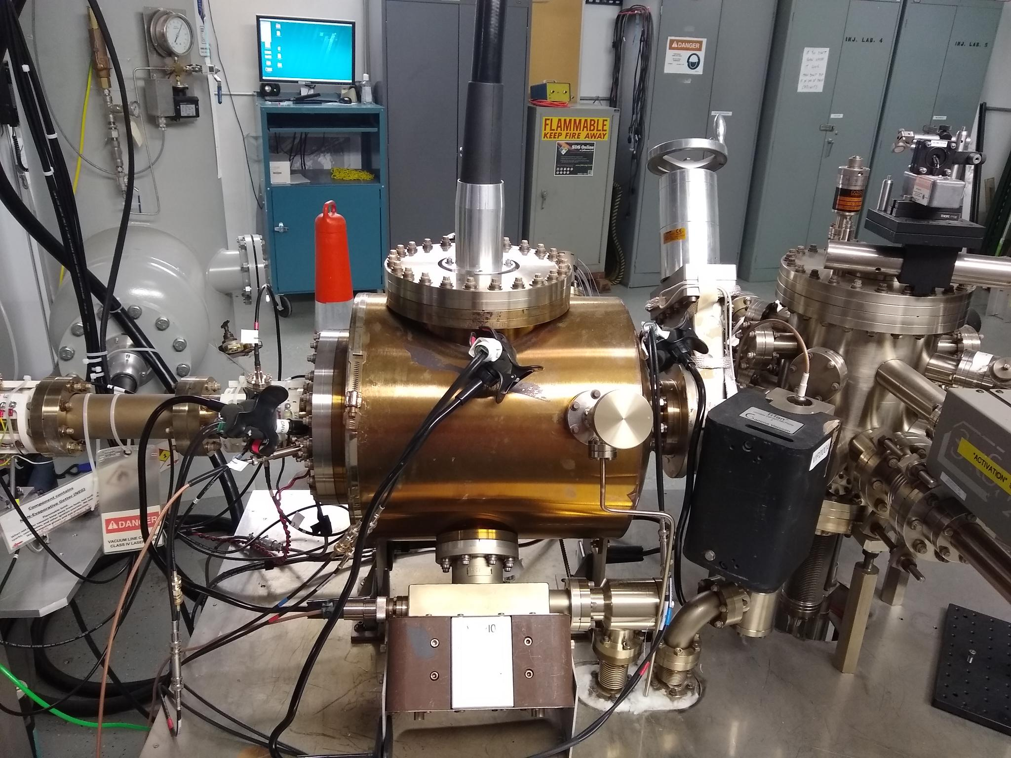
A high intensity polarized beam photogun for the Ce⁺BAF positron source
Towards 5X the beam current of the state-of-the-art CEBAF photogun
6 in
Carlos Hernandez-Garcia for the Ce⁺BAF team
CEBAF
130 keV
polarized
GTS
300 keV un-polarized
Prototype
500 kV
Positron Working Group Workshop ,Washington, DC, March 18-20, 2024

Slide 2

Designing a 1 mA polarized photogun as beam driver for positron production
Two challenging injectors have to be built considering two high risk R&D areas
High current polarized e-source > 1 mA
Polarized e- injector > 120 MeV
e+ beam to CEBAF
High power e+ conversion target.
(Andriy Ushakov)
> 100 kW target & cw-collection beam line

Slide 3
A photogun generating 1 mA CW beam will produce:
  86 C in a day
  600 C in a week
  2400 C in a month
Consequently the photocathode 1/e charge lifetime should be >1 kC, meaning the photogun can operate:
for ~ one month without intervention or
for a few weeks at a time at even higher beam current levels

Slide 4
What does a photogun need to provide for generating > 1 mA CW polarized beam?
  High polarization photocathodes with high QE > 1%
  Vacuum chamber with total Pressure < 1e-12 Torr
  High Voltage
  Long 1/e charge lifetime τ > 1000 C

Slide 5
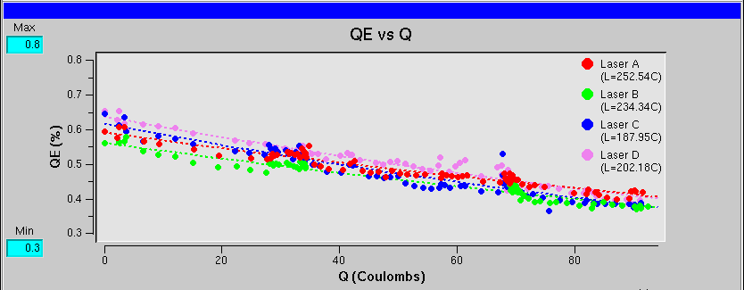
CEBAF polarized e- source @ 1 mA?
High polarization at 1 mA
[µA]
Gun2 Photocathode (Fall 2016 – Spring 2017)
QE = QE₀ e ^{-(Q/Lifetime)}
We have demonstrated polarization from the CEBAF PES remains steady up to 1 mA/499 MHz
The charge lifetime (at 0.2 mA) is about 200 C
This would provide only 2-3 days of positrons
Lifetime ~200 C (σ_{4D} ~ 1mm, I~200 μA)
Slide by J. Grames
Gun vacuum ~ 1x10⁻¹² Torr

Slide 6
CEBAF lifetime improvement with biased anode (GaAs/GaAsP)
Ions downstream of the anode are repelled back towards the beamline by the positive anode potential
Improving charge lifetime of CEBAF photogun
J. T. Yoskowitz et al., 12th Int. Particle Acc. Conf. IPAC2021, Campinas, SP, Brazil, doi:10.18429/JACoW-IPAC2021-WEPAB104
With a >400 C lifetime we could operate at 1 mA for almost 1 week
Slide by J. Grames

Slide 7
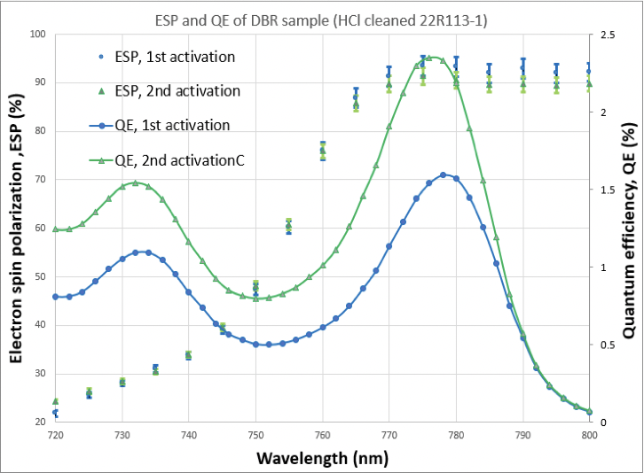
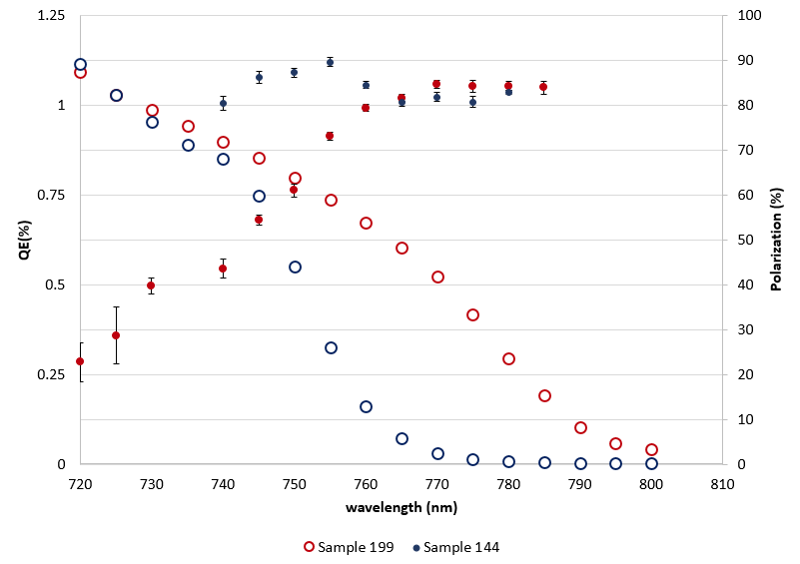
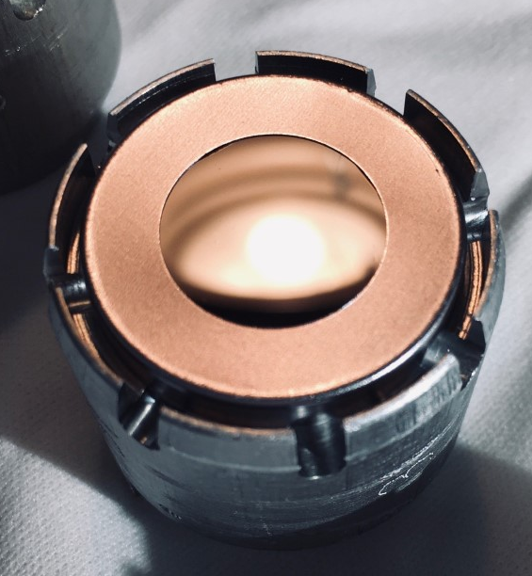
Developing polarized photocathodes with > 1% QE (DOE NP FOA LAB 20-2310)
JLAB-ODU-BNL
JLAB-UCSB
CEBAF
  Strained Super Lattice
  GaAs/GaAsP
  ~ 85% pol, ~0.3% QE
  MOCVD
  GaAs/GaAsP-DBR
  ~ 90% pol, ~ 2% QE
  CBE/MBE
  GaAs/GaAs/P
  InGaAs/InAlGaAs
  ~85% pol, ~ 1% QE
780 nm
780 nm
780 nm
B. Belfore et al., Appl. Phys. Lett. 123, 222102 (2023); doi: 10.1063/5.0170106
Graph courtesy S. Marsillac (ODU)
Graph courtesy M. Stutzman (JLab)

Slide 8
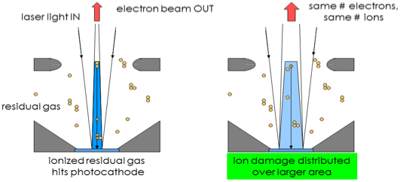
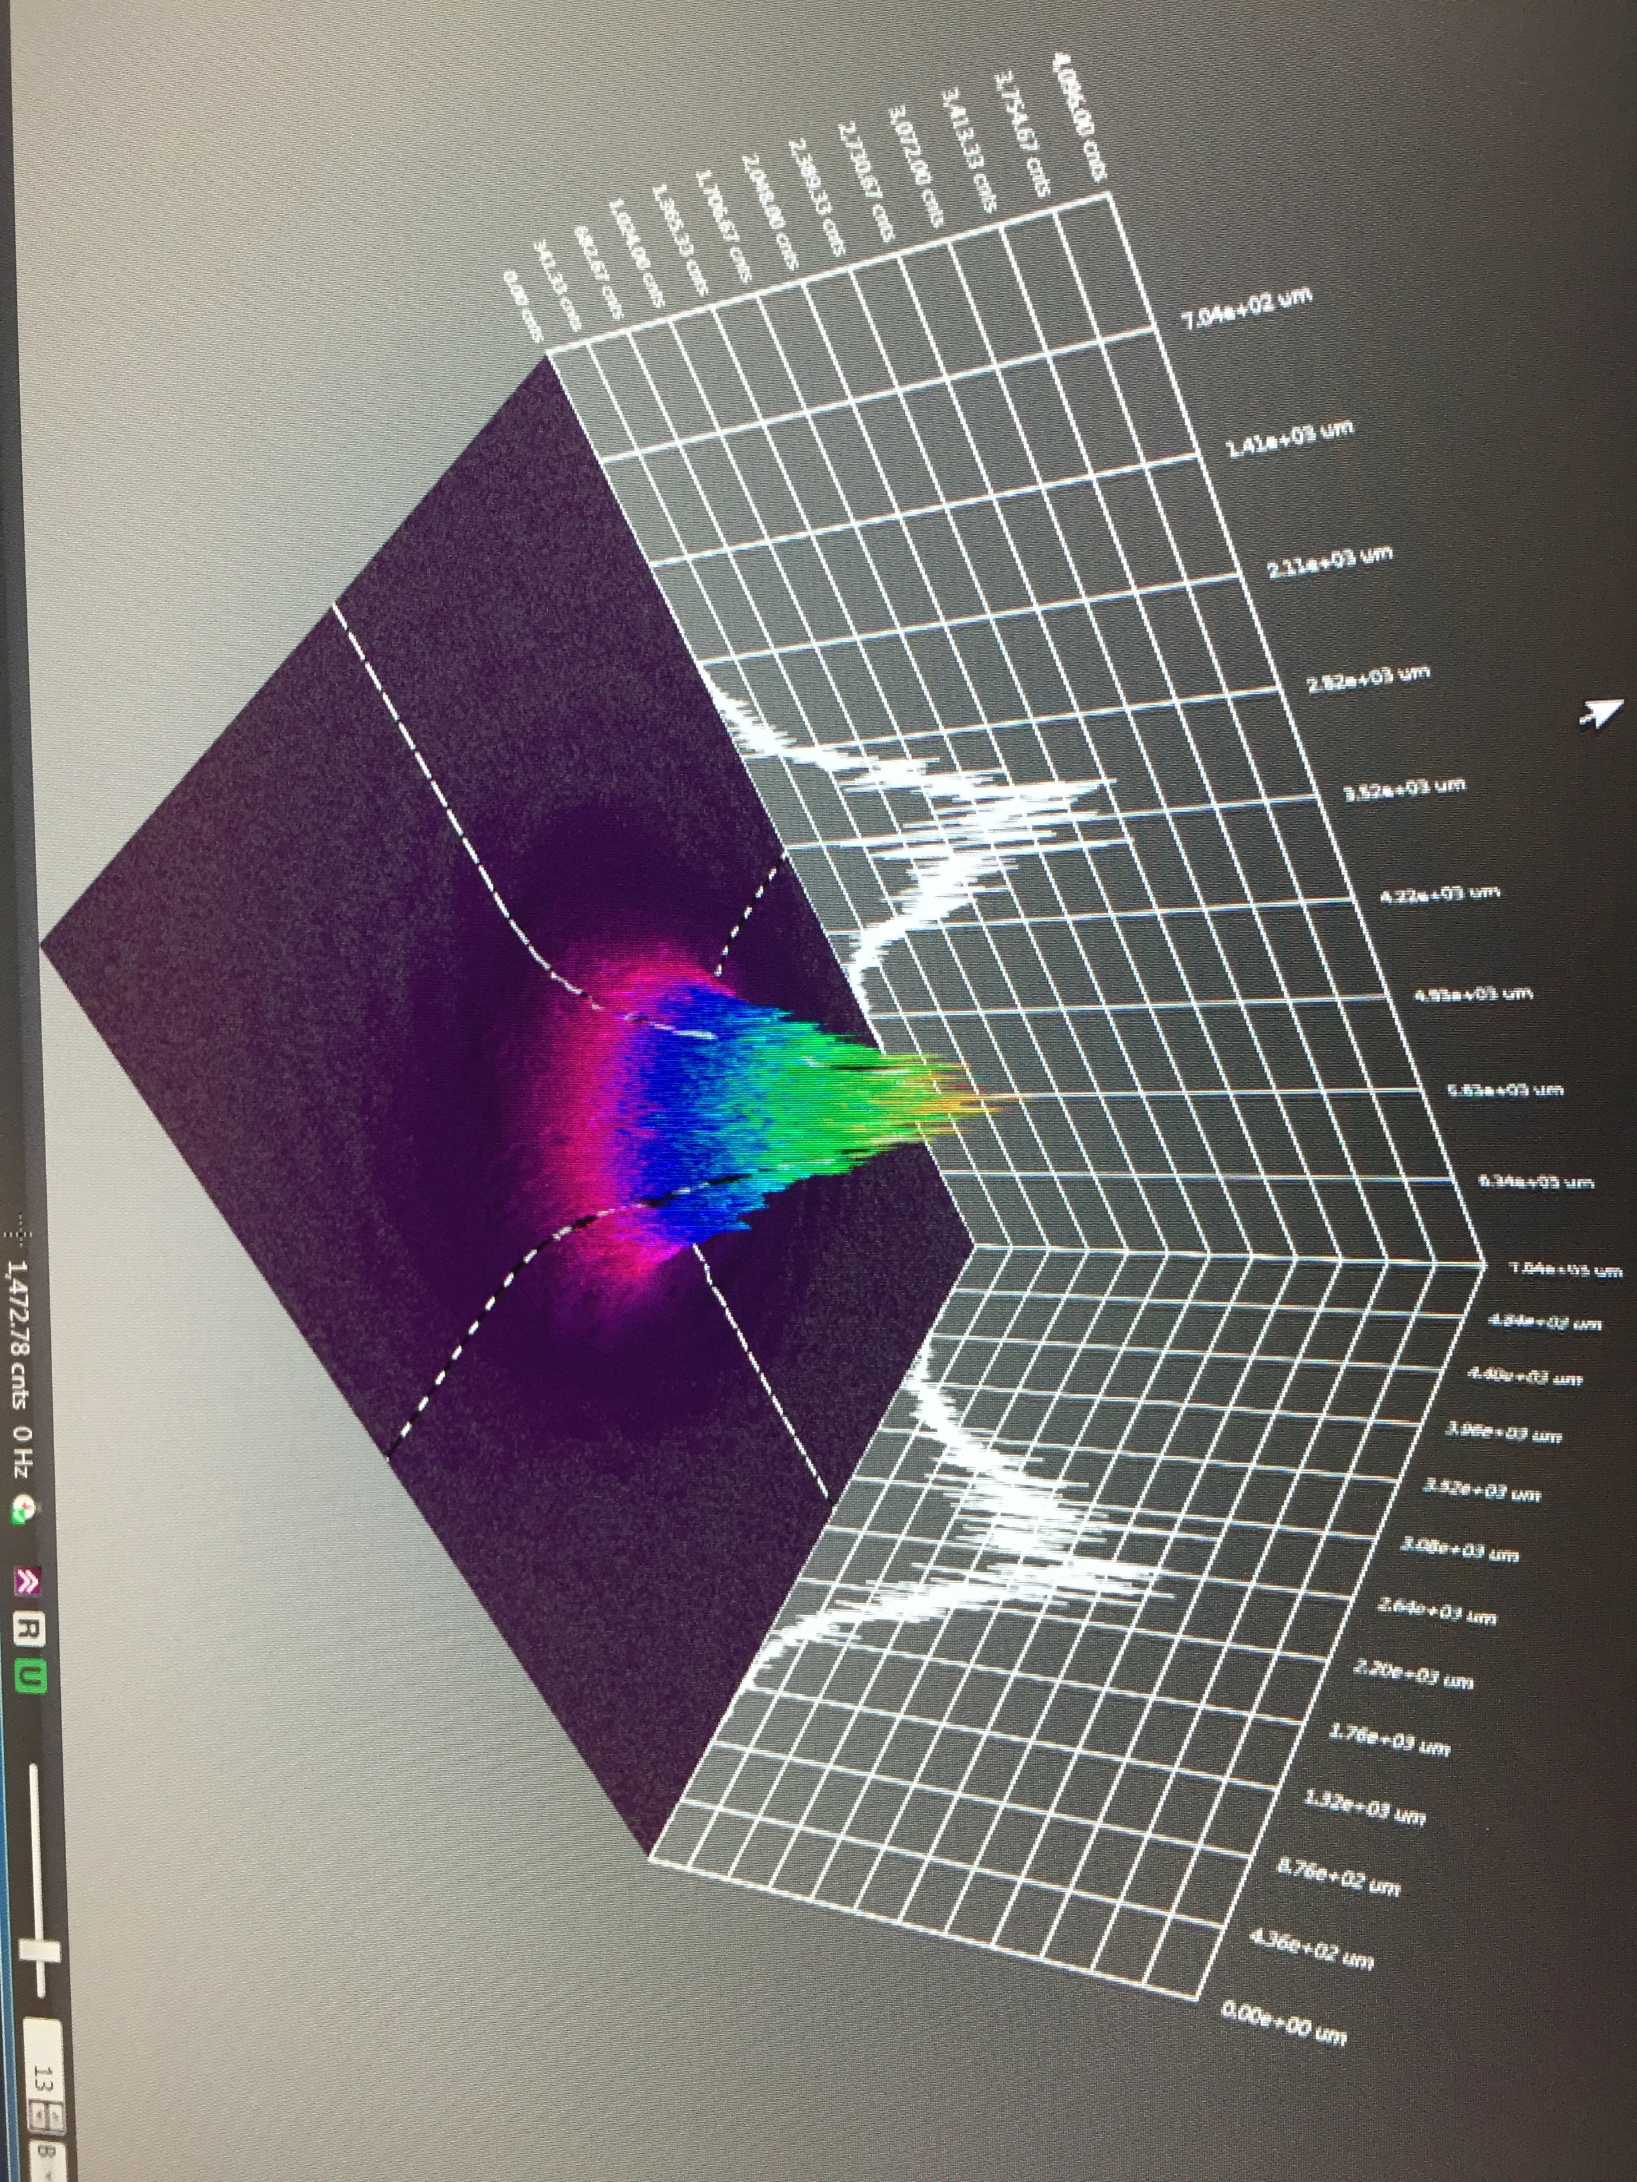

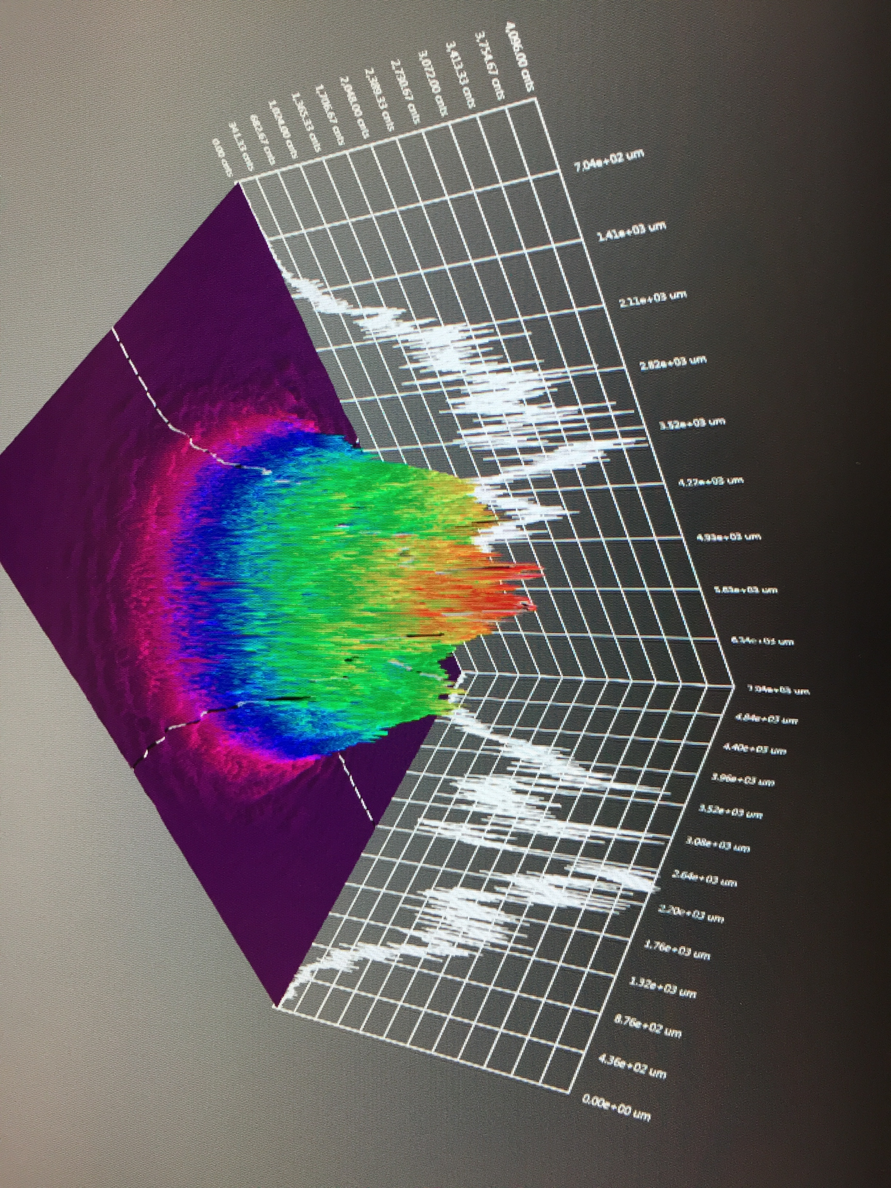
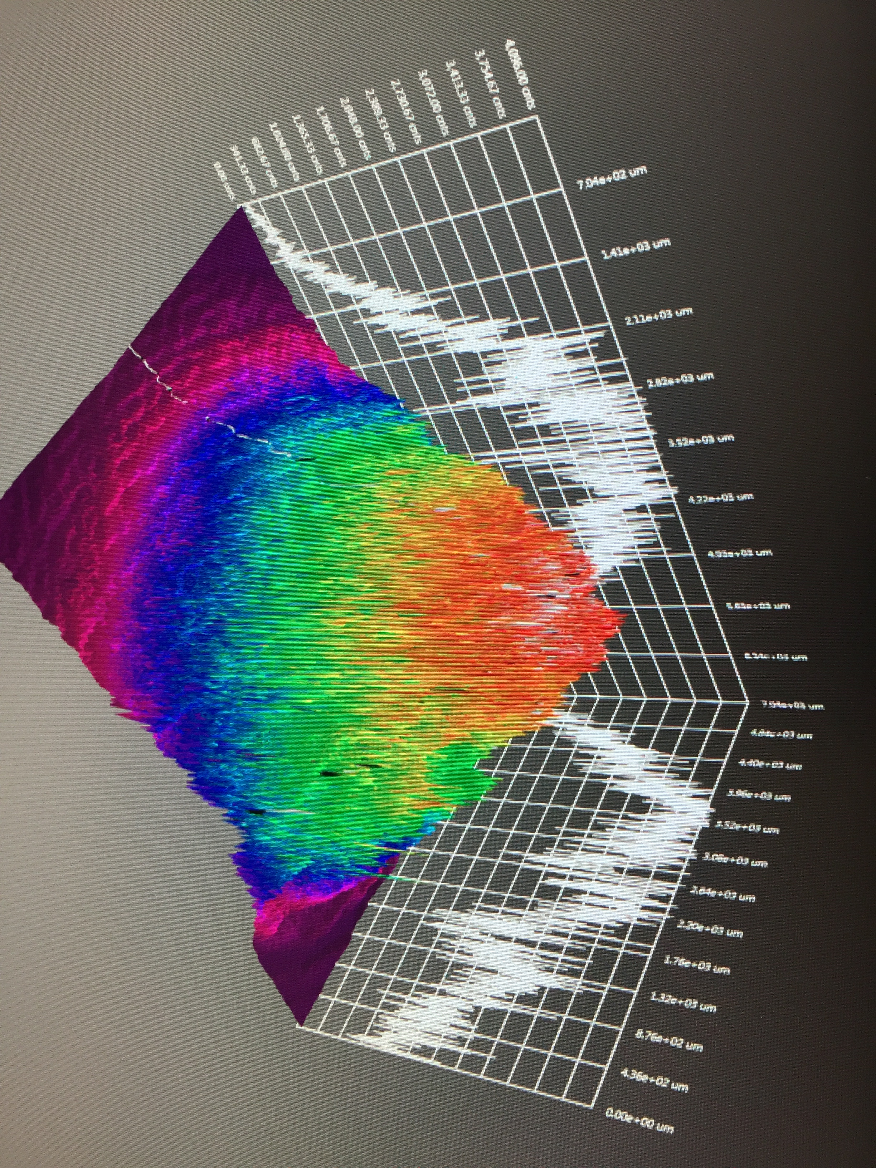
GaAs/GaAsP charge lifetime at milliamp current
Results from PSTP’17 suggests increasing laser spot size is viable to exceed >500 C lifetime; however we need to build another gun to test this assertion.
J. Grames, P. Adderley, J. Hansknecht, R. Kazimi, M. Poelker, D. Moser, M. Stutzman, S. Zhang, “Milliampere beam studies using high polarization photocathodes at the CEBAF Photoinjector” Polarized Sources, Targets and Polarimeters Workshop, Dajeon South Korea (2017)
Test performed with un-biased anode
4𝜎 ~ 10 mm
Days
Trend we want to realize
CEBAF (<1 mm²)
4𝜎 ~ 1 mm

Slide 9
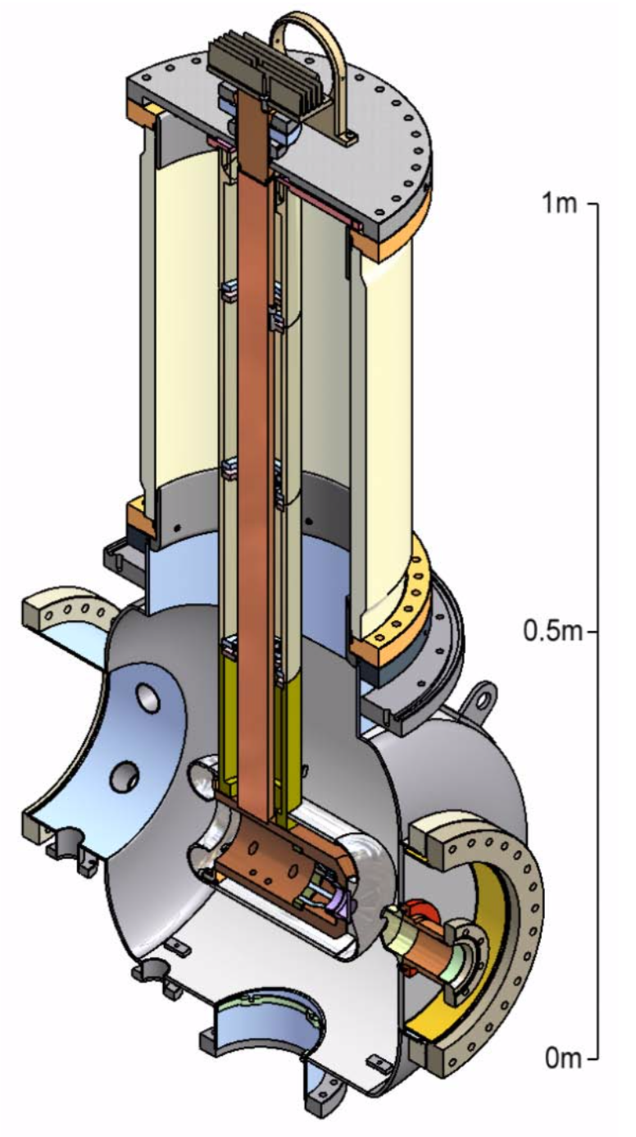
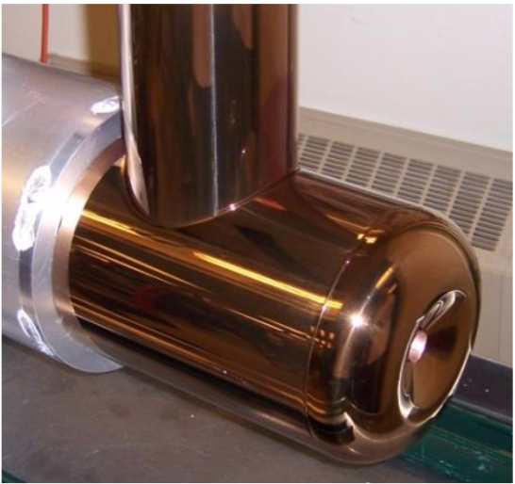
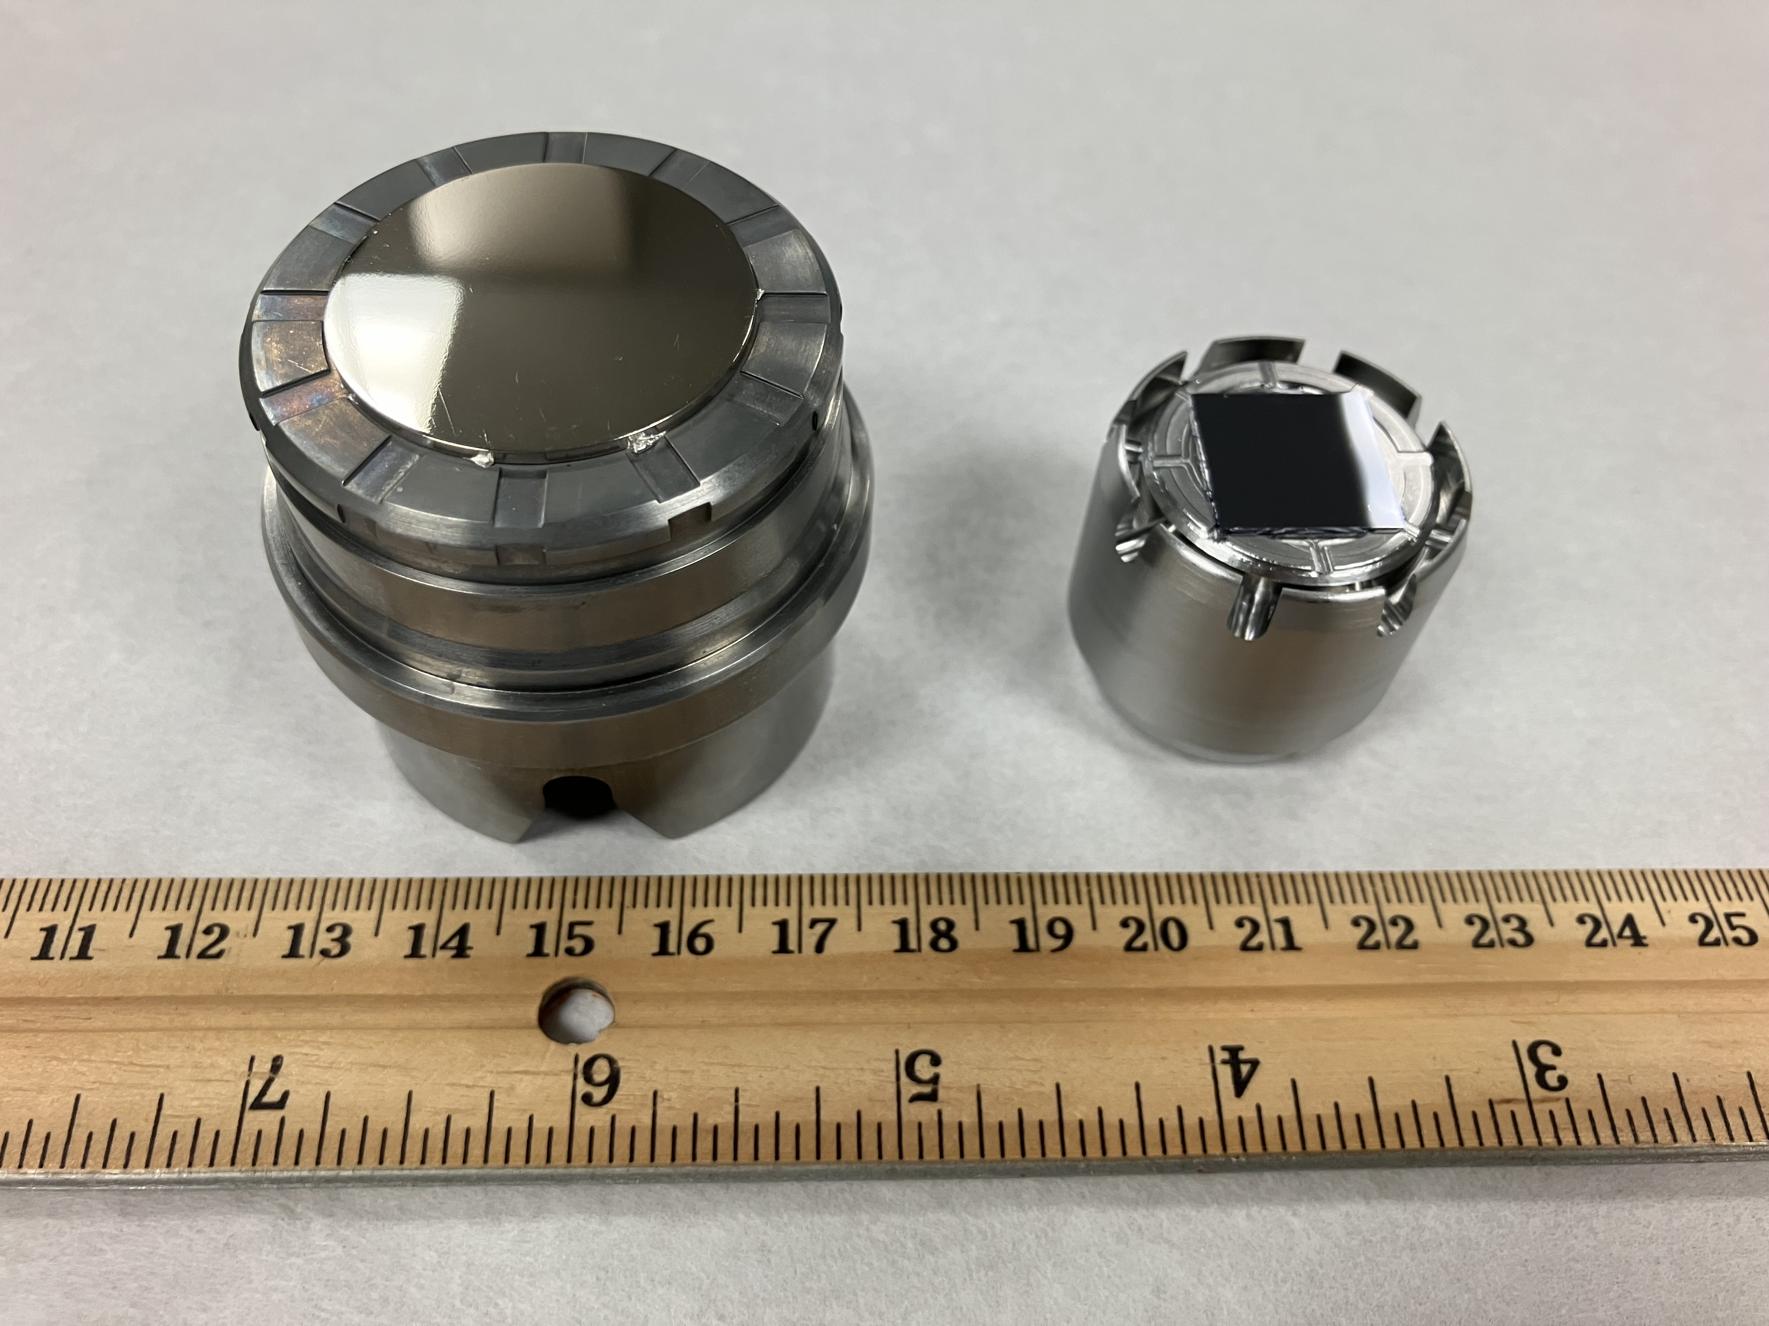
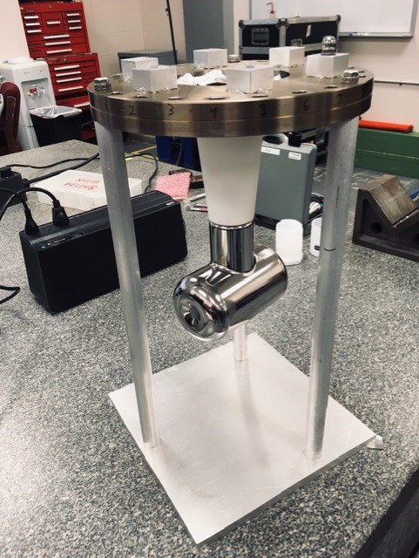
Larger size electrodes are needed for large size laser spot on photocathode
The Cornell photogun demonstrated up to 65 mA CW non-polarized beam from a ~ 4 mm diameter laser spot
Prototype photocathode puck
CEBAF photocathode puck
Cornell electrode
12 in
CEBAF electrode
6 in
B. Dunham et al., APPLIED PHYSICS LETTERS 102, 034105 (2013)

Slide 10
Polarized electron source for Ce⁺BAF
We want to deliver > 1 mA for weeks on end…
Two weeks @ 1 mA ≈ 1 kC
By increasing the laser size and biasing the anode charge lifetimes of 1 kC might be possible
Improving vacuum
Ce⁺BAF
Gun Charge in 2 weeks [Coulombs]
anode biasing
CEBAF
large laser size
Gun Current to make positrons [mA]
Slide by J. Grames

Slide 11
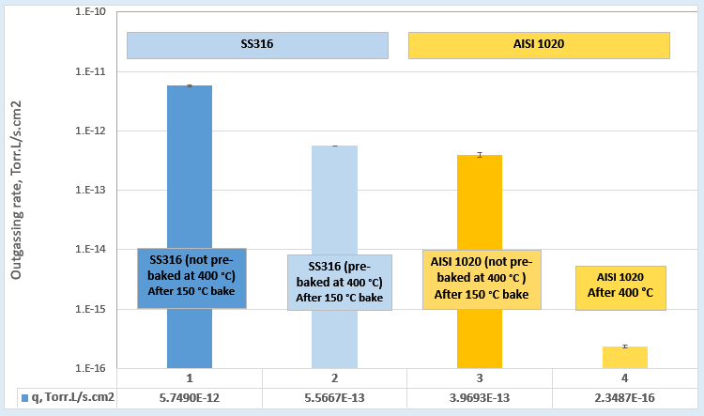
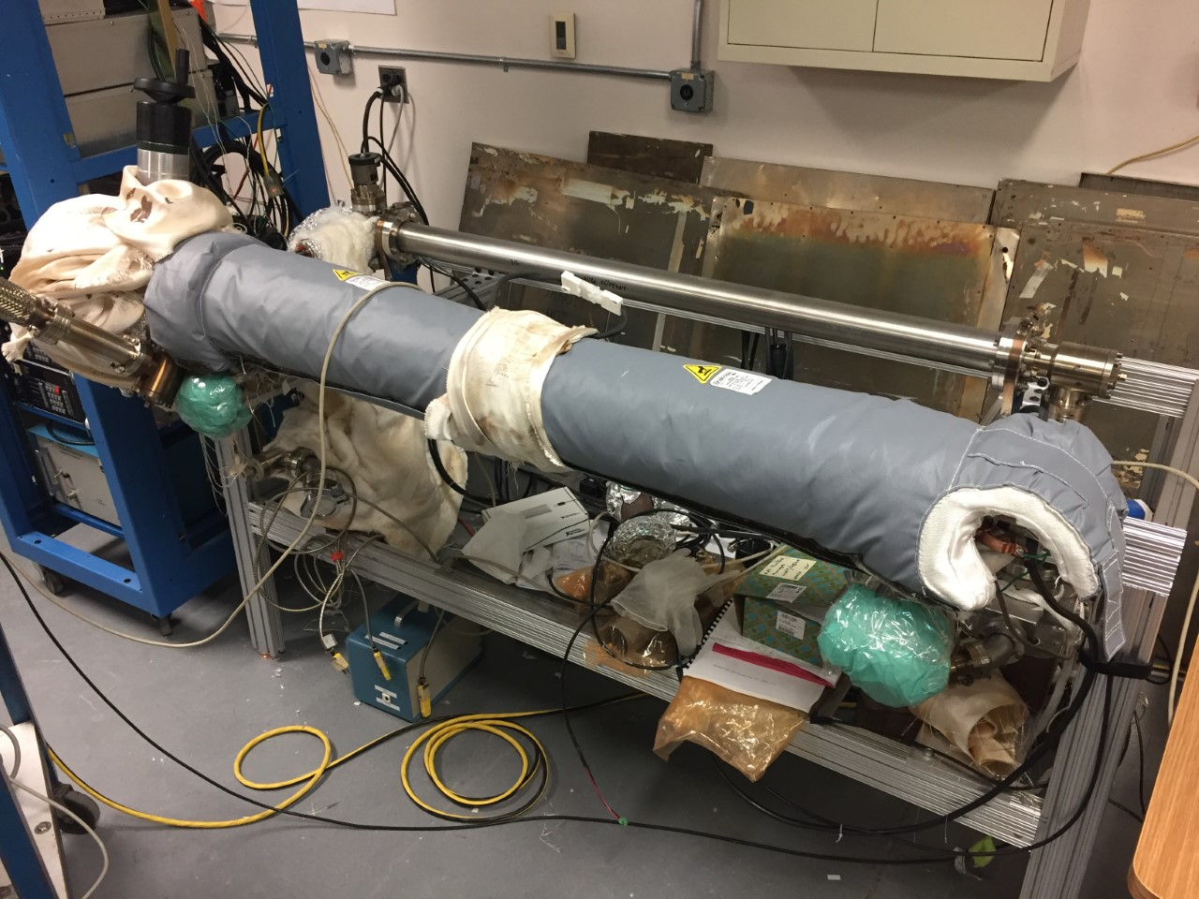
Improving photogun extreme high vacuum conditions
CEBAF photogun
316 stainless steel
R&D
low carbon steel
CEBAF photogun vacuum chamber after 400 C heat treatment
Test stand to measure hydrogen outgassing rate
Pump down “ultimate pressure” setup
Low carbon steel exhibits VERY low hydrogen outgassing rate. Our measurements consistent with those of Park et.al.,
Chongdo Park, Taekyun Ha and Boklae Cho, "Thermal outgassing rates of low-carbon steels," J. Vac. Sci. Technol. A 34, 021601 (2016); https://doi.org/10.1116/1.4936840
Slide courtesy M. Poelker

Slide 12
What else does a photogun need to provide for generating > 1 mA CW polarized beam?
  High Voltage
  Low limit
  Photocathode surface charge limit
  Space charge within the electron bunch
  High limit
  Field emission
  Minimum energy required for beam capture by the MeV SRF booster
  Commercial supply chain challenges manufacturing compact conical insulators
  High voltage power supply ($0.5 M, needs SF₆)
  High voltage commercial components operational limits
CEBAF photogun performance
130 kV, no field emission
~0.2 mA CW from 4𝜎 ~ 1 mm laser spot
~ 85% polarization beam injected to 0.5 MeV capture RF cavity
JLab FEL photogun performance
350 kV, some field emission
10 mA CW from 4𝜎 ~ 8 mm laser spot
Non-polarized beam injected to 10 MeV SRF booster

Slide 13
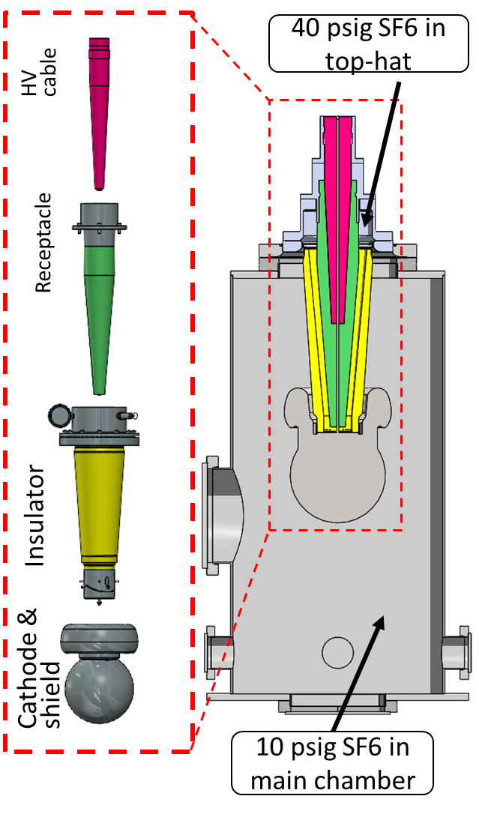
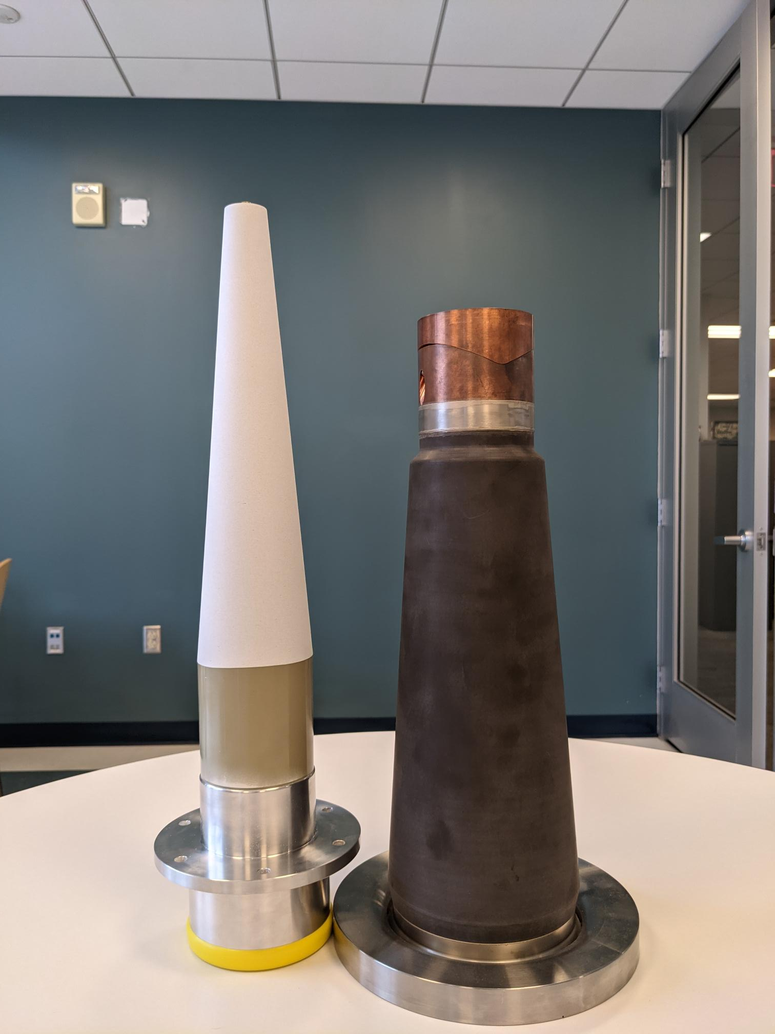
Addressing the high voltage limit for a 1 mA polarized photogun
Field emission free operation:
  Requires ~ 100 kV higher than operating voltage for field emission high voltage processing
Minimum gun voltage for beam capture by SRF booster:
  200 – 300 kV
There is no conical insulator capable of > 400 kV
  A compact, conical insulator is instrumental in the photogun design to minimize vacuum chamber volume and area
  A large insulator is required also for supporting larger electrodes
JLab demonstrated (2023) 500 kV using a very large, custom inverted insulator with SF₆ intervening volume mating to a modified HV cable receptacle
  This proof of principle is not directly applicable to a photogun design
There is no cable that fits this insulator
SF₆ intervening layer
18 in
C. Hernandez-Garcia, Positron Working Group Workshop, March 18-20, 2024
Funded through: NP FOA LAB 20-2310

Slide 14
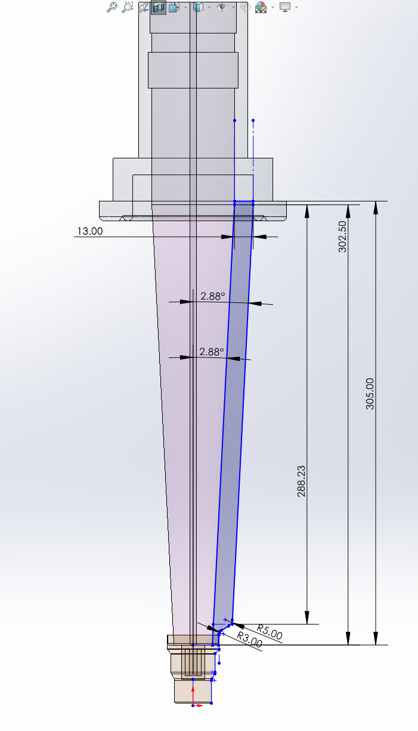
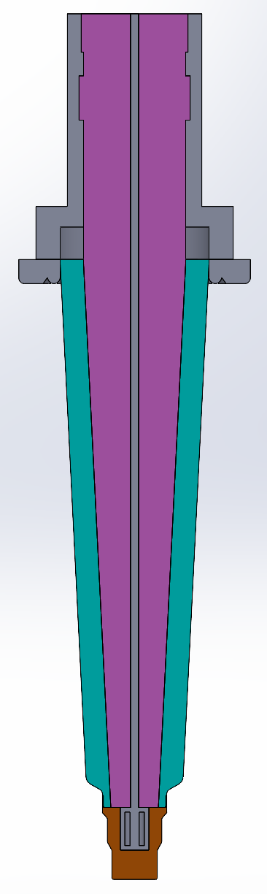
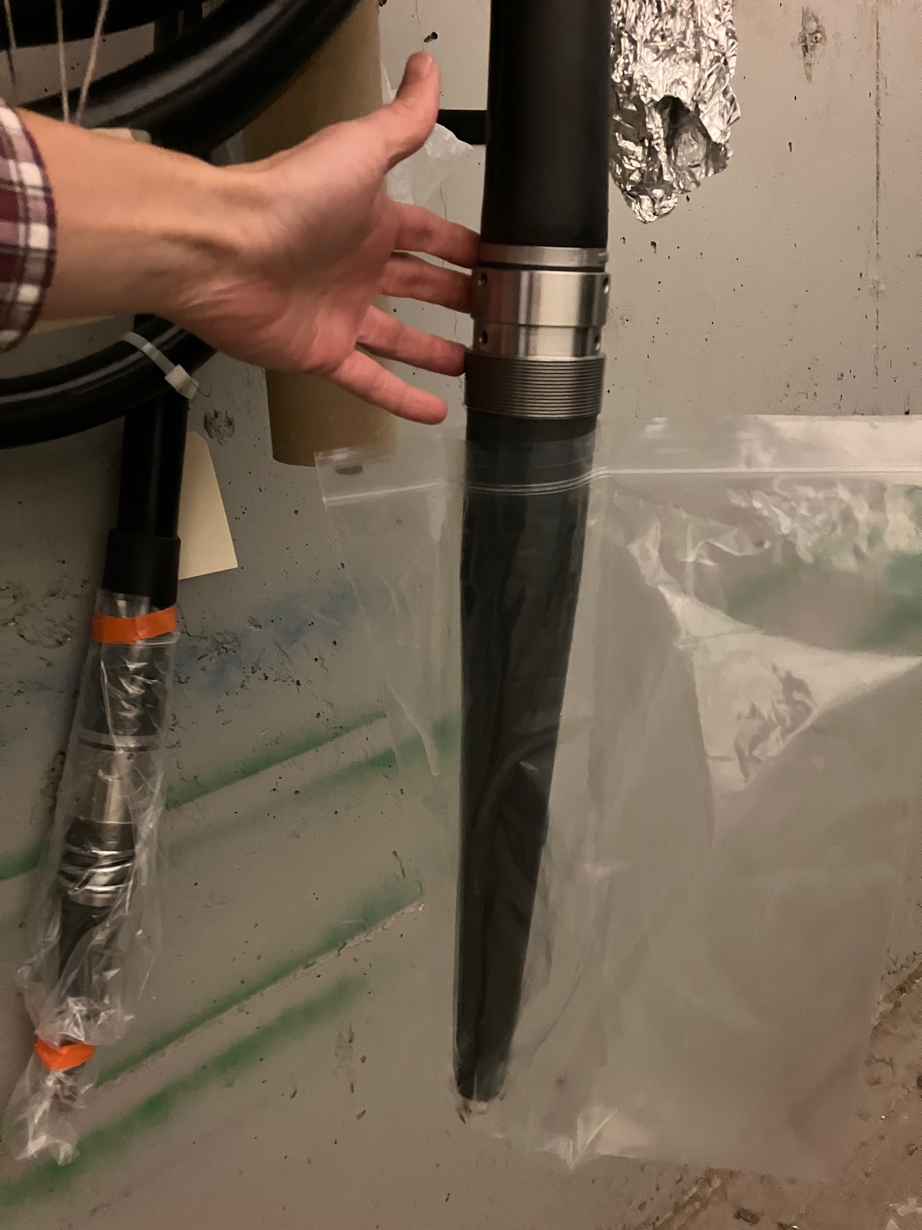
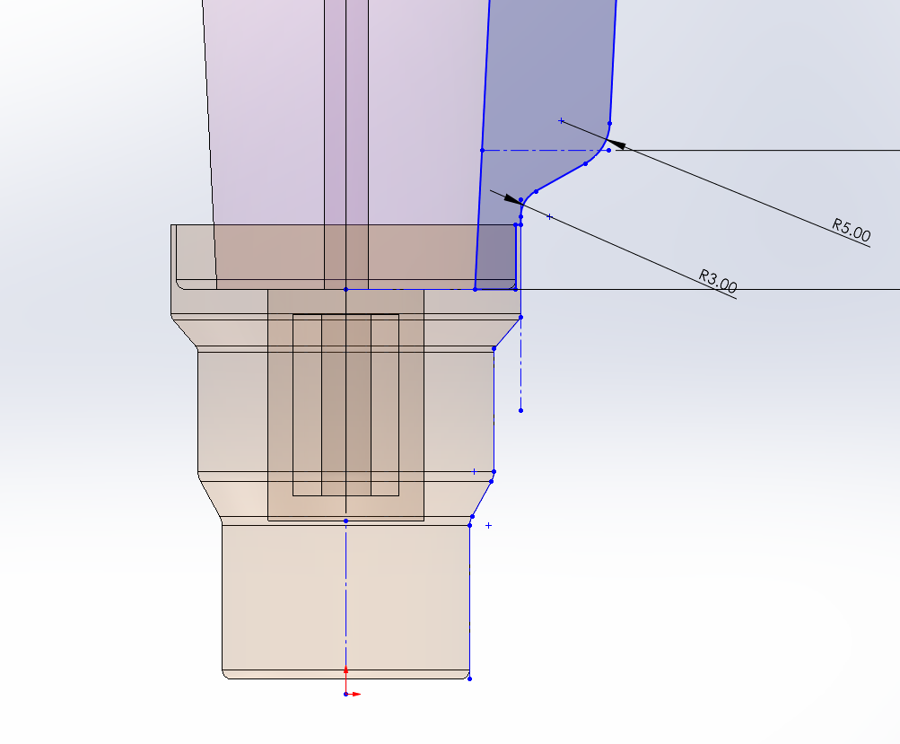
In 2023 we received a DOE HEP U.S.-Japan (FOA LAB 23-2858) grant to develop a 500 kV insulator fitting commercial HV cables
Electrostatic models in CST are being developed
The electrostatic potential simulations of the insulator will be used for designing a test electrode
Commercial HV cable rated to 400 kV
500 kV insulator prototype model

Slide 15
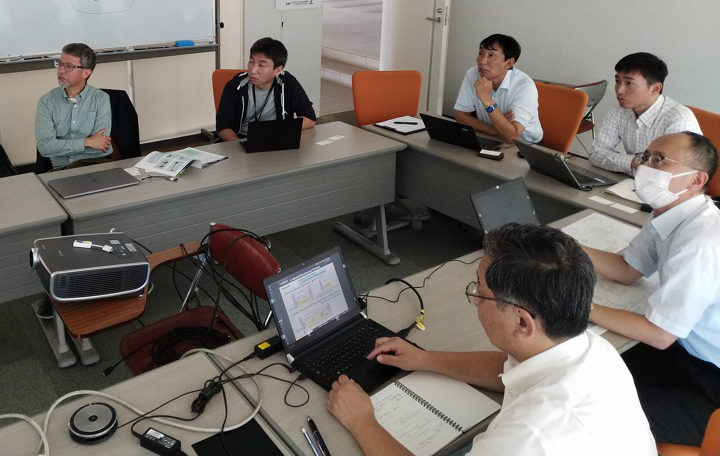
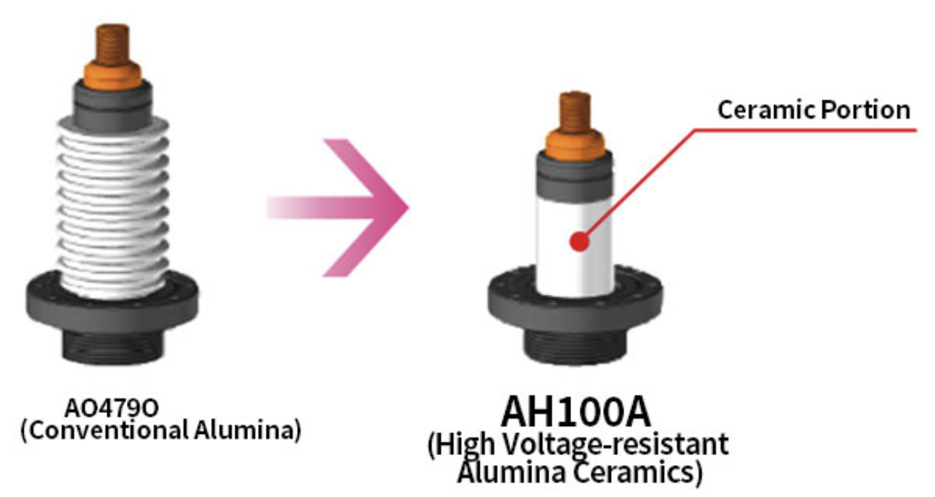
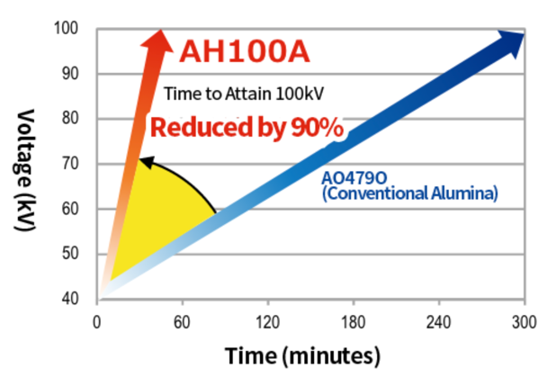
Progress on the HEP funded FOA: Initial meeting with industry
We met with Kyocera in September to discuss the design and evaluation of a new 500 kV insulator
Kyocera:
  Understands the opportunity to become a (likely sole) provider for inverted insulators for photoguns
  Willing to develop prototype insulator
  Will provide various material samples of new proprietary material to U. of Tsukuba for HV characterization
KEK, Tsukuba, Japan, Sept. 28th, 2023

Slide 16
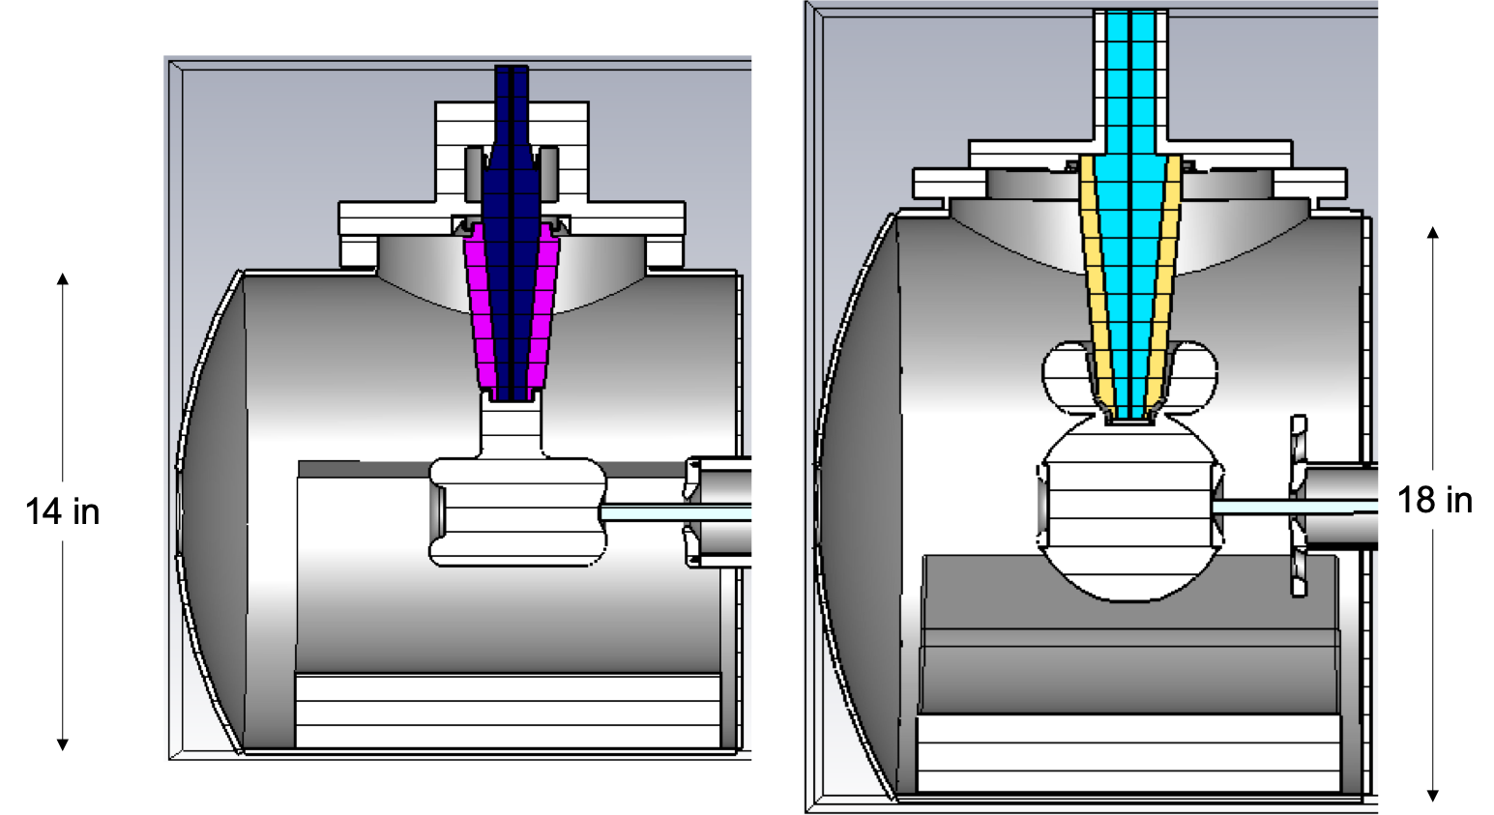
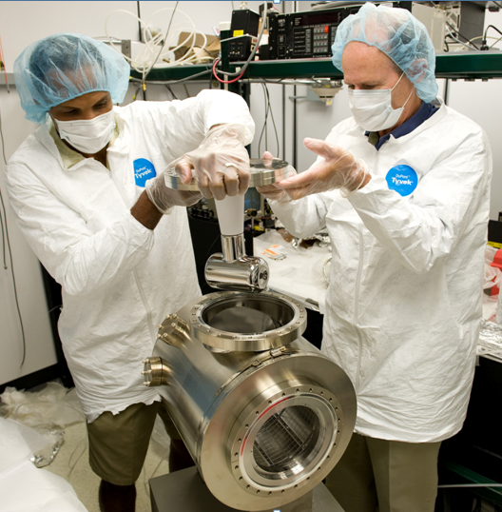
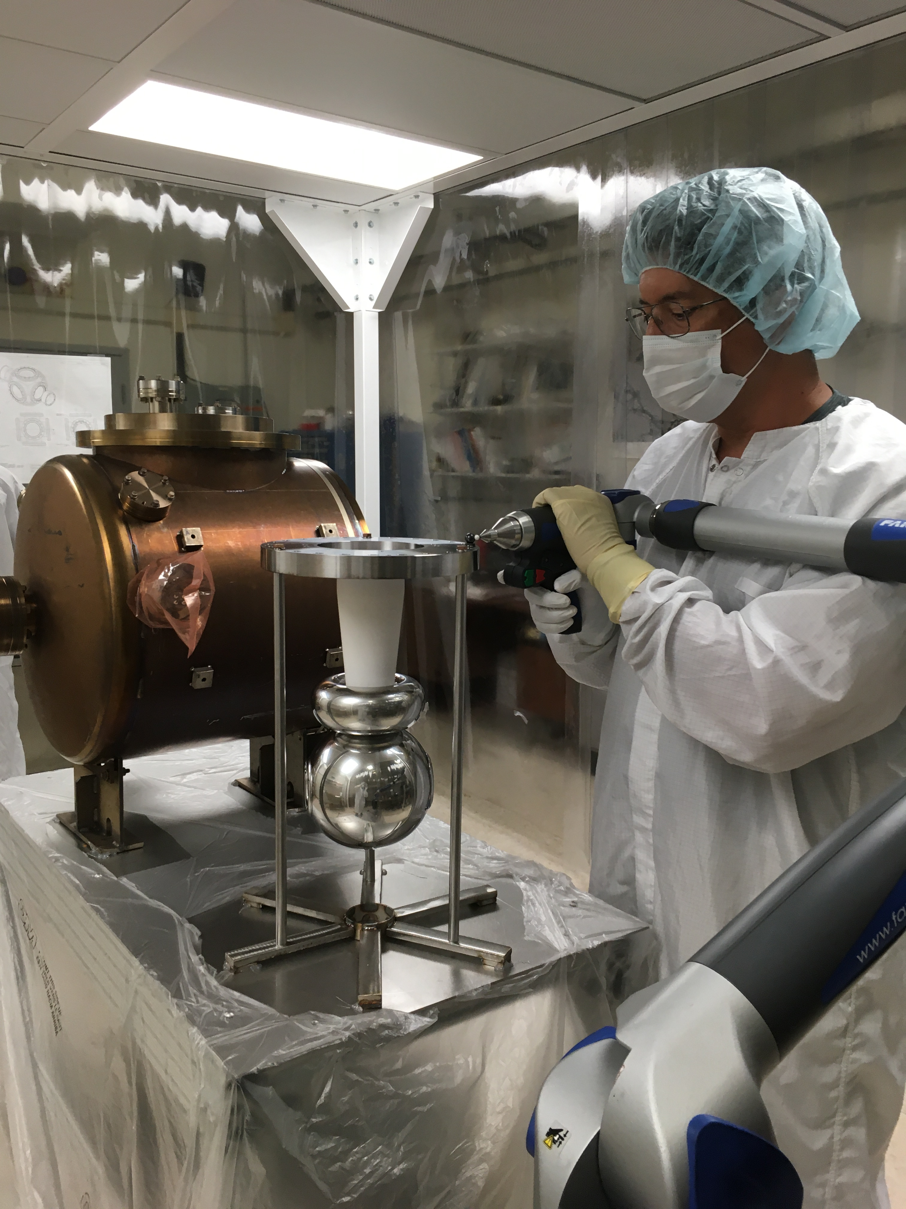
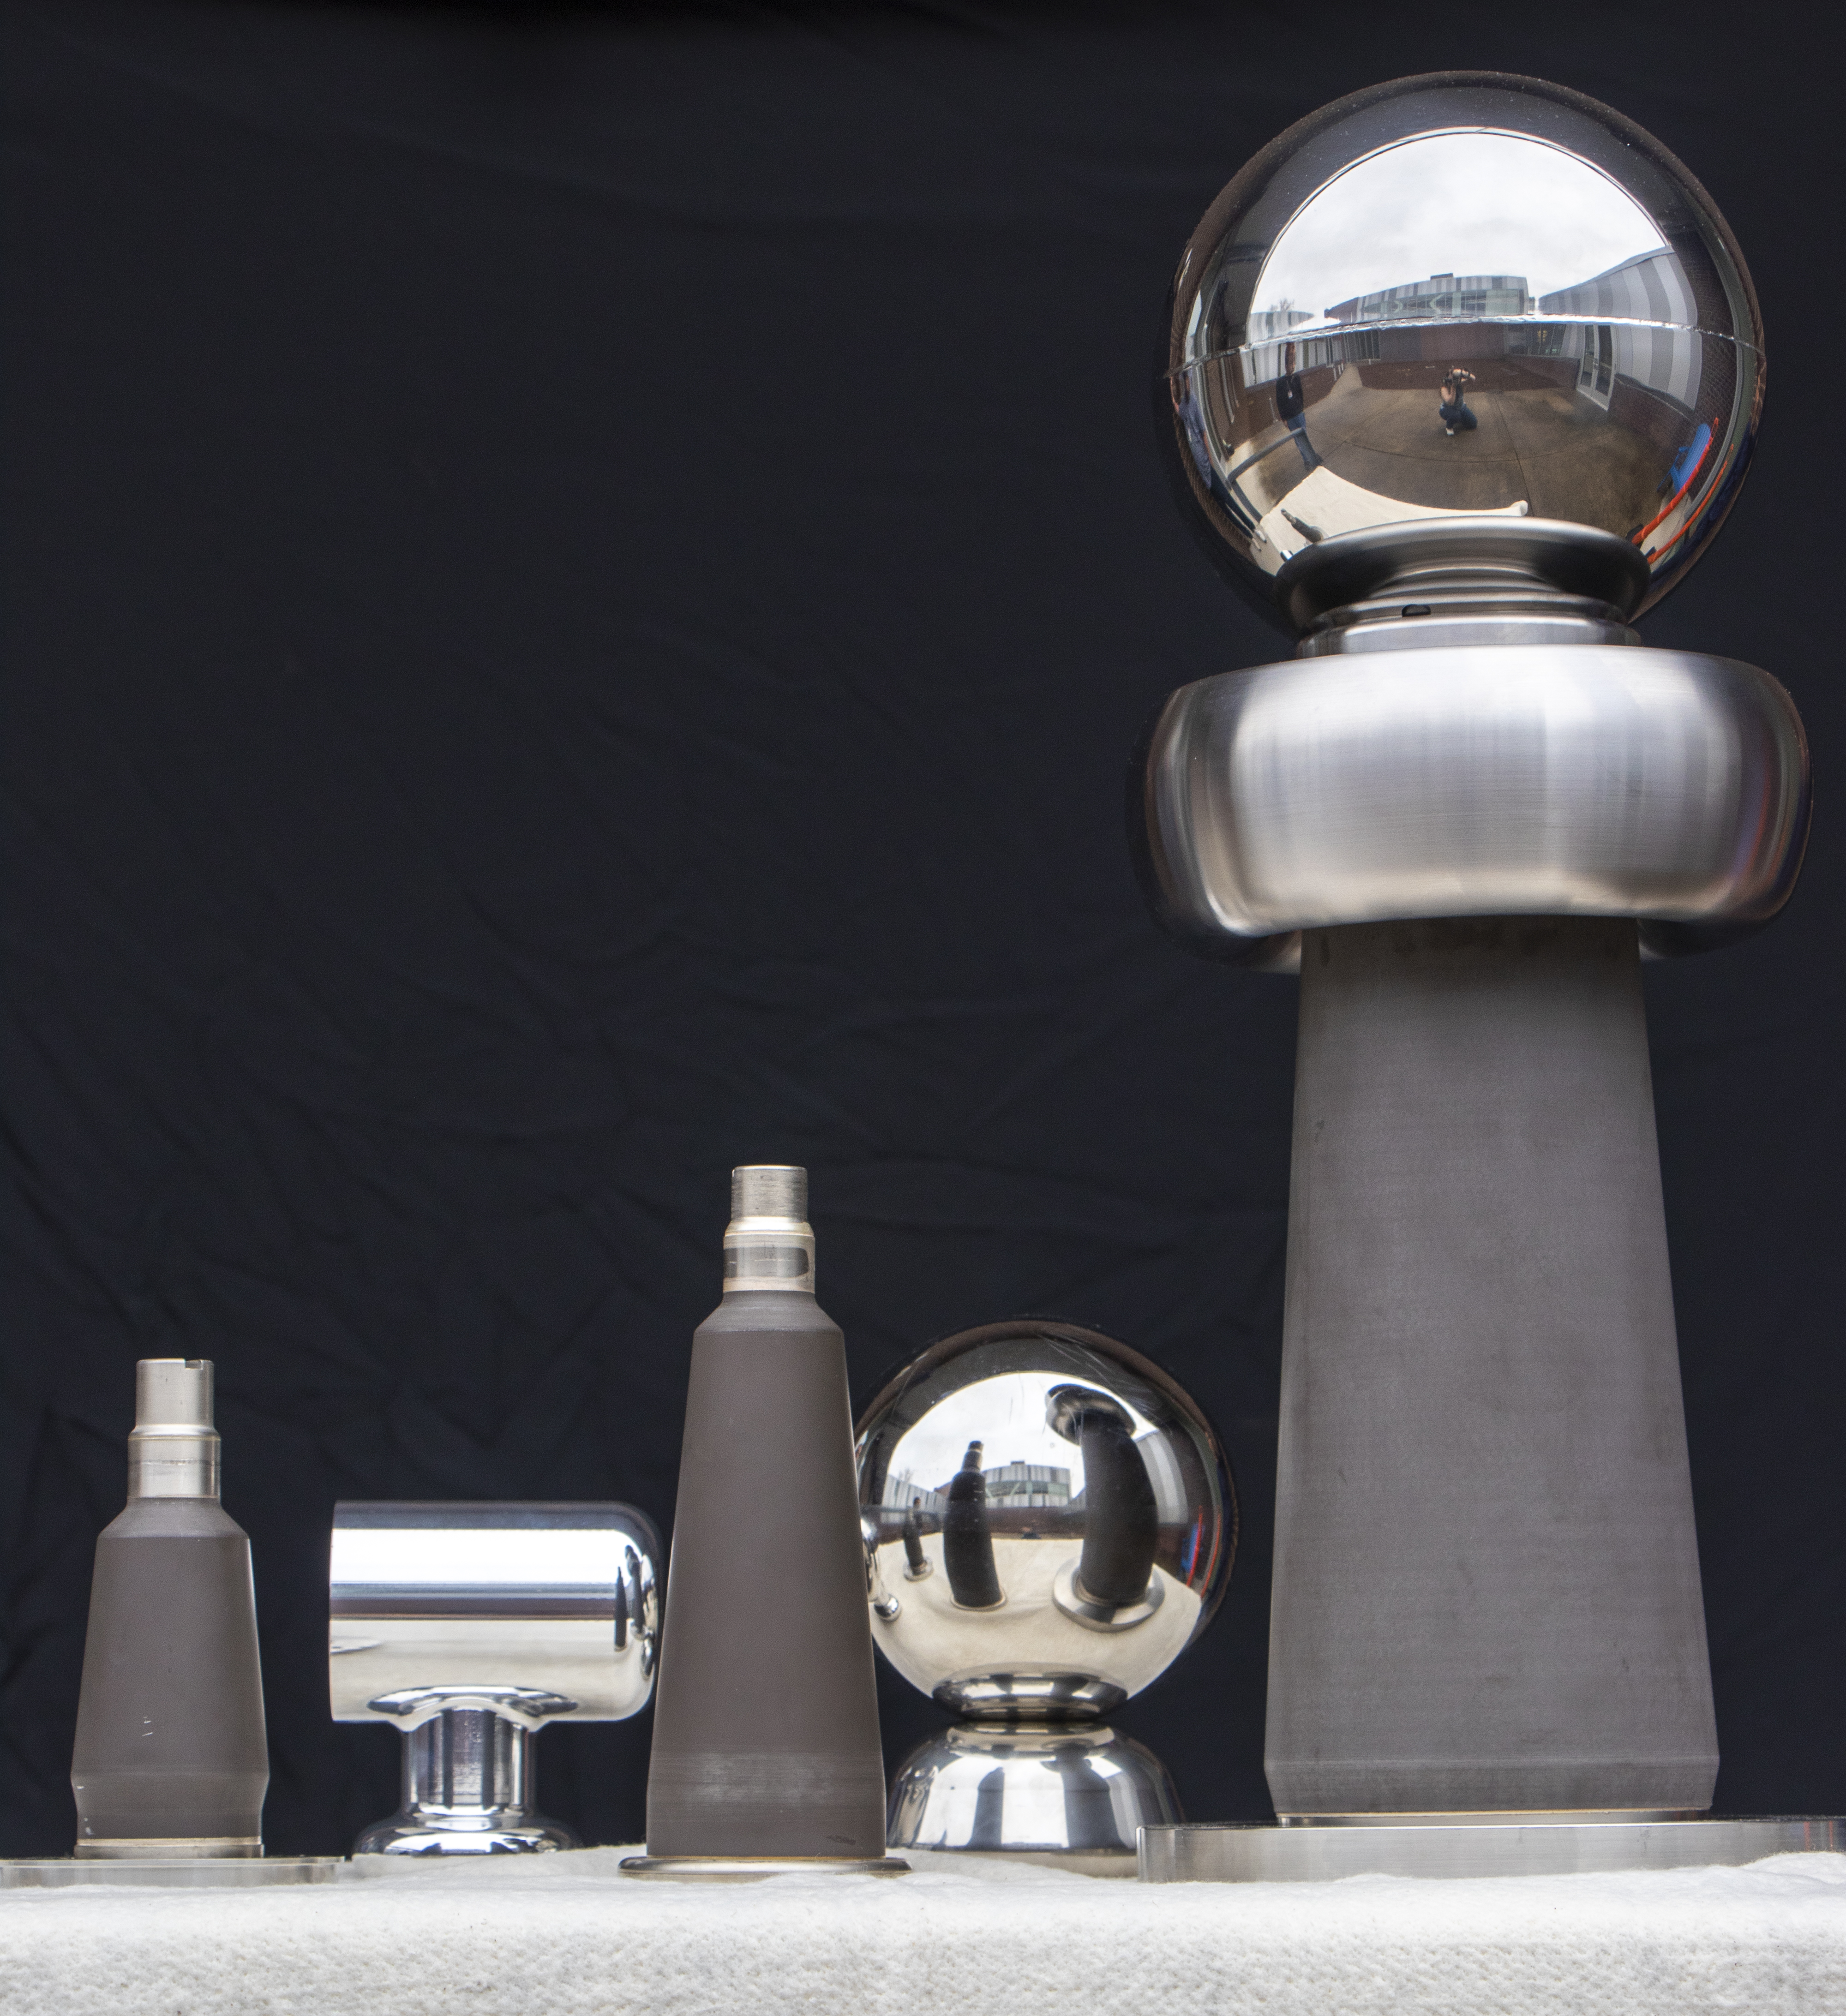
JLab has demonstrated capability to develop and operate high intensity, high polarization photoguns using inverted geometry insulators
We are ready to develop a prototype high current AND high polarization photogun for
Ce⁺BAF
Maximum applied voltage without breakdown
Achieved!
500 kV
concept
375 kV
R30
250 kV
R28
CEBAF 130 keV 0.2 mA CW > 80% polarized beam
Gun Test Stand (GTS)
keV, 5 mA CW magnetized beam
CEBAF
GTS
SF₆ intervening volume
test
16
16

