Slide 1
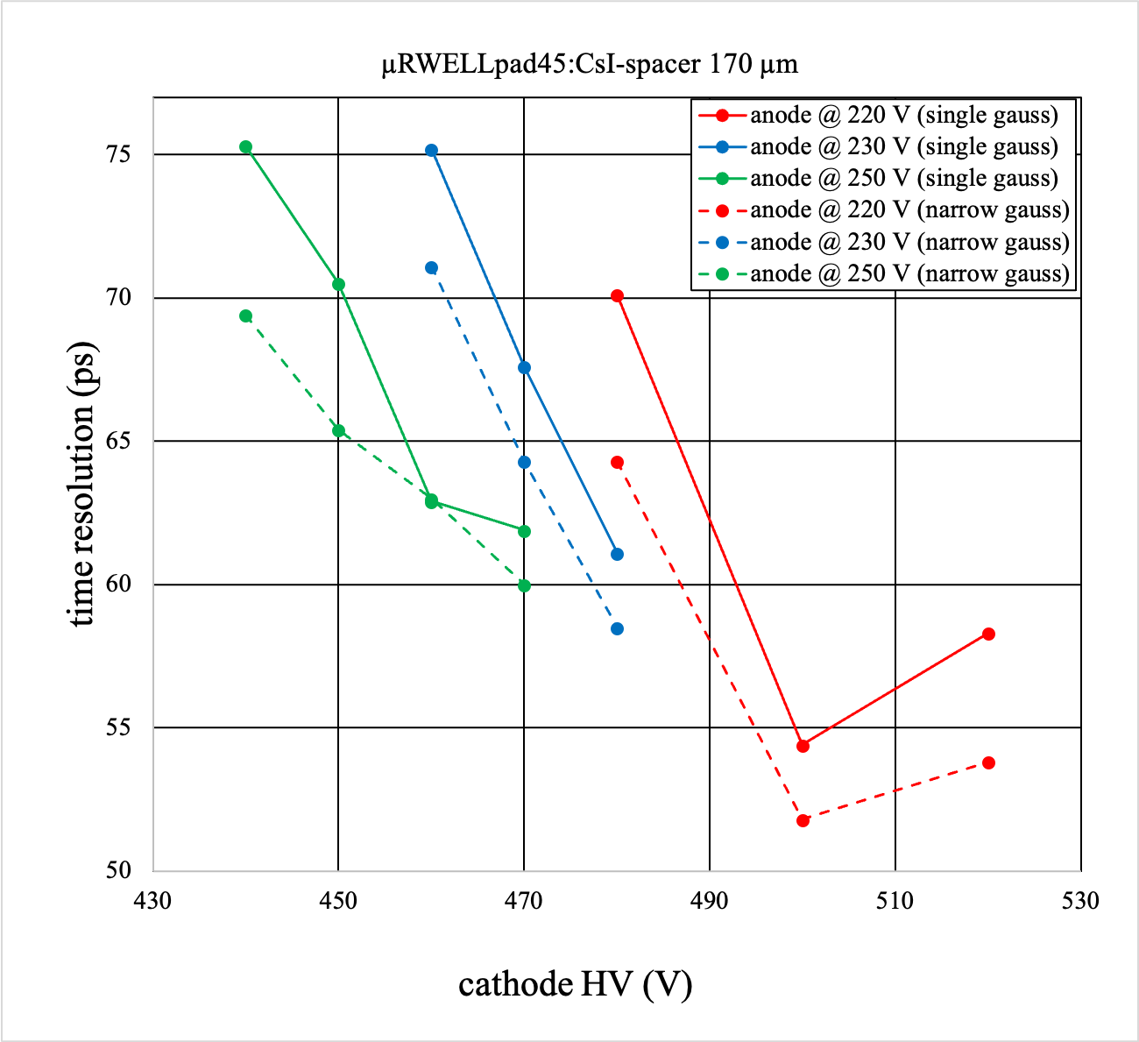
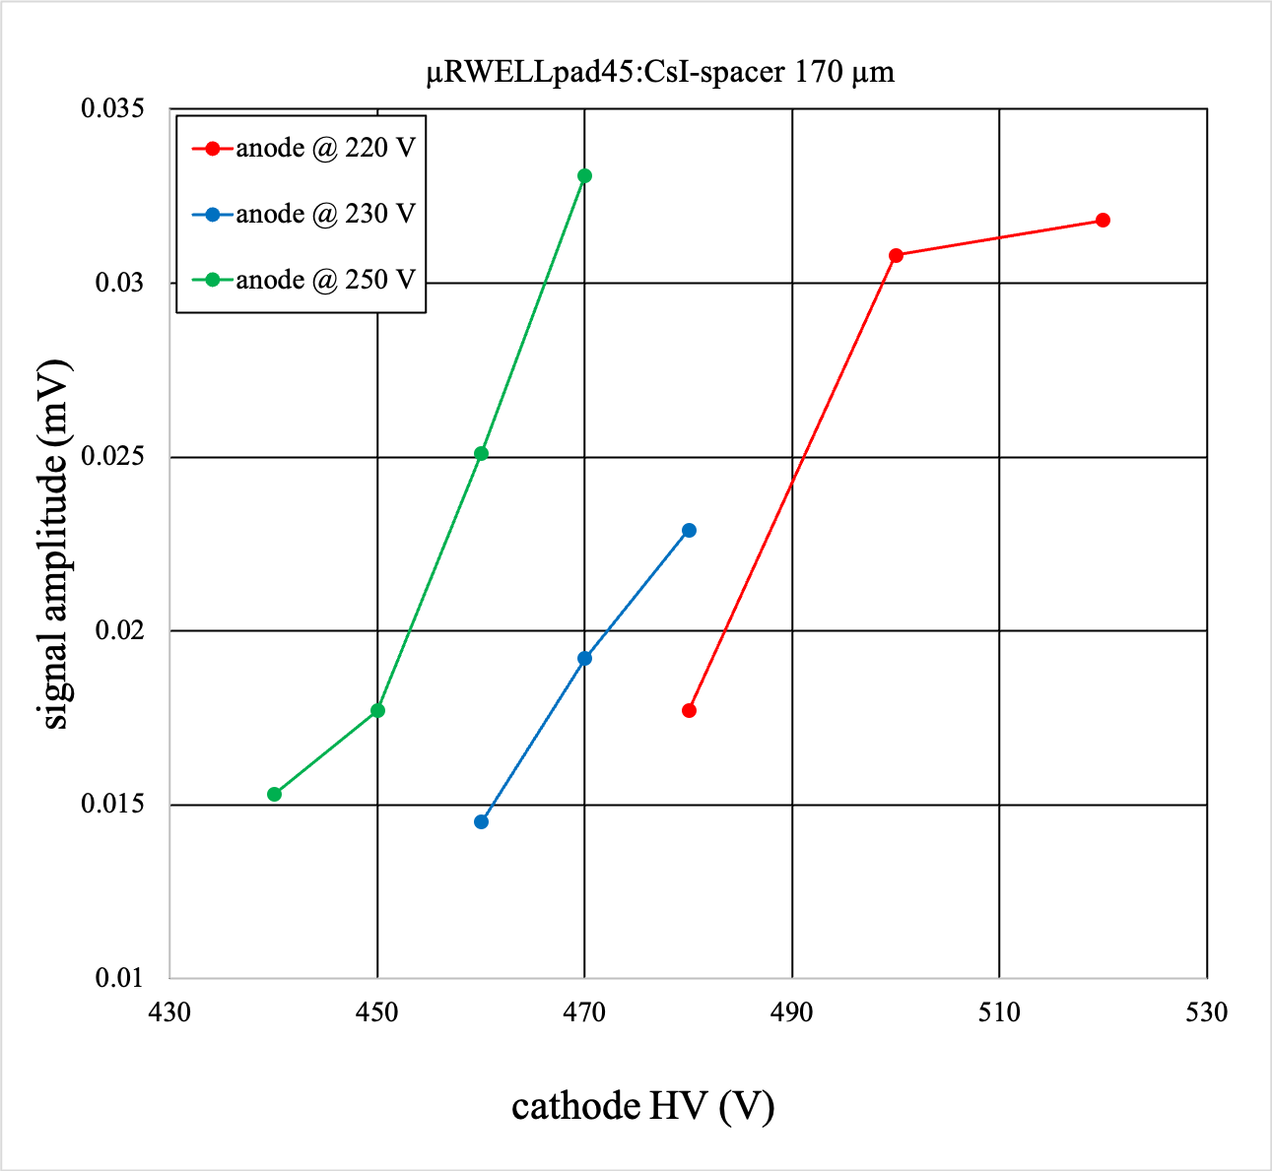
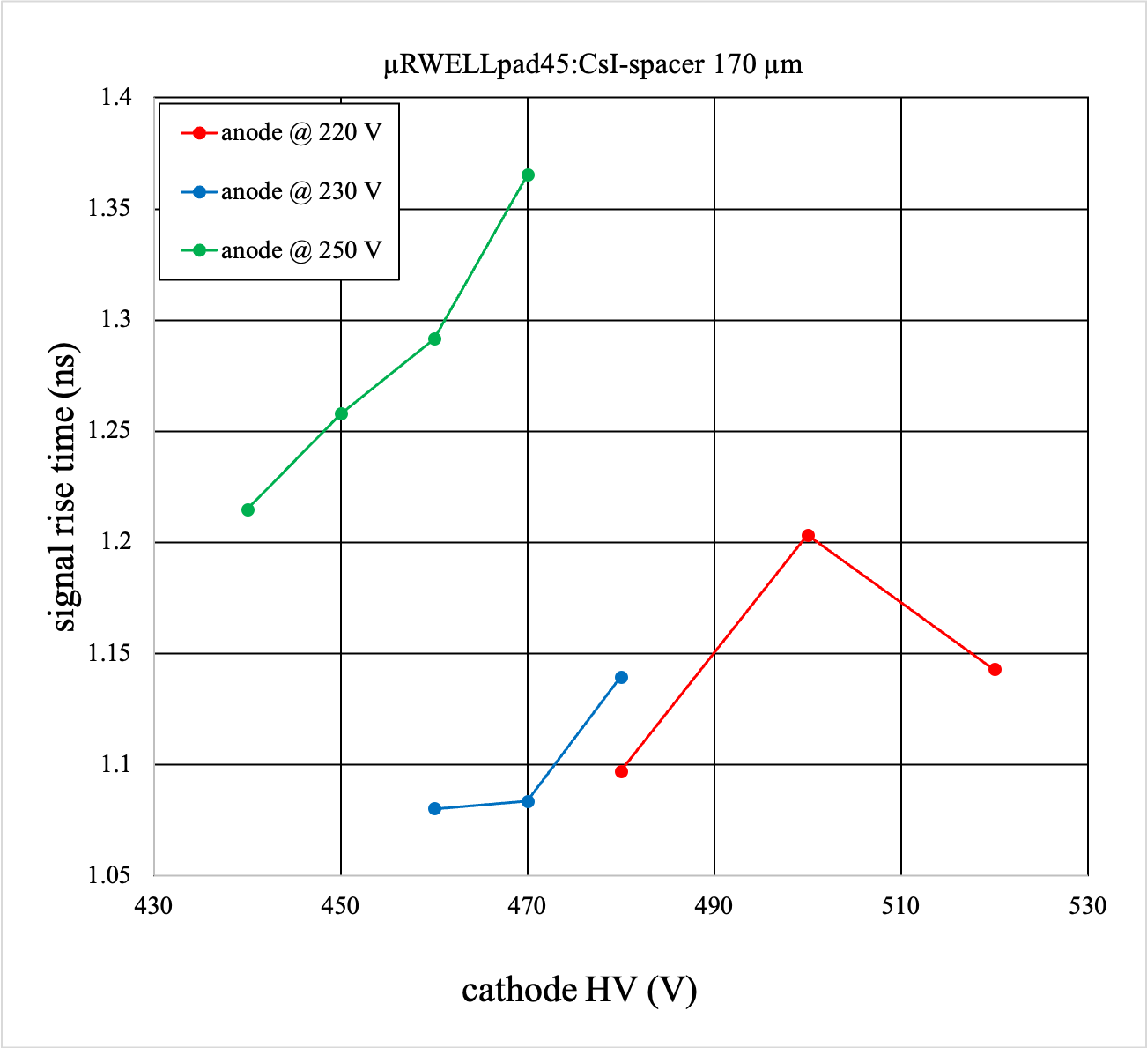
Results for individual pads of large pad uRWELL detector
Analysis of SAMPIC data for large pad is ongoing
Status- Adapting the SAMPIC analysis macro, Reconstructing the tracking data
Preparing for IEEE 2024 presentation

