Slide 1
Test Beam 2024 Results

Slide 2
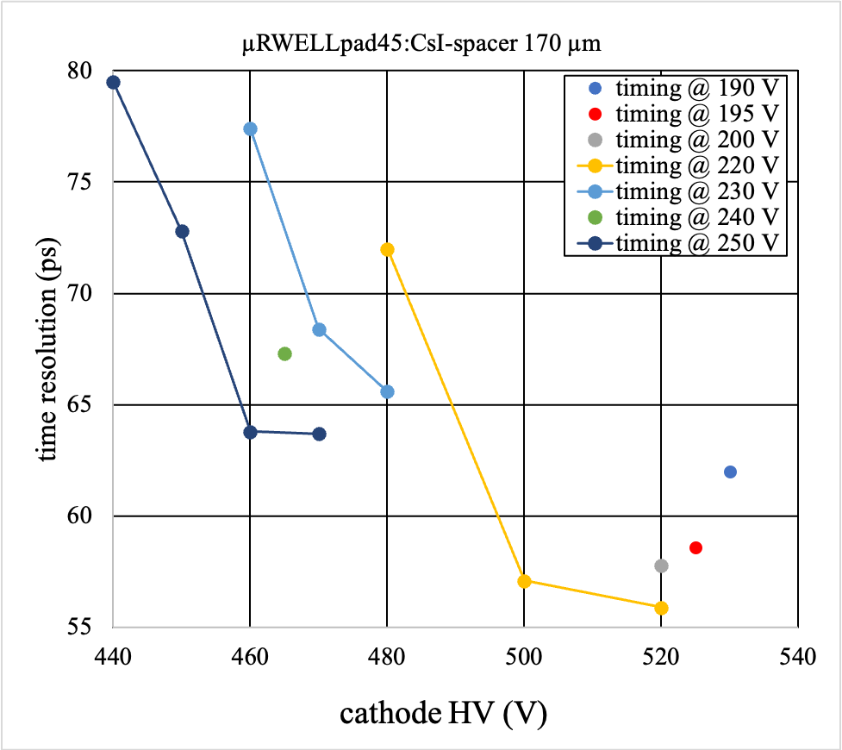
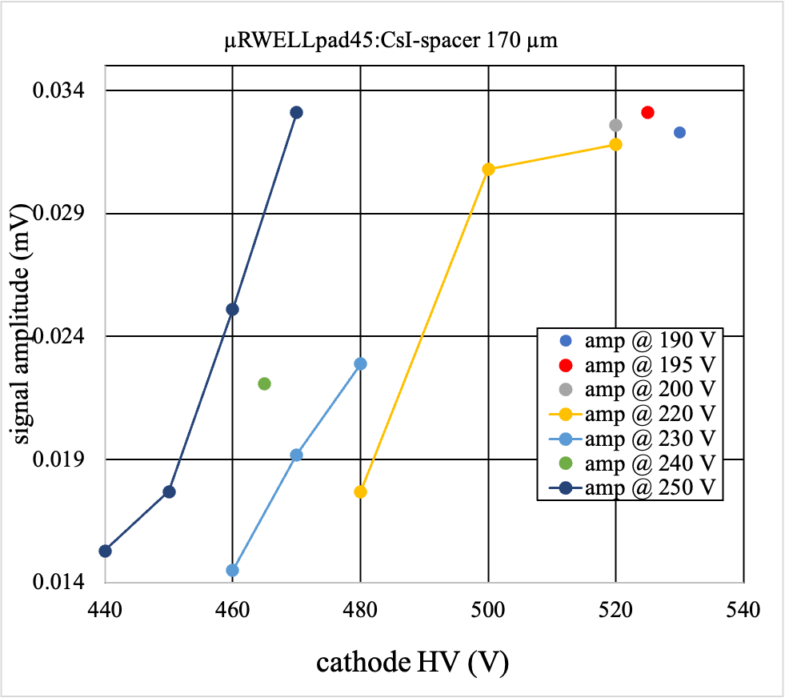
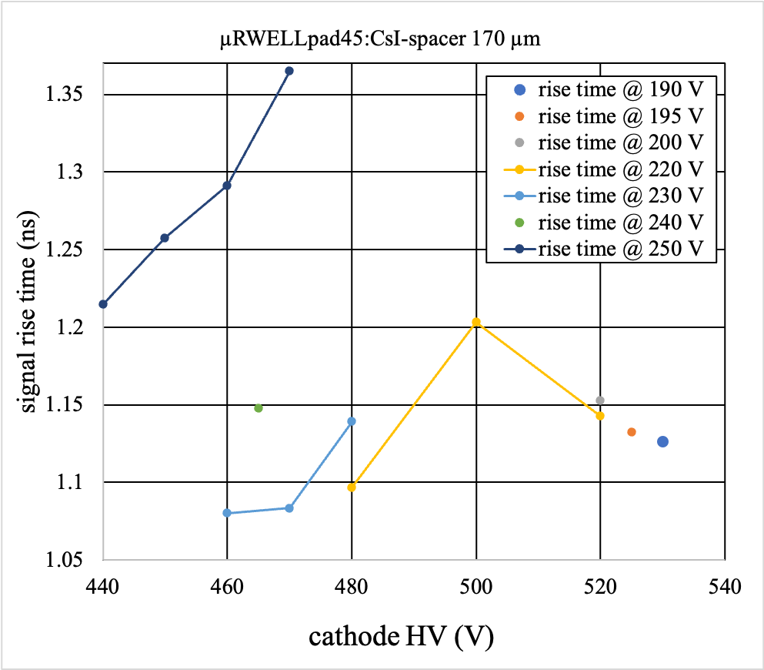
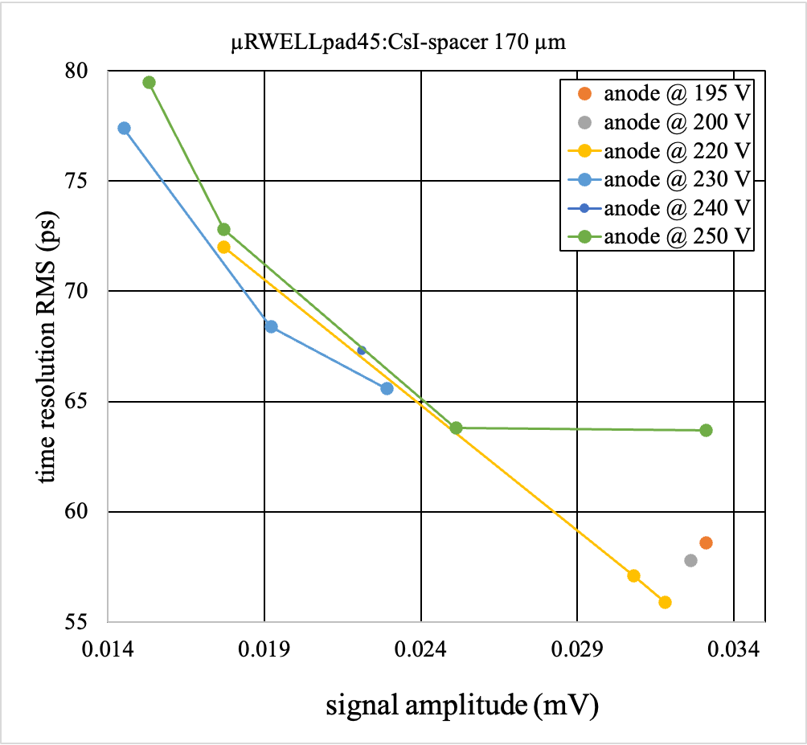
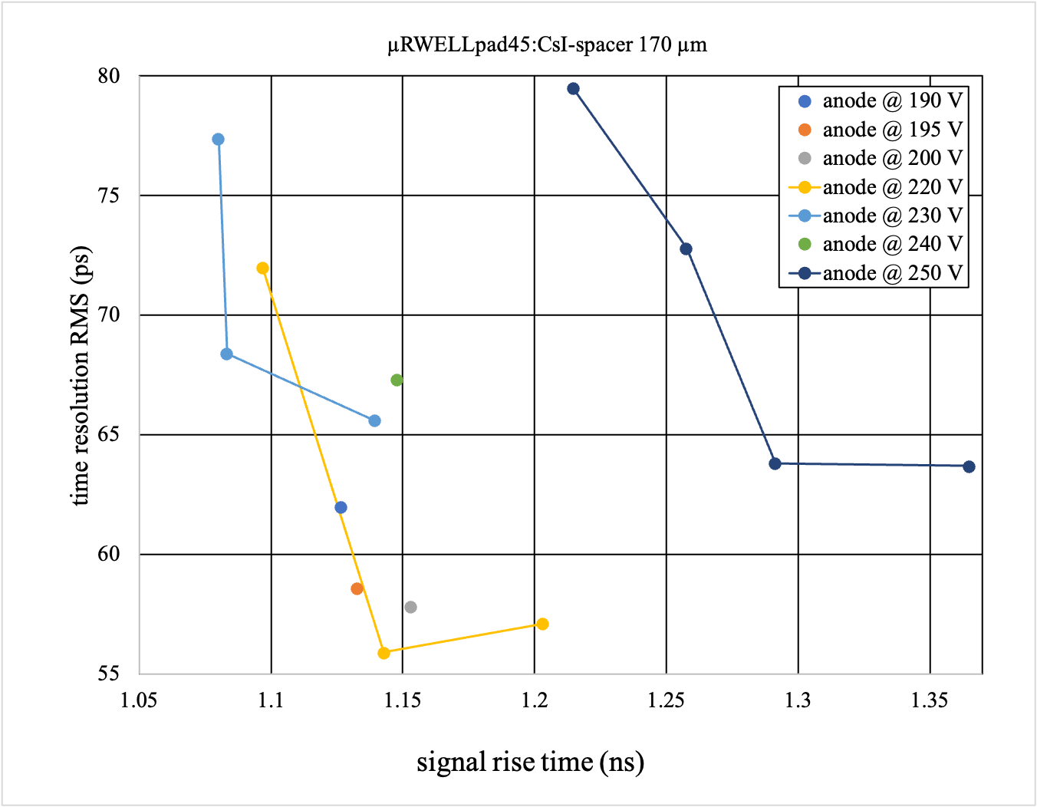
Testing of Large-area (10 cm × 10 cm) μRWELL-PICOSEC prototype with 100-pads readout
(June test beam 2024)

Slide 3
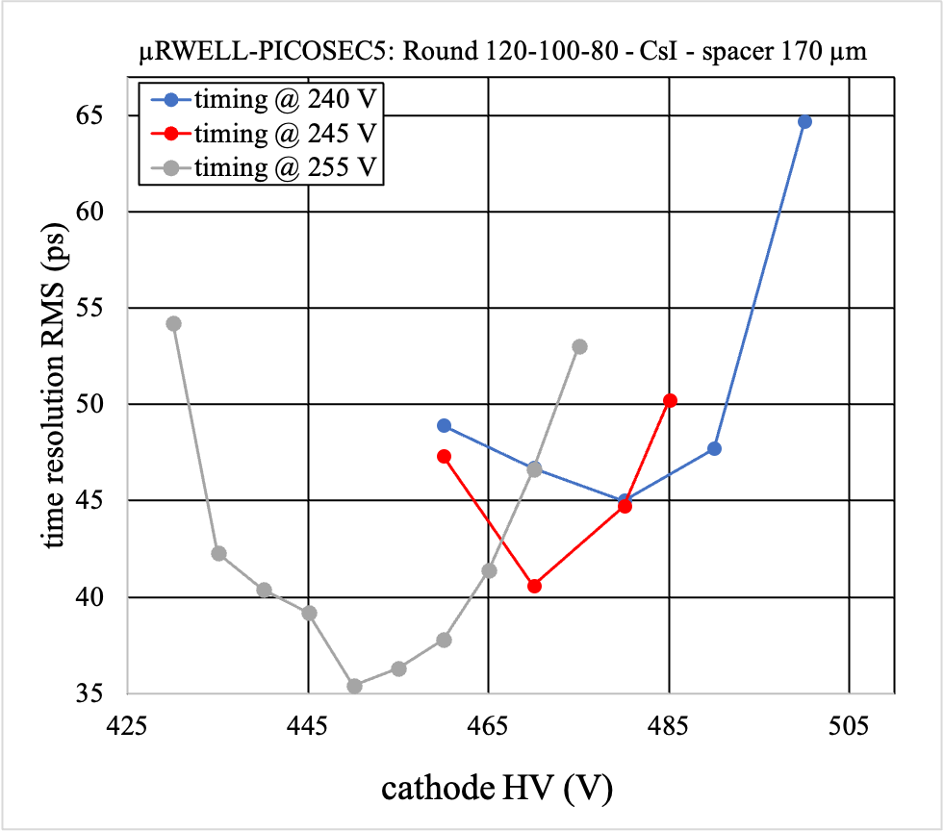
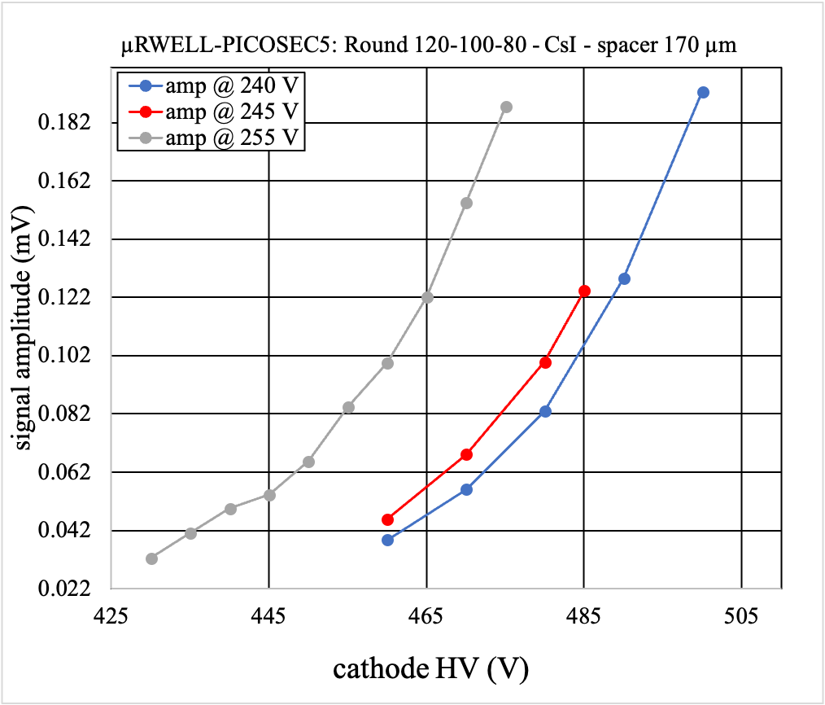
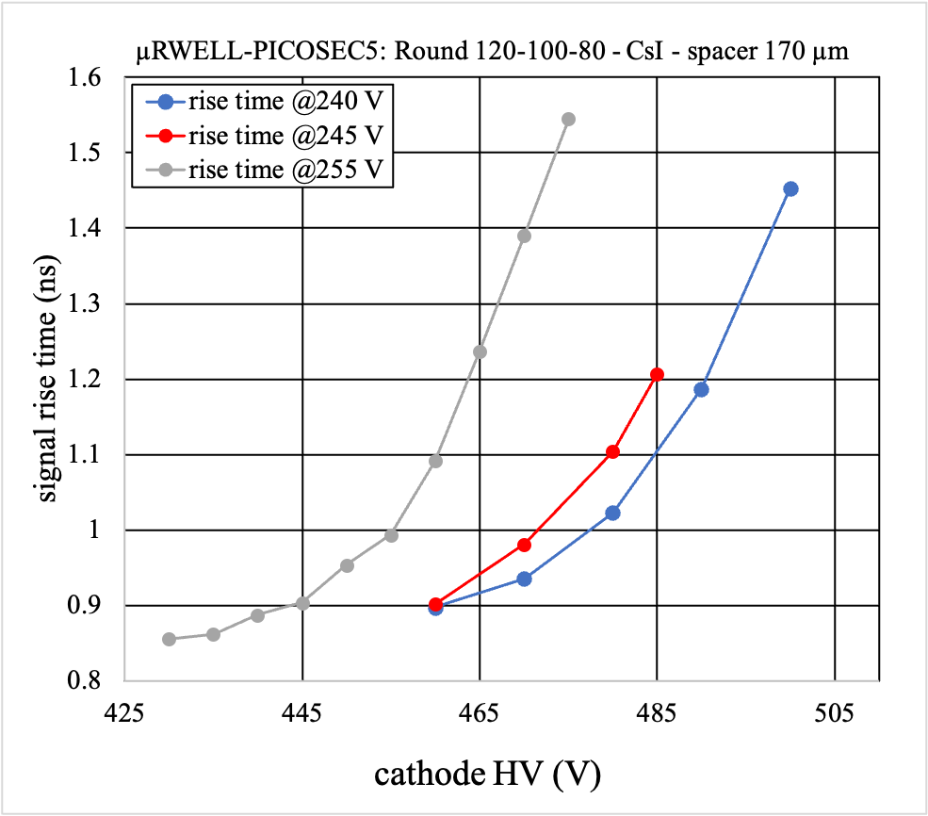
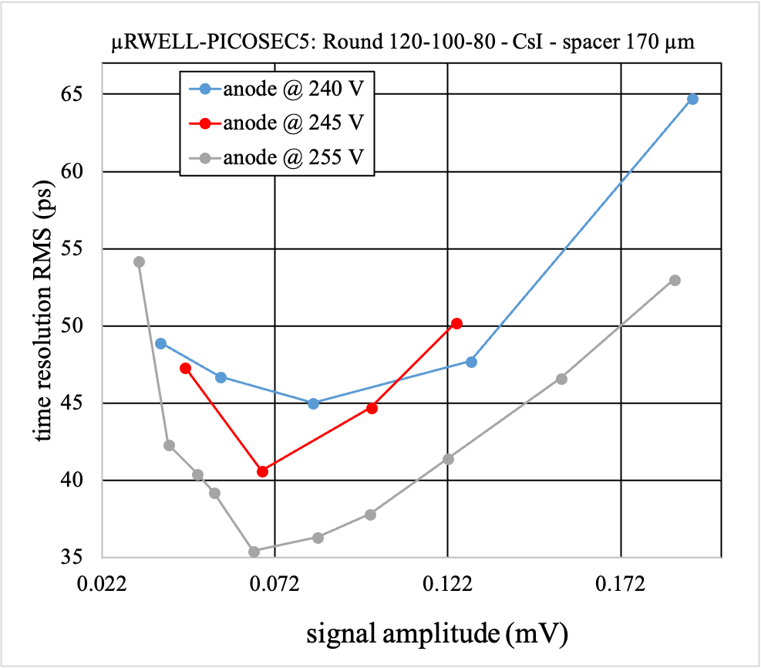
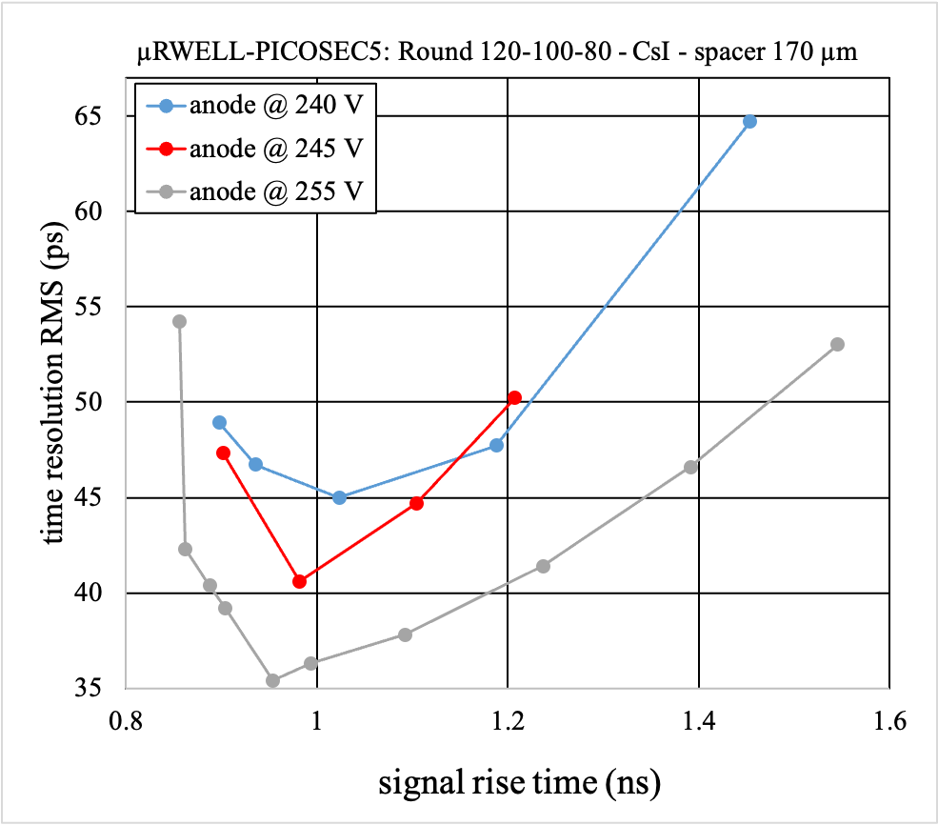
Time resolution
Signal amplitude
Signal rise time
Time resolution vs signal amplitude
Time resolution vs signal rise time
Figure2: μRWELL5 (CsI), Round P:120 H(o):100 H(i):80, Spacer: 170 um, Readout: Plain

Slide 4
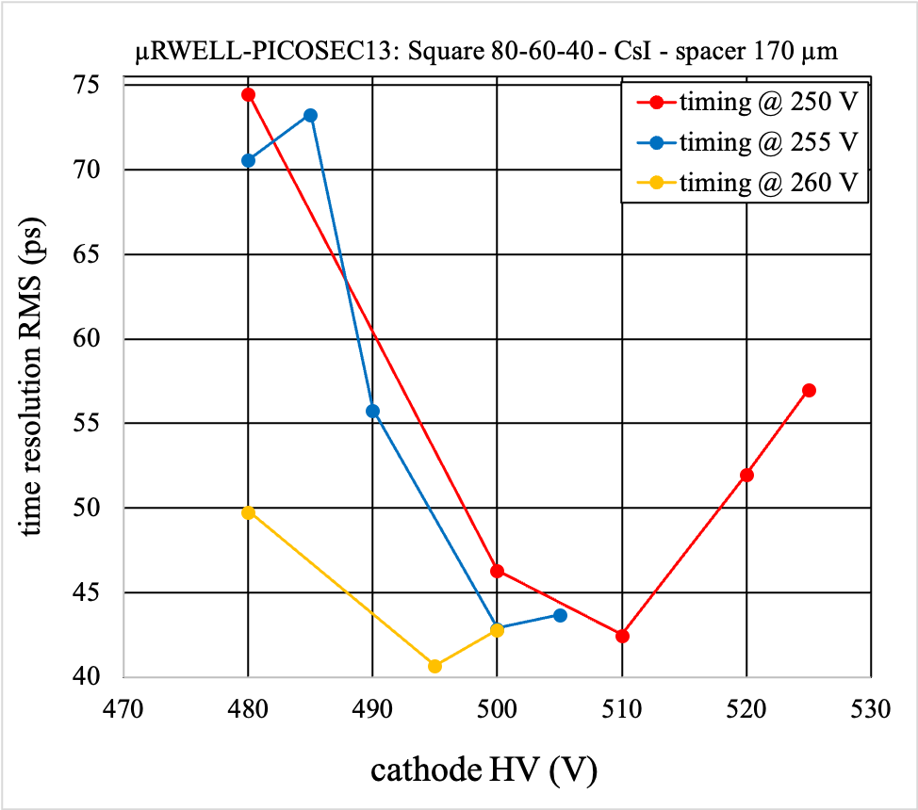
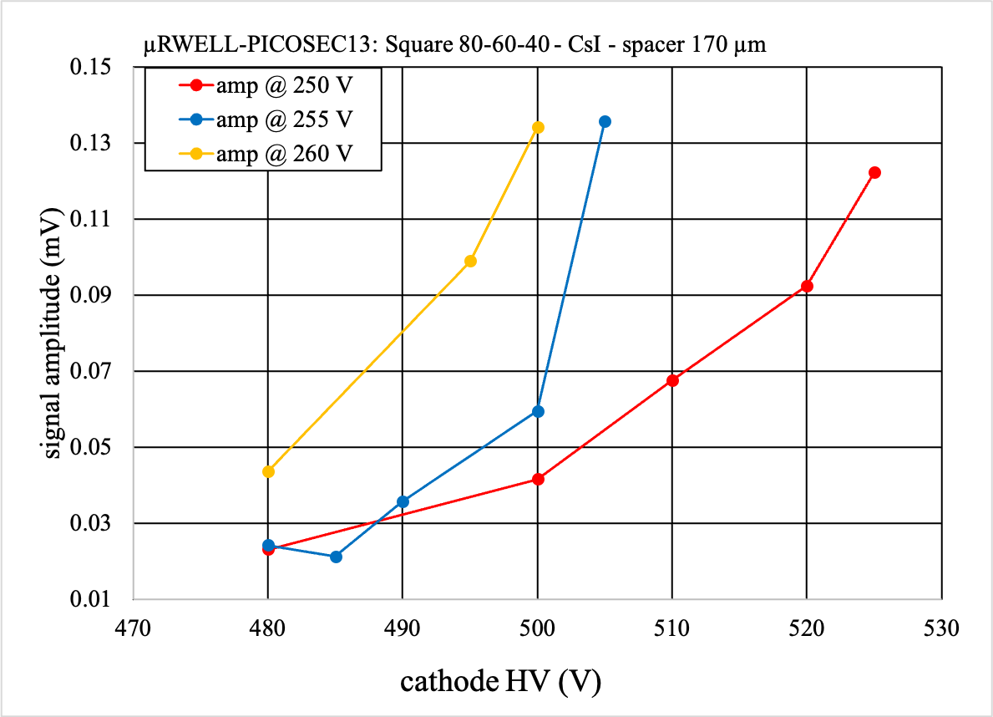
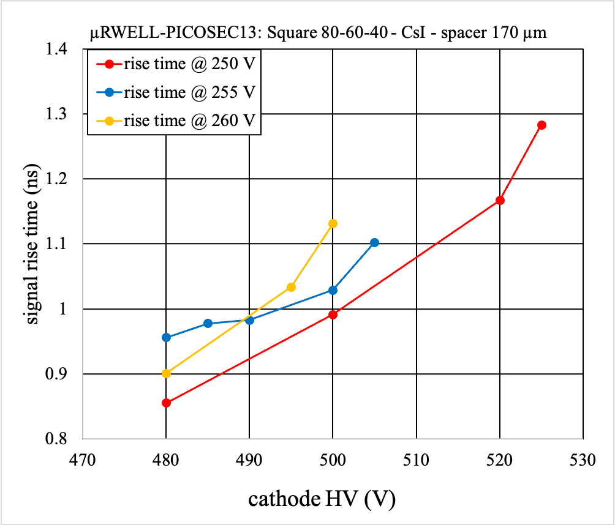
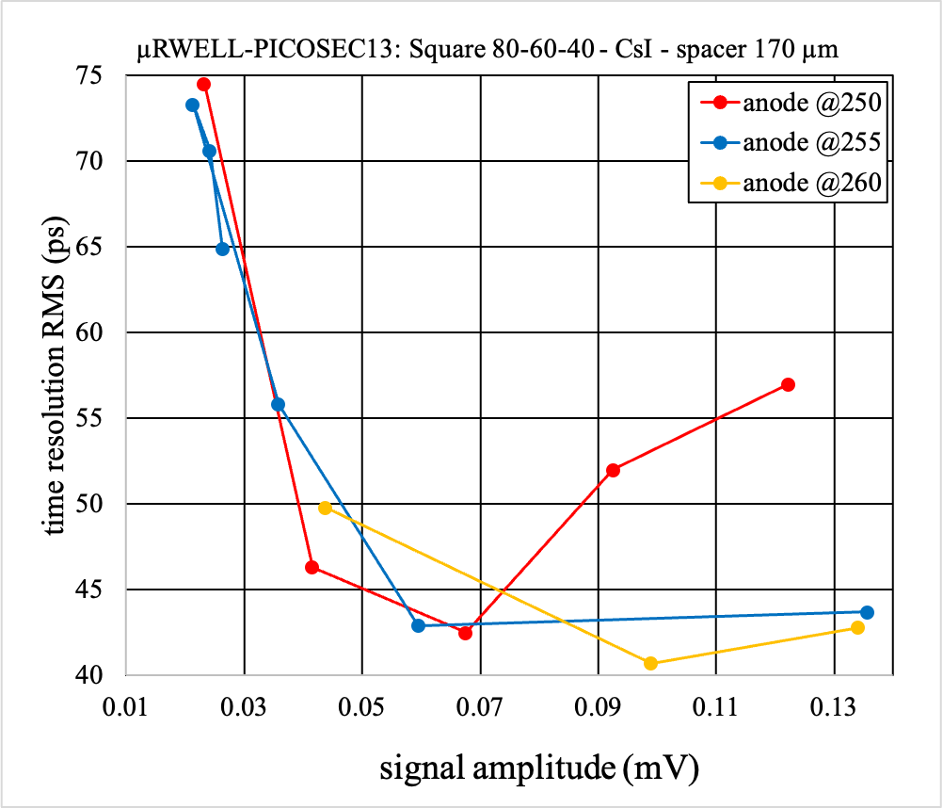
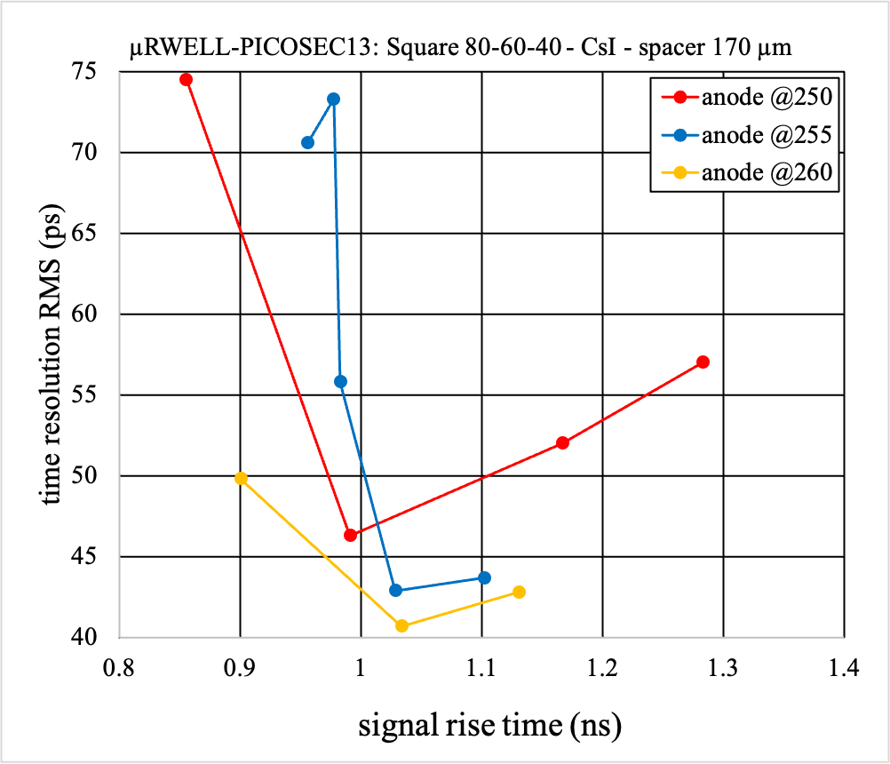
Time resolution
Signal amplitude
Signal rise time
Time resolution vs signal amplitude
Time resolution vs signal rise time
Figure3: μRWELL13 (CsI), Square P:80 H(o):60 H(i):40, Spacer 170 um, Readout: Plain

Slide 5
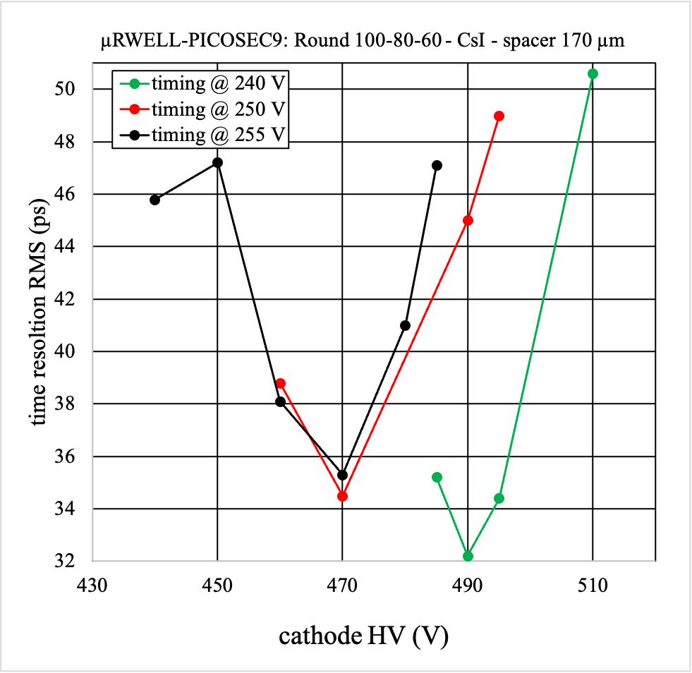
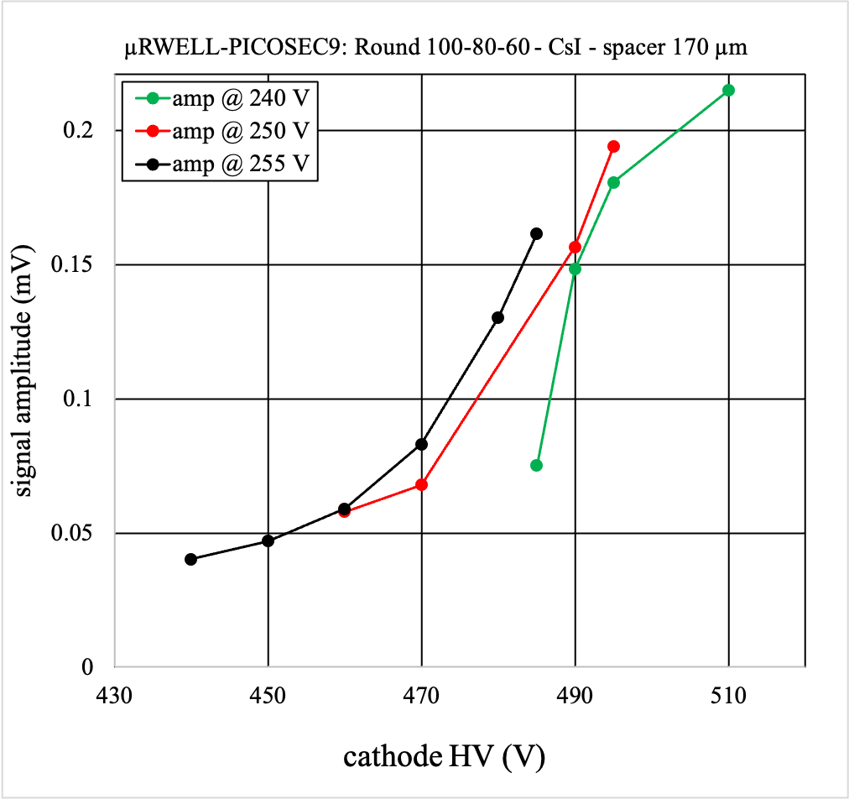
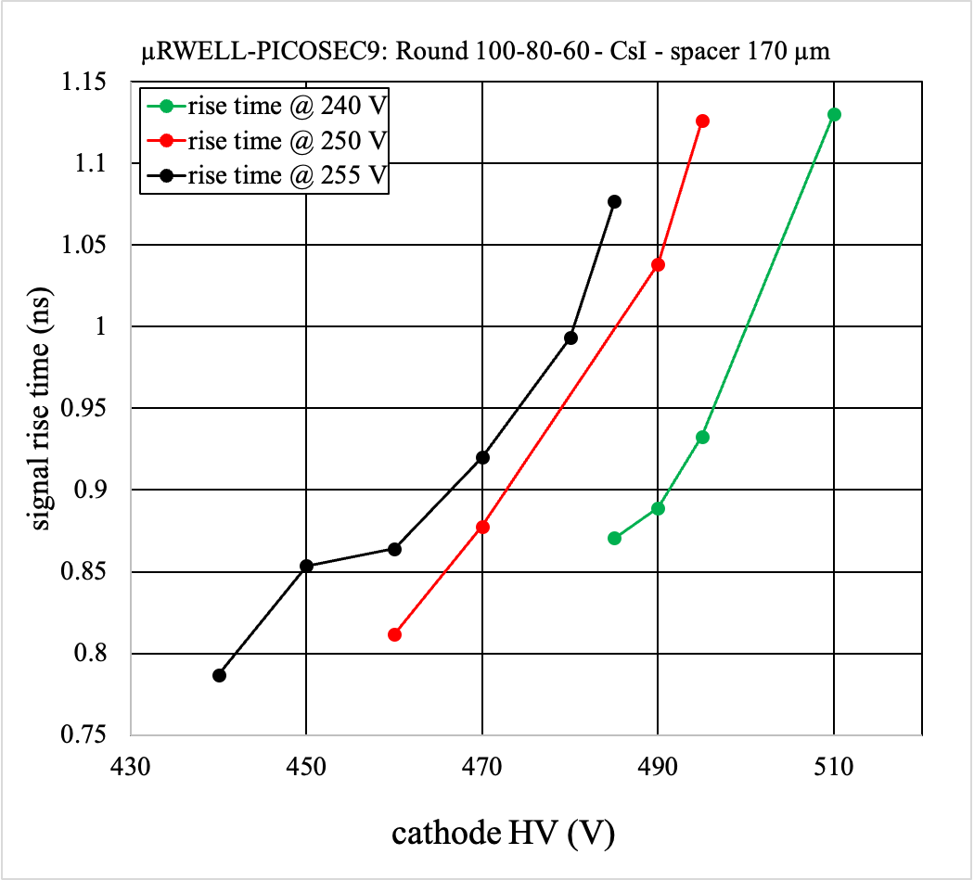
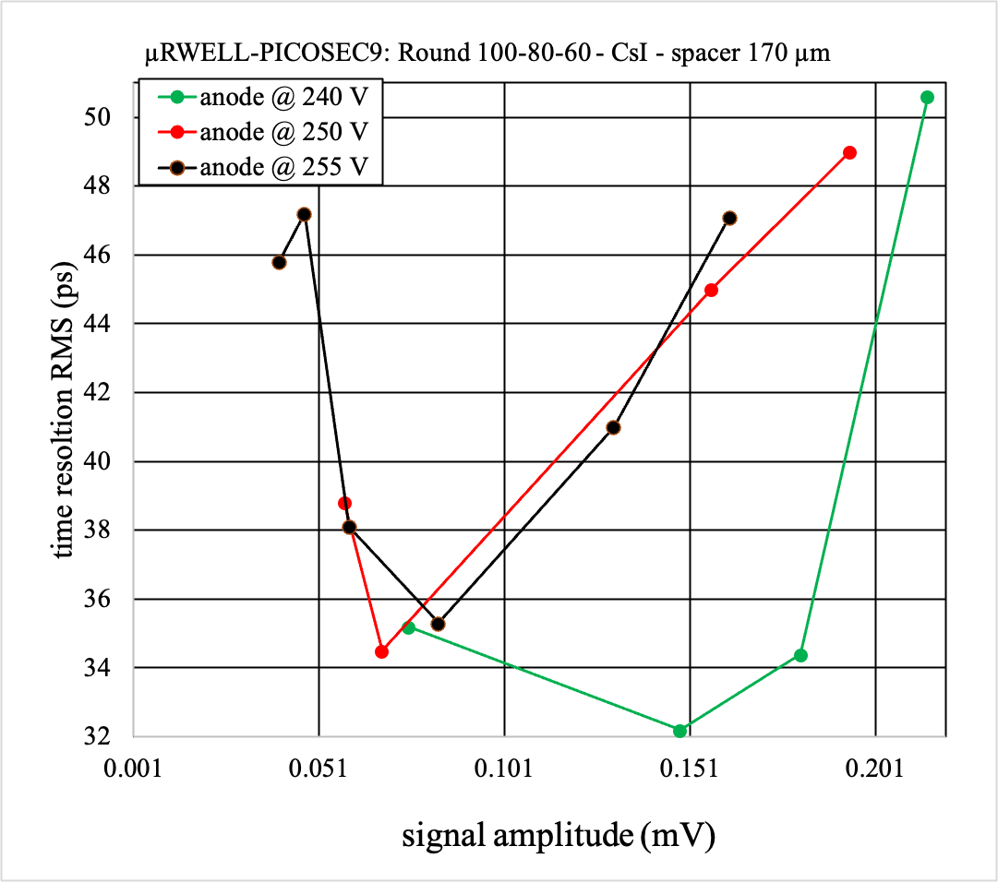
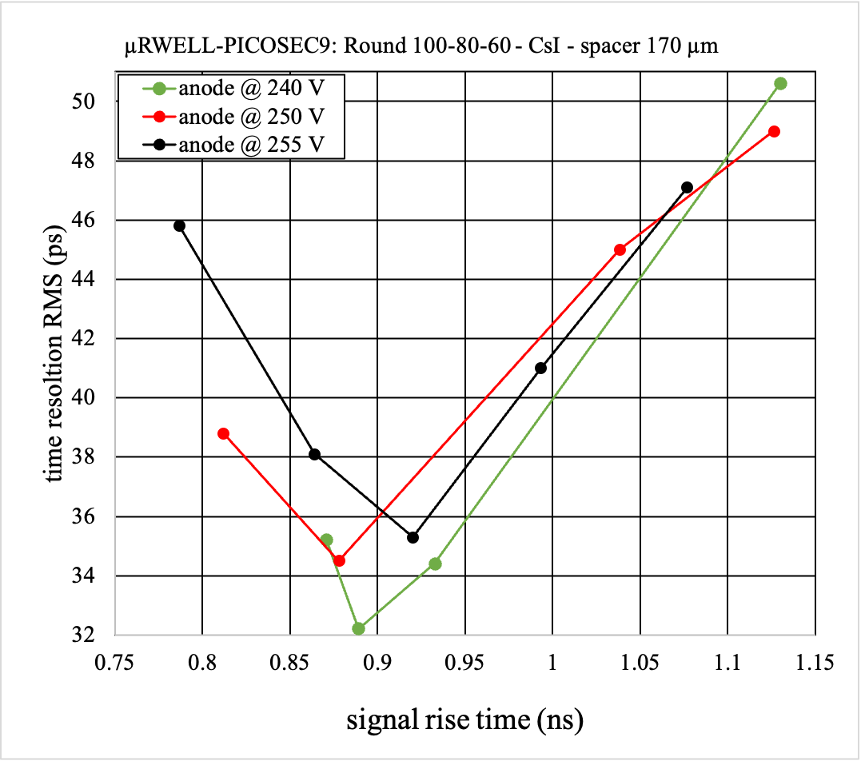
Time resolution
Signal amplitude
Signal rise time
Time resolution vs signal amplitude
Time resolution vs signal rise time
Figure1: μRWELL9 (CsI), Round P:100 H(o):80 H(i):60, Spacer 170 um, Readout: Plain

