Slide 1
LD2413 Development of µRWELL-PICOSEC Detectors FY24 Q2 meeting
Kondo Gnanvo
JLab Radiation Detectors & Imaging Group (RD & I Group)
Wenze Xi, Jack McKisson, Brian Kross, Akash Pandey
Seung Joon Lee (pro bono)
JLab - RD & I Group

Slide 2
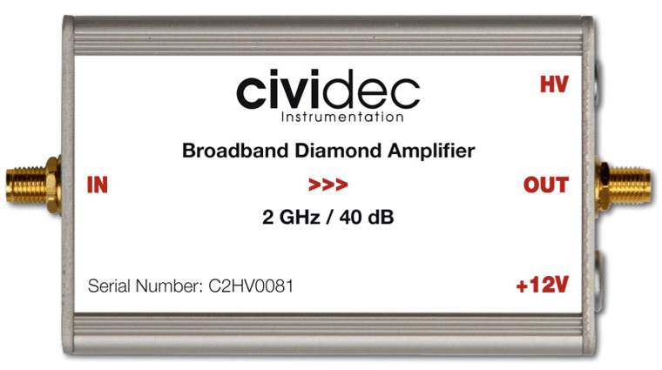
FY2413 µRWELL-PICOSEC – Q2 Progress & status
Single-channel µRWELL-PICOSEC protos
Telescope stand completed and on its way to CERN 
All parts of µRWELL-PICOSEC protos in hand 
Housing for 4 × single-channel protos 
MCP-PMT & 3 × GEM trackers for timing & tracking 
4 × CIVIDEC fast amplifier  + Oscilloscope DAQ (CERN)
Housing for single channel proto
MCP-PMT stand
GEM
Motorized linear stage & manual vertical jack
Ready for two-weeks test beam starting next week (04 / 10 / 2024) @ CERN
µRWELL-PICOSEC telescope
Alu housing
Cerenkov crystal
Cathode-spacer
µRWELL-PCB
Outer board PCB
Different elements of the single-channel µRWELL-PICOSEC prototypes
CIVIDEC pre-amplifier

Slide 3
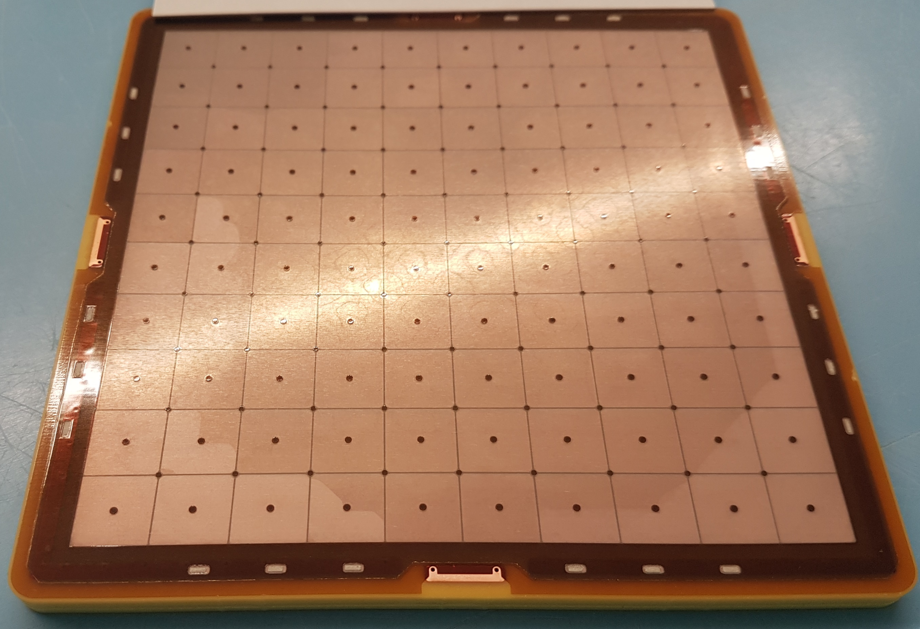
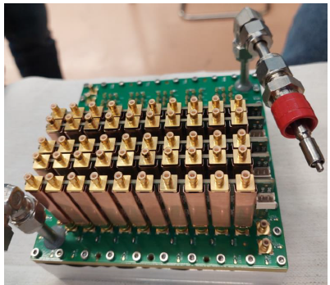
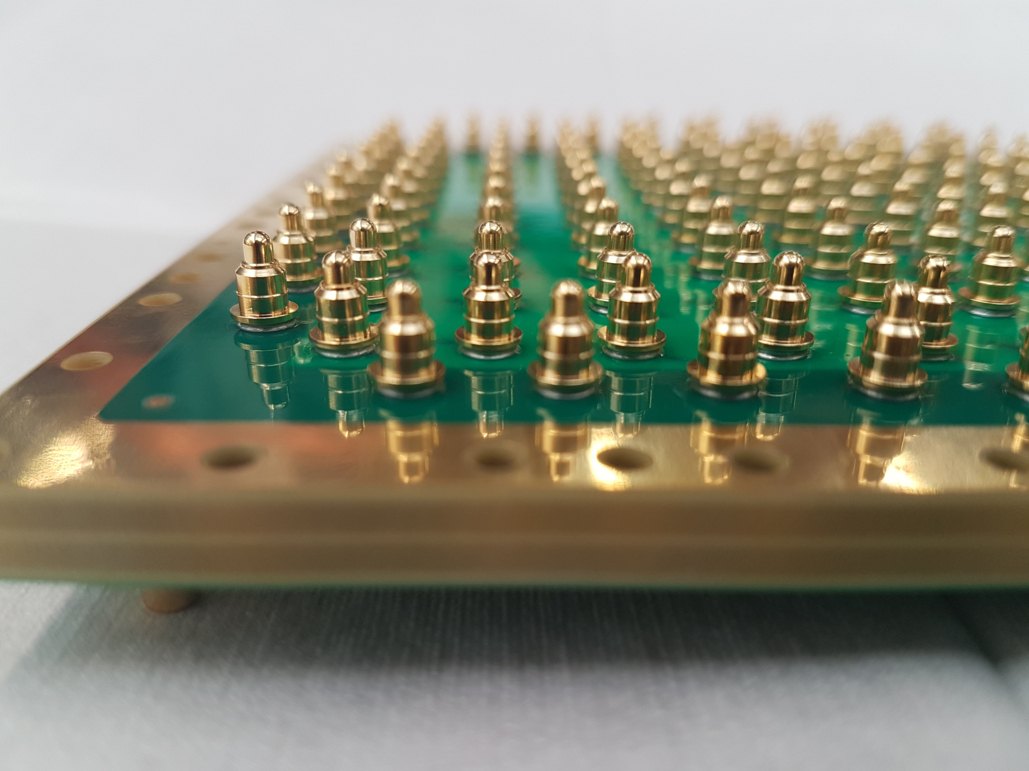
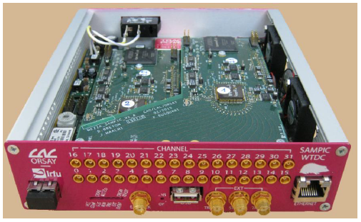
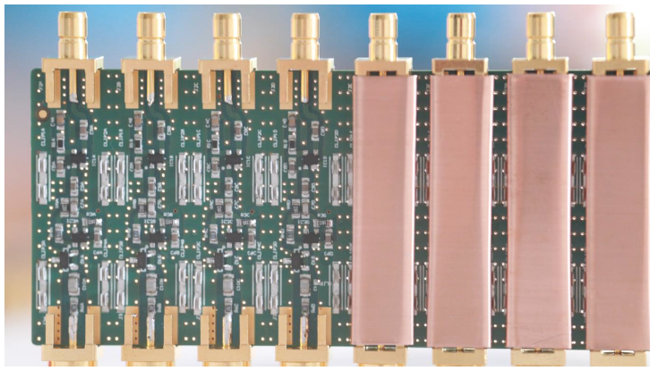
FY2413 µRWELL-PICOSEC – Q2 Progress & status
100-pads (10 cm × 10 cm) µRWELL-PICOSEC & MM-PICOSEC protos
Both 100-pad µRWELL-PICOSEC & MM-PICOSEC PCBs in hand 
Mechanical housing & Cerenkov crystal for 2 chambers 
Fabrication of two 100-pads outer PCB – ongoing
7 × 10-ch custom-made multi-channel pre-amplifiers for the readout 
Procurement of 64-ch Fast digitizer (SAMPIC) – ongoing
Preliminary test beam in April (04/10/2024) with borrowed electronics 
Final test in beam in end June 2024 with all 100 channels read out
Use the same telescope stand (with minor accommodations) – ongoing
100-pad reference MM-PICOSEC
Alu housing for 100-pad PICOSEC
64-channels SAMPIC Digitizer
10-channels custom preamplifier boards
100-pad outer PCB board

Slide 4
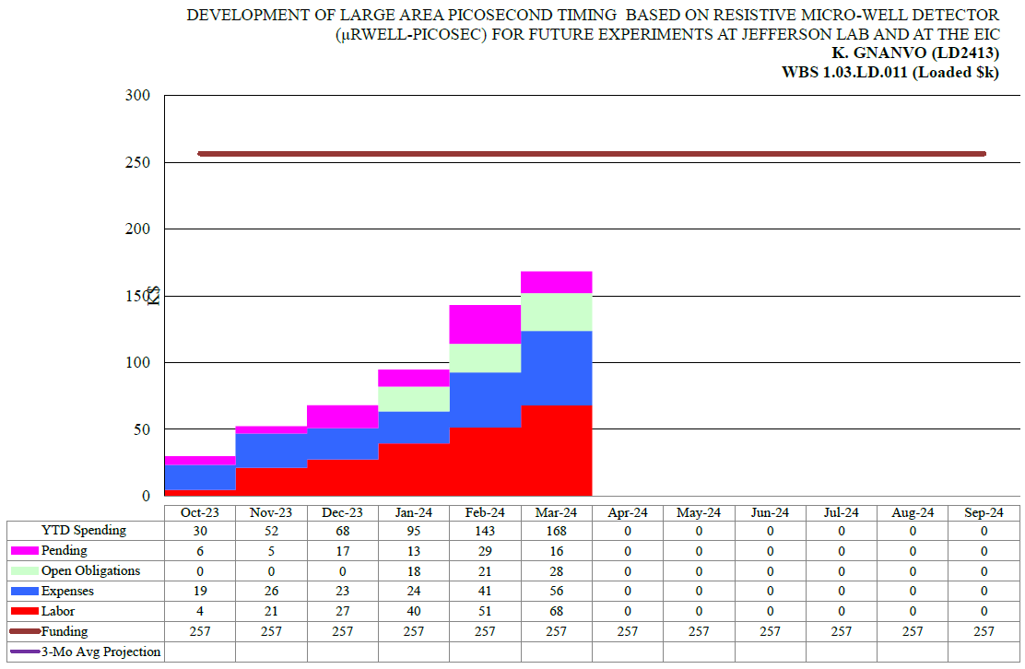
FY2413 µRWELL-PICOSEC – Q2 Budget
In good shape with respect to the projected spending profile so far:
Fabrication of PICOSEC telescope & prototypes for April beam test
In-house multi-channel readout based on LMH6881 chip + CAEN picoTDC DAQ to be evaluated in beam in June 2024
Completion of test stand in EEL126 : Q3 & Q4
Variances anticipated:
The spending trend exceed a little bit the projected profile
Most procurement of FY24 already placed in the first two quarters
No concerns about over spending for FY24
Final optimization 100-pad µRWELL-PICOSEC prototypes
Studies of spatial resolution with capacitive-sharing
Investigating new materials for photocathodes is unlikely to be completed this year
Ongoing difficulties with setting up JLab team account at CERN is affecting several aspects of our LDRD program:
Purchase of SRS crate for PICOSEC telescope GEM trackers
Need but small expenses during test beam activities at CERN
FY24 spending trend
Projected spending profile for FY24
Budget profile for the first six months of FY24

Slide 5
backup

Slide 6
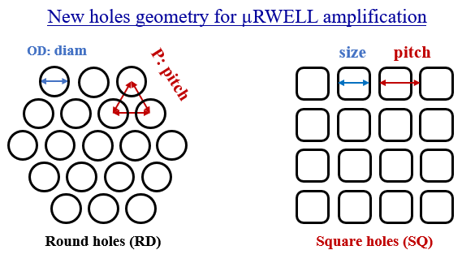
FY2413 µRWELL-PICOSEC – Q2 Progress & status
Optimization of single-channel µRWELL-PICOSEC prototypes
New µRWELL hole geometries: 3 main approaches under investigation
Minimize pitch to outer diameter ratio ➔ reduce e-field effect
Increase hole density ➔ Increase gain capability
Standard round holes vs. square holes ➔ mimic MM mesh pattern
Plain solid pad vs. hash pattern pad
Minimize detector capacitance ➔ improve S/N
Prototype | Shape | P (µm) | OD (µm) | ID (µm)
RD-T150-P80-D60 | round | 80 | 60 | 40
μRWELL#9 | round | 100 | 80 | 60
μRWELL#5 | round | 120 | 100 | 80
SQ-T150-P120-D100 | square | 120 | 100 | 80
Pad readout geometry
Contact
GND
Plain Cu electrode
Hash pattern Cu electrode

