Slide 1
LD2413 Development of µRWELL-PICOSEC Detectors FY24 Q1 meeting
Kondo Gnanvo
JLab Radiation Detectors & Imaging Group (RD&I Group)
Wenze Xi, Jack McKisson, Brian Kross, Akash Pandey
JLab - RD & I Group

Slide 2
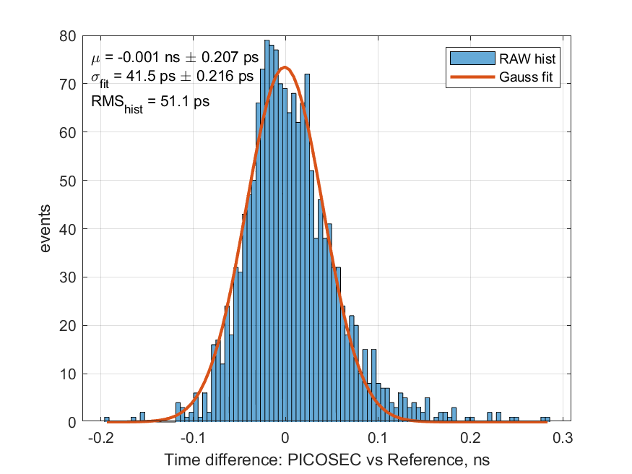
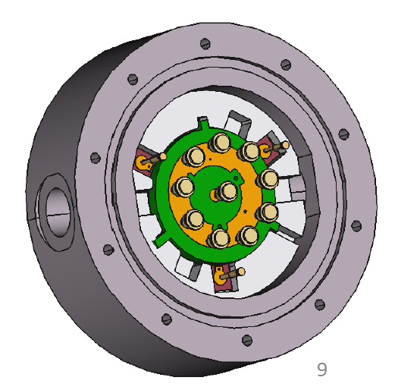
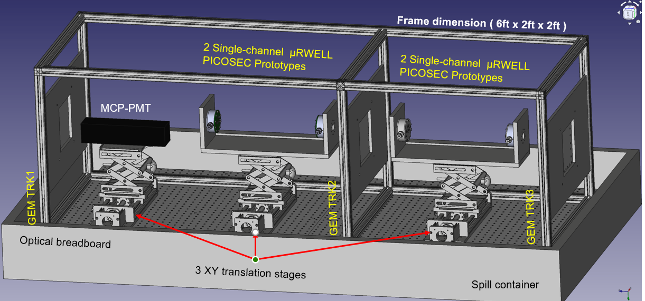
FY2413 µRWELL-PICOSEC – Q1 Progress & Issues
What we have achieved so far
Dr Akash Pandey started as post doc in Oct 2023 ➔ Lead the FY23 test beam data analysis effort and the preparation of the upcoming test beam
Procurement new single-pad and multi-pads µRWELL-PICOSEC prototypes
Presentation of FY23 results at the IEEE conference in Vancouver
https://www.eventclass.org/contxt_ieee2023/scientific/online-program/session?s=N-05#e1527
Preparation for test beam in April-Mai 2024 @ CERN (DRD1 PICOSEC)
Activities of last 3-months ➔ preparing for April-May 2024 beam test at CERN
µRWELL-PICOSEC test beam telescope ➔ test stand for up to 4 protos
Acquisition of multi-channels fast electronics ➔ Custom-made multi-channel pre-amplifiers + fast digitizer (SAMPIC) within the PICOSEC collaboration
Reference timing (MOC-PMT) and tracking (3 GEM trackers)
Anticipated challenges:
Investigation of new photocathodes and Cerenkov crystal materials is on hold
Setup of a characterization bench in EEL126 will be delayed ➔ lack of funds
41.5 ps
Performance of old prototype (FY23)
Design of new single-pad prototype
CAD design of the µRWELL-PICOSEC beam test telescope

Slide 3
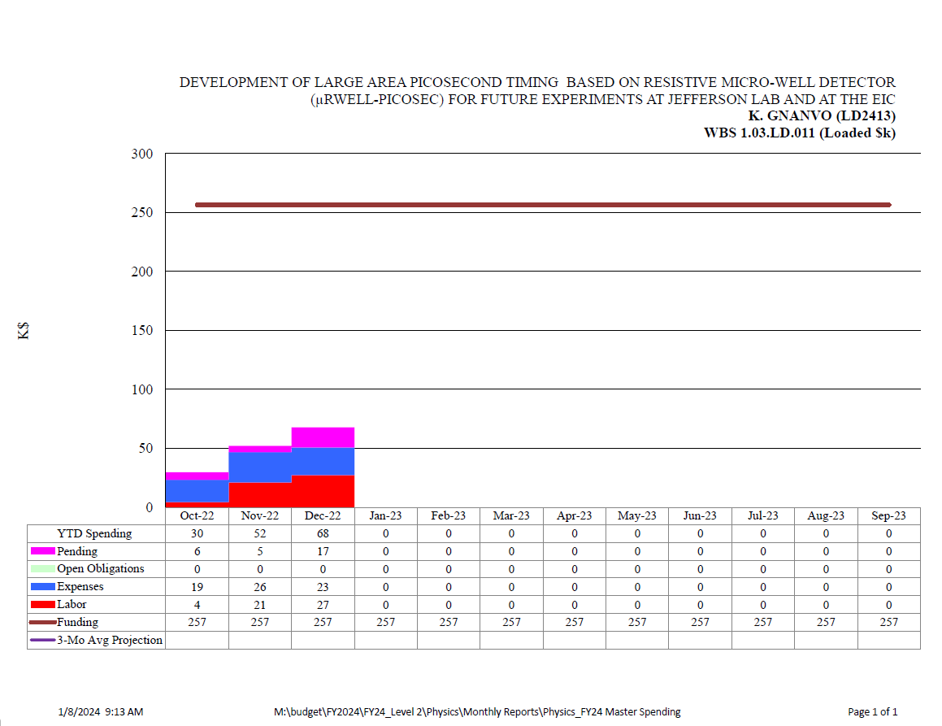
FY2413 µRWELL-PICOSEC – Q1 Budget
We are on part with the projected spending profile so far:
Labor times report more systematically than for FY24 ➔ full time post doc
Procurement of parts ➔ new prototypes and items for test beam telescope
Pending spending ➔ parts for telescopes and multi-channel readout
Variances anticipated:
Unexpected expense: Relocation package for Dr Akash Pandey was budgeted for FY23 but occurred FY24 ➔ Will impact part of the remaining program
The establishment of the PICOSEC test bench in EEL126 will be affected
The investigation of new materials for photocathodes and optics for PICOSEC detectors is on pause ➔ contribution from SBU. colleagues is on hold
We have identify an alternative candidate for multi-channel readout system than the initial plan:
We are still developing the LM6881 + picoTDC readout + DAQ but the purchase of the picoTDC will be put in hold for now
Alternatively, we are purchasing a 70-channels custom made pre-amplifier + SAMPIC digitizer developed within PICOSEC collaboration and tested thorougly with MM-PICOSEC
Projected spending budget profile for FY24
Budget profile for the first three months of FY24

