Slide 1
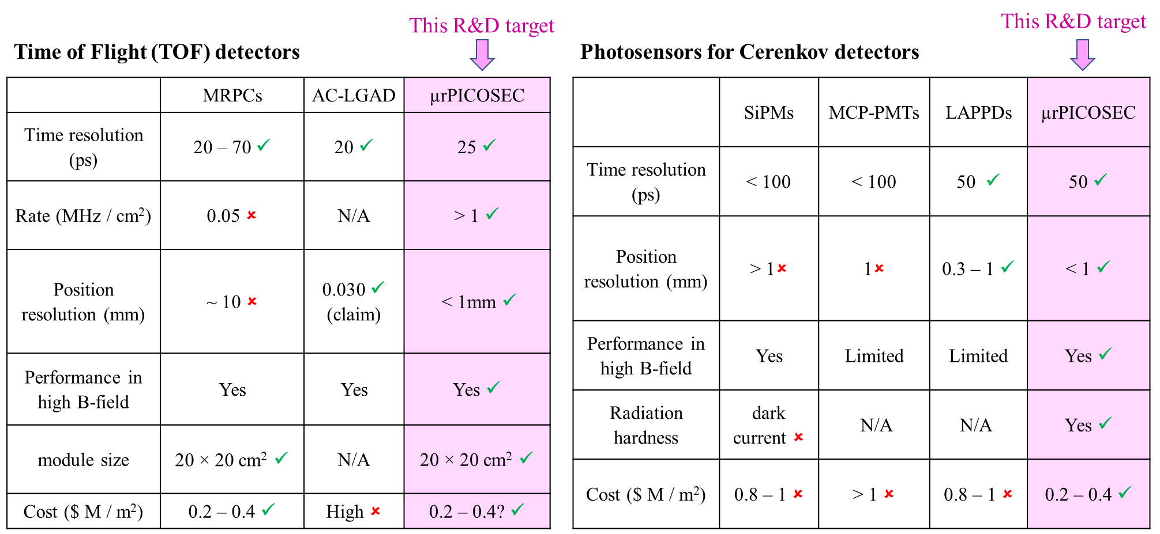
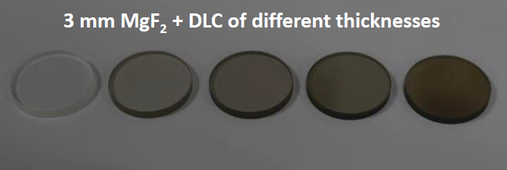
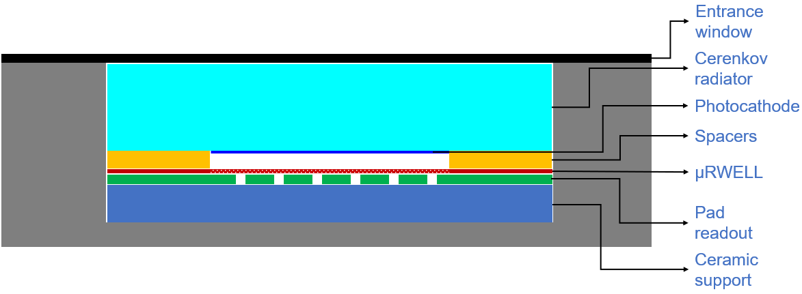
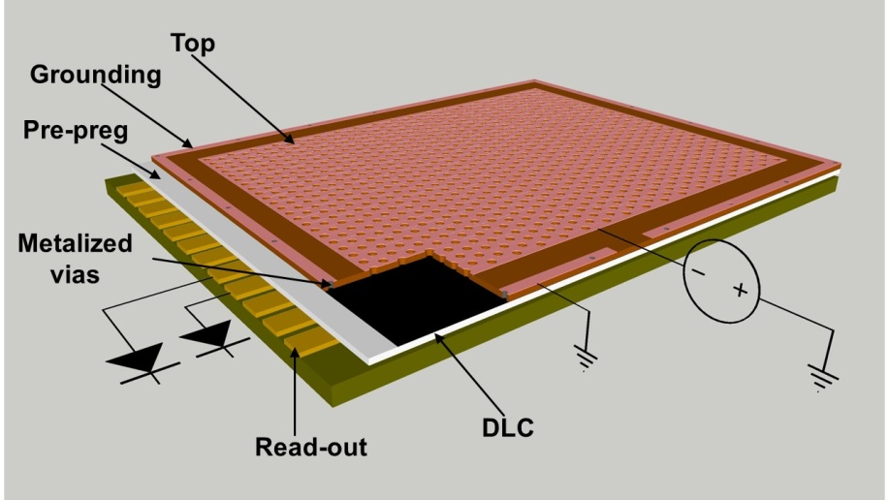
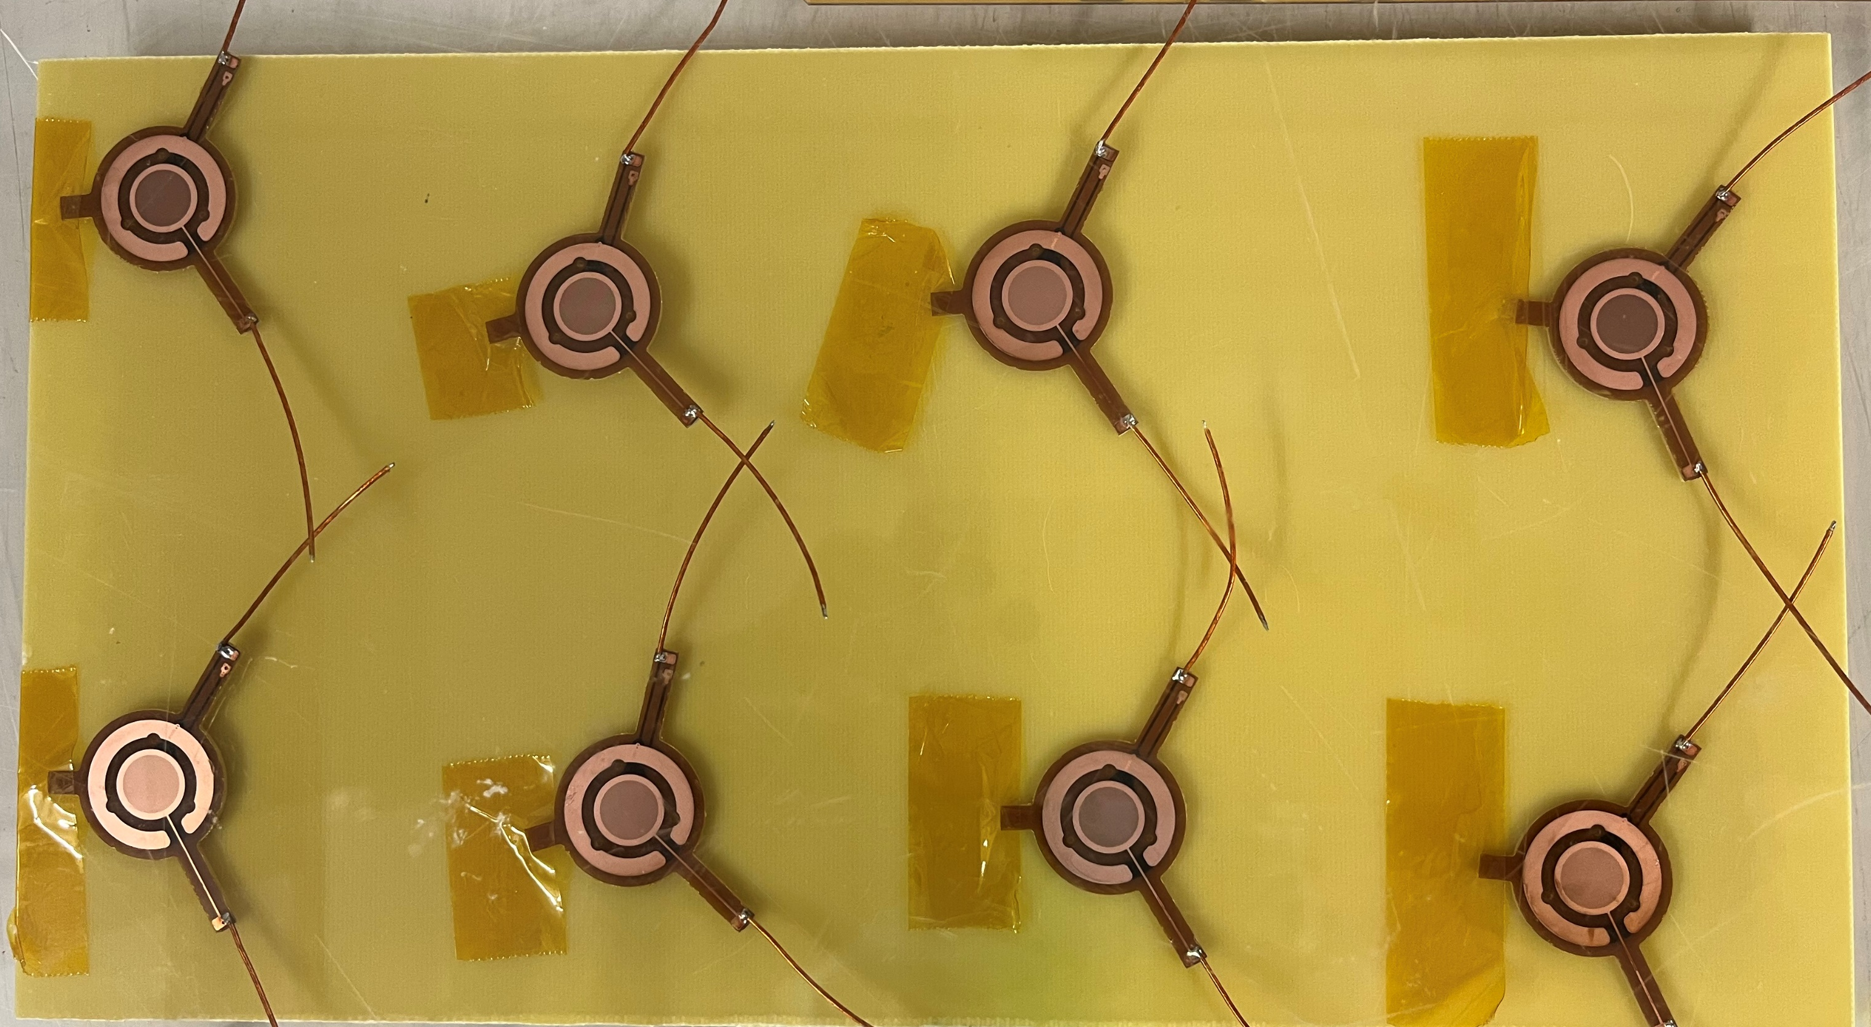
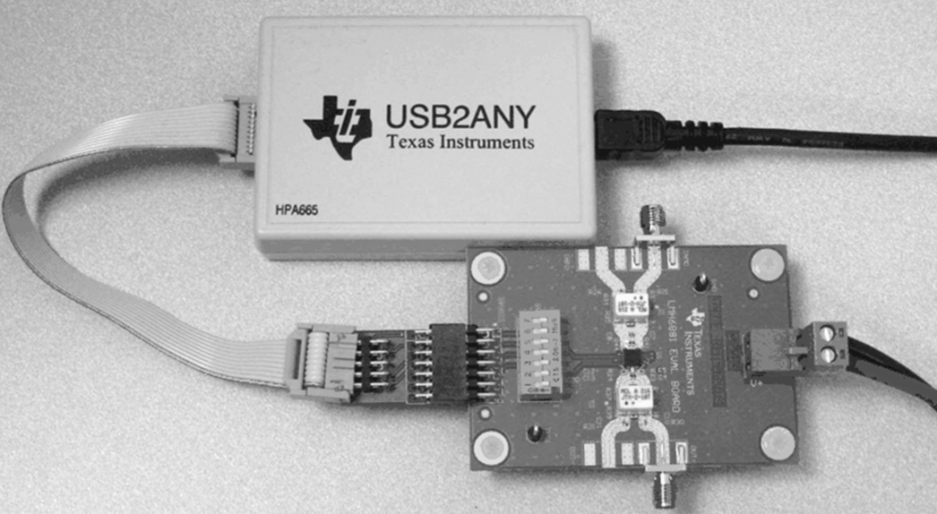
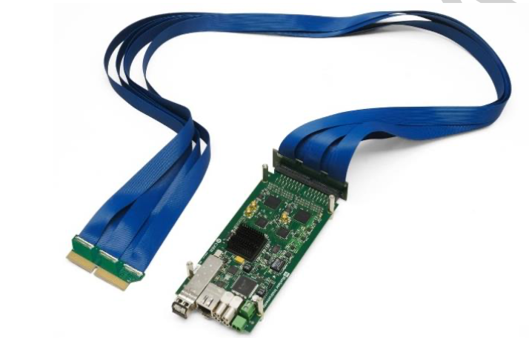
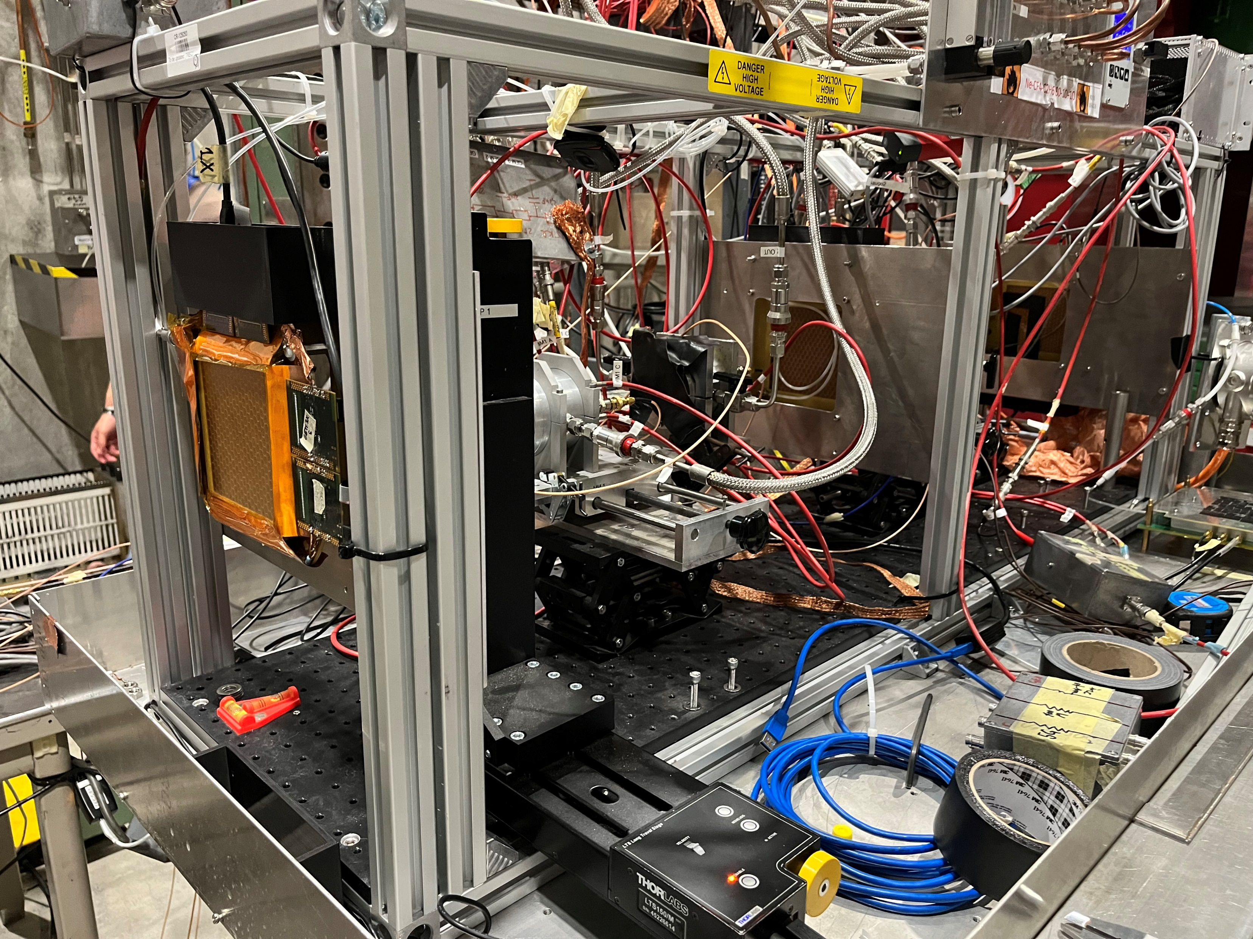
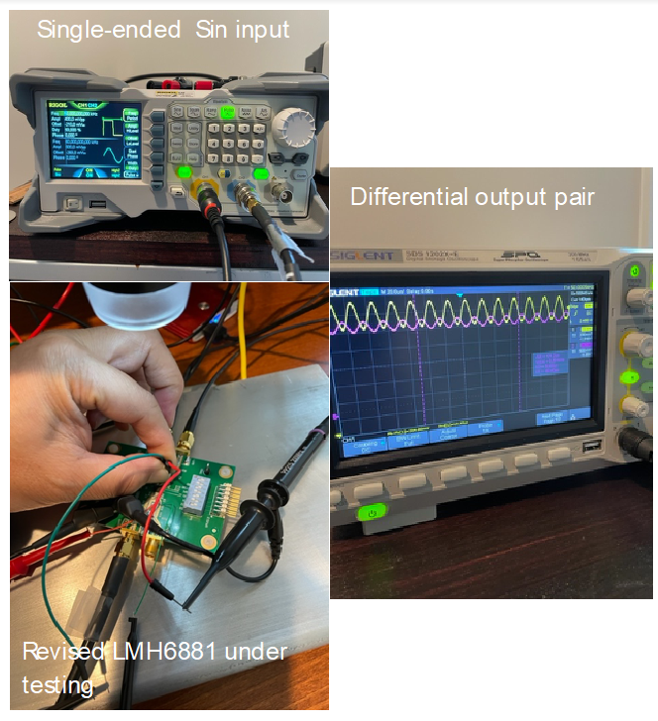
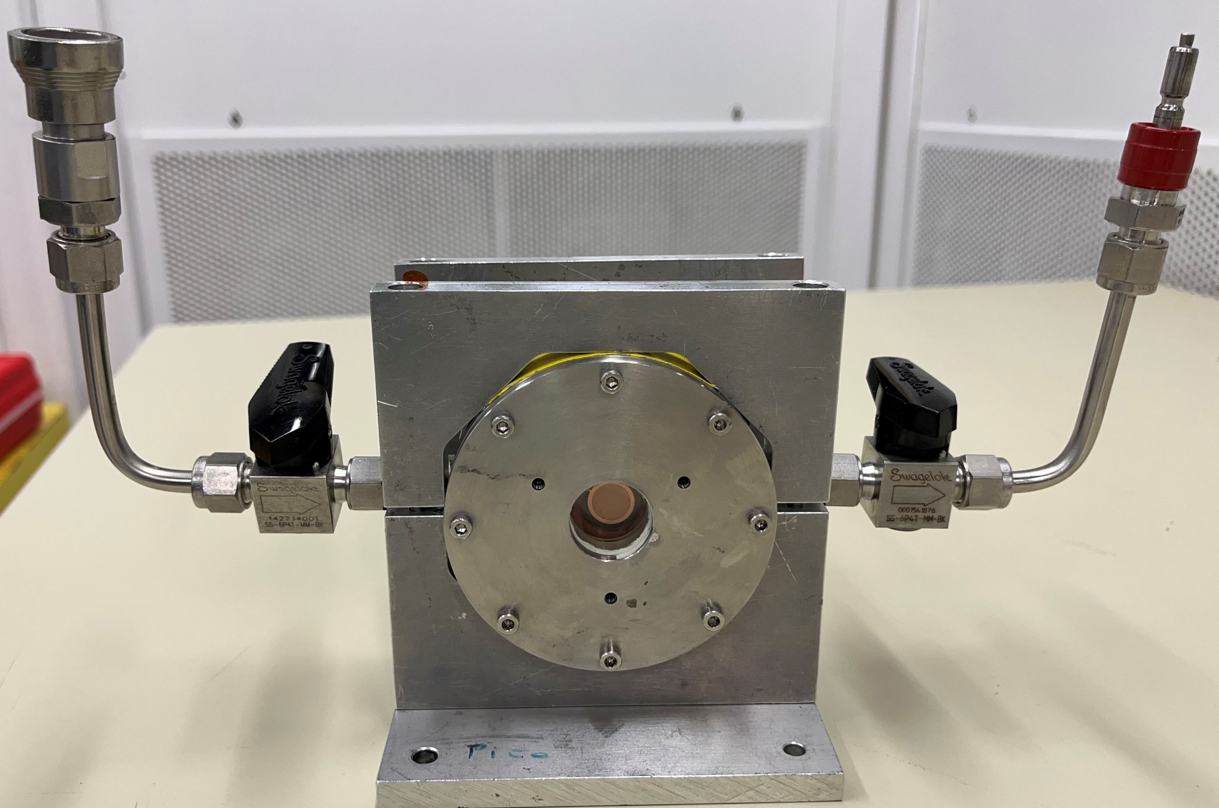
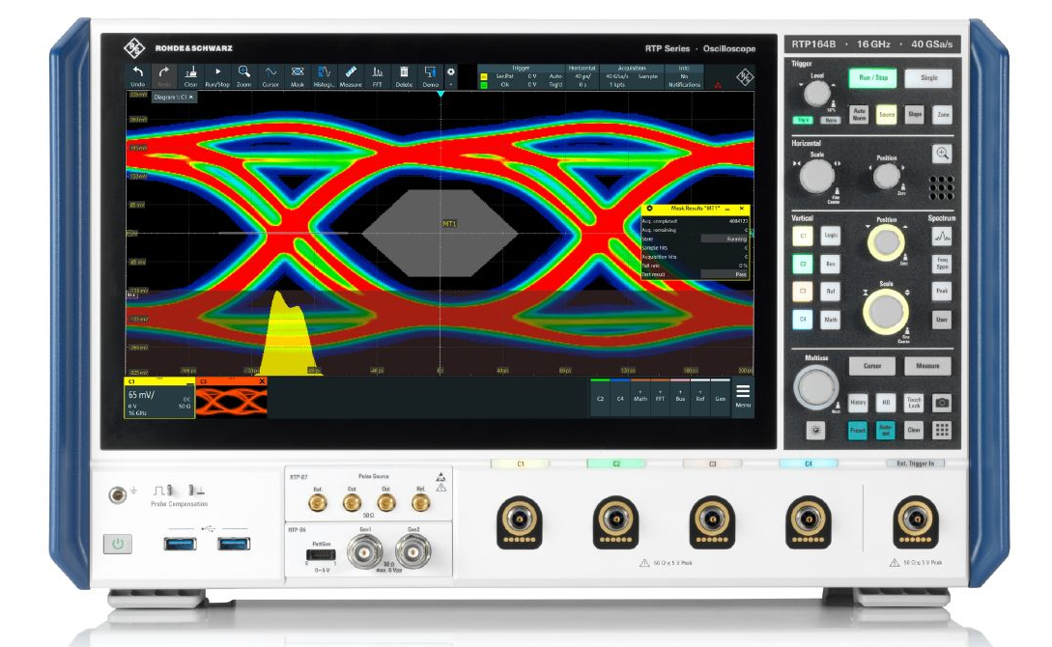
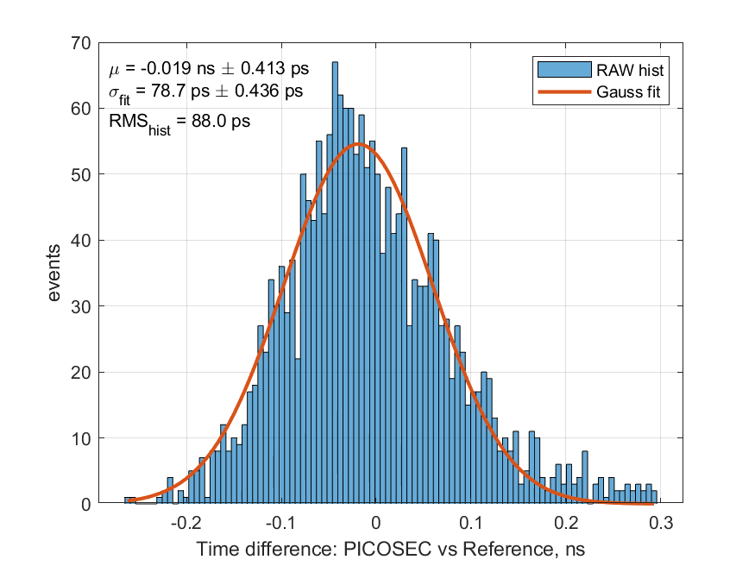
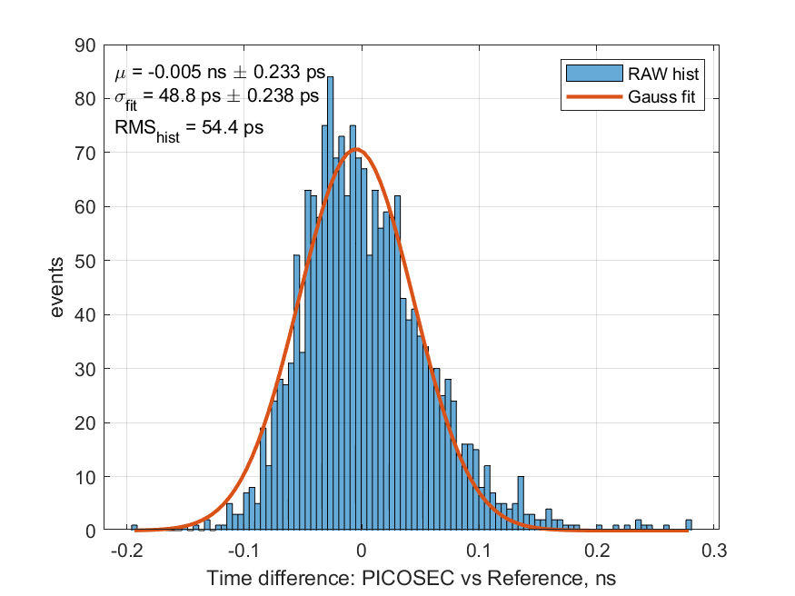
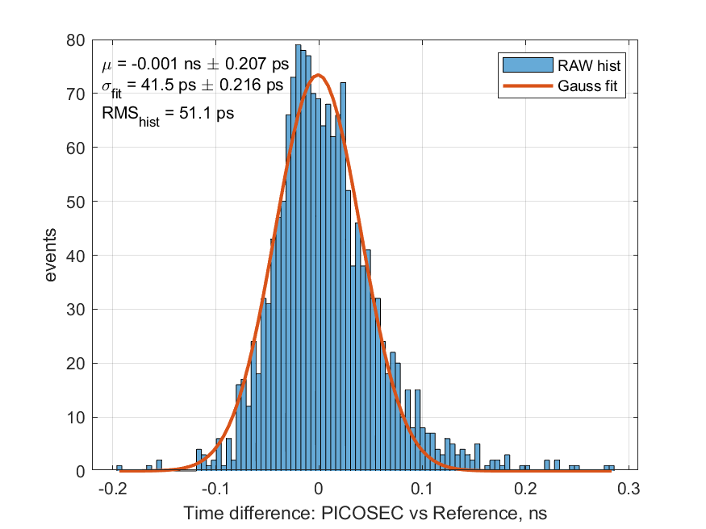
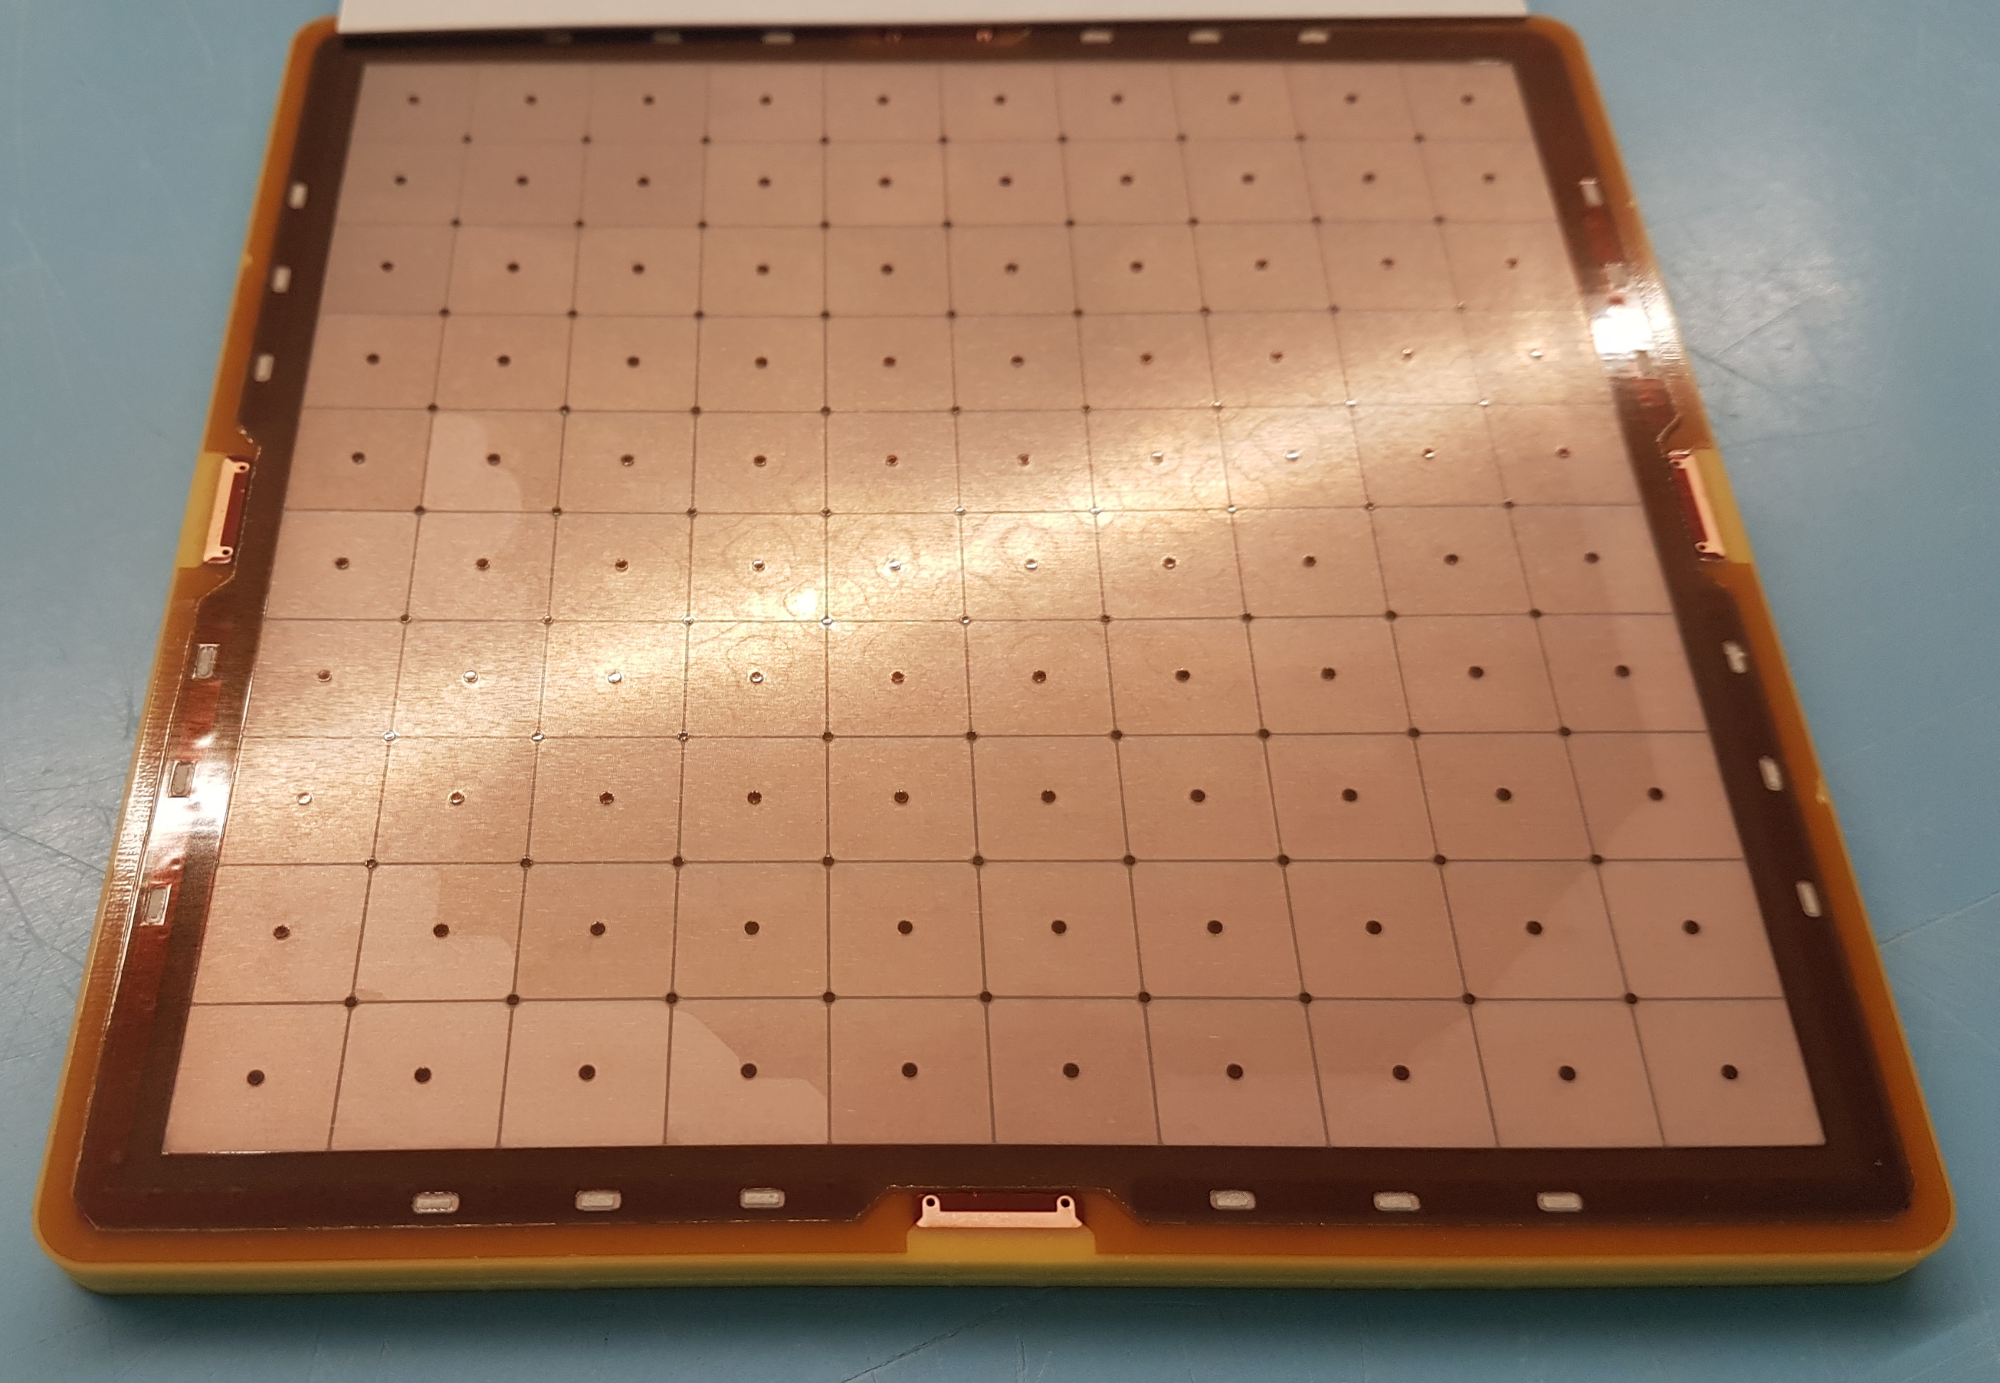
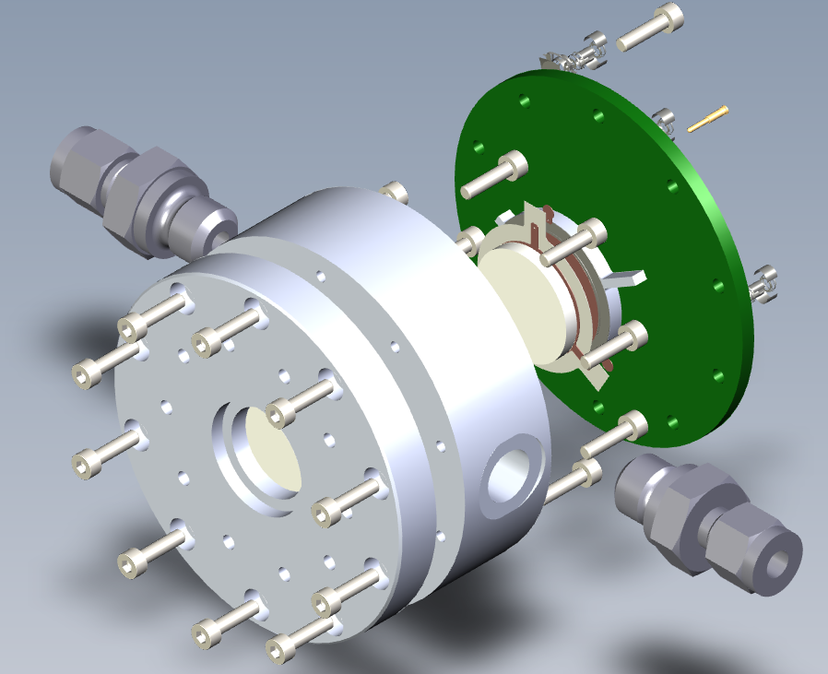
LD2309 – FY23: µRWELL-PICOSEC - Development of Fast Timing Detector based on Resistive Micro Well Detector Kondo Gnanvo¹ (PI), Klaus Dehmelt^{1,2}, Jack McKisson¹, Brian Kross¹, Drew Weisenberger¹, Wenze Xi¹ (Co-PI)
Background & Rationale:
Develop fast timing detector (picosecond) based on Resistive Micro-Well (µRWELL) technology.
Application: Time-Of-Flight (TOF) detector for PID
High-luminosity / high-energy upgrades @ JLab
ePIC Detector upgrade & EIC Detector II:
Consolidate Jlab high-profile physics program
Exploration of application medical field
Introduction
µRWELL-PICOSEC: LDRD R&D Goals
Cerenkov radiators & Photocathodes
Radiator: Magnesium Fluoride (MgF2)
Transparency in vacuum ultraviolet (VUV) but low photon yield & large Cerenkov angle = poor spatial information ➔ Will investigate alternative materials:
Photocathode: Cesium Iodide (CsI)
High quantum efficiency (QE) in vacuum ultraviolet (VUV) region which is most radiated by any radiator medium but Sensitivity to water and to Ion bombardment (IBF) of CsI is challenging for high rate
➔ Investigating alternative materials with similar QE:
Candidates are B4C, DLC and Nano diamond (ND)
Radiation hardness and unsensitivity to humid condition
Technologies
https://indico.cern.ch/event/757322/contributions/3387110/attachments/1839691/3015624/MPGD2019_WangXu_f.pdf
Cerenkov photons in radiator
1
µRWELL foil: amplification device
Photoelectrons in photocathode
2
D: diam
P: pitch
Pre-amplification in 200 µm gas
3
uRWELL amplification
Collection of electronic signal
4
µRWELL concept
µRWELL hole geometry
Concept of µrPICOSEC: Fast timing gaseous detector based on µRWELL amplification
Cherenkov photons: by relativistic charged particle ➔ prompt photons i.e., time resolution.
Photoelectrons: convert the photons into electrons, at same position in z ➔ timing resolution
Pre-amplification: 1st electrons amplification in high electric field in ~200 µm gas volume
Amplification : 2nd amplification in µRWELL structure high electric field (40 kV/cm)
Electronic Signal: Collection of the induced charges on pick up pad electrode.
uRWELL foil
Single-channel µRWELL-PICOSEC prototypes with different parameters
T
DLC layer
Nomenclature of µRWELL-PICOSEC prototype: T150-P140-D70
(Kapton thickness) T = 150 µm
(Hole pitch) P = 150 µm
(Holes Outer Diam) D = 70 µm
Kapton
Pad electrode
PCB support
Cross section view of µRWELL-PICOSEC PCB
Multi-channel Readout & DAQ
MM-PICOSEC Coll. Test beam setup @ CERN (July 2023)
Test beam @ CERN & Preliminary results
+
Join the PICOSEC Coll. 2 test beam campaigns @ CERN in July 2023 & Aug. –Sept. 2023
Several single-channel µRWELL-PICOSEC prototypes with different parameters were tested
HV scan on both the cathode (pre-amplification) and anode (µRWELL amplification)
Signal rise time and time resolution as function of signal amplitude
µRWELL-PICOSEC K150-H120-85-65 shows best time resolution of 41.5 ps
LMH6881: Programmable differential amplifiers
CAEN FERS-5203: 64-ch Pico-TDC
Provide 64 TDC channels :
~7 ps RMS timing resolution
LVDS input differential signals
3.5 Gbits/s Optical ethernet bus
Single-channel µRWELL-PICOSEC prototype
Test of the LMH6881 evaluation board (Wenze Xi)
Lab test of single channel prototypes
High performance oscilloscope:
2 × 16 GHz bandwidth channels for sub-ps timing resolution
40 GSamples/s & 16 bits measurement precision
Rohde & Schwarz, RTP164B
Proto I
T50-P140-D70
Proto II
T150-P140-D85
Proto III
T150-P120-D85
Alternative options
Multi channel digitizer SAMPIC (D. Breton, CEA Saclay)
Multi-channel custom-made pre-amplifier (M. Kovacic, U. of Zagreb)
78.7 ps
48.8 ps
41.5 ps
What’s next? – Large µRWELL-PICOSEC prototype & Optimization of timing performance
Summary & Perspectives
Multi-pad PICOSEC prototypes (Micromegas & µRWELL)
New mechanical housing for single-channel µRWELL-PICOSEC prototype
The progress on single-channel µRWELL-PICOSEC for fast timing has been encouraging for the Year 1 of the LDRD program
Timing of 41.5 ps was achieved in beam test and the performance is expected to be improved with some design modifications
In Year 2, we will extend the development to large multi-channel µRWELL-PICOSEC prototypes based on the performances results from with single-channel & the development of the associated multi-channel readout & DAQ
We will complete the setup of µRWELL-PICOSEC test bench in the RD&I MPGD lab in EEL126 for prototype characterisation
We plan to present the results at international conferences and publish in peer-reviewed paper by the end of Year 2
We will seek funding opportunities to continue the R&D on µRWELL-PICOSEC technologies beyond the LDRD program
Minimize external source of noise (i.e grounding, cables pick-up antenna …)
Makes it easier to quickly exchange prototypes (replacement of µRWELL-PCBs, photocathodes) during beam test
100-pad µRWELL-PICOSEC & MM-PICOSEC prototypes
Parameters based on single-channel prototypes studies
Mechanical housing fabricated in the JLab machine shop
Same housing for MM-PICOSEC & µRWELL-PICOSEC
Multi-channel readout PCB interface board under development
MM-PICOSEC used as reference detector
Large prototypes will be tested in beam at CERN in FY24
Courtesy Antonija Utrobicic
New µRWELL-PICOSEC prototypes with various holes geometries
D: diam
P: pitch
pitch
PICOSEC test bench setup @ RD&I Detector Lab
size
Acknowledgement:
We would like to thanks the great team of the MM-PICOSEC at CERN for the support during summer 2023 successful test beam campaigns at CERN
Florian Brunbauer, Eraldo Oliveri, Martha Lisowska, Alexandra Kallitsopoulou, Karl Floethner & Lucian Scharenberg
We will set up PICOSEC test bench in RD&I MPGD lab EEL126
Gas mixture system Ne-C₂H₁₀-CF₄ (80-10-10) & Vacuum pump
High bandwidth oscilloscope & low noise amplifier (CIVIDEC)
LED & laser sources for single photon detection measurement
Telescope with GEM trackers & MCP-PMT timing reference
Minimize capacitance and time resolution: Minimize µRWELL Cu-to-holes ratio
Square holes vs. round holes
Pitch vs. hole diameter, different hole diameters
Increase Kapton thickness between uRWELL and pick-up pad electrode
¹ Jefferson Lab, 12000 Jefferson Avenue, Newport News, VA 23606
² Stony Brook University, 100 Nicolls Road, Stony Brook, NY 11794

