Slide 1
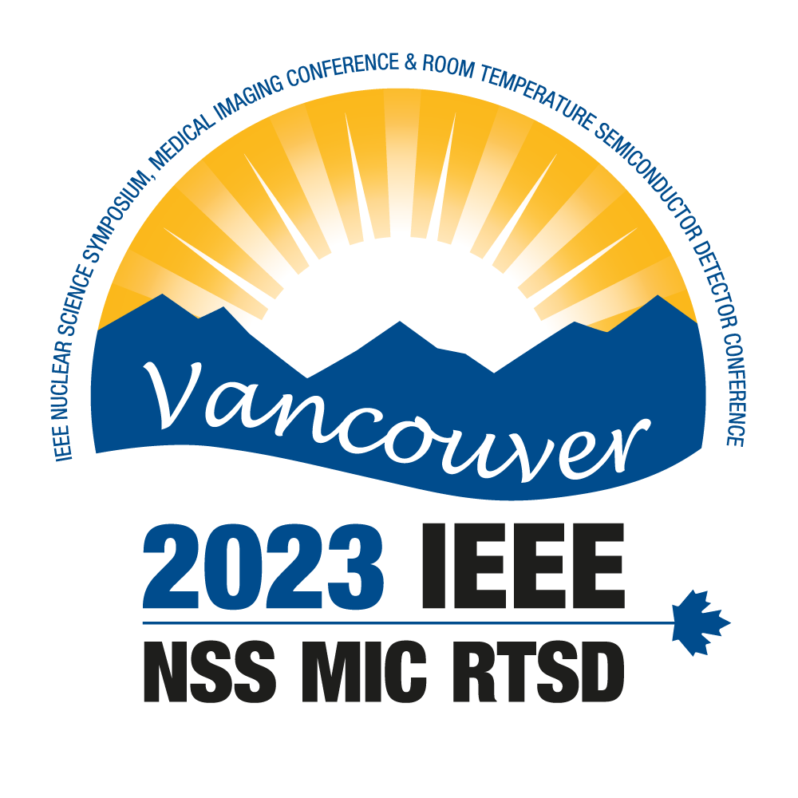
μRWELL-PICOSEC: The Development of Fast Timing Resistive Micro-WELL Detector Technology.
Kondo Gnanvo, Brian Kross, Jack McKisson, Drew Weisenberger, Wenze Xi
Radiation Detectors & Imaging Group (RD&I Group) @ Jefferson Lab
2023 IEEE NSS MIC RTSD - Nov. 4 - 11, 2023 Vancouver, Canada

Slide 2
Outline
Introduction and concept of picosecond timing Micro Pattern Gaseous Detectors (MPGDs)
Development of µRWELL-PICOSEC detector @ JLab (LDRD FY22).
Preliminary results: Impact µRWELL hole parameters on timing performance
Ongoing R&D and approaches to address challenges of µRWELL-PICOSEC.

Slide 3
µRWELL-PICOSEC: Fast Timing µRWELL Detector
Background & Rationale:
Develop precise and fast timing cost effective gaseous detectors for application in particle physics and medical instrumentation.
Properties such as stability, radiation hardness, large area, segmented readout are highly desirable for such timing detectors.
Proof of concept of precise timing detectors based on MPGDs has been established by the MM-PICOSEC collaboration with Micromegas
Development of picosecond detector based on µRWELL technology has the potential to satisfy such requirements.
Applications in future particle physics (HEP and NP) experiments:
Fast timing technology such as µRWELL-PICOSEC are attractive alternative PID technologies options such as Time-Of-Fight (TOF) detectors for charged particles or photosensors technologies for Cerenkov detectors.
The technology could be deployed in future Electron Ion Collider (EIC) Detector II, ePIC upgrade or future experiments at Jefferson Lab
Potential application in medical instrumentation such as for TOF-PET devices will be explored.

Slide 4
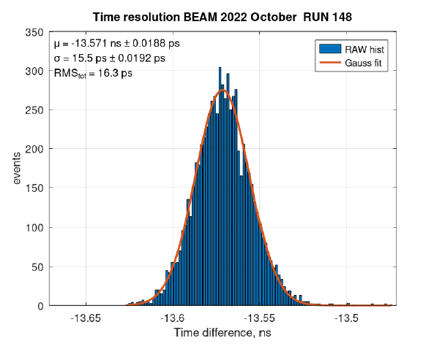
(MM-)PICOSEC Collaboration at CERN
MM-PICOSEC: Development of fast timing (picosecond resolution) MPGD using Micromegas amplification
Large ongoing collaboration based at CERN with several major institutions from France, Greece, Poland, China … and US (JLab)
Proof of principle picosecond timing with MPGD established with several MM-PICOSEC prototypes:
Large-area (10 cm × 10 cm) and multi-channel (100 pads) prototype ➔ < 20 ps with MIPs and 70 ps with single photon (laser)
PICOSEC-MM collaboration and RD51 collaboration ➔ strong connection (i.e., beam test campaign and GDD lab at CERN)
Strong synergy between MM-PICOSEC & µRWELL-PICOSEC ➔ leverage on expertise & experience of MM-PICOSEC community
RMS = 16.3 ps
Aune et al., Nuclear Inst. and Methods in Physics Research, A 993 (2021) 165076, https://doi.org/10.1016/j.nima.2021.165076
Bortfeldt et al., Nuclear Inst. and Methods in Physics Research, A 903 (2018) 317–325, https://doi.org/10.1016/j.nima.2018.04.033
A. Utrobicic et al., 2023 JINST 18 C07012, https://doi.org/10.1088/1748-0221/18/07/C07012

Slide 5
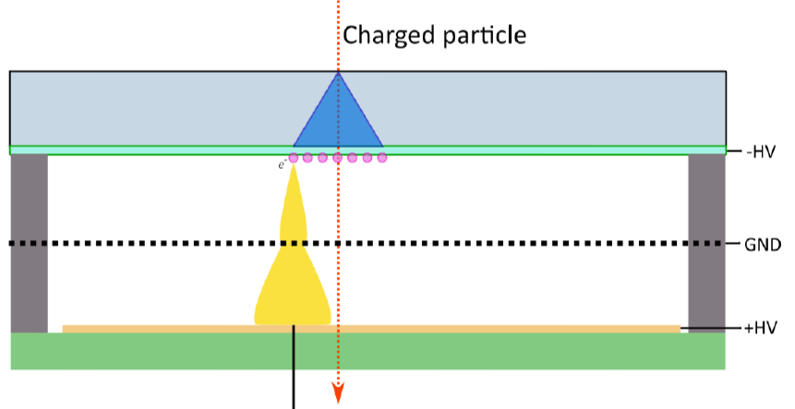
µRWELL-PICOSEC or MM-PICOSEC
μRWELL-PICOSEC and MM-PICOSEC belongs to the MPGD-based fast timing detector family
Different amplification structure will allow different optimization of the technologies in term of operation stability and timing performance
Parallel development of will mutually benefit the two technologies and offer options for applications
 | MM-PICOSEC | µRWELL-PICOSEC | Comments
Radiator / photocathode | Both technologies share the same devices | Both technologies share the same devices | common R&D
Readout structure | Both technologies share the same devices | Both technologies share the same devices | common R&D
Amplification structure | mesh ➔ 128 µm gap ✓ | Cu-clad Kapton foil ➔ 50 µm gap | large capacitance hurts µRWELL
Resistive vs. metallic | Both options available ✓ | Only resistive ✓ | Resistive ➔ HV stability
Segmentation MPGD | Segmentation of the mesh will be challenging | µRWELL Cu-electrode can be segmented ✓ | Improve rate capabilities for resistive
Mechanical structure | Mesh gap uniformity ➔ challenging for large area | Gap uniformity ➔ no pillar, no stretching ✓
MM-PICOSEC
µRWELL-PICOSEC
0.1 mm gas

Slide 6
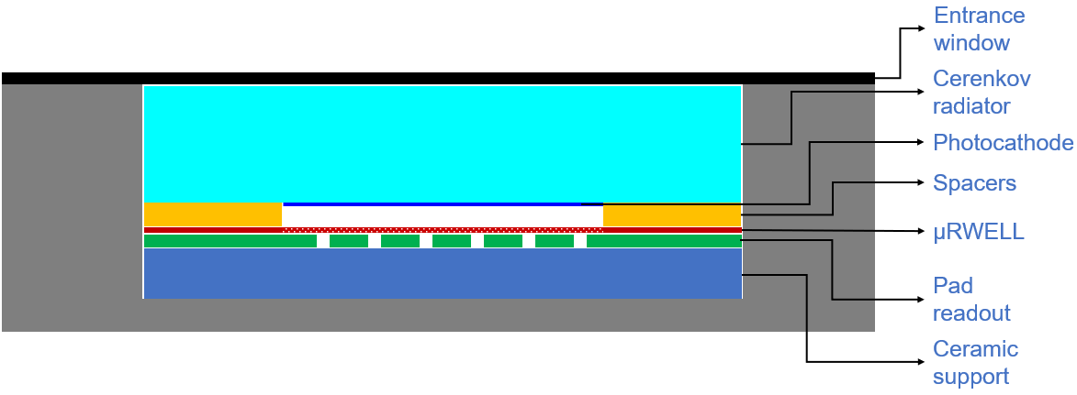
µRWELL-PICOSEC: Detector concept
Concept of µRWELL-PICOSEC: Develop fast timing gaseous detector using µRWELL amplification ➔ timing resolution of tens of ps
Cherenkov photons: relativistic charged particle creates Cerenkov photons ➔ prompt photons i.e., timing resolution.
Photoelectrons: convert the Cerenkov photons into electrons, all electrons created at the same z position ➔ timing resolution
Pre-amplification: First amplification of electrons 100 to 200 µm gas in high drift field region ( ~20 kV/cm)
Amplification : Final electron amplification in µRWELL gain structure ➔ high electric field (>40 kV/cm)
Electronic Signal: Arrival of the amplified electrons to the anode creates a signal.
Cerenkov photons in radiator
Photoelectrons in photocathode
1
Pre-amplification in 200 µm gas
2
3
uRWELL amplification
Collection of electronic signal
4

Slide 7
Outline
Introduction and concept of picosecond timing Micro Pattern Gaseous Detectors (MPGDs)
Development of µRWELL-PICOSEC detector @ JLab (LDRD FY22).
Preliminary results: Impact µRWELL hole parameters on timing performance
Ongoing R&D and approaches to address challenges of µRWELL-PICOSEC.

Slide 8
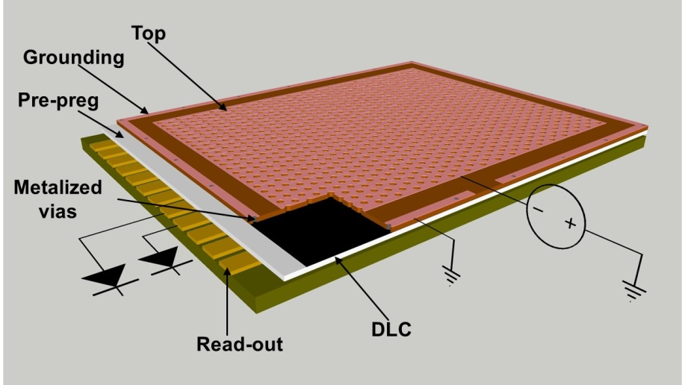
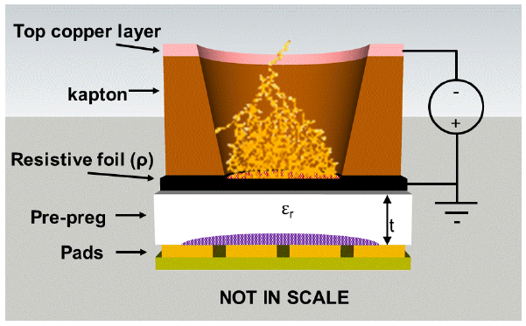
μRWELL-PICOSEC: Amplification structure
Design of µRWELL foil
Single layer amplification MPGD
Simple amplification structure using same material as GEM foil
Resistive technology ➔ intrinsically robust against spark
Large area capability
Specially well suited for PICOSEC technology
µRWELL is a resistive MPGD ➔ improve detector stability
Segmented µRWELL (PEP) ➔ improve rate capability & timing
Integration of capacitive-sharing readout structures
Capacitive-sharing pad readout will allow precise position information capability with limited readout channel number
Combining segmented µRWELL and capacitive-sharing ➔ best of both world
Segmented µRWELL: excellent timing resolution
Capacitive-sharing readout: excellent position resolution
G. Bencivenni et al 2015 JINST 10 P02008
µRWELL PCB
Concept capacitive-sharing pad readout
K. Gnanvo et al., NIM A, 1047 (2023) 167782

Slide 9
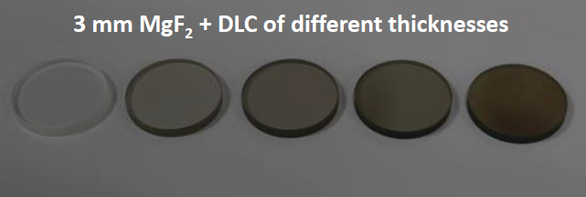
µRWELL-PICOSEC: Radiators and photocathodes
Photocathode:
Current technology: Cesium Iodide (CsI)
Pros:
High quantum efficiency (QE) in vacuum ultraviolet (VUV) region which is most radiated by any radiator medium
Cons:
Sensitivity to water ➔ performance rapidly deteriorates
Ion bombardment (IBF) of CsI is challenging for high rate
We will investigate materials with similar level of QE:
Candidates are B4C, DLC and Nano diamond (ND)
Goal is to achieve similar level of QE ➔ Extensive R&D
Radiation hardness and unsensitivity to humid condition
Radiator:
Current technology: Magnesium Fluoride (MgF2)
Pros:
Transparency in vacuum ultraviolet (VUV) region which is most radiated by any radiator medium
Cons:
Low photon yield
large Cerenkov angle sin (Ɵ_{c}) ➔ poor spatial information
Smaller Ɵ_{c} material will results in even lower photon yield
We will investigate radiator materials for higher photon yield capability
https://indico.cern.ch/event/757322/contributions/3387110/attachments/1839691/3015624/MPGD2019_WangXu_f.pdf

Slide 10
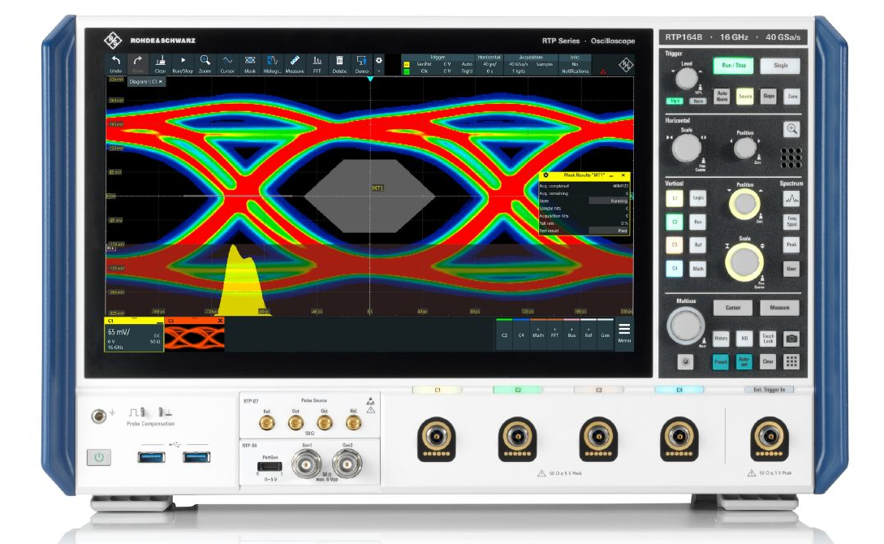
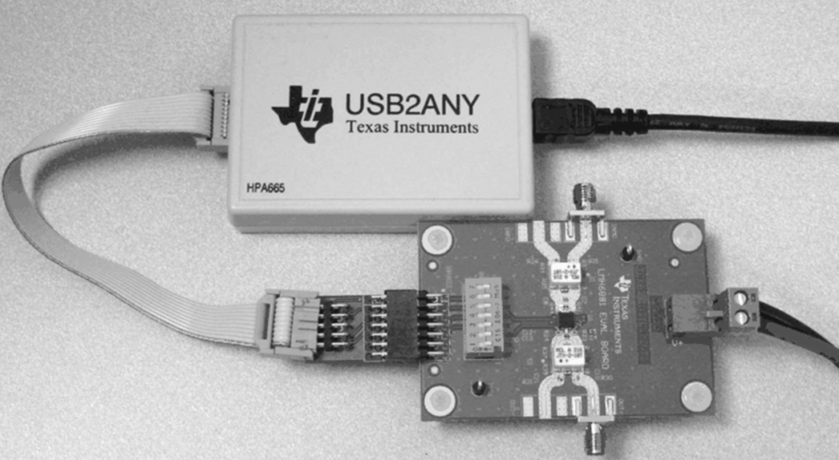
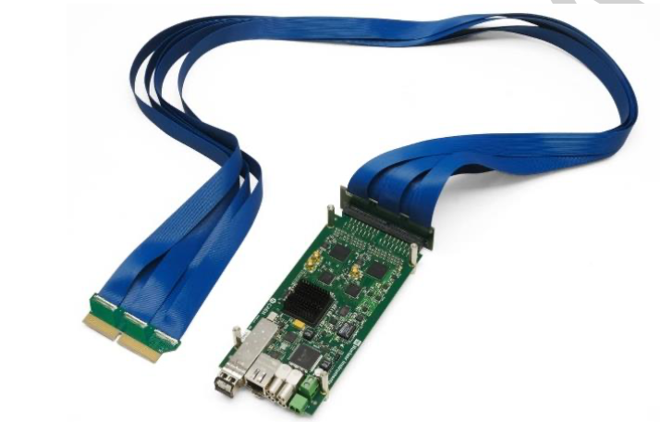
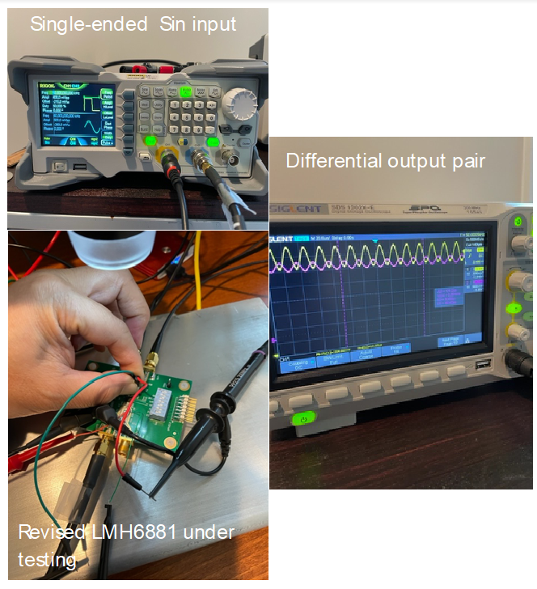
µRWELL-PICOSEC: Multi-channel readout and DAQ
Multi-channel Readout
Fast digitizer
Lab test of single channel prototypes
+
+
LMH6881: Programmable differential amplifiers
CAEN FERS-5203: 64-ch Pico-TDC
Provide 64 TDC channels :
~7 ps RMS timing resolution
LVDS input differential signals
3.5 Gbits/s Optical ethernet bus
Rohde & Schwarz, RTP164B:
High performance oscilloscope:
2 × 16 GHz bandwidth channels for sub-ps resolution
40 GSamples/s & 16 bits measurement precision
Alternative options
Multi channel digitizer SAMPIC (D. Breton, CEA Saclay)
Multi-channel custom-made pre-amplifier (M. Kovacic, U. of Zagreb)
Test of the LMH6881 evaluation board

Slide 11
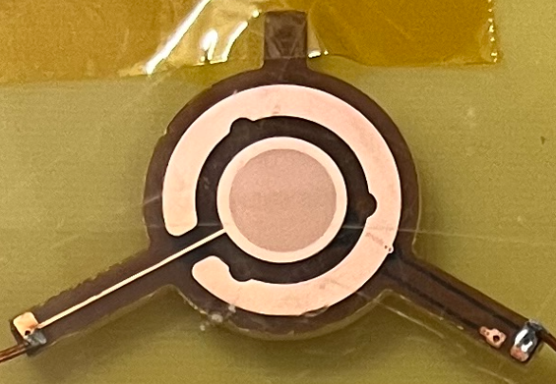
µRWELL-PICOSEC: Single-channel prototypes
Single-channel µRWELL-PICOSEC prototype
1 cm diameter active area / pad)
Two batches were produced for performance optimization
Batch I: Standard µRWELL (pitch 140 um, holes diameters 70/50
Batch II: Samples with different hole size, pitch, Kapton thickness
Tested in beam: RD51-PICOSEC July & August 2023 campaigns
HV scan for optimal timing
Test with different photocathodes (DLC and CsI)
Different pre-amplification gaps (167 µm & 117 µm
Nomenclature of the prototypes:
T150-P140-D70
T = 150 µm ➔ Kapton thickness
P = 140 µm ➔ Hole pitch
D = 70 µm ➔ Hole Outer Diam.
DLC
µRWELL
Signal
D: diam
P: pitch
µRWELL-PICOSEC prototype
batch | Prototype | T (µm) | P (µm) | D (µm) | d (µm)
I | T50-P140-D70 | 50 | 140 | 70 | 50
II | T150-P140-D70 | 150 | 140 | 70 | 50
II | T150-P140-D85 | 150 | 140 | 85 | 65
II | T150-P140-D70 | 150 | 120 | 70 | 50
II | T150-P140-D85 | 150 | 120 | 85 | 65
hole geometry
T
uRWELL foil
DLC layer
Kapton
Cross section view of µRWELL-PICOSEC PCB
Pad electrode
PCB support

Slide 12
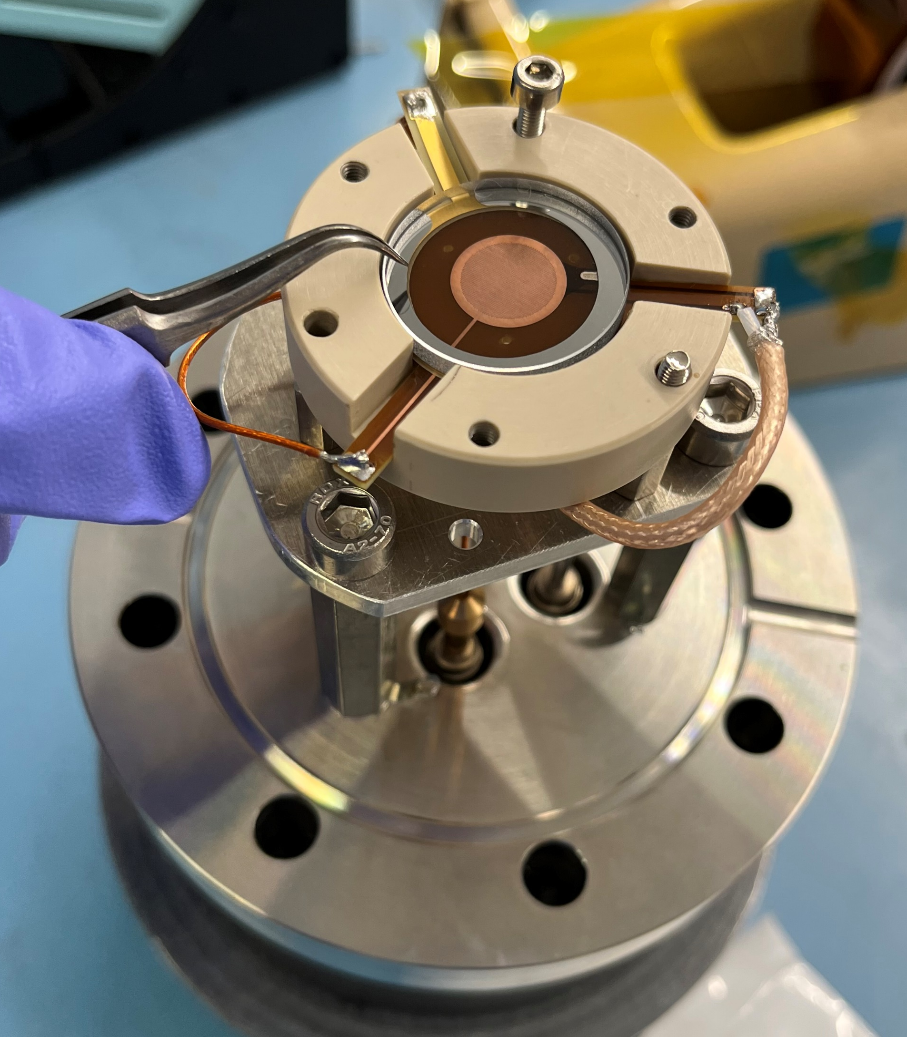
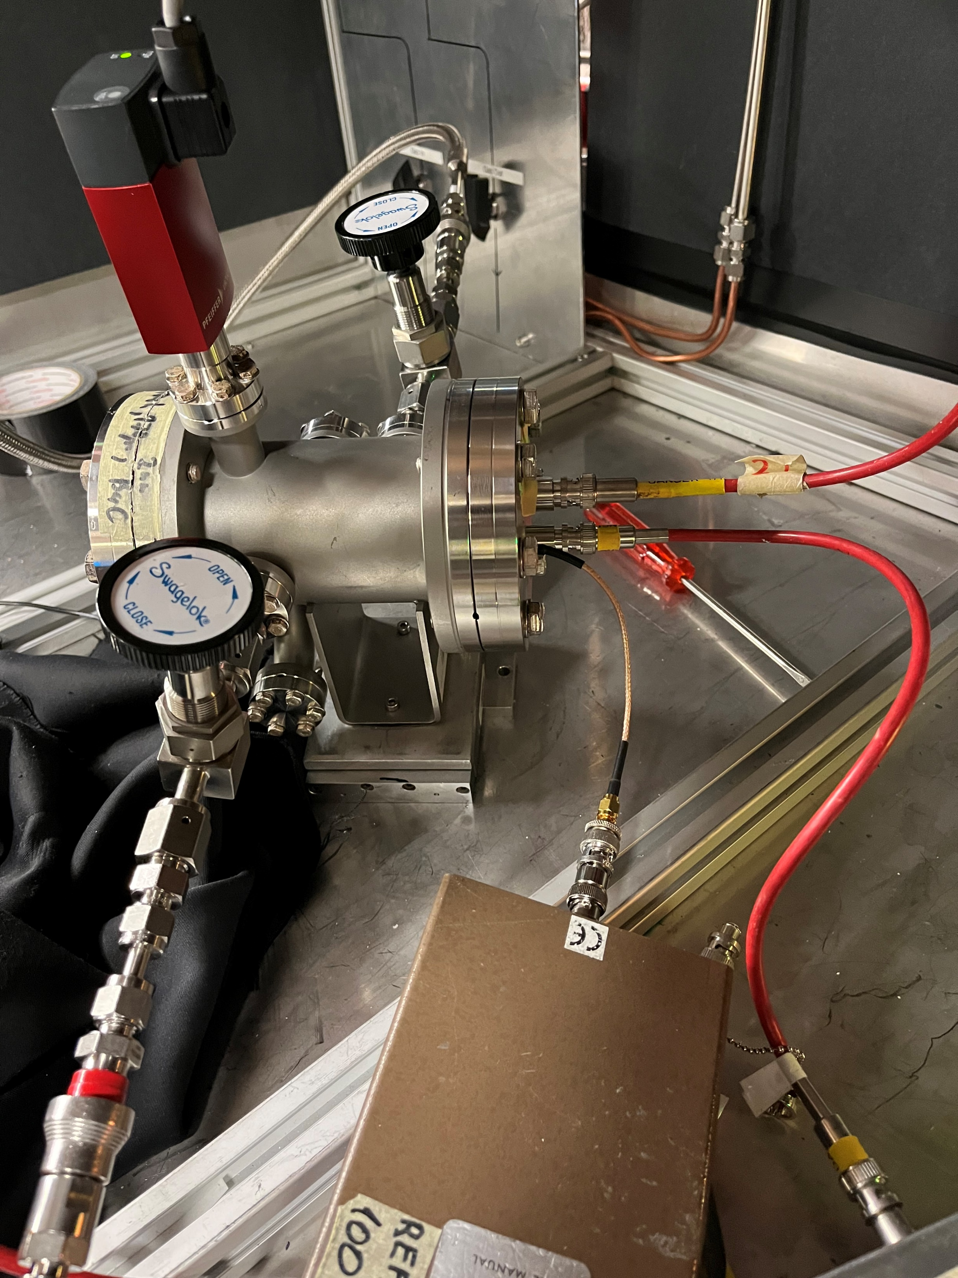
µRWELL-PICOSEC: Single-channel prototypes
First µRWELL-PICOSEC prototype
Single-pad small prototype
1 cm diameter active area
3 mm thick radiator + CsI photocathode
Sensor: 50 µm µRWELL on 50 µm Kapton
Holes parameters: 140 µm / 70 µm / 50 µm
First tests with LED source (GDD lab, 12/2022)
Poor timing compared to MM-PICOSEC
Prototype very resilient against sparks
Lessons learned from preliminary tests
Several parameters to be tweaked to improve resolution
µRWELL hole parameters to be optimized
Minimizing capacitance noise ➔ increase the gap between µRWELL device and pad layer
Reduce or eliminate all external source of capacitance noise ➔ wire connection …
Single-pad µRWELL-PICOSEC prototype
Prototype on test bench at CERN GDD Lab
cathode
GND
µRWELL electrode

Slide 13
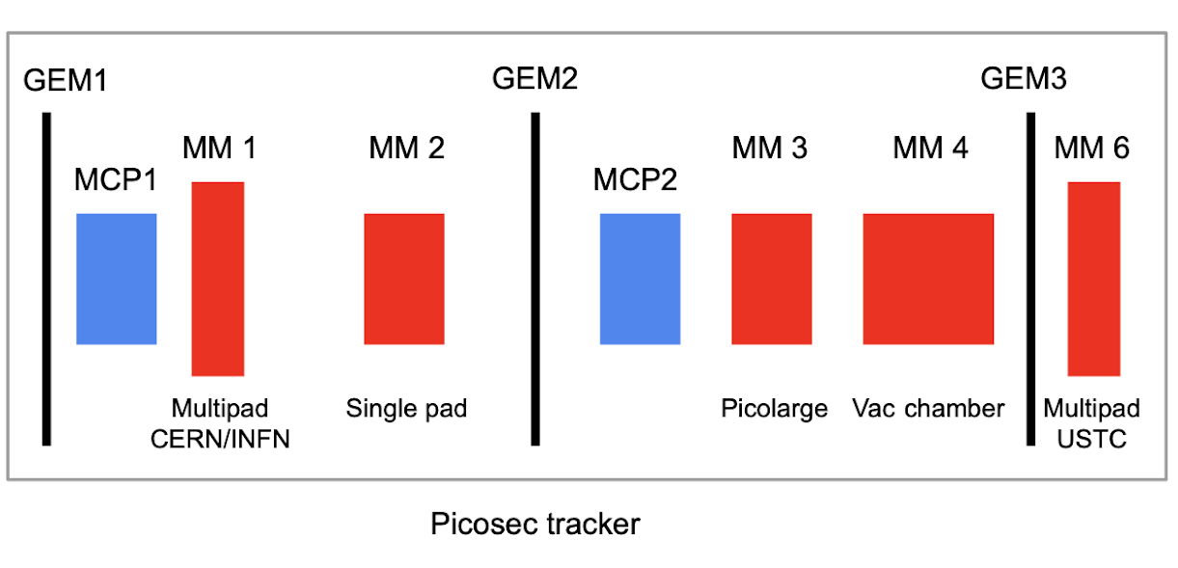
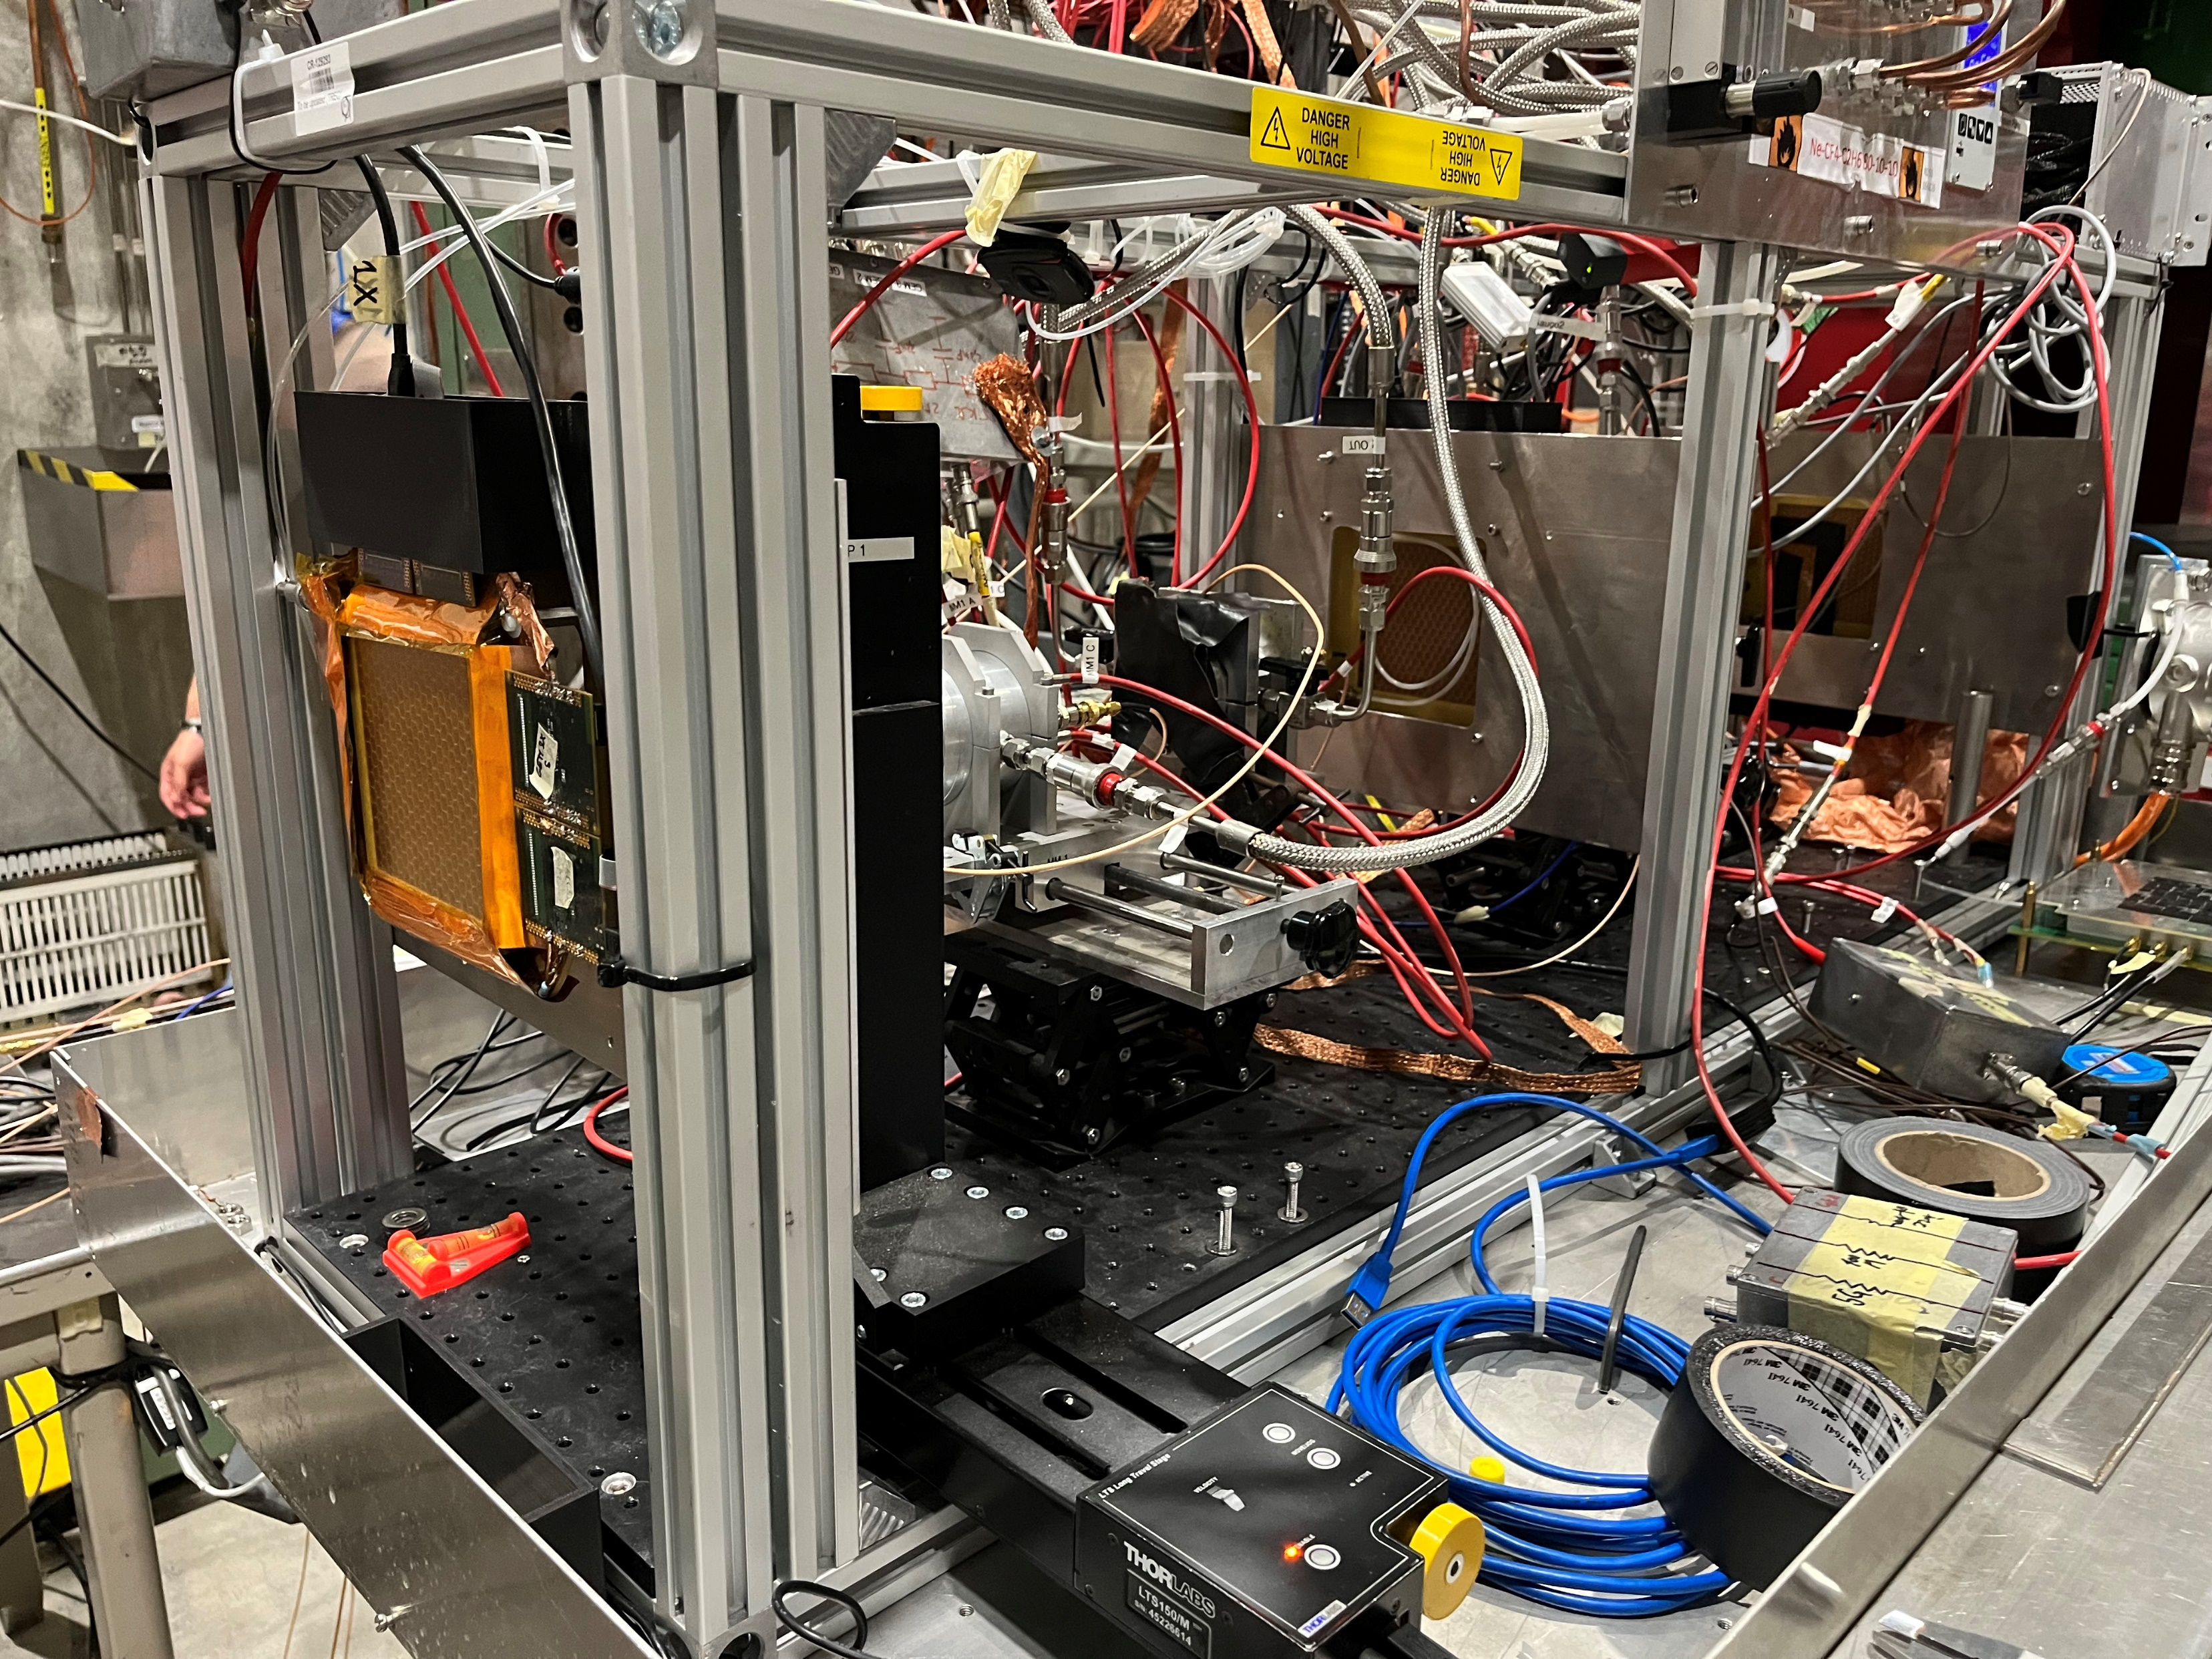
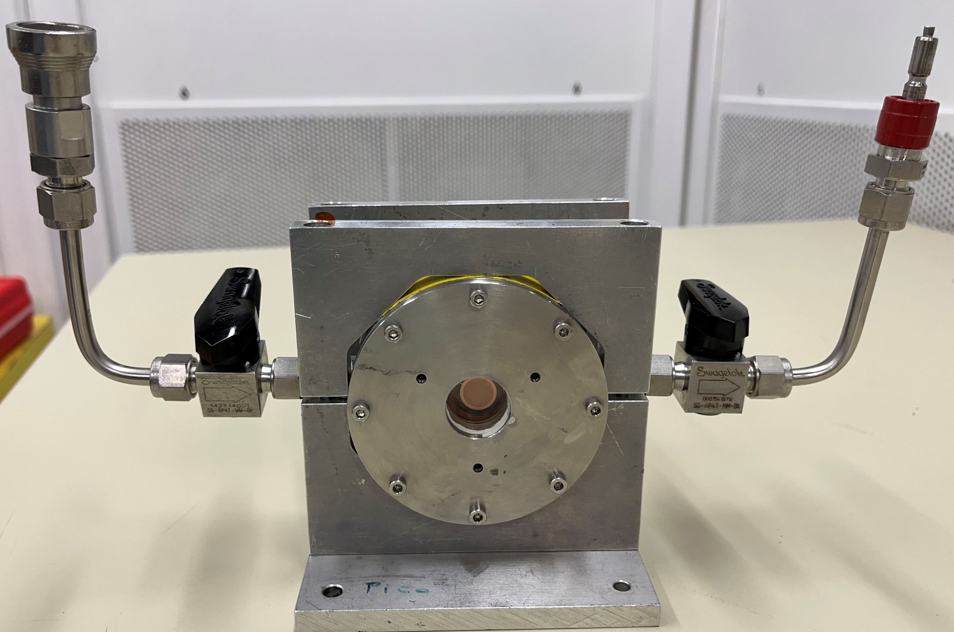
µRWELL-PICOSEC: CERN Test Beam (July & August 2023)
MM-PICOSEC Coll. Test beam setup @ CERN (July 2023)
Beam
Participate in the PICOSEC Coll. 2 test beam campaigns @ CERN in July 2023 & Aug. –Sept. 2023
Several single-channel µRWELL-PICOSEC prototypes with different parameters were tested
HV scan on both the cathode (pre-amplification) and anode (µRWELL amplification)
µRWELL-PICOSEC prototype

Slide 14
Outline
Introduction and concept of picosecond timing Micro Pattern Gaseous Detectors (MPGDs)
Development of µRWELL-PICOSEC detector @ JLab (LDRD FY22).
Preliminary results: Impact µRWELL hole parameters on timing performance
Ongoing R&D and approaches to address challenges of µRWELL-PICOSEC.

Slide 15
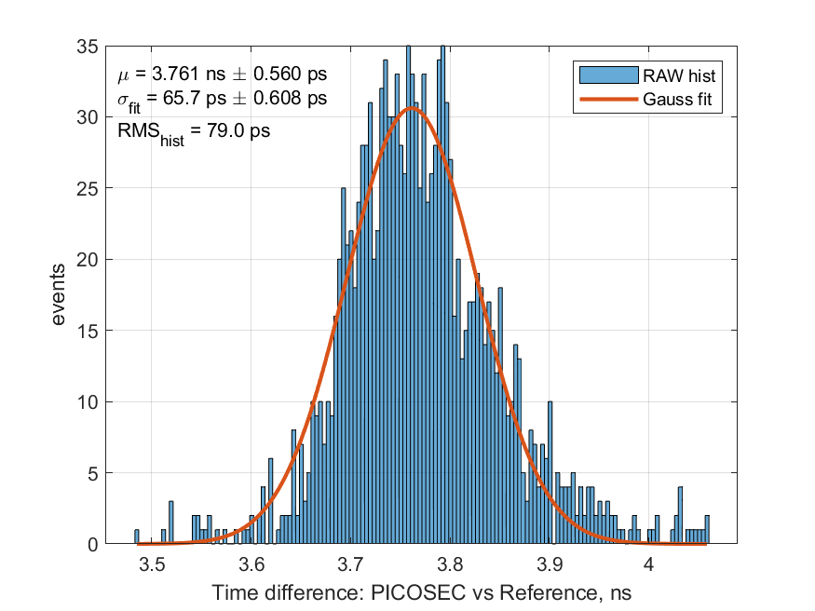
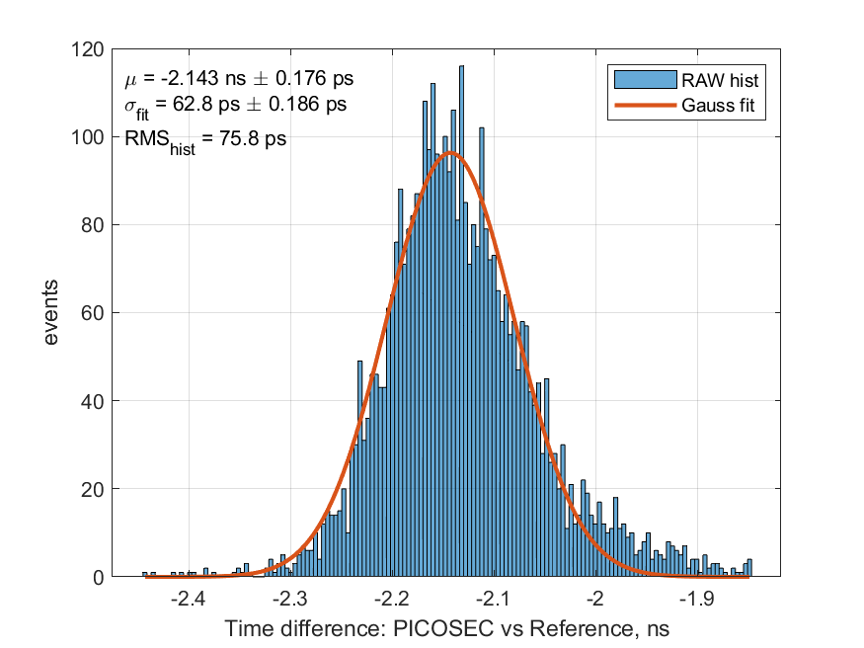
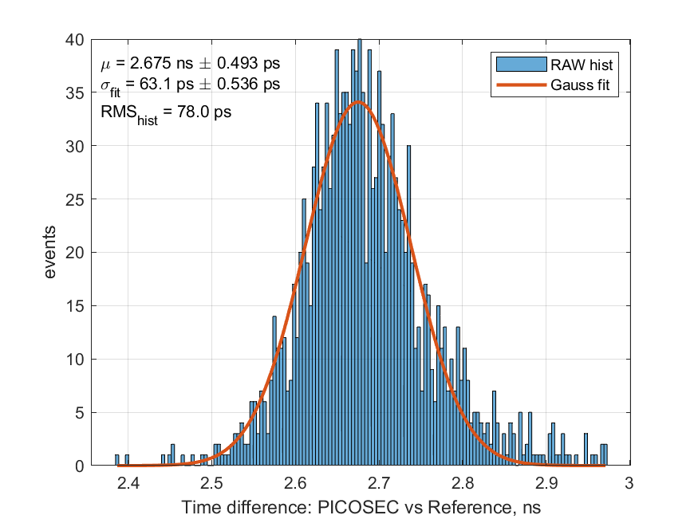
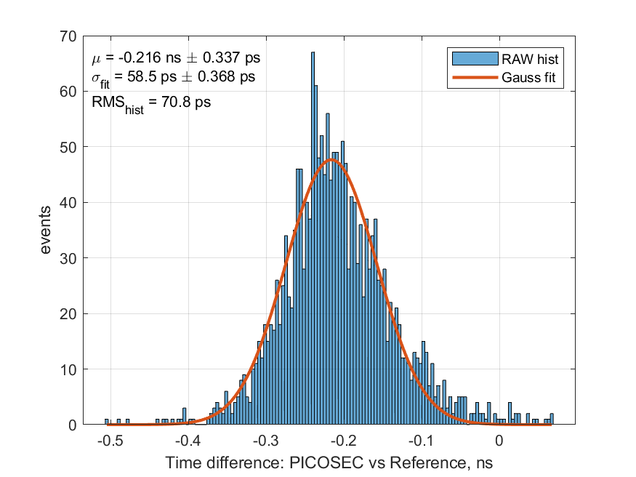
µRWELL-PICOSEC: Hole diameter comparison (07/2023)
July test beam (07/28): DLC photocathode
Single-pad prototype Alu vessel housing with long wires connection to prototype ground ➔ degrades timing
4 prototypes with different µRWELL holes parameters
2 × 140 µm pitch & outer / Inner diam 70 / 50 µm
2 × 120 µm pitch & outer / Inner diam 85 / 65 µm
Larger holes for same pitch ➔ better timing
Hypothesis:
Straighter field lines in pre-amplification gap to holes = shorter, uniform electron drift time
Smaller Cu-to-hole area ratio ➔ smaller input capacitance seen by FE pre-amplifier
smaller pitch ➔ better timing
Hypothesis: Same reason as above
More in next slides
σ = 66 ps
σ = 63 ps
T150-P140-D70
T150-P140-D85
σ = 63 ps
σ = 58 ps
T150-P120-D70
T150-P120-D85

Slide 16
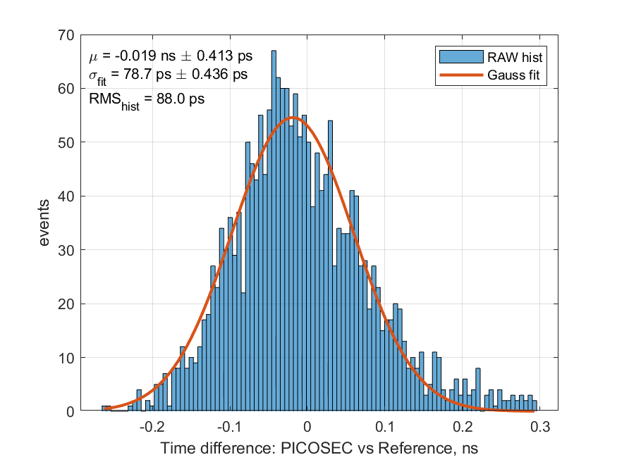
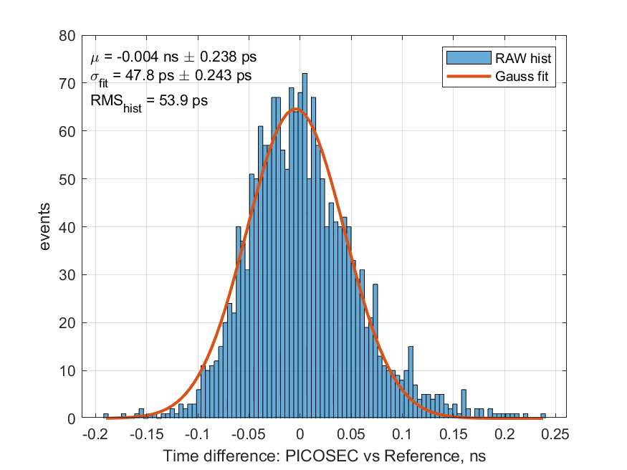
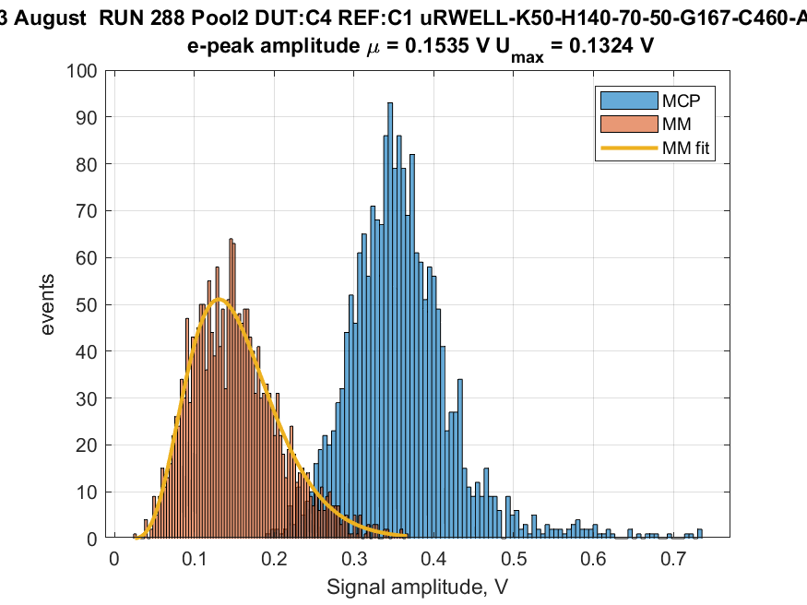
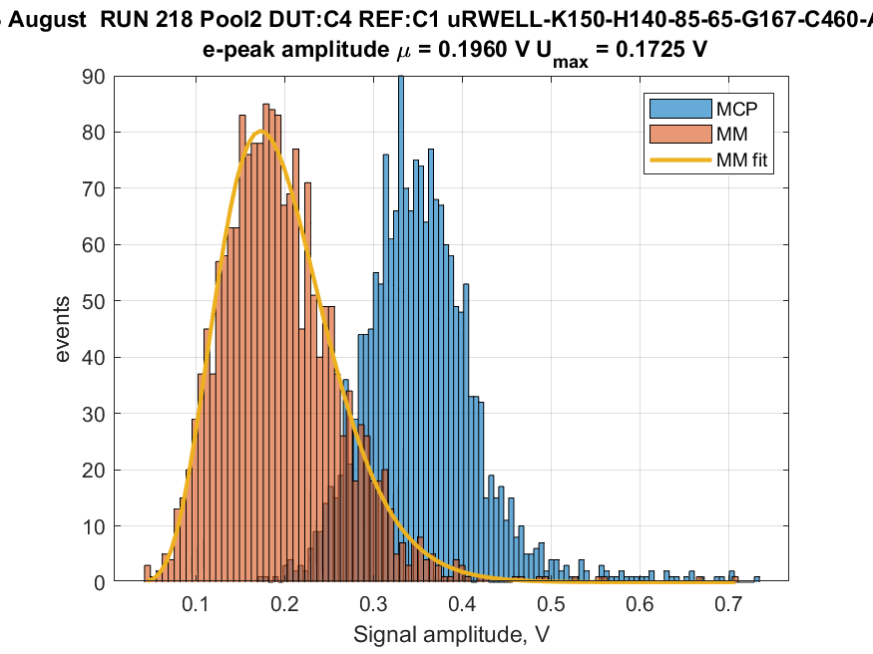
µRWELL-PICOSEC: Kapton thickness comparison (08/2023)
August test beam (08/28):
With CsI photocathode.
2 prototypes with different µRWELL holes parameters
Kapton thickness 50 µm - P/OD/ID: 140/70/50
Kapton thickness 150 µm - P/OD/ID: 140/70/50
Thicker Kapton ➔ better timing
Smaller capacitance between the pad and the µRWELL layer
σ = 79 ps
σ = 48 ps
T50-P140-D70
T150-P140-D70
uRWELL foil
0.15V
0.2V
DLC layer
T
Kapton
Pad electrode
PCB support
Cross section view of µRWELL-PICOSEC PCB
T50-P140-D70
T150-P140-D70

Slide 17
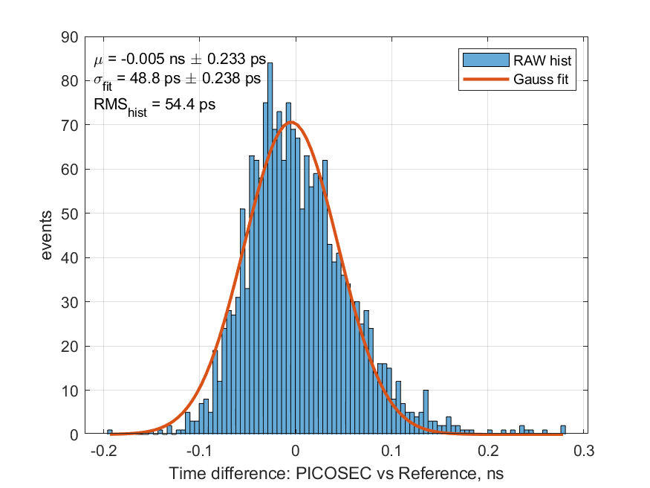
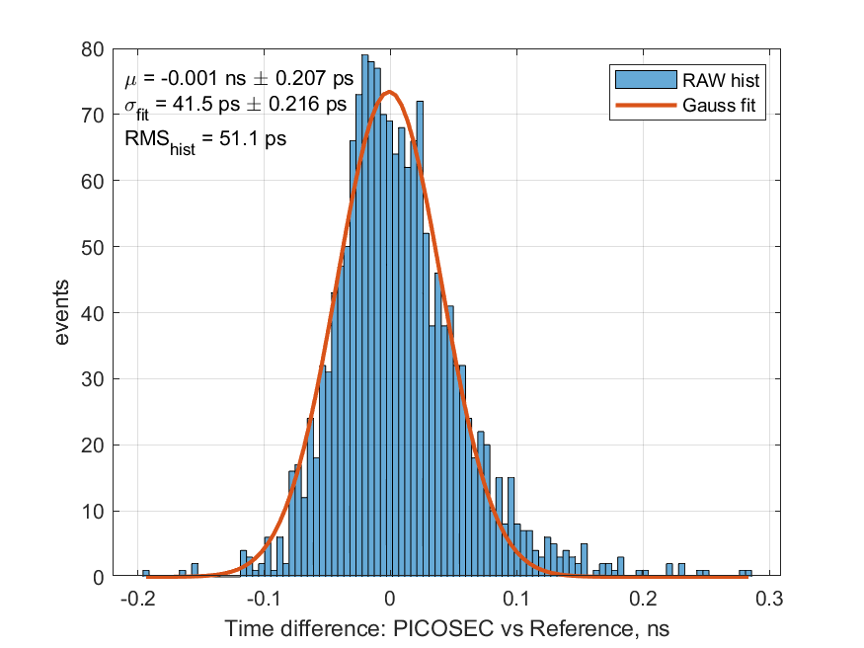
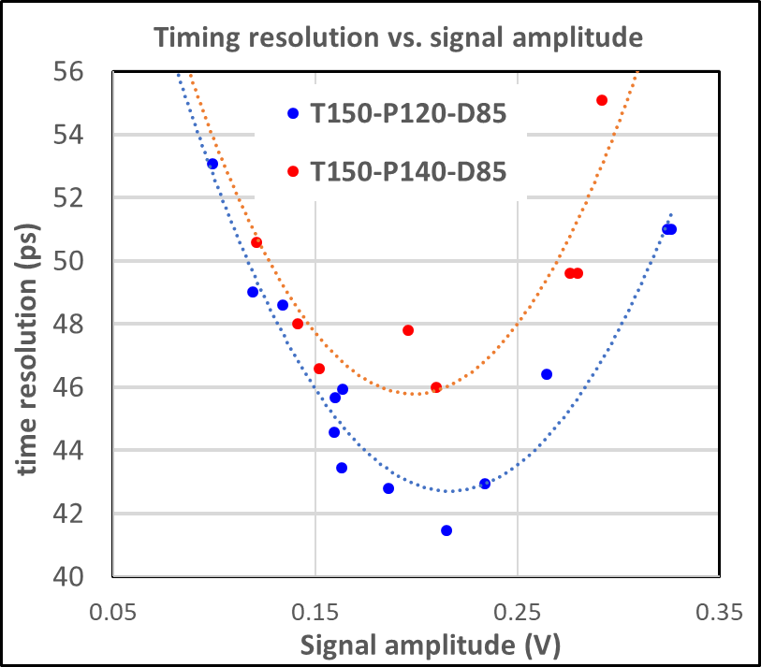
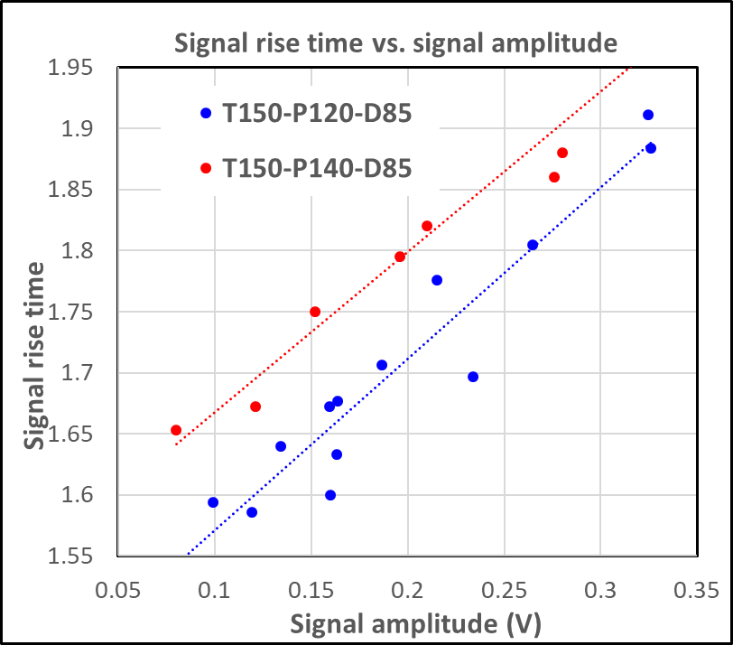
µRWELL-PICOSEC: Hole pitch comparison (08/2023)
August test beam (08/28): CsI photocathode
2 prototypes with different µRWELL holes parameters
140 µm & 120 µm pitch, outer / Inner diam 85 / 65 µm
smaller pitch ➔ better timing
Hypothesis:
Straighter field lines in pre-amplification gap
Smaller Cu-to-hole ratio ➔ smaller input capacitance
HV scan runs: Combination of µRWELL HV scan (amplification) and cathode HV scan (pre-amplification)
Signal amplitude of µRWELL-PICOSEC pad as variable
Timing has a minimum (optimal) at ~ 0.2 - 0.25 V ➔ explanation under investigation
Signal rise time: defined as the width of the distribution of the signal arrival time (SAT) w.r.t. MCP timing (ref) ➔ proportional to signal amplitude
σ = 49 ps
σ = 42 ps
T150-P140-D85
T150-P120-D85

Slide 18
Outline
Introduction and concept of picosecond timing Micro Pattern Gaseous Detectors (MPGDs)
Development of µRWELL-PICOSEC detector @ JLab (LDRD FY22).
Preliminary results: Impact µRWELL hole parameters on timing performance
Ongoing R&D and approaches to address challenges of µRWELL-PICOSEC.

Slide 19
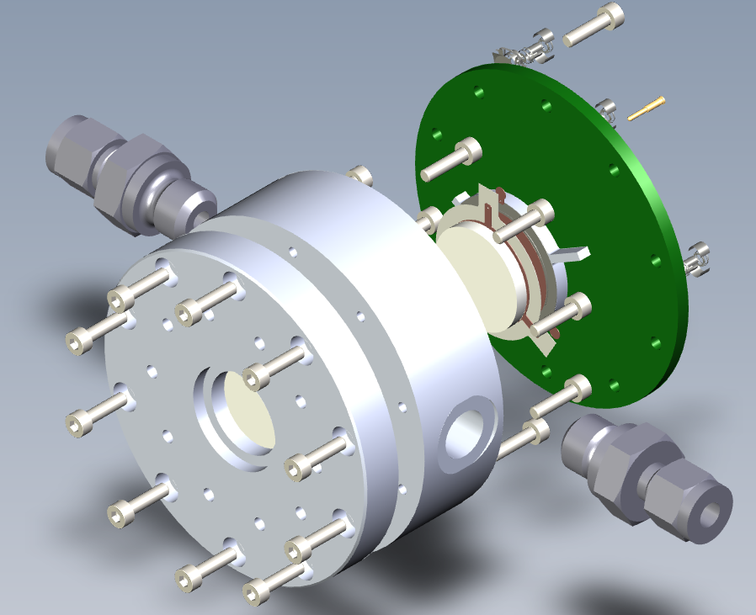
µRWELL-PICOSEC: Next steps ➔ Plans for 2024 test beam
New housing for single-channel prototypes
New holes geometries for µRWELL amplification
Courtesy Antonija Utrobicic
D: diam
size
pitch
Minimize external source of noise (i.e grounding, cables pick-up antenna …)
Makes it easier to quickly exchange prototypes (replacement of
P: pitch
Round holes (RD)
Round holes (RD)
Prototype | Shape | P | D | d
SQ-T150-P120-D100 | square | 120 | 100 | 80
RD-T150-P120-D100 | round | 120 | 100 | 80
RD-T150-P100-D80 | round | 100 | 80 | 60
RD-T150-P80-D60 | round | 80 | 60 | 40
Minimize external source of noise (i.e grounding, cables pick-up antenna …)
Makes it easier to quickly exchange prototypes (replacement of µRWELL-PCBs, photocathodes) during beam test

Slide 20
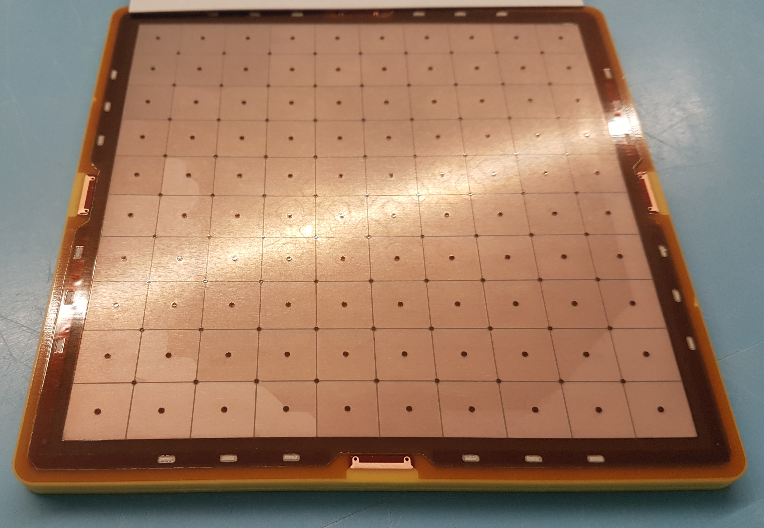
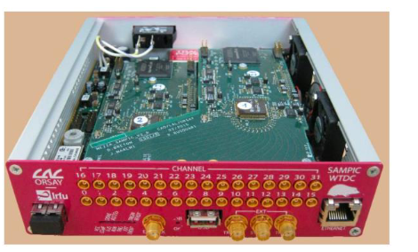
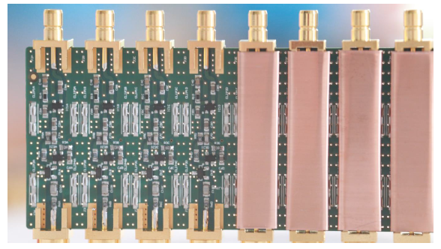
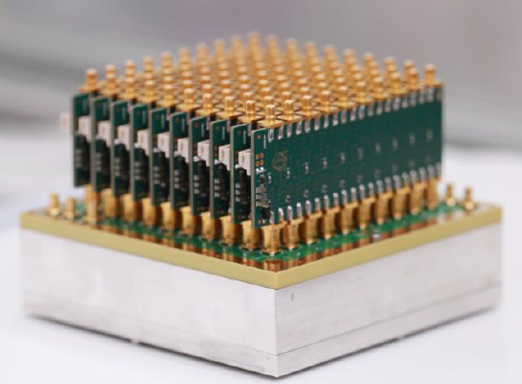
µRWELL-PICOSEC: Next steps ➔ Plans for 2024 test beam
Large 100-pad prototypes (Micromegas & µRWELL)
Multi channel digitizer SAMPIC (D. Breton, CEA Saclay)
https://indico.cern.ch/event/396441/contributions/1836629/attachments/794757/1089389/02_SAMPIC_Prague.pdf
100-pad µRWELL-PICOSEC & MM-PICOSEC prototypes
Parameters based on single-channel prototypes studies
Mechanical housing fabricated in the JLab machine shop
Same housing for MM-PICOSEC & µRWELL-PICOSEC
Multi-channel readout PCB interface board under development
MM-PICOSEC used as reference detector
Large prototypes will be tested in beam at CERN in FY24
Multi-channel custom-made pre-amplifier (M. Kovacic, U. of Zagreb)

Slide 21
Summary
Fast timing MPGD detector with picosecond level timing resolution is a very promising and fast emerging field pioneered by the development of Micromegas-based MM-PICOSEC detector by the PICOSEC collaboration at CERN
Fast timing MPGD can be option of choice for large area cost effective for Time of Flight (TOF) detector in HEP and NP field as well as in the field of medical instrumentation
The resistive micro-Well µRWELL detector is an alternative technology ideally suited for PICOSEC technology and share synergy with the MM-PICOSEC
Single-channel (1-cm diam.) µRWELL-PICOSEC prototypes have been developed and tested during two CERN RD51-PICOSEC test beam campaigns in summer 2023
Preliminary from the prototypes show promising results with < 42 ps time resolution achieved with MIPs and with CsI photocathode and suggest that with a careful optimization of the µRWELL geometry, one can reach a timing resolution in the order of 20 ps.
Large-area (10 cm × 10 cm) µRWELL-PICOSEC prototype with 100-pads readout and optimized µRWELL holes pattern is under fabrication for study in beam in 2024.
The research described in these slides was conducted under the Laboratory Directed Research and Development (LDRD) Program at Thomas Jefferson National Accelerator Facility for the U.S. Department of Energy

Slide 22
Back-up

Slide 23
µRWELL-PICOSEC: The R&D effort at JLab
LDRD: Development of large-area picosecond timing detectors based on Resistive Micro Well for experiments at JLab and at the EIC
Develop µrPICOSEC prototypes and demonstrate the proof of concept with the timing performance.
Design µRWELL amplification / multi-channel readout to combine with Cerenkov radiator and photocathodes.
Optimize the mechanical structure for uniformity over large area (100 cm²) and thin gap (100 - 200 µm) prototypes.
Full characterization of the prototype with laser source and in beam as well as test in high magnetic field.
Achieve the goal of a timing resolution better than 50 ps for charged particle with first prototype.
Investigate alternative radiator and photocathode materials.
Cesium Iodide (CsI) is unstable under humidity and susceptible to aging due to ion bombardment.
We will explore alternative and more robust photocathode materials with similarly high photoelectron yield.
Investigate ideas of focusing optic devices integrated with radiator for precise position measurement in addition to timing.
Implement multi-channel fast electronics readout and DAQ system for µrPICOSEC detector.
Lab bench precision measurement of the timing performances of µrPICOSEC prototypes.
Development of readout and DAQ system for 100-pads channels for µrPICOSEC prototypes.

Slide 24
µRWELL-PICOSEC: Potential operation modes
Timing detector for relativistic charged particles:
Cerenkov radiator crystal transparent in VUV region
High quantum efficiency (QE) photocathode in VUV medium ~ 7 photoelectrons for 3 mm MgF2
Goal for timing resolution (~25 ps)
Applications:
Time of Flight detector
T0 detector
Single photon photodetector:
High quantum efficiency (QE) photocathode in (VUV) medium which is most radiated by any radiator medium
Window transparent to Cerenkov radiation
High gain for single photon timing goal of ~50 - 70 ps
Applications:
Photosensor for RICH detectors
T0 tagger at neutrino detector (liquid Ar scintillator light)
Charged particle
Photon
Cerenkov radiator
Glass window

Slide 25
µRWELL-PICOSEC: Alternative technologies
This R&D target
This R&D target
Time of Flight (TOF) detectors
Photosensors for Cerenkov detectors
 | MRPCs | AC-LGAD | µrPICOSEC
Time resolution (ps) | 20 – 70 ✓ | 20 ✓ | 25 ✓
Rate (MHz / cm²) | 0.05 ✗ | N/A | > 1 ✓
Position resolution (mm) | ~ 10 ✗ | 0.030 ✓ (claim) | < 1mm ✓
Performance in high B-field | Yes | Yes | Yes ✓
module size | 20 × 20 cm² ✓ | N/A | 20 × 20 cm² ✓
Cost ($ M / m²) | 0.2 – 0.4 ✓ | High ✗ | 0.2 – 0.4? ✓
 | SiPMs | MCP-PMTs | LAPPDs | µrPICOSEC
Time resolution (ps) | < 100 | < 100 | 50 ✓ | 50 ✓
Position resolution (mm) | > 1✗ | 1✗ | 0.3 – 1 ✓ | < 1 ✓
Performance in high B-field | Yes | Limited | Limited | Yes ✓
Radiation hardness | dark current ✗ | N/A | N/A | Yes ✓
Cost ($ M / m²) | 0.8 – 1 ✗ | > 1 ✗ | 0.8 – 1 ✗ | 0.2 – 0.4 ✓

Slide 26
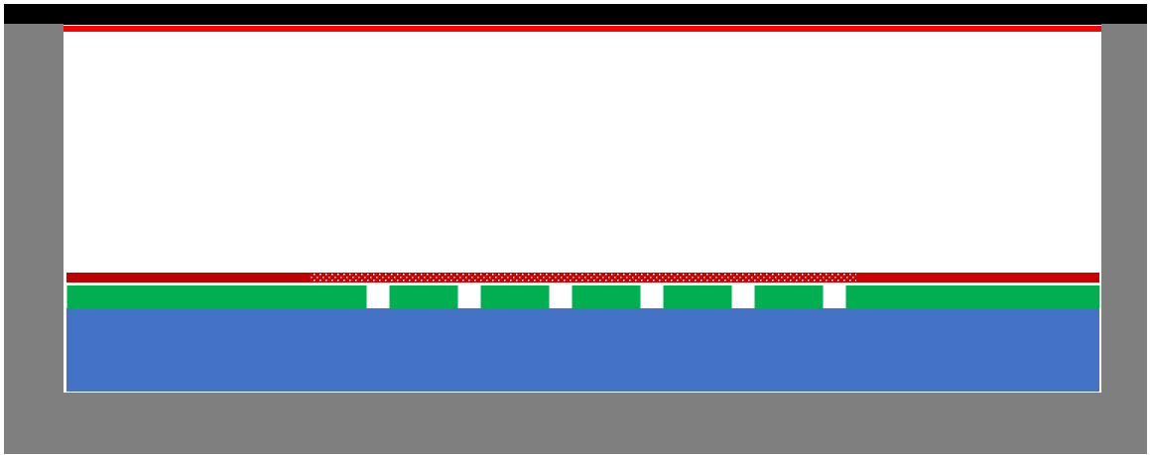
µRWELL-PICOSEC vs. standard µRWELL detector
 | Standard µRWELL detector | µrPICOSEC: picosecond uRWELL detector
Primary electrons production | Ionization of gas molecule by charged particles, typically, 3 mm gas ➔ limitation for timing performance | Charged particles creates Cerenkov photons in radiator ➔ photons conversion in photocathode ➔ produced photoelectrons
Amplification mechanism | Primary charges drift to µRWELL amplification stage ➔ amplification with typical gain of 10⁴ | Photoelectrons are pre-amplified in high e-field in 100 to 200 um gas then a second amplification by µRWELL ➔ total gain can reach 10⁷
Signal collection structures | Strips, pads, large capacitance, high rate | Pads, small capacitance critical for high S/N
Position resolution | ~50 to 100 µm space point resolution | To be evaluated
Timing resolution | ~ 4 ns with specific gas mixture | Goal: 25 ps for charged particle Goal: 50 to 100 ps for single photon detection
Area of application | Tracking: large-area, low-cost, precision position | PID: Time of flight (TOF) & photosensors for Cerenkov detectors
Standard µRWELL
µrPICOSEC
3 mm
gas
0.1 mm gas

Slide 27
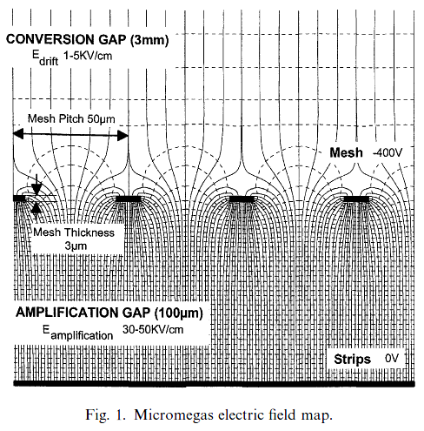
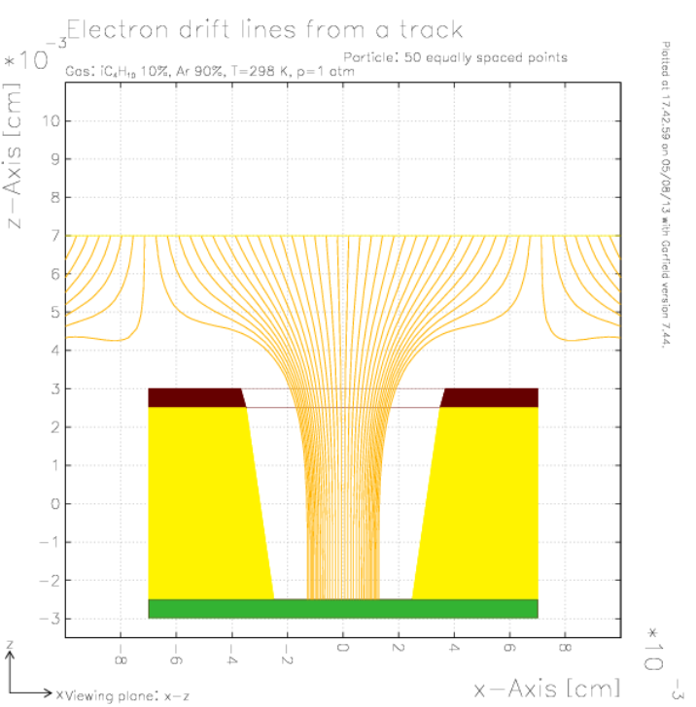
µRWELL vs. Micromegas: Drift Field Lines
MM-PICOSEC
µRWELL-PICOSEC
Mesh pitch = 50 µm
Mesh width = 3 µm
Holes pitch = 150 µm
Mesh diameter = 70 µm

Slide 28
Gas mixture choices
Lukas Sohl
RD51 miniweek 11/02/2020

Slide 29
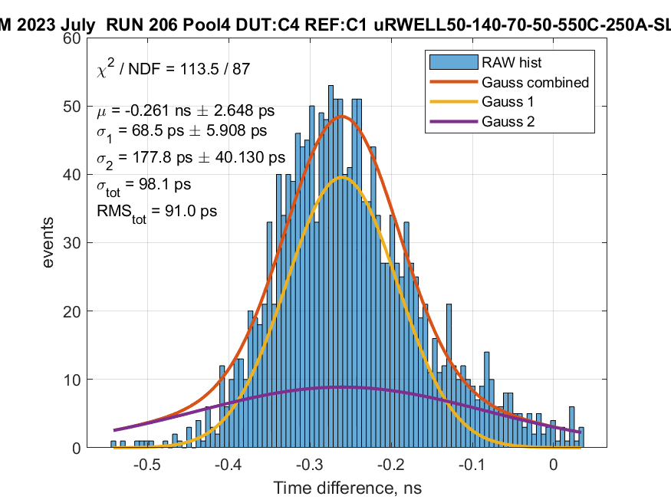
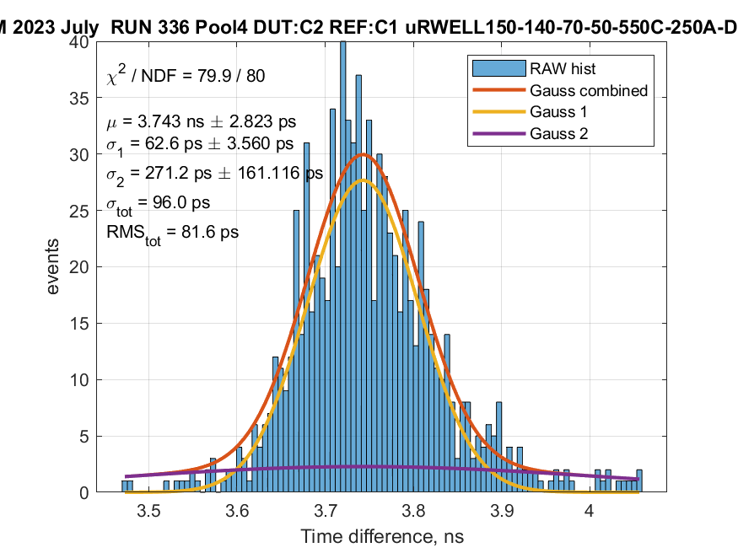
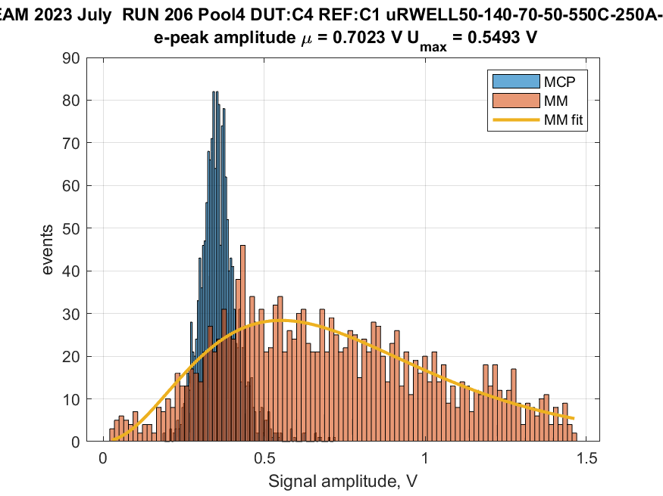
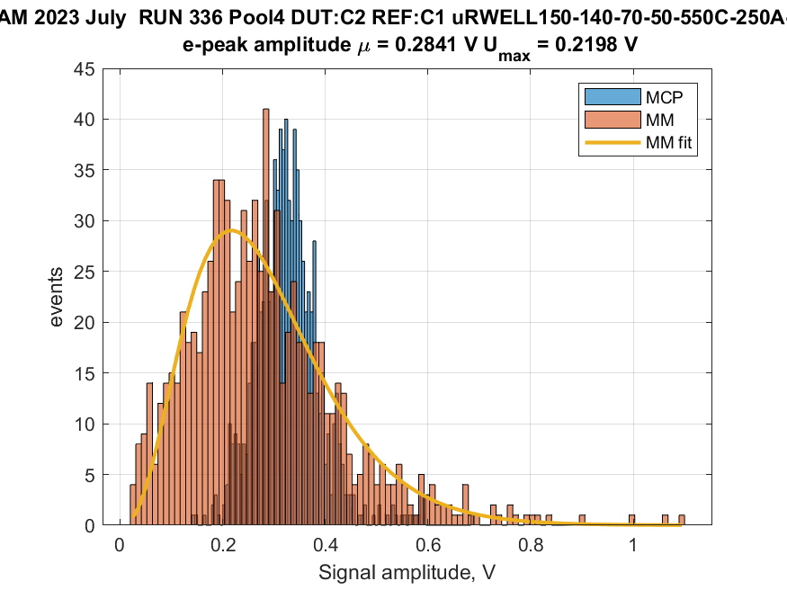
µRWELL-PICOSEC: Kapton thickness comparison (07/2023)
First µRWELL-PICOSEC prototype
Single-pad small prototype
1 cm diameter active area
3 mm thick radiator + DLC photocathode
Sensor: 50 µm µRWELL on 50 µm Kapton
Holes parameters: 140 µm / 70 µm / 50 µm
First tests with LED source (GDD lab, 12/2022)
Poor timing compared to MM-PICOSEC
RMS = 91 ps
RMS = 82 ps
T50-P140-D70
T150-P140-D70
uRWELL foil
DLC layer
T
Kapton
0.7V
0.28V
Pad electrode
PCB support
Cross section view of µRWELL-PICOSEC PCB
T50-P140-D70
T150-P140-D70

Slide 30
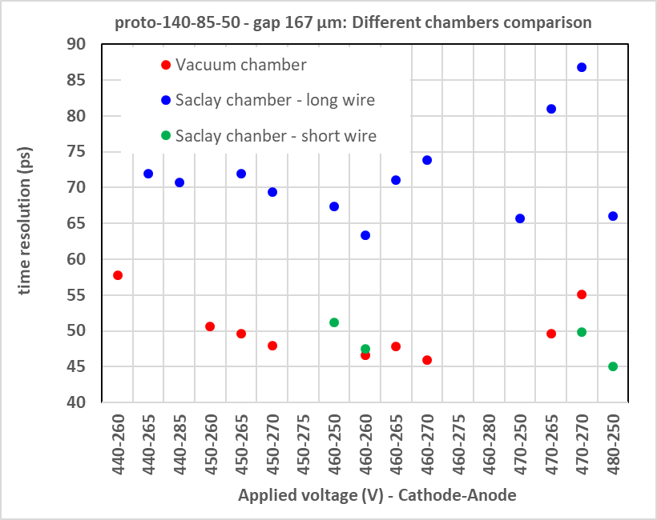
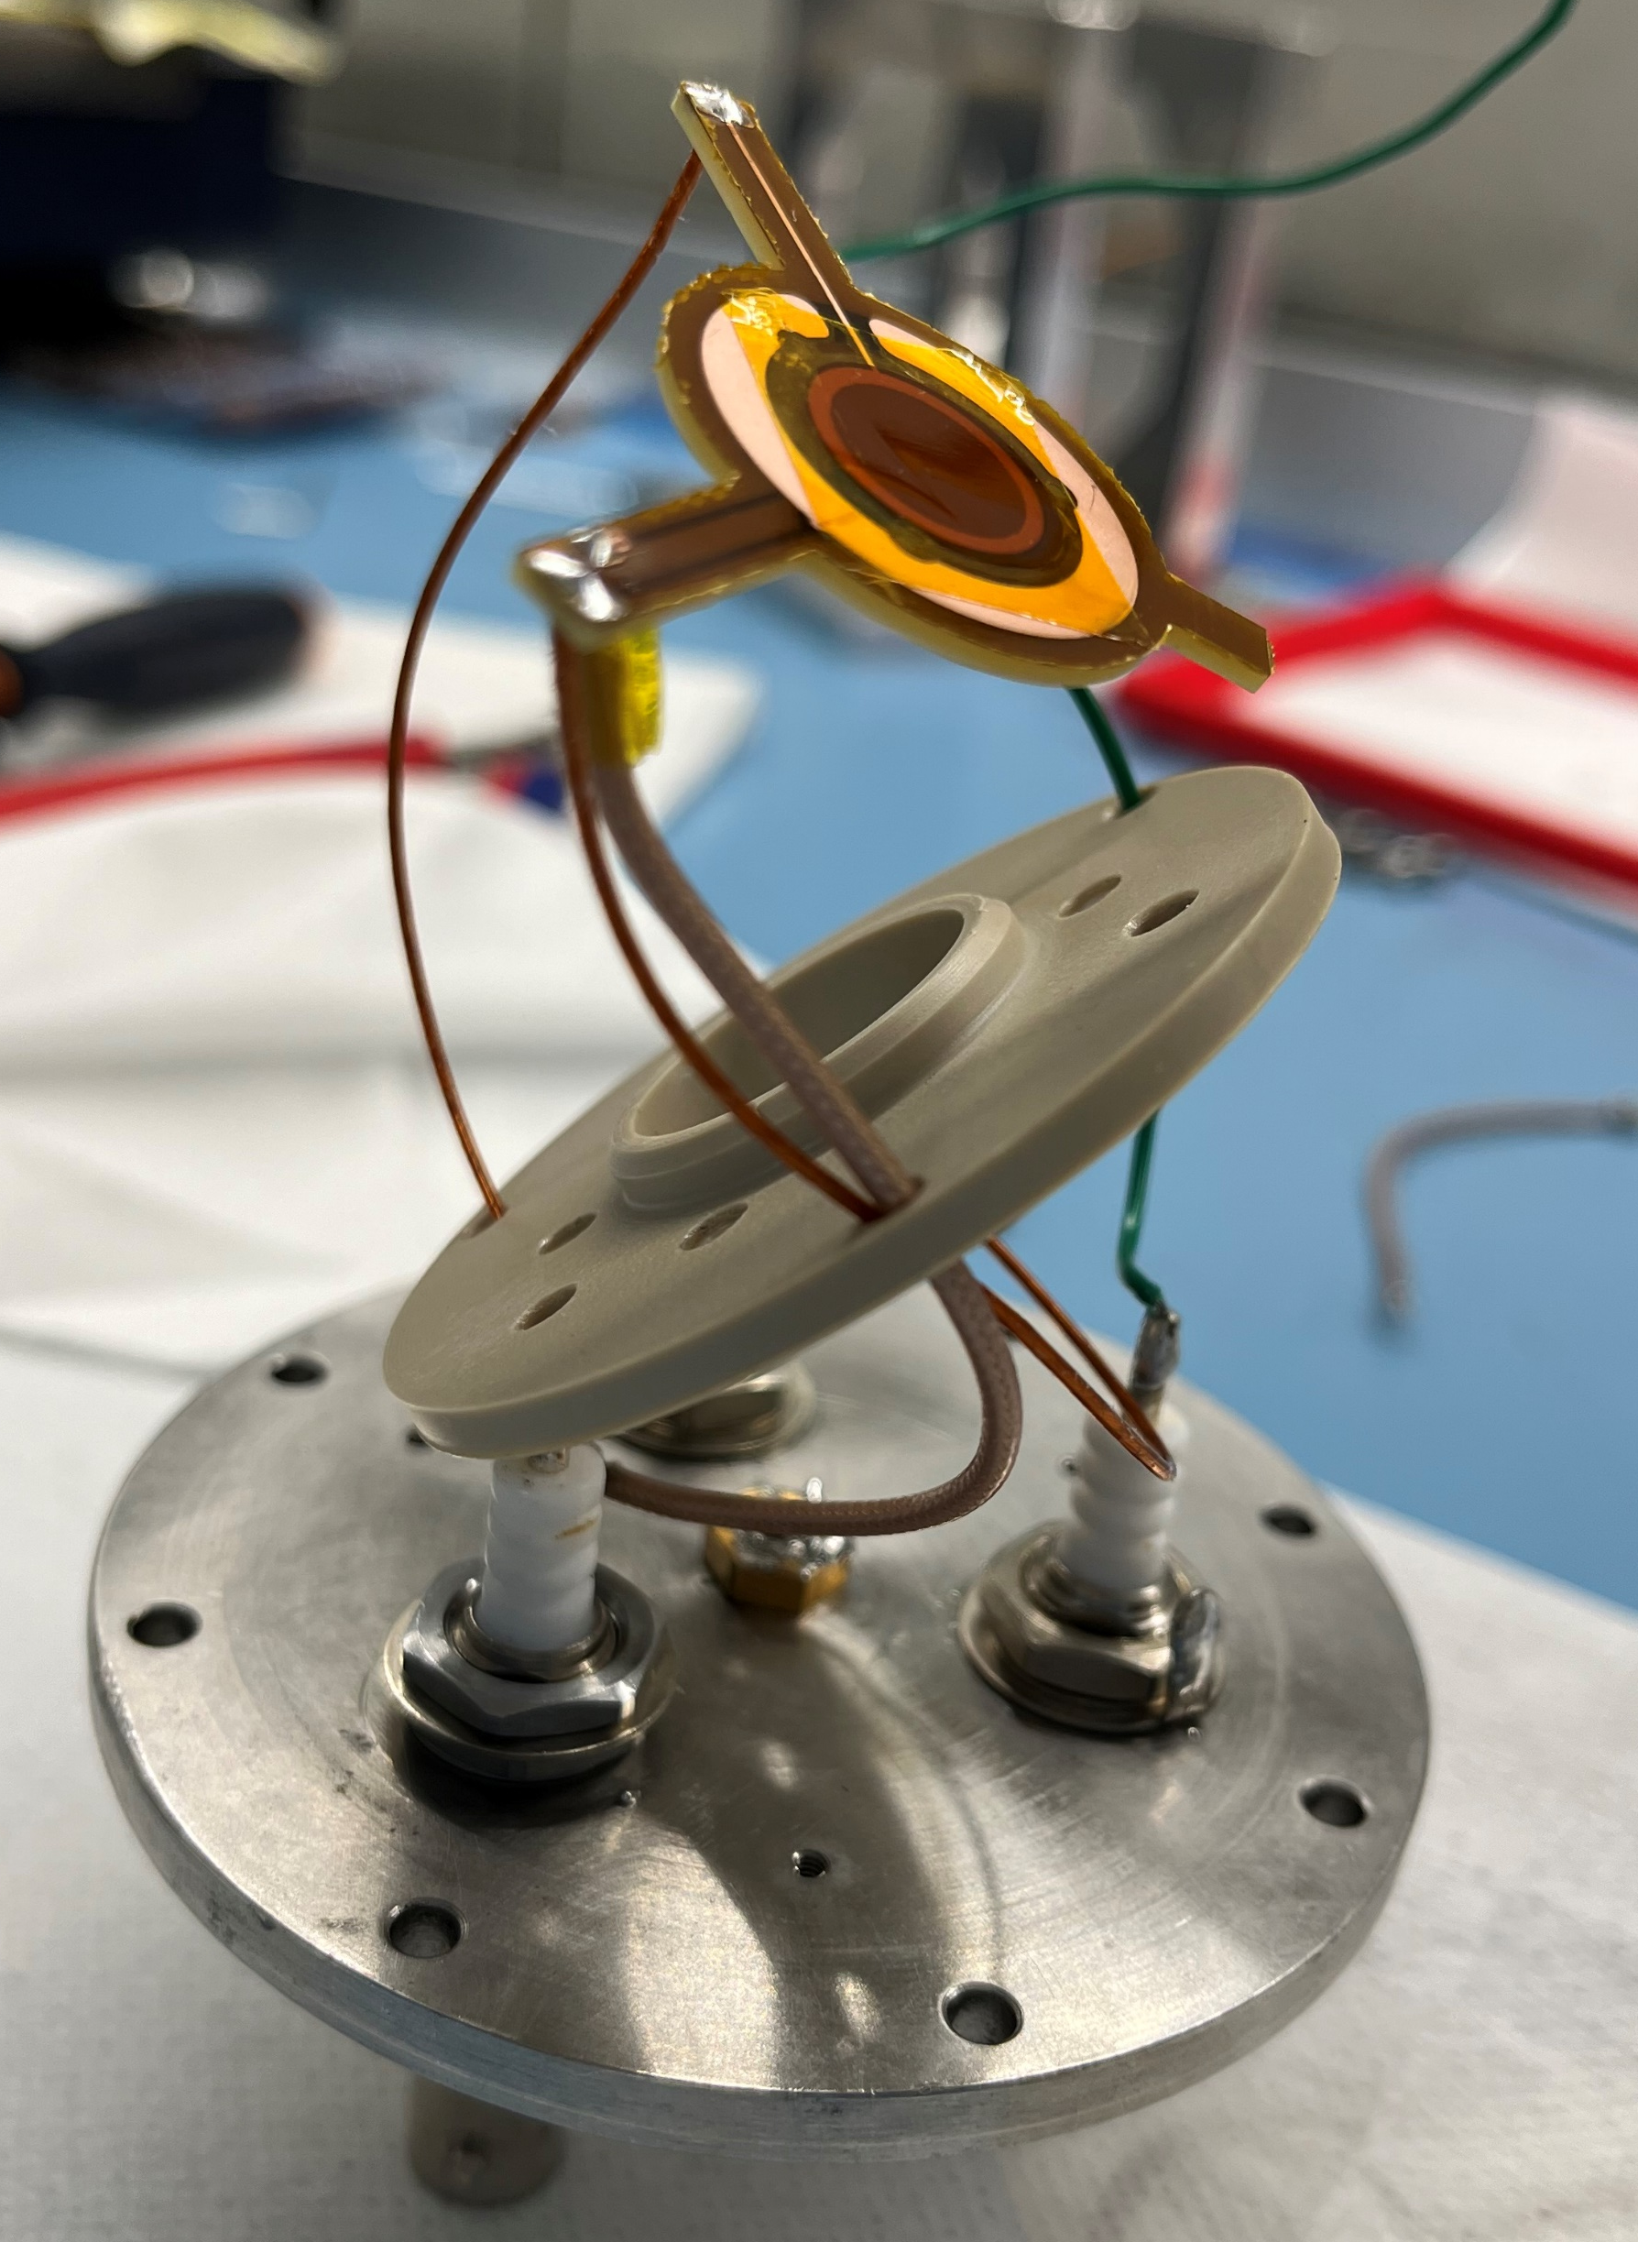
µRWELL-PICOSEC: External source of noise (08/2023)
µRWELL-PICOSEC prototype
Single-pad small prototype 1 cm diameter active area 3 mm thick radiator + CsI photocathode Sensor: 50 µm µRWELL on 50 µm Kapton
Holes parameters: 140 µm / 70 µm / 50 µm First tests with LED source (GDD lab, 12/2022)
Poor timing compared to MM-PICOSEC
T150-P140-D85
long wires in chamber 2
short wires in chamber 2
Short wires in chamber 1

