Slide 1
News from Jefferson Lab
Douglas Weadon Higinbotham, Ph.D.
Physics Division Senior Staff Scientist
Division Liasson to Accelerator and Chair of Experiment Scheduling Committee
29 October 2023

Slide 2
Bad News First
After several decades of operating behind the scenes, one of our high power, 1 Megawatt, dumps has experienced as series of leaks.
The leaks are in ”building 91” which is the small pump house behind Hall A. ( I had been at JLab on and off since 1993 and never had any reason to see building 91. )
210 gallons leaked the first time and after that was fixed a second leak developed which has caused the lab to cancel the short A_{LL} experiment.
Silver Lining
Hall A is now in an extended down which should give plenty of time for the leaks to be addressed.
By design, building 91, has a large sump and the water was captured and the water from the first leaks has already even been moved to a storage tank.

Slide 3
Jefferson Lab is going to become a multi-purpose lab.
Since the Lab’s start, it has been what DOE considers a single purpose lab. (i.e. one main funding source, DOE NP)
It was recently announced that JLab will host a large High Performance Data Facility (HPDF) https://hpdf.jlab.org/
This facility will be funded by DOE Advanced Scientific Computing Research (ASCR) funds and means that Jefferson Lab will because a multi-purpose lab.
THE VISION: An advanced computational facility that accelerates scientific discovery across DOE Office of Science programs by providing large-scale, high-performance computing to accelerate and maximize scientific insight.
A twin of this facility will be built on the west coast at LBNL and this will be done in partnership with Jefferson Lab.

Slide 4
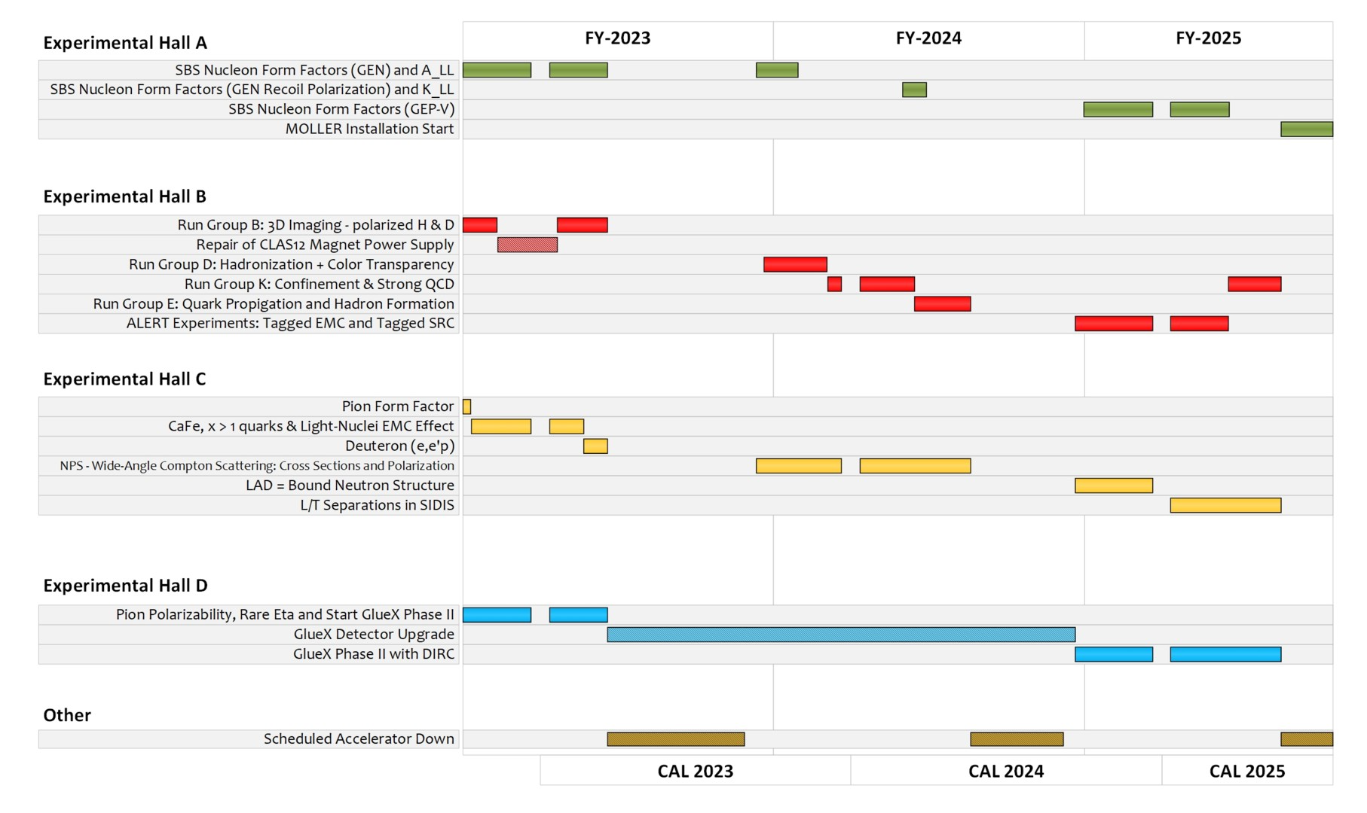
Schedule as posted online October 2023: https://www.jlab.org/physics/experiments/schedule

Slide 5
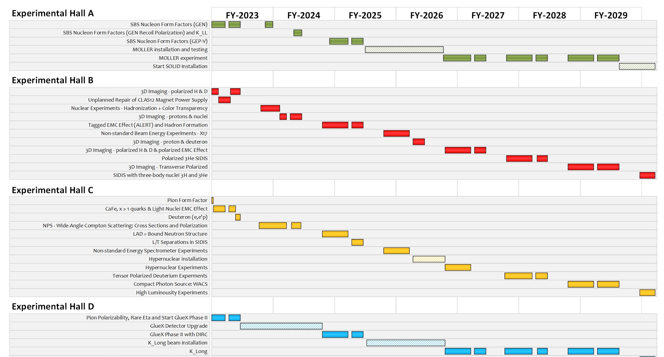
Safety Pauses Shifted Upcoming Schedule Out By Two Months And Is Not Yet Shown On This Figure.
TENATIVE LONG TERM CEBAF SCHEDULE
Use only to get a general picture of the future and not for exact dates!

Slide 6
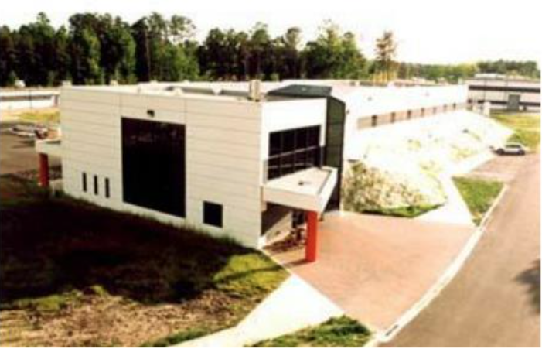
Low Energy Recirculator Facility (LERF) as the New Injector Facility for CEBAF
123 MeV e+
(650 MeV e-)
Inject e⁺ into North Linac to usual 12 GeV (w/ magnets reversed)
Build e⁺ injector at the LERF
Build new LERF to CEBAF tunnel
123 MeV e+
(650 MeV e-)
Build new transport line along South Linac and West Arc

Slide 7
PAC51 Positron Proposal Results
NUMBER | TITLE | CONTACT PERSON | HALL | DAYS REQUESTED | DAYS AWARDED | SCIENTIFIC RATING | PAC DECISION
PR12+23-002 | Beam Charge Asymmetries for Deeply Virtual Compton Scattering on the Proton at CLAS12 | Eric Voutier | B | 100 | 100 | A- | C1
PR12+23-003 | Measurement of Deep Inelastic Scattering from Nuclei with Electron and Positron Beams to Constrain the Impact of Coulomb Corrections in DIS | Dave Gaskell | C | 9.3 | 9.3 | A- | C1
PR12+23-005 | A Dark Photon Search with a JLab positron beam | Bogdan Wojtsekhowski | B | 60 |  |  | Deferred
PR12+23-006 | Deeply Virtual Compton Scattering using a positron beam in Hall C | Carlos Munoz Camacho | C | 137 | 137 | A- | C1
PR12+23-008 | A Direct Measurement of Hard Two-Photon Exchange with Electrons and Positrons at CLAS12 | Axel Schmidt | B | 55 | 55 | A | C1
PR12+23-012 | A measurement of two-photon exchange in unpolarized elastic positron–proton and electron–proton scattering | Michael Nycz | C | 56 | 56 | A- | C1
C1 = Conditionally Approved w/Technical Review by the Lab
Approved 155 PAC days in Hall B and 202 PAC days in Hall C for a total of 357 PAC days!
Three years of single hall running at 34 weeks per year. (One PAC day = Two calendar days)

Slide 8
EXTREMELY ROUGH Timeline CEBAF’s Future
Phase 1 includes building a positron source and the tunnel & beamline connecting the source to main machine.
Phase 2 includes the new permanent magnets to allow 22 GeV within current CEBAF footprint.
NOTE: Plan was formulated so that these projects are ramping up as the EIC project cost is ramping down.

Slide 9
Final Thoughts
Very strong partnership on the EIC project! EIC is a lot of ”JLab physicist” so lots of opportunities for our user committee to get involved (if you haven’t already).
The Jefferson Lab accelerator is now performing extremely well at 1047 MeV/c per linac plus injector energy (~10.5 GeV at 5th pass)
This is the same energy as last year’s run where the machine had many trips.
As machine continues to improve, we will look to push to the energy up. For reference, MOLLER requires an energy of between 10.6 and 11 GeV, so getting close.
Isgur Fellow Dr. Dien Nguyen has accepted a tenure track job at the Univ. of Tennessee so a posting for the experimental Isgur fellow will post any day now. Lots of academic freedom (though the boss can be tough). Talk to Dien if you want to learn more about this unique fellowship opportunity.
Many other jobs open at the lab, so if you are looking for positions, please keep an eye on the JLab job postings: https://www.jlab.org/recruiting
Jefferson Lab’s future looks very bright and is looking forward to many more decades of world case science!

