Slide 1
ePIC SVT Outer Barrel
James Glover
on behalf of EIC-UK WP1 (MAPS)
EIC UK meeting @ York
Fri, 1st March 2024

Slide 2
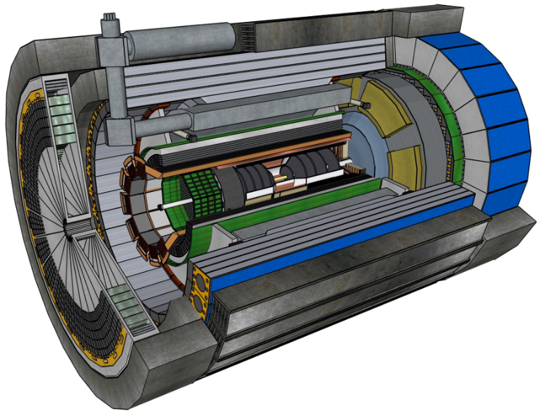
The ePIC detector
ePIC is the first detector to utilise the new electron storage ring of EIC.
  Added to the existing proton/ion beams of RHIC.
ePIC will be replacing the STAR detector (at IP6).
  Benefiting from the preexisting infrastructure, assembly hall, and control & DAQ room.
Inner (tracking) detector consists of:
  Silicon Vertex Tracker (SVT).
  Multi Pattern Gas Detectors (MPGD).
  AC-LGAD based Time of Flight (ToF).

Slide 3
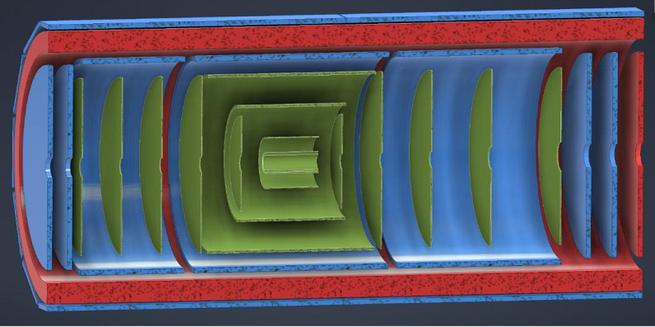
ePIC Silicon Vertex Tracker (SVT)
The ePIC SVT will be the combination of 5 barrel layers and 10 endcap discs.
  3 Inner Barrel (IB) layers – same curved, wafer-scale stitched MAPS used within ITS3.
  2 Outer Barrel (OB) layers – longer than IB, optimised sensor for EIC.
    Focus of EIC-UK WP1 (MAPS).
  5 discs for Electron and Hadron (going) Endcaps (EE/HE).
    Same optimised sensor as OB.
(MAPS – Monolithic Active Pixel Sensor)
Inner Barrel (IB)
3 curved layers
Outer Barrel (OB)
2 stave-based layers
SVT
MPGDs
ToF (fiducial volume)
Electron/Hadron Endcaps (EE, HE)
5 discs on either side of the IP

Slide 4

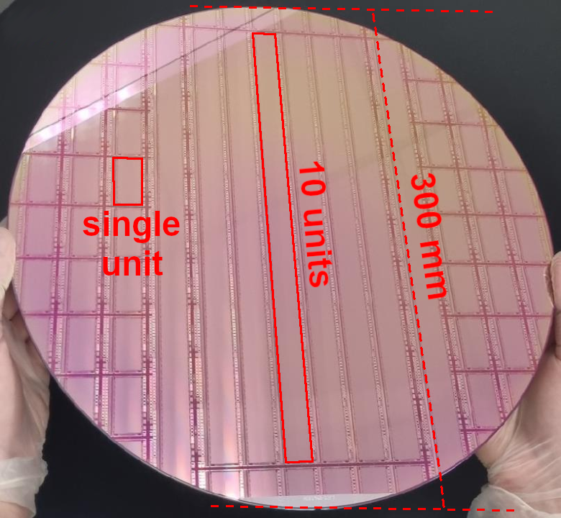
Stitched MAPS
Stitching means that MAPS can be fabricated up to full wafer scales.
  Unstitched fabrication was limited to structures that could fit in 1 “reticule”.
  The equivalent of a single unit.
This larger pixel array can be configured, with everything interconnected “on-wafer”.
  Only need connections at the extreme ends for data/power/slow controls.
  Wafer-scale stitched MAPS to be thinned and curved in ALICE ITS3 and ePIC SVT IB layers.

Slide 5
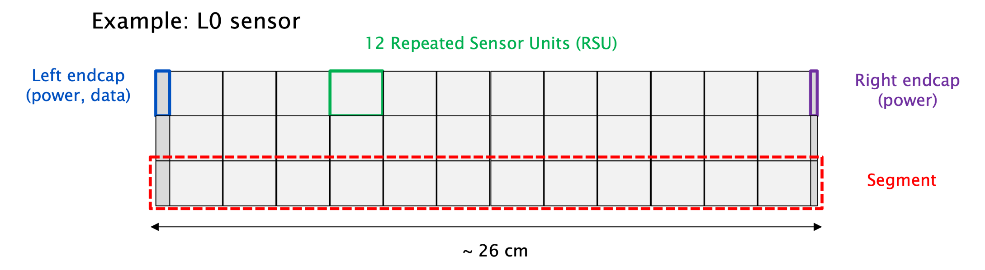
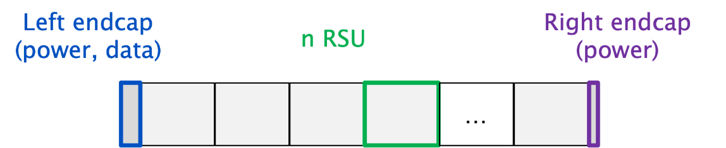
MAPS for EIC
IB example: L0 sensor
RSU:
Wafer-scale sensor used in IB.
EIC-LAS (Large Area Sensor) is the EIC optimised sensor variant to help minimise the material required due to service (data/power/control) connections and improve yield for large area coverage.
  For OB, EE, and HE of SVT.
LEC:
REC:
From: https://wiki.bnl.gov/EPIC/index.php?title=Si_Vertex_Tracker
IB | – | Inner Barrel
OB | – | Outer Barrel
EE | – | Electron (going) Endcap
HE | – | Hadron (going) Endcap
SVT | – | Silicon Vertex Tracker
LEC:
REC:
(stitching plan termination)
EIC-LAS

Slide 6
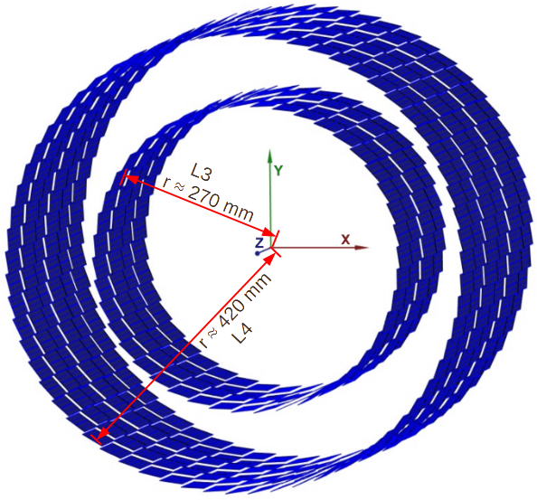
Outer barrel
2 stave-based layers (L3 and L4) of stitched MAPS.
Stave repeated around the Z-axis until number of staves fully cover the circumference (at required radii).

Slide 7
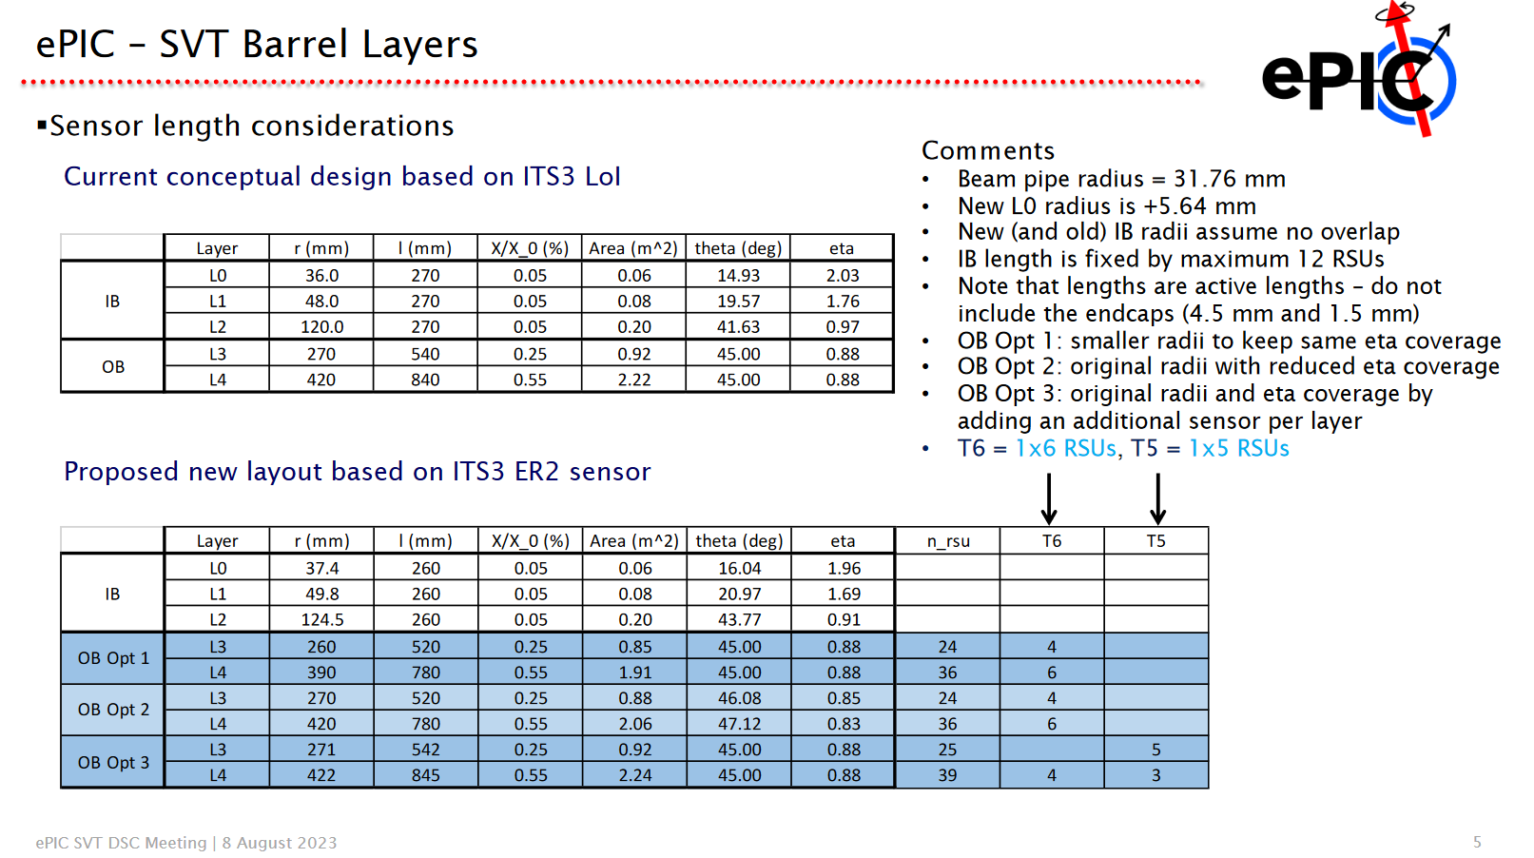
Initial stave considerations
Initial stave length/EIC-LAS considerations made by Peter Jones.
https://indico.bnl.gov/event/20219/contributions/79348/attachments/49030/83511/EIC-SVT-08Aug23.pdf

Slide 8
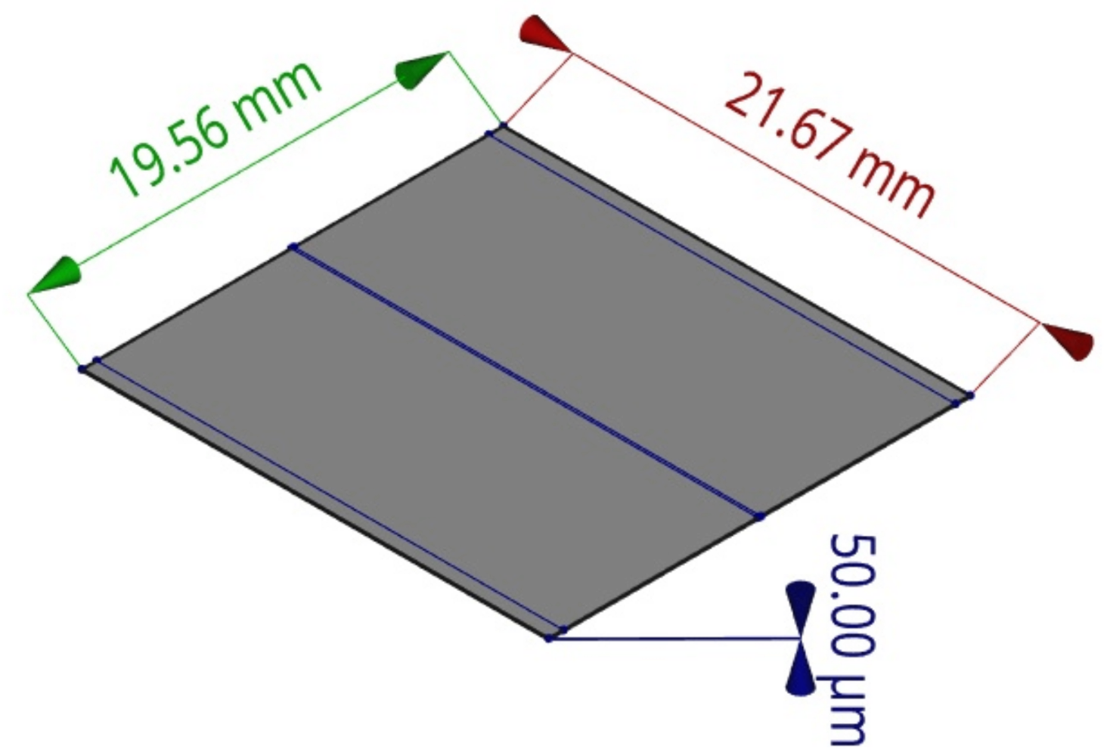
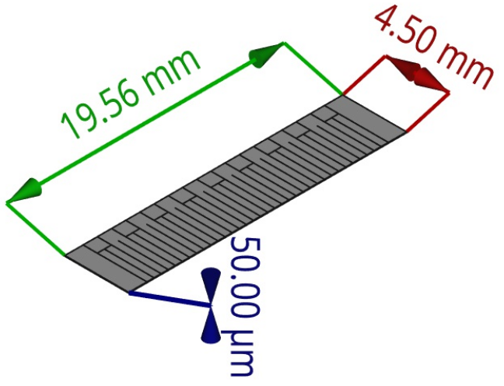
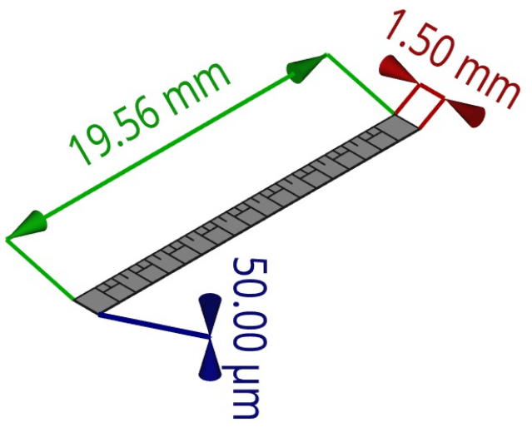
Start from smallest standard parts
Started with “smallest” elemental parts.
  Repeated Stitched Units (RSUs).
  Endcaps (ECs).
    REC: Right endcap (stitching termination).
    LEC: Left endcap (power and data).
RSU
LEC
REC

Slide 9
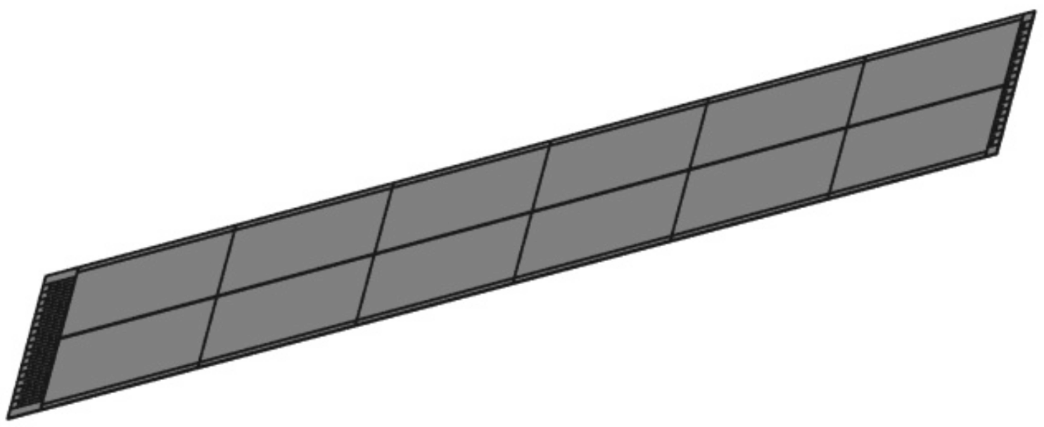
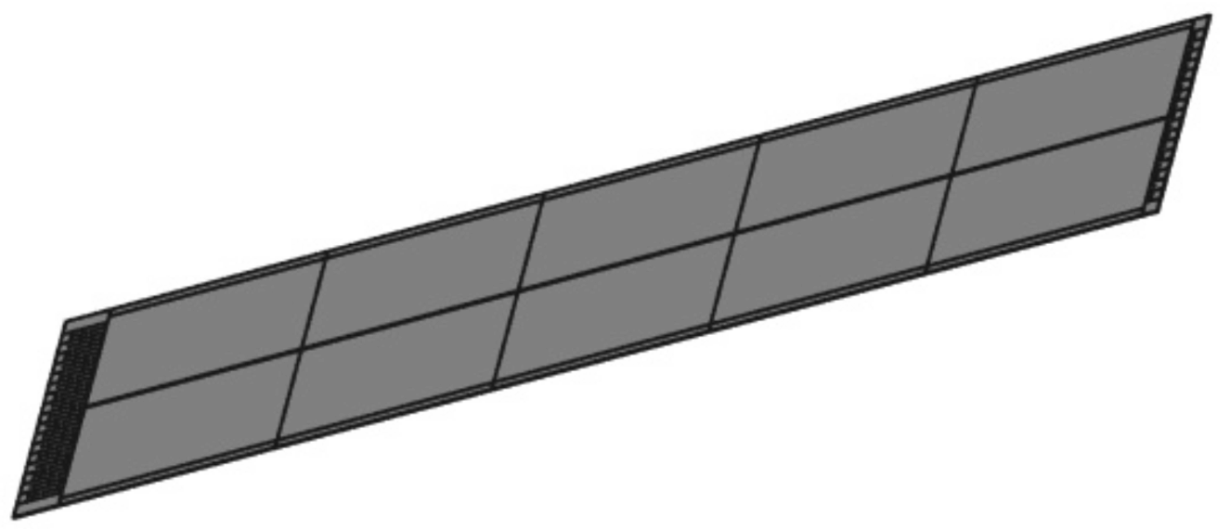
2 EIC-LAS lengths required
A segment is the name for the collection for stitched RSUs both a “Power and Data” and “Power Only” endcap (to terminate the stitching plan).
The aim is to have EIC-LAS (segments) with 6RSU (believed to be the longest we can power from just the LEC).
To realise the “OB Opt 3” from Peter’s slides, we would need an extra flavour of EIC-LAS:
  5RSUs in length (but still with both ECs).
1 2 3 4 5 6
1 2 3 4 5

Slide 10
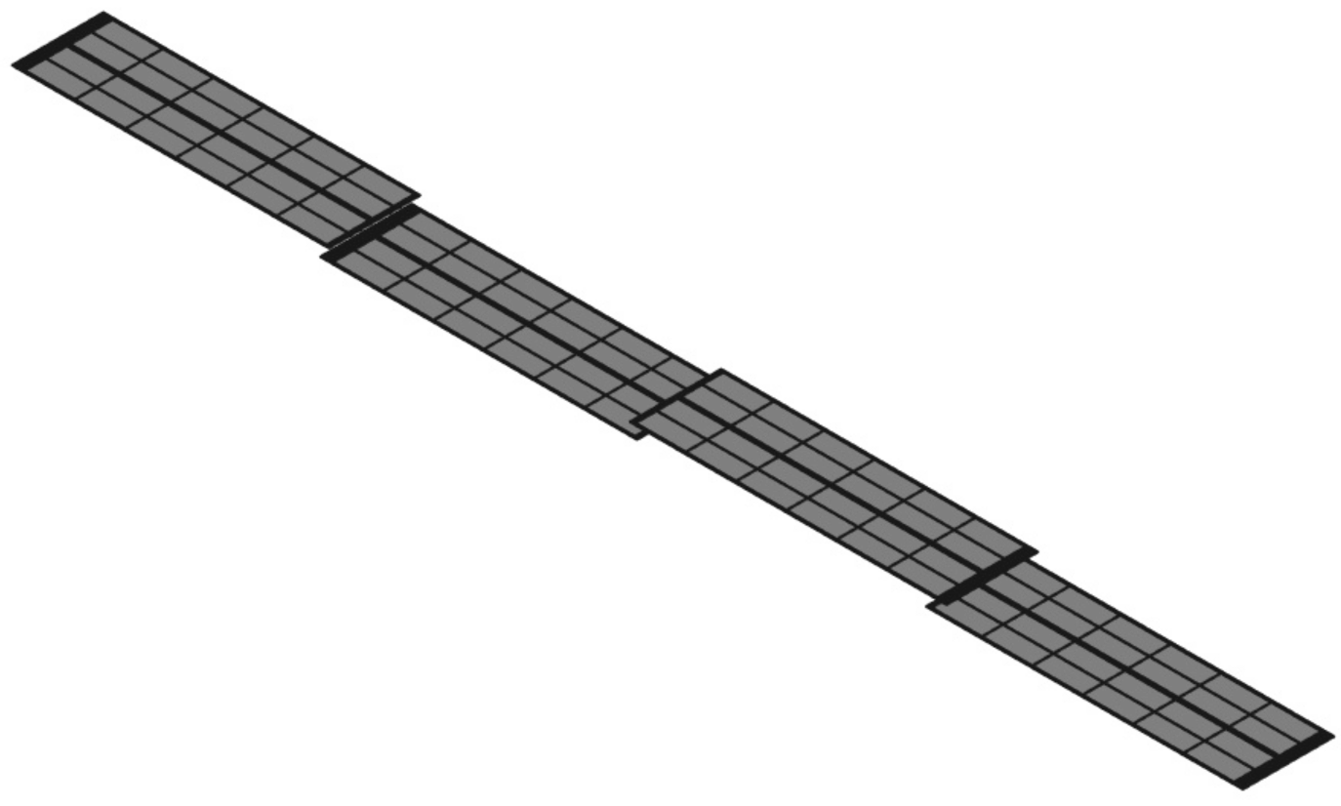
Construction of staves
Numerous stave structures are required for the OB layers (L3 and L4).
Peter also suggested different lengths and configurations for both L3 and L4 in his OB Opt 3.
  Layer length and for module configuration are the same for OB Opt 1 and 2.
To overlap the ECs of successive modules along the stave’s length, it has been suggested to place them on opposite sides of the stave structure.
L3 for OB Opt1 & 2 – Side view
L3 for OB Opt1 & 2 – Orthographic view
Services direction
Services direction

Slide 11

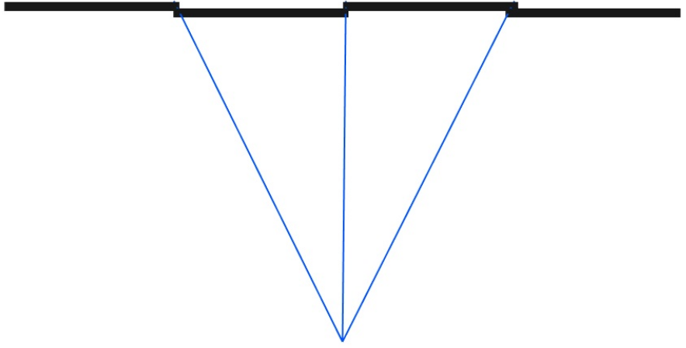
Overlapping modules along staves
Initial designs had no active area overlaps along the stave length.
1st step was to consider the overlap needed for an ideal interaction point (X=0, Y=0, Z=0).
  XY plane is perpendicular to the beam pipe (X=0, Y=0 is beam-pipe centre).
  Z-axis is parallel to the beam pipe (Z=0 is centre of barrel length).

Slide 12
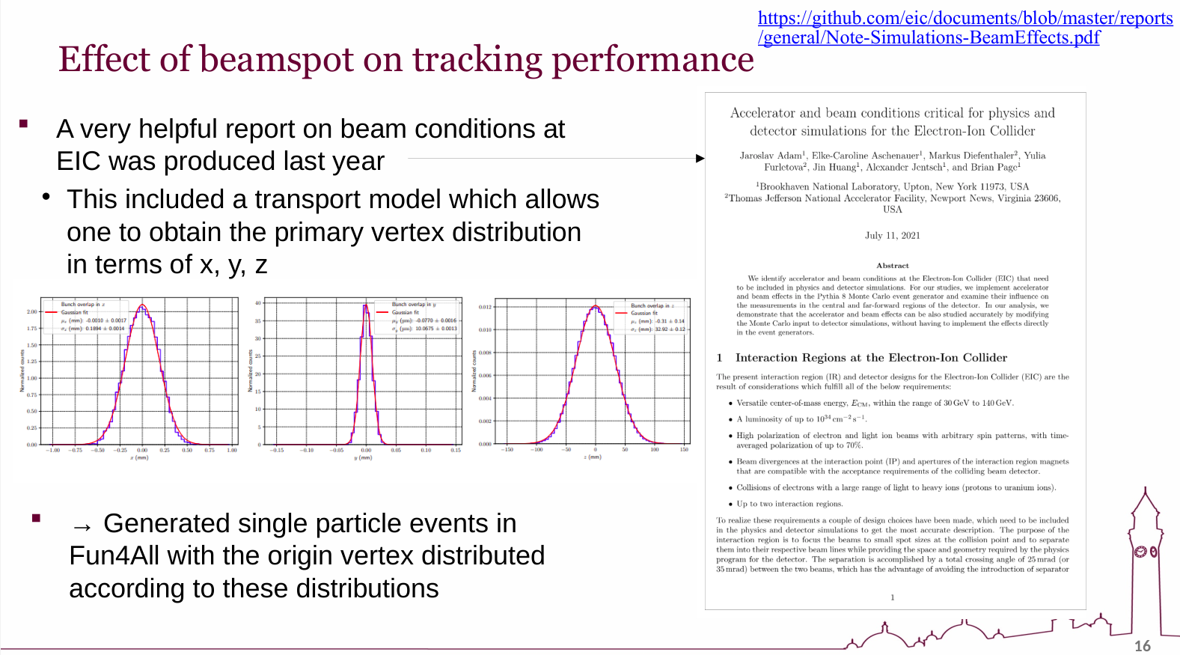
Interaction point variations
Summary from Stephen Maple, original information from here.
Important points (interaction point variation in):
X-axis = ± ~ 600 μm
Y-axis = ± ~ 30 μm
Z-axis = ± ~ 100 mm!

Slide 13
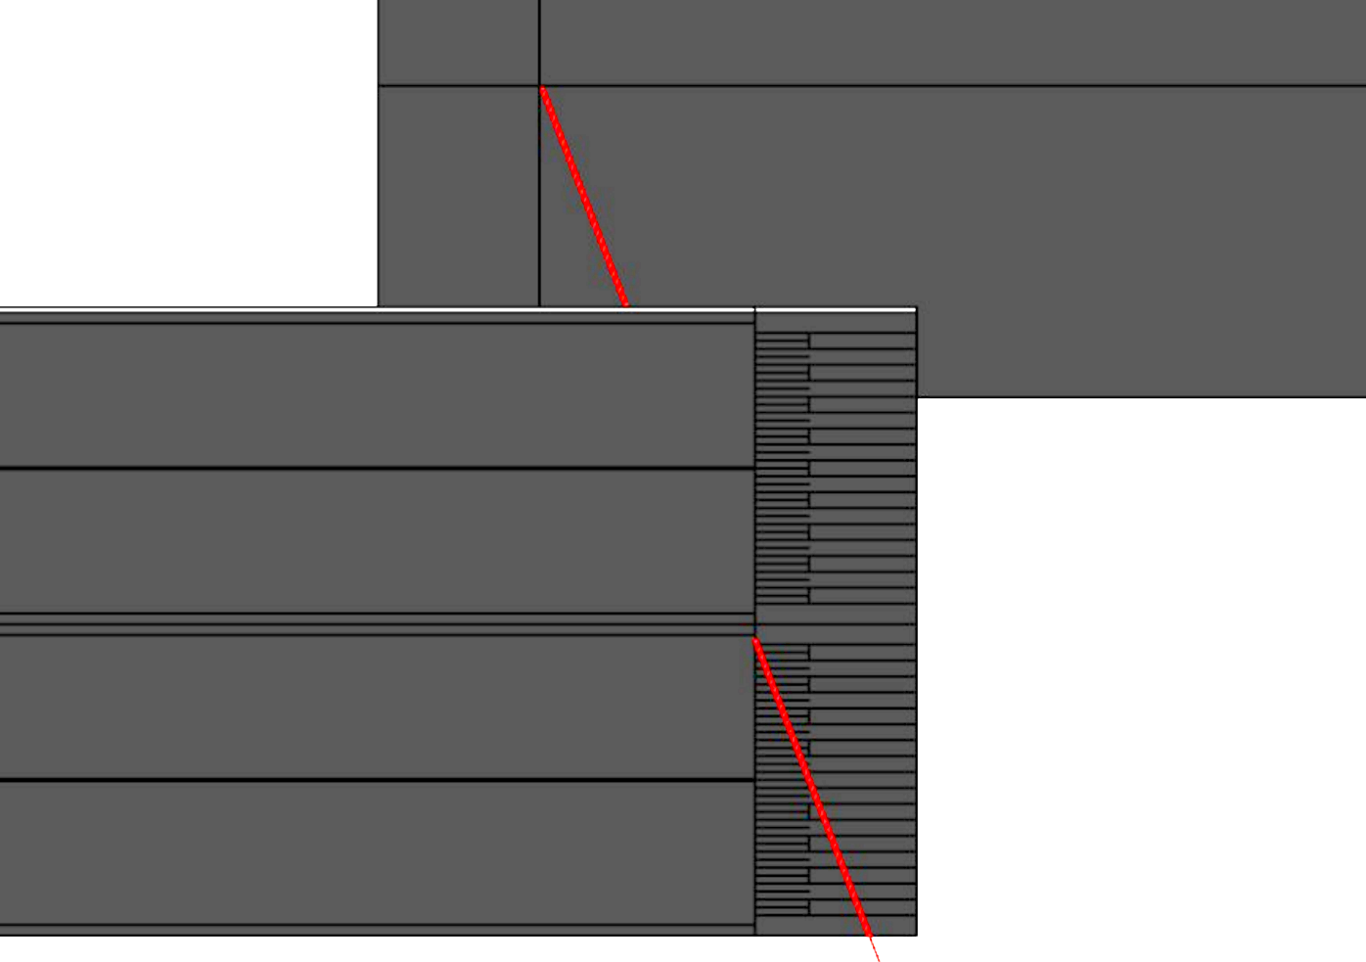
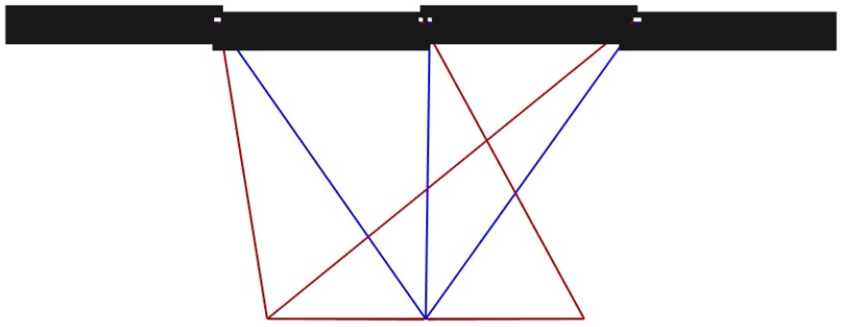
Accounting for IP variations
Variations for all axis can be considered, but as ΔX > ΔY and ΔZ >> ΔX, the Z-axis has the biggest influence.

Slide 14
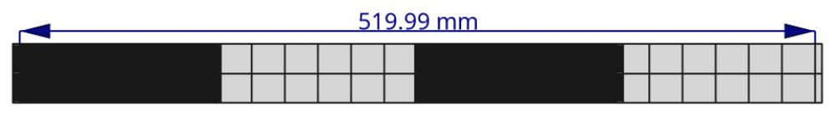
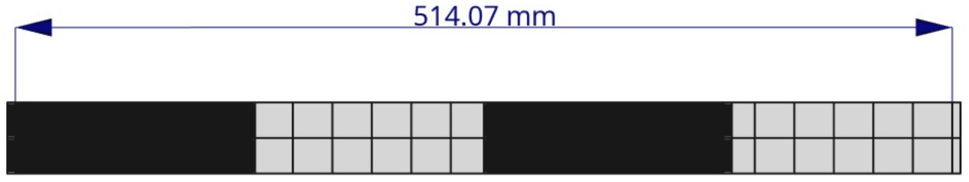
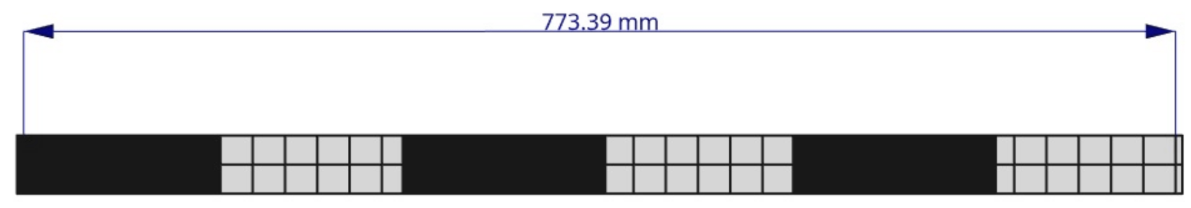
Stave length comparison
L3 for OB Opt 1 & 2 (no RSU overlap)
L4 for OB Opt 1 & 2 (no RSU overlap)
For Geometric Opt1, both L3 and L4 were reduced (in length) by ~1% (6 to 7 mm).
L3 for OB Opt 1 (overlap corrected modules)
L4 for OB Opt 1 (overlap corrected modules)

Slide 15
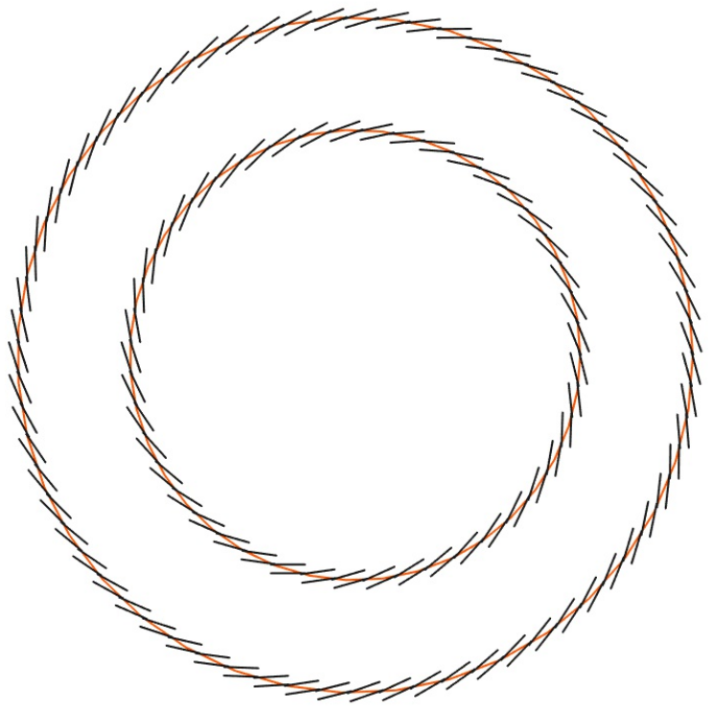
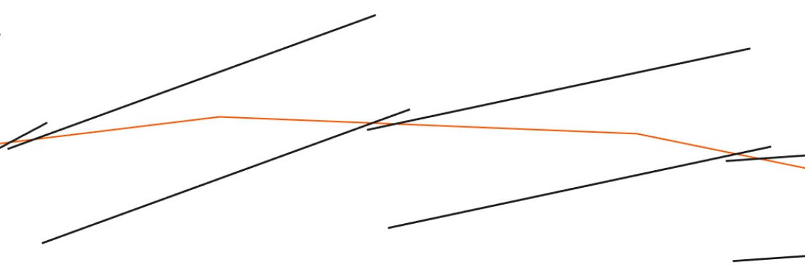
A tiled stave
A realistic number of staves accounted for.
Staves are inclined so that an entire stave overlaps the next stave.
  Each stave must slot in, between its neighbours.
  Might be challenging to replace a failed stave (remove many to get to 1).
Any number (odds) of stave can be used.
First module/stave structure
Next module/stave structure
External module layer
Ideal radius
Internal module layer

Slide 16
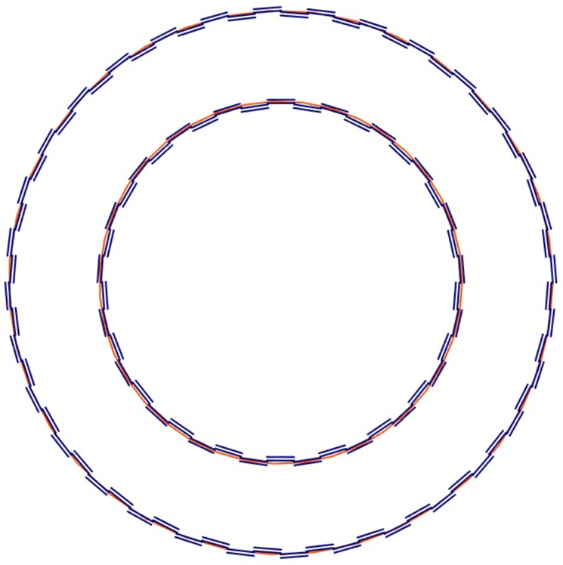
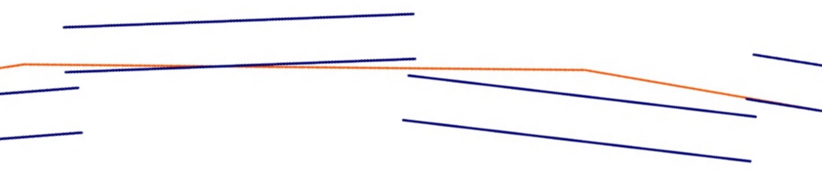
Castellated layout
Alternating inner/outer structure.
  Easier mounting/replacing (at most 3 staves removed to replace 1).
  Preferred for its “easier” mounting/replacing of staves.
Number of staves must be even.
Some overlap of staves (in both designs).
  To account to dead area at the sensor’s edge.
First module/stave structure
Next module/stave structure

Slide 17
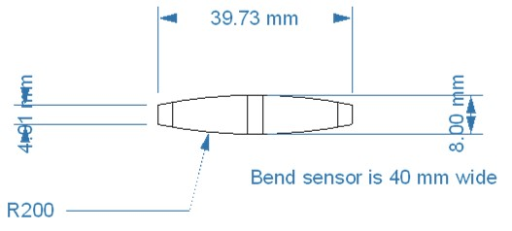
Conceptual stave structure
Following these barrel layout studies, wider mechanical meetings have been held to look at the how the stave could be built and supported from only the extreme ends.
Current plan is to thin and bend the sensor for increased rigidity.
This is yet to be incorporated in the CAD models.
From Georg Viehhauser (Oxford):
https://indico.bnl.gov/event/20473/contributions/85002/
(numbers is diagram are only approximate, not set to current sensor size)

Slide 18
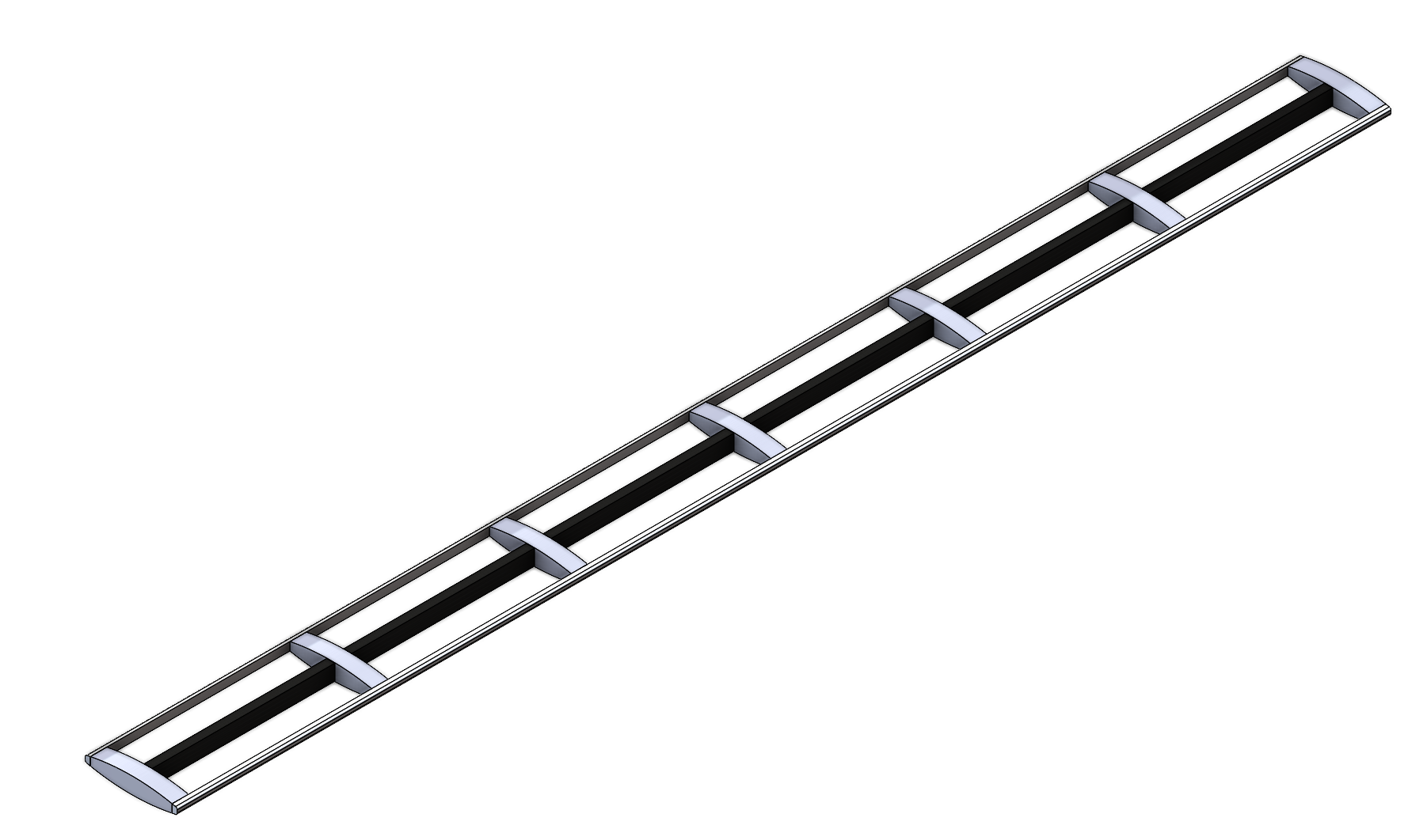
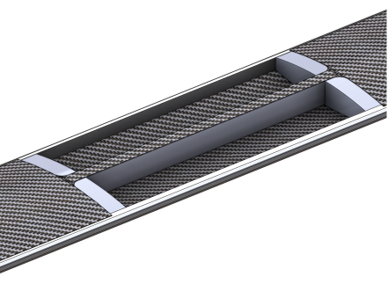
Curved staves
LEC areas backed by carbon foam ribs.
  Help heat dissipation and mechanically support bon areas.
Central spar will support joint between twin sensors and maintain curvature of sensors.
Surface between sensors covered with carbon fiber skin.
Sensors are placed over empty gaps.
Sensor edges to be sealed.
  Creating an air-tight tube for air cooling.
Preliminary renders (subject to change)
From Georg Viehhauser (Oxford):
https://indico.bnl.gov/event/20473/contributions/85002/

Slide 19
Considering services
To reduce material:
EIC-LAS is to have whole pixel array readout from a single data link in the LEC (hit rate is low enough to enable this).
  Fibre-optics lines, for data readout, as close to the sensor as possible (e.g. end of stave) – radiation expected to be low enough to enable this.
  To be done using a rad-hard electrical/optical transceiver – VTRx+.
  Each VTRx+ has 4 available data lines for readout.
Sensors to be powered in serial powering (SP) chains (reduces current per PSU channel and therefore wire gauge).
  The greater the number of sensors per SP chain, the greater the material saving.

Slide 20
FPC design
The flexible printer circuit (FPC) will be the interconnect between clusters of EIC-LAS. This needs:
To enable the readout of data from many EIC-LAS to 1 VTRx+.
Host the current to voltage regulation (for each EIC-LAS) and interconnections within a SP chain.
Clusters of 4 EIC-LAS per SP chain work well with VTRx+ readout.
FPC designs are preferring clusters 1 EIC-LAS wide (even if interfacing sensors on different sides of the same structure).

Slide 21
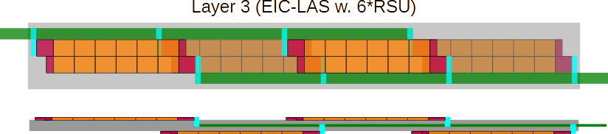
Effects of stave designs
The FPC design prefers staves for EIC-LAS in multiples of 4 (in length).
A convenient layout for L3 (with 6 RSUs) could look as follows:
This ties in well with the Opt1 or 2 previously reported.

Slide 22
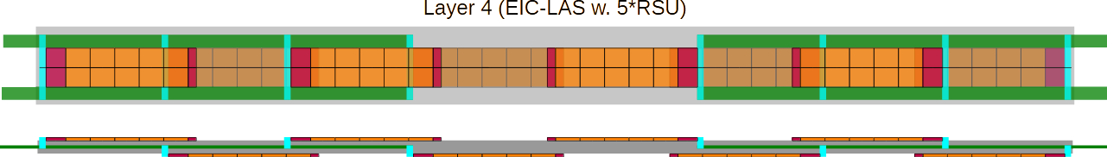
Layer 4 staves
To enable multiples of 4 in a L4 stave, switching to 5 RSU long EIC-LAS would be closer to the suggested staves lengths (Opt3’s length, but built from only 5 RSU long EIC-LAS).
This will lead to needing some overlap of RSUs (active sensors area) to get to the stave lengths required.
Stave length (no RSU overlap) = 866.67 mm. Longest stave in Peter’s studies = 845 mm.
Therefore, ~1 RSU too long!

Slide 23
Summary
Building CAD model of entire ePIC SVT OB.
Variations of stave structure and layer configuration are being considered.
  Includes consideration for sensor overlap between neighbouring staves.
Some consideration for overlap of modules along the length of OB staves.
  This includes consideration for the variation in the interaction point.
Consideration for curved sensors also on the OB staves.
Seen the effect services and FPC design will play on how the EIC-LAS will need to be laid out on a stave.

Slide 24
Thank you very much!
Any questions?

Slide 25
Additional (support) slides

Slide 26
From Iain Sedgwick (STFC):
https://indico.bnl.gov/event/20473/contributions/84984/
MOSAIX to EIC-LAS
Inner Barrel
12 RSUs
8 data links
7 slow control links
Direct powering
Outer Barrel
Reduced number of RSUs
Single data link
Multiplex slow control
Serial powering
Yield likely too low
Must be done on 65nm MOSAIX database
Excess material for required data rate
Excess material when built into stave
Could be on support chip
Excess material when built into stave

Slide 27
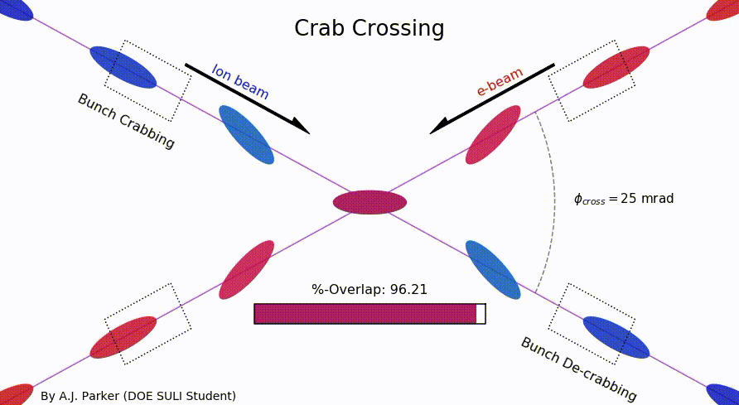
Beam crossing
From E. C. Aschenauer:
https://indico.bnl.gov/event/20473/contributions/85389/

Slide 28
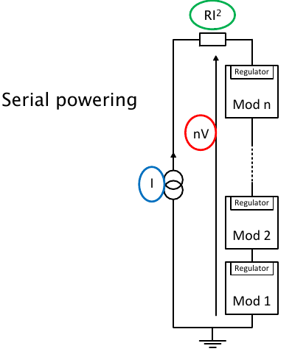
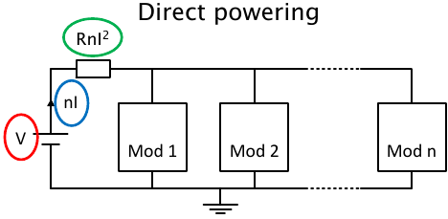
Serial powering basics
Serial powering is a current based powering scheme, where modules are powered in series by a constant current.
The current to voltage conversion is done by regulators close to/on module.
In a serial powering chain made of n modules, the transmitted current is only the current needed by one module, I.
For n modules powered in series, the current is reduced of a factor n with respect to a direct powering scheme → Higher power efficiency and reduced cable volume.
  Cable cross-section and the power losses on the cables scale by the same factor.

Slide 29
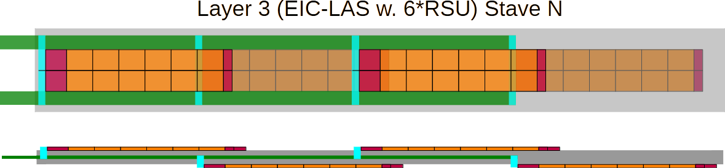
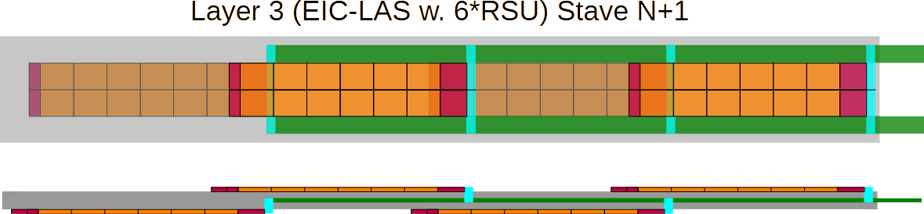
More likely L3 (6 RSU) layout
Both FPCs (on 1 stave) are likely to come from the same stave edge.
  Having neighbouring EIC-LAS in the same orientation for easier mounting.
If so, alternating staves would need to be connected to from opposite sides (to balance material).

Slide 30
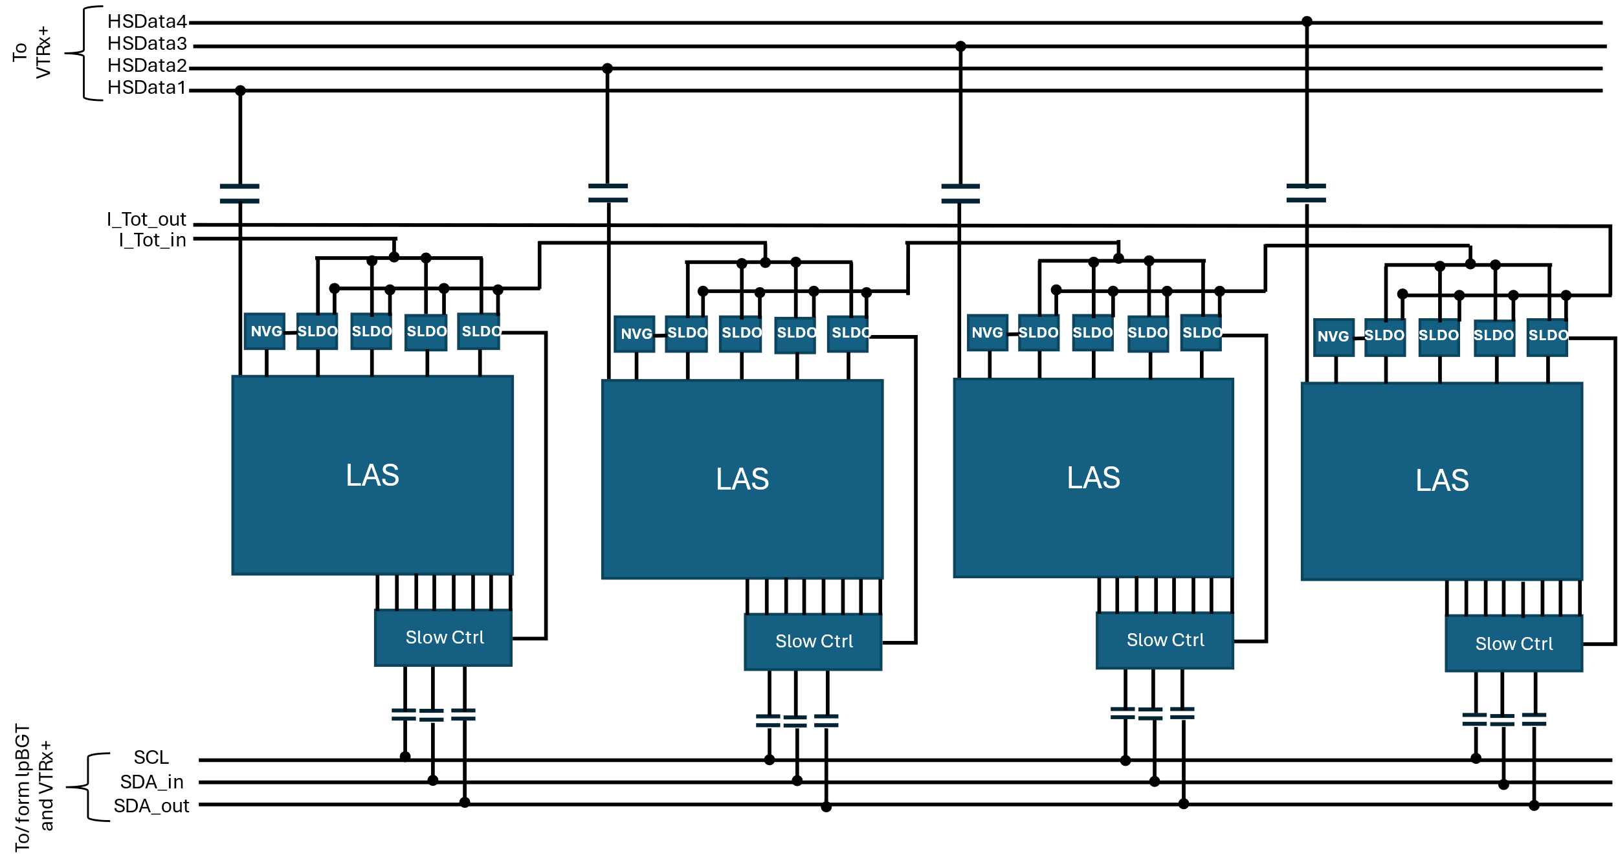
EIC-LAS connections on FPC
On this slide the three functions of the ancillary chip are shown separately for clarity.
Precise location of AC-coupling capacitors TBD.
Which SLDO powers what part of the auxiliary chip TBD.
Schematic drawing by Marcello Borri (STFC)

