Slide 1
UK EIC Accelerator R&D
Graeme Burt, Lancaster University/Cockcroft Institute, UK

Slide 2
UK Collider Expertise
Started in 2004 in LC-ABD: Linear collider beam delivery system (ILC)
  UK expertise in crab cavities (SRF), diagnostics, LLRF synchronisation, and fast beam feedback
2008: Europe's first Energy recovery linac (ALICE) built and tested at Daresbury
2012: UK project to deliver beam delivery for CLIC (crabs, diagnostics, synchronisation and fast beam feedback)
2016: UK launches HL-LHC-UK to deliver key components to LHC including crabs (SRF), diagnostics (EO-BPM), including some elements of beam feedback and LLRF
2022 STFC starts project to deliver SRF cryomodules to PIP-II

Slide 3









UK expertise
UK has expertise which is world leading and attractive to EIC in
  Superconducting RF systems
  Beam Instrumentation: Electro-optic beam position monitors, Gas Jet monitors and Beam loss monitors
  LLRF synchronisation and beam feedback
  Energy recovery linac modelling and design
  Beam dynamics

Slide 4
Strong Hadron Cooling

Slide 8
Energy recovery Linac
An Energy recovery linac, is a superconducting accelerator that recovers the beam energy as RF after each pass of the electron beam, and uses this to accelerate the bext batch of electrons
Required for machines with high currents such as the EIC SHC
UK built the first European ERL (ALICE) around 15 years ago and have significant expertise in this area.
We have worked on beam-induced RF transients and BBU for PERLE for a number of years.
  Have developed a beam loading code to model the interactions between the beam, RF system and LLRF system.
  Developed a BBU code that accounts for realistic timing structure of bunches in the electron beam

Slide 9
ERL studies for EIC
Impedance studies for the electron cooler and pre-cooler
  Model impedance for critical components (BPMs, shielded/regular valves, flanges…) and determine an impedance budget
Ion trapping
  Explore options
    Kick out part of the beam to create clearing gaps (affects beam loading)
    Insert clearing electrodes (ties back into impedance studies)
Bunch decompression schemes to create the 12 mm bunches needed for cooling
  12 mm is too long for the 591 MHz cavities (even with 3rd and 5th harmonic flattening cavities)
Beam-breakup instability studies for the pre-cooler and cooler (dominated by the 1773 MHz cavities)

Slide 11
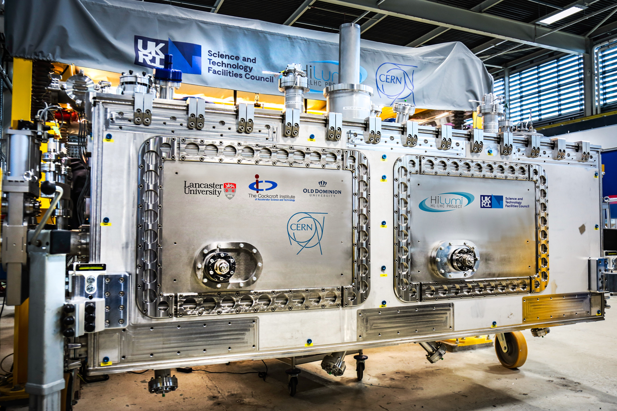
Daresbury → World Class SRF Lab
EIC 1.773 GHz Cavity Cryomodules
HI LUMI LHC CRAB CAVITIES
DQW SPS Cryomodule
RFD SPS Cryomodule
DQW LHC Cryomodules
My Involvement
ESS HIGH BETA
Cavity Procurement
Cavity Cold Testing
PIP II HIGH BETA
Cavity Procurement
Cavity Testing
Cryomodule Builds
DL SRF CAPABILITIES
Cryomodule DD&D | Cavity Procurement | Cavity Testing | Cleanroom Assembly | High Pressure Rinse (HPR) | Cryomodule Assembly & Welding | Anti-shock Transport | Cavity - Complete DD&D | Cryomodule - Complete DD&D | Cryomodule Testing
DD&D (Design, Development & Delivery)

Slide 12
UK-SRF for EIC
Lancaster will design the 3rd harmonic SRF cavity for the EIC ERL
Lancaster and STFC will design the cryomodule for this cavity
STFC/Lancaster is part of the IF bid to construct the cryomodule for EIC
Cryomodule is based on 591 MHz first article cryomodule and students may have some involvement in that program
Cryomodules for EIC should be as common as possible
3rd harmonic cryomodule will be 4 cavities in a single cryomodule, or two sets of two

Slide 13
Hadron Ring Studies

Slide 14

Hadron ring transition
Henry Lovelace^{1,2}
Steve Peggs²
Becky Seviour¹
University of Huddersfield (UK)
Brookhaven National Lab (USA)
In a circular machine increasing energy of electron bunches creates competing increases in velocity & trajectory length.
Below the transition energy the velocity increases faster than the length.
Above transition energy, the opposite is true.
At the transition energy, variation in velocity is compensated by variation in trajectory.
Crossing transition energys involves a perturbation of the longitudinal beam dynamics enhanced by space charge and chromatic effects.
The aim of this project is the design of a transition scheme suitable for the EIC.
EIC - CDR
H. Lovelace (2024)

Slide 15
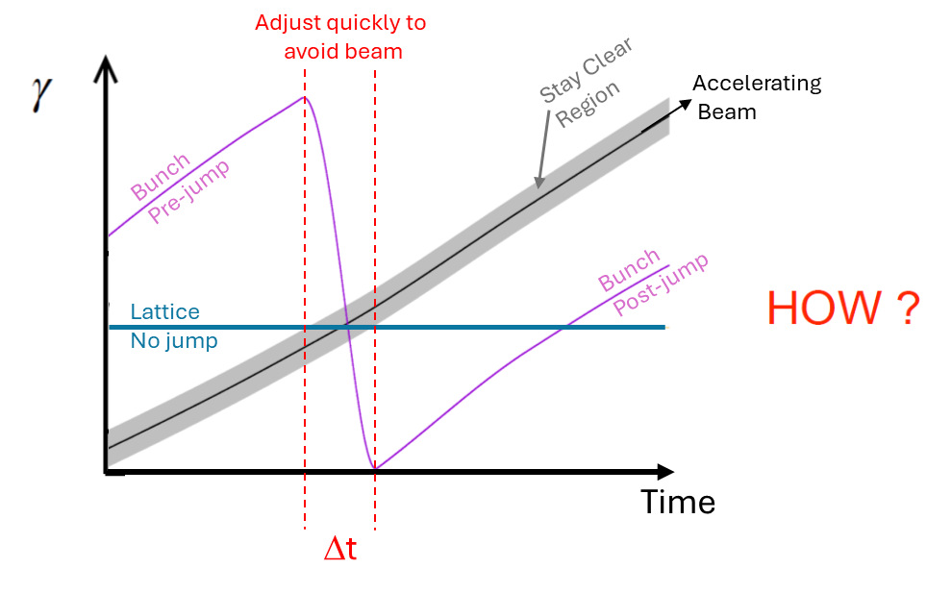
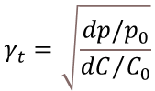
Hadron ring transition
The relativistic mass factor at transition is the ratio between the beam energy at transition and the electron rest energy and depends only on the machine optics and geometry
$$γ_{t}=\sqrt{\frac{dp/p_{0}}{{dC}/{C_{0}}}}$$
C₀ is the circumference with nominal momentum p₀ on the reference orbit
EIC - CDR

Slide 16
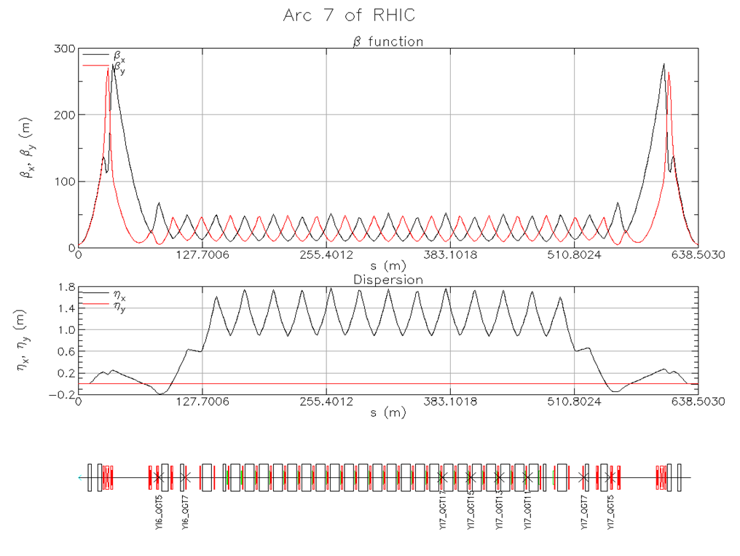
Solution

Slide 17
Secondaries and Eddy currents
Beam screens of thin layers of Cu will be installed over the 316LN steel of the storage ring to combat the production of secondary yield electrons.
Eddy currents delay the response of the field to the current as the jump quadrupole changes polarity. This delay, compounded with non-uniform thickness and defects in the copper impact the RRR of the copper Residual Resistivity Ratio (RRR), could cause issues for the transition jump.
(H. Lovelace, preliminary report U. Huddersfield 2024)

Slide 18
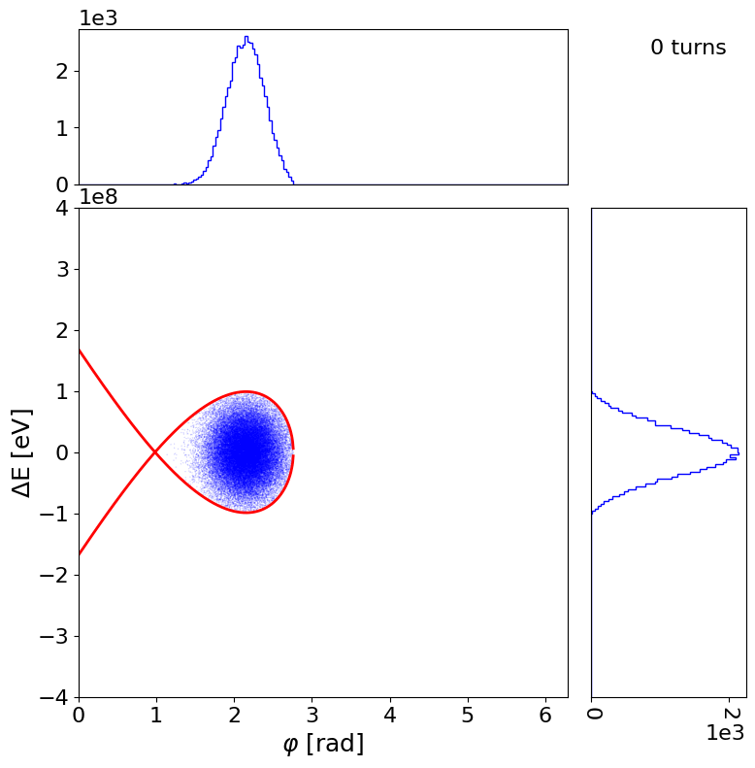
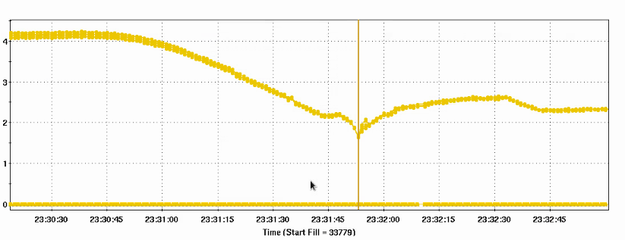
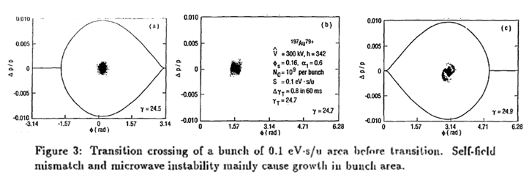
For the EIC one radical transition scheme we are going to consider….
Going to use the Beam Longitudinal Dynamics code (BLonD) to simulate longitudinal beam dynamics across transition.
(Left) BLonD example of acceleration in the LHC.
- Next step is RHIC simulation, to reproduce
Bunch length [nS]
RHIC
measurements
Transition
Jump
Future work to focus on simulations of EIC lattice to optimize transition

Slide 19
Possible other contributions

Slide 20
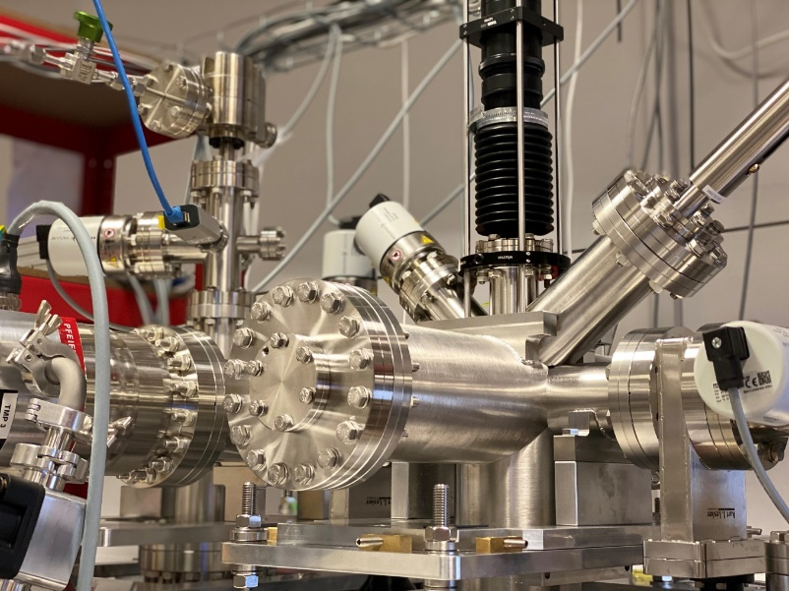
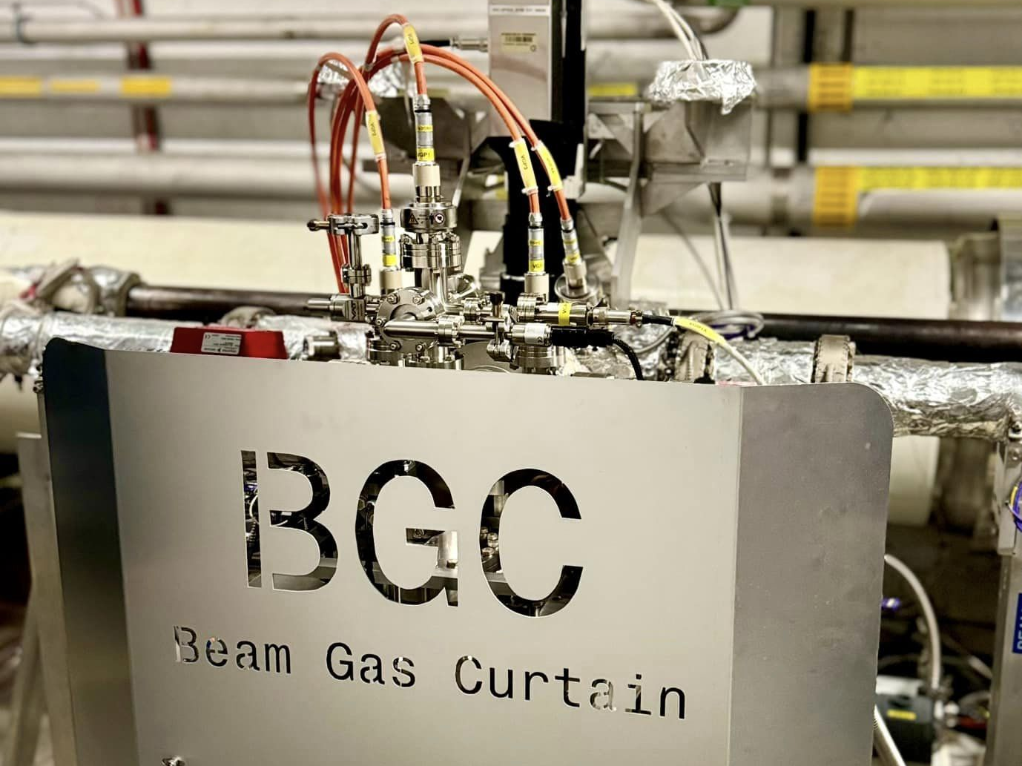
Beam Diagnostics R&D
Liverpool pursues R&D into wide range of cutting-edge diagnostics:
  Beam gas curtain monitor for LHC – designed and delivered, now operational in the LHC. Data taken with both, protons and ions in 2023.
  This has excellent potential for beam halo monitor and first stage collimation.
  Beam loss monitors based on fibers alongside ionization chambers
  Maximizing information from Longitudinal Beam Monitor using machine learning approaches
Closely connected with work into collimation system, machine protection and beam control.

Slide 21
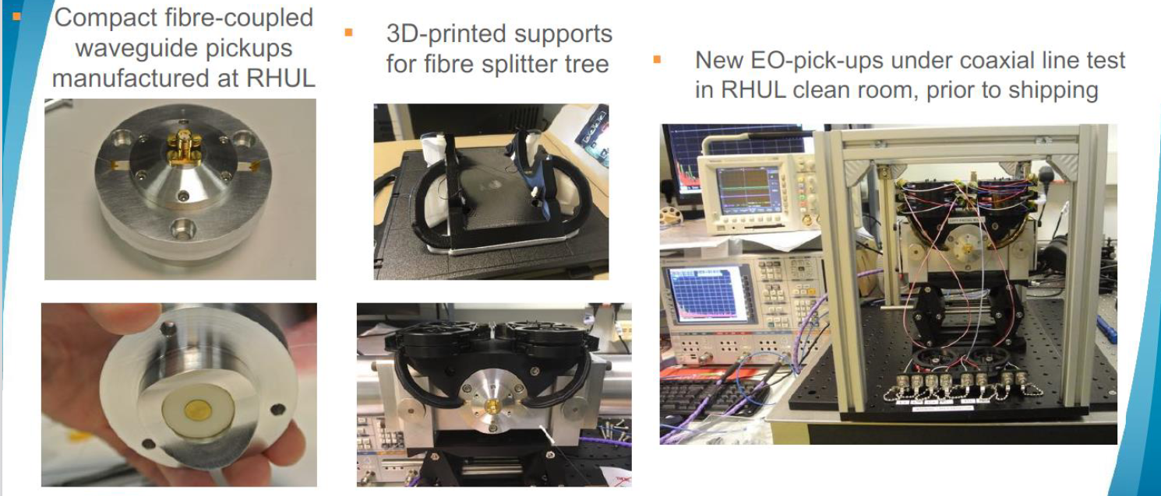
EO-BPM
Electro-Optic Beam position Monitors are wideband beam position monitors that can measure the offset along the length of a bunch
Developed in the UK, at RHUL, for LHC these are required to measure crab cavity beam rotation
Initially part of the IF bid with direct funding from BNL matching, however STFC removed from the bid after the outline stage. BNL still interested in funding some effort as UK has unique expertise

Slide 22
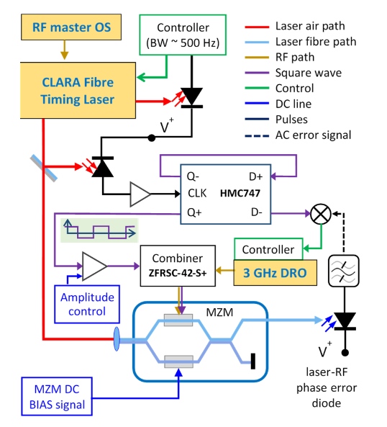
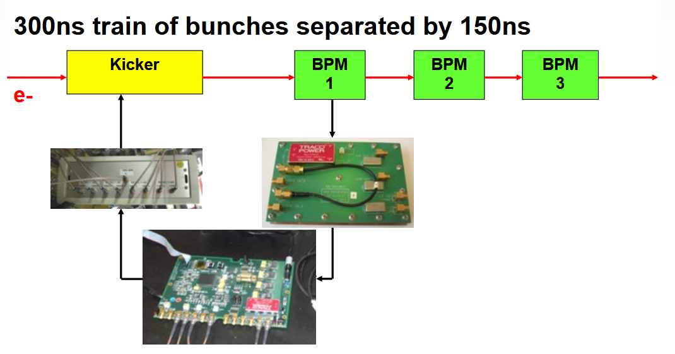
LLRF and feedback
  Lancaster have experience in RF interferometers and Mach-Zehnder interferometers for synchronisation of RF and lasers for crabs and FELs
  Oxford have experience in beam-based feedback for colliders based on beam offsets post-IP
  EIC crabbing system will need both to meet specifications
  Any noise on crab cavities (which transversely rotate the beam for collision) can cause displacement and misalignment at the IP losing significant luminosity.
  Initially part of the IF bid with direct funding from BNL matching, however STFC removed from the bid after the outline stage.

Slide 23
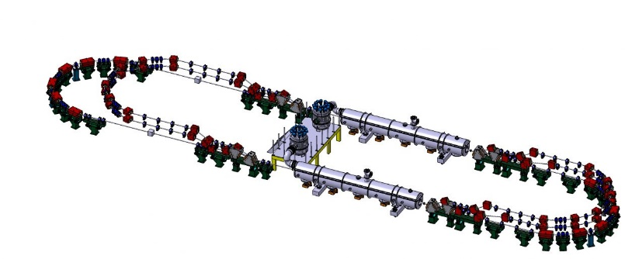
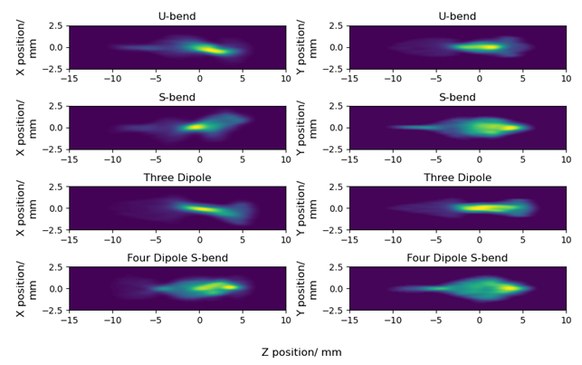
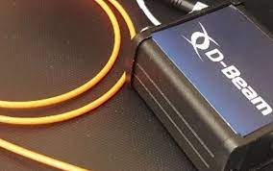
Accelerator Design & Optimization
PhD on machine design and beam transport R&D for PERLE Injector and merger regions with CNRS/ASTeC
Generic R&D into energy recovery linacs, focusing on cooling aspects for EIC
PhD on beam loss monitors for machine control and optimization
Integration of virtual diagnostics concept
Collaboration with industry (Teledyne e2v and D-Beam) to assess technology potential and pave the way for commercialization

Slide 24
Conclusion
The UK accelerator community have a unique set of skills that will be critical to the success of EIC.
Already making key contributions on the SRF, Cryomodule and impedance/BBU studies for the strong hadron cooler, and on transitions in the hadron ring.
Awaiting news on the IF bid to build hardware for EIC.
Potential for further contributions on beam instrumentation and low level RF control.

Slide 26
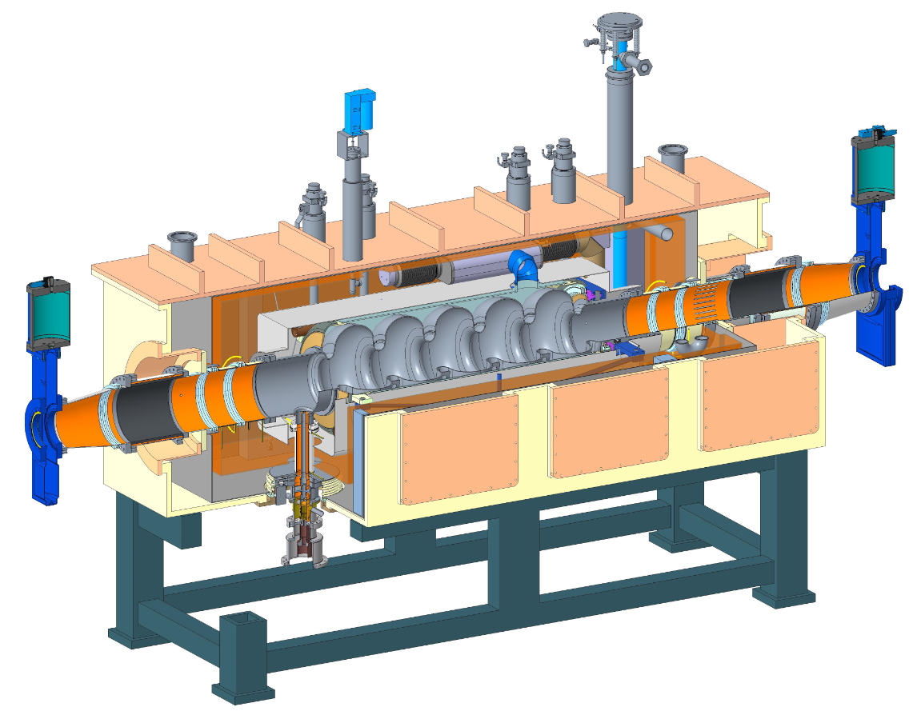
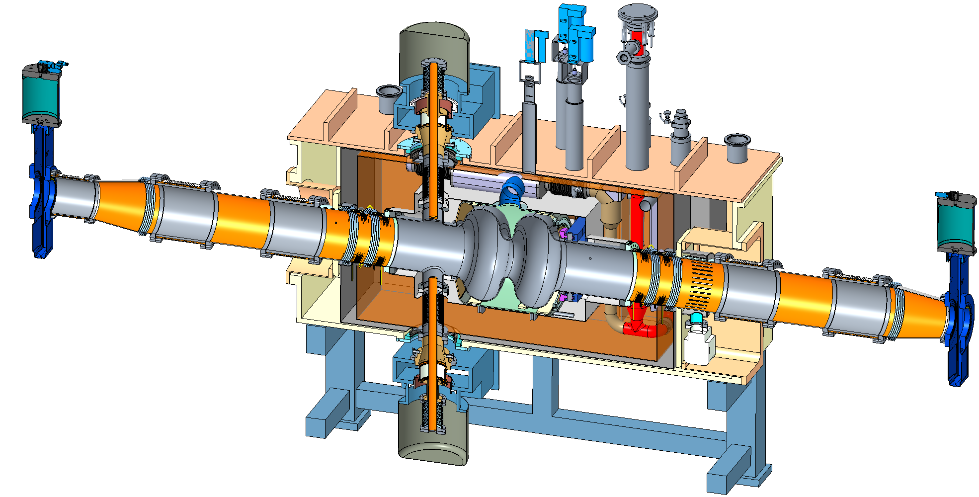
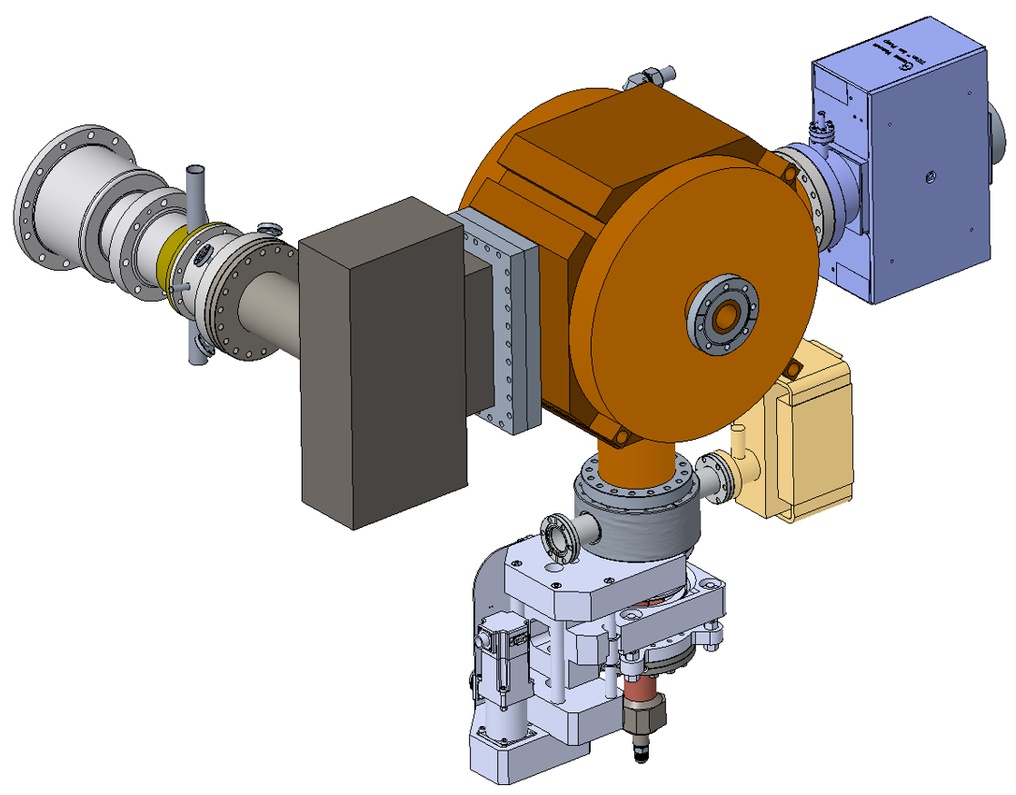
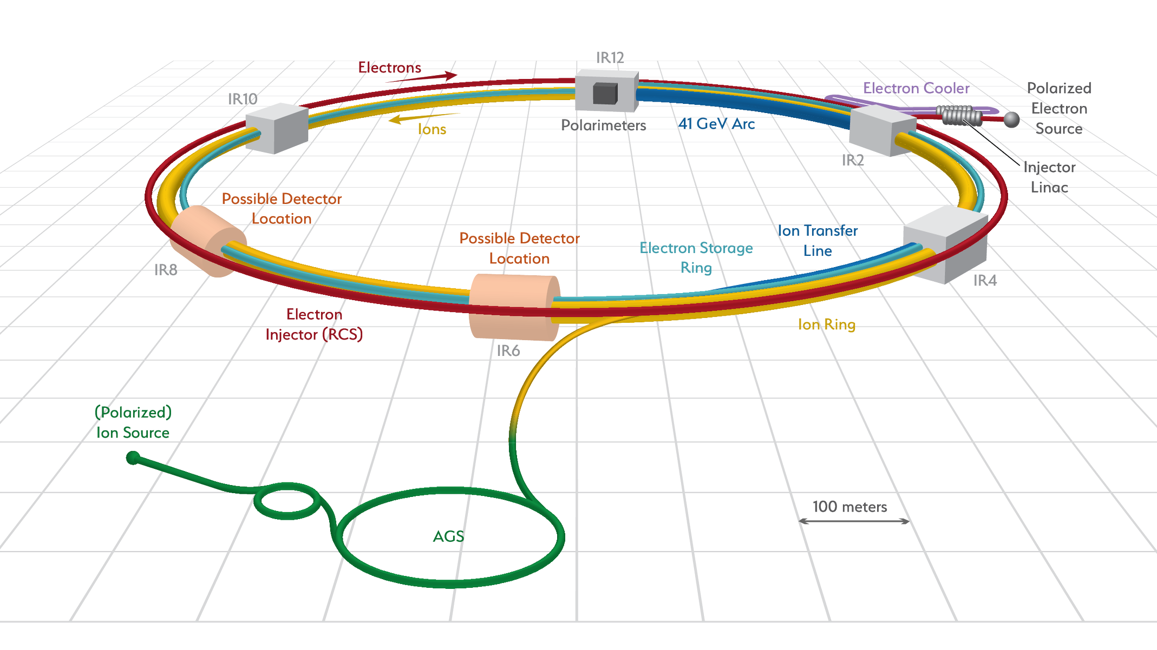
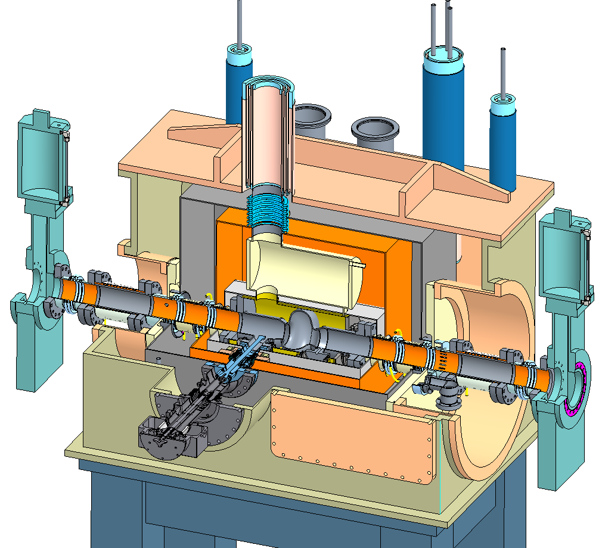
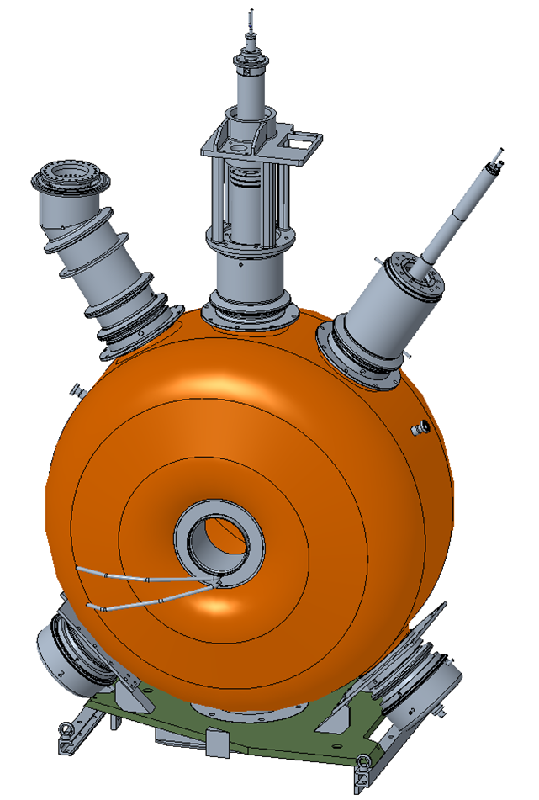
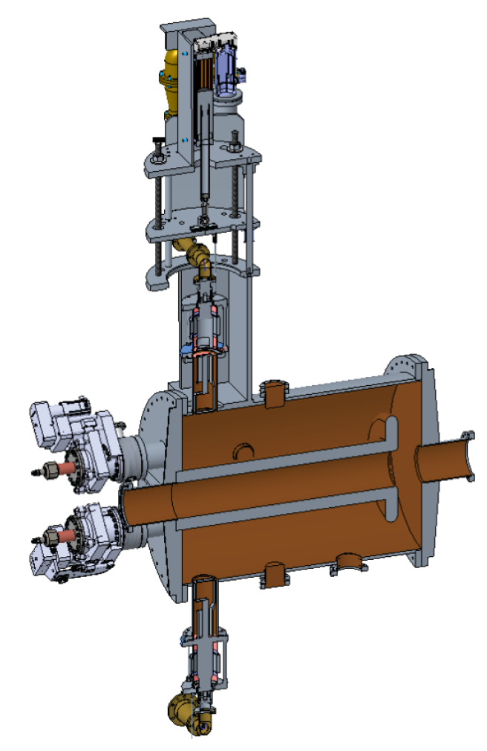
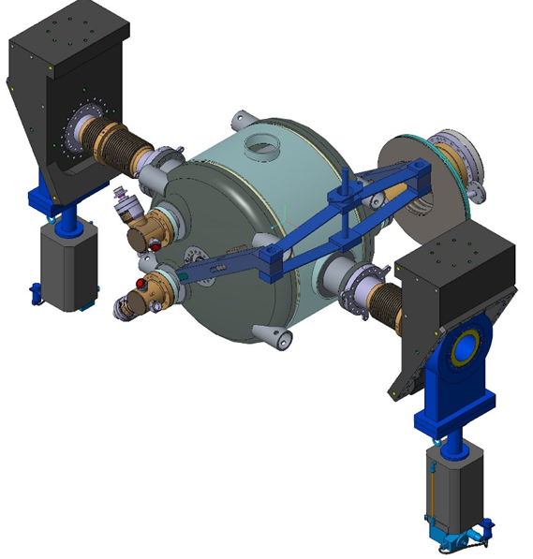
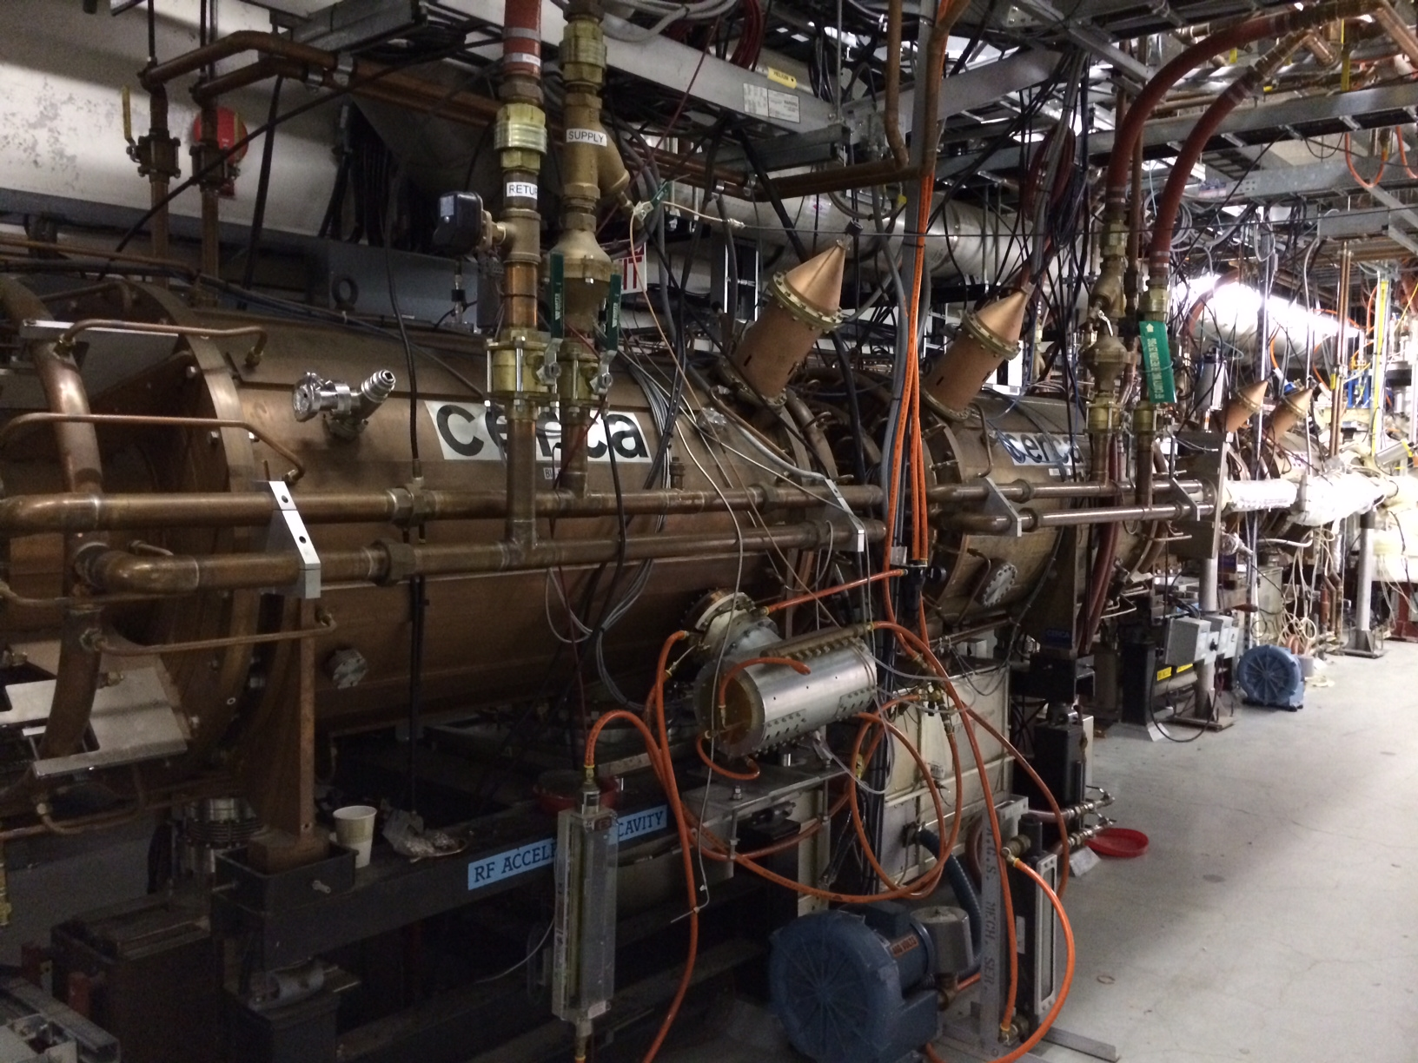
Hadron - 591 MHz bunch compression cavity
Hadron Cooling - 591 MHz acceleration cavity
Electron - 591 MHz electron storage cavity
Injector - 571 MHz bunch compression cavity
Electron - 1773 MHz 3rd harmonic cavity
Hadron - 197 MHz bunch compression cavity
Both rings – 400 MHz crab cavity
Hadron – 24.5 MHz acceleration cavity
Rapid Cycling Synchrotron - 591 MHz acceleration cavity
Hadron – 49.2 MHz and 98.5 MHz bunch splitter cavity

Slide 27
eRHIC RF system | RF sub system | Freq [MHz] | Type | Location | # of Cavities
Electron Storage Ring | Fundamental | 591 | SRF, 2-cell | IR-10 | 14
 | Third Harmonic | 1773 | SRF, 1-cell | IR-10 | 5
Rapid Cycling Synchrotron | Fundamental | 591 | SRF, 5-cell | IR-10 | 3
Pre-Injection LINAC | Bunch Compression 1 | 114 | Copper, capacitor loaded | IR-2 | 1
 | Bunch Compression 2 | 571 | Copper, 1-cell | IR-2 | 1
 | 400 MHz LINAC | 2856 | SLAC type LINAC | IR-2 | 8 x 3m sections
Hadron Ring | Capture/Acceleration | 24.6 | Copper, Quarter Wave | IR-4 | 2
 | Bunch Splitter 1 | 49.2 | Copper, Quarter Wave | IR-4 | 2
 | Bunch Splitter 2 | 98.5 | Copper, Quarter Wave | IR-4 | 2
 | Bunch Compression 1 | 197 | Copper, 1-cell | IR-4 | 12
 | Bunch Compression 2 | 591 | SRF, 5-cell | IR-10 | 2
Crab Cavity | Hadron | 394 | SRF, Double Quarter Wave | IR-6 | 8
 | Electron | 394 | SRF, Double Quarter Wave | IR-6 | 2
Hadron Cooling | SRF Booster | 118 | SRF, Quarter Wave | IR-2 | 2
 | Bunch Compression | 591 | Copper, 1-cell | IR-2 | 1
 | Fundamental | 591 | SRF, 5-cell | IR-2 | 9
 | Third Harmonic | 1773 | SRF, 5-cell | IR-2 | 2

Slide 28
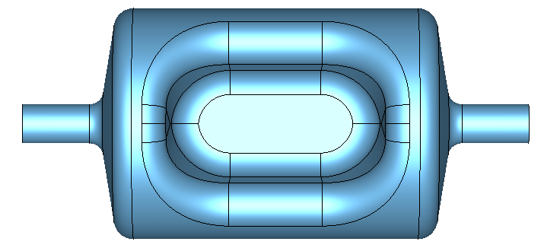
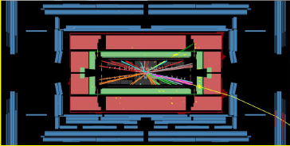
Crab crossing
Crab cavities
IR

