Slide 1
Stephen JD Kay 01/03/24
EIC UK 2024
UNIVERSITY OF YORK
KINGS MANOR K/133

Slide 2
WELCOME
Welcome to York!
Practical info
Brief overview of schedule
Context – Previous Meetings
Context – UK EIC Work
Acknowledgements

Slide 3
Practical Info
Refreshments/lunch will be provided in this room (K/133)
Weather permitting, benches available in the courtyard too
No fire alarm tests planned today
Please evacuate if there is an alarm!
Follow instructions from porters

Slide 4
Schedule
Morning
Focus on physics topics
Focus on detectors and hardware
Afternoon
Open discussion session to close the day

Slide 5
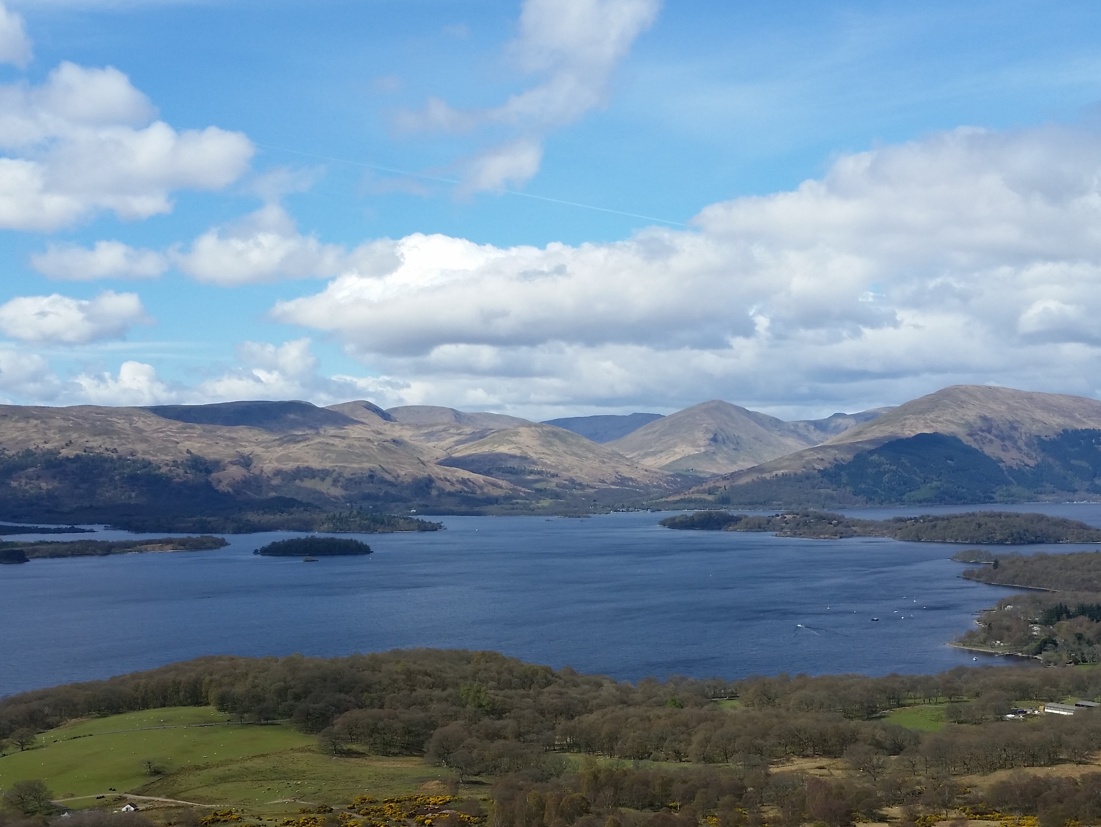
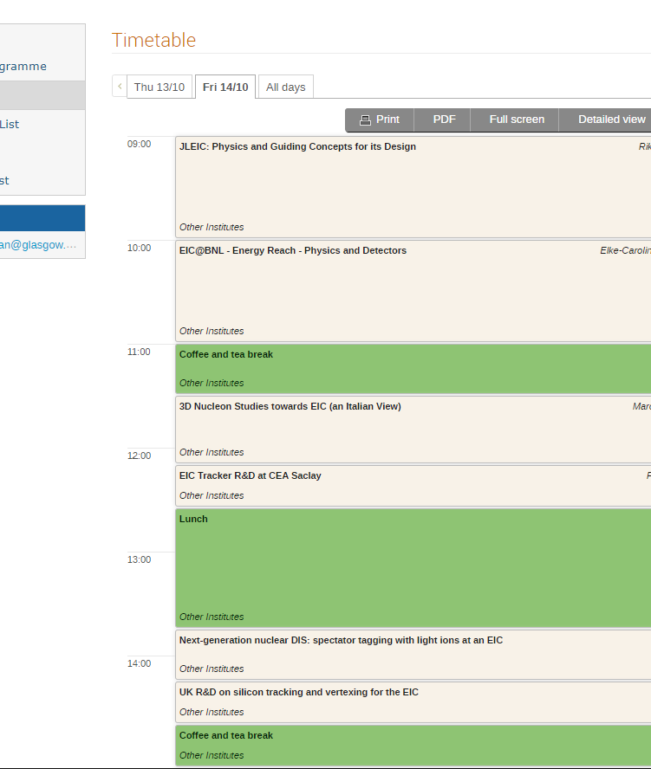
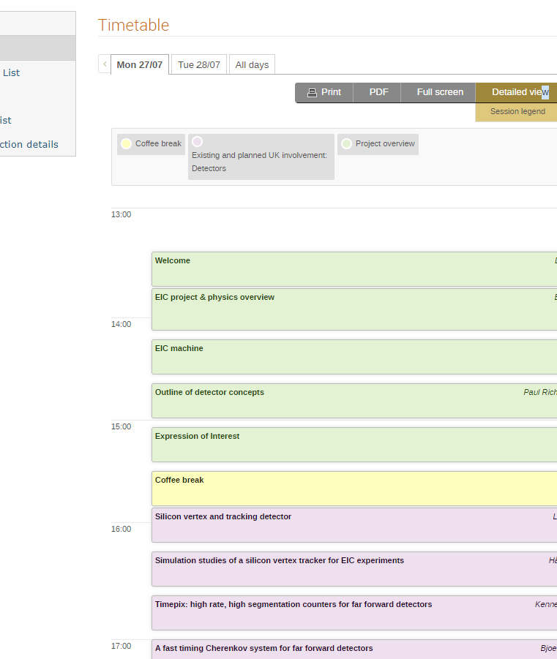
Previous Meetings
2016
Workshop in Loch Lomond
2020
Online workshop
First UK EIC workshop
Setting the scene for current EIC involvement
https://indico.cern.ch/event/565879/overview
https://indico.cern.ch/event/934314/overview
Notes:
2016 Loch Lomond - https://indico.cern.ch/event/565879/overview
2020 Online - https://indico.cern.ch/event/934314/overview

Slide 6
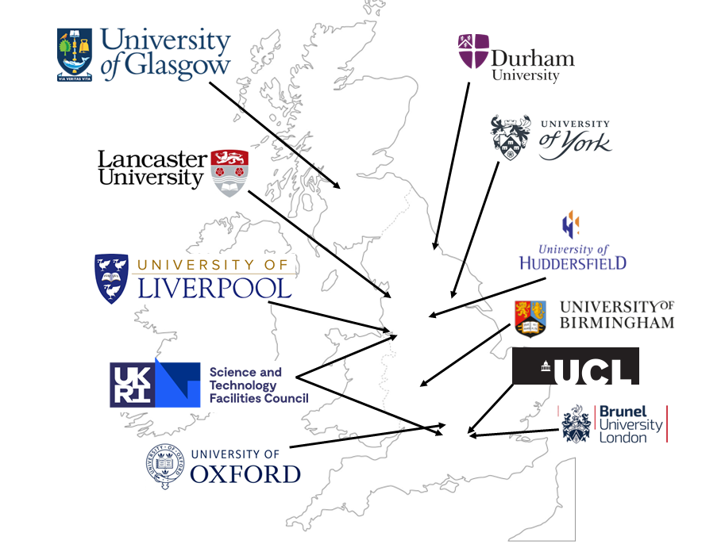
UK Involvement with the EIC
Interest across the country
Most also ePIC members
Nuclear and Particle physics interests
New links/partners?
ePIC TDR is coming…

Slide 7
Acknowledgements
The organisers would like to acknowledge the support of the IOP for this event.
Support has enabled the free nature of the event and the catering.

Slide 8
STEPHEN.KAY@YORK.AC.UK STUART.FEGAN@YORK.AC.UK OLIVER.JEVONS@GLASGOW.AC.UK

Slide 9
FOR THOSE NOT IMMEDIATELY AWAY AT 17:00…
House of Trembling Madness (Lendal)
Short 5 minute walk
Close to station (~10 minutes)
Food available

