Slide 1
Deuteron electro-Disintegration at very high missing momenta
Hall C Collaboration Meeting
Jan 2024
Gema P. Villegas Minyety Florida Interantional University
Carlos Yero Jefferson Lab
Mark K. Jones Jefferson Lab
Werner U. Boeglin Florida Interantional University
Notes:
Hi everyone! My name is Gema, I am a first year Physics PhD student from Florida International University (FIU). I will be speaking for the Deuteron Electro-disintegration experiment scheduled to run from feb 20 until beam is shut off on march 20. The main contact person in the experiment is Dr werner Boeglin from FIU, Carlos and Mark are also involved.

Slide 2
Outline
Motivation
Kinematics
Previous (and New) Work
Experiment Run (Feb – Mar 2023)
Calibration
Summary

Slide 3
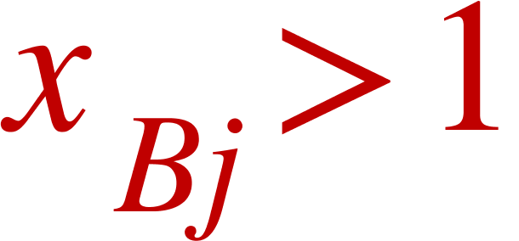
Goal
Motivation
Measure D(e,e'p)n cross sections at large and for missing momenta with a relative statistical error of < 20%.
NN interaction at < 1 fm is not well understood
There is little experimental data for missing momenta beyond 500 MeV/c
D(e,e'p)n is ideal for probing the repulsive part of the NN interaction
Notes:
Read Goal. I will expand on what kinematics of the reaction we are focusing on and why we want this specific parameters.
the deuteron the simplest bound neutron-proton system which makes it the perfect starting place for understanding the strong nuclear force, specially at extremely short distances. the reason Deep is an ideal reaction for probing the repulsive part of the force will become clear once we talk about the kinematics involved.
he deuteron is the only bound two-nucleon system and serves as an ideal framework to study the strong nu- clear force at the sub-Fermi distance scale, a region which is currently practically unexplored and not well under- stood.

Slide 4
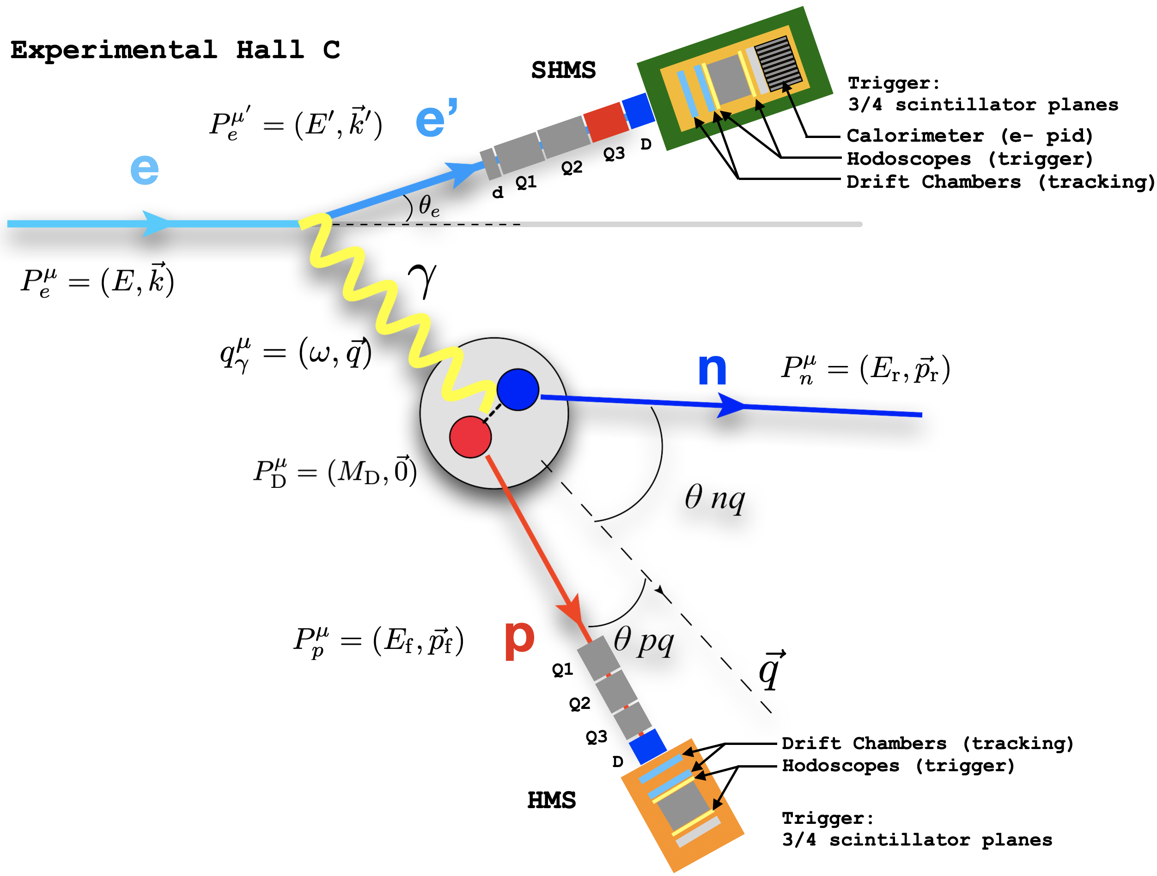
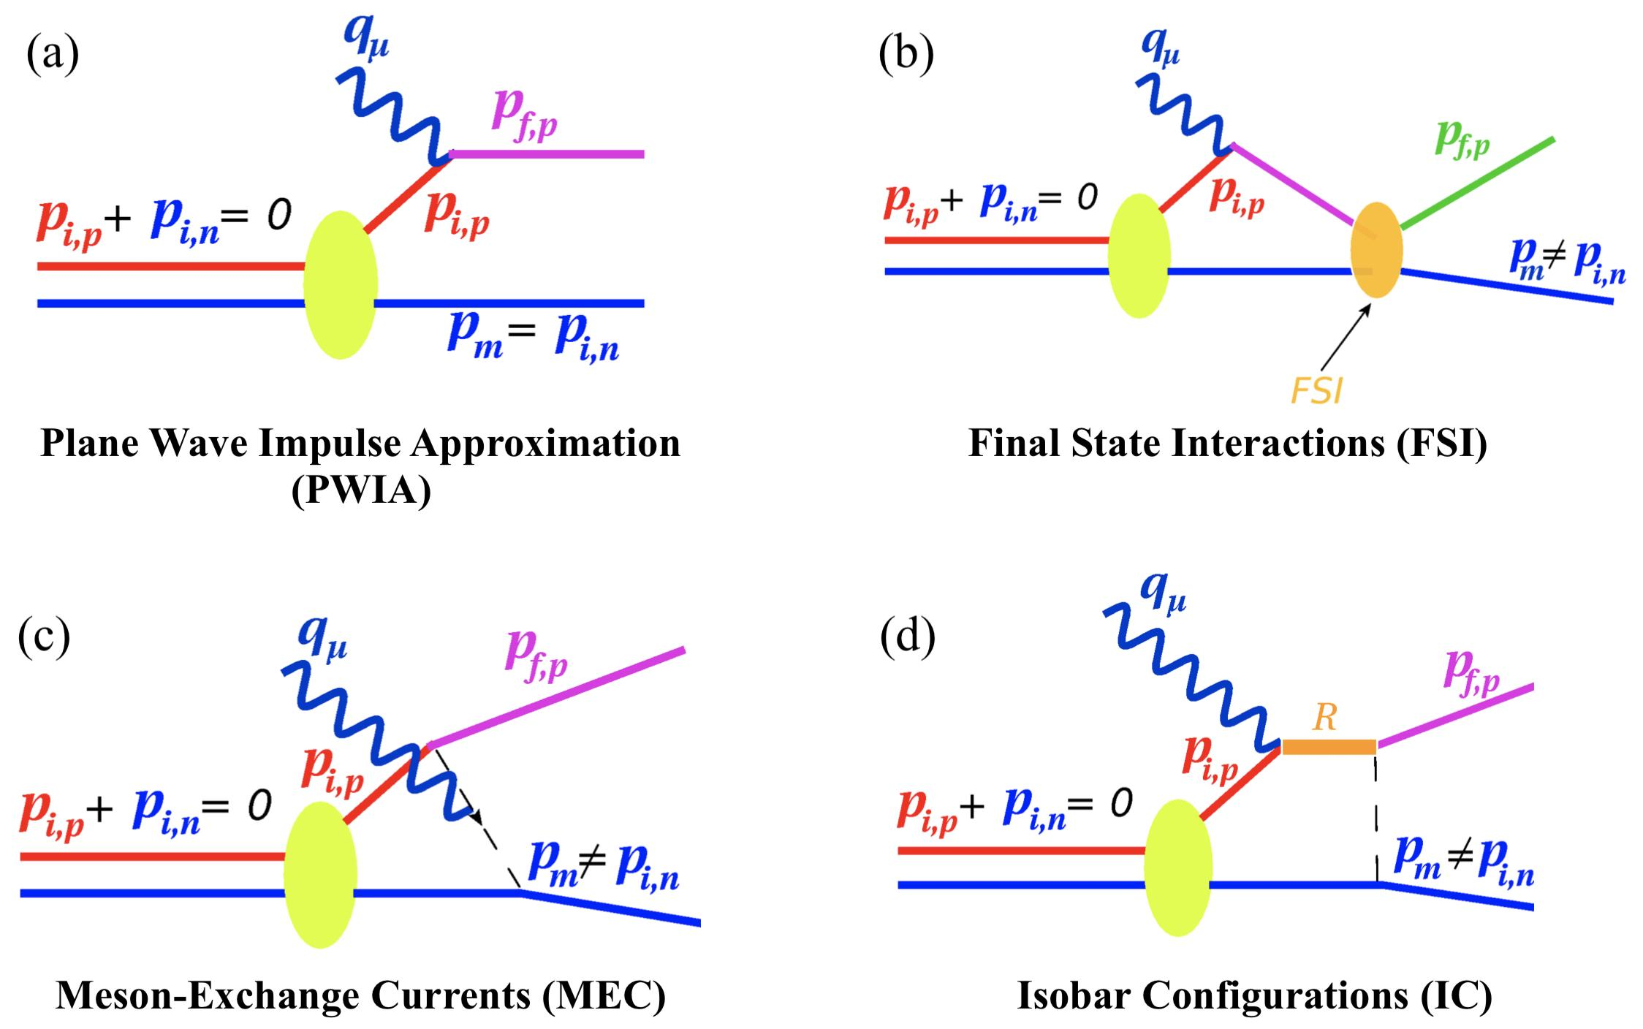
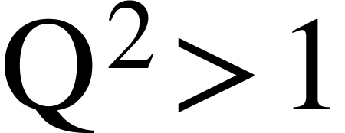
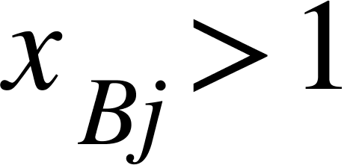
D(e,e'p)n Reaction Kinematics
C. Yero. (2020). Thesis
Suppressed at
Suppressed at
Suppressed at
4
Notes:
Here is an schematic of the reaction and where is detected. Describe where each particle is detected.
The goal is to isolate the kinematics in which the maximum recoil momentum of the neutron can be recovered.

Slide 5
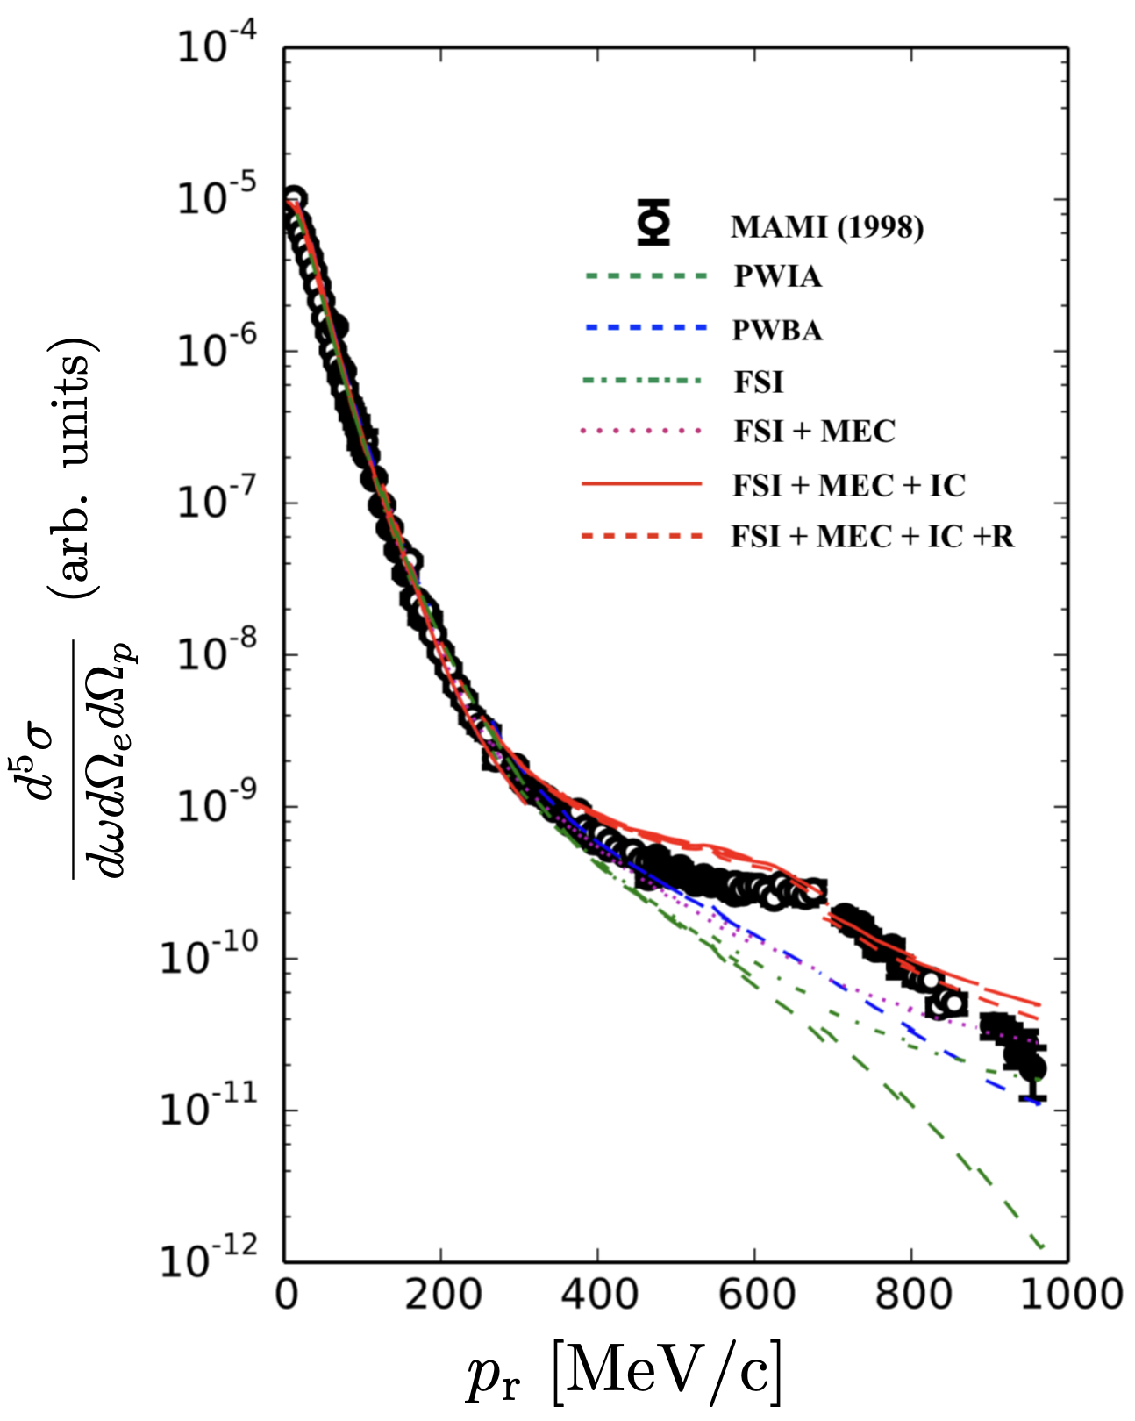
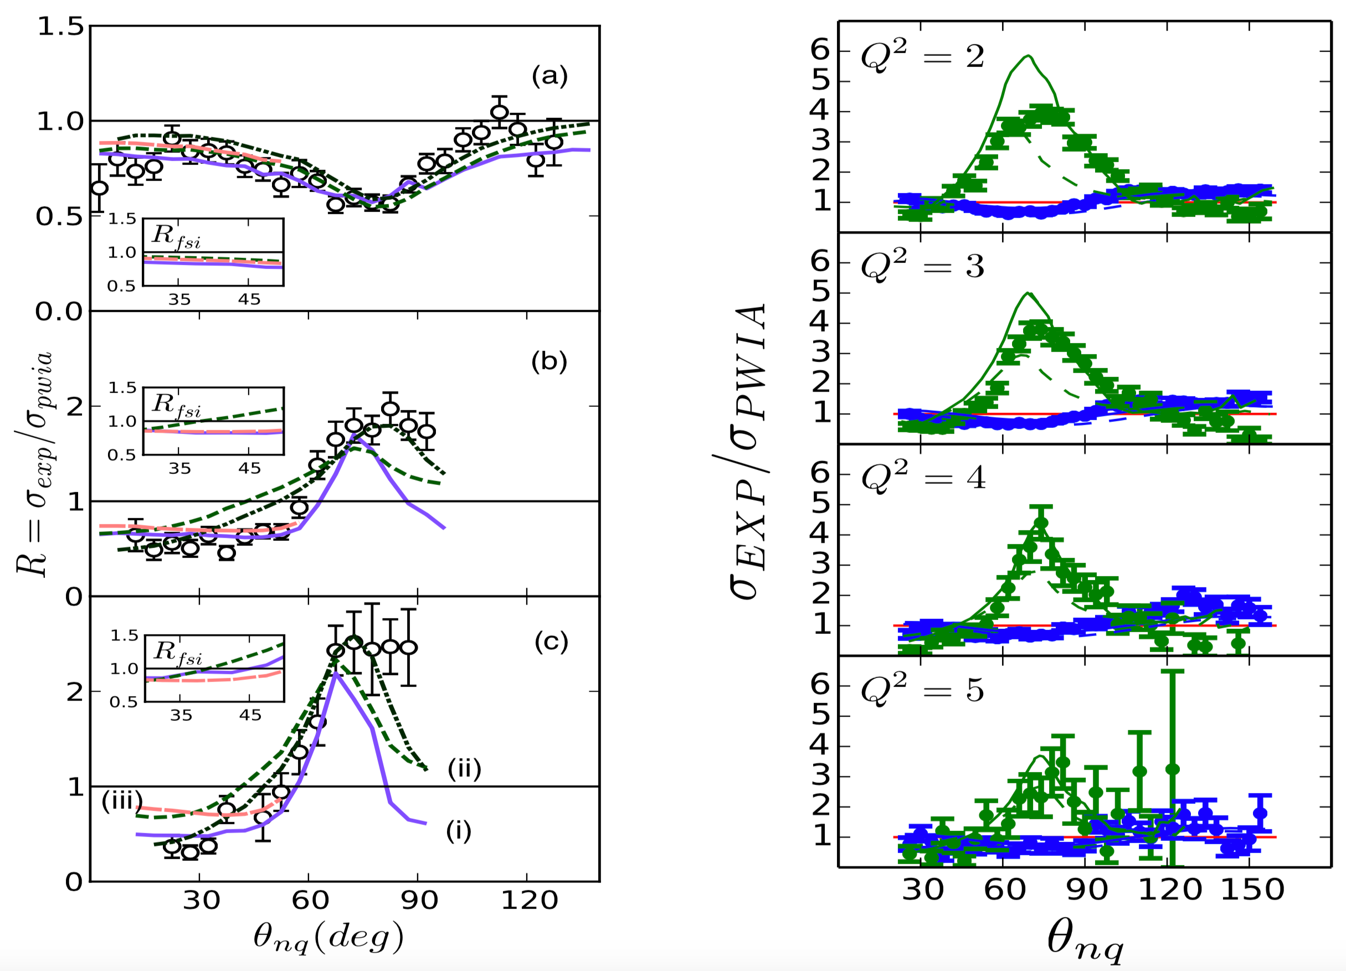
Previous Work
A)
B)
Hall A Data
Hall B Data
MAMI (1995)
W. Boeglin and M. Sargsian. (2015). DOI
Notes:
A) H(e, e0 p)n cross section versus neutron recoil momentum from the
MAMI (1998) experiment [48]. Theoretical calculations were performed by H.
Arenhövel [49].
B) 2 H(e, e0 p)n angular distributions of the cross section ratio, R =
σexp /σpwia . (Left) Hall A data at Q2 = 3.5 ± 0.25 (GeV/c)2 and recoil momen-
tum settings (a) pr = 0.2 GeV/c, (b) pr = 0.4 GeV/c and (c) pr = 0.5 GeV/c.
Theoretical calculations for (i) solid (purple) curves using the CD-Bonn potential
by M. Sargsian [59], (ii) dashed (green) curves using FSI and dashed-double dotted
(black) curves using FSI+MEC+IC by J.M. Laget [60] using the Paris potential
and (iii) dashed (pink) curves denote calculations by J.W. Van Orden [61]. (Right)
Hall B data at various Q2 settings. The green data (with FSI re-scattering peak)
correspond to 400 ≤ pr ≤ 600 MeV/c, and the blue data (no FSI re-scattering)
correspond to 200 ≤ pr ≤ 300 MeV/c. The solid curves are calculations from J.M.
Laget [60] and the dashed curves are from M. Sargsian [59]. Note: Reprinted from
Ref. [47].

Slide 6
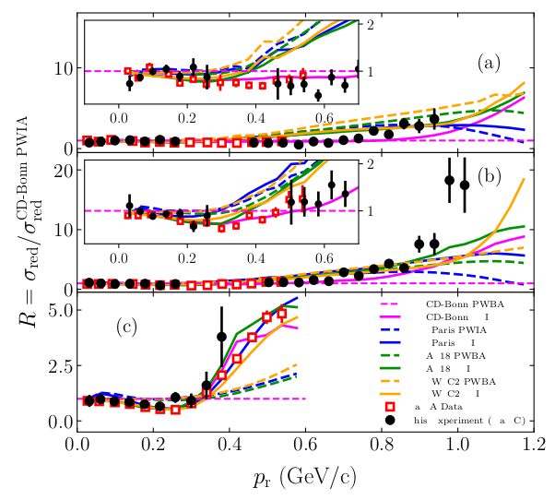
Experiment Run Apr 3-9, 2018
New Experiments
C. Yero et al. [Hall C]. (2020). DOI

Slide 7
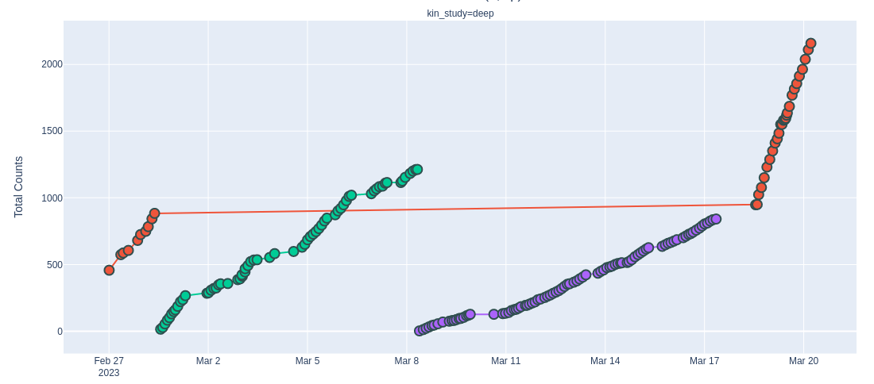
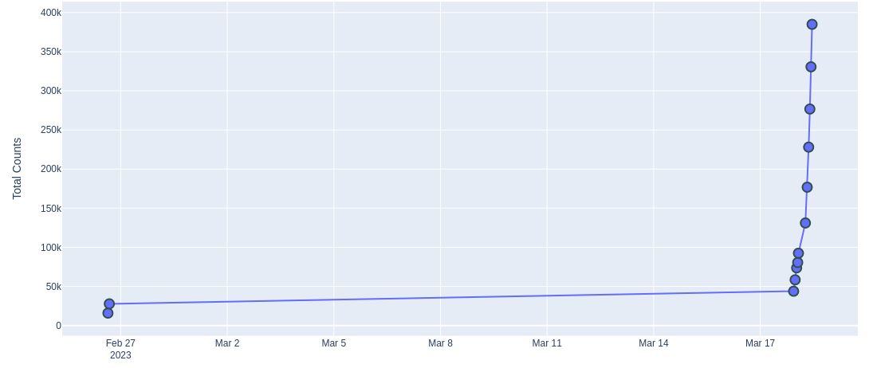
Experiment Run Feb 25, 2023 – Mar 20,2023
Total d(e,e'p) Counts
Pm_setting: 580 MeV/c
Counts: 2158
Charge: 10K mC
Pm_setting: 800 MeV/c
Counts: 1212
Charge: 16K mC
New Experiments
Central Missing Momentum Setting
[MeV/c]
120
580
800
900
Pm_setting: 900 MeV/c
Counts: 841
Charge: 21K mC
Pm_setting: 120 MeV/c
Counts: 384984
Charge: 977 mC

Slide 8
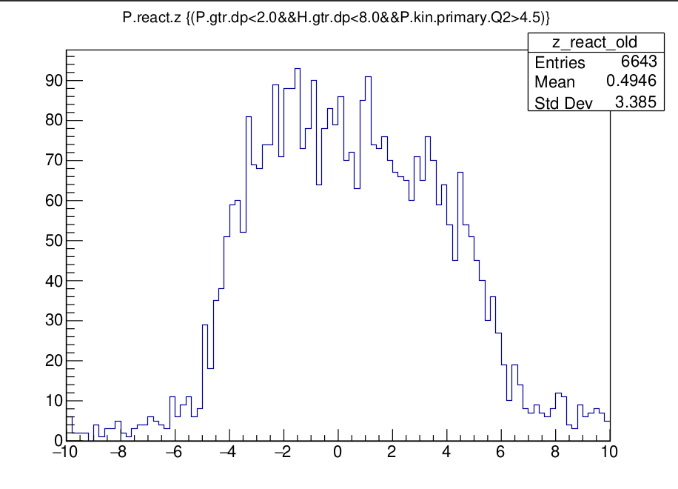
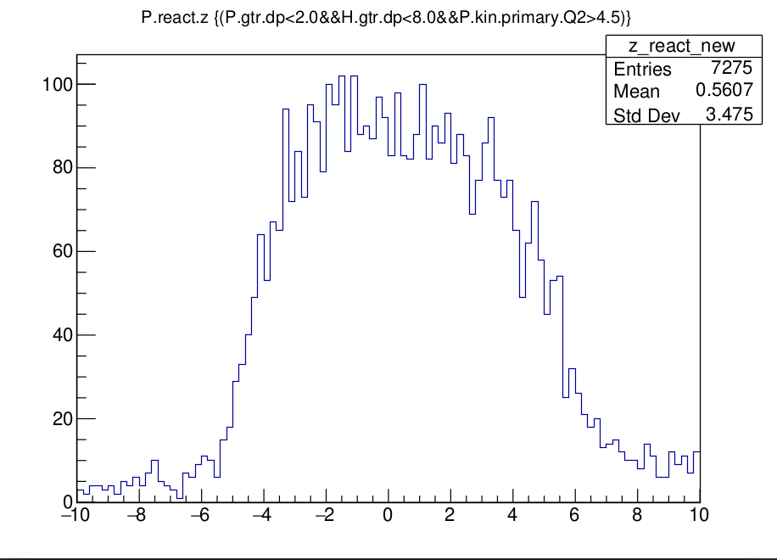
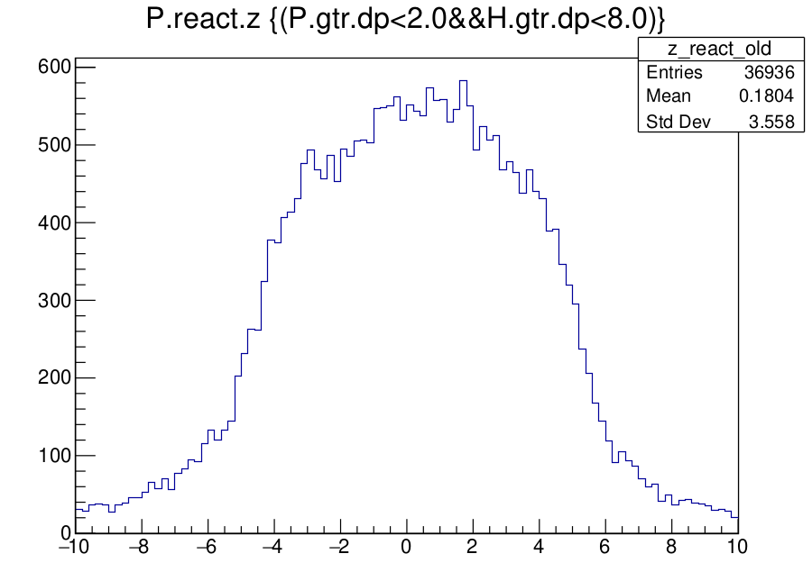
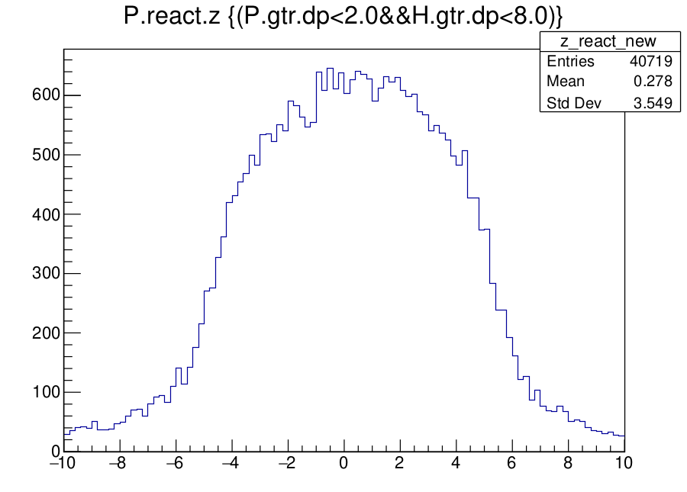
Ongoing Analysis
Calibration: Reference Time & Time Window Cuts
Run 20871 d(e,e'p)
Run 20840 h(e,e'p) coincidence
8
Notes:
Here is an schematic of the reaction and where is detected. Describe where each particle is detected.
The goal is to isolate the kinematics in which the maximum recoil momentum of the neutron can be recovered.

Slide 9
Summary
Deuteron electro-disintegration aims to measure D(e,e'p)n cross sections at high and missing momentum above 600 MeV
We want to probe the repulsive part of the NN interaction below 1 fm. Theoretical predictions poorly describe the data in this region
2018 results of the experiment published in PRL
New data was taken in Feb-Mar 2023, and analysis is in progress :)

