Slide 1
NPS Setup & Performance
Mitchell Kerver
Old Dominion University
Jan 19th 2024

Slide 2
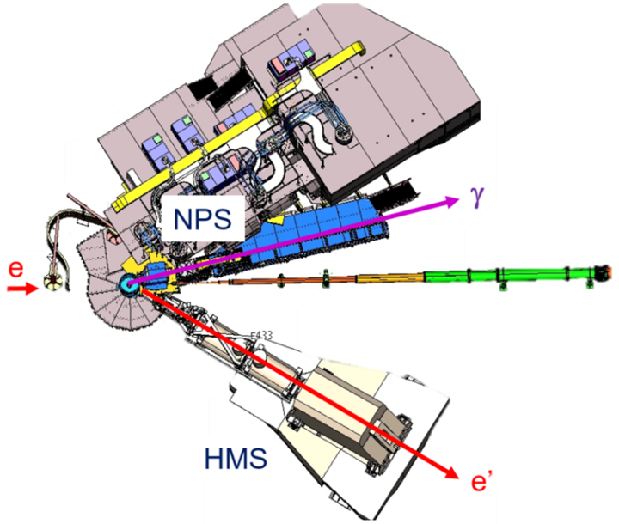
Neutral Particle Spectrometer
Scattered electrons are detected in the HMS and high energy photons in the calorimeter of the Neutral Particle Spectrometer (NPS)
The calorimeter is installed on a new platform attached to the SHMS carriage to allow remote rotation
A sweep magnet is installed to reduce charged background
Enables neutral particle detection with good energy and spatial resolution for precise cross-section measurements

Slide 3
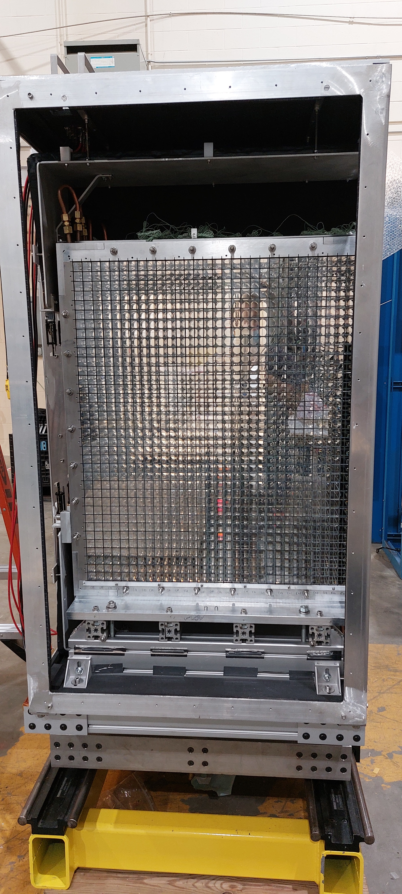
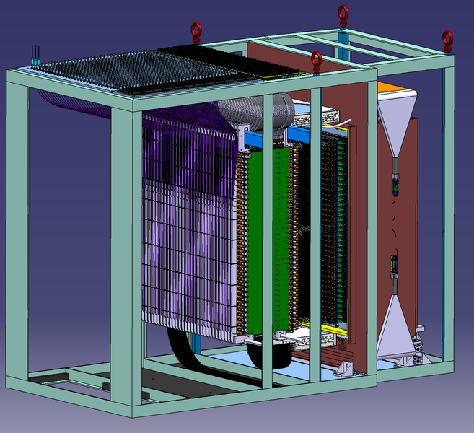
NPS Calorimeter
1080 PbWO₄ blocks
High energy resolution
High light yield
RadHard
Temperature controlled frame
Hamamatsu 4125 PMTs
HV divider and amplifier to reduced HV requirements
LED system for curing and gain monitoring
HV, LV, and LED signals distributed to an entire column through distribution board

Slide 4
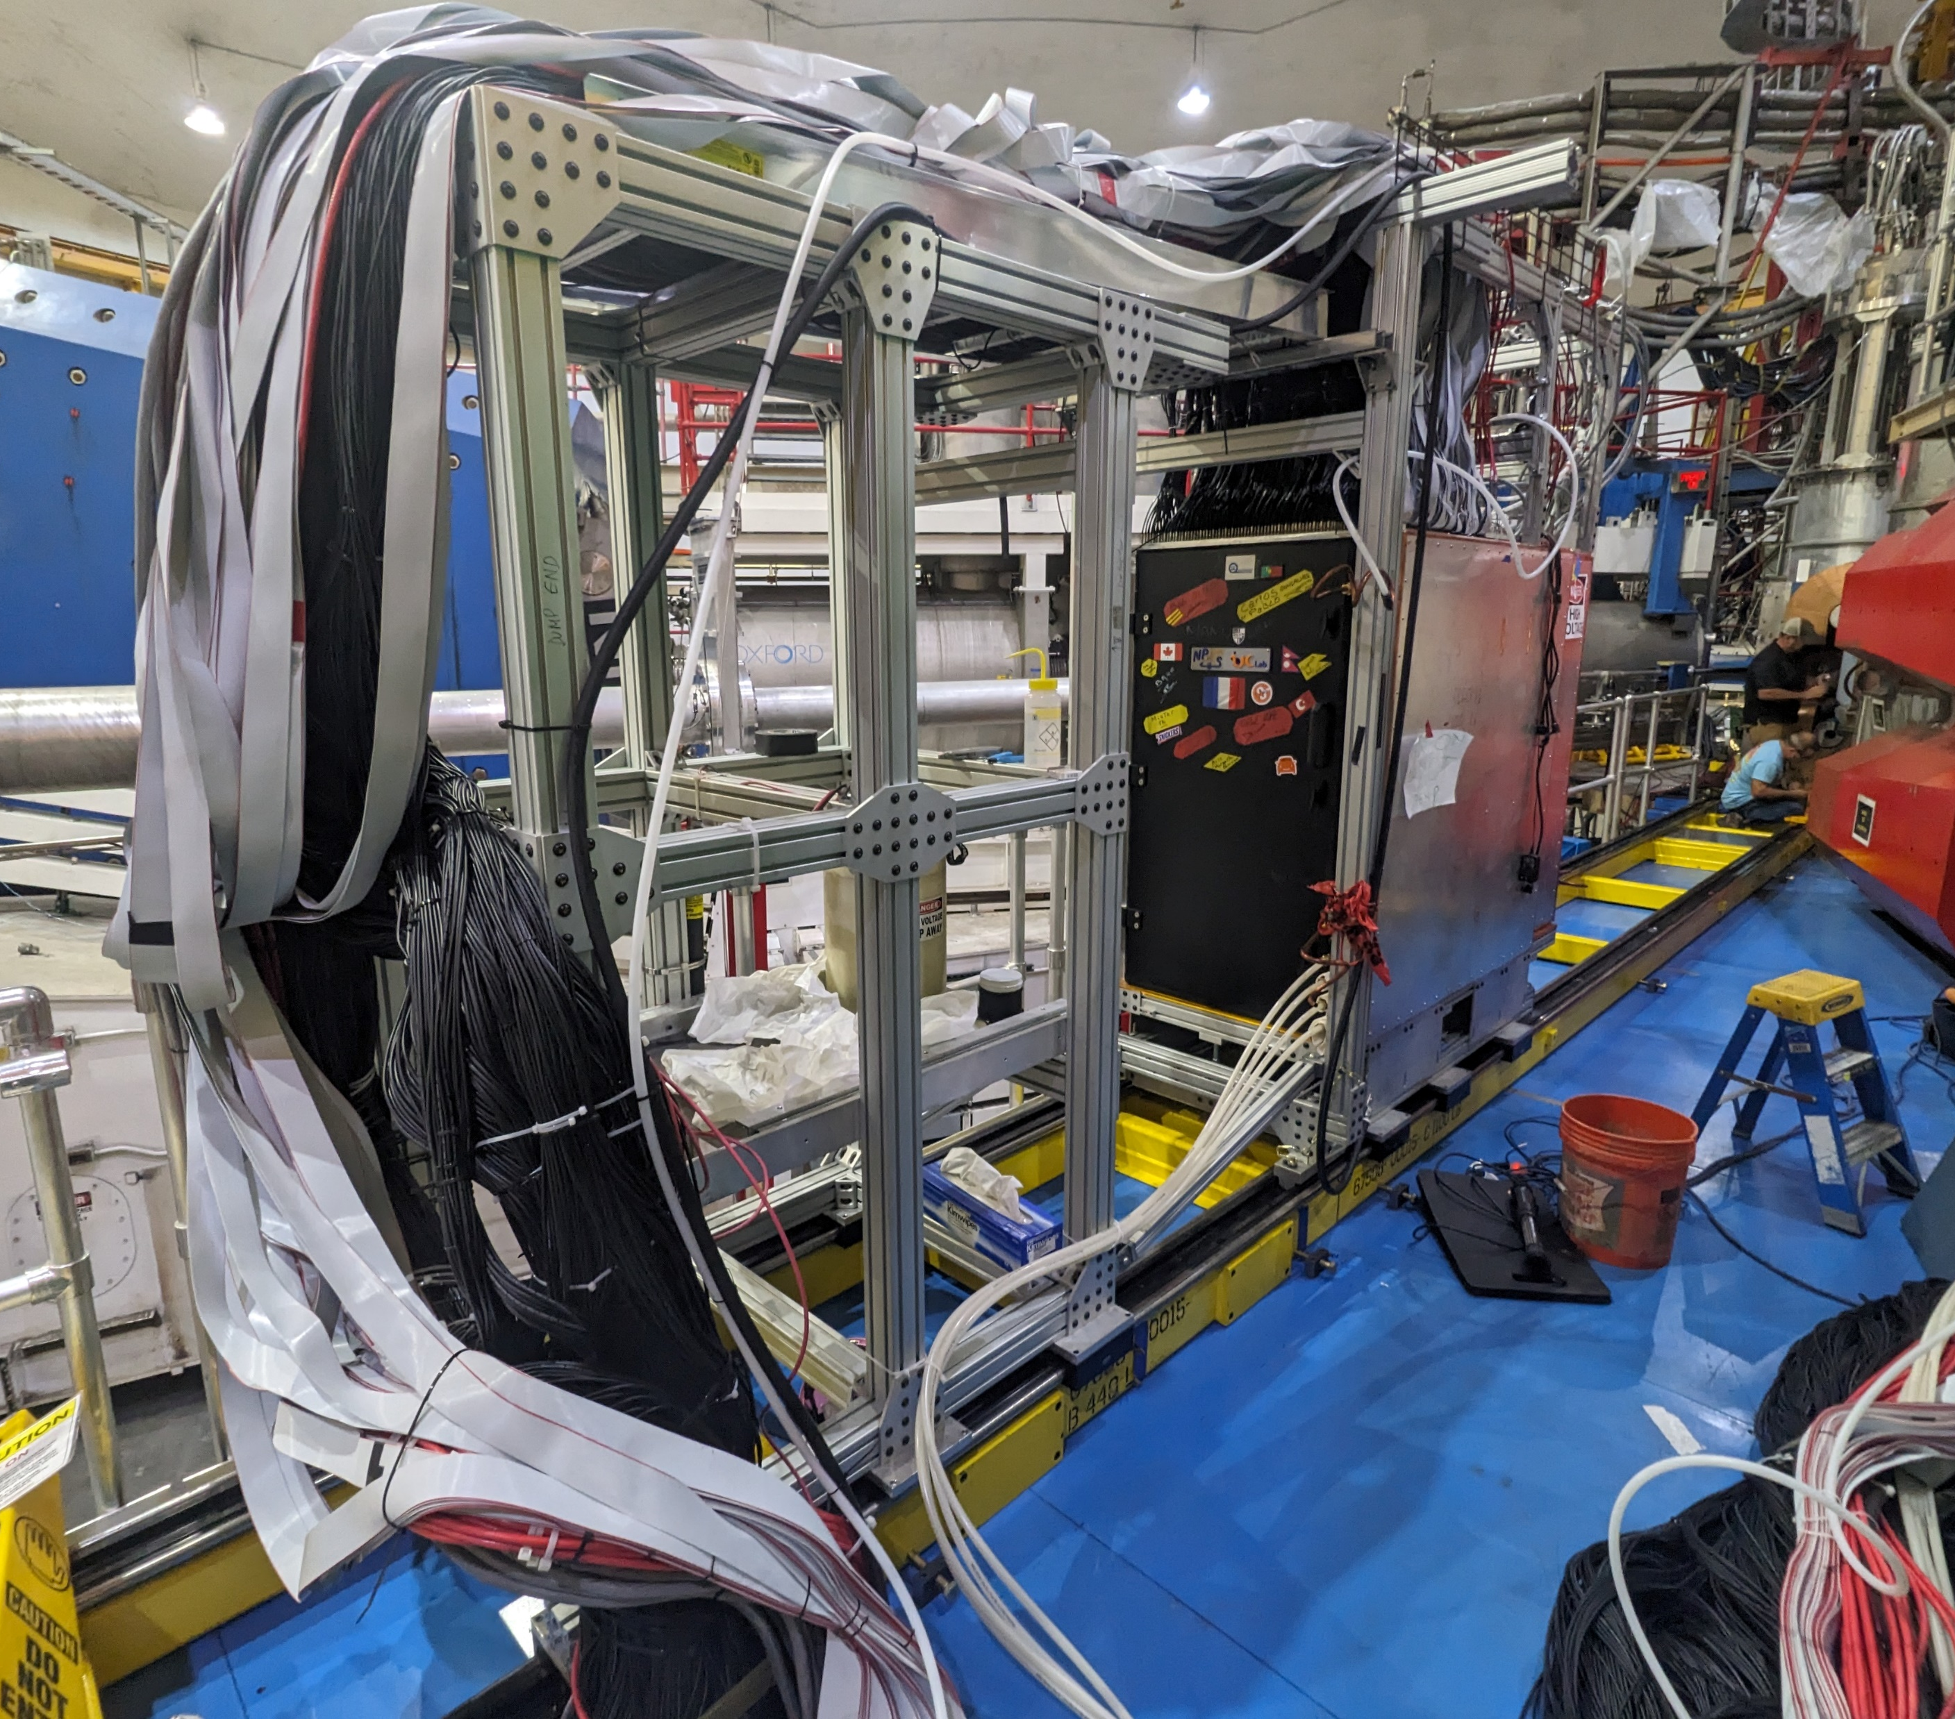
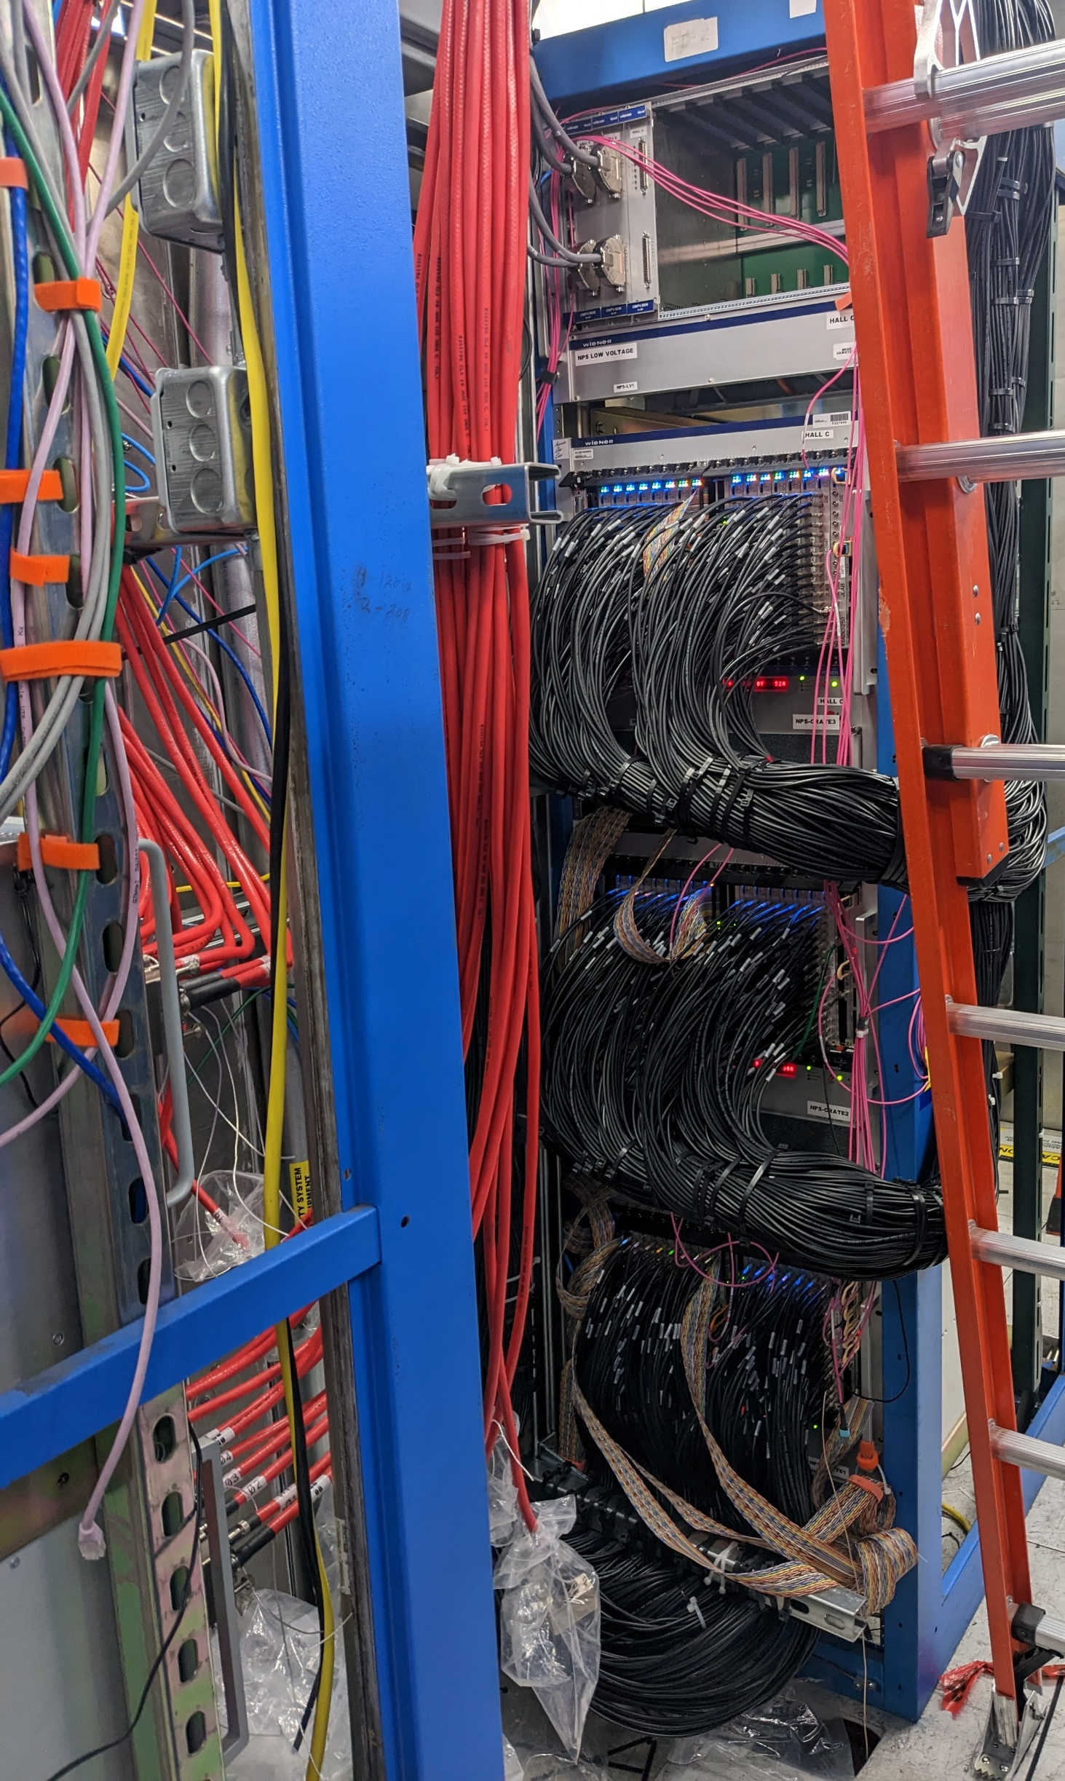
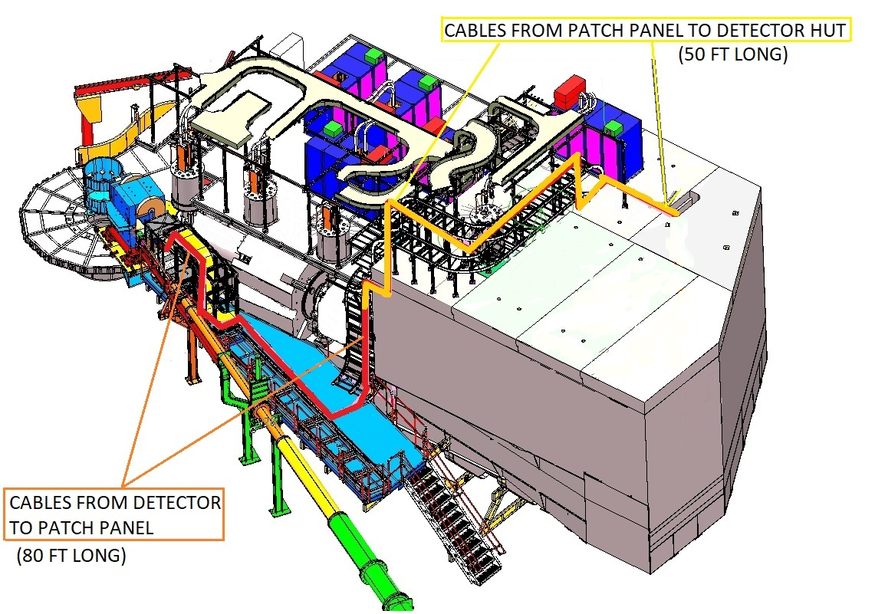
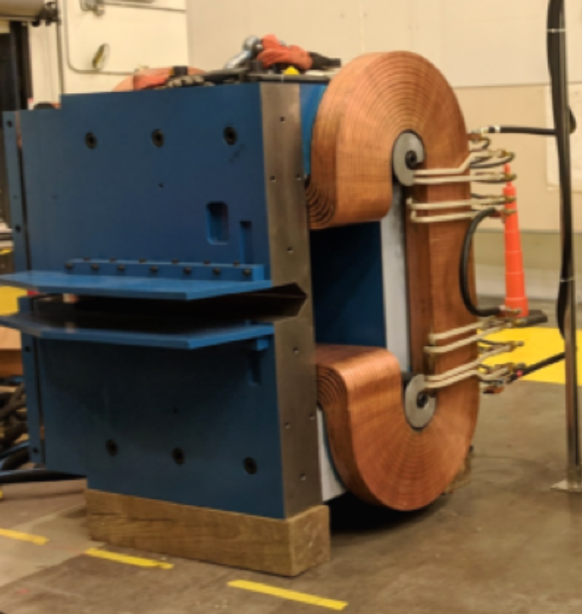
NPS Installation
Installation and cabling began in April and finished Jun 26th
Calorimeter installed on sliding rail
5 VME crates, 2 HV , and 1 LV power supplies added to SHMS hut
Cables ran through the hut roof down to the NPS platform
Sweeper magnet installed in place of Horizonal Bender
Sweep Magnet

Slide 5
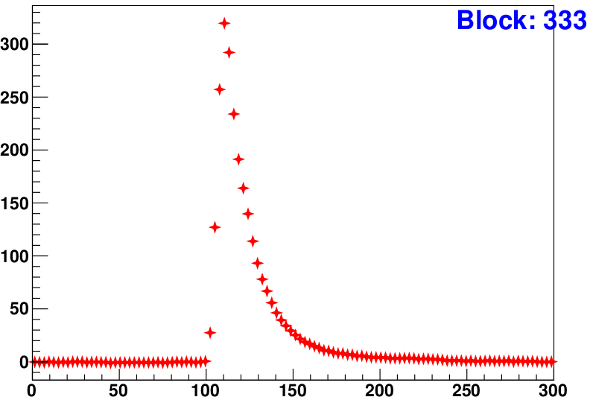
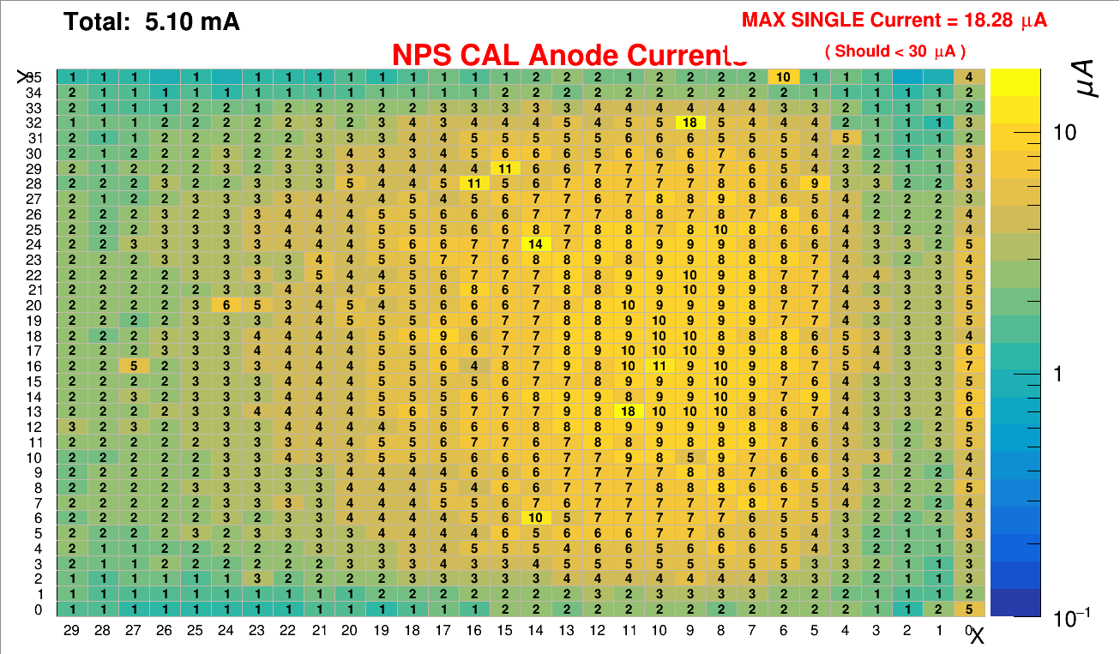
NPS Performance: It Works!
Photon Signal Waveform
mV
Stable temperature control
Sweep magnet effective at reducing background
Manageable amount of crystal darkening
Acceptable timing resolution
Energy resolution in progress
All while achieving a high luminosity(7.5x10³⁷ cm²/s)
Time (ns)

Slide 6
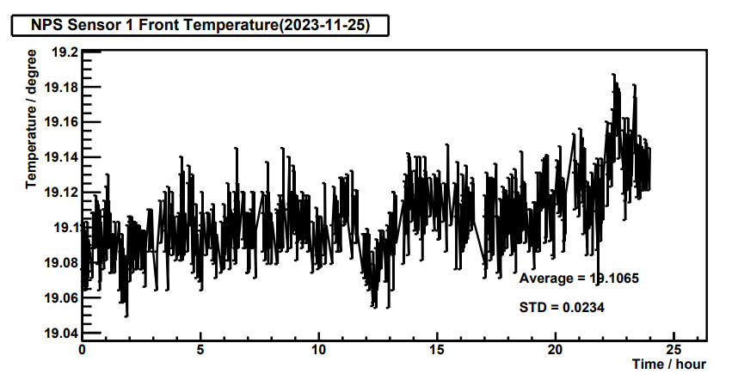
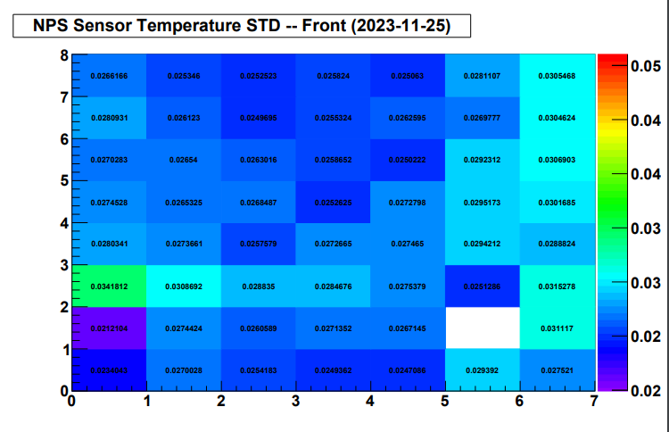
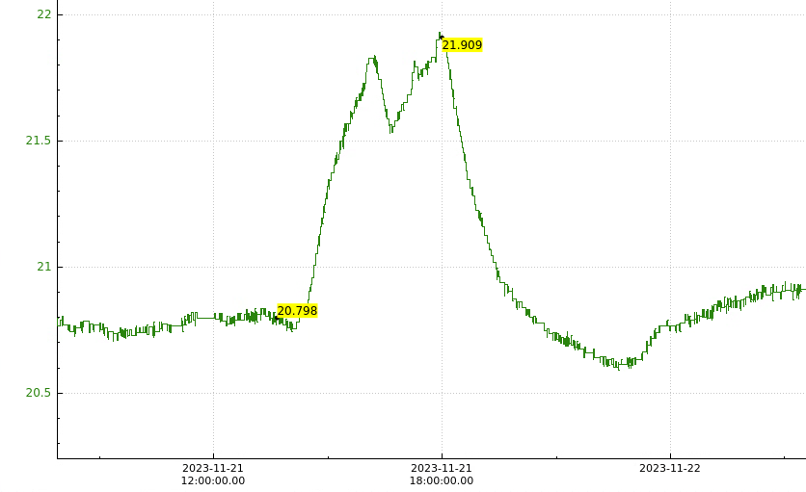
Temperature Control
Light yield from PbWO4 are temperature dependent (-2% / °C at 20°C)
For 0.5% energy stability need 0.1°C stability
The high-voltage dividers on the PMTs dissipate several hundred Watts
Water chillers cool copper frame
Takes up to 9hr to re-stabilize temperatures after changing HV
Temperature change from turning HV on/off

Slide 7
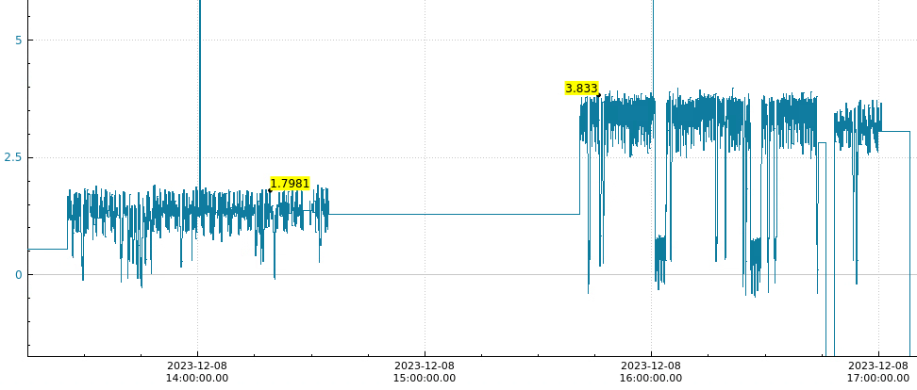
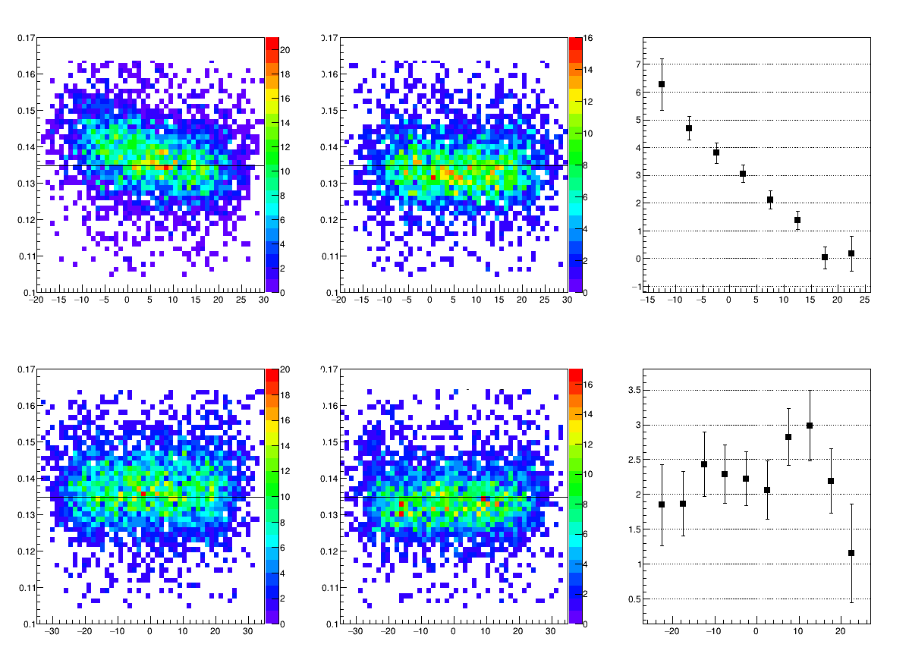
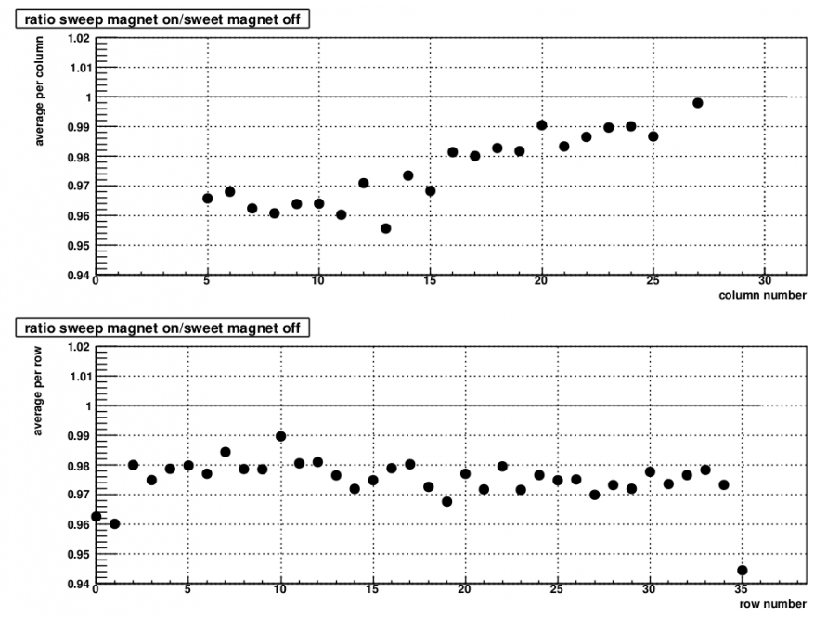
NPS Sweeper Magnet
Anode Current with Sweeper on/off
0.3 Tm conventional copper coil
Reduces electromagnetic background for high-rate environment
With 15uA beam on LD2 the maximum anode current reduced from 9.88uA →3.71 uA with the sweeper on/off
0-6% change in PMT gain as a function of the column #
Sweeper On
Sweeper Off
Change in γ γ Invariant Mass
Change in PMT gain from LED data
γ γ Invariant Mass (GeV)
Change in Gain (%)
X (cm)
X (cm)
X (cm)
γ γ Invariant Mass (GeV)
Change in Gain (%)
Y (cm)
Y (cm)
Y (cm)

Slide 8
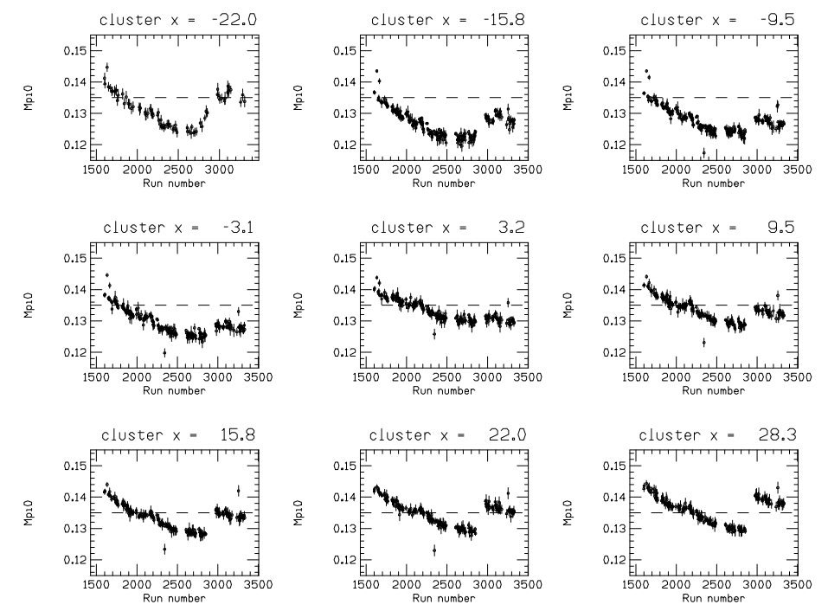
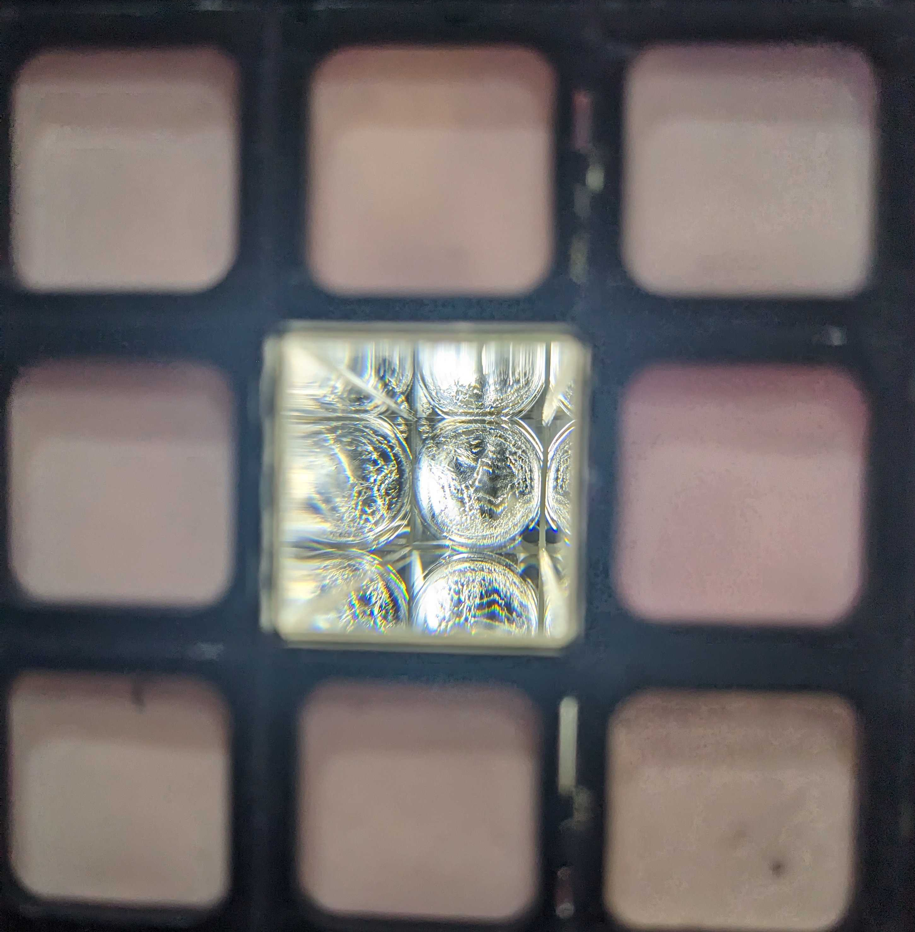
Crystal Darkening
Radiation causes darkening and discoloring of crystals which reduces the light transmission
So far, no visual discoloring of the crystals, but there has been a shift in the π⁰ mass over time
Columns on the edges of the calorimeter saw a larger shift in π⁰ mass
This effect is manageable and will be accounted for in calibration
π⁰ Mass as a Function of Run# for Different Values of x
Re-calibrated with new HVs

Slide 9
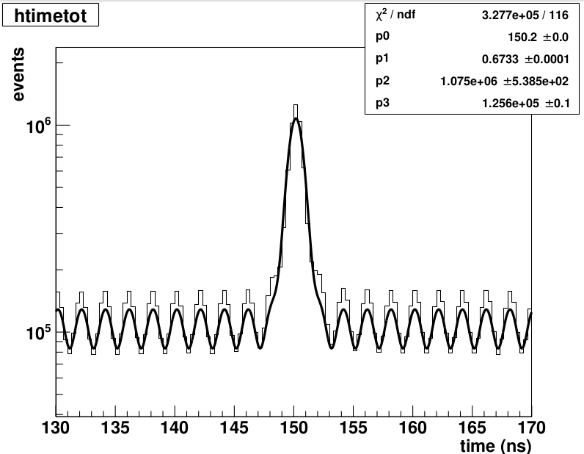
Timing Resolution
Time spectrum for all channels show a timing resolution of 0.67ns
True to accidentals ratio of 10:1

Slide 10
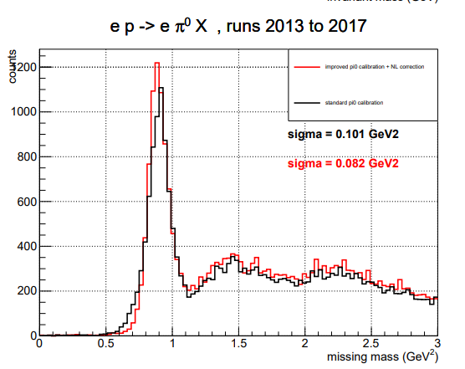
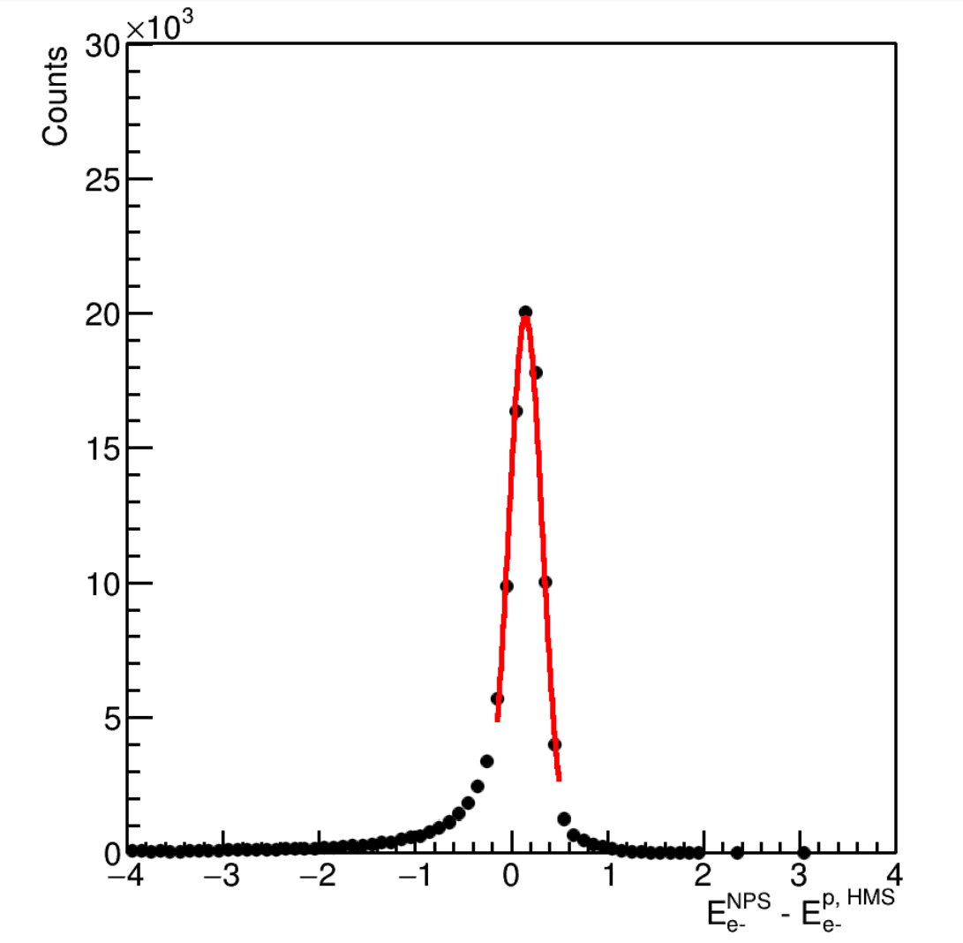
Energy Resolution
Exclusivity of the reaction is determined by the missing mass technique
Missing mass resolution is dominated by the energy resolution of the calorimeter
Energy resolution from elastic calibration ~2.3% at E_{e}=7.494 GeV
Missing mass resolution from π⁰ calibration 82MeV
Hear Hao’s talk for more details on calibrations
Energy Resolution
Elastic H(e,e'_{NPS} p_{HMS})
Mean = 0.103 GeV
σσ= 0.148 GeV
E_{e}=7.494 GeV
Resolution = 2.3%

Slide 11
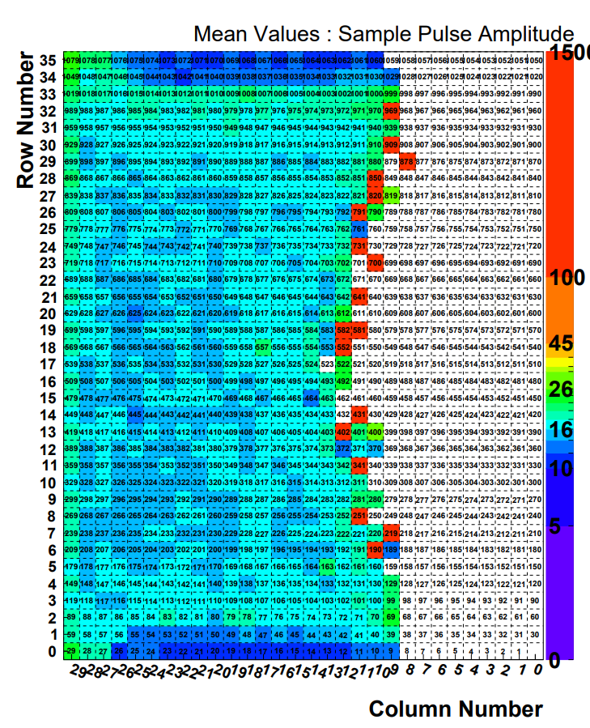
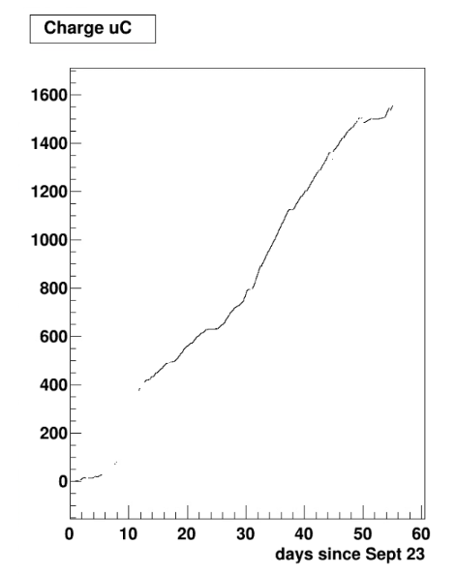
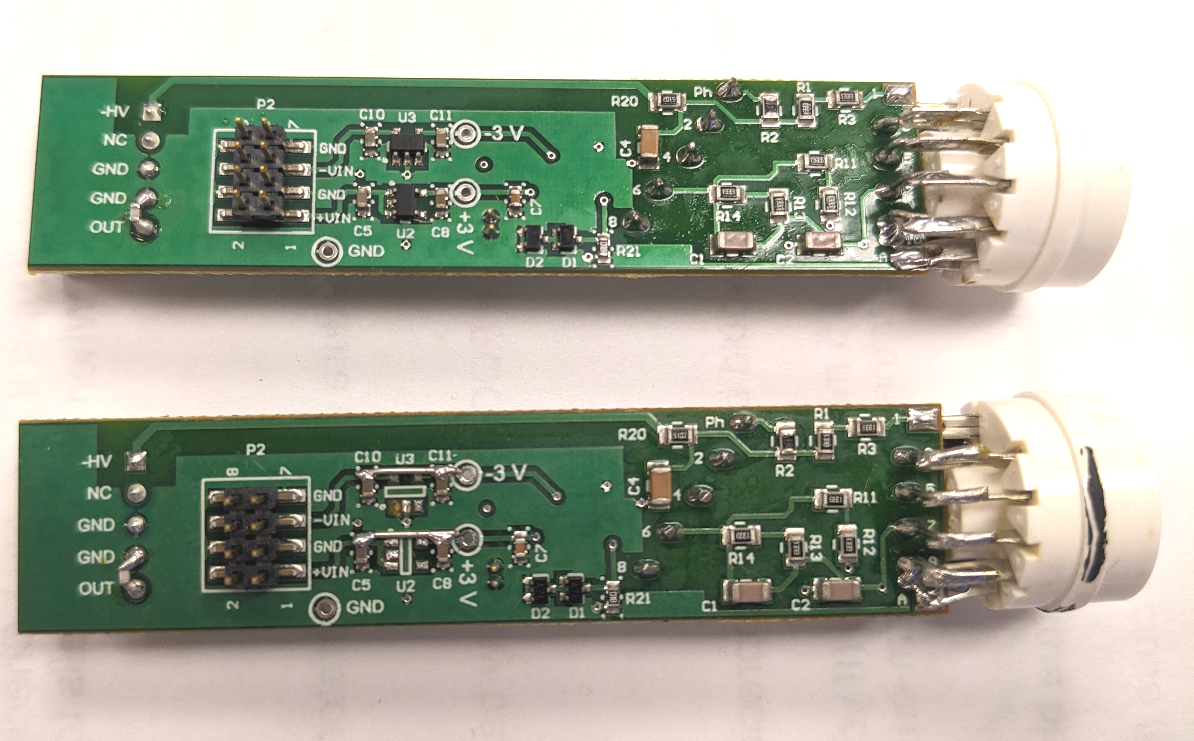
Radiation Damage
Radiation damage to the LV regulators on the PMT base pre-amps
Damaged amplifiers cause instability in the LV power supply for all channels in the column
Regions at beam height die faster
Use accumulated anode charge as an approximation of when bases will die
Accumulated Anode Charge
PMT#194
Anode Charge (uC)
Amp Died
Channels Close to Death
Columns Disabled
Top:Original Bottom: Bypassed Amplifier

Slide 12
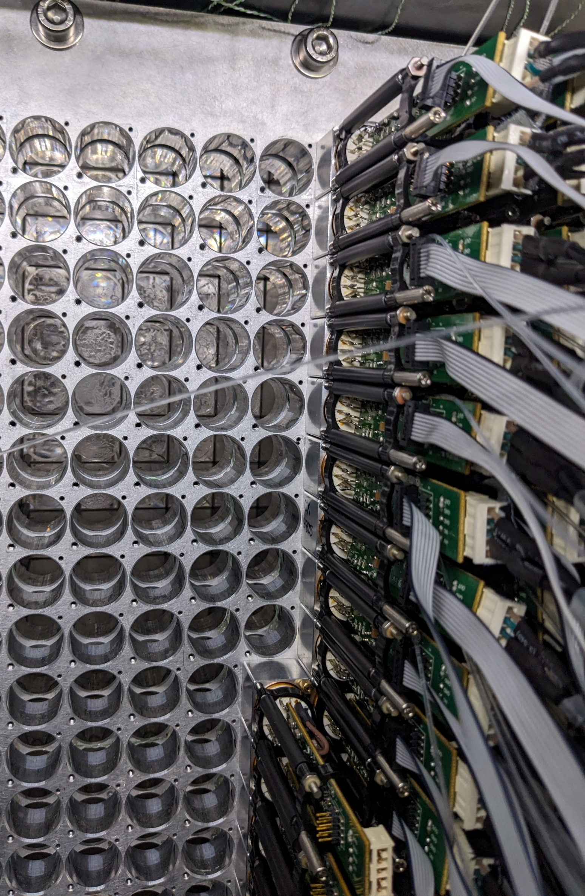
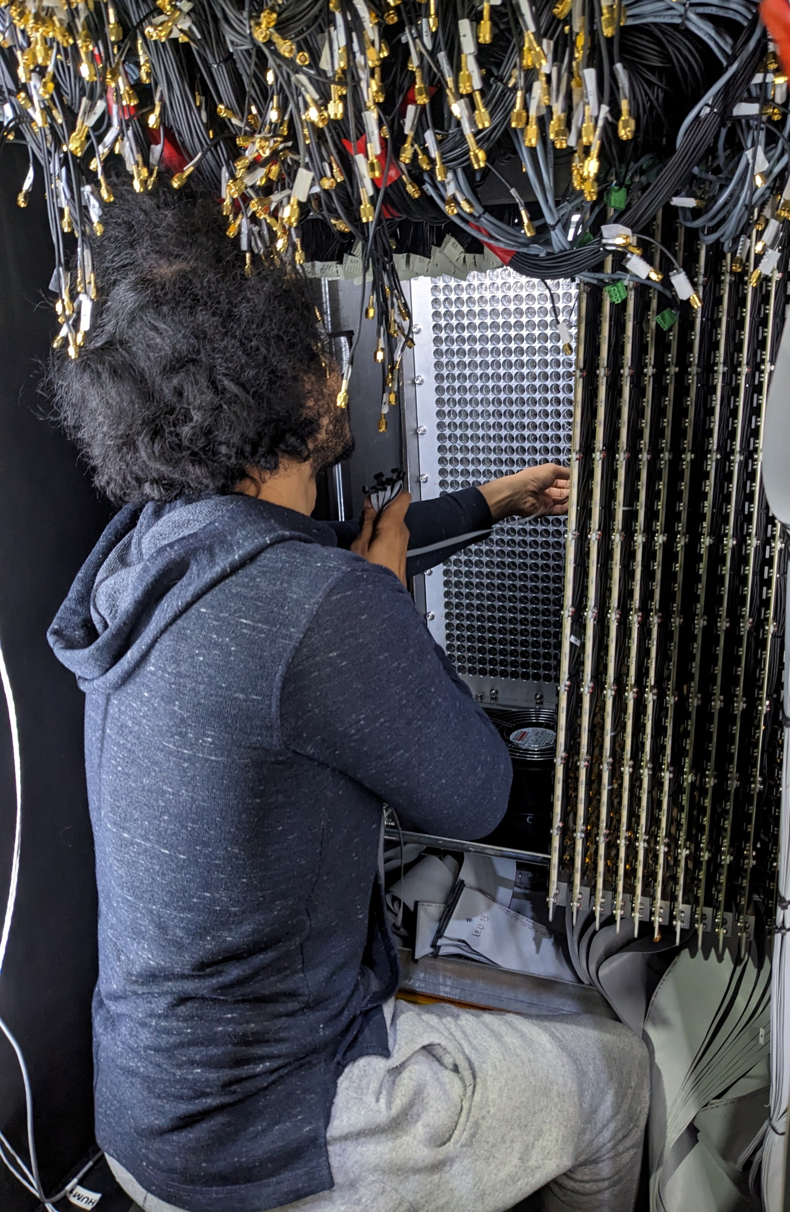
Repair Work
Started removing damaged bases on Nov 1
From Dec 15 – Jan 13 full-time work began repairing all channels in columns 0-19
We removed and disassembled 720 PMT+base assemblies
LV regulators were bypassed by Chris Stanislav and Josh Crafts
Amplifiers were tested without the regulators and seem stable + rad hard
Lead and polyethylene shielding added to side of calorimeter

Slide 13
Summary
NPS calorimeter and sweep magnet installed
20 columns of PMT bases have been removed, repaired, and reinstalled!
Sweep magnet successfully reduces EM background with small effect on the PMT gains
Temperature control system able to maintain <0.5°C stability
Elastic calibration data shows 2.3% at 7.494 GeV energy resolution
Timing Resolution of ~0.67ns
More data & analysis soon to come!
Thank you to everyone in the NPS Collaboration, the fast electronics group and Radcon for timely help with the repairs, and all other JLab staff involved!

