Slide 1
Muon channel for J/Ψ decay and the limits of pentaquark coupling
erhtjhtyhy
Jackson Swartz
Undergraduate Student, University of Chicago
January 18, 2024
Jefferson Lab

Slide 2
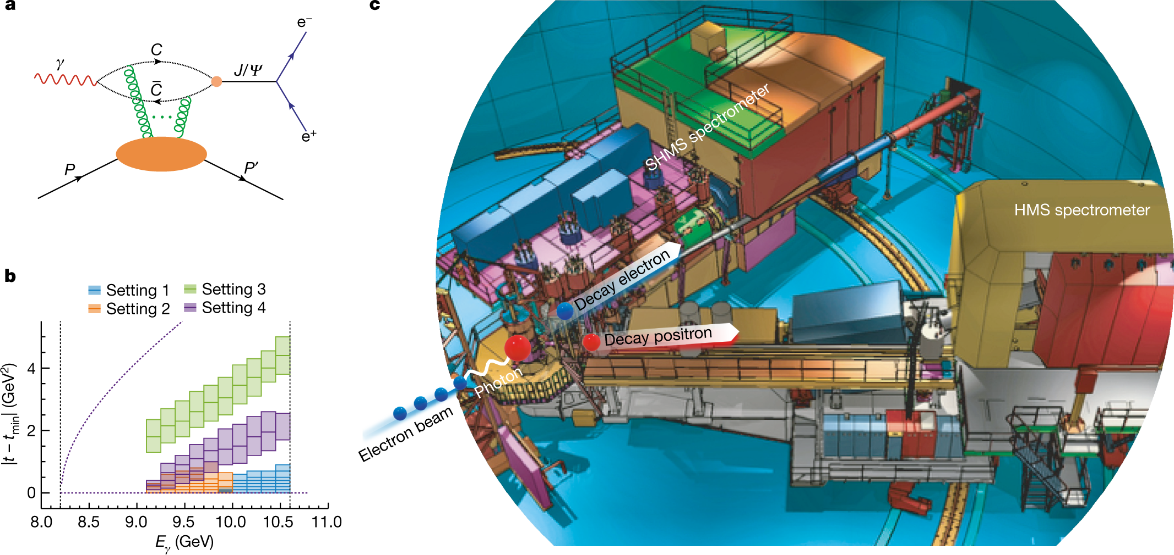
Overview of J/Ψ-007 Experiment
Motivation: confirm LHCb’s discovery of three charm pentaquark states
Experiment: measure differential J/Ψ photoproduction cross section as function of photon energy, Mandelstam variable t
(a) Feynman diagram of t-channel J/ψ photoproduction; (b) Phase space in photon energy and t covered by the experiment’s four kinematic settings; (c) Hall C illustration
Image Credit: Burcu Duran
Notes:
- Pentaquarks found at s-channel resonant photoproduction
- at high t channel J/psi photoproduction (shown above), s channel resonance maximized. In s channel, intermediate particle is produced- charm pentaquark

Slide 3
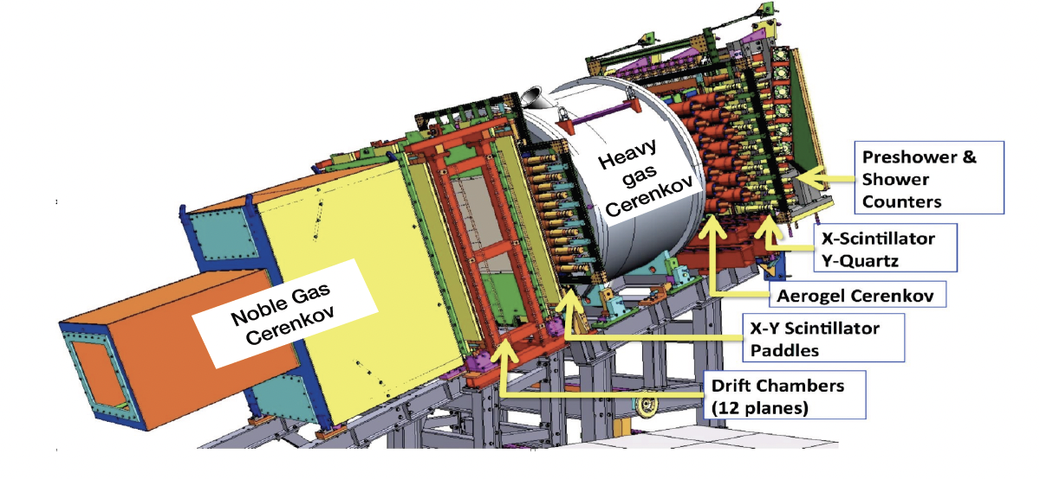
How do we detect J/Ψ’s?
10.6 GeV real photon beam hits liquid hydrogen target, producing J/Ψ’s
Two arm spectrometers used (SHMS and HMS) to detect dilepton J/Ψ decay pairs in coincidence
Analysis of electron channel J/Ψ decay already completed
My role: analyze muon channel J/Ψ decay
SHMS detector stack
Image Credit: Burcu Duran

Slide 4
Identifying dimuon J/Ψ decay pairs
Goal: using detector data, take cuts on experimental dataset until only dimuon (µ+µ-) events are left
Difficult problem: experiment not designed to identify dimuon events
Dipion (π+π-) events: main source of background, difficult to distinguish from µ+µ- events

Slide 5
Case study 1: Cherenkov detectors
How it works: when a charged particle travels faster than the speed of light in a medium, Cherenkov radiation emitted
Threshold momentum for pion: 5.69 GeV
Threshold momentum for muon: 4.34 GeV
Only in setting 1 can muons and pions be reliably distinguished
Image Credit: Burcu Duran

Slide 6
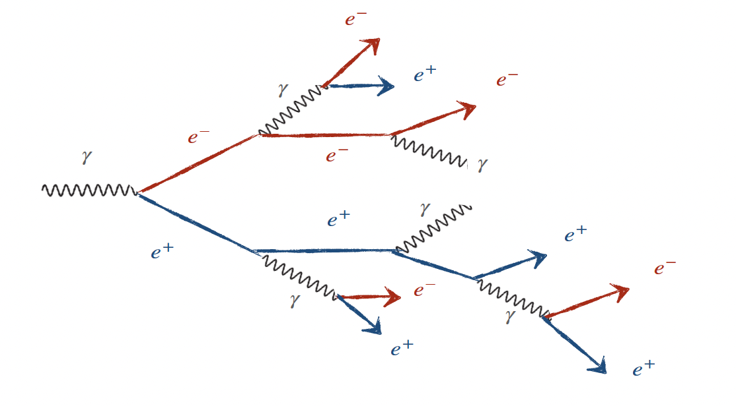
Case study 2: Shower Calorimeters
How it works: high energy photon incident on thick absorbing material, causing an electromagnetic shower (Bremsstrahlung radiation)
Muons and pions are minimum ionizing particles (MIPs): deposit small, equal amount of energy in calorimeter
However, pions sometimes deposit more energy than MIPs via hadronic interaction
Electromagnetic shower illustration
Image Credit: Burcu Duran

Slide 7
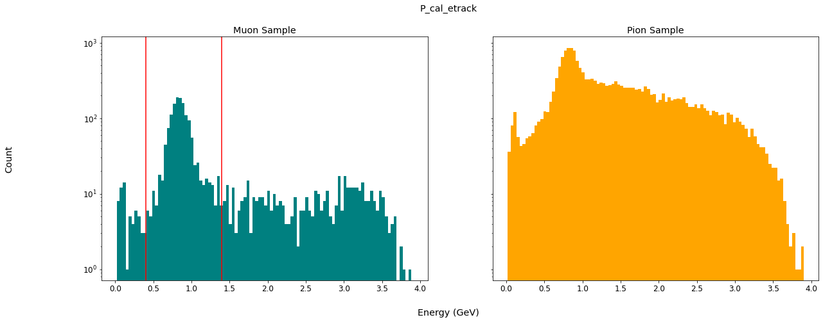
Muon/pion classification
In setting 1 data, use Cherenkov detector to distinguish µ+µ- and π+π- events. Then, plot histogram of calorimeter data:
Take cut around MIP peak. In later settings, use MIP peak cut to remove π+π- events from µ+µ- sample
Calorimeter data histograms for setting 1 muon and pion samples.

Slide 8
Calorimeter cuts
Many sets of calorimeter data from both spectrometers
For each histogram, cut out events not within the MIP peak:
Note: Only the π+π- events outside the MIP peak are removed

Slide 9
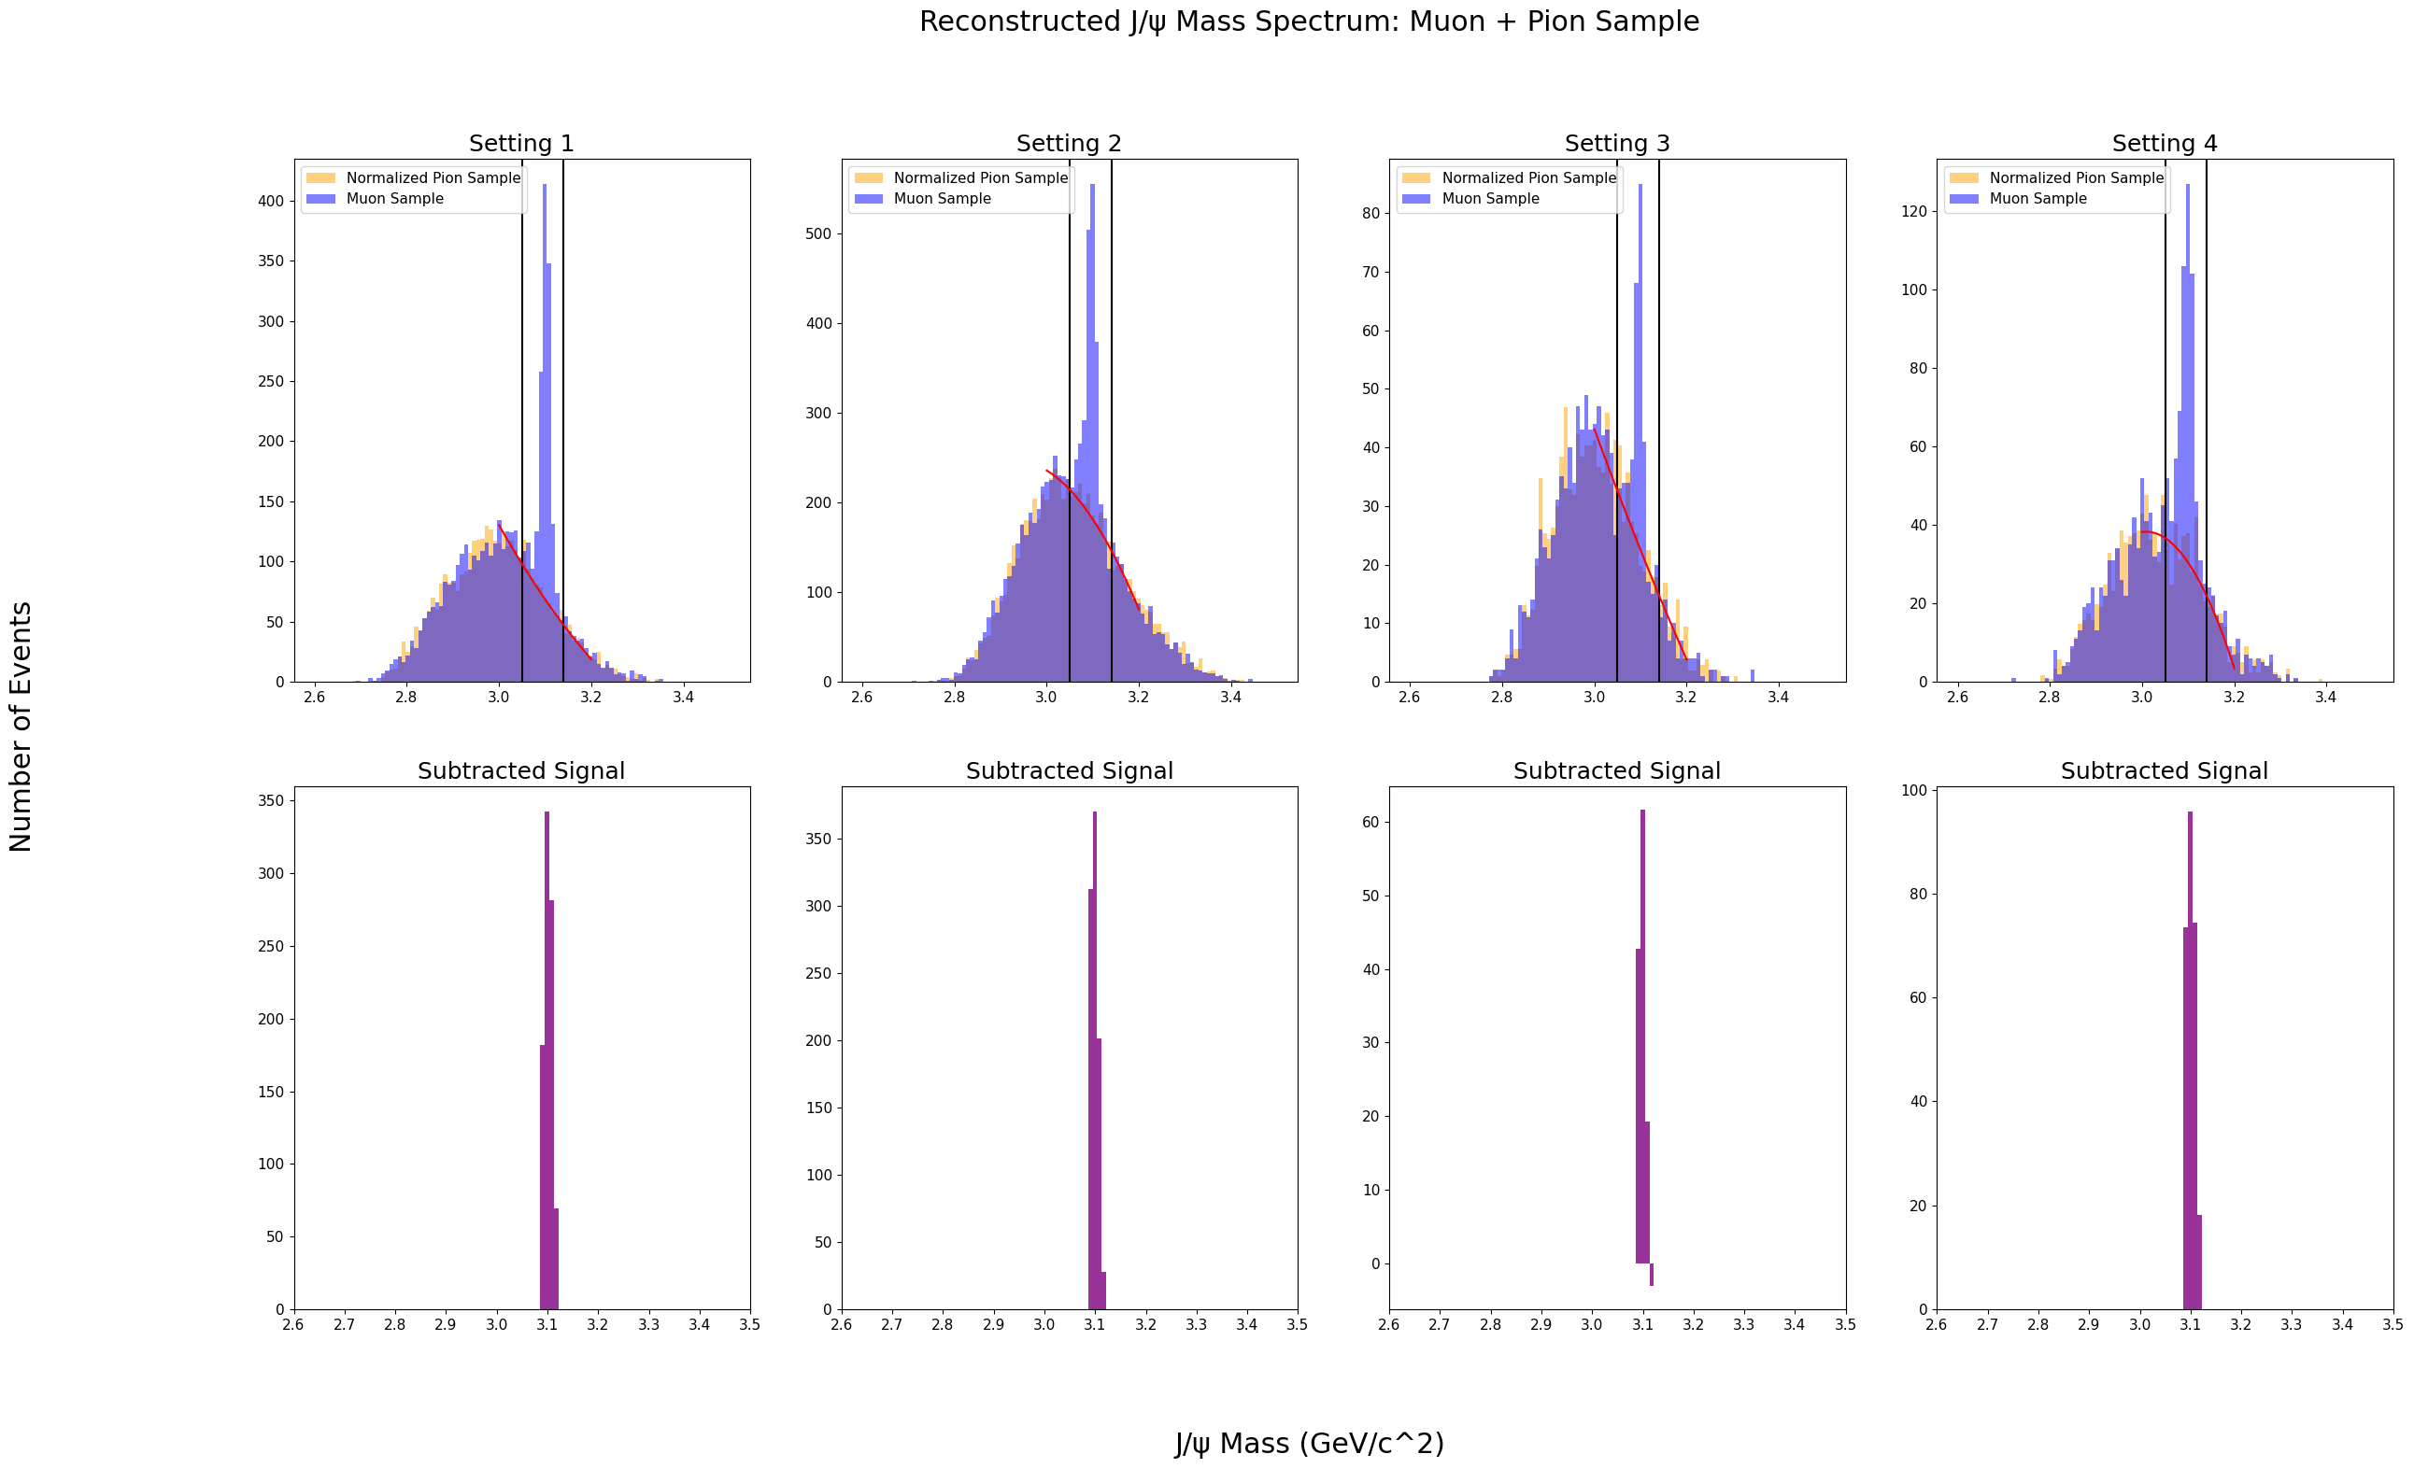
Background subtraction
Calorimeter cuts remove some, but not all π+π- events
Plot reconstructed J/Ψ invariant mass histograms for muon and pion samples:
Background subtraction method. Fit pion histogram to muon histogram and subtract out. Finally, take cut around J/Ψ mass peak to obtain the Subtracted Signal.

Slide 10
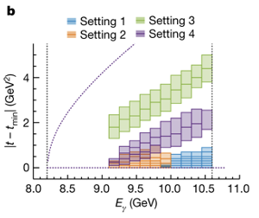
One-dimensional binning
To derive differential J/Ψ cross section as function of photon energy, need to first find J/Ψ counts in each photon energy bin
Separate muon and pion samples into photon energy bins, repeat background subtraction for each bin to obtain J/Ψ count
Binning used for the J/Ψ-007 experiment.
Image Credit: Burcu Duran

Slide 11
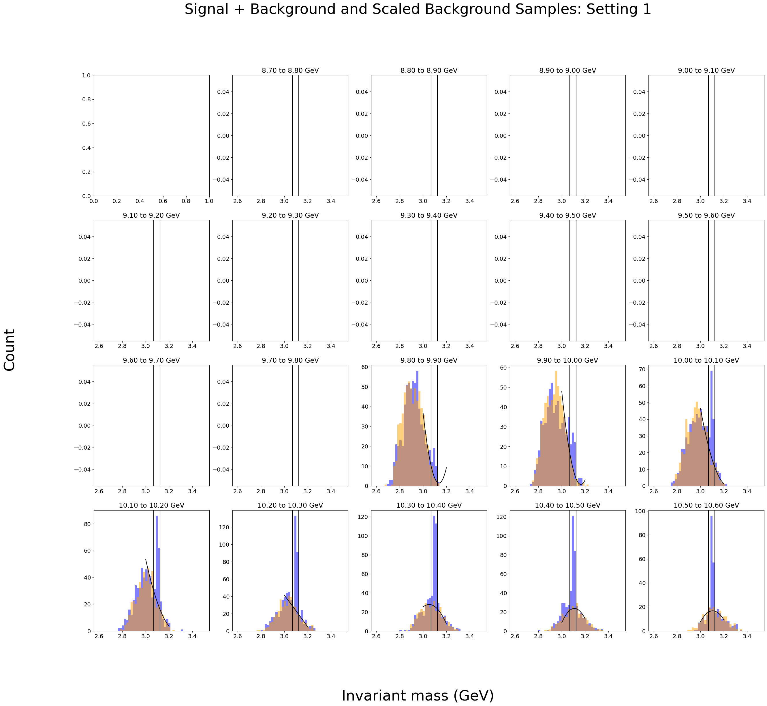
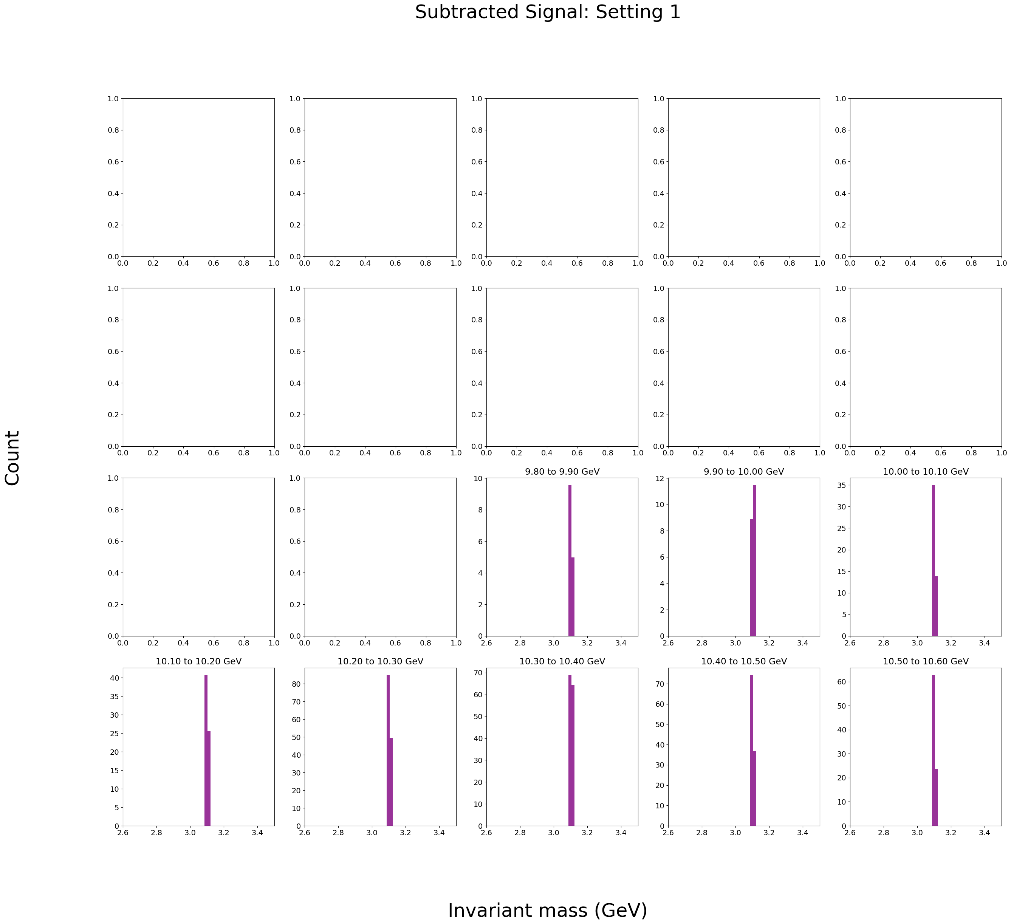
One-dimensional binning

Slide 12
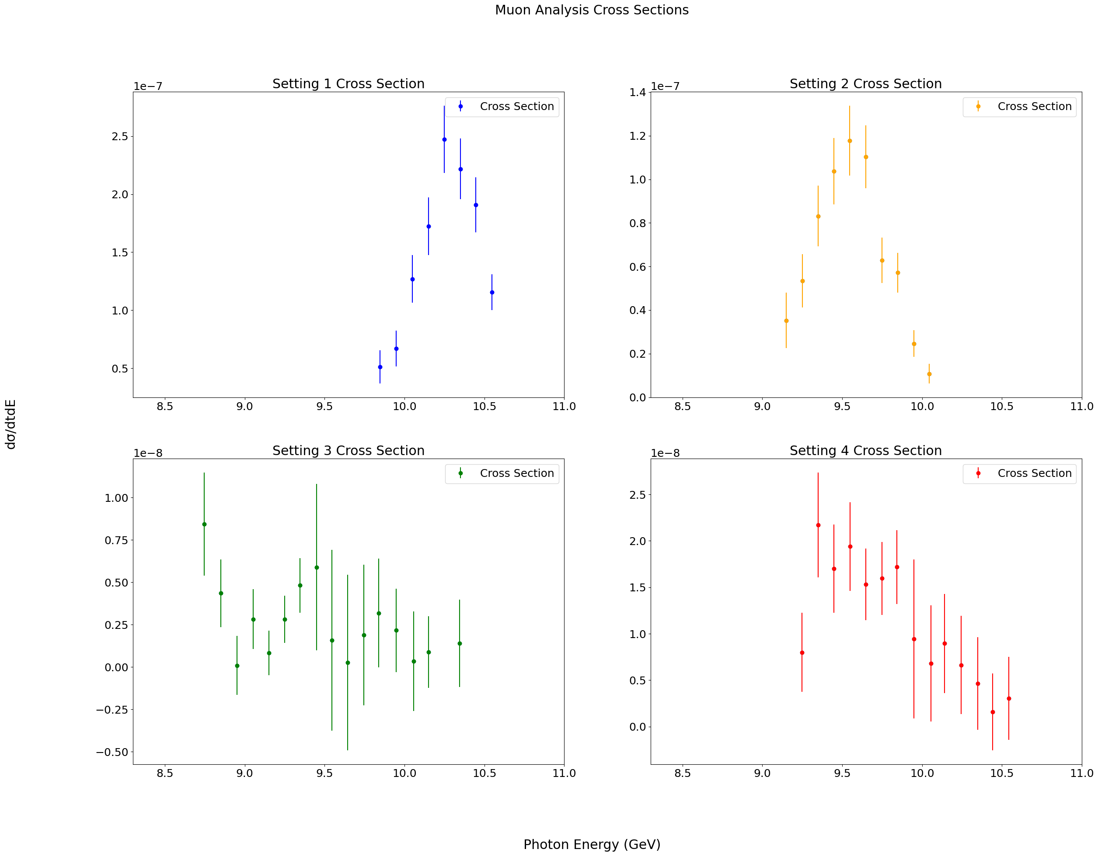
Final results
Use beam luminosity, apply corrections to convert raw J/Ψ counts into cross-sections:

Slide 13
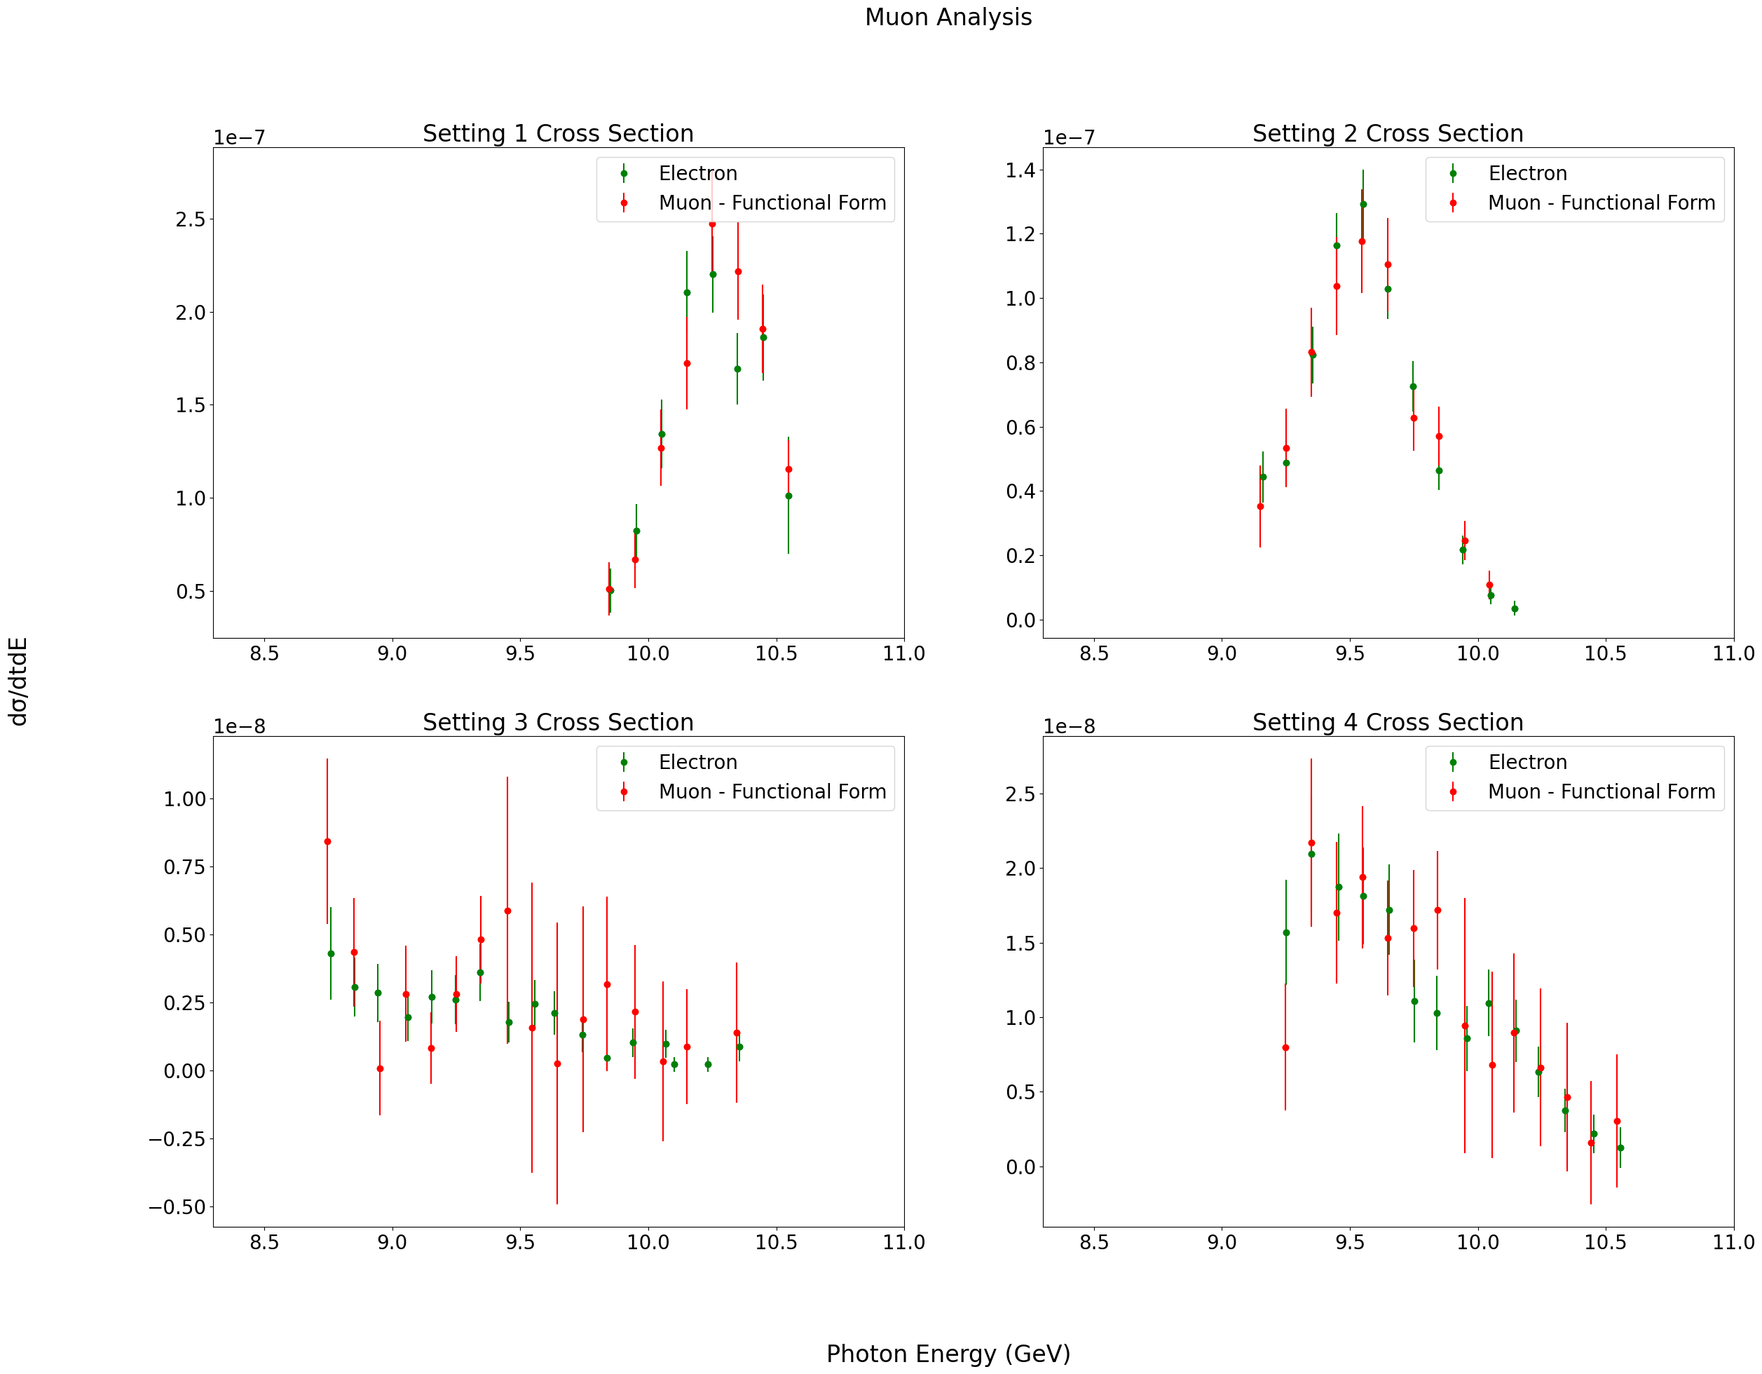
Comparison to electron analysis
Differential cross sections obtained from muon and electron analyses agree:

Slide 14
Fitting data to pentaquark model
Fit muon cross-section data to two different curves:
Gaussian curve: assumes no pentaquark
Gaussian plus histogram curve: assumes existence of pentaquark
Scale of histogram determined by pentaquark coupling
Gaussian curve constrains data well; pentaquark fit does worse as coupling increased

Slide 15
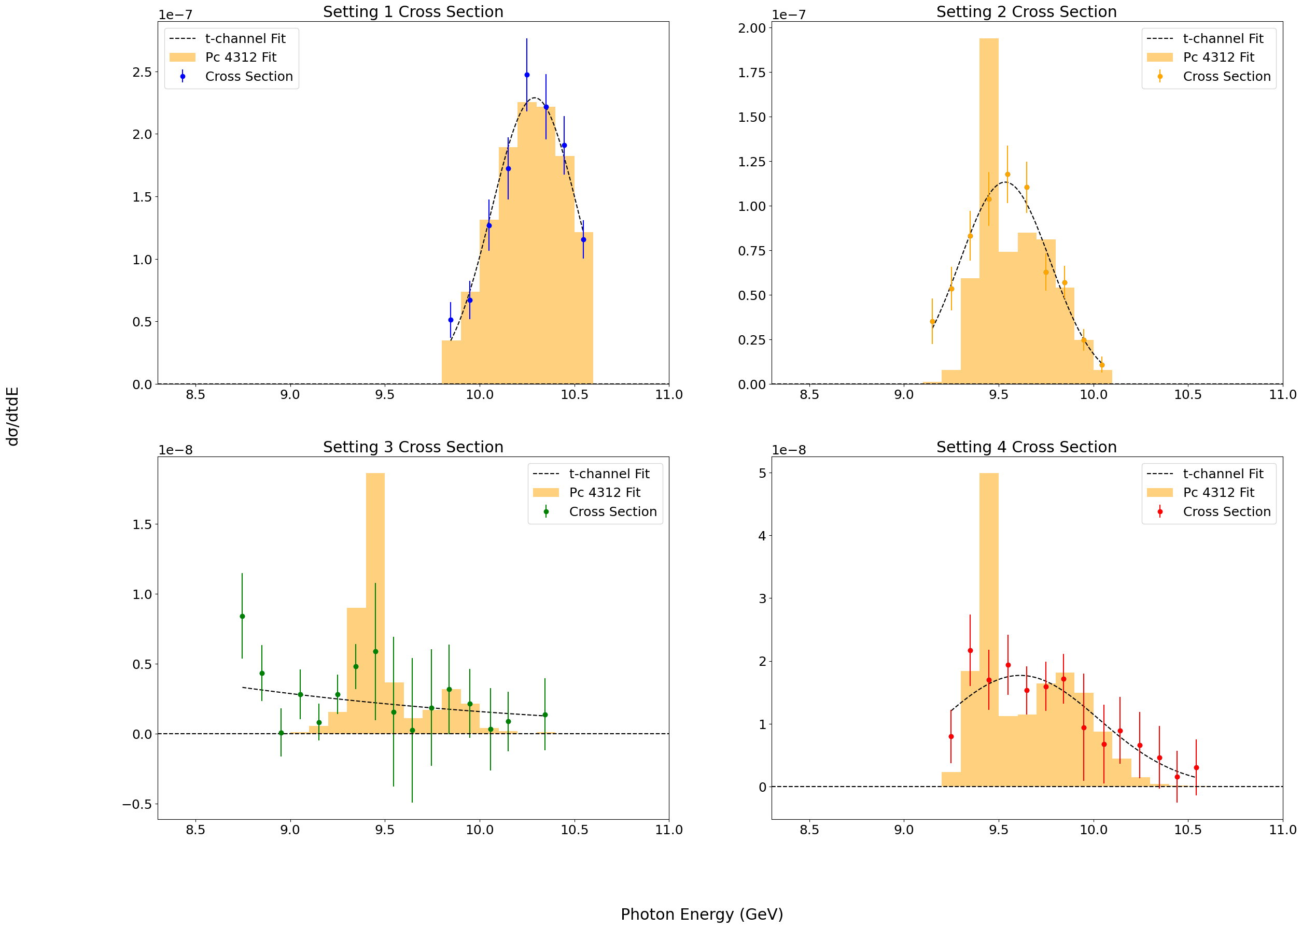
Fitting data to pentaquark model: Pc 4312 (5% Coupling)

Slide 16
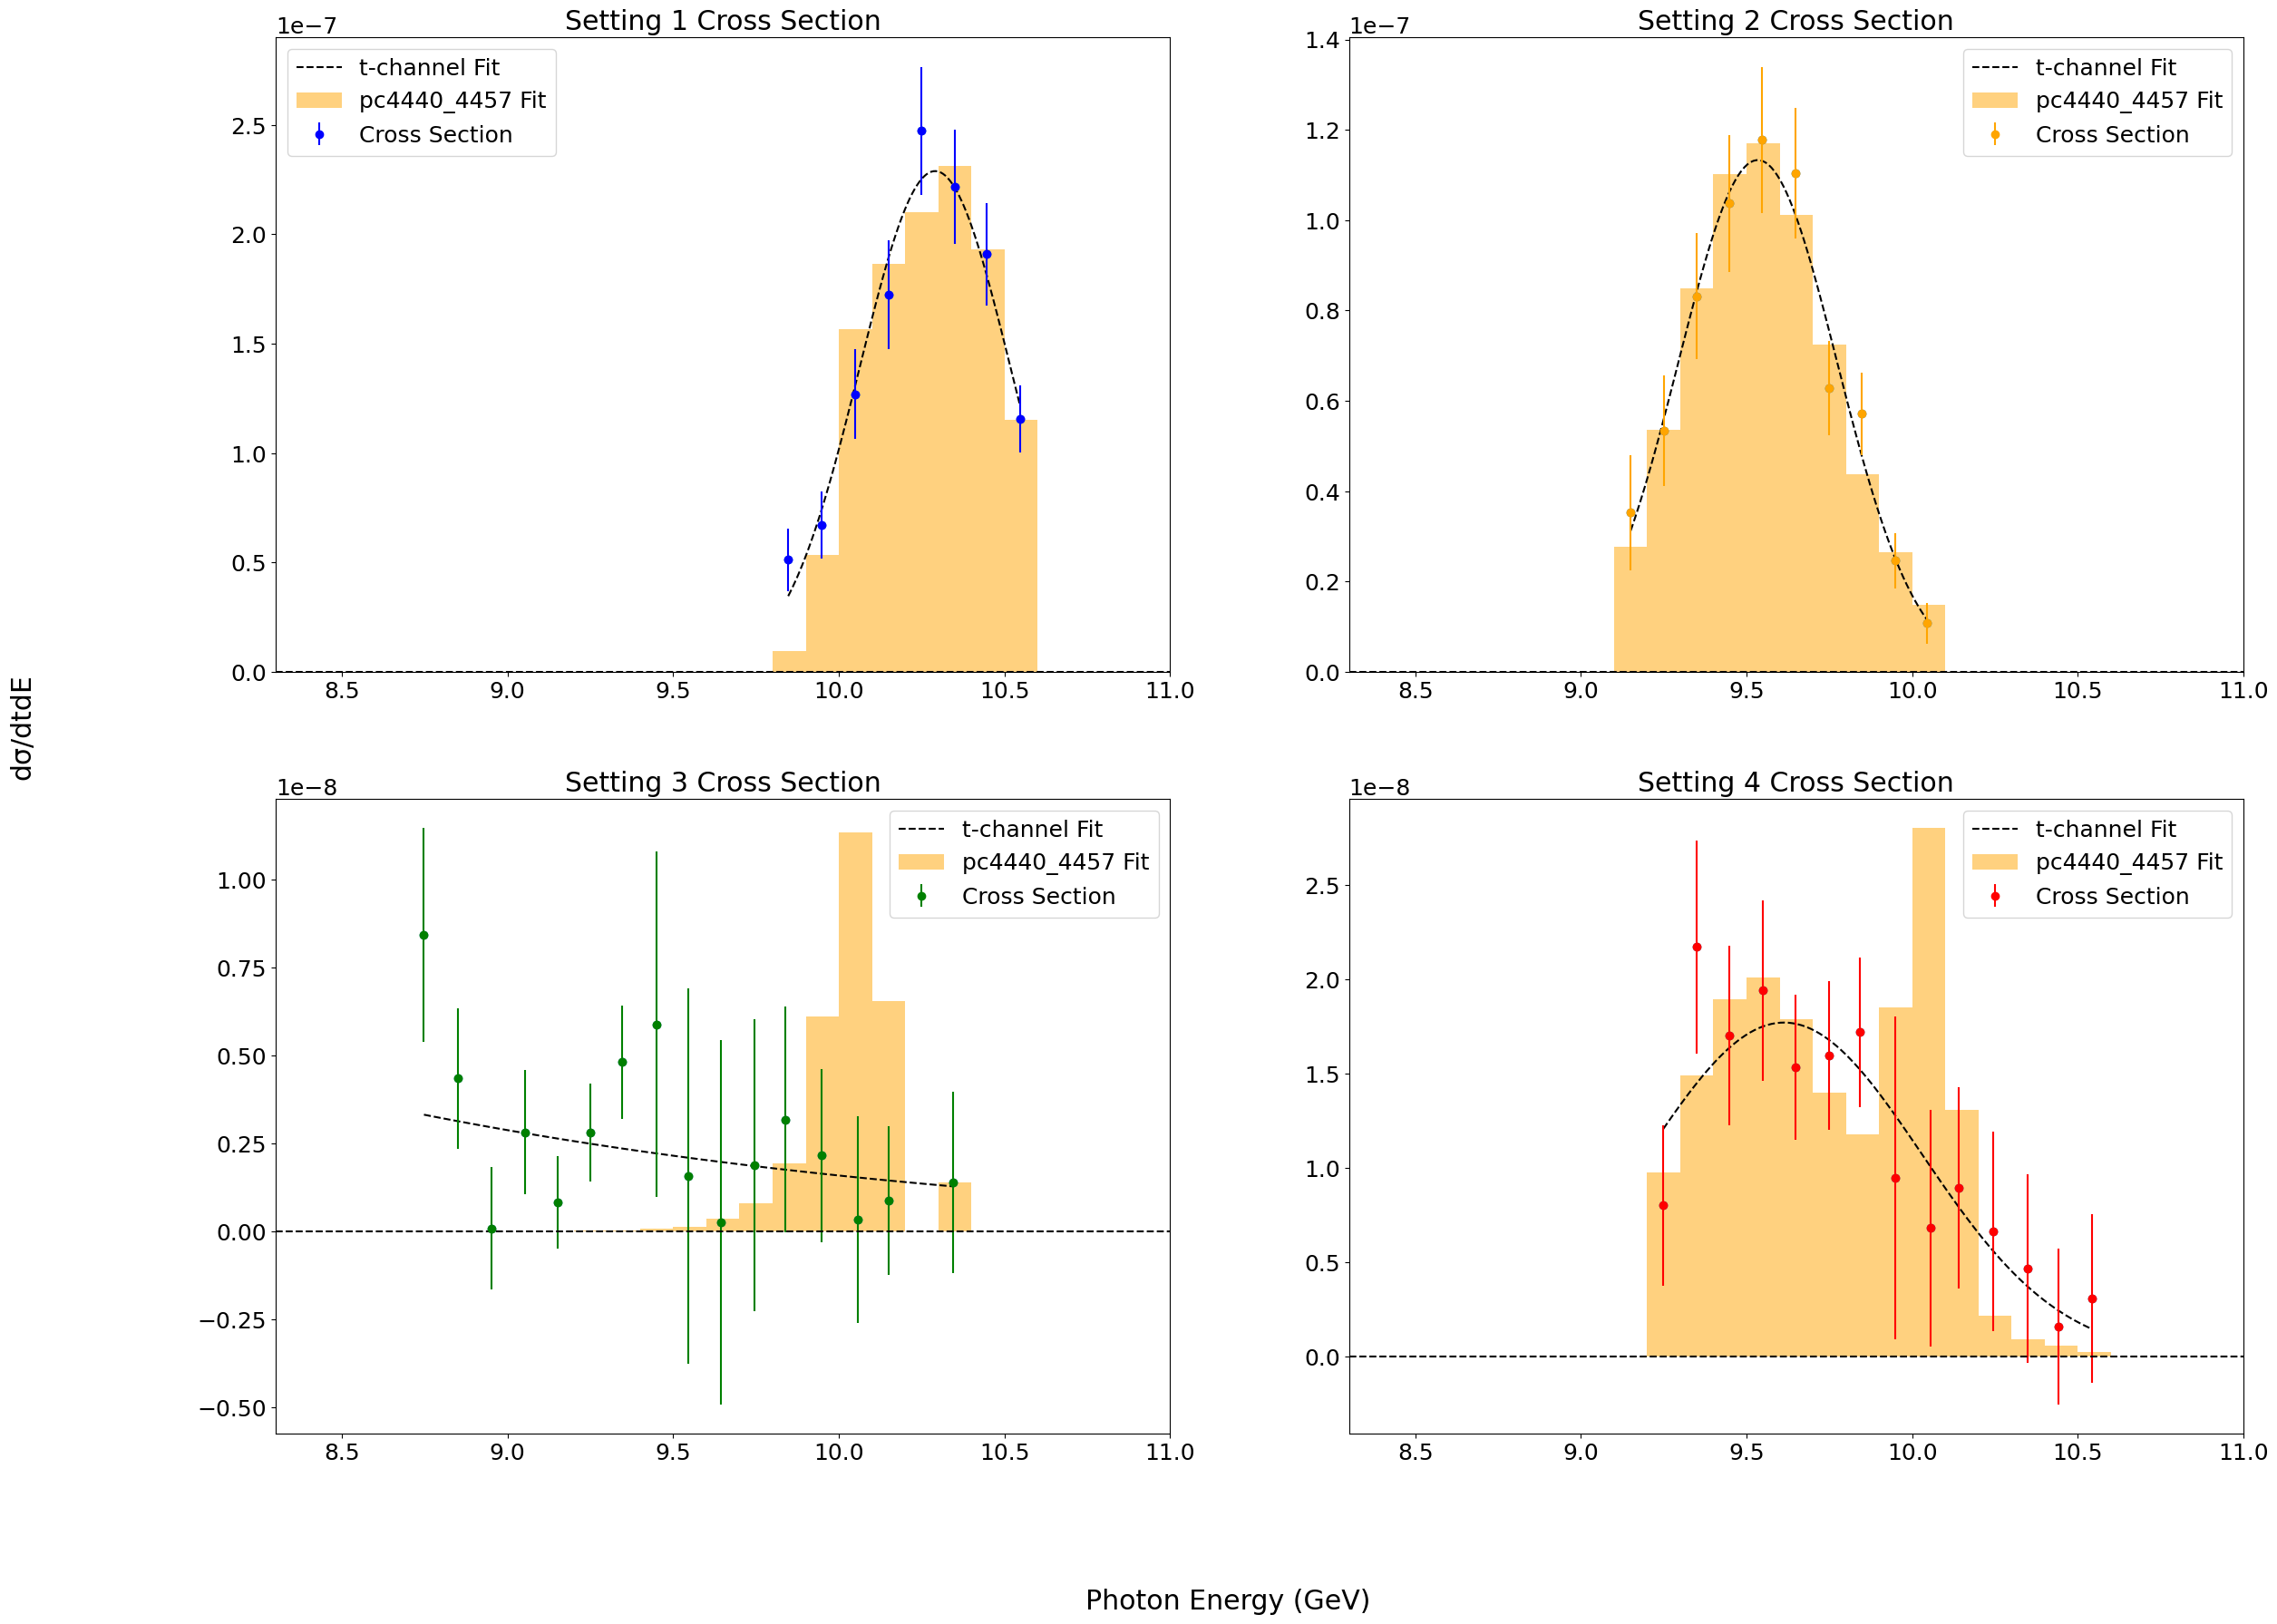
Fitting data to pentaquark model: Pc 4440+4457 (5% coupling)

Slide 17
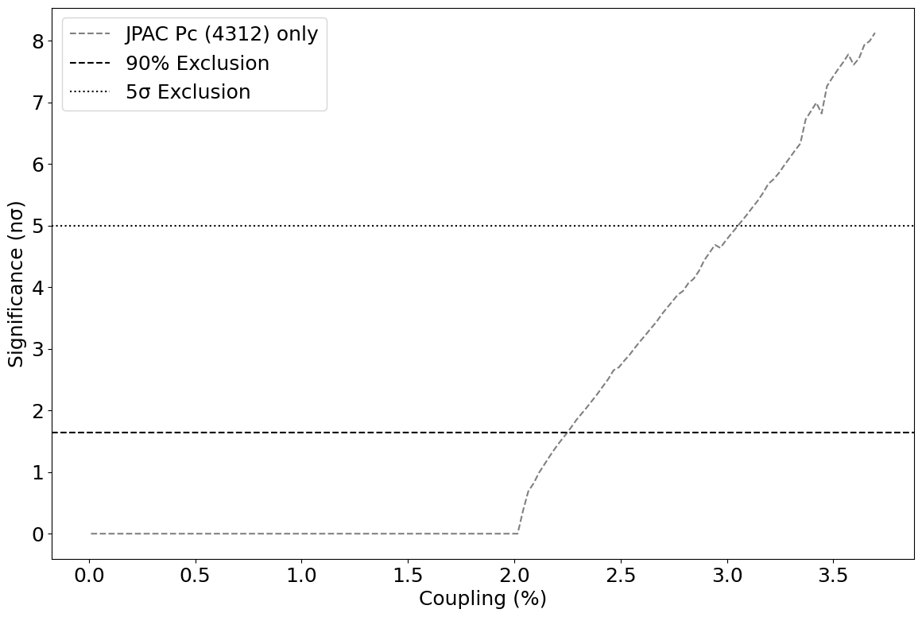
Limits on pentaquark coupling
Use Wilk’s theorem to determine to what extent the difference in fit performance is statistically significant:

Slide 18
Thank You To the below people for their invaluable support and mentorship:
Burcu Duran
Zein-Eddine Meziani
Sylvester Joosten
Shivangi prasad

Slide 19
Any questions?

