Slide 1
Winter Hall C Collaboration Meeting
Hall C Working Group AI4HallC
Casey Morean, Tanja Horn, Cristiano Fanelli
(Conveners of the AI4HallC WG)
DALL-E prompt:
“Create an image of data streaming into a holographic display with figments of AI and machine learning. Show a human finger touching the holographic interface”
1/18/2024
Supported in part by NSF grants PHY2012430 and PHY2309976

Slide 2
Current Projects – Hydra Deployment
Hydra implementation in Hall C for NPS
Huge effort and help from Thomas B, Torri J, Brad S, Anil P
Short-term: convert and label PDF output reports
Labelers needed soon!
Medium-term: Direct PNG output from onlineGUI
Long-term: Pre-experiment training on simulated data
Torri and Thomas kindly offering to run models in the short-term

Slide 3
Current Projects – Retrieval-Augmented Generation (RAG)
How do we leverage LLMs and AI agents to assist in research?
One may ask, “What happened on December 12th during the NPS experiment?”
Links to the Logbook entry of the shift summary, follow-up entries, wiki links
When did the drift chambers loose flow?
Logbook entries, wiki RC meeting, etc.
Please See Daniel Murnan slides on chATLAS from AI4EIC annual workshop!

Slide 4
Current Projects – Retrieval-Augmented Generation (RAG)
How do we leverage LLMs and AI agents to assist in research?
One may ask, “What happened on December 12th during the NPS experiment?”
Links to the Logbook entry of the shift summary, follow-up entries, wiki links
When did the drift chambers loose flow?
Logbook entries, wiki RC meeting, etc.
Please See Daniel Murnan slides on chATLAS from AI4EIC annual workshop!
Logbook
Hall C Wiki
Experiment Proposals
Standard Equip. Man.

Slide 5
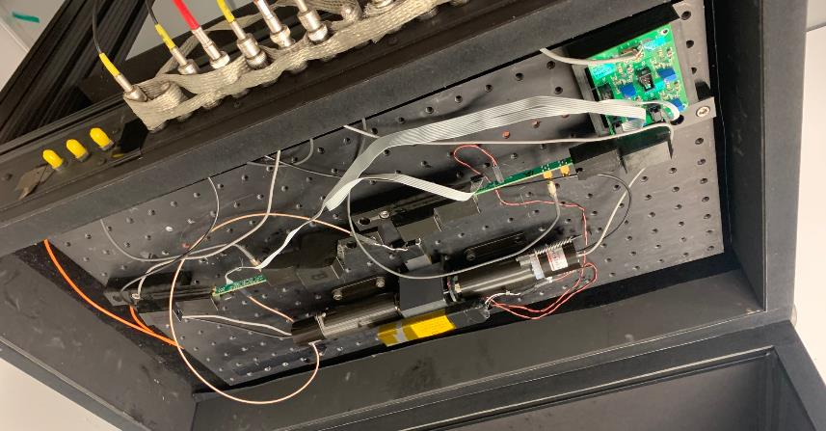
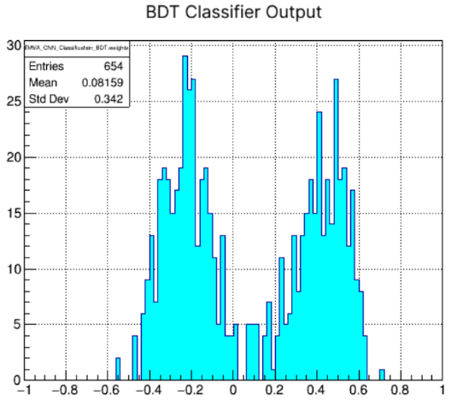
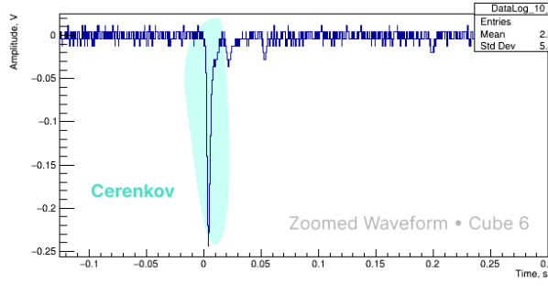
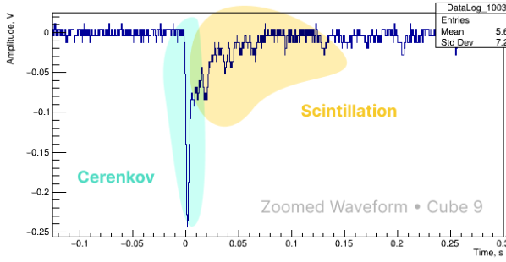
Current Projects – Dual Readout Calorimetry
People Presently working on this
Analyze full waveforms from CHGlass blocks
Two glass samples, one with scintillation centers, one without
One block only emits Cherenkov light
Benchmark standard algorithms against ML algorithms
Future: Perform trigger level or in-line subtraction
Cube 6

Slide 6
Please Get Involved!
Contact any of the conveners to get invovled
cmorean@jlab.org, hornt@cua.edu, cfanelli@wm.edu
Jump into previous meetings with:
Zoom Recording (ask for password)
Live Notes
Upcoming Meeting February 9th at 3:00 EST
Try Hands-On experiments
Open Jupyter Notebook and load an AI/ML setup
Start a HallC Slack channel
Start a bi-weekly meeting for show-and-tell
Mentor program for new people joining?

Slide 7
Current Projects – Overview
Contact:
cmorean@jlab.org
Get Involved!
Partner up with a ML practitioner
Get hands-on experience!
Attend the Feb. 9th Meeting, 3:00 EST
Invitation to be circulated soon via hallc mailing list
Help Hydra C
Works in Progress (cmorean@jlab.org)
Hydra implementation in Hall C for NPS
Retrieval-Augmented Generation Agent
Waveform analysis for dual readout calorimetry
Unsupervised learning for PID (TBD)
Future
AI/ML pipeline for deploying models
Here's your image showcasing quarks, mesons, and hadrons personified as animated characters. They are depicted with playful features, eagerly surrounding a scientist who is ready to analyze them with artificial intelligence. The scene captures the excitement of these subatomic particles in a modern, high-tech laboratory setting.

