Slide 1
Long Range Plan Outcomes and Implications
Cynthia Keppel
Hall C Collaboration Meeting
January 18, 2024
Jefferson Lab

Slide 2
Highlights from the Lab
12 GeV scientific era is going strong
  – ~30 weeks operation in FY23 and FY24 (planned), enabled by supportive Operations budget
  – High-profile results emerging from 12 GeV program – thank you all!
  – Progressing on accelerator refurbishments, accelerator uptime improved!
Successful partnership with BNL in management, design, construction of EIC Project
MOLLER Project well underway
Exploring technical innovation and scientific opportunities enabled by CEBAF upgrade concept
  Joint JLab/User committee formed, accelerator/theory/physics
  Expect invites to talk, workshops,….
HPDF approved for Jefferson Lab site!
Other initial steps toward diversifying Jefferson Lab’s scientific mission – BES, HEP,…
2

Slide 3

JLab in the Long Range Plan
It takes facilities, people, and funding to tackle these challenging questions
2023 LRP Science Questions
How do quarks and gluons make up protons, neutrons, and, ultimately, atomic nuclei?
How do the rich patterns observed in the structure and reactions of nuclei emerge from the interactions between neutrons and protons?
What are the nuclear processes that drive the birth, life, and death of stars?
How do we use atomic nuclei to uncover physics beyond the Standard Model?

Slide 4
Long Range Plan Title: “A new Era of Discovery”
We stand on the verge of a new era of discovery in nuclear science. The new discoveries, new tools, and new impact that we describe in these pages will ensure that the United States reaps the benefits of its ongoing investment in scientific discovery. (pg. 7, last paragraph)
THE ELECTRON–ION COLLIDER: A POWERFUL NEW MICROSCOPE TO LAUNCH A NEW ERA OF DISCOVERY (section 3.4 heading, pg. 34)
Enormous progress has been made since the last Long Range Plan toward understanding the valence structure of the proton and neutron. With the EIC, we will finally be able to study the contributions of gluons and sea quarks to the building blocks of the nucleus. A new era of discovery is within our reach. (pg. 45, end of section 3.4)
The CEBAF 12 GeV energy upgrade project was completed in fall 2017, beginning a new era at the laboratory. (pg. 122)
The optimal operation of US national user facilities and university laboratories, a healthy and robust experimental and theoretical core research program, and the pursuit of upgrades and new instruments are now needed to capitalize on previous strategic investments as we embark on a new era of discovery. (pg. 167, last sentence of plan)

Slide 5
The Recommendations: I
The highest priority of the nuclear science community is to capitalize on the extraordinary opportunities
for scientific discovery made possible by the substantial and sustained investments of the United States. We must draw on the talents of all in the nation to achieve this goal.
This recommendation requires:
Increasing the research budget that advances the science program through support of theoretical and experimental research across the country, thereby expanding discovery potential, technological innovation, and workforce development to the benefit of society.
Continuing effective operation of the national user facilities ATLAS, CEBAF, and FRIB, and completing the RHIC science program, pushing the frontiers of human knowledge.
Raising the compensation of graduate researchers to levels commensurate with their cost of living—without contraction of the workforce—lowering barriers and expanding opportunities in STEM for all, and so boosting national competitiveness.
Expanding policy and resources to ensure a safe and respectful environment for everyone, realizing the full potential of the US nuclear workforce.
Nuclear science is an ecosystem in which facility operations and research at laboratories and universities by senior investigators, technical staff, postdocs, and students work together to drive progress on the forefront science questions discussed above and throughout this Long Range Plan. A healthy workforce is central not only to these scientific goals but also to the nation’s security, technological innovation, and prosperity.

Slide 6
The Recommendations: II & III
Next, we reaffirm the exceptionally high priority of the following two investments in new capabilities for nuclear physics. The Electron–Ion Collider (EIC), to be built in the United States, will elucidate the origin of visible matter in the universe and significantly advance accelerator technology as the first new particle collider to be constructed since the LHC. Neutrinoless double beta decay experiments have the potential to dramatically change our understanding of the physical laws governing the universe.
As the highest priority for new experiment construction, we recommend that the United States lead an international consortium that will undertake a neutrinoless double beta decay campaign, featuring the expeditious construction of ton-scale experiments, using different isotopes and complementary techniques.
We recommend the expeditious completion of the EIC as the highest priority for facility construction.

Slide 7
The Recommendations: IV
We recommend capitalizing on the unique ways in which nuclear physics can advance discovery science and applications for society by investing in additional projects and new strategic opportunities.
Today’s investments enable tomorrow’s discoveries, with corresponding benefits to society. We underscore the importance of innovative projects and emerging technologies to extend discovery science, which plays a unique role in supporting national needs.

Slide 8
Section 1.3: Strategic Opportunities
1.3.1 Opportunities to Advance Discovery
Strategic opportunities exist to realize a range of projects that lay the foundation for the discovery science of tomorrow. These projects include the 400 MeV/u energy upgrade to FRIB (FRIB400), the Solenoidal Large Intensity Device (SoLID) at Jefferson Lab, targeted upgrades for the LHC heavy ion program, emerging technologies for measurements of neutrino mass and electric dipole moments, and other initiatives that are presented in the body of this report.
Future advances in nuclear physics rely upon a vibrant program of detector and accelerator R&D, pushing for instance the current limits on detector sensitivity and on accelerator beam transport technology. R&D for novel nuclear physics detector and accelerator ideas influence fields such as medicine and national security. Such developments must continue.
1.3.2 Cross-cutting Opportunities
Computing and sensing – Quantum, AI/ML, HPC
Multidisciplinary Centers – Collaborative centers built around experiment and theory
Nuclear Data – collaboratively funded projects

Slide 9
JLab SCIENCE in the LRP
Recent first measurements of production of a charm–anticharm bound state at Jefferson Lab suggest that the matter radius appears to be smaller than the charge radius. More detailed measurements are planned, and eventually we will be able to access gluons by detecting the production of heavier bottom–antibottom bound states at the EIC.
A model-independent extraction of the ratio in Figure 3.2 (ubar/dbar) can also be obtained in parity-violating DIS (PVDIS) with the proposed SoLID experiment at Jefferson Lab, where the strange-quark PDF in the valence regime can also be accessed.
Significant progress has been made since the last Long Range Plan: the valence quark spin contribution was measured using polarized electron beams scattering off polarized proton and nuclear targets at Jefferson Lab…Further investigation of the proton spin puzzle will be a major part of the EIC program and is discussed in greater detail in section 3.4.1.1.

Slide 10
JLab SCIENCE in the LRP
The possible addition of a polarized positron beam to CEBAF would enable precise separation of signal and background for one of the relevant processes to access GPDs. The future EIC will enable a complementary program to perform spatial imaging for quarks and gluons carrying smaller momentum fractions of the nucleon.
The origin of these large opposing spin-spin correlations is not yet understood. Proposed measurements at the Jefferson Lab SoLID detector and the future EIC will significantly improve our knowledge of these correlations.

Slide 11
JLab SCIENCE in the LRP
To investigate the other XYZP states, higher beam energy is required; the tetraquark candidate Z_{c} states would Z_{c} be copiously produced at a high-luminosity, fixed-target electron machine operating above 20 GeV.
Future high-resolution hyper-nuclear experiments at Jefferson Lab in Halls A and C and efforts to isolate hyperon–nucleon scattering in Hall B provide critical measurements to help solve this interdisciplinary problem.
Moller and SoLID also have good visibility in the fundamental symmetries section of the document
SOLID – mentioned 22 times

Slide 12
JLab Initiatives in the LRP
More than 50 US research institutions are involved in MPGDdevelopment or activities for experiments in different fields of physics that would benefit directly from a novel US-based MPGD facility.….Although the US institutions have benefitted from the facilities at CERN, the community is growing swiftly and no such facility in the United States can accommodate this need. A facility with similar capabilities has been proposed to be located at Jefferson Lab to support the US-based innovation in this novel detector technology and US researchers. It will strongly benefit future high-profile experiments at Jefferson Lab, the tracking system for the detectors of the EIC, and more and will be an asset to the nation’s scientific community.
Looking to the future, many opportunities for detector R&D in the near and intermediate term exist, and examples include superconducting nanowire particle detectors that are being developed for nuclear physics applications for the EIC and experiments at Jefferson Lab. Furthermore, excitingly, cross-cutting development efforts with advanced computing are conceived to facilitate self-driving detector systems: ePIC at EIC or SoLID at Jefferson Lab are candidates for initial large-scale deployment of such a concept. Here, a combination of heterogeneous computing, AI, ML, advanced computing, and streaming readout is anticipated to reduce the time from data collection to publication and improve efficiency of experimental operations.

Slide 13
But…
How do we fund all this?

Slide 14
Office of Science and NP budgets
NP funding generally tracks SC funding
Other fields are equally important
All fields produce highly trained technical workforce

Slide 15
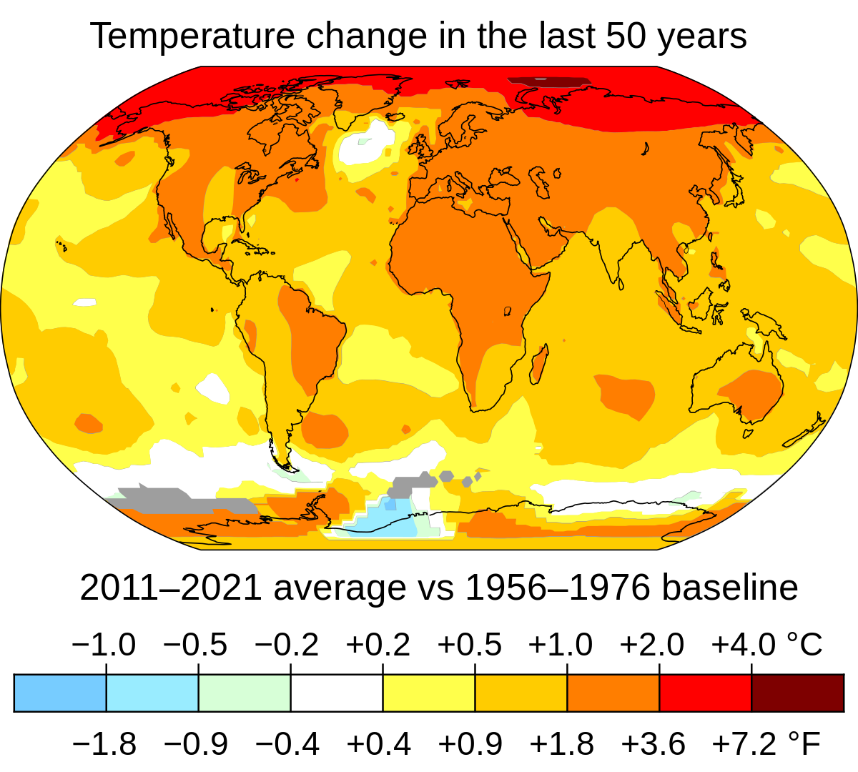
Concluding Thoughts: We Must BE Aggressive SCIENCE PROPONENTS
The laboratory did relatively well, and all priorities were met, but….
Budgets may be flat for at least 5 years (a prediction)
  FY2023 Budget Agreement implies a flat at best FY24 and FY25 (that’s 3 years at the same level)
  The federal budget deficit combined with high interest rates are starting to take a toll on federal spending
  Two wars may realign priorities
  Increased competition for budget, for instance climate change mitigation
https://data.giss.nasa.gov/gistemp/maps/index_v4.html

Slide 16
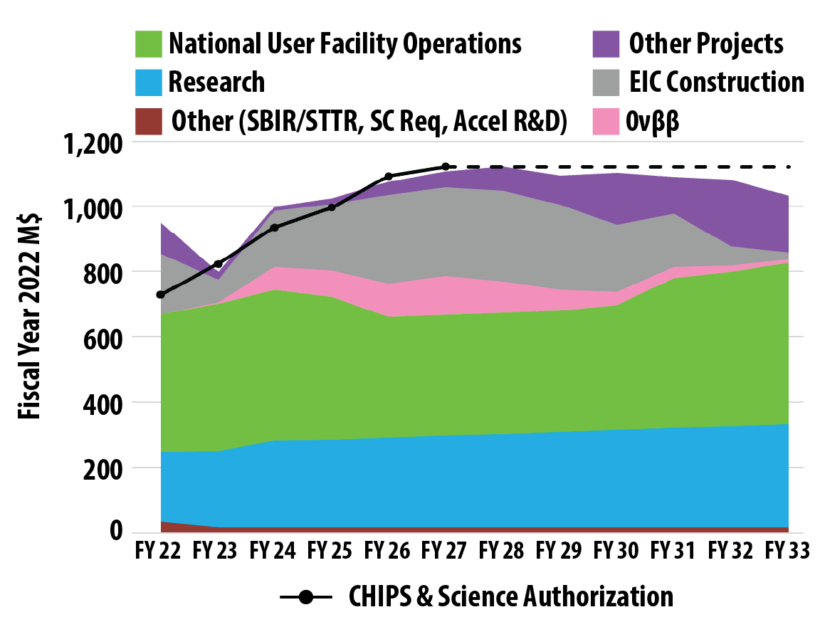
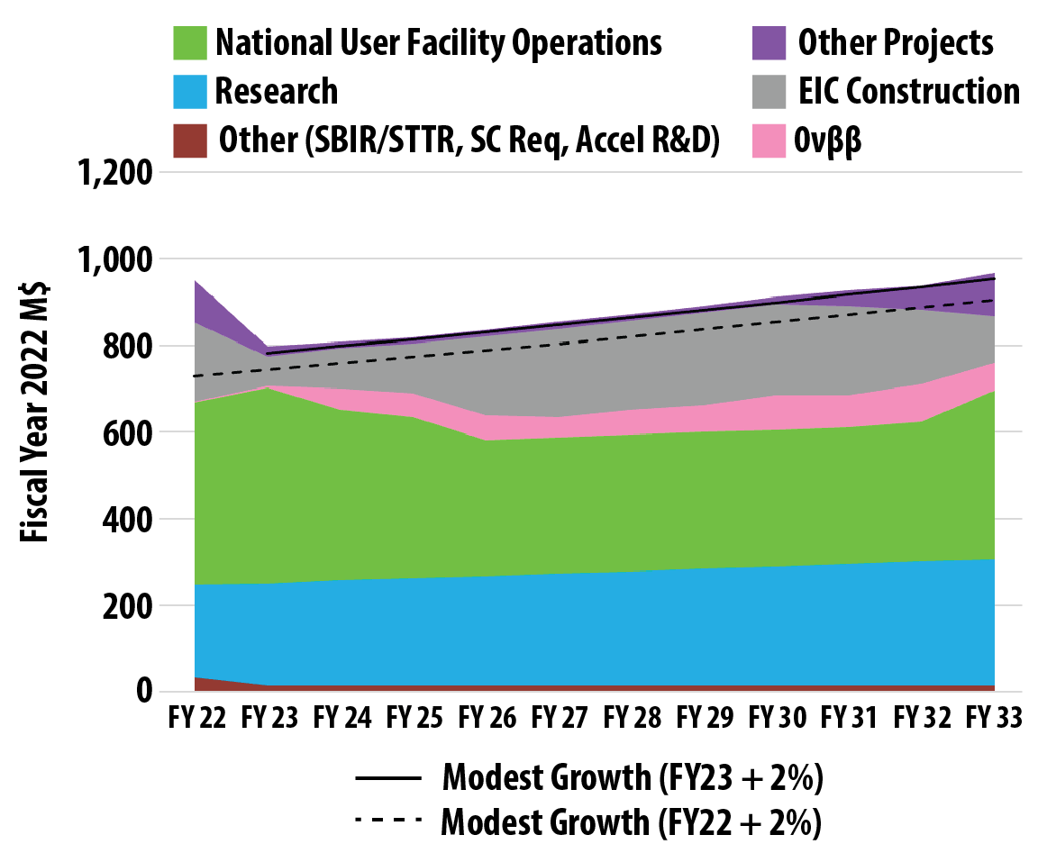

Two Budget Scenario Graphs presented
Note: LRP is not prescriptive, just provides examples
Left: Chips and Science Authorization
Right: Modest Growth (2% above inflation/year)
Fiscal Responsibility Act: FY24 and FY25 nearly flat

Slide 17
Budget Section Wording
In particular, funding for DOE NP at the levels authorized by the CHIPS and Science Act will enable the nuclear physics community to continue its world leadership in nuclear science and deliver innovations and innovators for the nation.
Under a modest-growth funding scenario, the EIC can still be realized but will be delayed. Facility operations will suffer. The decrease over current operating hours that Figure 12.5 represents would—if sustained for the entire decade—prevent fully realizing the scientific opportunities of recent investments: the newly commissioned FRIB facility, the largely-IRA funded MOLLER experiment, the world unique N = 126 Factory at ATLAS, and the 12 GeV upgrade at Jefferson Lab, not to mention the potential loss of trained staff.
Funding at constant effort for the next decade would sacrifice much of the new opportunities presented in this Long Range Plan and result in relinquishing US leadership in key areas of nuclear physics.

Slide 18
Facility Operations (the LRP vs the Congress)
Facility Operations.—The Committee continues to support robust user facility operations funding. The operation of large-scale scientific user facilities is integral to the mission of the Office of Science. The Department maintains and operates 28 user facilities across the country as shared resources for the scientific community. Nearly 34,000 researchers make use of these facilities each year. The Committee believes that supporting these vital user facilities should be a top priority for the Department to advance scientific discovery. The Department is directed to continue prioritizing the stewardship of the user facilities in future budget requests. (Senate Report 118-72, Energy and Water Development Appropriations, FY2024)
Hence the community’s primary recommendation is to increase funding to the research program to a level that will enable capitalizing on the optimal operation of DOE NP facilities…Funding at the level of the Creating Helpful Incentives to Produce Semiconductors (CHIPS) and Science Act, which was passed after the charge was issued to NSAC, would allow such an increase, enhancing the intellectual capital that drives innovation. (LRP, pg. 6)
A nuclear science budget consistent with modest growth over inflation would require deliberate choices while still permitting the nuclear physics community to deliver a compelling program of discovery science and benefits for the nation. In this scenario, the EIC can be realized with a two-year delay (relative to the CHIPS timeline), modest investments in the research community will address the most pressing issues, and neutrinoless double beta decay experiments can take place over a drawn-out period. Additionally, the national user facilities could run a program of exciting science, albeit with reduced impact owing to reduced operating funds, which may delay discoveries. (LRP, pg. 7)
Note: A 30% cut in operations = essentially no beam for experiments. It doesn’t mean 30% beam time cut. Keeping the lights on, the facility staffed, cryomodules cold, etc. is ~70% of operations.

Slide 19
Moving Forward
Avoiding downward pressure on JLab operations and research requires us to be active:
Pursue discoveries
  Ask interesting and important scientific questions; and suggest experiments to answer them…
Stay engaged
  Go to meetings; tell others about your great science, develop and propagate the “elevator speech”
  Advocate when possible, Day on the Hill, at your university, hadronic science podcasts ☺…
Pursue the Future
  Help us to hone the upgrade science case…what is the best science that can come from the upgrade(s)? What is your favorite, and what really pushes the community forward?
  We need to get to a pre-CDR (small group beginning to work on this – stay tuned!)

Slide 20
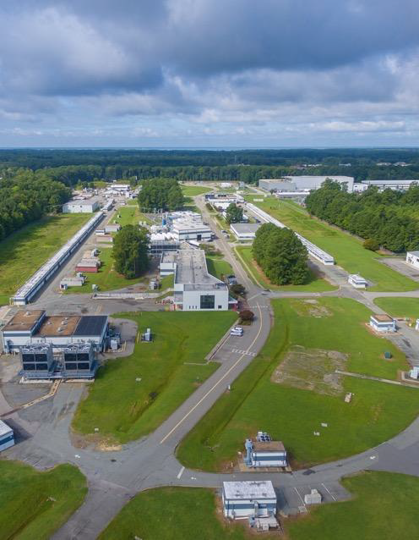
Summary
The Lab is in a strong position
Supportive funding for CEBAF Operations currently, and over a decade of approved science to run (at optimal operations)
Our future priorities are clear:
  Ensuring that the 12 GeV program is successful in all facets (SoLID,…)
  Moving EIC forward
  HPDF approved
  Laying the groundwork for an exciting role for JLab in the EIC era – positrons and 22 GeV
It will take unified effort to maintain this positive picture, and it might even be fun!
20

