Slide 1
Probing the gravitational form factors of the nucleon from near-threshold heavy quarkonium photo-production
Yuxun Guo
Lawrence Berkeley National Laboratory
[2103.11506]
[2305.06992]
[2308.13006]
In collaboration with Xiangdong Ji, Yizhuang Liu, Jinghong Yang, and Feng Yuan
SoLID Collaboration Meeting
Jefferson Lab, VA
Dec. 8 - 9th, 2023

Slide 2
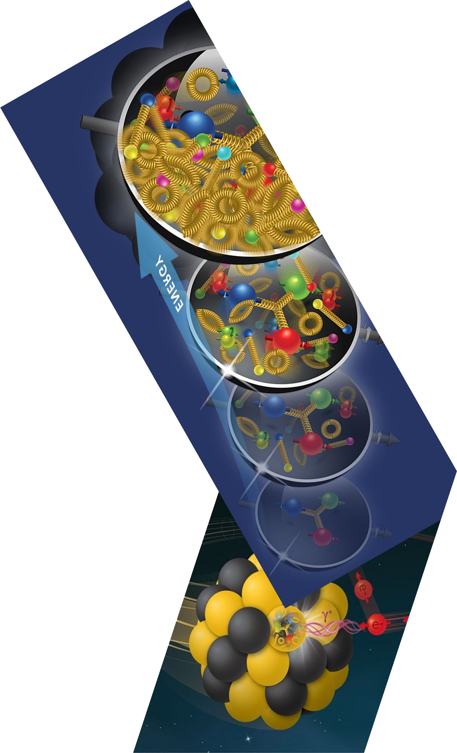
Outline
Intro – Nucleon structure and gravitational form factors
Quarkonium production and gluonic structure
Approach the GFFs with Compton form factors
Threshold J/psi production and proton GFFs
Summary and outlook

Slide 3
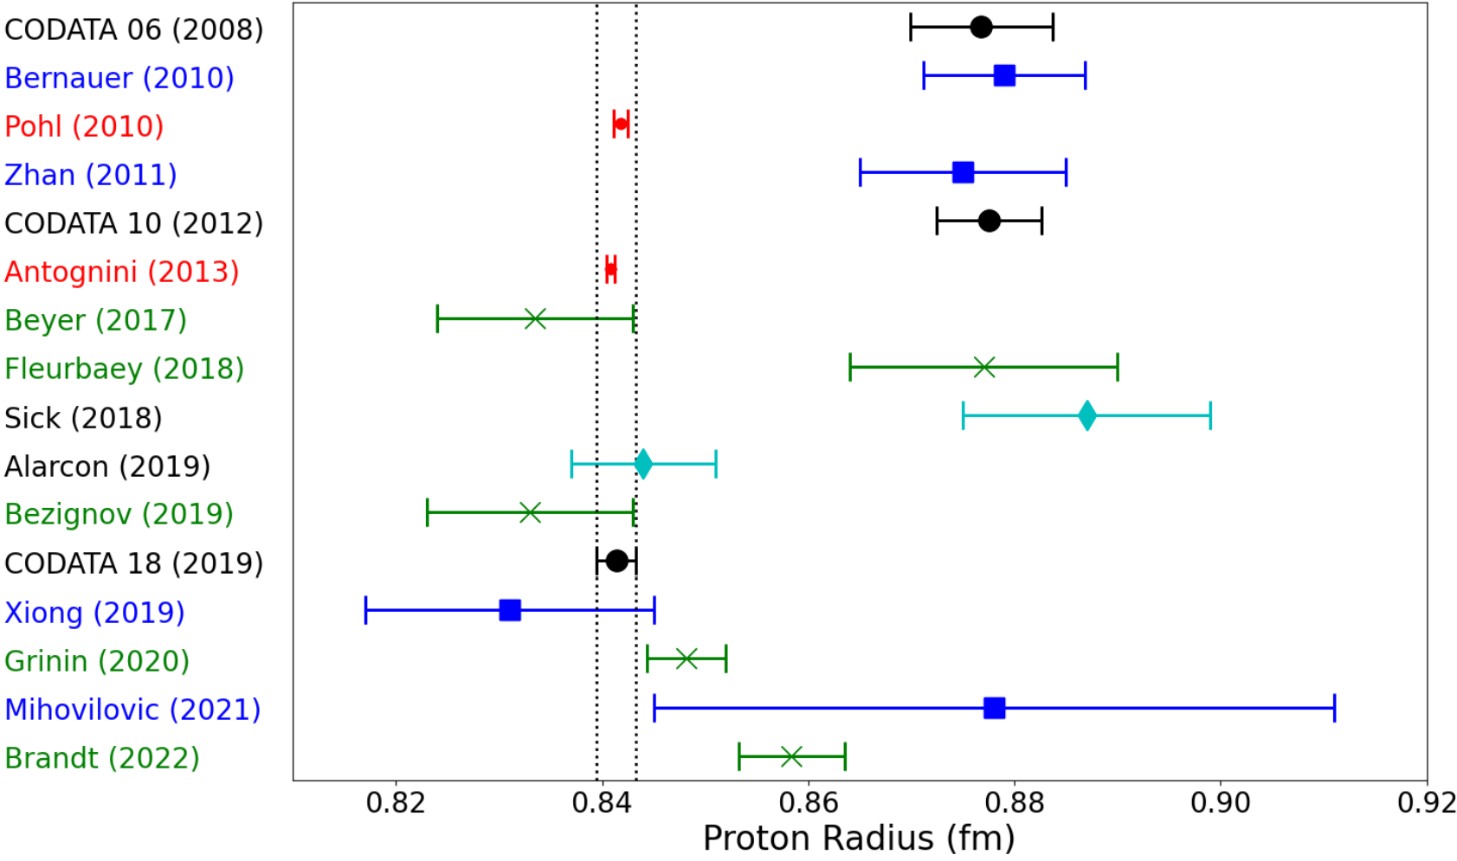
Mass structure of the nucleon
Even though we can get the nucleon mass itself easily and precisely, counter-intuitively, the mass structures of microscopic particles are hard to access.
More than 100 years after we know the proton charge, we are still puzzled by its charge radius.
We are doing worse on the proton mass structure, as gravitational scattering are much harder, if possible at all.
WE NEED THIS!
Plot by E. J. Downie at SPIN 2023 at Duke

Slide 4
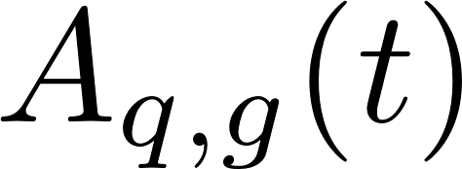
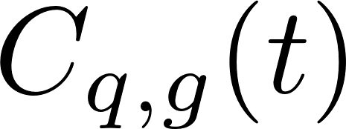
Energy-momentum tensor form factors
The energy-momentum tensor (EMT) is the tool to study the mechanical properties of the nucleon. Its nucleon matrix element can be written as:
X. Ji Phys. Rev. Lett. 78, 610 (1997)
Momentum form factors:
Angular momentum form factors:
Stress tensor form factors:

Slide 5
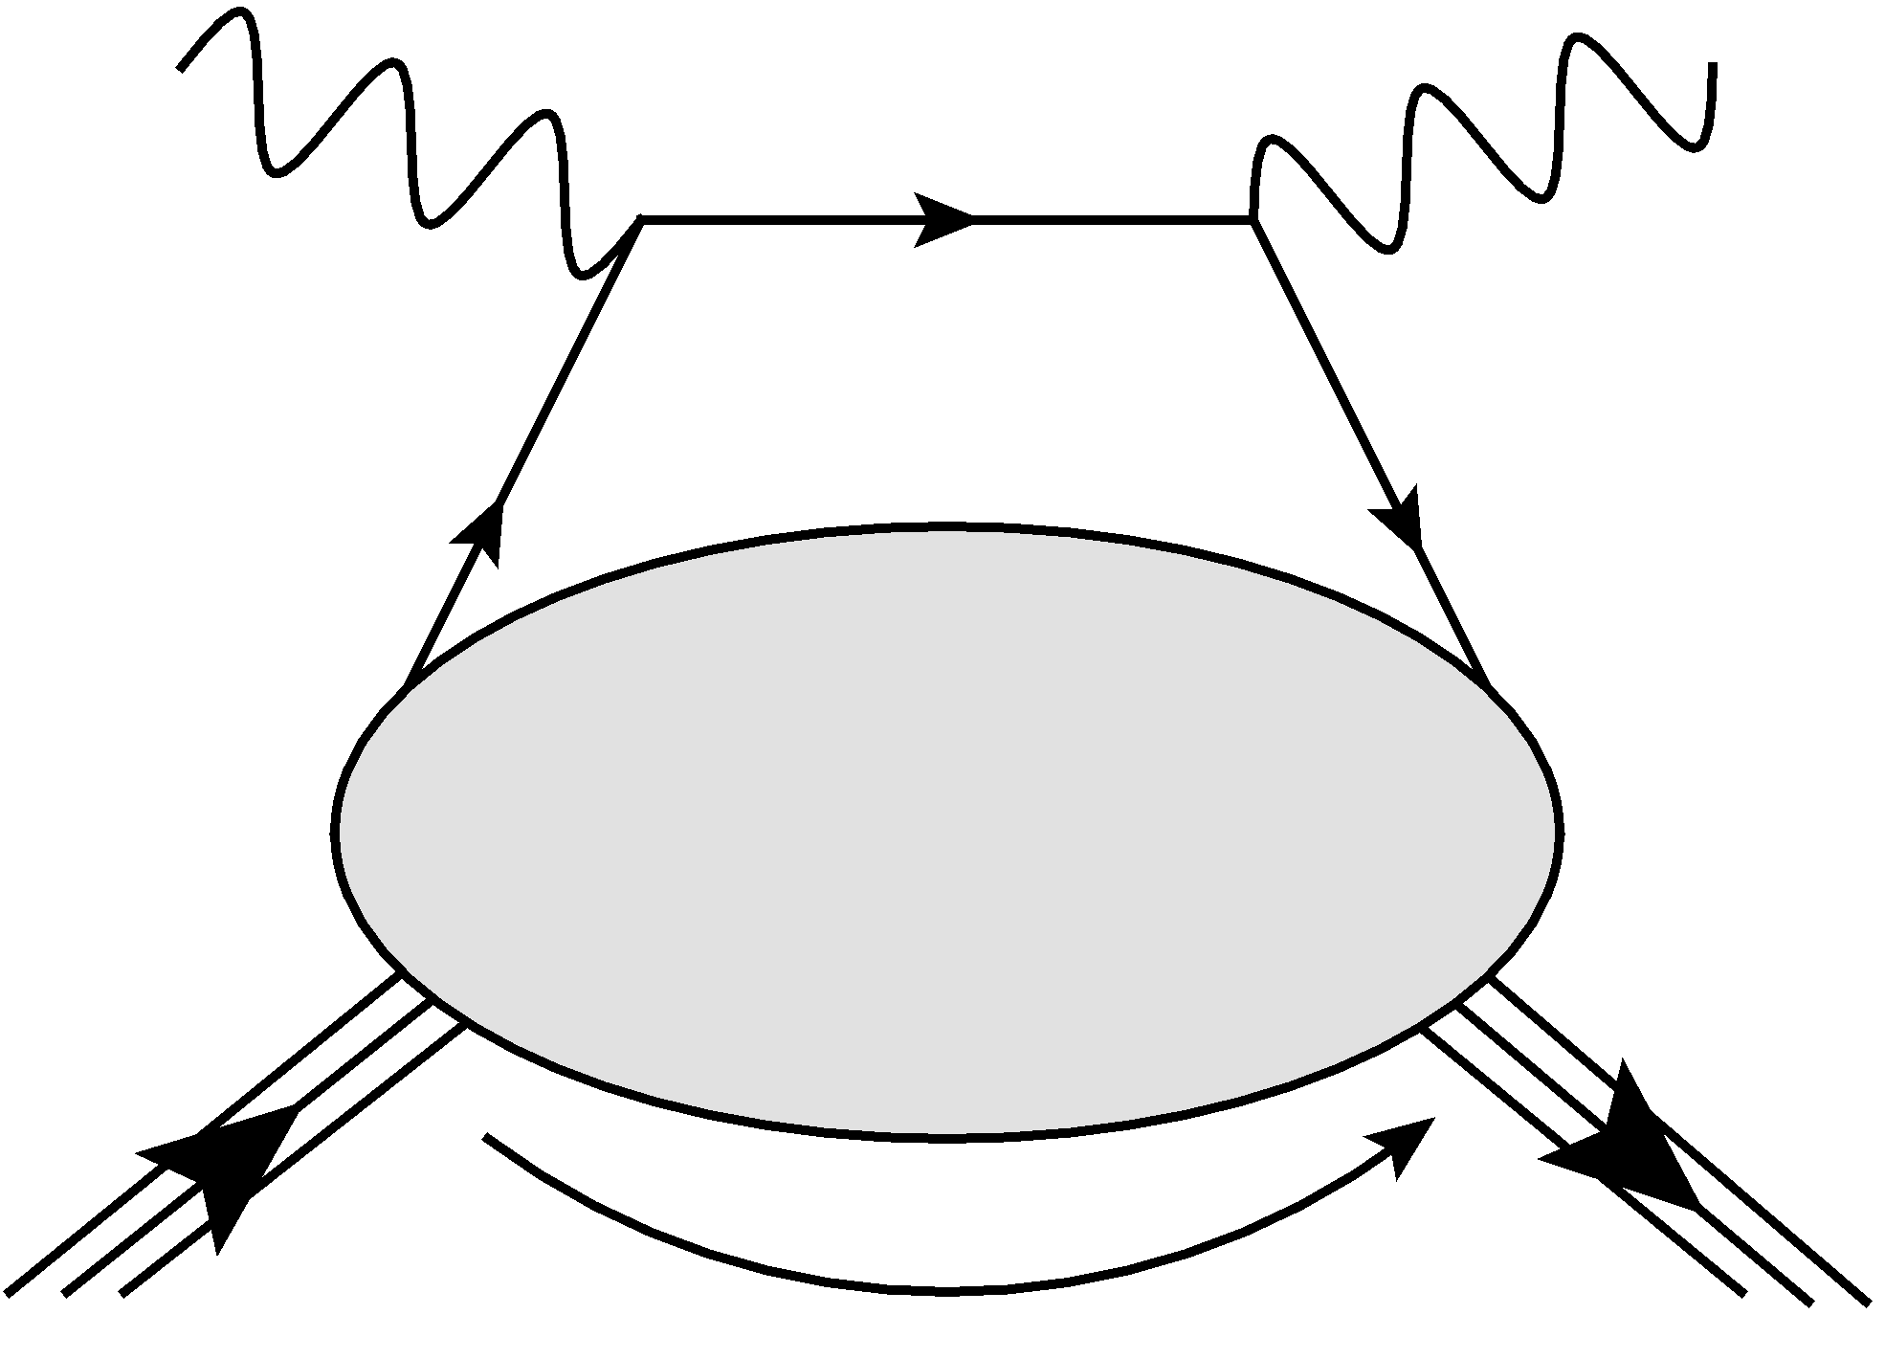
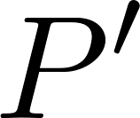
Generalized parton distributions (GPDs)
Instead of measuring the whole nucleon, we just knock out one parton at a time.
GPDs are distributions unifying parton distributions and form factors
GPDs
: average parton momentum fraction
: skewness – longitudinal momentum transfer
: total momentum transfer squared
D. Muller et. al. Fortsch.Phys. 42 101 (1994)
X. Ji Phys. Rev. Lett. 78, 610 (1997)
GPDs are partonic form factors? ─ at zero skewness

Slide 6
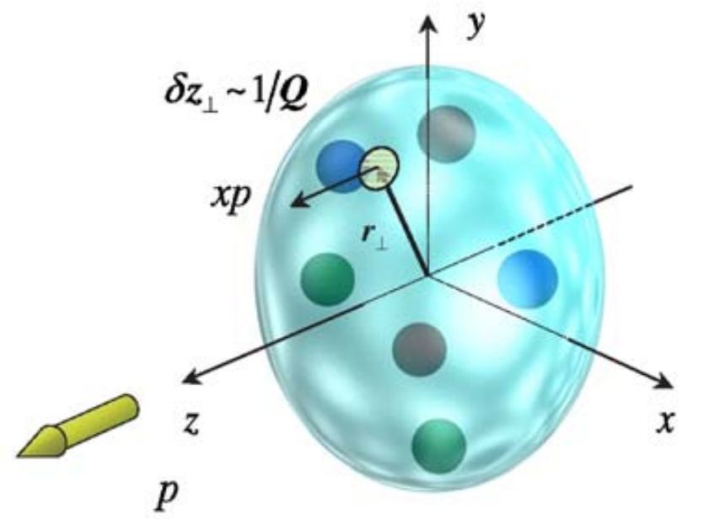
Nucleon 3D structures with GPDs
Adding the contributions from all parton, GPDs generate form factors:
X. Ji, J. Phys. G 24 1181-1205 (1998)
Charge FFs
Gravitational FFs
In the zero-skewness limit:
GPDs also provide an intuitive 3D image of nucleon:
M. Burkardt, Int. J. Mod. Phys. A 18 173-208 (2003)
3D quark/gluon dist.

Slide 7
Quarkonium Production

Slide 8
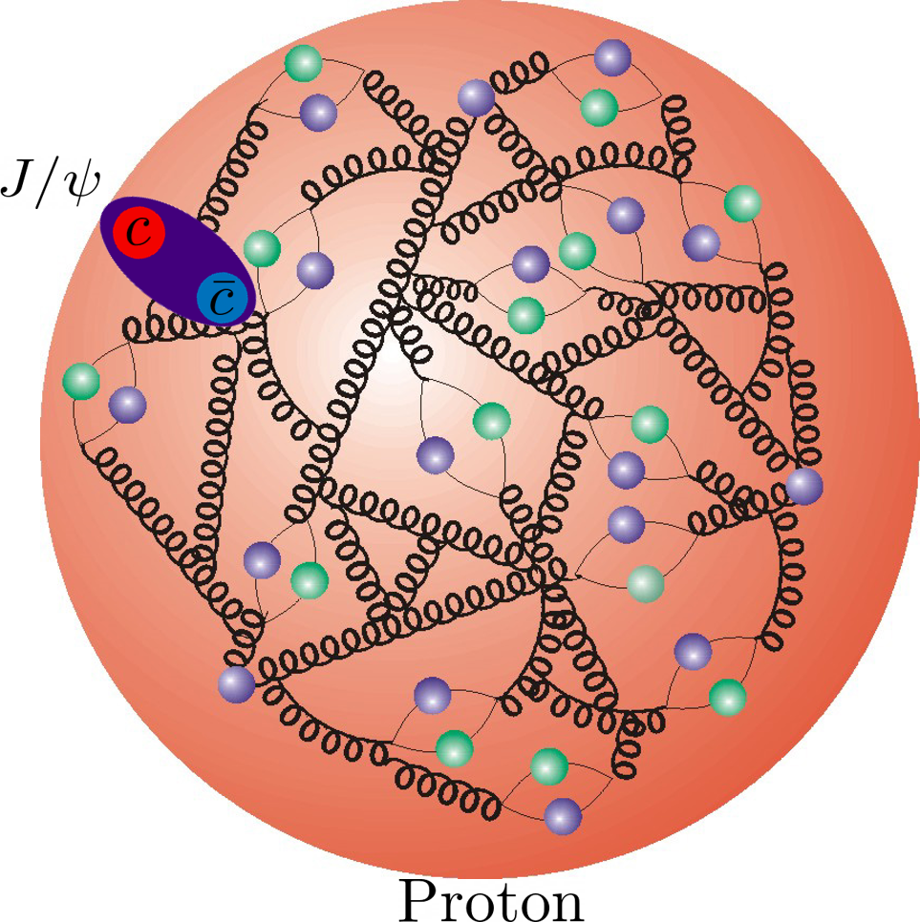
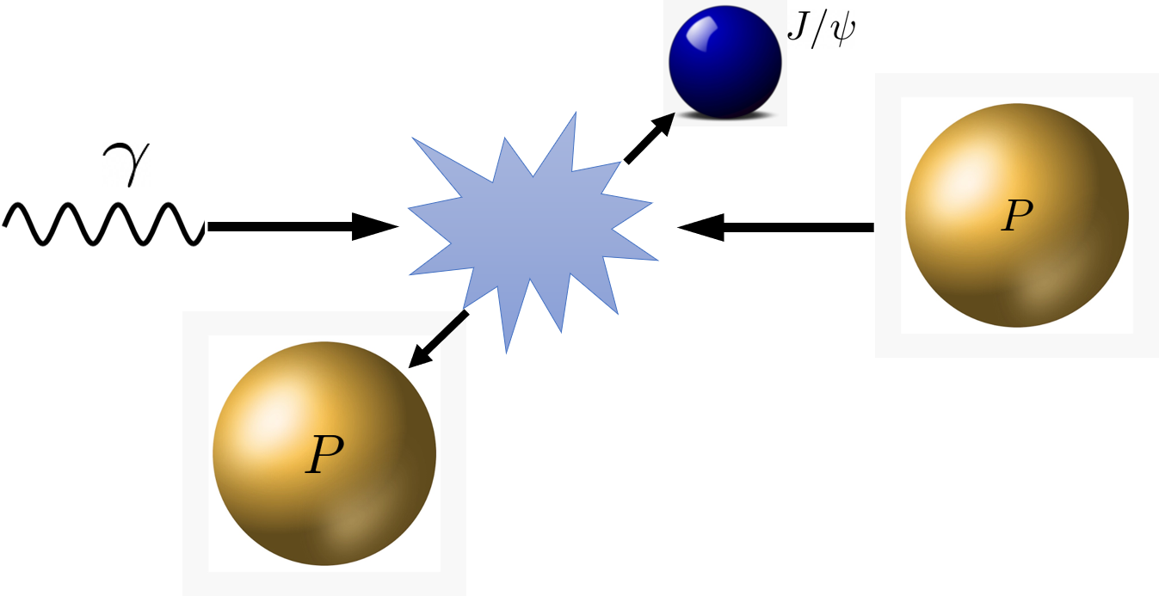
Color dipole probing the gluonic structure
Quadratic Stark effect in QCD – measures the color electric field:
M. B. Voloshin Nucl. Phys. B 154 365-380 (1979)
M. Luke et al. Phys. Lett. B 288 355-359 (1992)
D. Kharzeev et al., Eur. Phys. J. C 9 459-462 (1999)
Elastic scattering of J/psi off the nucleon would be ideal.
In real life we have photo-/electro- production instead
Heavy meson corresponds to small color dipole --- local gluonic distribution.

Slide 9
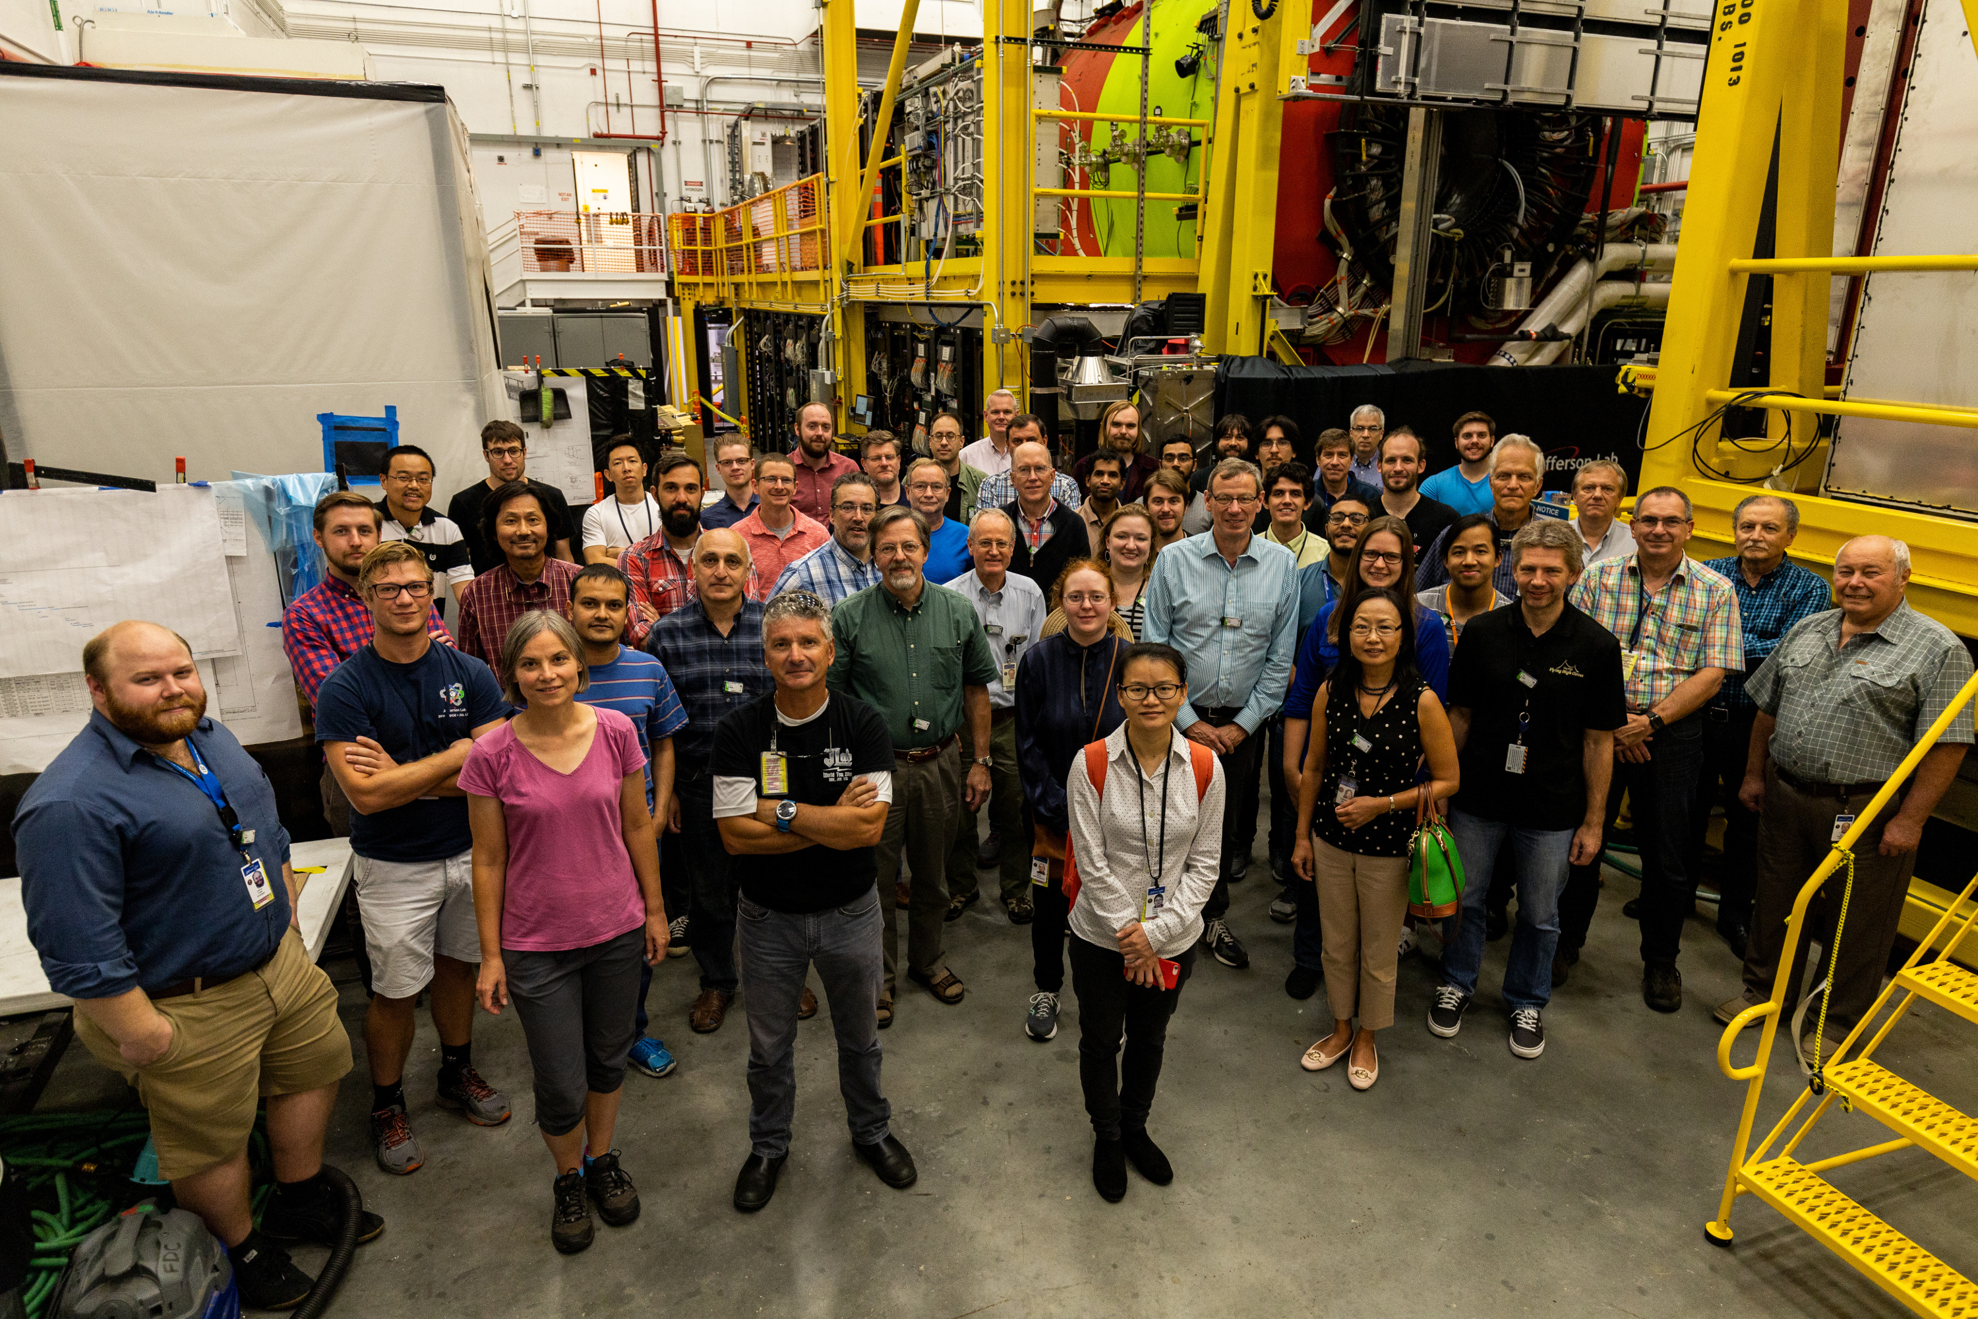
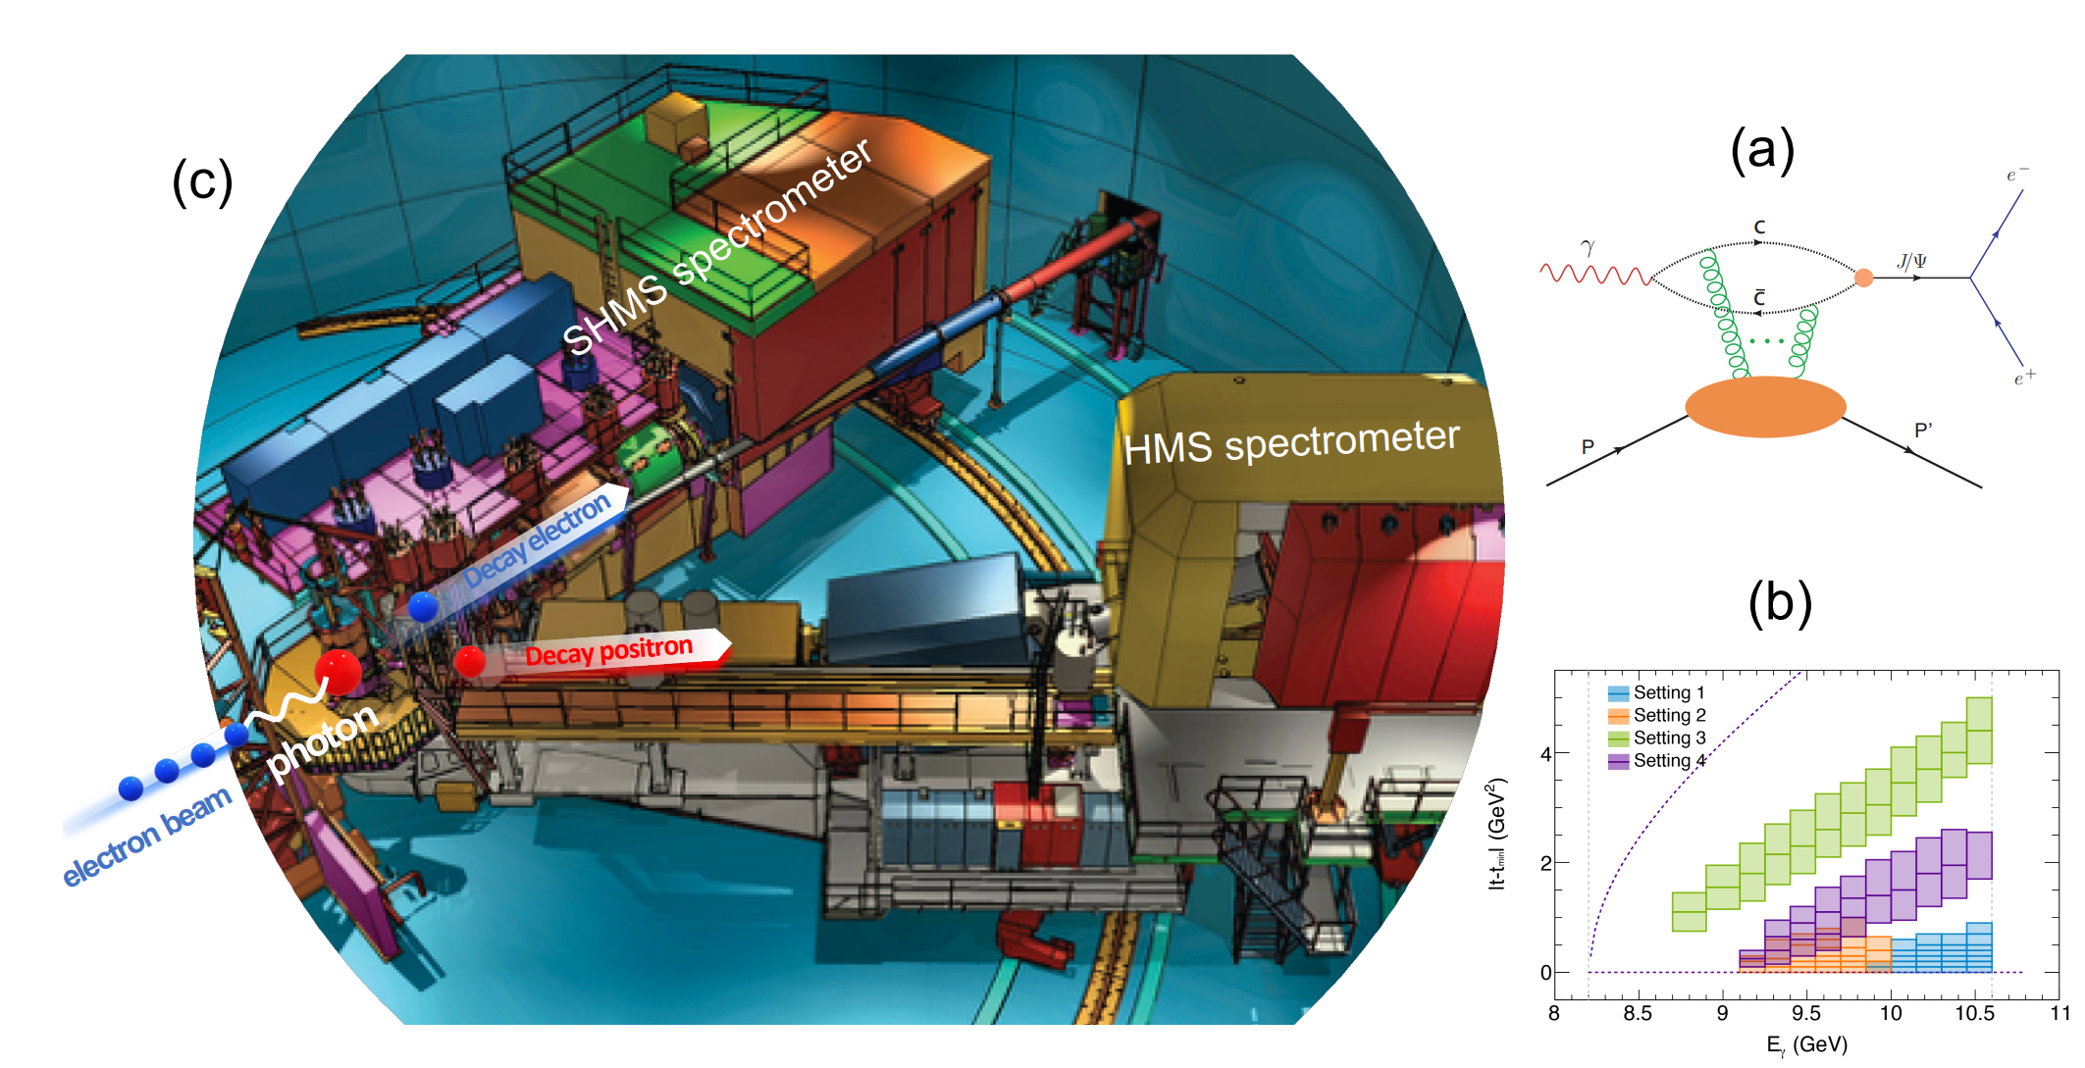
Near-threshold J/psi photoproduction
First measurement of near-threshold exclusive J/ψ photoproduction off the proton by GlueX
Another recent measurement by the J/psi 007 experiment at JLab Hall C
GlueX Collaboration Phys. Rev. Lett. 123, 072001 (2019)
GlueX Collaboration Phys. Rev. C 108 2, 025201 (2023)
B. Duran et. al. Nature 615 7954, 813-816 (2023)

Slide 10
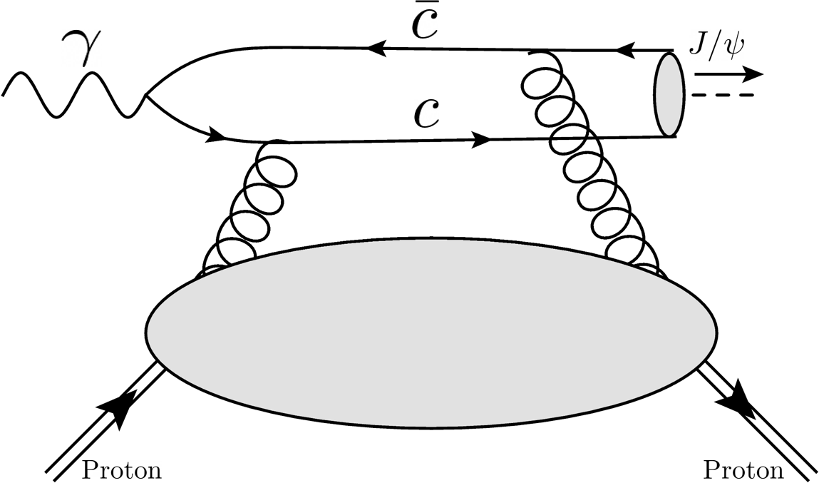
GPD framework for threshold production
Near-threshold exclusive heavy vector meson production in the GPD framework.
Leading order factorization with GPDs
The same amplitude as the collinear case but with different kinematics;
Large momentum transfer/skewness in the heavy quark limit;
GPD
Y. Guo et. al. Phys. Rev. D 103 9, 096010 (2021)
Will be sensitive to the so-called gluonic Compton form factors (gCFFs)

Slide 11
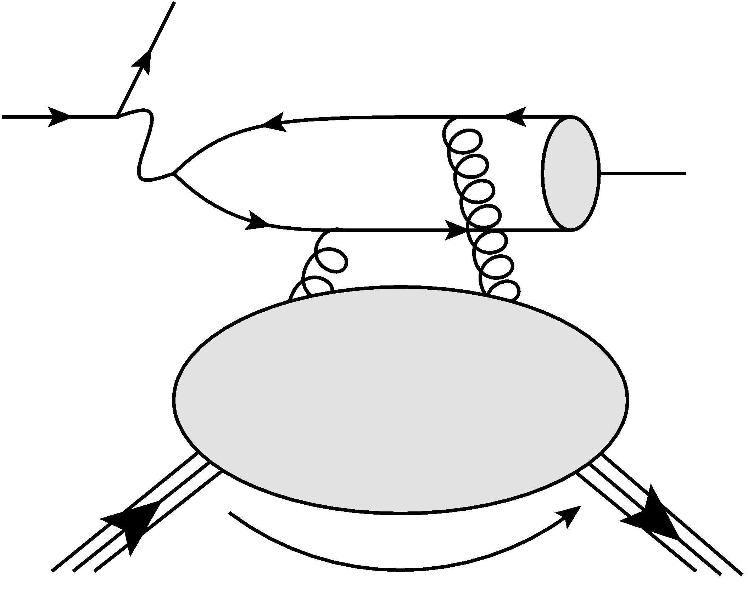
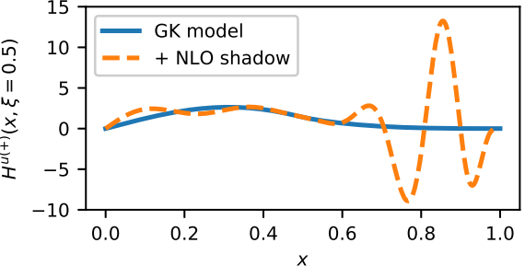
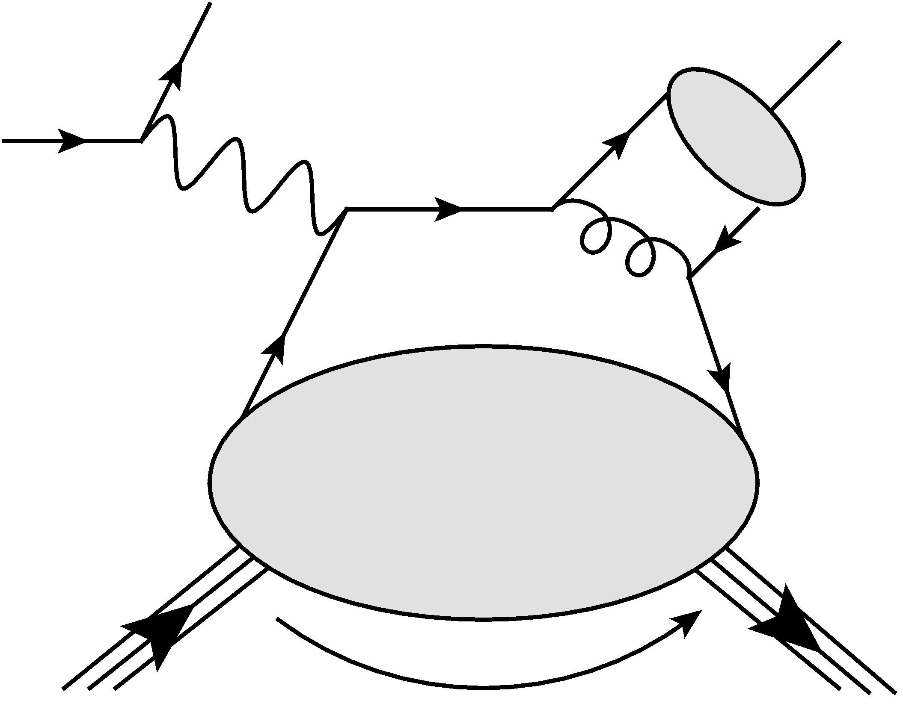
Inverse problem in exclusive productions
To keep the proton intact in the final state for an exclusive production, the parton will not be explicitly probed / knocked out.
The amplitude is not sensitive to the parton momentum x
V. Bertone et. al. SciPost Phys.Proc. 8 (2022) 107

Slide 12
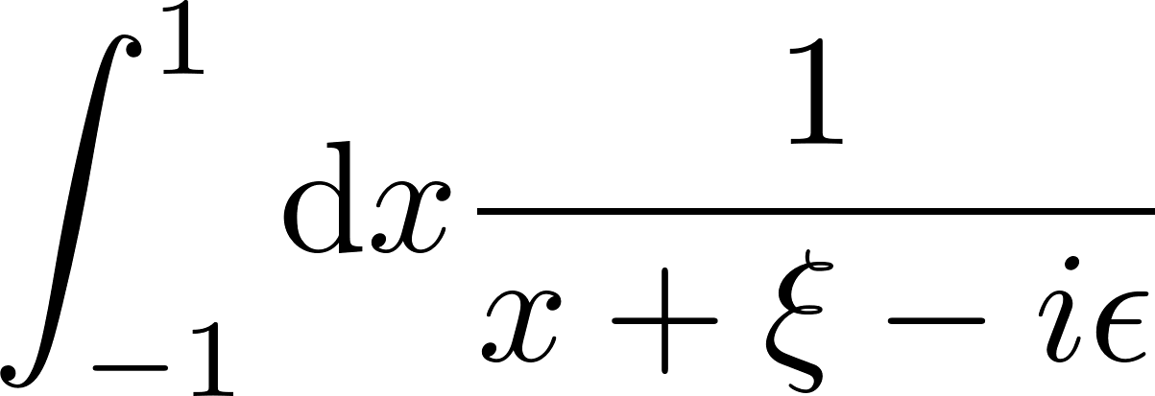
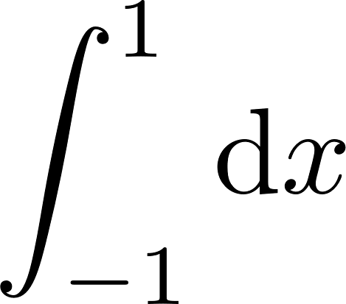
GFFs and CFFs
CFF
GPD
GFF

Slide 13
From CFFs to GFFs

Slide 14
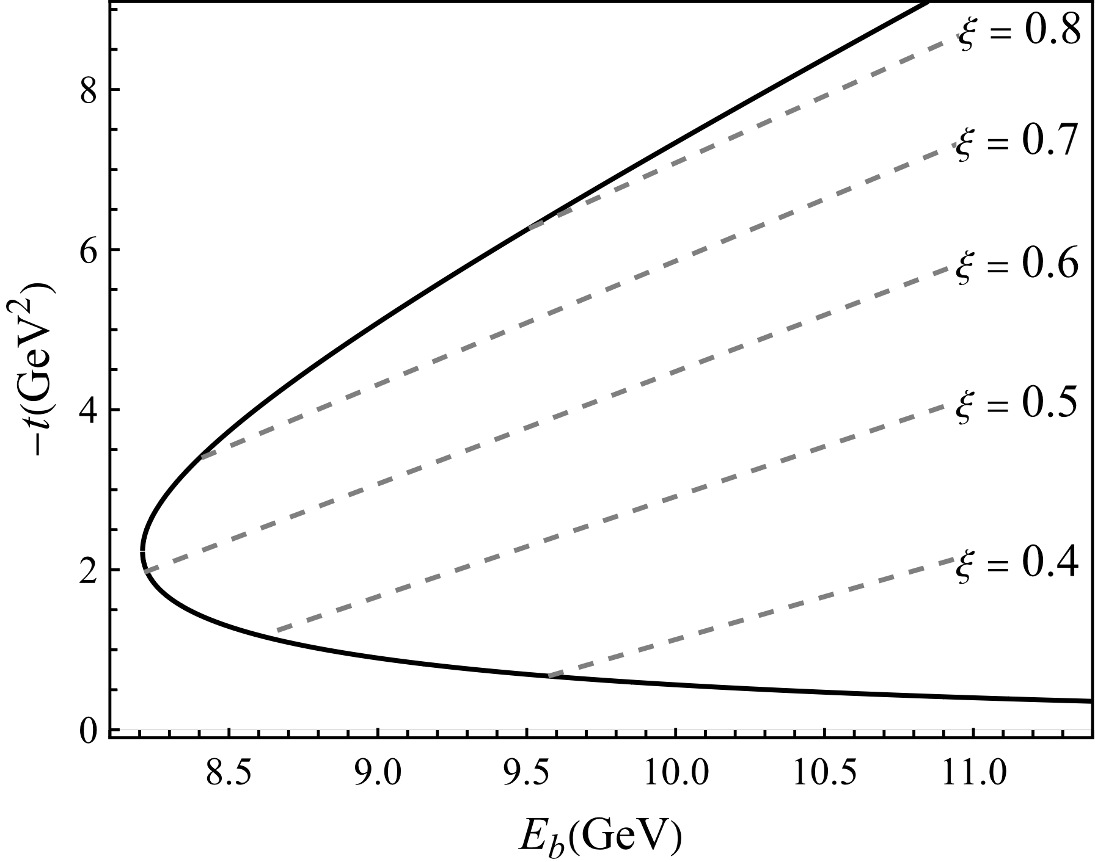
Large skewness near the threshold
When a heavy quarkonium is produced from a massless real photon near threshold, the momentum transfer must be large. Then consider a Taylor expansion:
The real part of the CFF can then be written as:
These x-integrals lead to generalized form factors

Slide 15
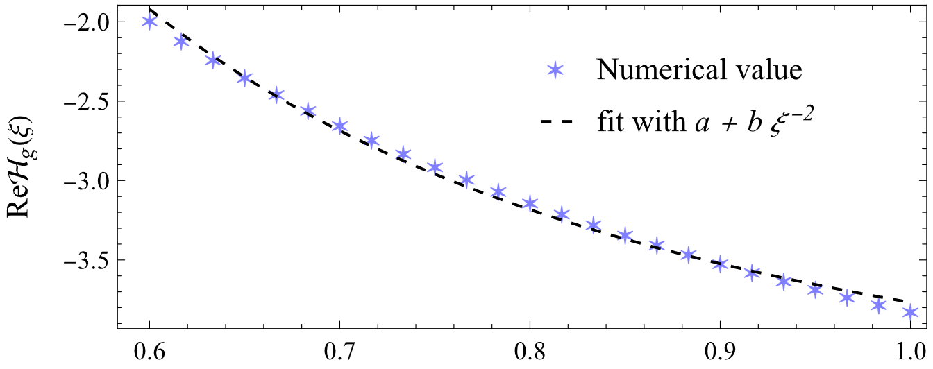
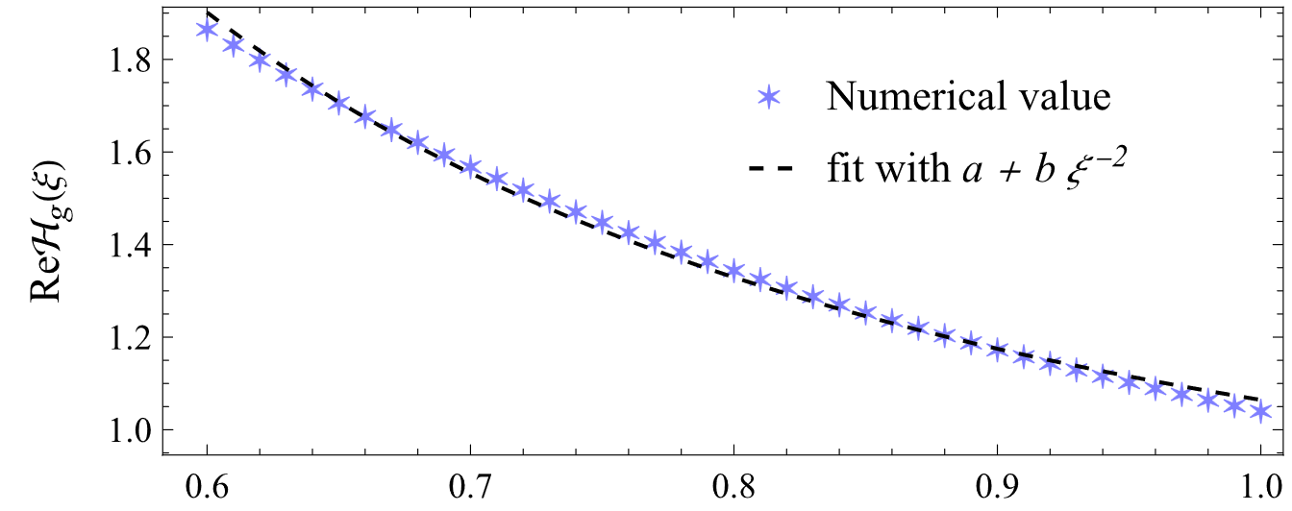
Skewness-scaling in the CFFs
Double distribution model
Conformal moment model
Y. Guo et. al. arxiv: 2308. 13006

Slide 16
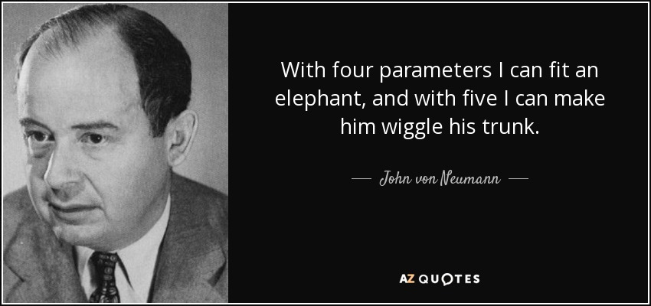
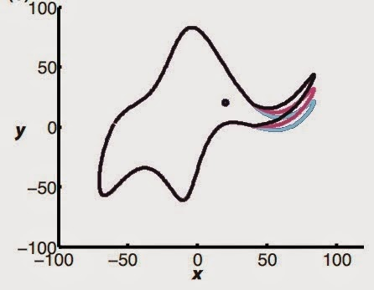
Fit is meaningless if not physical

Slide 17
GFFs from CFFs
Let’s see if the CFF is related to the GFFs. With the approximation, the CFF will be
Y. Guo et. al. arxiv: 2308. 13006
The input gluon moments are:
The extracted values are:
The extractions have 25% excess due to the higher-moment contamination.

Slide 18
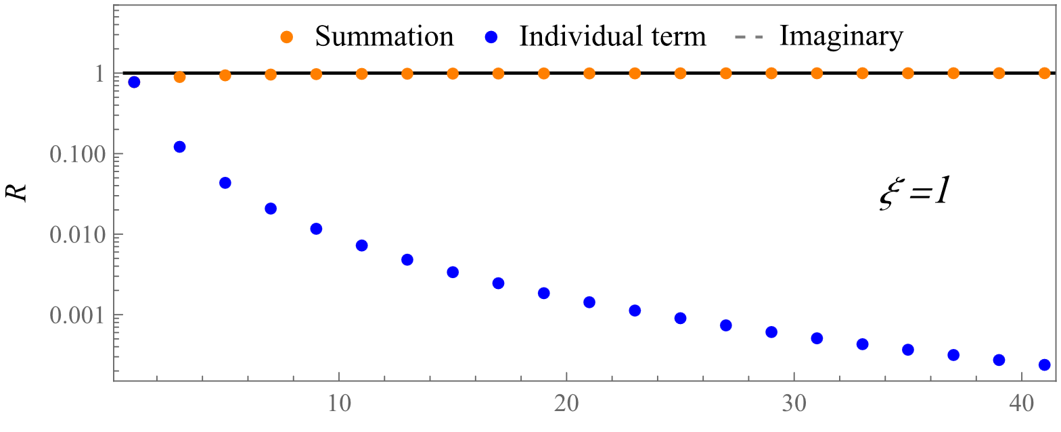
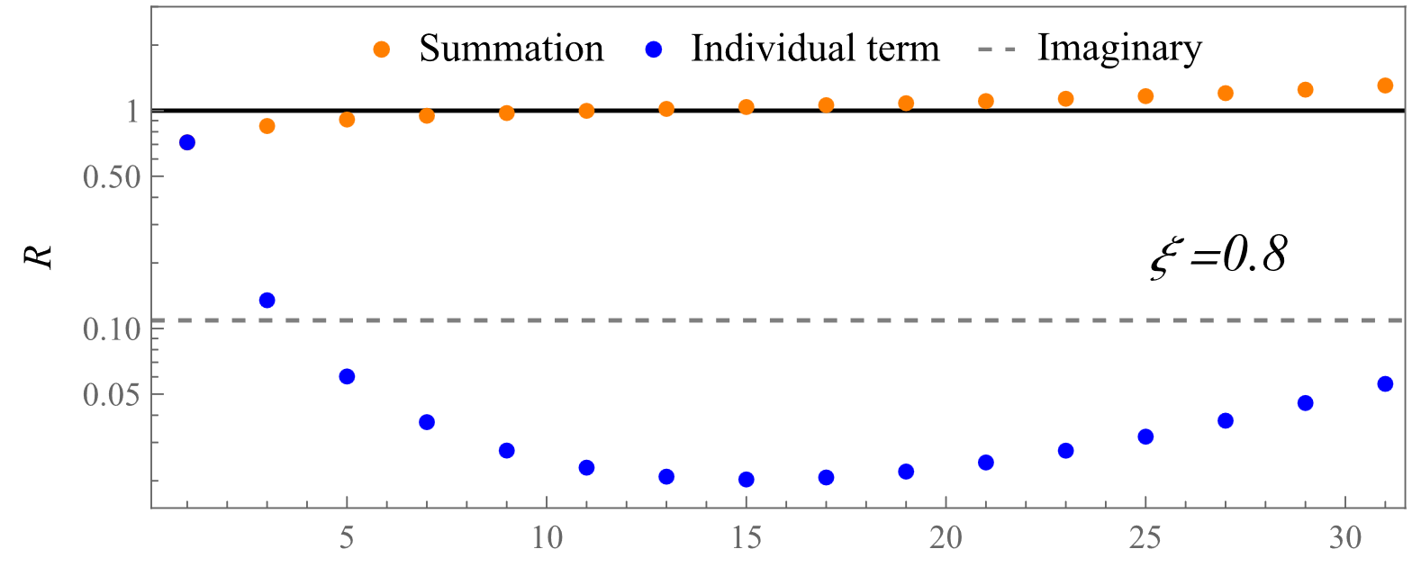
Asymptotic expansion
Convergent series
Individual term decreases and vanishes
Partial sum eventually approach the analytical result
Asymptotic series
Individual term decreases then increases
Partial sum eventually diverges
Truncation at minimal terms approximated the analytical results well

Slide 19
Proton GFFs from J/Psi production

Slide 20
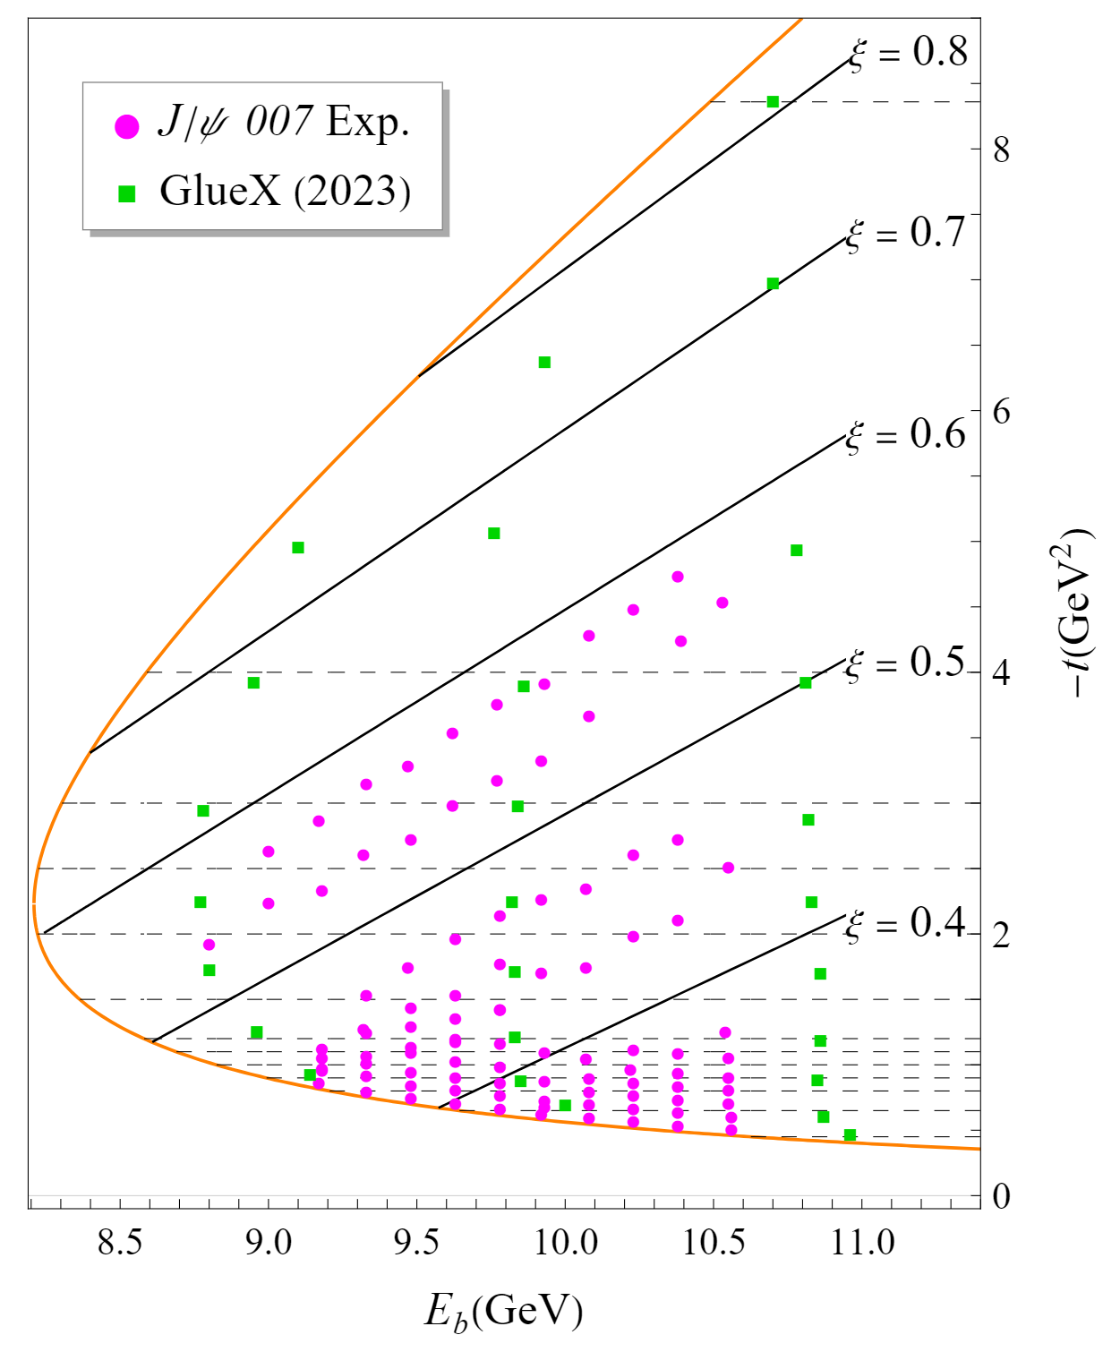
General framework
Under the approximation of large skewness expansion AND higher-moment suppression, one has:
We can then extract the GFFs from the gCFFs, utilizing the large skewness kinematics in the near-threshold region in the heavy quark limit.
Unfortunately, much more data in the lower ξ region
Y. Guo et. al. Phys. Rev. D 108, 034003 (2023)

Slide 21
Extraction of the nucleon GFFs
GFFs can be constrained noting the higher-moment contaminations as well as other corrections.
With ξ > 0.5 data
Y. Guo et. al. Phys. Rev. D 108, 034003 (2023)
D. Pefkou et. al. Phys. Rev. D 105 5, 054509 (2022)
Not a completely independent extraction:
The lower-t region is not constrained well by the data.
The gluonic momentum fraction from PDF is used as input
The coverage in ξ is rather limited.

Slide 22
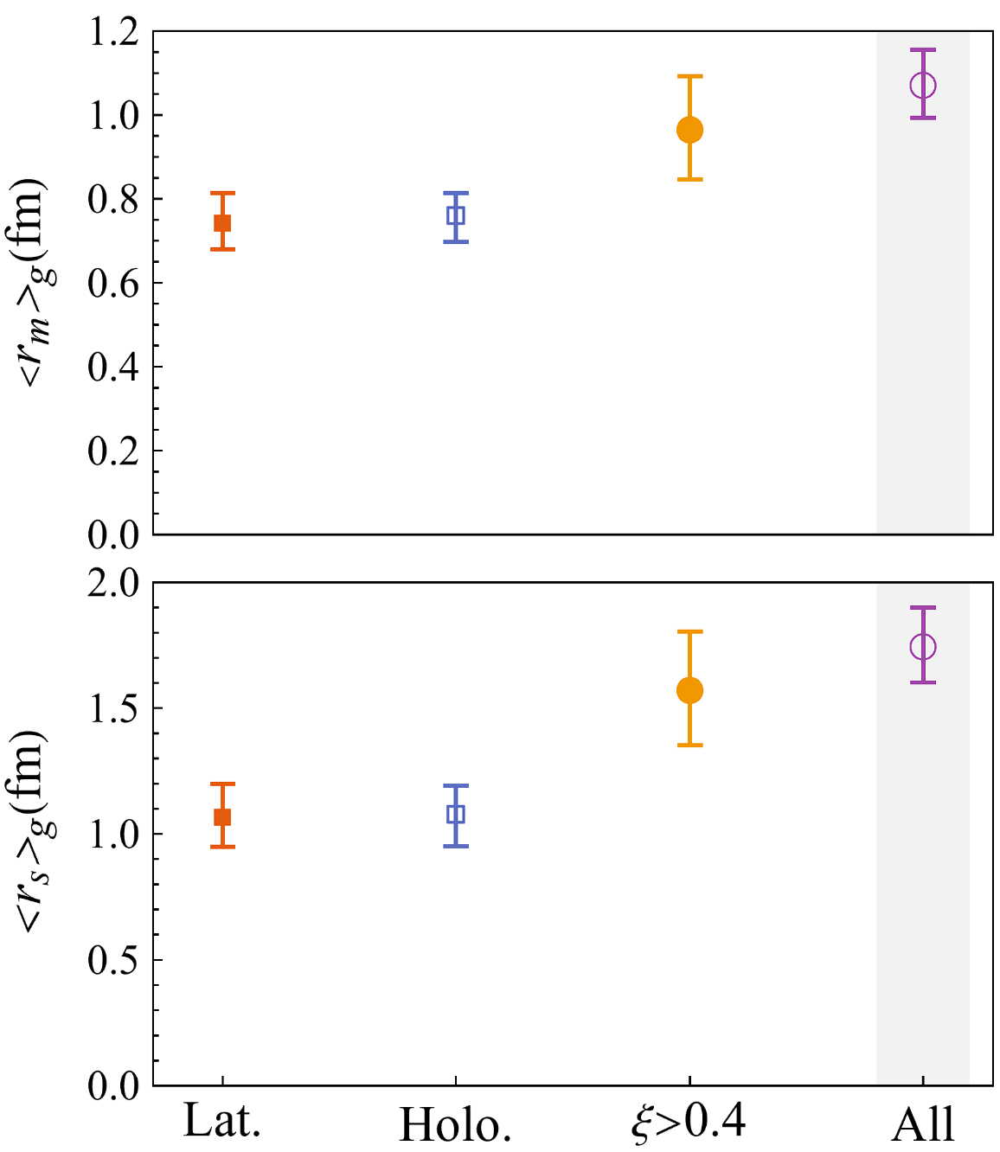
Proton mass radius extraction
Proton mass and scalar radii are closely related to the form factors at t = 0
Inclusion of lower-ξ data shows better statistics but introduces massive systematical uncertainties.
Y. Guo et. al. Phys. Rev. D 108, 034003 (2023)
Due to the large-ξ/t nature of this framework, the extraction of proton radii with controlled precision will need more efforts.

Slide 23
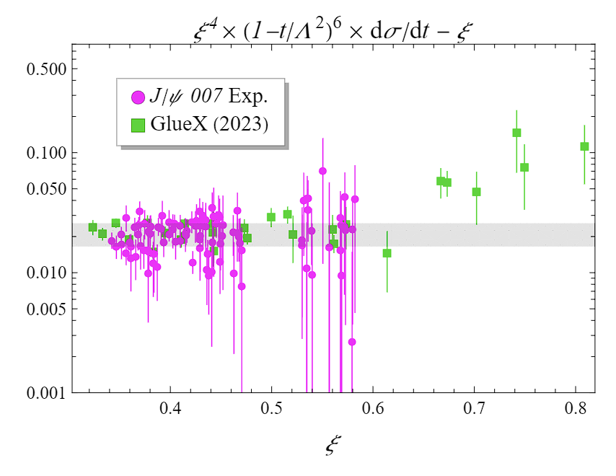
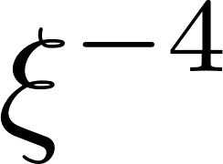
Utilizing the skewness dependence
How to test the large-skewness framework and quality of the extraction?
The ξ-scaling of the cross-section has non-trivial behaviors at large ξ.
The overall ξ-scaling are consistent with
Extra ξ-scaling crucial for the separation of A and C form factors
More complicated when consider t-dependence
Y. Guo et. al. arxiv: 2308. 13006

Slide 24
More J/ψ data at JLab
Slide from Z.-E. Meziani
 | GlueX HALL D | HMS+SHMS HALL C | CLAS 12 upgrade I HALL B | SoLID HALL A
J/ψ counts (photo-prod.) | ~469 published, 10k phase I+II | 4k | 14k | 804k
J/ψ Rate (electro-prod.) |  |  | 1k | 21k
Photon-proton luminosity
Acceptance | ~ 2$π$ | < 3x10⁻⁴ | < 2$π$ | ~ 2$π$
When? | Finished | Finished | Proposed | ~8 years?

Slide 25
Summary and outlook
Summary
Exclusive heavy quarkonium production as probe of gluonic structures
Large skewness behavior of gCFFs in near-threshold heavy quarkonium production
(Potential) extraction of gluonic GFFs in the nucleon with such framework
Outlook
Next-to-leading order effects in strong coupling and non-relativistic corrections
Extension to quark GPDs, e.g., time-like Compton scattering for the quark case
Relations to the other frameworks – collinear NRQCD factorization

Slide 26
Thank you!

Slide 27
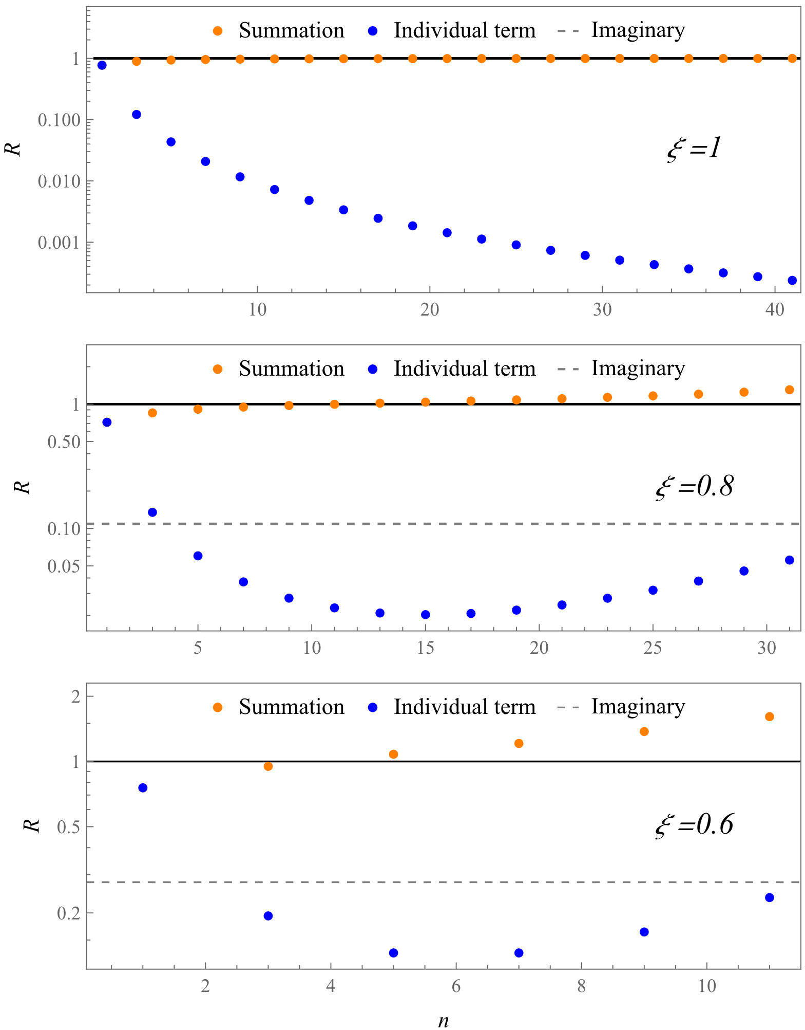
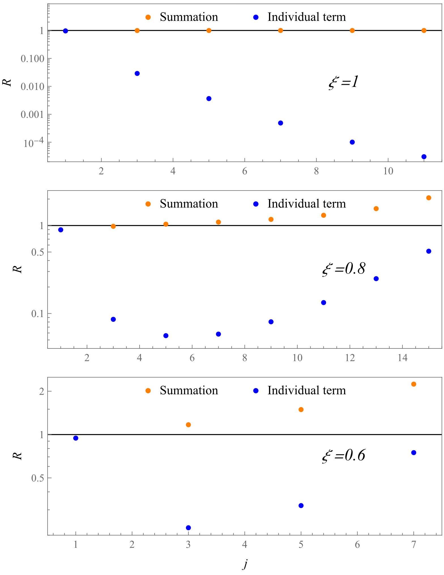
Conformal moment expansion

Slide 28
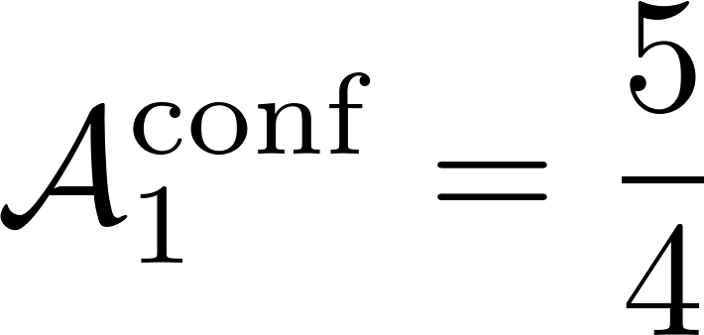
Two more comments
The asymptotic expansion is closely related to the endpoint constraints
Asymptotic Expansion
Higher Moment Suppression
Endpoint Constraints
The 25% excess from higher moments contamination relate to the conformal ratio?
Y. Guo et. al. arxiv: 2308. 13006

Slide 29
What can we do with CFF
Compton-like amplitudes basically measure GPDs at x=ξ
Imaginary parts given by GPDs at x=ξ
Real parts given by dispersion relation
Real parts can be formally written as
Imaginary parts – inverse Mellin transform:
The two statements are mathematically equivalent!
The different applicable regions (near forward/ large skewness) distinguish them

Slide 30
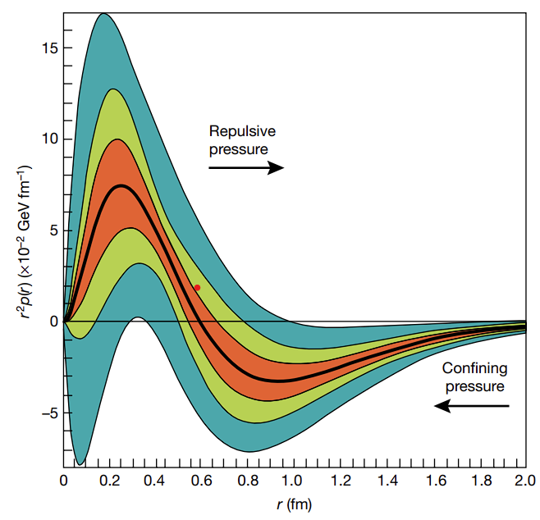
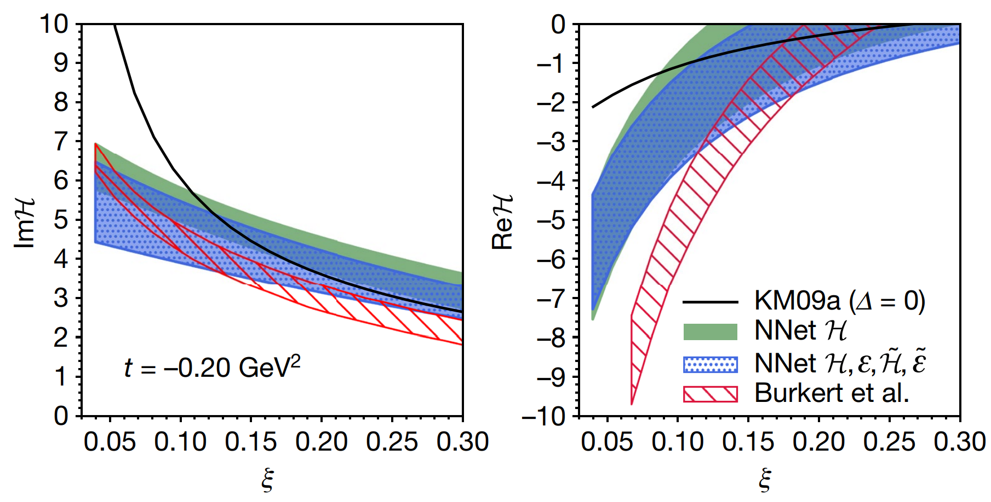
One interesting quark analogy
The C form factor can be extracted through the dispersion relation as well:
The extraction seems to be more consistent with increasing ξ:
V. D. Burkert et. al., Nature 557 7705, 396-399 (2018)
K. Kumericki., Nature 570 (2019) 7759, E1-E2

