Slide 1
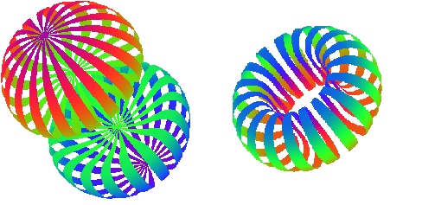
Tensor Spin Structure Function b₁ & Quasi-Elastic Asymmetry A_{zz} for Deuteron
Elena Long
SOLID Collaboration Meeting
Jefferson Lab
December 8th, 2023

Slide 2
What is Tensor Polarization?
A high-luminosity tensor-polarized target has promise as a novel probe of nuclear physics
-
Spin-1
System
$$>$$
$$→ 0<Q≤1$$
“Normal” Polarization:
Vector $P=P_{z}=p_{+}−p_{−}$
m = +1
$$=$$
$$=$$
$$→ Q=0$$
m = 0
( + )-2
m = -1
$$<$$
$$→ −2≤Q<0$$
Tensor Polarization:
$$Q=P_{zz}={(p}_{+}+p_{−})−2p_{0}$$
J Forest, et al, PRC 54 646 (1996)

Slide 3
Tensor Observables
In the polarized deuteron cross section, there are four asymmetry terms
$h_{e}= \text{Electron} helicity$
$P=P_{z}=$ Vector polarization
$Q=P_{zz}=$Tensor polarization
Integrating electron helicity suppresses $A_{||}$ and $A_{T}^{ed}$
Switching between positive and negative vector polarizations and integrating suppresses $A_{V}^{d}$
$$×$$
$$×$$
$$×$$
$$0$$
$$0$$
W. Leidemann, E.L. Tomusiak, H. Arenhovel, Phys. Rev. C 43, 1022 (1991)

Slide 4
Tensor Asymmetry $A_{zz}$
Observables most simply accessible using tensor enhanced & unpolarized measurements
Tensor polarized: $σ_{Q}=σ\left(P,Q\right)$
Unpolarized: $σ_{0}=σ\left(0,0\right)$
$$b_{1}=−\frac{3}{2}F_{1}A_{zz}$$
$$T_{20}≈\frac{A_{zz}}{\sqrt{2}d_{20}}$$
$$A_{zz}=\frac{2}{fQ}\left(\frac{σ_{Q}−σ_{0}}{σ_{0}}\right)$$
DIS
Quasi-Elastic/SRC
Elastic
$$<0.5$$
$$0.8−1.8$$
$$2$$
$$x$$

Slide 5
Tensor Structure Function, $b_{1}$
$$W_{μν}=−{αF}_{1}+{βF}_{2}$$
Scattering on Unpolarized Targets
$$+iγg_{1}+iδg_{2}$$
Scattering on Vector Polarized Targets
$$−εb_{1}+ζb_{2}+ηb_{3}+κb_{4}$$
Scattering on Tensor-Polarized Targets
P Hoodbhoy et al, Nucl. Phys. B312, 571 (1989)
A Airapetian, et al, PRL 95 242001 (2005)

Slide 6
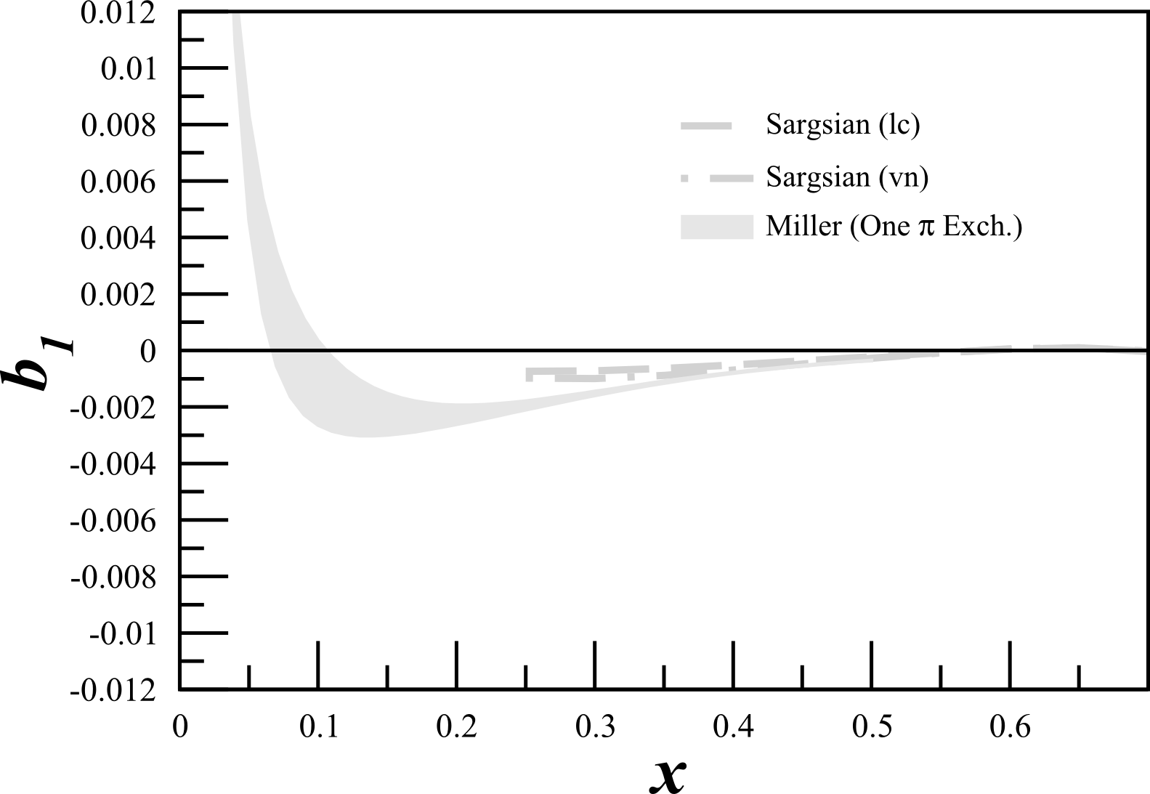
Tensor Structure Function, $b_{1}$
$b_{1}$ probes nuclear effects at quark resolution!
$$b_{1}\left(x\right)=\frac{q^{0}\left(x\right)−q^{±1}(x)}{2}$$
All conventional models predict small or vanishing values of $b_{1}$
A Airapetian, et al, PRL 95 242001 (2005)
K Slifer, et al, JLab C12-13-011

Slide 7
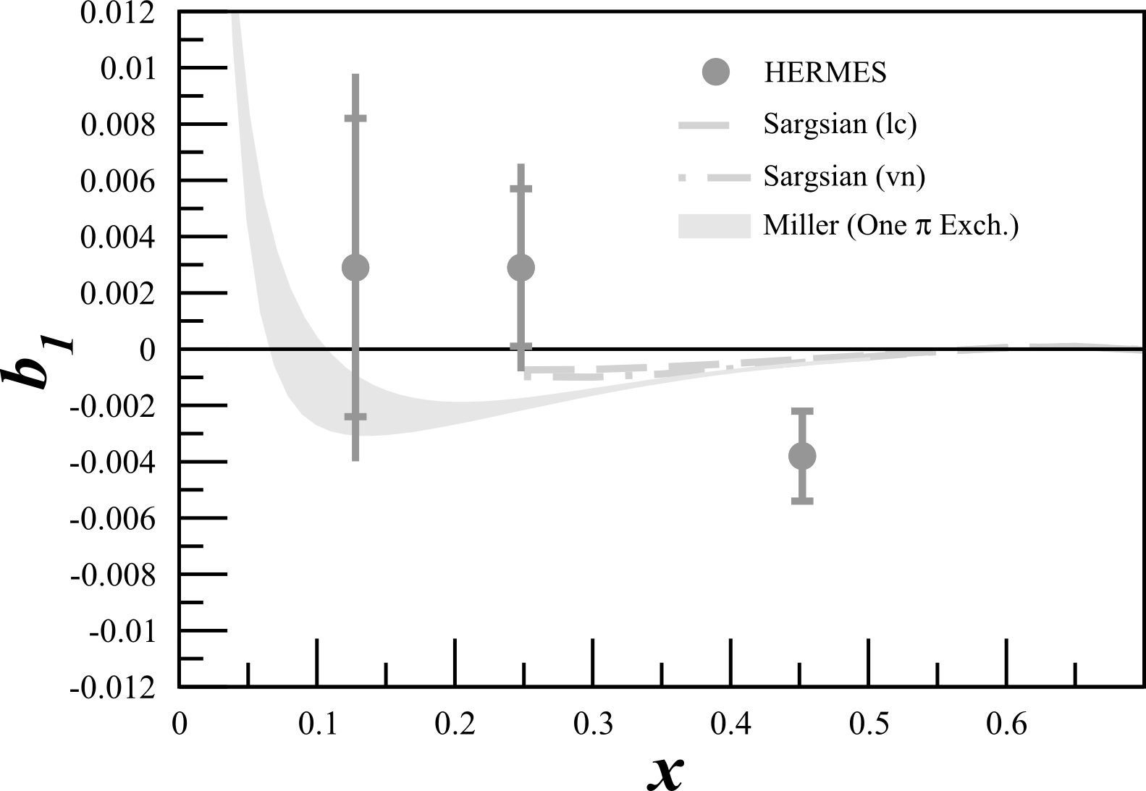
Tensor Structure Function, $b_{1}$
$b_{1}$ probes nuclear effects at quark resolution!
$$b_{1}\left(x\right)=\frac{q^{0}\left(x\right)−q^{±1}(x)}{2}$$
All conventional models predict small or vanishing values of $b_{1}$
HERMES found something very different!
A Airapetian, et al, PRL 95 242001 (2005)
K Slifer, et al, JLab C12-13-011

Slide 8
Tensor Structure Function, $b_{1}$
$b_{1}$ probes nuclear effects at quark resolution!
$$b_{1}\left(x\right)=\frac{q^{0}\left(x\right)−q^{±1}(x)}{2}$$
All conventional models predict small or vanishing values of $b_{1}$
HERMES found something very different!
Only $\sim 2σ$
A Airapetian, et al, PRL 95 242001 (2005)
K Slifer, et al, JLab C12-13-011

Slide 9
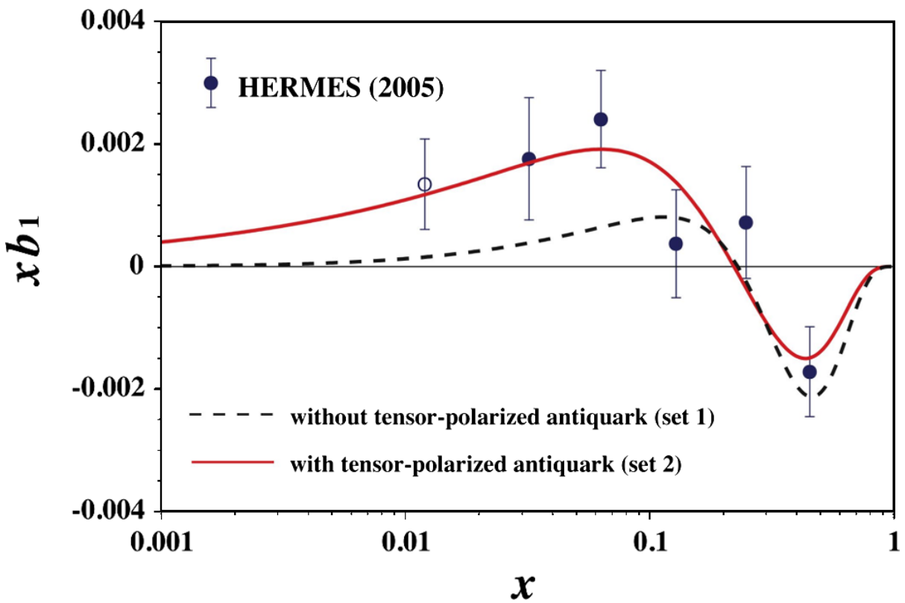
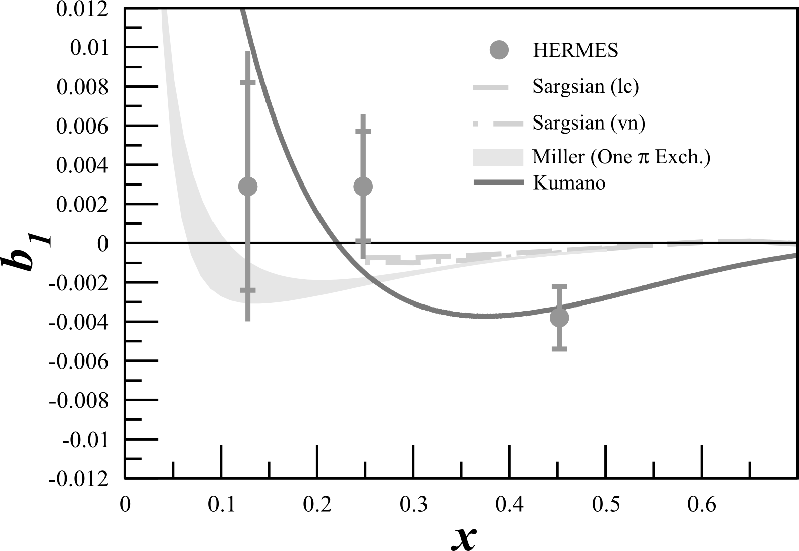
Tensor Structure Function, $b_{1}$
$b_{1}$ probes nuclear effects at quark resolution!
$$b_{1}\left(x\right)=\frac{q^{0}\left(x\right)−q^{±1}(x)}{2}$$
All conventional models predict small or vanishing values of $b_{1}$
HERMES found something very different!
Any measurement of $b_{1}<0$ indicates exotic physics
Indicates significant tensor polarization in antiquark distributions
A Airapetian, et al, PRL 95 242001 (2005)
K Slifer, et al, JLab C12-13-011
S Kumano, PRD 82 017501 (2010)

Slide 10
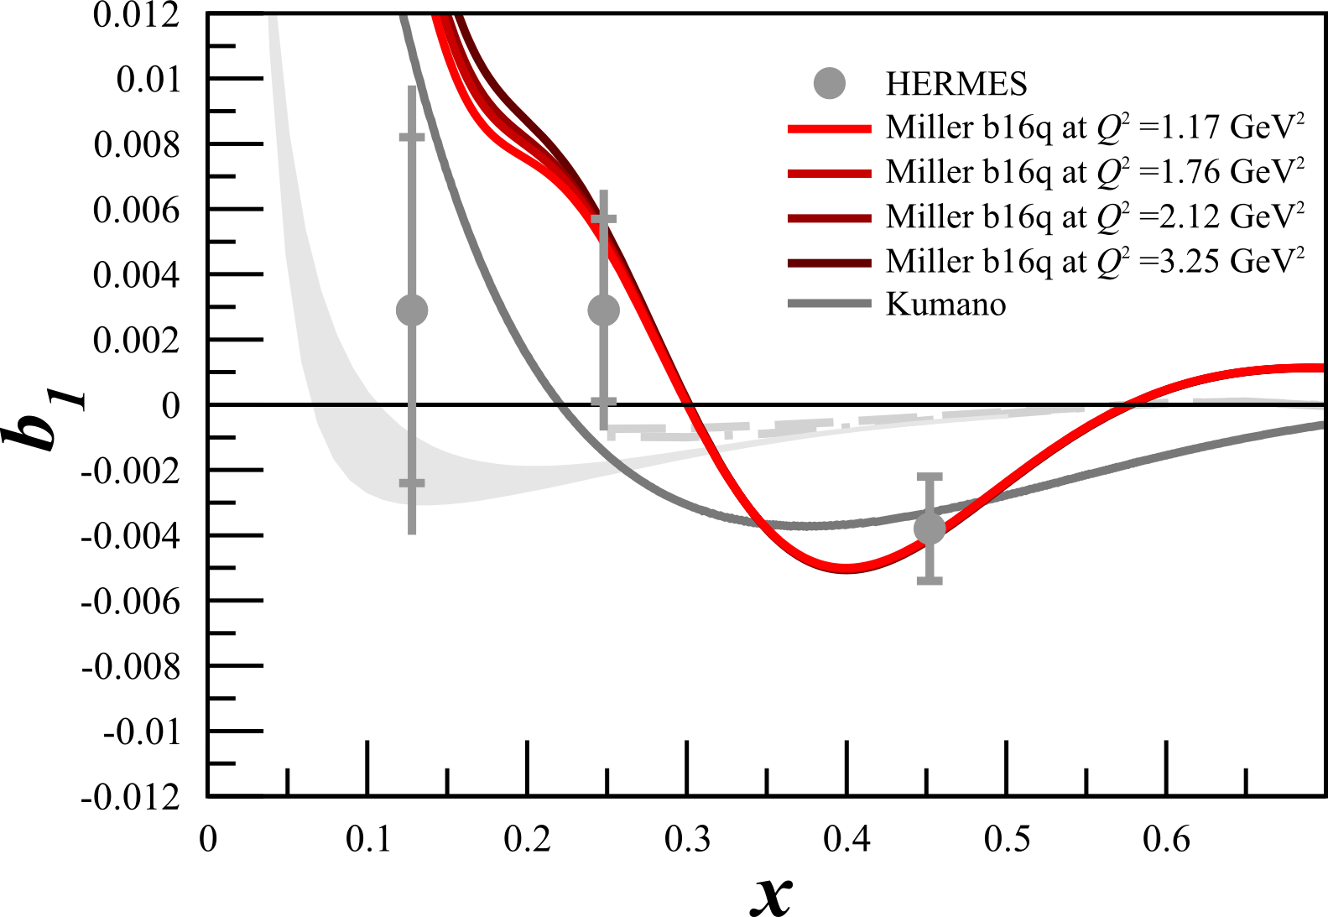
Tensor Structure Function, $b_{1}$
$b_{1}$ probes nuclear effects at quark resolution!
$$b_{1}\left(x\right)=\frac{q^{0}\left(x\right)−q^{±1}(x)}{2}$$
Pionic Effects
All conventional models predict small or vanishing values of $b_{1}$
HERMES found something very different!
Any measurement of $b_{1}<0$ indicates exotic physics
Predictions using 6q Hidden Color
A Airapetian, et al, PRL 95 242001 (2005)
K Slifer, et al, JLab C12-13-011
S Kumano, PRD 82 017501 (2010)
G Miller, PRC 89 045203 (2014)

Slide 11
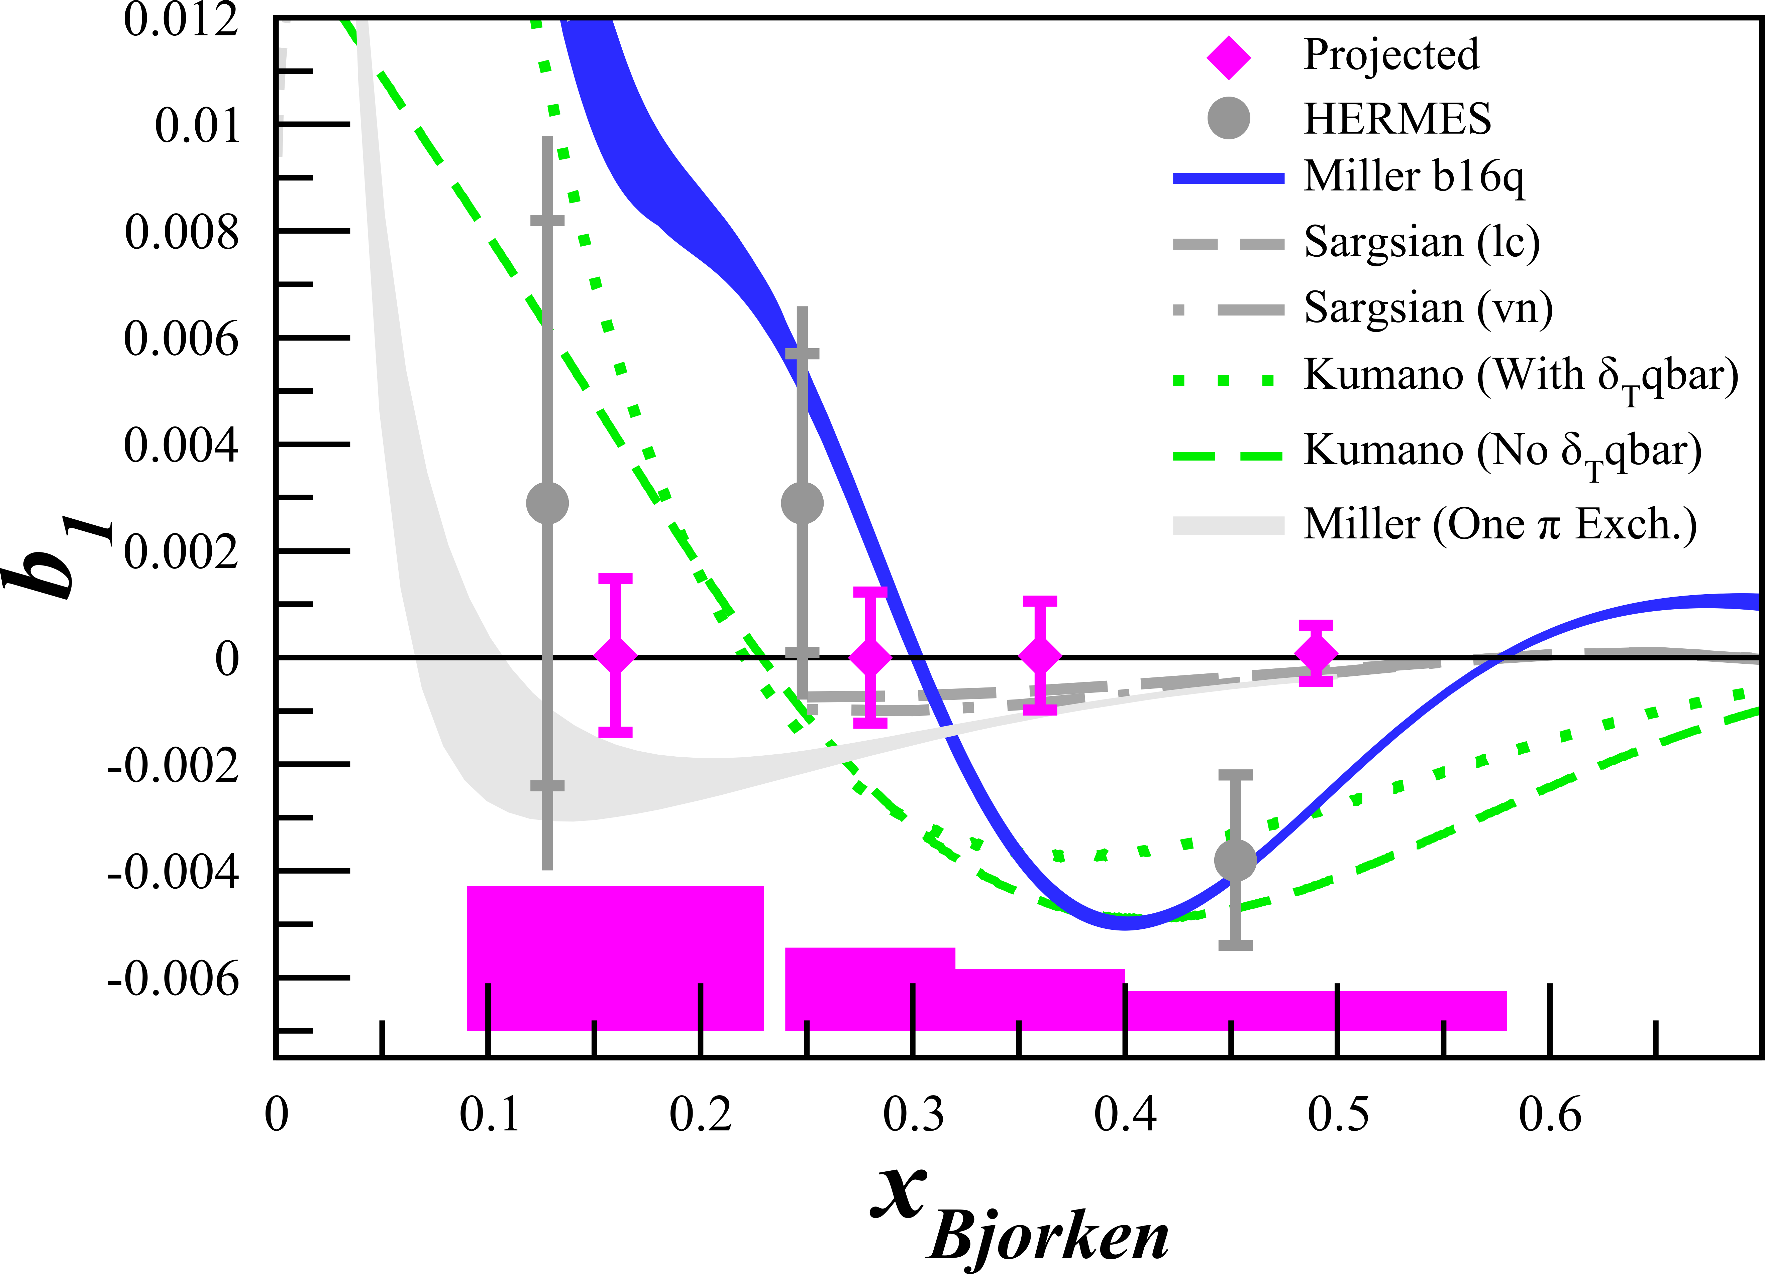
Tensor Structure Function, $b_{1}$
$b_{1}$ probes nuclear effects at quark resolution!
$$b_{1}\left(x\right)=\frac{q^{0}\left(x\right)−q^{±1}(x)}{2}$$
All conventional models predict small or vanishing values of $b_{1}$
HERMES found something very different!
Any measurement of $b_{1}<0$ indicates exotic physics
JLab
E12-13-011
+ Insight in Close-Kumano Sum Rule & Quark Orbital Angular Momentum
FE Close, S Kumano, PRD 42 2377 (1990)
A Airapetian, et al, PRL 95 242001 (2005)
K Slifer, et al, JLab C12-13-011
SK Taneja et al, PRD 86 036008 (2012)
S Kumano, PRD 82 017501 (2010)
G Miller, PRC 89 045203 (2014)

Slide 12
$b_{1}$ Kinematics
SHMS
SHMS
Slow
Raster
Faraday Cup
Lumi
Unpolarized
Beam
Fast
Raster
Polarized
Target
Jefferson Lab’s Hall C
Unpolarized beam, tensor polarized target (longitudinal alignment)
Identical equipment to $A_{zz}$
HMS
Det. | $$x$$ | $$Q^{2}$$ (GeV²) | $$W$$ (GeV) | $$E_{e′}$$ (GeV) | $$θ_{e′}$$ (deg) | Rate (kHz) | Time (Day)
SHMS | 0.15 | 1.21 | 2.78 | 6.70 | 7.4 | 1.66 | 6
SHMS | 0.30 | 2.00 | 2.36 | 7.45 | 9.0 | 0.79 | 9
SHMS | 0.45 | 2.58 | 2.0 | 7.96 | 9.9 | 0.38 | 15
HMS | 0.55 | 3.81 | 2.0 | 7.31 | 12.5 | 0.11 | 30

Slide 13
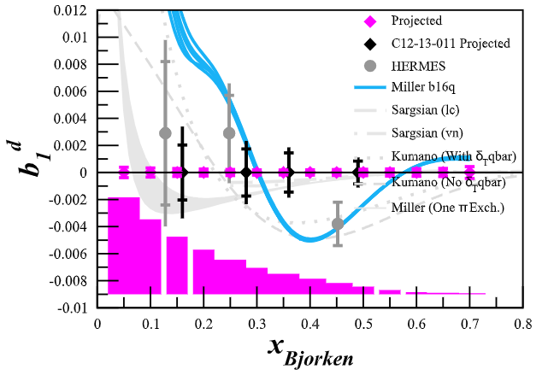
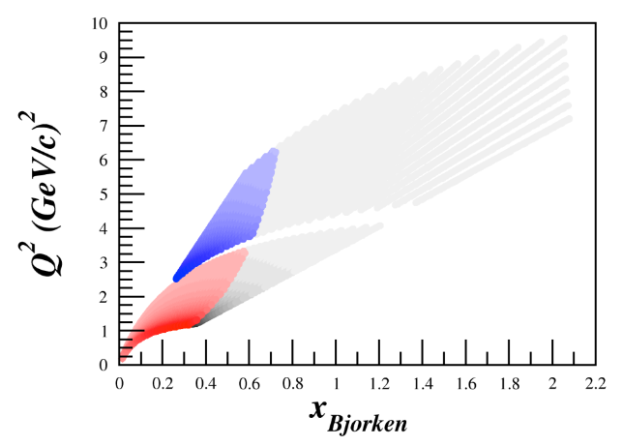
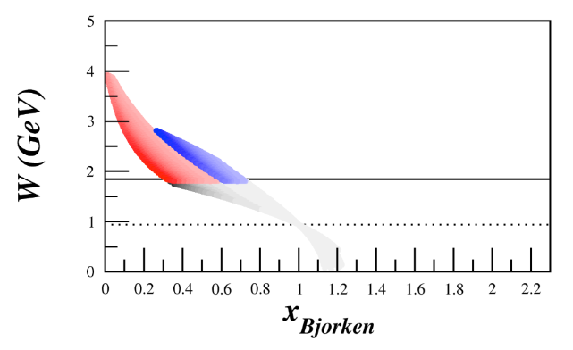
LOI12-21-004: b₁ with SoLID @ 8.8 GeV Beam, 7 PAC days

Slide 14
$A_{zz}$ and $T_{20}$ E12-15-005: Quasi-Elastic and Elastic Deuteron Tensor Asymmetries
$$0.5<x≤2$$
QE/SRC/Elastic
Approved, A- Physics Rating
Spokespeople:
E. Long*, K. Slifer, P. Solvignon, D. Day, D. Keller,
D. Higinbotham

Slide 15
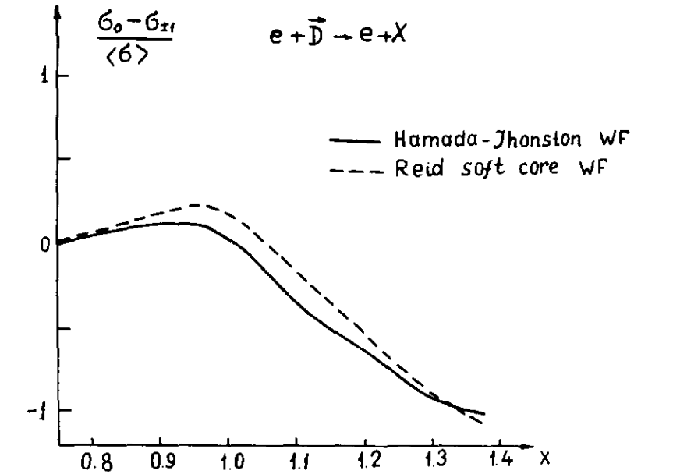
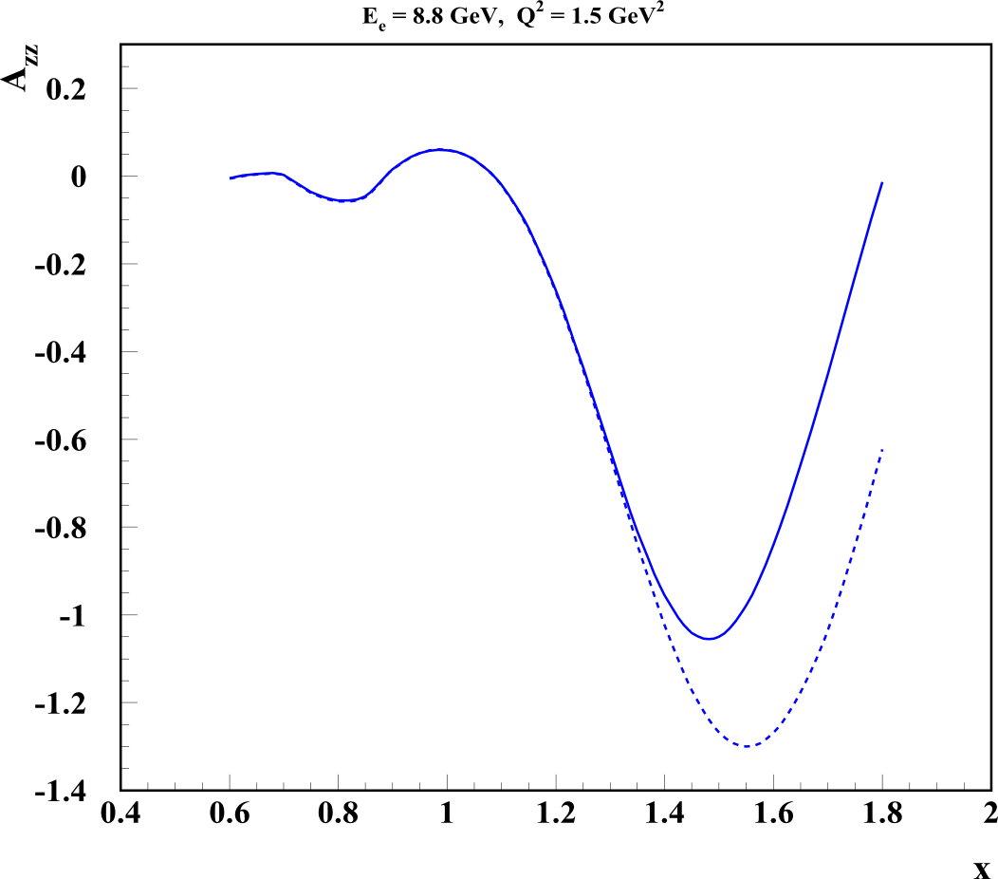
Deuteron Wavefunction
“There is a strong need for models of the deuteron wave function that are both realistic ”
- J. Terry, G. Miller, arXiv:1603.07032 (2016)
First calculated in the ‘70s, $A_{zz}$ can be used in to discriminate between hard and soft wave functions
$A_{zz} = \frac{2}{fQ}\left(\frac{σ_{Q}−σ_{0}}{σ_{0}}\right)$
In the impulse approximation, $A_{zz}$ is directly related to the S- and D-states
$$A_{zz} ∝ \frac{\frac{1}{2}w^{2}\left(k\right)−u\left(k\right)w(k)\sqrt{2}}{u^{2}\left(k\right)+w^{2}(k)}$$
Modern calculations indicate a large separation of hard and soft WFs begins just above the quasi-elastic peak at $x>1.3$
AV18
0%
~60%
$$S→u\left(k\right)$$
$$D→w\left(k\right)$$
-100%
CDBonn
LL Frankfurt, MI Strikman, Phys. Rept. 76 215 (1981)
M Sargsian

Slide 16
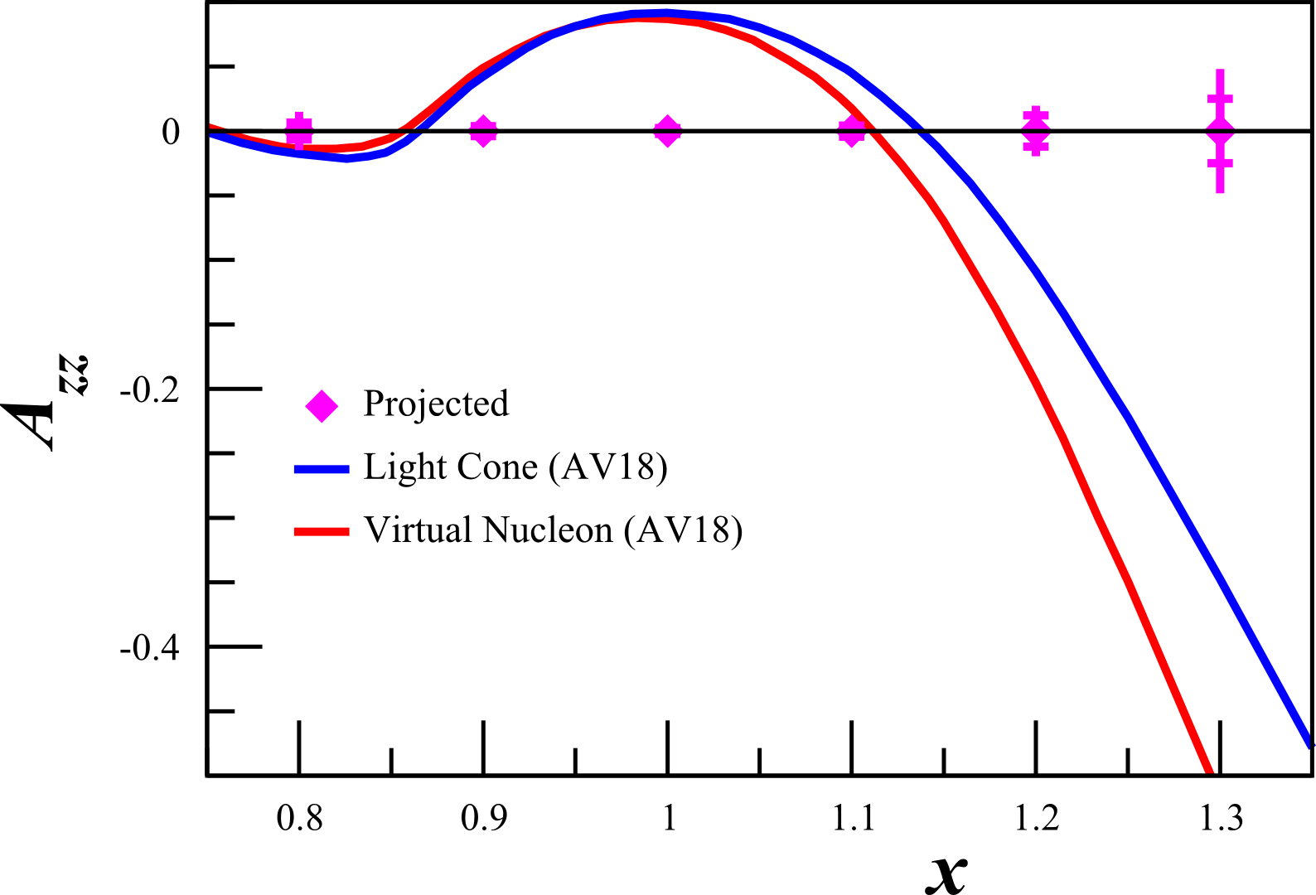
Relativistic NN Bound System
“There is a strong need for models of the deuteron wave function that are both realistic and relativistic.”
- J. Terry, G. Miller, arXiv:1603.07032 (2016)
Understanding SRCs requires relativistic calculations at high p
Currently two methods:
Light Cone (LC)
Virtual Nucleon (VN)
Large $p>500 MeV/c$ needed to discriminate with unpolarized deuterons
With tensor $A_{zz}$, significant difference at much lower $p>300 MeV/c$ and$x>1.1$
M Sargsian, Tensor Spin Observables Workshop (2014)

Slide 17
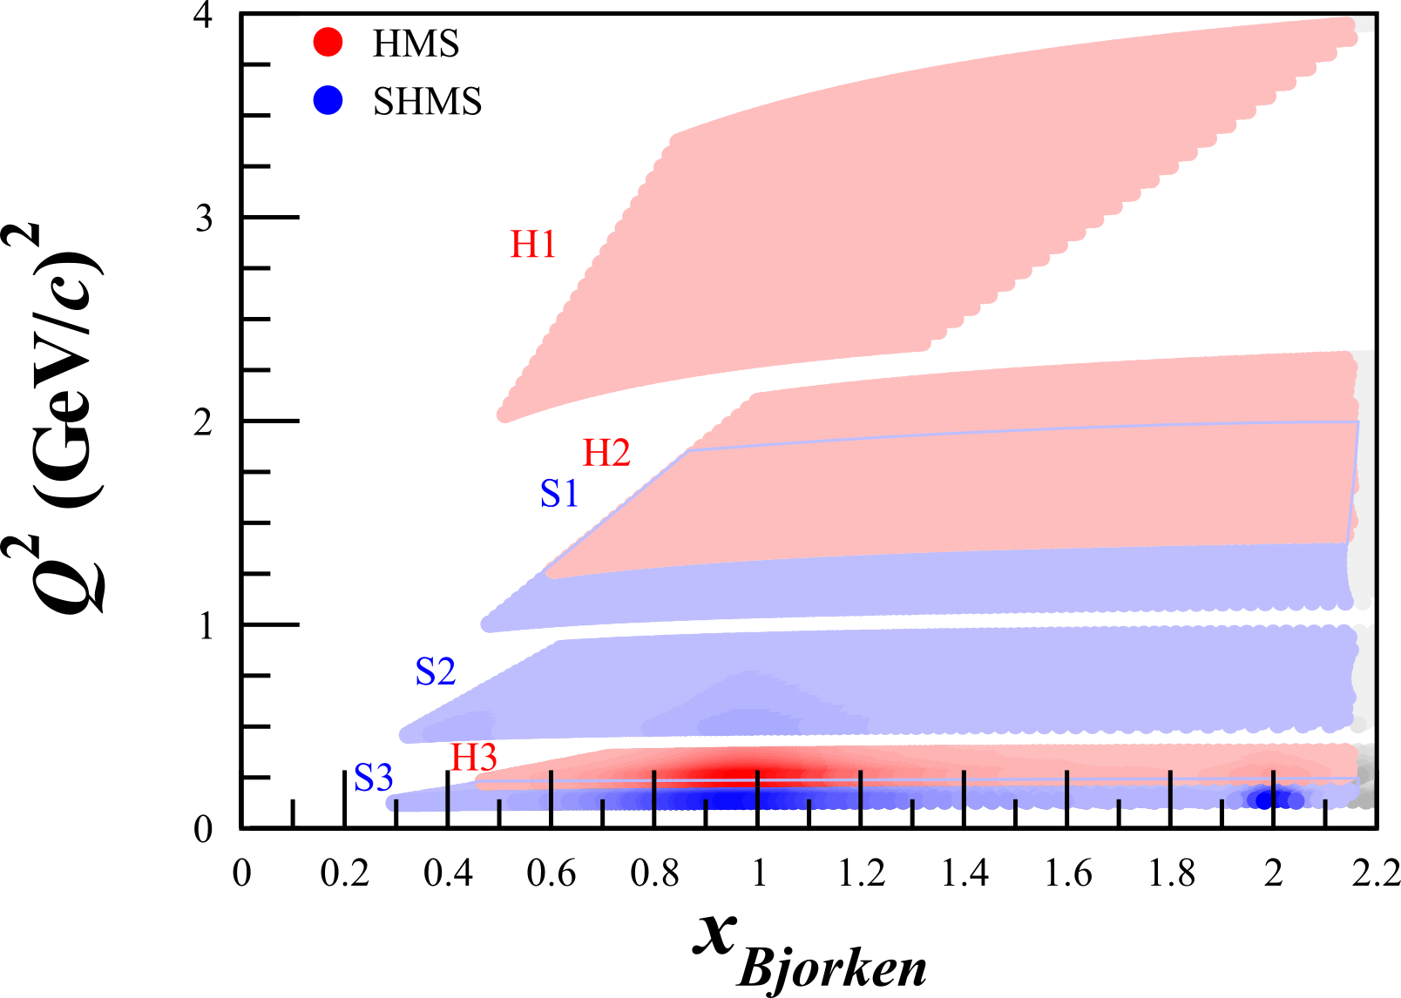
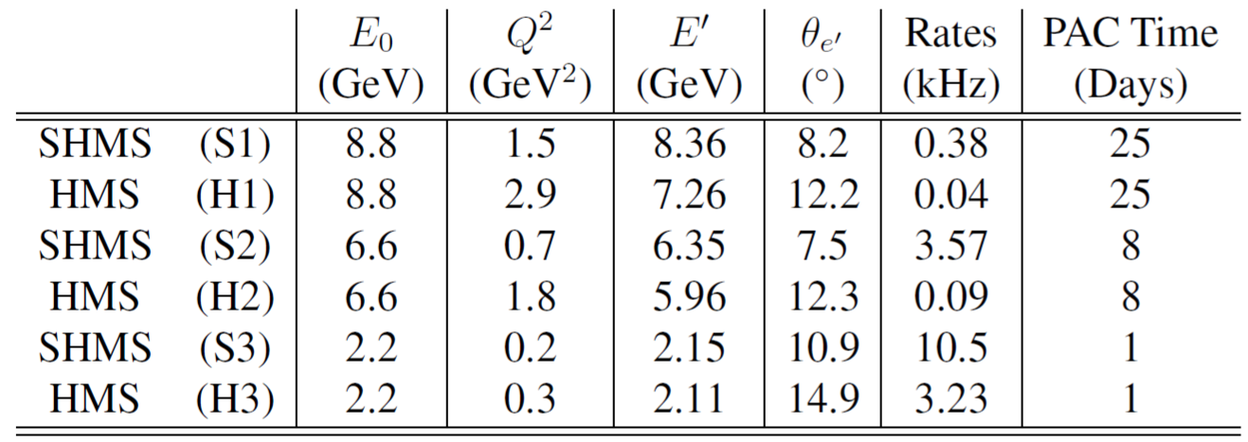
Kinematics
SHMS
Longitudinally
Polarized
Target
SHMS
Slow
Raster
Faraday Cup
Unpolarized
Beam
Lumi
Fast
Raster
HMS
JLab Hall C with HMS & SHMS
Unpolarized beam, tensor polarized target (longitudinal alignment)

Slide 18
First Measurement of Quasi-Elastic $A_{zz}$
No current quasi-elastic tensor measurements
Sensitive to effects that are very difficult or impossible to measure with unpolarized or vector polarized deuterons
Huge 10-100% asymmetry
Decades of theoretical interest that we can only now probe with a high-luminosity tensor-polarized target
Importance ranges from understanding short-range correlations to the equations of state of neutron stars
Bonus: $T_{20}$ over widest $Q^{2}$
E Long, et al, JLab C12-15-005

Slide 19
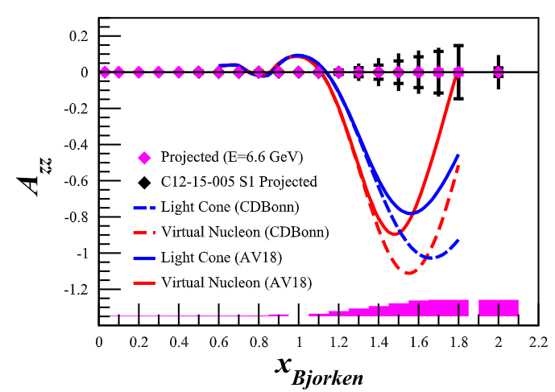
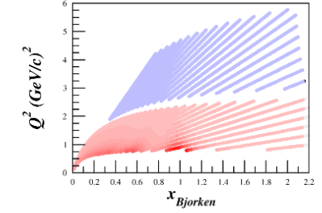
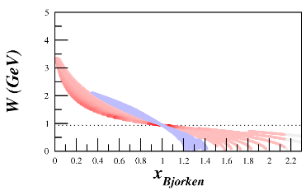
LOI12-21-002: A_{zz} with SoLID @ 6.6 GeV Beam, 7 PAC days

Slide 20
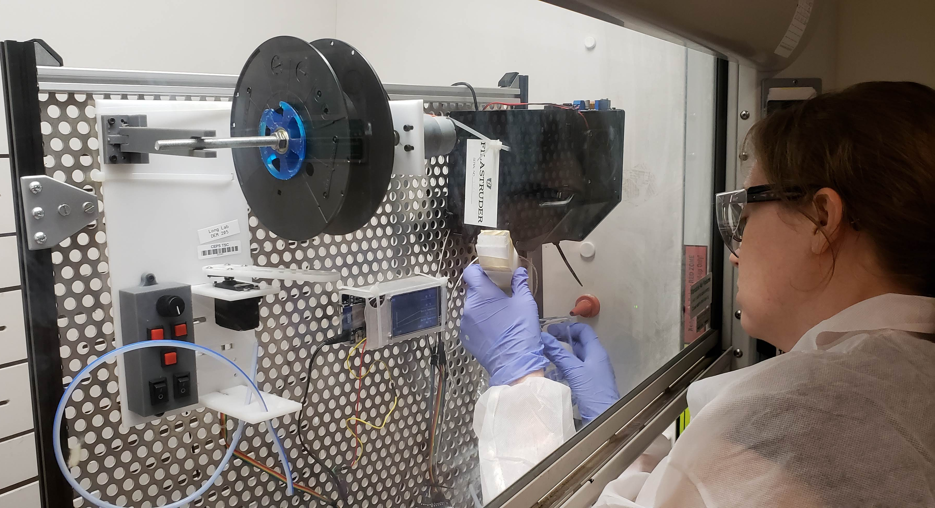
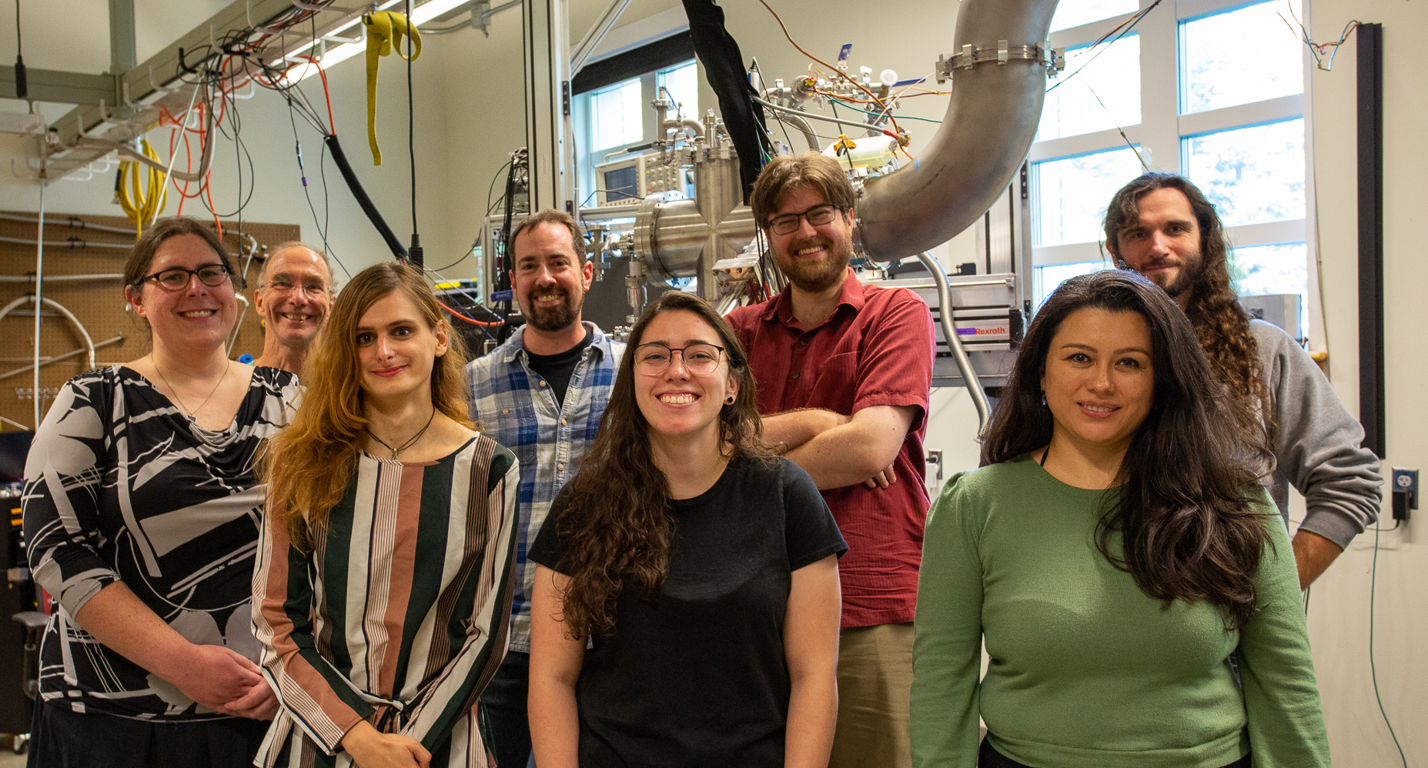
K. McGuire UG (prev)
Thank you!
A. Gudinas UG (prev)
R. Williams UG (prev)
D. Ruth Post Doc
M. McClellan PhD Student
K. Slifer PI
E. Long
PI
J. Yost UG (prev)
A. Zec
Post Doc
Z. Wolters PhD Student
N. Santiesteban PI
& collaborators at
M. McClellan PhD Student
L. Kurbany
PhD Student (prev)
D. Ruth Post Doc

Slide 22
Backup Slides

Slide 23
$$P_{zz}=25\% pf=0.65 I=100 nA$$

